Slide 1


Slide 2
Avahi
Avahi 是一個在區域網路內,，用來廣播自己是什麼服務以及用來尋找那些服務的一個工具，Avahi 是利用 multicast 來做到這件事，安裝上可以分成 server 以及 client。
Avahi is a system which facilitates service discovery on a local network via the mDNS/DNS-SD protocol suite.

Slide 3
Avahi-utils
client的部份主要是用來聽廣播，得到網路上所有可使用的服務。
sudo apt-get install avahi-utils
avahi-browse –help
avahi-browse –a

Slide 4
Avahi-daemon
server 的部份主要是要告訴大家你自己是誰，提供什麼服務。
sudo apt-get install avahi-daemon
sudo vi /etc/avahi/services/multiple.service
sudo service avahi-daemon restart
sudo /etc/init.d/avahi-daemon restart

Slide 5
Bonjour
Bonjour for Windows
Bonjour Print Services for Windows
https://developer.apple.com/bonjour/
Bonjour for Developers
Windows
Bonjour SDK for Windows Download the SDK and distribute Bonjour as part of your Windows app.
Bonjour Print Services for Windows Configure Bonjour-enabled printers from your Windows computer.

Slide 6
Bonjour browser
http://hobbyistsoftware.com/bonjourbrowser

Slide 7
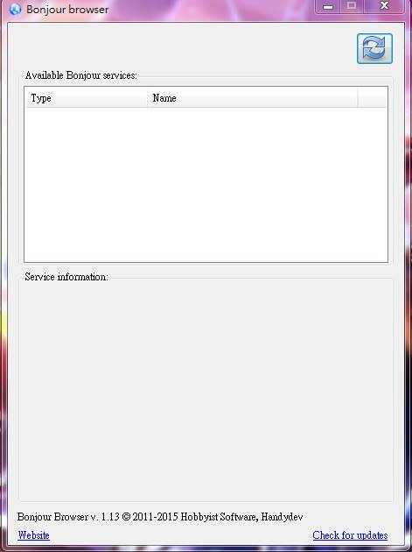
Bonjour browser

Slide 8
Bonjour browser(Demo)
Type | Name
_http._tcp. | NsdServer
IP Address | Port number
192.168.0.5 | 9000

Slide 9
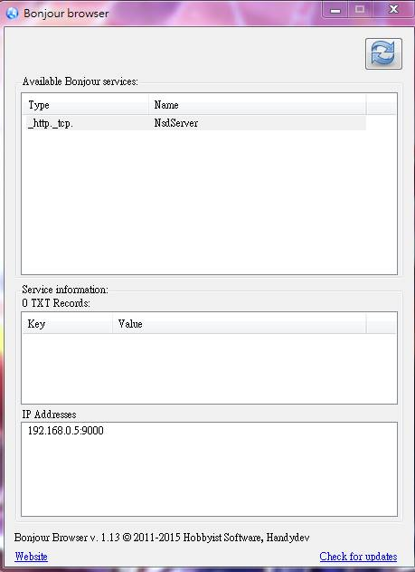
Bonjour browser(Demo)(cont.)

Slide 10
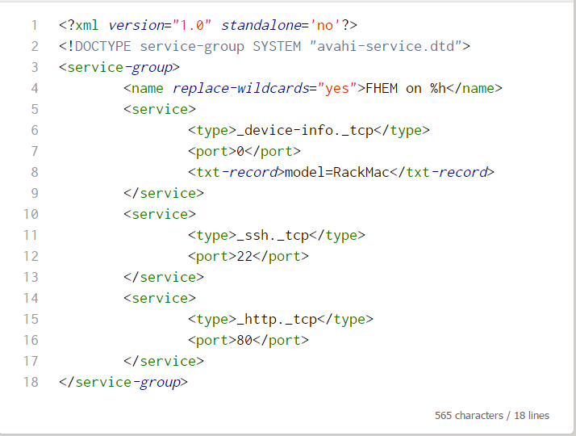
multiple.service

Slide 11
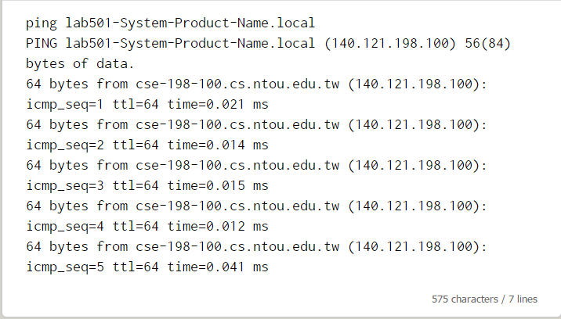
Demo：ping hostnmae.local
http://lab501-System-Product-Name.local

Slide 12
Integrated with apache2
sudo vi /etc/apache2/sites-available/000-default.conf
ServerName 127.0.0.1
ServerAlias lab501-System-Product-Name.local
使用Virtualhost導致

Slide 13
nsd in Android phone
Network service discovery （Added in API level 16）
Android 4.1 adds support for multicast DNS-based service discovery, which allows you to find and connect to services offered by peer devices over Wi-Fi, such as mobile devices, printers, cameras, media players, and others that are registered on the local network.
Android 4.1,4.1.1=API level 16

Slide 14
Hybrid app solution(Android)
https://github.com/perak/cordova-nsd-example
Based on Andoird Nsd

Slide 15
nsd sample app
step1：Initialize
step2：Advertise
step3：Discover
step4：Connect
step5：Chat
step6：unbindService

Slide 16
測試裝置
系統： Android 4.2.1 、Android 5.0

Slide 17
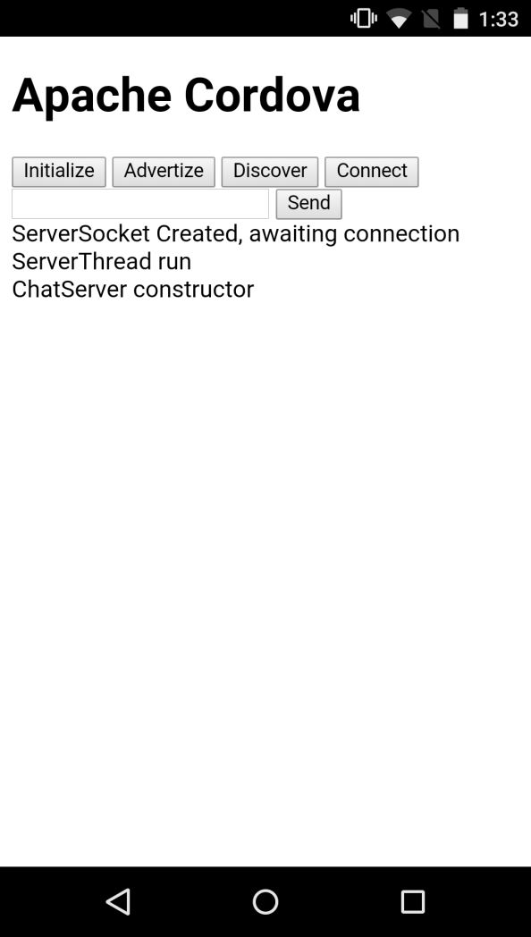
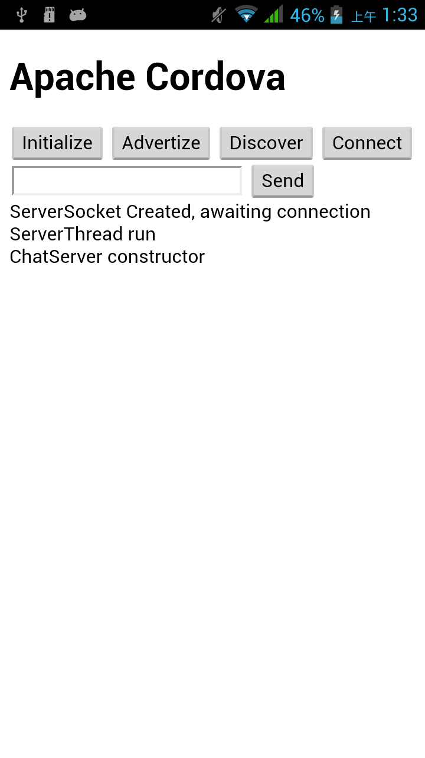
Initialize

Slide 18
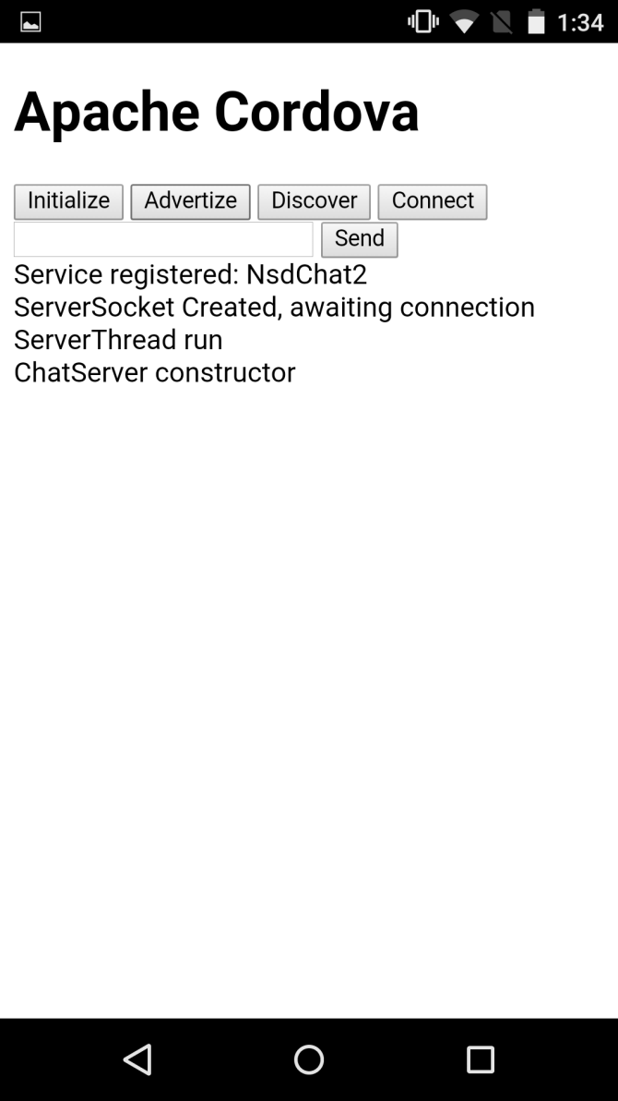
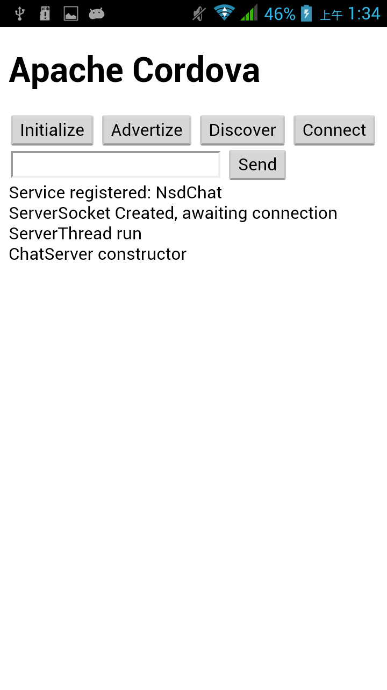
Advertise

Slide 19
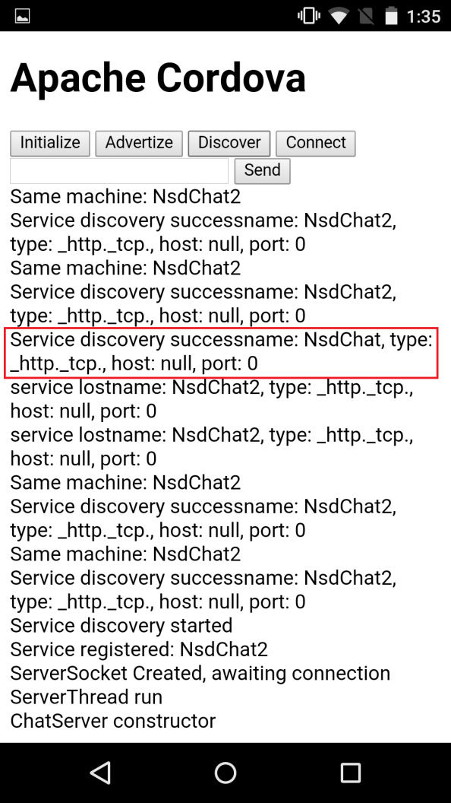
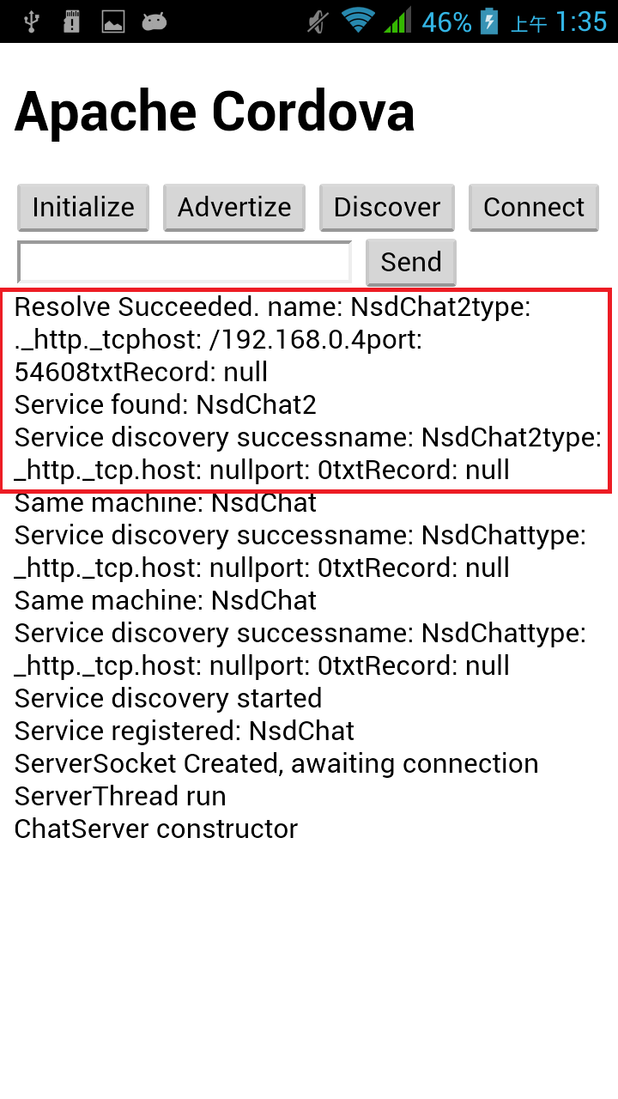
Discover
Notes:
右邊先按下Discover後，馬上找到區域網路的也有在開此服務的位置，另外一臺再按下Discover後，則可以搜尋到

Slide 20
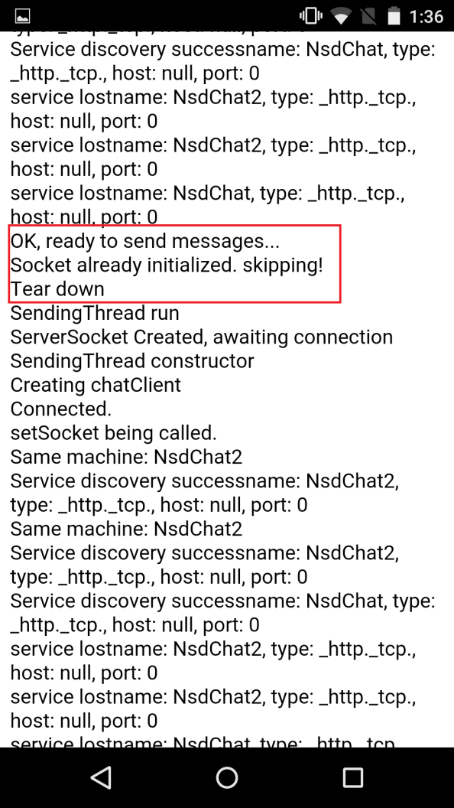
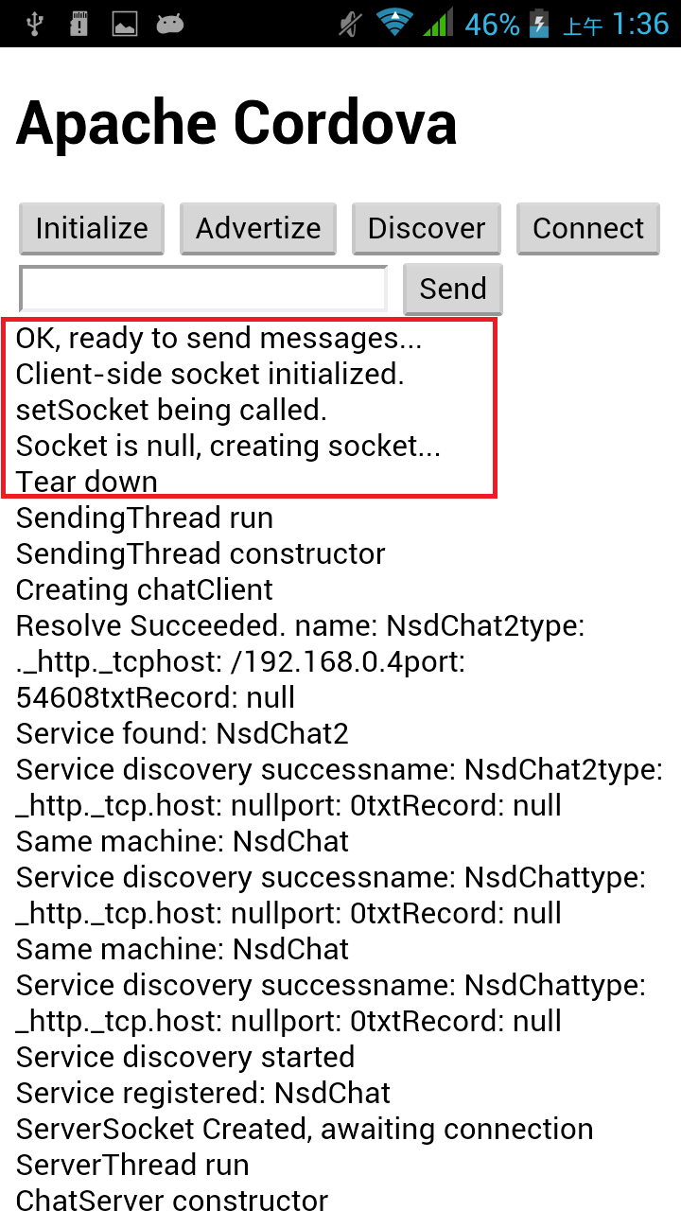
Connect

Slide 21
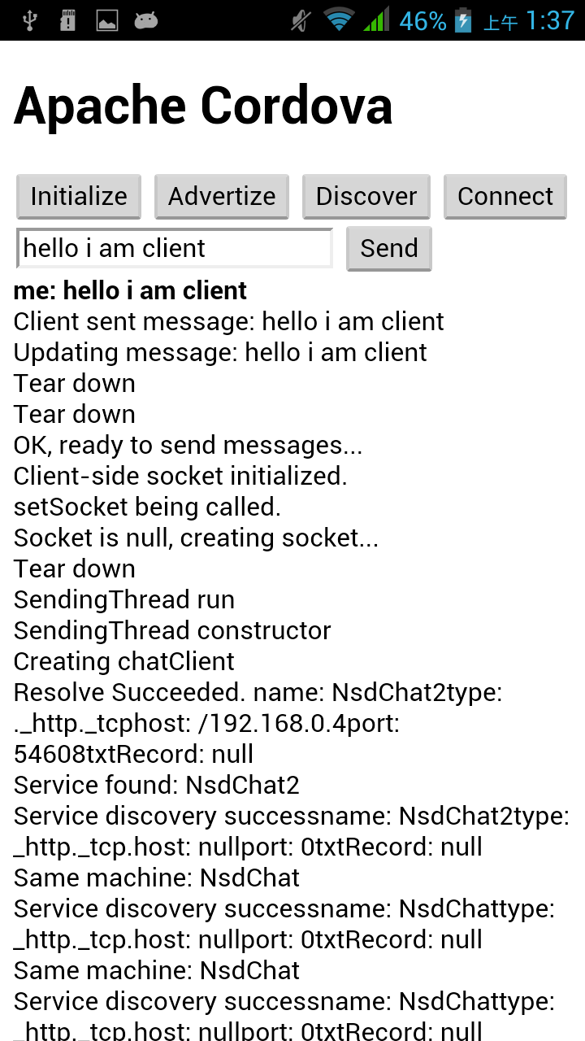
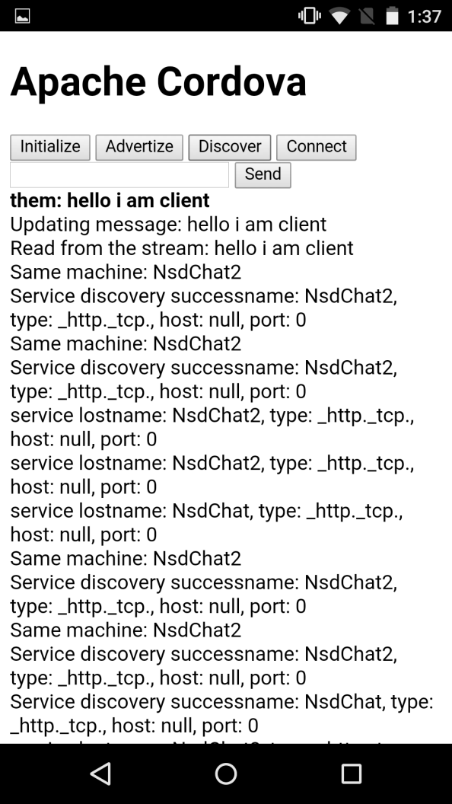
Chat

Slide 22
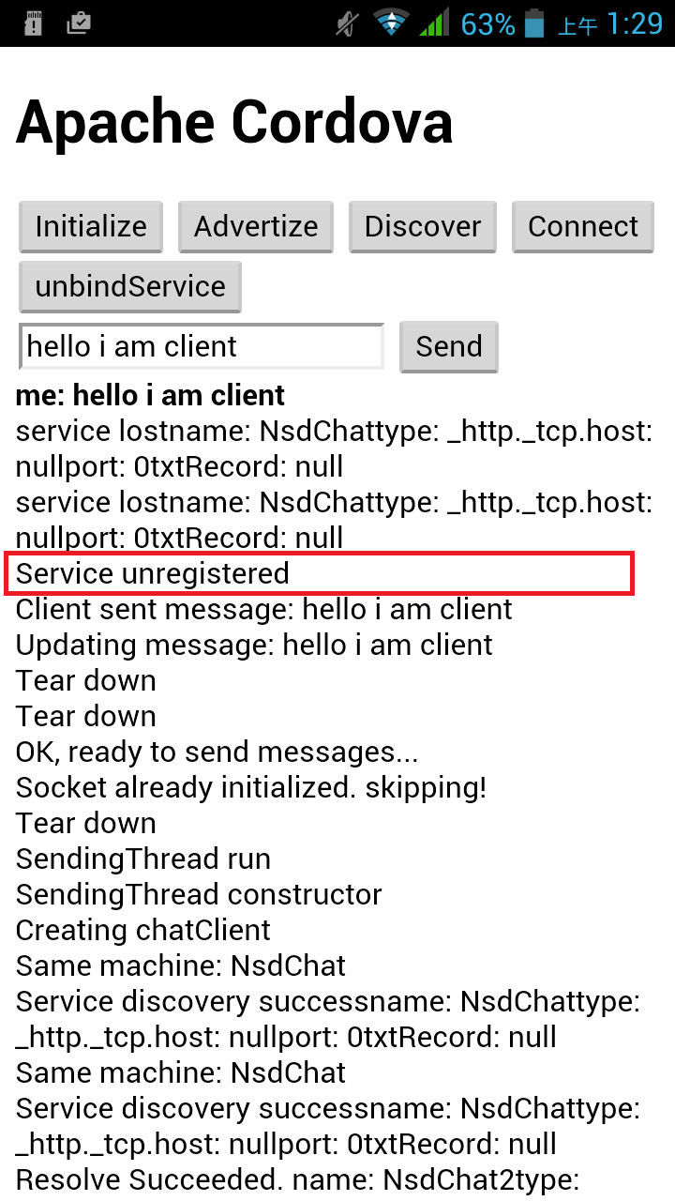
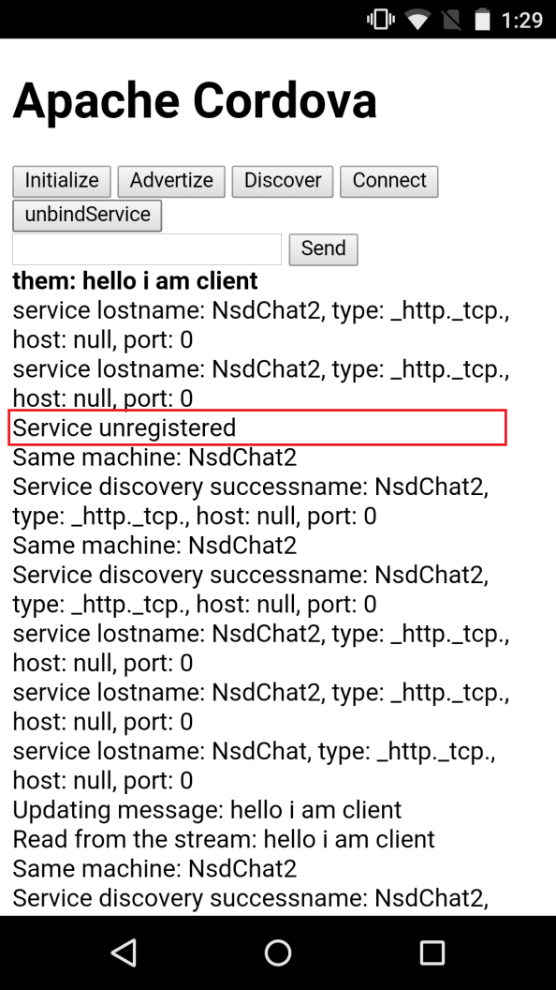
unbindService

Slide 23
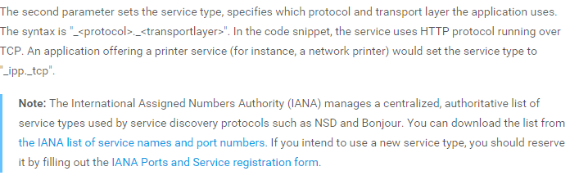
About setServiceType
http://www.iana.org/assignments/service-names-port-numbers/service-names-port-numbers.xml

Slide 24
Service type 說明
SERVICE_TYPE is a custom name you make up (that must conform to a standard). This is the name of your app on the network.
Note: If you plan on publishing an app to the app store that uses NSD you should register your protocol to the International Assigned Numbers Authority (IANA). They manage a centralized.

Slide 25
Service type 說明（cont.）
其實可以自行定義協定名稱，僅限於開發與實驗時使用，不過當要上架到APP store時，還是必須要去註冊自己定義的協定名稱。

Slide 26
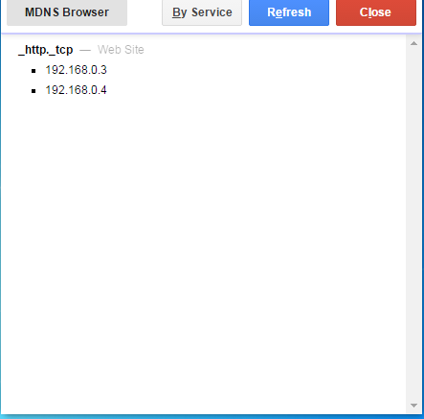
Chrome app mDNS browser

Slide 27
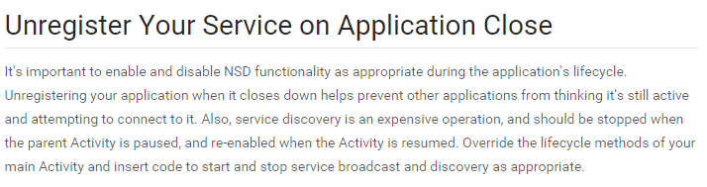
Attention

Slide 28
Android NSD server(Fail)
Register service name and service type.
Using socket server.

Slide 29
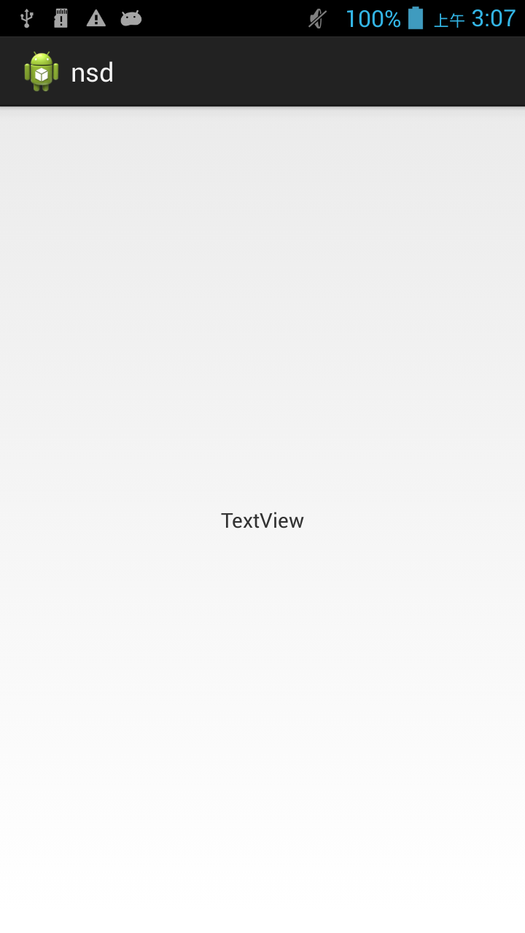
Server

Slide 30
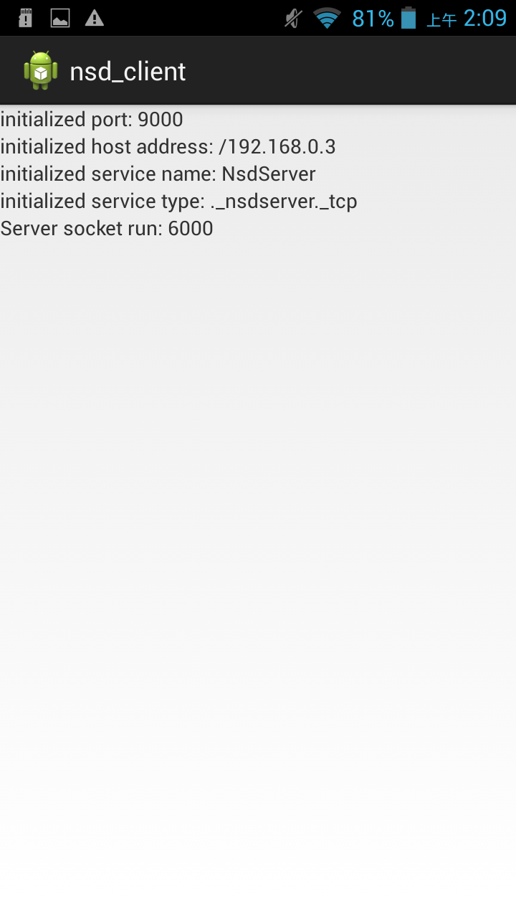
client（mobile device）

Slide 31

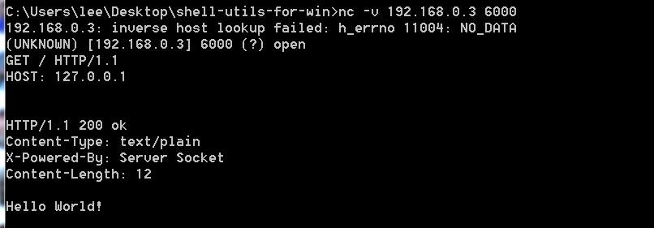
client（notebook）

Slide 32
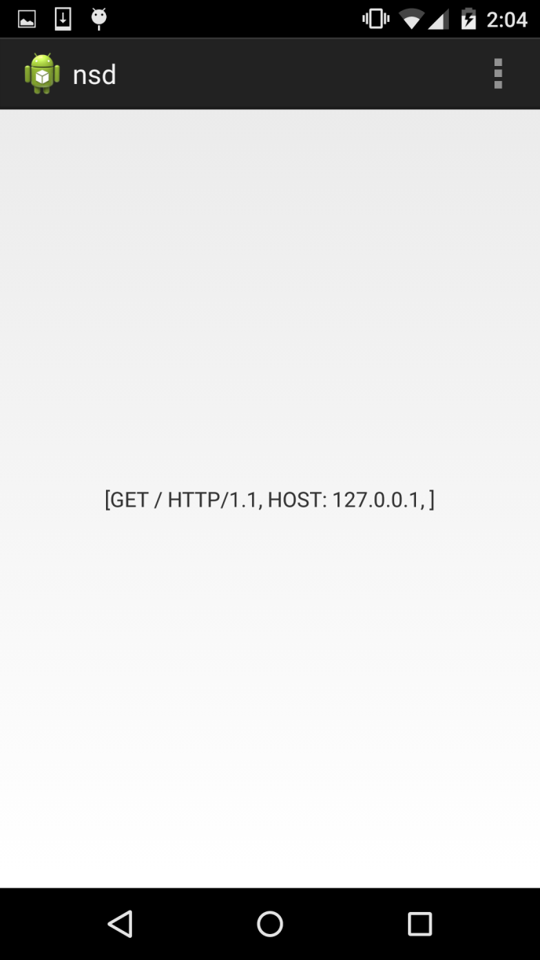
Android NSD server(Fail)

Slide 33
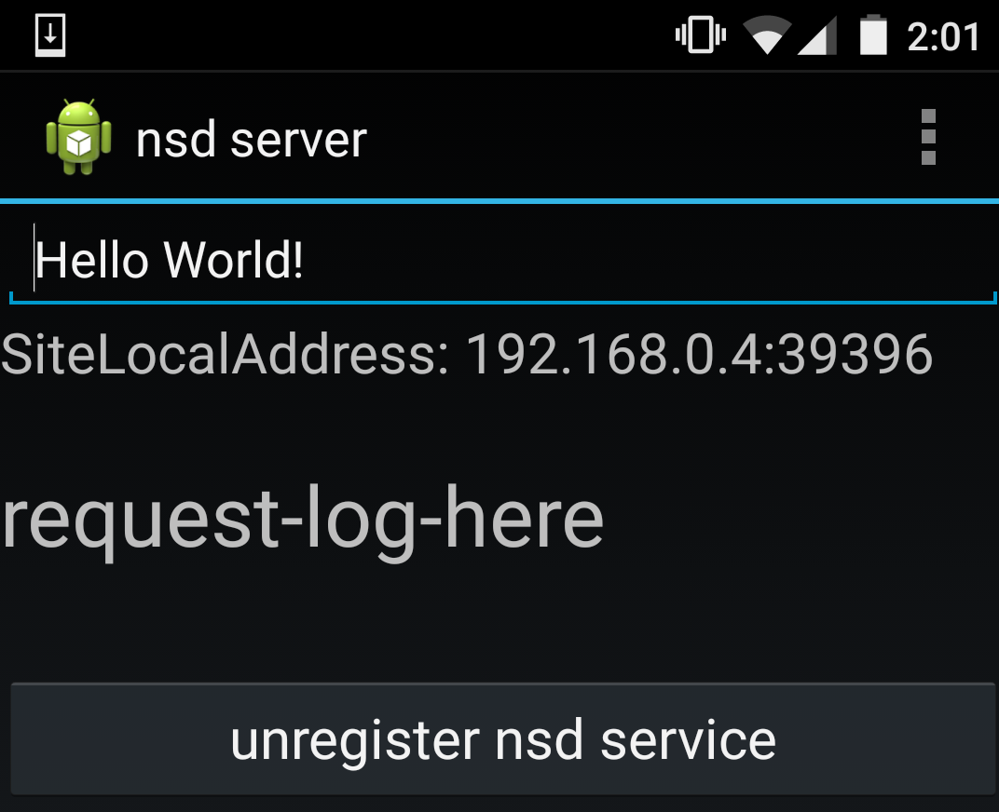
Android NSD server

Slide 34
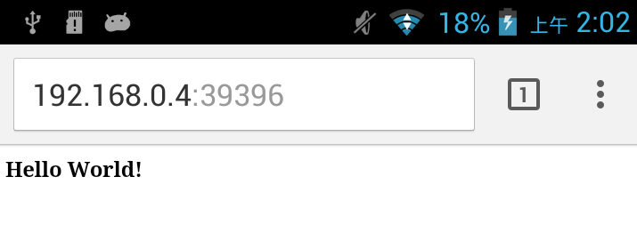
Web browser

Slide 35
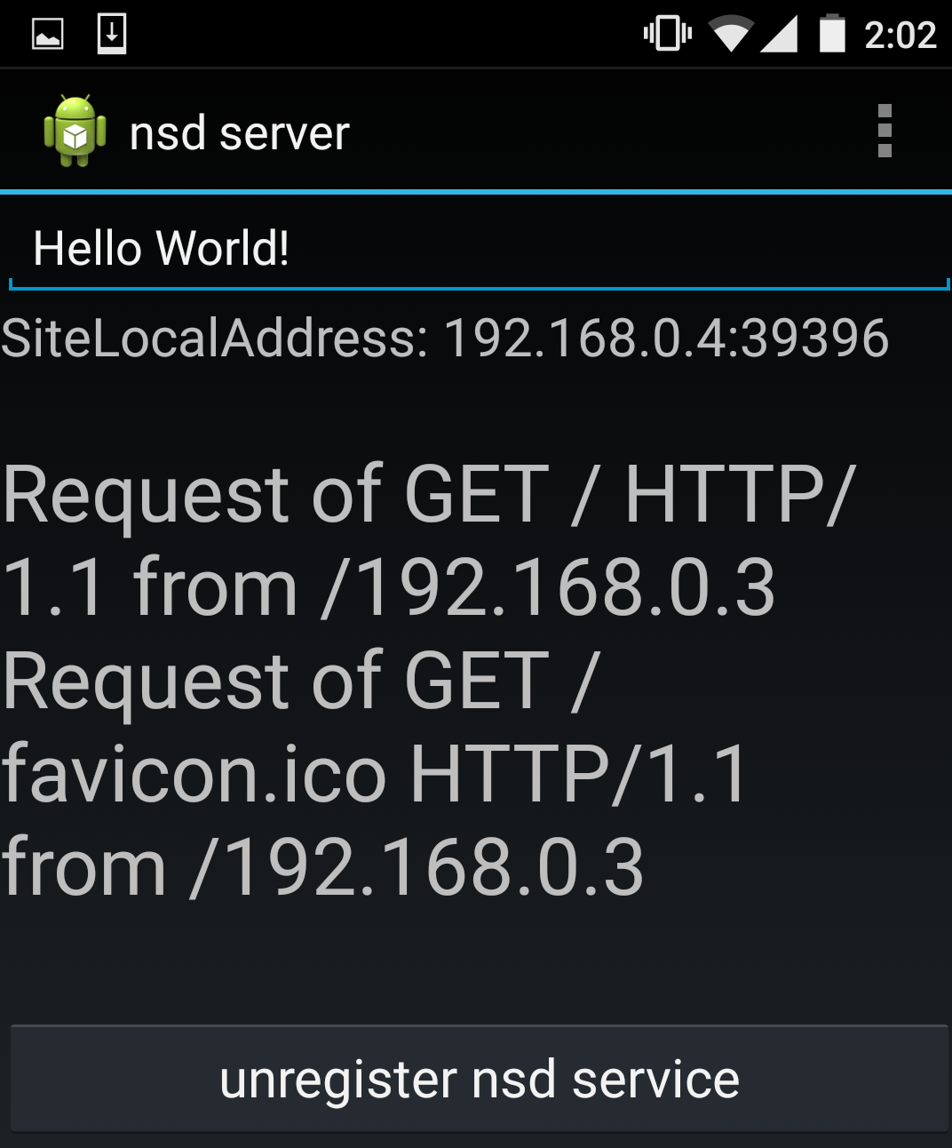
Android NSD server(cont.)

Slide 36
Dynamic server socket port
private int SocketServerPort = 0;
httpServerSocket = new ServerSocket(SocketServerPort);

Slide 37
client(initializeResolveListener)
https://gist.github.com/peter279k/b25cc517cf0187954d2c

Slide 38
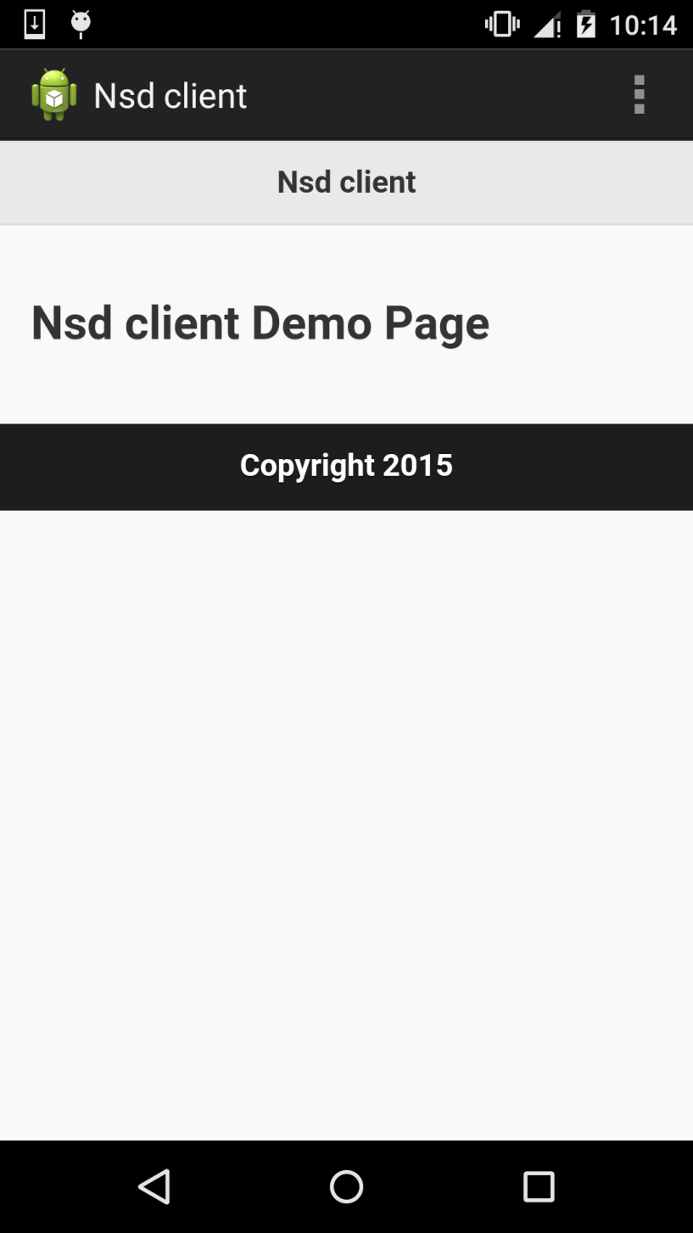
Web server/NSD server + Web view / NSD client

Slide 39
Web Server app
Palapa Web Server
App link：https://play.google.com/store/apps/details?id=com.alfanla.android.pws
Features
- Lighttpd 1.4.35
- PHP 5.5.15
- MySQL 5.1.69
- MSMTP 1.4.32 ： An SMTP client
- Web Admin 2.1.0
- phpMyAdmin

Slide 40
mDNS reference
http://developer.android.com/reference/android/net/nsd/NsdManager.html
替代方案（ JmDNS Java Library. ）
針對API level 16以下
http://stackoverflow.com/questions/15163544/nsd-equivalent-in-android-api-level-16
http://stackoverflow.com/questions/14007372/android-network-discovery-service-ish-before-api-14

