Slide 1


Slide 2
Introduction
PRoot is a user-space implementation of chroot, mount --bind, and binfmt_misc.
proot -r /mnt/slackware-8.0/ cat /etc/motd Welcome to Slackware Linux 8.0
proot -b /tmp/alternate_opt:/opt
proot -R /mnt/slackware-8.0/
proot -S /mnt/slackware-8.0/
proot -R /mnt/armslack-12.2/ -q qemu-arm
  sudo apt-get install qemu-system

Slide 3
Downloads
for x86_64: http://portable.proot.me/proot-x86_64
for x86: http://portable.proot.me/proot-x86
for ARM: http://portable.proot.me/proot-arm

Slide 4
Rootfs
http://download.openvz.org/template/precreated/
https://images.linuxcontainers.org/images/
http://distfiles.gentoo.org/releases/
http://cdimage.ubuntu.com/ubuntu-core/releases/
http://ftp.debian.org/debian
http://archlinuxarm.org/developers/downloads

Slide 5
Examples
sudo apt-get install proot
proot -r ./ubuntu/ cat /etc/issue
  host：Ubuntu 14.10 \n \l
  guest：Ubuntu 12.04.5 LTS \n \l
proot -b ./ubuntu/bin/:/bin
  bash --version
  GNU bash, version 4.2.25(1)-release (x86_64-pc-linux-gnu)
  GNU bash, version 4.3.30(1)-release (x86_64-pc-linux-gnu)

Slide 6
Examples（cont’）
proot -S ./ubuntu
lab501@lab501-System-Product-Name:~$ proot -S ./ubuntu
# pwd
/bin/dash: 1: pwd: not found
# sudo -i
/usr/bin/groups: cannot find name for group ID 119
/usr/bin/groups: cannot find name for group ID 1000
root@lab501-System-Product-Name:~# su
/usr/bin/groups: cannot find name for group ID 119
/usr/bin/groups: cannot find name for group ID 1000
root@lab501-System-Product-Name:~# pwd
/root

Slide 7
Examples（cont’）
Error message ： /usr/bin/qemu-arm: error while loading shared libraries: libglib-2.0.so.0: cannot open shared object file: No such file or directory
lab501@lab501-System-Product-Name:
~$ proot -S ./ubuntu3 -q qemu-arm
# sudo -i
root@lab501-System-Product-Name:~# su
root@lab501-System-Product-Name:~# ls ../
bin dev home lib mnt proc run srv tmp var
boot etc host-rootfs media opt root sbin sys usr
root@lab501-System-Product-Name:~# cat /etc/issue
Ubuntu 14.04 LTS \n \l

Slide 8
Applications
GNURoot: use several Linux distros on Android without root access. （GNURootDebian）
Debian noroot: use Debian Linux on Android without root access.

Slide 9
PRoot for ARM
for ARM: http://portable.proot.me/proot-arm
(503 service unavailable)
https://github.com/proot-me/PRoot

Slide 10
PRoot for ARM problems
proot error: can't create temporary directory:
No such file or directory proot error:
can't create glue rootfs proot warning: sanitizing the guest path (binding) "/storage/emulated/0/ubuntu-rootfs": No such file or directory proot error: '/bin/sh' is not executable fatal error: see `proot-arm --help`.

Slide 11
PRoot for ARM problems(cont’)
Solution: https://github.com/prootme/PRoot/issues/94
Using"next"branch
https://github.com/proot-me/PRoot/tree/next
proot.mp2_x000b_https://github.com/corbinlc/GNURootDebian/blob/master/GNURootDebianSource/src/armhf/assets/proot.mp2

Slide 12
PRoot for ARM problems(cont’)
proot error: '/bin/sh' is not executable
proot info: vpid 1: terminated with signal 11
proot error: execve("/bin/bash"): Exec format error proot info: possible causes:
* the program is a script but its interpreter (eg. /bin/sh) was not found;
* the program is an ELF but its interpreter (eg. ld-linux.so) was not found;
* the program is a foreign binary but qemu was not specified;
* qemu does not work correctly (if specified);
* the loader was not found or doesn't work. fatal error: see `proot.mp2 --help`. proot error: can't chmod '/data/data/demo.proot.lee.prootdemo/files/img/tmp/proot-4081-51utTO': No such file or directory

Slide 13
Using PRoot build rootfs(pre.)
Solution:
https://github.com/pelya/debian-noroot/issues/12
copyAssetExecute
(dist-gimp-jessie-armeabi-v7a.tar)
copyAssetsExecute("busybox");
copyAssetsExecute("proot.mp2");
exec("chmod 755 " + getFilesDir().getPath() + "/proot.mp2");
exec("chmod 755 " + getFilesDir().getPath() + "/busybox");

Slide 14
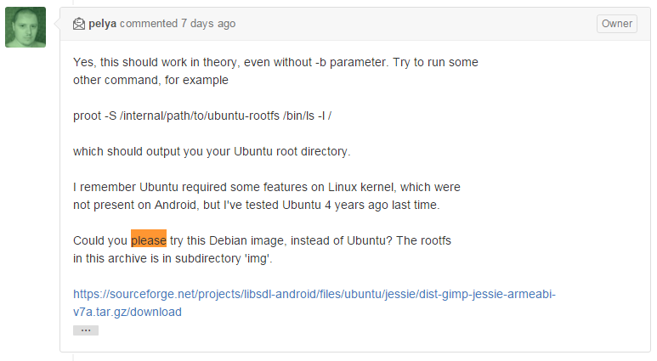
Using PRoot build rootfs(cont’)(pre.)

Slide 15
Using PRoot build rootfs(cont’)(pre.)
exec("chmod 777 " + getFilesDir().getPath() + "/dist-gimp-jessie-armeabi-v7a.tar");
doDecompress: create folders
exec("chmod -R 777 " + getFilesDir().getPath() + "/img");
Using terminal emulator
  Intent intent = new Intent("jackpal.androidterm.RUN_SCRIPT");
  intent.addCategory(Intent.CATEGORY_DEFAULT);
  intent.putExtra("jackpal.androidterm.iInitialCommand", "cd " + getFilesDir().getPath() + ";./busybox tar xvf dist-gimp-jessie-armeabi-v7a.tar;exit");
  startActivity(intent);

Slide 16
Using PRoot build rootfs(cont’)(pre.)
  Intent intent = new Intent("jackpal.androidterm.RUN_SCRIPT");
  intent.addCategory(Intent.CATEGORY_DEFAULT);
  intent.putExtra("jackpal.androidterm.iInitialCommand", "export PROOT_TMP_DIR=" + getFilesDir().getPath() + "/img/tmp" + ";" + getFilesDir().getPath() + "/proot.mp2 -S " + getFilesDir().getAbsolutePath() + "/img " + "/bin/bash -l");
  startActivity(intent);

Slide 17
Using PRoot build rootfs(cont’)
copyAssetsExecute → Apache Commons IO
exec → Process process = Runtime.getRuntime().exec(cmd);
doDecompress → Apache Commons Compress
Intent 呼叫外部 terminal emulator app
Intent 呼叫內部 terminal emulator app

Slide 18
Security
Like chroot, proot provides only filesystem level isolation.
Programs inside the proot "jail" share the same kernel, hardware, process space, and networking subsystem.
chroot and proot are not designed to be substitutes for real virtualization applications, such as hypervisors and paravirtualizers.

Slide 19
Security(cont’)
Talk:Proot
Are /proc, /sys, and /dev accessible inside a proot?
  No paths from the actual rootfs are accessible in the guest rootfs, unless they are explicitly bound (c.f. -b, -R, and -S options).
Is privilege escalation possible?
  PRoot relies on ptrace, an unprivileged feature not known to be a privilege escalation vector. Moreover, the Linux kernel does not allow a ptraced process to gain privileges, even when it is legit (like with setuid binaries):

Slide 20
Security(cont’)
$ proot ping localhost ping: icmp open socket: Operation not permitted
$ proot -0 ping localhost ping: icmp open socket: Operation not permitted

Slide 21
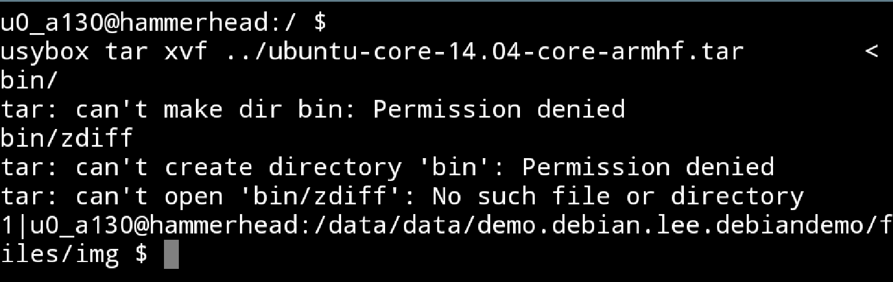
chmod 775 problems
Permission denied.
GNURootDebian source used the command : chmod 0777 the directories of root filesystem.

Slide 22
Solution
解決 Permission denied 問題
    改成內部 Intents 呼叫 terminal emulator app
    See slide 16

Slide 23
Using PRoot build rootfs(now.)
copyAssetsExecute("busybox");
copyAssetsExecute("proot.mp2");
copyAssetsExecute("libdisableselinux.so");
copyAssetsExecute("debian.tar");
new File(getFilesDir().getPath() + "/busybox").setExecutable(true);
new File(getFilesDir().getPath() + "/proot.mp2").setExecutable(true);
creating required folders.

Slide 24
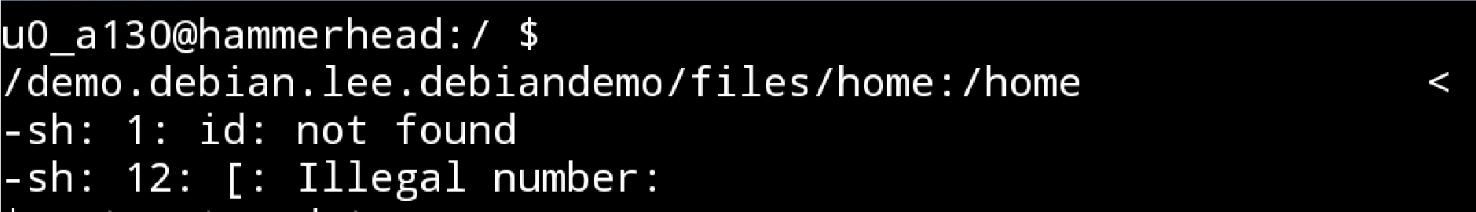
Launching root filesystem problems
proot –S /path/to/debian
  sh: line 4: id: command not found
  sh: line 4: [: : integer expression expected

Slide 25
Launching root filesystem problems
apt-get update (/etc/resolv.conf problem)
Err http://security.debian.org squeeze Release.gpg
Could not resolve 'security.debian.org'
Err http://http.us.debian.org squeeze Release.gpg
Could not resolve 'http.us.debian.org'
Err http://security.debian.org/ squeeze//updates Translation-en
Could not resolve 'security.debian.org'
Err http://security.debian.org/ squeeze/contrib Translation-en
Could not resolve 'security.debian.org'
…….
Reading package lists... Done

Slide 26
Launching root filesystem problems (cont.)
W: Failed to fetch http://http.us.debian.org/debian/dists/squeeze/Release.gpg Could not resolve 'http.us.debian.org'
W: Failed to fetch http://http.us.debian.org/debian/dists/squeeze/contrib/i18n/Translation-en.lzma Could not resolve 'http.us.debian.org'
W: Failed to fetch http://http.us.debian.org/debian/dists/squeeze/main/i18n/Translation-en.lzma Could not resolve 'http.us.debian.org'
W: Failed to fetch
http://http.us.debian.org/debian/dists/squeeze/non-free/i18n/Translation-en.lzma Could not resolve 'http.us.debian.org'
…….

Slide 27
Solution
apt-get update
  Using root filesystem which is in the Github repository of GNURootDebian
  File name ： main.10.com.gnuroot.debian
  Archive file size ：137 MB
  Building own root filesystem
  Reference ： createReleaseRootfs.sh

Slide 28
createReleaseRootfs.sh
# get necessary packages
#reduce size
#basic dns setup
#basic sources.list setup
#add a non-root user
#tar this up into .obb file
#build proot to go with the release
#build disableselinux to go with this release
#get busybox to go with the release

Slide 29
buildRootfs ---- bash script
改成自己的 bash script 版本
https://gist.github.com/peter279k/64df15baad39de7c92db

Slide 30
Solution(cont.)
  sh: line 4: id: command not found
sh: line 4: [: : integer expression expected
  PRoot 正確設定

Slide 31
Solution(cont.) Ref ： GNURootDebian(pre.)
/path/to/busybox sh if [[ $? == 0 ]]; then linkOption=\" \"; else linkOption=\"-l\"; fi;LD_PRELOAD=" + "/path/to/libdisableselinux.so;"
"PATH=/usr/local/sbin:/usr/local/bin:/usr/sbin:/usr/bin:/sbin:/bin;export PROOT_TMP_DIR=" + "/path/to/img/tmp" + ";" +
"/patrh/to/proot.mp2 -r " + "/path/to/img" + " -v -1 -H $linkOption -0 -b /sys -b /dev -b /data -b /proc -b /mnt -b /proc/mounts:/etc/mtab -b " + " -b /:/host-rootfs /path/to/intents:/intents -b " +
" /path/to/home:/home -b " + "/path/to/img:/.proot.noexec -b " +
"/path/to:/sdcard -b " + "/path/to/support/:/support $@"

Slide 32
Solution(cont.) Ref ： GNURootDebian(now.)
"rm /path/to/support/testln &> /dev/null; "
"ln /path/to/support/busybox /path/to/support/testln &> /dev/null; "
"PATH=/usr/local/sbin:/usr/local/bin:/usr/sbin:/usr/bin:/sbin:/bin "
"export LD_PRELOAD=/support/libdisableselinux.so; "
"export PROOT_TMP_DIR=/path/to/support/;"
" /path/to/support/proot.mp2 –r /path/to/img -v -1 -H -0 -b /sys -b /dev -b /data -b /proc -b /mnt -b /proc/mounts:/etc/mtab -b "
" /path/to/intents:/intents –b /home:/home –b /img:/.proot.noexec –b "
" /path/to:/sdcard –b /path/to/support/:/support $@ /bin/bash"

Slide 33
Result
apt-get update ……. ok
  sh: line 4: id: command not found ……ok
  sh: line 4: [: : integer expression expected ……ok
  apt-get install vim………………………….ok

Slide 34
SSH server
apt-get install dropbear or apt-get install openssh-server
dropbear----lightweight ssh server
Modify /etc/default/dropbear and
change the DROPBEAR_PORT to anything > 1024.
etc/init.d/dropbear start
  output message ：Starting Dropbear SSH server: dropbear.
passwd root

Slide 35
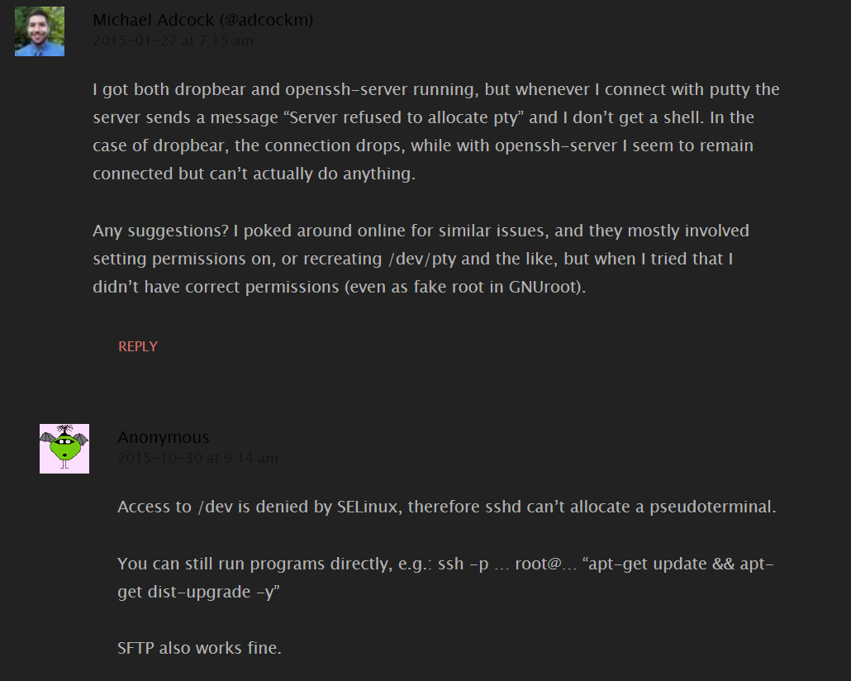
SSH 連線問題

Slide 36
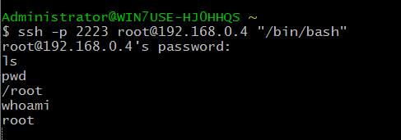
SSH 連線問題(cont.)
the server sends a message “Server refused to allocate pty”
Access to /dev is denied by SELinux, therefore sshd can’t
allocate a pseudoterminal.
You can still run programs directly, e.g.: ssh -p … root@… “apt-get update && apt-get dist-upgrade -y”
  ssh –p port-number user@ip-address “/bin/bash”
SFTP also works fine.(openssh-server)
Cygwin
  PTY allocation request failed on channel 0
  shell request failed on channel 0
  login as: root
Putty
  root@192.168.0.4's password:
  Server refused to allocate pty

Slide 37
setup-instances
Apache
Lighttpd
Testing environment：Ubuntu 14.10(PC)
sudo apt-get install lighttpd

Slide 38
setup-instances(cont.)
sudo useradd peter2
sudo passwd peter2 (optional)
sudo mkdir /home/peter2
sudo mkdir /home/peter2/lighttpd
sudo mkdir /home/peter2/www
sudo mkdir /home/peter2/cache
sudo cp /etc/lighttpd/lighttpd.conf /home/peter2/lighttpd/
sudo cp /var/run/lighttpd.pid /home/peter2/lighttpd/
sudo chown peter2:peter2 /home/peter2 –R
su peter2
#modify lighttpd.conf file
vi /home/peter2/lighttpd/lighttpd.conf

Slide 39
setup-instances(cont.)
cd ~/lighttpd
lighttpd –f ./lighttpd.conf
#end-script
Lighttpd.conf

Slide 40
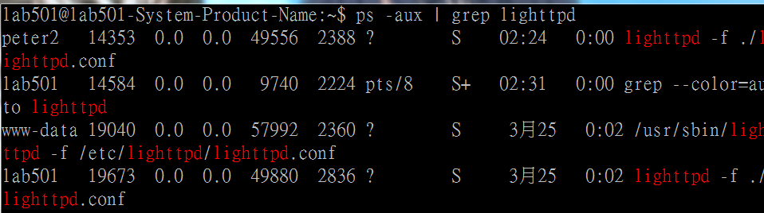
驗證是否有啟動
ps –aux | grep lighttpd
Notes:
有加「-」的 aux 選項是要 ps 顯示出指定使用者 ID 所執行的所有在 terminal 下執行的程序(Process)，而沒有加「-」的 aux 則是以 BSD-Style 顯示所有的process

Slide 41
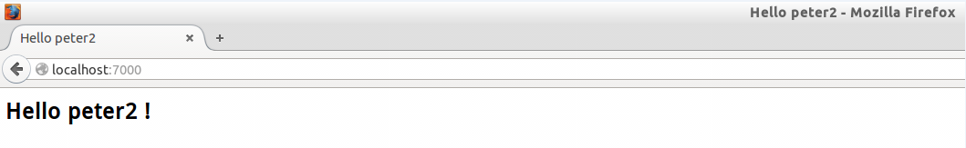
驗證是否有啟動

Slide 42
Apache for set up instances
setup-instances

Slide 43
Alternative solution for SSH
Install vsftpd for ftps server to edit some configration files.
sudo apt-get install vsftpd

Slide 44
References
http://proot.me/
https://github.com/corbinlc/GNURootDebian
https://github.com/corbinlc/gnuroot
https://wiki.archlinux.org/index.php/Proot
https://miracoin.wordpress.com/2014/05/28/installation-of-ssh-server-for-debian-in-android-gnuroot/
terminal emulator
Apache Commons IO
Apache Commons Compress

