Slide 1
Project Management System
Камен Тодоров, 61808
Петър Татерски, 61845

Slide 2
Функционални изисквания
Create project - Registered user will be able to create project to which he can add tasks and team members.
Manage project info - Edit project information
Browse project - List own projects and projects in which the user is member
Create task - Create user task with detailed information about the task - time frame, description, task name, checklist, tags etc.
Create subtask - Create subtask to a task
Edit task info - Edit already created task information
Browse tasks for project - See all tasks that are related to project
Browse members for project - View all members of a project.
Add/remove member - Add or remove existing user as a member to the project.
Register - Anonymous User can register in the system by providing a valid e-mail address, first and last name, and choosing password. By default, all new registered users have Regular role. Administrator can register new user by entering User Data and choosing a Role (Regular or Administrator).

Slide 3
Функционални изисквания
Change User Data - Registered User can view and edit their personal User Data. Administrator can view and edit User Data of all Users and assign them Roles: Regular or Administrator.
Manage Users - Administrator can browse users. Administrator can choose a User to manage and can manage the chosen User - edit or delete. Administrator can create a new user.
Create sprint - Groups tasks in sprint
Finish sprint - Complete sprint (The sprint must not have pending tasks. All open tasks will go in the backlog - list of all tasks that doesn’t have sprint)
List all sprints - Show all sprints to the user
Move task to sprint - Move task to sprint, the sprint should be active
View sprint statistic - View details about the sprint - open/closed/opened tasks, time
Estimation from the team
Comments for the estimations

Slide 4
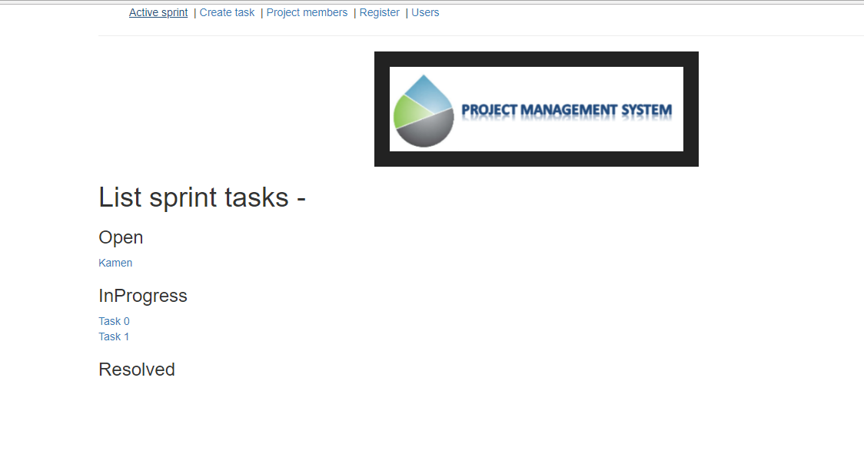
Разглеждане на задачи в активен спринт

Slide 5
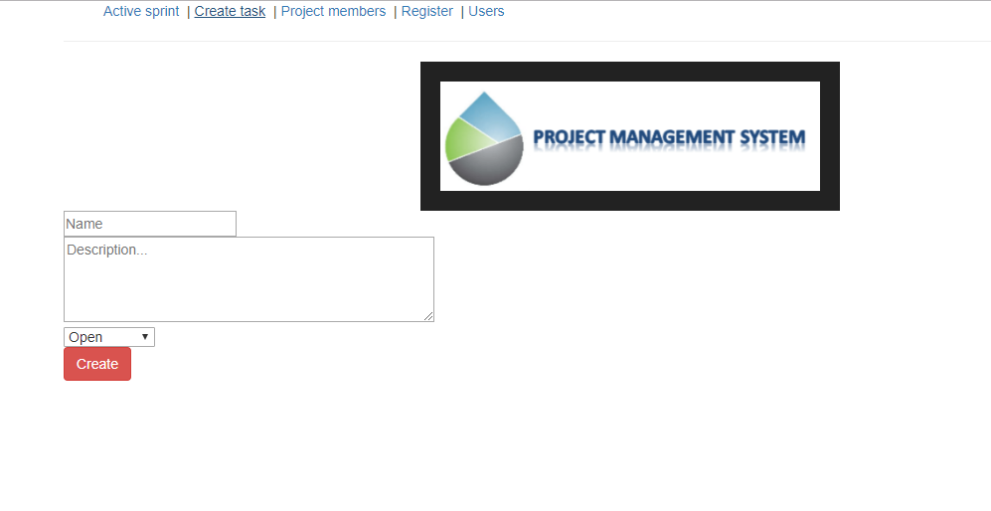
Създаване на задача

Slide 6
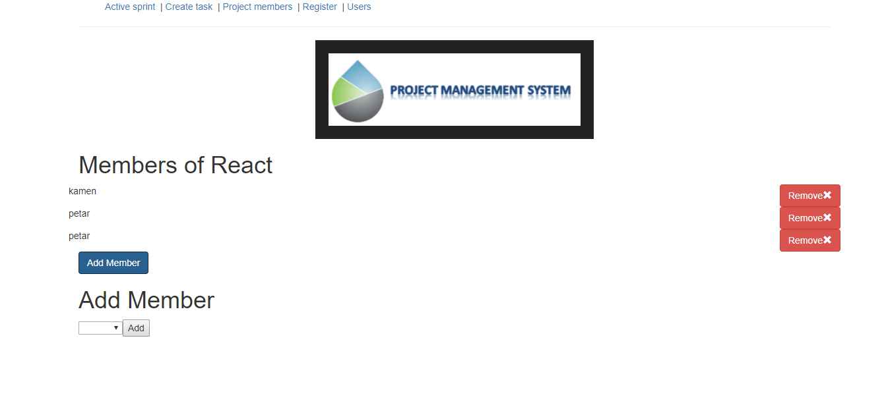
Менажиране на участниците в проекта

Slide 7
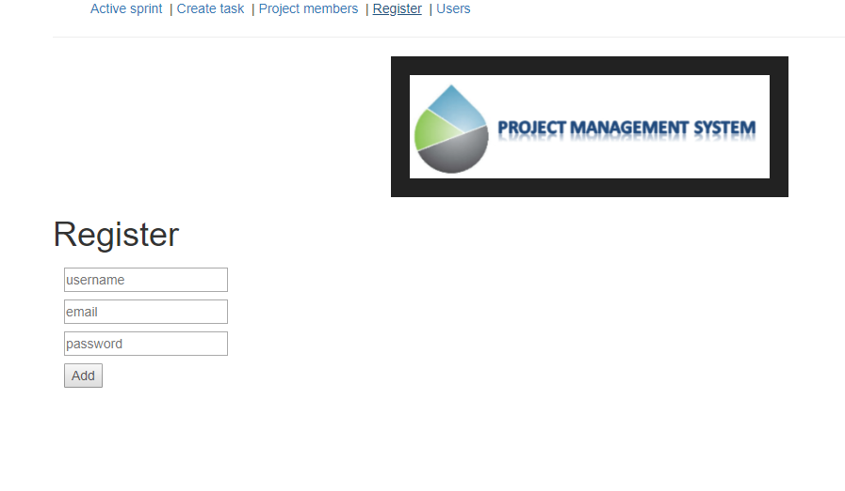
Регистриране на потребител

Slide 8
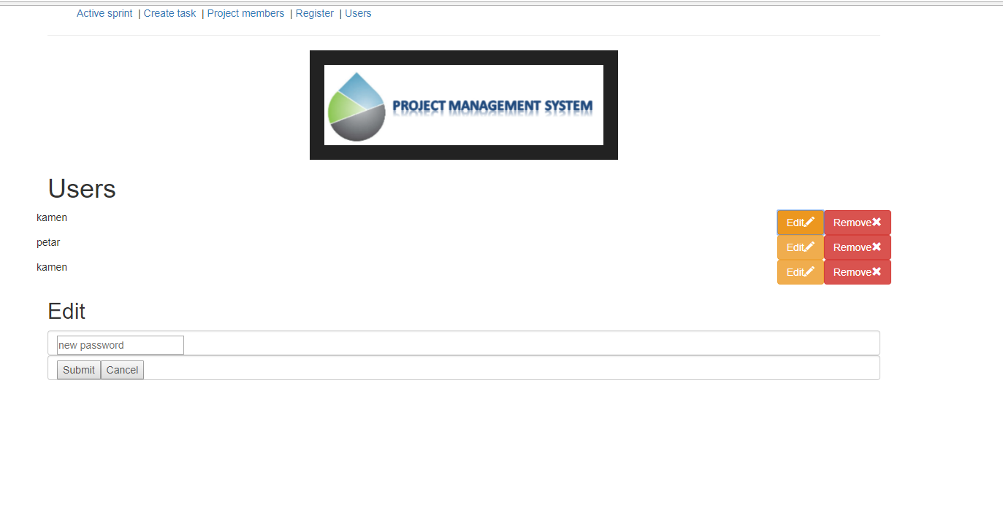
Редактиране на потребителски акаунти

Slide 9
Архитектура
Client-server
REST API

Slide 10
Заключение
В бъдеще очакваме проекта да бъде довършен и може да бъде използван за малки проекти.

