Slide 1
ICDV
吳岳霖 00357107
謝侑錦 00357116
陳柏禎 00357117
April 2017
NTOU CS

Slide 2
First What is ICDV?
NTOU CS

Slide 3
First What is ICDV?
International Company Data Visualization
NTOU CS

Slide 4
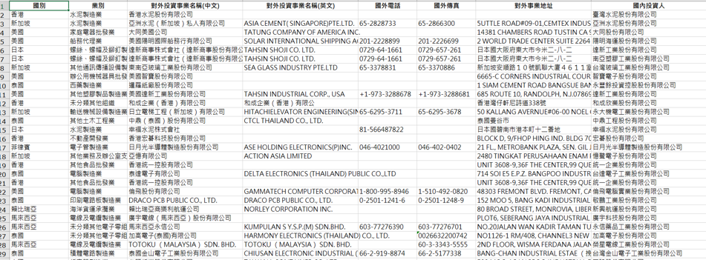
Problem
The Information of Foreign investment is very scattered. (原始資料太雜亂 )
There is not a “user-friendly” presentation for all the related data. ( 可讀性低 )
NTOU CS

Slide 5
Goal
  Provides a platform to study the distribution of foreign investment.
  ( 提供一個能夠研究外商分布的平台 )
  The platform will provide the filters to let users know what they want to know.
  ( 平台能夠使使用者過濾資訊 )
NTOU CS

Slide 6
Solution
  We create an online platform. ( 線上平台 )
  Make the related data to visualization. ( 視覺化 )
  Classified the data more clearly. ( 分類資料 )
NTOU CS

Slide 7
How
D3.js
Google Map
Python
Marker Cluster
NTOU CS

Slide 8
Possible problems in the future
(未來可能碰到的問題)
Mixed data of the old and new system
( 新舊制的資料混雜在一起 )
The address of the data may not be converted into latitude and longitude
( 資料的地址有可能無法轉成經緯度 )
統計的資料量十分龐大
NTOU CS

Slide 9

Q & A
NTOU CS

