Slide 1

DARCY FLOW IN POROUS MEDIA
CHE 514 — Fluid Mechanics
Ting-Wei Chen
Notes:
Good morning, everyone. My name is Ting-Wei Chen, and today I will talk about Darcy flow in porous media.

Slide 2

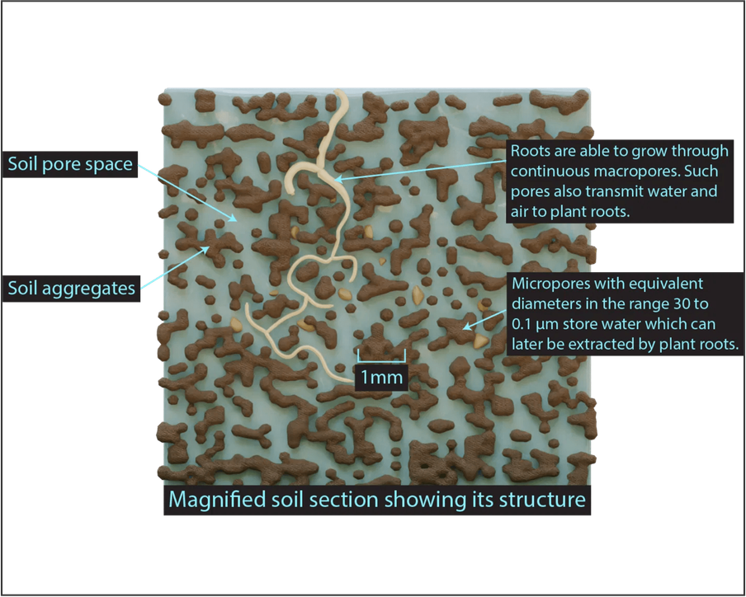
WHAT IS POROUS MEDIA?
Porous Media are materials that contain many small holes or spaces where fluid can flow.
Common Examples:
Soil
Sand
Rocks
Filters
Sponges
Notes:
First, let us look at what porous media are.
Porous media are materials that contain many small holes or spaces where fluids can flow.
Common examples include:
soil
sand
rocks
filters
and sponges.
In these materials, fluids move through a complex network of small pores.
This type of flow is very important in many natural and engineering systems.

Slide 3




WHAT IS DARCY FLOW?
Darcy Flow describes fluid movement through porous materials driven by pressure difference.
Key Idea: The flow rate depends on:
Pressure difference
Permeability of the material
Fluid viscosity
These factors control how easily fluid moves through porous materials.
Higher permeability means the material allows fluid to flow more easily.
Notes:
Next, we look at Darcy flow.
Darcy flow describes how fluids move through porous materials when there is a pressure difference.
The flow rate depends on three main factors:
the pressure difference
the permeability of the material
and the viscosity of the fluid.
Permeability describes how easily fluid can move through the pore structure.
For example, sand usually has higher permeability than clay, so fluid flows more easily through sand.

Slide 4

FROM STOKES FLOW TO DARCY’S LAW
Microscopic Scale
Macroscopic Scale
Fluid moves through many small pores. At this small scale, the flow follows:
Average behavior across many pores leads to the empirical law:
Averaging the flow behavior across many pores
Stokes Equation
(Viscous dominated flow)
Darcy’s Law
(Bulk flow properties)
Key Idea: Darcy's Law is the macroscopic representation of microscopic viscous flow.
Notes:
To understand Darcy’s law, we can first look at the microscopic scale.
Inside porous materials, fluid moves through many very small pores.
At this small scale, the flow is dominated by viscous forces and can be described by the Stokes equation.
When we average the flow behavior across many pores, we obtain a macroscopic relationship.
This averaged behavior leads to Darcy’s law, which describes the bulk flow through porous media.
So in simple terms, Darcy’s law is the macroscopic representation of microscopic viscous flow.

Slide 5

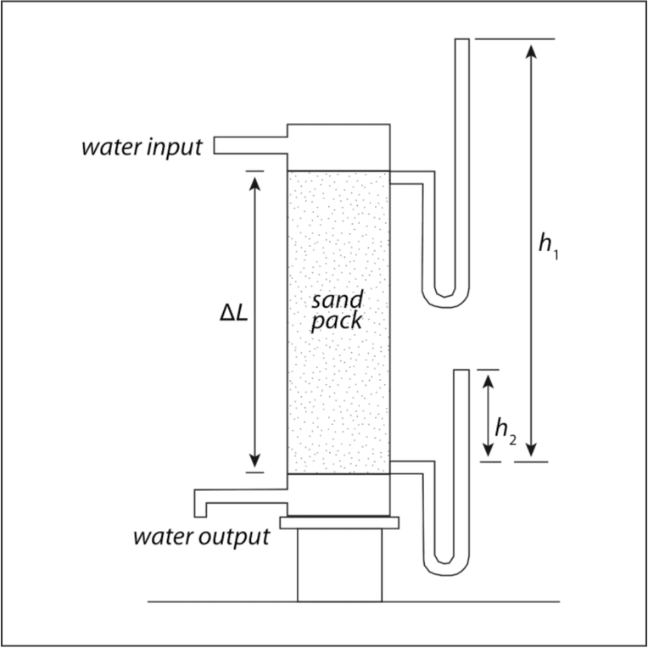

DARCY'S LAW EQUATION
Q = -kA · (dP/dx)
Q
Volumetric flow rate
k
Permeability of the material
A
Cross-sectional area
dP/dx
Pressure gradient
Figure: Darcy's Experimental Setup
Notes:
Darcy’s law describes the relationship between the flow rate and the pressure gradient.
The equation is:
Q equals negative k times A times dP over dx.
Here:
Q is the volumetric flow rate
k is the permeability of the material
A is the cross-sectional area
and dP over dx is the pressure gradient.
This equation shows that the flow rate increases when the pressure gradient or permeability increases.
Darcy’s law is valid mainly for laminar flow in porous media and relatively low Reynolds numbers.

Slide 6

PHYSICAL MEANING AND FACTORS
1. Permeability (k)
Measures how easily a fluid can flow through the porous material. It depends on the size and connectivity of the pores.
Sand
Clay
High Permeability
Low Permeability
2. Pressure Gradient (dP/dx)
The driving force of the flow. A steeper pressure gradient results in a higher flow velocity.
Relationship: Stronger Pressure Difference → Faster Flow
Notes:
Now let us look at the physical meaning of Darcy’s law.
One important factor is permeability.
Permeability measures how easily fluid can flow through a material.
For example:
Sand usually has high permeability because its pores are larger and better connected.
Clay has much lower permeability because the pores are very small.
Another important factor is the pressure gradient.
A larger pressure difference creates a stronger driving force and increases the flow velocity.

Slide 7

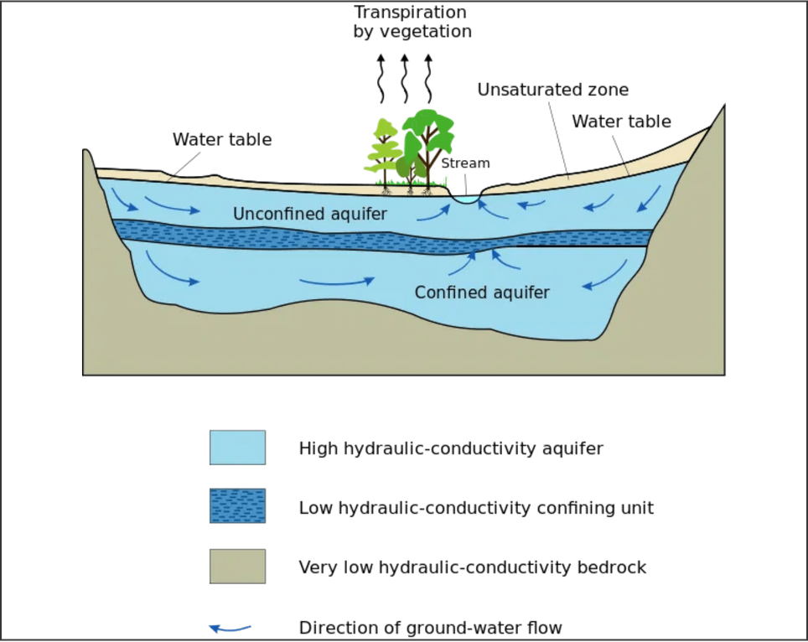




ENGINEERING APPLICATIONS
Groundwater Flow
Modeling water movement through soil and aquifers.
Oil and Gas Reservoirs
Predicting oil and gas flow through porous rock formations.
Filtration Systems
Designing water filters and industrial separation processes.
Environmental Engineering
Tracking pollutant transport in subsurface environments.
Illustration of Groundwater Flow in Aquifers
Notes:
Darcy flow is widely used in many engineering fields.
One example is groundwater flow.
Scientists use Darcy’s law to study how water moves through soil and underground aquifers.
There are also some examples like Oil and gas reservoirs, Filtration systems, and environmental engineering

Slide 8




CONCLUSION
Darcy Flow is the fundamental concept describing fluid movement through porous media.
The flow rate is primarily governed by the permeability of the material and the pressure gradient.
Darcy’s law is widely used in groundwater hydrology and petroleum engineering.
Notes:
In conclusion, Darcy flow describes how fluids move through porous materials.
The flow rate is mainly controlled by the permeability of the material and the pressure gradient.
Darcy’s law is a simple but very powerful model that is widely used in groundwater hydrology and petroleum engineering.
Understanding Darcy flow helps engineers analyze many natural and industrial processes.
Thank you for your attention.

Slide 9

REFERENCES
Darcy, H. (1856). Les fontaines publiques de la ville de Dijon. Victor Dalmont, Paris.
Bear, J. (1972). Dynamics of Fluids in Porous Media. American Elsevier Publishing Company.
Bear, J., & Bachmat, Y. (1990). Introduction to Modeling of Transport Phenomena in Porous Media. Kluwer Academic Publishers.
Fetter, C. W. (2001). Applied Hydrogeology. Prentice Hall.
Whitaker, S. (1986). Flow in porous media I: A theoretical derivation of Darcy's law. Transport in Porous Media, 1(1), 3-25.

Slide 10

Thank you for your attention

