Slide 1
Solid Catalyzed Reaction Processes​
Sin Yu Chen
Yu Hsuan Tseng
Ting Wei Chen
Notes:
我們今天要介紹的是「固體催化反應程序」的數學模型建立。 本專題的重點在於建立一個完整的異相催化機制模型，並推導各物種的淨反應速率方程式。 我們會從模型假設開始，接著介紹表面反應機構、單步反應速率、最後建立完整的動力學方程系統。
Today, we are going to present our mathematical model for a solid-catalyzed reaction process.
The main objective of this project is to construct a complete heterogeneous catalyst reaction mechanism and derive the net reaction expressions for all species.
We will start at model assumptions, then introduce the surface reaction mechanism, individual reaction rates, and finally the full kinetic model.

Slide 2
Background & Motivation
• Solid-catalyzed reactions are industrially important
• Wall-coated microreactors enhance surface interaction
• Hydrodynamics controls surface mass transfer
• Flow modeling is required
Notes:
Solid-catalyzed reactions occur at the catalytic surface rather than in the bulk fluid, so reactor performance depends strongly on the interaction between the flowing reactants and the catalyst surface.
Parallel-plate microreactors provide a high surface-to-volume ratio, which improves contact between the fluid and the catalyst-coated walls.
Because mass transfer to the surface depends on the flow field, it is important to first establish a reliable hydrodynamic model before analyzing reaction and transport processes.
固相催化反應發生在催化劑表面而非本體流體中，因此反應器的性能很大程度上取決於流動反應物與催化劑表面的相互作用。
平行板微反應器具有較高的表面積/體積比，從而改善了流體與塗覆催化劑的壁面之間的接觸。
由於向表面的傳質取決於流場，因此在分析反應和傳輸過程之前，首先建立可靠的流體動力學模型至關重要。

Slide 3
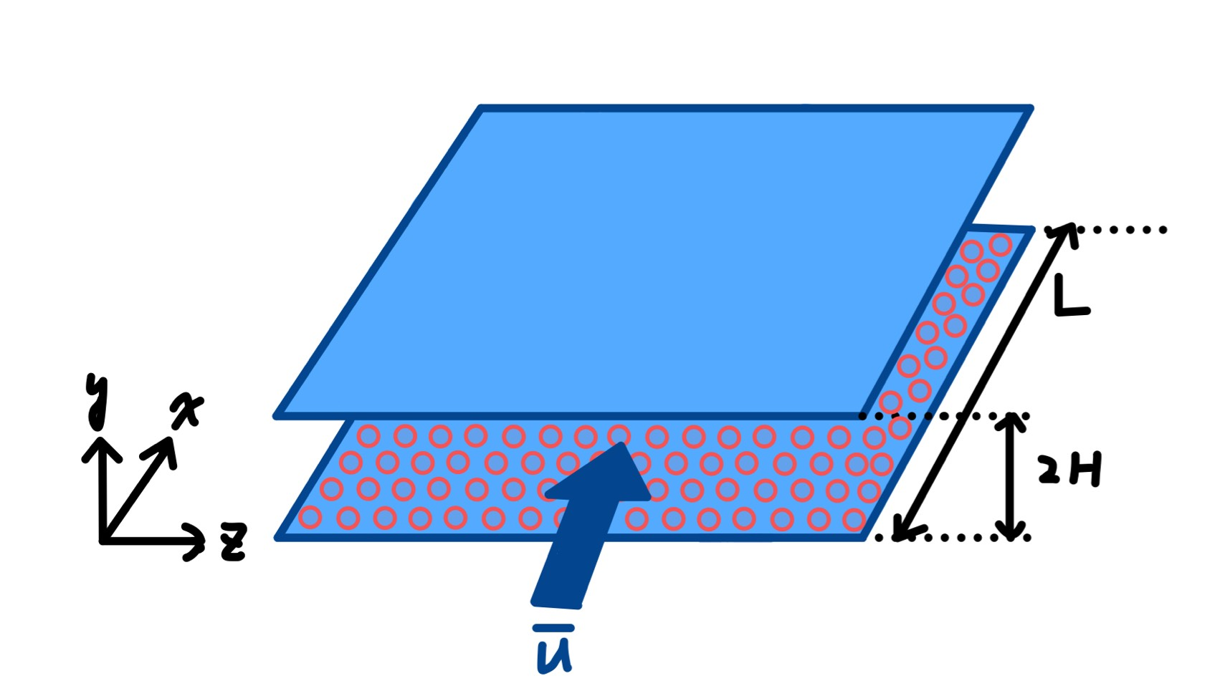
Reaction Schematic
Notes:
This figure shows the parallel-plate microreactor geometry used in our model. The flow moves along the x-direction, while velocity varies across the gap in the y-direction.
A thin catalyst layer is coated on the reactor walls, where the reaction occurs. Reactant A is transported downstream by convection, while diffusion in the y-direction carries species to the catalytic surface.
Finally, we assume the reactor is uniform in the z-direction, so the model can be simplified to a two-dimensional system in x and y.
這張圖展示的是我們所使用的平行板微反應器模型。
反應器由兩塊平行板構成，板間距為 2H，通道長度為 L。流體沿 x 方向流動，而速度分佈則在 y 方向（跨通道方向）發生變化。
整個通道體積都由流體佔據。固體催化劑以極薄的薄膜形式沉積在壁面上。由於催化層厚度遠小於通道高度，因此被視為二維表面，不形成額外的流動區域。
反應物 A 進入通道後，沿 x 方向受到對流傳輸。同時，在 y 方向發生擴散，將反應物傳輸至壁面催化層進行反應。生成的產物再擴散回流體本體，並隨對流被帶往下游。
雖然圖示為三維結構，但我們假設反應器在寬度方向（z 軸）上是均勻的。z 方向沒有幾何變化或邊界條件改變，因此不存在速度梯度或濃度梯度。基於此假設，模型可簡化為 x–y 二維形式。

Slide 4
Microchannel Reactor Assumptions
Steady state
Laminar, fully developed flow
Incompressible Newtonian fluid
Isothermal system
Uniform in z-direction (2D model)
Catalyst treated as 2D surface on wall
No-slip boundary
Notes:
First, we assume steady-state operation, which means all flow variables are time-independent.
Second, the flow is assumed to be laminar and fully developed. Because the channel is small and the Reynolds number is low, laminar flow is expected, and the velocity varies only in the cross-gap direction.
We also assume an incompressible Newtonian fluid, so that we can apply the classical Poiseuille flow solution.
At the reactor walls, we apply the no-slip boundary condition, which means that the fluid velocity at the wall is zero.
Finally, we assume isothermal operation and no variation in the z-direction, so the model can be simplified to a two-dimensional system in x and y.
首先，我們假設運行處於穩態，這意味著所有流動變數均與時間無關。
其次，我們假設流動為層流且充分發展。由於通道尺寸較小且雷諾數較低，因此預期流動為層流，且速度僅在橫向方向上變化。
我們也假設流體為不可壓縮牛頓流體，以便應用經典的泊肅葉流動解。
在反應器壁面處，我們應用無滑移邊界條件，這意味著壁面處的流體速度為零。
最後，我們假設運行在等溫條件下，且z方向無變化，因此模型可以簡化為x和y方向的二維系統。

Slide 5
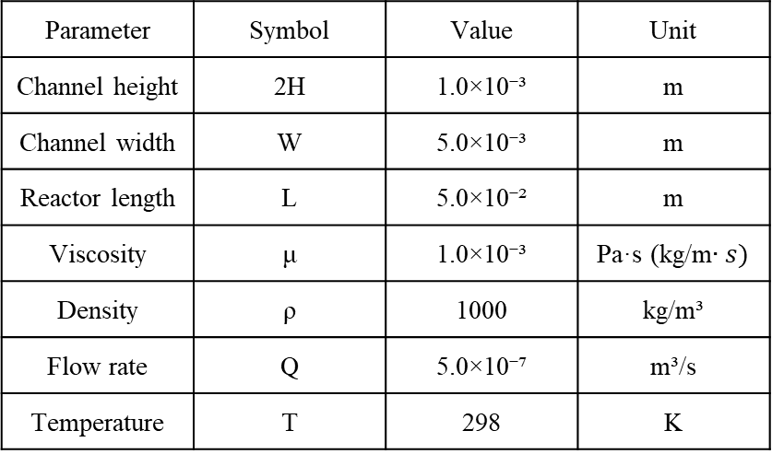
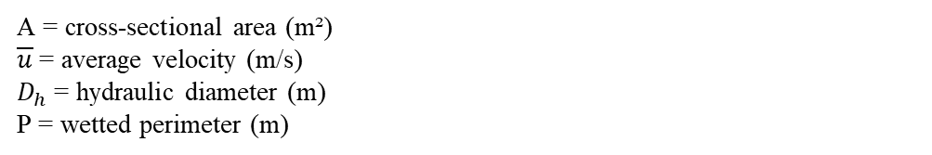
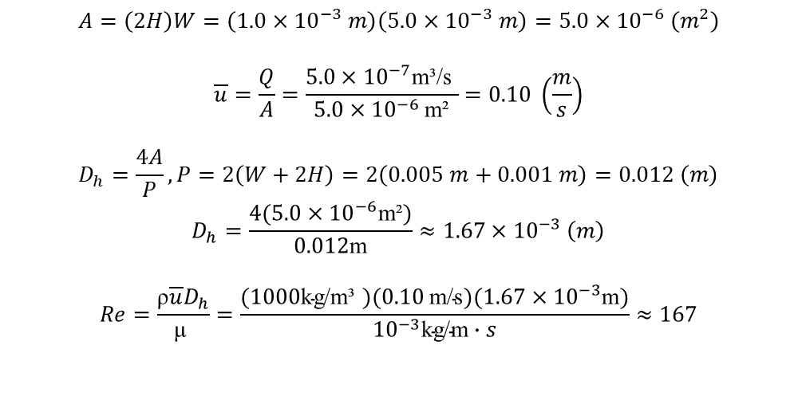
Design Data
$$A=\left(2H\right)W=\left(1.0×{10}^{−3} m\right)\left(5.0×{10}^{−3} m\right)=5.0×{10}^{−6} \left(m^{2}\right)$$
$$\overline{u}=\frac{Q}{A}=\frac{5.0×{10}^{−7}\text{m}\text{³}\text{/}\text{s} }{5.0×{10}^{−6} \text{m}\text{²}}=0.10 \left(\frac{m}{s}\right)$$
$$D_{h}=\frac{4A}{P}, P=2\left(W+2H\right)=2\left(0.005 m+0.001 m\right)=0.012 \left(m\right)$$
$$D_{h}=\frac{4(5.0×{10}^{−6}\text{m}\text{²})}{0.012\text{m}}≈1.67×{10}^{−3} \left(m\right)$$
$$Re=\frac{\text{ρ}\overline{u}D_{h}}{\text{μ} }=\frac{(1000\text{kg}\text{/}\text{m}\text{³ })(0.10 \text{m}\text{/}\text{s})(1.67×{10}^{−3}\text{m})}{{10}^{−3}\text{kg}\text{/}\text{m}∙s}≈167$$
Parameter | Symbol | Value | Unit
Channel height | 2H | 1.0×10⁻³ | m
Channel width | W | 5.0×10⁻³ | m
Reactor length | L | 5.0×10⁻² | m
Viscosity | μ | 1.0×10⁻³ | Pa·s (kg/m$∙s)$
Density | ρ | 1000 | kg/m³
Flow rate | Q | 5.0×10⁻⁷ | m³/s
Temperature | T | 298 | K
A = cross-sectional area (m²)
$\overline{u}$= average velocity (m/s)
$D_{h}$= hydraulic diameter (m)
P = wetted perimeter (m)
Notes:
The channel height is 1 mm and the width is 5 mm. Because the width is much larger than the gap, the z-direction can be considered uniform, which supports the two-dimensional model.
The reactor length is 5 cm, allowing the flow to become fully developed.
For the fluid properties, we use water at room temperature, with a viscosity of ${10}^{−3}$Pa·s and density of 1000 kg/m³. Using the selected flow rate, the estimated Reynolds number is about 167, which confirms that the laminar flow assumption is valid.
通道高度為 1 mm，寬度為 5 mm。由於寬度遠大於間隙，因此可以認為 z 方向均勻，這支援了二維模型。
反應器長度為 5 cm，足以使流動充分發展。
流體性質方面，我們使用室溫下的水，其粘度為 10⁻³ Pa·s，密度為 1000 kg/m³。使用選定的流速，估計的雷諾數約為 167，這證實了層流假設的有效性。

Slide 6
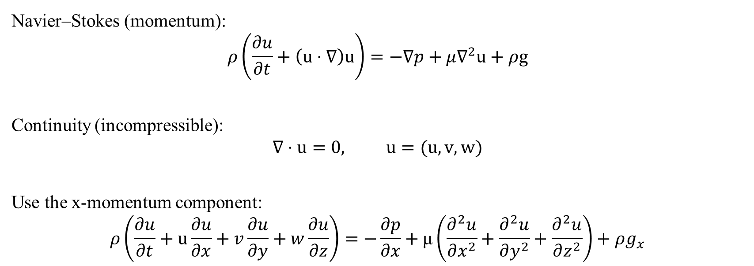
Governing Equations
Navier–Stokes (momentum):
$$ρ\left(\frac{∂u}{∂t}+\left(u⋅∇\right)u\right)=−∇p+μ∇^{2}u+ρg$$
Continuity (incompressible):
$$∇⋅u=0, u=(u, v, w)$$
Use the x-momentum component:
$$ρ\left(\frac{∂u}{∂t}+u\frac{∂u}{∂x}+v\frac{∂u}{∂y}+w\frac{∂u}{∂z}\right)=−\frac{∂p}{∂x}+\text{μ}\left(\frac{∂^{2}u}{∂x^{2}}+\frac{∂^{2}u}{∂y^{2}}+\frac{∂^{2}u}{∂z^{2}}\right)+ρg_{x}$$
Notes:
English Script (spoken version)
Now I will start with the governing equations used to describe the flow inside the reactor channel.
First, we begin with the continuity equation for incompressible flow. This equation tells us that the velocity field must satisfy mass conservation, meaning the fluid density remains constant and the flow has zero divergence.
Next, we use the Navier–Stokes equation, which describes the momentum balance of a Newtonian fluid.
Since our flow is mainly along the x-direction, we focus on the x-momentum equation.
Under the assumptions of steady state, fully developed flow, and unidirectional flow, the velocity only depends on the y-direction across the channel gap.
Because of this, the transverse velocities are zero and the velocity does not change along the x or z directions.
This means that many of the convection terms disappear, which greatly simplifies the momentum equation.
Finally, the equation reduces to a balance between the pressure gradient driving the flow and the viscous diffusion of momentum.
中文講稿
接下來我會從 **governing equations（控制方程）**開始，來描述反應器通道內的流動行為。
首先我們從 不可壓縮流體的 continuity equation 開始。 這個方程代表質量守恆，也就是說流體密度是固定的，速度場的散度為零。
接著我們使用 Navier–Stokes 方程式，它描述的是牛頓流體的動量平衡。
因為我們的流動主要是在 x 方向，所以我們只需要考慮 x-direction 的動量方程。
在我們的假設下，例如 steady state、fully developed flow、以及 unidirectional flow，速度只會隨 y 方向改變。
因此橫向速度會等於零，而且速度在 x 與 z 方向都不會改變。
在這些條件下，大部分的 convection terms 都會消失，方程式就會大幅簡化。
最後我們得到的方程式其實就是 pressure gradient 與 viscous diffusion 的平衡。

Slide 7
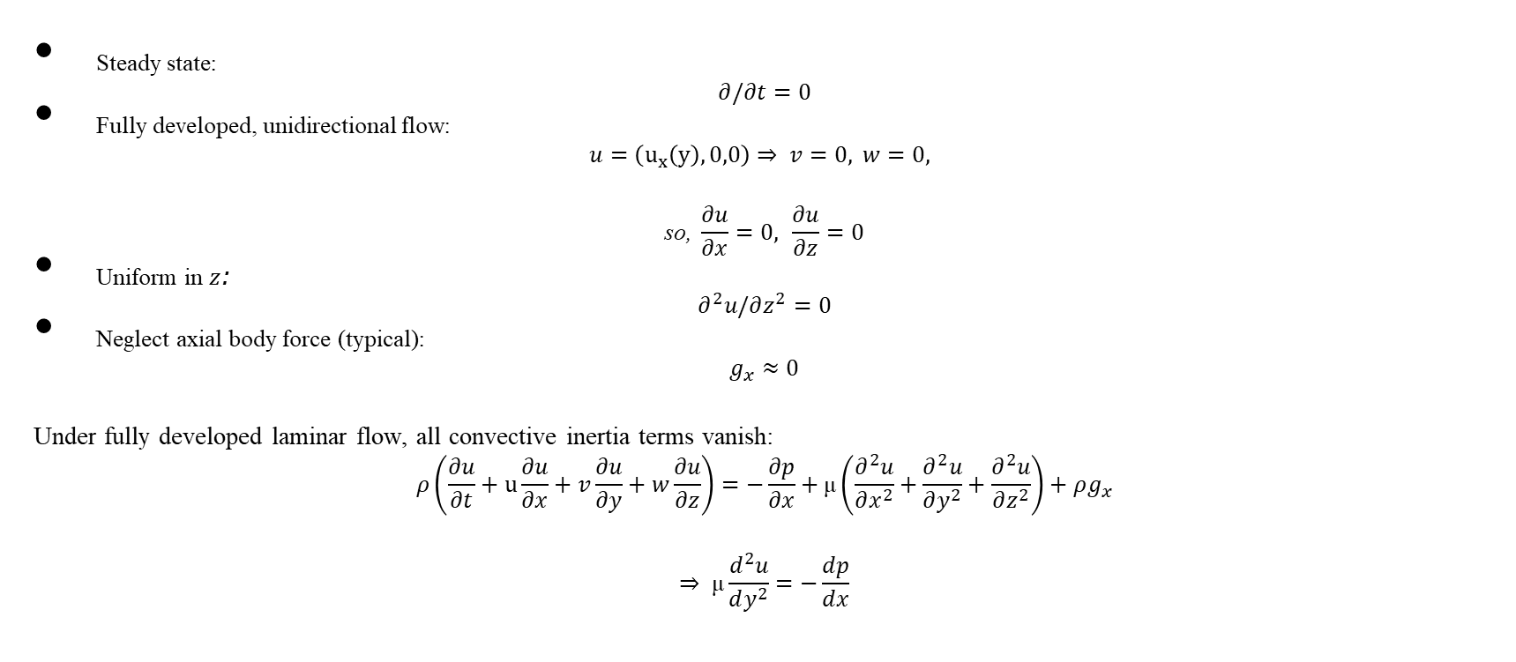
Apply Assumptions
Steady state:
$$∂/∂t=0$$
Fully developed, unidirectional flow:
$$u=\left(u_{x}\left(y\right),0,0\right)⇒ v=0, w=0,$$
$$\text{so}\text{,} \frac{∂u}{∂x}=0, \frac{∂u}{∂z}=0$$
Uniform in $z$:
$$∂^{2}u/∂z^{2}=0$$
Neglect axial body force (typical):
$$g_{x}≈0$$
Under fully developed laminar flow, all convective inertia terms vanish:
$$ρ\left(\frac{∂u}{∂t}+u\frac{∂u}{∂x}+v\frac{∂u}{∂y}+w\frac{∂u}{∂z}\right)=−\frac{∂p}{∂x}+\text{μ}\left(\frac{∂^{2}u}{∂x^{2}}+\frac{∂^{2}u}{∂y^{2}}+\frac{∂^{2}u}{∂z^{2}}\right)+ρg_{x}$$
$$⇒ \text{μ}\frac{d^{2}u}{dy^{2}}=−\frac{dp}{dx}$$
Notes:
nglish Script
Next, we apply the assumptions that simplify the governing equation.
First, we assume steady-state flow, so the time derivative term becomes zero.
Second, we assume fully developed and unidirectional flow. This means the velocity vector only has one component in the x-direction.
The transverse velocity components are zero, and the velocity does not change along the x direction.
We also assume that the reactor is uniform in the z direction, so there are no velocity gradients in that direction.
Finally, we neglect the axial body force, because for pressure-driven flow in microchannels, the pressure gradient is much larger than gravitational effects.
Under these assumptions, all of the convective inertia terms vanish, and the equation becomes much simpler.
中文講稿
接下來我們把剛剛提到的 假設條件套用到方程式裡。
第一個是假設 steady state， 所以時間微分項會變成零。
第二個是假設 fully developed 且 unidirectional flow。 也就是說速度只存在 x 方向。
橫向速度是零，而且速度在 x 方向不再變化。
接著我們假設反應器在 z 方向是均勻的， 所以在 z 方向沒有速度梯度。
最後，我們忽略 axial body force。 因為在這種 pressure-driven microchannel flow 中，壓力梯度通常遠大於重力影響。
在這些假設之下， 所有 convective inertia terms 都會消失， 所以整個方程會變得非常簡單。

Slide 8
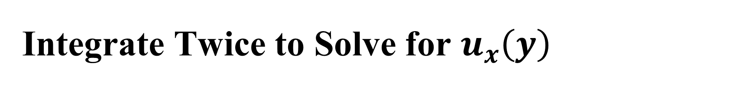
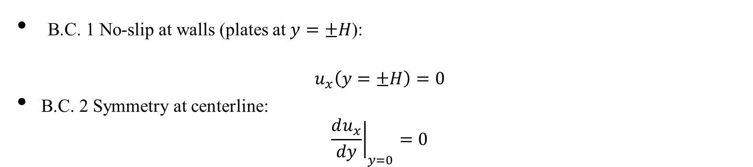
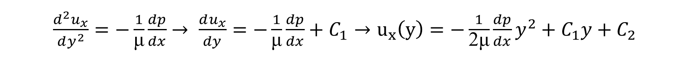
Integrate Twice to Solve for $u_{x}\left(y\right)$
$\frac{d^{2}u_{x}}{dy^{2}}=−\frac{1}{\text{μ}}\frac{dp}{dx}$ $→ \frac{du_{x}}{dy}=−\frac{1}{\text{μ}}\frac{dp}{dx}+C_{1}→u_{x}\left(y\right)=−\frac{1}{\text{2}\text{μ}}\frac{dp}{dx}y^{2}+C_{1}y+C_{2}$
Boundary Conditions
B.C. 1 No-slip at walls (plates at $y=±H$):
$$u_{x}\left(y=±H\right)=0$$
B.C. 2 Symmetry at centerline:
$${\frac{du_{x}}{dy}∣}_{y=0}=0$$
Notes:
English Script
After simplifying the equation, we integrate it twice with respect to the y-direction.
This gives us a quadratic velocity expression.
To determine the constants in this equation, we need to apply boundary conditions.
The first boundary condition is the no-slip condition at the walls. At the solid plates, the fluid velocity must be zero.
The second boundary condition is symmetry at the centerline.
At the center of the channel, the shear stress is zero, which means the velocity gradient with respect to y is zero.
By applying these two boundary conditions, we can determine the integration constants and obtain the classical Poiseuille parabolic velocity profile.
中文講稿
接下來我們對方程式 對 y 積分兩次。
這樣可以得到一個 二次型的速度解。
但是這個解裡面會有一些常數， 所以我們需要使用 boundary conditions 來求出這些常數。
第一個邊界條件是 wall 的 no-slip condition。 也就是在壁面上，流體速度必須等於零。
第二個邊界條件是 centerline symmetry。
在通道中心線的位置， 剪切力為零，因此 速度梯度等於零。
利用這兩個條件，我們就可以求出常數， 最後得到經典的 Poiseuille 拋物線速度分佈。

Slide 9

Apply B.C. 2:
$${\frac{du}{dy}∣}_{0}=0⇒C_{1}=0$$
So:
$$u_{x}\left(y\right)=−\frac{1}{2μ}\frac{dp}{dx}y^{2}+C_{2}$$
Apply B.C. 1 at $y=H$:
$$0=−\frac{1}{2μ}\frac{dp}{dx}H^{2}+C_{2}⇒C_{2}=\frac{1}{2μ}\frac{dp}{dx}H^{2}$$
Thus:
$$\boxed{u_{x}\left(y\right)=−\frac{1}{2μ}\frac{dp}{dx}\left(H^{2}−y^{2}\right)}$$
Notes:
English Script
Using the results from the integration and boundary conditions, we obtain the velocity equation for the parallel-plate channel.
The velocity distribution has a parabolic shape, which is typical for laminar flow between two plates.
The maximum velocity occurs at the centerline of the channel, where the shear stress is zero.
At the walls, the velocity becomes zero because of the no-slip boundary condition.
This velocity profile will later be used to calculate the volumetric flow rate and average velocity, which are important for analyzing mass transport and reaction in the reactor.
中文講稿
透過剛剛的積分以及邊界條件，我們可以得到平行板通道中的 velocity equation。
這個速度分佈會呈現 拋物線形狀， 這是平行板 laminar flow 的典型結果。
最大速度會出現在 通道中心線， 因為那裡的剪切力為零。
而在壁面位置，速度會變成零， 這是 no-slip condition 的結果。
接下來我們會利用這個 velocity profile 去計算 flow rate 和 average velocity， 這些對於後面的 mass transfer 與 reaction analysis 都非常重要。

Slide 10

Velocity Equation
$$u_{x}\left(y\right)=−\frac{1}{2μ}\frac{dp}{dx}\left(H^{2}−y^{2}\right)$$
Maximum velocity at centerline ($y=0)$:
$$u_{\text{max}}=u_{x}\left(0\right)=\frac{1}{2μ}\left(−\frac{dp}{dx}\right)H^{2}$$
$u_{\text{max}}$Substitute to velocity equation:
$u_{x}\left(y\right)=$ $u_{\text{max}}(1−\frac{y^{2}}{H^{2}})$
Notes:
Based on what Yu-Hsuan explained earlier, we have already derived the velocity equation. If we look at this equation, we can see that when y equals zero, the velocity reaches its maximum value.
In other words, the maximum velocity occurs at the centerline of the channel.
Therefore, we can express the maximum velocity using this equation. Then we substitute this expression back into the original velocity equation.
After simplifying, we obtain the final velocity profile shown here.

Slide 11
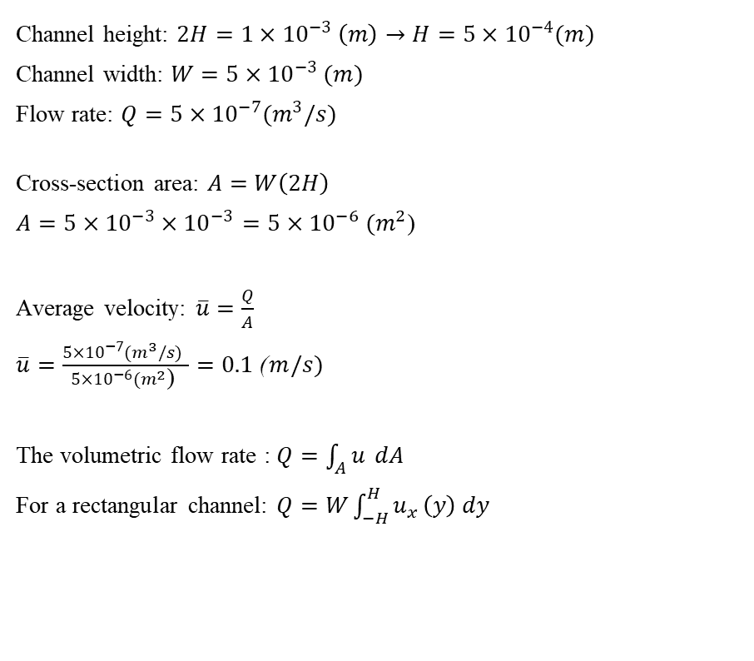

Numerical velocity
Channel height: $2H=1×{10}^{−3} \left(m\right)→H=5×{10}^{−4}(m)$
Channel width: $W=5×{10}^{−3} (m)$
Flow rate: $Q=5×{10}^{−7}{(m}^{3}/s)$
Cross-section area: $A=W\left(2H\right)$
$A=5×{10}^{−3}×{10}^{−3}$ $=5×{10}^{−6} (m^{2}$)
Average velocity: $\overline{u}=\frac{Q}{A}$
$\overline{u}=\frac{5×{10}^{−7}{(m}^{3}/s) }{5×{10}^{−6}(m^{2}\text{) }}$ $=0.1 \text{(} m/s)$
The volumetric flow rate : $Q=\int_{A}{u} dA$
For a rectangular channel: $Q=W\int_{−H}^{H}{u_{x}}\left(y\right) dy$
Substituting the velocity profile into the flow rate equation:
$$Q=Wu_{max}\int_{−H}^{H}{\left(1−\frac{y^{2}}{H^{2}}\right)}dy$$
Evaluate the integral:
$$\int_{−H}^{H}{\left(1−\frac{y^{2}}{H^{2}}\right)}dy=2H−\frac{1}{H^{2}}\left(\frac{2H^{3}}{3}\right)=\frac{4H}{3}$$
Thus, the flow rate becomes:
$$Q=Wu_{max}\frac{4H}{3}=\overline{u}∙A$$
$$→\overline{u}=\frac{Wu_{max}\frac{4H}{3}}{2HW}$$
$$→\overline{u}=\frac{2}{3}u_{max},{ u}_{max}=0.15 \text{(} m/s)$$
Notes:
Next, we apply our design data to estimate the numerical velocity in our system. Using our design parameters, we first calculate that the average velocity is 0.1 m/s.
The volumetric flow rate is defined as the integral of velocity over the cross-sectional area:
For a rectangular channel, this expression becomes Q equals W times the integral of u sub x of y from minus H to H with respect to y.
Next, we substitute our velocity profile equation into this expression and express it in terms of the maximum velocity. After performing the integration, we obtain: Q equals W times u sub max times four H over three.
On the other hand, the volumetric flow rate can also be written as the average velocity multiplied by the cross-sectional area. By equating these two expressions, we obtain the relationship.
Finally, by substituting our design data, we find that the maximum velocity is approximately 0.15 m/s.

Slide 12
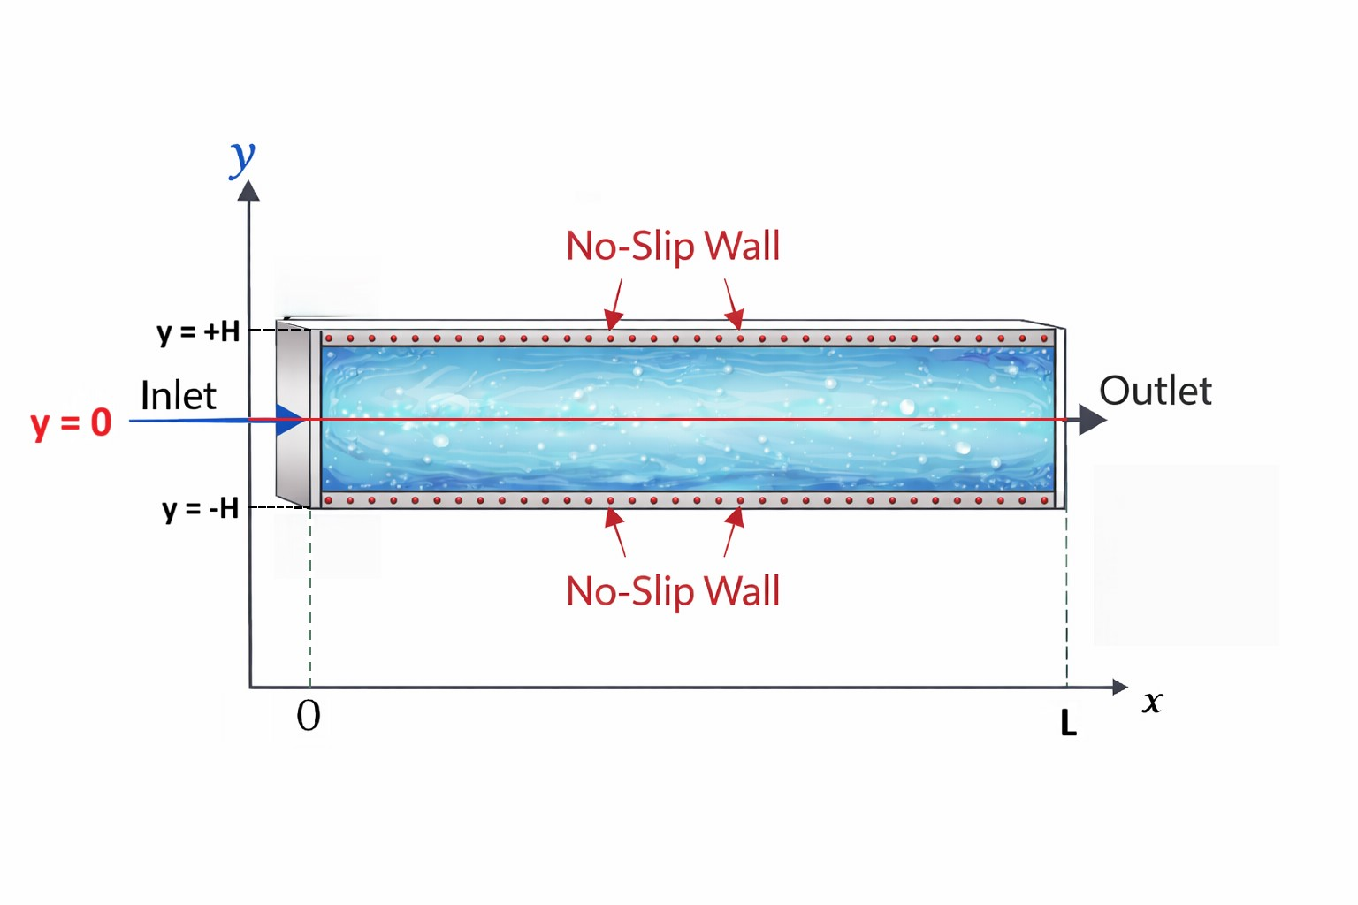
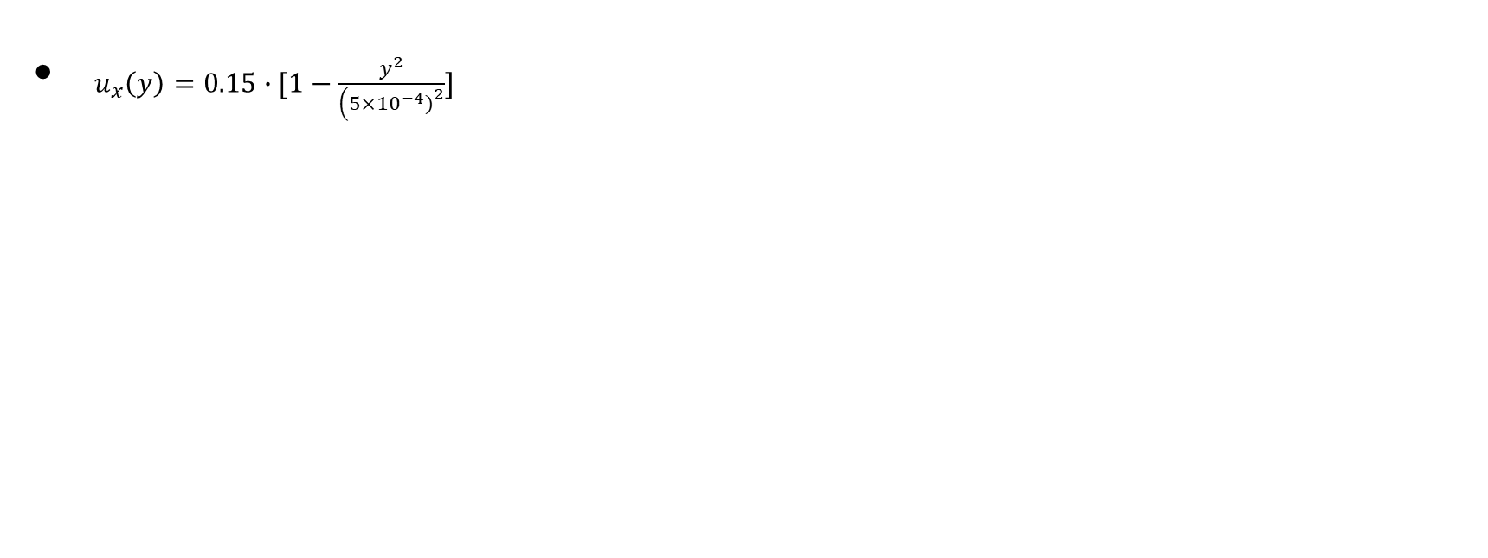
Velocity Profile
$u_{x}\left(y\right)=0.15∙[1−\frac{y^{2}}{\left(5×{10}^{−4}{\left.)\right.}^{2}\right.}]$
Notes:
Next, we substitute the average velocity, the maximum velocity, and the other known parameters into the velocity equation that we derived earlier.
By doing this, we can obtain the numerical velocity profile.
Then, we implement this equation in Excel, where the x-axis represents the channel height position and the y-axis represents the velocity.
From this plot, we can observe that the velocity distribution inside our reactor follows a parabolic profile.
The maximum velocity appears at the centerline of the channel, which is about 0.15 m/s, while the velocity at the top and bottom walls is zero.
This result is also consistent with the boundary conditions we discussed earlier.

Slide 13

Parametric Study
Effect of Channel Height and Velocity
$$A=\left(2H\right)W$$
$$\overline{u} =\frac{Q}{A}$$
Transport Characteristic Times
$$τ_{conv}=\frac{L}{U}$$
$$τ_{diff}=\frac{H^{2}}{D}$$
Pressure Drop
$$ΔP=\frac{12μLU}{H^{2}}$$
Notes:
From this parametric study, we can see that channel height and velocity strongly influence the transport behavior in the reactor, including the convection time, diffusion time, and pressure drop.
Reducing the channel height increases the velocity and shortens the transport time, but it also significantly increases the pressure drop. Therefore, these parameters must be carefully balanced in the reactor design.
After understanding the transport characteristics of the system, we now move to the reaction aspect of the model.
In the next section, we will introduce the kinetic model, which describes how the chemical reactions occur on the catalyst surface. This kinetic model will be combined with the transport model to analyze the overall behavior of the reactor.

Slide 14
Kinetics Assumptions
• Isothermal system • Catalyst surface is well-mixed • Catalyst treated as a thin surface layer (no internal diffusion) • Total surface site concentration is constant • Reaction occurs only on the catalyst surface
Notes:
Before introducing the reaction equations, we first define several model assumptions to simplify the analysis.
First, we assume the system is isothermal, meaning the temperature remains constant throughout the reactor.
Second, we assume the catalyst surface is well mixed, so the species concentrations on the surface are uniform.
Third, the catalyst is treated as a thin surface layer, which means internal diffusion inside the catalyst particles is neglected.
We also assume that the total concentration of active surface sites remains constant during the reaction.
Finally, we assume that all reactions occur only on the catalyst surface, rather than in the bulk fluid.
These assumptions allow us to develop a simplified surface reaction kinetic model for the system.

Slide 15
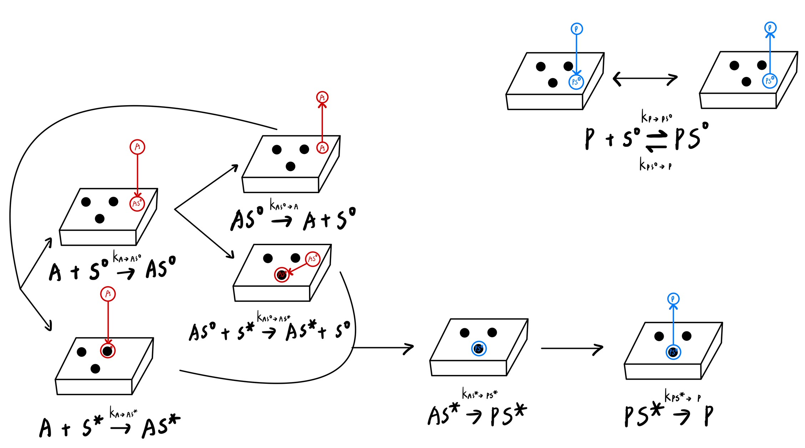
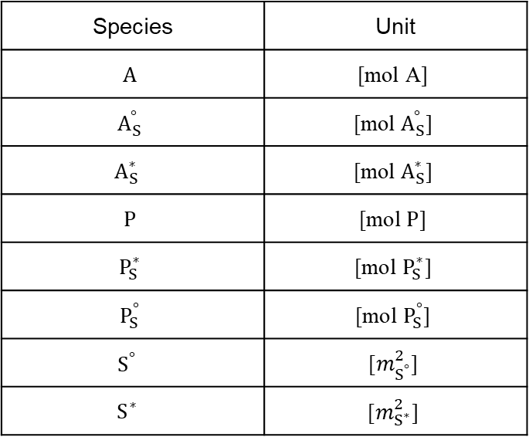
Surface Reaction Mechanism
Species | Unit
$$A$$ | $$\text{[}\text{mol} \text{A}\text{]}$$
$$A_{S}^{°}$$ | $$\text{[}\text{mol}{ A}_{S}^{°}\text{]}$$
$$A_{S}^{∗}$$ | $$\text{[}\text{mol}{ A}_{S}^{∗}\text{]}$$
$$P$$ | $$\text{[}\text{mol} P\text{]}$$
$$P_{S}^{∗}$$ | $$\text{[}\text{mol} P_{S}^{∗}\text{]}$$
$$P_{S}^{°}$$ | $$\text{[}\text{mol}{ P}_{S}^{°}\text{]}$$
$$S^{°}$$ | $$\text{[}m_{S^{°}}^{2}\text{]}$$
$$S^{∗}$$ | $$\text{[}m_{S^{∗}}^{2}\text{]}$$
Notes:
Next, we introduce the surface reaction mechanism that describes how the reactant is converted to the product on the catalyst surface.
First, the reactant A in the fluid phase can adsorb onto either an empty surface site $S^{∘}$or an activated site $S^{∗}$, forming the adsorbed species $AS^{∘}$or $AS^{∗}$.
When A adsorbs onto $S^{∘}$, the reaction is reversible, which means the adsorbed species $AS^{∘}$can also desorb back into the fluid phase as $A+S^{∘}$.
After being adsorbed, the species $AS^{∘}$can move along the catalyst surface and interact with an $S^{∗}$site, forming $AS^{∗}$.
During this process, the original $S^{∘}$site is released, allowing new reactant molecules to adsorb and continue the reaction.
Once $AS^{∗}$is formed, it can undergo surface transformation and convert into the product intermediate $PS^{∗}$.
Next, the product species P is formed when $PS^{∗}$desorbs from the $S^{∗}$site and returns to the fluid phase.
Finally, the product P can also adsorb onto an $S^{∘}$site to form $PS^{∘}$. This adsorption step is also reversible, meaning $PS^{∘}$can convert back to $P+S^{∘}$

Slide 16
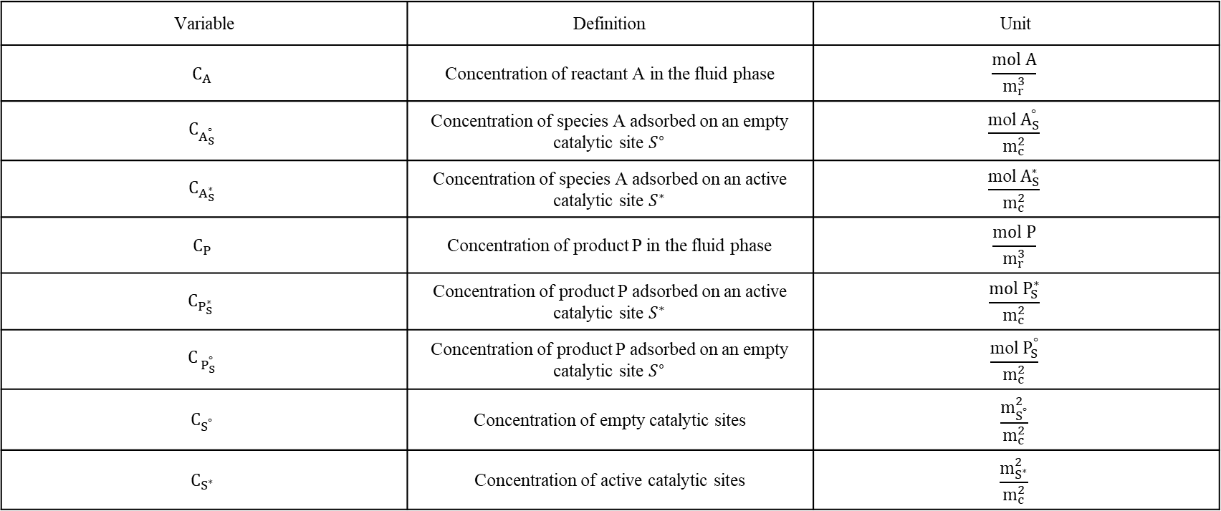
Variable Definition Table
Variable | Definition | Unit
$$C_{A}$$ | Concentration of reactant A in the fluid phase | $$\frac{mol A}{m_{r}^{3}}$$
$$C_{A_{S}^{°}}$$ | Concentration of species A adsorbed on an empty catalytic site $S^{∘}$ | $$\frac{\text{mol}{ A}_{S}^{°}}{m_{c}^{2}}$$
$$C_{A_{S}^{∗}}$$ | Concentration of species A adsorbed on an active catalytic site $S^{∗}$ | $$\frac{\text{mol}{ A}_{S}^{∗}}{m_{c}^{2}}$$
$$C_{P}$$ | Concentration of product P in the fluid phase | $$\frac{mol P}{m_{r}^{3}}$$
$$C_{P_{S}^{∗} }$$ | Concentration of product P adsorbed on an active catalytic site $S^{∗}$ | $$\frac{mol P_{S}^{∗}}{m_{c}^{2}}$$
$$C_{{ P}_{S}^{°}}$$ | Concentration of product P adsorbed on an empty catalytic site $S^{∘}$ | $$\frac{\text{mol}{ P}_{S}^{°}}{m_{c}^{2}}$$
$$C_{S^{°}}$$ | Concentration of empty catalytic sites | $$\frac{m_{S^{°}}^{2}}{m_{c}^{2}}$$
$$C_{S^{∗}}$$ | Concentration of active catalytic sites | $$\frac{m_{S^{∗}}^{2}}{m_{c}^{2}}$$
Notes:
Next, we summarize the variables used in the kinetic model in this table, including their definitions and corresponding units.
First, the fluid-phase species include the concentration of reactant A, denoted as $C_{A}$, and the concentration of product P, denoted as $C_{P}$. These concentrations are expressed per fluid volume, so their units are moles per cubic meter.
Next, we define the surface species, which represent molecules adsorbed on the catalyst surface. These include $C_{AS^{∘}}$, $C_{AS^{∗}}$, $C_{PS^{∗}}$, and $C_{PS^{∘}}$.
Since these species exist on the catalyst surface, their concentrations are expressed per surface area, so their units are moles per square meter.
Finally, $C_{S^{∘}}$and $C_{S^{∗}}$represent the concentrations of empty catalytic sites and active catalytic sites on the surface.

Slide 17
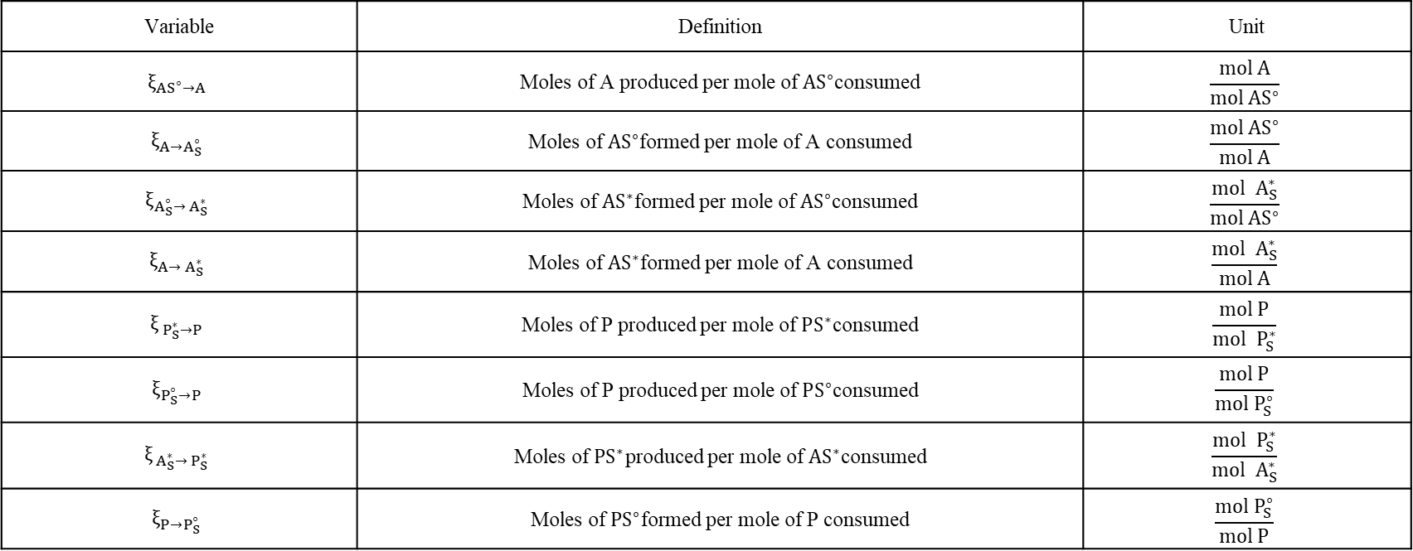
Variable Definition Table
Variable | Definition | Unit
$$ξ_{AS^{∘}→A}$$ | Moles of A produced per mole of $AS^{∘}$consumed | $$\frac{mol A}{mol AS^{∘}}$$
$$ξ_{A→A_{S}^{∘}}$$ | Moles of $AS^{∘}$formed per mole of A consumed | $$\frac{mol AS^{∘}}{mol A}$$
$$ξ_{A_{S}^{∘}→{ A}_{S}^{∗}}$$ | Moles of $AS^{∗}$formed per mole of $AS^{∘}$consumed | $$\frac{mol { A}_{S}^{∗}}{mol AS^{∘}}$$
$$ξ_{A→{ A}_{S}^{∗}}$$ | Moles of $AS^{∗}$formed per mole of A consumed | $$\frac{mol { A}_{S}^{∗}}{mol A}$$
$$ξ_{{ P}_{S}^{∗}→P}$$ | Moles of P produced per mole of $PS^{∗}$consumed | $$\frac{mol P}{mol { P}_{S}^{∗}}$$
$$ξ_{P_{S}^{∘}→P}$$ | Moles of P produced per mole of $PS^{∘}$consumed | $$\frac{mol P}{mol P_{S}^{∘}}$$
$$ξ_{{ A}_{S}^{∗}→{ P}_{S}^{∗}}$$ | Moles of $PS^{∗}$produced per mole of $AS^{∗}$consumed | $$\frac{mol { P}_{S}^{∗}}{mol { A}_{S}^{∗}}$$
$$ξ_{P→P_{S}^{∘}}$$ | Moles of $PS^{∘}$formed per mole of P consumed | $$\frac{mol P_{S}^{∘}}{mol P}$$
Notes:
In this table, we define the stoichiometric coefficients, denoted as $ξ$, used in the kinetic model.
These coefficients describe the mole relationship between species in each reaction step.
For example, $ξ_{AS^{∘}→A}$represents the number of moles of A produced per mole of $AS^{∘}$consumed.
Similarly, $ξ_{A→AS^{∘}}$represents the number of moles of $AS^{∘}$formed per mole of A consumed.
These coefficients will be used later when constructing the net rate expressions for each species in the kinetic model.

Slide 18
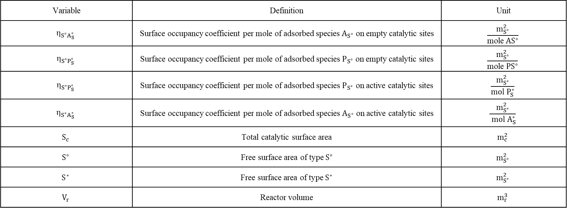
Variable Definition Table
Variable | Definition | Unit
$$η_{S^{∘}A_{S}^{∘}}$$ | Surface occupancy coefficient per mole of adsorbed species $A_{S^{∘}}$ on empty catalytic sites | $$\frac{m_{S^{∘}}^{2}}{\text{mole} AS^{∘}}$$
$$η_{S^{∘}P_{S}^{∘}}$$ | Surface occupancy coefficient per mole of adsorbed species $P_{S^{∘}}$ on empty catalytic sites | $$\frac{m_{S^{∘}}^{2}}{\text{mole} PS^{∘}}$$
$$η_{S^{∗}P_{S}^{∗}}$$ | Surface occupancy coefficient per mole of adsorbed species $P_{S^{∗}}$ on active catalytic sites | $$\frac{m_{S^{∗}}^{2}}{mol{ P}_{S}^{∗}}$$
$$η_{S^{∗}A_{S}^{∗}}$$ | Surface occupancy coefficient per mole of adsorbed species $A_{S^{∗}}$ on active catalytic sites | $$\frac{m_{S^{∗}}^{2}}{ mol{ A}_{S}^{∗}}$$
$$S_{c}$$ | Total catalytic surface area | $$m_{c}^{2}$$
$$S^{∘}$$ | Free surface area of type $S^{∘}$ | $$m_{S^{∘}}^{2}$$
$$S^{∗}$$ | Free surface area of type $S^{∗}$ | $$m_{S^{∗}}^{2}$$
$$V_{r}$$ | Reactor volume | $$m_{r}^{3}$$
Notes:
In this table, we define additional variables related to surface site occupancy and catalyst surface area.
First, the parameters $η$represent the surface occupancy coefficients. These coefficients describe the surface area occupied per mole of adsorbed species.
For example, $η_{S^{∘},AS^{∘}}$represents the surface area occupied by one mole of $AS^{∘}$on empty catalytic sites.
Similarly, other $η$coefficients describe how much surface area is occupied by different adsorbed species, such as $PS^{∘}$, $PS^{∗}$, or $AS^{∗}$.
Next, $S_{c}$represents the total catalytic surface area available in the system.
The variables $S^{∘}$and $S^{∗}$represent the free surface area of empty sites and active sites, respectively.
Finally, $V_{r}$represents the reactor volume.

Slide 19
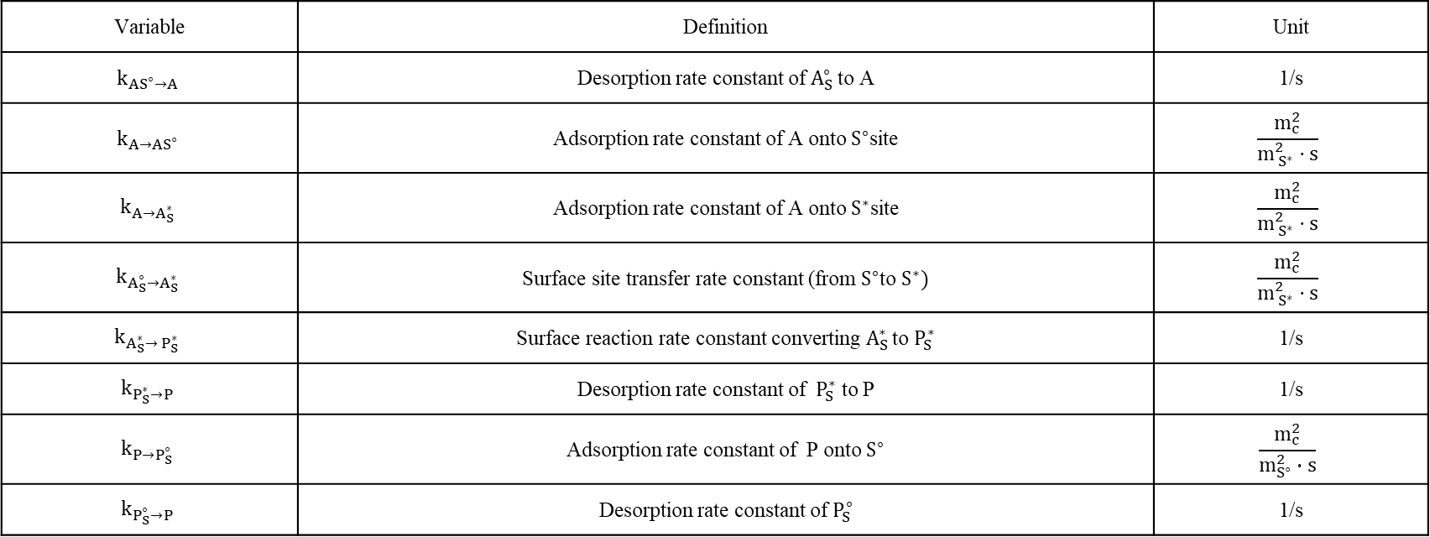
Variable Definition Table
Variable | Definition | Unit
$$k_{AS^{∘}→A}$$ | Desorption rate constant of $A_{S}^{∘ }$to A | 1/s
$$k_{A→AS^{∘}}$$ | Adsorption rate constant of A onto $S^{∘}$site | $$\frac{m_{c}^{2}}{m_{{ S}^{∗}}^{2}⋅s}$$
$$k_{A→A_{S}^{∗}}$$ | Adsorption rate constant of A onto $S^{∗}$site | $$\frac{m_{c}^{2}}{m_{{ S}^{∗}}^{2}⋅s}$$
$$k_{A_{S}^{∘}→A_{S}^{∗}}$$ | Surface site transfer rate constant (from $S^{∘}$to $S^{∗})$ | $$\frac{m_{c}^{2}}{m_{{ S}^{∗}}^{2}⋅s}$$
$$k_{A_{S}^{∗}→{ P}_{S}^{∗}}$$ | Surface reaction rate constant converting $A_{S }^{∗ }$to $P_{S}^{∗}$ | 1/s
$$k_{P_{S}^{∗}→P}$$ | Desorption rate constant of ${ P}_{S}^{∗}$ to P | 1/s
$$k_{P→P_{S}^{∘}}$$ | Adsorption rate constant of P onto $S^{∘}$ | $$\frac{m_{c}^{2}}{m_{S^{∘}}^{2}∙s}$$
$$k_{P_{S}^{∘}→P}$$ | Desorption rate constant of $P_{S}^{∘}$ | 1/s
Notes:
In this table, we define the kinetic rate constants associated with each reaction step in the surface reaction mechanism.
The units of the rate constants depend on the order of the reaction and the form of the rate expression.
For example, in first-order reactions, the rate depends on only one species concentration. Therefore, the rate constant typically has units of 1 per second.
However, in second-order reactions, the rate depends on the product of two concentrations, such as a fluid species concentration and a surface site concentration. As a result, the rate constant must include additional dimensional terms to maintain dimensional consistency.
Therefore, the units of the rate constants can become expressions such as
$$\frac{m_{c}^{2}}{m_{S^{∘}}^{2}⋅s}$$
or
$$\frac{m_{c}^{2}}{m_{S^{∗}}^{2}⋅s}.$$

Slide 20
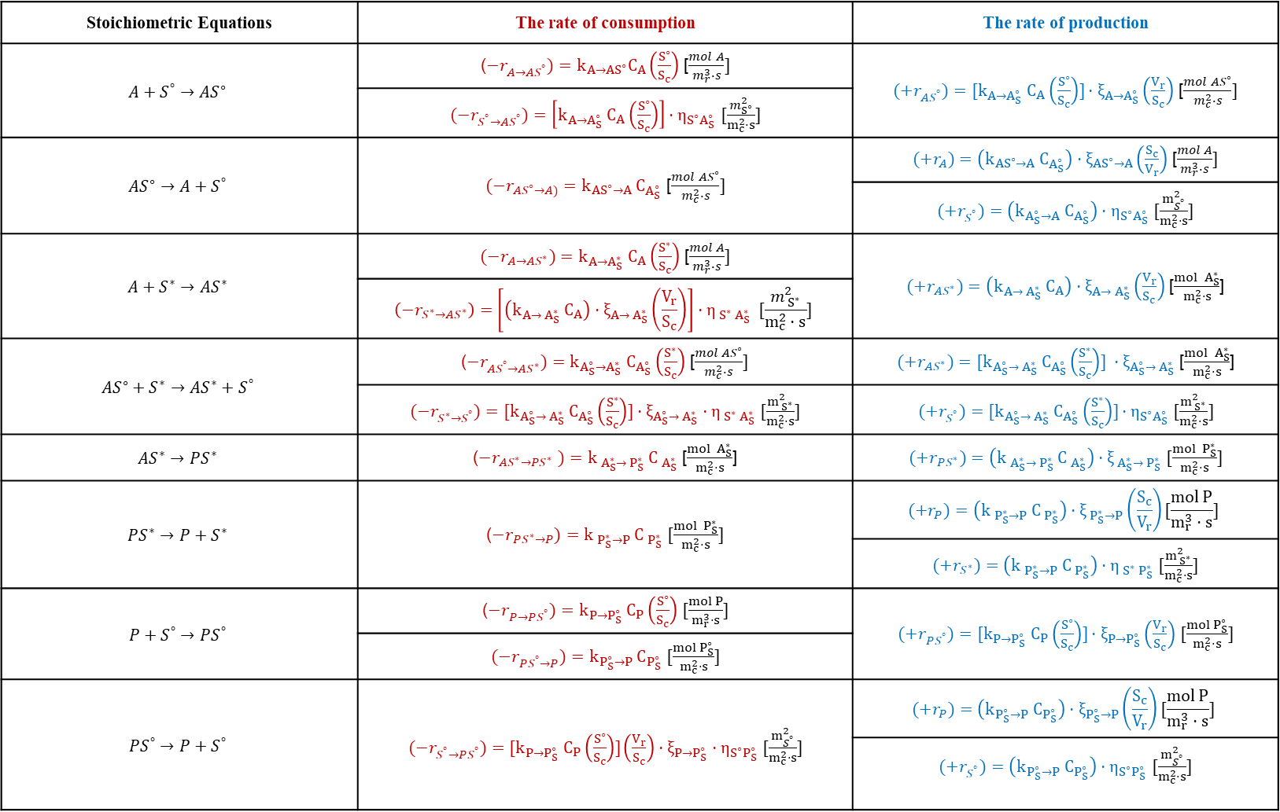
Rate Expressions
Stoichiometric Equations | The rate of consumption | The rate of production
$$A+S^{°}→AS^{∘}$$ | ($−r_{A→AS^{°}})=k_{A→AS^{∘}}C_{A}\left(\frac{S^{∘}}{S_{c}}\right)$ [$\frac{mol A}{m_{r}^{3}∙s}]$ | ${(+r}_{AS^{°}})=[k_{A→A_{S}^{∘}} C_{A}\left(\frac{S^{∘}}{S_{c}}\right)]⋅ξ_{A→A_{S}^{∘}}\left(\frac{V_{r}}{S_{c}}\right)$ [$\frac{mol AS^{∘}}{m_{c}^{2}∙s}]$
 | $(−r_{S^{°}→AS^{°}})=\left[k_{A→A_{S}^{∘}} C_{A}\left(\frac{S^{∘}}{S_{c}}\right)\right]⋅η_{S^{∘}A_{S}^{∘}}$ $[\frac{m_{S^{∘}}^{2}}{m_{c}^{2}⋅s}]$
$$AS^{∘}→A+S^{°}$$ | $(−r_{AS^{∘}→A)}=k_{AS^{∘}→A} C_{A_{S}^{∘}}$ [$\frac{mol AS^{∘}}{m_{c}^{2}∙s}]$ | ${(+r}_{A})=\left(k_{AS^{∘}→A} C_{A_{S}^{∘}}\right)⋅ξ_{AS^{∘}→A}\left(\frac{S_{c}}{V_{r}}\right)$ [$\frac{mol A}{m_{r}^{3}∙s}]$
 |  | ${(+r}_{S^{°}})=\left(k_{A_{S}^{∘}→A} C_{A_{S}^{∘}}\right)⋅η_{S^{∘}A_{S}^{∘}}$ $[\frac{m_{S^{°}}^{2}}{m_{c}^{2}⋅s}]$
$$A+S^{∗}→AS^{∗}$$ | $(−r_{A→AS^{∗}})=k_{A→A_{S}^{∗}} C_{A}\left(\frac{S^{∗}}{S_{c}}\right)$ [$\frac{mol A}{m_{r}^{3}∙s}]$ | ${(+r}_{AS^{∗}})=\left(k_{A→{ A}_{S}^{∗}} C_{A}\right)⋅ξ_{A→{ A}_{S}^{∗}}\left(\frac{V_{r}}{S_{c}}\right)$ [$\frac{mol { A}_{S}^{∗}}{m_{c}^{2}⋅s}$]
 | $$\left(−r_{S^{∗}→AS^{∗}}\right)=\left[\left(k_{A→{ A}_{S}^{∗}} C_{A}\right)⋅ξ_{A→{ A}_{S}^{∗}}\left(\frac{V_{r}}{S_{c}}\right)\right]⋅η_{{ S}^{∗}{ A}_{S}^{∗}} [\frac{m_{{ S}^{∗}}^{2}}{m_{c}^{2}⋅s}]$$
$$AS^{∘}+S^{∗}→AS^{∗}+S^{°}$$ | ($−r_{AS^{°}→AS^{∗}})=k_{A_{S}^{∘}→A_{S}^{∗}} C_{A_{S}^{∘}}\left(\frac{S^{∗}}{S_{c}}\right)$ [$\frac{mol AS^{∘}}{m_{c}^{2}∙s}]$ | ${(+r}_{AS^{∗}})=[k_{A_{S}^{∘}→{ A}_{S}^{∗}} C_{A_{S}^{∘}}\left(\frac{S^{∗}}{S_{c}}\right)] ⋅ξ_{A_{S}^{∘}→{ A}_{S}^{∗}}$ [$\frac{mol { A}_{S}^{∗}}{m_{c}^{2}⋅s}$]
 | $(−r_{S^{∗}{→S}^{°}})={[k}_{A_{S}^{∘}→{ A}_{S}^{∗}} C_{A_{S}^{∘}}\left(\frac{S^{∗}}{S_{c}}\right)]⋅ξ_{A_{S}^{∘}→{ A}_{S}^{∗}}⋅η_{{ S}^{∗}{ A}_{S}^{∗}}$ $[\frac{m_{{ S}^{∗}}^{2}}{m_{c}^{2}⋅s}]$ | ${(+r}_{S^{°}})=[k_{A_{S}^{∘}→{ A}_{S}^{∗}} C_{A_{S}^{∘}}\left(\frac{S^{∗}}{S_{c}}\right)]⋅η_{S^{∘}A_{S}^{∘}}$ $[\frac{m_{{ S}^{∗}}^{2}}{m_{c}^{2}⋅s}]$
$$AS^{∗}→PS^{∗}$$ | ($−r_{AS^{∗}→PS^{∗} })=k_{{ A}_{S}^{∗}→{ P}_{S}^{∗}} C_{{ A}_{S}^{∗}}$ [$\frac{mol { A}_{S}^{∗}}{m_{c}^{2}⋅s}$] | ${(+r}_{PS^{∗}})=\left(k_{{ A}_{S}^{∗}→{ P}_{S}^{∗}} C_{{ A}_{S}^{∗}}\right)⋅ξ_{{ A}_{S}^{∗}→{ P}_{S}^{∗}}$ $[\frac{mol { P}_{S}^{∗}}{m_{c}^{2}⋅s}]$
$$PS^{∗}→P+S^{∗}$$ | ($−r_{PS^{∗}→P})=k_{{ P}_{S}^{∗}→P} C_{{ P}_{S}^{∗}}$ $[\frac{mol { P}_{S}^{∗}}{m_{c}^{2}⋅s}]$ | $${(+r}_{P})=\left(k_{{ P}_{S}^{∗}→P} C_{{ P}_{S}^{∗}}\right)⋅ξ_{{ P}_{S}^{∗}→P}\left(\frac{S_{c}}{V_{r}}\right)[\frac{mol P}{m_{r}^{3}⋅s}]$$
 |  | ${(+r}_{S^{∗}})=\left(k_{{ P}_{S}^{∗}→P} C_{{ P}_{S}^{∗}}\right)⋅η_{{ S}^{∗}{ P}_{S}^{∗}}$ $[\frac{m_{{ S}^{∗}}^{2}}{m_{c}^{2}⋅s}]$
$$P+S^{°}→PS^{°}$$ | ($−r_{P→PS^{°}})=k_{P→P_{S}^{∘}} C_{P}\left(\frac{S^{∘}}{S_{c}}\right)$ $[\frac{mol P}{m_{r}^{3}⋅s}]$ | ${(+r}_{PS^{°}})={[k}_{P→P_{S}^{∘}} C_{P}\left(\frac{S^{∘}}{S_{c}}\right)]⋅ξ_{P→P_{S}^{∘}}\left(\frac{V_{r}}{S_{c}}\right)$ $[\frac{mol P_{S}^{∘}}{m_{c}^{2}⋅s}]$
 | $(−r_{PS^{°}→P})=k_{P_{S}^{∘}→P} C_{P_{S}^{∘}}$ $[\frac{mol P_{S}^{∘}}{m_{c}^{2}⋅s}]$
$$PS^{°}→P+S^{°}$$ | $(−r_{S^{°}→PS^{°}})=[k_{P→P_{S}^{∘}} C_{P}\left(\frac{S^{∘}}{S_{c}}\right)]\left(\frac{V_{r}}{S_{c}}\right)⋅ξ_{P→P_{S}^{∘}}⋅η_{S^{∘}P_{S}^{∘}}$ $[\frac{m_{S^{°}}^{2}}{m_{c}^{2}⋅s}]$ | $${(+r}_{P})=\left(k_{P_{S}^{∘}→P} C_{P_{S}^{∘}}\right)⋅ξ_{P_{S}^{∘}→P}\left(\frac{S_{c}}{V_{r}}\right)[\frac{mol P}{m_{r}^{3}⋅s}]$$
 |  | ${(+r}_{S^{°}})=\left(k_{P_{S}^{∘}→P} C_{P_{S}^{∘}}\right)⋅η_{S^{∘}P_{S}^{∘}}$ $[\frac{m_{S^{°}}^{2}}{m_{c}^{2}⋅s}]$
Notes:
Next, we construct the rate expressions for each reaction step in the kinetic model.
First, we list all the stoichiometric equations for the reaction mechanism. In this table, the red terms represent the rate of consumption, while the blue terms represent the rate of production for each species.
For example, in the reaction A + S° → AS°, we can see that A is consumed, S° is consumed, and AS° is produced.
In adsorption reactions, the reaction rate depends on both the fluid-phase concentration and the available surface sites. Therefore, the rate expression includes terms such as the fluid concentration $C_{A}$and the fraction of available surface sites $S^{∘}/S_{c}$.
In contrast, for surface reactions, the rate mainly depends on the concentration of adsorbed species on the catalyst surface.
In addition, we introduce the parameter η, which represents the surface occupancy coefficient. This parameter relates the amount of adsorbed species to the catalytic surface area, allowing us to convert between surface concentration and surface site coverage.
Finally, we use the stoichiometric coefficient $ξ$to relate the rates of different species in each reaction step. Using $ξ$, we can systematically convert the reaction step rates into the net production or consumption rates for each species.
In this way, we can establish the complete net rate equations for the entire kinetic model.

Slide 21
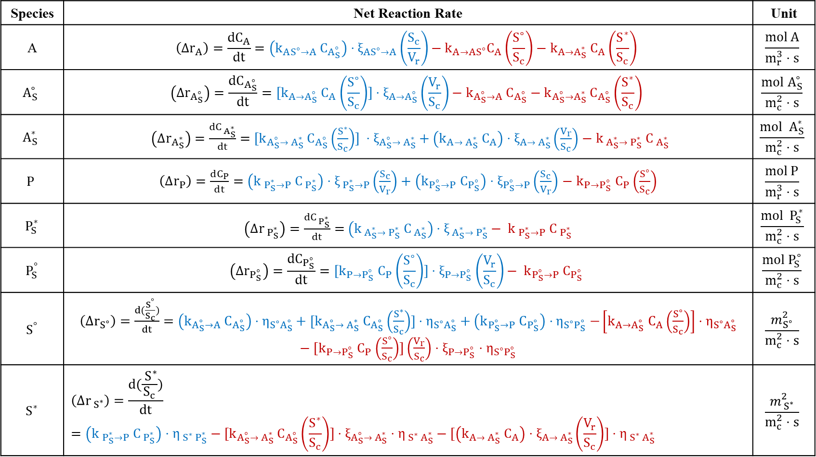
Net Reaction Rate
Species | Net Reaction Rate | Unit
A | $$\left(Δr_{A}\right)=\frac{dC_{A}}{dt}=\left(k_{AS^{∘}→A} C_{A_{S}^{∘}}\right)⋅ξ_{AS^{∘}→A}\left(\frac{S_{c}}{V_{r}}\right)−k_{A→AS^{∘}}C_{A}\left(\frac{S^{∘}}{S_{c}}\right)−k_{A→A_{S}^{∗}} C_{A}\left(\frac{S^{∗}}{S_{c}}\right)$$ | $$\frac{mol A}{m_{r}^{3}⋅s}$$
$$A_{S}^{∘}$$ | $$\left(Δr_{A_{S}^{∘}}\right)=\frac{dC_{A_{S}^{∘}}}{dt}=[k_{A→A_{S}^{∘}} C_{A}\left(\frac{S^{∘}}{S_{c}}\right)]⋅ξ_{A→A_{S}^{∘}}\left(\frac{V_{r}}{S_{c}}\right)−k_{A_{S}^{∘}→A} C_{A_{S}^{∘}}−k_{A_{S}^{∘}→A_{S}^{∗}} C_{A_{S}^{∘}}\left(\frac{S^{∗}}{S_{c}}\right)$$ | $$\frac{mol A_{S}^{∘}}{m_{c}^{2}⋅s}$$
$$A_{S}^{∗}$$ | $\left(Δr_{A_{S}^{∗}}\right)$ $=\frac{dC_{{ A}_{S}^{∗}}}{dt}=$ $[k_{A_{S}^{∘}→{ A}_{S}^{∗}} C_{A_{S}^{∘}}\left(\frac{S^{∗}}{S_{c}}\right)] ⋅ξ_{A_{S}^{∘}→{ A}_{S}^{∗}}+\left(k_{A→{ A}_{S}^{∗}} C_{A}\right)⋅ξ_{A→{ A}_{S}^{∗}}\left(\frac{V_{r}}{S_{c}}\right)$ $− k_{{ A}_{S}^{∗}→{ P}_{S}^{∗}} C_{{ A}_{S}^{∗}}$ | $$\frac{mol { A}_{S}^{∗}}{m_{c}^{2}⋅s}$$
$$P$$ | $\left(Δr_{P}\right)=\frac{dC_{P}}{dt}=$ $\left(k_{{ P}_{S}^{∗}→P} C_{{ P}_{S}^{∗}}\right)⋅ξ_{{ P}_{S}^{∗}→P}\left(\frac{S_{c}}{V_{r}}\right)+\left(k_{P_{S}^{∘}→P} C_{P_{S}^{∘}}\right)⋅ξ_{P_{S}^{∘}→P}\left(\frac{S_{c}}{V_{r}}\right)$ $− k_{P→P_{S}^{∘}} C_{P}\left(\frac{S^{∘}}{S_{c}}\right)$ | $$\frac{mol P}{m_{r}^{3}⋅s}$$
$${ P}_{S}^{∗}$$ | $\left(Δr_{{ P}_{S}^{∗}}\right)=\frac{dC_{{ P}_{S}^{∗}}}{dt}=$ $\left(k_{{ A}_{S}^{∗}→{ P}_{S}^{∗}} C_{{ A}_{S}^{∗}}\right)⋅ξ_{{ A}_{S}^{∗}→{ P}_{S}^{∗}}− k_{{ P}_{S}^{∗}→P} C_{{ P}_{S}^{∗}}$ | $$\frac{mol { P}_{S}^{∗}}{m_{c}^{2}⋅s}$$
$${ P}_{S}^{°}$$ | $$\left(Δr_{P_{S}^{∘}}\right)=\frac{dC_{P_{S}^{∘}}}{dt}={[k}_{P→P_{S}^{∘}} C_{P}\left(\frac{S^{∘}}{S_{c}}\right)]⋅ξ_{P→P_{S}^{∘}}\left(\frac{V_{r}}{S_{c}}\right)− k_{P_{S}^{∘}→P} C_{P_{S}^{∘}}$$ | $$\frac{mol P_{S}^{∘}}{m_{c}^{2}⋅s}$$
$${ S}^{°}$$ | $\left(Δr_{S^{∘}}\right)=\frac{d(\frac{S^{°}}{S_{c}})}{dt}=\left(k_{A_{S}^{∘}→A} C_{A_{S}^{∘}}\right)⋅η_{S^{∘}A_{S}^{∘}}+[k_{A_{S}^{∘}→{ A}_{S}^{∗}} C_{A_{S}^{∘}}\left(\frac{S^{∗}}{S_{c}}\right)]⋅η_{S^{∘}A_{S}^{∘}}+\left(k_{P_{S}^{∘}→P} C_{P_{S}^{∘}}\right)⋅η_{S^{∘}P_{S}^{∘}}$ $−\left[k_{A→A_{S}^{∘}} C_{A}\left(\frac{S^{∘}}{S_{c}}\right)\right]⋅η_{S^{∘}A_{S}^{∘}}−[k_{P→P_{S}^{∘}} C_{P}\left(\frac{S^{∘}}{S_{c}}\right)]\left(\frac{V_{r}}{S_{c}}\right)⋅ξ_{P→P_{S}^{∘}}⋅η_{S^{∘}P_{S}^{∘}}$ | $$\frac{m_{S^{∘}}^{2}}{m_{c}^{2}⋅s}$$
$${ S}^{∗}$$ | $$\left(Δr_{{ S}^{∗}}\right)=\frac{d(\frac{{ S}^{∗}}{S_{c}})}{dt}=\left(k_{{ P}_{S}^{∗}→P} C_{{ P}_{S}^{∗}}\right)⋅η_{{ S}^{∗}{ P}_{S}^{∗}}−{[k}_{A_{S}^{∘}→{ A}_{S}^{∗}} C_{A_{S}^{∘}}\left(\frac{S^{∗}}{S_{c}}\right)]⋅ξ_{A_{S}^{∘}→{ A}_{S}^{∗}}⋅η_{{ S}^{∗}{ A}_{S}^{∗}}−[\left(k_{A→{ A}_{S}^{∗}} C_{A}\right)⋅ξ_{A→{ A}_{S}^{∗}}\left(\frac{V_{r}}{S_{c}}\right)]⋅η_{{ S}^{∗}{ A}_{S}^{∗}}$$ | $$\frac{m_{{ S}^{∗}}^{2}}{m_{c}^{2}⋅s}$$
Notes:
After defining the rate expressions for each elementary reaction step, we can now construct the net reaction rate for each species.
The net reaction rate is obtained by combining the rates of production and consumption from all reaction steps involving that species.
For example, for species A, the net reaction rate is written as the rate of change of its concentration, which includes the adsorption reactions where A is consumed and the desorption reactions where A can be produced.
Similarly, for surface species such as AS° and AS*, their net reaction rates include all reaction steps where these species are either formed or consumed on the catalyst surface.
For the product P, the net reaction rate accounts for the desorption of product from the catalyst surface as well as possible readsorption reactions.
Finally, for the surface sites S° and S*, their net rates describe the change of available catalytic surface sites, which depends on how the sites are occupied or released during the reaction steps.
By combining all these contributions, we obtain the complete net reaction rate equations for each species in the kinetic model.

Slide 22
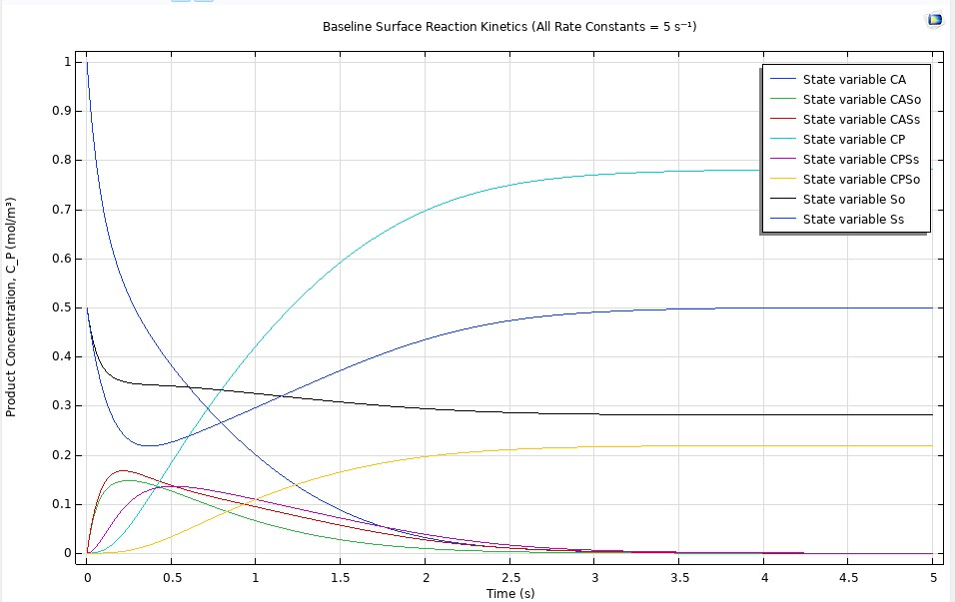




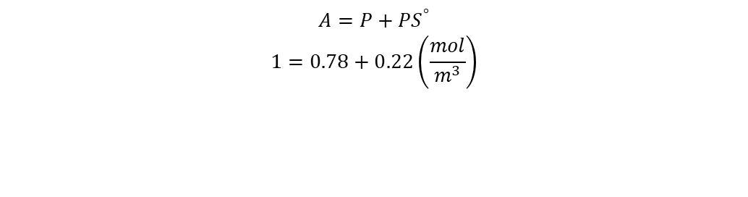








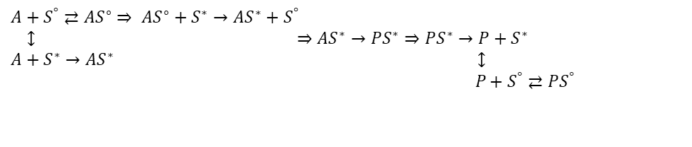






Reaction Kinetics Model
$$t=0$$
$$C_{A}=1 \frac{mol }{m^{3}}$$
$$C_{P}=0 \frac{mol }{m^{3}}$$
$$C_{AS^{∘}}=0 \frac{mol }{m^{3}}$$
$$C_{AS^{∗}}=0 \frac{mol }{m^{3}}$$
$$C_{PS^{∗}}=0 \frac{mol }{m^{3}}$$
$$C_{PS^{°}}=0 \frac{mol }{m^{3}}$$
$$C_{S^{∗}}=0.5 \frac{mol }{m^{3}}$$
$$C_{S^{°}}=0.5 \frac{mol }{m^{3}}$$
$$t=5$$
$$C_{A}=0 \frac{mol }{m^{3}}$$
$$C_{P}=0.78 \frac{mol }{m^{3}}$$
$$C_{AS^{∘}}=0 \frac{mol }{m^{3}}$$
$$C_{AS^{∗}}=0 \frac{mol }{m^{3}}$$
$$C_{PS^{∗}}=0 \frac{mol }{m^{3}}$$
$$C_{PS^{°}}=0.22 \frac{mol }{m^{3}}$$
$$C_{S^{∗}}=0.5 \frac{mol }{m^{3}}$$
$$C_{S^{°}}=0.28 \frac{mol }{m^{3}}$$
$$A$$
$A+S^{°}⇄AS^{∘}$ $⇒$ $AS^{∘}+S^{∗}→AS^{∗}+S^{°}$
$↕$ $⇒$ $AS^{∗}→PS^{∗}$ $⇒PS^{∗}→P+S^{∗}$
$A+S^{∗}→AS^{∗}$ $↕$
$$P+S^{°}⇄PS^{°}$$
$$A$$
$$P$$
$$P$$
$$S^{∗}$$
$$S^{∗}$$
$$S^{°}$$
$$A=P+{PS}^{°}$$
$$1=0.78+0.22\left(\frac{mol}{m^{3}}\right)$$
$${AS}^{∗}$$
$$S^{°}$$
$${AS}^{∗}$$
$${PS}^{∗}$$
$${PS}^{°}$$
$${AS}^{°}$$
$${PS}^{∗}$$
$${PS}^{°}$$
$${AS}^{°}$$
Notes:
After obtaining the net reaction rate equations, we implemented them in COMSOL to build the reaction kinetics model.
From the results, we can see that the initial concentration of reactant A is 1 mol/m³, and it gradually decreases to zero as the reaction proceeds.
At the same time, the product P increases from zero to about 0.78 mol/m³. This is because part of the product remains adsorbed on the catalyst surface as $PS^{∘}$.
If we add the concentrations of P and $PS^{∘}$together, the total equals the initial concentration of A, which confirms that the mass balance is satisfied.
We also observe that $S^{∗}$returns to its initial value after the reaction, since the active sites are released, while $S^{∘}$remains lower because some product stays adsorbed on the surface.
The intermediate species such as $AS^{∘}$, $AS^{∗}$, and $PS^{∗}$appear temporarily during the reaction and eventually return to zero.
These results indicate that our kinetic model is physically reasonable.

Slide 23
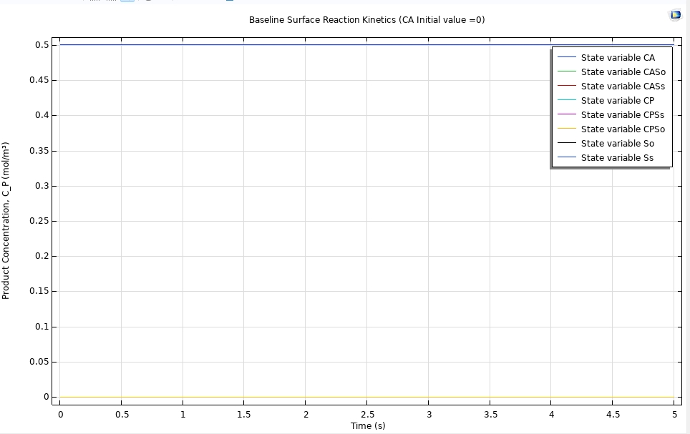






Reaction Kinetics Model
$$S^{°}$$
$$S^{∗}$$
$A+S^{°}⇄AS^{∘}$ $⇒$ $AS^{∘}+S^{∗}→AS^{∗}+S^{°}$
$↕$ $⇒$ $AS^{∗}→PS^{∗}$ $⇒PS^{∗}→P+S^{∗}$
$A+S^{∗}→AS^{∗}$ $↕$
$$P+S^{°}⇄PS^{°}$$
$$A$$
$$P$$
$${PS}^{°}$$
$${AS}^{∗}$$
$${PS}^{∗}$$
$${AS}^{°}$$
Notes:
Additionally, if we set the initial concentration of A to zero, we can observe that no intermediates or products are formed, and their concentrations remain zero throughout the simulation.
At the same time, the surface site concentrations $S^{∘}$and $S^{∗}$remain constant at 0.5.
This indicates that no reactions occur in the system, and it further confirms that our kinetic model satisfies mass balance.

Slide 24
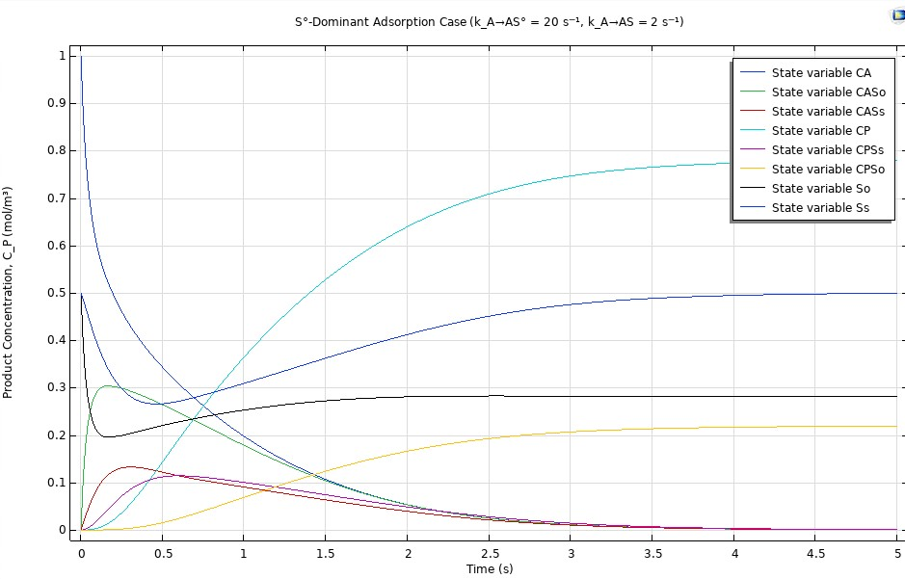
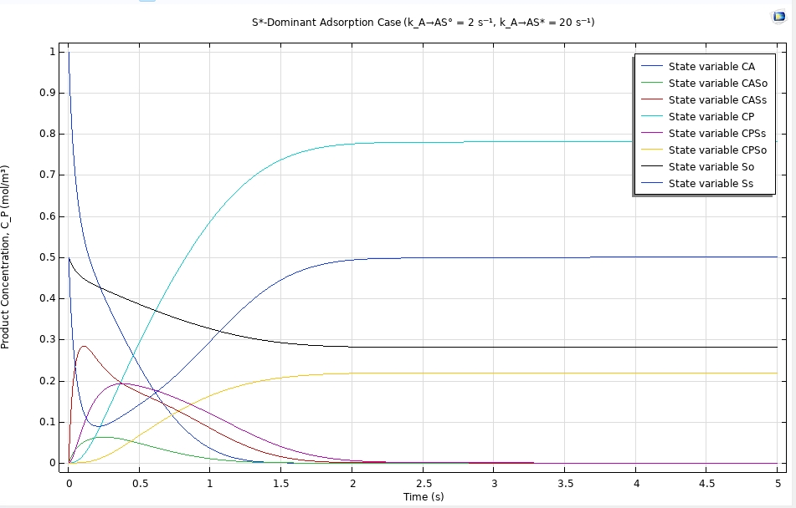






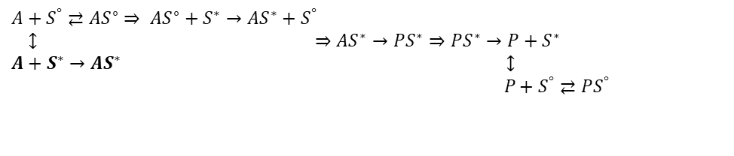




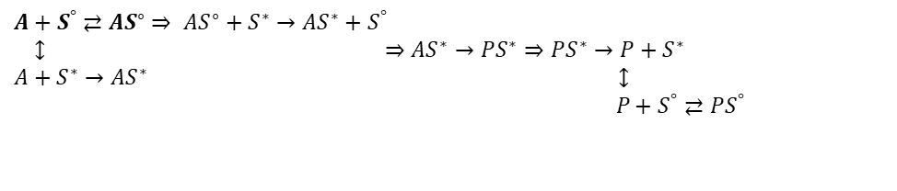








Reaction Kinetics Model
$$A$$
$$A$$
$$A$$
$$P$$
$$P$$
$$P$$
$$S^{∗}$$
$$S^{∗}$$
$${AS}^{°}$$
$$S^{°}$$
$${AS}^{∗}$$
$$S^{°}$$
$$S^{∗}$$
$${PS}^{°}$$
$${PS}^{∗}$$
$${PS}^{°}$$
$${AS}^{∗}$$
$${PS}^{∗}$$
$${AS}^{°}$$
$$S^{°}$$
$A+S^{°}⇄AS^{∘}$ $⇒$ $AS^{∘}+S^{∗}→AS^{∗}+S^{°}$
$↕$ $⇒$ $AS^{∗}→PS^{∗}$ $⇒PS^{∗}→P+S^{∗}$
$A+S^{∗}→AS^{∗}$ $↕$
$$P+S^{°}⇄PS^{°}$$
$A+S^{°}⇄AS^{∘}$ $⇒$ $AS^{∘}+S^{∗}→AS^{∗}+S^{°}$
$↕$ $⇒$ $AS^{∗}→PS^{∗}$ $⇒PS^{∗}→P+S^{∗}$
$A+S^{∗}→AS^{∗}$ $↕$
$$P+S^{°}⇄PS^{°}$$
Notes:
Furthermore, we investigated the effect of changing the rate constants. In the figure on the left, the adsorption rate of A to $AS^{∘}$is larger, while on the right the adsorption rate of A to $AS^{∗}$is larger.
From the results, we can observe that the concentrations of the intermediates change accordingly, and the formation time of the product P is also different, depending on which adsorption pathway is faster.
However, the final concentration of P remains approximately the same in both cases.
This indicates that although changing the rate constants affects the reaction pathway and intermediate distributions, the overall conversion remains consistent. Therefore, our kinetic model behaves reasonably and remains valid under different kinetic parameters.

Slide 25
Mathematical Model Assumptions
Steady-state
Incompressible laminar flow
Newtonian fluid
Isothermal reactor
Reaction occurs only on catalyst surface
No homogeneous reaction in bulk
Convection occurs only in the x-direction
Diffusion occurs in the y-direction
Surface convection and surface diffusion neglected
Axial diffusion neglected
Notes:
Now I will introduce the mathematical model of our reactor.
🔷 Assumption 1 — Steady-state operation
First, we assume steady-state operation. This means the concentration profile does not change with time. So in our mass balance equation, the time derivative term is zero.
🔷 Assumption 2 — Incompressible laminar flow
We assume incompressible laminar flow in the CSF region. Since the velocity is low and the channel dimension is small, the Reynolds number is small, so laminar flow is reasonable.
（如果教授問 Re，你可以說 Re ≪ 2000）
🔷 Assumption 3 — Newtonian fluid
The cerebrospinal fluid is treated as a Newtonian fluid, meaning the viscosity is constant and shear stress is proportional to velocity gradient.
🔷 Assumption 4 — Isothermal reactor
We assume the reactor is isothermal. Since the reaction rate is relatively small and the system is surrounded by biological tissue, we neglect temperature variation.
🔷 Assumption 5 — Reaction only on catalyst surface
The reaction occurs only on the catalyst surface inside the hydrogel region.
There is no homogeneous reaction in the bulk fluid.
🔷 Assumption 6 — No surface convection/diffusion
Finally, we neglect surface convection and surface diffusion. So the reaction rate depends only on the local concentration at the interface.

Slide 26
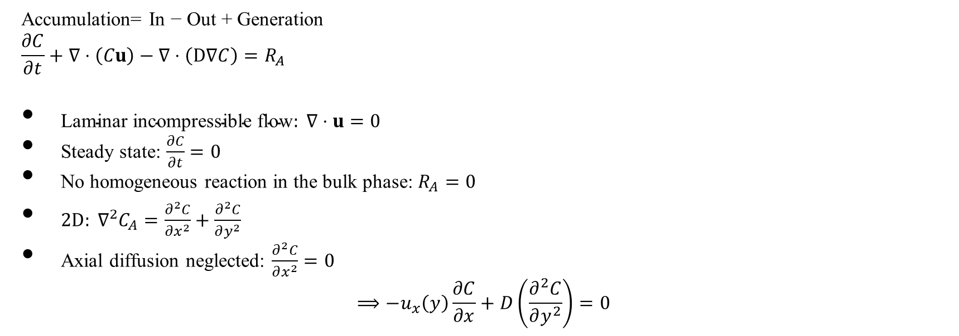
Mathematical Model: Mass Balance Equation
Accumulation= In − Out + Generation
$$\frac{∂C}{∂t}+∇⋅\left(Cu\right)−∇⋅\left(D∇C\right)=R_{A}$$
$\text{Laminar} \text{incompressible} \text{flow}: ∇⋅u=0$
Steady state: $\frac{∂C}{∂t}=0$
No homogeneous reaction in the bulk phase: $R_{A}=0$
$2D: ∇^{2}C_{A}=\frac{∂^{2}C}{∂x^{2}}+\frac{∂^{2}C}{∂y^{2}}$
Axial diffusion neglected: $\frac{∂^{2}C}{∂x^{2}}=0$
$$⟹−u_{x}\left(y\right)\frac{∂C}{∂x}+D\left(\frac{∂^{2}C}{∂y^{2}}\right)=0$$
[Convection]
[Diffusion]
[Reaction]
Notes:
Now I will derive the governing mass balance equation for species A.
We start from the general conservation equation:
Accumulation equals In minus Out plus Generation.
The first term represents accumulation, the second term is convection, the third term is diffusion, and the right-hand side represents reaction.
Since the geometry is rectangular and the width is much larger than thickness, we reduce the model to a two-dimensional system.
Therefore, the final governing equation in the CSF region is a convection-diffusion equation, where the velocity only exists in the x-direction and varies with y.

Slide 27
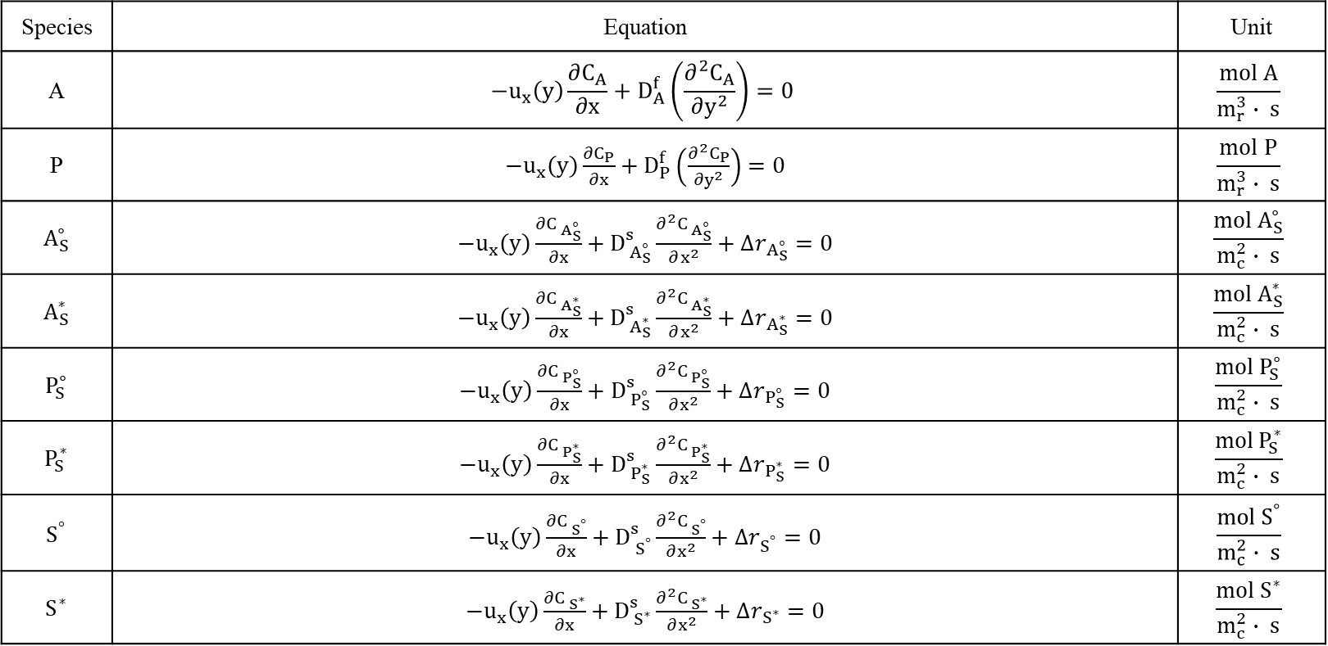
Mathematical Model: Differential Equations
Species | Equation | Unit
A | $$−u_{x}\left(y\right)\frac{∂C_{A}}{∂x}+D_{A}^{f}\left(\frac{∂^{2}C_{A}}{∂y^{2}}\right)=0$$ | $$\frac{mol A}{m_{r}^{3}∙ s}$$
P | $−u_{x}\left(y\right)\frac{∂C_{P}}{∂x}+D_{P}^{f}\left(\frac{∂^{2}C_{P}}{∂y^{2}}\right)=0$ | $$\frac{mol P}{m_{r}^{3}∙ s}$$
$${ A}_{S}^{∘}$$ | $−u_{x}\left(y\right)\frac{∂C_{{ A}_{S}^{∘}}}{∂x}+D_{{ A}_{S}^{∘}}^{s}\frac{∂^{2}C_{{ A}_{S}^{∘}}}{∂x^{2}}+∆r_{A_{S}^{∘}}=0$ | $$\frac{mol{ A}_{S}^{∘}}{m_{c}^{2}∙ s}$$
$${ A}_{S}^{∗}$$ | $−u_{x}\left(y\right)\frac{∂C_{{ A}_{S}^{∗}}}{∂x}+D_{{ A}_{S}^{∗}}^{s}\frac{∂^{2}C_{{ A}_{S}^{∗}}}{∂x^{2}}+∆r_{A_{S}^{∗}}=0$ | $$\frac{mol{ A}_{S}^{∗}}{m_{c}^{2}∙ s}$$
$${ P}_{S}^{∘}$$ | $−u_{x}\left(y\right)\frac{∂C_{{ P}_{S}^{∘}}}{∂x}+D_{{ P}_{S}^{∘}}^{s}\frac{∂^{2}C_{{ P}_{S}^{∘}}}{∂x^{2}}+∆r_{P_{S}^{∘}}=0$ | $$\frac{mol{ P}_{S}^{∘}}{m_{c}^{2}∙ s}$$
$${ P}_{S}^{∗}$$ | $−u_{x}\left(y\right)\frac{∂C_{{ P}_{S}^{∗}}}{∂x}+D_{{ P}_{S}^{∗}}^{s}\frac{∂^{2}C_{{ P}_{S}^{∗}}}{∂x^{2}}+∆r_{P_{S}^{∗}}=0$ | $$\frac{mol{ P}_{S}^{∗}}{m_{c}^{2}∙ s}$$
$${ S}^{°}$$ | $−u_{x}\left(y\right)\frac{∂C_{{ S}^{°}}}{∂x}+D_{{ S}^{°}}^{s}\frac{∂^{2}C_{{ S}^{°}}}{∂x^{2}}+∆r_{S^{°}}=0$ | $$\frac{mol{ S}^{°}}{m_{c}^{2}∙ s}$$
$${ S}^{∗}$$ | $−u_{x}\left(y\right)\frac{∂C_{{ S}^{∗}}}{∂x}+D_{{ S}^{∗}}^{s}\frac{∂^{2}C_{{ S}^{∗}}}{∂x^{2}}+∆r_{S^{∗}}=0$ | $$\frac{mol{ S}^{∗}}{m_{c}^{2}∙ s}$$
Notes:
Based on the mass balance we just derived, we now write the governing differential equations for each species in the system.
For bulk species A and P, the equations include convection in the x-direction and diffusion in both x and y directions.
Since there is no bulk reaction, there is no reaction term in these equations.
(紅線部分)
For the surface species, convection is neglected, because these species are immobilized on the catalyst surface.
Also, surface diffusion occurs only along the surface direction, so the equations reduce to diffusion-reaction form.
The reaction terms Δr represent the net production or consumption rate of each surface species based on the reaction mechanism.
In summary, bulk species follow convection-diffusion equations, while surface species follow diffusion-reaction equations.

Slide 28
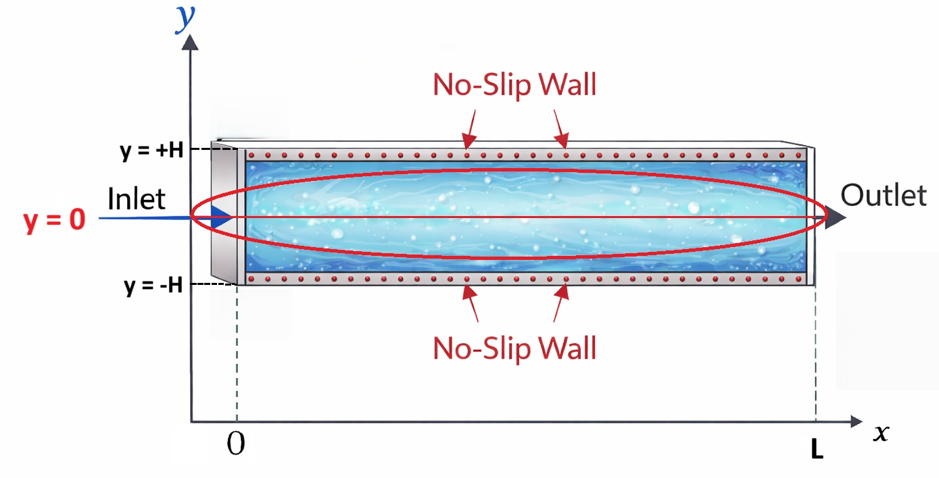


Boundary Condition: Symmetry at centerline
(1) Symmetry at centerline: ${\frac{∂C_{A}}{∂y}∣}_{y=0}=0$
(2) Symmetry at centerline: ${\frac{∂C_{P}}{∂y}∣}_{y=0}=0$
Notes:
Next, I will introduce the boundary conditions applied to our model.
$${\frac{∂C_{A}}{∂y}∣}_{y=0}=0$$
At the centerline, we apply a symmetry boundary condition. This means there is no mass flux across the centerline, so the concentration gradient in the y-direction is zero.
$$y=H: −D_{A}^{f}{A_{n}\frac{∂C_{A}}{∂y}∣}_{y=H}=V_{r}\left(Δr_{A}\right)$$

Slide 29
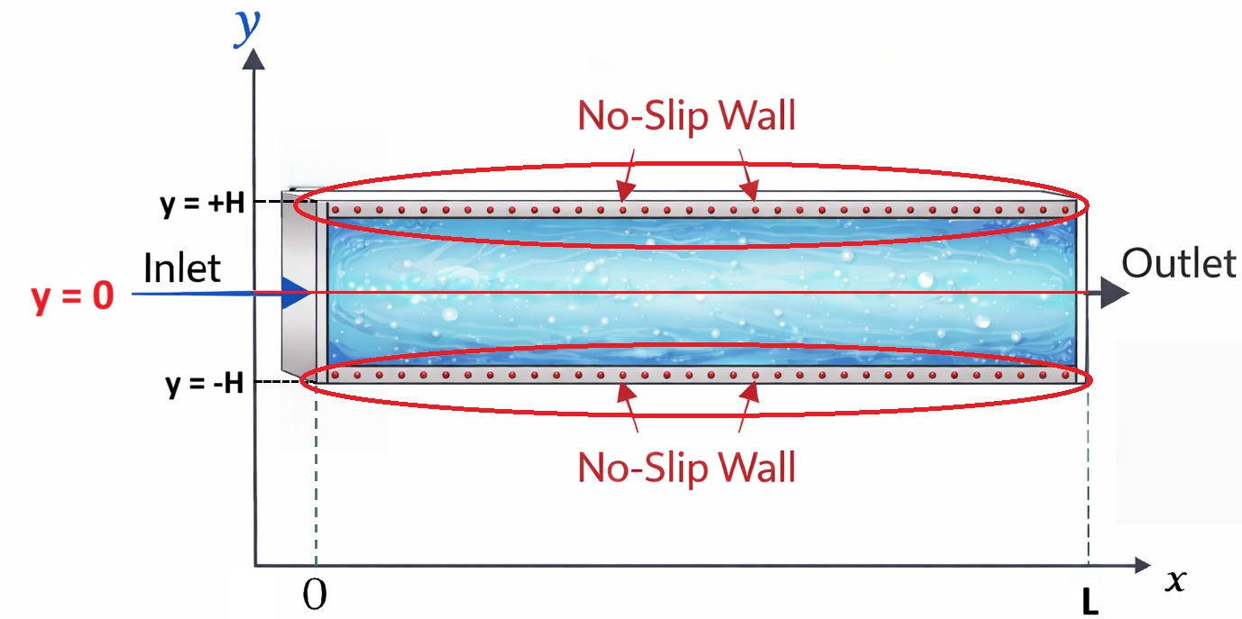


Boundary Condition: Catalytic surface
(3) Catalytic surface at $y=H: −D_{A}^{f}{A_{n}\frac{∂C_{A}}{∂y}∣}_{y=H}=V_{r}\left(Δr_{A}\right)$
(4) Catalytic surface at $y=H: −D_{P}^{f}{A_{n}\frac{∂C_{P}}{∂y}∣}_{y=H}=V_{r}\left(Δr_{P}\right)$
Notes:
$$y=H: −D_{A}^{f}{A_{n}\frac{∂C_{A}}{∂y}∣}_{y=H}=V_{r}\left(Δr_{A}\right)$$
At the catalytic surface, the diffusive flux of species A equals the reaction rate occurring on the surface.
In other words, whatever diffuses to the surface is immediately consumed by reaction.
$$y=H: −D_{P}^{f}{A_{n}\frac{∂C_{P}}{∂y}∣}_{y=H}=V_{r}\left(Δr_{P}\right)$$
For product P, the diffusive flux leaving the surface equals the rate of production from the reaction.

Slide 30
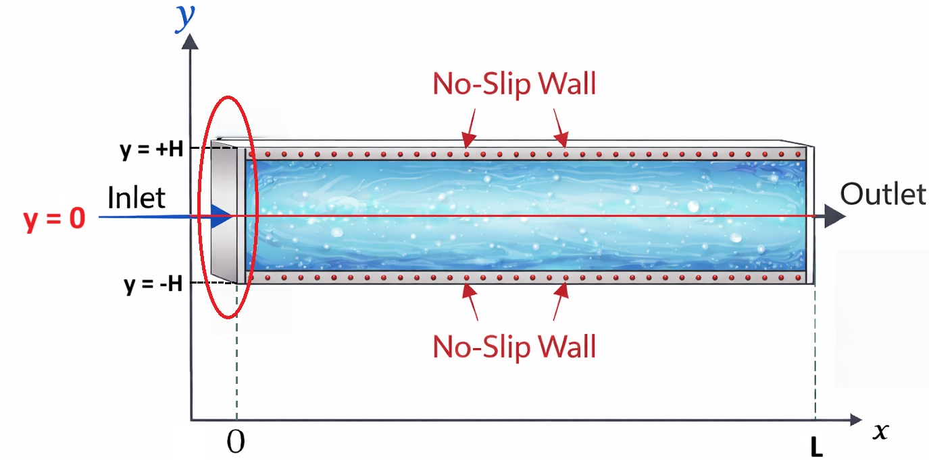


Boundary Condition: Inlet
(5) Inlet at $x=0: C_{A}=C_{A}^{in}$
(6) Inlet at $x=0: C_{P}=0$
Notes:
$$C_{A}=C_{A}^{in}$$
At the inlet, we assume a fixed concentration of A entering the reactor.
$$C_{P}=0$$
Since no product is present at the inlet, we set its concentration to zero.

Slide 31
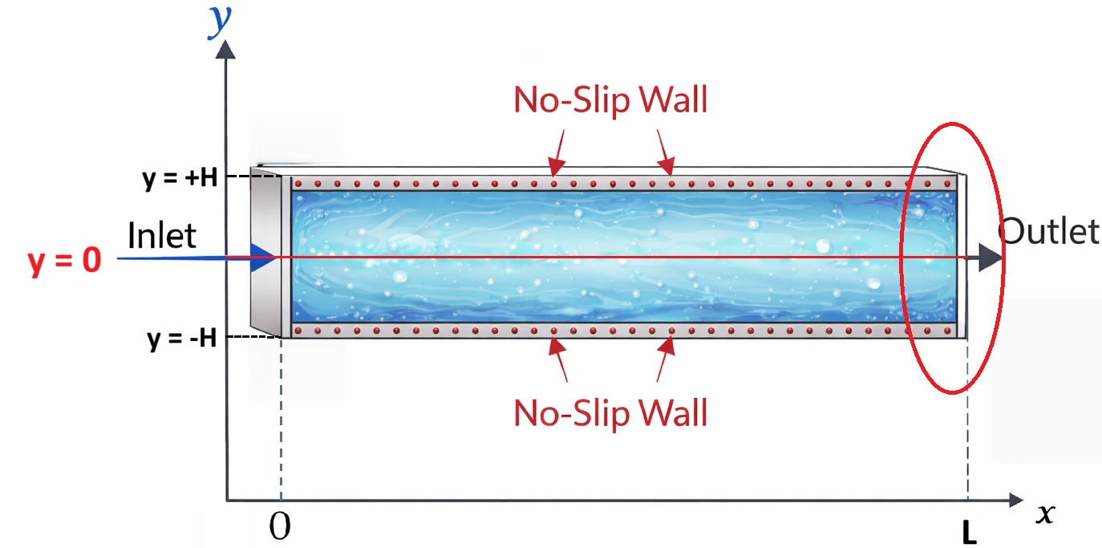


Boundary Condition: Outlet
(7) Outlet at $x=L: {\frac{∂C_{A}}{∂x}∣}_{x=L}=0$
(8) Outlet at $x=L: {\frac{∂C_{P}}{∂x}∣}_{x=L}=0$
Notes:
$$: {\frac{∂C_{A}}{∂x}∣}_{x=L}=0$$
At the outlet, we assume no change in concentration in the flow direction.
Overall, these boundary conditions ensure conservation of mass and properly couple diffusion with surface reaction.

Slide 32

Time Scale Analysis: Axial diffusion vs Convection (x-direction)
L = 0.05 m D = 1 × 10⁻⁹ m²/s Q = 5 × 10⁻⁷ m³/s A = 5 × 10⁻⁶ m² H = 5 × 10⁻⁴ m
Axial diffusion time
$$τ_{Dx}=\frac{L^{2}}{D}$$
$$τ_{Dx}=\frac{\left(0.05{\left.)\right.}^{2}\right.}{{10}^{−9}}=2.5×{10}^{6} s$$
29 ≈ days
Convection time
$$τ_{conv}=\frac{L}{u_{avg}}$$
$$\overline{u}=\frac{Q}{A}=\frac{5×{10}^{−7}}{5×{10}^{−6}}=0.1 m/s$$
$$τ_{conv}=\frac{0.05}{0.1}=0.5 s$$
Comparison
$$τ_{Dx}>>τ_{conv}$$
Notes:
$\text{🟦} \text{Slide} \text{1}$
$\text{Axial} \text{Diffusion} \text{vs} \text{Convection} \text{(}\text{Flow} \text{Direction}\text{)}$
$\text{🎤} \text{English}$
$\text{First}\text{, }\text{I} \text{compared} \text{axial} \text{diffusion} \text{and} \text{convection} \text{along} \text{the} \text{reactor} \text{length}\text{.}$
$\text{The} \text{diffusion} \text{time} \text{in} \text{the} \text{flow} \text{direction} \text{is} \text{extremely} \text{long} \text{— }\text{on} \text{the} \text{order} \text{of} \text{weeks}\text{.}$
$\text{In} \text{contrast}\text{, }\text{the} \text{fluid} \text{only} \text{stays} \text{inside} \text{the} \text{reactor} \text{for} \text{about} \text{half} \text{a} \text{second}\text{.}$
$\text{Because} \text{the} \text{residence} \text{time} \text{is} \text{so} \text{short}\text{, }\text{molecules} \text{simply} \text{do} \text{not} \text{have} \text{enough} \text{time} \text{to} \text{diffuse} \text{along} \text{the} \text{length} \text{of} \text{the} \text{reactor}\text{.}$
$\text{Instead}\text{, }\text{they} \text{are} \text{carried} \text{forward} \text{by} \text{the} \text{flow}\text{.}$
$\text{This} \text{clearly} \text{shows} \text{that} \text{transport} \text{in} \text{the} \text{x}\text{−}\text{direction} \text{is} \text{convection} \text{dominated}\text{.}$
$\text{Therefore}\text{, }\text{axial} \text{diffusion} \text{can} \text{reasonably} \text{be} \text{neglected} \text{in} \text{the} \text{mathematical} \text{model}\text{.}$
$\text{🎤} \text{中文}$
$\text{首先}\text{，}\text{我比較了流動方向上的軸向擴散與對流}\text{。}$
$\text{計算結果顯示}\text{，}\text{軸向擴散需要數週時間才會有明顯影響}\text{。}$
$\text{但流體在反應器內只停留約 }\text{0.}\text{5 }\text{秒}\text{。}$
$\text{停留時間非常短}\text{，}\text{分子根本來不及沿著反應器長度擴散}\text{。}$
$\text{它們主要是被流體直接帶走}\text{。}$
$\text{因此可以判斷}\text{，}\text{在 }\text{x} \text{方向上是對流主導}\text{。}$
$\text{所以在數學模型中}\text{，}\text{可以合理忽略軸向擴散}\text{。}$

Slide 33
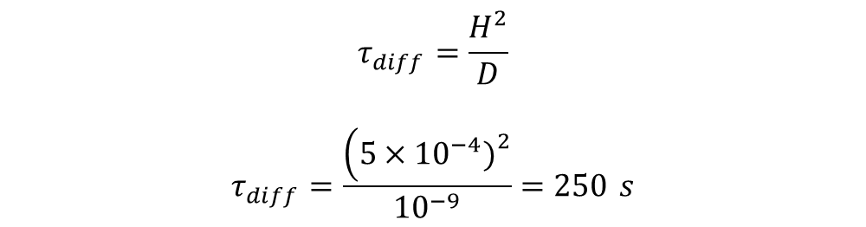
Time Scale Analysis: Diffusion Time in y-direction
L = 0.05 m D = 1 × 10⁻⁹ m²/s Q = 5 × 10⁻⁷ m³/s A = 5 × 10⁻⁶ m² H = 5 × 10⁻⁴ m
$$τ_{diff}=\frac{H^{2}}{D}$$
$$τ_{diff}=\frac{\left(5×{10}^{−4}{\left.)\right.}^{2}\right.}{{10}^{−9}}=250 s$$
Notes:
Next is the diffusion time in the y-direction, it will be half reactor height square divide by diffusion coefficient. So in our model that will be 250s.

Slide 34

Time Scale Analysis: Reaction Time
$S^{∘}=0.2\sim 0.5\left[m2\right], S^{∗}=0.3\sim 0.5\left[m2\right],S_{c}=1$ $\left[m2\right]$
Reaction | Rate Constant | Reaction Rate | Characteristic Time
$$A+S^{∘}→AS^{∘}$$ | $$k_{A→AS^{∘}}=5 \left[\frac{m_{S^{∘}}^{2}}{m_{c}^{2}⋅s}\right]$$ | $$r=k_{A→AS^{∘}}C_{A}\left(S^{∘}/S_{c}\right)$$ | $$τ=\frac{1}{5\left(0.2∼0.5\right)}=0.4∼1 s$$
$$AS^{∘}→A+S^{∘}$$ | $$k_{AS^{∘}→A}=5 \left[\frac{1}{s}\right]$$ | $$r=k_{AS^{∘}→A}C_{AS^{∘}}$$ | $$τ=1/5=0.2s$$
$$A+S^{∗}→AS^{∗}$$ | $$k_{A→AS^{∗}}=5 \left[\frac{m_{S^{∗}}^{2}}{m_{c}^{2}⋅s}\right]$$ | $$r=k_{A→AS^{∗}}C_{A}\left(S^{∗}/S_{c}\right)$$ | $$τ=\frac{1}{5\left(0.3∼0.5\right)}=0.4∼0.67 s$$
$$AS^{∘}+S^{∗}→AS^{∗}{+S}^{∘}$$ | $$k_{AS^{∘}→AS^{∗}}=5 \left[\frac{m_{S^{∗}}^{2}}{m_{c}^{2}⋅s}\right]$$ | $$r=k_{AS^{∘}→AS^{∗}}C_{AS^{∘}}\left(S^{∗}/S_{c}\right)$$ | $$τ=0.4∼0.67 s$$
$$AS^{∗}→P_{S}^{∗}$$ | $$k_{AS^{∗}→P_{S}^{∗}}=5 \left[\frac{1}{s}\right]$$ | $$r=k_{AS^{∗}→P_{S}^{∗}}C_{AS^{∗}}$$ | $$τ=0.2 s$$
$$P_{S}^{∗}→P+S^{∗}$$ | $$k_{P_{S}^{∗}→P}=5 \left[\frac{1}{s}\right]$$ | $$r=k_{P_{S}^{∗}→P}C_{P_{S}^{∗}}$$ | $$τ=0.2 s$$
$$P+S^{∘}→P_{S}^{∘}$$ | $$k_{P→P_{S}^{∘}}=5 \left[\frac{m_{S^{∘}}^{2}}{m_{c}^{2}⋅s}\right]$$ | $$r=k_{P→P_{S}^{∘}}C_{P}\left(S^{∘}/S_{c}\right)$$ | $$τ=0.4∼1 s$$
$$P_{S}^{∘}→P+S^{∘}$$ | $$k_{P_{S}^{∘}→P}=5 \left[\frac{1}{s}\right]$$ | $$r=k_{P_{S}^{∘}→P}C_{P_{S}^{∘}}$$ | $$τ=0.2 s$$
Notes:
English Script
Next, we analyze the reaction time scale of the system.
In this model, we first assume that all the reaction rate constants are equal to 5. Using this assumption, we estimate the characteristic reaction time for each elementary reaction step.
However, the surface sites $S^{∘}$and $S^{∗}$are not constant. During the reaction process, these surface sites are continuously occupied and regenerated due to adsorption and desorption. Therefore, the available surface sites vary with time.
In our model, we assume that the available $S^{∘}$sites vary approximately between 0.2 and 0.5, while the $S^{∗}$sites vary between 0.3 and 0.5. The total catalytic surface area $S_{c}$is normalized to 1.
By substituting the assumed rate constant $k=5$and the possible ranges of surface site coverage into this expression, we calculate the characteristic time for the reactions.
From the results, we find that most reaction characteristic times fall within the range of approximately 0.2 to 1 second.
Therefore, we estimate that the overall reaction time scale of this system is between 0.2 and 1 second.
中文講稿
接下來我們要分析這個系統的 reaction time scale（反應時間尺度）。
在這個模型中，我們首先假設所有的 reaction rate constant 都等於 5。利用這個假設，我們可以估算每一個 elementary reaction step 的 characteristic reaction time。
然而，系統中的表面位點 $S^{∘}$和 $S^{∗}$並不是固定不變的。在反應過程中，由於 adsorption 和 desorption 持續發生，這些表面位點會不斷被佔用並重新生成，因此可用的表面位點數量會隨時間改變。
在我們的模型中，我們假設 $S^{∘}$的可用範圍大約在 0.2 到 0.5 之間，而 $S^{∗}$的範圍大約在 0.3 到 0.5 之間，而整個表面面積 $S_{c}$被 normalized 為 1。
將假設的 rate constant $k=5$以及表面位點可能的範圍代入計算之後，我們可以得到各 reaction step 的 characteristic time。
從計算結果可以看到，大部分 reaction 的 characteristic time 大約落在 0.2 到 1 秒之間。
因此我們可以估算整個系統的 reaction time scale 約在 0.2 到 1 秒之間。

Slide 35

Time Scale Analysis: Final Comparison
$τ_{rxn}=0.2 s$-1.0 s
$$τ_{conv}=0.5 s$$
$$τ_{diff}=250 s$$
$$τ_{rxn}<τ_{conv}≪τ_{Dy}$$

Slide 36


Case 1: Concentration Distribution (2H = 0.001 m)
Cross-section area
$$A=\left(2H\right)W$$
$$A=\left(0.001\right)\left(0.005\right)$$
$$A=5×{10}^{−6} m^{2}$$
Velocity
$$\overline{u}=\frac{Q}{A}$$
$$\overline{u}=\frac{5×{10}^{−7}}{5×{10}^{−6}}$$
$$\overline{u}=0.10 m/s$$
Convection time
$$τ_{conv}=\frac{L}{U}$$
$$τ_{conv}=0.5 s$$
Diffusion time
$$τ_{diff}=\frac{H^{2}}{D}$$
$$τ_{diff}=250 s$$
Pressure drop
$$ΔP=\frac{12μLU}{H^{2}}$$
$$ΔP=\frac{12∙(1.0×{10}^{−3})∙(5.0×{10}^{−2})∙0.1 }{{(0.0005)}^{2}}=240 Pa$$
Notes:
According to the result, we knew that the system is diffusion-limited. So we want to decrease the height, which will make our diffusion time lower.
This is the original result we ran in COMSOL
At this figure, we can see the concentration distribution of the reactant A didn’t absorb onto the catalyst surface. Because the concentration of A didn’t change.

Slide 37


Case 2: Concentration Distribution (2H = 0.00001 m)
Cross-section area
$$A=\left(2H\right)W$$
$$A=\left(0.00001\right)\left(0.005\right)$$
$$A=5×{10}^{−8} m^{2}$$
Velocity
$$\overline{u}=\frac{Q}{A}$$
$$\overline{u}=\frac{5×{10}^{−7}}{5×{10}^{−8}}$$
$$\overline{u}=10 m/s$$
Convection time
$$τ_{conv}=\frac{L}{U}$$
$$τ_{conv}=0.005 s$$
Diffusion time
$$τ_{diff}=\frac{H^{2}}{D}$$
$$τ_{diff}=0.025 s$$
Pressure drop
$$ΔP=\frac{12μLU}{H^{2}}$$
$$ΔP=\frac{12∙(1.0×{10}^{−3})∙(5.0×{10}^{−2})∙\text{10} }{{(0.000005)}^{2}}=2.4×{10}^{8}Pa , Re≈200$$
Notes:
This is the result when we divide our height by 100
At this figure, we can see the concentration distribution of the reactant A normally absorbed into the catalyst surface.

