Slide 1



Modeling Lidocaine Dynamics Using a Two-Compartment ODE System
Ting-Wei Chen & Suttana Vicharnpootorn
CHE 525 - Final Project
x'(t) = -0.09x(t) + 0.038y(t) y'(t) = 0.066x(t) - 0.038y(t)
Notes:
Peter:
“Hello, my name is Ting-Wei Chen , and this is my partner Suttana Vicharnpootorn. For our CHE 525 final project, we modeled how lidocaine moves inside the human body using a two-compartment system of ordinary differential equations.”

Slide 2








Why Model Drug Distribution?
Treating Ventricular Arrhythmia
Lidocaine is a fast-acting local anesthetic that stabilizes cardiac electrical activity, but its effectiveness depends on proper concentration in the bloodstream.
Blood Concentration Thresholds
Effective Level
Dangerous Level
Clinical Thresholds
1.5 mg/L
6 mg/L
Effective concentration: ~1.5 mg/L
Dangerous concentration: ~6 mg/L
Patient-specific modeling needed
Prediction Needs
Patients differ in body weight, metabolism, and organ perfusion, making mathematical modeling valuable for predicting drug behavior.
How quickly drug reaches therapeutic levels
Whether a dose risks reaching toxic levels
How long the drug remains effective
Modeling Lidocaine Dynamics Using a Two-Compartment ODE System
CHE 525 Final Project
Notes:
Peter:
“Lidocaine is a life-saving drug used for treating ventricular arrhythmia. It acts quickly, but there is a narrow safety margin. About 1.5 mg/L is effective, while around 6 mg/L can be dangerous.
Since patients differ in metabolism and organ perfusion, it’s very helpful to have a mathematical model that predicts how quickly lidocaine peaks, how long it stays effective, and whether a given dose risks toxicity.”

Slide 3

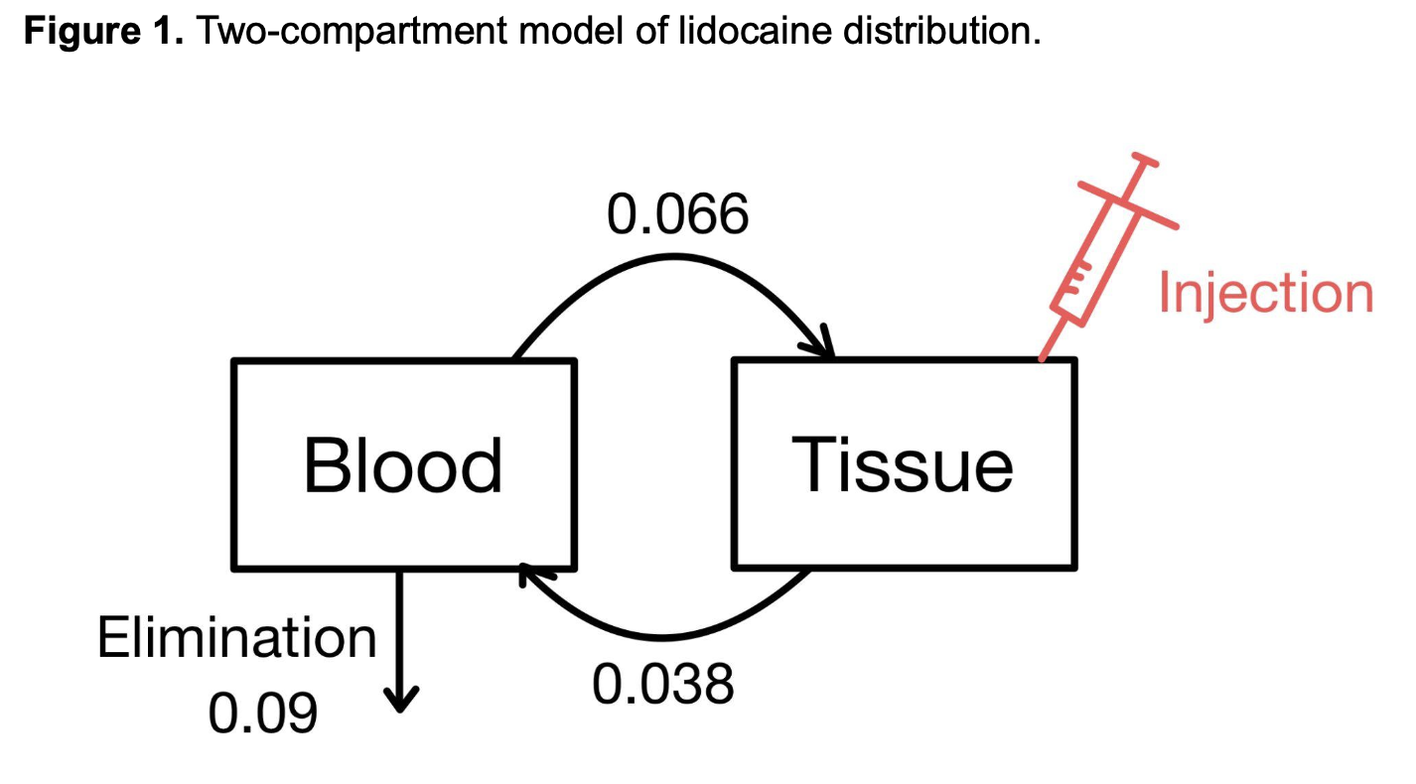


Two-Compartment System Overview
Compartment Model
The human body is simplified into two interacting regions:
Bloodstream (central compartment)
Body tissue (peripheral compartment)
Transfer Rates
0.066: Blood → Tissue transfer rate
0.038: Tissue → Blood transfer rate
Elimination
0.09: Elimination rate from bloodstream
Modeling Lidocaine Dynamics Using a Two-Compartment ODE System
CHE 525 Final Project
Notes:
First:
“To keep the model simple and mathematically tractable, we use a classical two-compartment pharmacokinetic model. Lidocaine exchanges between two main regions: the tissue compartment and the bloodstream compartment. It moves back and forth with transfer rates, and is eliminated from the bloodstream at a known rate. This framework captures the essential physiology while allowing us to use linear ODE tools from class.”

Slide 4







Mathematical Model
Two-Compartment ODE System
System of linear ODEs describing lidocaine distribution:
x'(t) = -0.09x(t) + 0.038y(t)
y'(t) = 0.066x(t) - 0.038y(t)
Parameter Interpretation
Variables:
0.066 → transfer from blood → tissue
x(t): amount of lidocaine in bloodstream
0.038 → transfer from tissue → blood
y(t): amount of lidocaine in tissue
0.09 → elimination from blood
Initial Condition:
x(0) = 0, y(0) < 0 (injection dose)
Modeling Lidocaine Dynamics Using a Two-Compartment ODE System
CHE 525 Final Project
Notes:
First:
“Let $x\left(t\right)$ be the amount of drug in the bloodstream and $y\left(t\right)$ the amount in tissue. The exchange is described by this pair of linear ODEs. We assume the drug starts in the tissue immediately after injection, so $x\left(0\right)=0$ and $y\left(0\right)=y_{0}$ which <0. Even though the model is small, it already produces realistic pharmacokinetic behavior.”

Slide 5










Matrix Form and Solution Method
Matrix Form
System Matrix A 2x2
$$x′(t) = Ax(t)$$
$$\left[\begin{matrix}−0.09 & 0.038 \\ 0.066 & −0.038\end{matrix}\right]$$
where $x\left(t\right)=\left[{x(t) \atop y(t)}\right]$
CHE 525 Connection
Solution Method
This method directly uses course concepts:
$$x(t) = e^{At}x_{0}$$
Because A is diagonalizable:
Eigenvalues
Eigenvectors
Matrix Exponentials
$${A=VΛV^{−1}, e}^{At}=Ve^{Λt}V^{−1}$$
Compute eigenvalues and eigenvectors
Form matrix exponential
Multiply by initial condition
Modeling Lidocaine Dynamics Using a Two-Compartment ODE System
CHE 525 Final Project
Notes:
First:
“We write the system compactly as $x^{′}=Ax$, where A is a 2×2 matrix. Because this system is linear, the exact solution is
$$x\left(t\right)=e^{At}x_{0},$$
and we compute the matrix exponential using diagonalization: $A=VΛV^{−1}$. This uses the same eigenvalue and eigenvector techniques we learned in CHE 525.”

Slide 6


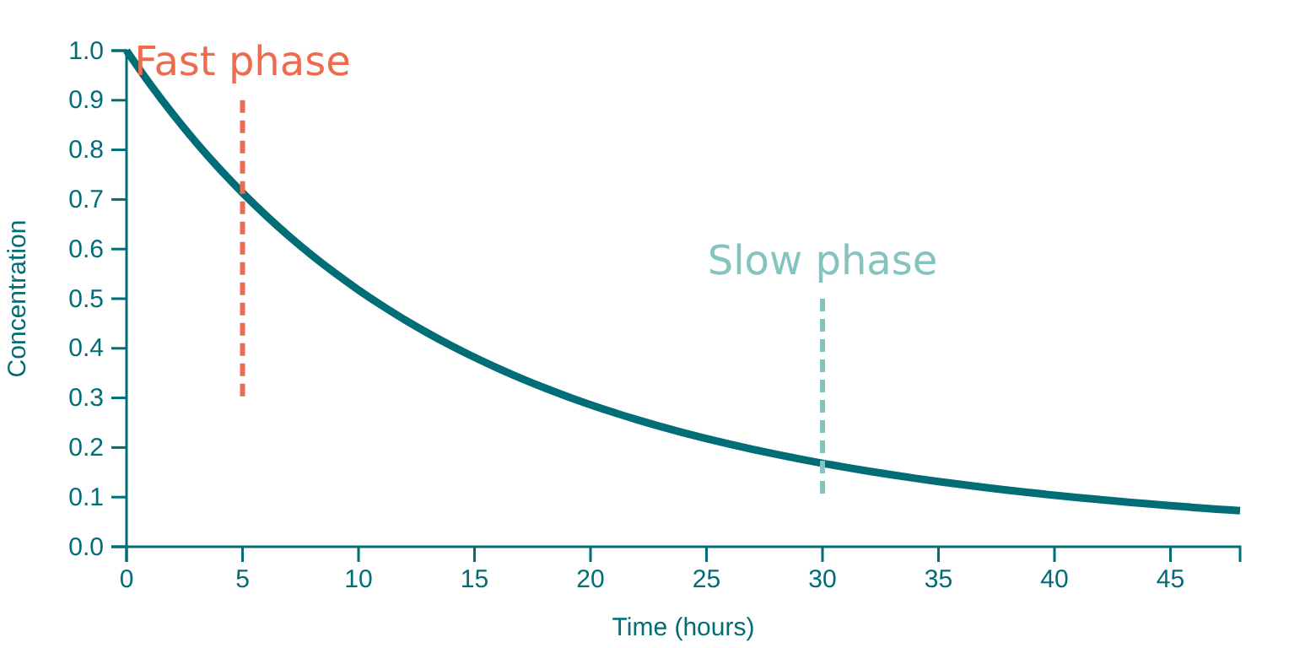








Eigenvalue Insights
Eigenvalue Approach
Biphasic PK Curve
For the linear system $x′(t) = Ax(t)$, the solution involves matrix exponentials:
$$x(t) = e^{At}x_{0}$$
Since A is diagonalizable:
$${A=VΛV^{−1}, e}^{At}=Ve^{Λt}V^{−1}$$
Large Negative Eigenvalue
Small Negative Eigenvalue
Fast distribution phase
Slow elimination phase
Distribution Phase
Elimination Phase
Controls the initial rapid decline
Controls the gradual decline
Rapid initial drop due to fast distribution
Slow, gradual decline as drug is eliminated
Modeling Lidocaine Dynamics Using a Two-Compartment ODE System
CHE 525 Final Project
Notes:
First:
“The two eigenvalues of A are both negative, but one has a much larger magnitude. This creates two time scales: a fast decay phase corresponding to drug distribution into tissues, and a slow phase corresponding to elimination. This directly explains the two phase curve of real concentration-time profiles.”

Slide 7

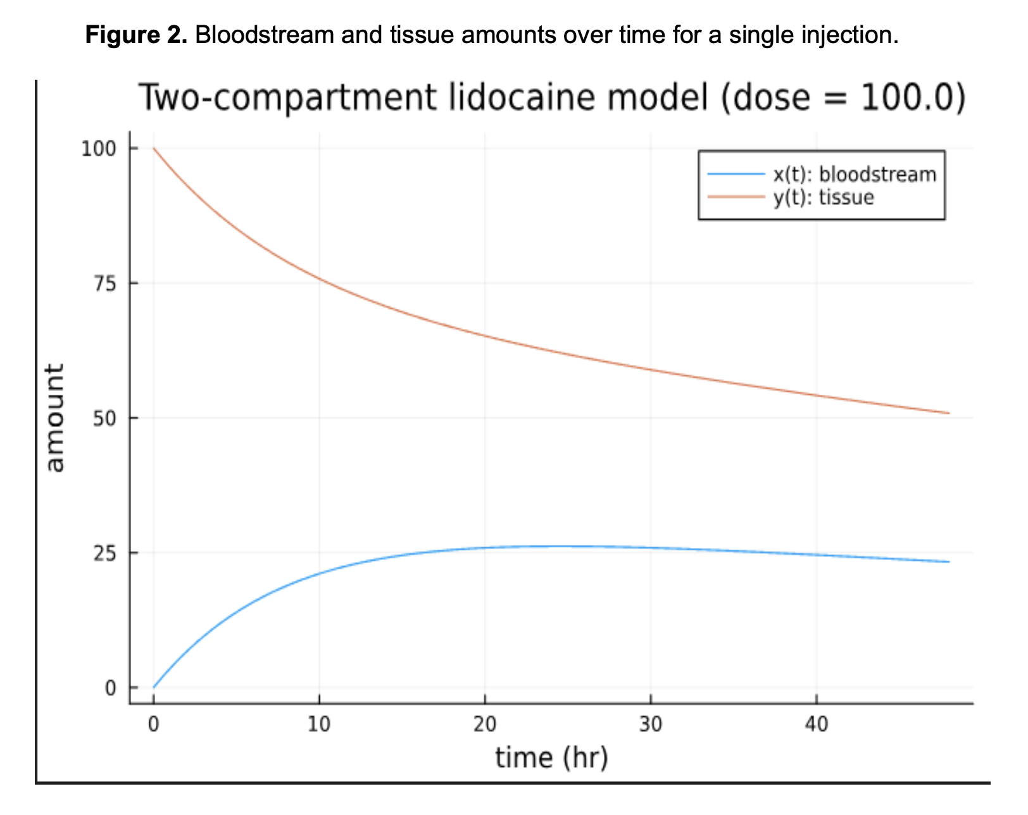




Single Dose Simulation Results
Key Observations
Drug rapidly enters bloodstream from tissue
Single injection of 100.0 mg lidocaine
Bloodstream concentration peaks within hours
Slow decline over tens of hours
Tissue compartment retains drug longer
Clinical Significance
The simulation shows the biphasic elimination curve:
Fast initial drop (distribution phase)
Slow, gradual decline (elimination phase)
Modeling Lidocaine Dynamics Using a Two-Compartment ODE System
CHE 525 Final Project
Notes:
First:
“Here we show a simulation of a single dose of 100 units. The bloodstream concentration rises quickly, peaks within a few hours, and then slowly declines over almost two days. The tissue compartment acts as a reservoir, releasing drug back into the bloodstream.”

Slide 8

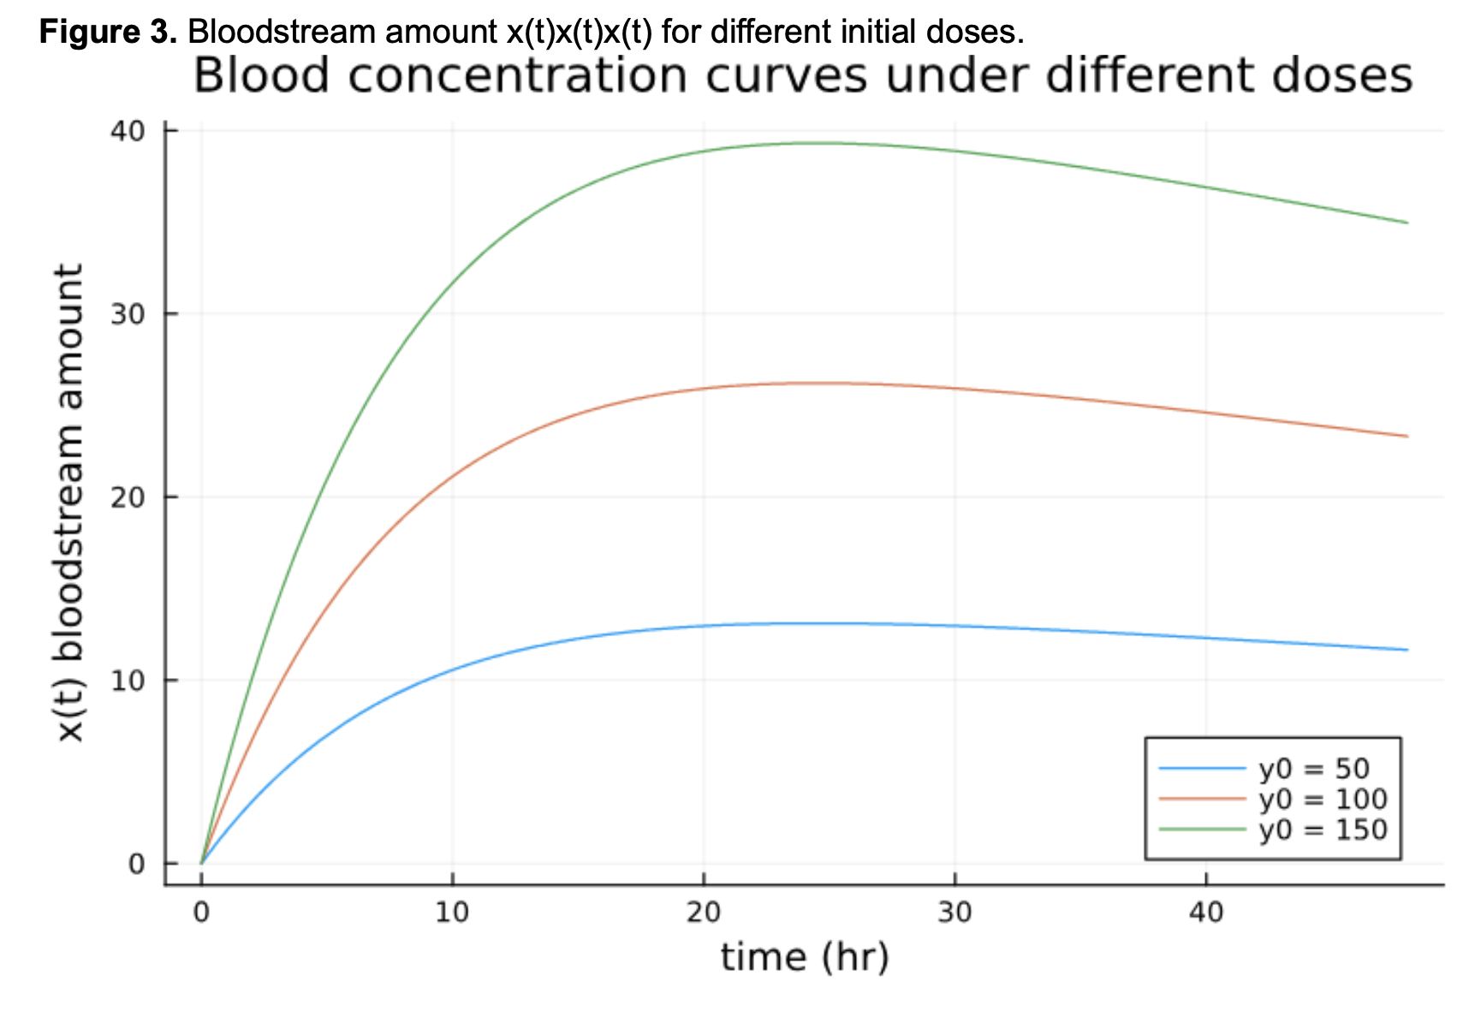




Multiple Dose Comparison
Key Observations
Higher doses peak higher
The maximum concentration in the bloodstream increases with dose magnitude
Longer persistence
Higher doses maintain elevated levels for extended periods
Linear scaling
Due to the linearity of the ODE model, curves scale proportionally with dose
Clinical Implications
This information helps assess the risk of exceeding dangerous concentration limits (6 mg/L) while ensuring therapeutic efficacy (1.5 mg/L).
Modeling Lidocaine Dynamics Using a Two-Compartment ODE System
CHE 525 Final Project
Notes:
First:
“We also simulated doses of 50, 100, and 150. Higher doses lead to higher peaks and maintain elevated bloodstream levels for longer. Because this is a linear model, the peak heights scale almost proportionally with the initial dose.”

Slide 9












Clinical Interpretation
Clinical Applications
Model Validity
Despite its simplicity, the two-compartment model captures essential pharmacokinetic behavior:
Therapeutic Window
Model predicts time above therapeutic threshold (1.5 mg/L), helping determine dosing frequency.
Biphasic elimination pattern (distribution & elimination phases)
Linear scaling of concentration with dose
Overdose Risk
Higher initial doses increase peak concentrations, enabling risk assessment for toxic levels (>6 mg/L).
Concentration-Time Relationship
Therapeutic
Toxic
Model captures realistic PK behavior for clinical decision support
Modeling Lidocaine Dynamics Using a Two-Compartment ODE System
CHE 525 Final Project
Notes:
Peter:
“From these curves, we can evaluate key clinical questions: • How long does the drug remain above the therapeutic threshold? • Does a particular dose risk exceeding toxic levels? • How sensitive is the peak to small changes in dosage?
Even though this is a simplified two-compartment model, it captures essential pharmacokinetic effects.”

Slide 10







Conclusion
Model Analysis
Two-compartment model effectively captures lidocaine distribution dynamics
Mathematical Modeling in Drug Administration
Eigenvalue analysis revealed biphasic elimination behavior
Matrix exponential methods provide exact solutions
Mathematical Model
Clinical Application
Despite its simplicity, the two-compartment model provides valuable insights into drug behavior.
Clinical Impact
Predicts time above therapeutic threshold
Mathematical modeling serves as a bridge between theory and clinical practice.
Identifies overdose risk with simple model
Supports safe and effective dosing decisions
"Mathematical models help clinicians make informed decisions about drug administration."
Modeling Lidocaine Dynamics Using a Two-Compartment ODE System
CHE 525 Final Project
Notes:
Peter:
“In summary, we used linear ODE systems, eigenvalues, eigenvectors, and matrix exponentials to model lidocaine distribution. This model reveals how lidocaine moves between tissues and bloodstream, how long therapeutic levels persist, and how dose size influences peak concentration and toxicity risk.
This project demonstrates how mathematical modeling—not just in chemistry, but using linear algebra—supports real decisions in chemical, biomedical, and clinical engineering. Thank you.”

