Slide 1
SmartCard Lab - Final Presentation Group 3
Team 1:
Faraz Bhatti
Lu Yongchen
Mao Kaiyi
Team 2:
Christoph Wittmann
Yizhou Liu

Slide 2
Content
Improvements on AES
Speed up attacking script
Pseudo Random Number Generator
Implemented countermeasures
Hiding
Dummy Operations
Shuffling
Masking
True Random Number generator
Benchmark
Conclusion

Slide 3
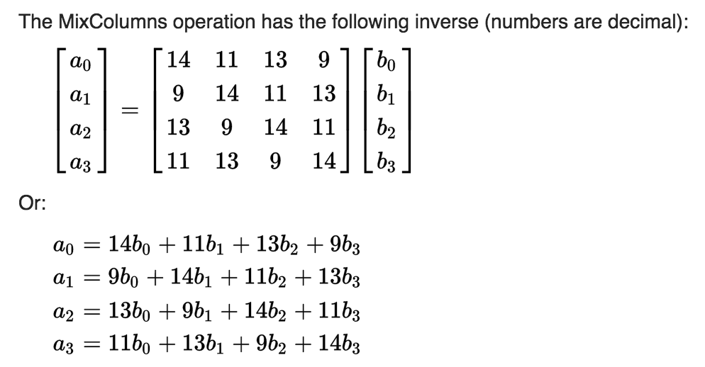
Improvements on AES - matrix multiply lookup tables
Since this math is done in 2⁸ field, the addition above is actually an exclusive or operation, and multiplication is a complicated operation.

Slide 4
Improvements on AES -- matrix multiply lookup tables
Instead of the complicated math calculation, we defined the look-up tables for inverse MixColomns
The processing time has been improved significantly.
For example: Lookup table for multiplying by 9
//0 1 2 3 4 5 6 7 8 9 A B C D E F
0x00, 0x09, 0x12, 0x1b, 0x24, 0x2d, 0x36, 0x3f, 0x48, 0x41, 0x5a, 0x53, 0x6c, 0x65, 0x7e, 0x77,
0x90, 0x99, 0x82, 0x8b, 0xb4, 0xbd, 0xa6, 0xaf, 0xd8, 0xd1, 0xca, 0xc3, 0xfc, 0xf5, 0xee, 0xe7,
…

Slide 5

Script Speed Up Using Multiprocessing
-Amdahl's Law
-Parallel Part and Sequential Part of The Script
-Pool of Processes
-Spawning Processes
-Up to 3x Faster Processing

Slide 6
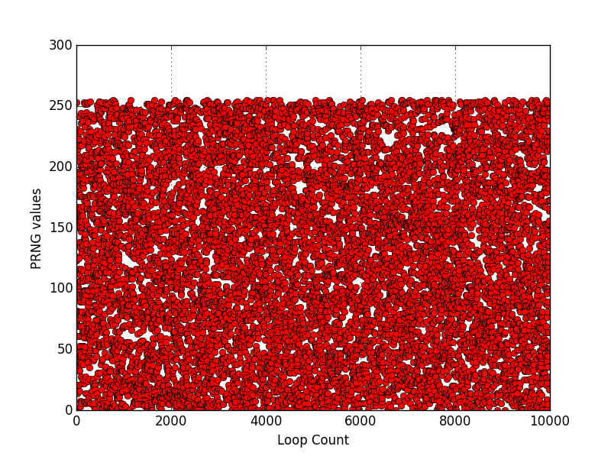
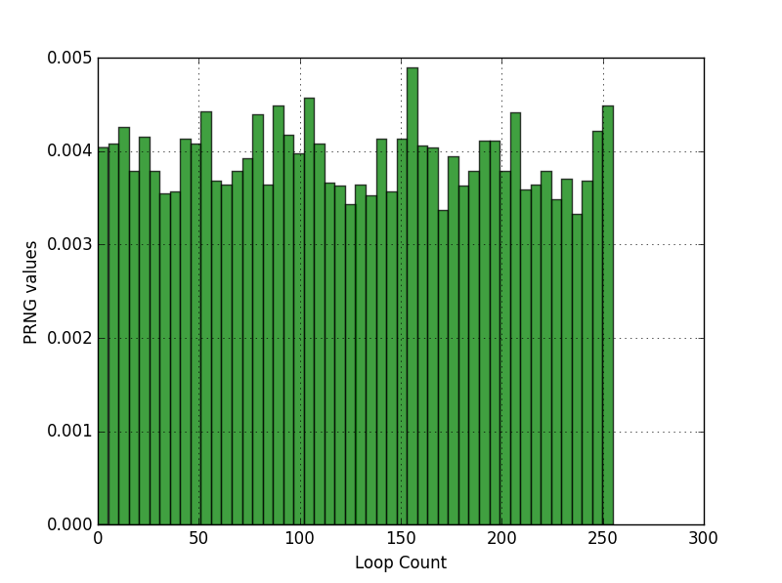
Random Number Generator
XOR SHIFT PRNGs:
Input is a linear function of the previous state.
PRNG Tests:
Entropy Test :7.099790 bits per byte

Slide 7
Hiding
Dummy Operation
Shuffling

Slide 8
Hiding (Dummy Operations) Implementation
- Random misalignment of the AES operations in the time domain.
- Insert NOP operations so that the traces are not aligned in order to do compression or DPA attacks.
- The sum of operations should be the same in the end
- Total Number of Operations allowed – random()
- Last Count for NOP operations = remaining operations count.
- DPA Attack is not effective anymore
- 0 Correct Key Bytes

Slide 9
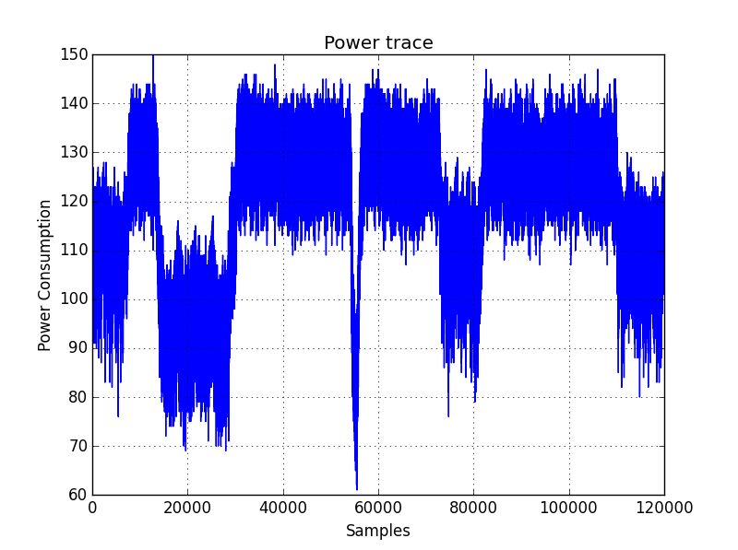
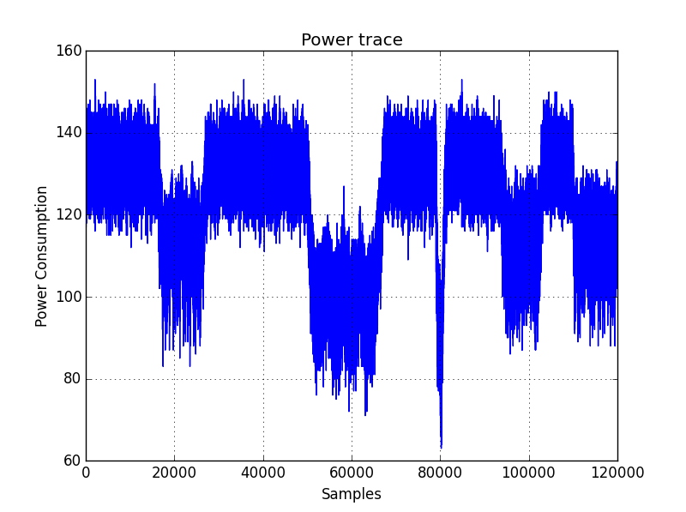
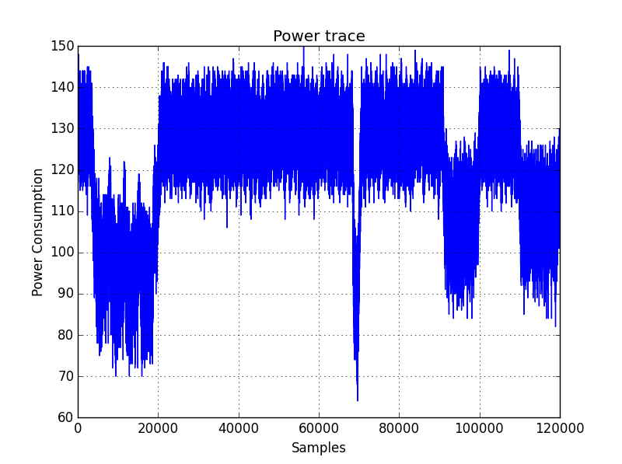
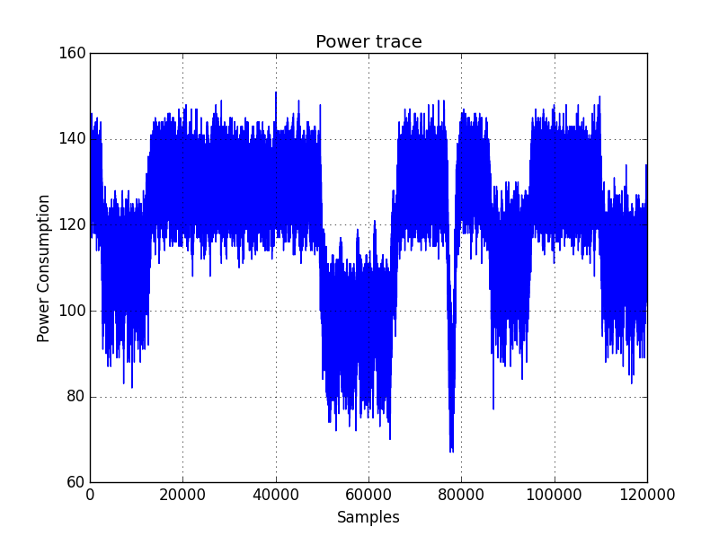
Hiding( Dummy Operation ) Resultant Power Traces

Slide 10
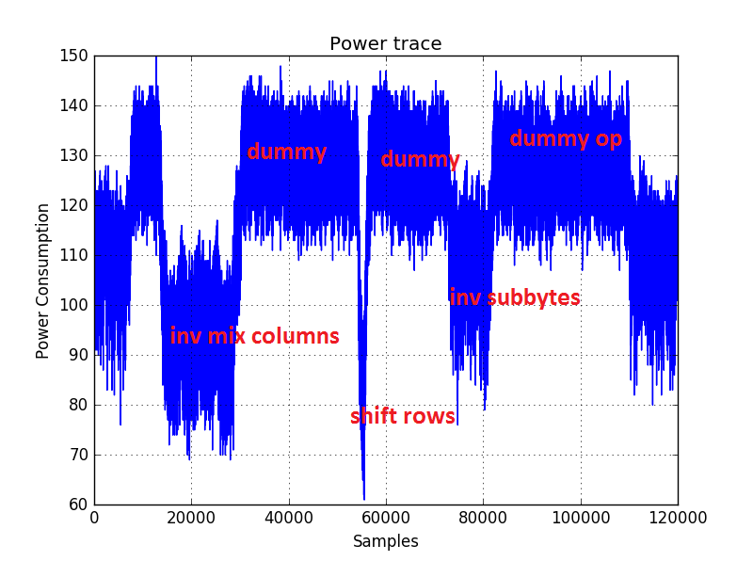
Power Trace Analysis

Slide 11
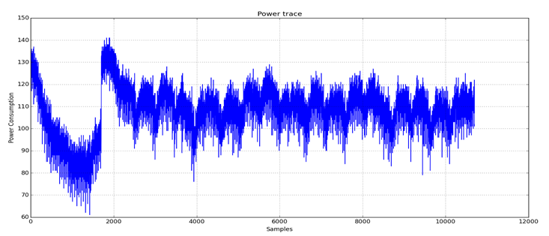
Attacking Dummy Operations using MSE (Mean Squared Error)
Resultant Trace After Preprocessing
Then we perform simple 1st Order DPA Attack on this Trace .
And got correct key with 800 Traces in 72 seconds.

Slide 12
Shuffling
Focusing on inverse SubByte
Using random numbers to determine the sequence of 16 S-box look-ups
1 | 5 | 9 | 13
2 | 6 | 10 | 14
3 | 7 | 11 | 15
4 | 8 | 12 | 16
1 | 2 | 3 | 4 | 5 | 6 | 7 | 8 | 9 | 10 | 11 | 12 | 13 | 14 | 15 | 16
After Shuffling
15 | 2 | 10 | 3 | 9 | 14 | 16 | 8 | 13 | 4 | 6 | 1 | 5 | 11 | 7 | 12
Mixed the sequence of SubByte
Hard to apply DPA attack

Slide 13
Attacking on shuffling
If we take enough sample traces, and then for every single byte during the process, it should appear at the correct place several times. Thus we can still get the intermediate value correctly.
In phase 1,
500 traces
Correct key
After shuffling,
with 10000 traces
183 seconds

Slide 14
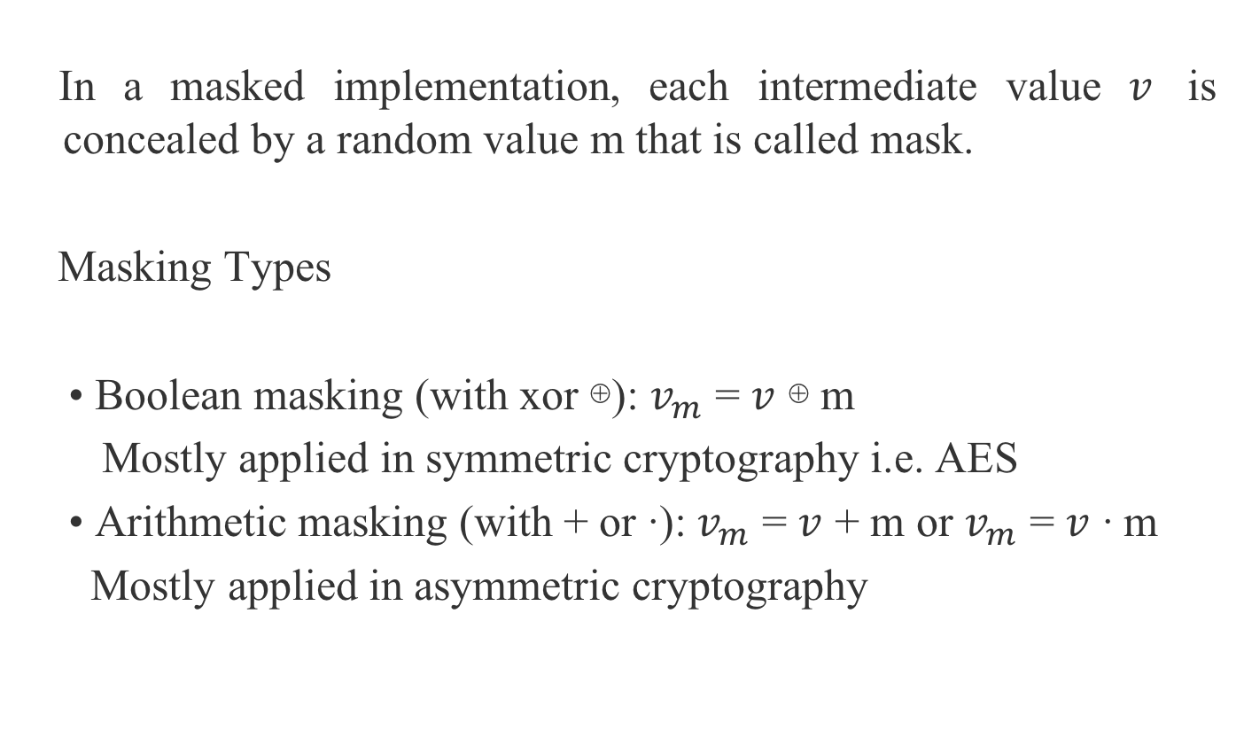
Masking
In a masked implementation, each intermediate value $v$ is concealed by a random value $m$ that is called mask.
Masking Types
• Boolean masking (with xor ⊕): $v_{m}$ = $v$ ⊕ $m$
Mostly applied in symmetric cryptography i.e. AES
• Arithmetic masking (with + or ∙): $v_{m}$ = $v$ + $m$ or $v_{m}$ = $v$ ∙ $m$
Mostly applied in asymmetric cryptography

Slide 15
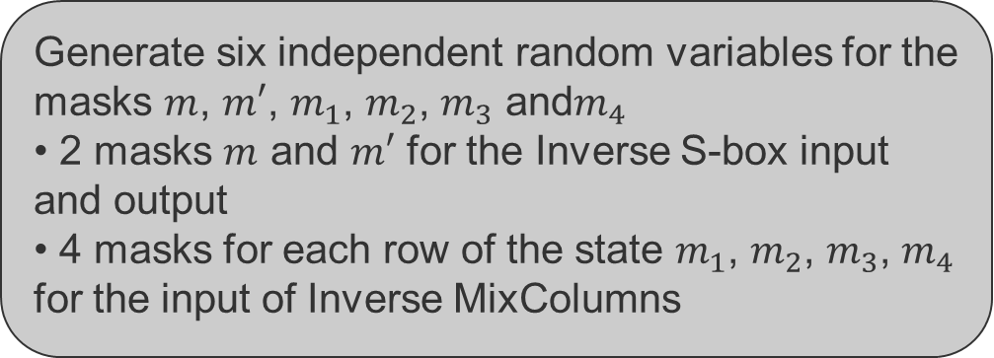
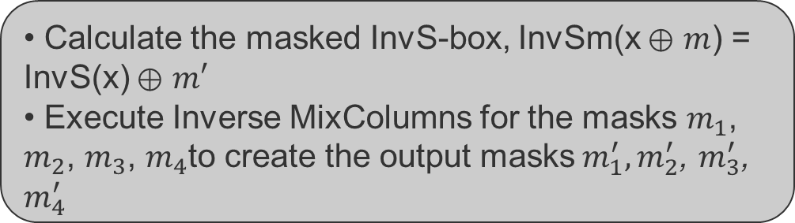
Masking
Generate six independent random variables for the masks $m$, $m′$, $m_{1}$, $m_{2}$, $m_{3}$ and${ m}_{4}$
• 2 masks $m$ and $m′$ for the Inverse S-box input and output
• 4 masks$m_{1}$, $m_{2}$, $m_{3}$, $m_{4}$ for each row of the state for the input of Inverse MixColumns
• Calculate the masked InvS-box
InvSm(x ⊕ $m$) = InvS(x) ⊕ $m′$
• Execute Inverse MixColumns for the masks $m_{1}$, $m_{2}$, $m_{3}$, $m_{4}$to create the output masks${ m}_{1}^{′}, m_{2}^{′}$, $m_{3}^{′}$, $m_{4}^{′}$

Slide 16
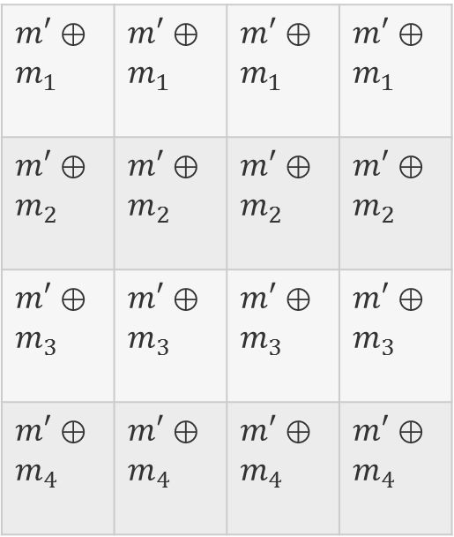
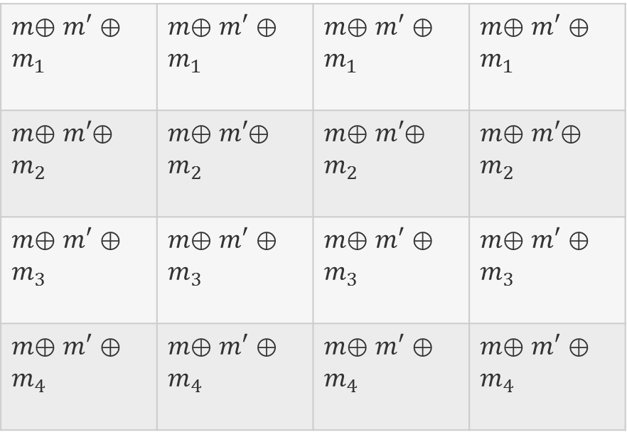
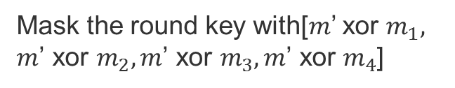
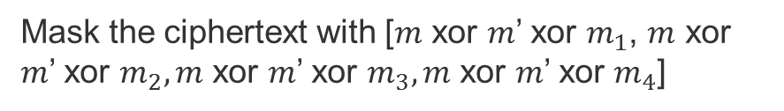
Masking
Ciphertext
RoundKey
$m$⊕ $m′$ ⊕ $m_{1}$ | $m$⊕ $m′$ ⊕ $m_{1}$ | $m$⊕ $m′$ ⊕ $m_{1}$ | $m$⊕ $m′$ ⊕ $m_{1}$
$m$⊕ $m′$⊕ $m_{2}$ | $m$⊕ $m′$⊕ $m_{2}$ | $m$⊕ $m′$⊕ $m_{2}$ | $m$⊕ $m′$⊕ $m_{2}$
$m$⊕ $m′$ ⊕ $m_{3}$ | $m$⊕ $m′$ ⊕ $m_{3}$ | $m$⊕ $m′$ ⊕ $m_{3}$ | $m$⊕ $m′$ ⊕ $m_{3}$
$m$⊕ $m′$ ⊕ $m_{4}$ | $m$⊕ $m′$ ⊕ $m_{4}$ | $m$⊕ $m′$ ⊕ $m_{4}$ | $m$⊕ $m′$ ⊕ $m_{4}$
$m′$ ⊕ $m_{1}$ | $m′$ ⊕ $m_{1}$ | $m′$ ⊕ $m_{1}$ | $m′$ ⊕ $m_{1}$
$m′$ ⊕ $m_{2}$ | $m′$ ⊕ $m_{2}$ | $m′$ ⊕ $m_{2}$ | $m′$ ⊕ $m_{2}$
$m′$ ⊕ $m_{3}$ | $m′$ ⊕ $m_{3}$ | $m′$ ⊕ $m_{3}$ | $m′$ ⊕ $m_{3}$
$m′$ ⊕ $m_{4}$ | $m′$ ⊕ $m_{4}$ | $m′$ ⊕ $m_{4}$ | $m′$ ⊕ $m_{4}$
Mask the ciphertext with [$m$ xor $m′$ xor $m_{1}$, $m$ xor $m′$ xor $m_{2},m$ xor $m′$ xor $m_{3},m$ xor $m′$ xor $m_{4}$]
Mask the round key with[$m′$ xor $m_{1}, m\text{’} \text{xor} m_{2},m\text{’} \text{xor} m_{3},m\text{’} \text{xor} m_{4}$]

Slide 17
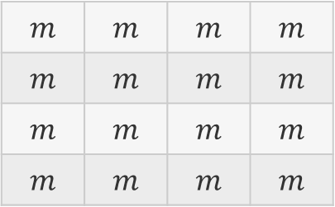
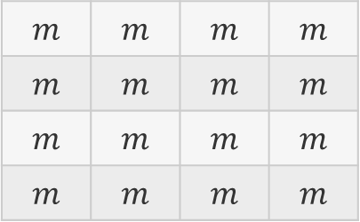
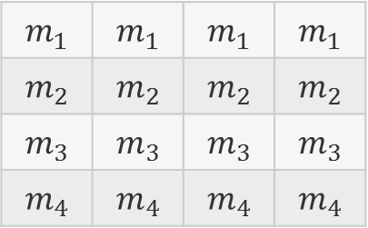
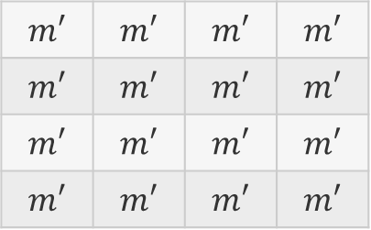
Masking
AddRoundKey
Inverse ShiftRows
$$m$$ | $$m$$ | $$m$$ | $$m$$
$$m$$ | $$m$$ | $$m$$ | $$m$$
$$m$$ | $$m$$ | $$m$$ | $$m$$
$$m$$ | $$m$$ | $$m$$ | $$m$$
$$m$$ | $$m$$ | $$m$$ | $$m$$
$$m$$ | $$m$$ | $$m$$ | $$m$$
$$m$$ | $$m$$ | $$m$$ | $$m$$
$$m$$ | $$m$$ | $$m$$ | $$m$$
AddRoundKey
Inverse SubBytes
$$m_{1}$$ | $$m_{1}$$ | $$m_{1}$$ | $$m_{1}$$
$$m_{2}$$ | $$m_{2}$$ | $$m_{2}$$ | $$m_{2}$$
$$m_{3}$$ | $$m_{3}$$ | $$m_{3}$$ | $$m_{3}$$
$$m_{4}$$ | $$m_{4}$$ | $$m_{4}$$ | $$m_{4}$$
$$m′$$ | $$m′$$ | $$m′$$ | $$m′$$
$$m′$$ | $$m′$$ | $$m′$$ | $$m′$$
$$m′$$ | $$m′$$ | $$m′$$ | $$m′$$
$$m′$$ | $$m′$$ | $$m′$$ | $$m′$$

Slide 18
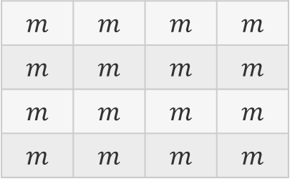
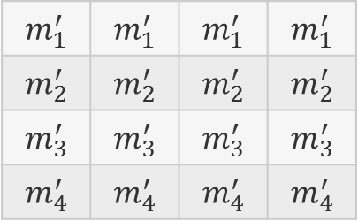
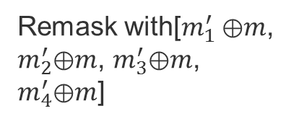
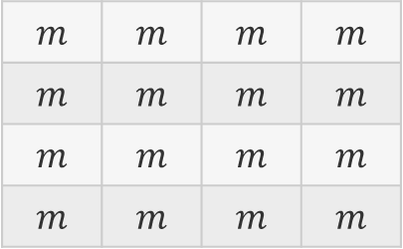
Masking
Inverse MixColumns
Remask with[$m_{1}^{′}$⊕$m$, $m_{2}^{′}$⊕$m$, $m_{3}^{′}$⊕$m$, $m_{4}^{′}$⊕$m$]
Remasking
$$m_{1}^{′}$$ | $$m_{1}^{′}$$ | $$m_{1}^{′}$$ | $$m_{1}^{′}$$
$$m_{2}^{′}$$ | $$m_{2}^{′}$$ | $$m_{2}^{′}$$ | $$m_{2}^{′}$$
$$m_{3}^{′}$$ | $$m_{3}^{′}$$ | $$m_{3}^{′}$$ | $$m_{3}^{′}$$
$$m_{4}^{′}$$ | $$m_{4}^{′}$$ | $$m_{4}^{′}$$ | $$m_{4}^{′}$$
$$m$$ | $$m$$ | $$m$$ | $$m$$
$$m$$ | $$m$$ | $$m$$ | $$m$$
$$m$$ | $$m$$ | $$m$$ | $$m$$
$$m$$ | $$m$$ | $$m$$ | $$m$$
Inverse ShiftRows
In the final round, skip Inverse MixColumns and Remasking. Remove the masks from the plaintext.
$$m$$ | $$m$$ | $$m$$ | $$m$$
$$m$$ | $$m$$ | $$m$$ | $$m$$
$$m$$ | $$m$$ | $$m$$ | $$m$$
$$m$$ | $$m$$ | $$m$$ | $$m$$

Slide 19
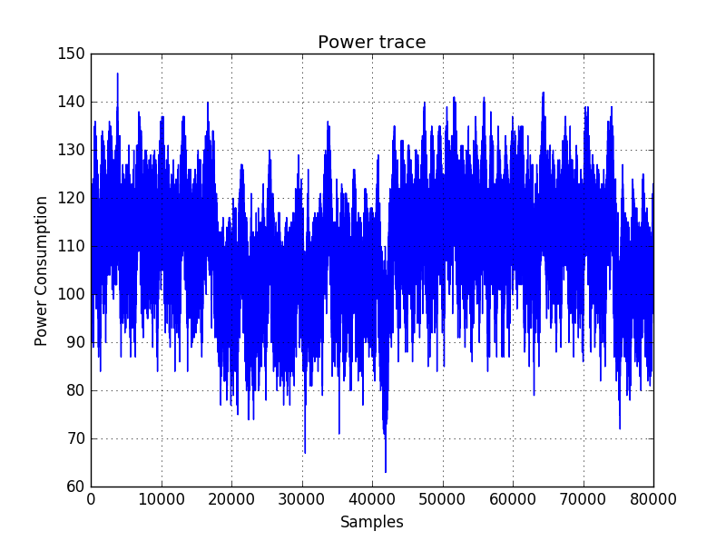
Masking
Inverse
ShiftRows
Remasking
Remove the masks from the plaintext
Inverse SubBytes
AddRoundKey
Inverse MixColumns
Inverse SubBytes
AddRoundKey

Slide 20


Attack on Masking
Method: Second Order DPA
Idea: Using the two intermediate value
$U_{m}⊕V_{m}$=($U⊕m$)$⊕(V⊕m)=U⊕V$
Preprocessing: Use a combination function to combine points of the power trace (e.g. absolute difference, normalized product, … )
New sample size $L=\frac{l∗(l−1)}{2}$
DPA attack: Perform a first-order DPA attack on the preprocessed power traces.

Slide 21


Attack on Masking
m | m | m | m
m | m | m | m
m | m | m | m
m | m | m | m
Method: Second Order DPA
First Mask Implementation Strategy
$$m=m^{′}$$
(($d_{i}⨁k_{j})⨁m)⨁(SBox(d_{i}⨁k_{j})⨁$ $m$)
= ($d_{i}⨁k_{j})⨁(SBox(d_{i}⨁k_{j})$ )
Inverse SubBytes
Result: Successful with first-order DPA attack 800 traces
m’ | m’ | m’ | m’
m’ | m’ | m’ | m’
m’ | m’ | m’ | m’
m’ | m’ | m’ | m’
Reason: The result of two intermediate values
with the same mask would be unmasked

Slide 22

Attack on Masking
m | m | m | m
m | m | m | m
m | m | m | m
m | m | m | m
Method: Second Order DPA
Second Mask Implementation Strategy
$$m{≠m}^{′}$$
Inverse SubBytes
m’ | m’ | m’ | m’
m’ | m’ | m’ | m’
m’ | m’ | m’ | m’
m’ | m’ | m’ | m’

Slide 23
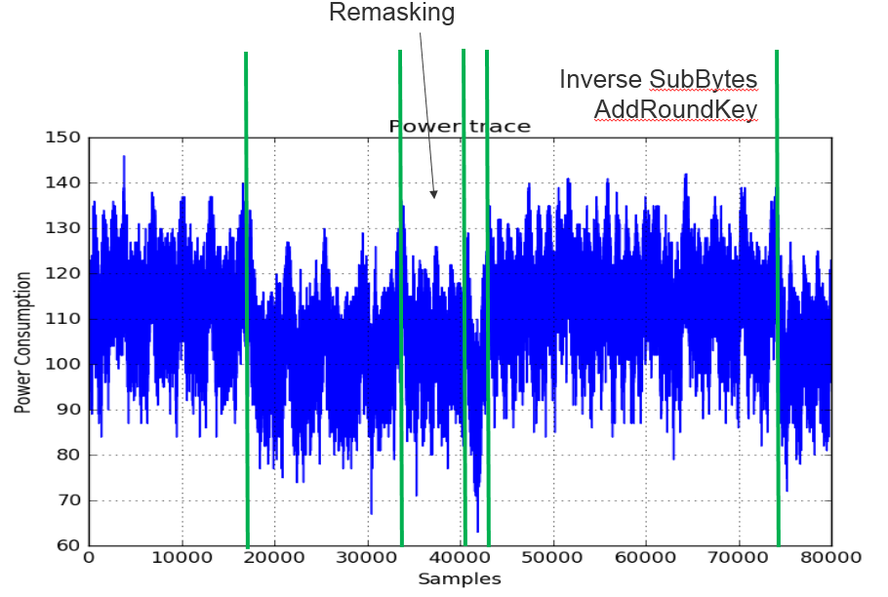
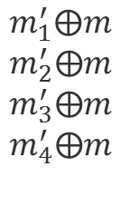


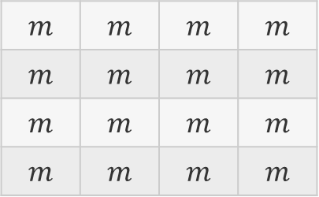
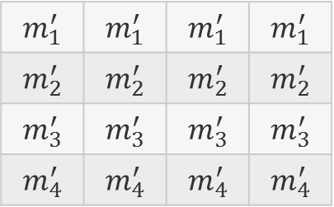
Attack on Masking
$$m_{1}^{′}$$ | $$m_{1}^{′}$$ | $$m_{1}^{′}$$ | $$m_{1}^{′}$$
$$m_{2}^{′}$$ | $$m_{2}^{′}$$ | $$m_{2}^{′}$$ | $$m_{2}^{′}$$
$$m_{3}^{′}$$ | $$m_{3}^{′}$$ | $$m_{3}^{′}$$ | $$m_{3}^{′}$$
$$m_{4}^{′}$$ | $$m_{4}^{′}$$ | $$m_{4}^{′}$$ | $$m_{4}^{′}$$
$$m_{1}^{′}⨁m$$
$$m_{2}^{′}⨁m$$
$$m_{3}^{′}⨁m$$
$$m_{4}^{′}⨁m$$
$$m$$ | $$m$$ | $$m$$ | $$m$$
$$m$$ | $$m$$ | $$m$$ | $$m$$
$$m$$ | $$m$$ | $$m$$ | $$m$$
$$m$$ | $$m$$ | $$m$$ | $$m$$
$$m$$
$$SBox(d_{i}⨁k_{j})⨁m$$

Slide 24

Attack on Masking
$m⨁(SBox(d_{i}⨁k_{j})⨁m$) = $SBox(d_{i}⨁k_{j})$
$$m$$
$$SBox(d_{i}⨁k_{j})⨁m$$

Slide 25




Attack on Masking
$$m_{known}$$
$$SBox(d_{i}⨁k_{j})⨁m_{known}$$
$$Corr=0.48$$
$$Corr=0.36$$
$$m$$
$$SBox(d_{i}⨁k_{j})⨁m$$

Slide 26
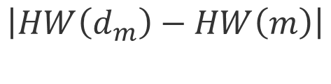
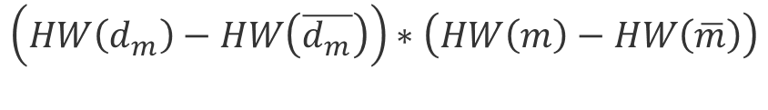
Attack on Masking
Normalized product combination:
$$\left(HW\left(d_{m}\right)−HW\left(\overline{d_{m}}\right)\right)∗\left(HW\left(m\right)−HW\left(\overline{m}\right)\right)$$
Absolute difference combination:
$$\left|HW\left(d_{m}\right)−HW\left(m\right)\right|$$
Result: Not successful with second-order DPA
(even with 10000 traces)
Problems: Dealing with huge amount of traces
More effort for preprocessing

Slide 27
Benchmark-Attack
Implementation | Time[s] | Yes/ No | No. Of Traces
Reference card | 70 | Yes | 170
Reference card | 6.3 | Yes | 800
Own Implementation(No Countermeasure) | 5.9 | Yes | 800
Own Implementation + Dummy Operations | 72 | Yes | 800
Own Implementation+ Shuffling | 183.47 | Yes | 10000
Own Implementation + Masking | N/A | No | 50000
Own Implementation + Masking m=m' | 11 | Yes | 800
Own Implementation + All Countermeasures | N/A | No | 50000

Slide 28
True Random Number Generator
Create true random numbers using ADC readings
Two floating inputs
Differential mode with maximal gain (200x)
Sequential readings only taking the LSB
Post processing with von Neumann corrector
New random seed after each decryption
ADC readings do not affect AES Execution time
149 of 160 NIST tests passed [1]
[1] Source: http://csrc.nist.gov/groups/ST/toolkit/rng/documentation_software.html

Slide 29
Benchmark – Execution time
Measurement with TRNG and own PRNG

Slide 30
Benchmark – Memory usage
Compiled with code size optimization and own PRNG

Slide 31
Conclusion
Lookup tables reduced the execution time of the AES to 2.7ms
Dummy Operations, Shuffling and Masking implemented successfully
Less than 10% of ROM and ~60% of SRAM used
Multiprocessing increased the script performance by a factor of upto 3x
Dummy Operations and Shuffling were attackable with adequate number of traces

