Slide 1
SmartCard Lab Midterm Presentation Group 3
Team 1:
Faraz Bhatti
Lu Yongchen
Mao Kaiyi
Team 2:
Christoph Wittmann
Yizhou Liu

Slide 2
Team 1
Power Traces Measurement
Decryption Implementation with Python
Traces Compression
Performance and Analysis
Team 2
Makefile
Cryptographic Core
Operating System (Command Interpreter)
Communication Interface
T=0 Protocol
Performance

Slide 3
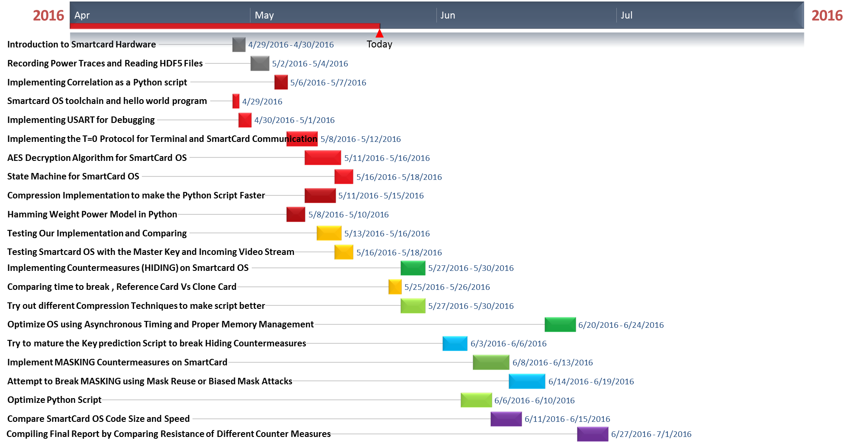
Task Oriented Detailed Timeline

Slide 4
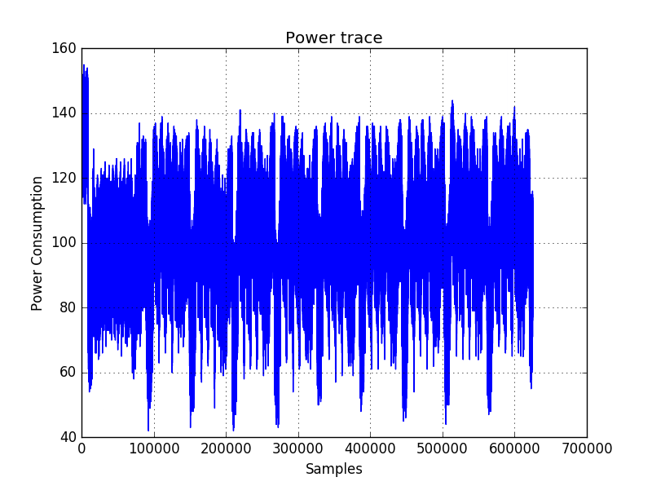
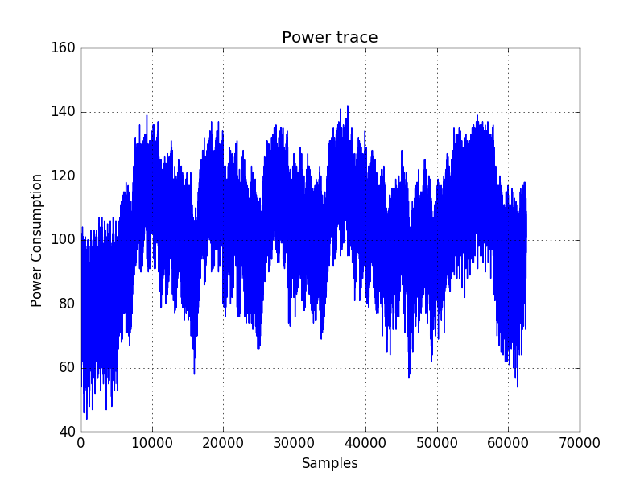
1. Power Traces Measurement
10 rounds traces
(625000 samples)
last rounds traces
(62500 samples)

Slide 5
2. Decryption Implementation with Python
$$k_{1}$$
$$k_{2}$$
…
$$k_{400}$$
$$k_{1}$$ | $$k_{2}$$ | … | $$k_{256}$$
vector k with 256 key hypothesis
vector d with 400 plaintext
Cryptographic
algorithm
Power traces
$$t_{1,1}$$ | $$t_{1,2}$$ | … | $$t_{1,62500}$$
$$t_{2,1}$$ | $$t_{2,2}$$ | … | $$t_{2,62500}$$
… | … | … | …
$$t_{400,1}$$ | $$t_{400,2}$$ | … | $$t_{400,62500}$$
$$v_{1,1}$$ | $$v_{1,2}$$ | … | $$v_{1,256}$$
$$v_{2,1}$$ | $$v_{2,2}$$ | … | $$v_{2,256}$$
… | … | … | …
$$v_{400,1}$$ | $$v_{400,2}$$ | … | $$v_{400,256}$$
intermediate values $v_{i,j}$ with all key hypothesis
Power Model
Statistical
analysis
Matrix of correlation
coefficients
$$h_{1,1}$$ | $$h_{1,2}$$ | … | $$h_{1,256}$$
$$h_{2,1}$$ | $$h_{2,2}$$ | … | $$h_{2,256}$$
… | … | … | …
$$h_{400,1}$$ | $$h_{400,2}$$ | … | $$h_{400,256}$$
$$r_{1,1}$$ | $$r_{1,2}$$ | … | $$r_{1,62500}$$
$$r_{2,1}$$ | $$r_{2,2}$$ | … | $$r_{2,62500}$$
… | … | … | …
$$r_{256,1}$$ | $$r_{256,2}$$ | … | $$r_{256,62500}$$
hypothetical power values

Slide 6
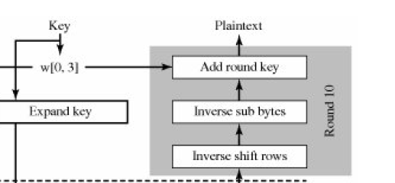
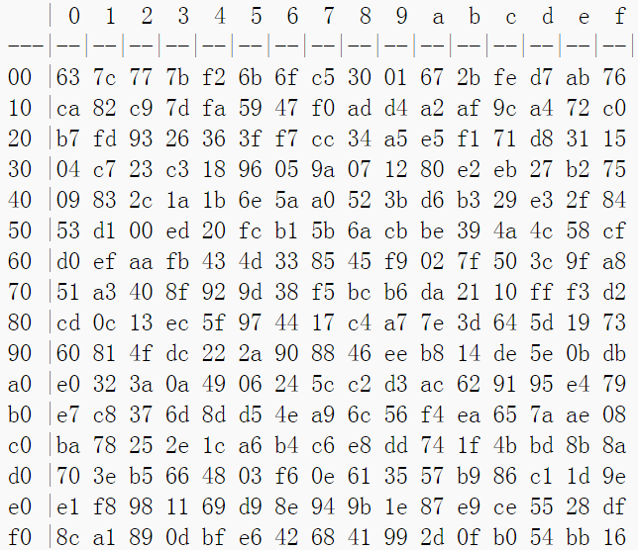
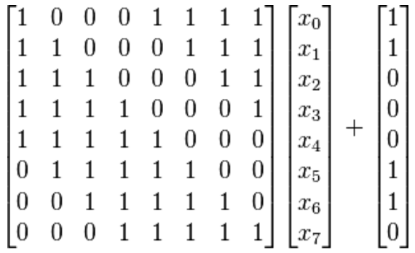
2. Decryption Implementation with Python
S-box
https://en.wikipedia.org/wiki/Rijndael_S-box
Sub Byte
GF(2⁸) = GF(2)[x]/(x⁸ + x⁴ + x³ + x + 1)

Slide 7
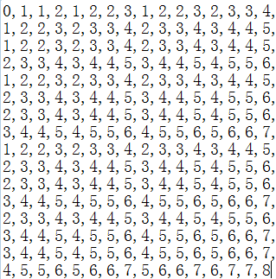
2. Decryption Implementation with Python
Hamming Weight Model
H(00000000) = 0
H(10100010) = 3
H(111111111) = 8
…
Hamming Weight Table

Slide 8
2. Decryption Implementation with Python
$${key}_{1}$$ | $${key}_{2}$$ | … | $${key}_{16}$$
16
×
$$k_{1}$$ | $$k_{2}$$ | … | $$k_{256}$$
key hypothesis
256
×
Statistical Correlation
62500
$$t_{1,1}$$ | $$t_{1,2}$$ | … | $$t_{1,62500}$$
$$t_{2,1}$$ | $$t_{2,2}$$ | … | $$t_{2,62500}$$
… | … | … | …
$$t_{400,1}$$ | $$t_{400,2}$$ | … | $$t_{400,62500}$$
256,000,000

Slide 9
3.Traces Compression
Concept:
Power traces contain many points with lots of redundancy
Methods to compress a trace | Performance
Sum of absolute values over a time interval | good
Sum of squared values over a time interval | cannot realize
Maximum value in a time interval | worse

Slide 10
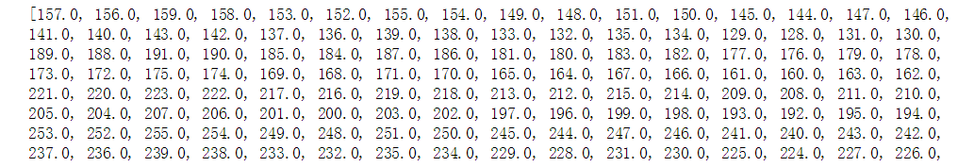
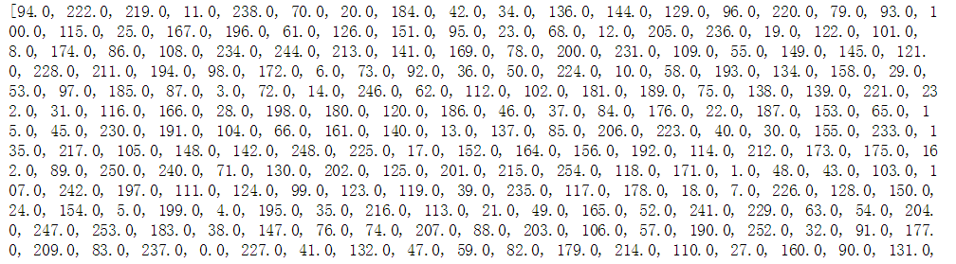
4. Performance and Analysis
Data for AddRoundKey and SubBytes operations
AddRoundKey
SubBytes

Slide 11
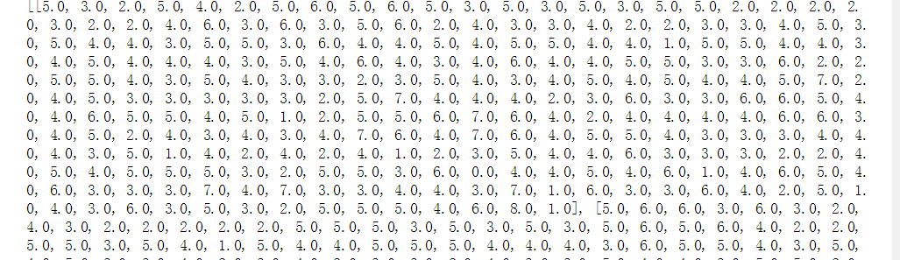
4. Performance and Analysis
Data for Hamming Weight

Slide 12
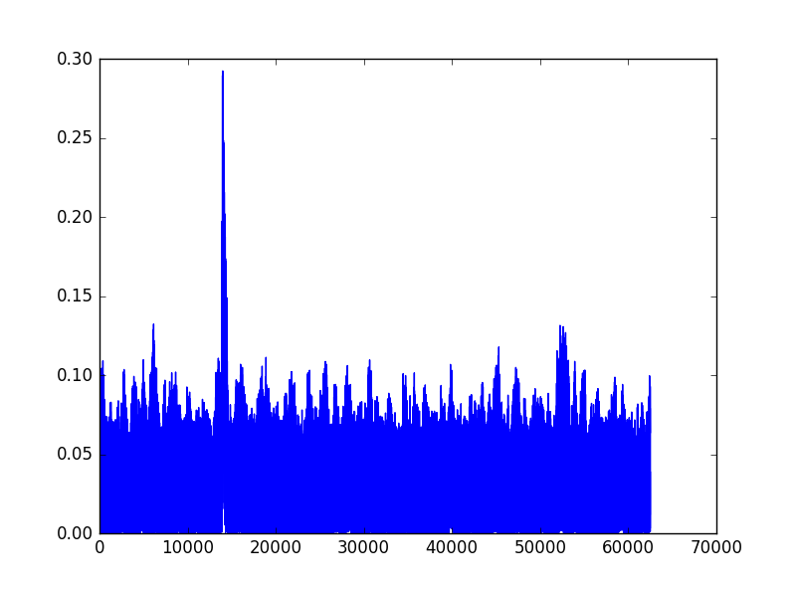
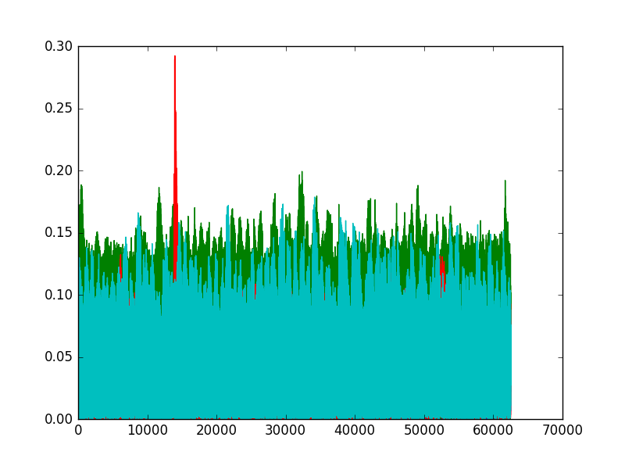
4. Performance and Analysis
Diagram for correlation
of the first right key
Comparison with other assumed keys

Slide 13
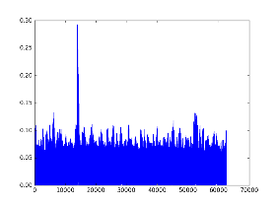
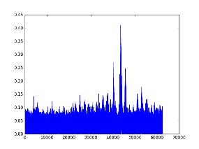
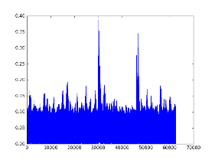
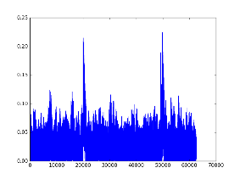
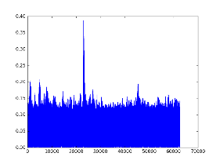
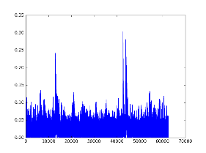
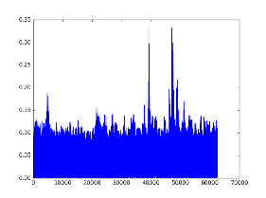
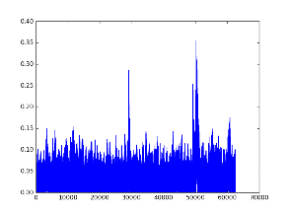
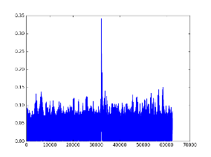
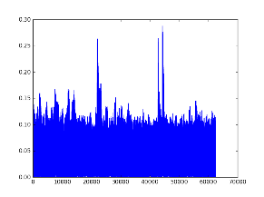
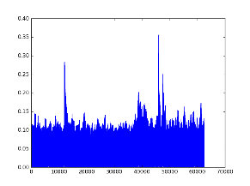
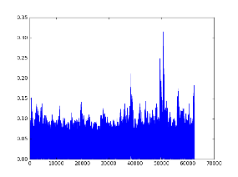
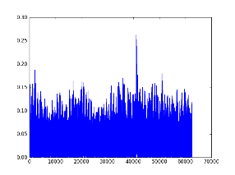
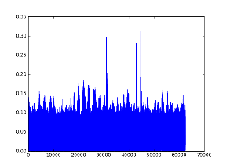
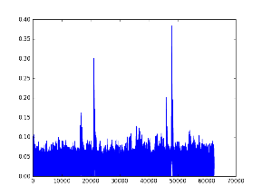
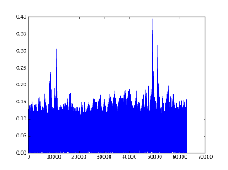
4. Performance and Analysis
Diagram for correlation of all 16 keys

Slide 14
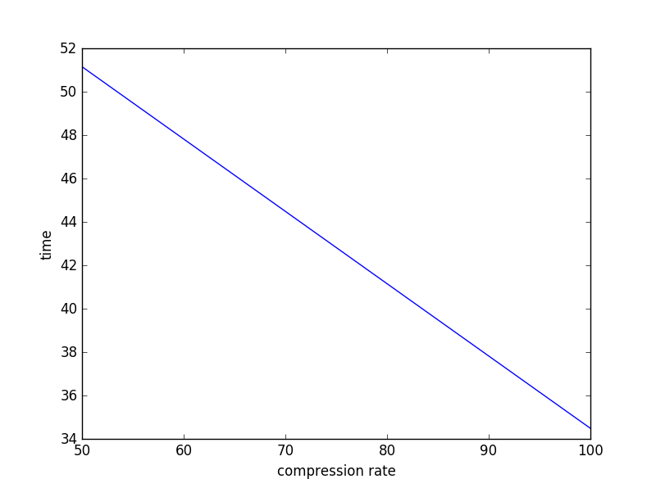
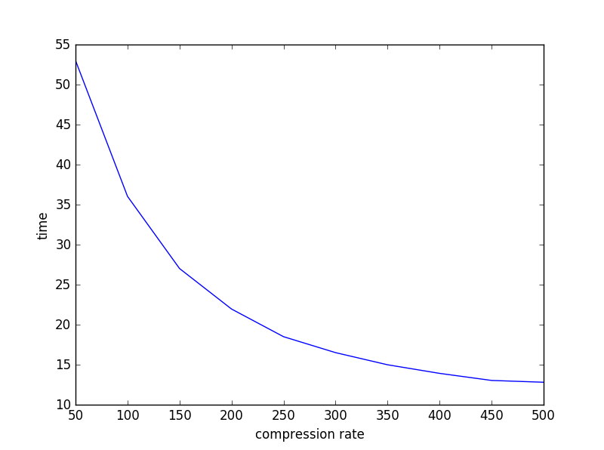
4. Performance and Analysis
Diagram of time for compression
Maximum value in a time interval
Sum of absolute values
over a time interval

Slide 15
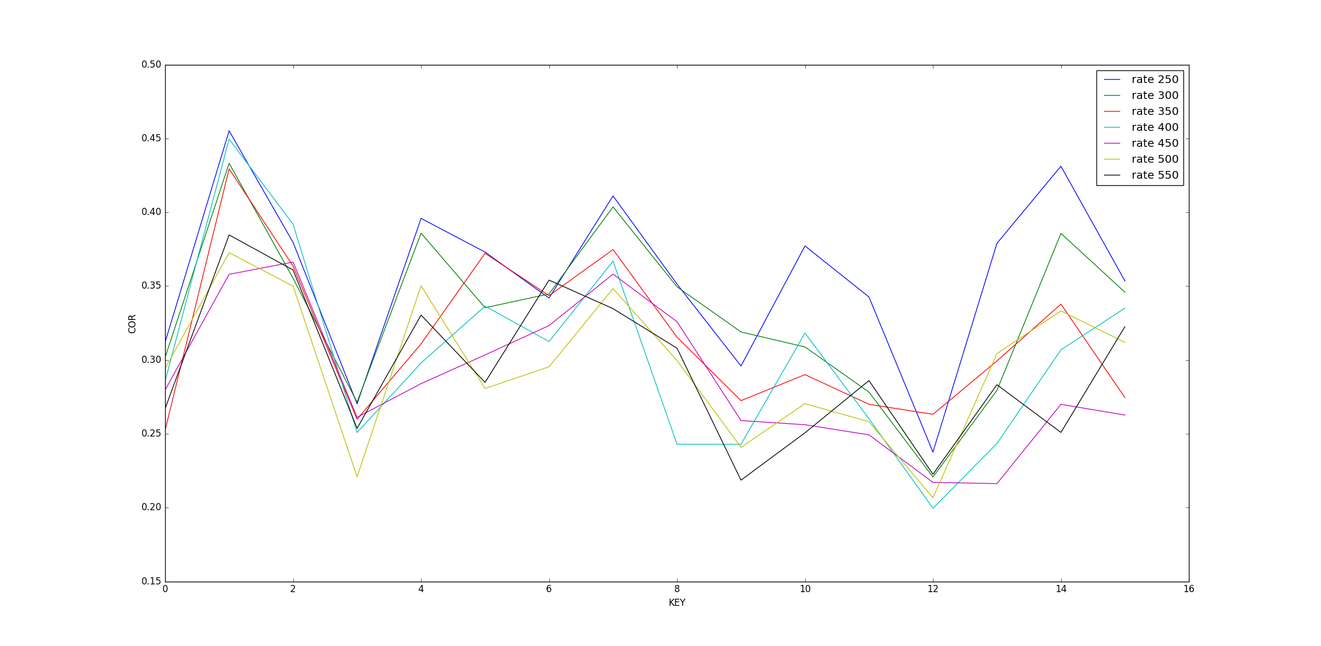
4. Performance and Analysis
Diagram for correlation of all keys for different compression rates

Slide 16
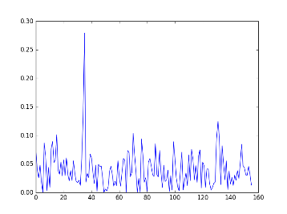
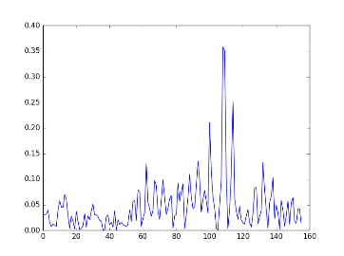
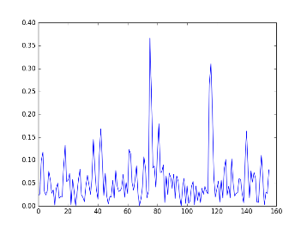
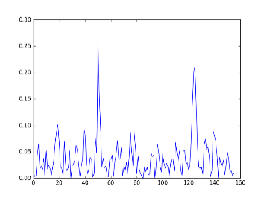
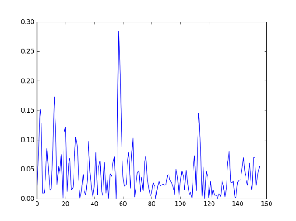
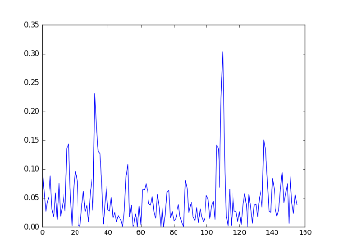
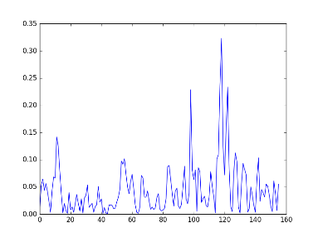
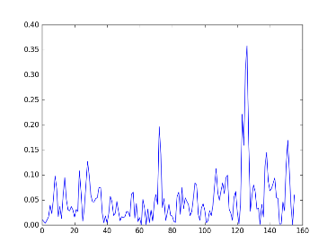
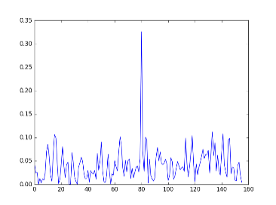
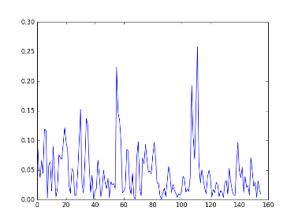
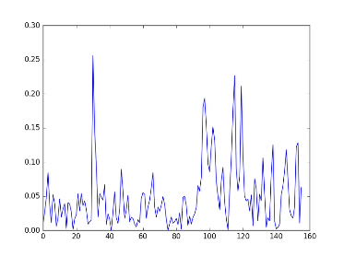
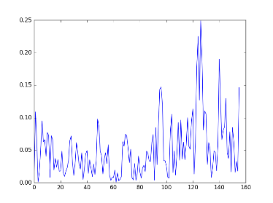
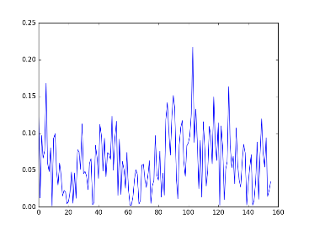
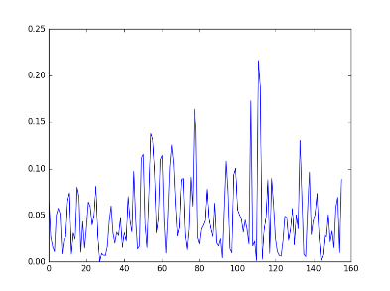
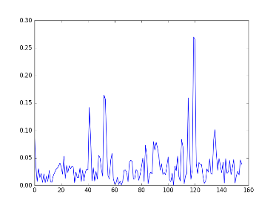
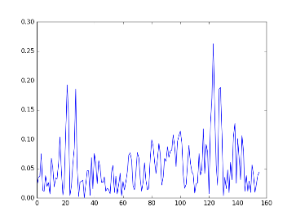
4. Performance and Analysis
Diagram for correlation of all 16 keys at compression rate of 500

Slide 17
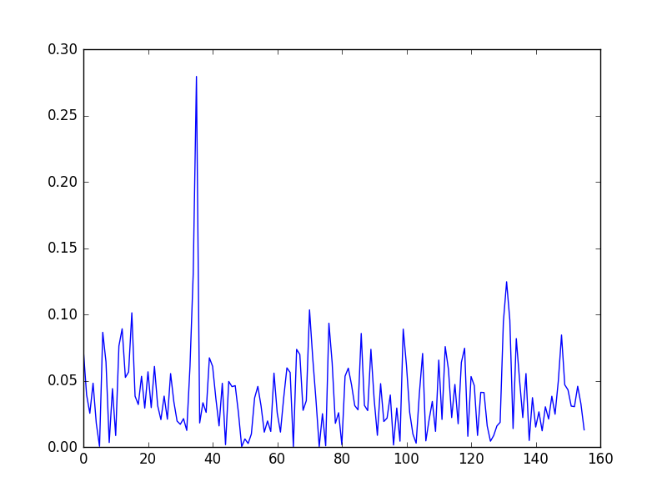
4. Performance and Analysis

Slide 18
Team 2
Makefile
Cryptographic Core
Operating System (Command Interpreter)
Communication Interface
T=0 Protocol
Performance

Slide 19
1. Get familiar with the hardware
Determined the smartcard that need to be programed
Connected the smartcard correctly with AVR programmer and power supply

Slide 20
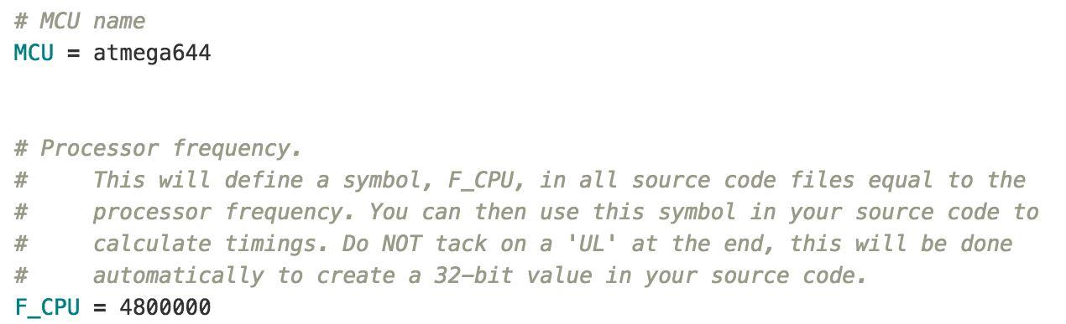
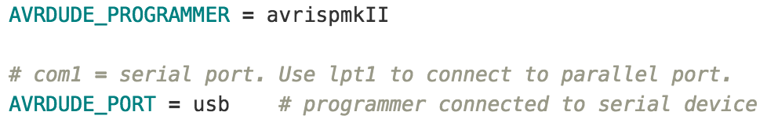
2. Implement the Makefile
Instead of using eclipse with AVR add-in, we used Makefile under terminal.
Apply the specification of our smartcard to the Makefile.

Slide 21
3. Cryptographic Core (AES-128)

Slide 22

What we lack: Add the trigger pin so that we can also apply DPA to the colon card.

Slide 23
4. Operating System (State Machine)

Slide 24
5. Communication Interface
Send function implemented with delays based on clock cycles
Makes it invariant to clock
CPU is blocked and does nothing
Receive function uses Pin Change Interrupt to detect start bit
New sync at each byte
Interrupt must be enabled before and disabled after receiving

Slide 25
6. T=0 protocol
T=0 standard implemented
No error cases supported yet
Slight changes to the reference card

Slide 26
7. Performance
Memory usage
Data: 229 bytes→ 5,72% of SRAM
Program: 2226 bytes→ 3,48% of Flash
Eeprom: 767 bytes → 38,35% of EEPROM
Total: 3222 bytes
Speed
Decryption: 21.38ms
Decryption + T=0: ~93 ms
Possible improvements:
Store expanded Key also in EEPROM
…

Slide 27

Timeline

