Slide 1
Quantitative Analysis for Business
Course Content
Introduction to Quantitative Analysis
Probability Concepts
Decision Analysis
Regression Models
Forecasting
Inventory Control Models
Linear Programming
Transportation and Assignment Models
Network Models
Project Management
Activities
Chapter lectures
Group and individual presentation of solved problems
Group and individual case study presentations and discussions
Final examinations
Grading System
Rubrics
TOS
Software to use
QM for Windows

Slide 2
Quantitative Analysis for Business
References
Quantitative Techniques for Management-Mishra and Jainsankar
Quantitative Methods for Business-12th Edition by Anderson et al.
Quantitative Analysis for Management-11th Edition by Render, Stair and Hanna
Installing QM for Windows
Browse on the folder for the installer containing setup
Click on the setup (by-passed)
Allow user control
Click Next
Click Next to agree on the license agreement
Enter your details (initials are recommended)
Click for individual installation
Click Next to install

Slide 3
Quantitative Analysis
Class Organization and processes
Chapter Lectures
Learning Objectives
Discussion
Self-test
Problem Solving
Case Studies

Slide 4
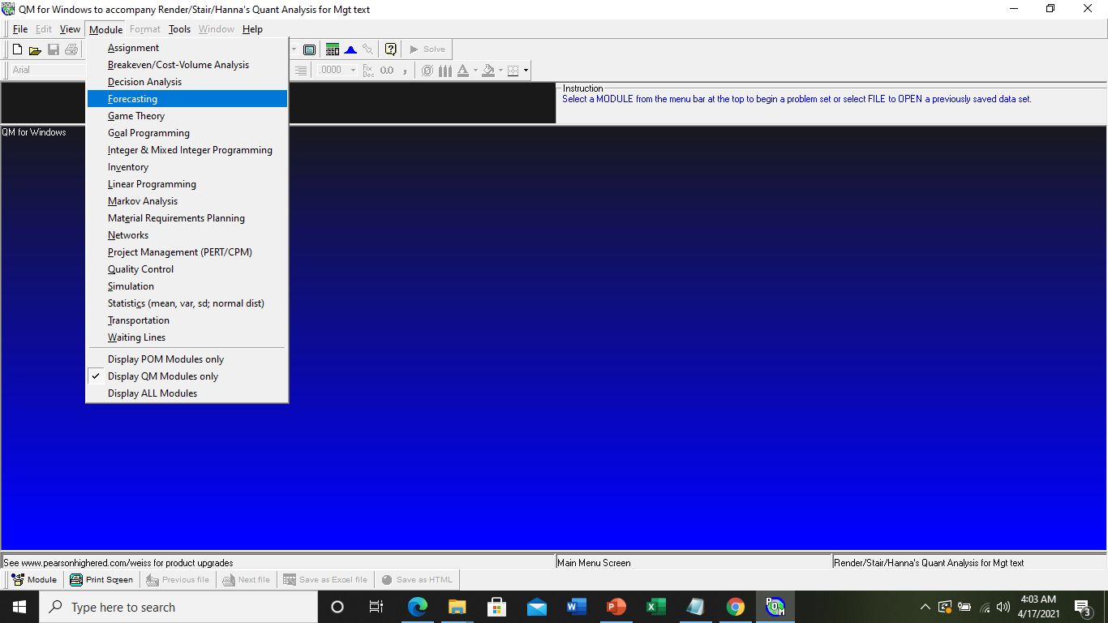
Quantitative Analysis for Business
How to Use QM for Windows
Click short cut icon at the Desktop to view the application

Slide 5
Quantitative Analysis for Business
Quantitative Analysis for Business
(MBA-A&B: 8:00-10:00AM & 10:00-12:00AM)
Topic 1: Introduction to Quantitative Analysis
Learning Objectives
Describe the quantitative analysis approach
Understand the application of quantitative analysis in a real situation
Describe the use of modeling in quantitative analysis
Use computers and spreadsheet models to perform quantitative analysis
Discuss possible problems in using quantitative analysis
Perform a break-even analysis
Quantitative Analysis is a scientific approach to managerial decision making utilizing data for manipulation and processing into an information.
Origin of Quantitative Analysis was pioneered by Frederick W. Taylor in 1900s. It was first used by military in developing their techniques. Today, it is used by consultants to provide scientific management of problems and opportunities.

Slide 6
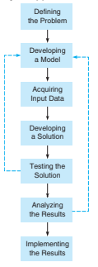
Quantitative Analysis for Business
Quantitative Analysis Approach
Defining the problem
Identify the cause of the problem
A problem maybe related to other problem
Organization’s problem cannot be solve at once
Solutions must focus on greatest increased profits or reduction of costs
Leads to the discovery of variables for quantification and the development of specific and measurable objectives
Ex. For an inadequate health care services, objectives can be increase no. of beds, reduce the average stay of patient and increase of physician-to-patient ratio

Slide 7
Quantitative Analysis for Business
Quantitative Analysis Approach
Developing A Model
It is usually a representation of a situation
Physical model (of a building, a plant)
Schematic diagram (flowchart)
A mathematical model
It is expressed in variables and parameters
Variables are measurable unknown quantity that is subject to change and parameters are inherent known property in the problem
Ex. Variables describing profit requires input data such as revenue and cost (R&C), while R&C requires unit price as parameters

Slide 8
Quantitative Analysis for Business
Quantitative Analysis Approach
Acquiring Input Data
A good model needs an accurate data (garbage in, garbage out)
Sources are reports, documents, interviews and experiences
Example
Production supervisor telling how long does it take to produce a certain product (variable or parameter?)
Sampling and direct measurement (R&D)
How much is the average cost of delivering a product to households of Mati City
The optimum cost of transporting raw materials from a warehouse

Slide 9
Quantitative Analysis
Quantitative Analysis Approach
Developing a solution
Manipulating the model for an optimal (best) solution to a problem
Trying various approaches (complete enumeration) to arrive at best results
Algorithmic
Testing the Solution
To determine the accuracy and completeness of the data used in the model
Validating data from other source (validate interview with direct measurement)
Align results with the problem

Slide 10
Quantitative Analysis for Business
Quantitative Analysis Approach
Analyzing Results and its Sensitivity
Solution will change an organization’s operational processes
Sensitivity Analysis (post-optimality analysis) identifies how the solution will change if there are changes in the model or input data
When the solution is sensitive to changes, additional testing is necessary
Ex. You have been running a restaurant for about four years but you haven't seen an increase in business in the last two years. You are to determine what you can do to increase sales in the next twelve months. You can change menu, re-decorate, change the theme or type of food you offer, add catering, or expand dining room size.

Slide 11
Quantitative Analysis for Business
Quantitative Analysis Approach
Implementing the Results
Incorporate the solution into the system
Organizational resistance
Monitoring the implementations
Implement changes and enhancements according to the demands of the economy, managers and other fluctuation

Slide 12
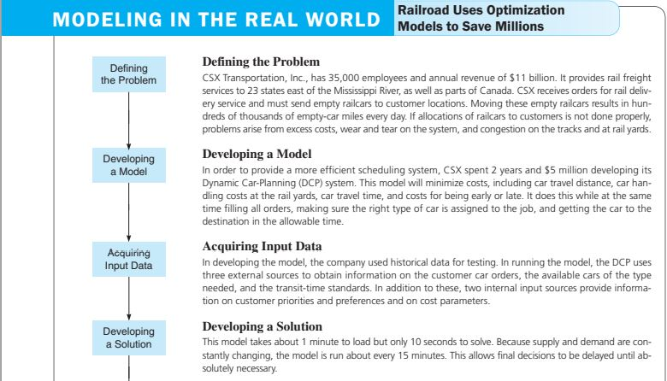
Quantitative Analysis for Business
Case Analysis

Slide 13
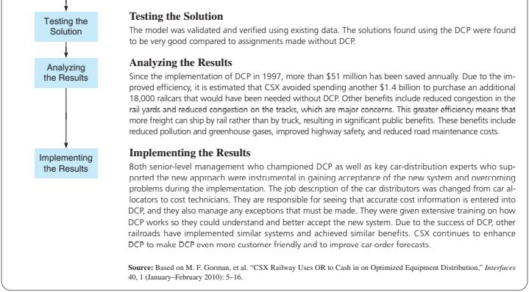
Quantitative Analysis for Business
Case Analysis

Slide 14
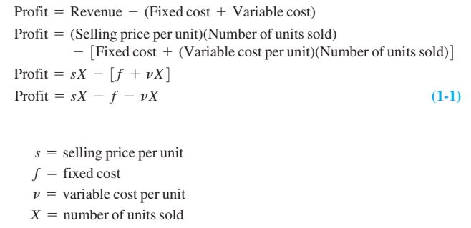
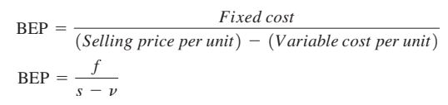
Quantitative Analysis for Business
Developing a Quantitative Model: The Profit Model
Sample Problem
To produce 100 reams (A4 substance 20 bond paper), you need Php 12,500.00 to cover plant processing cost (PC). If the fixed cost in this case is Php 2,000.00 and the markup margin (MM) is 50% of the total cost, what is the profit if 80% of the units produced are sold? What is the maximum profit? What is the Break-Even Point (BEP)?
Variable Cost
Profit=X(s-v) - f
Solution
PC= 12500 ; f = 2000 ; Total Cost (TC) =14500; v = 125
UC=145 ; s = 217.50 ; X@80%= 80
Profit@80%=2,900 Max. Profit=7,250.00

Slide 15
Solution:
Profit@80%=217.50(80)-2000-12500=2,900.00
Profit@100%=217.50(100)-2000-12500=7250.00
BEP=2000/(217.50-125) = 21.62 = 22
Note: the variable cost for Profit@80% and100% is the same since the bond papers are produced in batch. Another Ex. Selling 100 stick of banana cue and sold only 80… we cannot adjust VC to be at 80, it must be at the production level of 100 banana cues…
Different case follows for Water Refilling Station wherein production can be outrightly produced and sold, and the v will be based on a per gallon served…

Slide 16

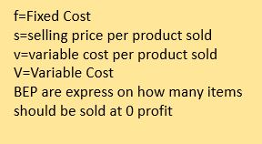
Quantitative Analysis for Business
BEP Analysis
Break-even Point is the instant wherein the profit is zero which means, no gain no loss
The BEP
Review Points:
Self test (page 17); and, Discussion Question and Problems (page 17).
Problems 1-14 to 1-23 (page 18); and, Case Study (page 19)
f=Fixed Cost
s=selling price per product sold
v=variable cost per product sold
V=Variable Cost
BEP are express on how many items should be sold at 0 profit

Slide 17
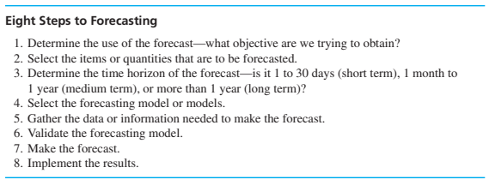
Forecasting
is the process of making predictions based on past and present data and most commonly by analysis of trends

Slide 18
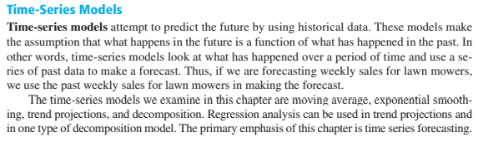
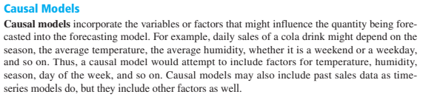
Types of Forecast

Slide 19
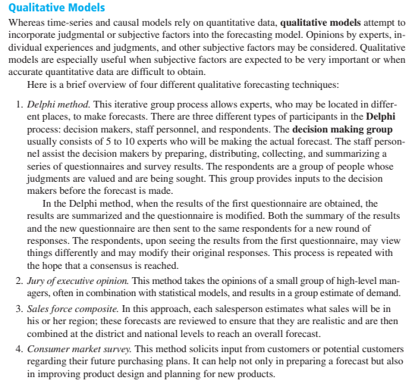
Types of Forecast

Slide 20

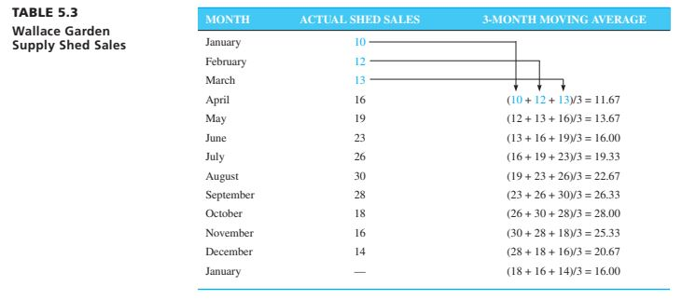
Types of Time-Series Forecast

Slide 21
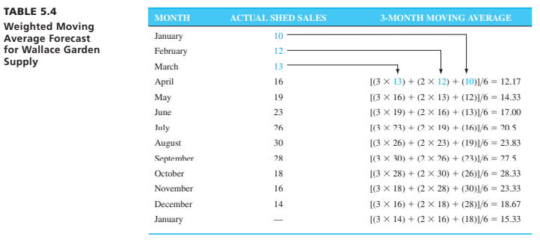
Types of Time-Series Forecast
(Weighted Moving Averages)

Slide 22
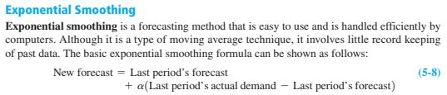
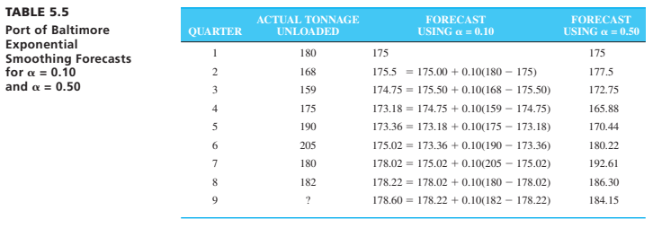
Types of Time-Series Forecast

Slide 23
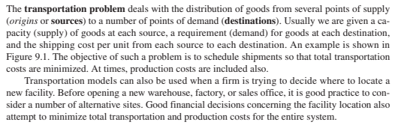
Transportation, Assignment and Transhipment

Slide 24
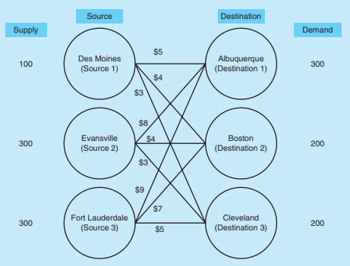
Sample: Transportation Models

Slide 25
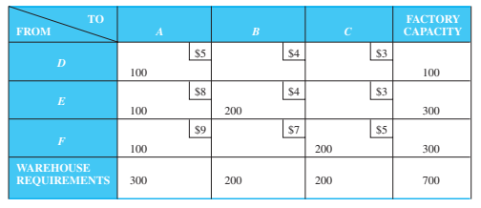
Presenting the model in tabular form

Slide 26
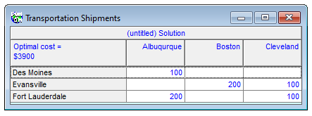
Solution from the QM for Windows

Slide 27
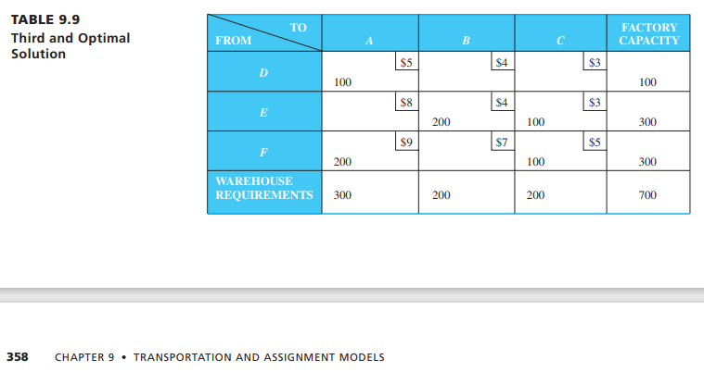

Slide 28
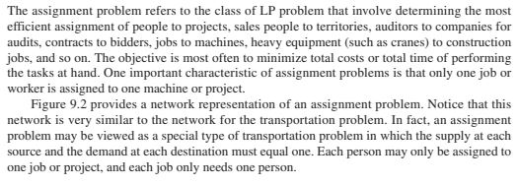
Assignment

Slide 29
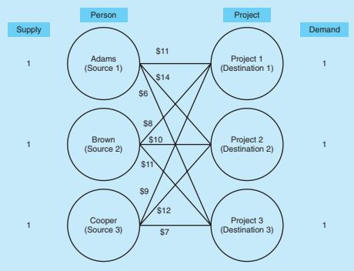
Sample: Assignment Models

Slide 30
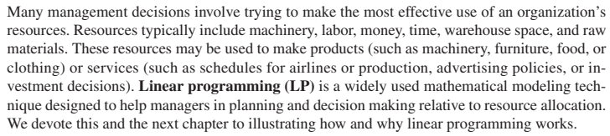
Linear Programming

Slide 31
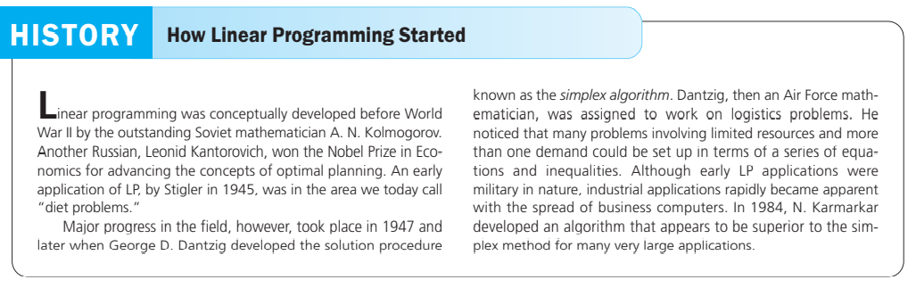

Slide 32
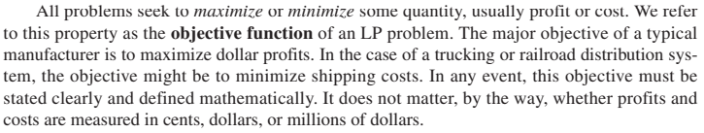
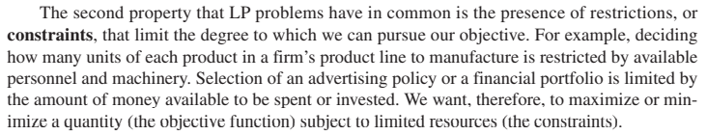
Requirements of a Linear Programming Problem Solving Process

Slide 33
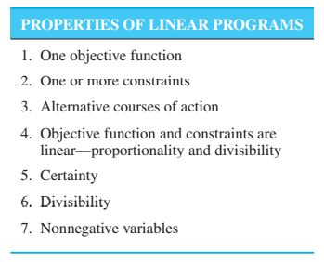
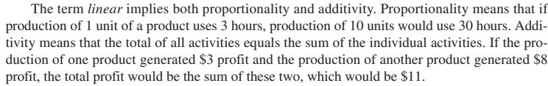



Slide 34
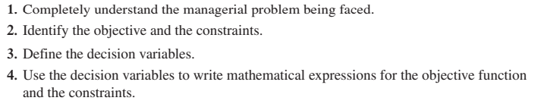
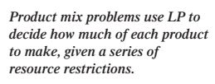
Formulating a Linear Programming Problem Solving Process

Slide 35
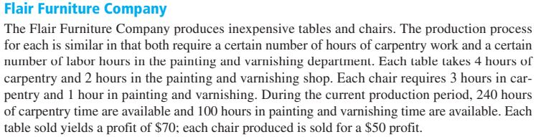

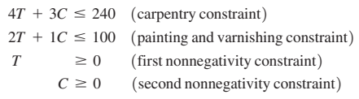
Sample Problem (maximization)
Objective Function
Constraints

Slide 36
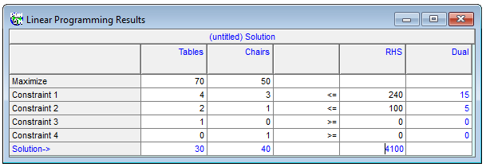
Solution to Sample Problem (maximization)

Slide 37
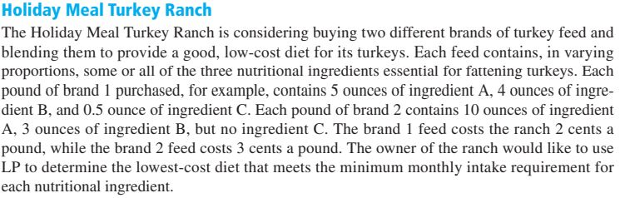
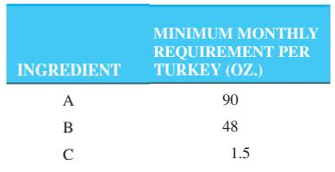
Sample Problem (minimization)

Slide 38


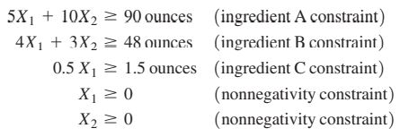
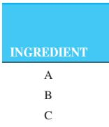
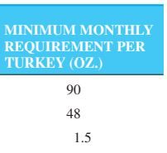
Sample Problem (minimization)
Objective Function
Constraints

Slide 39
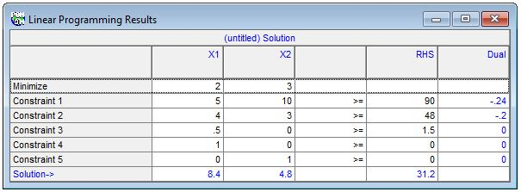
Solution to Sample Problem (minimization)
Solve problems on page 293…

Slide 40
Decision Analysis
the successes or failures that a person experiences in life depend on the decisions that he or she makes
The person who managed the ill-fated space shuttle Challenger is no longer working for NASA
The person who designed the top-selling Mustang became president of Ford.
Decision theory is an analytic and systematic approach to the study of decision making by presenting the mathematical models useful in helping managers make the best possible decisions

Slide 41
Objective
To learn how to make guided decisions in respective workplaces using mathematical models of decision theory
Manually
By the aid of a software

Slide 42
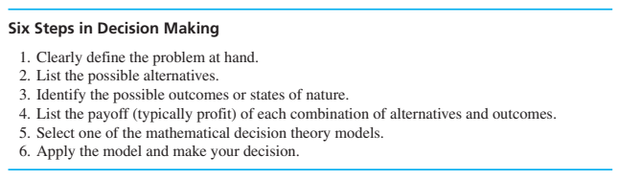


Slide 43
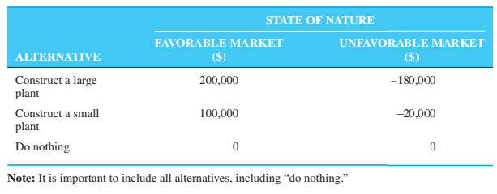
In decision theory, those outcomes over which the decision maker has little or no control are called states of nature

Slide 44

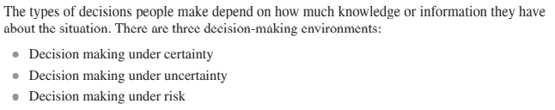

Slide 45
In the environment of decision making under certainty, decision makers know with certainty the consequence of every alternative or decision choice
In decision making under uncertainty, there are several possible outcomes for each alternative, and the decision maker does not know the probabilities of the various outcomes.
In decision making under risk, there are several possible outcomes for each alternative, and the decision maker knows the probability of occurrence of each outcome

Slide 46
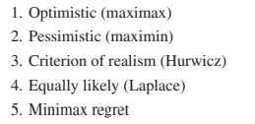
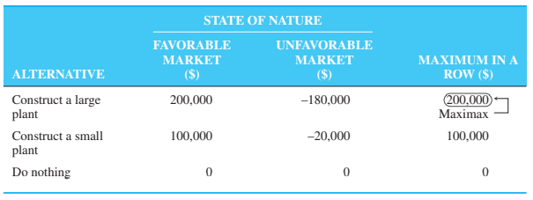
Decision making under certainty
In using the optimistic criterion, the best (maximum) payoff for each alternative is considered and the alternative with the best (maximum) of these is selected, hence, the optimistic criterion is sometimes called the maximax criterion

Slide 47
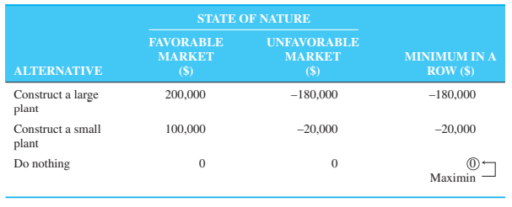
In using the pessimistic criterion, the worst (minimum) payoff for each alternative is considered and the alternative with the best (maximum) of these is selected. Hence, the pessimistic criterion is sometimes called the maximin criterion

Slide 48
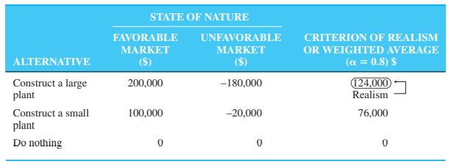
Often called the weighted average, the criterion of realism (the Hurwicz criterion) is a compromise between an optimistic and a pessimistic decision. To begin with, a coefficient of realism, , is selected; this measures the degree of optimism of the decision maker. This coefficient is between 0 and 1. When is 1, the decision maker is 100% optimistic about the future. When is 0, the decision maker is 100% pessimistic about the future. The advantage of this approach is that it allows the decision maker to build in personal feelings about relative optimism and pessimism
Using alpha=0.80

Slide 49
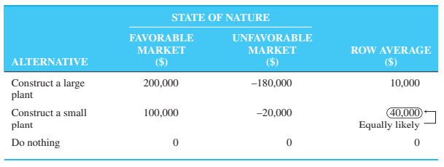
One criterion that uses all the payoffs for each alternative is the equally likely, also called Laplace, decision criterion. This involves finding the average payoff for each alternative, and selecting the alternative with the best or highest average. The equally likely approach assumes that all probabilities of occurrence for the states of nature are equal, and thus each state of nature is equally likely

Slide 50
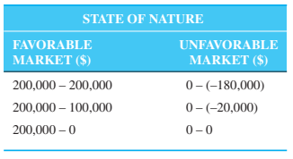
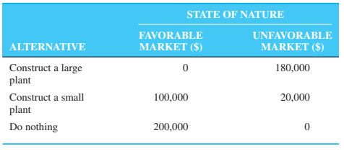
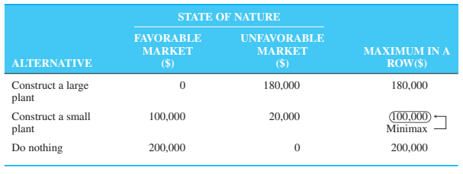
Minimax Regret. The next decision criterion that we discuss is based on opportunity loss or regret. Opportunity loss refers to the difference between the optimal profit or payoff for a given state of nature and the actual payoff received for a particular decision. In other words, it’s the amount lost by not picking the best alternative in a given state of nature

Slide 51


Decision making under Risks
Given a decision table with conditional values (payoffs) that are monetary values, and probability assessments for all states of nature, it is possible to determine the expected monetary value (EMV) for each alternative. The expected value, or the mean value, is the long-run average value of that decision. The EMV for an alternative is just the sum of possible payoffs of the alternative, each weighted by the probability of that payoff occurring

Slide 52


Slide 53



Slide 54



EVPI=EOL

Slide 55
Application in QM for Windows

