Slide 1
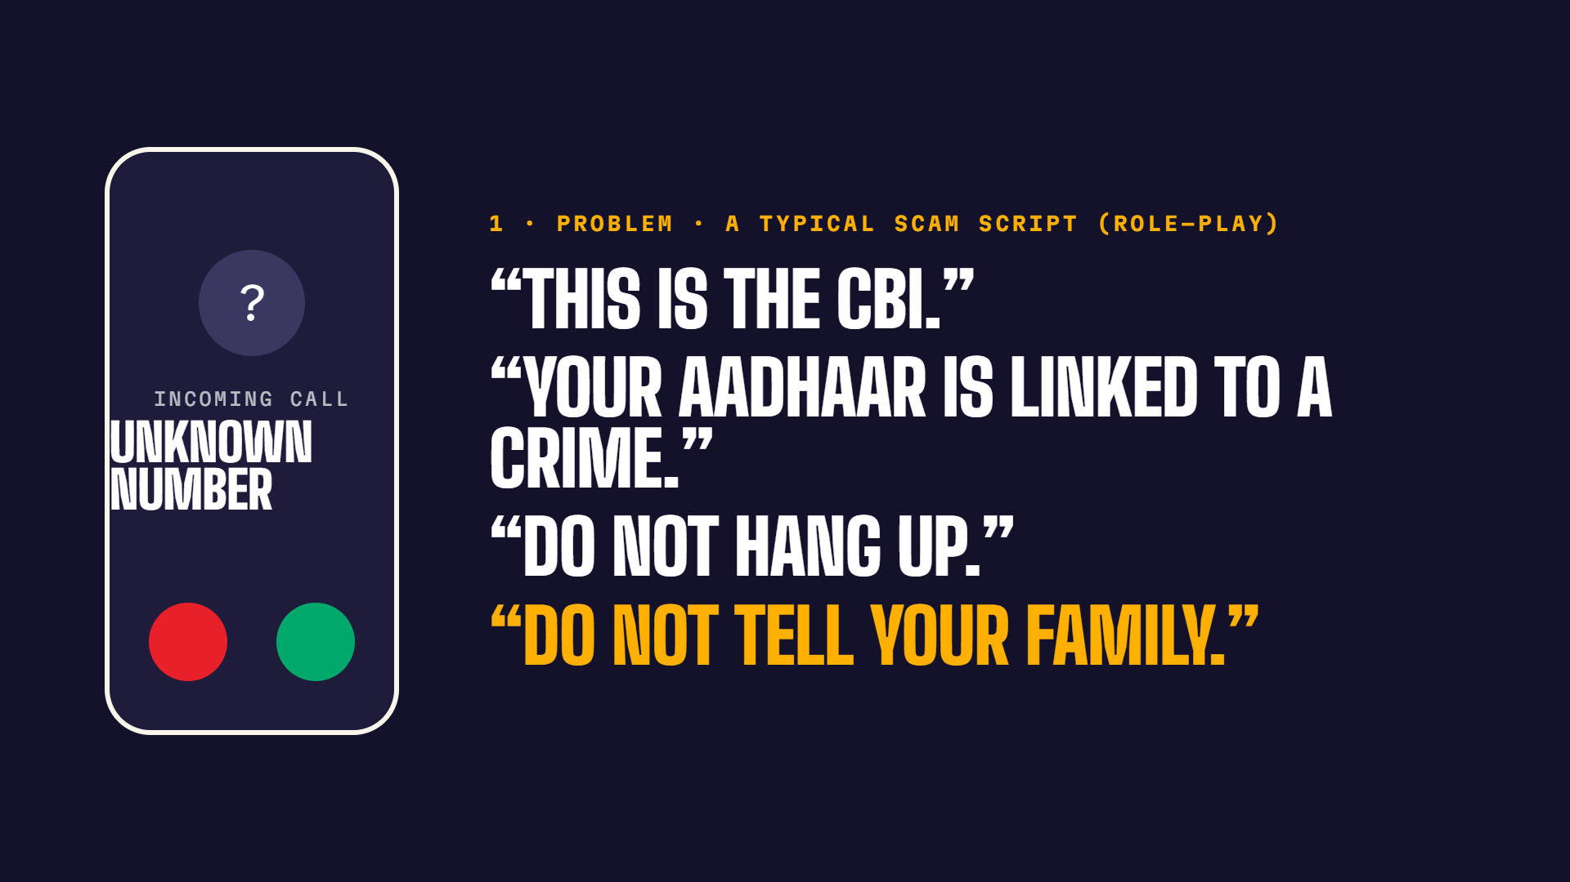
Notes:
3-minute pitch (25 s): Ruko means 'stop'. This is how the scam starts: 'This is the CBI. Your Aadhaar is linked to a crime. Do not hang up. Do not tell your family.' Older adults are kept on video for hours until they transfer their savings. Families find out after the money is gone.
Loom (35 s): Ruko means 'stop'. This is how the scam starts: 'This is the CBI. Your Aadhaar is linked to a crime. Do not hang up. Do not tell your family.' Older adults are kept on video for hours until they transfer their savings. Families find out after the money is gone.

Slide 2
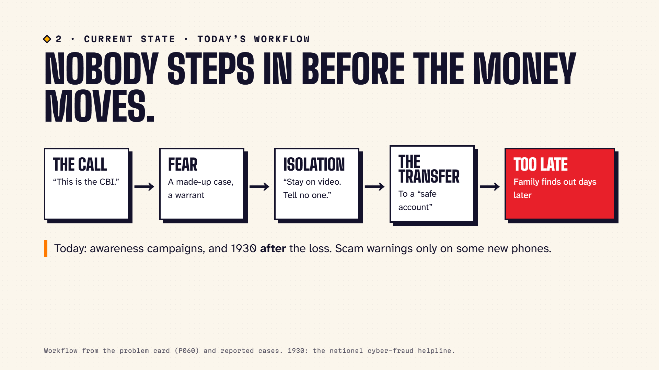
Notes:
3-minute pitch (20 s): Today's workflow: the call, fear, isolation, the transfer, and the family finds out days later. The help that exists comes too late: awareness campaigns, and 1930 after the loss. Nobody steps in before the money moves.
Loom (30 s): Today's workflow: the call, fear, isolation, the transfer, and the family finds out days later. The help that exists comes too late: awareness campaigns, and 1930 after the loss. Nobody steps in before the money moves.

Slide 3
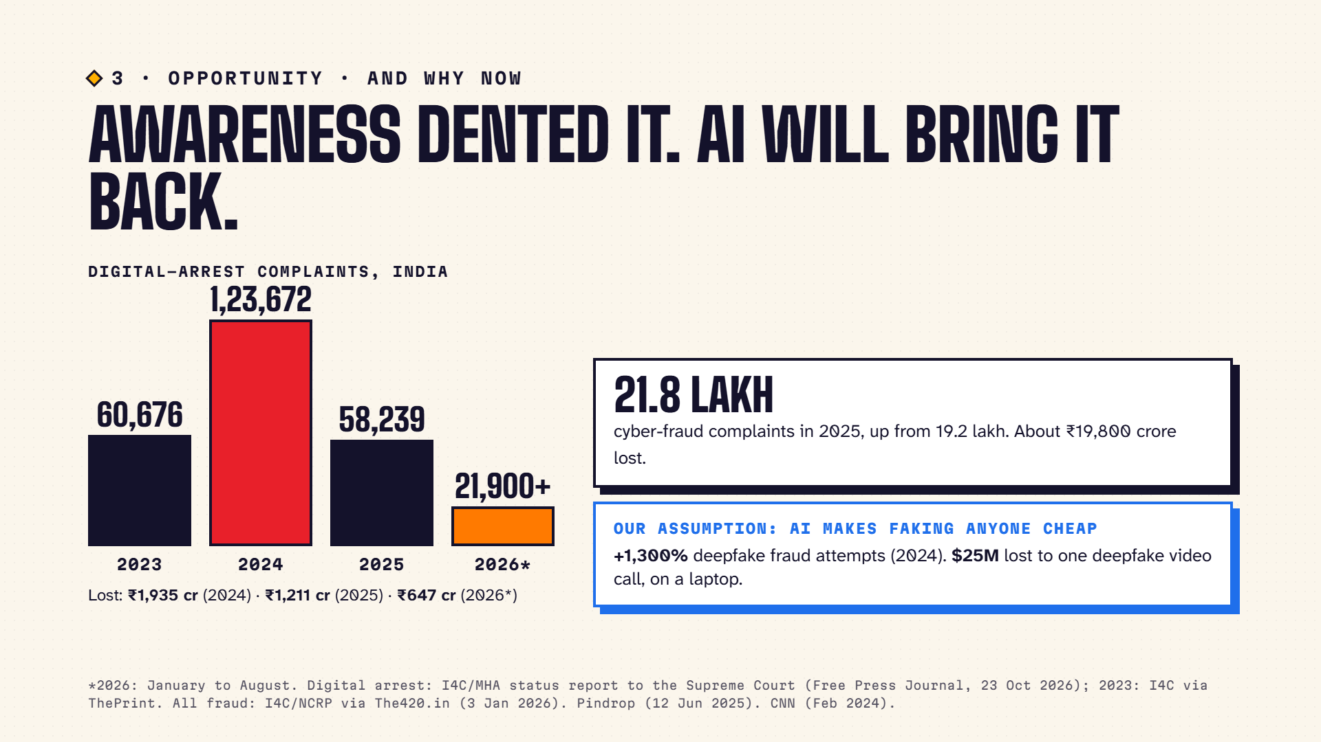
Notes:
3-minute pitch (20 s): Digital-arrest complaints doubled to 1,23,672 in 2024, with ₹1,935 crore lost. In 2025 they fell to 58,239, so awareness works, but this year there are already over 21,900 complaints and ₹647 crore lost by August. And fraud overall is still growing: 21.8 lakh complaints and about ₹19,800 crore lost in 2025. Our assumption: AI makes it cheap to fake any voice or face, on a phone or a laptop. Deepfake fraud attempts rose 1,300% in 2024, and one company paid out 25 million dollars after a deepfake video call.
Loom (35 s): Digital-arrest complaints doubled to 1,23,672 in 2024, with ₹1,935 crore lost. In 2025 they fell to 58,239, so awareness works, but this year there are already over 21,900 complaints and ₹647 crore lost by August. And fraud overall is still growing: 21.8 lakh complaints and about ₹19,800 crore lost in 2025. Our assumption: AI makes it cheap to fake any voice or face, on a phone or a laptop. Deepfake fraud attempts rose 1,300% in 2024, and one company paid out 25 million dollars after a deepfake video call.

Slide 4
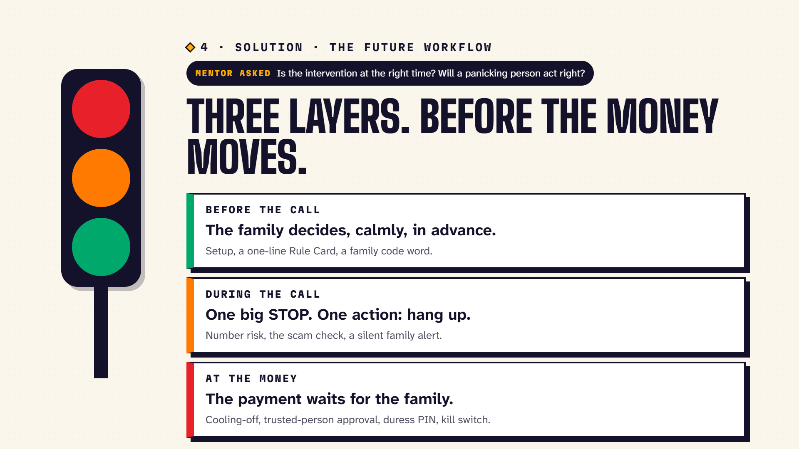
Notes:
3-minute pitch (35 s): Our mentor asked: is the intervention at the right time, and will a panicking person act right? We don't rely on them. Before the call, the family sets Ruko up calmly. During the call, one big STOP with one action, and the family is told silently. At the money, the payment waits for the family's code word, even if the person is fully convinced.
Loom (120 s): Our mentor asked whether the intervention comes at the right time. We don't rely on a panicking person. Three layers: before, during, at the money. Let me show it live with a new call. [Switch to ruko-seven.vercel.app, press 2. Answer and play the older person with your own new replies. Show STOP. Choose 'I still want to pay': the bank pauses it, the family phone gets the request, refuse it: 'Money did not move'. Press X to show the trace.]

Slide 5
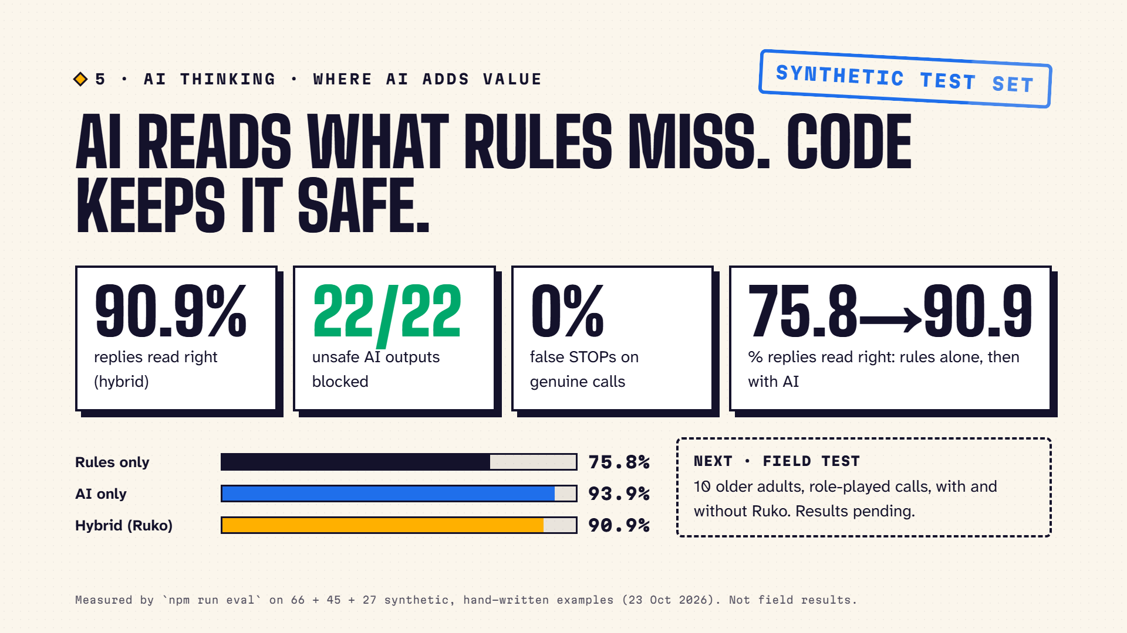
Notes:
3-minute pitch (25 s): Where AI adds value: it reads what the person meant when the rules can't tell, extracts scam signs from speech, text or a photo, and words calm guidance. Measured on our synthetic test set: rules alone read 75.8% of replies right, with AI 90.9%. And code keeps it safe: the guard blocked all 22 unsafe AI outputs, zero false STOPs on genuine calls.
Loom (40 s): Where AI adds value: it reads what the person meant when the rules can't tell, extracts scam signs from speech, text or a photo, and words calm guidance. Measured on our synthetic test set: rules alone read 75.8% of replies right, with AI 90.9%. And code keeps it safe: the guard blocked all 22 unsafe AI outputs, zero false STOPs on genuine calls.

Slide 6
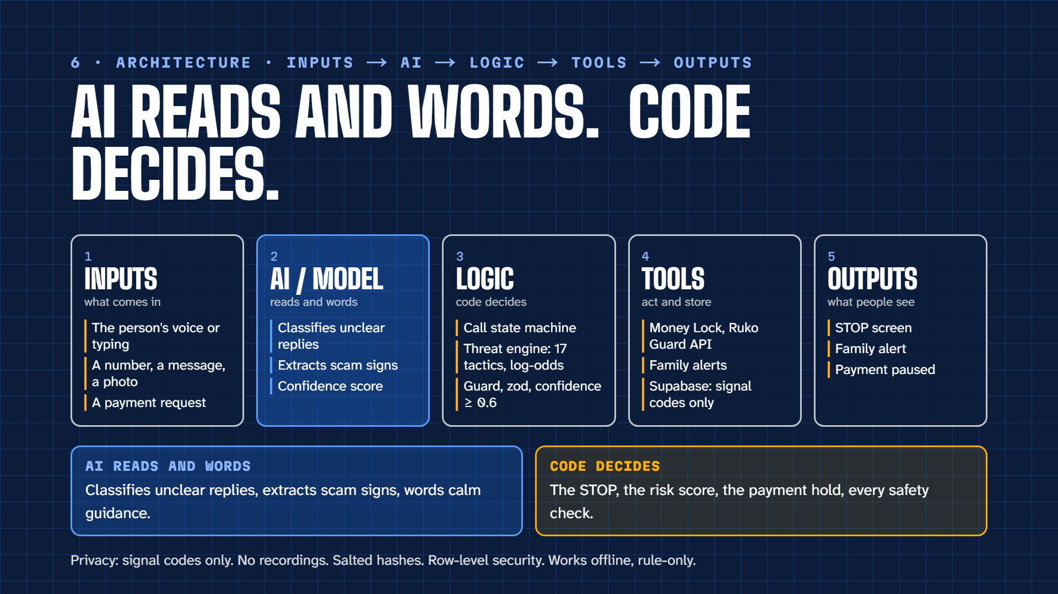
Notes:
3-minute pitch (25 s): Inputs: voice, a number, a message, a payment. The AI model reads and words, with a confidence score. Logic decides: the call state machine, the threat engine fusing 17 tactics with log-odds, the guard. Tools act: Money Lock, the Ruko Guard API, family alerts, Supabase with signal codes only. Outputs: STOP, the family alert, the payment paused. AI reads and words; code decides.
Loom (45 s): Inputs: voice, a number, a message, a payment. The AI model reads and words, with a confidence score. Logic decides: the call state machine, the threat engine fusing 17 tactics with log-odds, the guard. Tools act: Money Lock, the Ruko Guard API, family alerts, Supabase with signal codes only. Outputs: STOP, the family alert, the payment paused. AI reads and words; code decides.

Slide 7
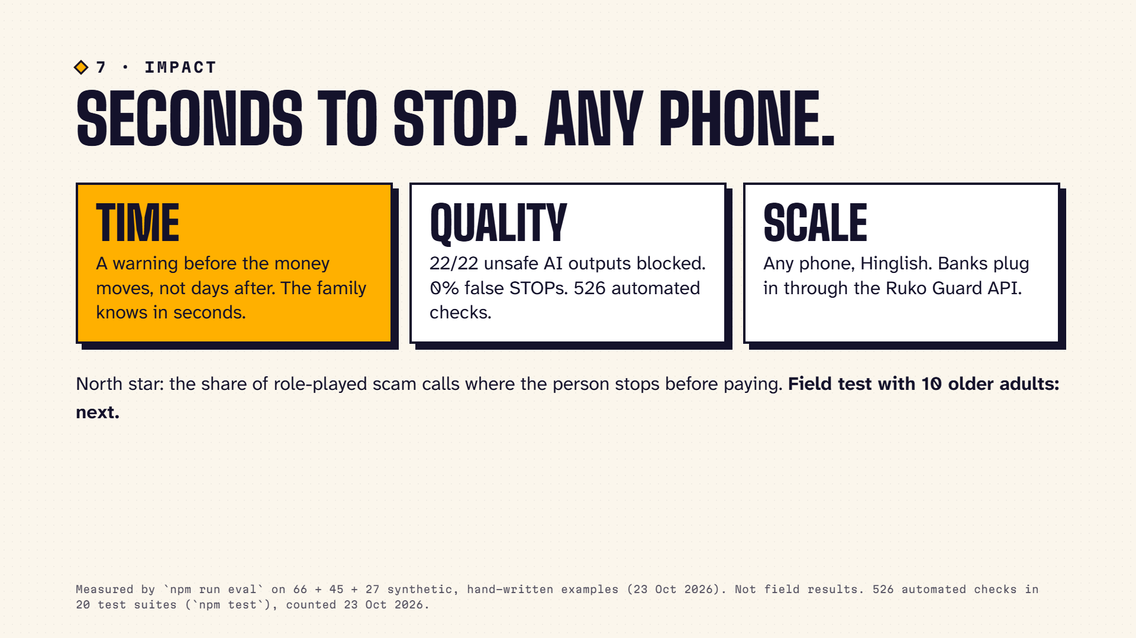
Notes:
3-minute pitch (15 s): Time: a warning before the money moves, not days after. Quality: measured safety and accuracy, 526 automated checks. Scale: any phone, Hinglish, and banks can plug in through the Ruko Guard API. Next: a field test with 10 older adults.
Loom (30 s): Time: a warning before the money moves, not days after. Quality: measured safety and accuracy, 526 automated checks. Scale: any phone, Hinglish, and banks can plug in through the Ruko Guard API. Next: a field test with 10 older adults.

Slide 8
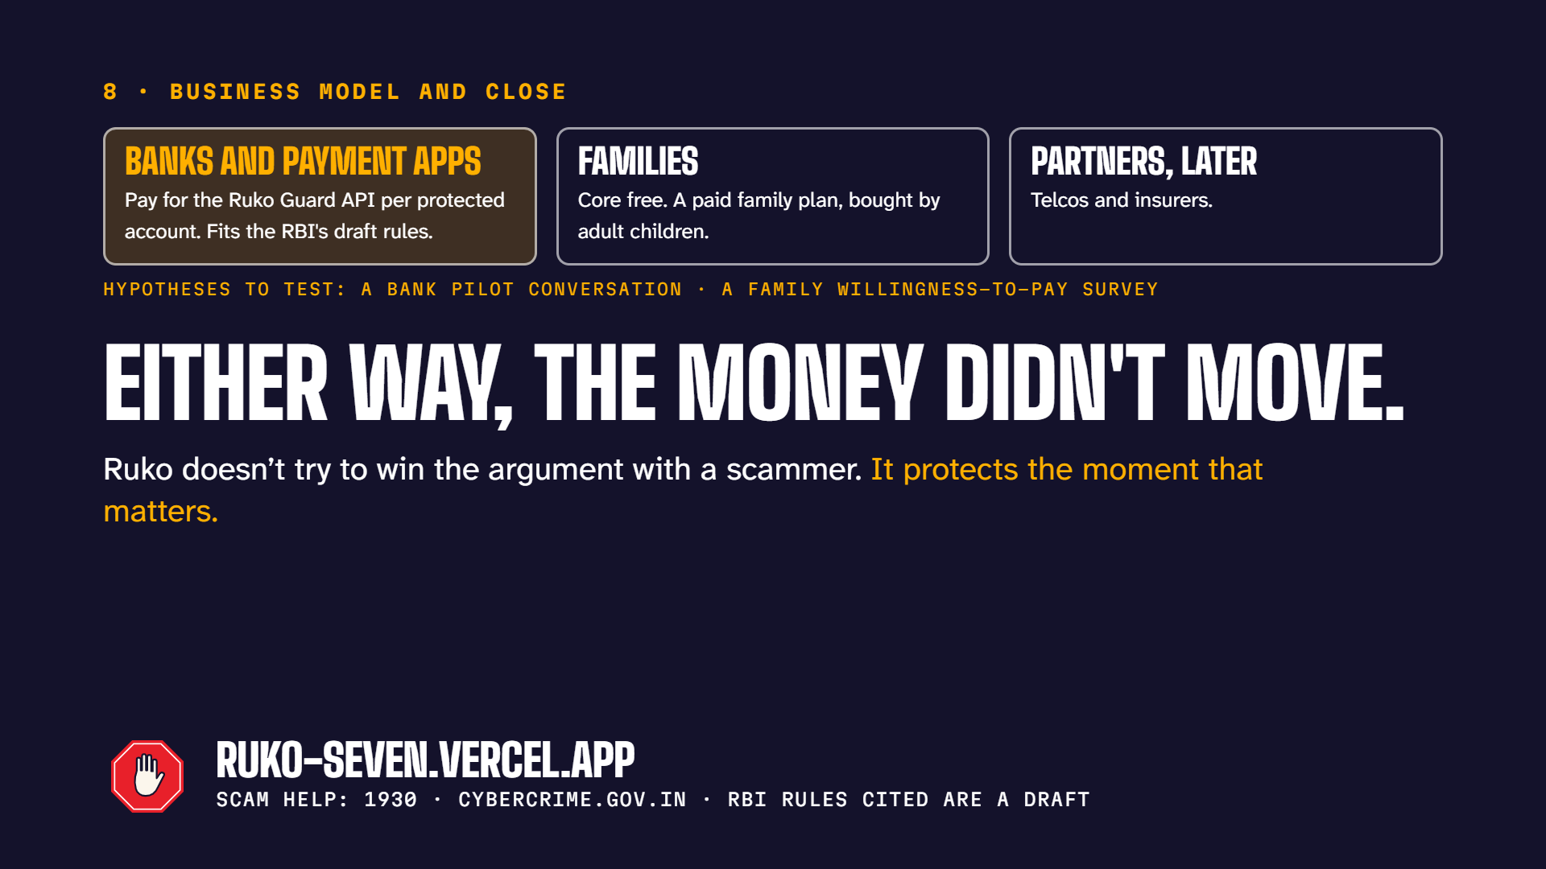
Notes:
3-minute pitch (15 s): Business, as hypotheses we will test: banks and payment apps pay for the Ruko Guard API per protected account, families get core protection free with a paid family plan, telcos and insurers later. Either way, the money didn't move. Ruko doesn't try to win the argument with a scammer. It protects the moment that matters.
Loom (30 s): Business, as hypotheses we will test: banks and payment apps pay for the Ruko Guard API per protected account, families get core protection free with a paid family plan, telcos and insurers later. Either way, the money didn't move. Ruko doesn't try to win the argument with a scammer. It protects the moment that matters.

