Slide 1
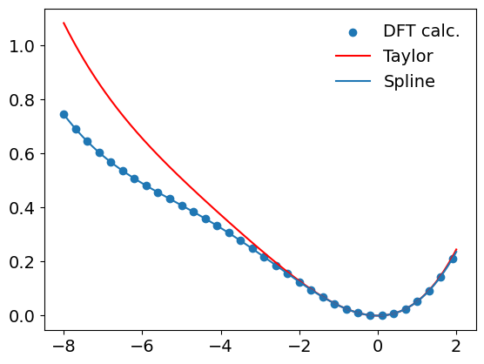
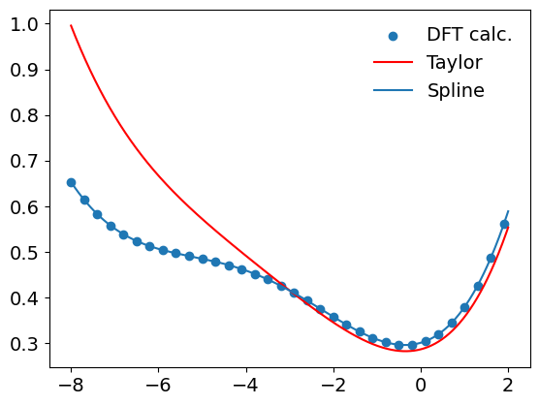
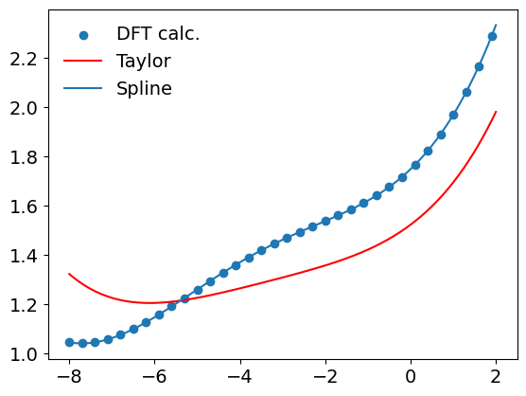




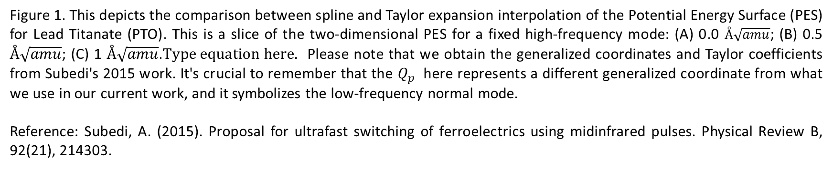



(A)
(B)
(C)
$$Q_{IR}\left(t\right)=0.0$$
$$Q_{IR}\left(t\right)=0.5$$
$$Q_{IR}\left(t\right)=1.0$$
$$Q_{p}\left(t\right), Å\sqrt{amu}$$
$$Q_{p}\left(t\right), Å\sqrt{amu}$$
$$Q_{p}\left(t\right), Å\sqrt{amu}$$
Figure 1. This depicts the comparison between spline and Taylor expansion interpolation of the Potential Energy Surface (PES) for Lead Titanate (PTO). This is a slice of the two-dimensional PES for a fixed high-frequency mode: (A) 0.0 $Å\sqrt{amu}$; (B) 0.5 $Å\sqrt{amu}$; (C) 1 $Å\sqrt{amu}$. Please note that we obtain the generalized coordinates and Taylor coefficients from Subedi's 2015 work. It's crucial to remember that the $Q_{p}$ here represents a different generalized coordinate from what we use in our current work, and it symbolizes the low-frequency normal mode.
Reference: Subedi, A. (2015). Proposal for ultrafast switching of ferroelectrics using midinfrared pulses. Physical Review B, 92(21), 214303.

