Slide 1

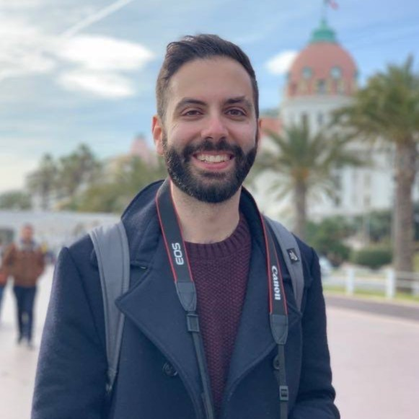
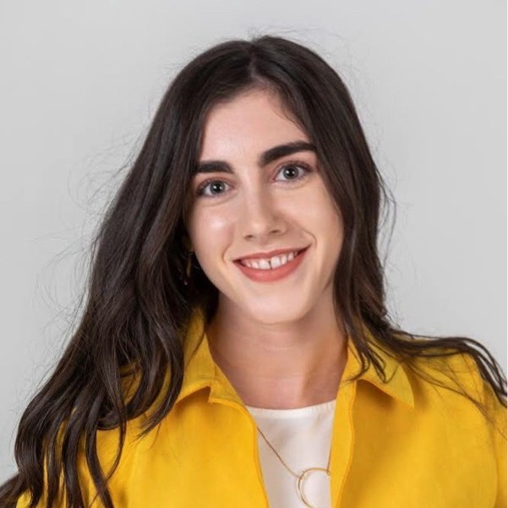
AGE (STATE) OCCUPATION SPONSOR CATEGORY: X
PLAYER NAME
SHORT TAGLINE
Energy Level – out of 5 – this helps us when booking players for later in the day
Top line character points – we don’t need to now if they are "bubbly/energetic/likable" as it doesn’t really help Grant. But if they have traits like – they just don’t stop talking / they argue with their podium partner as they're bossy etc / infectious or funny laugh. That is stuff we can work with in an episode.
Meet story (if applicable)
3 key stories/facts/interesting points
How much they want to win -
What they’d do with prize money (high and low) - 100K and if they win only $1000
How they might play game / Risk taker?
Other game shows / prize money won / previously on DOND
ATTENDING WITH …
NAME (RELATIONSHIP)
PRODUCER: INSERT NAME

