Slide 2
Filter by Total Wind

Slide 3
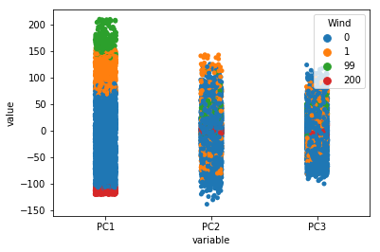
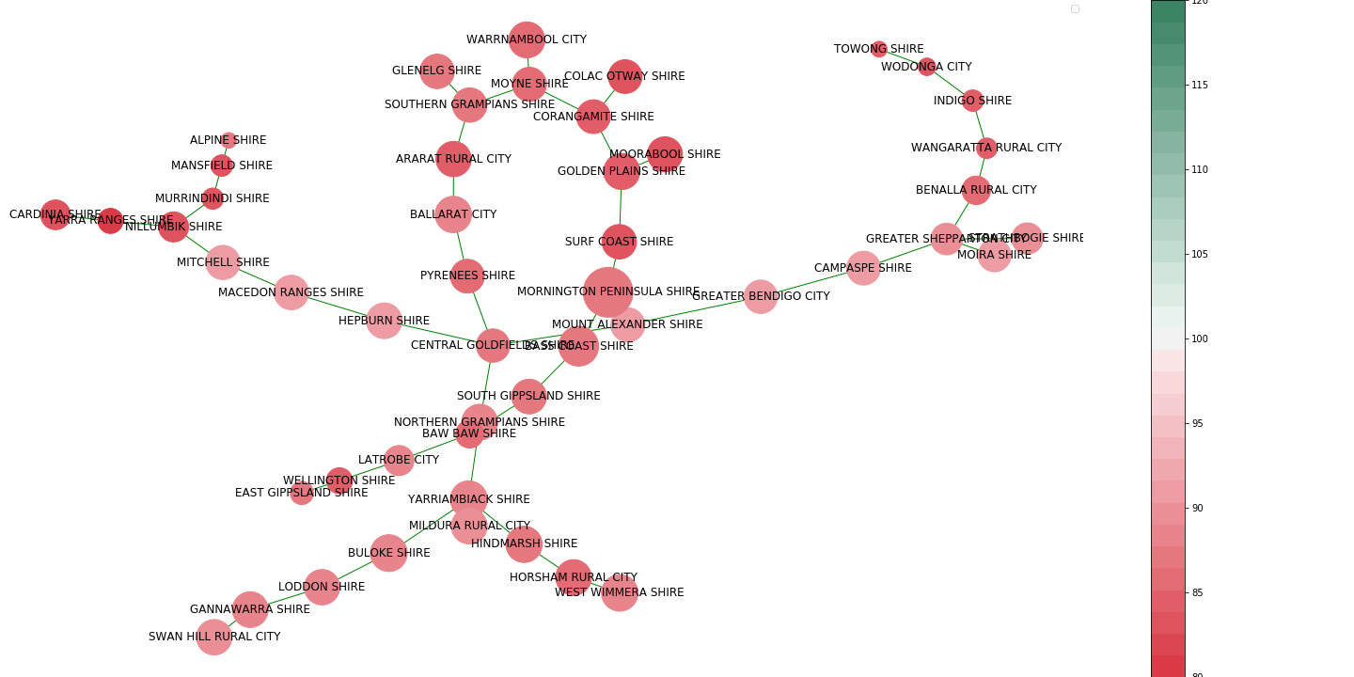
Just Summer
Dot = timepoint
Something from Graph

Slide 4
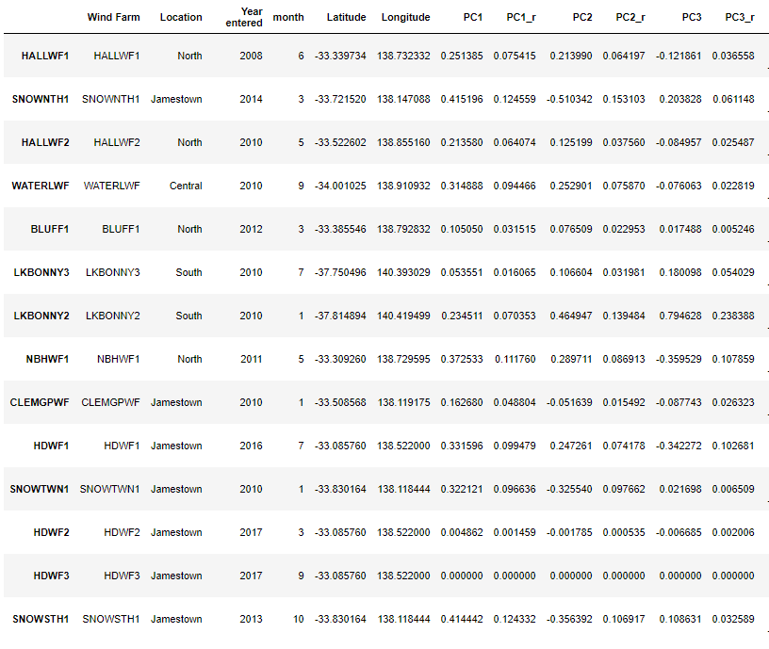
High Wind top 5%
High Wind top 20%
No filter
Low wind Bottom 10
?

Slide 5
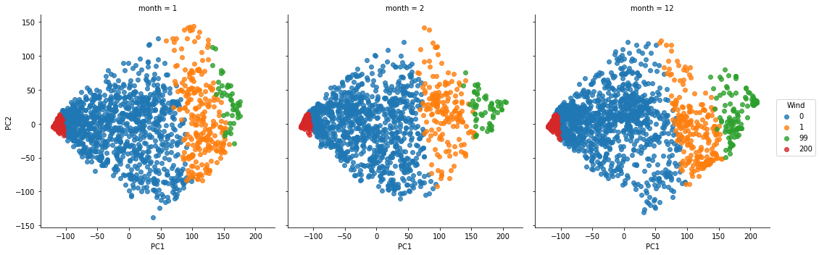

Slide 6
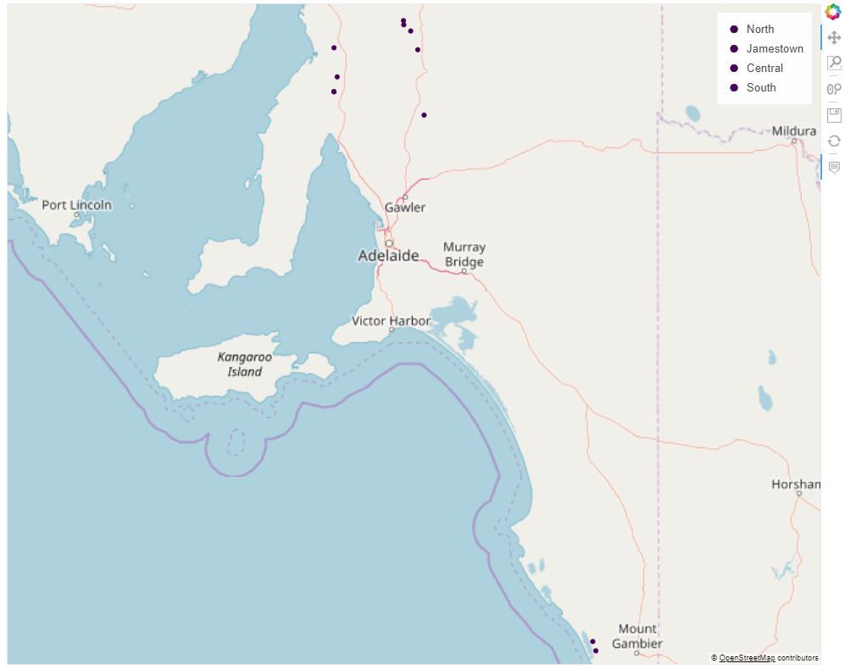
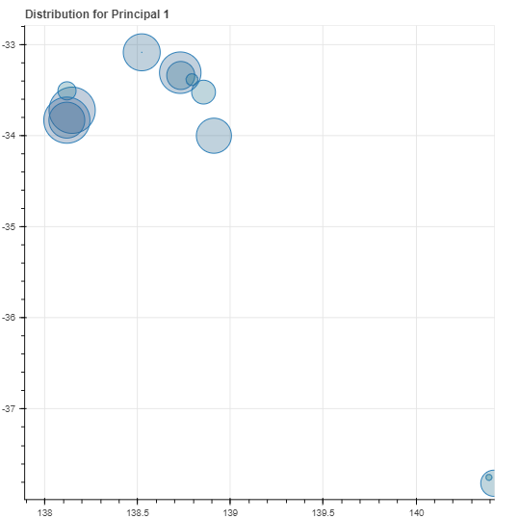

Slide 7
HALLGAP
LkBonny
SnowTown
Waterlow

Slide 8
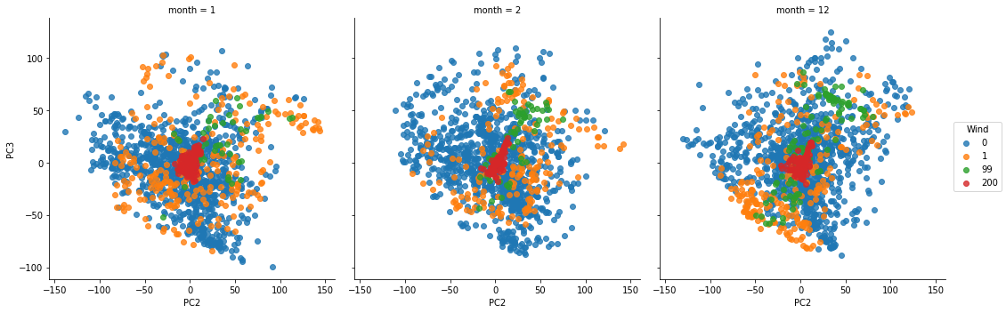
What about PC2 and PC3?

Slide 9
Filter by Price

Slide 10
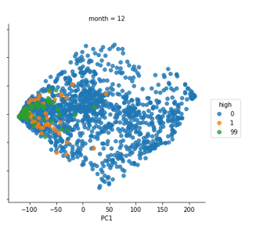
Top 5%
Top 20%
Everything

Slide 11
Important
SnowTWN
NBHIll
Hornsdale
Not Important
Clement Gap
Bluff1
HallWF2
LKBNY3
HALLGAP
LkBonny
Important
SnowTown
Waterlow
Ignore

Slide 12
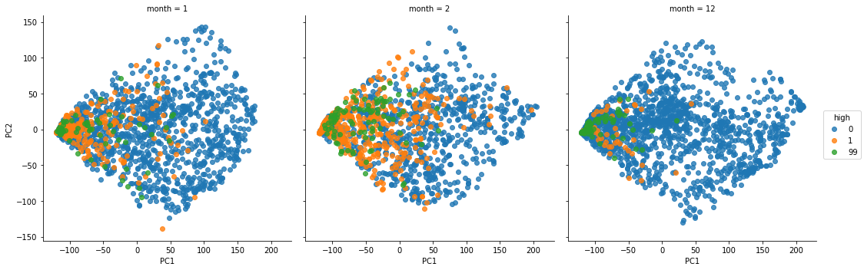
HALLGAP
LkBonny
SnowTown
Waterlow

Slide 13
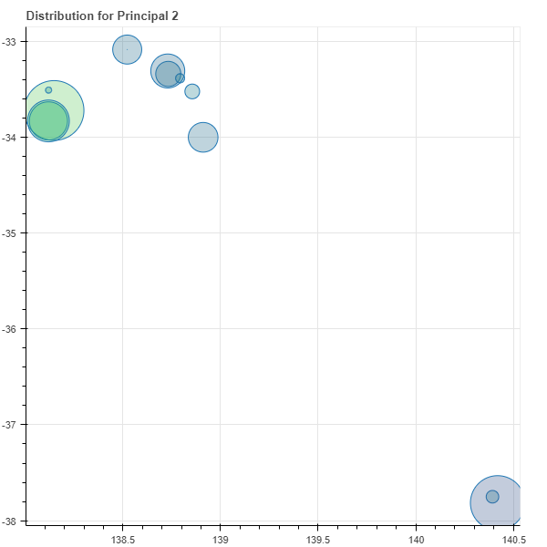
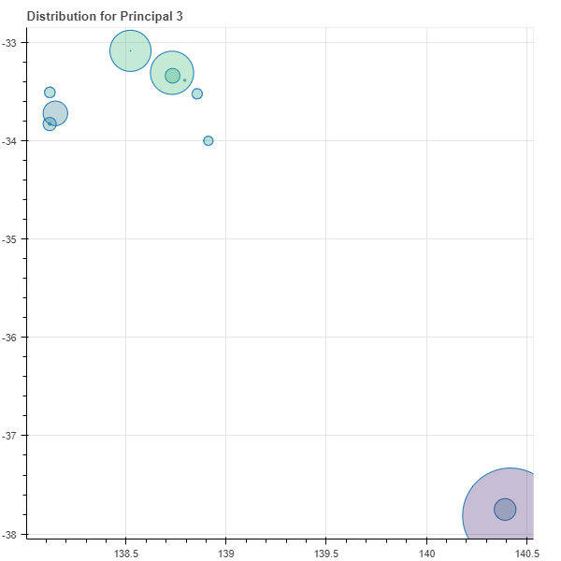
OTHER PATTERNS

Slide 14
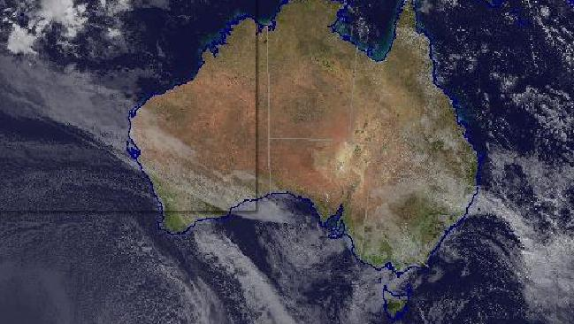
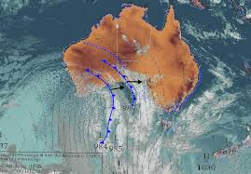
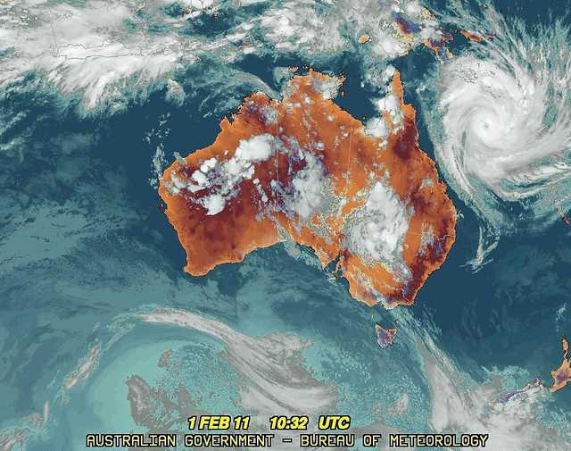
OTHER PATTERNS

Slide 15
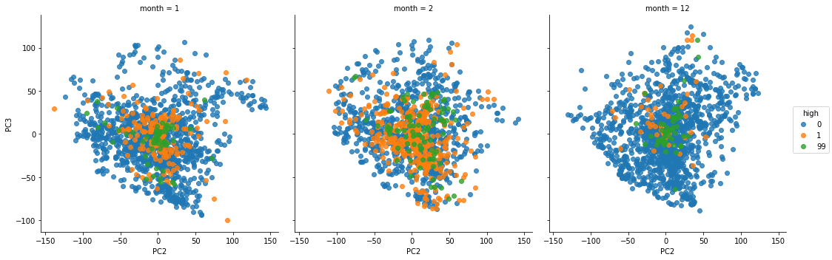
PC2 and PC3 Centre

Slide 16
Tabular

Slide 17
Robust to Other seasons
Connection to graph
Timeseries meaning how can PC1 be all negativr
Other variables

