Slide 1


Leveraging TVM as a front-end compiler for RISC-V based custom tinyML processor
Vaibhav Verma and Mircea R. Stan
High-Performance Low-Power Lab (HPLP)
University of Virginia
vv8dn@virginia.edu

Slide 2






Need for on-device tinyML
Latency – enable real-time AI systems
QoS – cannot rely on connectivity in remote areas
Security – sending data over network not secure
Privacy – keep private data locally on device
Bandwidth – send “information” to cloud rather than “data”
Cost – data communication is costly
On-device AI

Slide 3
But tinyML/Edge AI is different!
Smaller neural network models
Smaller batch sizes (≈ 1)
Edge devices are power, cost, area and size limited
Edge processors support both AI and non-AI applications
Edge processors lack support for Keras, PyTorch, MXNet etc.

Slide 4
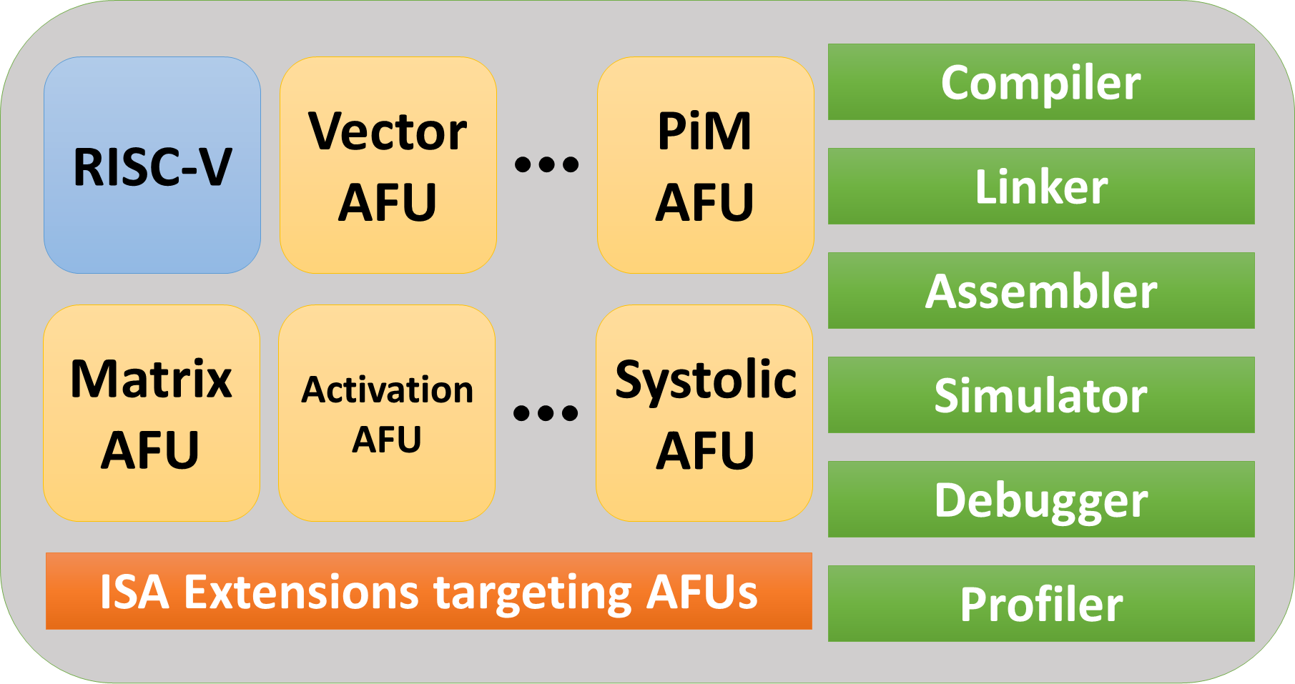
AI-RISC
Custom RISC-V processor with ISA extensions targeting AI applications
End-to-end hardware/software co-design solution
Tightly integrated AI accelerators for fine-grained offloading of AI tasks
Support for AI and non-AI applications on the same processor

Slide 5
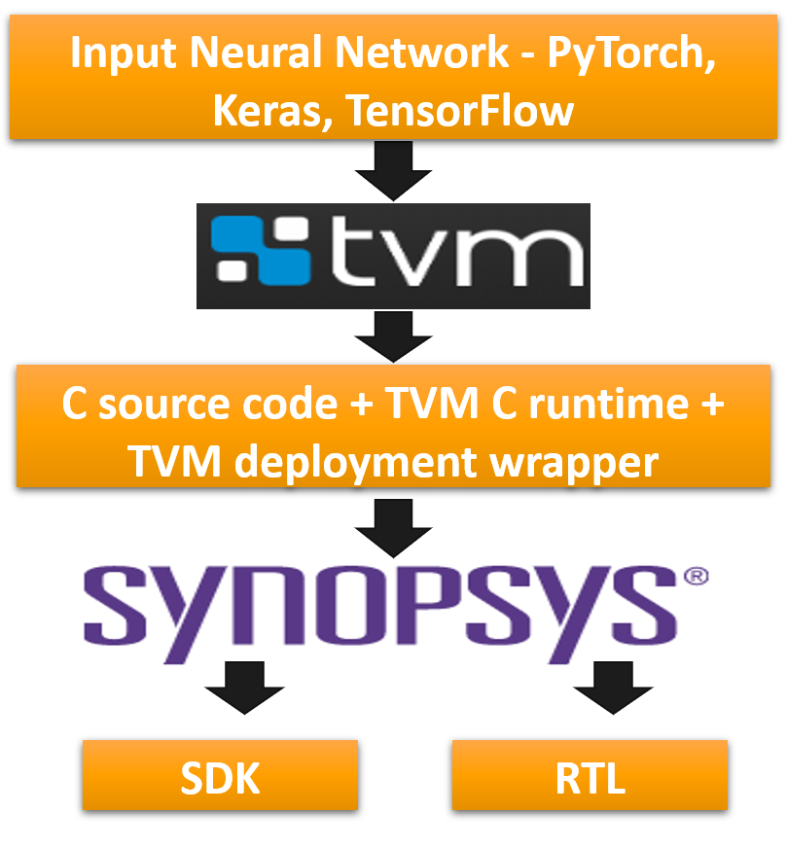
Hardware/Software Co-design
End-to-end design methodology
TVM on the frontend
Synopsys ASIP Designer on the backend
Support for multiple Domain Specific Language (DSL) frontends - Pytorch, MXNet, TFLite, Tensorflow, DarkNet etc.
Verified with both 32 and 64-bit RISC-V
Quantization support

Slide 6
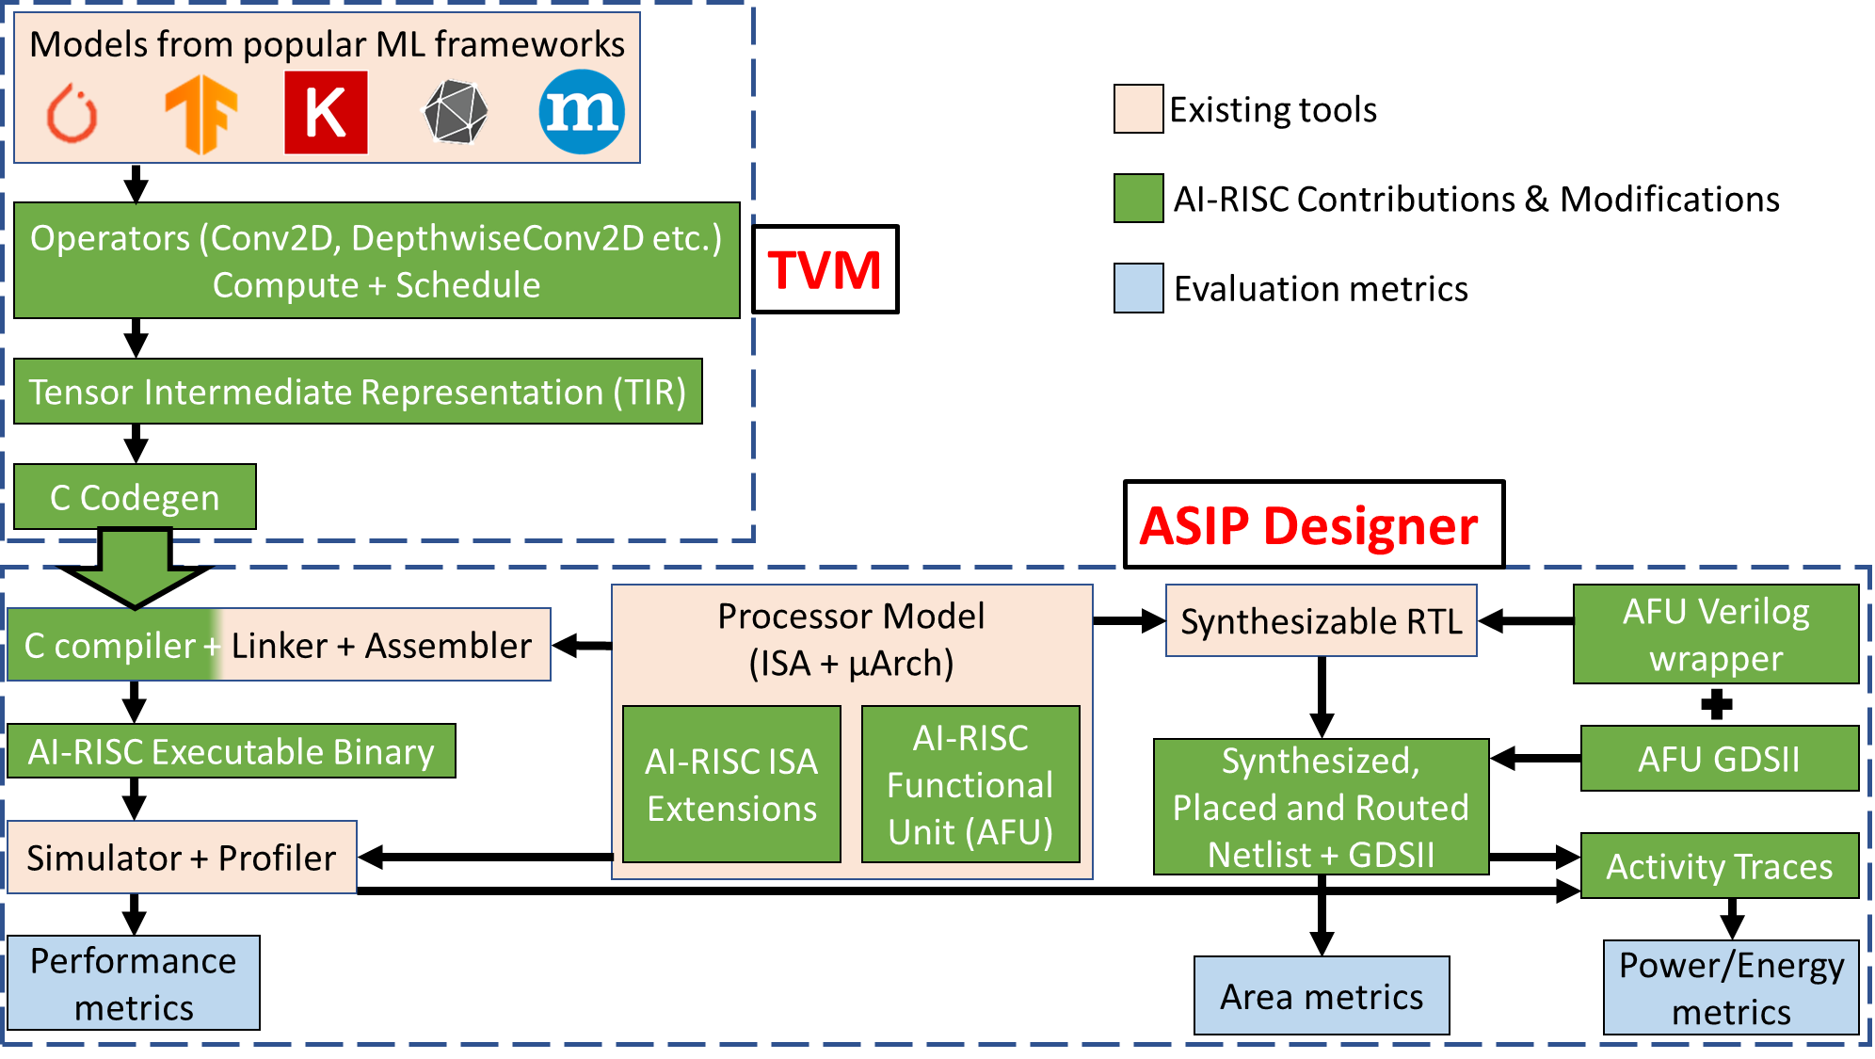
Deep dive

Slide 7
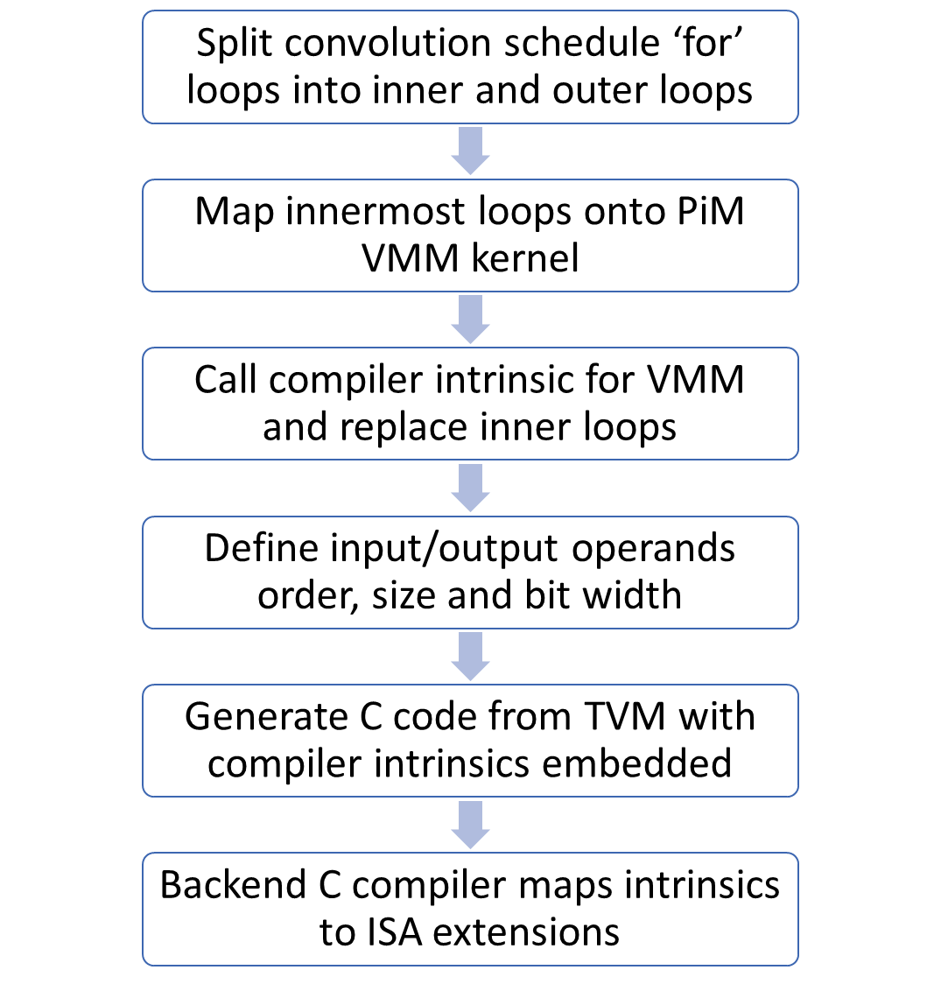
Compilers are hard!
2-step compilation – TVM + ASIP Designer generated C compiler
Goal is to have no/minimum interaction with TVM generated C code
Problem 1 – ASIP Compiler is not smart enough to detect opportunities for complex instructions like VMM, GEMM etc.
Works well for simple instructions like MAC.
Solution - Expose new instructions to TVM via compiler intrinsics.

Slide 8
Compiler issues with custom instructions
Problem 2 – Breaking the convolution schedule leads to accuracy issues.
Issue 1 – Wrong allocation of operands
Solved by TVM buffer and strided access of operands from bigger matrix
Issue 2 – Wrong data type in quantized NN
Defined input/output data types in TVM hardware intrinsic call
8-bit inputs and 16/32-bit accumulated result.
Issue 3 – Kernel and Input data layout
TVM supports only a few Input/Filter layouts with specific ISA.
Adding support for required Input-Filter layout combinations in TVM for C hardware target used in AI-RISC.

Slide 9
More Compiler issues
Problem 3 – TVM support for breaking the convolution computation to match custom extension kernel size is limited.
TVM throws random errors when breaking the computation schedule using “tensorize” schedule pass.
Exact same convolution works with tensorize as a standalone kernel but not as a part of neural network.
Solution – Trying to debug the exact issue but till we find a reliable solution we work with what we have.
Breaking the computation schedule into error-free parts and adapting the custom instructions accordingly for testing purposes.

Slide 10
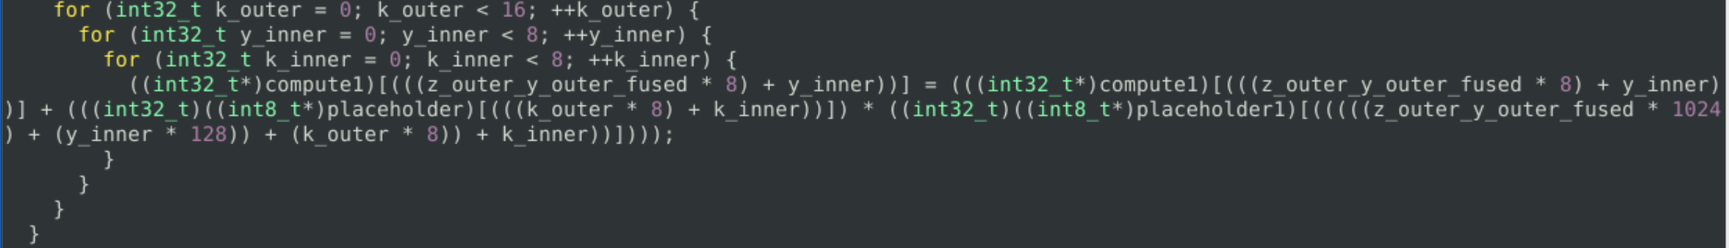
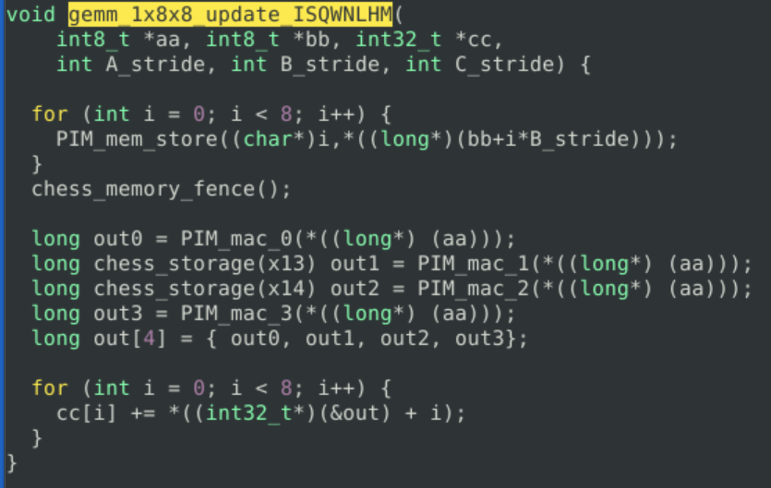
TVM generated C code
Without Custom instructions
With Custom instructions

Slide 11
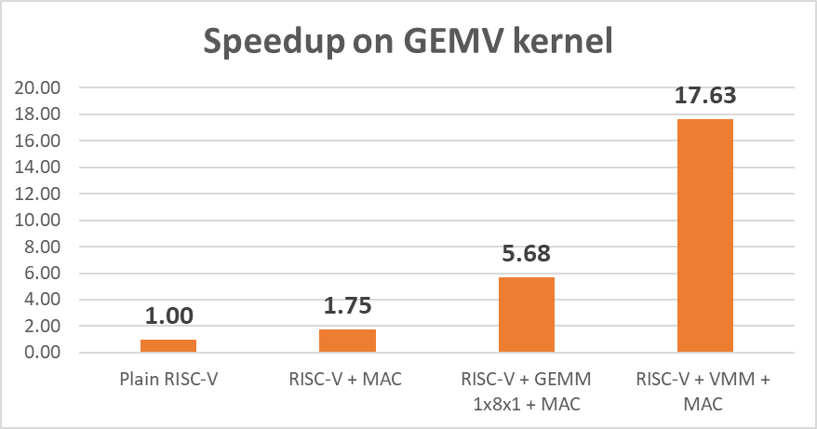
Speedup on GEMV kernel
A Matrix → 8x8
B Vector → 1x8
Input datatype → int8
Output datatype → int16

Slide 12
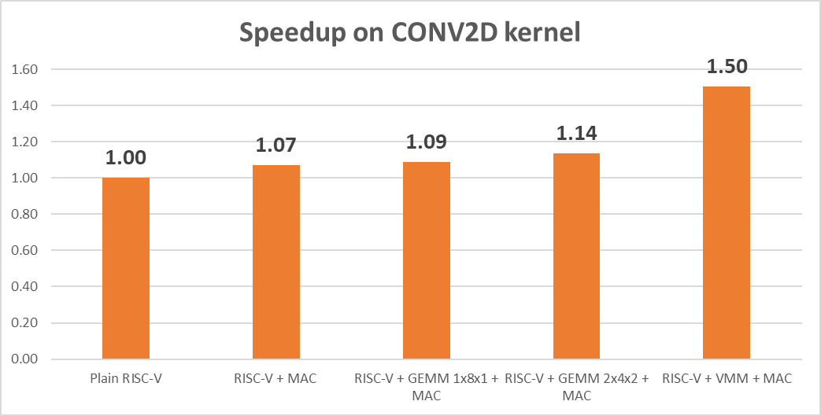
Speedup on single CONV2D kernel
Input image → 7x7
Input channels → 8
Filter → 2x2
Output channels → 2
Input datatype → int8
Output datatype → int16
data_layout → NHWC
kernel_layout → HWIO

Slide 13
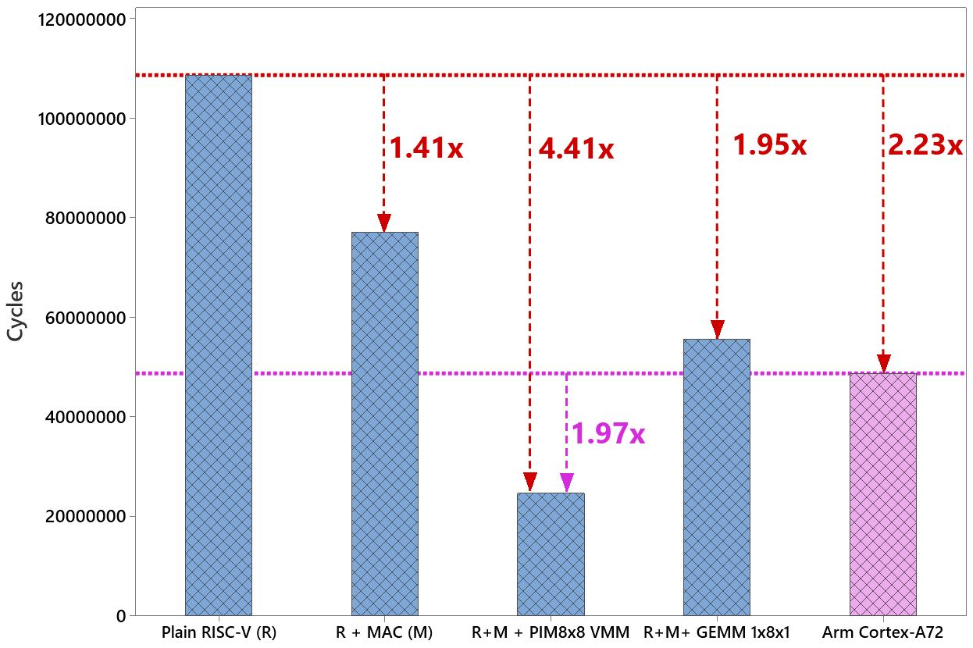
Speedup on ResNet-8 network from MLPerf Tiny

Slide 14
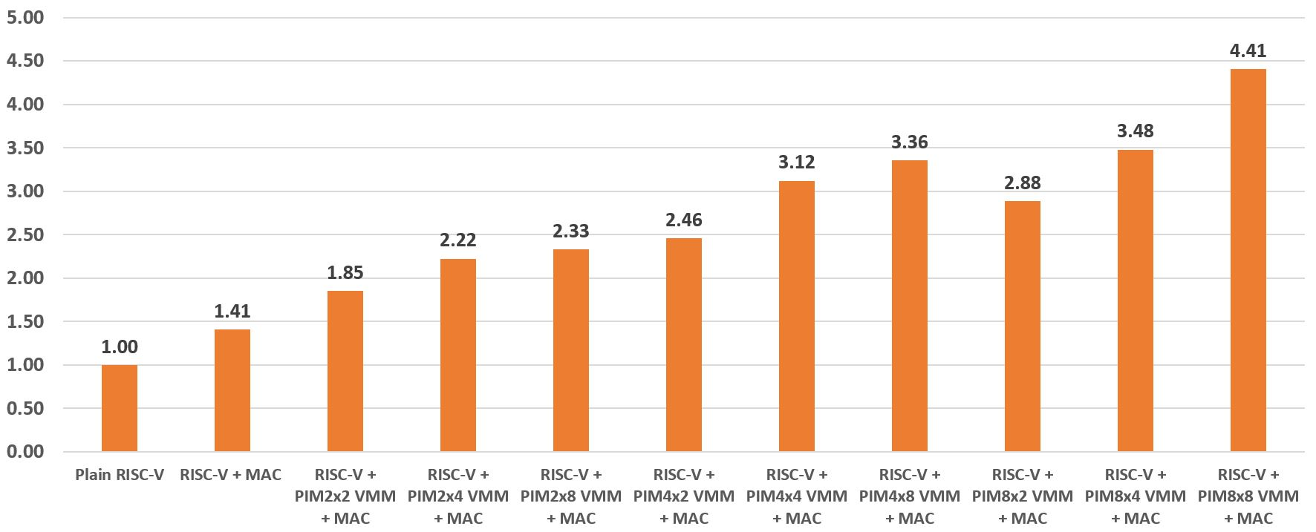
Design-Space Exploration for PIM-VMM sizes

Slide 15
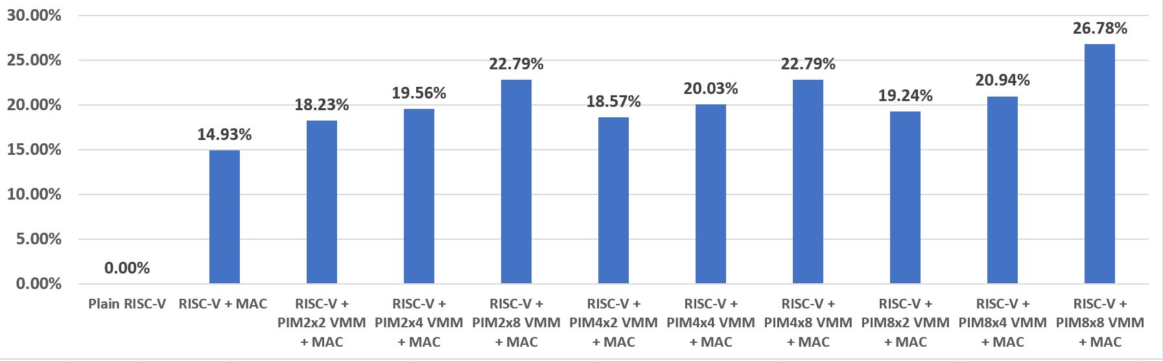
Area Overhead using Synthesis Results

Slide 16
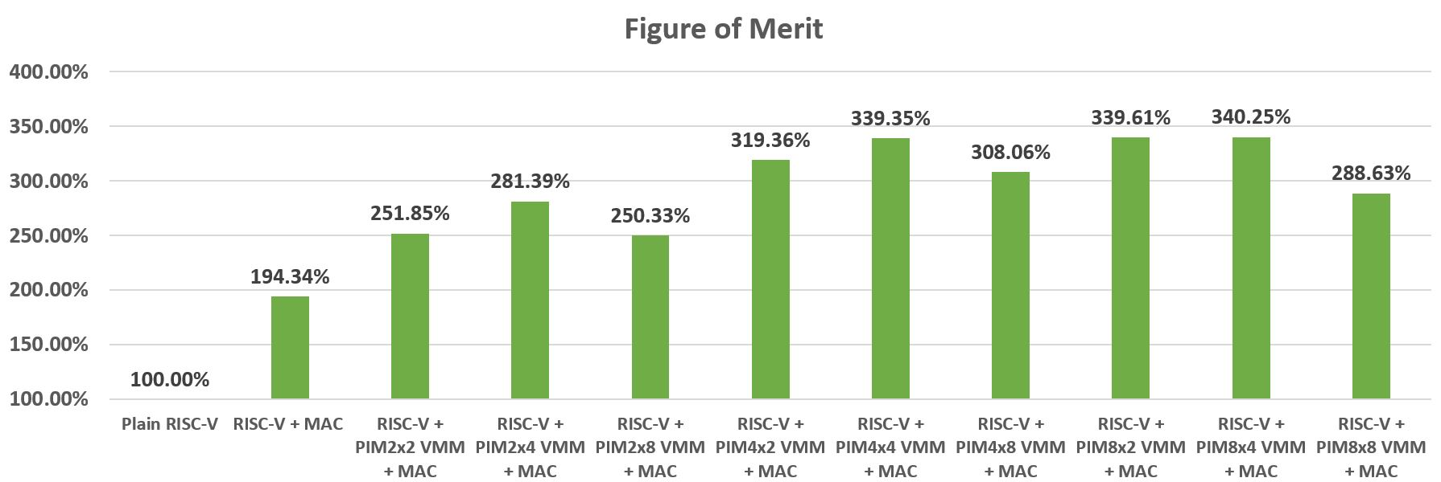
FoM for optimal PIM size
Figure of Merit = Performance gain / Area Overhead

Slide 17
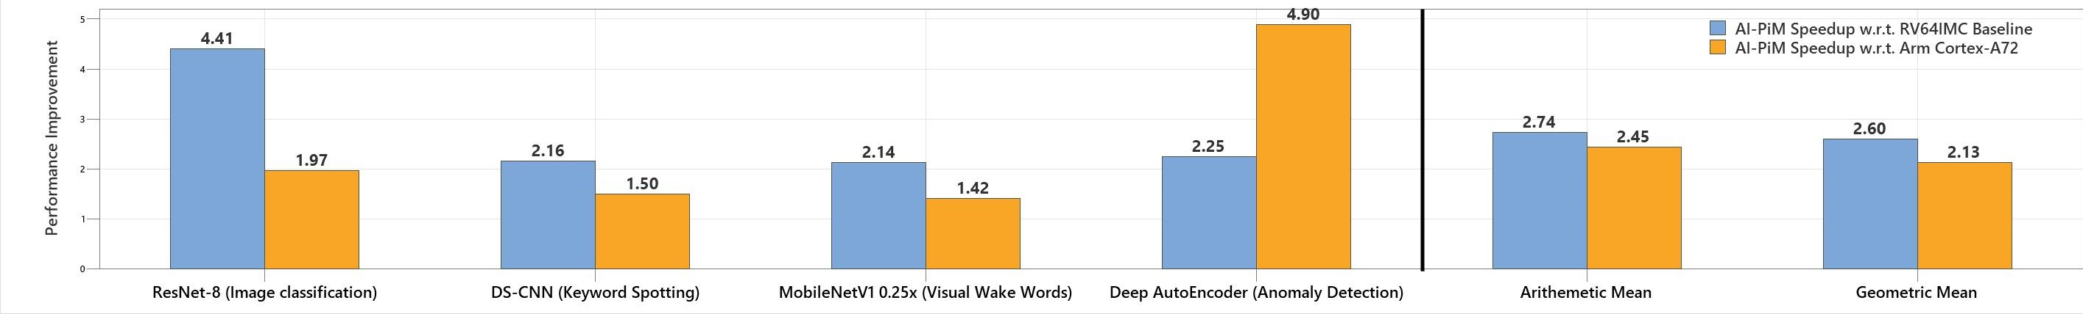
Speedup on MLPerf Tiny Benchmark

Slide 18
Summary
AI-RISC = Custom RISC-V processor for Edge AI
Tightly integrated AI Functional Units (AFU)
Custom ISA extensions to RISC-V
Complete SDK generation including compiler support for PyTorch, TensorFlow etc.
Speedup w.r.t RV64IMC → 17.6x for GEMV, 2.74x (avg) for MLPerf Tiny Benchmark
Speedup w.r.t Arm Cortex-A72 → 2.45x (avg) for MLPerf Tiny Benchmark
Scalable, flexible and support for both AI and non-AI applications

Slide 19
Talks and Publications
V. Verma, M. Stan, “Co-designing the hardware, ISA and software for RISC-V based tinyML processor,” tinyML Summit, San Francisco, CA, March 2022.
V. Verma, M. Stan, “Leveraging TVM as a front-end compiler for RISC-V based custom tinyML processor,” Apache TVM and Open Source ML Acceleration Conference (TVMCON), December 2021.
V. Verma, M. Stan, “AI-RISC - Custom Extensions to RISC-V for Energy-efficient AI Inference at the Edge of IoT,” RISC-V Summit co-located with Design Automation Conference (RISC-V), San Francisco, CA, December 2021.
V. Verma, T. Tracy, M. Stan, “EXTREM-EDGE - EXtensions To RISC-V for Energy-efficient ML inference at the EDGE of IoT,” The 12th International Green and Sustainable Computing Conference (IGSC), October 2021.
V. Verma, M. Stan, “AI-RISC: Extending RISC-V with tightly integrated accelerators and custom instructions for AI inference at the Edge of IoT,” IBM IEEE CAS/EDS - AI Compute Symposium (AICS),October 2021.

Slide 20


Questions?
This work is funded by SRC under GRC AIHW task 2945.001.

