Slide 1


The Case for Cloud-based Task Parallelism
Hervé Yviquel, Marcio Pereira, and Guido Araujo
Instituto de Computação – UNICAMP

Slide 2
Programming Clusters is Increasingly Complex
Requires various programming languages and API
OpenMP / Multithreading for multicore processors
MPI for programming distributed architectures
CUDA for GPUs
Checkpoint library for fault tolerance
High cost of development and maintenance

Slide 3
Our proposal
Programming heterogenous cluster with OpenMP only
Programming using all OpenMP directives together (parallel, task, target, etc.)
Need to deal with heterogeneity
Extending the OpenMP runtime for distributed architectures
Using MPI and fault-tolerance library within the runtime

Slide 4
Dealing with GPUs
Extension for programming accelerators (v4.0+)
New directives for local accelerators (e.g. GPU)
Transformed into CUDA/OpenCL kernels
int MatMul(float *A, float *B, float *C) { #pragma omp target device(GPU) #pragma omp map(to: A[:N*N], B[:N*N]) map(from: C[:N*N]) #pragma omp parallel for for(int i=0; i < N; ++i) for(int j = 0; j < N; ++j) C[i * N + j] = 0; for(int k = 0; k < N; ++k) C[i * N + j] += A[i * N + k] * B[k * N + j]; return 0; }

Slide 5
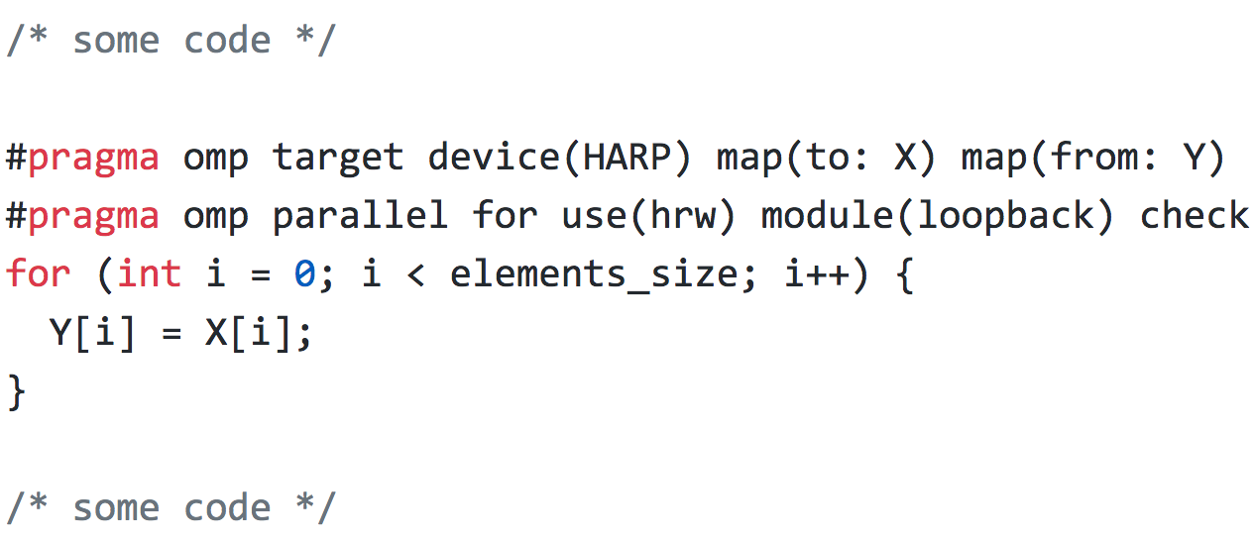
Dealing with FPGAs (Intel HARP) (FCCM 2018)
Supported by:
Intel
www.hardcloud.org

Slide 6
Shared Memory
CPU
…
FPGA
X
…
Y

Slide 7
Shared Memory
CPU
…
FPGA
X
…
Y

Slide 8
buffer
[read request]
read_stream(id, size)
[read response]
valid()
read_indexed(id, offset)
data()
[write request]
write_stream(id, data)
write_indexed(id, offset, data)

Slide 9
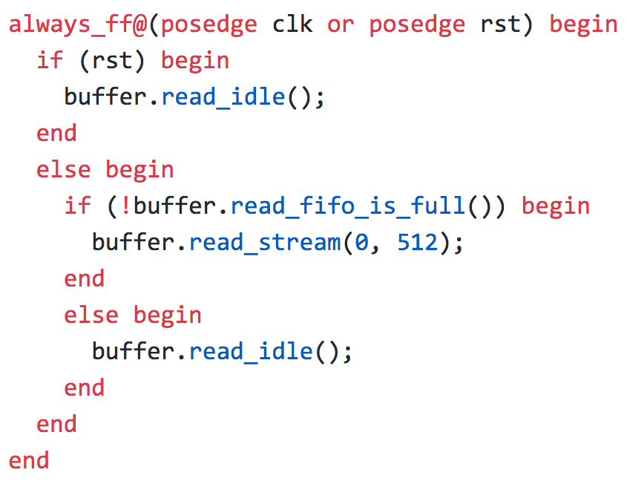
Before HardCloud
Using HardCloud
logic [31:0] cnt_request;
t_rd_state rd_state;
t_rd_state rd_next_state;
t_ccip_c0_ReqMemHdr rd_hdr;
always_ff@(posedge clk or posedge reset) begin
if (reset) begin
cnt_request <= '0;
end
else begin
logic [31:0] request;
logic [31:0] response;
if ((rd_state == S_RD_FETCH) && (cnt_request < FFT_FIFO_DEPTH) && !ccip_rx.c0TxAlmFull) begin
request = 32'h1;
end
else begin
request = 32'h0;
end
if ((ccip_rx.c0.rspValid) && (ccip_rx.c0.hdr.resp_type == eRSP_RDLINE)) begin
response = 32'h1;
end
else begin
response = 32'h0;
end
cnt_request <= cnt_request + request - response;
end
end
always_ff@(posedge clk or posedge reset) begin
if (reset) begin
ccip_c0_tx.valid <= 1'b0;
rd_offset <= '0;
rd_hdr = t_ccip_c0_ReqMemHdr'(0);
end
else begin
case (rd_state)
S_RD_IDLE:
begin
ccip_c0_tx.valid <= 1'b0;
end
S_RD_FETCH:
begin
if (cnt_request >= FFT_FIFO_DEPTH) begin
ccip_c0_tx.valid <= 1'b0;
end
else if (!ccip_rx.c0TxAlmFull) begin
rd_hdr.cl_len = eCL_LEN_1;
rd_hdr.address = hc_buffer[1].address + rd_offset;
ccip_c0_tx.valid <= 1'b1;
ccip_c0_tx.hdr <= rd_hdr;
rd_offset <= t_ccip_clAddr'(rd_offset + 1);
end
else begin
ccip_c0_tx.valid <= 1'b0;
end
end
S_RD_WAIT:
begin
ccip_c0_tx.valid <= 1'b0;
end
S_RD_FINISH:
begin
ccip_c0_tx.valid <= 1'b0;
end
endcase
end
end
always_ff@(posedge clk or posedge reset) begin
if (reset) begin
rd_state <= S_RD_IDLE;
end
else begin
rd_state <= rd_next_state;
end
end
always_comb begin
rd_next_state = rd_state;
case (rd_state)
S_RD_IDLE:
begin
if (hc_control == HC_CONTROL_START) begin
T;
end
else if (!ccip_rx.c0TxAlmFull && ((rd_offset + 1) == hc_buffer[1].size)) begin
enq_data <= '0;
en end
end
~100 lines of code

Slide 10
Compatible with LLVM/Clang 4.X (FCCM 2018)
Application
Clang/LLVM libomptarget.so
(device agnostic)
HARP plugin
other plugin
OPAE
SW
FIU
HW
Basic Building Blocks
IP

Slide 11
Dealing with FPGAs (Xilinx AWS)
device(AWS:F1)
Supported by:
Xilinx
www.hardcloud.org

Slide 12
OpenMP + Cloud = OmpCloud
Programming the Cloud with OpenMP
Cloud is just another accelerator available in your computer
Transformed into MapReduce Spark job by our custom LLVM compiler
int MatMul(float *A, float *B, float *C) { #pragma omp target device(AWS | Azure) #pragma omp target map(to: A[:N*N], B[:N*N]) map(from: C[:N*N]) #pragma omp parallel for for(int i=0; i < N; ++i) for(int j = 0; j < N; ++j) C[i * N + j] = 0; for(int k = 0; k < N; ++k) C[i * N + j] += A[i * N + k] * B[k * N + j]; return 0; }

Slide 13
OmpCloud Workflow

Slide 14
How to use OmpCloud?
Describe the application using OpenMP
Compile it with our LLVM custom compiler
Instantiate a Spark cluster in your favorite cloud provider (e.g. Amazon Web Service)
Run the application...

Slide 15

OmpCloud in Computer Graphics
(WAMCA 2018)
Supported by:
Microsoft Azure
Amazon AWS

Slide 16
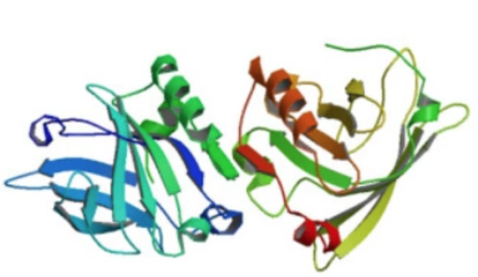
OmpCloud in Molecular Dynamics (HPCCS)
Single core (6h) Microsoft Azure (5min)
Supported by:
Microsoft Azure
Amazon AWS

Slide 17
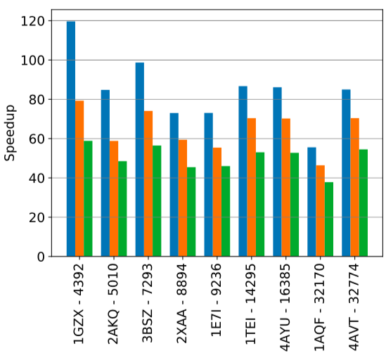
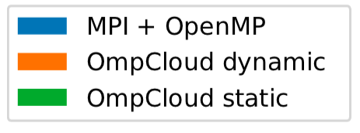
OmpCloud in Molecular Dynamics (HPCCS)

Slide 18
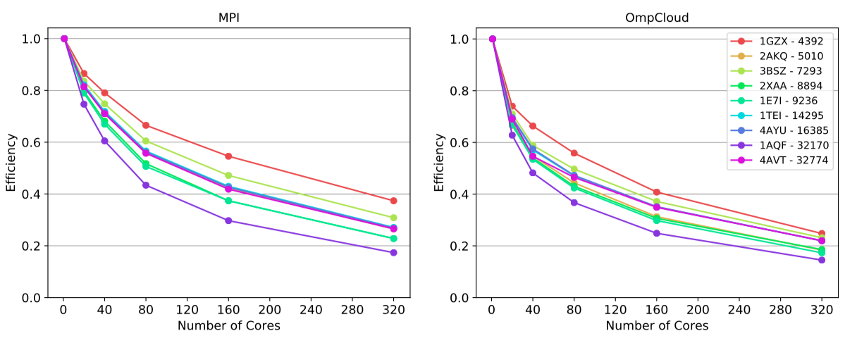
OmpCloud in Molecular Dynamics (HPCCS)

Slide 19
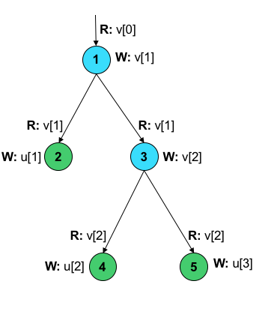
OpenMP Tasking
Extension for modeling asynchronous tasks (v3.0+)
New directives for describing dependences
Tasks are scheduled automatically by the runtime
for(int i=1, j=1; i<N; i++) {
#pragma omp task depend(in: v[i-1])
depend(out: v[i])
fun1(&v[i-1], &v[i]);
for(int k=0; k<i; k++, j++) {
#pragma omp task depend(in: v[i])
depend(out: u[j])
fun2(&v[i], &u[j]);
}
fun3(3*i); }

Slide 20
Programming Heterogeneous Cluster with OpenMP
Block-based matrix multiplication
Compute each block asynchronously using tasks
int BlockMatMul(float *A, float *B, float *C) {
for(int i = 0; i < N; i+=BS)
for(int j = 0; j < N; j+=BS)
for(int k = 0; k < N; k+=BS)
#pragma omp task depend(in: A[i:BS][k:BS], B[k:BS][j:BS])
depend(inout: C[i:BS][j:BS])
for(int ii = i; ii < i+BS; ++i)
for(int jj = j; jj < j+BS; ++j)
C[ii][jj] = 0;
for(int kk = k; kk < k+BS; ++k)
C[ii][jj] += A[ii][kk] * B[kk][jj];}

Slide 21
Programming Heterogeneous Cluster with OpenMP
Asynchronous target tasks are sent to remote worker nodes
Each block is computed in parallel within the node
int BlockMatMul(float *A, float *B, float *C) {
#pragma omp target device(CLUSTER)
for(int i = 0; i < N; i+=BS)
for(int j = 0; j < N; j+=BS)
for(int k = 0; k < N; k+=BS)
#pragma omp task depend(in: A[i:BS][k:BS], B[k:BS][j:BS])
depend(inout: C[i:BS][j:BS])
#pragma omp target map(to: A[i:BS][k:BS], B[k:BS][j:BS])
map(tofrom: C[i:BS][j:BS])
#pragma omp parallel for
for(int ii = i; ii < i+BS; ++i)
for(int jj = j; jj < j+BS; ++j)
C[ii][jj] = 0;
for(int kk = k; kk < k+BS; ++k)
C[ii][jj] += A[ii][kk] * B[kk][jj];
}

Slide 22
Programming Heterogeneous Cluster with OpenMP
The blocks multiplication can be written in CUDA manually by the programmer
int BlockMatMul(float *A, float *B, float *C) {
#pragma omp target device(CLUSTER)
for(int i = 0; i < N; i+=BS)
for(int j = 0; j < N; j+=BS)
for(int k = 0; k < N; k+=BS)
#pragma omp task depend(in: A[i:BS][k:BS], B[k:BS][j:BS])
depend(inout: C[i:BS][j:BS])
#pragma omp target map(to: A[i:BS][k:BS], B[k:BS][j:BS])
map(tofrom: C[i:BS][j:BS])
cuda_matmul_block(&A[i][k], &B[k][j], &C[i][j], BS);
}

Slide 23
Programming Heterogeneous Cluster with OpenMP

Slide 24

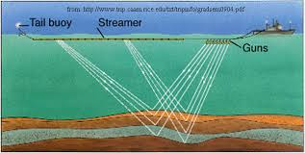
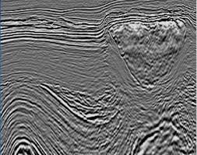
Motivation: Seismic Imaging (RTM and FWI Problems)

Slide 25
Merci! Thanks! Obrigado! Any questions ? 😃 Contact: guido@ic.unicamp.br

