Slide 1
Collection delay shifts cash needs
A four-period synthetic fixture keeps billings and cash costs fixed
UNFUNDED GAP AFTER THE ASSUMED BUFFER
0 SCU
0 SCU
45 SCU
No lag
One-period lag
Two-period lag
SYNTHETIC TEST DATA - internal output-format demonstration
SCU is not a real currency. Internal format test; no client or accounting conclusion.

Slide 2
The scenario holds billings and costs constant
400 SCU
240 SCU
75 SCU
Billings
Cash costs
Available buffer
same in all cases
same in all cases
assumption only
Assumptions are artificial test inputs; the fixture does not model revenue recognition, taxes, customer credit risk or actual financing.

Slide 3
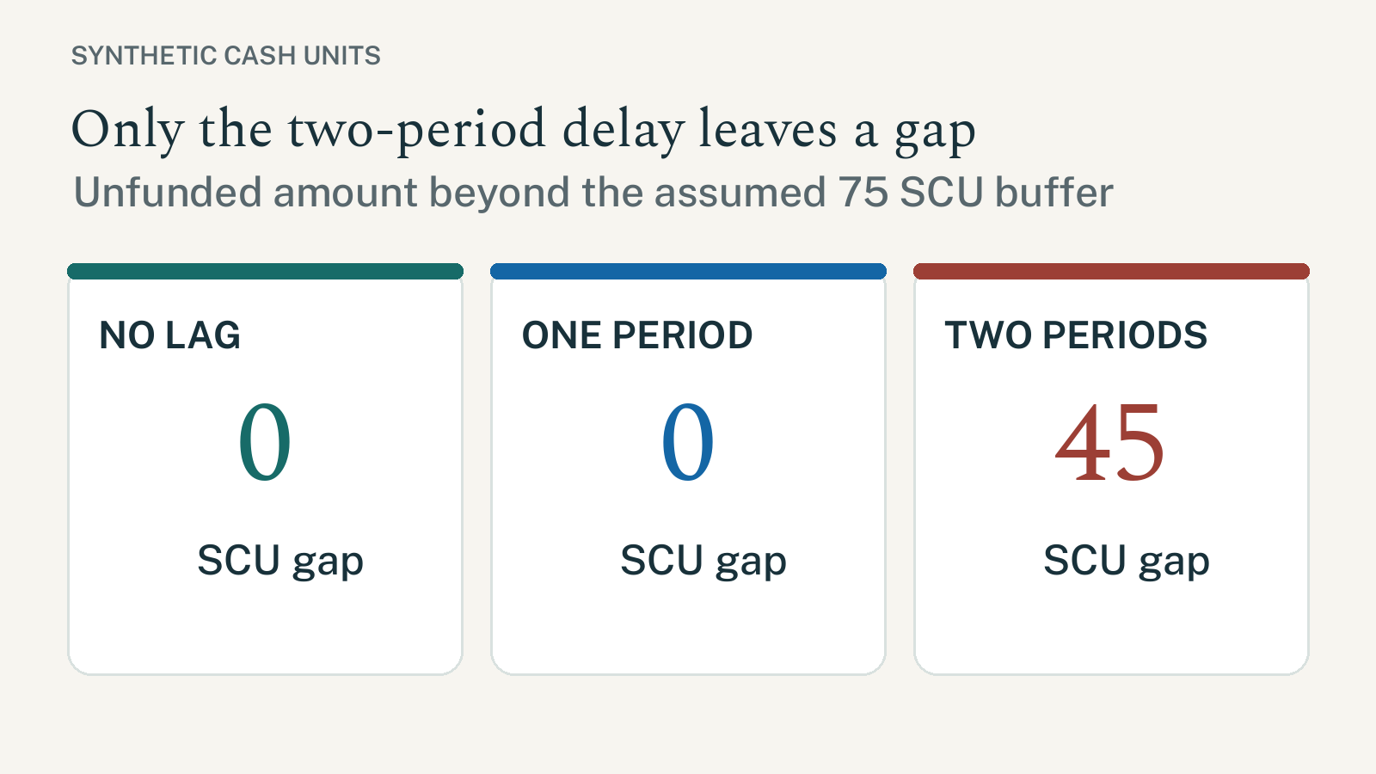
Buffer gap by collection delay
Synthetic calculation; not a forecast or committed funding gap.

Slide 4
Only receipt timing changes across the three cases
Lag
Cash trough
Funding need
Buffer
Gap
Ending AR
0 period(s)
0
0
75
0
0
1 period(s)
-60
60
75
0
100
2 period(s)
-120
120
75
45
200
Receivables are fixture billings not received by period 4; this is not an accounting subledger balance.

Slide 5
Use this pack to test file production, not to approve a transaction
01 Reporting entity, framework and transaction source: NOT ASSESSED.
02 Tax, revenue recognition and statutory presentation: NOT ASSESSED.
03 Independent Controller, language-owner and client review: NOT ASSESSED.
04 Before real use, reperform against an approved source contract and reconcile outputs.
No client, market, tax or financing claim is made. Do not publish or use as a client pack.

