Slide 1
STEP Tutorial:
“Fundamentals of STEP”
David Briggs, Boeing
January 16, 2001
PDES, Inc.
®
2001 NASA STEP Workshop
step.nasa.gov

Slide 2
Design Principles behind STEP (ISO 10303)
Incorporate meaning of data into a data structure
Provide a formal and computer sensible modeling language
Utilize a development process that allows subject area experts to focus on the meaning of the data to be exchanged
Retain independence of enterprise information from implementation forms (a single representation (model) can be used across all forms of implementation)
Notes:
Lessons learned from earlier translator efforts like IGES made several of these obvious. One of the key features of STEP that should become apparent from reading the above principles is that STEP is modular, both in structure and methodology.

Slide 3
ISO 10303
Document Architecture
Application Protocols
and Abstract Test Suites
Parts 200+ & 300+
Application Interpreted Constructs
Parts 500+
Description
Methods
Part 11
EXPRESS
Framework
Part 13
STEP
Development
Methodology
Conformance
Methods
Part 31
Conformance
Testing
Methods:
General
Concepts
Parts 32-39
Application Modules
Parts 1000+
Integrated Resources
Application Resources
Parts 101+
Generic Resources
Parts 41-99
Implementation Methods
Part 21 Exchange File, Parts 22-29
Notes:
23

Slide 4
The EXPRESS Modeling Language (ISO 10303-11)
What is EXPRESS?
  Formal information requirements specification language
  Computer sensible lexical and (partial) graphical form
  Object oriented flavor with multiple inheritance
  Population constraint rules
Why EXPRESS?
  Precision in definition of information model
  Allows use of computers to check for consistency of presentation
  Allows use of computers to develop any number of secondary views, particularly implementation views

Slide 5
EXPRESS Sample
SCHEMA example;
TYPE hair_type = ENUMERATION OF (blonde, black, brown, white); END_TYPE;
TYPE date = ARRAY [1:3] of integer; END TYPE;
ENTITY person SUPERTYPE OF (ONEOF(female, male));
first_name : STRING;
last_name : STRING;
nickname : OPTIONAL STRING;
birth_date : date;
children : SET [0:?] OF person;
hair : hair_type;
DERIVE age : INTEGER := years(birth_date);
INVERSE parents : SET [0:2] OF person FOR children;
END_ENTITY;
ENTITY female SUBTYPE OF (person);
INVERSE husband : SET [0:1] OF male FOR wife; ---husband is optional!
END_ENTITY;
ENTITY male SUBTYPE OF (person);
wife : OPTIONAL female;
END_ENTITY;
FUNCTION years(past : date): INTEGER;
(*This function calculates years from birthdate and current date.)
END_FUNCTION;
END_SCHEMA;

Slide 6
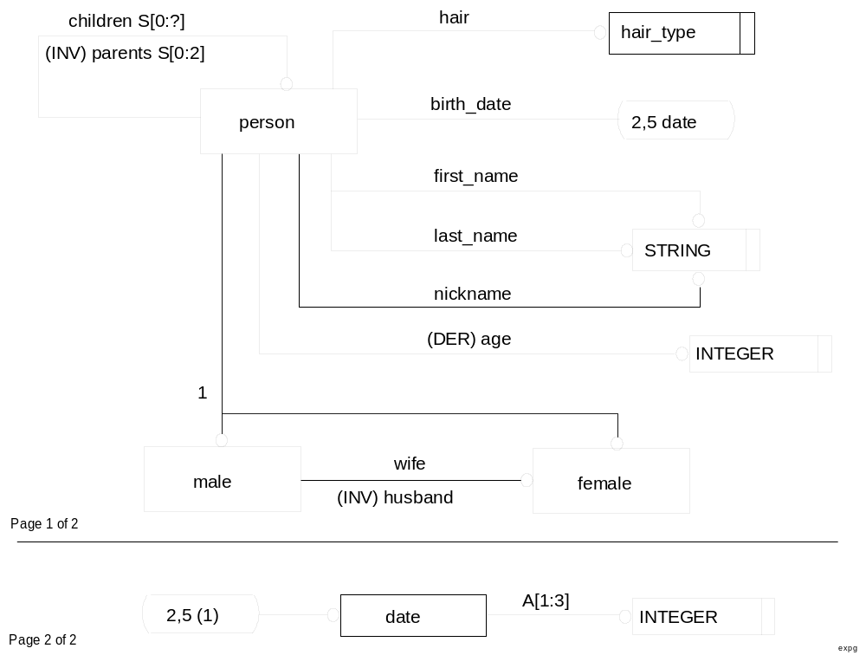
EXPRESS-G Example

Slide 7
Application Protocols
An Application Protocol (AP) defines the usage of STEP Product Data for a given application context
An Application Protocol represents a measurable and shareable subset of STEP capability that is expressed in an industry’s or discipline’s terminology
Application Protocols are the implementable parts of STEP and conformance testing is done for APs

Slide 8
Components of an AP &
Abstract Test Suite
A
P
P
L
I
C
A
T
I
O
A
N
P
P
L
I
C
A
T
I
O
N
R
E
F
E
R
E
N
C
S
E
C
O
P
E
/
R
E
Q
U
I
R
E
M
E
N
T
S
I
N
T
E
R
P
R
E
T
E
D
M
O
D
E
L
(
A
I
M
M
)
O
D
E
L
(
A
R
M
&
)
C
O
M
M
O
N
A
L
I
T
I
E
S
H
o
w
d
o
I
r
e
p
r
e
s
e
n
W
t
h
a
t
I
n
f
o
r
m
a
t
i
o
n
O
v
e
r
l
a
p
s
?
t
h
i
s
i
n
f
o
r
m
a
t
i
o
W
n
h
a
t
i
n
f
o
r
m
a
t
i
o
W
n
h
a
t
F
u
n
c
t
i
o
n
s
?
w
i
t
h
S
T
E
P
d
?
o
I
n
e
e
d
t
o
d
W
o
h
a
t
P
r
o
d
u
c
t
L
i
n
e
s
?
S
c
h
e
m
m
a
y
j
o
b
?
E
n
t
i
t
y
P
r
o
d
u
c
W
t
h
a
t
K
i
n
d
o
f
S
o
f
t
w
a
r
e
S
y
s
t
e
m
?
P
i
d
:
S
t
r
i
n
E
g
n
t
i
t
y
C
o
m
p
o
s
i
t
i
o
A
n
s
s
e
m
b
l
y
:
P
i
C
d
o
m
p
o
n
e
n
t
:
S
e
t
o
f
P
i
d
A
S
S
E
M
B
L
Y
C
O
M
P
O
N
E
N
T
S
E
N
T
I
T
Y
C
U
R
V
E
.
;
.
.
E
N
D
_
E
N
T
I
T
Y
;
C
O
N
F
O
R
M
A
N
C
E
R
E
Q
U
I
R
E
M
E
N
T
S
A
B
S
T
R
A
C
T
T
E
S
T
S
U
I
T
&
E
T
E
S
T
P
U
R
P
O
S
E
S
W
h
a
t
w
i
l
l
I
t
e
s
t
f
o
r
?
S
T
A
T
E
S
T
C
A
S
E
S
F
i
n
d
C
e
n
t
e
r
P
o
i
n
t
s
o
f
H
u
b
a
n
d
W
h
e
e
F
l
i
n
d
t
h
e
S
i
z
e
o
f
t
h
e
W
h
e
e
l
T
h
e
C
o
m
p
l
e
t
e
S
e
t
o
f
A
b
s
t
r
a
c
t
T
e
s
t
C
a
s
e
F
s
i
n
d
t
h
e
C
i
r
c
u
l
a
r
T
o
l
e
r
a
n
c
e
N
e
c
e
s
s
a
r
y
t
o
P
e
r
f
o
r
m
C
o
n
f
o
r
m
a
n
c
e
T
e
s
t
i
n
F
g
i
n
d
A
l
l
C
o
m
p
o
n
e
n
t
P
a
r
t
s
i
n
t
h
e
A
s
s
e
m
b
l
y

Slide 9
Integrated Resource Models
Fundamental building blocks of product data
Created to service the needs of APs
A single large data model
Structurally and semantically integrated, not a simple pile of models
Example topics include geometry, product structure, configuration management, finite elements, drafting resources, etc.

Slide 10
Implementation Methods
Mapping of STEP information models in EXPRESS into implementation forms
Part 21: Clear text encoding for exchange file
Parts 22,23,24,26,27,29: Standard Data Access Interface
  Definition of a virtual data repository and programming interfaces (API’s)
  Binding for C, C++, OMG IDL, Java (regular and lightweight)
Part 28: XML representation of EXPRESS and data
  Multiple bindings
  Still in development

Slide 11
ISO 10303-21 File Example
ISO-10303-21;
HEADER;
FILE_DESCRIPTION((‘This is a sample person schema’),’1’);
FILE_NAME(‘Example P21 File’,’1999-08-08 T15:30:00’,(‘J.Doe’), (PDES, Inc.’),
‘Version 1’,’APPROVED BY P.H. Boss’);
FILE_SCHEMA;
ENDSEC;
DATA;
#1=PERSON(‘Dilbert’,’Jones’,$,(30,5,1962),(),.WHITE.);
#2=PERSON(‘Wally’,’Smith’,$,(30,5,1960),(#11,#20),.BROWN.);
...
#10=MALE(‘Pointy’,’Boss’,$,(29,05,1961),(),.BLACK.,#21);
#11=MALE(‘Atos’,’Smith’,$,(16,03,1990),(),.BROWN.,$);
...
#20=FEMALE(‘Ellen’,’Smith’,$,(08,03,1992),().BLONDE.);
#21=FEMALE(‘Francis’,’Boss’,’Fran’,(18,6,1962),(),.BROWN.);
.
.
ENDSEC;
END-ISO-10303-21;

Slide 12



Conformance Testing and Certification
STEP objectives include assertions that an implementation completely supports one or more conformance classes (ISO 10303-3X)
APs includes a collection of test cases which must be met using a standardized test methodology
Software vendors’ STEP products are being certified through an international Certification Board

Slide 13
Current Focus Areas in STEP
Harmonization of AP semantics
Modular architecture
Standards published on the Web
Integration of STEP with XML and other Web technologies
Notes:
Lessons learned from earlier translator efforts like IGES made several of these obvious. One of the key features of STEP that should become apparent from reading the above principles is that STEP is modular, both in structure and methodology.

Slide 14
Major Requirements for Modularization
High cost and lengthy time for developing an AP
Companies requiring the implementation of a combination of multiples APs or AP extensions
Expectation from vendors for the reuse of application software
Duplication and repeated documentation of the same requirements in different APs
Reuse of data generated by an implementation of one or more APs, by an implementation of one or more different APs (AP interoperability)

Slide 15
Evolving the
STEP Architecture
Comprehensive
Group of STEP
Modules
APs with
initial AICs
CDIMs/
APs
AP
AIC
AP
AIC
AIC
AP
AP
Implementor
Agreements
Usage Guides
Islands of APs
AP Interoperability
Plug and Play
1988-1994
1994-2000
1997-2003

Slide 16
Foundation Modules and the
AP Architecture
Application Protocol
STEP
Suite(s)
of
Interoperable,
Harmonized
and
Integrated
Modules
Application Modules
STEP Foundation
Application Modules
Integrated Resources,
AIRs, and AICs

Slide 17
STEP for the Web Architecture
Application Activity Model
- What process do I want to
support?
Application Reference Model
- What are the information
requirements of the activity
in industry terminology?
Application Interpreted Model
Usage Guide
- How do I model the
required information using
STEP and EXPRESS XML?
Design
Assembly
Components
definition
Build
relationship
Test
assm_rel
Components of a STEP Application Protocol
EXPRESS Language
- A data specification
language
- Entity
- Subtype
- Attribute
- Data Type
- Rule
EXPRESS-driven XML
Implementation Method
- What Web implementation
technology do I need?
Integrated Resource Models
written in EXPRESS
- Generic structures specialized
in application protocols
definition
relationship
assm_rel

Slide 18
Summary
STEP is designed to provide specifications and methods that enable the exchange and sharing of enterprise information
New approaches are defining a modular architecture and methods for using STEP on the Web
STEP provides a flexible way for implementors to meet the data exchange needs for multiple industries and disciplines
Visit http://www.nist.gov/sc4 for more details about the fundamentals of STEP

Slide 19
Questions?
Notes:
Lessons learned from earlier translator efforts like IGES made several of these obvious. One of the key features of STEP that should become apparent from reading the above principles is that STEP is modular, both in structure and methodology.

Slide 20
Back-up slides
Notes:
Lessons learned from earlier translator efforts like IGES made several of these obvious. One of the key features of STEP that should become apparent from reading the above principles is that STEP is modular, both in structure and methodology.

Slide 21
Architecture of STEP
Industrial Needs (Scope)
Satisfies Data Requirements of
Has Complete Mapping To
Application Reference Model (ARM)
Describes Processes for
Tests Satisfaction of
Business Process Application Model (AAM)
Based On
Is Driven By
Has Complete Mapping to
Abstract Test Suites (ATS)
Based On
STEP Integrated Resources (IR)
Uses
Is Certified Against
Conformance Classes
Is Subset Of
Application Interpreted Model (AIM)
Uses
Algorithmically Based on
Application Interpreted Constructs (AIC)
STEP Conformant Implementation
Satisfies One or More
Uses
Data Access Via
Uses
Exchange File Format Part 21
Data Definition Language (DDL) EXPRESS
Part 11
Data Manipulation Language (DML)
Part 22
Application Programming Interfaces (API)
Part 2X
Based on
Described Using
Described Using

Slide 22
EXPRESS-G Syntax Reference Sheet

