Slide 1

Estimation of demolition and new construction of housing in US counties until 2060 Implications for building material reuse potential
Peter Berrill
ICWMT 15, June 30, 2020
Notes:
While many of the lectures in this course will deal with the nuts and bolts of how buildings work and how they use energy, this talk presents a top down analysis of recent trends and drivers of US REC.

Slide 2

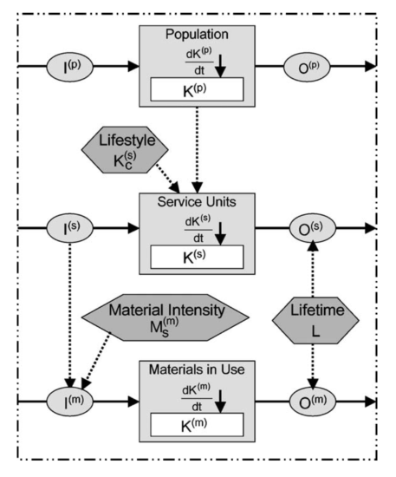
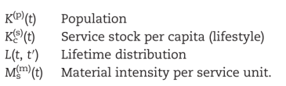
Dynamic Stock Models of Buildings
Dynamic Stock Model
Drivers (Inputs)
Results, over time
Inputs (construction)
Outputs (demolition)
Total Stock
Müller, D.B (2006), Ecol. Econ., ‘Stock dynamics for forecasting material flows—Case study for housing in The Netherlands’
Notes:
Valuable not only in terms of economic worth, but crucial to everyday life. We pay a lot of money for housing. More than anything else.
If we pay so much for housing, it is one of the major ways we can affect our footprints through what we buy.
We should also aim to be comfortable and healthy in our homes. Something that requires energy, but the amount of energy required to maintain healthy comfortable conditions varies a lot by home type (and climate).

Slide 3

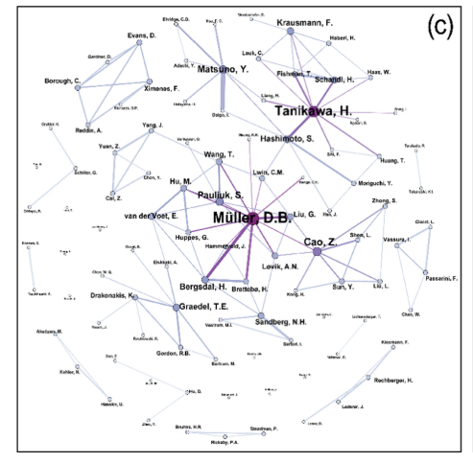
Dynamic Stock Models of Buildings
b) Tag cloud of the journal article authors
c) Network of coauthorship
Lanau et al. (2019), Env. Sci. Tech., ‘Taking Stock of Built Environment Stock Studies: Progress and Prospects’, Fig. 2
Notes:
Valuable not only in terms of economic worth, but crucial to everyday life. We pay a lot of money for housing. More than anything else.
If we pay so much for housing, it is one of the major ways we can affect our footprints through what we buy.
We should also aim to be comfortable and healthy in our homes. Something that requires energy, but the amount of energy required to maintain healthy comfortable conditions varies a lot by home type (and climate).

Slide 4
Current research goals
Identify strategies for GHG reduction from US residential buildings, all life cycle stages
Model and project results of
Energy demand
Construction material requirements and waste generation
Comprehensive GHG emissions from residential sector activities
Data needs: housing stock by type, age, location

Slide 5
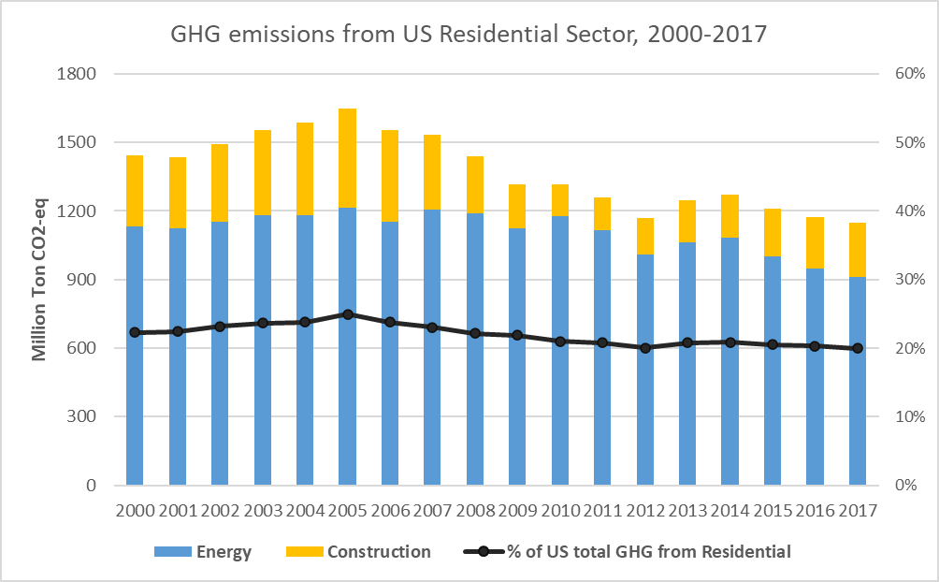
US residential sector in context global GHG emission
In top 2 emitters of residential GHG emissions globally: ~1Gt CO₂ from energy, 0.2Gt CO₂ from construction. Reducing by ~1.5% annually, due to low-C electricity

Slide 6
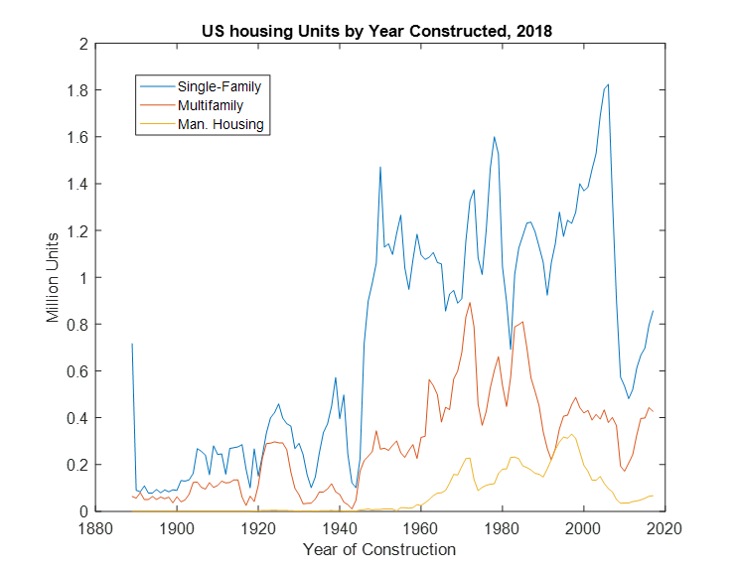
US housing mostly older & single-family
EIA, 2018
Own calculations, based on several sources

Slide 7
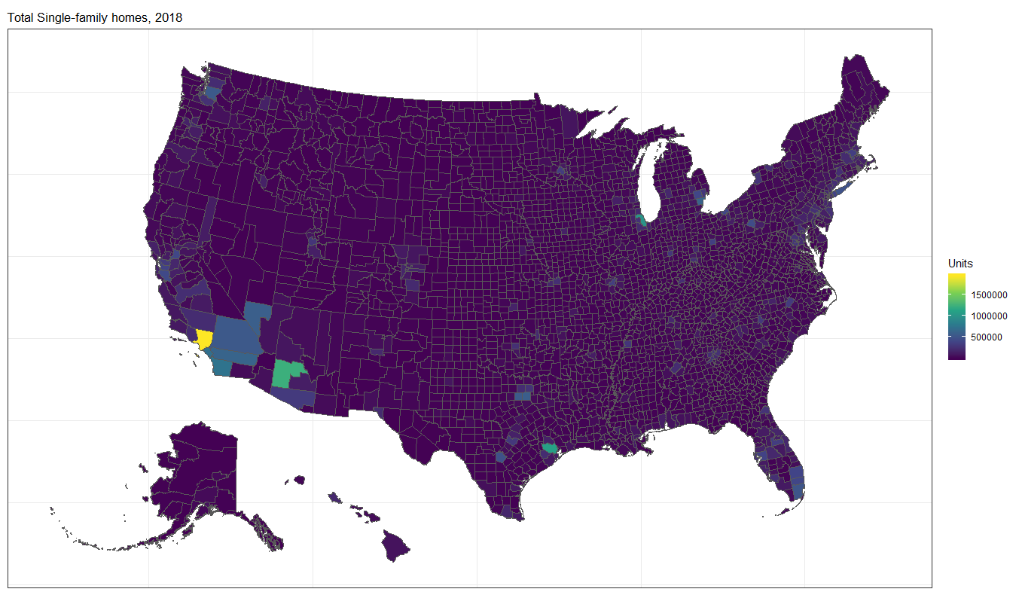
Spatially disaggregated housing stock – Single-family

Slide 8
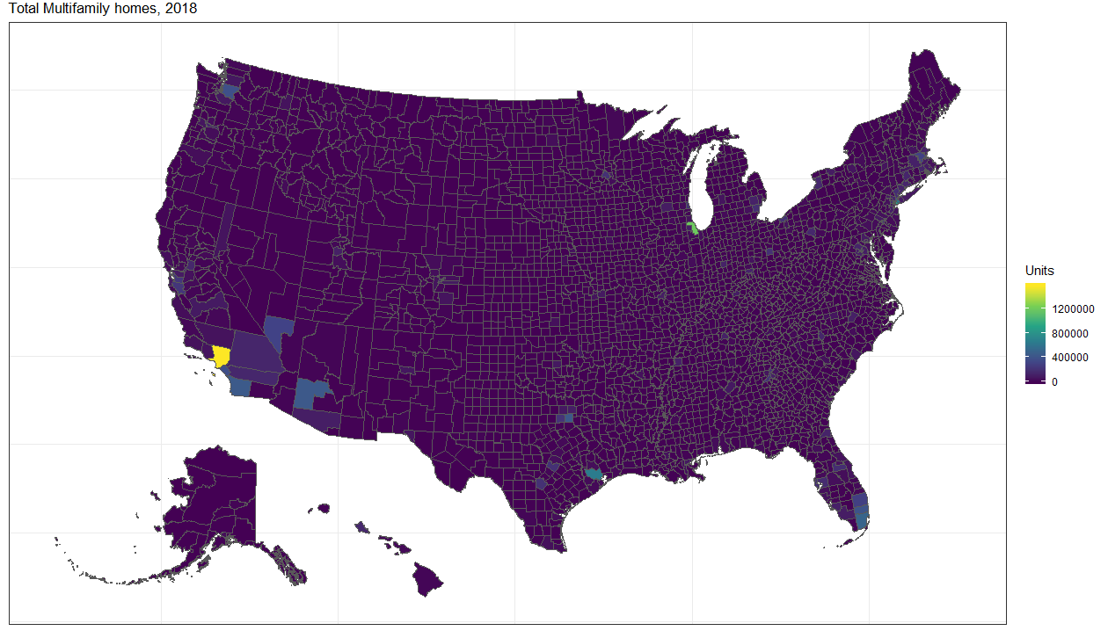
Spatially disaggregated housing stock – Multifamily

Slide 9
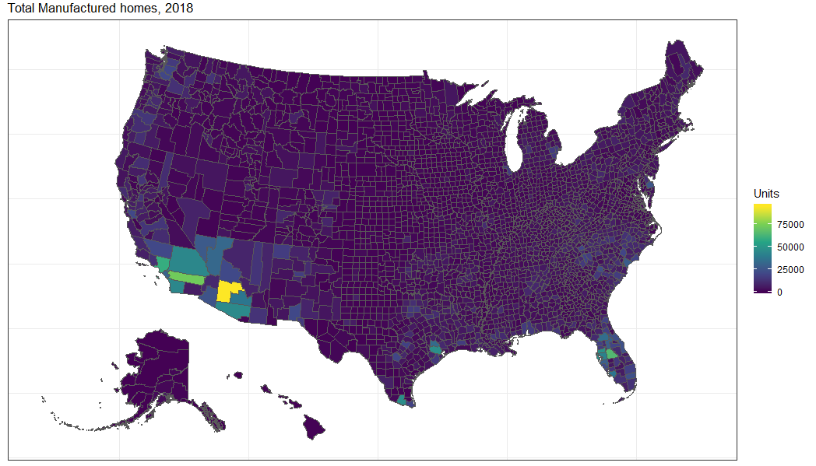
Spatially disaggregated housing stock – Manuf. Homes

Slide 10
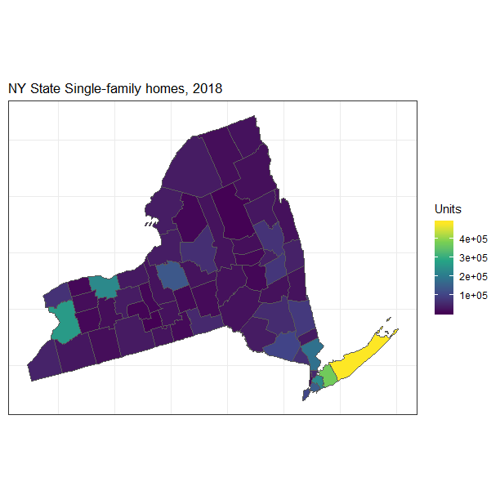
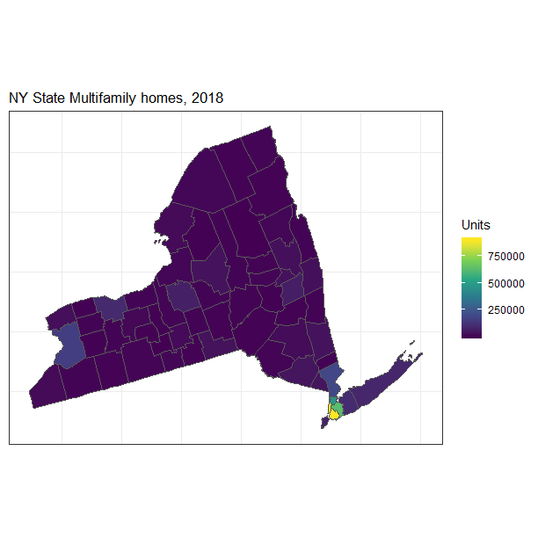
Single-family and Multifamily homes, NY State

Slide 11
Basic stock model equations
C_{t+1} = (S_{t+1} - S_{t}) + D_{t+1}
C = new construction, D = demolition, S = stock = V*O
V = vacancy ratio = total units/occupied units; O = occupied units
New construction can results from S_{t+1} > S_{t}, from D_{t+1} > 0, or from V_{t+1} > V_{t}
Notes:
Need to change the formulation to allow for varying vacancy rates. So that counties with shrinking populations can have increasing vacancy rates, and counties with rapidly increasing population could have smaller vacancy rates, at least for a while.
Also need to allow for changes in the type splits. Currently the type split is kept constant across counties.

Slide 12
Projections of demolition, based on lifetime distribution
Year of construction (<1890 to 2017) based on decadal Censes, various survey data, and estimates by Moura et al (2015)
Lifetime distribution functions estimated per each decadal cohort (1940s, 1950s, etc.)

Slide 13

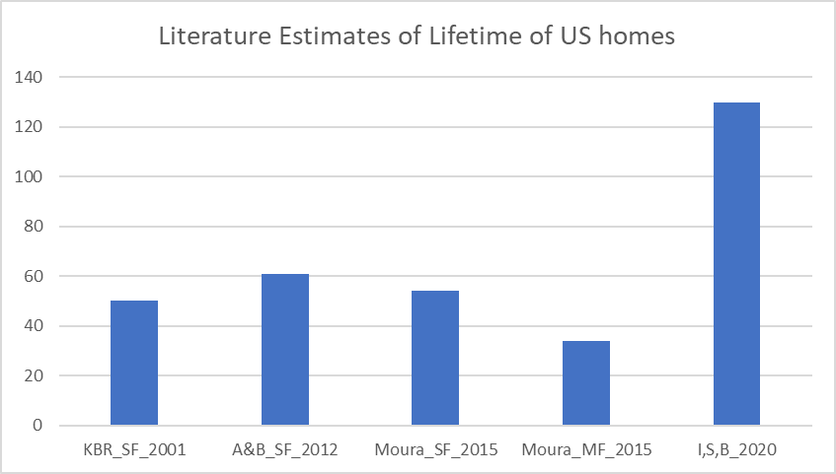
What is the lifetime of a house in the US?
Sources: Keolian et al (2001); Aktas & Bilec (2012); Moura et al (2015); Ianchenko et al (2020)

Slide 14
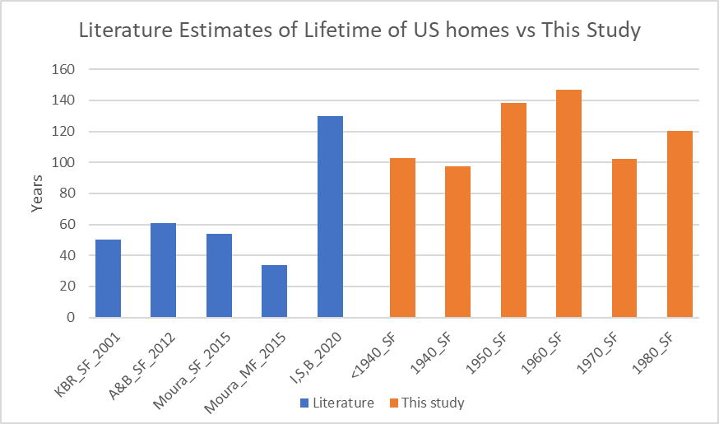
What is the lifetime of a house in the US?
Median lifetimes estimated based on Weibull lifetime distribution functions for different vintages
Sources: Keolian et al (2001); Aktas & Bilec (2012); Moura et al (2015); Ianchenko et al (2020). See also Miatto et al (2017)

Slide 15
Method to project future demand for housing
C_{t+1} = (S_{t+1} - S_{t}) + D_{t+1}
Estimate future stock of total housing per county based on three factors:
Population by house type
Household size by house type
Vacancy rate by house type

Slide 16

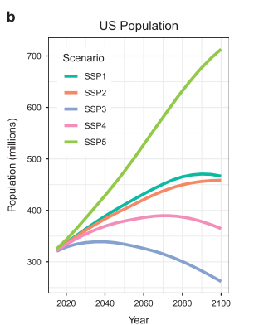
1. Q: Who would estimate future population at local scale?
A: Hauer (2019) scaled SSP population projections to 2100 to US county level

Slide 17
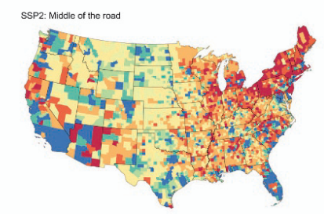
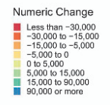
1. Q: Who would estimate future population at local scale?
A: Hauer (2019) scaled SSP population projections to 2100 to US county level

Slide 18
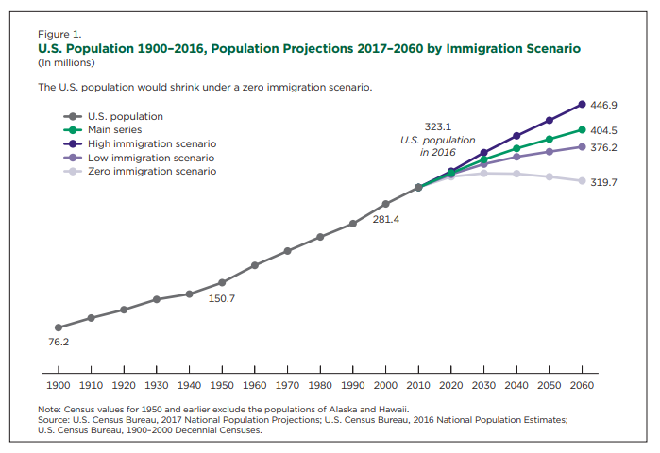
1. Implementation of Hauer Population Data
Scaled SSP2 to match the main series from the USCB population projection
Assumed no change in house type split of population per county, for now

Slide 19
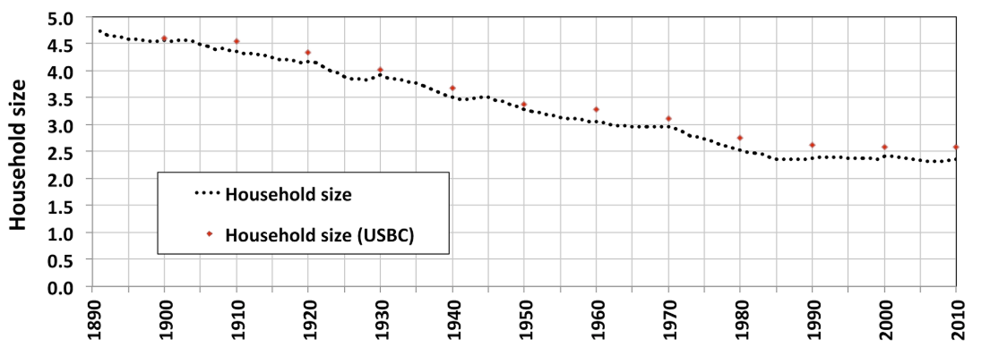
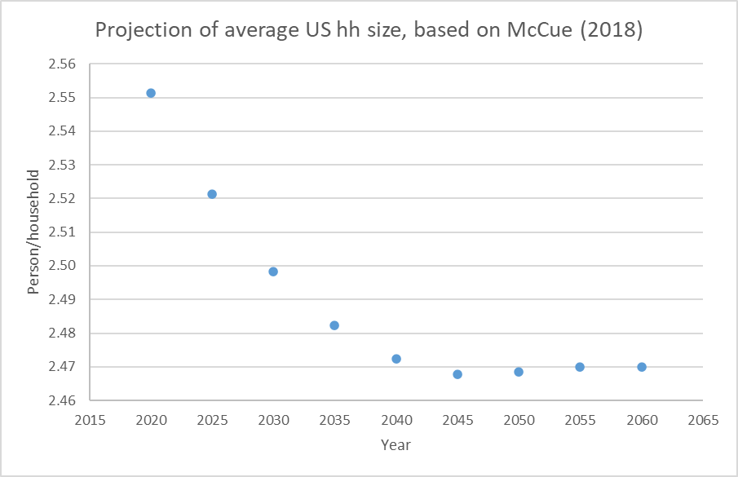
2. Projections of household size
Like most countries, US has seen notable decline in household size
I use data from McCue (2018) to project further modest reductions from 2020-2060, with the same average reduction applying evenly to different house types and counties
Moura et al (2015)

Slide 20
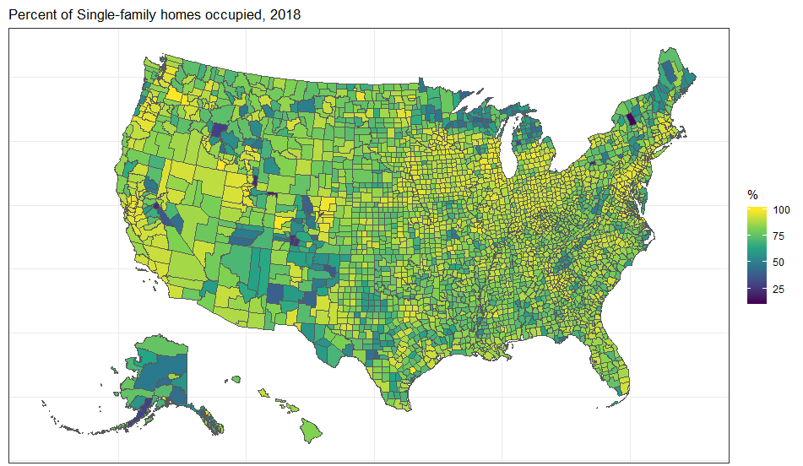
3. Occupancy/vacancy rates by county
10% of SF homes are vacant. 15% for MF, 22% for MH. Lowest rates since mid-1980s

Slide 21
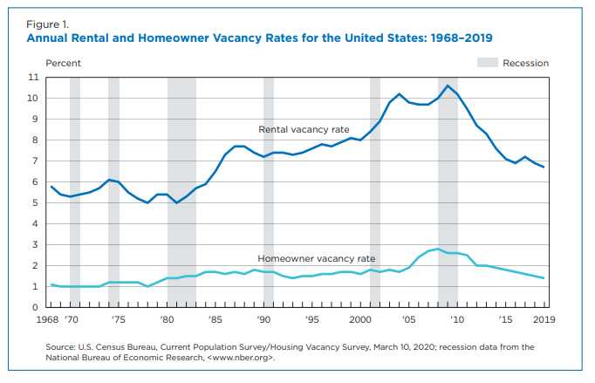
3. How will vacancy rates develop?
On downward trend, construction is currently not keeping up with population growth, & large increase in demand for rental housing

Slide 22
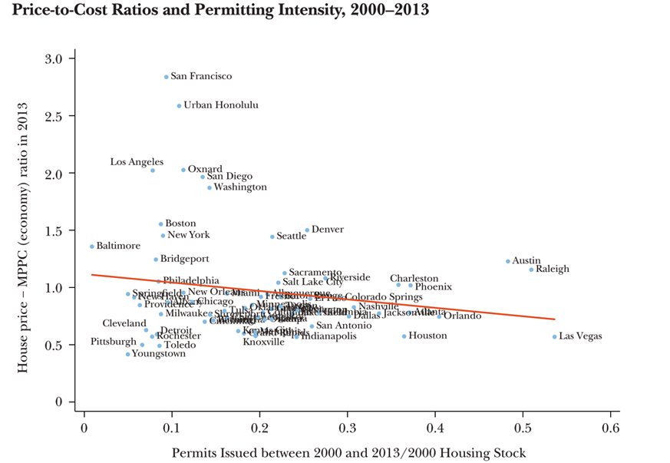
How will vacancy rates develop?
Currently no modeled change in vacancy rates. Adapt -> reduce vacancy in growing/highly regulated counties. Increase vacancy in declining counties
Housing construction highly restricted, vacancy rates may decline
Population decreasing, low demand for new housing, vacancy rates may increase
Glaeser & Gyourko (2018), Jour. Econ. Per., ‘The economic implications of housing supply’

Slide 23
Results: National annual construction and demolition
National total

Slide 24
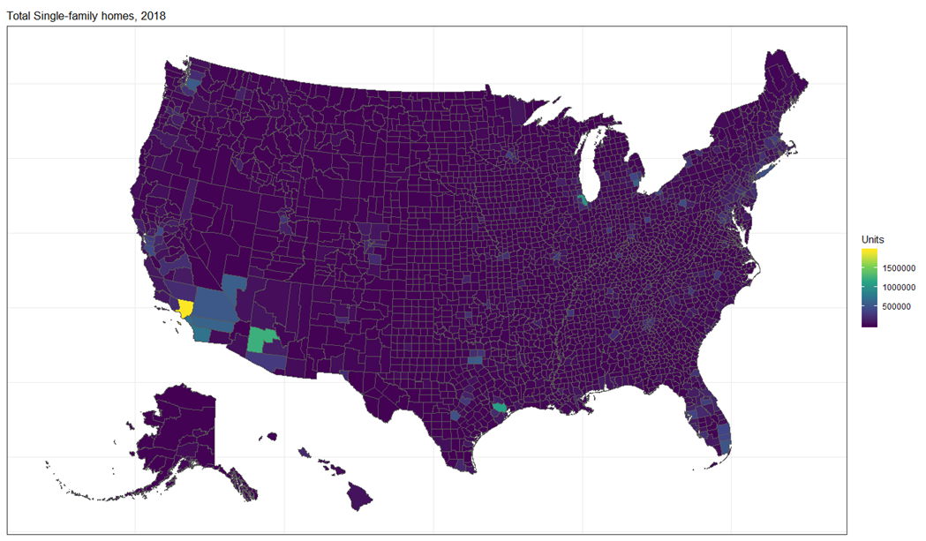
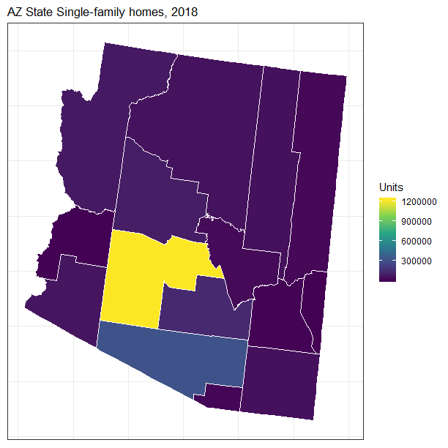
Results: National annual construction and demolition
Maricopa Cty, AZ

Slide 25
Results: National annual construction and demolition
Cochise Cty, AZ

Slide 26
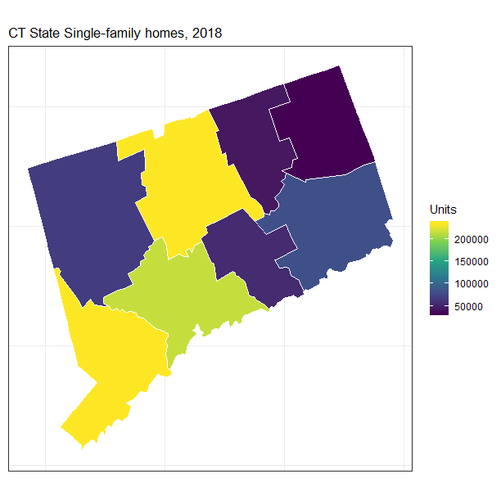
Results: National annual construction and demolition
New Haven Cty, CT

Slide 27
Implications for material reuse
Circular economy potential may exist for bulk construction material in some counties
With further refining of our model and investigating of local effects, we can find out which locations have highest/lowest potential for material reuse
Currently only considering one sector – residential buildings. Broadening scope to include non-residential buildings, roads, and other infrastructure can give more insights

Slide 28
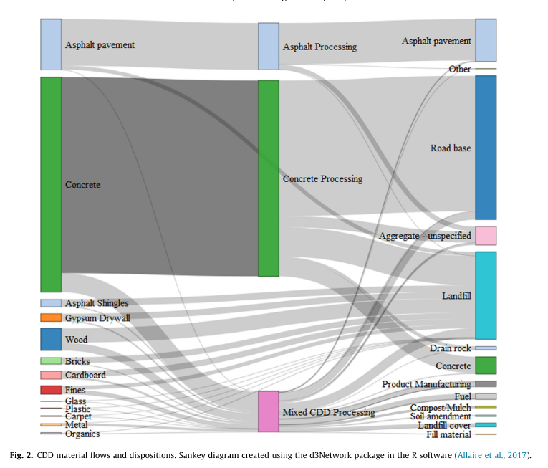
Where does construction waste currently go?
Most end-of-life concrete currently goes back into road bases, only a small part goes back into new concrete
Townsend et al (2018), Waste Mgmt., ‘CDDPath: A method for quantifying the loss and recovery of construction and demolition debris in the US’

Slide 29
Next steps
Assumptions regarding vacancy rates
Calculation of material intensity of housing, to estimate material flows
Investigate environmental benefit of circular material flows
Energy scenarios based on lifetime distribution, household size, housing type mix

Slide 30

Thank you!
peter.berrill@yale.edu
https://github.com/peterberr
https://www.researchgate.net/profile/Peter_Berrill

