Slide 1
Yoga
Péter Borkuti

Slide 2
Why
5+ years
Useful
Cheap
Not consumes time
Notes:
Why I Chose Yoga
I have benn doing Yoga more than 5 years
It is useful (back-pain, strengthen, challenge)
Cheap (no equips, no fitnesclub, no special clothes)
I can do when/where I want

Slide 3
Summary
Compare sports
Yoga in a nutshell
Warming up
Beginner's set
Tips & Tricks
Questions

Slide 4
Compare Sports
Important features of sports
Notes:
Comparing sports with each other
Let's choose some sport
Activity: give some ideas about features
of sports to compare them

Slide 5
Compare Sports
Equipments
Cloths
Price
Dependent Whether/Place/Season/Time/Others
Boring
Improvement
Outdoor/Indoor
Room
Usefulness

Slide 6
Compare Sports
 | FBall | Run | Bike | Aikido | Fitness | Judo | Swim | Skii | Yoga
Equips
Cloths
Price
Outd
Boring
Indoor
Room
Group
Useful

Slide 7
About Yoga - Meaning

Slide 8
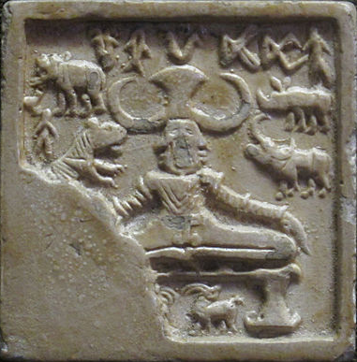
About Yoga - History
2000-1500 B.C. ???
Notes:
Indus Valley Civilization
Mohenjo-daro
Planned streets, bath and drainage system nearly every houses
Stamp seal – carved stone used to impress picture into soft, prepared clay. Usually only the impresses survived through time

Slide 9
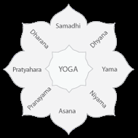
About Yoga - History
- 400 CE – Yoga Sutras by Patanjali
Yama (proper behavior)
Niyama (proper attitude)
Asana (posture)
Pranayama (breath/energy)
Pratyahara (withdrawing)
Dharana (concentration)
Dhyana (meditation)
Samadhi (absorption)
Notes:
Nyama : do, yama: do not do

Slide 10
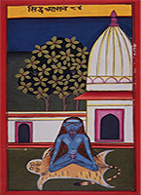
HATHA YOGA PARADIPIKA
15th century CE
Synthesis of older Sanskrit texts
15 asanas
Notes:
i.e., cold bath in the morning, eating at night, or eating fruits only
Yoga is destroyed by the following six causes:—Over-eating, exertion, talkativeness, adhering to rules, i.e., cold bath in the morning, eating at night, or eating fruits only, company of men, and unsteadiness

Slide 11
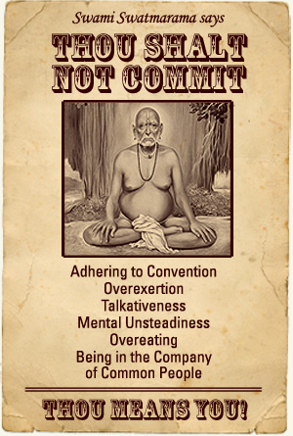
HATHA YOGA PARADIPIKA
Six not to do
adhering to rules
Too much effort
Chattering
Notes:
i.e., cold bath in the morning, eating at night, or eating fruits only
Yoga is destroyed by the following six causes:—Over-eating, exertion, talkativeness, adhering to rules, i.e., cold bath in the morning, eating at night, or eating fruits only, company of men, and unsteadiness

Slide 12
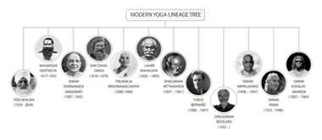
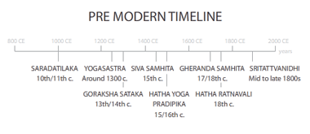
About Yoga - History
1000 CE – 1900 CE

Slide 13
About Yoga - Types

Slide 14
Warming Up
7+ minutes
Every joint
Every muscle
Systematic (up-down)
Sweat
Body resistance
Ended with dynamic warming up
Not stretching

Slide 15
Warming Up - Joints
Neck
Arms
Upper body
Hips
Foots
Combined jumps

Slide 16
Beginner's set
10 minutes
3 / week for 2 months
5 / week for 3 months
Danger! Start with a lecturer!
Danger! Ask your doctor!
Danger! Only when you are health

Slide 17
Important
Necessary muscles are working
Unnecessary muscles are relaxing
How do you know that your muscle is relaxing?

Slide 18
Let's relax
Prof. Dr. Bagdy Emőke: psychofitness
Laugh
Jog
Relax
Touch
Help
(kacagj, kocogj, lazíts, érints, segíts)

Slide 19
Lightning relaxation

Slide 20
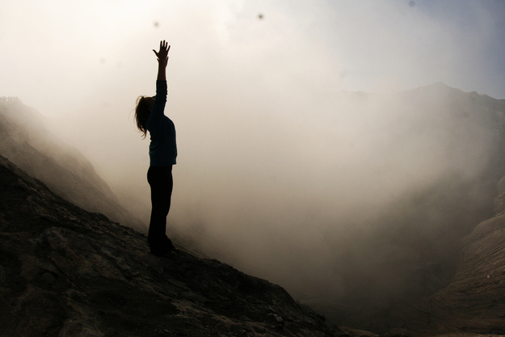
Mountain Pose
Notes:
Simple standing pose
You may strech out your hand to the sky or just behind you formed an upside-down V or just hang themnext to your body

Slide 21
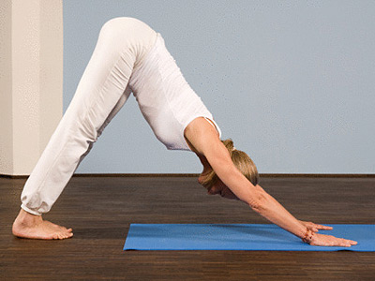
Downward Facing Dog
Notes:
Shape your body like an inverted V
May put your heels onto the ground
Keep your back straight
Stretch with psuhing your heels onto the ground

Slide 22
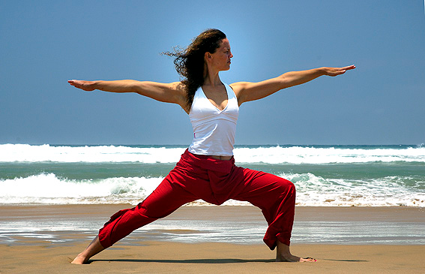
Warrior pose
Notes:
Left foot bend in 90 degrees
Turn your left foot in a bit
Dont let your knee go past your toes
Turn out your right foot 90 degrees

Slide 23
Warrior pose
Notes:
Left foot bend in 90 degrees
Turn your left foot in a bit
Dont let your knee go past your toes
Turn out your right foot 90 degrees

Slide 24
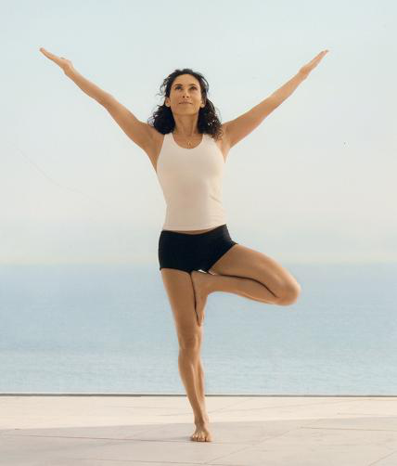
Tree pose
Notes:
place the sole of your left foot inside your right thigh

Slide 25
Tree pose - variations
Notes:
place the sole of your left foot inside your right thigh

Slide 26
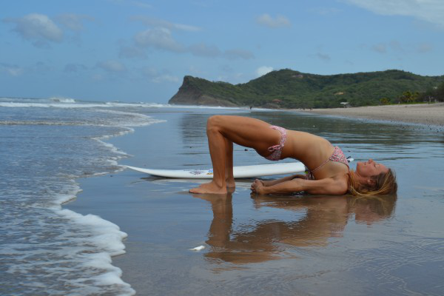
Bridge pose
Notes:
place the sole of your left foot inside your right thigh

Slide 27
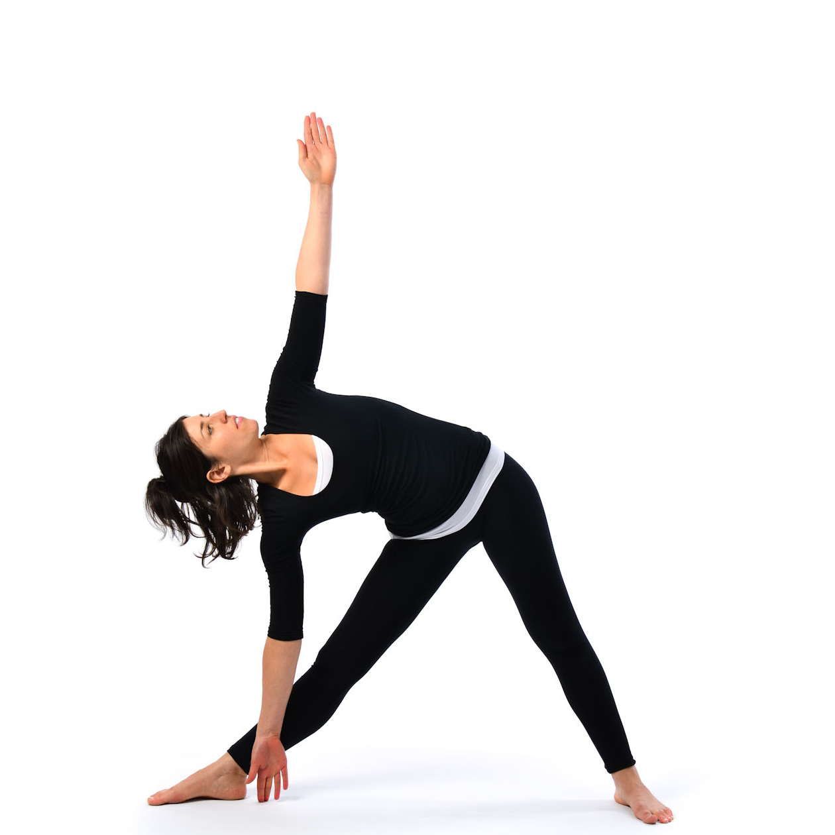
Triangle pose
Notes:
place the sole of your left foot inside your right thigh

Slide 28
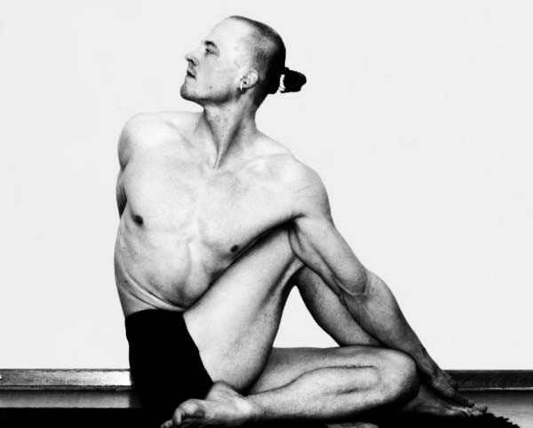
Seated twist
Notes:
place the sole of your left foot inside your right thigh

Slide 29
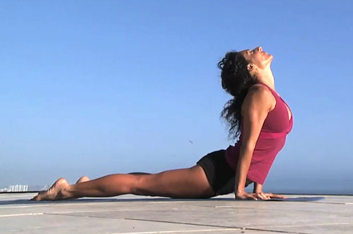
Upward facing dog

Slide 30
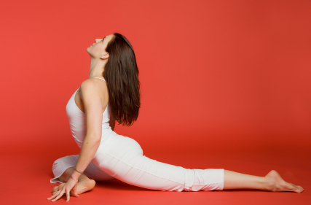
Pigeon pose

Slide 31
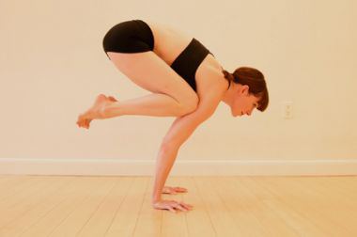
Crow pose

Slide 32
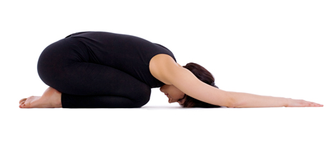
Child pose

Slide 33
Tips
Teacher's Adjustment
Notes:
feel confident that you can politely refuse any teacher's adjustment. If you think, that you have some sensitive areas, you can talk to your teacher before class or just say "no thanks" if they move to deepen your pose.

Slide 34
Tips
Listen to your body
Notes:
always listen to your own body and respect your edge. Forcing your way into for example a deeper forward bend is going to be extremely counter productive.

Slide 35
Tips
Select an appropriate teacher
  Not only one
  Change with time
  Balanced person
Notes:
Train with more than one teacher: if he/she disappears, you wont give yoga up
A teacher who appropriate at the first 3 months, may not be appropriate for you after 2 years practicing
The most important thing is yoga-teaching. But if your teacher is not suits to you, you may not be motivated enough

Slide 36
Tips
Boring
  Visit different yoga clubs
  Choose alternative poses

Slide 37
Questions

