Slide 1

Learning
Notes:
This presentation is organized around the most important questions regarding to learning and I will try to help you to choose the best answers for these questions.
Questions about Learning:
What to learn?
How to learn effectively?
Where to learn?
Why to leanr?
When to learn?
Who will be your teacher?
Let's see the weight of the topics

Slide 2
Learning
0.5
2(5)+
1(5)
1(4)
22
0.5
Notes:
The numbers means the number of slides, in brackets the number of different subtopics in a slide.
And the bonus topic:

Slide 3



Learning
Notes:
Proof
I will cover what proof means, what are the possible proofs after learning.
You are allowed to stop me any time with questions.
Questions about the topics which will be covered in the next 30-40 minutes?
Lets see our first two topic (which is a bit out of scope, so I will only touch it)

Slide 4

What
Notes:
What to learn? We skip this section, Nowdays anybody can learn nearly everything from Jiu-Jitsu to rocket science
Why to learn? However it is very important question I will also skip this because of our time limits. It is important because if you do not know why to learn you may not have enough motivation and learning can be a long, hard task, you definitely must have strong motivation.
So please do not ask about these two topics, just skip them a see the next topic, which is a really huge one.

Slide 5

Notes:
Where to Learn?
Let's see the possibilites.

Slide 6





Notes:
At Universities, at home, at professionals (I mean at companies), in groups and in groups which have one or more leaders.
Let's go into the details

Slide 7
Notes:
Learning at Universities is a very common way of gathering knowledge but it is not easy to choose the right one. So I will show you how to to choose one.
Probably you would like to choose a good university.
Look at the next slide, who are the people on it?

Slide 8
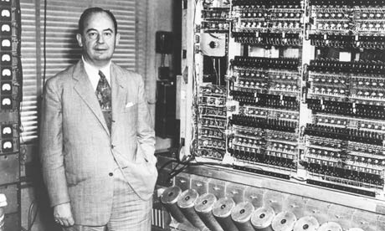
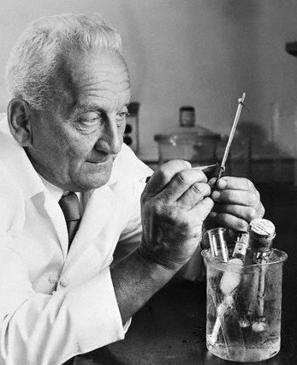
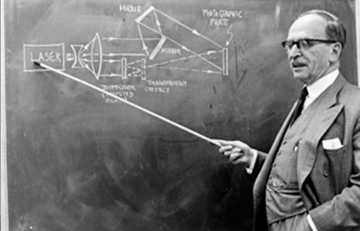
Notes:
Clue: famous Hungarian-born scientists. Two of the rewarded with Nobel price. One of them was working in Hungary when he was promoted to the Nobel price.

Slide 9
Three Famous Hungarian Scientists
John von Neumann
Albert Szent-Györgyi
Dennis Gabor
Notes:
John von Neumann: mathemathician, physicist, one of the fathers of computer sciences, He was an extraordinary child prodigy in the areas of language, memorization, and mathematics. As a 6-year-old, he could divide two 8-digit numbers in his head.By the age of 8, he was familiar with differential and integral calculus
Dennis Gabor: electrical engineer and physicist. Got Nobel prize in Physics in 1971 for his invention and development of the holographic method
Albert Szent-Györgyi physiologist Got Nobel prize in 1937. He is known for vitamin C, discovering the components and reactions of the citric acid cycle
I checked where they were graduated.

Slide 10



Three Famous Hungarian Universities
John von Neumann
Albert Szent-Györgyi
Dennis Gabor
Notes:
Eötvös Loránd University,
BUDAPEST UNIVERSITY OF TECHNOLOGY
Semmelweis University
What do you think about the quality of these universities? Bad, good?
Ask Enikő what She thinks about the next two Cvs. Which one looks better?

Slide 11
Two CVs
CV 1
  Education
    Budapest University of Technology and Economics
CV 2
  Education
    Massachusetts Institute of Technology
Notes:
OK, so we think, probably MIT is better then Budapest University of Technology.
But how much better is it? Just a bit? Or, let's say, 10 times?
There are some university ranking organizations.
One of them is Times Higher Education which creates The World University Rankings

Slide 12

Notes:
I checked it, and there is no Hungarian university on it. No one. Not in the first 400 Universities in the World. There are Chinese, German, Sweden, Austrian, Indian, Turkey, Even one from Czech Republic. Charles University in Prague.
So if you are would like to learn in a good university, sorry, you should have choose one from abroad.
Why not to choose one from the bests?

Slide 13







Notes:
http://www.topuniversities.com/student-info/choosing-university/mit-or-caltech
Princeton, MIT, Harward, Stanford, California Institute of Technology, Oxford,
So why not one from these?

Slide 14
$40,000
Notes:
http://www.topuniversities.com/student-info/choosing-university/mit-or-caltech
Sorry. It is probably too expensive.
And add to more $20,000 for other expenses, like
accommodation, living expenses, health insurance, transport and study supplies
Bad (if it is close to you), expensive (if it is good), Moreover farm time consuming, unnecessary lectures, you should adapt to others, when will you work?
We need to find other opportunities for learning. Just skip universities.

Slide 15
Notes:
Learn from Professionals!
Try to find a company which is good at what you are longing for, for example

Slide 16








Notes:
Impossible. How can you get into a company without the knowledge? And you are about to gain the knowledge which is in the company, but they do not let you in without that knowledge.

Slide 17

Notes:
Comfortable, cheap, you are not wasting time with traveling. Nice dream.
But the knowledge very rarely comes to you.

Slide 18
Notes:
(small, large or in between) with people who share your interests and learn the same thing as you do, there are people among them who are in a lower lever like you and there are many who are on a higher level.
Think of a learning group, where people are together but they do not start your course at the same time and where they are not moving with the same speed. So you can always ask somebody if you are stuck and you are always questioned by others. You do not have to answer, but if you do, you will be rewarded and thanked or you will be edited and your answer will be improved.

Slide 19
Notes:
Think of the previous situation but there are one or more leaders in the group, who are masters in the field of your interests. Like professionals or researchers. You are not allowed to question directly the leaders, but when you ask something and it is not answered for a predefined time by other group members, a leader will answer. There is no other responsibility of a leader so they can work on to improve their knowledge.
But how can you find and join to that group? Do such groups exists?
The answer is yes, do exist such groups, however not in the real world but in the cyberspace.

Slide 20




Notes:
Learn from the best universities, from the bets companies at home (or at any places) via the internet.

Slide 21

Notes:
Top universities, Broad spectrum of fields, arts, sciences, business, medicine, etc. Inherently computer sciences is a top category, because it was the first to adapt to new technology (web) (200 courses), but there are many others , business: 150 courses, arts 50, etc, countless.
Lectures on many languages (not Hungarian, sorry however you can find some with Hungarian subtitles), but there are subtitles.

Slide 22

Notes:
Top Universities, 480+ courses from all fields, from Humanities, Economics, Design, Arts, etc.

Slide 23



Facebook
Google
Salesforce
AT&T
Cloudera
Autodesk
Cadence
Hack Reactor
MongoDB
Nvidia
Twitter
Zipfian
Georgia IoT
San Jose SU
23andMe
Notes:
IoT : Institute of Technology
SU: State University
Mainly tech related courses from technical companies like Google, Facebook, AT&T, etc.

Slide 24
Notes:
We have seen some advantages of these e-learning sites. Are there more? Do you remember the top universities prices?
Now think of something unbeatable, unimaginable, unbelievable..
Just watch

Slide 25

Notes:
Free: learning is free
But additional services not:
Coursera: certificate: $50/course
Specialization (selected courses with certification + projekt which costs $50)
EdX: Xseries, costs vary, 20-50 / course, and a verified certification
Udacity: nanodegree, $200/month with a coach
So the knowledge is really free
And what is more

Slide 26

Notes:
Meaning, that you can enroll to any class. Does not matter where you live, how old are you, did you have a high school degree or not, did you take some pre-requisited courses before this or not
And now we will go around the question, who will your teacher be.

Slide 27
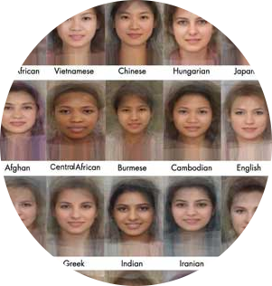

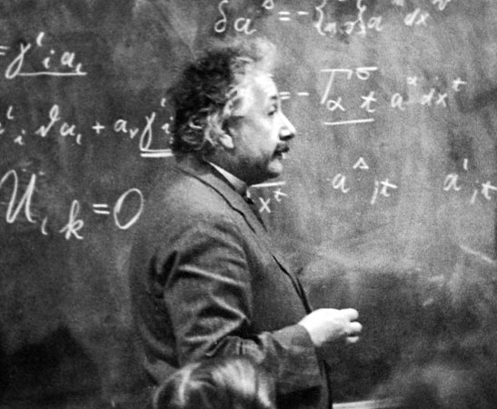

Who
Notes:
Anybody who knows
Researcher who knows nearly everything of a specialized field
Lecturer who knows a particular thing very accurately, deeply, but may not use it on a real life situation (Somebody knows it, somebody teaches it)
Professional who's qualified in a particular profession, in a field of your interest and may not know all the science behind the field, but can adapt her/his knowledge very well in daily situations

Slide 28
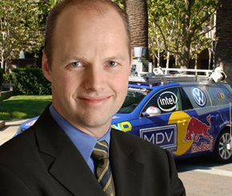
Who
Notes:
Now dream about all the last three and check Udacity's founder, Sebastian Thrun
Researcher at Stanford
Was a lecturer at Stanford but gave it up for the sake of Udacity (teach thousands instead of tens)
Leader at Google

Slide 29

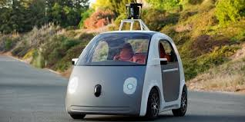
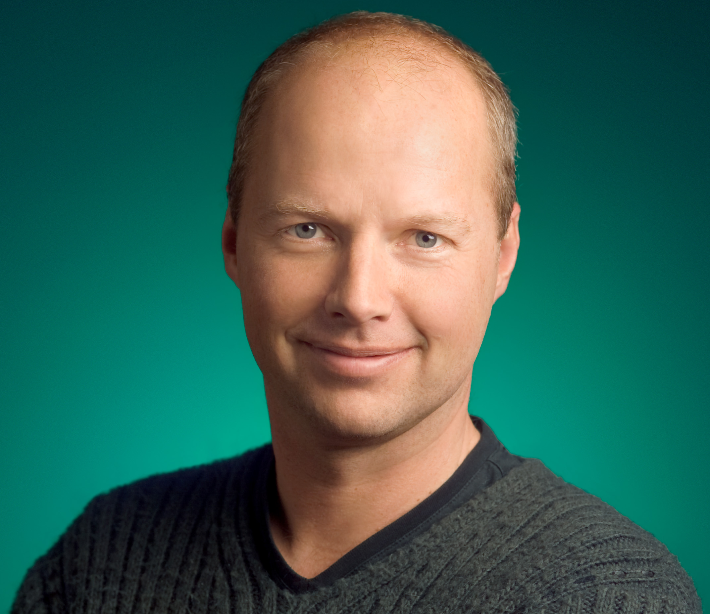

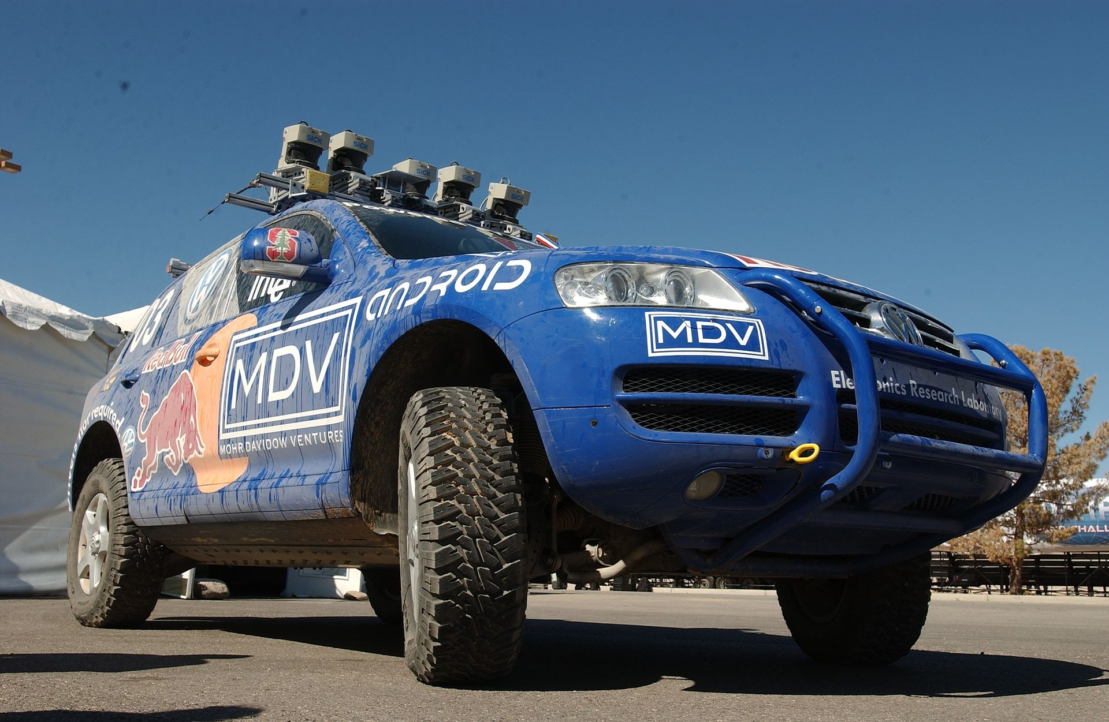



Sebastian Thrun
Notes:
the Stanley robot car to compete in a 2005 Pentagon road race aimed at sparking innovation. Stanley took home the $2 million prize after successfully traveling 131 miles across the Mojave Desert.
Was Choosen among the top 100 globals thinkers in 2012
Named one of Brilliant 5 by Popular Science in 2005

Slide 30

Notes:
When to learn
All-in-One
Anytime (Self-paced)
Previously set times, semester at univ.
Short terms
Short terms with optional blocks

Slide 31
Notes:
All-in-One
You have a free weekend or be in a sick leave and decide to learn on both days.
A speed reader can read 1000 words per minute from a book with 60% of comprehension (1% minority). Average reader can read 240 wpm (paper) and 200 wpm on screen.
I did 118 wpm on screen in English with 100% comprehension.
A book may contains 80,000 – 110,000 words
A book can be finished in 10-20 hours, you can watch 20-30 hours of video during two days which is equal to 12-20 1,5 hours video-lesson which is equal to 3-6 months of university course (one lesson per week)

Slide 32
Notes:
Anytime
means self-paced. Chances are high you will abandon it or forget everything if it takes too long

Slide 33
Notes:
Semesters
like at universities, at pre-occupied events
Probably you will skip lessons and will not understand anything on the next, you will sit on unnecessary lessons and may loose your interest. Because you will not questioned, you may forget nearly everything. In half-a-year your life can be changed in a way that you have to abandon the course.

Slide 34
Notes:
During short terms, like some weeks, 1-2 months, learning 6-15 hours a week
most effective. In such a short term, your life may not change, you may not loose your motivation. You can spare 6-10 hours in a week for a short term easily. It is not too long for forgetting the first lessons and not too short to not gathering enough knowledge.
the knowledge what you are longing for is not fit to a short term so somebody has to slice it in a meaningful way.

Slide 35

Notes:
How to learn
Learn all then be questioned
Chunk
Learn a chunk (1,5 hour video lesson or a section from a book) then be questioned
Small-chunk
small-chunks with quizzes grouped together about topics and questioned after learning a chunk
Small chunk + Project
small-chunks and chunks with a projekt at the end of the course

Slide 36



Notes:
Proof
What to prove?
Sitting in the classroom
think of attendance register, so if you are sitting on all lectures like a dumb, you will score 100% based on an attendance register
Passing the exam
You can prove, that you learn something and you can recite it by hart or you can choose the best answers among 5 possibilities (from which two are usually totally unrelated)

Slide 37

Notes:
Knowing the material
So you can create lectures for others or you can explain to others some of the hardest points of the material.

Slide 38

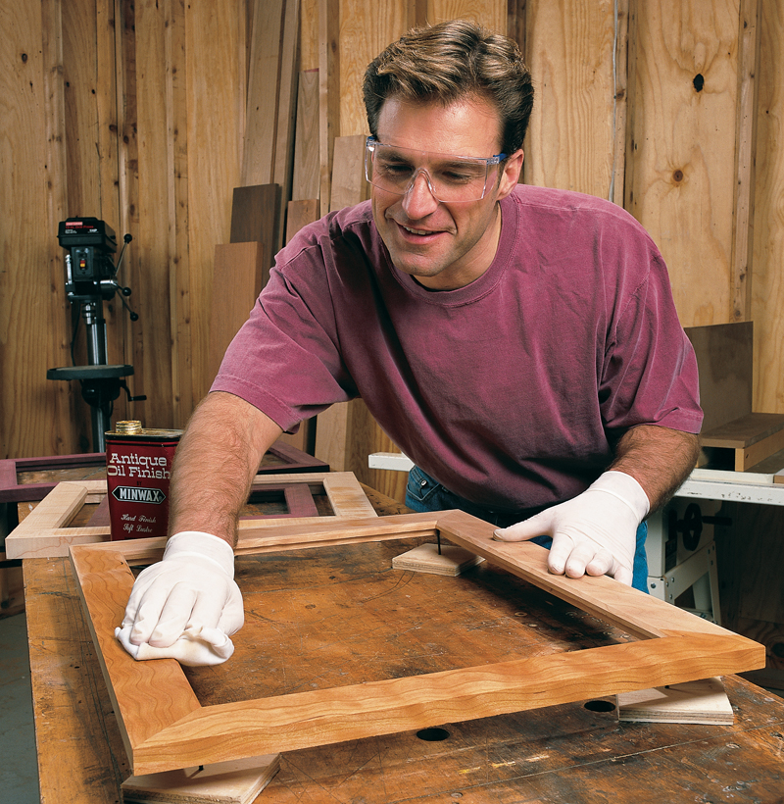




Notes:
Using the knowledge
The real point is :
Are you capable of doing something valuable based on what you have learned?
Think of it. Who can examine this? How can you prove this?
(Picture of a diploma cap and a working robot. Which one proves better your knowledge?)
See Udacity's projects.

