Slide 1
e-Learning

Slide 2
Learning
Introduction
What and Why
Where
Who
How and When
Proof
Summary
Questions

Slide 3
Learning
What
Why
Where
Who
How
When
Proof
Summary

Slide 4

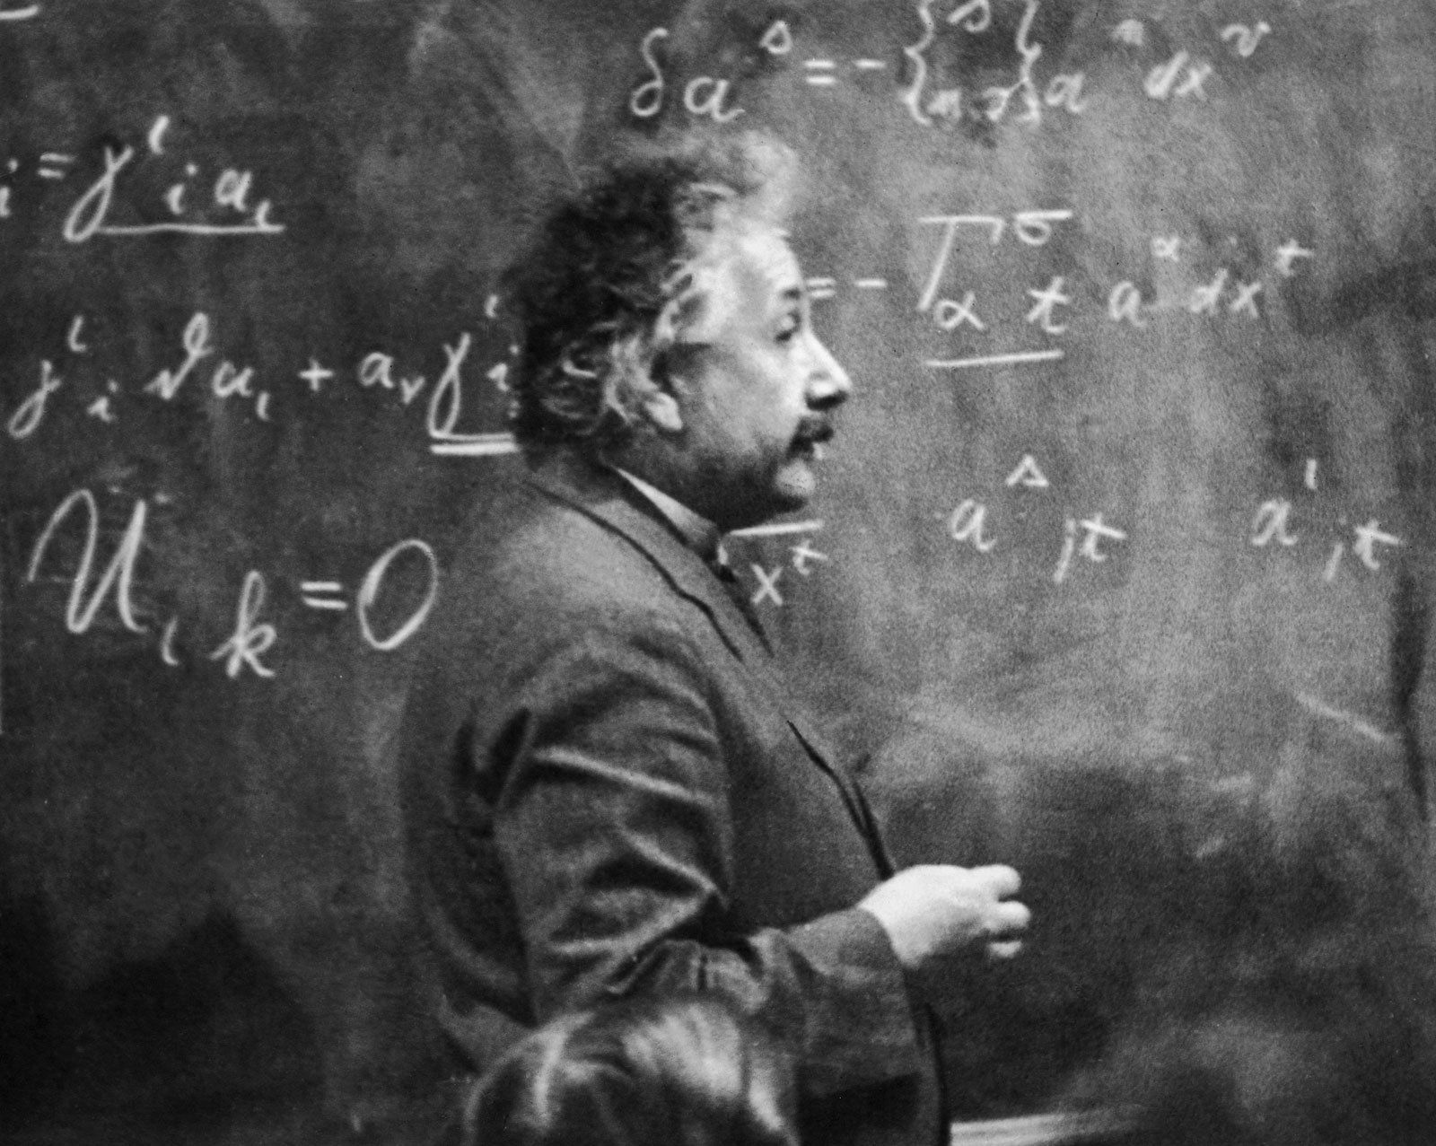



Slide 5

Learning

Slide 6
Learning

Slide 8
Learning

Slide 9
What to learn

Slide 10
Why to learn

