Slide 1




e-Learning

Slide 2
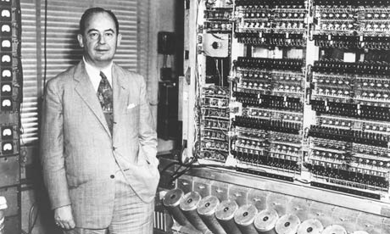
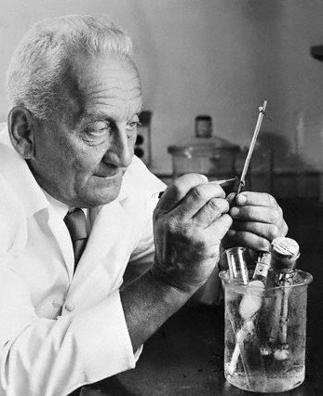
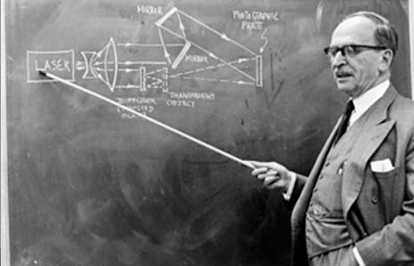
Motivation

Slide 3
Three Famous Hungarian Scientists
John von Neumann
Albert Szent-Györgyi
Dennis Gabor

Slide 4



Three Famous Hungarian Universities
John von Neumann
Albert Szent-Györgyi
Dennis Gabor

Slide 5
Two CVs
CV 1
  Education
    Budapest University of Technology and Economics
CV 2
  Education
    Massachusetts Institute of Technology

Slide 6


Slide 7
Prices/Year
Tuition: $40,000
Other: $20,000
Notes:
http://www.topuniversities.com/student-info/choosing-university/mit-or-caltech
accommodation, living expenses, health insurance, transport and study supplies

Slide 8


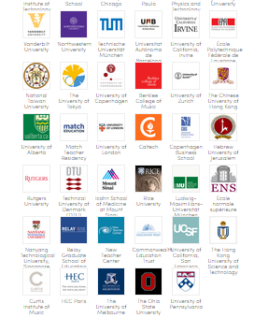
OPEN
FREE

Slide 9



OPEN
FREE

