Slide 1
Robot Localization
Péter Borkuti
2014. 08
What is it
Maps
Localization algorithms
Rotary encoders
Real World Application

Slide 2
Robot Localization
Definition
Localization is the ability for a machine to locate itself in it's world

Slide 3
Why Localization Is Important?
Autonomous car – crashes
Robot in a factory – breaks everything
Robot in a hospital – gives pills to the wrong patient
...

Slide 4
Two Questions
Imagine
  you gave up in an unknown city
  You can not speak to anybody
  You have to go to an address in that city
What do you have to have?
What do you need to know?

Slide 5
Two Questions
How does the World look like?
Where I am?

Slide 6
Two Questions
How does the World look like?
  Map
Where I am?
  Localization method

Slide 7
Two Questions
How does the World look like?
  Map
Where I am?
  Localization method
    Find your place on Map based on sensed data
  Sensors
    Sensing surroundings

Slide 8
We will learn
Maps
Localization algorithms

Slide 9

Theoretical Example
Localization with elevation data

Slide 10
Simplify the map
Elevation map
  Topography: graphic representation of a feature of points of a map
  Geographic topography: the points are geographic points
  Elevation map: the feature is the height above or below of the Earth's sea level
  Graphic representation: coloring

Slide 11
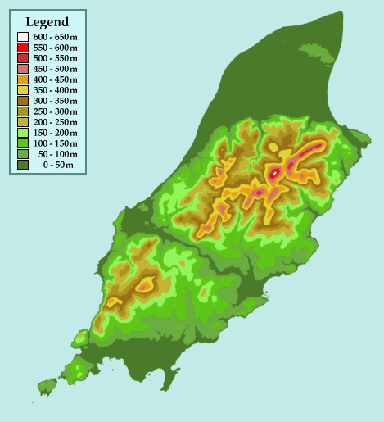
Elevation map

Slide 12
Simplify more
2D → 1D

Slide 13
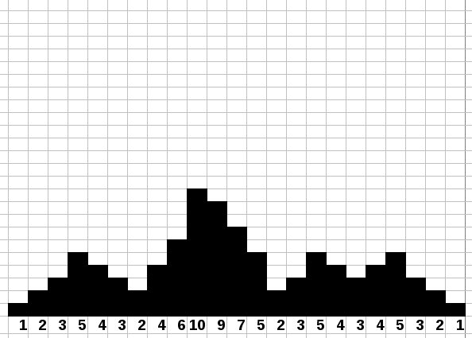
1D Elevation Map I

Slide 14

1D Elevation Map II

Slide 15
1D Elevation Map III

Slide 16
1D Elevation Map IV

Slide 17
1D Elevation Map V

Slide 18
Localization Algorithm
Repeat
  Read sensors
  Update guesses on Map based on sensor data
  Move
  Update guesses according to move

Slide 19

Simplify More
Binary Map (landmarks)

Slide 20

Binary Map circular

Slide 21

Binary Map landmarks

Slide 22
Your turn!
Make pairs
Choose a 2 maps and a robot
One put the robot somewhere
The other try to figure out, where the robot is

Slide 23
Your turn!
REPEAT
  A tells to B the sensor value (Black/White)
  B guess (tells to A the number of cell)
  If B is right, game ends, change the roles
  B tells to A :move the robot (step right/step left)

Slide 24
Problems of localization
There is no exact data in the Real World
Sensors behave weird
Switches bounce
Moves are not exact

Slide 25
Problems of localization
Localization can not be exact, just a guess with more or less preciseness

Slide 26
Problems of localization
Localization can not be exact, just a guess with more or less preciseness
To solve this:
Probability theory
https://www.udacity.com/course/cs373

Slide 27
Histogram Localization
What we did (without proper steps)

Slide 28
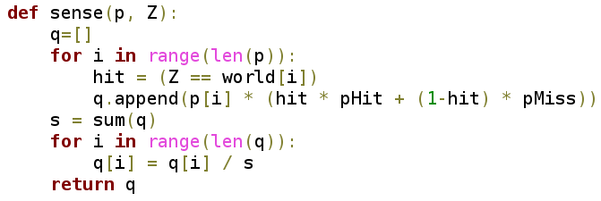
Histogram Localization sense

Slide 29
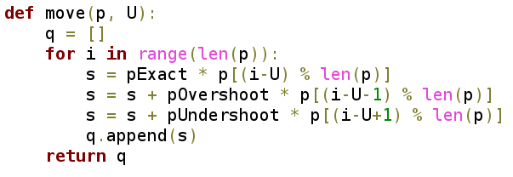
Histogram Localization move

Slide 30

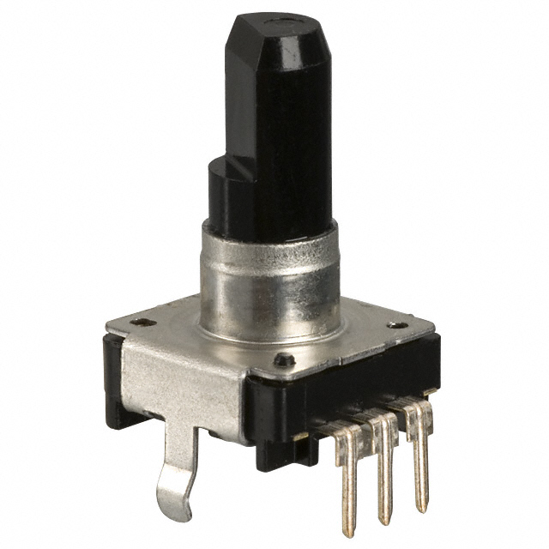
Real World Application
Rotary encoder

Slide 31
Real World Application
Rotary encoder
  electro-mechanical device that converts the angular position of a shaft to a digital code

Slide 32
Rotary Encoders
Incremental
  Direction of rotation (+-1 click)
Absolute
  Absolute position of the shaft

Slide 33
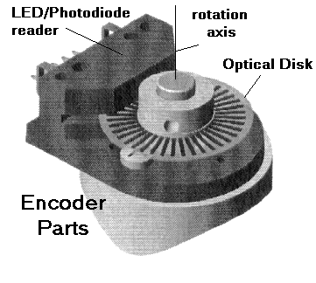
Incremental encoder

Slide 34


Incremental encoder disc

Slide 35

Absolute encoder disks

Slide 36

Histogram encoder disk

Slide 37
Histogram rotary encoder
Incremental encoder + histogram encoder disk
+

Slide 38
How to create a good H.E.D.?

Slide 39
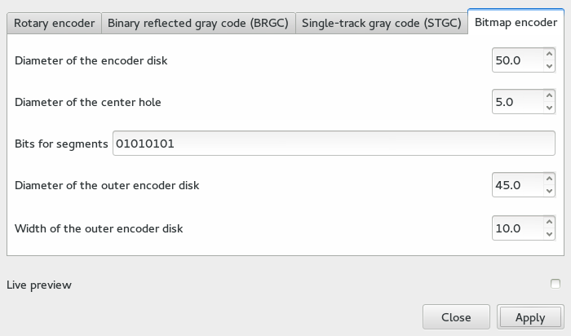
How to print H.E.D.?
Inkscape

Slide 40
Demonstration

