Slide 1
JavaScript by Examples
I. part
Language basics
Péter Borkuti
2013

Slide 2
Preview I.
background
History (IT, Netscape)
JS History
Reputation, what is JS?
Start learning (Node, Rhino, Firebug, HTML)

Slide 3
Preview II.
JS Types
Math library
Syntax: if, ===, switch
Objects
Objects inheritance
Arrays
Array-like objects

Slide 4
Preview III. Functions
  anatomy
  Parameters, arguments
  variables: globals, locals, hiding, scope
  Hoisting, function expression
  immediate invoke
  return

Slide 5
Preview IV. Functions
  nested functions
  Closures + closures and HTML
  objects and functions
  constructor
  invocation
  closure and this
  Function as parameter (callback sync/async) + AJAX
  Method chaining (cascade)

Slide 6
Preview V. Functions
  augmenting built-ins, inheritance
  module pattern
  can JS oop?
  bonus ??
  questions
  homework

Slide 7

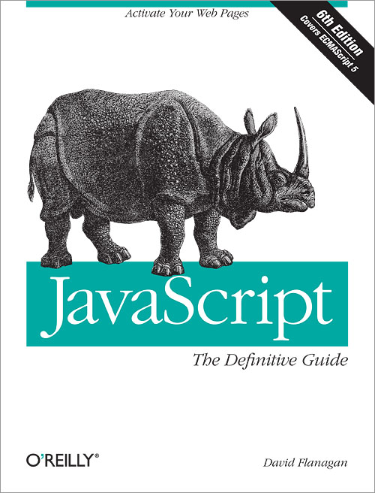
Background
Douglas Crockford David Flanagan
developer.mozilla.org/en-US/docs/JavaScript
Notes:
Douglas Crockford is an American computer programmer
involvement in the development of the JS, popularized JSON ,JSLint , JSMin.senior JavaScript architect at PayPal
(MIT licence)The Software shall be used for Good, not Evil.

Slide 8
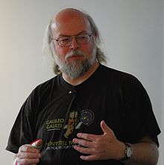
History - pre-JS years
James Gosling

Slide 9
History - pre-JS years
Sun, Java, James Gosling
1990, Sun, alternative to C++/C
modify and extend C++ - “C++ ++ --”
1992, new language Oak - embedded for PDA, set-top-boxes
1994, new platform: Internet, new name: Java
browser: WebRunner->HotJava
Notes:
http://www.ibiblio.org/e-notes/Mview/MViewer.htm

Slide 10
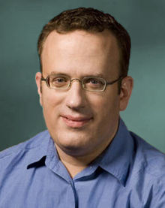
History - pre-JS years
Netscape, Brendan Eich

Slide 11
History -pre-JS - Browsers
NCSA Mosaic, 1993
Marc Andreessen, Eric Bina
Netscape 1.0, 1994 (No JS, No Java)
Brendan Eich, Mocha/LiveScript/JavaScript
Netscape 2.0, 1995, Java, JavaScript support
Microsoft JScript, 1996

Slide 12
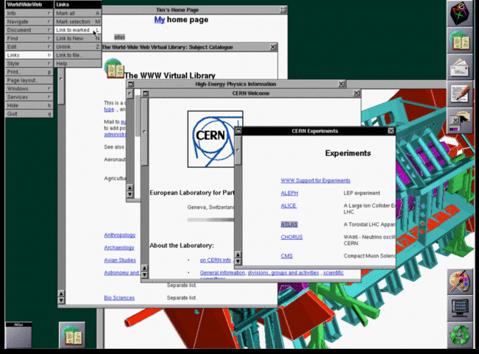
Tim Berners-Lee's browser
Notes:
Tim Berners-Lee's original WorldWideWeb browser running on a NeXT computer in 1993
CERN
NextComputer: John Carmack, Wolfensteind 3D, Doom

Slide 13
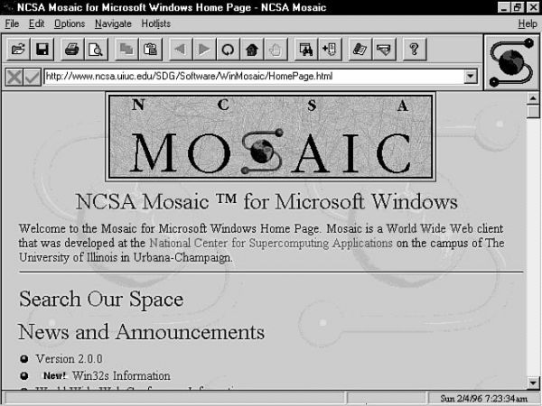
NCSA Mosaic
Notes:
National Center for Supercomputing Applications
NCSA Mosaic, 1993
Marc Andreessen, Eric Bina
Netscape 1.0, 1994 (No JS, No Java)
Brendan Eich, Mocha/LiveScript/JavaScript
Netscape 2.0, 1995, Java, JavaScript support
Microsoft JScript, 1996

Slide 14
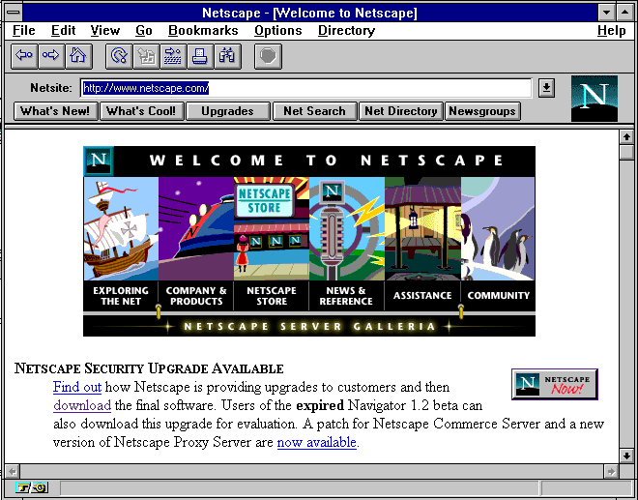
Netscape
Notes:
NCSA Mosaic, 1993
Marc Andreessen, Eric Bina
Netscape 1.0, 1994 (No JS, No Java)
Brendan Eich, Mocha/LiveScript/JavaScript
Netscape 2.0, 1995, Java, JavaScript support
Microsoft JScript, 1996

Slide 15
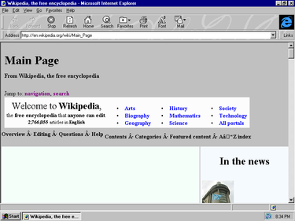
IE 3
Notes:
NCSA Mosaic, 1993
Marc Andreessen, Eric Bina
Netscape 1.0, 1994 (No JS, No Java)
Brendan Eich, Mocha/LiveScript/JavaScript
Netscape 2.0, 1995, Java, JavaScript support
Microsoft JScript, 1996

Slide 16
Goals of Netscape Corp.
Beat Microsoft
C++ - Java
VB - own script language
Browser as “The Platform”

Slide 17
Goals of JavaScript I.
“look like Java” programming language
“doing Scheme” in Netscape
dynamic web

Slide 18
Goals of JavaScript II.
HTML needed a "scripting language", [...] that was easy to use by amateurs and novices, where the code could be written directly in source form as part of the Web page markup. We aimed to provide a "glue language" for the Web designers [...] who were building Web content from components such as images, plugins, and Java applets. We saw Java as the "component language" used by higher-priced programmers, where the glue programmers [...] would assemble components and automate their interactions using JS. (Brendan Eich, CW interview)

Slide 19
History of JavaScript
1994-95 Mocha/LiveScript/JavaScript 1.0
1996 MS JScript
1996 Netscape went to ECMA
1997 ECMAScript v1 (JavaScript 1.3)
1999 ECMAScript v3 (JavaScript 1.5)
2009 ECMAScript v5 (JavaScript 1.8?)
2011 ECMAScript v5.1

Slide 20
Reputation of JS
Java !== JavaScript, Java !> JavaScript
DOM is a mess
JavaScript is not easy
JavaScript is not like the programming language you know
Scripting language

Slide 21
What JavaScript is I.
THE language of the web
Powerful language
loose typing but not untyped
object literal notation
dynamic objects
prototypal inheritance

Slide 22
What JavaScript is II.
C syntax
Java Date, Math packages, Boolean/String/... wrapper objects
functions are first-class objects/citizens
closures
global objects
Smalltalk/Lisp/Scheme

Slide 23
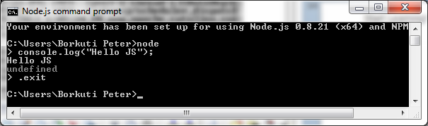
Start Learning! Node.js

Slide 24
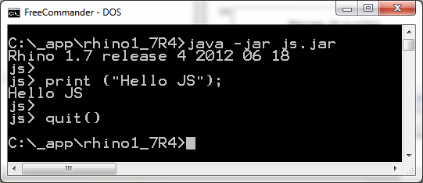
Start Learning! Rhino

Slide 25
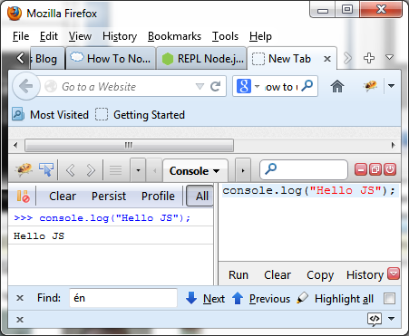
Start Learning! FireBug

Slide 26
Start Learning! HTML
<!DOCTYPE html>
<head><meta charset="UTF-8"/>
<title>example 0</title></head>
<html>
<body>
<script>
console.log("Hello Js");
</script>
</body>
</html>

Slide 27
Placing JS in HTML
HTML:
<script src="example01.js">
</script>
example01.js:
console.log("Hello js");

Slide 28
More js in one HTML
HTML:
<body>
<script src="example01.js">
</script>
<script src="example02.js">
</script>
</body>

Slide 29
Exercises 1
Write your name to the console with js in a html page
Write your name to the console with an included js file
Write your name and your birthday with two separate js files which included into one html

Slide 30
Homework 1
Check js reference's Window object
alert your name
print the contents of the window
check confirm(),prompt()
(hard)Create a html with js which reads user's input (a string) and alerts it. Be simple, without variables!

Slide 31
JS Types
Boolean
String
Number
Null
Undefined
Object

Slide 32
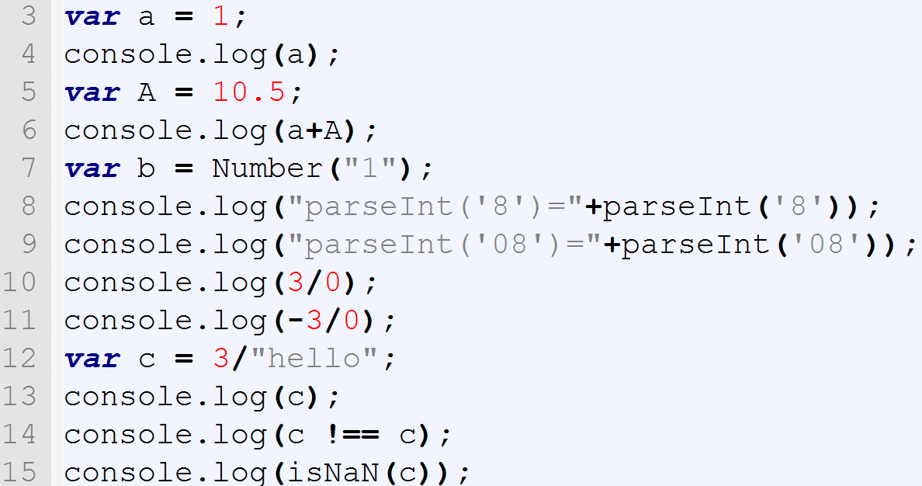
Syntax and types
Notes:
parseInt: “0x” -hexa, “0...” octal
ECMAScript 5 dropped octal behaviour but not browsers!
numberType.toString(radix)

Slide 33
Syntax and types
1
11.5
parseInt('8')=8
parseInt('08')=0
Infinity
-Infinity
NaN
true
true

Slide 34
Syntax and types - Numbers
No Integer type
64-bit floating point (double) IEEE 754
Beware of bit-operations
Number(“42”)
+”42”
parseInt(“8”,10)
Infinity,-Infinity,NaN

Slide 35
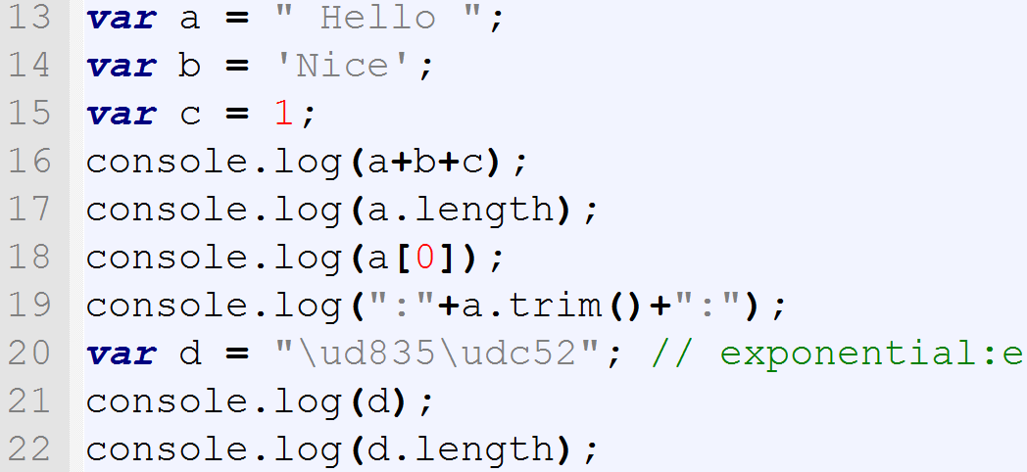
Syntax and types

Slide 36
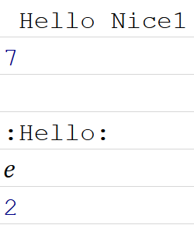
Syntax and types

Slide 37
Syntax and types - Strings
new String(“Hello”)
Concatenation : +
“ or ', no difference
UTF-16 (surrogate pairs!)
.length counts 16-bit values
Dynamic type conversion

Slide 38
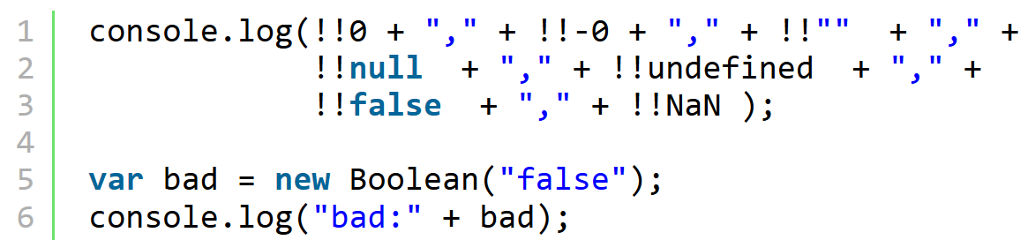
Syntax and types - Boolean
Notes:
these are falsy values. Everything else is truthy! Objects also!
!!{}

Slide 39
Syntax and types - Boolean
false,false,false,false,false,false,false
bad:true
!!{}

Slide 40
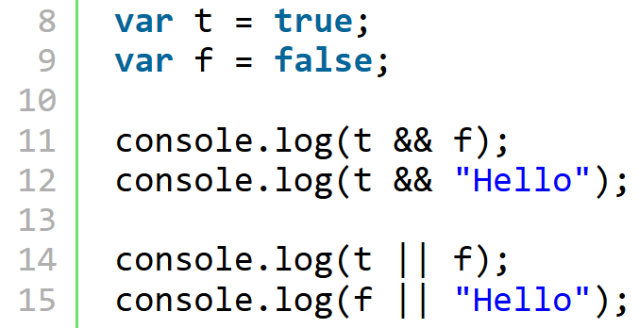
Syntax and types – Boolean op
Notes:
Boolean : true, false
Falsy values: 0,””,null,NaN, undefined, false
Truthy values: everything else (objects also)
&&,|| may give any value, short circuit
! : always boolean, !!: convert to boolean
New Boolean() : avoid it
Loose/weak typing

Slide 41
Syntax and types – Boolean op
false
Hello
true
Hello

Slide 42
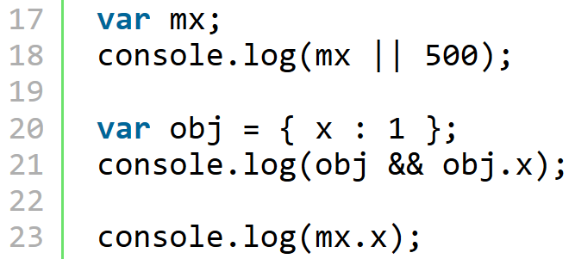
Syntax and types – Boolean op
Notes:
Boolean : true, false
Falsy values: 0,””,null,NaN, undefined, false
Truthy values: everything else (objects also)
&&,|| may give any value, short circuit
! : always boolean, !!: convert to boolean
New Boolean() : avoid it
Loose/weak typeing

Slide 43
Syntax and types – Boolean op
Notes:
mx && mx.x ---> undefined

Slide 44
Syntax and types – Boolean op
500
1
TypeError: mx is undefined

Slide 45
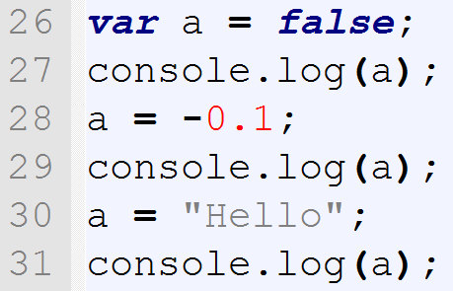
Syntax and TYPES

Slide 46
Syntax and types
Boolean : true, false
Falsy values: 0,””,null,NaN, undefined, false
Truthy values: everything else (objects also)
&&,|| may give any value, short circuit
! : always boolean, !!: convert to boolean
New Boolean() : avoid it
Loose/weak typeing

Slide 47
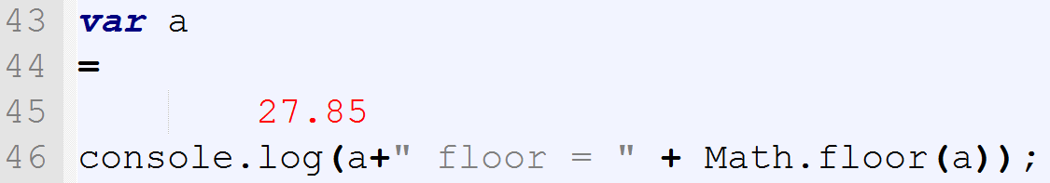
Syntax – Math lib

Slide 48
Syntax – Math lib
Free-form language
; optional (see later: ASI)
Math lib from Java

Slide 49
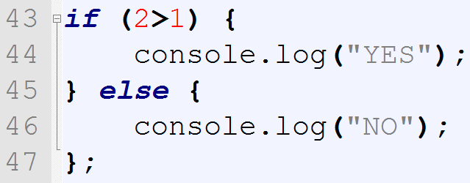
Syntax – branching - if

Slide 50
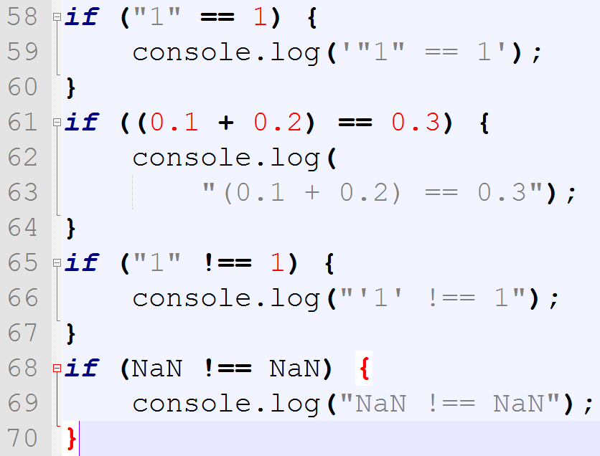
Syntax – == vs ===

Slide 51
Syntax – == vs ===
"1" == 1
'1' !== 1
NaN !== NaN

Slide 52
Syntax == vs ===
== : type coercion (implicit/automatic conv.)
AVOID it!
=== strict equality/identity op.
NaN !== NaN

Slide 53
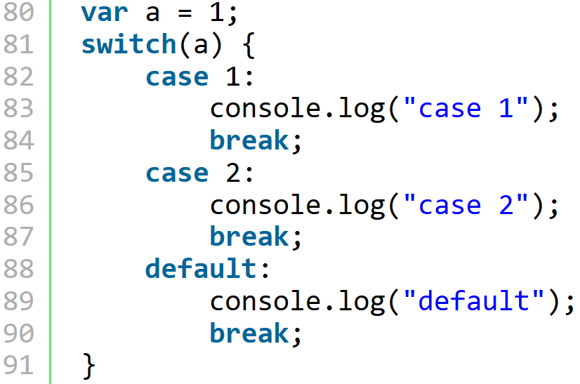
Syntax – switch 1

Slide 54
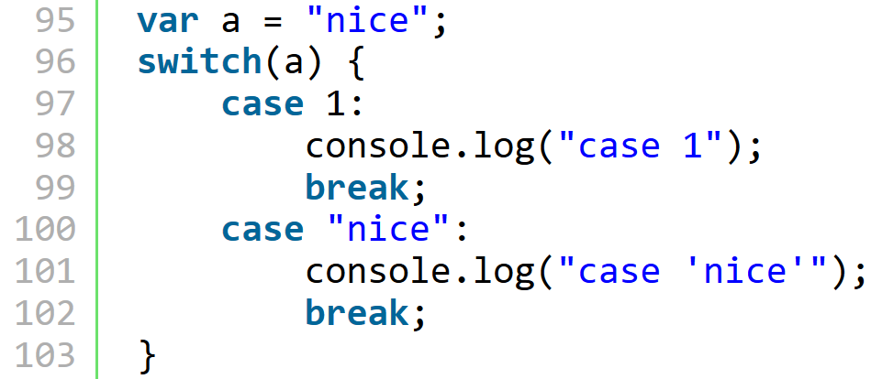
Syntax – switch 2

Slide 55
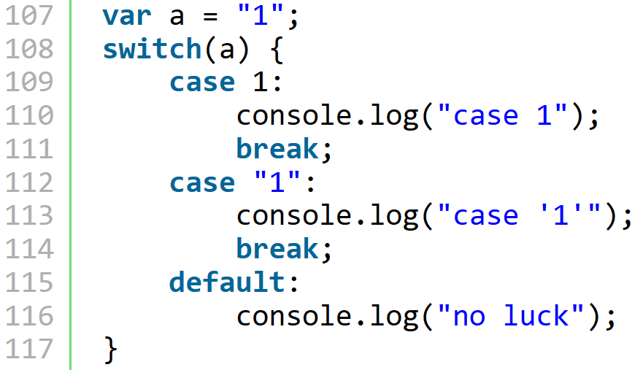
Syntax – switch 3

Slide 56
Syntax - switch
With Strings also
Checking with '==='
Expressions may be in 'case'
Break
Slow

Slide 57
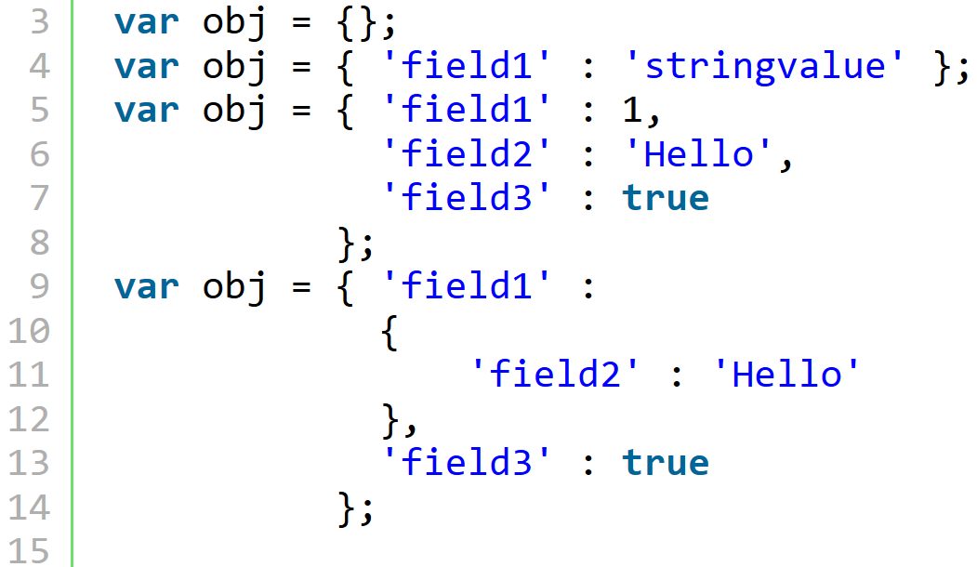
Object – create objects
Notes:
!!{}

Slide 58
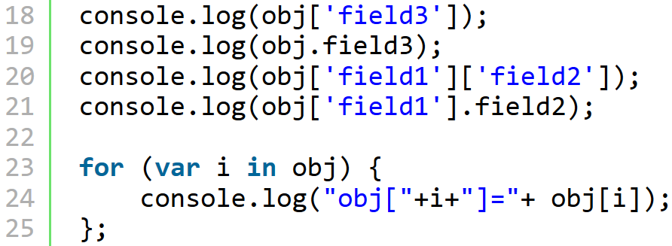
Object – access fields

Slide 59
Object – access fields
true
true
Hello
Hello
obj[field1]=[object Object]
obj[field3]=true

Slide 60

Object – add/update fields

Slide 61

Object – delete fields

Slide 62
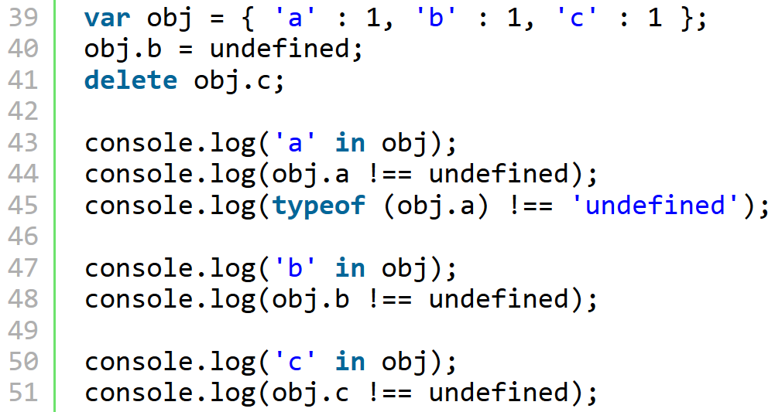
Object – checking fields
Notes:
obj.b = undefined does not delete
so 'b' in obj true
in sees the inherited fields also
true
true
true
true
false
false
false

Slide 63
Object – checking fields
true
true
true
true
false
false
false

Slide 64
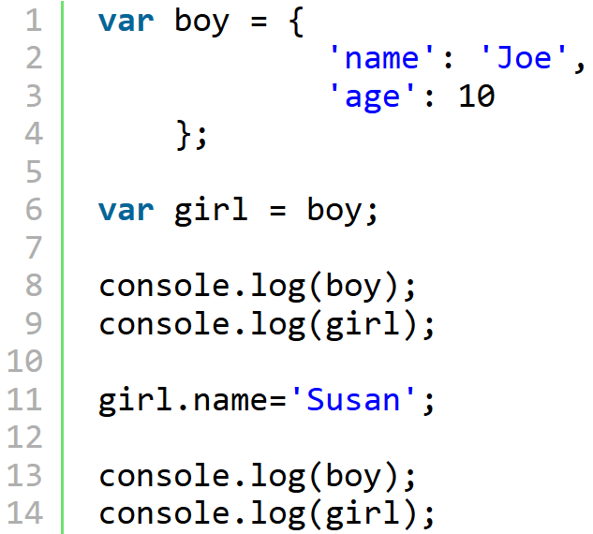
Object – inheritation
Notes:
Object.getPrototypeOf(o)

Slide 65
Object – inheritation
Object { name="Joe", age=10}
Object { name="Joe", age=10}
Object { name="Susan", age=10}
Object { name="Susan", age=10}

Slide 66
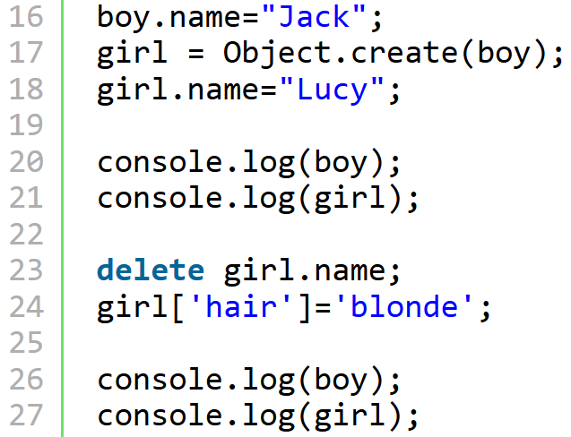
Object – inheritation

Slide 67
Object – inheritation
Object { name="Jack", age=10}
Object { name="Lucy", age=10}
Object { name="Jack", age=10}
Object { hair="blonde", name="Jack", age=
10}

Slide 68
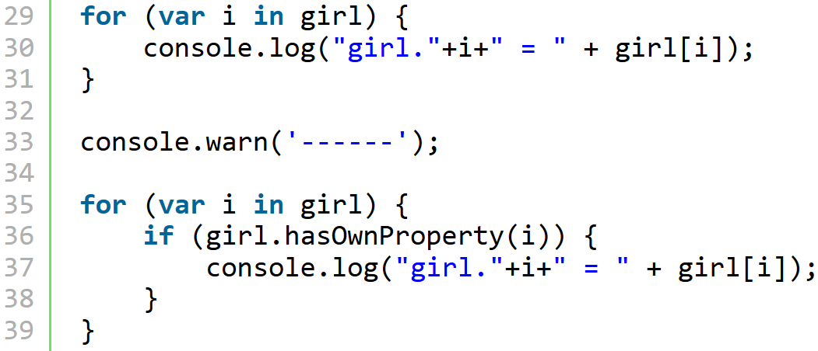
Object – inheritation

Slide 69
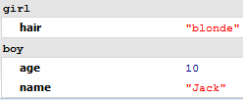
Object – inheritation

Slide 70
Objects
Object literal powerful, nice
Object vars - reference
Inheritance with linking
Inherited fields can be hidden
HasOwnProperty, in, typeof, undefined
Object.getPrototypeOf(o) //ES 5

Slide 71
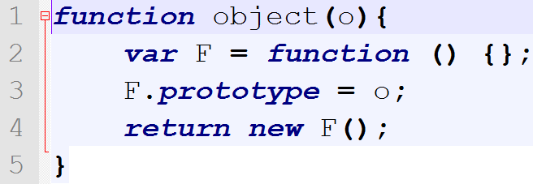
Object.create
ECMAScript 5
ECMAScript 3 : ( from YUI)

Slide 72
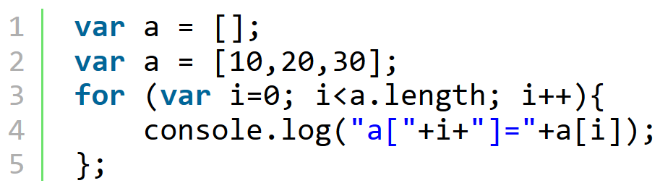
Syntax – Arrays I.

Slide 73
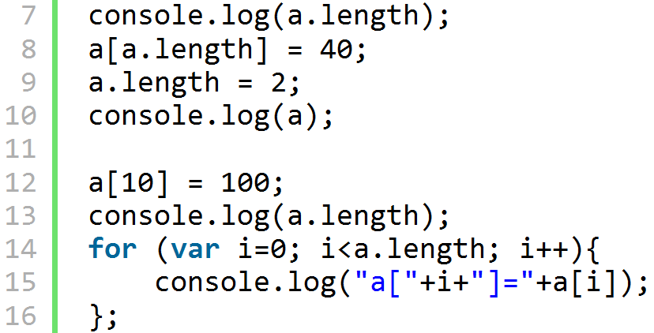
Syntax – Arrays II.

Slide 74
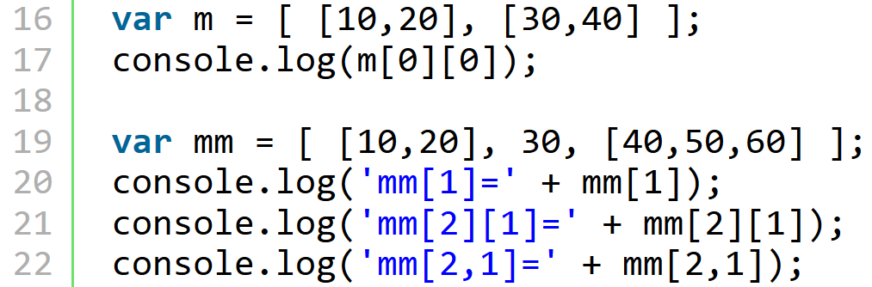
Syntax – Arrays III.

Slide 75
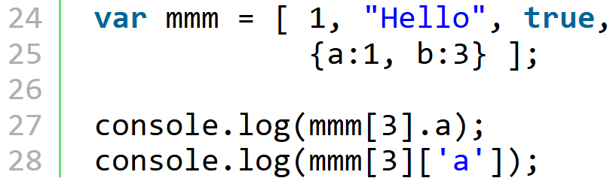
Syntax – Arrays IV.

Slide 76
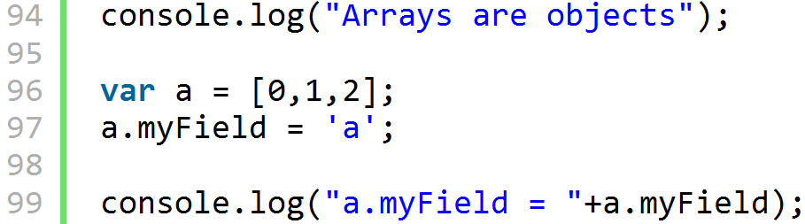
Syntax – Arrays V.

Slide 77
Syntax – Arrays
create: []
any value/objects, dynamic
length writeable
undefined elements
arrays are objects

Slide 78
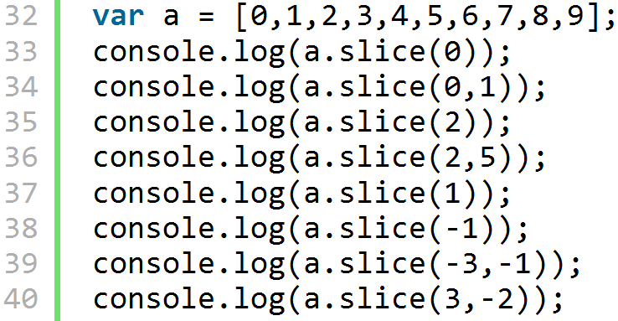
Syntax – Array.slice

Slide 79
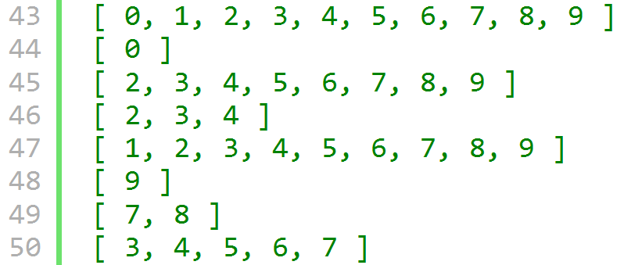
Syntax – Array.slice

Slide 80
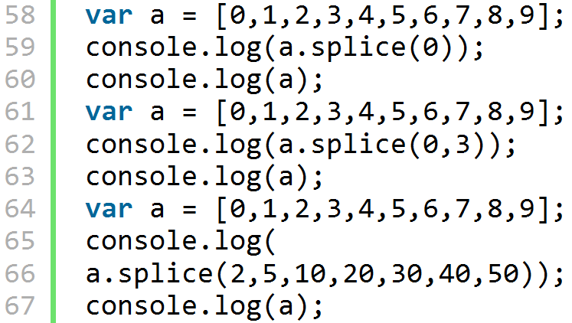
Syntax – Array.splice

Slide 81
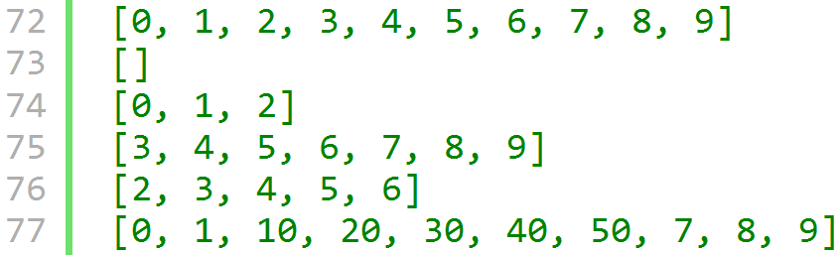
Syntax – Array.splice

Slide 82
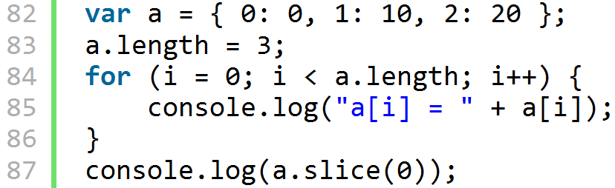
Array-like objects I.

Slide 83
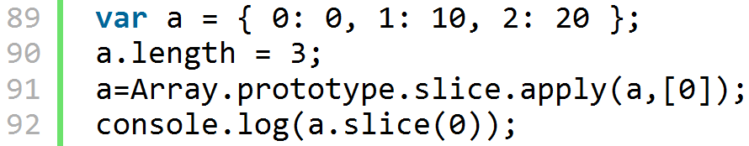
Array-like objects II.

Slide 84
JavaScript by Examples
II. part
Basic JS: Functions
Péter Borkuti
2013

Slide 85
JS Functions
powerful structure
subroutine, function, module, class
Notes:
Subroutine → no recursion ->stack

Slide 86
JS functions - preview I
anatomy
Parameters, arguments
variables: globals, locals, hiding, scope
hoisting
immediate invoke
return

Slide 87
JS functions - preview II
nested functions
Closures + closures and HTML (Optional)
objects and functions, constructors
invocation
closure and this, callbacks, AJAX, cascade
Augmenting built-ins, inheritance
module (Crockford's steps)

Slide 88
JS functions - preview III
is JS OOP? (theory, optional)
Homework
Bonus (optional)
forthcoming (in preparation)
  YUI
  AlloyUI
  AlloyUI and Liferay

Slide 89
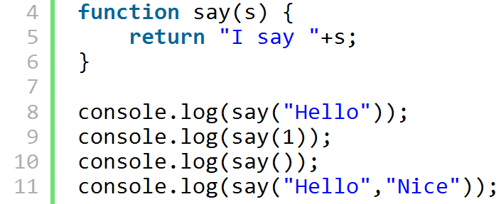
Functions - definition
example_functions.html

Slide 90
Functions - definition
function name(params) {}
any num. of params, arguments
I say Hello
I say 1
I say undefined
I say Hello

Slide 91
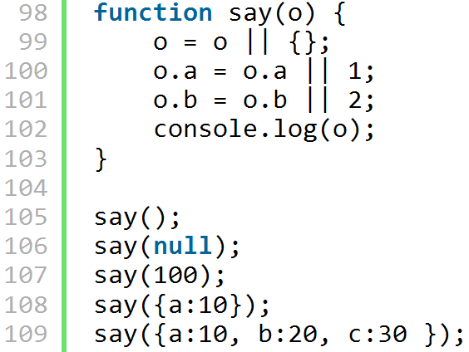
Functions - object param

Slide 92
Functions - object param
Object { a= 1 , b= 2 }
Object { a= 1 , b= 2 }
100
Object { a= 10 , b= 2 }
Object { a= 10 , b= 20 , c= 30 }

Slide 93
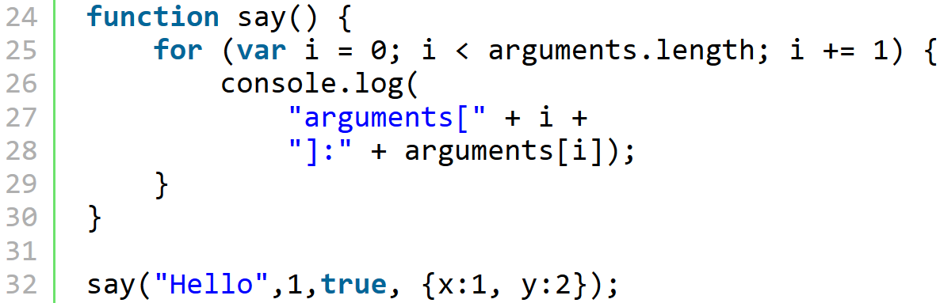
Functions - arguments I

Slide 94
Functions - arguments I
arguments[0]:Hello
arguments[1]:1
arguments[2]:true
arguments[3]:[object Object]

Slide 95
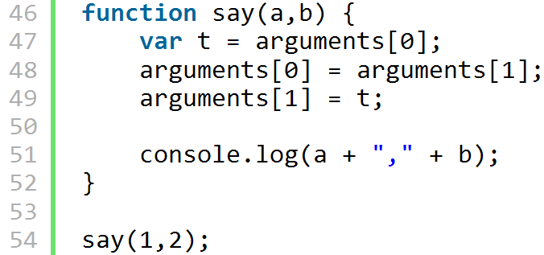
Functions - arguments II
Notes:
Output: 2,1
Beware modify arguments!

Slide 96
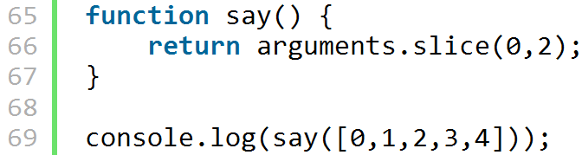
Functions - arguments IIIa
Notes:
TypeError: arguments.slice is not a function

Slide 97
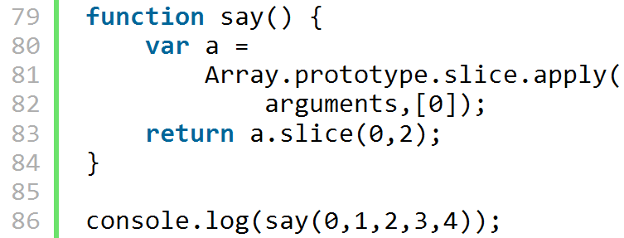
Functions - arguments IIIb
Notes:
Array.prototype.slice.call([0,1,2,3,4],0)

Slide 98
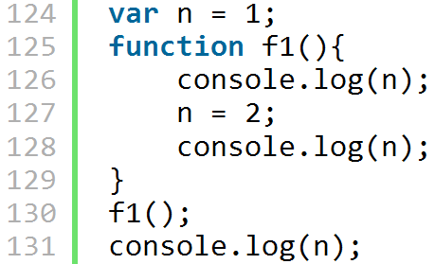
Functions - globals
Notes:
1
2
2

Slide 99
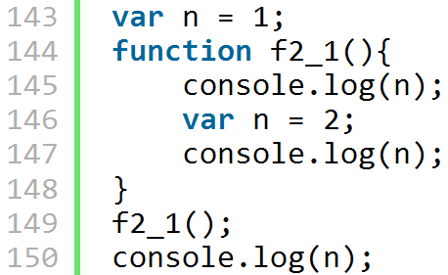
globals and locals + hoisting
Notes:
hoist: emel, felhúz
undefined
2
1
var n = 2;
var n;
...
n = 2;

Slide 100

globals and locals + hoisting
Notes:
undefined
2

Slide 101

variables - function scope
Notes:
when calling f3_1:
ReferenceError: i is not defined
undefined
0
1
2
3
let - block scope - ECMAScript 6

Slide 102
variables - function scope
undefined
0
1
2
3

Slide 103

function statement - hoisting I
Notes:
I say1 Hello - before
I say1 Hello - after

Slide 104

function expression - hoisting II
Notes:
I say1 Hello - before
I say1 Hello - after

Slide 105
function expression - hoisting II
TypeError: say2 is not a function
I say2 Hello - after
Notes:
var say4 = function say4(s) {
//"Mozilla error: invalid scope variables" when call
console.log(typeof say4);
};

Slide 106

immediately invoking

Slide 107
immediately invoking
console.log("f5_1::"+f5_1.toString());
f5_1::function () {
return Math.random();
}
console.log("f5_21::"+f5_21.toString());
f5_21::0.7356408222533187

Slide 108

immediately invoking
Notes:
function () {
console.log("Imm. inv. - bad");
}();

Slide 109

immediately invoking parameter
Notes:
line 332: ; is necessary -> TypeError

Slide 110

function is object
Notes:
function () {
console.log("Imm. inv. - bad");
}();

Slide 111

function in object

Slide 112

nested function

Slide 113

return

Slide 114

return
Notes:
var t = [['F[i]()'],['new F[i]']];
for (var i in F) {
t[0].push(F[i]());
t[1].push(new F[i]);
}
console.table(t);

Slide 115

return - how to output
Notes:
for ... in not good for array!
use for <length

Slide 116

closures - warming up I

Slide 117

closures - warming up II

Slide 118

closures - warming up III
Notes:
How can I output “I am in c0_21” ?

Slide 119

closures - warming up III
Notes:
;

Slide 120

closures - I
Notes:
Will there be output when run line 514?

Slide 121
closures - Ia
I am in c0_31 Hello
function c0_31() {
console.log("I am in c0_31 " + s);
}

Slide 122

closures - Ib
I am in c0_4 return Hello
function () {
console.log("I am in c0_4 return " + s);
}
Notes:
This is nearly the same as the previous example.
What is the difference?

Slide 123

closures - Ic
Notes:
This is nearly the same as the previous example.
What is the difference?

Slide 124
closures - Ic
Hello
elloH
lloHe
loHel
oHell
Hello
Notes:
This is nearly the same as the previous example.
What is the difference?

Slide 125

closures - II

Slide 126

closures - II
Notes:
1000
100
101
1001

Slide 127

closures - III warming up

Slide 128

closures - III warming up

Slide 129

closures - III warming up

Slide 130

closures - III
c05("Counter1", 100, 110, 50)
Counter1 = 100
Counter1 = 101
Counter1 = 102
Counter1 = 103
...
Counter1 = 109

Slide 131
closures - III

Slide 132
closures - III
write a stop() function, which stops the counting
How to use it?
remark: setTimeout, setInterval returns with a handler. With it you can stop the timer with clearTimeout, clearInterval

Slide 133

closures - III

Slide 134
closures - III

Slide 135
closures - III
var stopc06 = c06("counter2",100,200,500);
..........
stopc06()

Slide 136
closures
function together with it's parent environment (function parameters, local variables and inner functions)
not values! Living, common references
the environment is living after the parent function exits
see example_closure0?.html

Slide 137

constructor
When is GLOBAL impacted?
Let's see in FF!
example_function.html

Slide 138

constructor and public, private, privileged I

Slide 139

constructor and public, private, privileged II
private and privileged methods can be added only in constructor
public can be added at any time to prototype

Slide 140
constructor
new
return optional
() optional
this.constructor
do not use function expression form:
var C = function () {}
identity of an object ( “class” )

Slide 141
constructor
function A() {};
var a = new A;
a instanceof A // true
typeof a //"object"
a.constructor //A()
a.valueOf() //A { }

Slide 142
invocations of functions
function
F()
method
o.F()
constructor
new F
indirect
F.apply, F.call

Slide 143
invocations of functions
function
F() this:global, in strict mode: undefined
method
o.F() this: o
constructor
new F this: new object
indirect
F.apply, F.call this: given

Slide 144

method invocation

Slide 145

method invocation

Slide 146
method invocation
this: Object { f1=h1() }

Slide 147

method invocation

Slide 148
method invocation
this: [ 0, 1, h1()]

Slide 149

indirect invocation
Notes:
Window
Window
Window
Object { x=2}
[10, 20, 30]

Slide 150
indirect invocation
F.apply(object,[params_array]);
F.call(object, param1, param2,...);
In ECMAScript3/5
Object === undefined, null → global object
primitive value → wrapper object
In ECMAScript5 strict mode: retains value
Notes:
Window
Window
Window
Object { x=2}
[10, 20, 30]

Slide 151

Closure and “this”
Notes:
What will be the output?
Wa are waiting Object { y : 1 },
But it will be the global object because of the “function invocation” in h2.
How can we avoid? How can closure remember the original this?

Slide 152

Closure and “this”
Notes:
Var that = this “trick”

Slide 153
Function as parameter
“callback”
  Synchronous
  Asynchronous
Notes:
Var that = this “trick”

Slide 154

Callbacks – warming up
Notes:
Var that = this “trick”

Slide 155
Callbacks – warming up
Notes:
Var that = this “trick”

Slide 156

Synchronous callback
Notes:
Var that = this “trick”

Slide 157
Synchronous callback
Notes:
Var that = this “trick”

Slide 158
Synchronous callback
How can we multiply the elements in an array?
Notes:
Var that = this “trick”

Slide 159

Synchronous callback
How can we multiply the elements in an array?
Notes:
Var that = this “trick”

Slide 160
callback examples
Array methods
  forEach
  map
  filter
  parseInt (!)
  AJAX
Notes:
Var that = this “trick”

Slide 161

callback examples
Notes:
Write multiply!
var mul = 1;
[1,2,3,4].forEach(
function (element, index, array) {
mul *= element
});
console.log(mul);

Slide 162
callback examples
map, array → array
every element will be the return value of callback
Square array: [1,2,3] → [1,4,9]
Math.sqrt array : [9,16,25] → [3,4,5]
ParseInt array : [“2”,”3”,”4”] → [2,3,4]
Notes:
Write multiply!
var mul = 1;
[1,2,3,4].forEach(
function (element, index, array) {
mul *= element
});
console.log(mul);

Slide 163

callback examples
Notes:
Write multiply!
var mul = 1;
[1,2,3,4].forEach(
function (element, index, array) {
mul *= element
});
console.log(mul);

Slide 164

callback examples
Notes:
Write multiply!
var mul = 1;
[1,2,3,4].forEach(
function (element, index, array) {
mul *= element
});
console.log(mul);

Slide 165

callback examples
Notes:
Write multiply!
var mul = 1;
[1,2,3,4].forEach(
function (element, index, array) {
mul *= element
});
console.log(mul);

Slide 166
callback examples
?
Notes:
Write multiply!
var mul = 1;
[1,2,3,4].forEach(
function (element, index, array) {
mul *= element
});
console.log(mul);

Slide 167

callback examples
Notes:
Write multiply!
var mul = 1;
[1,2,3,4].forEach(
function (element, index, array) {
mul *= element
});
console.log(mul);

Slide 168
callback examples
Filter array → array
if callback returns false, skip the element
Create an array : skip the first, keep the second element, and so on
[1, 2, 3, 4] → [2, 4]
Notes:
Write multiply!
var mul = 1;
[1,2,3,4].forEach(
function (element, index, array) {
mul *= element
});
console.log(mul);

Slide 169

callback examples
Notes:
Write multiply!
var mul = 1;
[1,2,3,4].forEach(
function (element, index, array) {
mul *= element
});
console.log(mul);

Slide 170

Asynchronous callbacks
Notes:
Write multiply!
var mul = 1;
[1,2,3,4].forEach(
function (element, index, array) {
mul *= element
});
console.log(mul);

Slide 171


Asynchronous callbacks
?

Slide 172

Asynchronous callbacks

Slide 173


Asynch callbacks (Optional)
?
Notes:
;

Slide 174

Asynch callbacks (Optional)
Notes:
;

Slide 175
AJAX
Asynchronous JavaScript and XML
wikipedia.org/wiki/Ajax_(programming)
  a group of interrelated web development techniques used on the client-side to create asynchronous web applications
  Could be synchronous
  use of XML is not required (JSON is often used instead)
Notes:
Write multiply!
var mul = 1;
[1,2,3,4].forEach(
function (element, index, array) {
mul *= element
});
console.log(mul);

Slide 176
AJAX
When “using” AJAX
  JavaScript modify HTML/CSS
  JavaScript and DOM
  sends/receives data without reloading page
  JavaScript + XMLHttpRequest object
  Do this in the background so browser is always responsive
  short, fast callbacks
Notes:
Write multiply!
var mul = 1;
[1,2,3,4].forEach(
function (element, index, array) {
mul *= element
});
console.log(mul);

Slide 177

data request I

Slide 178

data request II
Notes:
onreadystatechange Stores a function (or the name of a function) to be called automatically each time the readyState property changes
readyState Holds the status of the XMLHttpRequest. Changes from 0 to 4:
0: request not initialized
1: server connection established
2: request received
3: processing request
4: request finished and response is ready
status 200: "OK"
404: Page not found

Slide 179
The server program
Notes:
onreadystatechange Stores a function (or the name of a function) to be called automatically each time the readyState property changes
readyState Holds the status of the XMLHttpRequest. Changes from 0 to 4:
0: request not initialized
1: server connection established
2: request received
3: processing request
4: request finished and response is ready
status 200: "OK"
404: Page not found

Slide 180

The server program
Notes:
onreadystatechange Stores a function (or the name of a function) to be called automatically each time the readyState property changes
readyState Holds the status of the XMLHttpRequest. Changes from 0 to 4:
0: request not initialized
1: server connection established
2: request received
3: processing request
4: request finished and response is ready
status 200: "OK"
404: Page not found

Slide 181
JavaScript by Examples
III. part
Basic JS: Finishing Functions
Inheritance, Module
Péter Borkuti
2013

Slide 182

Method chaining – warming up
Write field names and values with printField01

Slide 183
Method chaining – warming up

Slide 184

Method chaining – warming up
Write field names and values with printField02
In ONE LINE!

Slide 185
Method chaining – warming up

Slide 186

Method chaining
Write field names and values with printField

Slide 187
Method chaining

Slide 188
Method chaining
Clever thing
If your function does not return anything, take into accout return with “this”

Slide 189

Augmenting built-in objects
Dangerous

Slide 190

Augmenting built-in Array obj
Dangerous I

Slide 191
Augmenting built-in Array obj
Dangerous II
Google maps API insertAt()
How can you decide, that a built-in object is intact?
How can you decide, that a JS function is the built-in one or a framework creates it?

Slide 192
Augmenting built-in Array obj
Dangerous III
console.log(a.sayHello.toString());
function () {
console.log("Hello" + this);
}
console.log(a.join.toString());
function join() {
[native code]
}

Slide 193
Augmenting built-in Array obj
Dangerous III
console.log(a.join.toString());
function join() {
[native code]
}
Unfortunately, not in the standard.
ES5 shims
Notes:
Shim: alátétlemez, hézagoló

Slide 194
Inheritance
Infinity number of patterns
Some of imitates “classical” (class based) inheritance, some not
We will see some patterns
Let's create some “rules” to decide if a pattern is adequate or not
example_inheritance.html

Slide 195
Inheritance test case
A object/class is inherited from Object.prototype
A has an own property, “a”
B's parent is A
B has an own property “b”

Slide 196
Inheritance Rules
Firebug logs the “class” of the object
example: A { }, instead of Object {}
(a.valueOf())
Obj b instanceof A and B
A.isPrototypeOf(b)
Obj b's own property only b, 'a' must be inherited

Slide 197

Constructor based inheritance I

Slide 198
Constructor based inheritance I

Slide 199

Constructor based inheritance II

Slide 200

Constructor based inheritance II

Slide 201
inheritance with Object.create
Object.create(prototype-object, props);
Props: propname : property-descriptor
{ a : { value : 1,
writable: true,
enumerable: true,
configurable: true}
}

Slide 202
Property descriptor
https://developer.mozilla.org/en-US/docs/Enumerability_and_ownership_of_properties
Writable : value can be changed, def. false
Enumerable : for .. in, def. false
Configurable : may delete, property descriptor may be changed, def: false
https://developer.mozilla.org/en-US/docs/JavaScript/Reference/Global_Objects/Object/defineProperty

Slide 203

inheritance with Object.create

Slide 204

inheritance with Object.create
Notes:
isOwn_a and isOwn_b FALSE!!!
But see the next slide

Slide 205
inheritance with Object.create

Slide 206

functional inheritance

Slide 207

functional inheritance
Notes:
Constructor parameters – easy
Private, privileged, public

Slide 208


YUI classical inheritance

Slide 209
YUI classical inheritance
Notes:
Constructor-parameters !

Slide 210
inheritance
Constructor with parameters
Not finished yet
Notes:
onreadystatechange Stores a function (or the name of a function) to be called automatically each time the readyState property changes
readyState Holds the status of the XMLHttpRequest. Changes from 0 to 4:
0: request not initialized
1: server connection established
2: request received
3: processing request
4: request finished and response is ready
status 200: "OK"
404: Page not found

Slide 211
Module pattern
Crockford's Module pattern in six steps
example_module.html

Slide 212

Module pattern I
Create namespace

Slide 213

Module pattern II
Create an empty module

Slide 214

Module pattern III
Create private vars

Slide 215

Module pattern IV
Create private funcs

Slide 216

MP V – Create public vars

Slide 217

MP VI – Create public funcs

Slide 218
MP – Use the module I

Slide 219

MP – Use the module II

Slide 220
JS functions - oop?
wikipedia: Object-oriented_programming
Encapsulation
Dynamic dispatch
Subtype polimorphism
Inheritance
Open recursion
example_isjsoop.html

Slide 221
JS functions - oop? I.
encapsulation
  bundling data with the methods operating on that data
DATA + METHOD

Slide 222

JS functions - oop? II.
encapsulation
  bundling data with the methods operating on that data

Slide 223
JS functions - oop? III.
dynamic dispatch
x.foo() but which foo()?
  x : object, type known only runtime. call x.foo()
  Decide at runtime which implementation of foo() to invoke, based on the runtime type of object x
  single dispatch, because decision based on a single type, the type of x. (ex. Java)
  multiple dispatch: x.foo(y) decision based on both x and y

Slide 224

JS functions - oop? III.
Dynamic
spatch

Slide 225
JS functions - oop? IV.
Subtype polymorphism
function f(supertype/subtype)
  program elements written to operate on objects of the supertype can also operate on objects of the subtype

Slide 226

JS functions - oop? IV.
Subtype
polymorphism

Slide 227
JS functions - oop? V.
Inheritance
  a way to establish Is-a relationship between objects
  JS: differential inheritance
  We saw many examples before

Slide 228
JS functions - oop? VI.
Open recursion
  a special variable that allows a method body to invoke another method of the same object
  object -> runtime, so we can reach even subclass methods/fields from a superclass with this variable
subtype
supertype

Slide 229

JS functions - oop? VI.
Open
recursion

Slide 230
Bonus
YUI oop (oop\yui-oop.html)
DOM basics (DOMBasics\index.html)
Sprites (see animation.html)
Background scrolling (see map.html)
WebGL (http://alteredqualia.com/three/examples/webgl_terrain_dynamic.html)

Slide 231
Questions

Slide 232
Homework - Games
TiliToli
Memory
MathTeacher
WordCard
MineSweeper
Snake
Chess
Tetris
Tennis
Artillery duel
Amoba
Hunters and rabbit
Battle
Sudoku
...

Slide 233
Requisites for source I
minimal impact on global object (only 1 global object)
using at least one module pattern
using at least one callback
“use strict”
own code
JSHint/JSLint

Slide 234
Requisites for source II
using at least 1 function-value return
jslint with default options (tabs, globals (document) allowed)
frameworks are forbidden
browser specific things are forbidden
use ECMAScript 5 (“use strict”)
at least 100 non-empty, non-comment program-rows

Slide 235
Plus points
unit tests
doc-comments
code coverage test
AJAX
server with nodejs
using at least one inheritance-pattern

Slide 236
Exercises 2
write a quadratic equation solver
  pure js, without variables, without i/o, just the formula with numbers
  pure js, with variables, without i/o
  check if a variable is number, see js globals parseInt, Number, isNaN and Number

Slide 237
Homework 2
In old days, programmers showed messages in browser's status bar. Now browsers disable this (annoying) feature, so you should enable this.
In FF, use about:config as a web-address, then set dom.disable_window_status_change to false.

Slide 238
Homework 2
Write a program which rotates your name in the status bar.
See String object in js ref

