Slide 1
JS Basics by Examples
Péter Borkuti
2013

Slide 2
Preview I.
background
History (IT, Netscape)
JS History
Reputation, what is JS?
Start learning (Node, Rhino, Firebug, HTML)

Slide 3
Preview II.
JS Types
Math library
Syntax: if, ===, switch
Objects
Objects inheritance
Arrays
Array-like objects

Slide 4
Preview III.
Functions
  anatomy
  parameters
  variables: globals, locals, hiding, scope
  hoisting
  immediate invoke
  return

Slide 5
Preview IV.
Functions
  nested functions
  closures
  objects and functions
  invocation
  closure and this

Slide 6
Preview V.
Functions
  inheritance
  module pattern
  can JS oop?
  bonus ??
  questions
  homework

Slide 7
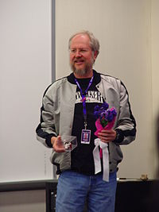
Background
Douglas Crockford

Slide 8

History - pre-JS years
James Gosling

Slide 9
History - pre-JS years
Sun, Java, James Gosling
1990, Sun, alternative to C++/C
modify and extend C++ - “C++ ++ --”
1992, new language Oak - embedded for PDA, set-top-boxes
1994, new platform: Internet, new name: Java
browser: WebRunner->HotJava

Slide 10
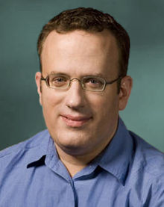
History - pre-JS years
Netscape, Brendan Eich

Slide 11
History -pre-JS - Browsers
NCSA Mosaic, 1993
Marc Andreessen, Eric Bina
Netscape 1.0, 1994
Brendan Eich, Mocha/LiveScript/JavaScript
Netscape 2.0, 1995, Java, JavaScript support
Microsoft JScript, 1996

Slide 12
Goals of Netscape Corp.
Beat Microsoft
C++ - Java
VB - own script language
Browser as “The Platform”

Slide 13
Goals of JavaScript I.
“look like Java” programming language
“doing Scheme” in Netscape
dynamic web

Slide 14
Goals of JavaScript II.
HTML needed a "scripting language", [...] that was easy to use by amateurs and novices, where the code could be written directly in source form as part of the Web page markup. We aimed to provide a "glue language" for the Web designers [...] who were building Web content from components such as images, plugins, and Java applets. We saw Java as the "component language" used by higher-priced programmers, where the glue programmers [...] would assemble components and automate their interactions using JS. (Brendan Eich, CW interview)

Slide 15
History of JavaScript
1994-95 Mocha/LiveScript/JavaScript 1.0
1996 MS JScript
1996 Netscape went to ECMA
1997 ECMAScript v1 (JavaScript 1.3)
1999 ECMAScript v3 (JavaScript 1.5)
2009 ECMAScript v5 (JavaScript 1.8?)
2011 ECMAScript v5.1

Slide 16
Reputation of JS
Java !== JavaScript, Java !> JavaScript
DOM is a mess
JavaScript is not easy
JavaScript is not like the programming language you know
Scripting language

Slide 17
What JavaScript is I.
THE language of the web
Powerful language
loose typeing but not untyped
object literal notation
dynamic objects
prototypal inheritance

Slide 18
What JavaScript is II.
functions are first-class objects/citizens
closures
global objects
Smalltalk/Lisp/Scheme
C syntax
Java Date, Math packages, Boolean/String/... wrapper objects

Slide 19
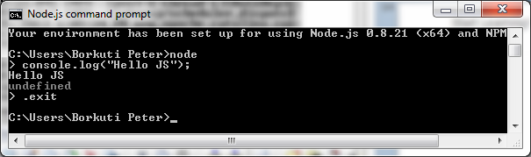
Start Learning! Node.js

Slide 20
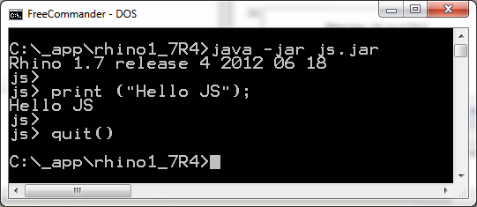
Start Learning! Rhino

Slide 21
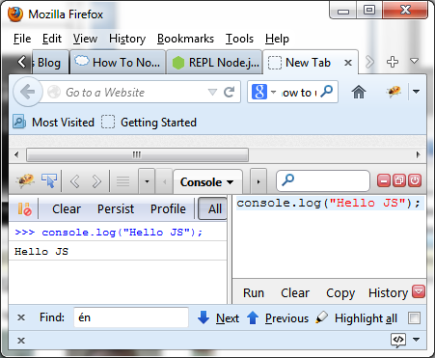
Start Learning! FireBug

Slide 22
Start Learning! HTML
<!DOCTYPE html>
<head><meta charset="UTF-8"/>
<title>example 0</title></head>
<html>
<body>
<script>
console.log("Hello Js");
</script>
</body>
</html>

Slide 23
Placing JS in HTML
HTML:
<script src="example01.js">
</script>
example01.js:
console.log("Hello js");

Slide 24
More js in one HTML
HTML:
<body>
<script src="example01.js"></script>
<script src="example02.js"></script>
</body>

Slide 25
Exercises 1
Write your name to the console with js in a html page
Write your name to the console with an included js file
Write your name and your birthday with two separate js files which included into one html

Slide 26
Homework 1
Check js reference's Window object
alert your name
print the contents of the window
check confirm(),prompt()
(hard)Create a html with js which reads user's input (a string) and alerts it. Be simple, without variables!

Slide 27
JS Types
Boolean
String
Number
Null
Undefined
Object

Slide 28
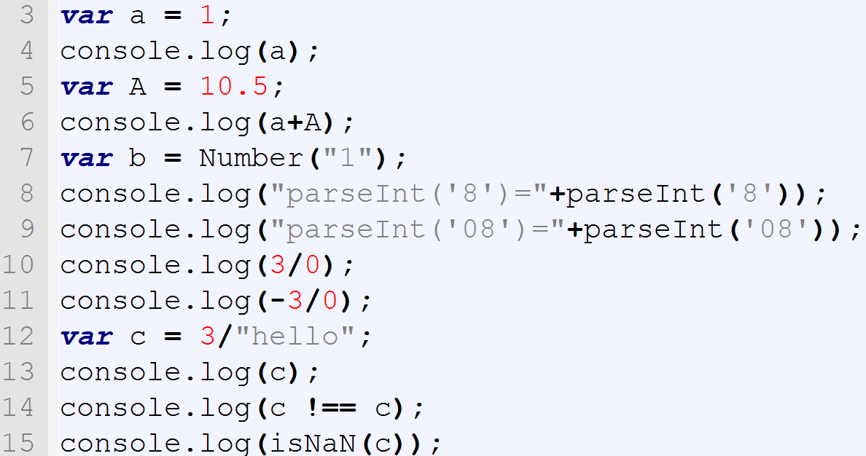
Syntax and types

Slide 29
Syntax and types - Numbers
No Integer type
64-bit floating point (double)
Beware of bit-operations
Number(“42”)
+”42”
parseInt(“8”,10)
Infinity,-Infinity,NaN

Slide 30
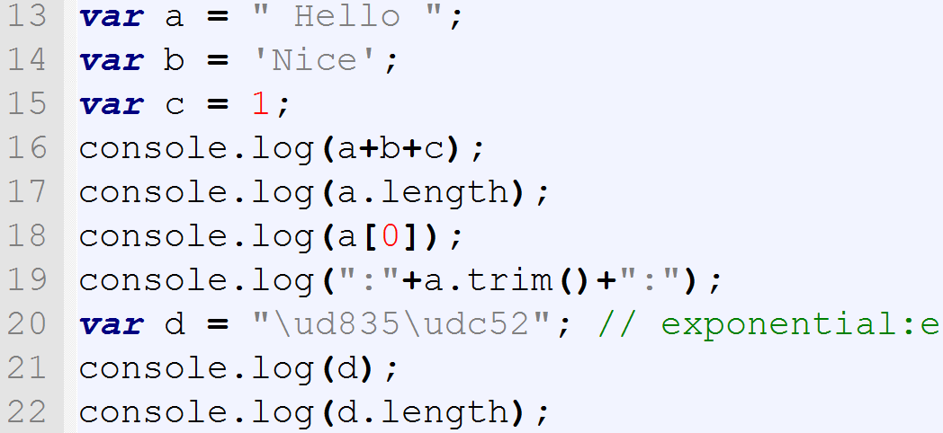
Syntax and types

Slide 31
Syntax and types - Strings
new String(“Hello”)
Concatenation : +
“ or ', no difference
UTF-16 (surrogate pairs!)
.length counts 16-bit values
Dynamic type conversion

Slide 32
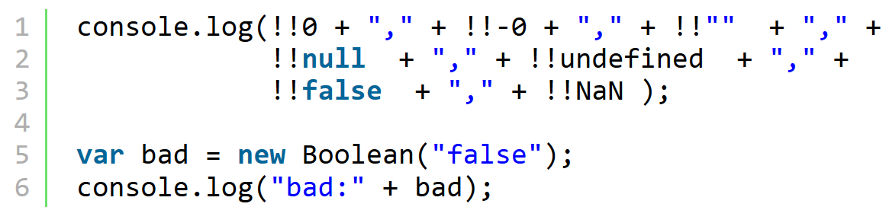
Syntax and types - Boolean

Slide 33
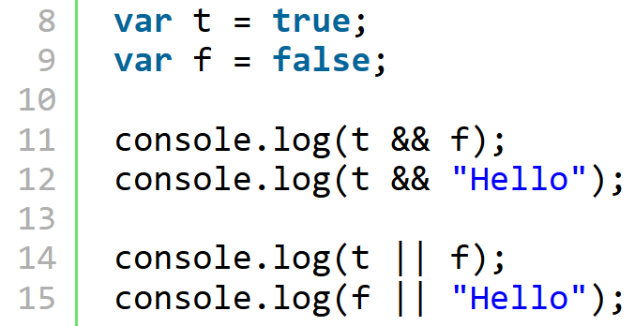
Syntax and types – Boolean op

Slide 34
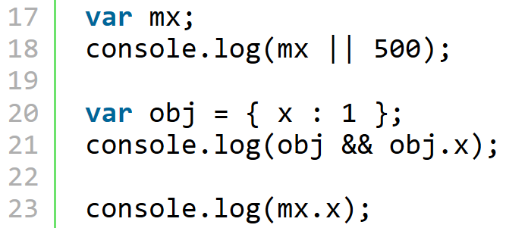
Syntax and types – Boolean op

Slide 35
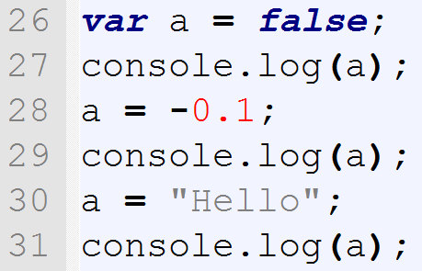
Syntax and TYPES

Slide 36
Syntax and types
Boolean : true, false
Falsy values: 0,””,null,NaN, undefined, false
Truthy values: everything else (objects also)
&&,|| may give any value
! : always boolean, !!: convert to boolean
New Boolean() : avoid it
Loose/weak typeing

Slide 37
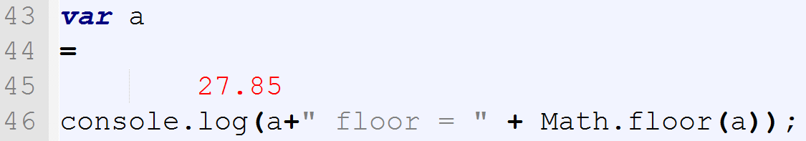
Syntax – Math lib

Slide 38
Syntax – Math lib
Free-form language
; optional (see later: ASI)
Math lib from Java

Slide 39
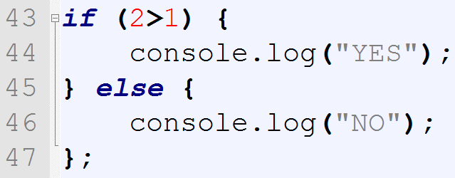
Syntax – branching - if

Slide 40
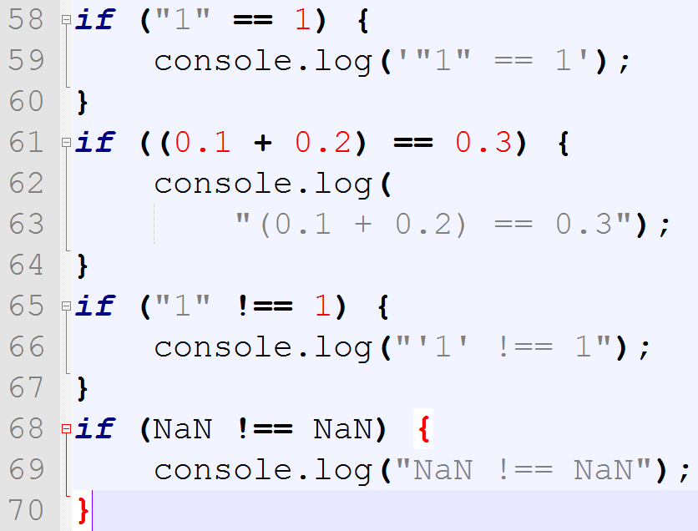
Syntax – == vs ===

Slide 41
Syntax == vs ===
== : type coercion (implicit/automatic conv.)
AVOID it!
=== strict equality/identity op.
NaN !== NaN

Slide 42
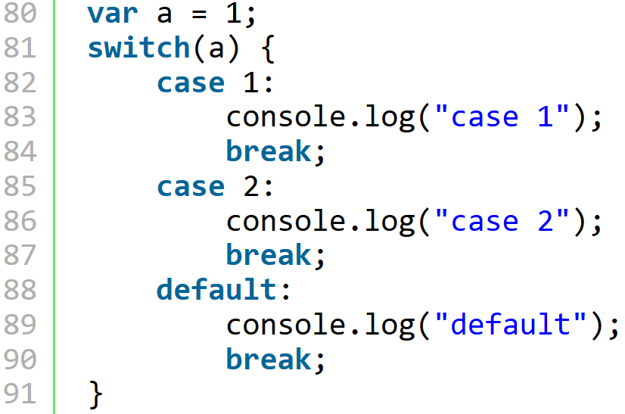
Syntax – switch 1

Slide 43
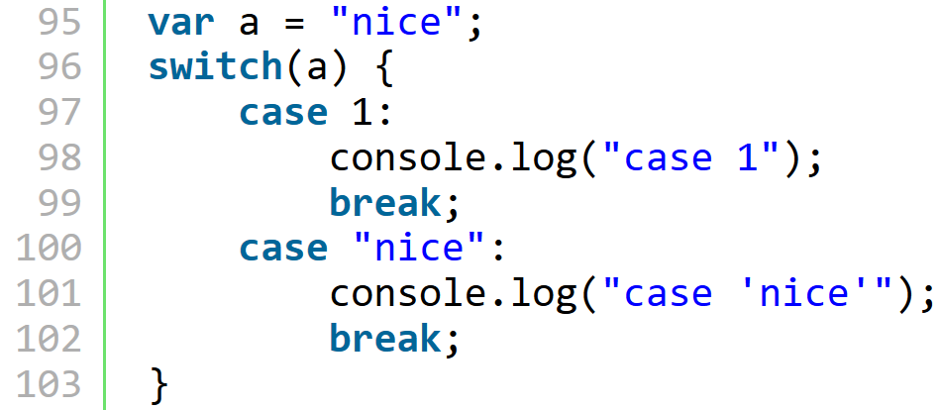
Syntax – switch 2

Slide 44
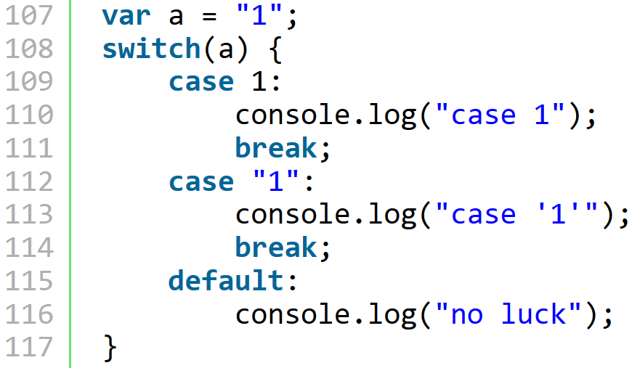
Syntax – switch 3

Slide 45
Syntax - switch
With Strings also
Checking with '==='
Expressions may be in 'case'
Break
Slow

Slide 46
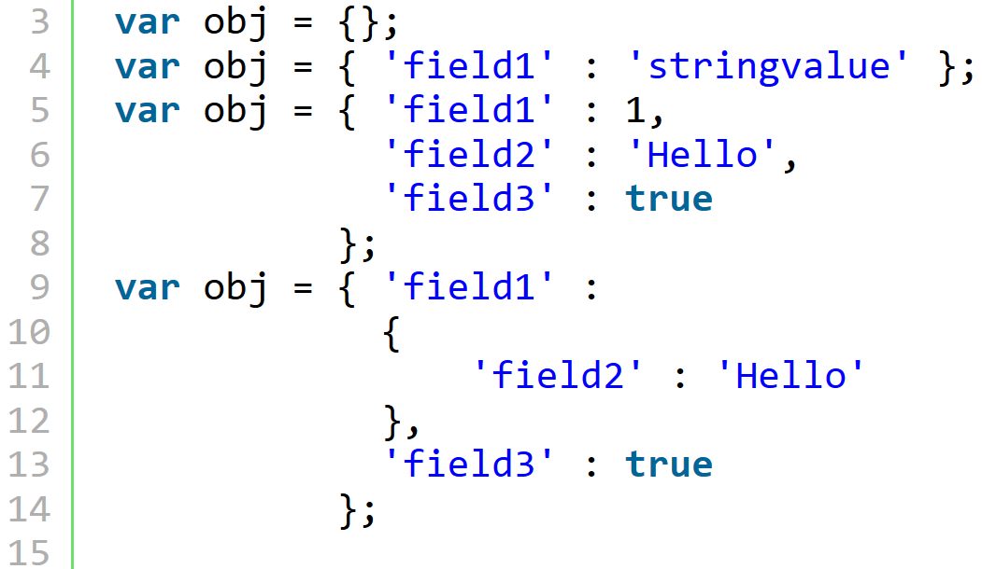
Object – create objects

Slide 47
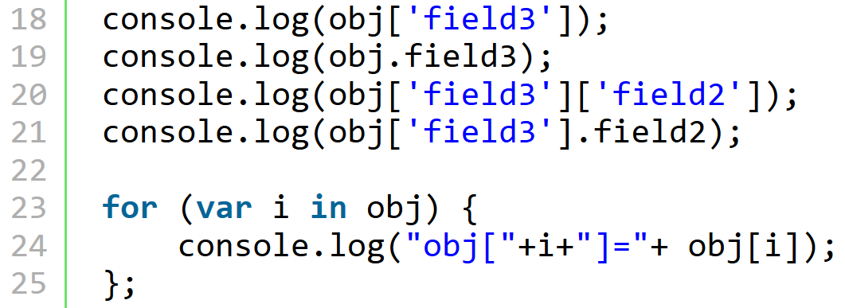
Object – access fields

Slide 48

Object – add/update fields

Slide 49

Object – delete fields

Slide 50
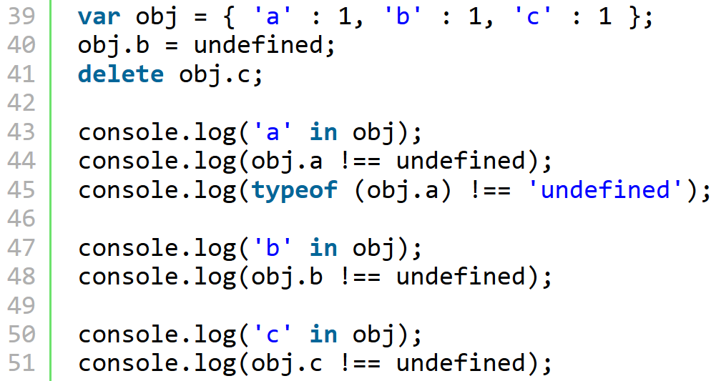
Object – checking fields

Slide 51
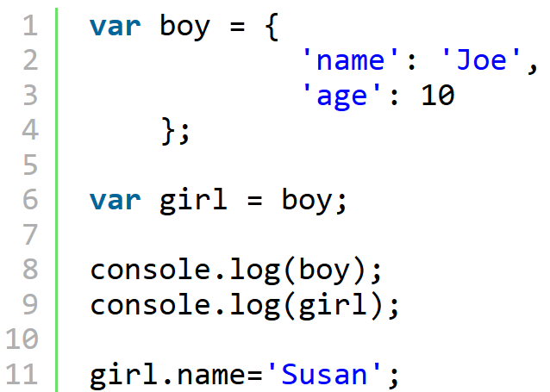
Object – inheritation

Slide 52
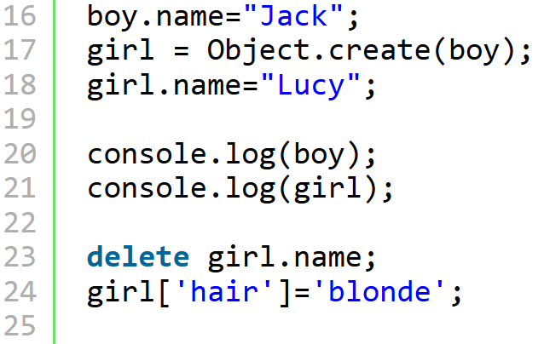
Object – inheritation

Slide 53
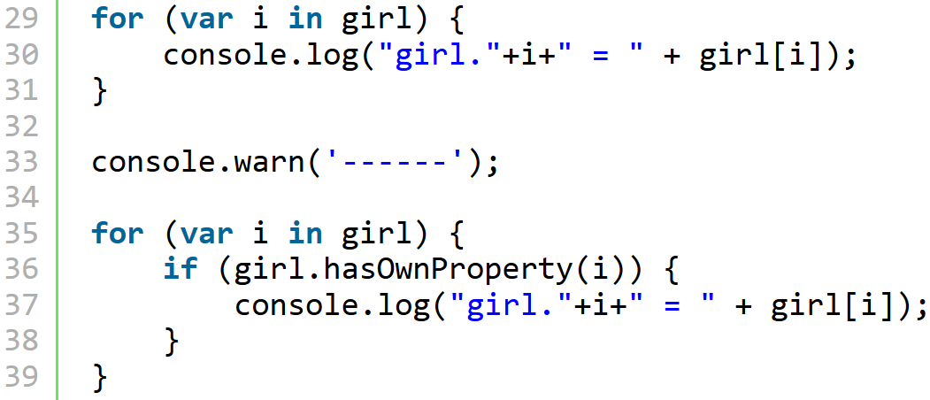
Object – inheritation

Slide 54
Objects
Object literal powerful, nice
Object vars - reference
Inheritance with linking
Inherited fields can be hidden
HasOwnProperty, in, typeof, undefined

Slide 55
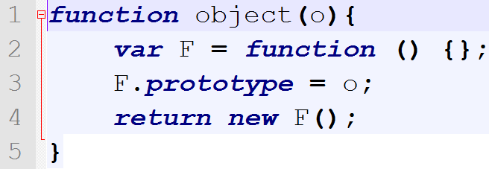
Object.create
ECMAScript 5
ECMAScript 3 : ( from YUI)

Slide 56
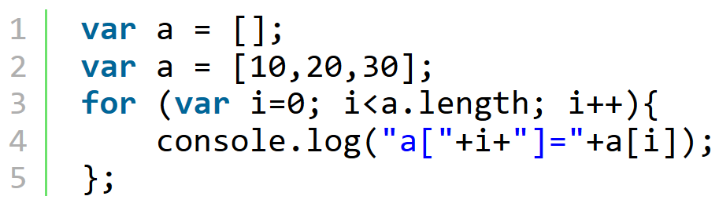
Syntax – Arrays I.

Slide 57
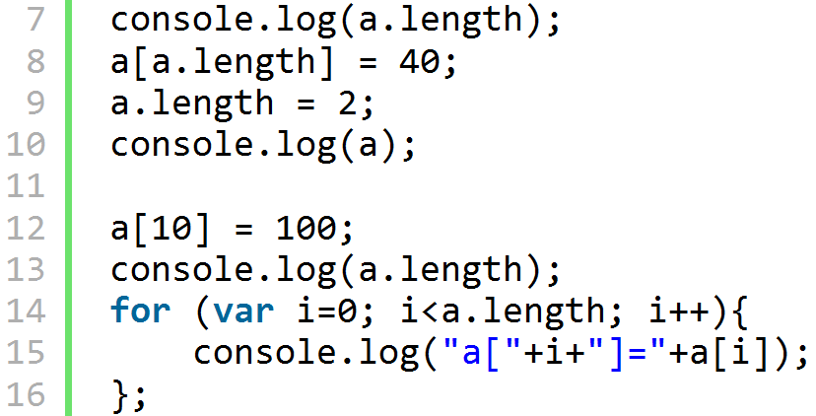
Syntax – Arrays II.

Slide 58
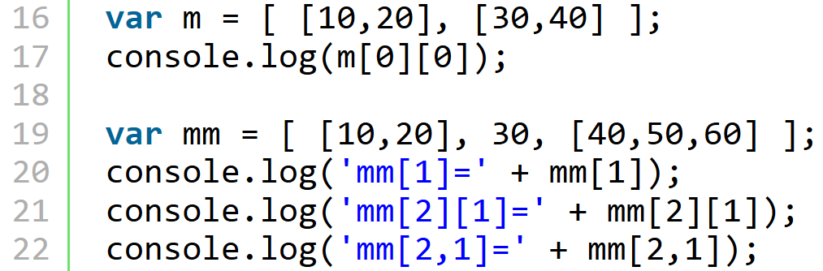
Syntax – Arrays III.

Slide 59
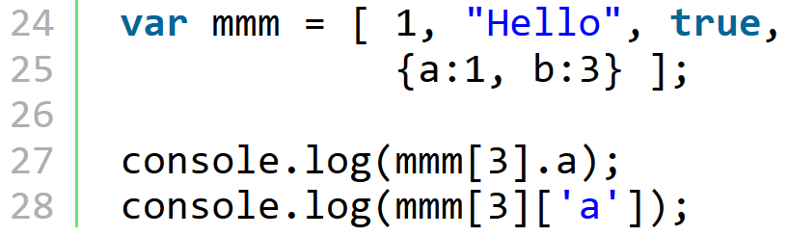
Syntax – Arrays IV.

Slide 60
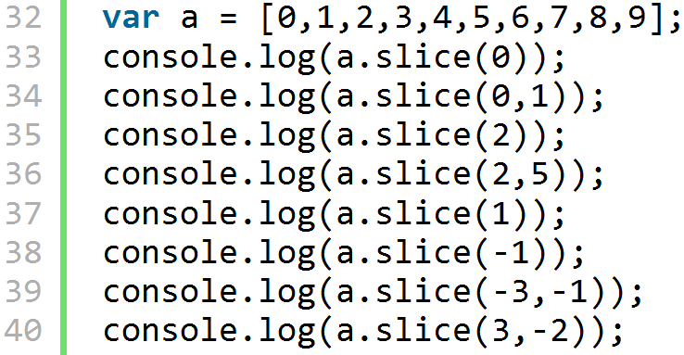
Syntax – Array.slice

Slide 61
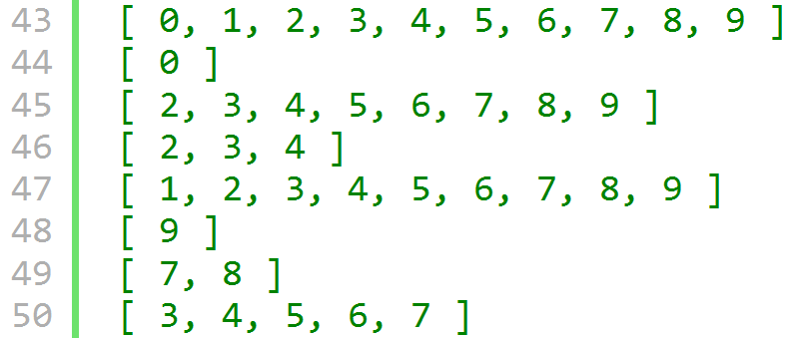
Syntax – Array.slice

Slide 62
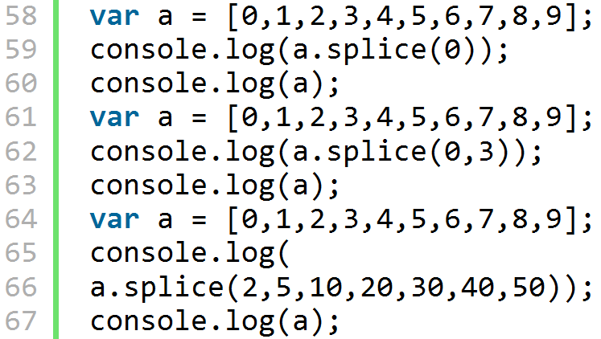
Syntax – Array.splice

Slide 63
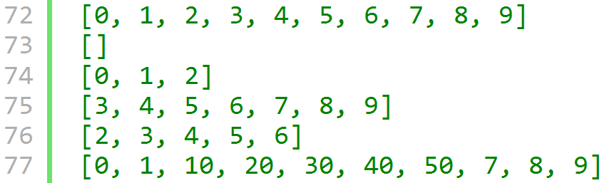
Syntax – Array.splice

Slide 64
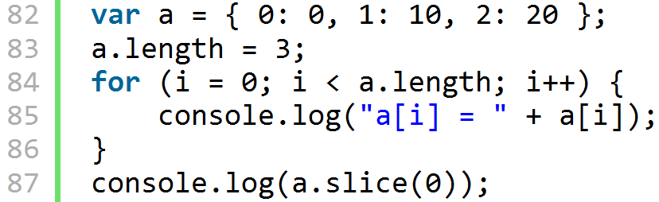
Array-like objects I.

Slide 65
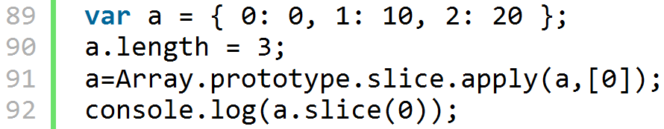
Array-like objects II.

Slide 66
JS Functions
powerful structure
subroutine, function, module, class

Slide 67
JS functions - preview I
anatomy
parameters
variables: globals, locals, hiding, scope
hoisting
immediate invoke
return

Slide 68
JS functions - preview II
nested functions
closures
objects and functions
invocation
closure and this
see: example_functions.html
see: example_closure_0?.html for better understanding

Slide 69
JS functions - oop I
Inheritance
  constructor
  Object.create(parentObj)
  functional (Crockord's inheritance)
see: example_inheritance.html

Slide 70
JS functions - oop II
Module
  encapsulation
  information hiding
  Object.create(parentObj)
  functional (Crockord's inheritance)
see: example_module.html

Slide 71
JS functions - oop?
wikipedia: Object-oriented_programming
Encapsulation
Dynamic dispatch
Subtype polimorphism
Inheritance
Open recursion

Slide 72
JS functions - oop? I.
encapsulation
  bundling data with the methods operating on that data
dynamic dispatch
  x : object, type known only runtime. call x.foo()
  Decide at runtime which implementation of foo() to invoke, based on the runtime type of object x
  in Java: single dispatch, because decision based on a single type, the type of x.

Slide 73
JS functions - oop? II.
Subtype polymorphism
  program elements written to operate on objects of the supertype can also operate on objects of the subtype
Inheritance
  a way to establish Is-a relationship between objects
  JS: differential inheritance

Slide 74
JS functions - oop? III.
Open recursion
  a special variable that allows a method body to invoke another method of the same object
  object -> runtime, so we can reach even subclass methods/fields from a superclass with this variable

Slide 75
Bonus
YUI oop (oop\yui-oop.html)
DOM basics (DOMBasics\index.html)
Sprites (not finished)
Background scrolling (not finished)

Slide 76
Questions

Slide 77
Exercises 2
write a quadratic equation solver
  pure js, without variables, without i/o, just the formula with numbers
  pure js, with variables, without i/o
  check if a variable is number, see js globals parseInt, Number, isNaN and Number

Slide 78
Homework 2
In old days, programmers showed messages in browser's status bar. Now browsers disable this (annoying) feature, so you should enable this.
In FF, use about:config as a web-address, then set dom.disable_window_status_change to false.

Slide 79
Homework 2
Write a program which rotates your name in the status bar.
See String object in js ref

