Slide 1
JS Basics by Examples
Péter Borkuti
2013

Slide 2
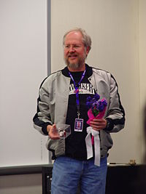
Background
Douglas Crockford

Slide 3

History - pre-JS years
James Gosling

Slide 4
History - pre-JS years
Sun, Java, James Gosling
1990, Sun, alternative to C++/C
modify and extend C++ - “C++ ++ --”
1992, new language Oak - embedded for PDA, set-top-boxes
1994, new platform: Internet, new name: Java
browser: WebRunner->HotJava

Slide 5
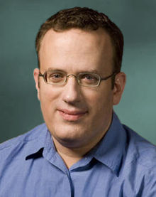
History - pre-JS years
Netscape, Brendan Eich

Slide 6
History -pre-JS - Browsers
NCSA Mosaic, 1993
Marc Andreessen, Eric Bina
Netscape 1.0, 1994
Brendan Eich, Mocha/LiveScript/JavaScript
Netscape 2.0, 1995, Java, JavaScript support
Microsoft JScript, 1996

Slide 7
Goals of Netscape Corp.
Beat Microsoft
C++ - Java
VB - own script language
Browser as “The Platform”

Slide 8
Goals of JavaScript I.
“look like Java” programming language
“doing Scheme” in Netscape
dynamic web

Slide 9
Goals of JavaScript II.
HTML needed a "scripting language", [...] that was easy to use by amateurs and novices, where the code could be written directly in source form as part of the Web page markup. We aimed to provide a "glue language" for the Web designers [...] who were building Web content from components such as images, plugins, and Java applets. We saw Java as the "component language" used by higher-priced programmers, where the glue programmers [...] would assemble components and automate their interactions using JS. (Brendan Eich, CW interview)

Slide 10
History of JavaScript
1994-95 Mocha/LiveScript/JavaScript 1.0
1996 MS JScript
1996 Netscape went to ECMA
1997 ECMAScript v1 (JavaScript 1.3)
1999 ECMAScript v3 (JavaScript 1.5)
2009 ECMAScript v5 (JavaScript 1.8?)
2011 ECMAScript v5.1

Slide 11
Reputation of JS
Java !== JavaScript, Java !> JavaScript
DOM is a mess
JavaScript is not easy
JavaScript is not like the programming language you know
Scripting language

Slide 12
What JavaScript is I.
THE language of the web
Powerful language
loose typeing but not untyped
object literal notation
dynamic objects
prototypal inheritance

Slide 13
What JavaScript is II.
functions are first-class objects/citizens
closures
global objects
Smalltalk/Lisp/Scheme
C syntax
Java Date, Math packages, Boolean/String/... wrapper objects

Slide 14
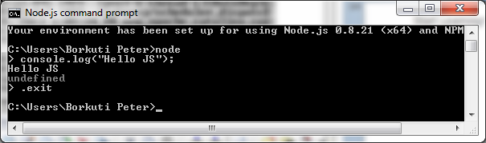
Start Learning! Node.js

Slide 15
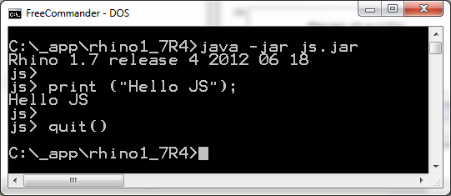
Start Learning! Rhino

Slide 16
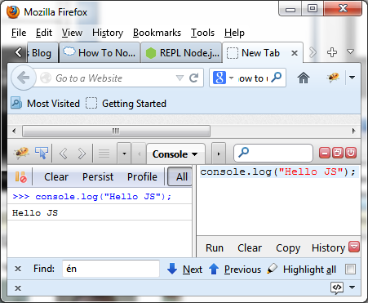
Start Learning! FireBug

Slide 17
Start Learning! HTML
<!DOCTYPE html>
<head><meta charset="UTF-8"/>
<title>example 0</title></head>
<html>
<body>
<script>
console.log("Hello Js");
</script>
</body>
</html>

Slide 18
Placing JS in HTML
HTML:
<script src="example01.js">
</script>
example01.js:
console.log("Hello js");

Slide 19
More js in one HTML
HTML:
<body>
<script src="example01.js"></script>
<script src="example02.js"></script>
</body>

Slide 20
Exercises 1
Write your name to the console with js in a html page
Write your name to the console with an included js file
Write your name and your birthday with two separate js files which included into one html

Slide 21
Homework 1
Check js reference's Window object
alert your name
print the contents of the window
check confirm(),prompt()
(hard)Create a html with js which reads user's input (a string) and alerts it. Be simple, without variables!

Slide 22
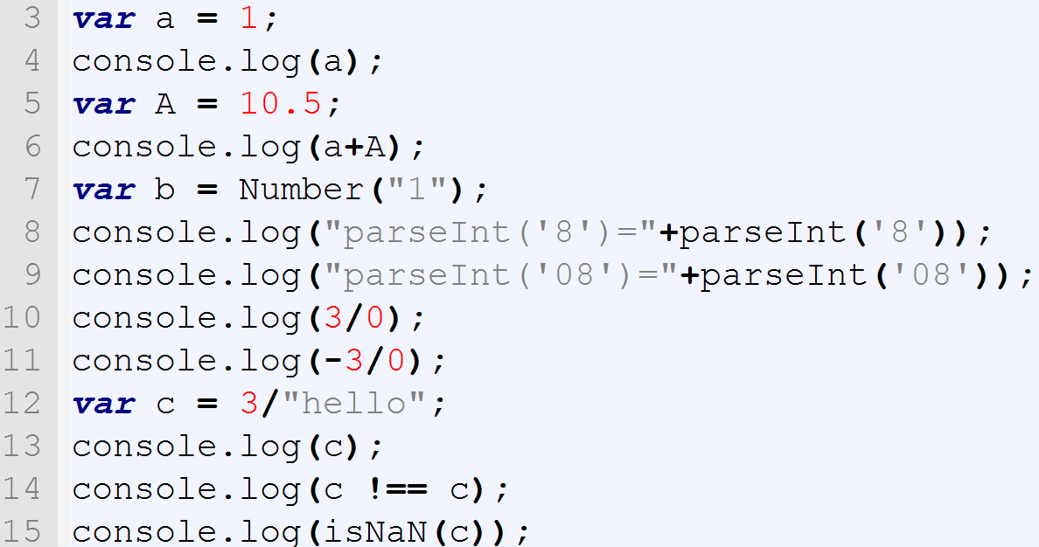
Syntax and types

Slide 23
Syntax and types - Numbers
No Integer type
64-bit floating point (double)
Beware of bit-operations
Number(“42”)
+”42”
parseInt(“8”,10)
Infinity,-Infinity,NaN

Slide 24
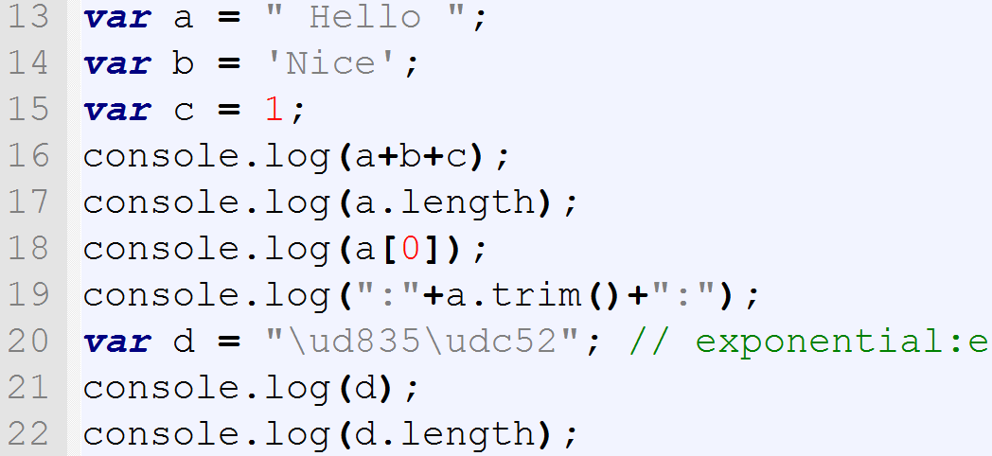
Syntax and types

Slide 25
Syntax and types - Strings
new String(“Hello”)
Concatenation : +
“ or ', no difference
UTF-16 (surrogate pairs!)
.length counts 16-bit values
Dynamic type conversion

Slide 26
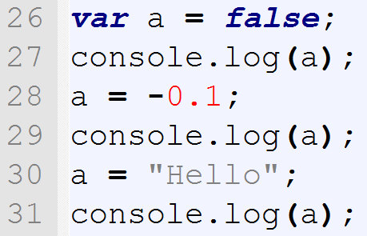
Syntax and types

Slide 27
Syntax and types
Boolean : true, false
Loose/weak typeing

Slide 28
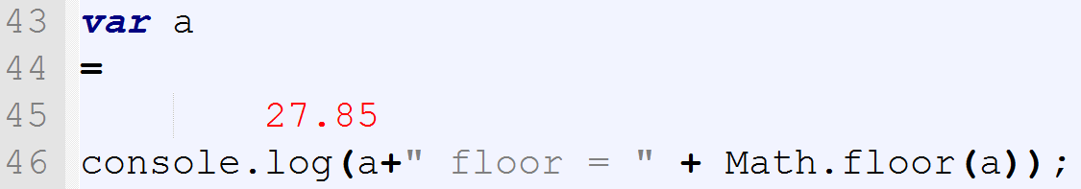
Syntax – Math lib

Slide 29
Syntax – Math lib
Free-form language
; optional (see later: ASI)
Math lib from Java

Slide 30
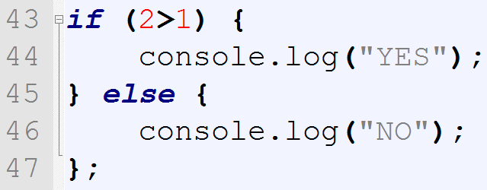
Syntax – branching - if

Slide 31
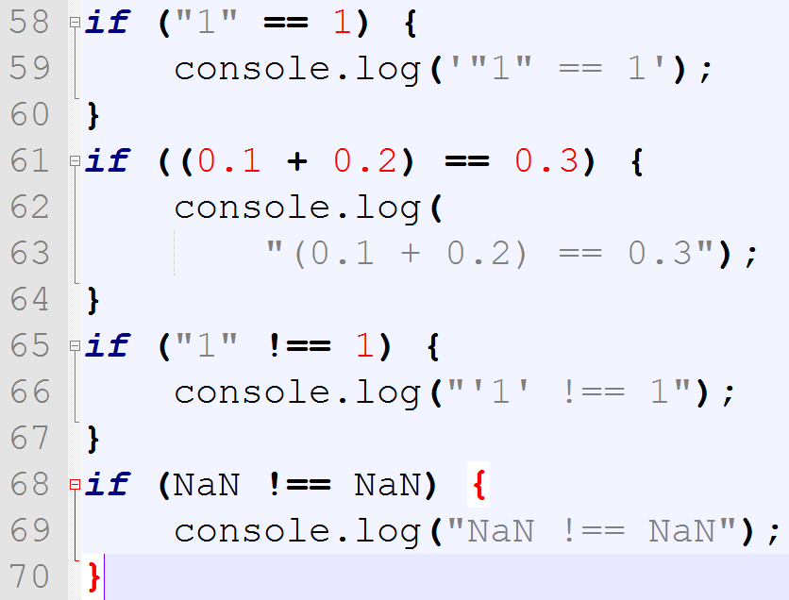
Syntax – == vs ===

Slide 32
Syntax == vs ===
== : type coercion (implicit/automatic conv.)
AVOID it!
=== strict equality/identity op.
NaN !== NaN

Slide 33
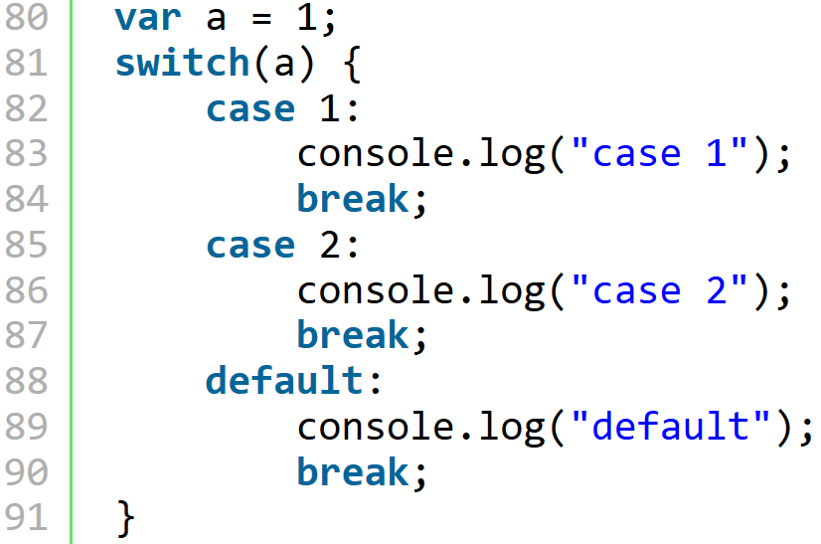
Syntax – switch 1

Slide 34
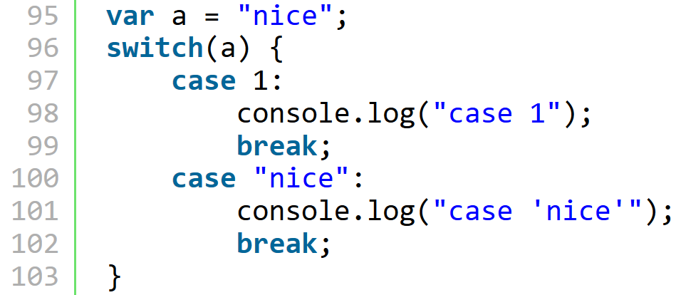
Syntax – switch 2

Slide 35
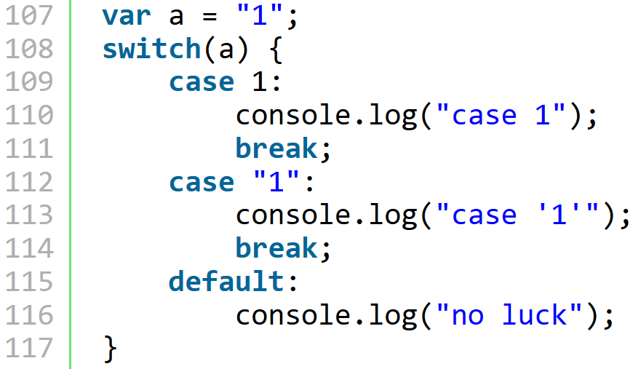
Syntax – switch 3

Slide 36
Syntax - switch
With Strings also
Checking with '==='
Expressions may be in 'case'
Break
Slow

Slide 37
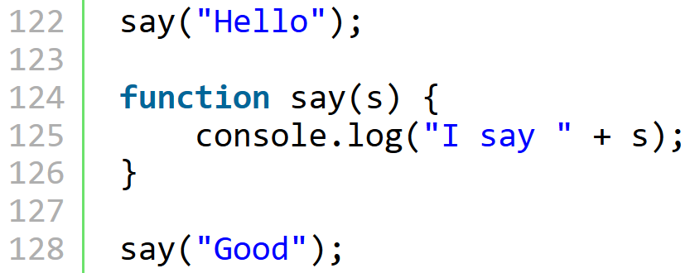
Syntax - functions

Slide 38
Exercises 2
write a quadratic equation solver
  pure js, without variables, without i/o, just the formula with numbers
  pure js, with variables, without i/o
  check if a variable is number, see js globals parseInt, Number, isNaN and Number

Slide 39
Homework 2
In old days, programmers showed messages in browser's status bar. Now browsers disable this (annoying) feature, so you should enable this.
In FF, use about:config as a web-address, then set dom.disable_window_status_change to false.

Slide 40
Homework 2
Write a program which rotates your name in the status bar.
See String object in js ref

