Slide 1
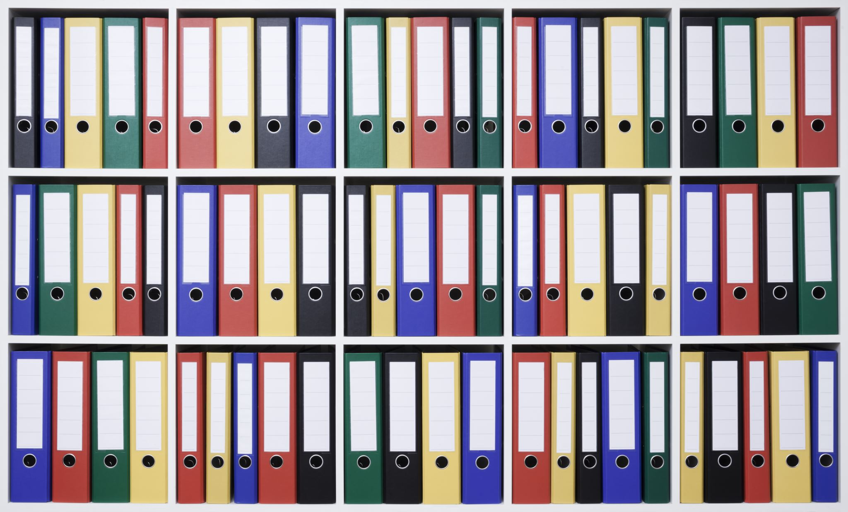
BioCat: A Catalogue System
By: Steven Dang, Peter Bui, Cyrus Ng, Scott Heigl-Yates, Thinh Phan

Slide 2
AGENDA
Overview
System
Lessons Learned
Client
Current System
Design Challenges
System Solutions
Design Process
Demo

Slide 3
Overview

Slide 4

CLIENT
Doctor Robert Jennings
Biology Department Lab Manager and Assistant Professor
Contact Info: rob.jennings@temple.edu
Location: BioLife 248G

Slide 5
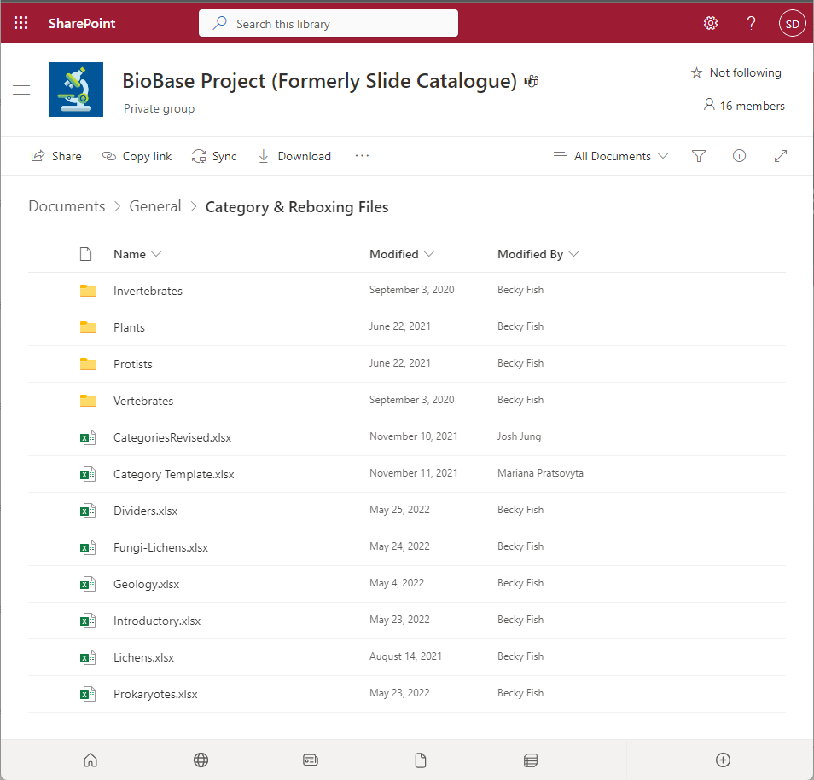
CURRENT SYSTEM
Currently all the microscope slides are being managed through multiple excel sheets under the BioBase Project SharePoint.
Lab Coordinators must meet with Dr. Jennings to look through extensive excel files and find necessary slides for their class and labs.

Slide 6
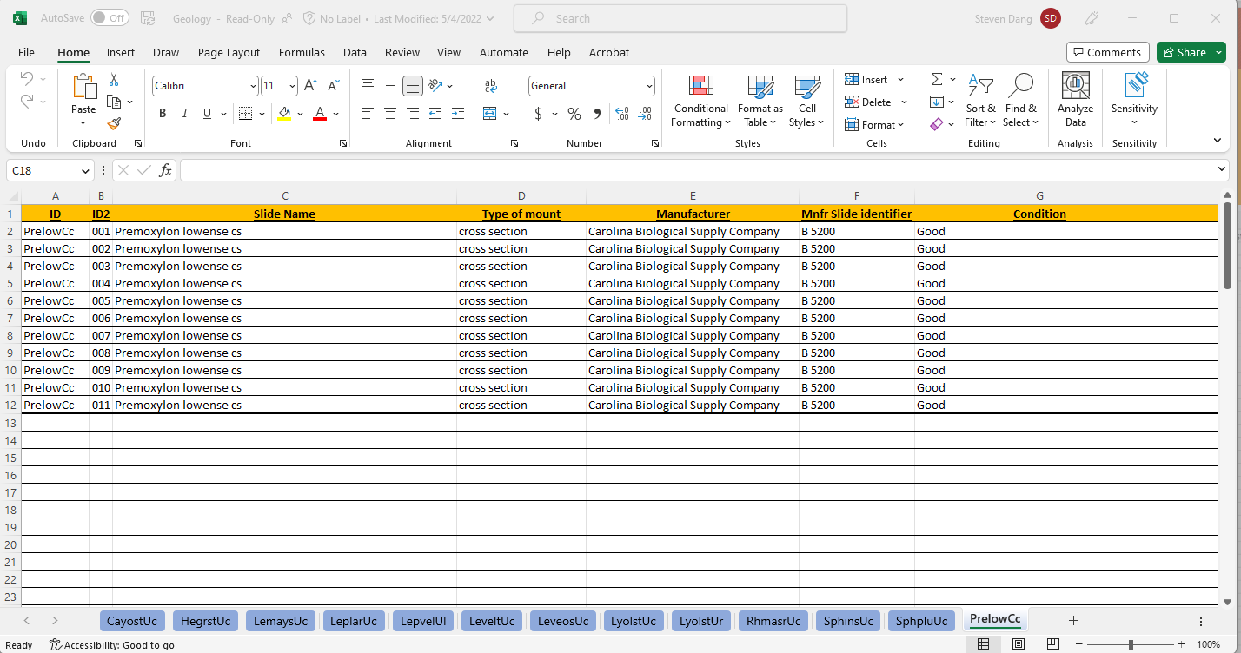
Geology Excel File

Slide 7



CHALLENGES
Currently over 50,000 slides exists and all being manage and track through various excel files.
Dr. Jennings wants a system to manage and track the microscope slides electronically without the use of excel files.
A way for Lab Coordinators and Faculty can browse and request slides electronically.

Slide 8
Our System

Slide 9
SYSTEM SOLUTION
A backend where Dr. Jennings and his team can manage and track the slides through a database, with the ability to import prior slides through excel files, add new slides, and delete old slides, and update slide information.
A Wawa-Like System, where lab coordinators and faculty can browse the catalogue of slides the biology department has to offer.
The catalogue will have a request system where users can select slides from the catalogue they want and it will send a request to the admin team.

Slide 10
DESIGN PROCESS
Utilizing Microsoft ASP.NET Framework 4.7, with MVC 5 and Entity Framework (Object-Relational-Mapping) to build out our system in Visual Studio with GitHub as our version control.
Work in a Simulated Agile Development with Iterative processes such as sprints, scrum reports, test plans, etc.
With weekly reports and updates made to our Professor Rob Zahorchak.

Slide 11
Demo

Slide 12
LESSONS LEARNED
Microsoft ASP.NET Framework 4.7
Agile Development an Iterative processes.
Model-View-Controller Software Design Pattern
Entity Framework, Object Relational Mapping
Documentation; Sprints, scrum reports, test plans, etc.
Version Control, mainly GitHub

