Slide 1
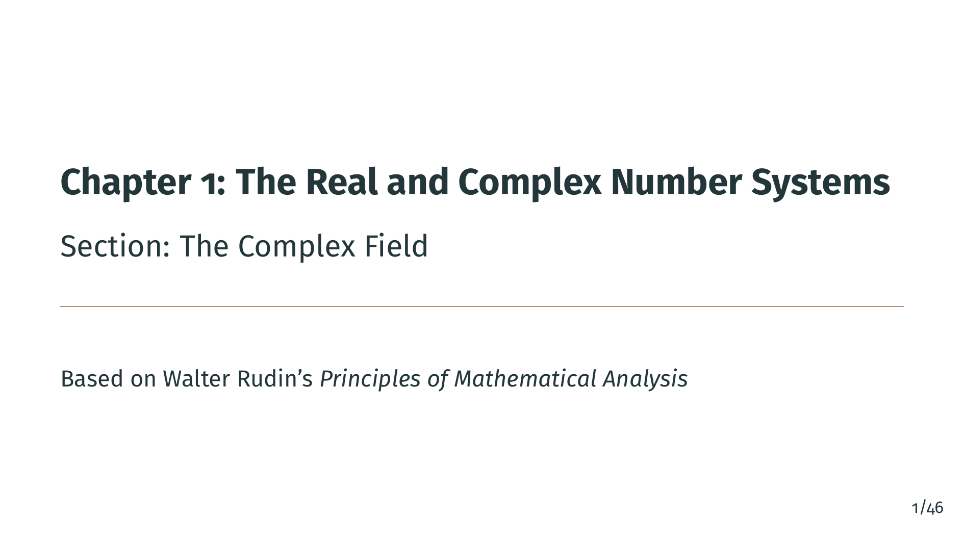
Notes:
Welcome to Chapter 1, Section 6: The Complex Field. In this section we construct the complex numbers from scratch, using nothing more than ordered pairs of real numbers. We will see that these ordered pairs, equipped with the right addition and multiplication rules, form a field. Along the way we will meet the imaginary unit "i", the conjugate, the absolute value, and the important Schwarz inequality.

Slide 2
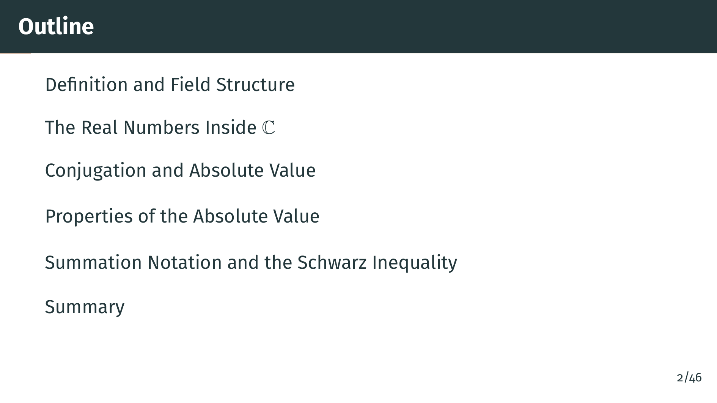
Notes:
Here is our outline for this section. We begin with the definition of complex numbers and verify that they form a field. Then we show how the familiar notation "a" plus "b" "i" arises naturally. Next we study conjugation and the absolute value, establishing the triangle inequality. Finally, we prove the Schwarz inequality, which will be important throughout the rest of the book. Let's start with some motivation.

Slide 3


Slide 4
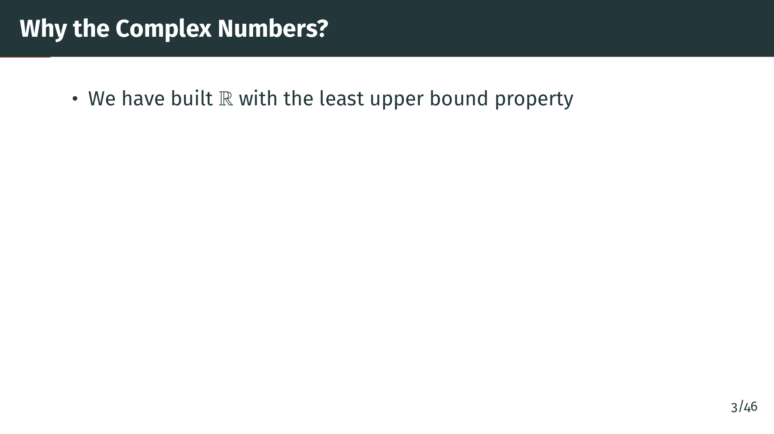
Notes:
Let's begin with some motivation. In the previous sections we carefully constructed the real number system and established its key property: the least upper bound property. So the reals are a complete ordered field. Why would we want anything more? Well, there is a limitation.

Slide 5
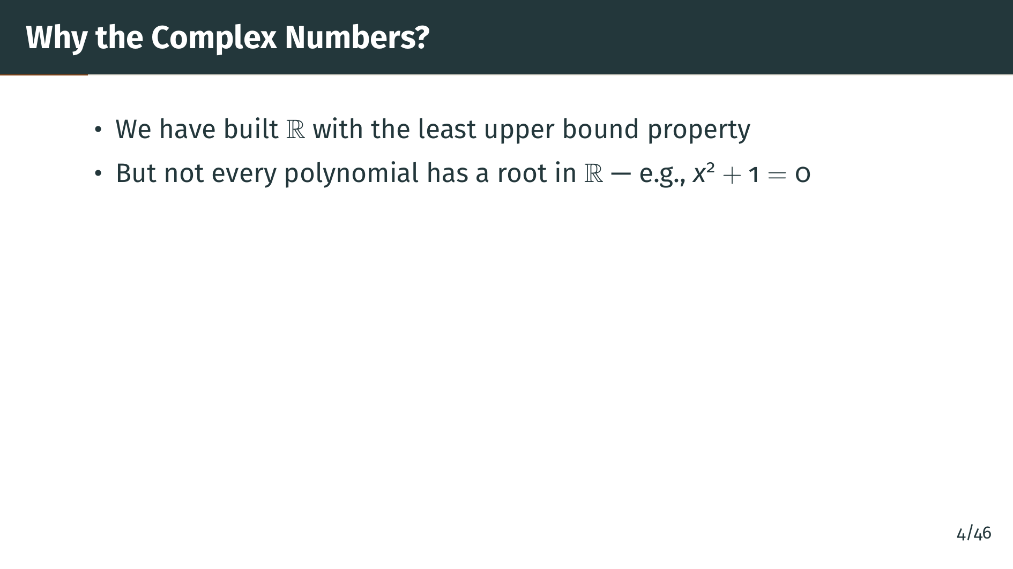
Notes:
The problem is that certain very simple equations have no solution in the reals. For instance, the equation x squared plus one equals zero has no real solution, since the square of any real number is nonnegative. This is a serious limitation if we want a number system where every polynomial equation can be solved. So how do we fix this?

Slide 6
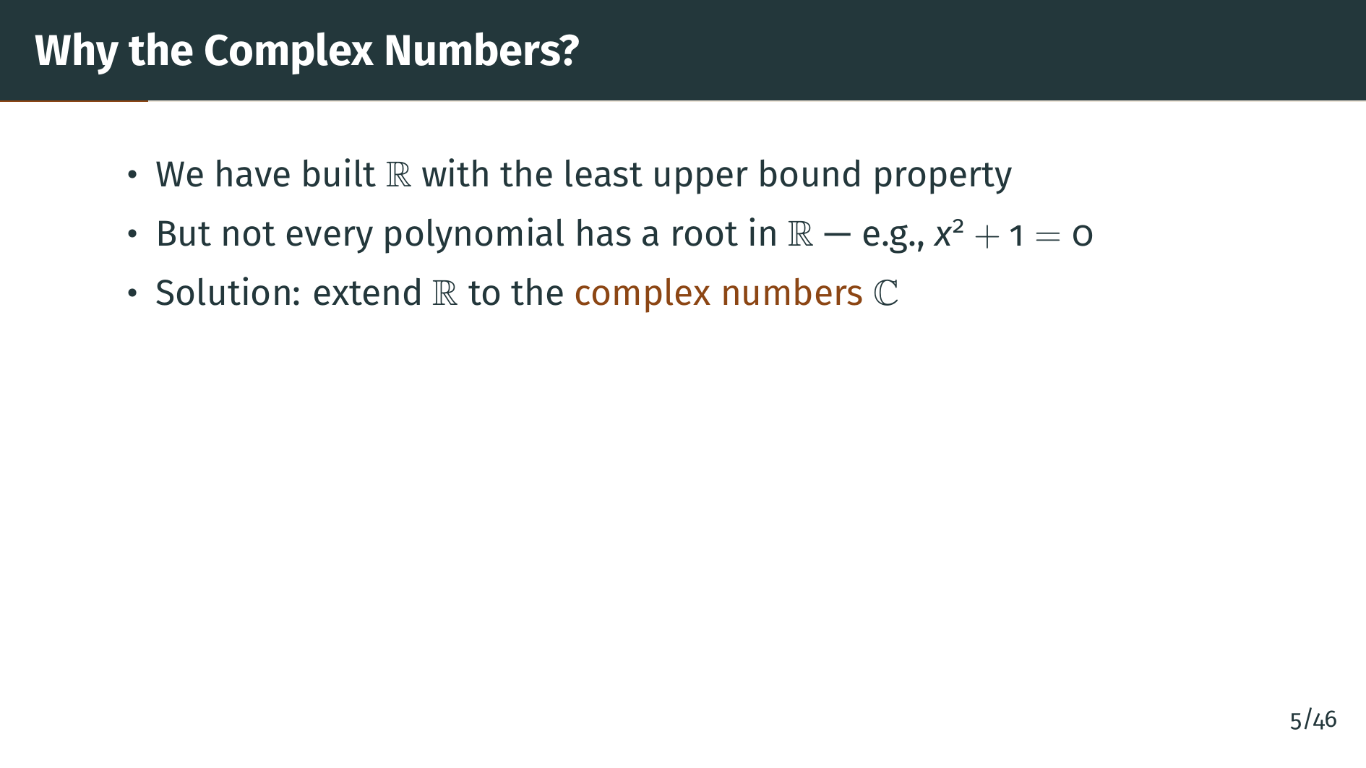
Notes:
The solution is to extend the real numbers to a larger number system, the complex numbers. Rudin's approach is elegant: he defines complex numbers purely as ordered pairs of reals with specific arithmetic rules. No mysterious square root of negative one is assumed to exist. Let's see how this works.

Slide 7
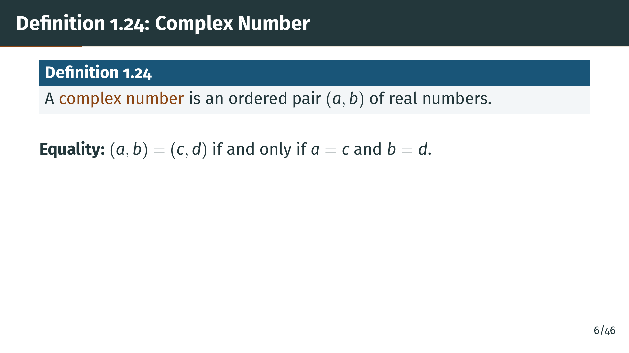
Notes:
Here is the formal definition. A complex number is simply an ordered pair of real numbers. The word ``ordered'' means that the pair "a", "b" and the pair "b", "a" are different whenever "a" is not equal to "b". Two complex numbers are equal precisely when both their first components and second components match. This may seem obvious, but Rudin points out that the definition is not entirely superfluous --- think of how equality of rational numbers works when they are represented as quotients of integers. Now let's define the arithmetic operations.

Slide 8
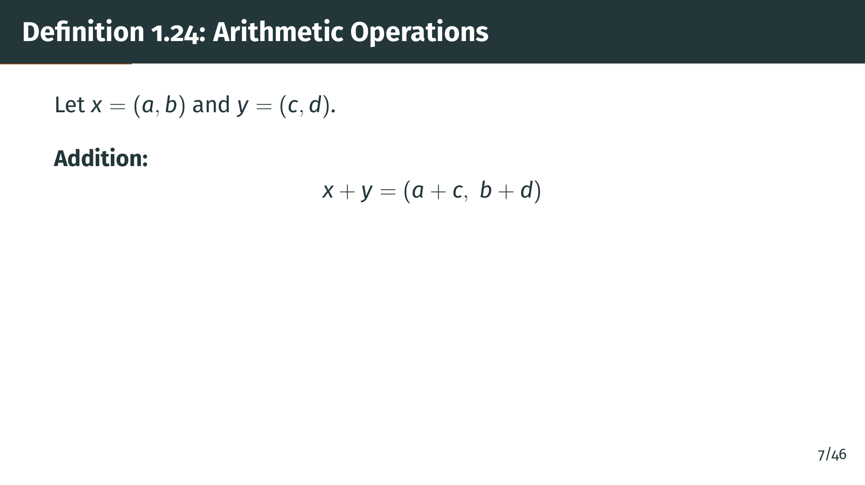
Notes:
Now we define the arithmetic. Addition is done component-wise: we add the first components and the second components separately. This is exactly what you would expect --- nothing surprising here. Next, let's see the multiplication rule, which is more surprising.

Slide 9
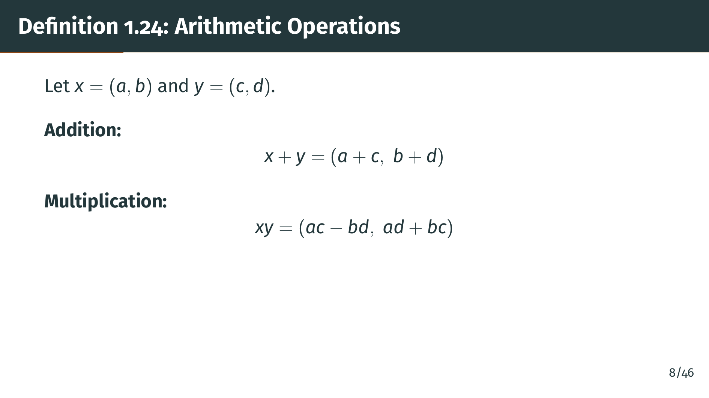
Notes:
Multiplication is more interesting. The formula may look strange at first, but there is a natural motivation: it is exactly what you get if you formally expand the product using the rule that "i" squared equals negative one. Of course, we haven't introduced "i" yet --- that comes later. For now, this is just a definition, and its justification will become clear shortly. Let's visualize these ordered pairs in the plane.

Slide 10
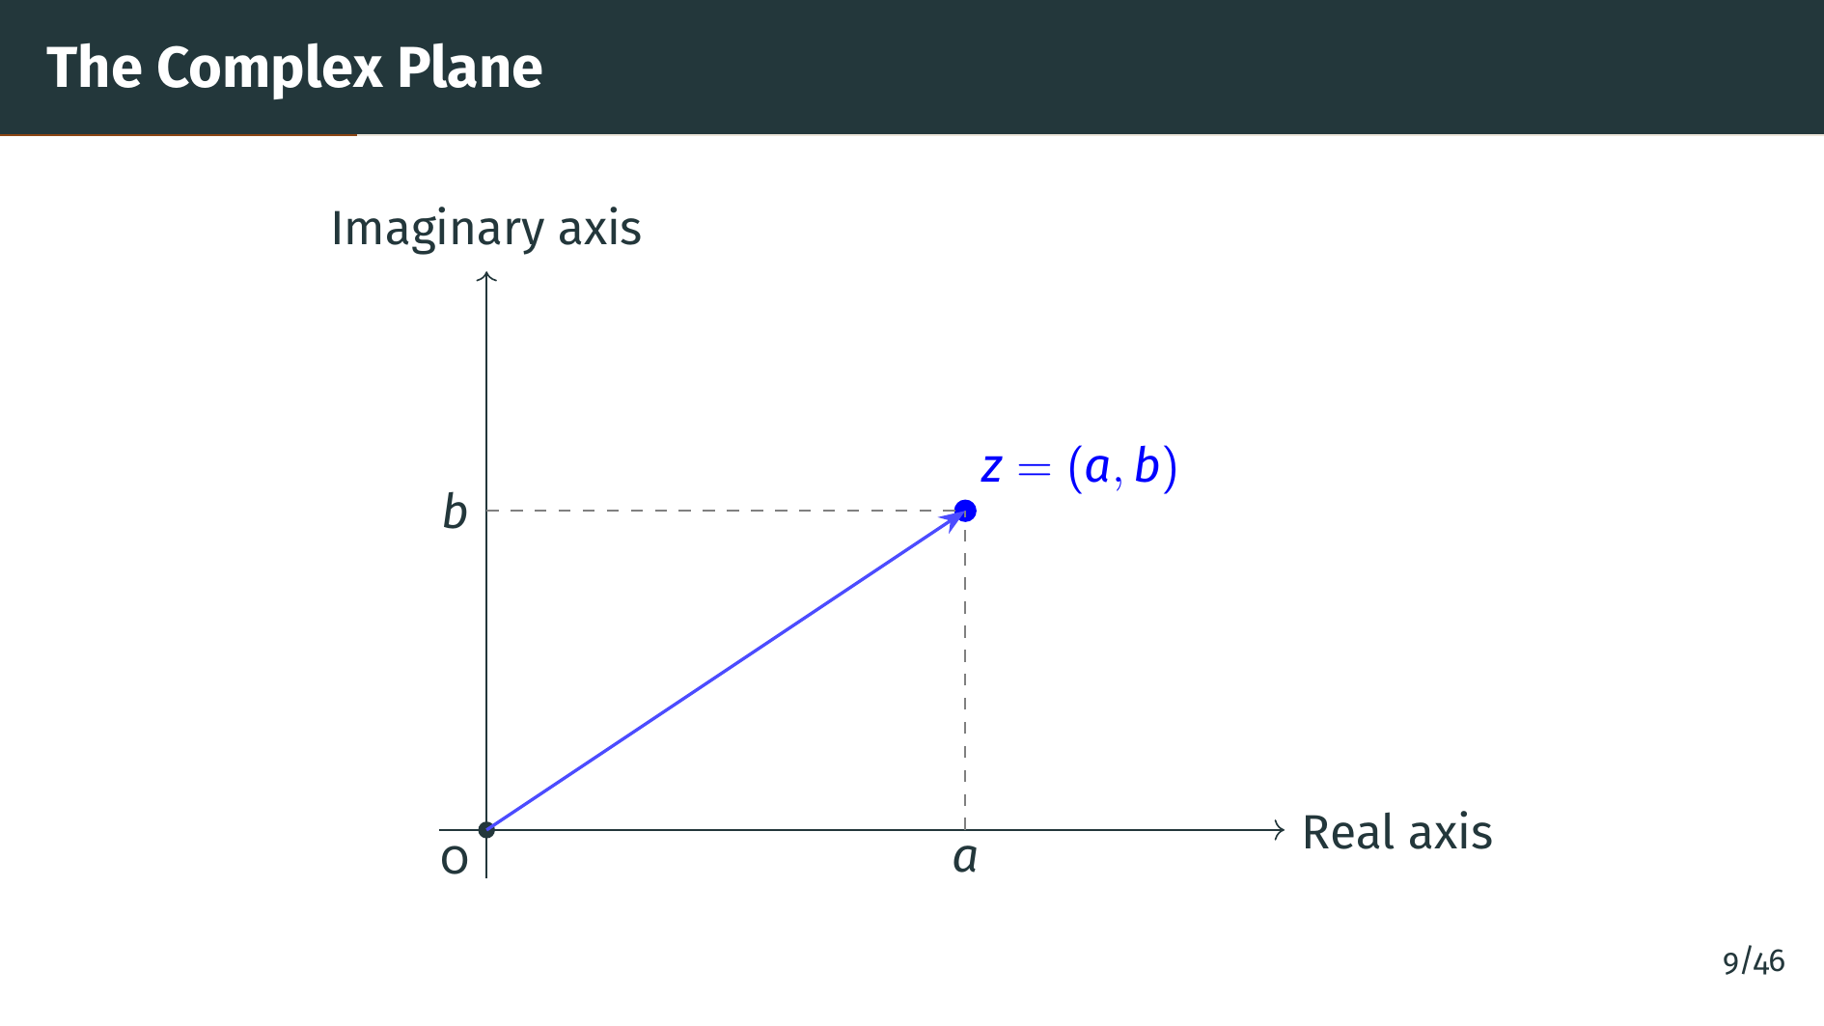
Notes:
We can visualize each complex number as a point in the plane. The horizontal axis represents the first component, which we will call the real part, and the vertical axis represents the second component, the imaginary part. The complex number "z" equals the pair "a", "b" corresponds to the point with coordinates "a" and "b". We can also think of "z" as a vector from the origin to that point. This geometric picture will be very helpful later when we discuss absolute values and the triangle inequality. Now let's verify that these arithmetic rules give us a field.

Slide 11
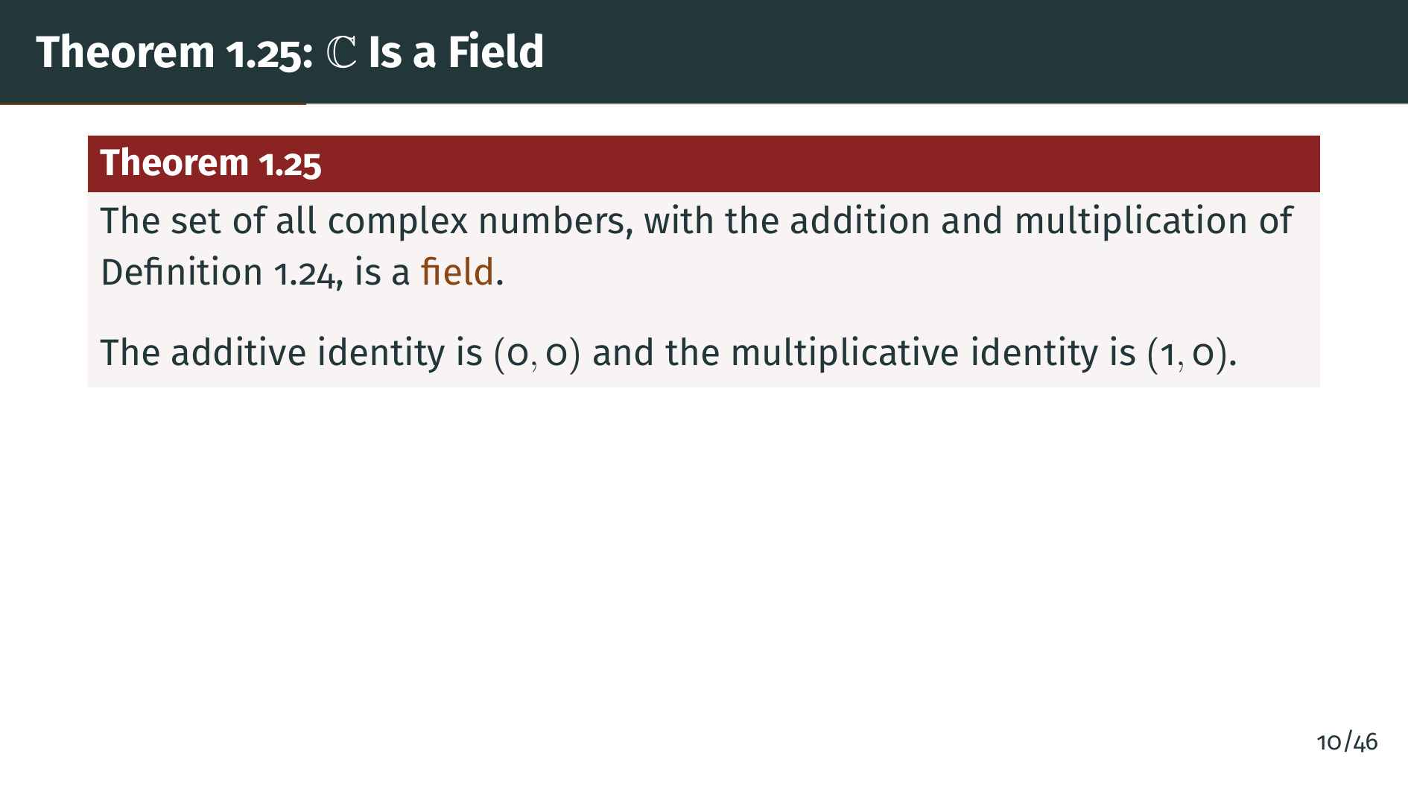
Notes:
This is the main structural result. The complex numbers form a field. That means all the field axioms we listed back in Definition 1.12 are satisfied: commutativity and associativity of addition and multiplication, existence of identity elements and inverses, and the distributive law. The zero element is the pair zero, zero and the one element is the pair one, zero. The proof is a systematic verification of each axiom using the field properties of the reals. Let's look at the proof strategy.

Slide 12
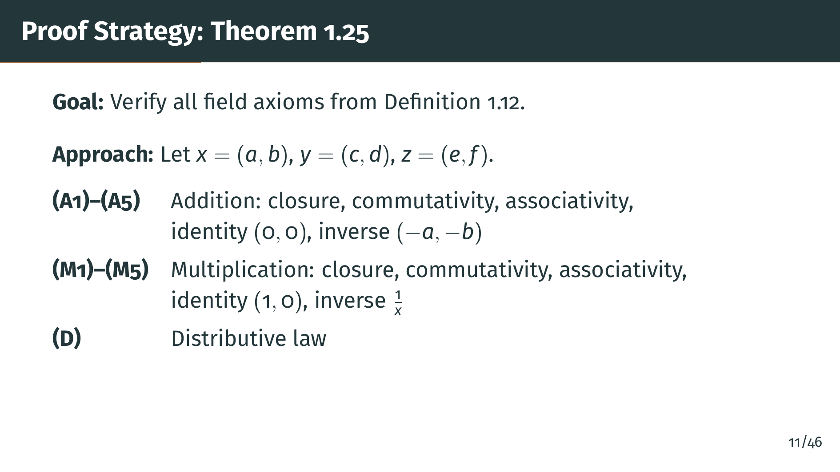
Notes:
Here is the roadmap for the proof. We verify each field axiom one by one. The addition axioms are straightforward since addition is component-wise, so they inherit directly from real number properties. The multiplication axioms require more computation: associativity involves expanding lengthy products, and the existence of multiplicative inverses requires a clever formula. Let us walk through the key steps, starting with addition.

Slide 13
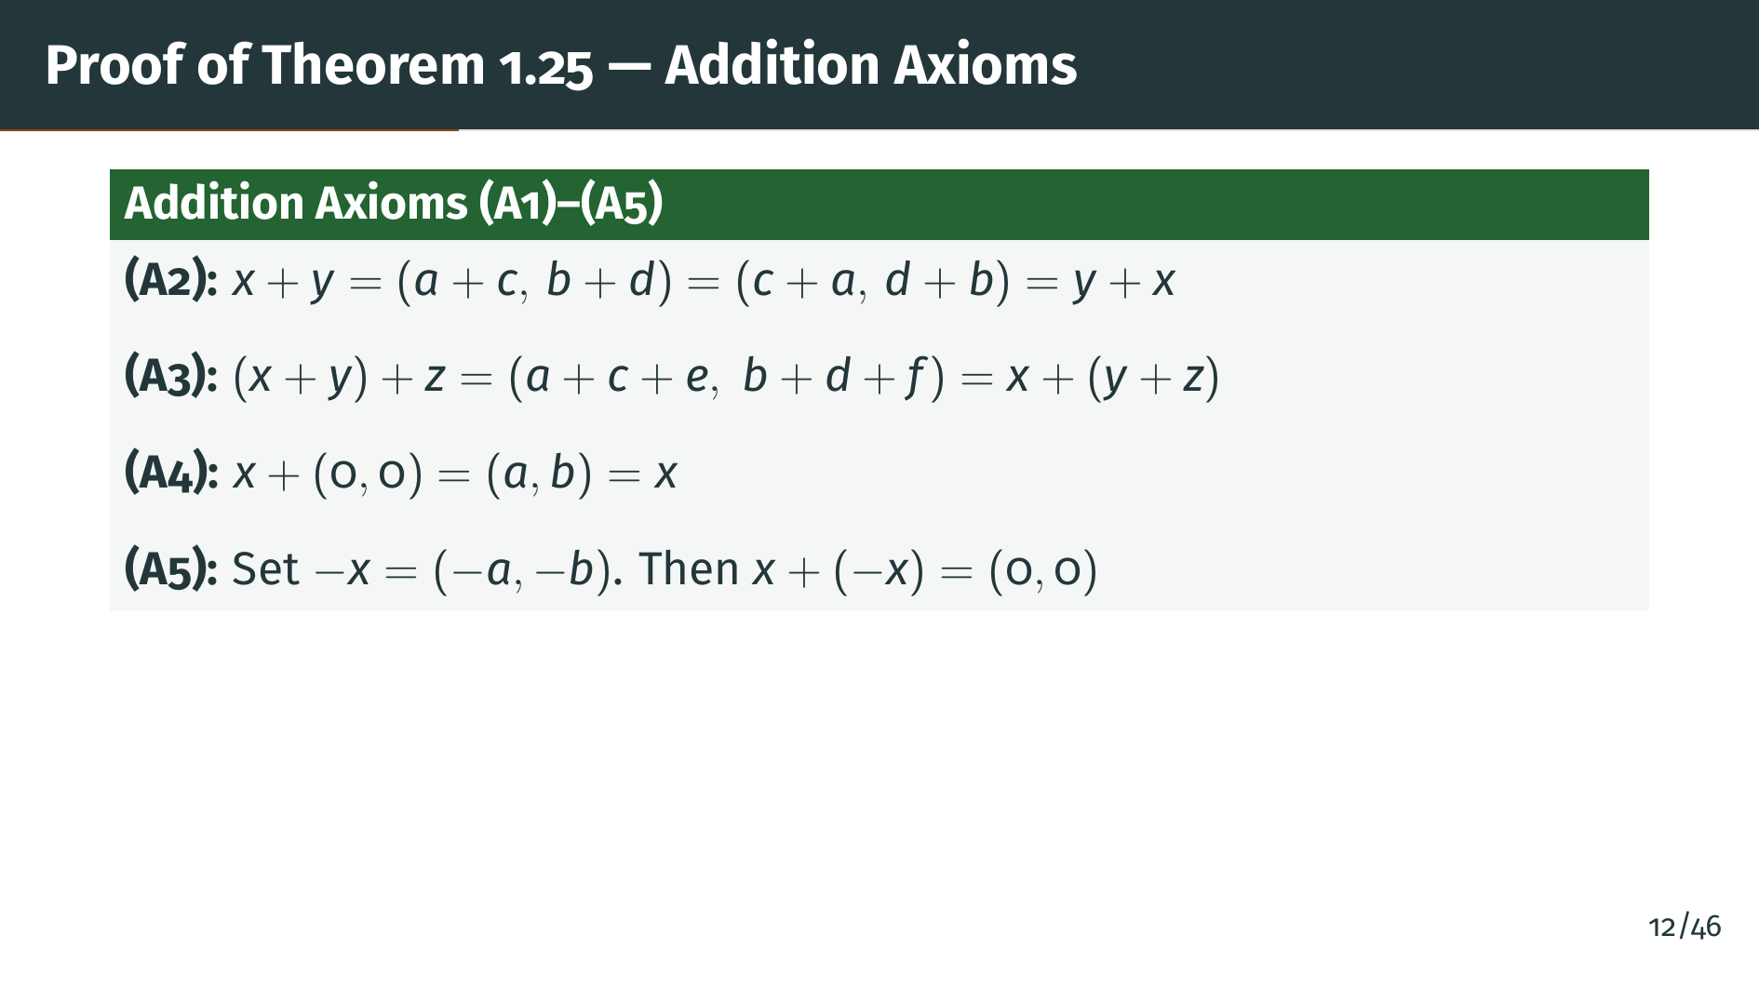
Notes:
The addition axioms follow directly from the corresponding properties of real number addition. Commutativity holds because real addition is commutative. Associativity works because we can regroup the real additions in each component freely. The pair zero, zero is the additive identity because adding zero to each component leaves the number unchanged. And the additive inverse of the pair "a", "b" is the pair negative "a", negative "b", since adding them gives zero, zero. Closure is clear since sums of real numbers are real. Now let's turn to the multiplication axioms, which are more interesting.

Slide 14
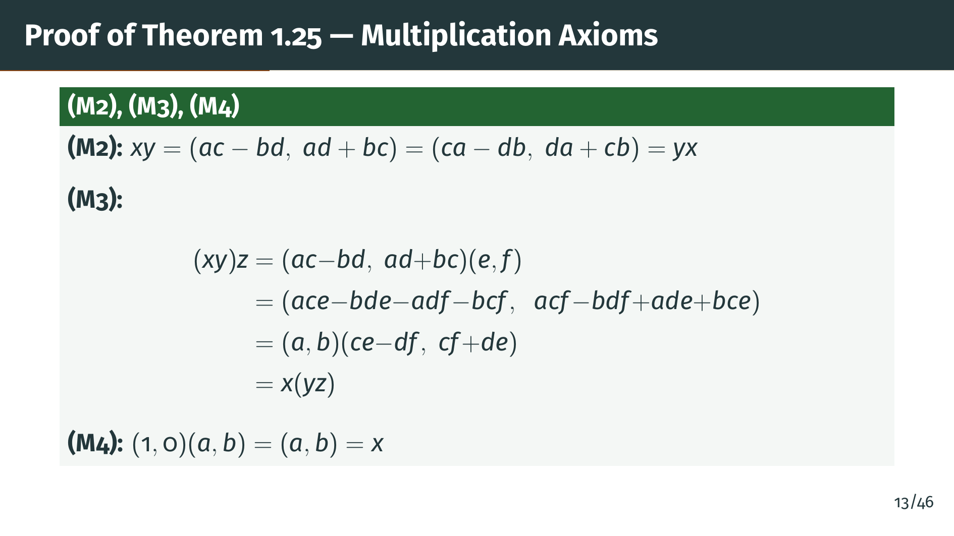
Notes:
Commutativity of multiplication follows because real multiplication is commutative. Associativity is the most tedious verification --- the slide shows the full expansion. The key point is that no matter which product you compute first, the cross terms rearrange to give the same result. You can verify this yourself by expanding in the other order. Finally, the pair one, zero acts as the identity. The crucial remaining axiom is the existence of multiplicative inverses, which we address next.

Slide 15
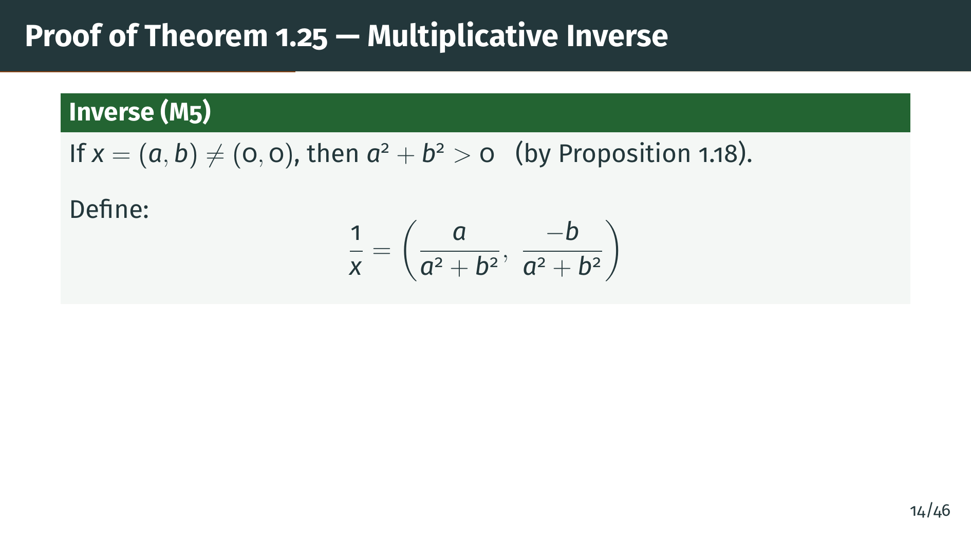
Notes:
The most important part of the proof is the multiplicative inverse. If "x" is nonzero, then at least one component is nonzero, so the sum of squares in the denominator is strictly positive by Proposition 1.18. This guarantees we can divide by it. Pay attention to the formula on the slide: notice how it resembles rationalizing a denominator. This is no coincidence --- we are essentially dividing by "a" plus "b" "i" by multiplying numerator and denominator by the conjugate. Let's verify that this formula actually works.

Slide 16
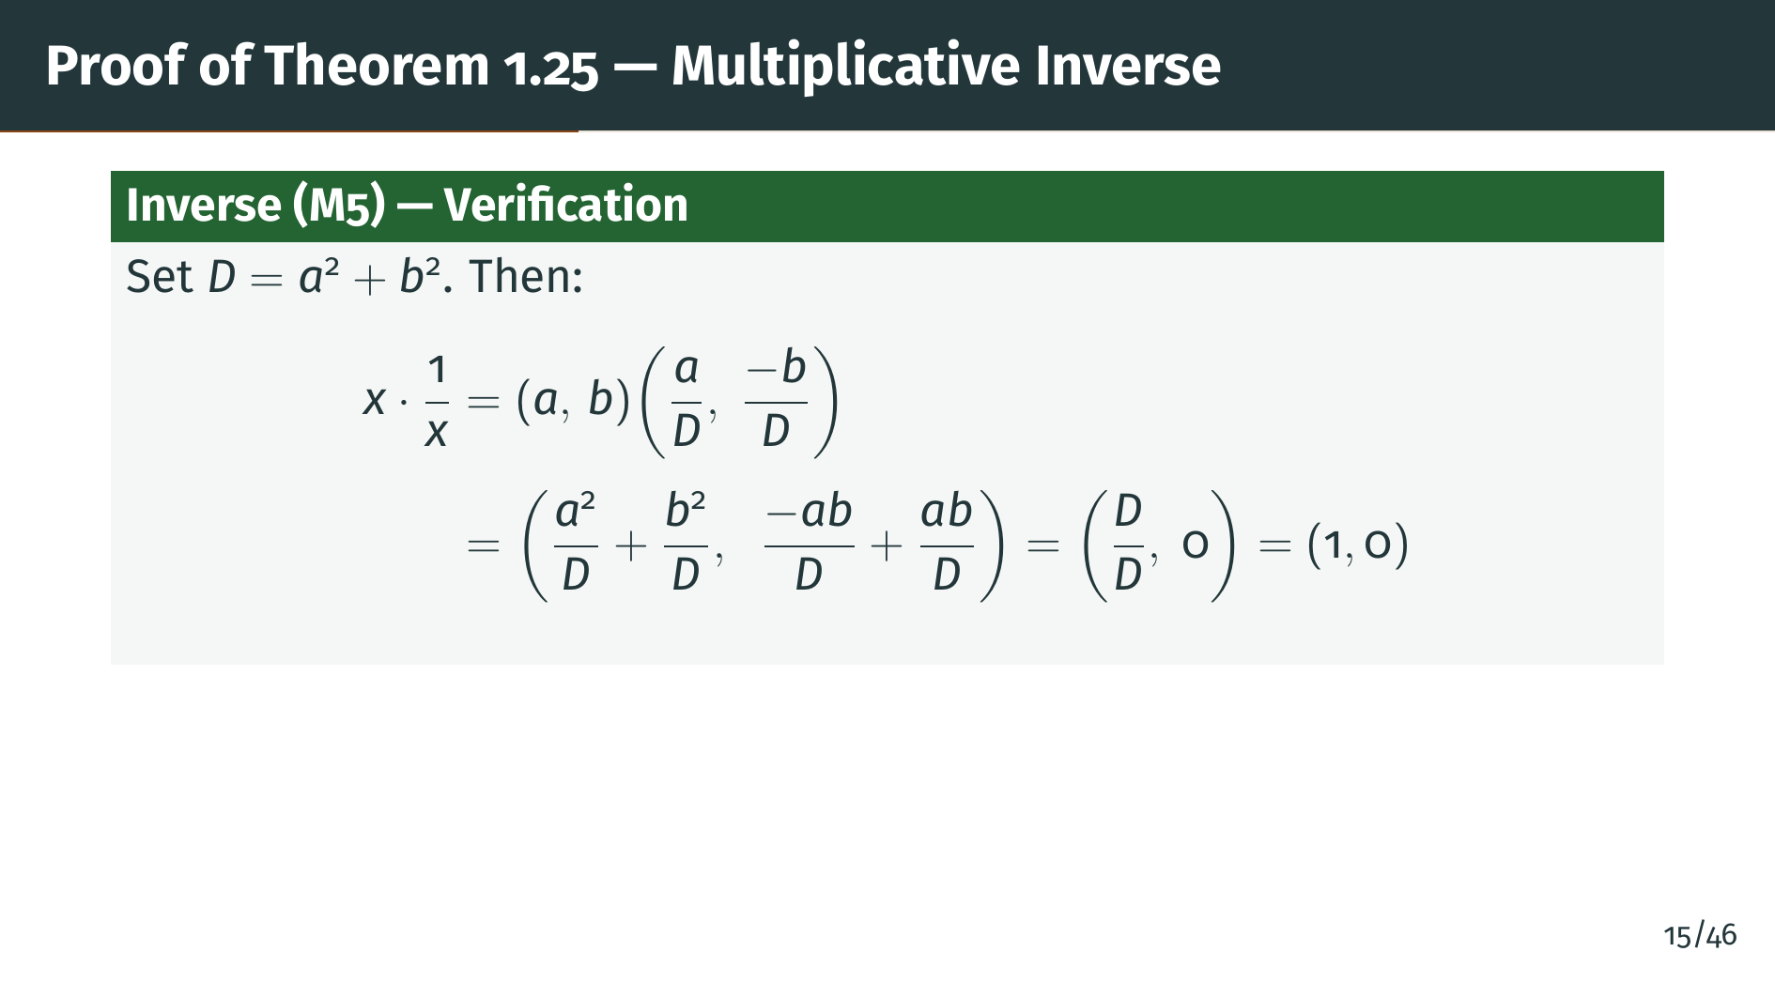
Notes:
The verification is shown on the slide. The key thing to notice is why it works: in the first component, the two squared terms add up to exactly "D" over "D", which is one. In the second component, the two cross terms cancel perfectly, giving zero. This cancellation pattern is the whole reason the conjugate-based formula works. The result is the pair one, zero, confirming we have a valid inverse. The last axiom to check is the distributive law.

Slide 17
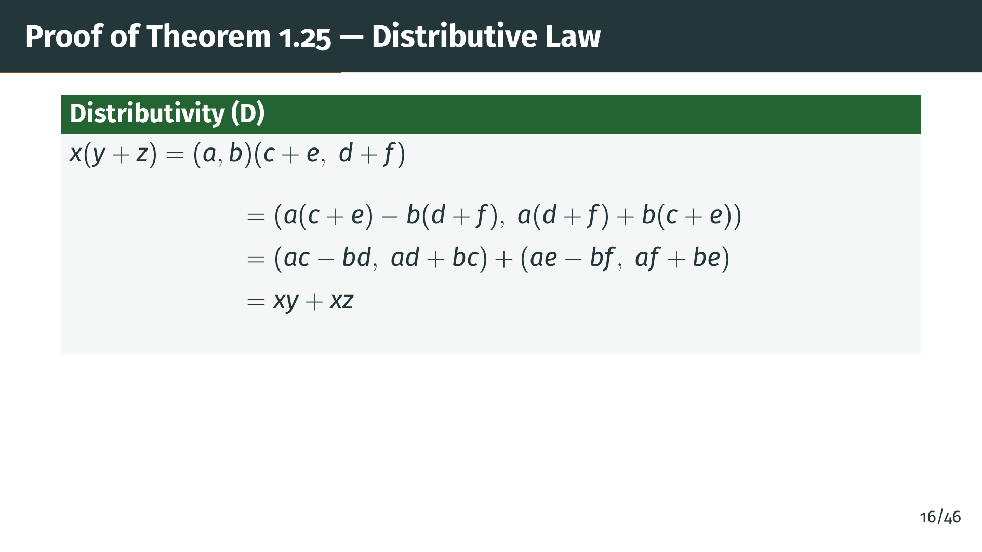
Notes:
Finally, the distributive law. The idea is simple: we expand the left-hand side using the multiplication formula, then use the distributive law for real numbers to split everything apart. The terms regroup perfectly into the two separate products. This completes the verification of all field axioms, so the complex numbers indeed form a field. Next, let's see how the real numbers sit inside this new field.

Slide 18


Slide 19
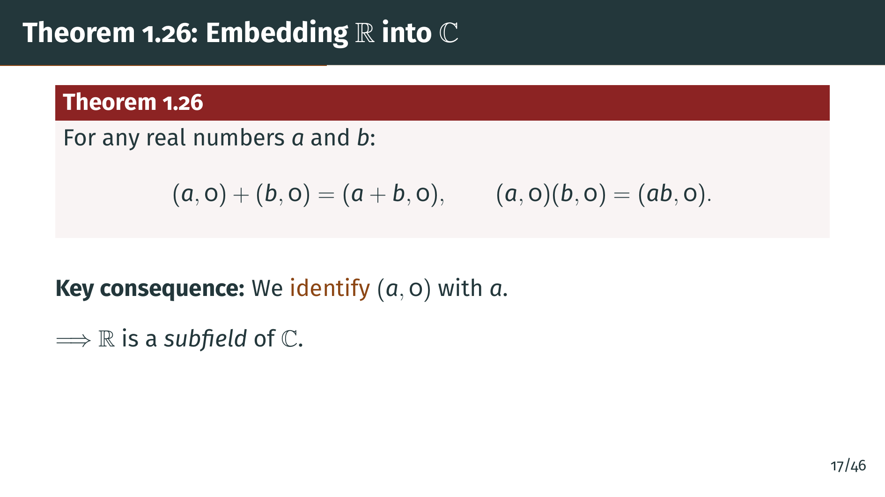
Notes:
Theorem 1.26 says that complex numbers of the form "a", zero behave exactly like the real number "a": addition and multiplication of such pairs match the usual real arithmetic. The proof is immediate from the definitions. Because of this, we can identify the pair "a", zero with the real number "a". Under this identification, the real field becomes a subfield of the complex field. Every real number is a complex number whose second component is zero. Now, let's introduce the key ingredient that makes the complex numbers special.

Slide 20
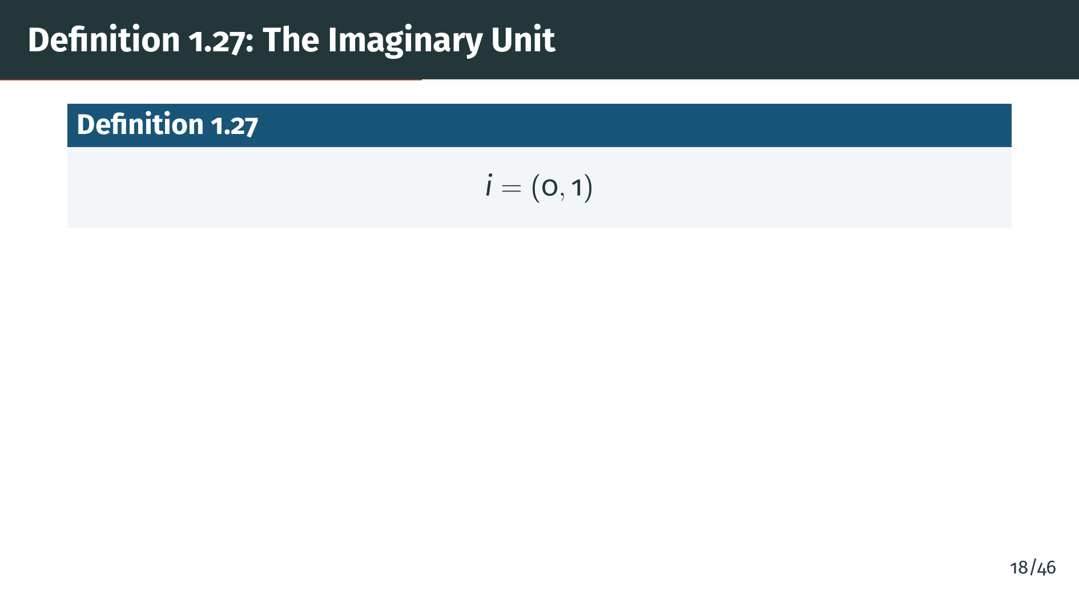
Notes:
Now we define the famous imaginary unit. It is simply the ordered pair zero, one. There is nothing mysterious about it --- it is a perfectly concrete object, just a pair of real numbers. All of its special properties will follow from the multiplication rule we already defined. Let's see what happens when we square "i".

Slide 21
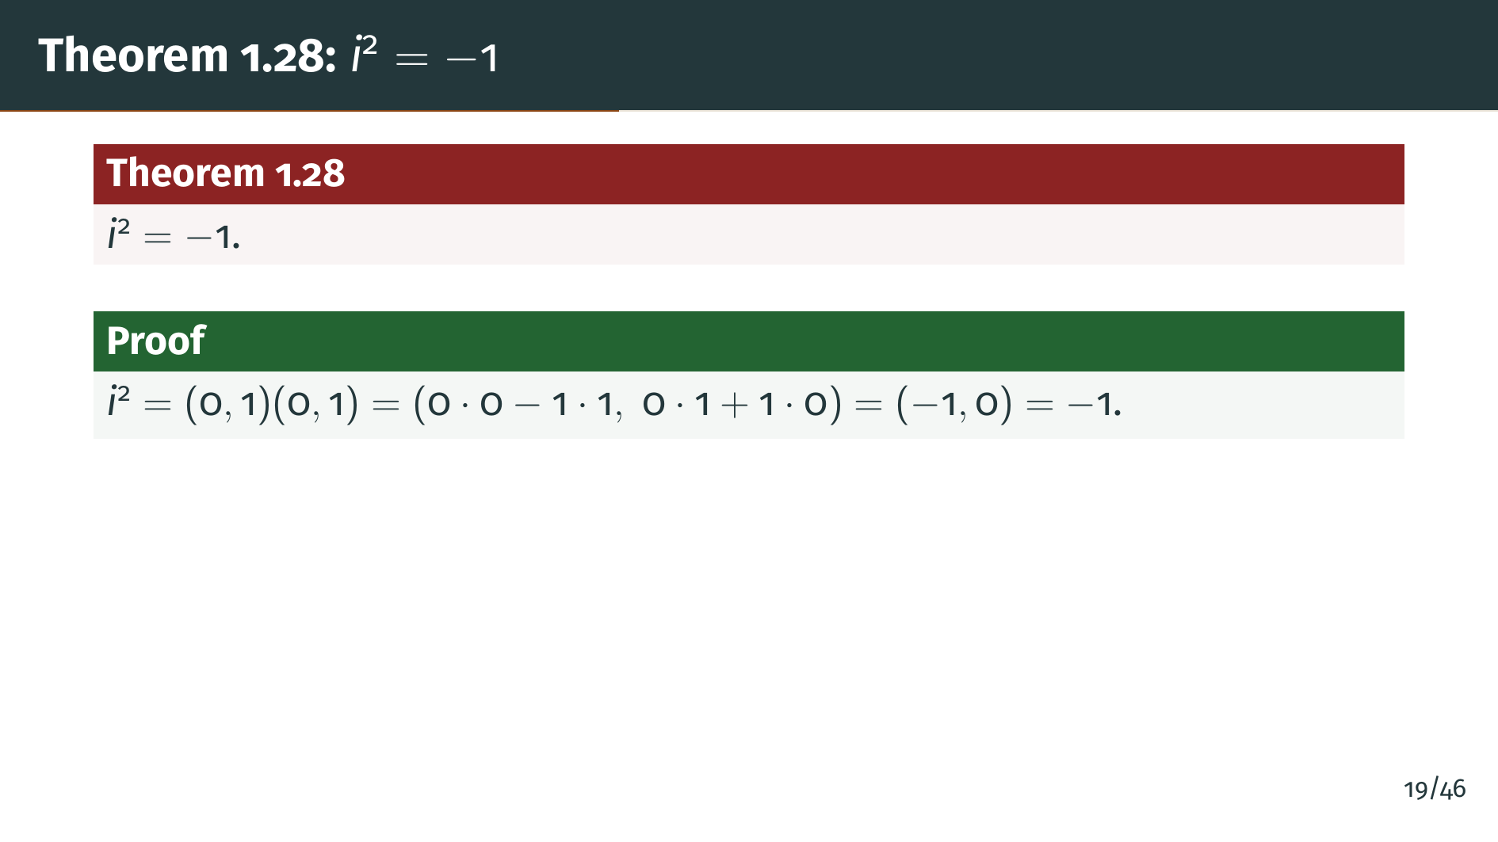
Notes:
Here is the payoff. If we multiply "i" by itself using our multiplication formula, we get the pair negative one, zero, which we just identified with the real number negative one. So "i" squared equals negative one. We did not assume this; it is a consequence of our definitions. The ``square root of negative one'' has been constructed, not postulated. Now we can connect the ordered pair notation to the more familiar form.

Slide 22
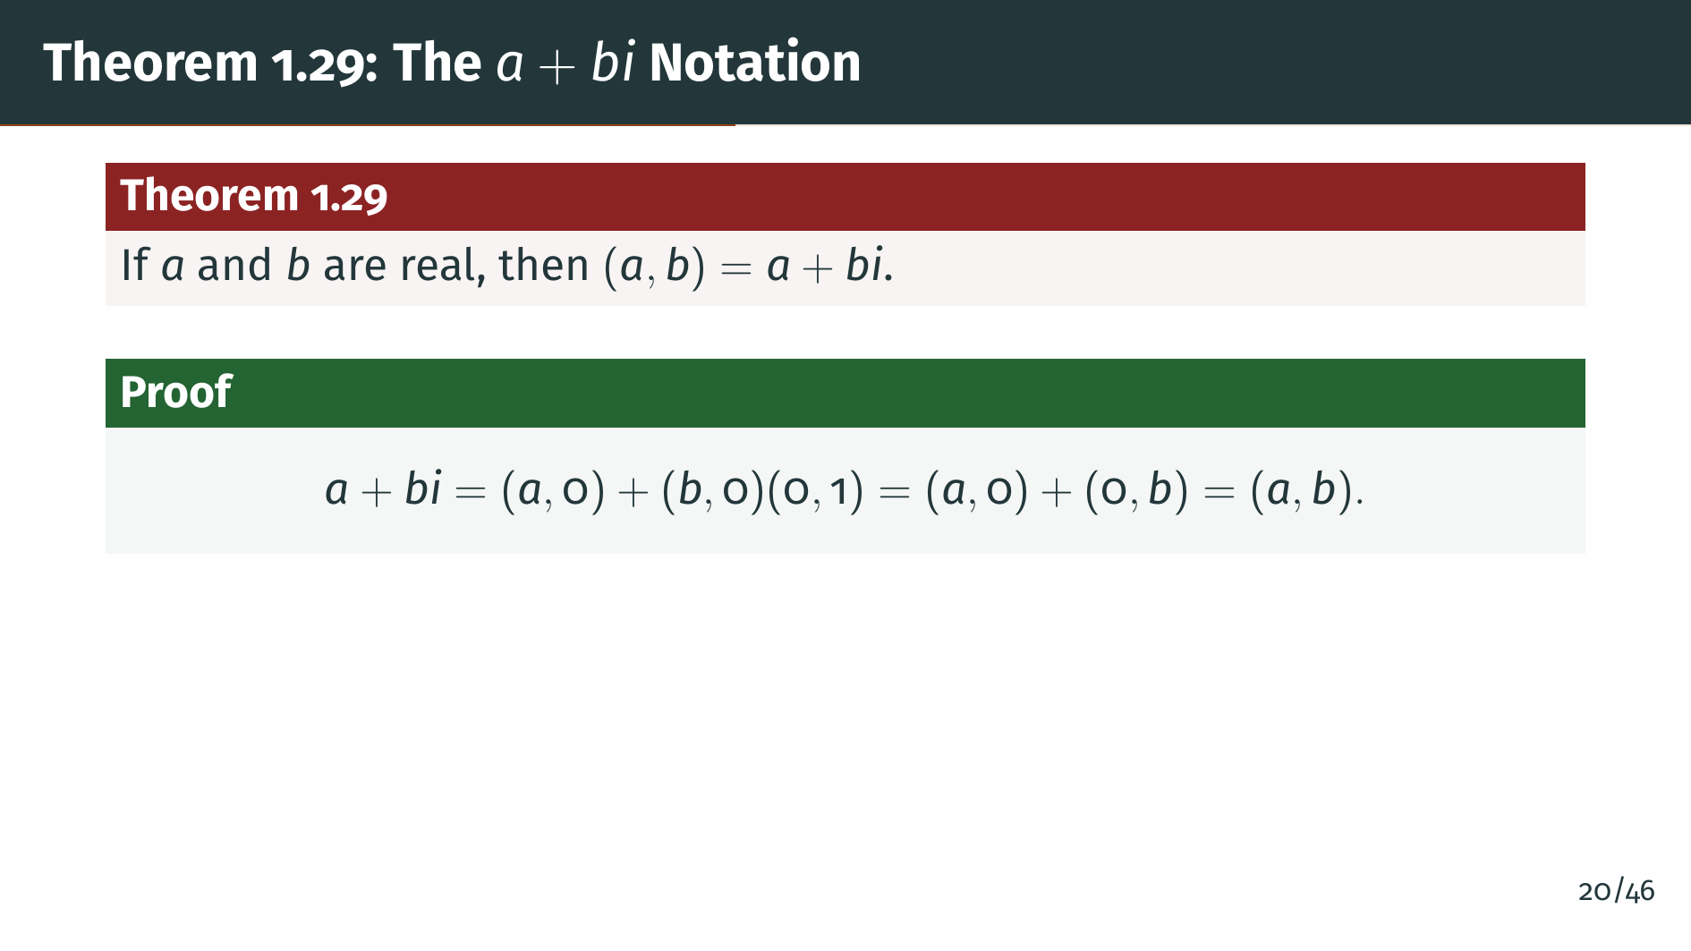
Notes:
This theorem bridges the two notations. The proof on the slide is just one line, but the idea is important: using the identification of reals with pairs and the multiplication rule we already defined, the "a" plus "b" "i" notation falls out automatically. We did not need to introduce any new assumptions. From now on, we can freely write complex numbers in either form. With this notation in hand, let's explore conjugation and the absolute value.

Slide 23


Slide 24
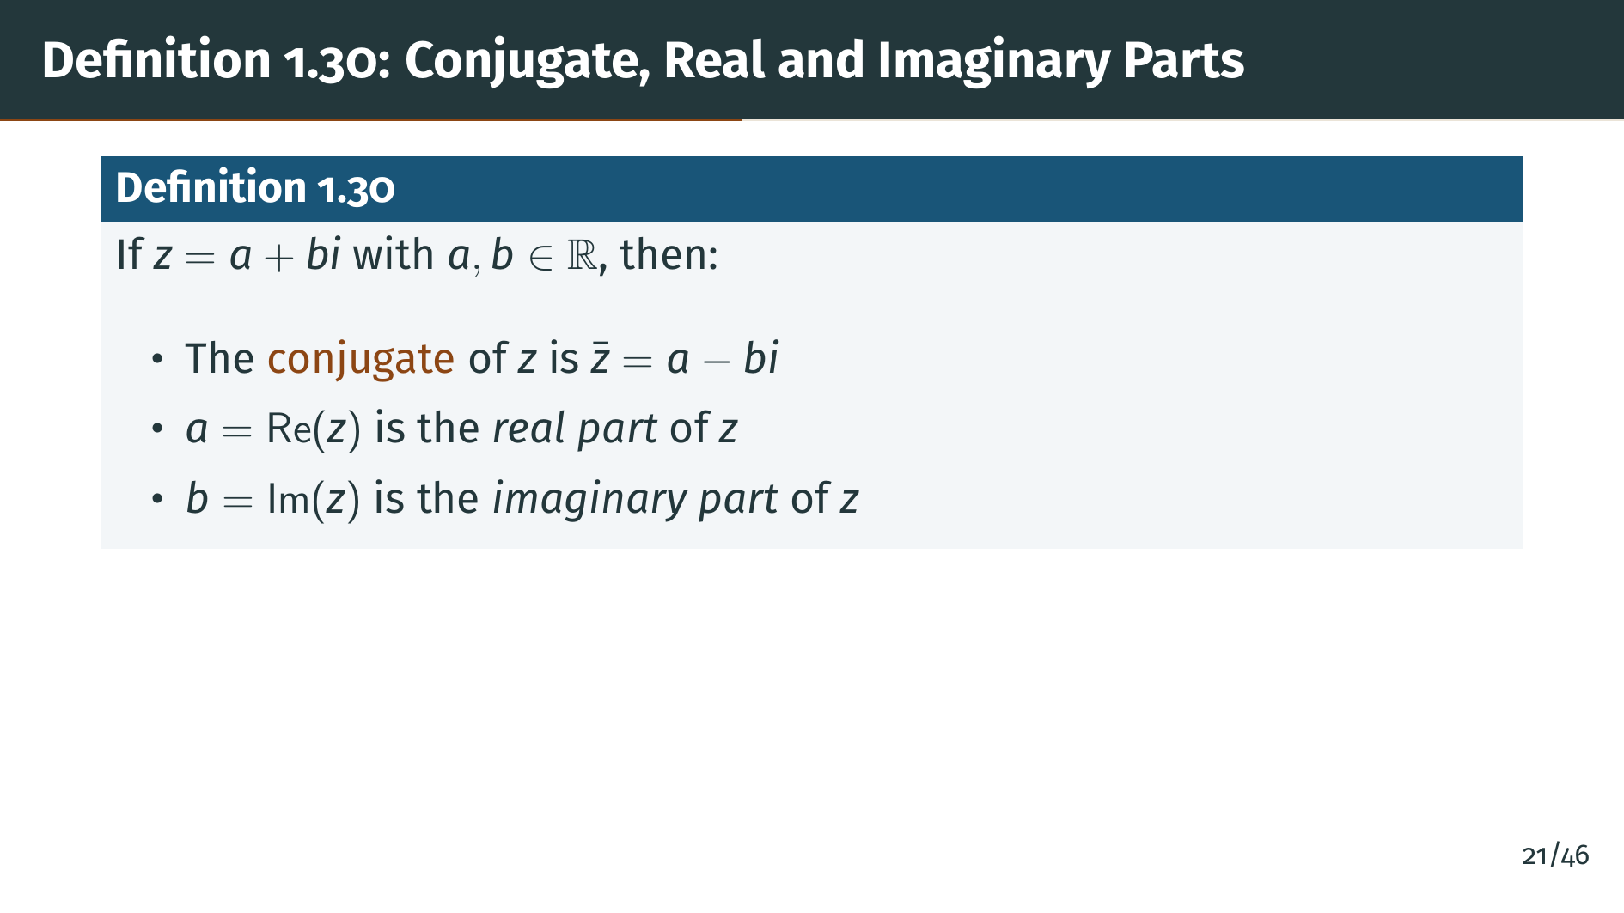
Notes:
The conjugate of "z" is obtained by flipping the sign of the imaginary part. Geometrically, this reflects the point across the real axis. We also give names to the two components: the real part and the imaginary part. One subtle point worth noting: the imaginary part is itself a real number --- it is the coefficient of "i", not the entire "b" "i" term. Let's see what conjugation looks like geometrically.

Slide 25
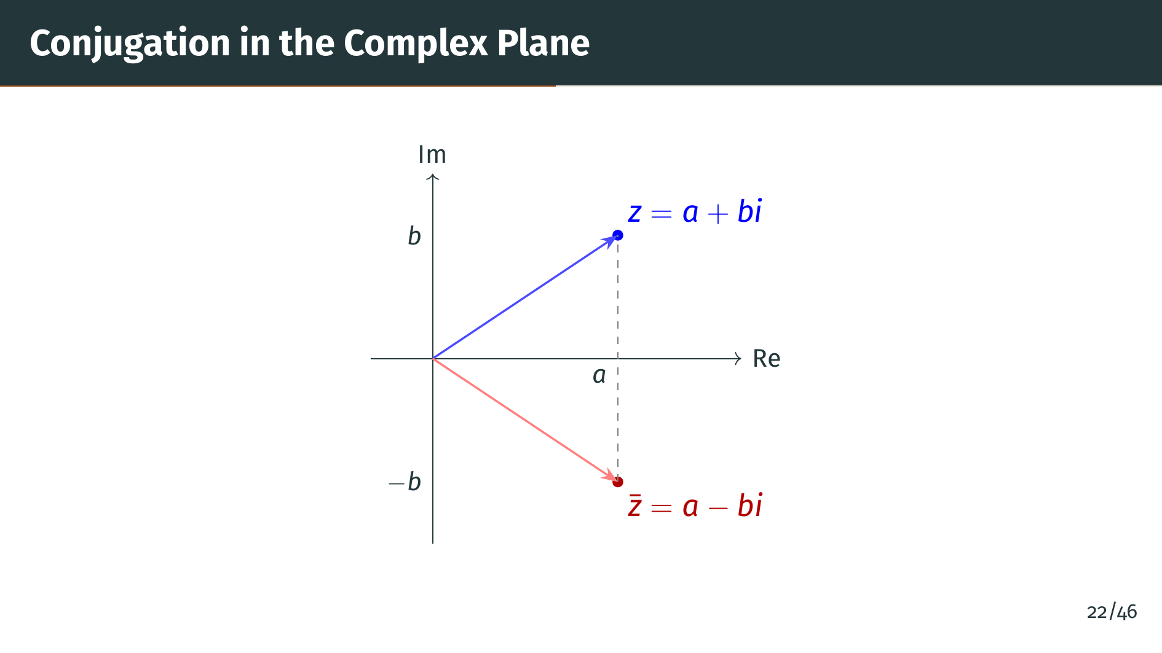
Notes:
This diagram shows conjugation geometrically. The complex number "z" is the blue point in the upper half-plane, and its conjugate "z" bar is the red point in the lower half-plane, obtained by reflecting across the real axis. Both points have the same real part "a", but their imaginary parts have opposite signs. Now let's explore the algebraic properties of conjugation.

Slide 26
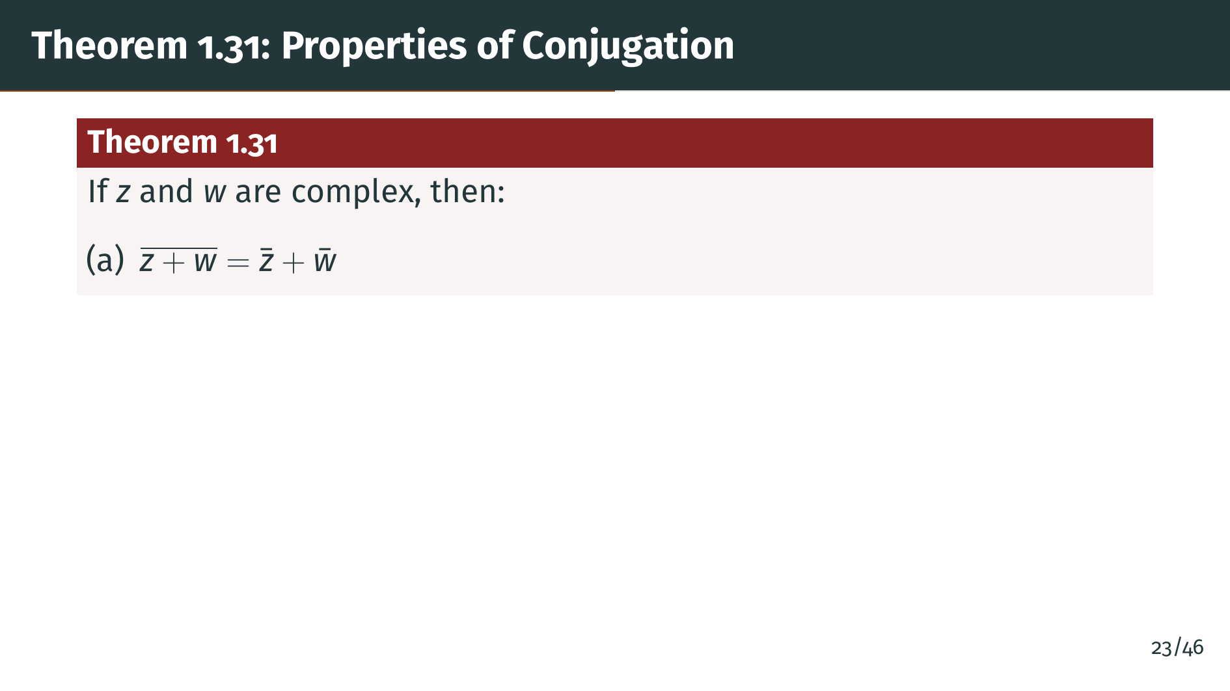
Notes:
Theorem 1.31 lists the key properties of conjugation. Part "a" says that conjugation distributes over addition: the conjugate of a sum is the sum of the conjugates. This follows directly from the definition. The same kind of thing happens with multiplication.

Slide 27
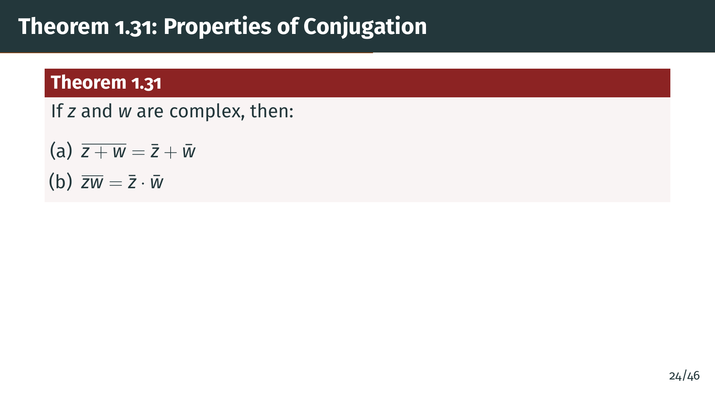
Notes:
Part "b" says conjugation also distributes over multiplication. The conjugate of a product equals the product of the conjugates. This is verified by direct computation using the multiplication formula. In other words, conjugation is both an additive and multiplicative homomorphism. These two properties together mean that conjugation respects the entire field structure. Next, let's see how conjugation helps us extract the real and imaginary parts.

Slide 28
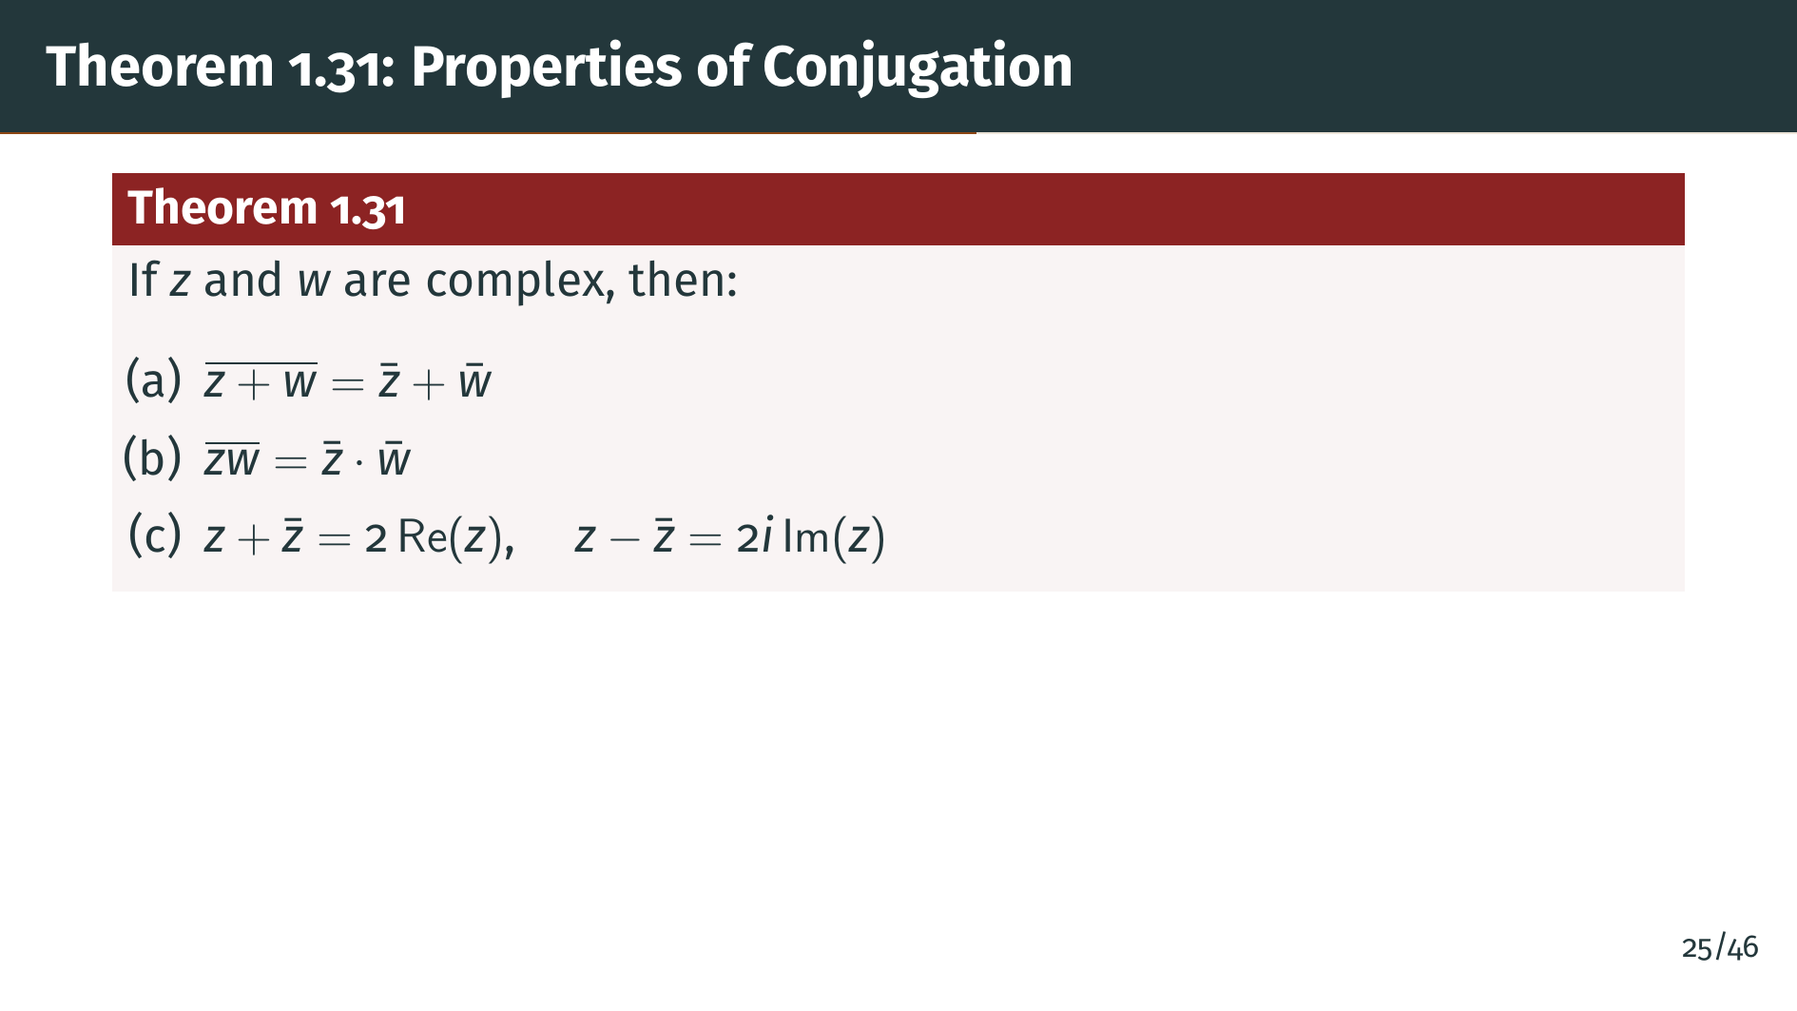
Notes:
Part "c" gives us formulas for extracting the real and imaginary parts using conjugation. The idea is that adding "z" and "z" bar cancels the imaginary parts, leaving twice the real part. Subtracting cancels the real parts, leaving twice the imaginary part. These identities will be useful shortly when we prove the triangle inequality. Finally, the most important property.

Slide 29
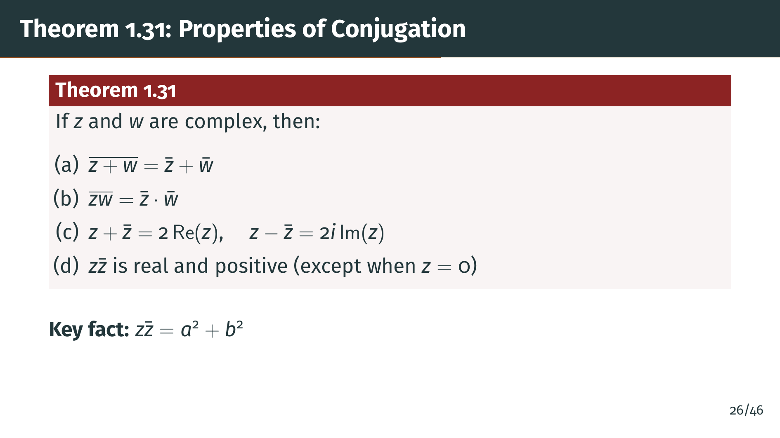
Notes:
Part "d" is especially important. The product "z" times "z" bar always gives a nonnegative real number. This quantity is zero only when both "a" and "b" are zero, that is, when "z" is zero. Otherwise it is strictly positive. This product is the foundation for defining the absolute value, which we introduce next.

Slide 30
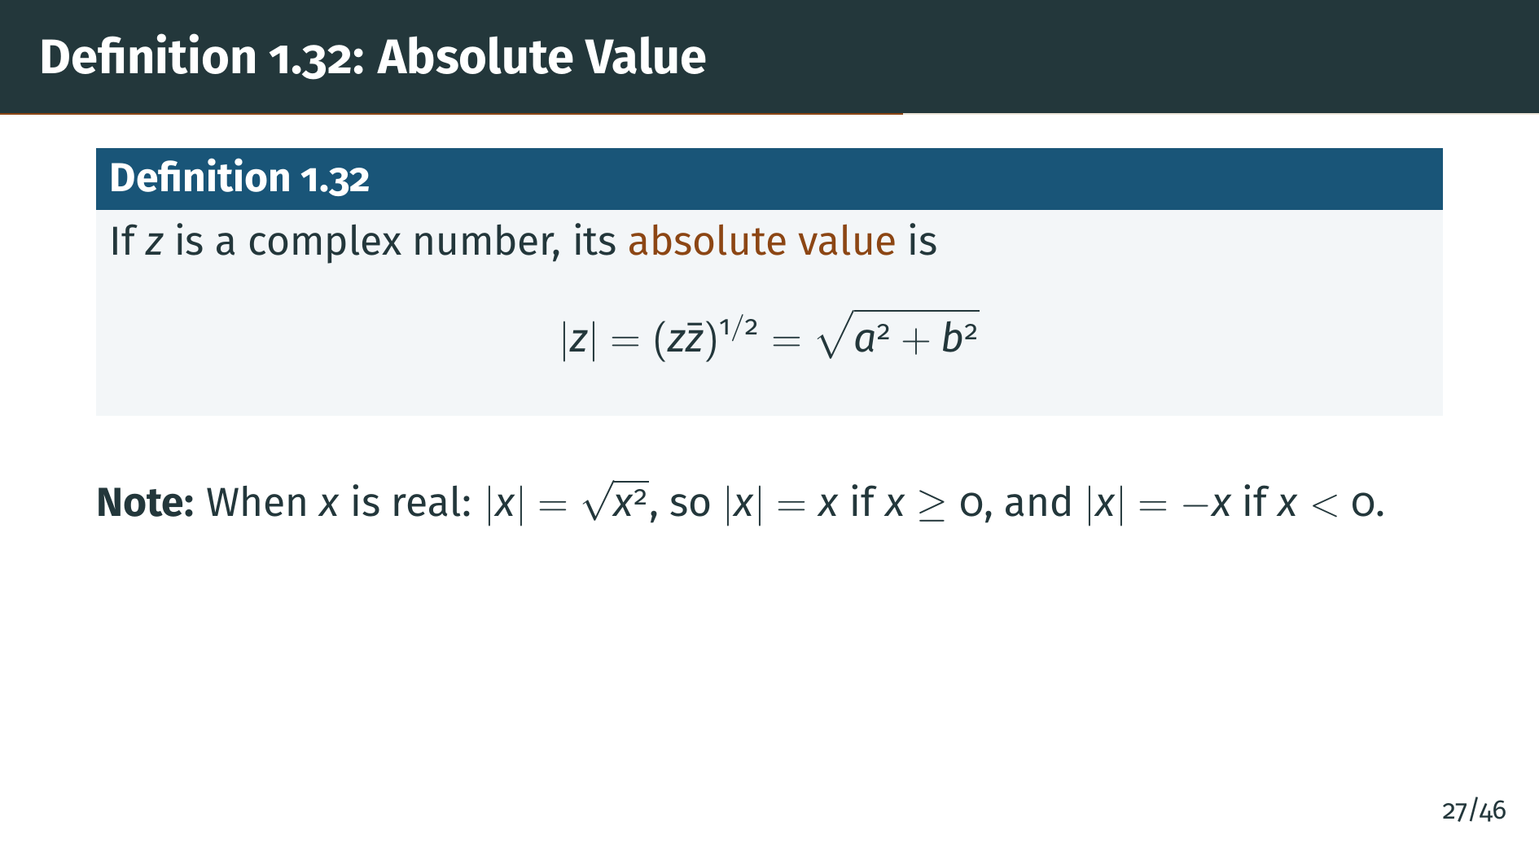
Notes:
The absolute value is defined using the product of "z" with its conjugate, which we just showed is always a nonnegative real number. Taking the square root is justified by Theorem 1.21. Geometrically, this gives the distance from "z" to the origin in the complex plane. An important consistency check: when "z" is real, the conjugate equals "z" itself, so we recover the usual real absolute value. Let's visualize this geometrically.

Slide 31
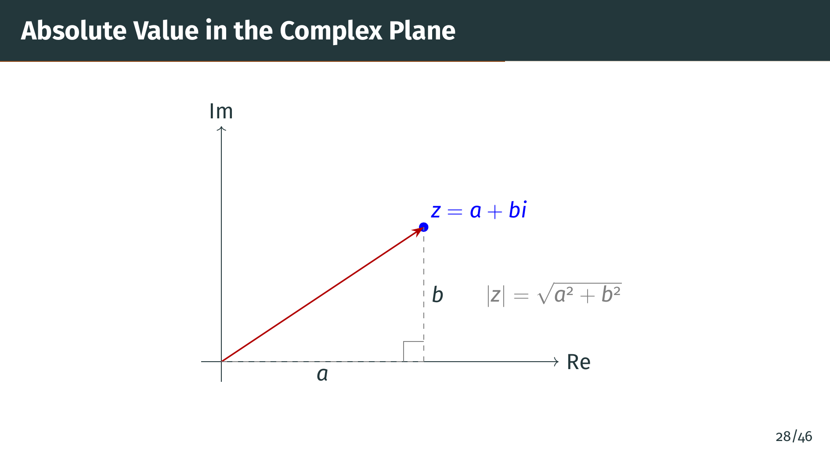
Notes:
This diagram makes the definition concrete. The red arrow shows the vector from the origin to "z", and its length is the absolute value. Notice the right triangle formed by the real and imaginary components. By the Pythagorean theorem, the hypotenuse gives exactly the formula from the definition. This geometric interpretation is why the absolute value is also called the modulus. Now let's study the key properties of the absolute value.

Slide 32


Slide 33
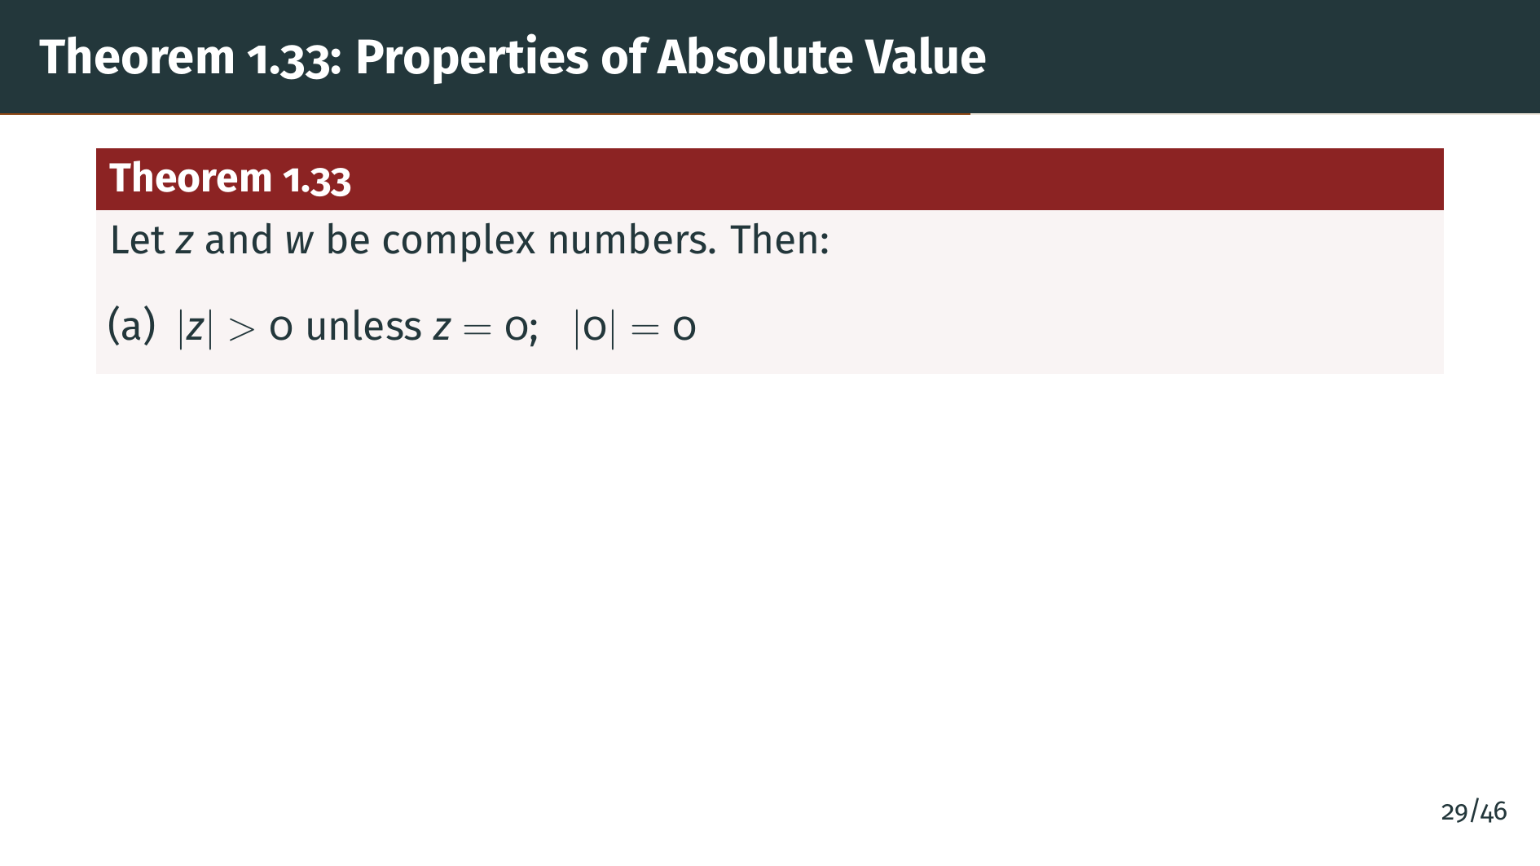
Notes:
Theorem 1.33 collects the fundamental properties of the absolute value. Part "a" says the absolute value is positive-definite: it is strictly positive for every nonzero complex number, and equals zero only when "z" is zero. This follows immediately from the definition and Theorem 1.31 part "d". The absolute value detects whether a complex number is zero, just as it does for real numbers. Next, let's see what happens under conjugation.

Slide 34
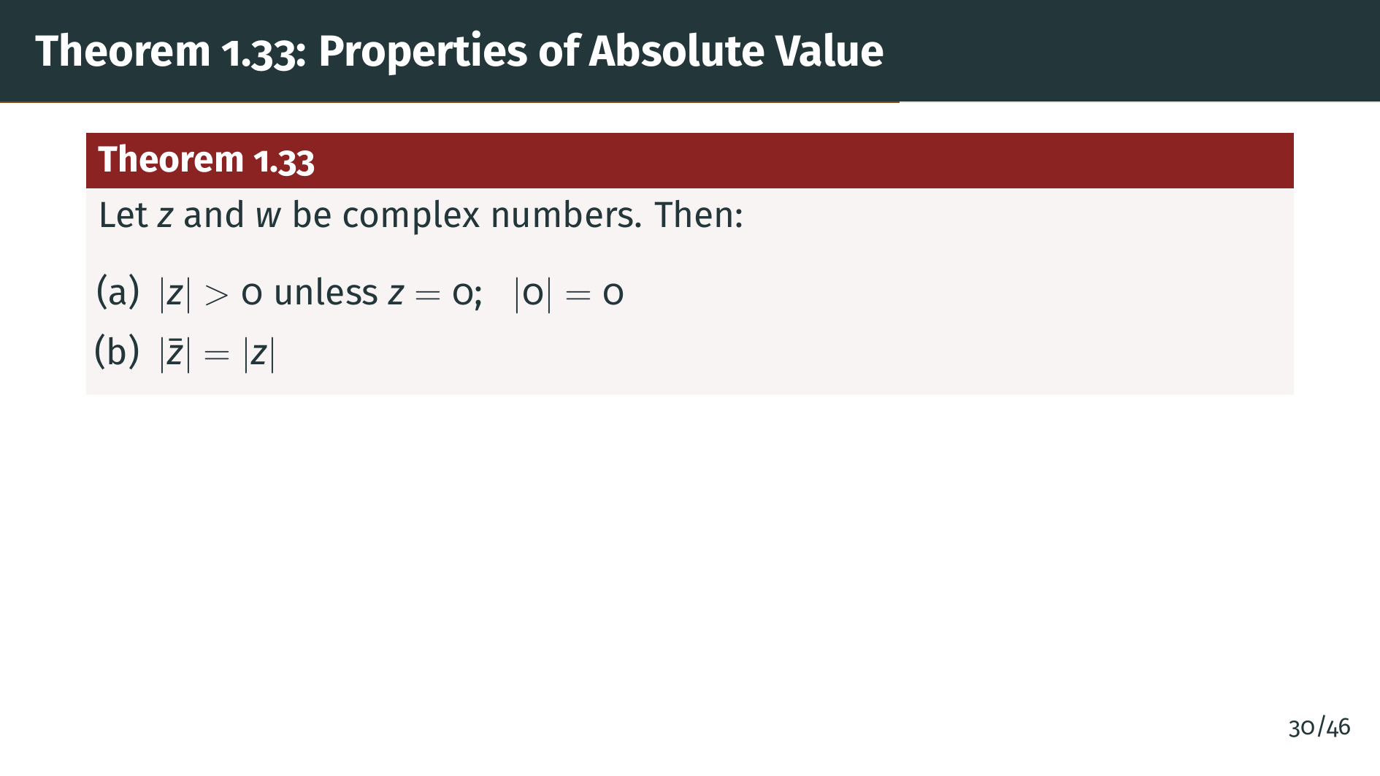
Notes:
Part "b" says that a complex number and its conjugate have the same absolute value. This makes geometric sense: "z" and "z" bar are reflections of each other across the real axis, so they are the same distance from the origin. Next, a key algebraic property.

Slide 35
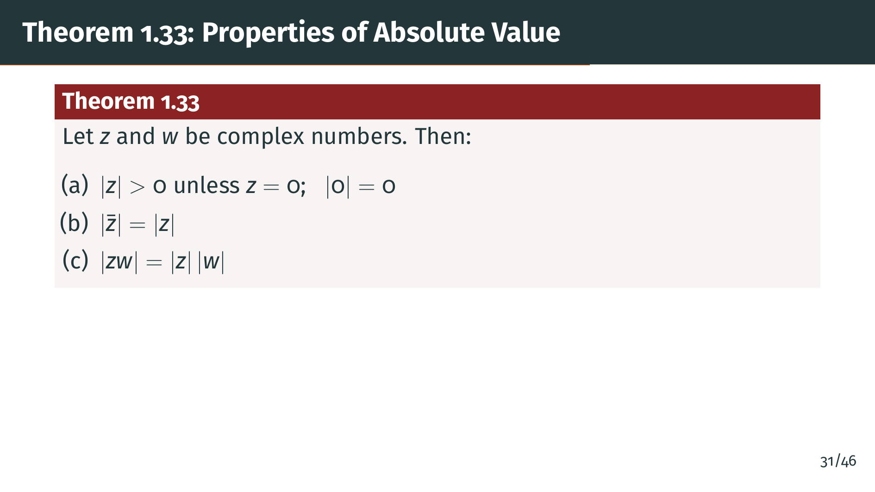
Notes:
Part "c" says the absolute value is multiplicative: the absolute value of a product equals the product of the absolute values. This is a crucial property. It means the absolute value is a homomorphism from the multiplicative group of complex numbers to the positive reals. Next, a comparison between the real part and the full absolute value.

Slide 36
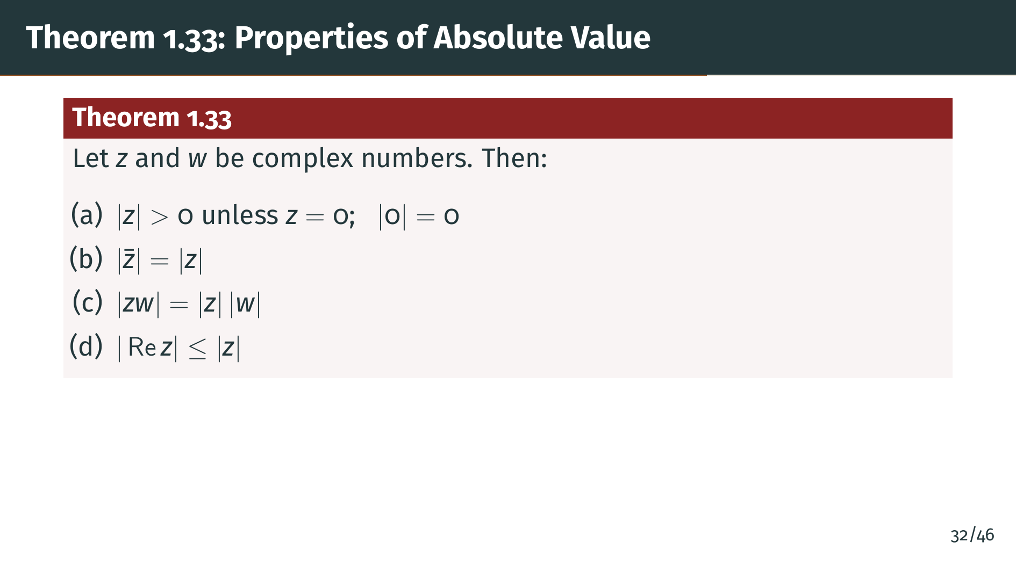
Notes:
Part "d" says the real part is never larger in absolute value than the full complex number. Geometrically, a projection onto one axis cannot be longer than the vector itself. This seemingly simple fact will be a key step in proving the triangle inequality. And now the most important property of all.

Slide 37
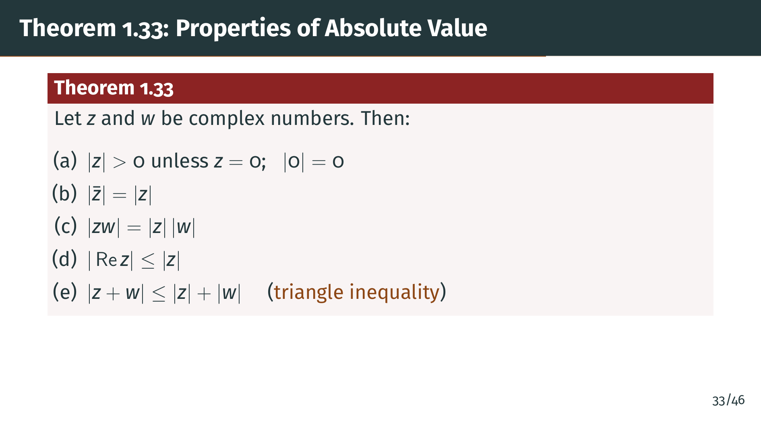
Notes:
Part "e" is the triangle inequality, which is perhaps the single most important inequality in all of analysis. It says the absolute value of a sum is at most the sum of the absolute values. Geometrically, the length of one side of a triangle is at most the sum of the lengths of the other two sides. Let's prove the multiplicativity and the triangle inequality carefully.

Slide 38
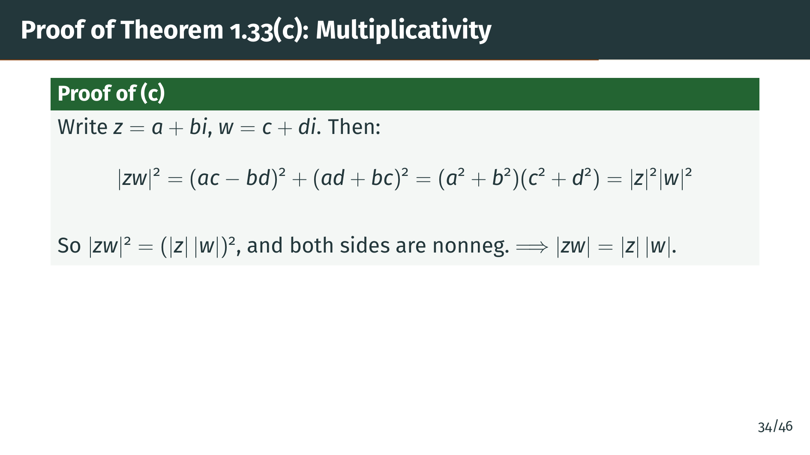
Notes:
The proof strategy is to work with squared absolute values, which avoids dealing with square roots. The key insight is that when you expand the squared terms on the slide, all the cross terms cancel out perfectly. This is a useful trick that appears often in complex analysis: working with squares simplifies everything because the mixed terms vanish. The uniqueness of square roots from Theorem 1.21 then lets us conclude. Now let's tackle the triangle inequality, which requires a more subtle argument.

Slide 39
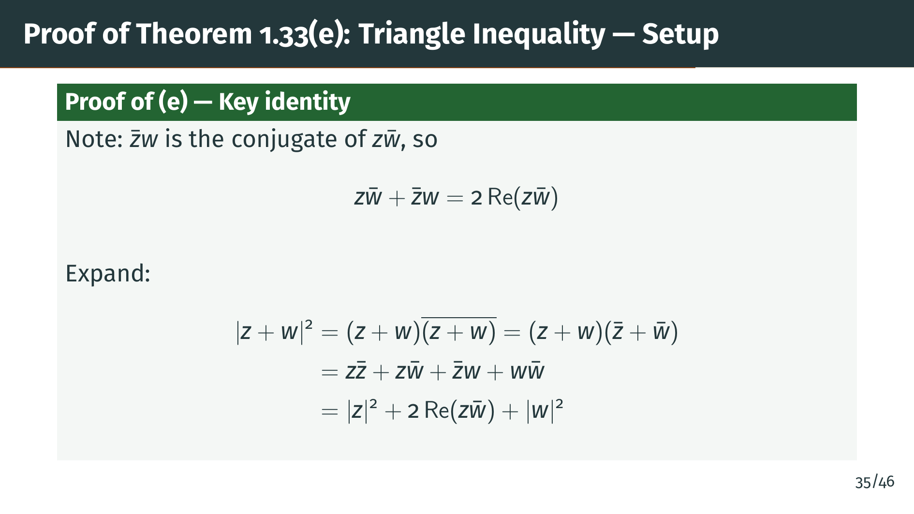
Notes:
The proof of the triangle inequality is the most involved argument in this section, and the technique is worth understanding well. The trick is to square both sides to avoid square roots, then expand. Notice the key identity at the top of the slide: the cross terms combine into twice the real part of a single product. This is the crucial observation --- it lets us replace a complex expression with a real quantity that we can bound. Pay attention to how parts "c" and "d" of the theorem are about to come together.

Slide 40
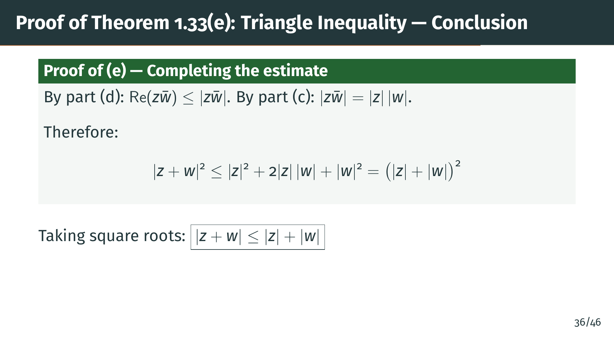
Notes:
Here is where the earlier results pay off. We chain two inequalities: part "d" bounds the real part by the absolute value, and part "c" factors the absolute value of a product into a product of absolute values. Together, these turn the middle term into exactly what we need to complete the square on the right-hand side. The whole proof hinges on this two-step bound. Taking square roots gives the triangle inequality. Let's see what this means geometrically.

Slide 41
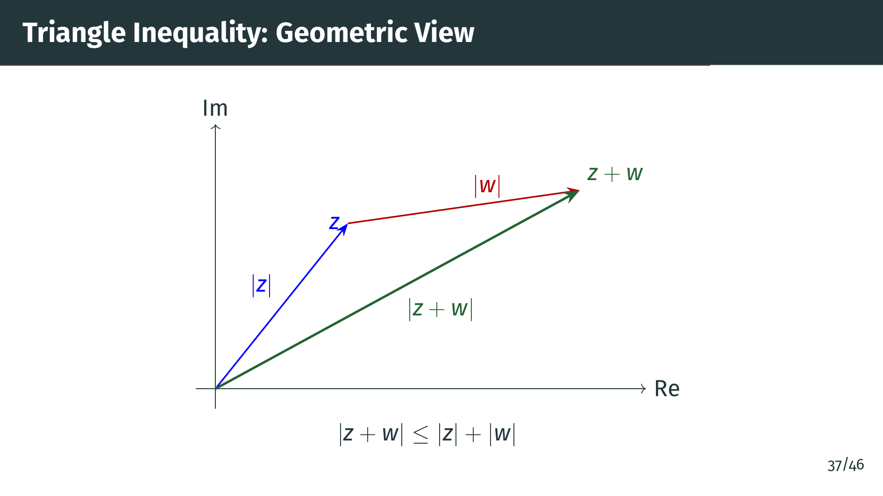
Notes:
Here is the geometric meaning. We have the vector "z" shown in blue, and the vector "w" shown in red, placed tip to tail. The green vector from the origin to "z" plus "w" is the sum. The triangle inequality says that the length of the green side, the direct path, cannot exceed the total length of the blue and red sides, the indirect path through "z". This is exactly the statement that one side of a triangle is at most the sum of the other two sides. We now move on to the final topic of this section: the Schwarz inequality.

Slide 42


Slide 43
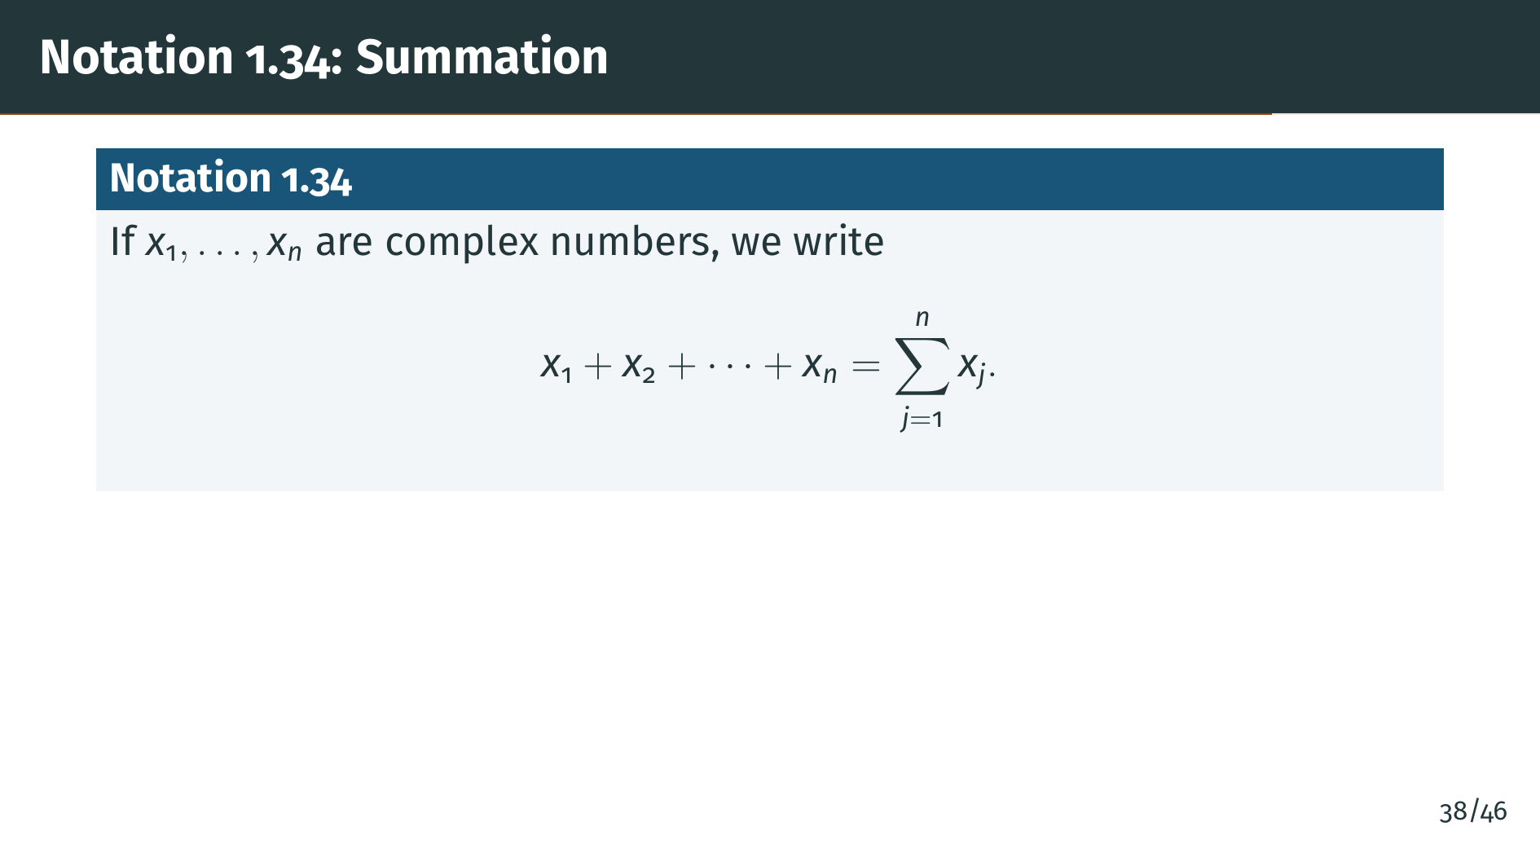
Notes:
Before we state the Schwarz inequality, we introduce the standard summation notation. The capital sigma denotes a sum over the index j running from 1 to n. This is purely a notational convenience, but it will make the upcoming theorem statement much more compact. Now let's state the Schwarz inequality.

Slide 44
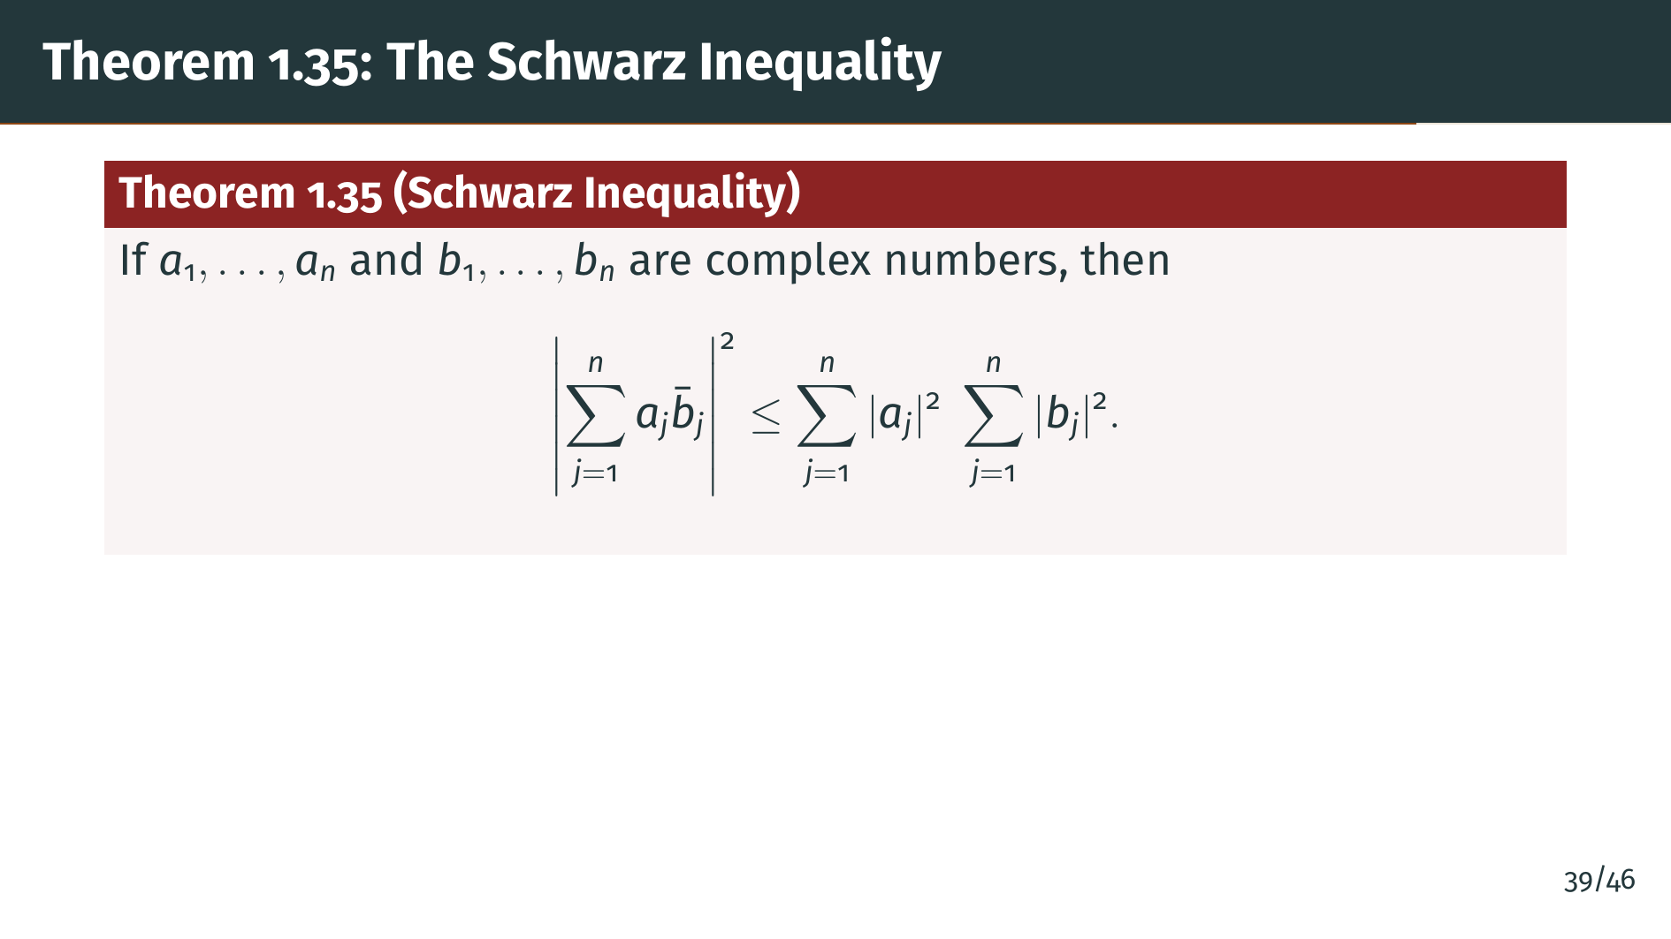
Notes:
This is the Schwarz inequality, one of the most important inequalities in all of mathematics. It says that the absolute value squared of the inner product of two sequences of complex numbers is at most the product of their squared norms. Let's see the proof.

Slide 45
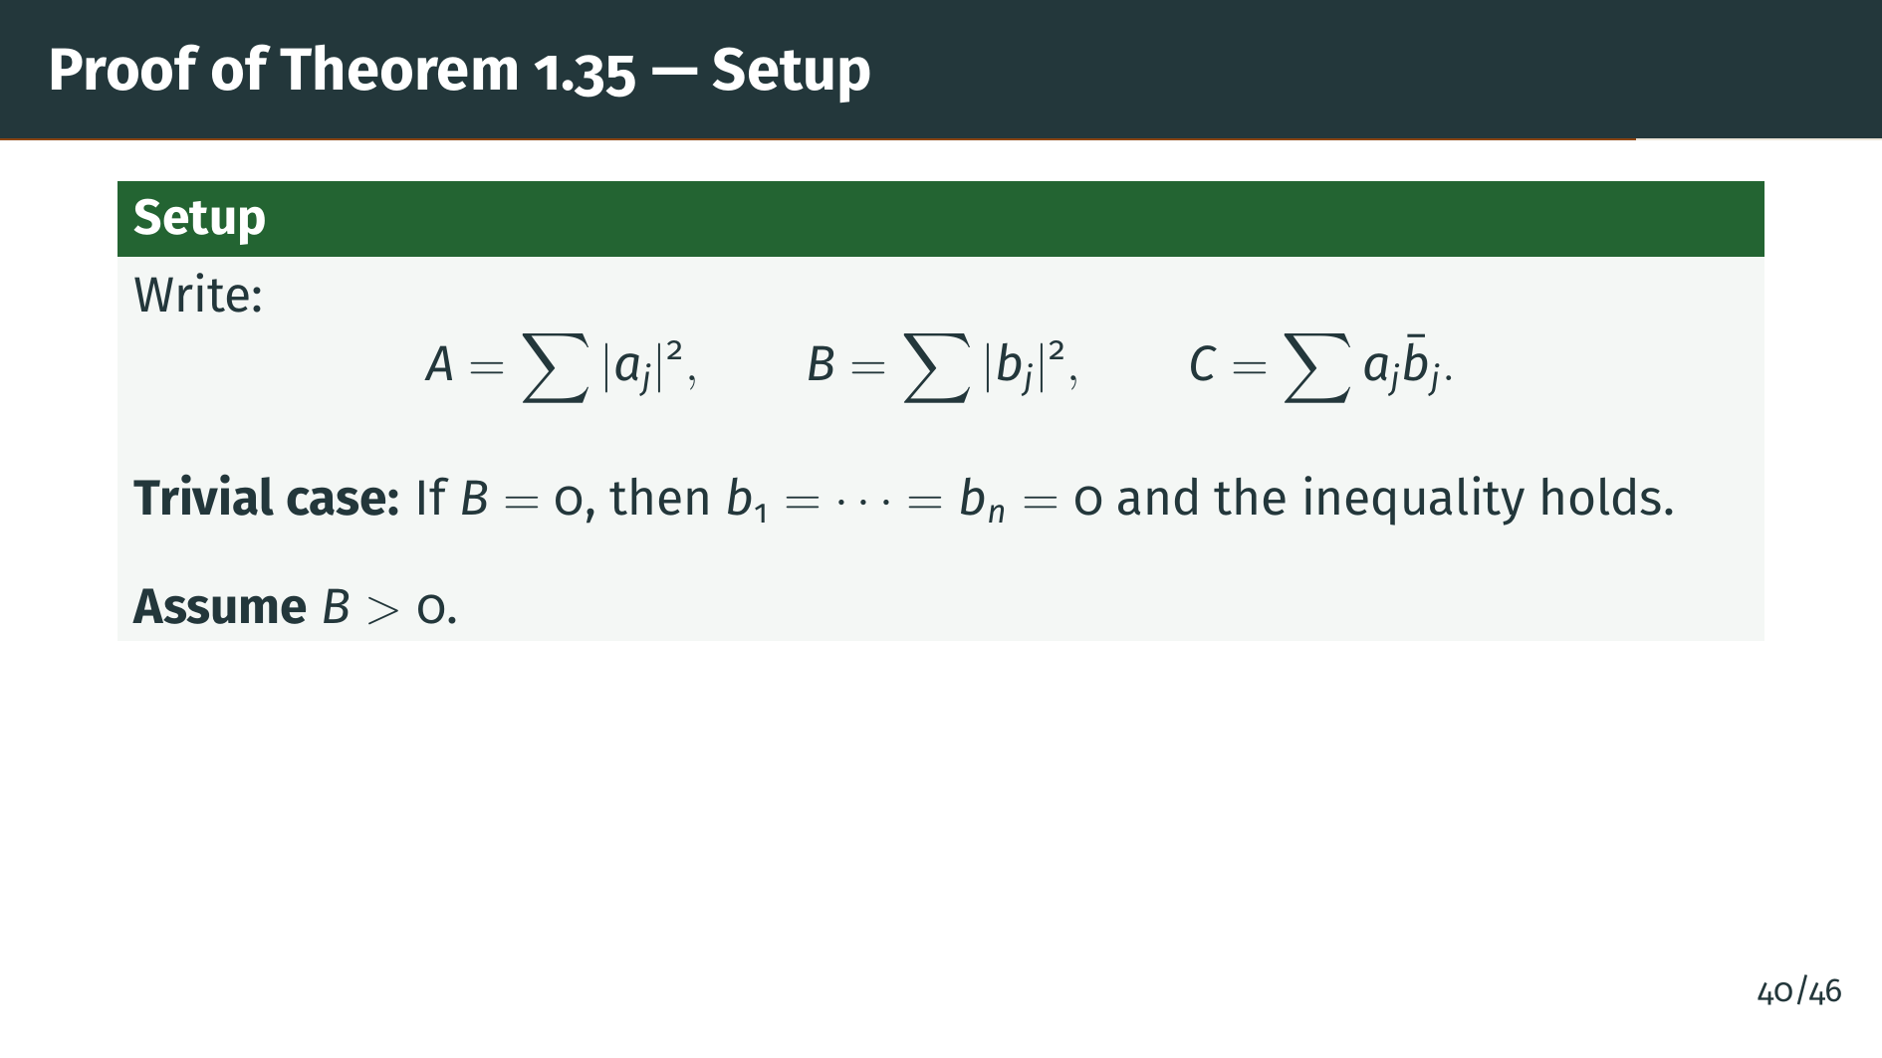
Notes:
We introduce shorthand "A", "B", and "C" as shown on the slide to keep the expressions manageable. The trivial case is when all the "b" terms are zero. Otherwise "B" is positive, and we can use it as a denominator. Now here comes the key trick of the proof.

Slide 46
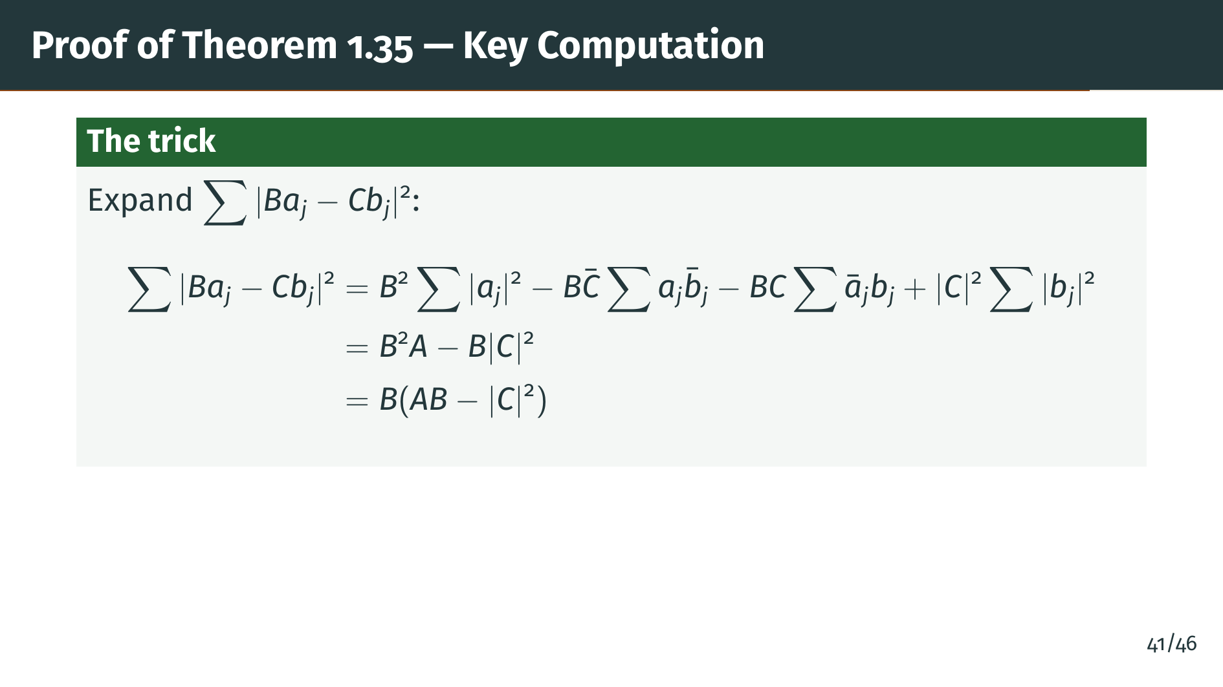
Notes:
Here is the heart of the proof. The trick is to construct a sum of nonnegative terms that, when expanded, produces exactly the quantity we want to bound. This is a classic technique: introduce a cleverly chosen auxiliary expression whose nonnegativity forces the desired inequality. Notice how the choice of coefficients "B" and "C" is designed so that most terms cancel during expansion. The slide shows the result after simplification. Now we can finish the argument.

Slide 47
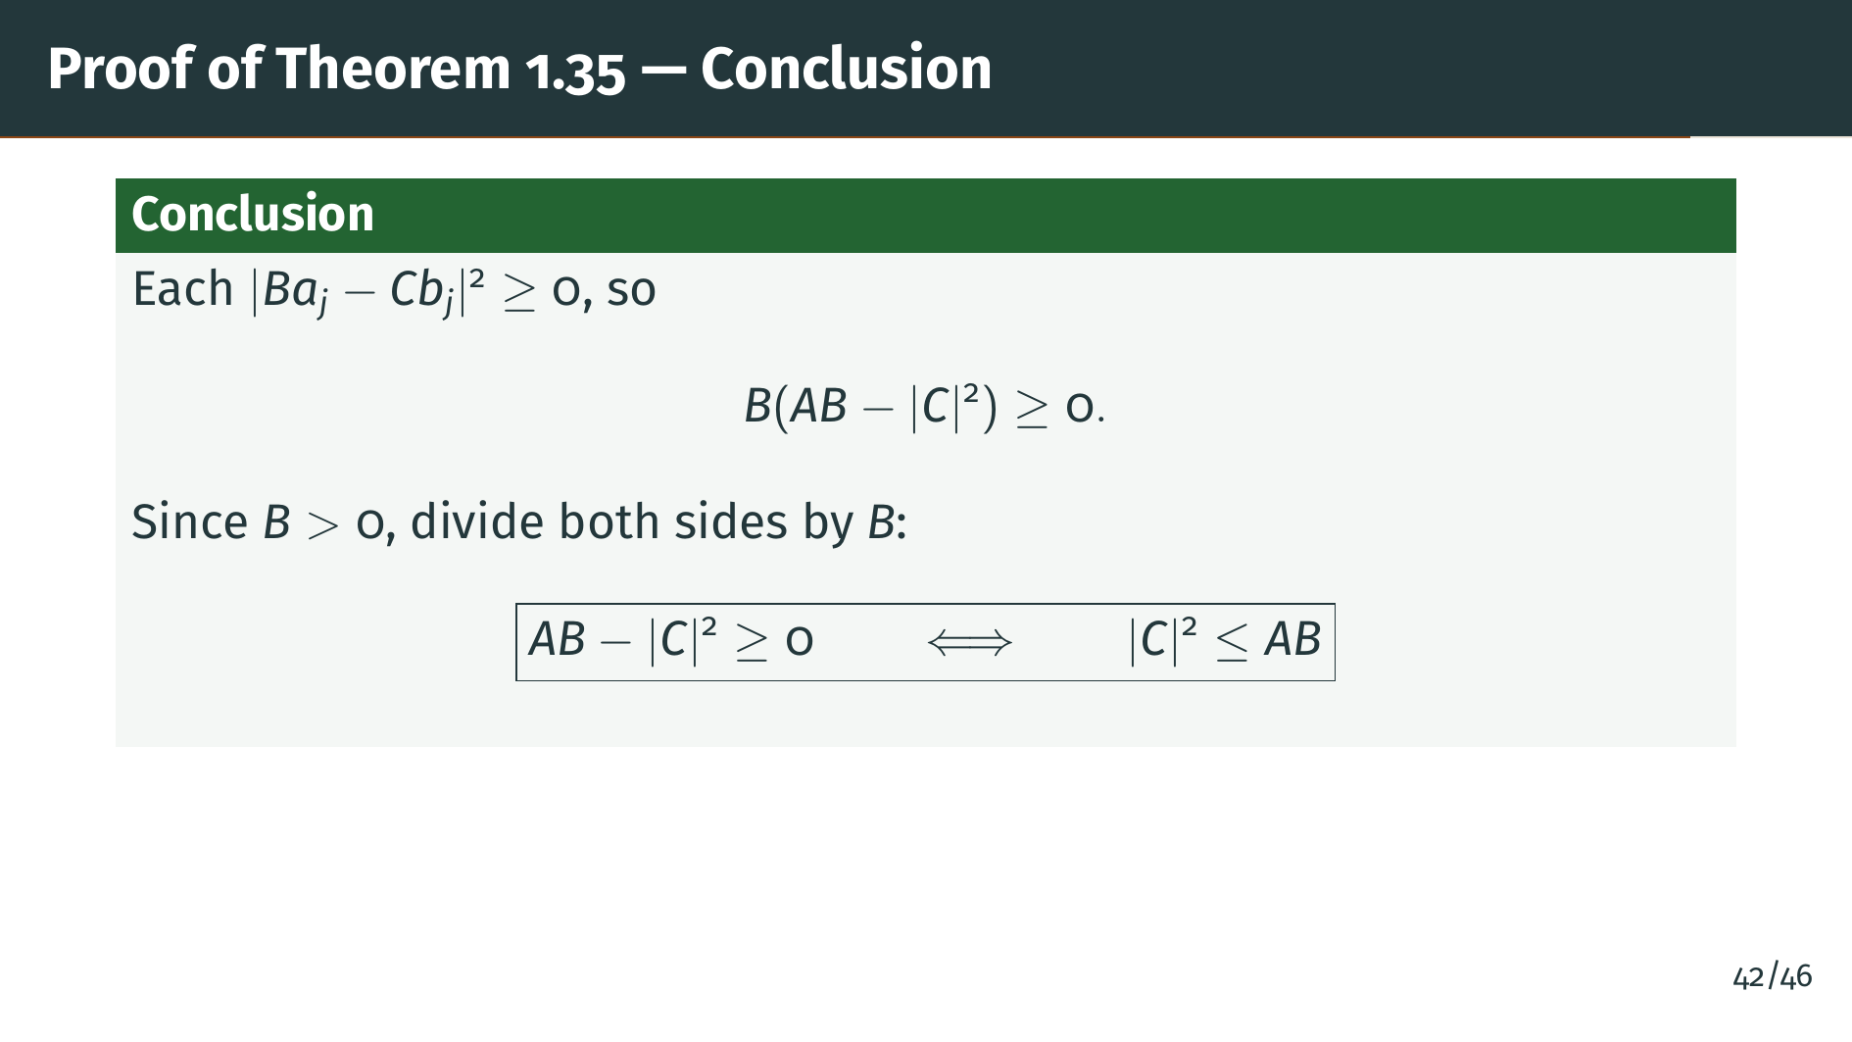
Notes:
The endgame is clean: the entire sum is nonnegative because each term is a squared absolute value. Since "B" is positive, we can divide it out, and the inequality falls straight out. Step back and appreciate the proof technique: we never needed to be clever with algebraic manipulations. Instead, we constructed a single nonnegative quantity whose expansion encodes the inequality we wanted. This ``sum of nonnegative terms'' trick is a powerful technique that appears throughout analysis. Let's now summarize the key ideas from this section.

Slide 48


Slide 49
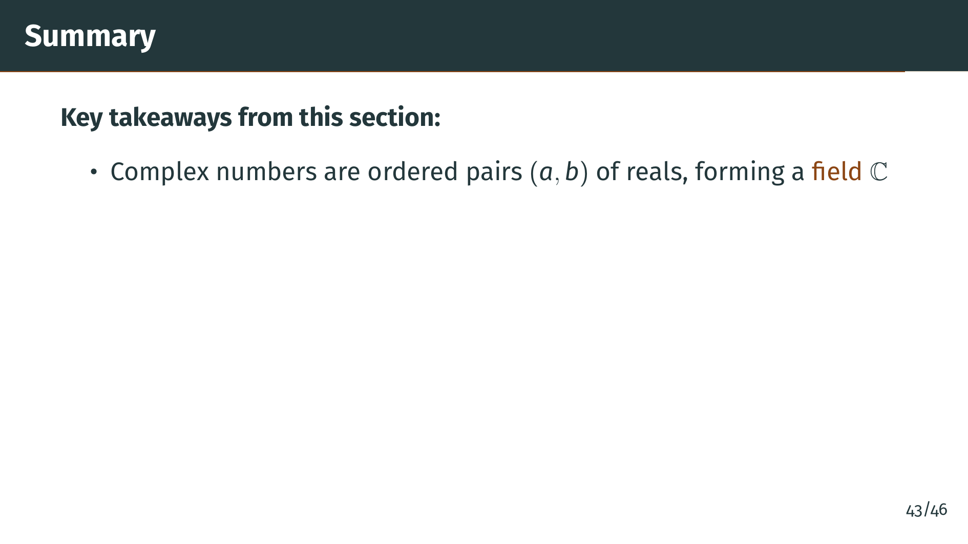
Notes:
Let's review what we covered in this section. First, we defined complex numbers as ordered pairs of real numbers, gave them addition and multiplication rules, and proved that the resulting system is a field. The hardest part was finding the multiplicative inverse, where the trick was essentially rationalizing the denominator using the conjugate.

Slide 50
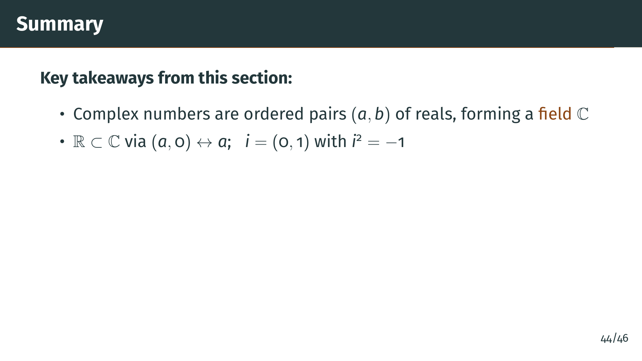
Notes:
Second, we showed that the reals embed naturally into the complex numbers as pairs with zero second component. The imaginary unit "i" equals the pair zero, one, and its square is negative one. This gives us the familiar "a" plus "b" "i" notation, which is completely equivalent to the ordered pair notation. We also developed important tools for working with these numbers.

Slide 51
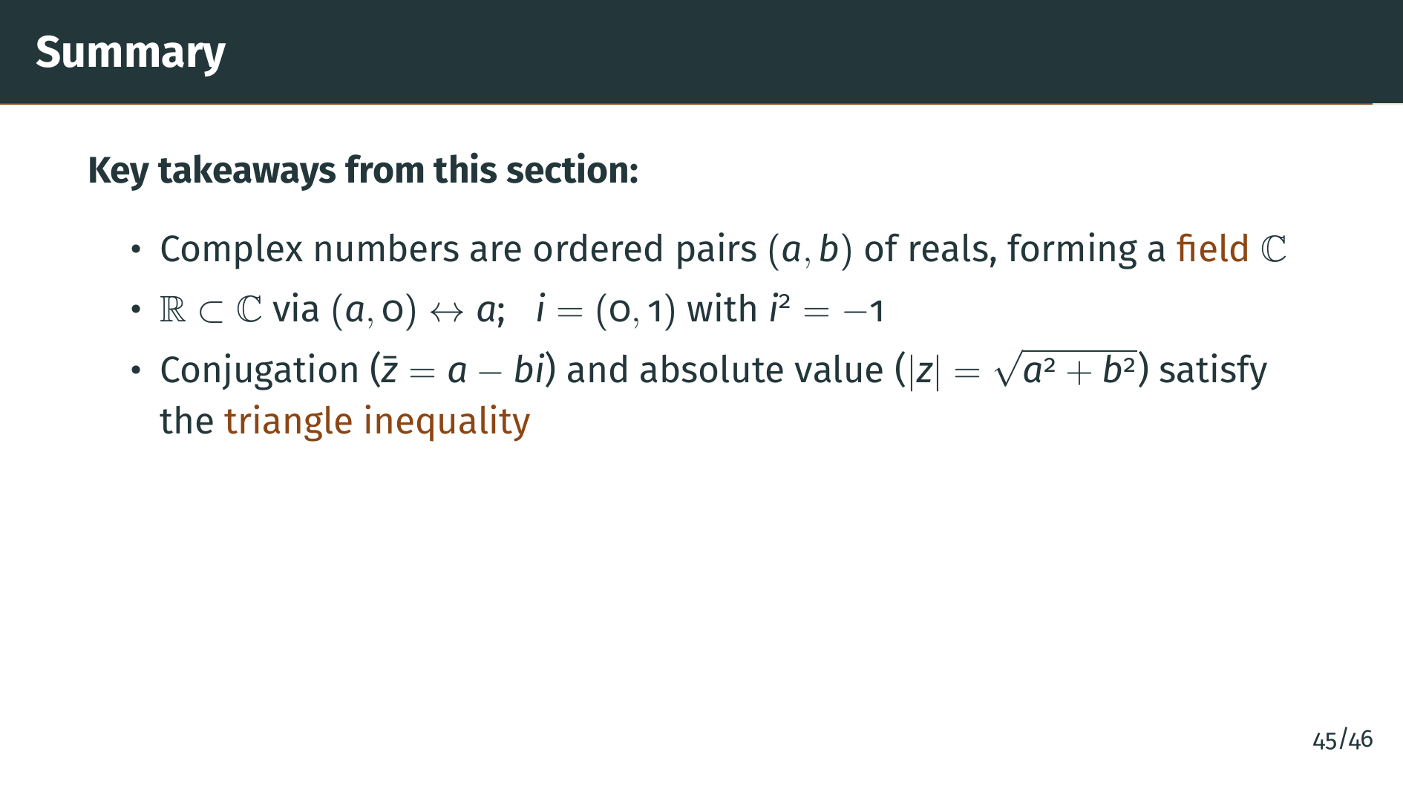
Notes:
Third, we introduced conjugation and the absolute value, and proved the triangle inequality: the absolute value of a sum is at most the sum of the absolute values. The absolute value measures distance from the origin in the complex plane, and the triangle inequality captures a fundamental geometric fact about distances. And there was one more major result.

Slide 52
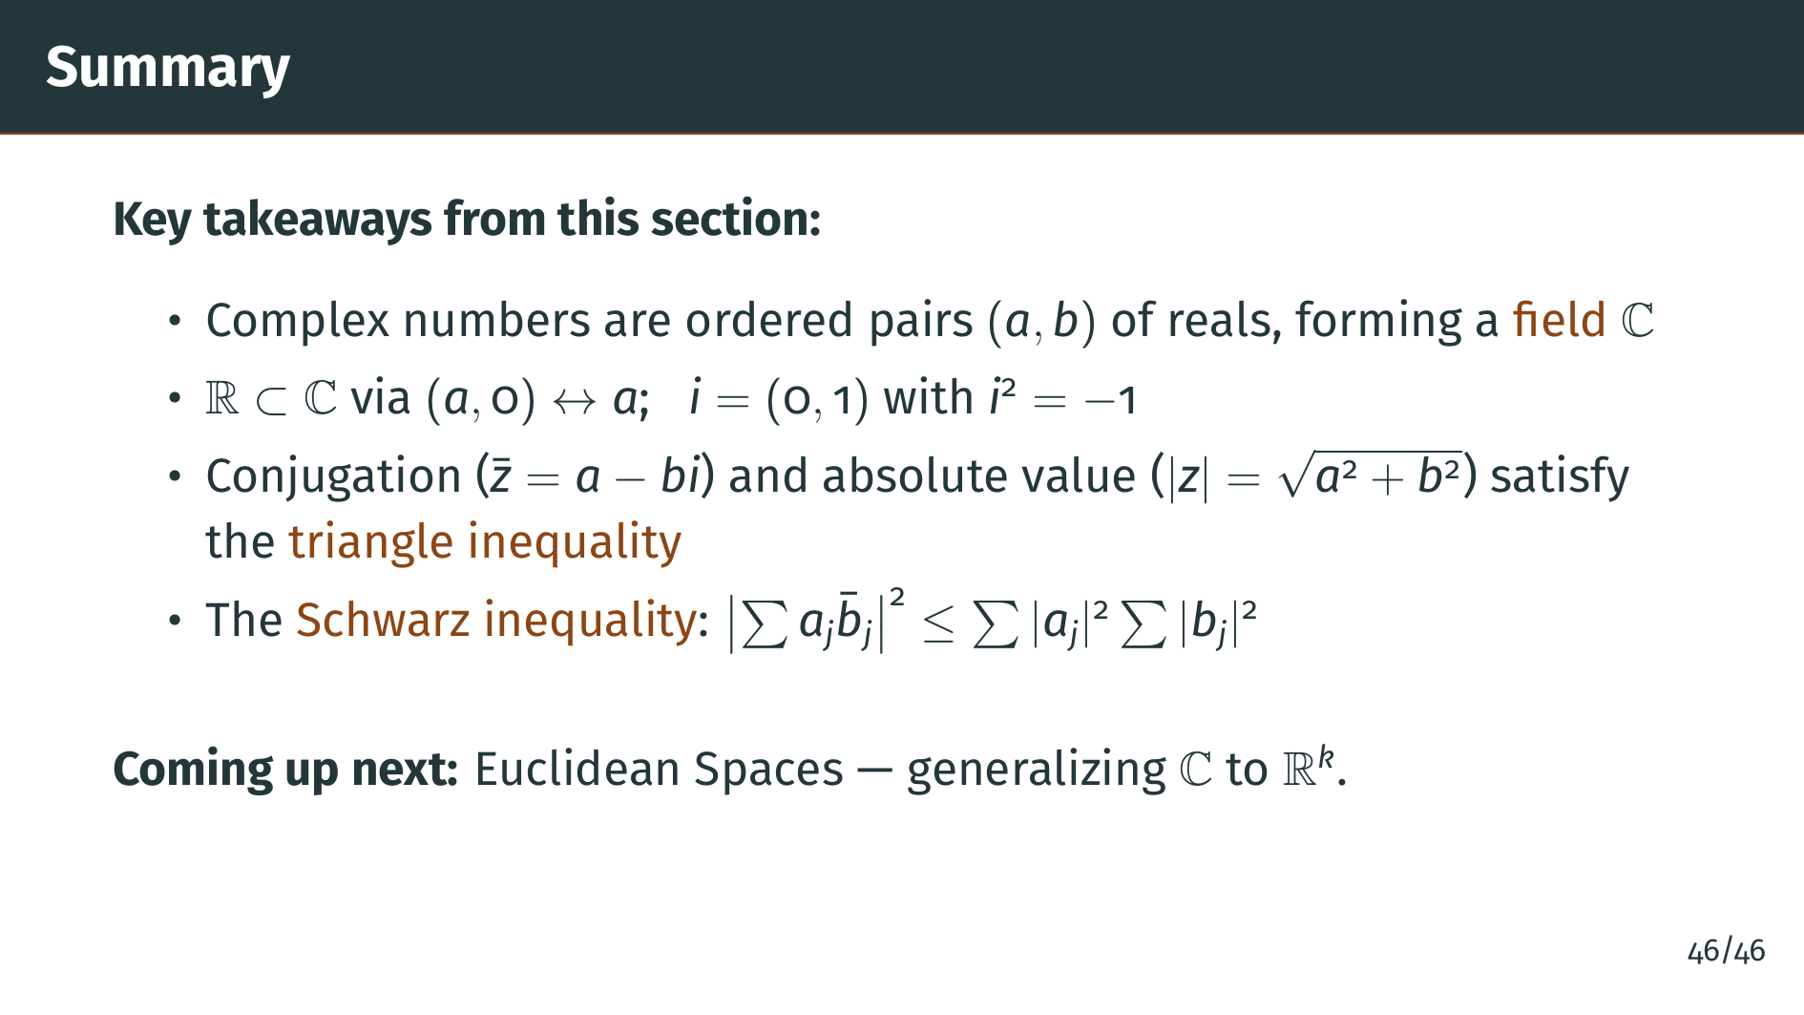
Notes:
Finally, we proved the Schwarz inequality, which bounds the inner product of two sequences by the product of their norms. This inequality will be essential when we study Euclidean spaces in the next section, where we generalize from the complex plane to higher-dimensional real vector spaces. Thank you for watching.

