Slide 1

Notes:
Welcome to Chapter 1, Section 7: Euclidean Spaces. In this section we generalize what we have done so far to higher dimensions. We define the space "R" "k" of ordered "k"-tuples of real numbers, equip it with an inner product and a norm, and prove the fundamental properties of the norm, including the Schwarz inequality and the triangle inequality. These results will allow us to treat "R" "k" as a metric space, which is the starting point for all the topology and analysis in later chapters.

Slide 2

Notes:
Here is our outline for this section. We begin with the definitions of "R" "k", its vector operations, the inner product, and the norm. Then we state and prove Theorem 1.37, which gives six key properties of the norm. The proof relies on the Schwarz inequality from the previous section. Finally, we close with some remarks connecting "R" "k" to the metric spaces we will study in Chapter 2. Let's get started.

Slide 3


Slide 4

Notes:
Let's begin with some context. In the previous sections we carefully built the real number system and the complex number system. The reals give us a complete ordered field, and the complex numbers give us an algebraically closed field. But both of these are essentially one-dimensional or two-dimensional objects. What if we need more dimensions?

Slide 5
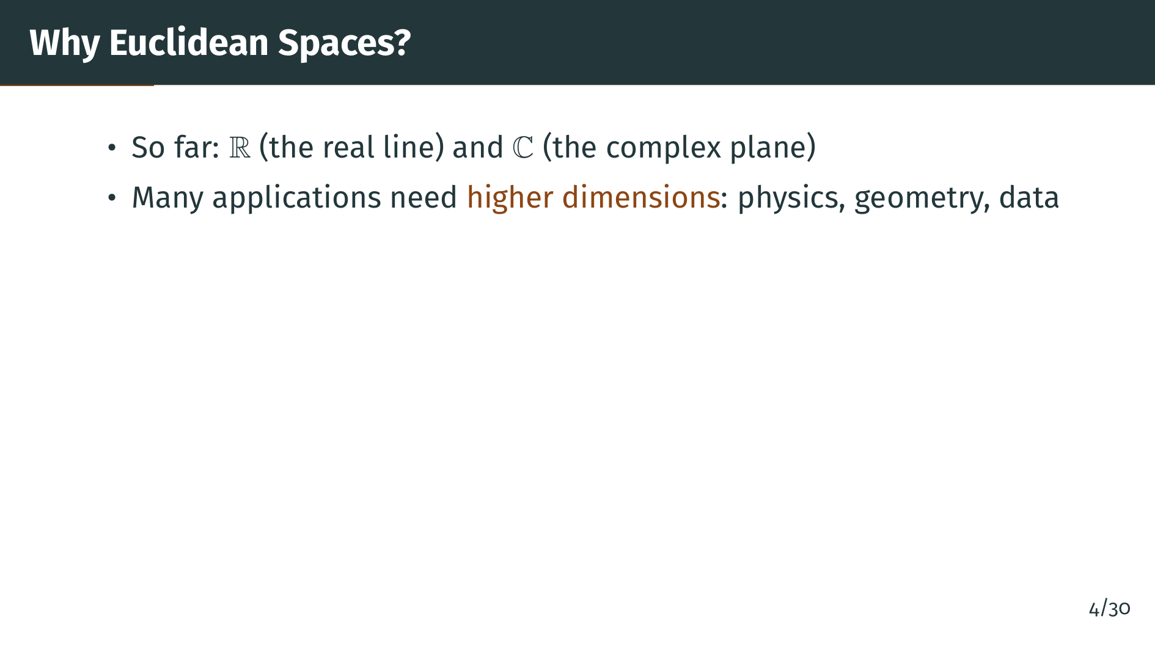
Notes:
In many parts of mathematics and its applications we need to work in higher dimensions. Physics uses three-dimensional space, quantum mechanics uses infinite-dimensional spaces, and many modern applications in data science and optimization work in spaces of very high dimension. We need a framework that handles all of these dimensions at once. So what is our plan?

Slide 6
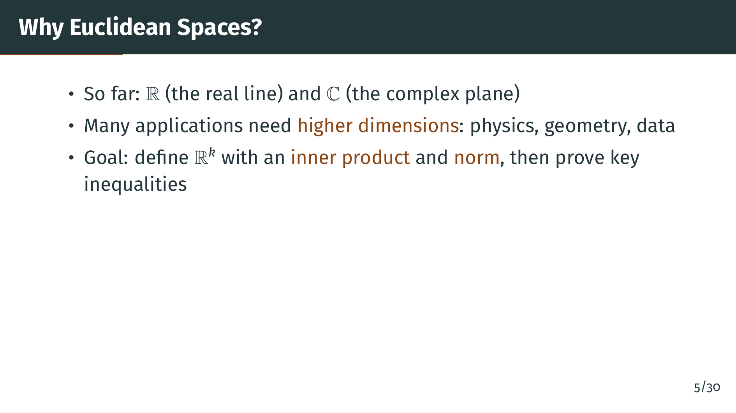
Notes:
Our goal in this section is to define the space "R" "k" for any positive integer "k", equip it with an inner product and a norm, and then establish the fundamental inequalities --- particularly the triangle inequality --- that make "R" "k" into a metric space. Let's start with the definitions.

Slide 7
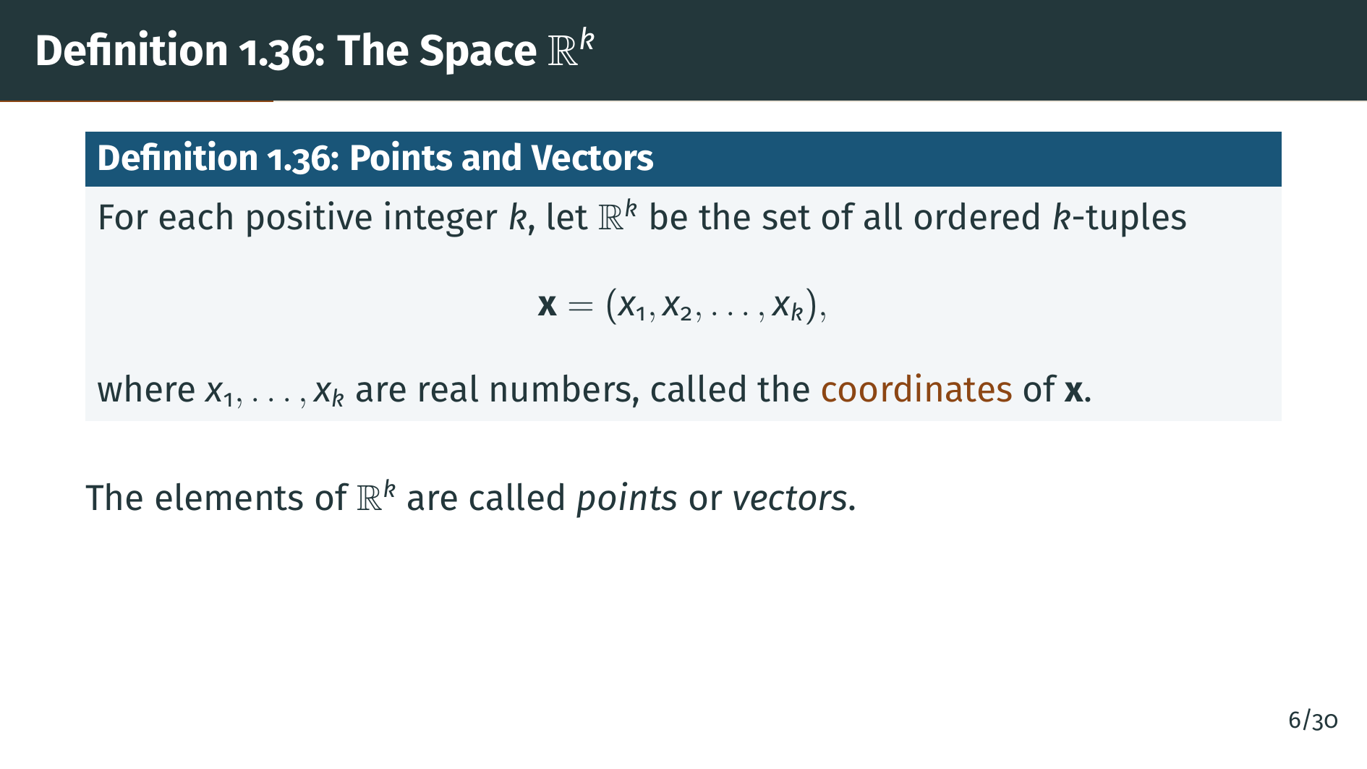
Notes:
Here is the basic definition. "R" "k" is the set of all ordered "k"-tuples of real numbers. The numbers "x" one through "x" "k" are the coordinates of the point "x". We call the elements of "R" "k" either points or vectors, depending on the context. When "k" equals 1, this is just the real line. When "k" equals 2, this is the plane. When "k" equals 3, this is three-dimensional space. But the definition works for any positive integer "k". Next, let's define the algebraic operations on these vectors.

Slide 8
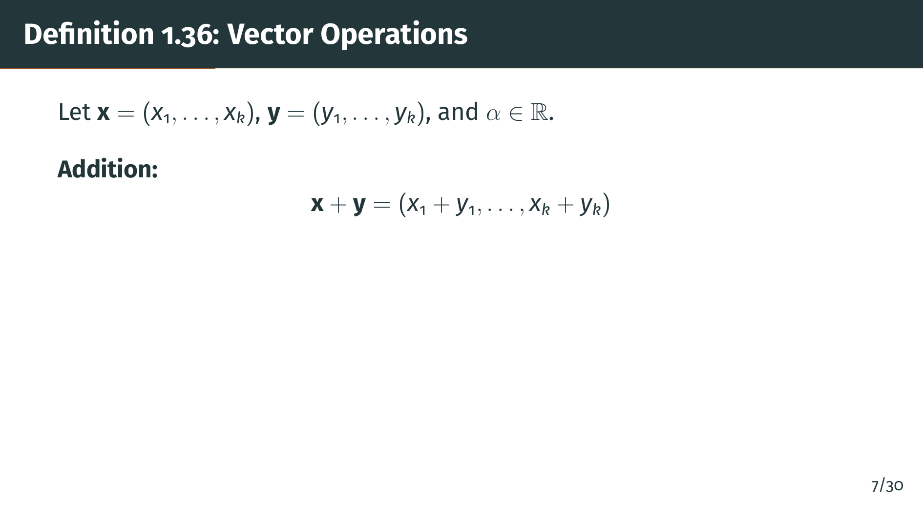
Notes:
Vector addition is defined component by component: you add the first coordinates, the second coordinates, and so on. This is exactly what you would expect. Notice that the sum of two vectors in "R" "k" is again a vector in "R" "k", so "R" "k" is closed under addition. Now let's see scalar multiplication.

Slide 9
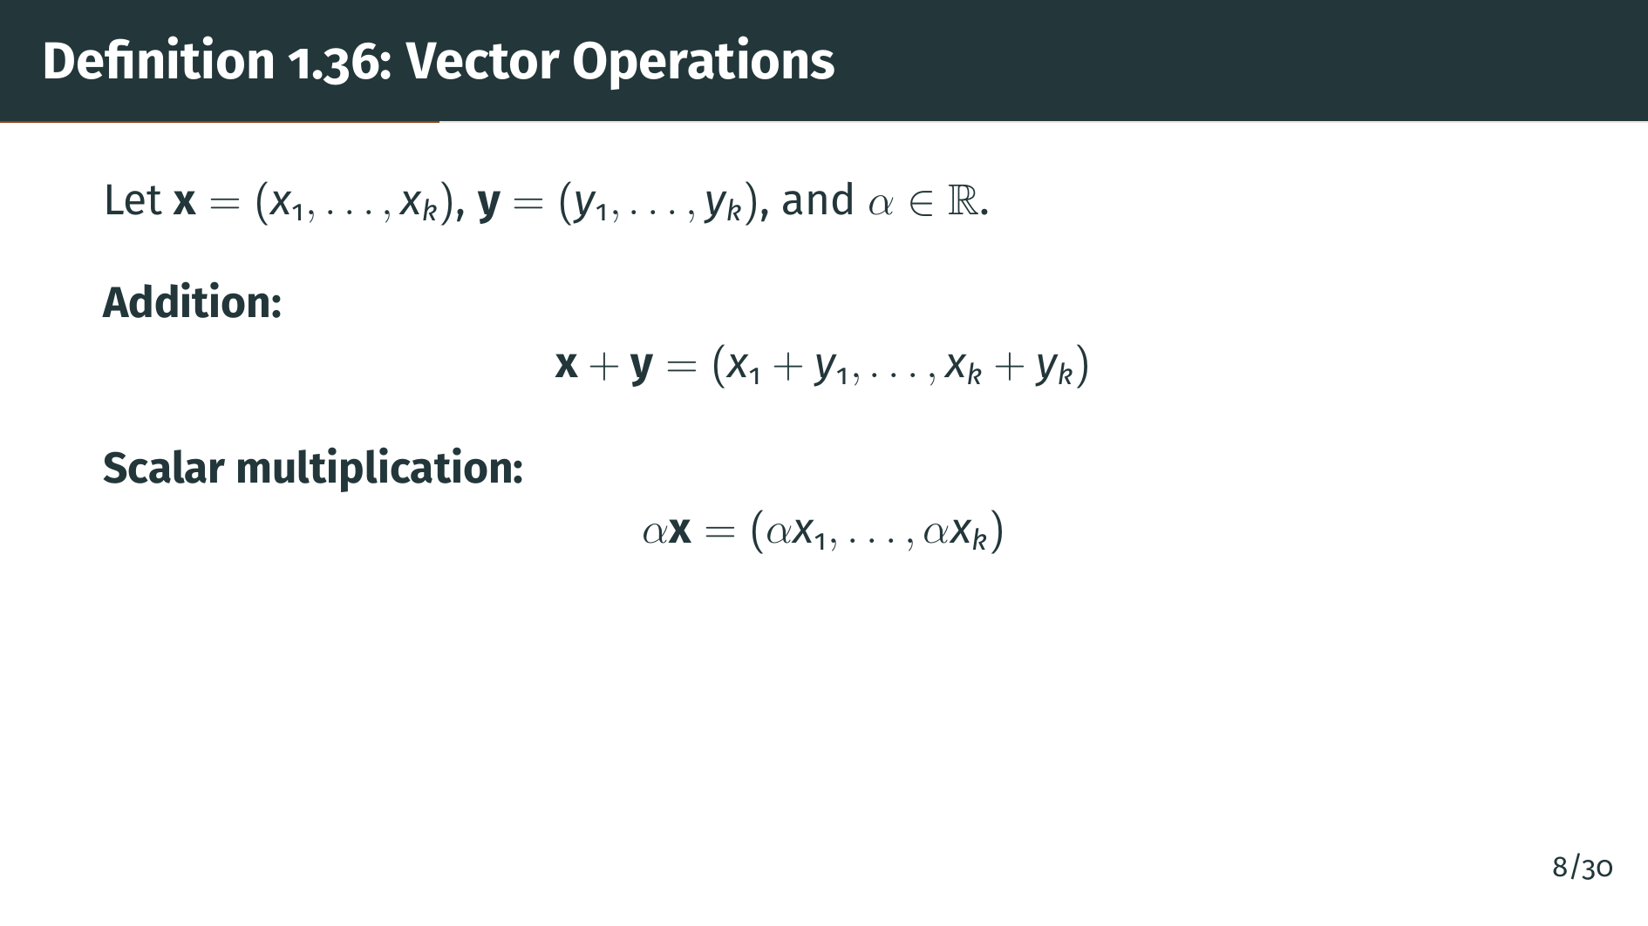
Notes:
Scalar multiplication scales each coordinate by the real number alpha. Again, the result is in "R" "k". Together, addition and scalar multiplication satisfy all the usual laws: commutativity, associativity, and distributivity. These follow trivially from the corresponding properties of the real numbers. This makes "R" "k" a vector space over the real field. Let's also note the special zero element.

Slide 10
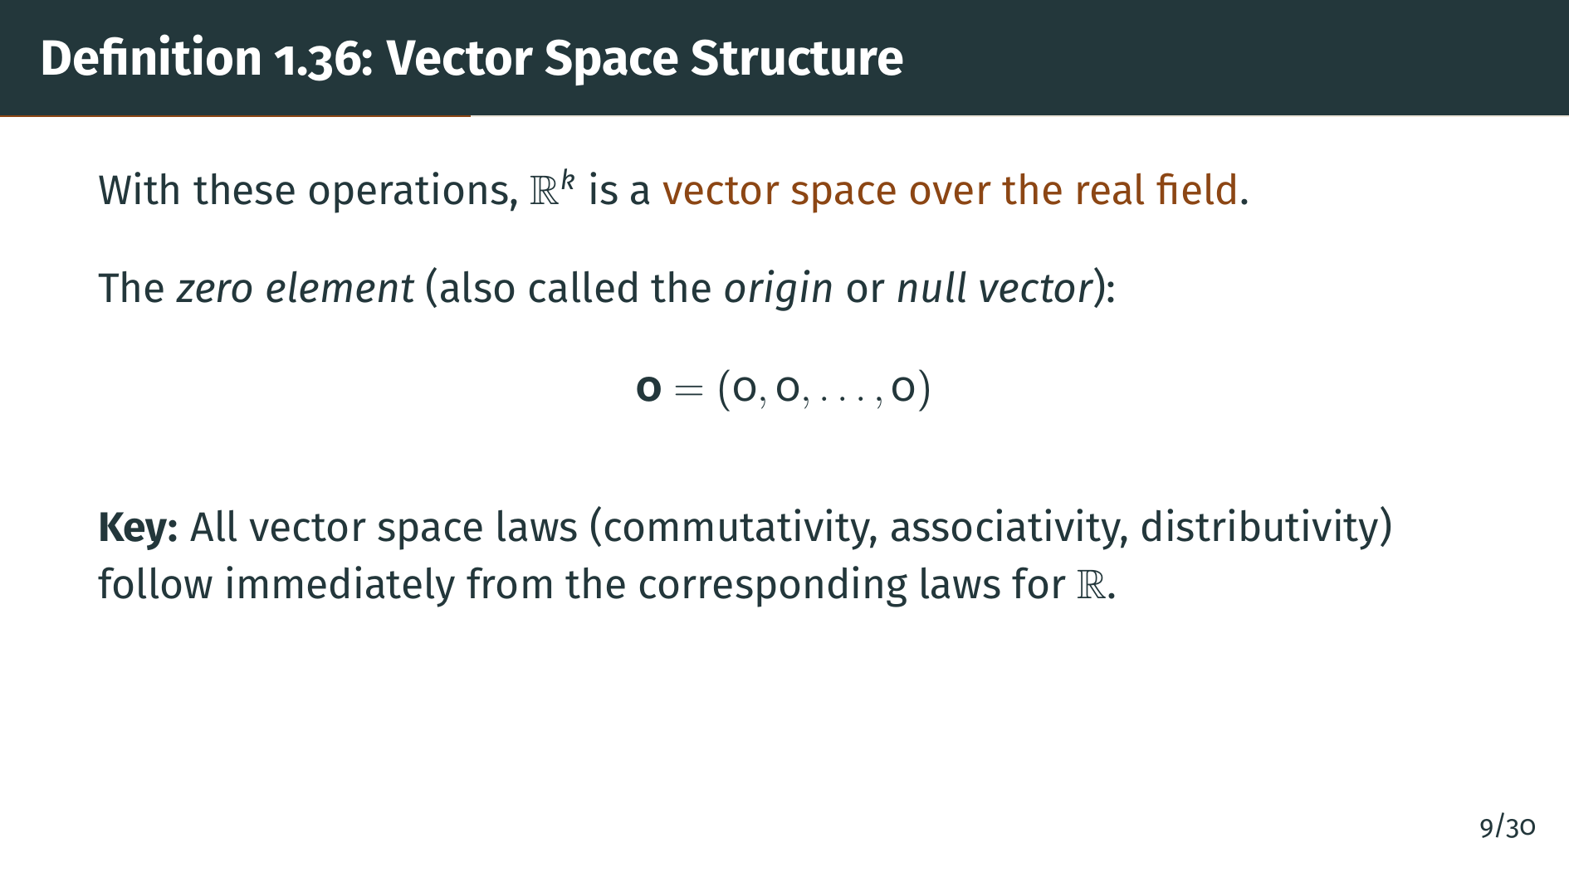
Notes:
The zero vector is the "k"-tuple with all coordinates equal to zero. It serves as the additive identity: adding it to any vector gives back the same vector. Notice that verifying the vector space laws here is trivial, since everything reduces to the corresponding property of the real numbers applied coordinate by coordinate. This is much simpler than the previous section, where proving the field axioms for the complex numbers required real computation. But the vector space structure alone is just algebra. The interesting geometry comes next, from the inner product and the norm.

Slide 11
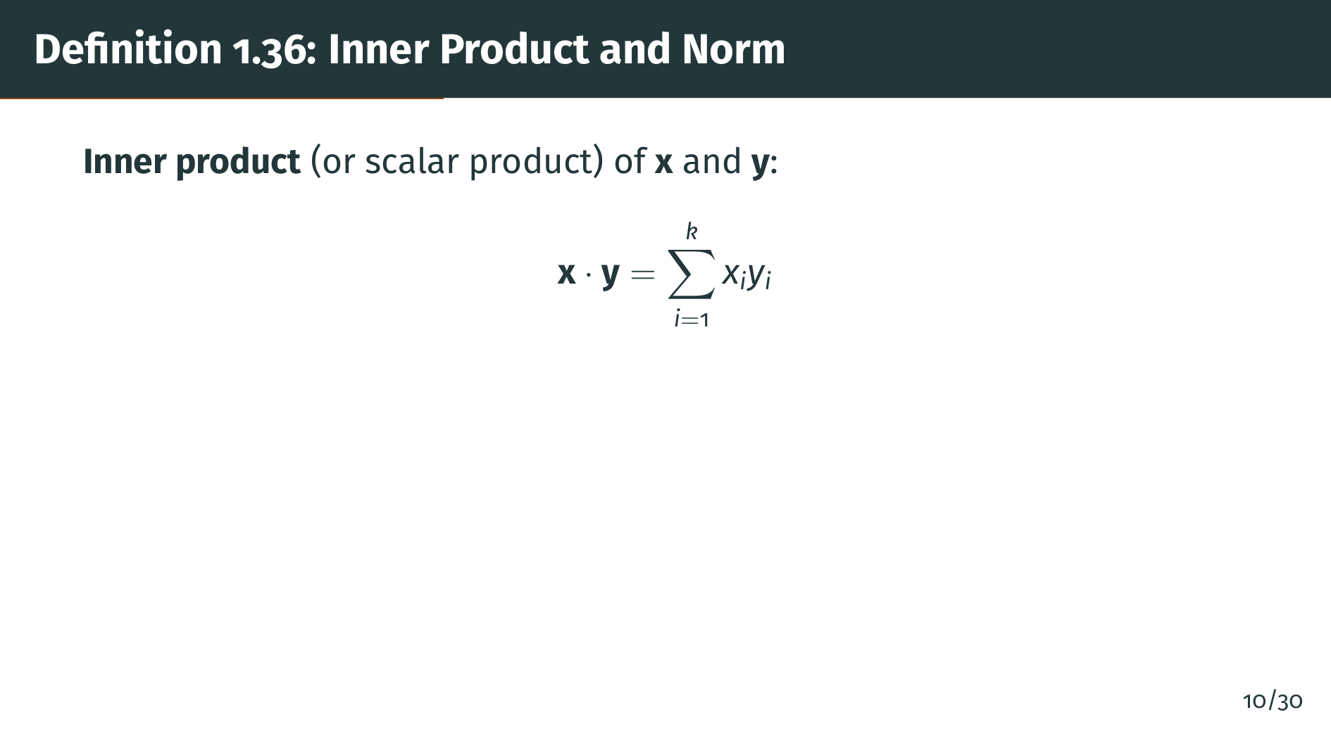
Notes:
The inner product, also called the scalar product or dot product, takes two vectors and produces a single real number. You multiply corresponding coordinates and add up the results. As shown in the formula on the slide, this is a sum of "k" products. Geometrically, the inner product captures how much two vectors point in the same direction: it is large and positive when they point the same way, zero when they are perpendicular, and negative when they point in opposite directions. Next comes the norm.

Slide 12
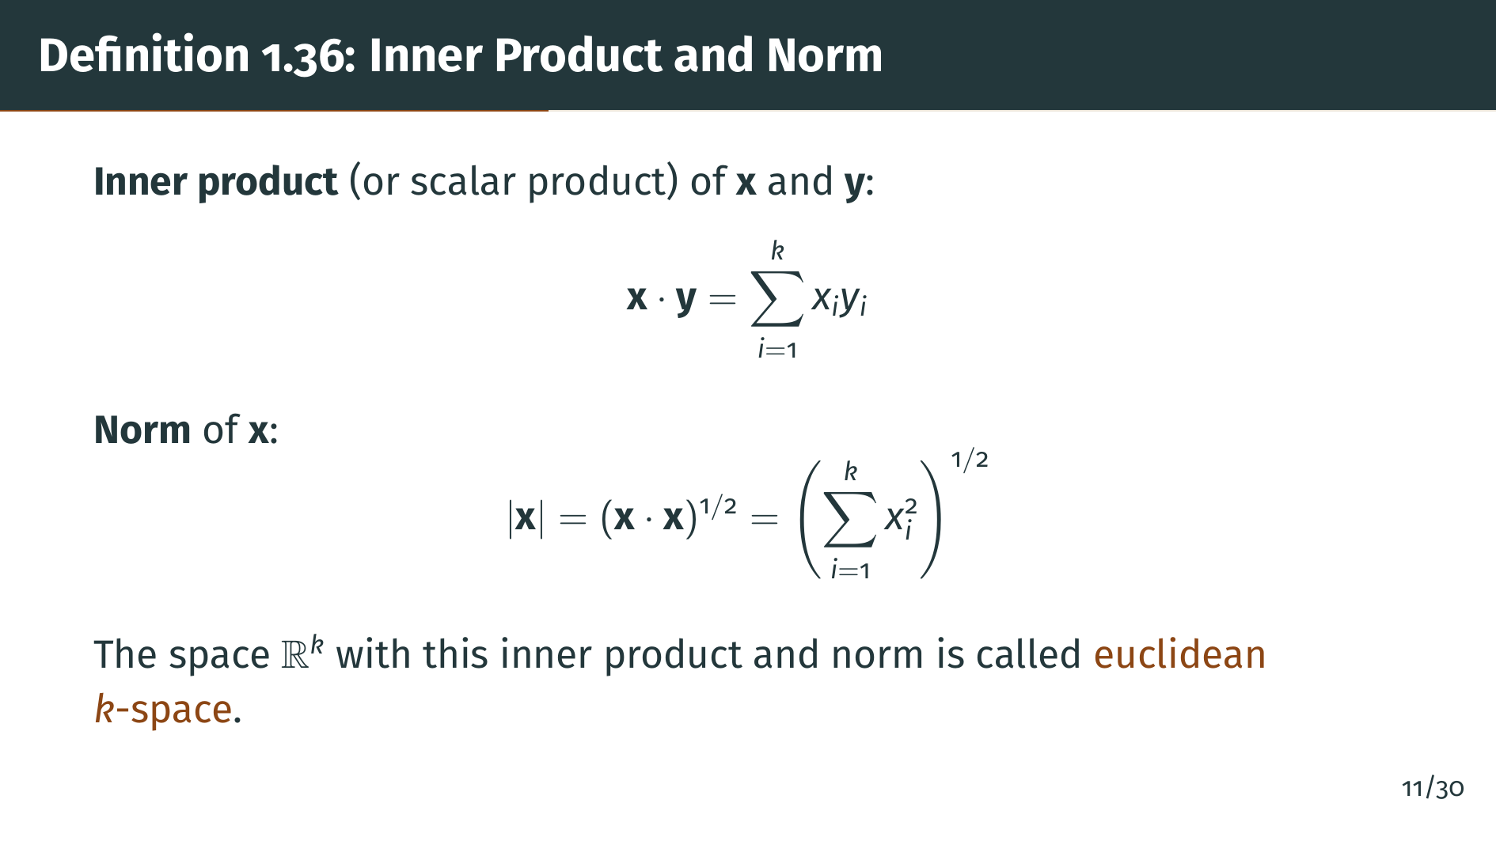
Notes:
The norm of a vector "x" is the square root of the inner product of "x" with itself. This is simply the square root of the sum of the squares of all coordinates. Geometrically, in two or three dimensions, this is the length of the vector, which you can derive from the Pythagorean theorem. The space "R" "k" equipped with this inner product and norm is what we call euclidean "k"-space. Let's visualize these concepts with a diagram.

Slide 13
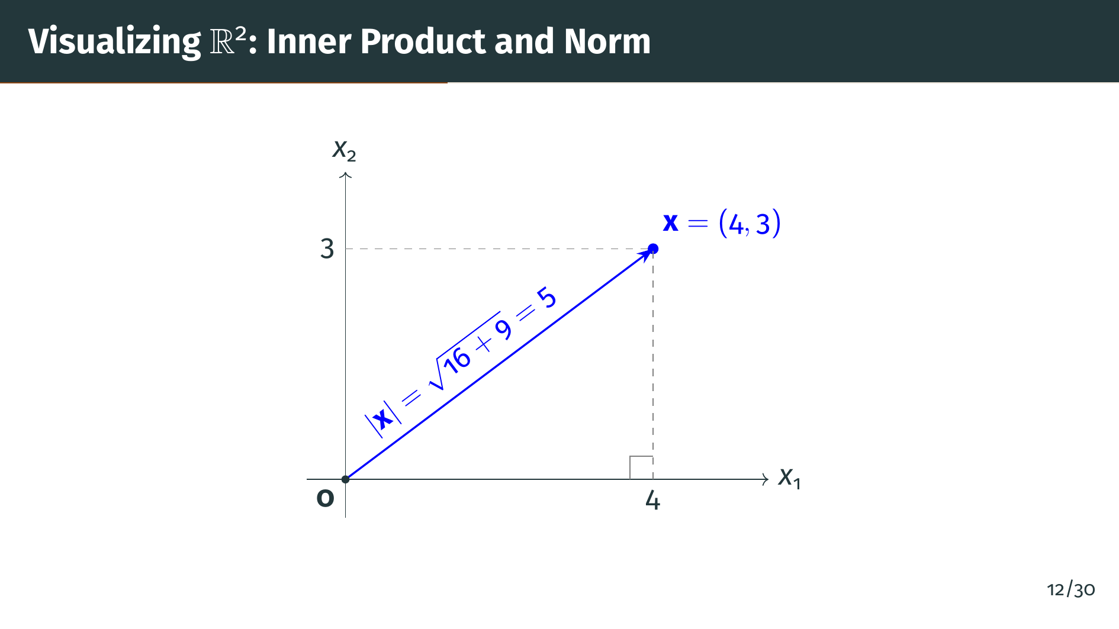
Notes:
Here is a concrete example in "R" 2. The vector "x" equals 4, 3 is shown as an arrow from the origin. Its norm is the length of that arrow, which by the Pythagorean theorem is the square root of 4 squared plus 3 squared, which equals the square root of 25, which equals 5. This is a familiar 3-4-5 right triangle. The same idea extends to any number of dimensions, even though we cannot draw a picture for "k" greater than 3. Now let's state the key properties of the norm.

Slide 14


Slide 15
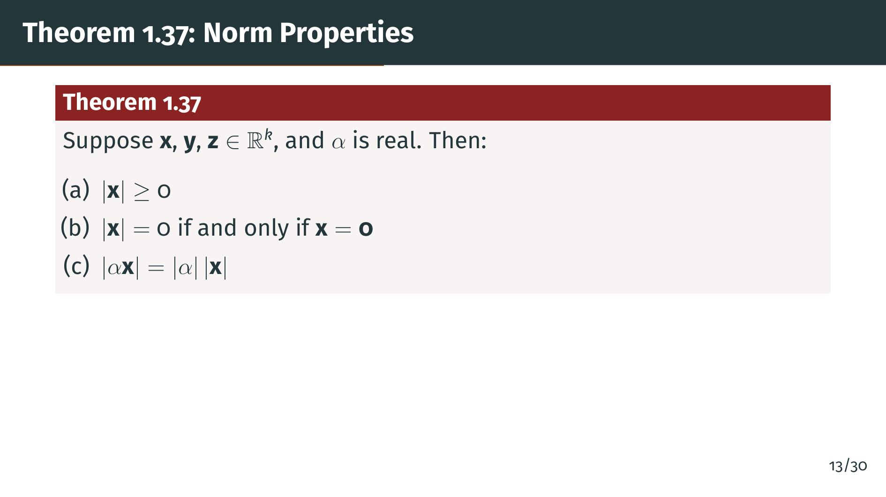
Notes:
Theorem 1.37 lists six properties of the norm. Let's start with the first three. Part "a" says the norm is always nonnegative, which makes sense since it is a square root of a sum of squares. Part "b" says the only vector with zero length is the zero vector. And part "c" says that scaling a vector by alpha multiplies its norm by the absolute value of alpha. All three of these are straightforward consequences of the definition. Let's see the remaining three properties.

Slide 16
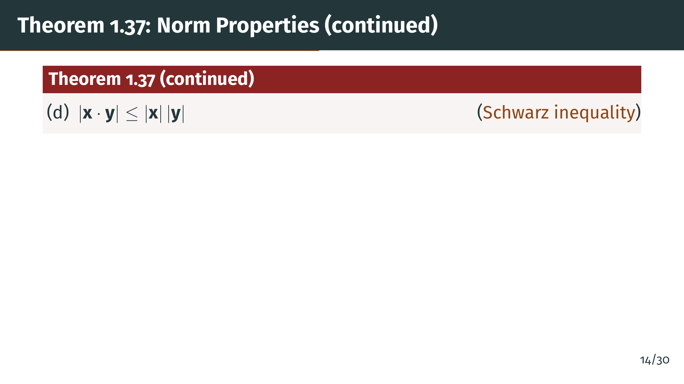
Notes:
Part "d" is the Schwarz inequality, now stated for "R" "k". It says the absolute value of the inner product of two vectors is at most the product of their norms. This was already proved in the previous section for complex numbers. Here in "R" "k" it follows as an immediate consequence of that result, since real "k"-tuples are a special case. The next property is even more important.

Slide 17
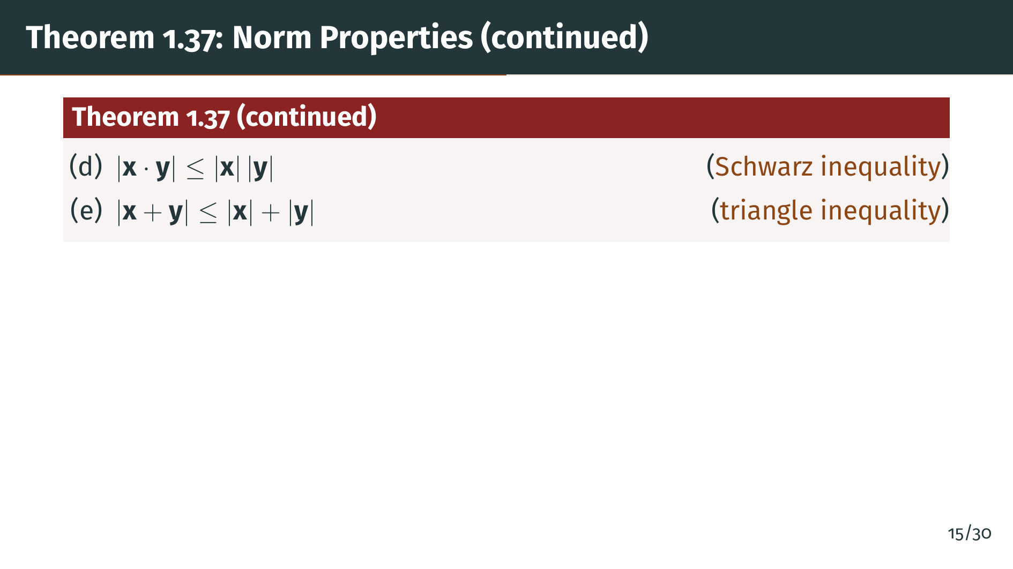
Notes:
Part "e" is the triangle inequality: the norm of the sum of two vectors is at most the sum of their norms. Geometrically, this says that one side of a triangle is never longer than the sum of the other two sides. This is perhaps the single most important inequality in analysis. There is one more form of it.

Slide 18
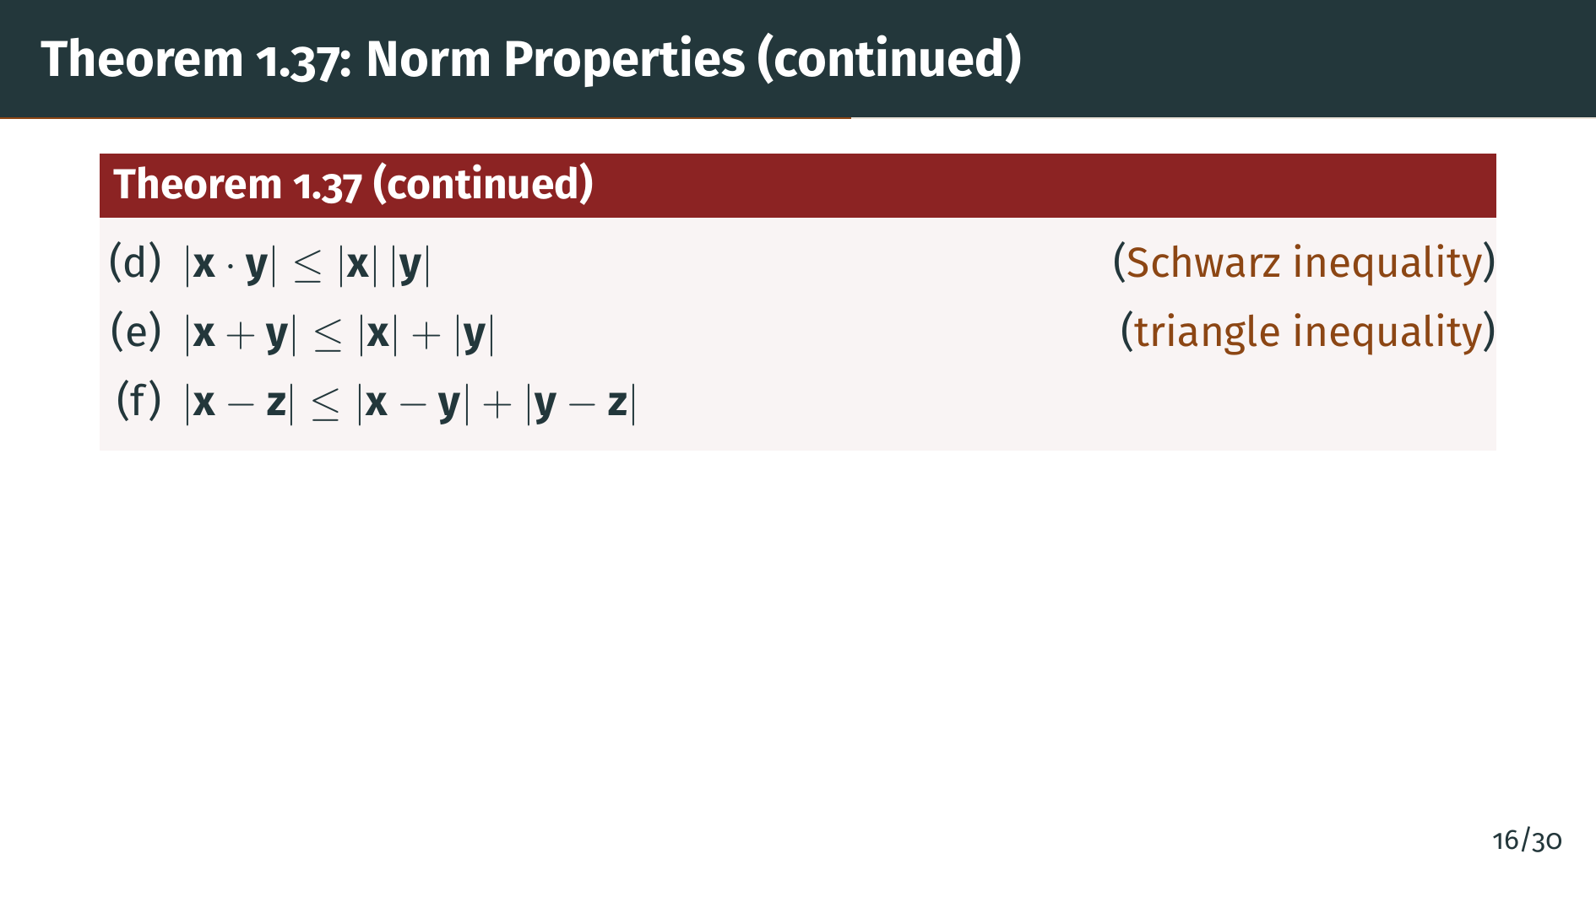
Notes:
Part "f" is the triangle inequality restated in terms of distances. It says the distance from "x" to "z" is at most the distance from "x" to "y" plus the distance from "y" to "z". This is the version that will be directly used when we define metric spaces in Chapter 2. It follows from part "e" by a simple substitution. Let's now look at how these properties are proved.

Slide 19
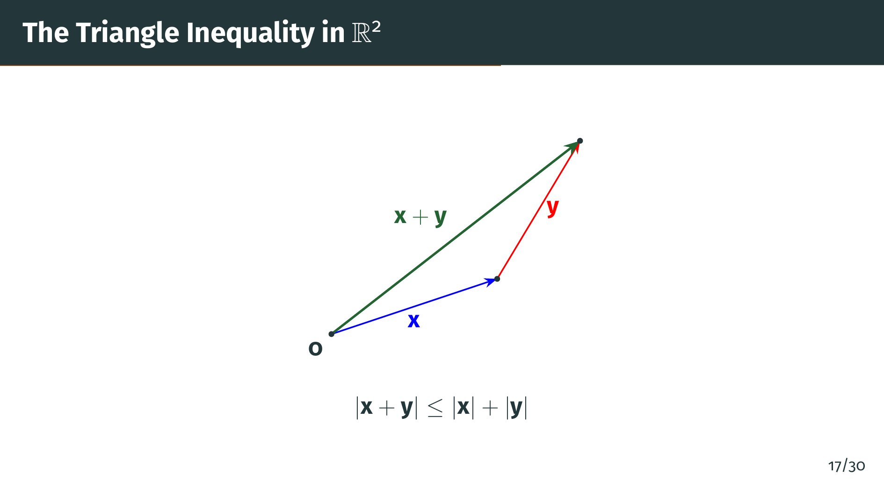
Notes:
This diagram illustrates the triangle inequality in "R" 2. The vector "x" is shown in blue, the vector "y" in red, and their sum "x" plus "y" in green. The three vectors form a triangle. The triangle inequality says that the length of the green side --- the direct route from the origin to the tip of "x" plus "y" --- is at most the sum of the lengths of the blue and red sides. The shortcut is never longer than the detour. Now let's prove these properties.

Slide 20
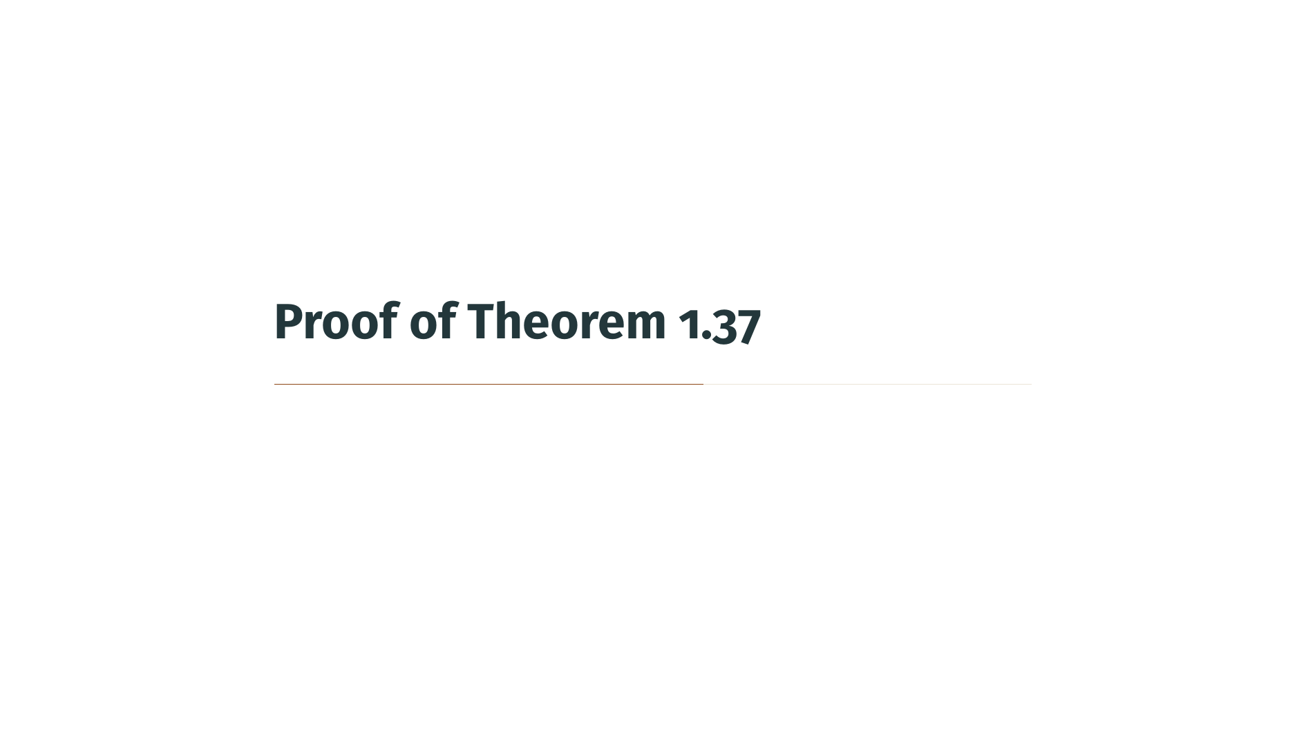

Slide 21
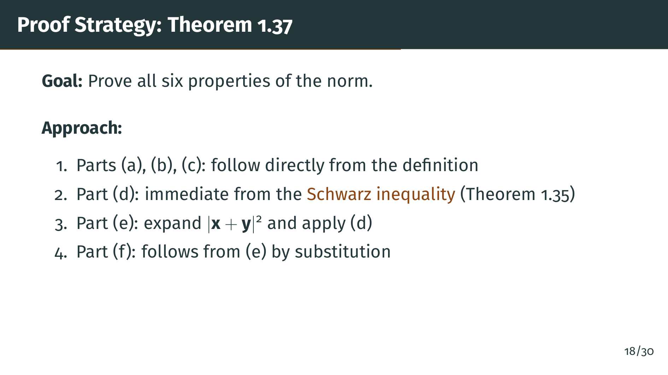
Notes:
Before diving in, let's outline the strategy. Parts "a", "b", and "c" are obvious from the definition of the norm, so we won't spend much time on them. Part "d", the Schwarz inequality, was essentially proved in the previous section. The real work is in part "e", the triangle inequality, which requires us to expand a squared norm and apply the Schwarz inequality. Part "f" then follows from "e" by a clever substitution. Let's go through each part.

Slide 22
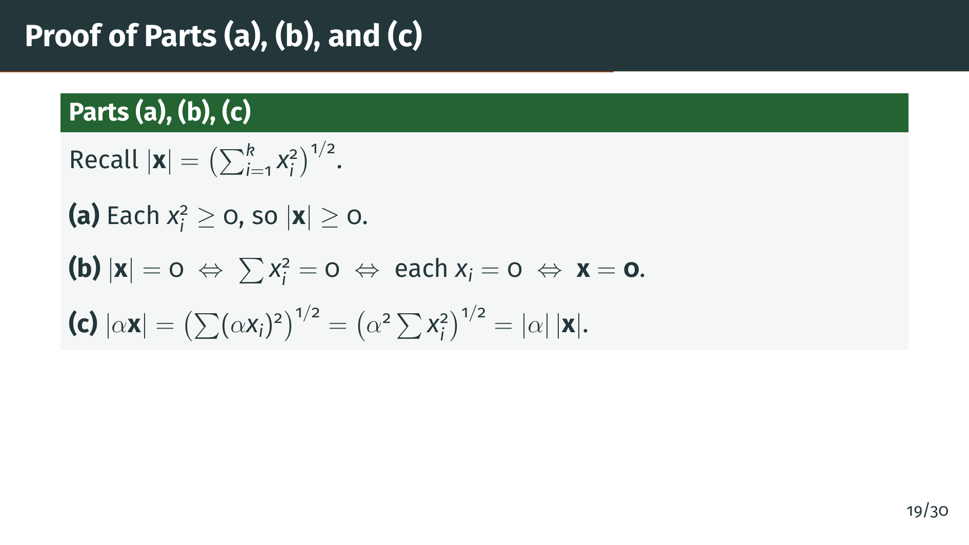
Notes:
These three parts are straightforward. Part "a" holds because each "x" "i" squared is nonnegative, so the sum is nonnegative, and the square root of a nonnegative number is nonnegative. Part "b" says the norm is zero exactly when all coordinates are zero, which is clear because a sum of squares of real numbers is zero only when each term is zero. Part "c" uses the fact that alpha squared factors out of the sum and then out of the square root, becoming the absolute value of alpha. Now let's handle the more interesting parts.

Slide 23
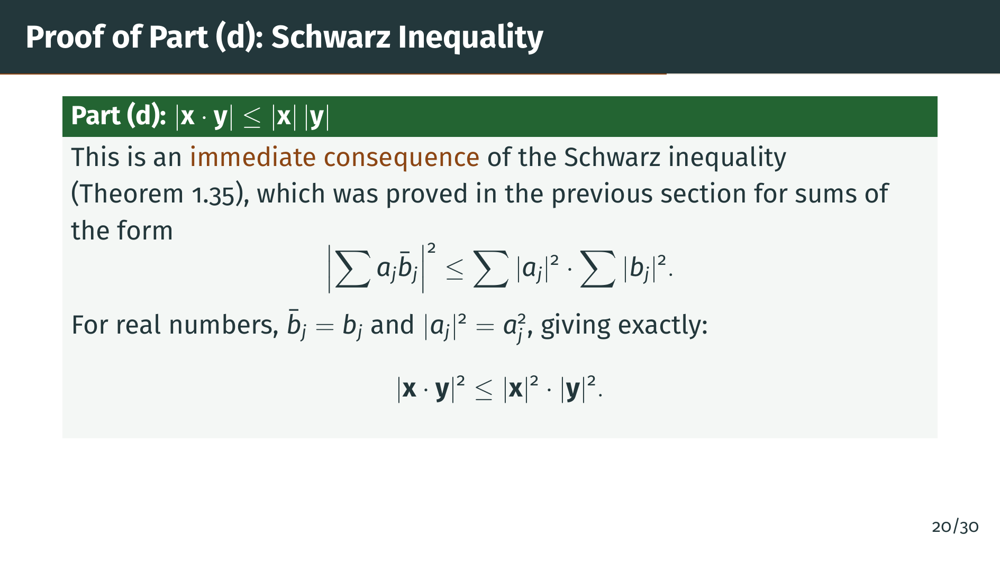
Notes:
Part "d" does not require any new work. In the previous section on the complex field, we proved the Schwarz inequality for sums involving complex numbers. Since real numbers are a special case of complex numbers, where the conjugate of "b" "j" is just "b" "j" itself, the Schwarz inequality applies directly. Taking square roots of both sides gives us the result. Now let's prove the triangle inequality, which is where the Schwarz inequality gets used in a beautiful way.

Slide 24
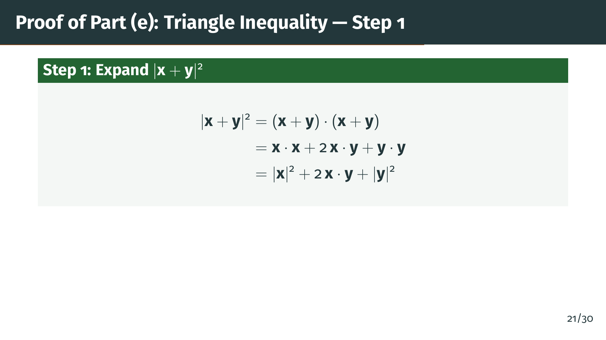
Notes:
Here is the key computation. We compute the squared norm of "x" plus "y" by expanding it using the definition of the inner product. The inner product distributes over addition just like ordinary multiplication, giving us three terms. The middle term, 2 times the inner product of "x" and "y", is the cross term that we need to estimate. Let's apply the Schwarz inequality to it.

Slide 25
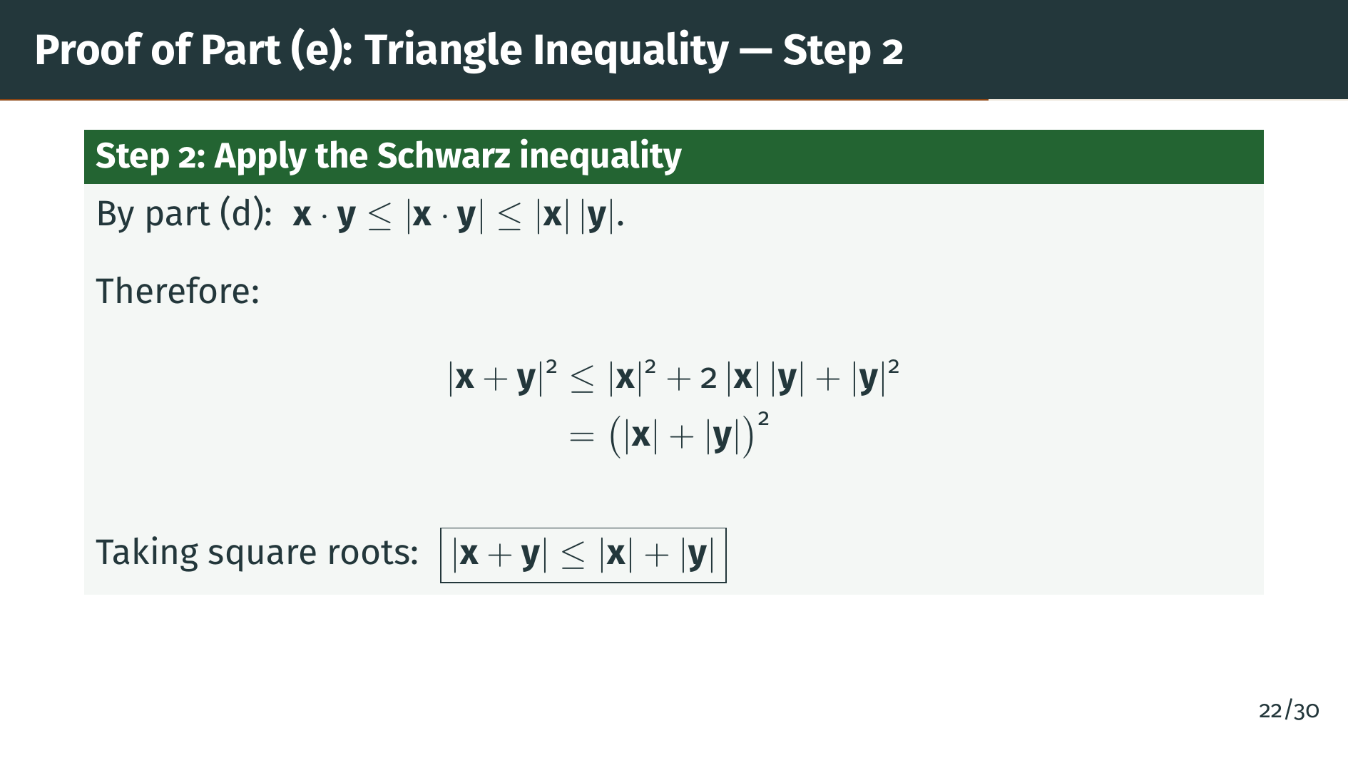
Notes:
The Schwarz inequality tells us that the cross term "x" dot "y" is at most the product of the norms. Substituting this bound into our expansion, the right-hand side becomes a perfect square. Taking square roots of both sides completes the proof of part "e". Notice how elegant this is: the entire triangle inequality proof comes down to a single application of the Schwarz inequality to the cross term. Now let's finish with part "f".

Slide 26
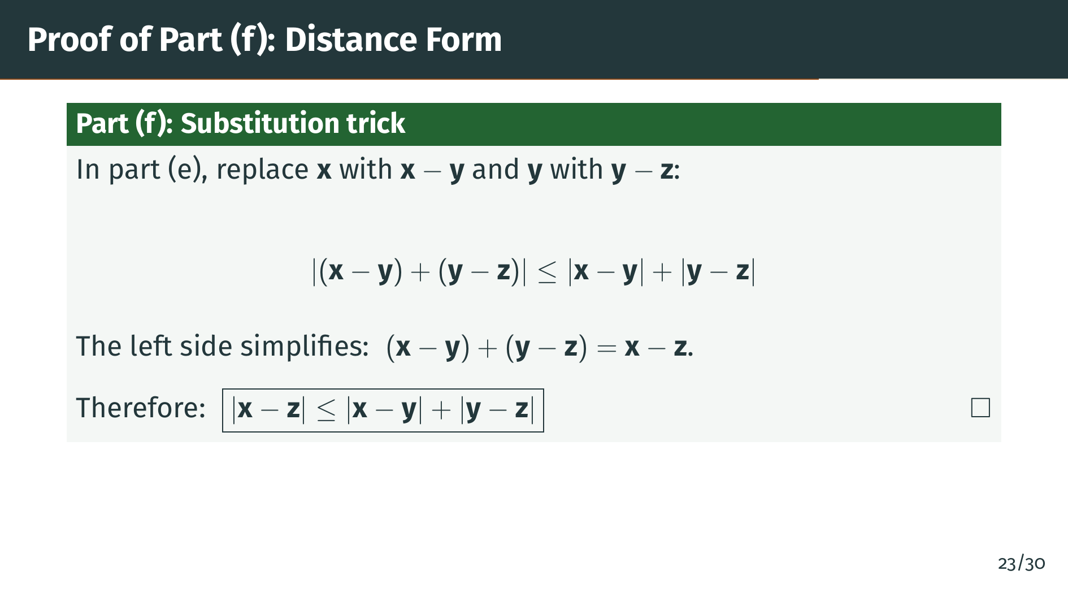
Notes:
Part "f" is a direct consequence of part "e". We make the substitution: replace "x" with "x" minus "y", and replace "y" with "y" minus "z". On the left side, the "y" terms cancel, giving "x" minus "z". So we get the distance form of the triangle inequality. This version says the distance from "x" to "z" is at most the distance from "x" to "y" plus the distance from "y" to "z". This is exactly the property needed to make "R" "k" a metric space, as we will see in Chapter 2. That completes the proof of Theorem 1.37.

Slide 27


Slide 28
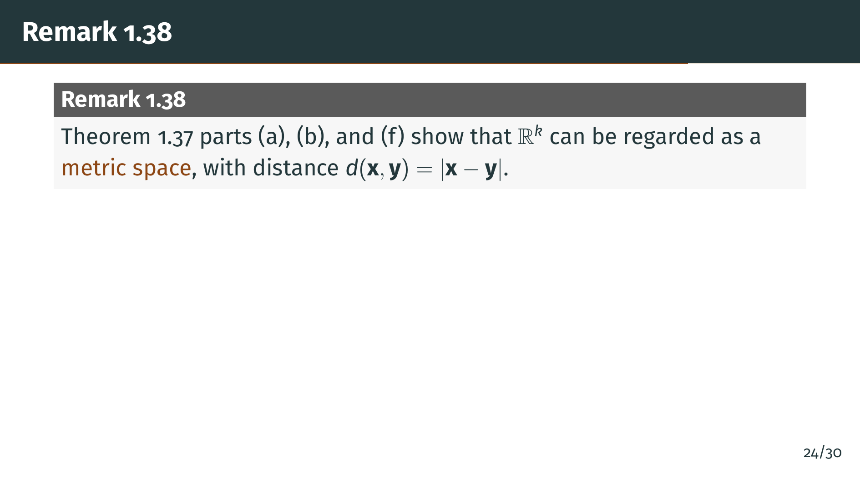
Notes:
Remark 1.38 makes the important observation that properties "a", "b", and "f" are exactly the axioms for a metric space, which we will define formally in Chapter 2. The function that sends two points "x" and "y" to the norm of "x" minus "y" gives a well-defined notion of distance. This distance is nonnegative, is zero only when the two points coincide, and satisfies the triangle inequality. Let's note the special cases.

Slide 29
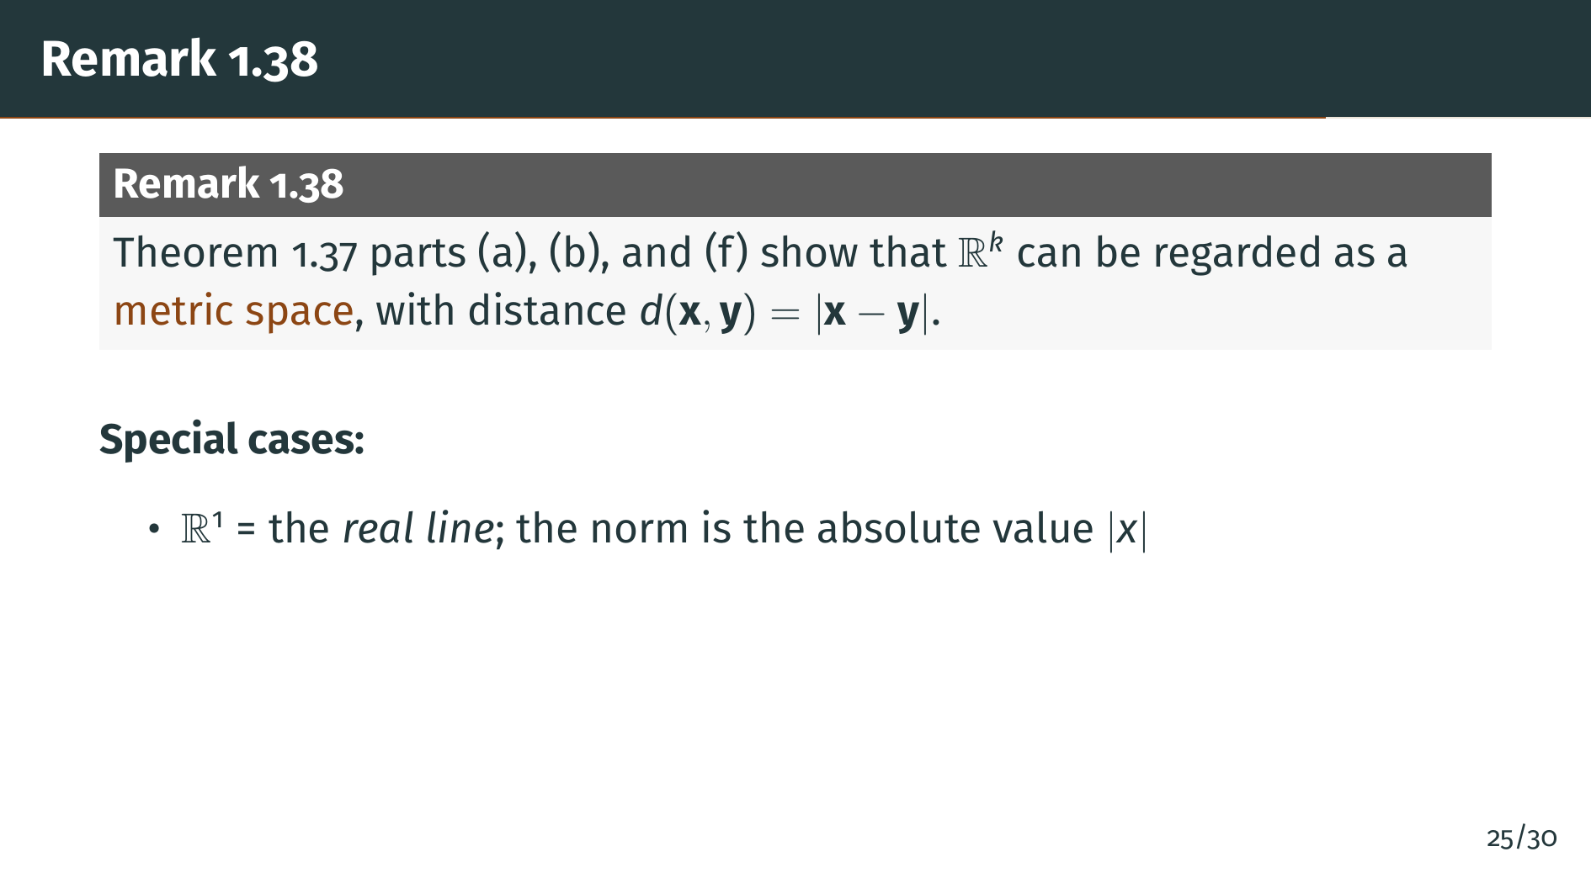
Notes:
When "k" equals 1, the space "R" 1 is just the set of all real numbers, also known as the real line. The norm of a one-tuple containing "x" is just the square root of "x" squared, which is the absolute value of "x". So the norm in "R" 1 is exactly the absolute value we have been using all along. Now let's look at the two-dimensional case.

Slide 30
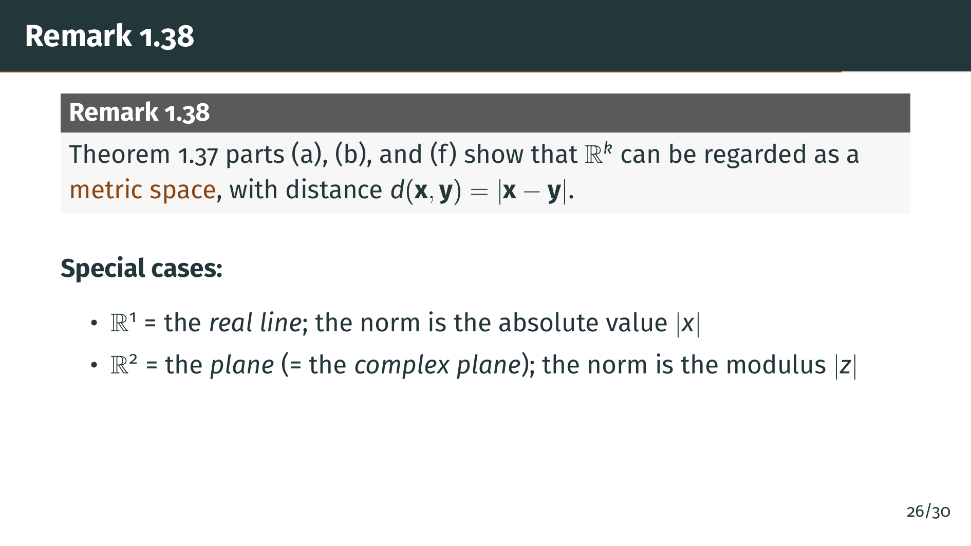
Notes:
When "k" equals 2, the space "R" 2 is the plane. Rudin notes that we can identify "R" 2 with the complex plane by comparing Definitions 1.24 and 1.36: match the pair "a", "b" with the complex number "a" plus "b" "i". Under this identification, the norm of the pair "a", "b" is the square root of "a" squared plus "b" squared, which is exactly the modulus of the corresponding complex number. So the Euclidean norm on "R" 2 and the complex modulus are the same thing. This unifies the real, complex, and higher-dimensional settings under one framework. Let's wrap up with a summary.

Slide 31


Slide 32

Notes:
Let's review what we covered. We began by defining "R" "k" as the set of all ordered "k"-tuples of real numbers, with component-wise addition and scalar multiplication making it a vector space over the real field. But a vector space alone is not enough for analysis.

Slide 33
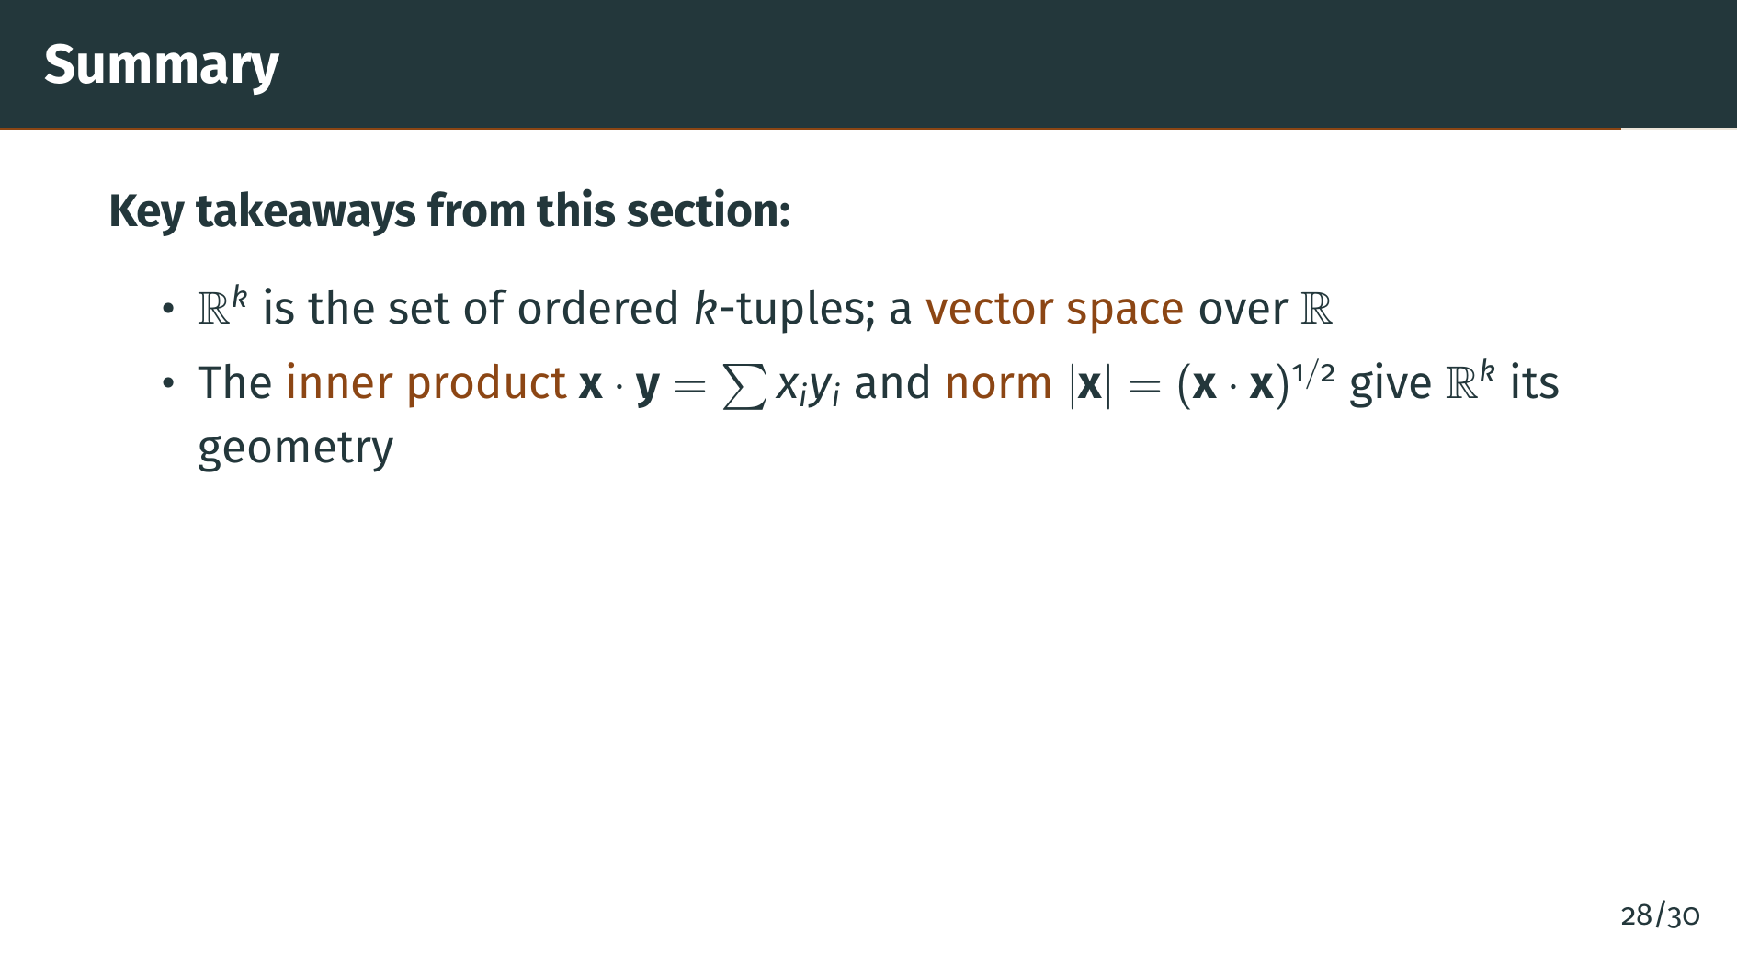
Notes:
We then introduced the inner product and the norm, which give "R" "k" its geometric structure. The inner product captures the idea of angle, and the norm captures the idea of length. These are the tools we need to measure things in "R" "k".

Slide 34
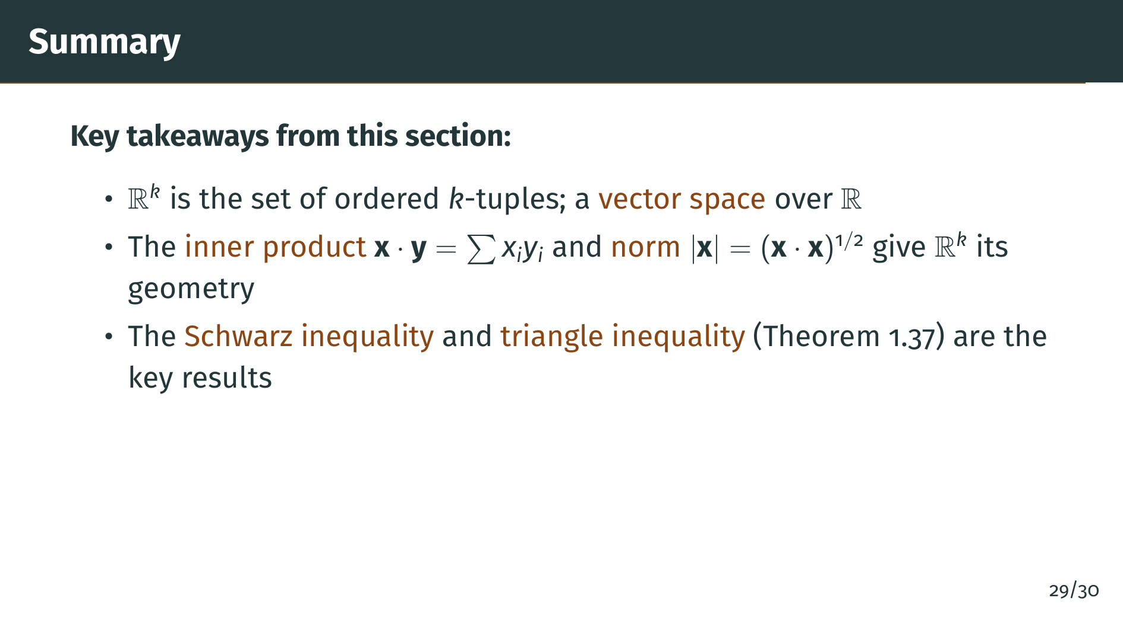
Notes:
The main results are the Schwarz inequality and the triangle inequality. The Schwarz inequality bounds the inner product by the product of norms, and the triangle inequality bounds the norm of a sum by the sum of norms. Together, these make "R" "k" a well-behaved geometric space. And the payoff is our final takeaway.

Slide 35
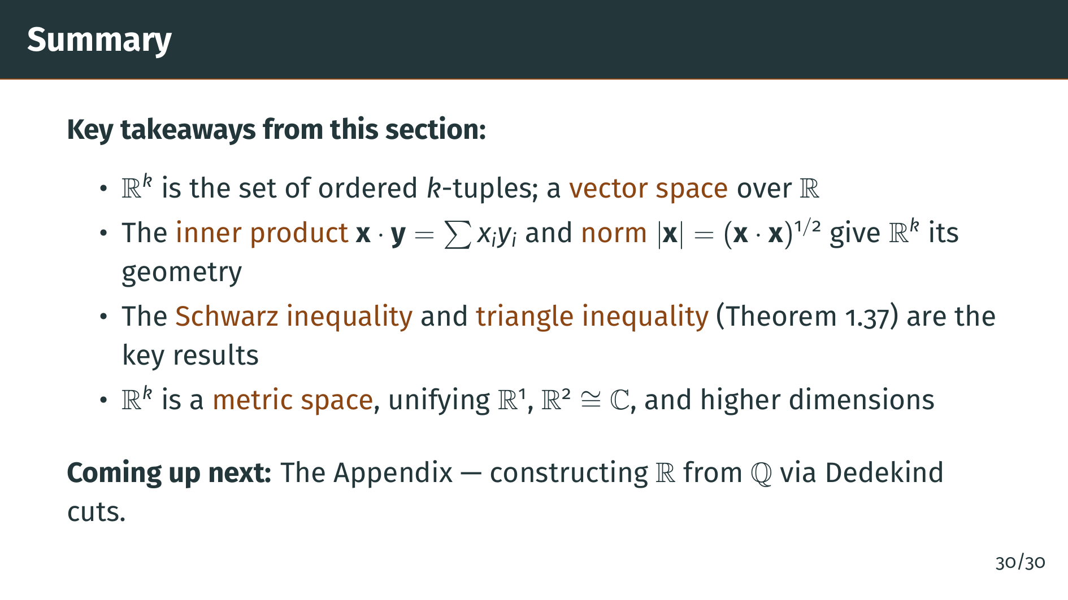
Notes:
Finally, we saw that "R" "k" is a metric space, with distance defined by the norm. This unifies the real line, the complex plane, and all higher-dimensional Euclidean spaces under a single framework. This framework is exactly what we need to do topology and analysis in multiple dimensions, which begins in Chapter 2. In the next and final section of Chapter 1, we look at the Appendix, where Rudin constructs the real numbers from the rationals using Dedekind cuts. Thank you for watching.

