Slide 1
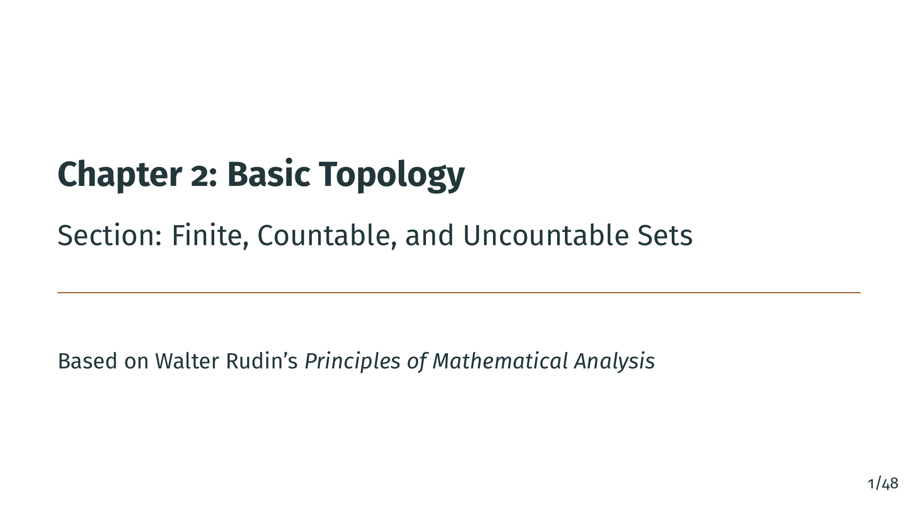
Notes:
Welcome to Chapter 2 of Principles of Mathematical Analysis. In this first section, we study finite, countable, and uncountable sets. This is the foundation for everything that follows in topology and analysis. We will learn how to compare the sizes of infinite sets, a surprisingly subtle question that leads to beautiful and sometimes counterintuitive results.

Slide 2
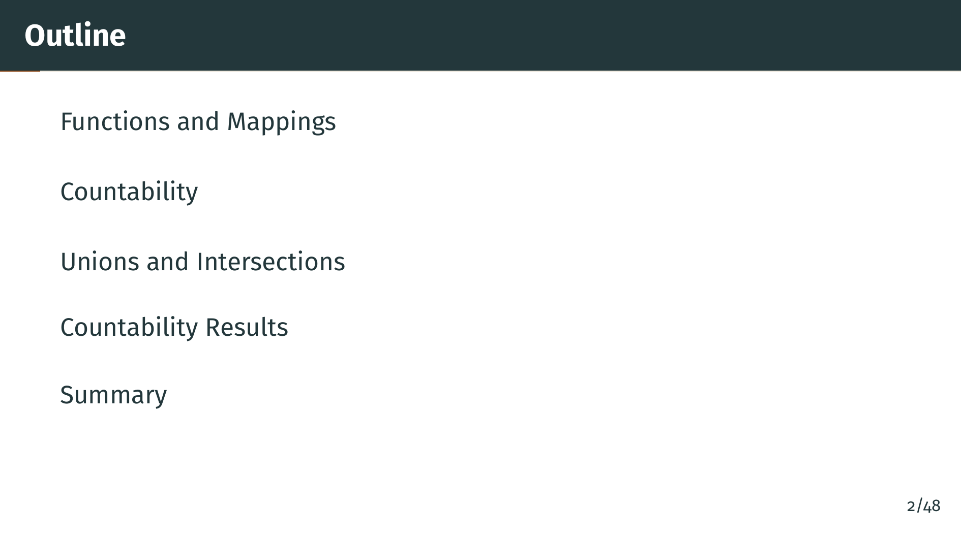
Notes:
Here is what we will cover. We begin with the precise definitions of functions and mappings, then introduce the concept of countability, which lets us compare sizes of infinite sets. We will study unions and intersections of sets, and finally prove some powerful results about countability, culminating in Cantor's diagonal argument showing that some infinities are strictly larger than others.

Slide 3
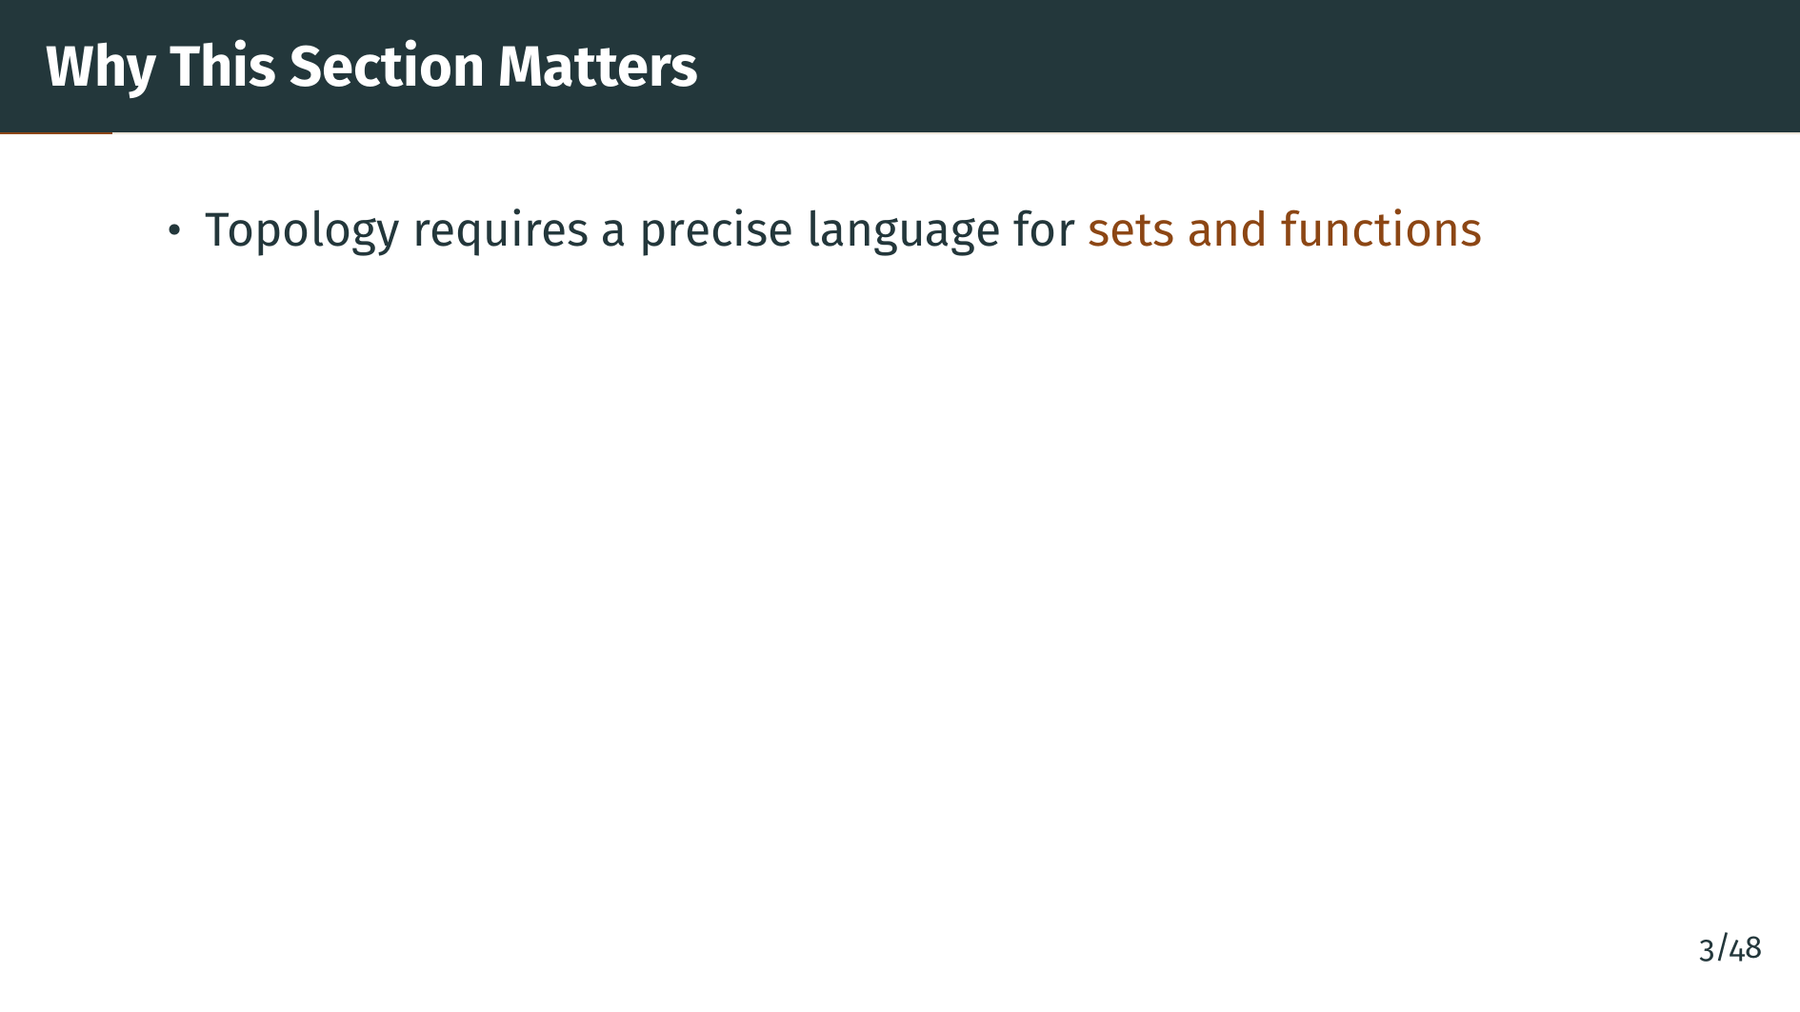
Notes:
Before we can study topology, which is the main subject of this chapter, we need a precise language for talking about sets and functions. These are the building blocks of all modern analysis.

Slide 4
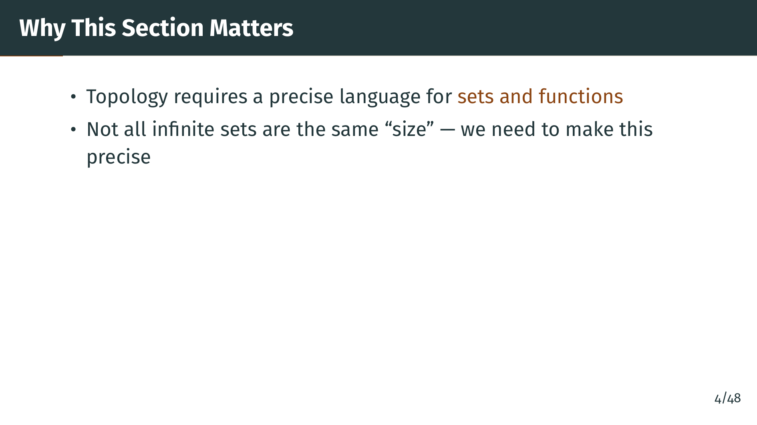
Notes:
A key insight in this section is that infinite sets come in different sizes. The integers and the rationals are both infinite, but are they the same kind of infinite? What about the real numbers? We need precise definitions to answer these questions.

Slide 5
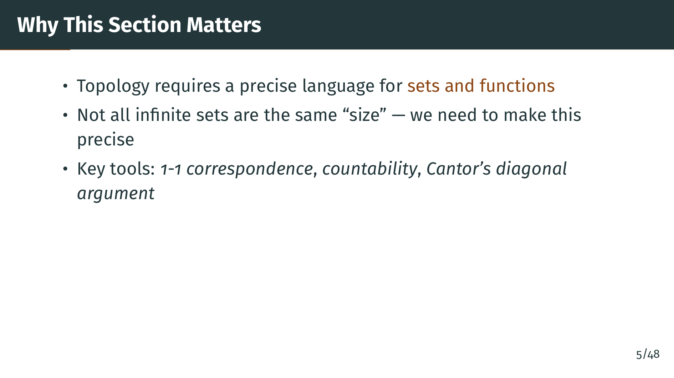
Notes:
The main tools we develop are one-to-one correspondences for comparing set sizes, the notion of countability for classifying infinite sets, and Cantor's diagonal argument, which is one of the most elegant proofs in all of mathematics. Let us begin with the basics.

Slide 6
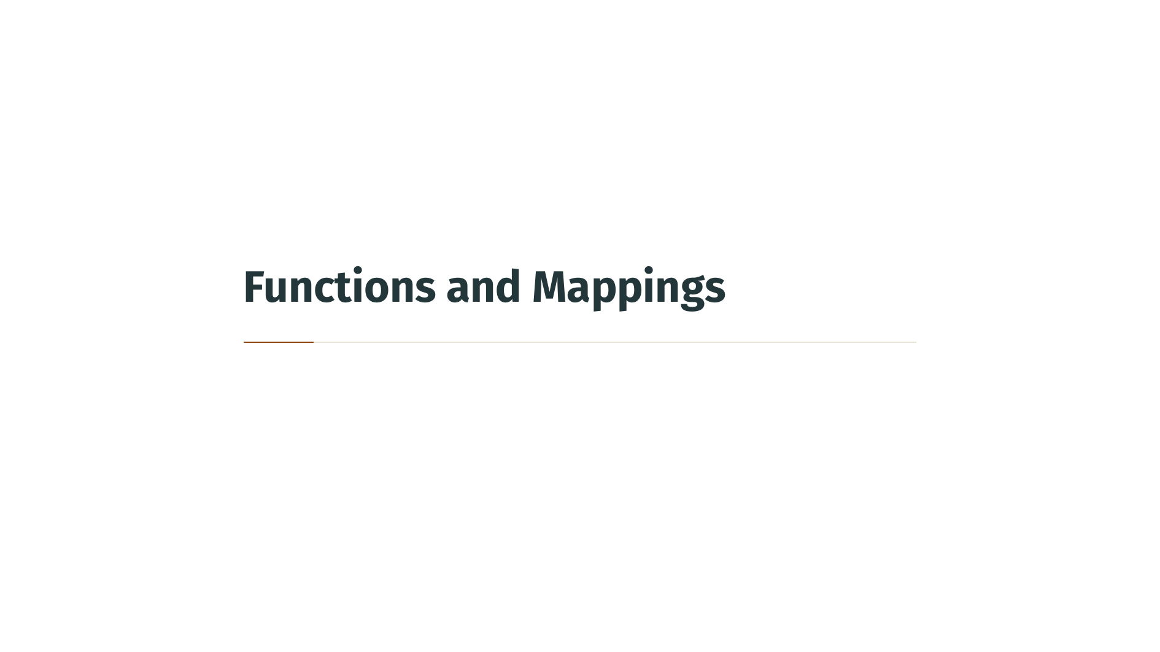

Slide 7
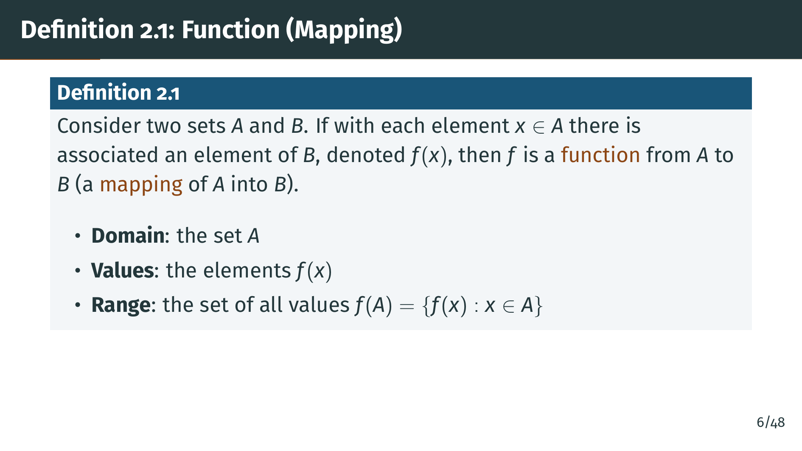
Notes:
We begin with the formal definition of a function. You may already have an intuitive idea of what a function is, but in analysis we need precision: every element of the domain must be assigned exactly one output. No element can be left unassigned, and no element can have two different outputs. Notice that the range, the set of actual outputs, may be smaller than "B" itself. This distinction between the range and the target set "B" will matter shortly. Let us look at a diagram to make this concrete.

Slide 8
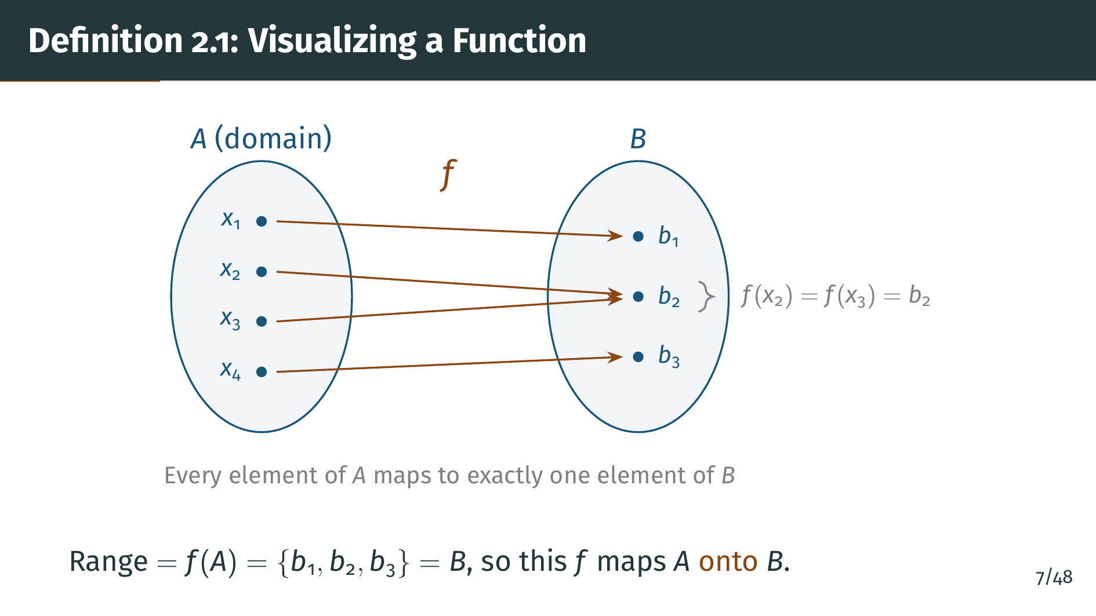
Notes:
Look at the diagram carefully. Notice two things. First, "x" sub 2 and "x" sub 3 both map to "b" sub 2. A function is allowed to send multiple inputs to the same output; that does not violate the definition. Second, every element of "B" is reached by at least one arrow, which is why this particular function maps "A" onto "B". If "b" sub 3 had no arrow pointing to it, the function would still be valid, but it would only map "A" into "B", not onto "B". The distinction between "into" and "onto" will be important when we define equivalence of sets.

Slide 9
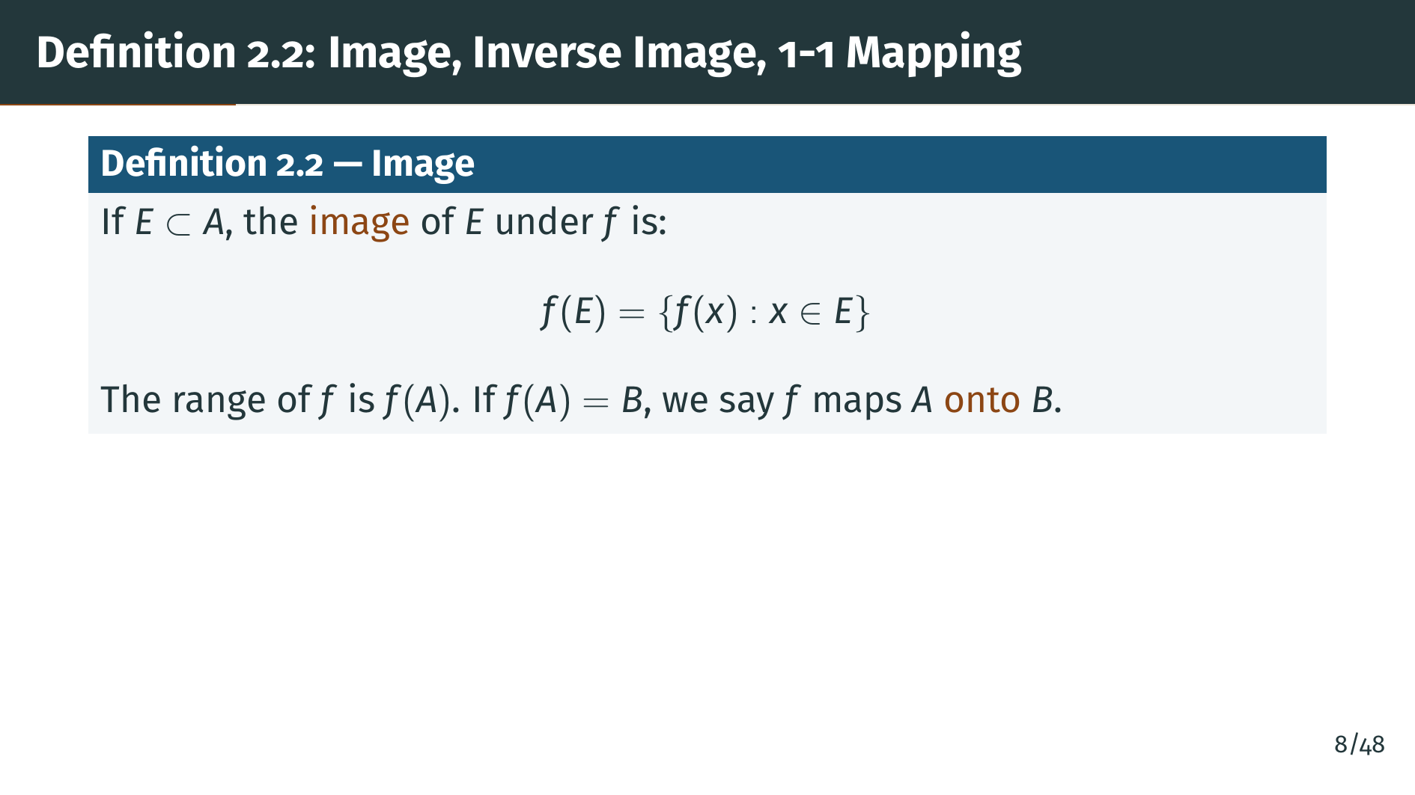
Notes:
Definition 2.2 introduces several related concepts. First, the image of a subset "E" of "A" is the set of all outputs you get by applying "f" to elements of "E". If the image of the entire domain equals "B", we say "f" maps "A" onto "B". Note that "onto" is stronger than "into": every element of "B" must actually be hit by some element of "A".

Slide 10
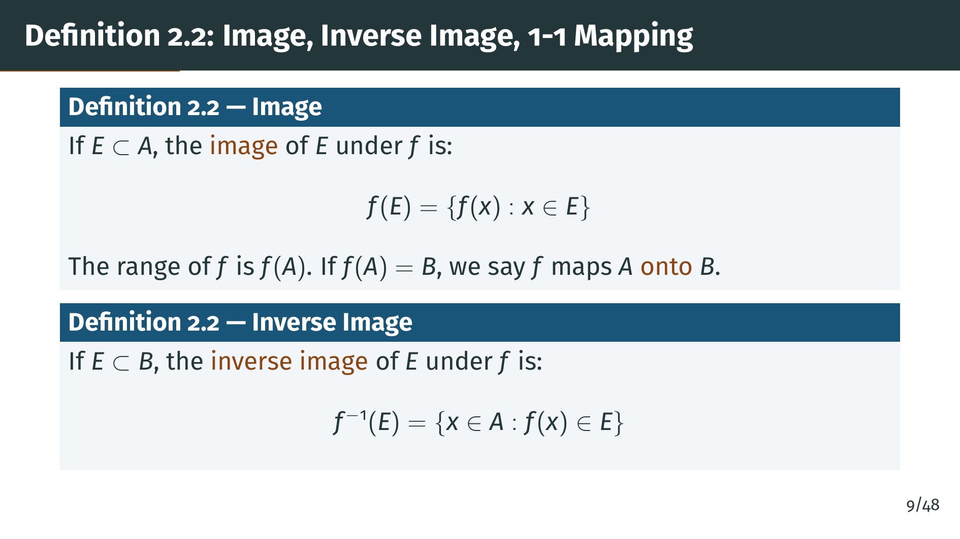
Notes:
Next, the inverse image. Given a subset "E" of "B", the inverse image is the set of all elements in "A" that map into "E". Note that the inverse image is defined even when "f" has no inverse function. It is simply a way of pulling subsets of "B" back to subsets of "A".

Slide 11
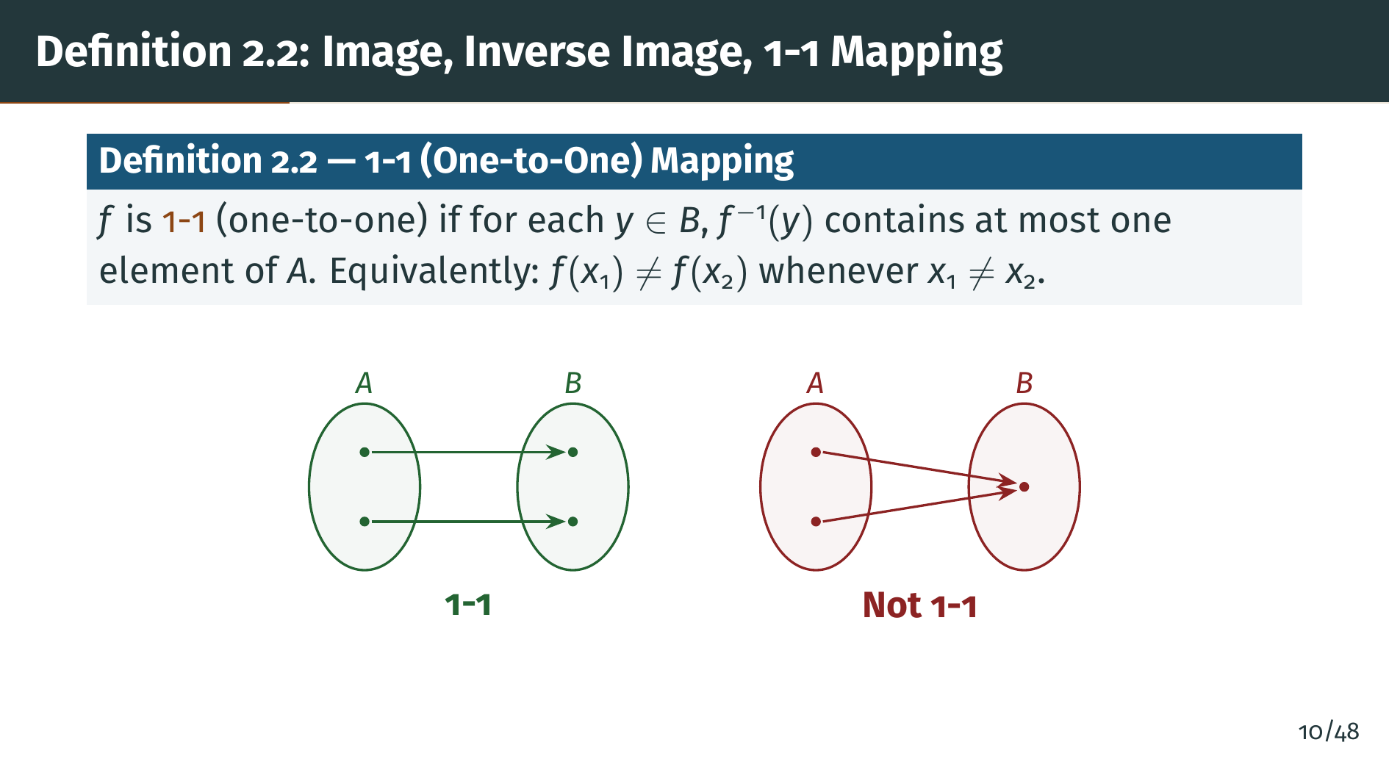
Notes:
Why does the one-to-one property matter so much? Because it is half of what we need to compare the sizes of two sets. If a function is one-to-one, it proves that "A" is no larger than "B", since distinct elements of "A" use up distinct elements of "B". Combined with "onto", which ensures "A" is no smaller than "B", we get a perfect pairing. The diagram on the left shows a one-to-one mapping, while the right side shows a failure: two inputs collide at the same output. Next, we will combine both conditions to define when two sets have the same size.

Slide 12
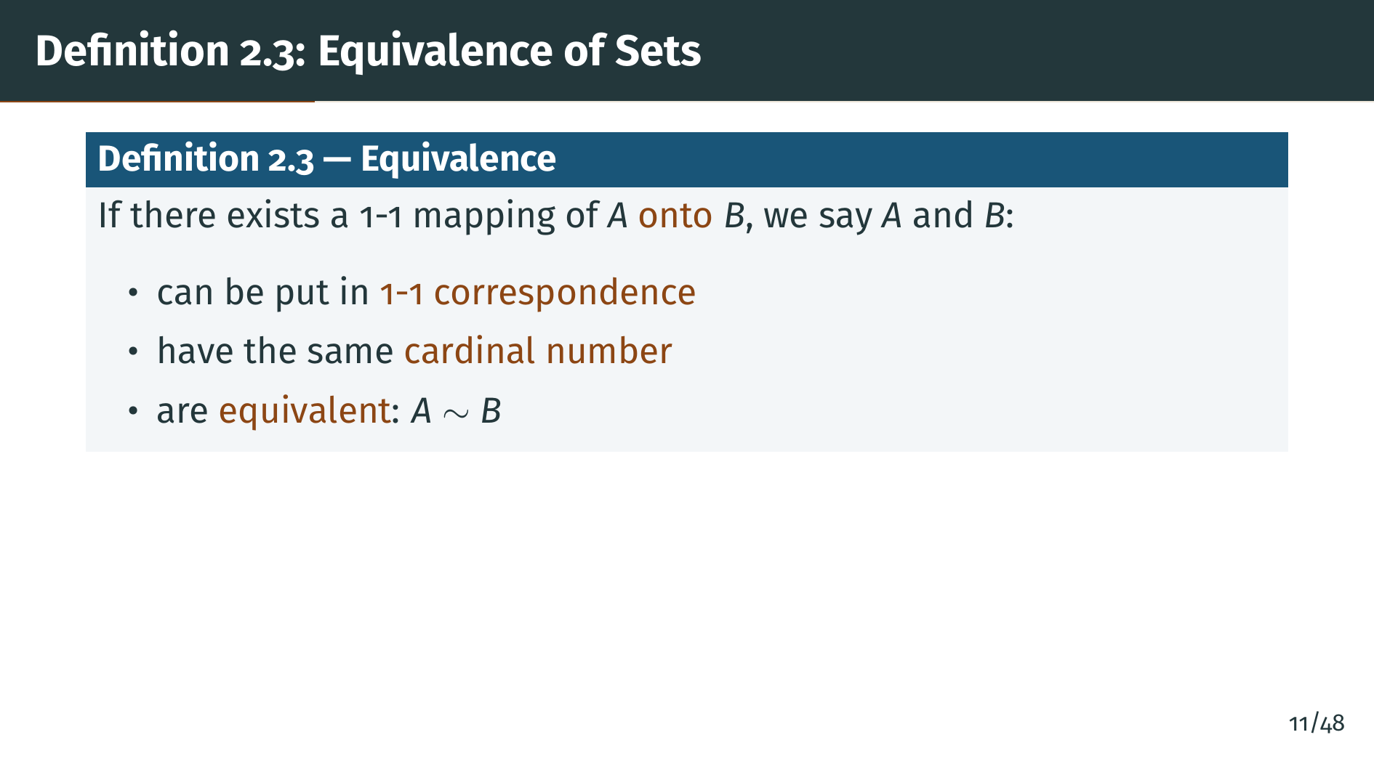
Notes:
This definition is the cornerstone of the entire section. Notice that we need both one-to-one and onto. One-to-one alone would mean "A" is no bigger than "B", and onto alone would mean "A" covers all of "B". Together they give a perfect pairing, what mathematicians call a bijection, and this is our precise way of saying two sets have the same size. The word "cardinal number" is used loosely here; a rigorous treatment of cardinal arithmetic requires more set theory than Rudin develops, but the intuition is clear: equivalent sets are the same size.

Slide 13
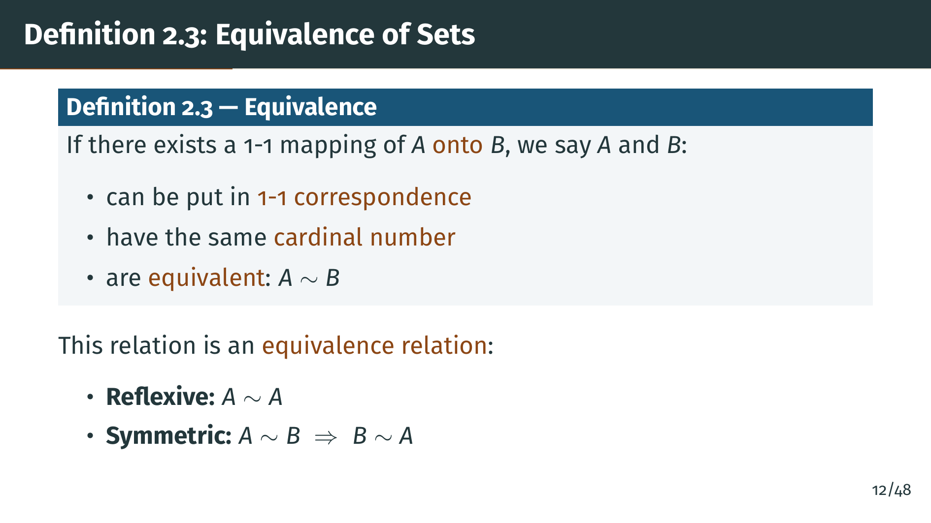
Notes:
The equivalence relation has three properties. First, reflexivity: every set is equivalent to itself via the identity function. Second, symmetry: if "A" is equivalent to "B", then "B" is equivalent to "A", because we can invert a bijection.

Slide 14
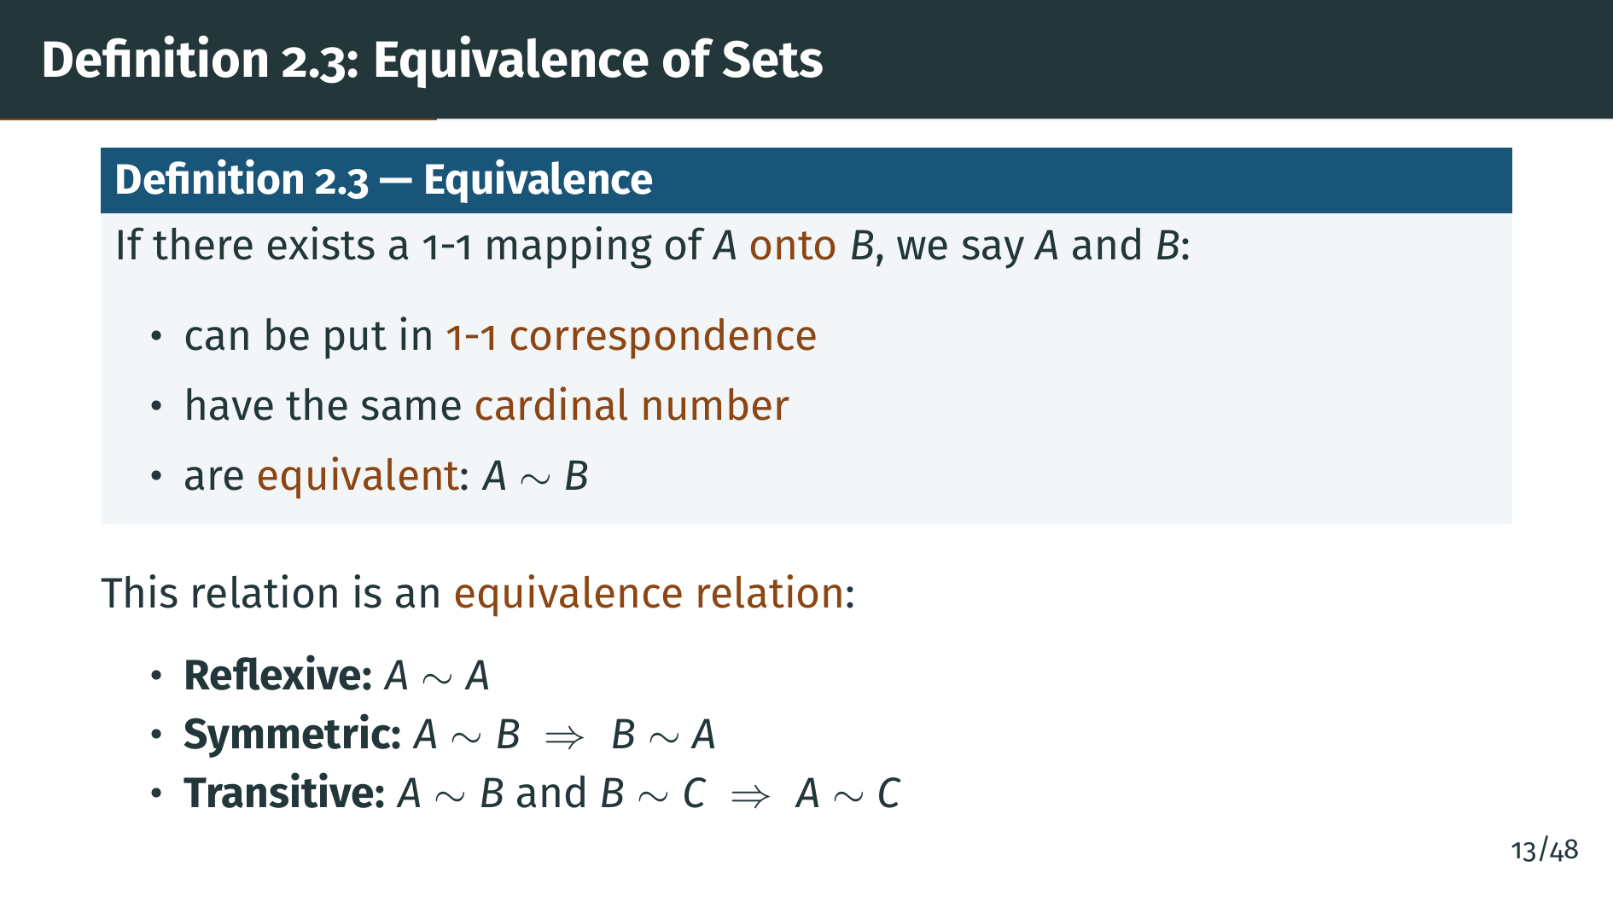
Notes:
And third, transitivity: if "A" is equivalent to "B" and "B" is equivalent to "C", then "A" is equivalent to "C", because we can compose two bijections. Any relation satisfying these three properties is called an equivalence relation. Now let us use this concept to classify sets by their size.

Slide 15


Slide 16
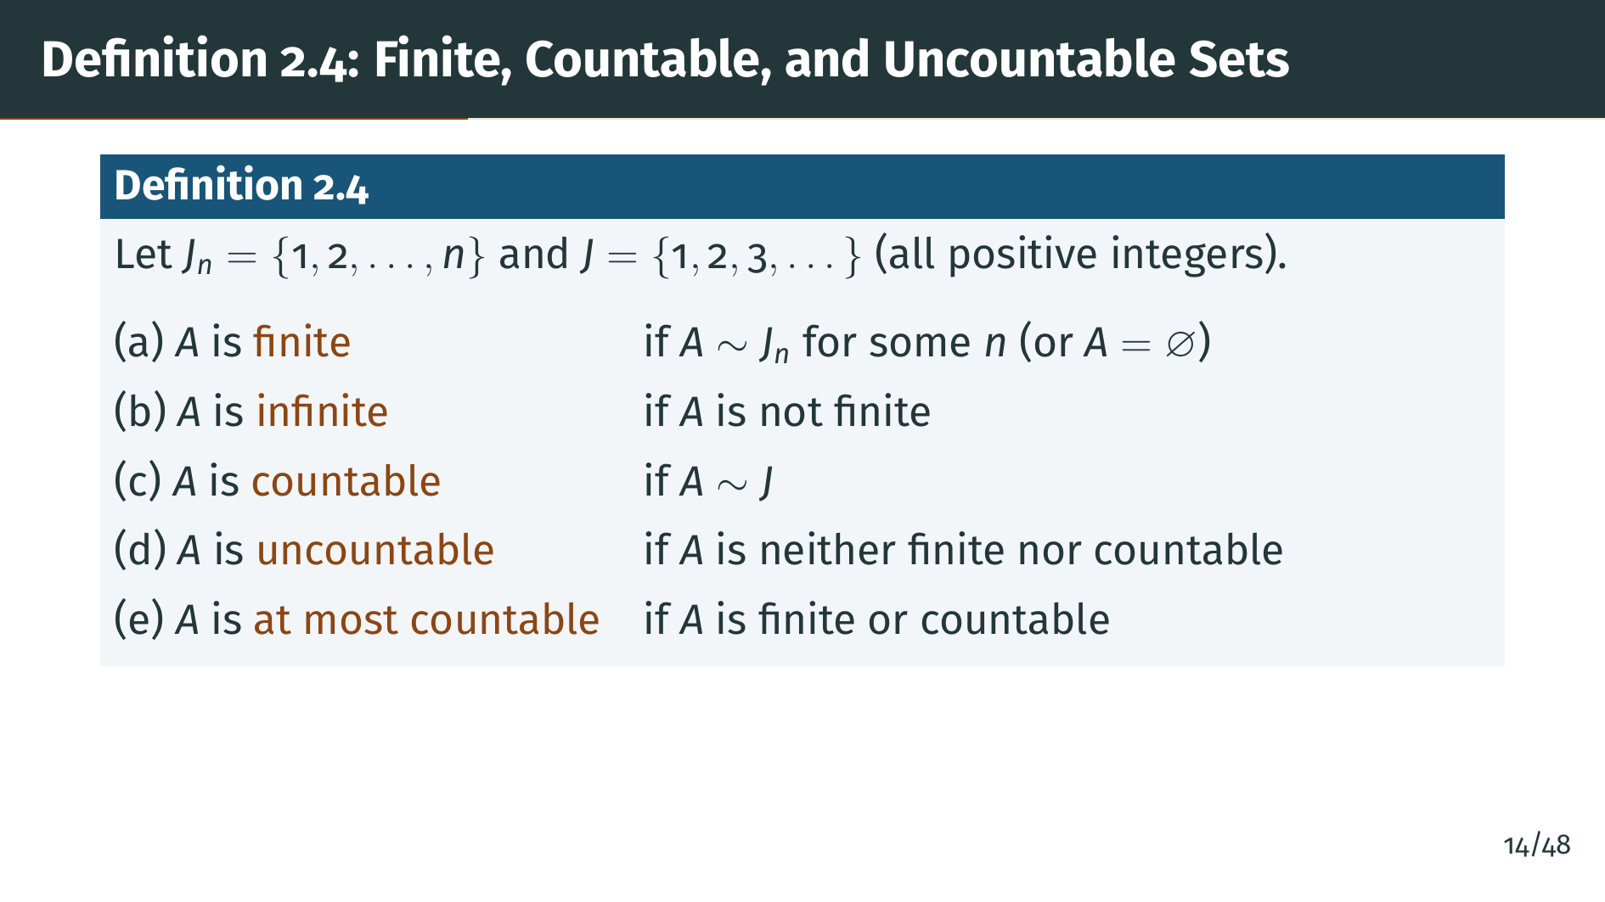
Notes:
Pay attention to Rudin's terminology, because it differs from some other authors. For Rudin, "countable" means specifically equivalent to the full set of positive integers, that is, countably infinite. Some textbooks use "countable" to include finite sets as well. Rudin uses the phrase "at most countable" for that broader meaning. This distinction will matter in the theorems that follow. The key conceptual point is that we now have a hierarchy of sizes: finite sets are the smallest, then countable sets form the next level, and uncountable sets are strictly larger. Whether there are sizes between countable and uncountable is a deep question related to the continuum hypothesis.

Slide 17
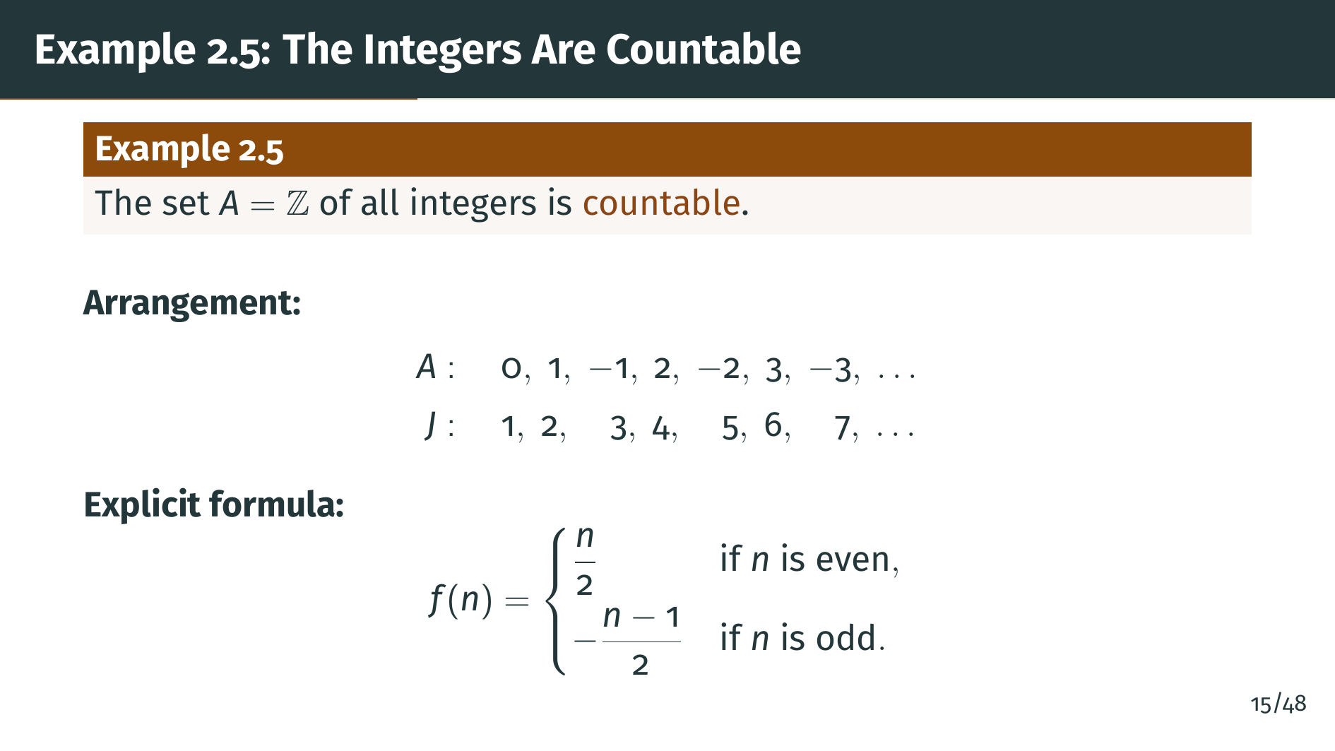
Notes:
Here is our first surprising example. The integers include both positive and negative numbers, so intuitively there are "twice as many" integers as positive integers. But they are equivalent! We can list them as 0, 1, negative 1, 2, negative 2, 3, negative 3, and so on. The explicit formula shows exactly how to pair each positive integer "n" with an integer. Even numbers map to positive integers and odd numbers map to negative integers and zero. This is a perfect one-to-one correspondence.

Slide 18
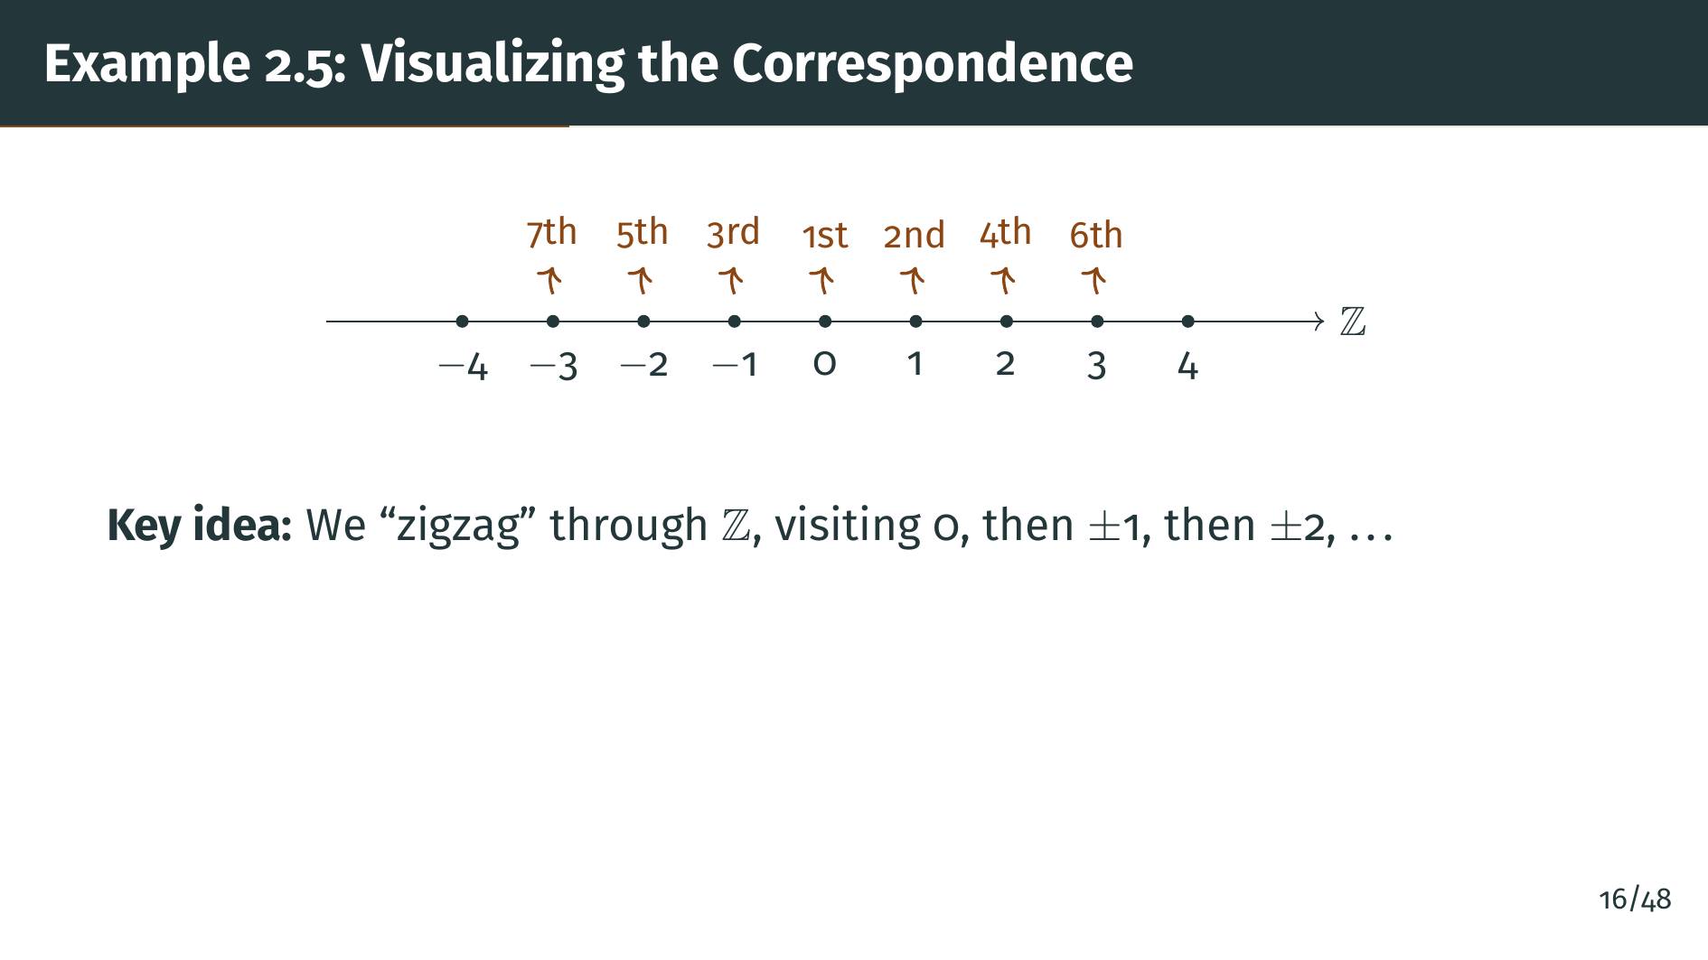
Notes:
The zigzag trick shown here illustrates a general principle: to prove a set is countable, you just need to find any systematic way to list all its elements as a sequence. The listing does not need to follow the natural order of the elements. Here, instead of trying to start from negative infinity, which is impossible, we start at zero and alternate between positive and negative integers. This idea of clever enumeration will appear again in the proofs of Theorems 2.12 and 2.13, where we use diagonal enumeration for more complex situations.

Slide 19
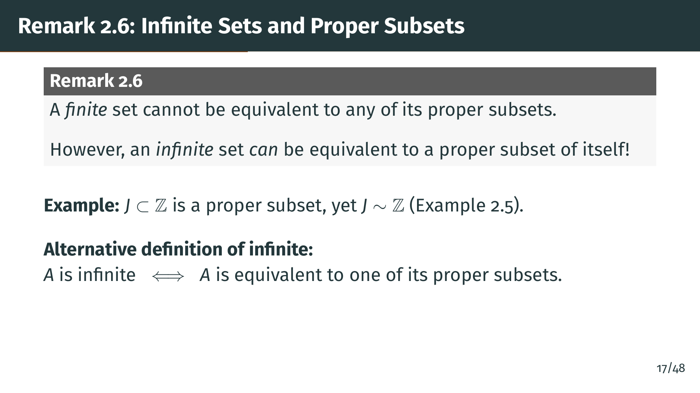
Notes:
This remark highlights a key difference between finite and infinite sets. If you remove an element from a finite set, you always get a strictly smaller set. But for infinite sets, this is not true! Example 2.5 showed that the positive integers are equivalent to all integers, even though the positive integers are a proper subset. In fact, this property can serve as an alternative definition of infinity: a set is infinite if and only if it can be put in one-to-one correspondence with a proper subset of itself. This is sometimes called Dedekind's definition of infinite sets.

Slide 20
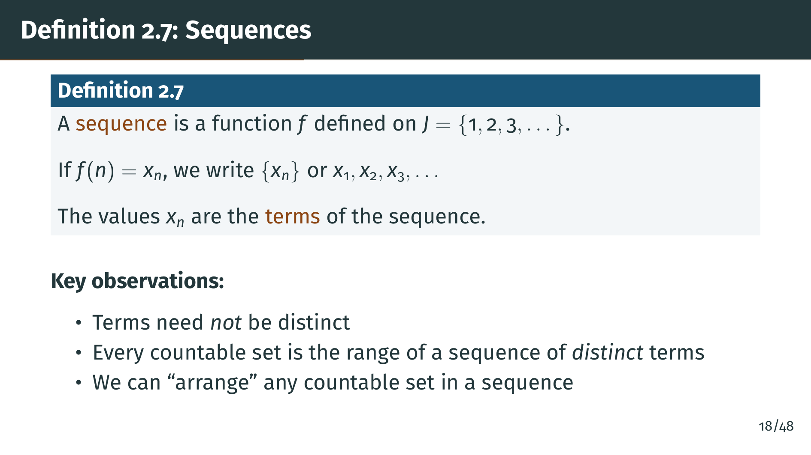
Notes:
The formal definition of a sequence as a function on the positive integers may seem overly pedantic, but it is important. It lets us apply function concepts like range and one-to-one to sequences. The crucial observation is the link between sequences and countability: saying a set is countable is the same as saying its elements can be arranged as a sequence of distinct terms. This is why "countable" is sometimes called "enumerable." Conversely, a sequence whose terms are not all distinct has a range that is at most countable, not necessarily countable. We will rely on this connection in the very next theorem.

Slide 21
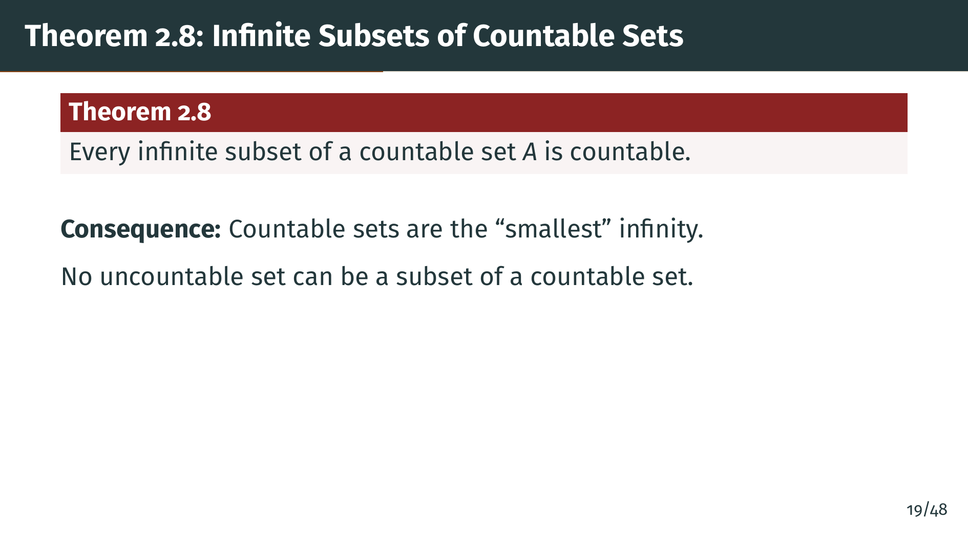
Notes:
This theorem establishes that countable infinity is the smallest type of infinity. You might wonder: could there be an infinite set that is too small to be countable? This theorem says no. Every infinite subset of a countable set is itself countable. So there is nothing between finite and countable. This fact will be used as a workhorse throughout the section: whenever we need to show a set is countable, it often suffices to embed it into a known countable set and verify it is infinite. Let us see the proof.

Slide 22
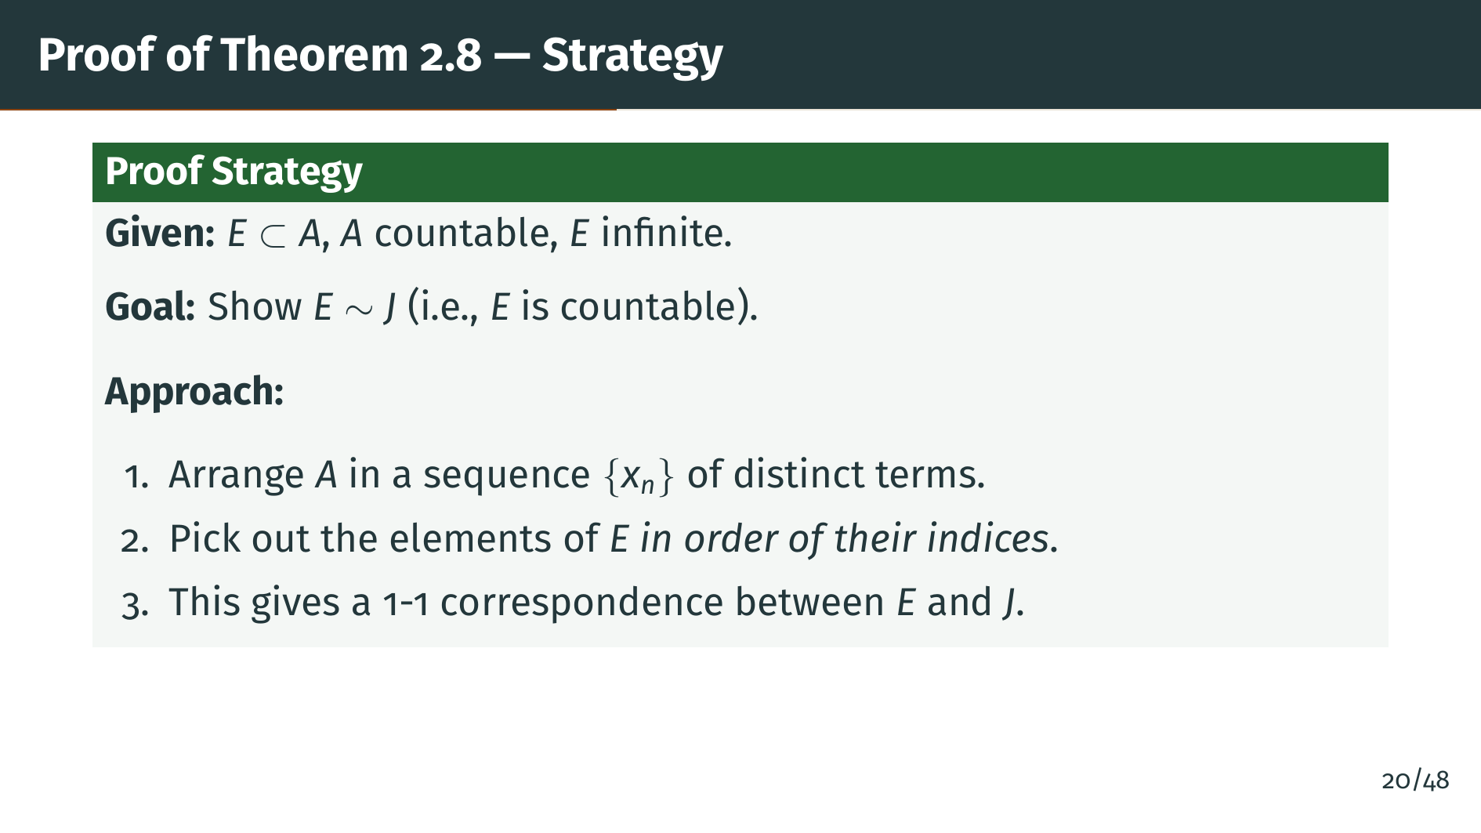
Notes:
The idea behind the proof is to inherit the ordering from "A". Since "A" is countable, it already comes with a sequence ordering. We simply filter this sequence, keeping only elements of "E". The key subtlety is why this produces a bijection with the positive integers: the one-to-one property follows because we pick each element at most once, and the onto property follows because "E" is infinite, so the filtering process never terminates. If "E" were finite, we would run out of elements and only get a bijection with some finite set.

Slide 23
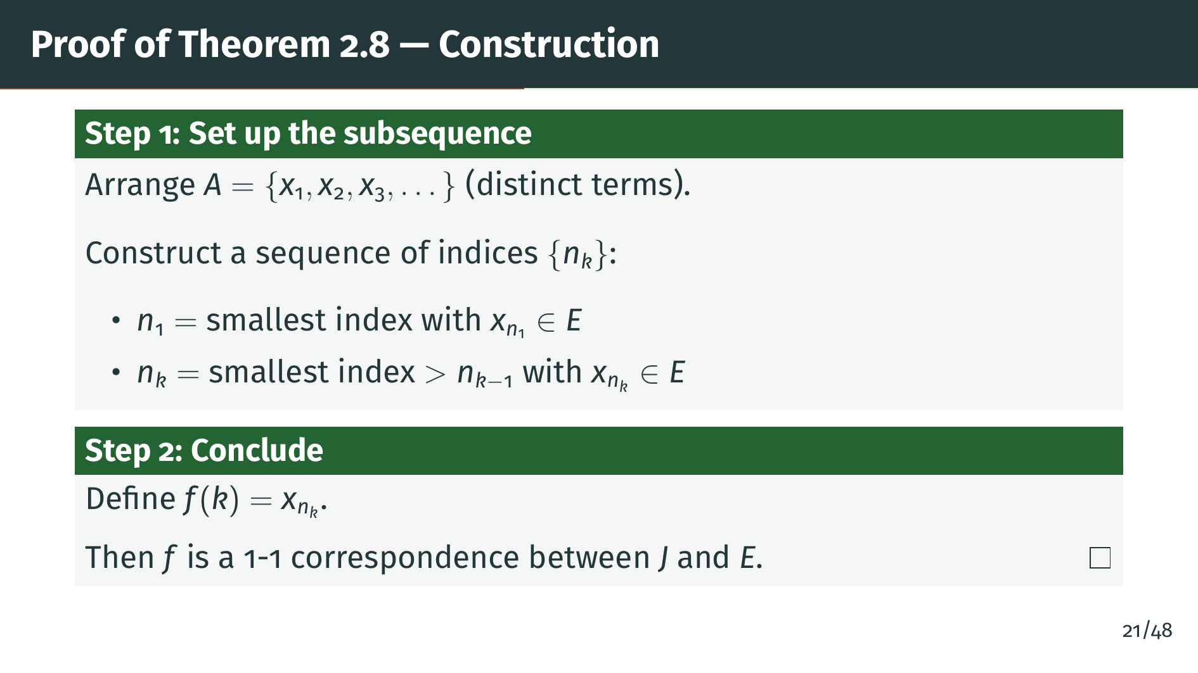
Notes:
Here is the construction. We start with "A" listed as a sequence. To find the first element of "E", we scan through the sequence and take the first element that belongs to "E". Call its index "n" sub 1. For the second element, we continue scanning past index "n" sub 1 and take the next element in "E", and so on. Since "E" is infinite, this process never terminates. The function "f" of "k" equals "x" sub "n" sub "k" gives us a one-to-one correspondence between the positive integers and "E". The proof is complete.

Slide 24


Slide 25
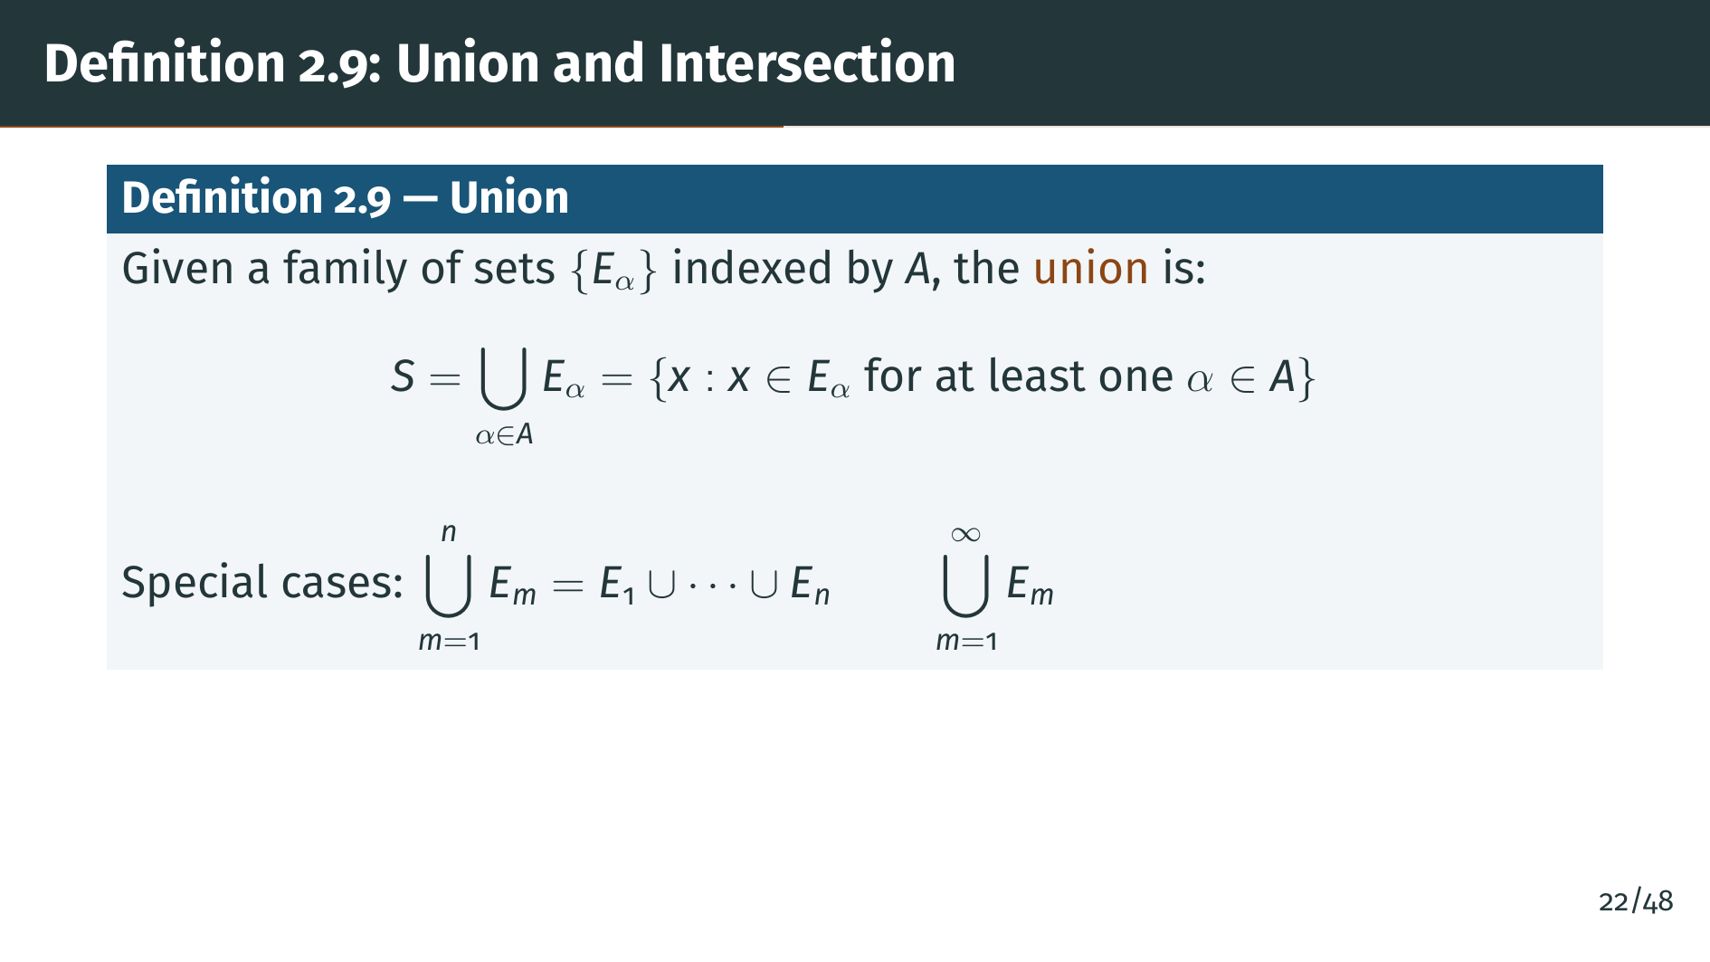
Notes:
Why does Rudin define unions and intersections so generally, using an arbitrary index set "A"? Because in topology and analysis, we frequently need unions over uncountable families, not just finite or countable ones. For example, when we later define open sets, we will need to take unions of uncountably many neighborhoods. The general notation with a subscript "alpha" in "A" handles all cases uniformly. The special cases shown at the bottom are just convenient shorthand for finite and countable unions.

Slide 26
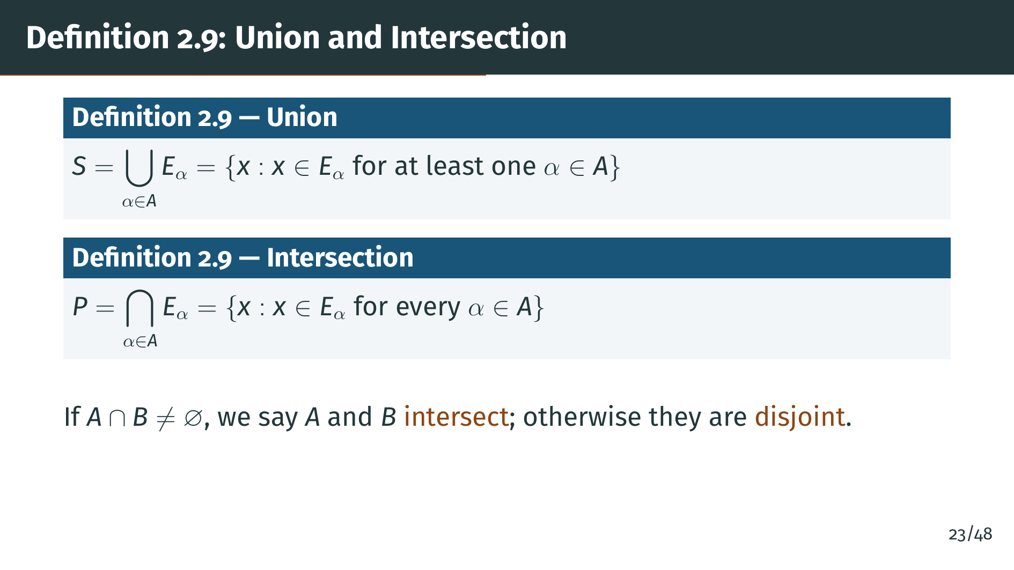
Notes:
Notice the contrast: for the union, an element needs to be in just one of the sets, while for the intersection, it must be in every single one. As we will see in Example 2.10, this makes intersections of infinite families much more restrictive and sometimes empty even when every individual set is nonempty. The terminology "disjoint" for non-intersecting sets will appear constantly in topology, particularly when we discuss separation properties and partitions. Let us look at some concrete examples.

Slide 27
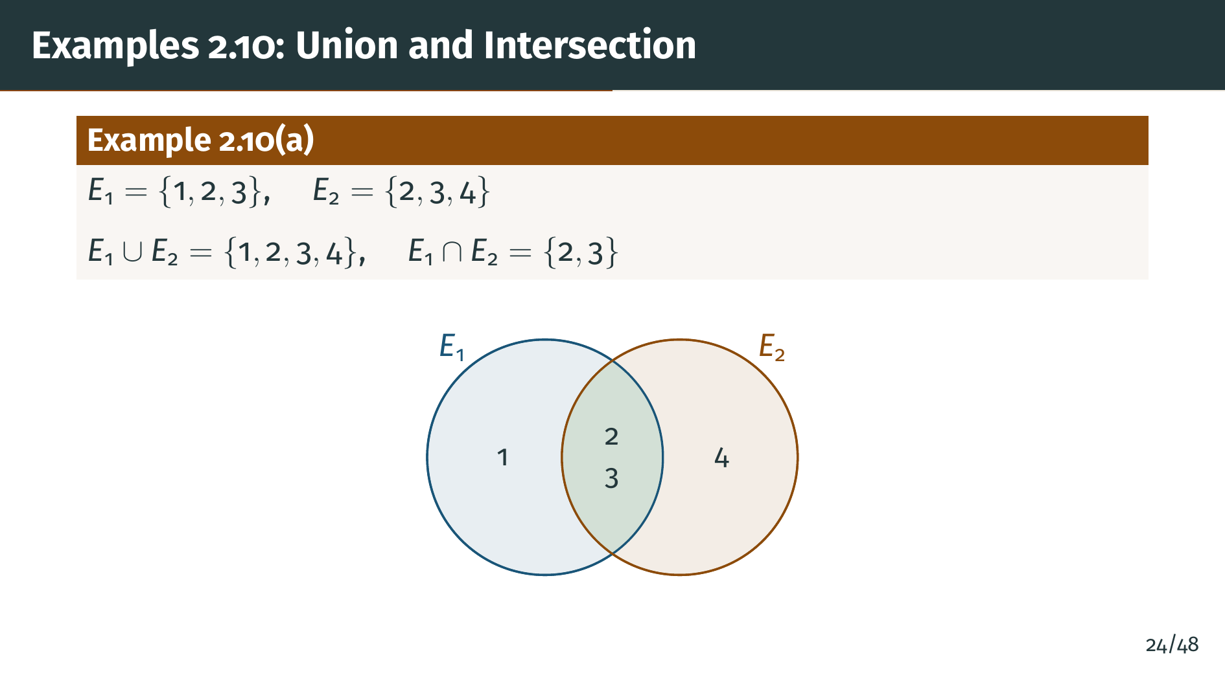
Notes:
This is a straightforward example with finite sets, where union and intersection behave exactly as you would expect. The green overlap in the Venn diagram is the intersection. Notice that the union has 4 elements, not 6: we do not count 2 and 3 twice. In general, for finite sets, the size of "A" union "B" equals the size of "A" plus the size of "B" minus the size of "A" intersect "B". This inclusion- exclusion principle generalizes to more than two sets. The next example is more subtle, involving an uncountable family of sets.

Slide 28
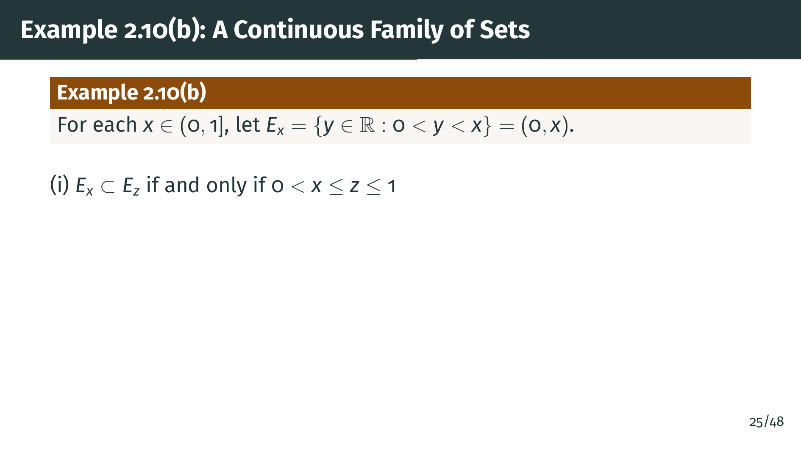
Notes:
Part "b" is more interesting. Here we have a continuous family of sets indexed by the interval from 0 to 1. Each set "E" sub "x" is the open interval from 0 to "x". The containment relation is natural: a smaller "x" gives a smaller interval.

Slide 29
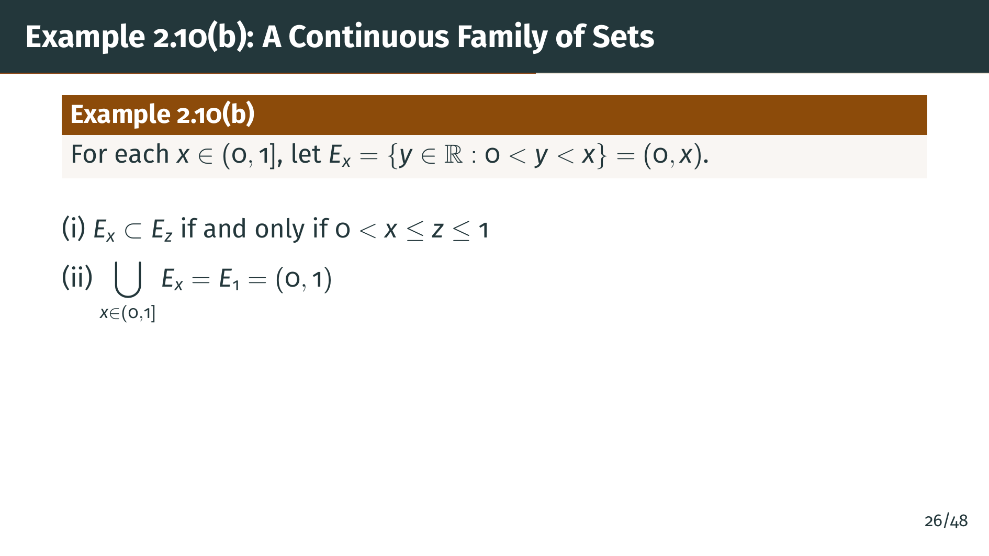
Notes:
The union of all these intervals is the largest one, which is the open interval from 0 to 1. This makes sense because "E" sub 1 contains all the others, so their union is just "E" sub 1 itself.

Slide 30
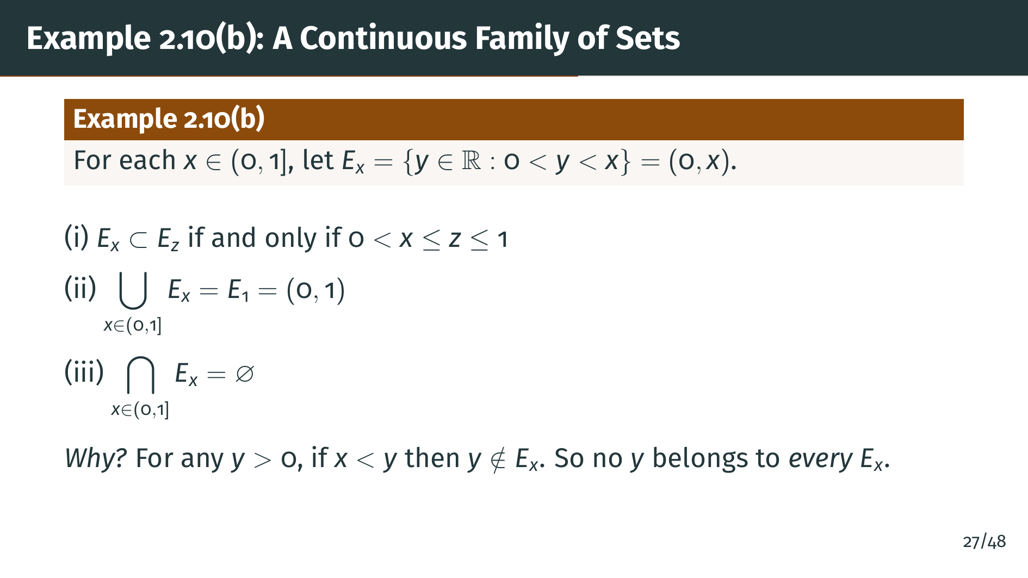
Notes:
The intersection is empty! This is the surprising part. For any positive number "y", no matter how small, we can find an "x" less than "y", and then "y" does not belong to "E" sub "x". So no single "y" is in all the sets simultaneously. This shows that intersections of infinitely many sets can behave very differently from finite intersections.

Slide 31
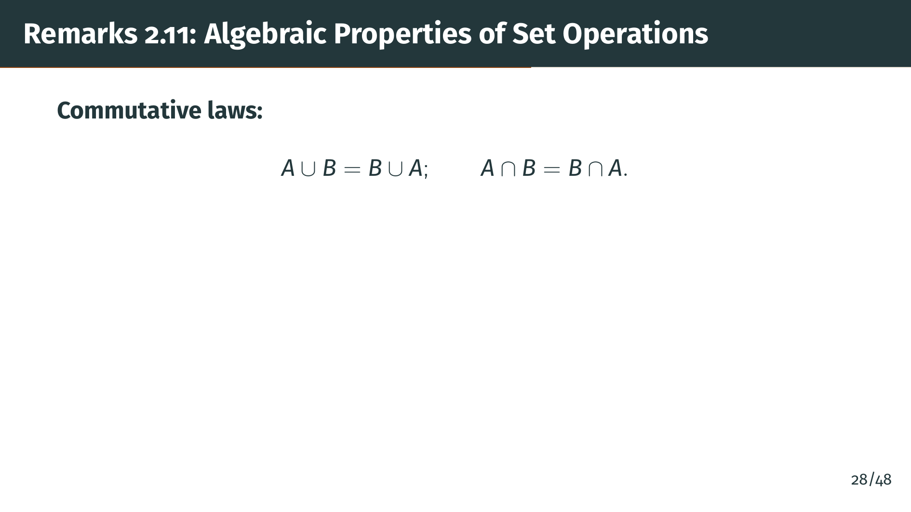
Notes:
Rudin lists several algebraic properties of unions and intersections that are analogous to properties of addition and multiplication. First, the commutative laws: the order does not matter for either union or intersection.

Slide 32
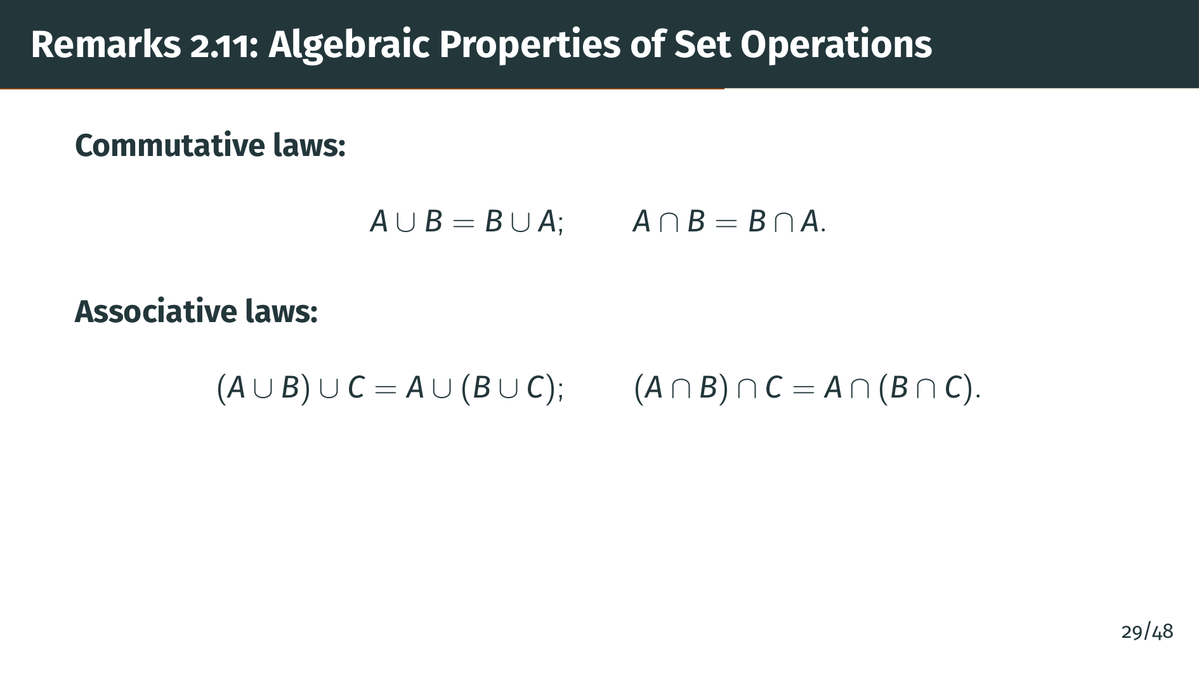
Notes:
The associative laws say that grouping does not matter. We can write "A" union "B" union "C" without ambiguity. The same holds for intersection.

Slide 33
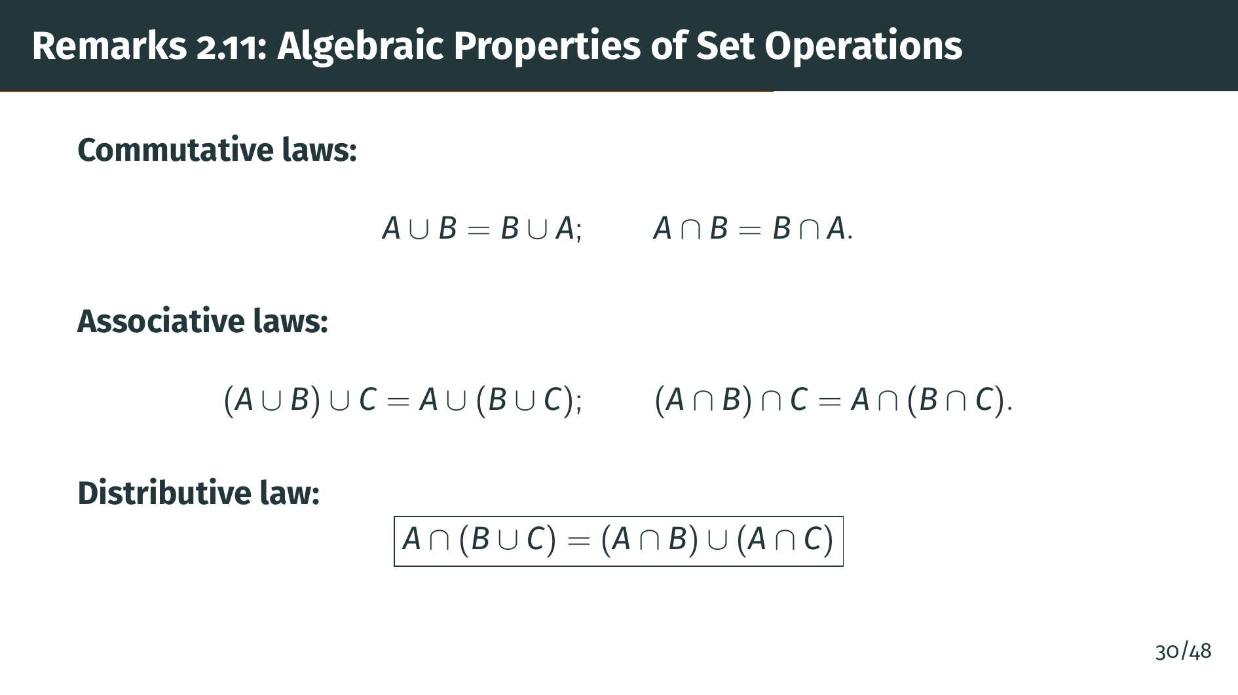
Notes:
The distributive law is the most important one. Intersection distributes over union, just as multiplication distributes over addition. The proof is a straightforward element-chasing argument: you show that every element of the left side belongs to the right side, and vice versa.

Slide 34
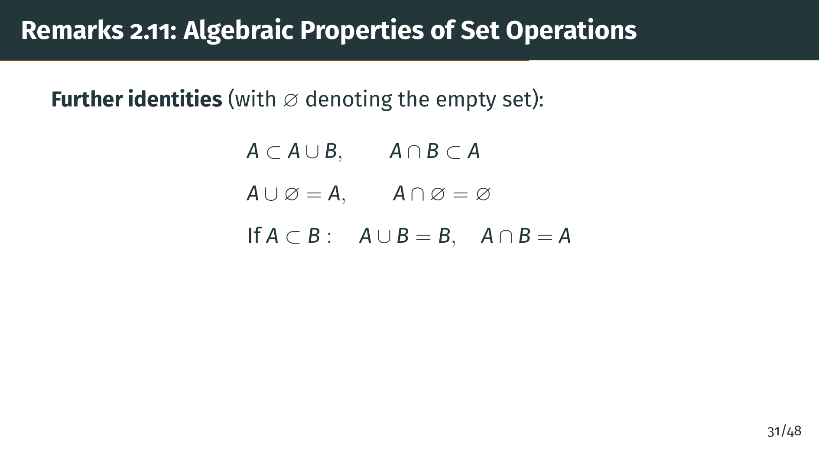
Notes:
Rudin also lists several additional identities. "A" is always a subset of "A" union "B", and "A" intersect "B" is always a subset of "A". The empty set acts as an identity for union and as an annihilator for intersection. And if "A" is a subset of "B", then their union is just "B" and their intersection is just "A". These properties are easy to verify directly from the definitions. Now let us move to the main countability results of this section.

Slide 35


Slide 36
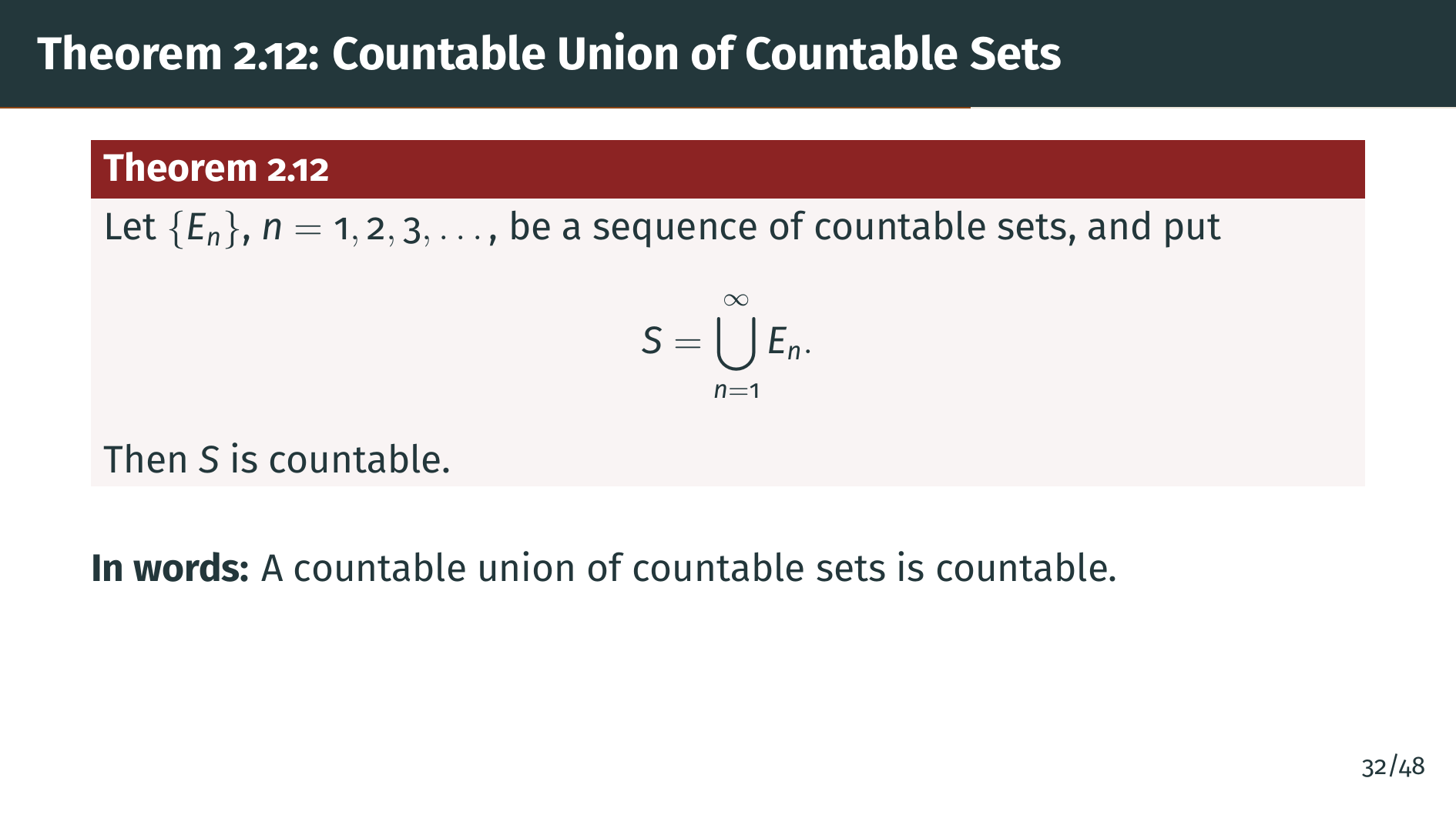
Notes:
This is one of the most powerful results in this section. It says that if you take countably many sets, each of which is countable, and form their union, the result is still countable. You might think that combining countably many infinite sets would produce something uncountable, but it does not. The proof uses a beautiful diagonal arrangement.

Slide 37
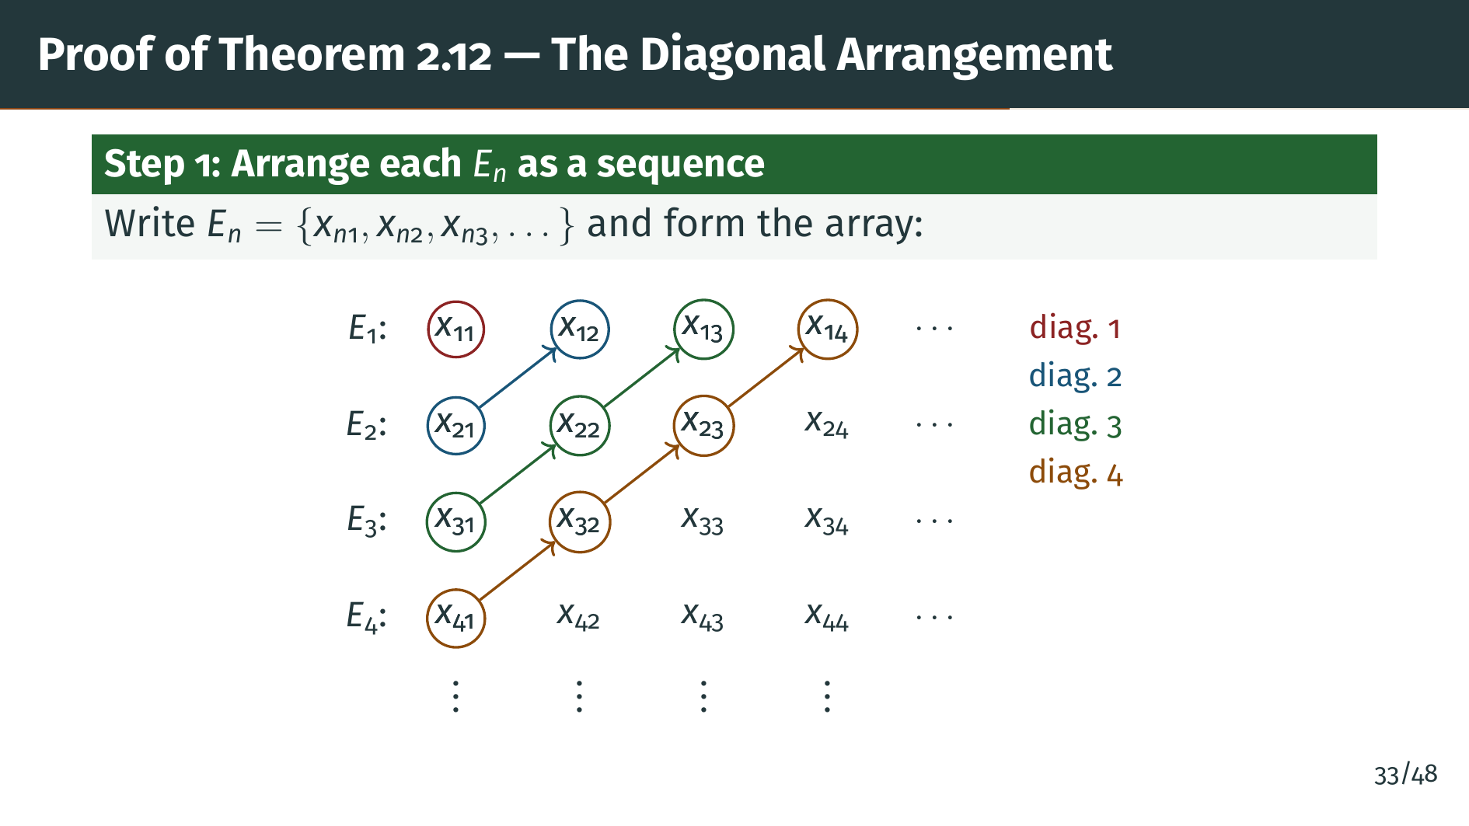
Notes:
The trick here is to flatten a two-dimensional array into a single sequence. We cannot go row by row, because we would spend all of eternity on just the first row and never reach the second. Instead, we traverse along finite diagonals: the "k"-th diagonal contains all entries where the row number plus the column number equals "k" plus 1. Each diagonal is finite, so we finish it and move on. This guarantees that every entry in the array is eventually reached. The color-coded circles on the slide show the first four diagonals. This diagonal enumeration idea is one of the most useful techniques in set theory.

Slide 38
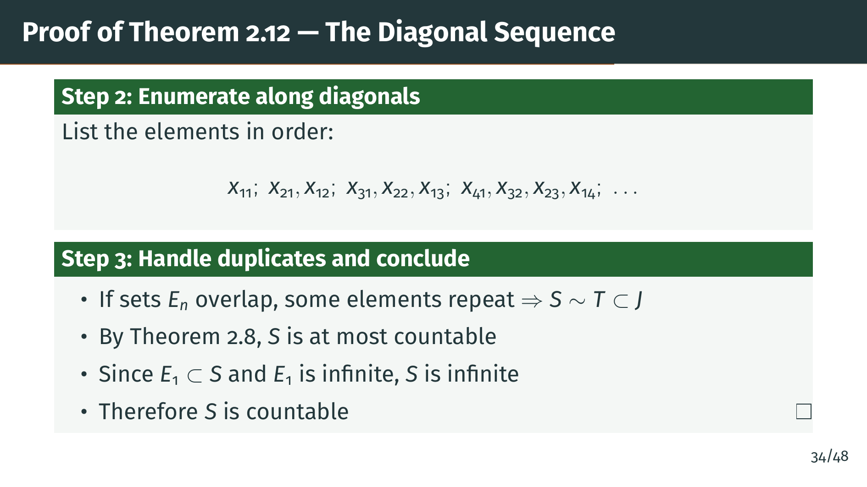
Notes:
There is a subtle point about duplicates. The diagonal listing may contain the same element more than once if the sets "E" sub "n" overlap. But that does not cause a problem: we simply remove repeated entries. Formally, this means "S" is equivalent to some subset "T" of the positive integers. By Theorem 2.8, "S" is at most countable. The final step is clever: we use the assumption that each "E" sub "n" is infinite, not just nonempty, so "S" contains the infinite set "E" sub 1. This forces "S" to be infinite, and an infinite set that is at most countable must be countable.

Slide 39
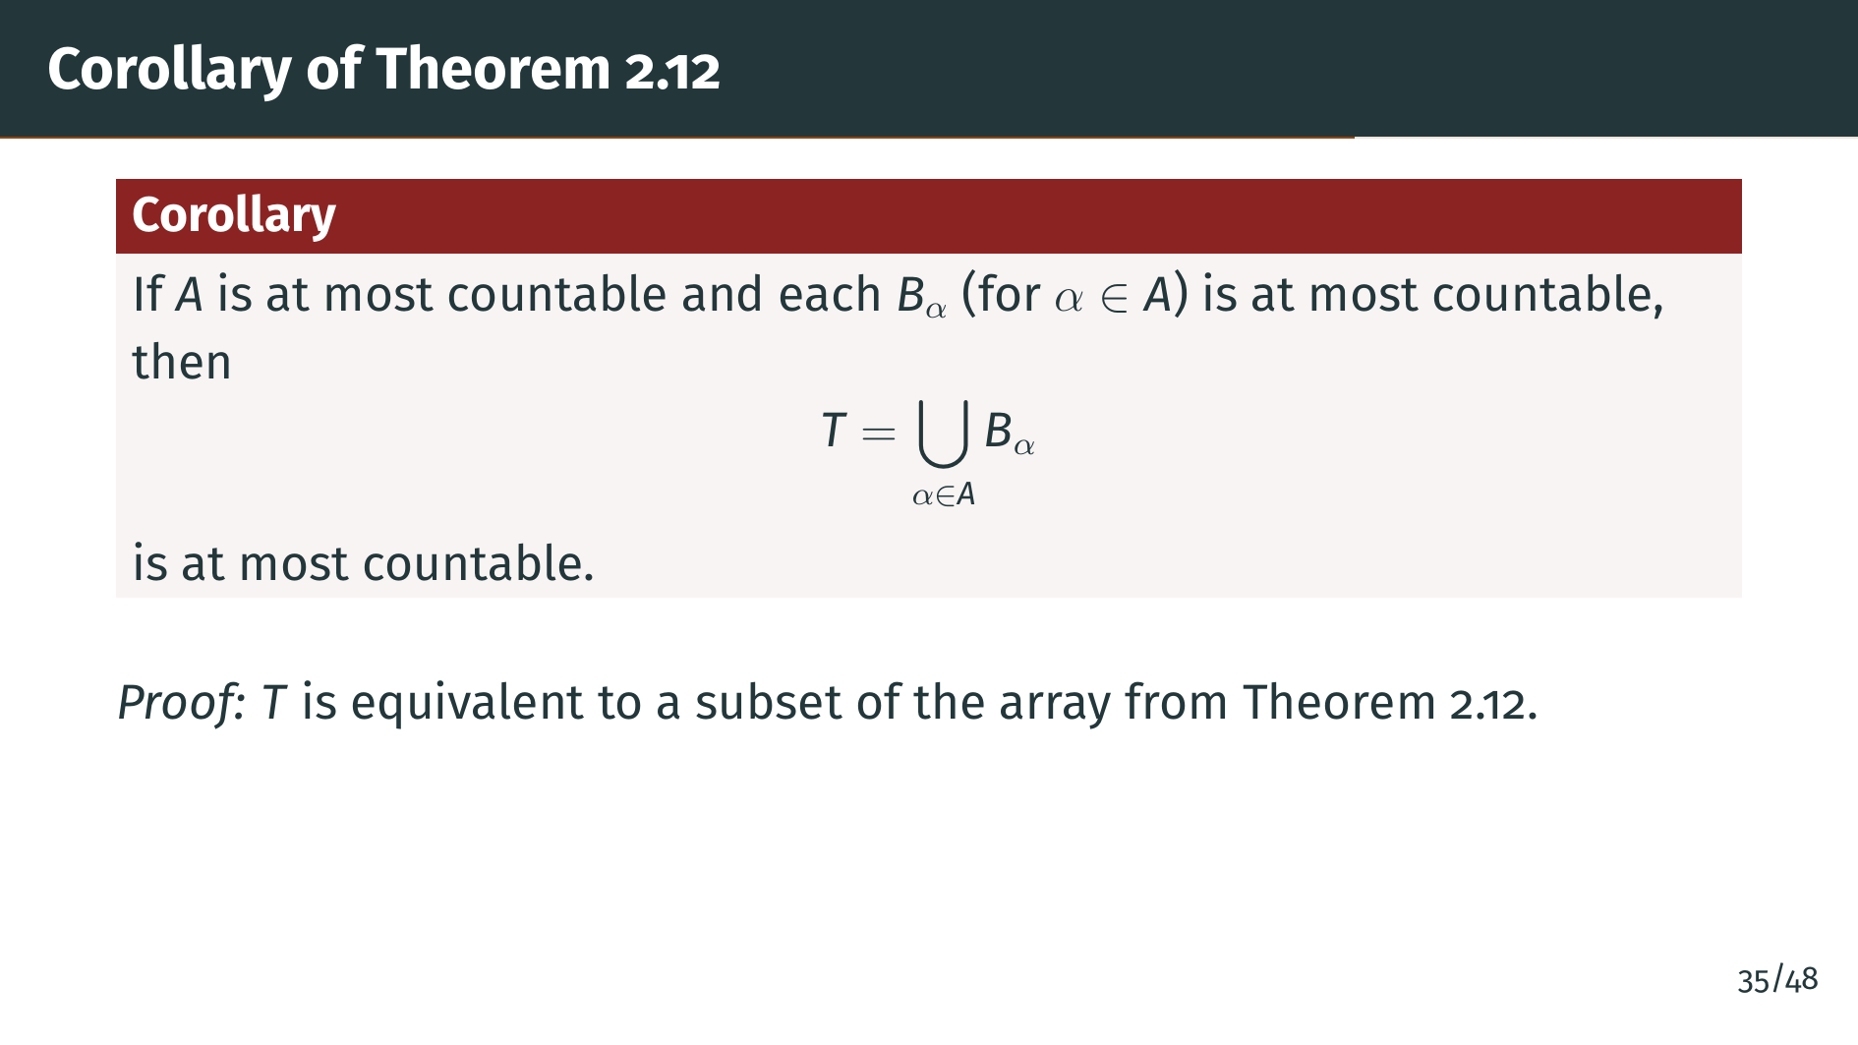
Notes:
This corollary relaxes the hypotheses: the index set and the individual sets only need to be at most countable, not necessarily countable. The conclusion weakens accordingly to "at most countable." This version is often more convenient in practice because we do not need to check whether the sets are finite or countable. Notice that the conclusion cannot be strengthened to "countable," because a finite union of finite sets is finite. Now let us see a powerful application of Theorem 2.12.

Slide 40
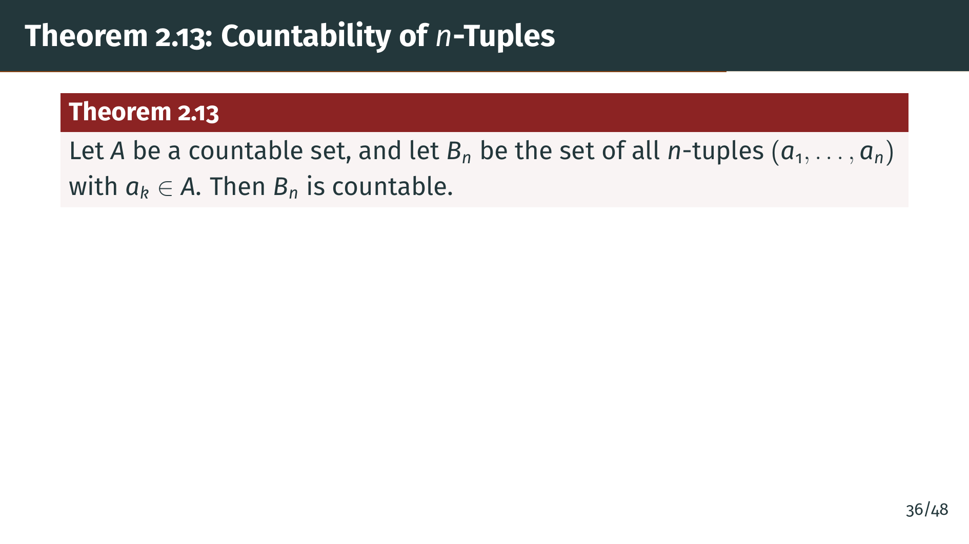
Notes:
This theorem is surprisingly powerful. It says that forming all ordered tuples of any fixed length from a countable set does not increase the size beyond countable. Think about what this means for pairs: the set of all pairs of integers is countable, even though it seems to be a "two-dimensional infinity." The key constraint is that "n" must be fixed. If we allowed tuples of all lengths simultaneously, we would get the set of all finite sequences, which is still countable, but infinite sequences form an uncountable set, as we will soon see.

Slide 41
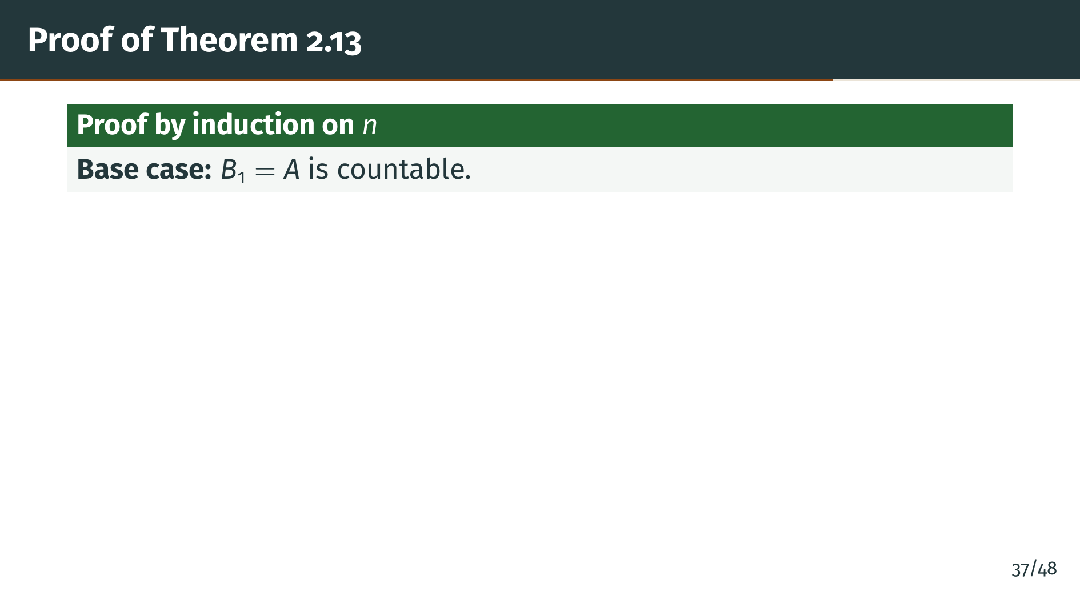
Notes:
The proof uses induction on the tuple length "n". The base case is immediate: 1-tuples are just individual elements, so "B" sub 1 is simply "A" itself. The real work happens in the inductive step, where we reduce "n"-tuples to "n" minus 1 tuples plus one extra element.

Slide 42
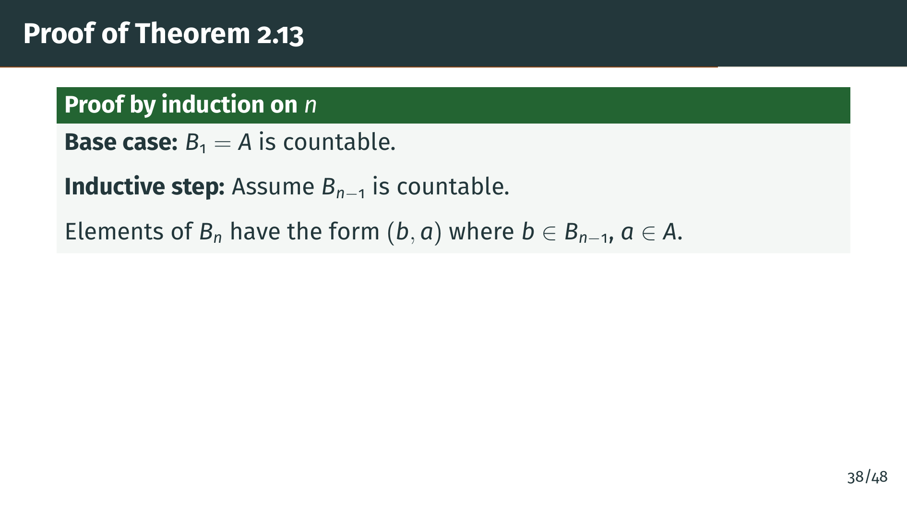
Notes:
Here is the clever decomposition. An "n"-tuple is just an "n" minus 1 tuple with one more element appended. So we can think of "B" sub "n" as a collection of pairs, where the first component comes from "B" sub "n" minus 1 and the second comes from "A". This reduces the problem to understanding the set of all such pairs.

Slide 43
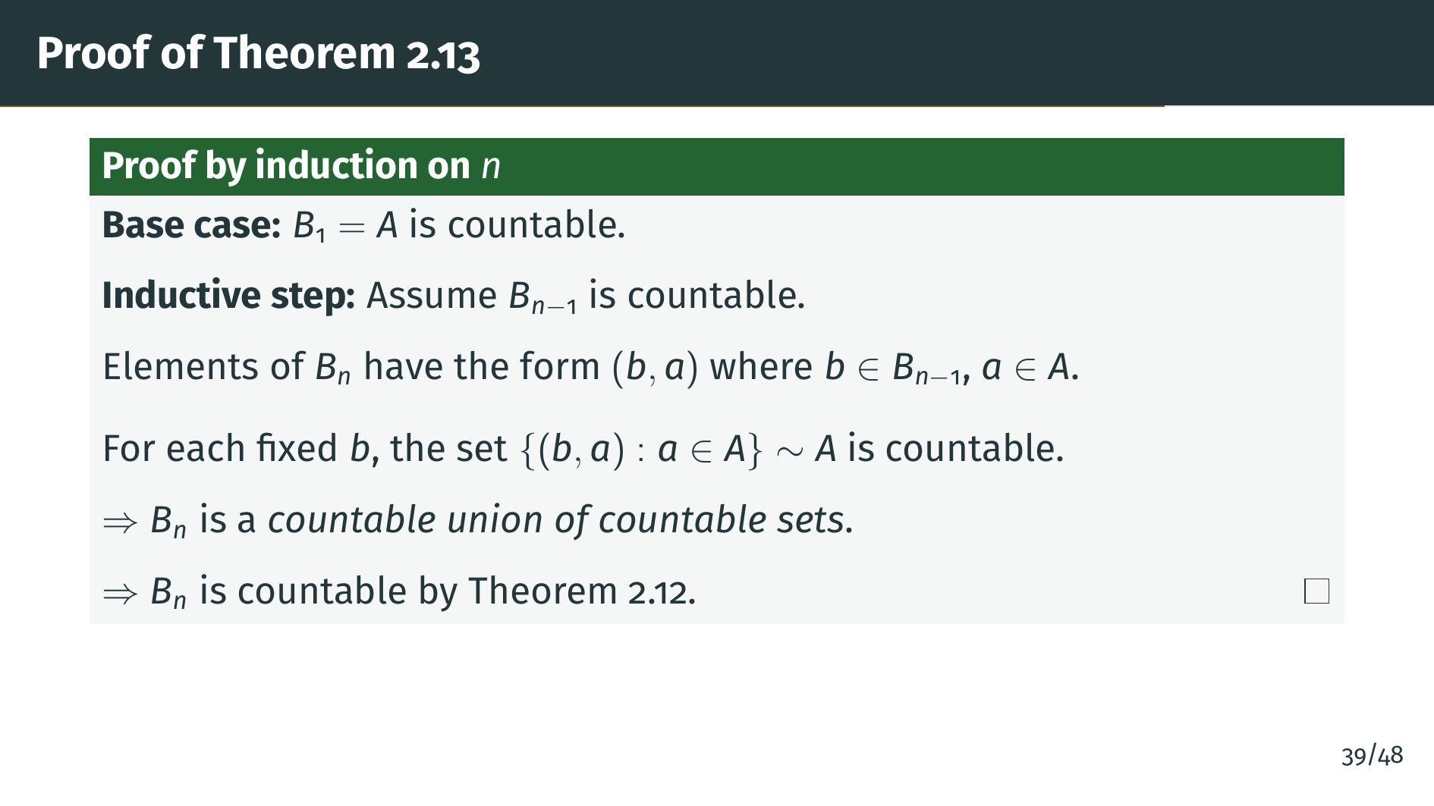
Notes:
Now we see why Theorem 2.12 is so useful. For each fixed "b", varying "a" over "A" gives a countable set. And we are taking the union over all "b" in "B" sub "n" minus 1, which is countable by the inductive hypothesis. So "B" sub "n" is a countable union of countable sets. Theorem 2.12 immediately tells us it is countable. Notice how the induction and Theorem 2.12 work hand in hand: each step peels off one component of the tuple.

Slide 44
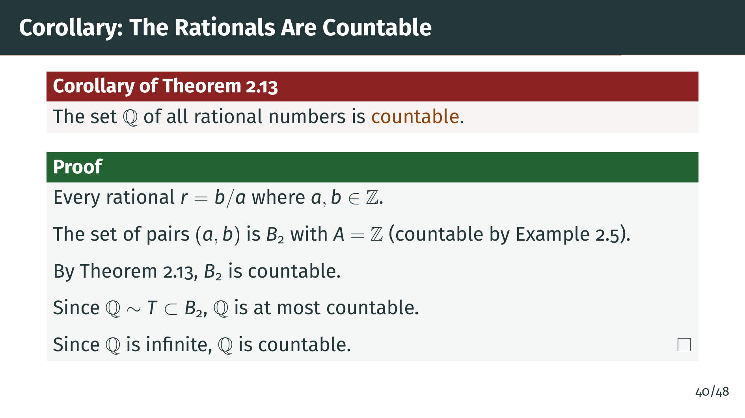
Notes:
Here is a beautiful application. Every rational number can be written as "b" over "a" where "a" and "b" are integers. So the rationals correspond to a subset of all pairs of integers. By Example 2.5, the integers are countable, so by Theorem 2.13, the set of all pairs is countable. The rationals form a subset, so by Theorem 2.8, they are at most countable. Since they are clearly infinite, they are countable. Rudin also notes that even the algebraic numbers are countable. But as we are about to see, not all infinite sets are countable.

Slide 45
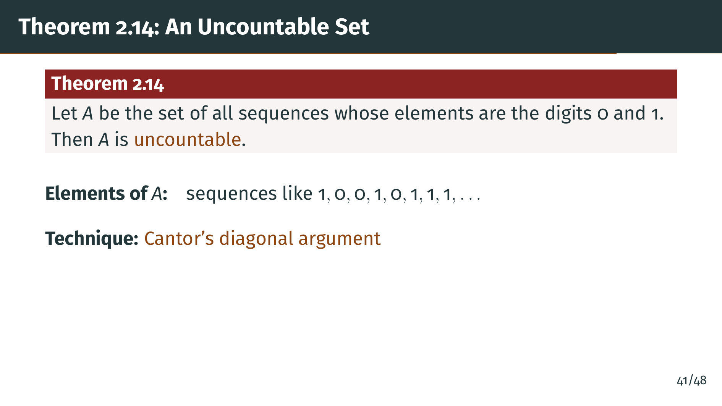
Notes:
This is perhaps the most famous theorem in set theory. The set of all infinite binary sequences is uncountable. This is proved using Cantor's diagonal argument, one of the most celebrated proofs in mathematics. The idea is beautifully simple, yet its consequences are profound. It shows that some infinities are strictly larger than others.

Slide 46
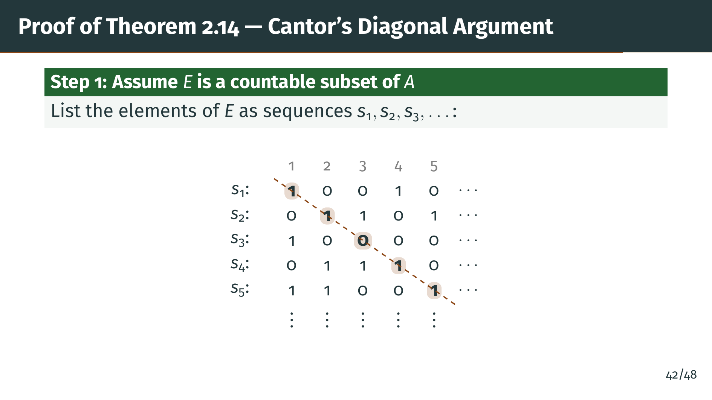
Notes:
The proof uses a clever indirect approach. Rather than trying to show directly that no bijection exists, we prove something stronger: every countable subset of "A" misses at least one element. To set this up, we take any countable subset "E" and arrange its elements in a grid. The highlighted diagonal entries are the key to the construction: by looking at the "n"-th digit of the "n"-th sequence, we will build a sequence that cannot appear anywhere in the list.

Slide 47
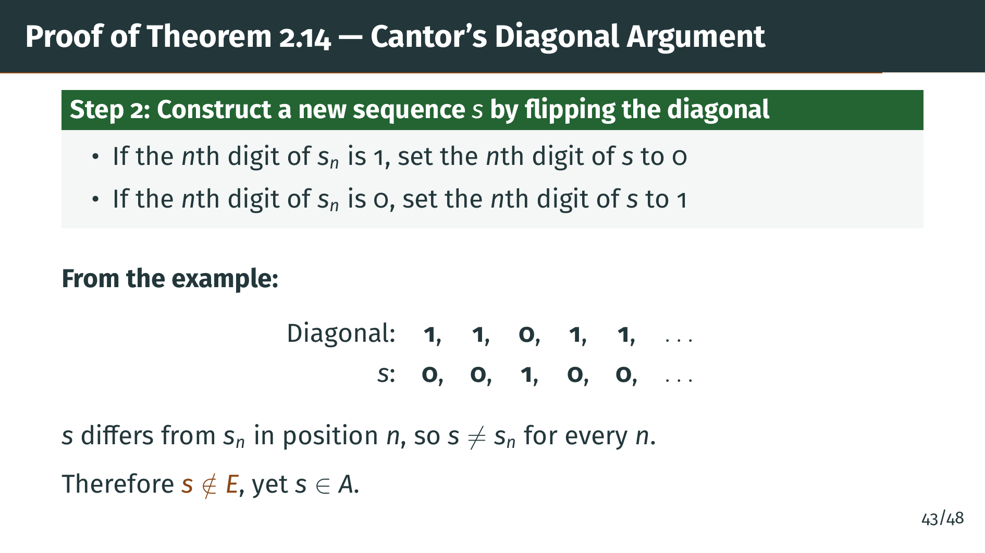
Notes:
This is the heart of the argument, and it is worth understanding deeply. We only need to change one digit to make "s" different from a given sequence, but we need "s" to differ from every sequence in the list simultaneously. The diagonal ensures this: by flipping the "n"-th digit of "s" sub "n", we guarantee disagreement with "s" sub "n" at position "n", regardless of what happens at other positions. No matter how long the list is, "s" escapes it. This is why the argument is called the diagonal process: the construction literally follows the diagonal of the grid. The key insight is that the diagonal touches every row exactly once.

Slide 48
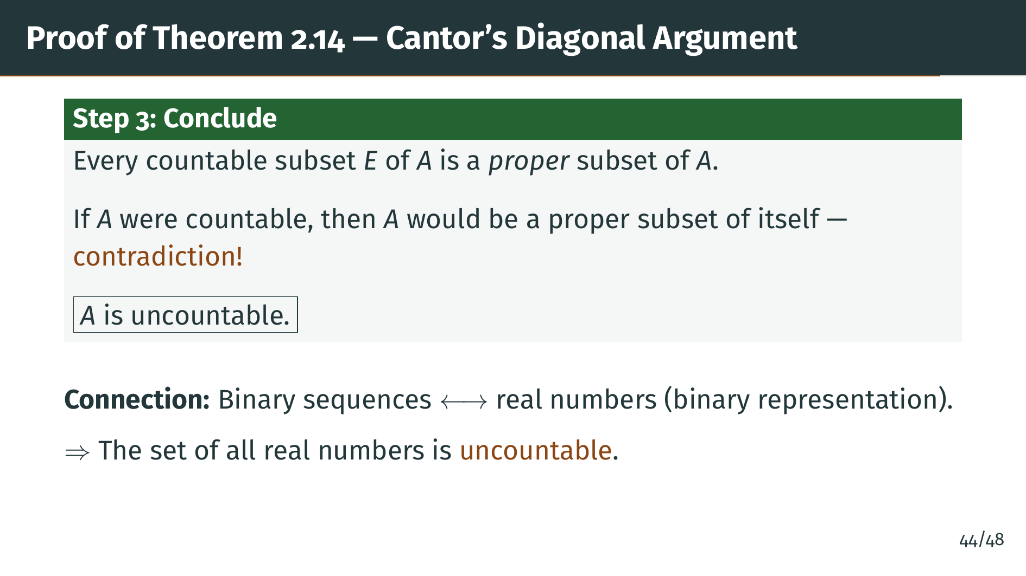
Notes:
We have shown that any countable subset of "A" must miss at least one element. If "A" itself were countable, it would be a proper subset of itself, which is absurd. Therefore "A" is uncountable. This argument is called Cantor's diagonal process because the construction follows the diagonal of the array. As Rudin notes, if you are familiar with binary representations of real numbers, this immediately implies that the real numbers are uncountable. We will give a second proof of this fact later, in Theorem 2.43.

Slide 49


Slide 50
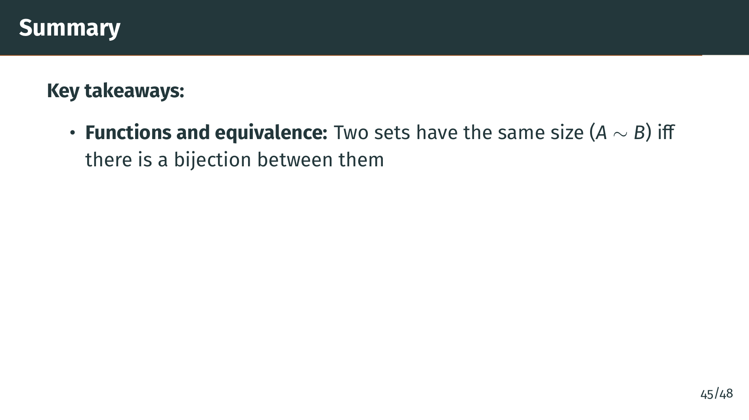
Notes:
Let us review the main ideas from this section. The fundamental concept is that of equivalence: two sets are the same size if and only if there is a one-to-one correspondence between them.

Slide 51
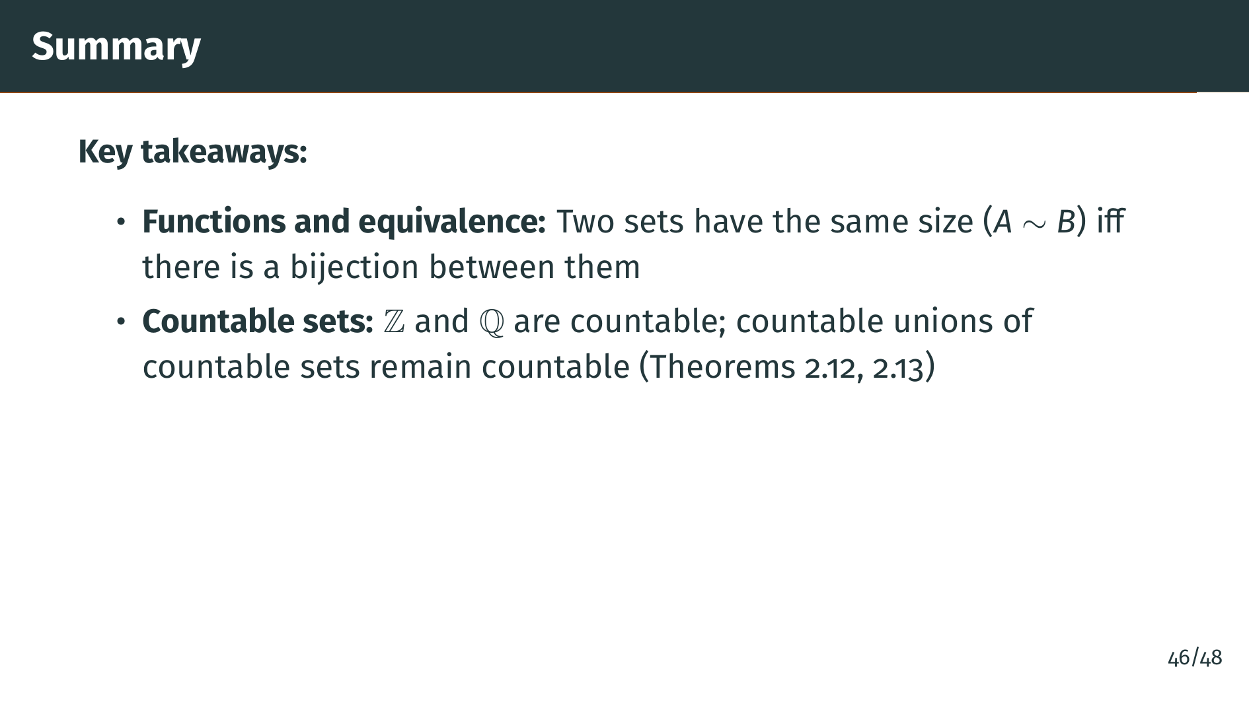
Notes:
The integers and rationals are both countable, which may be surprising given how much "denser" the rationals are on the number line. The key tools were the diagonal enumeration of Theorem 2.12 and the inductive argument of Theorem 2.13. These will be used repeatedly in later chapters.

Slide 52
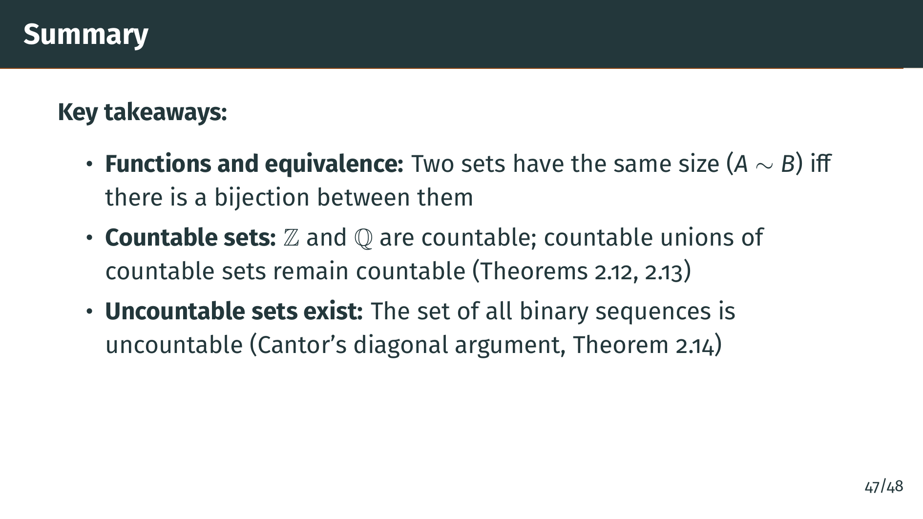
Notes:
But not all infinite sets are countable. Cantor's diagonal argument reveals that the set of binary sequences, and therefore the real numbers, is strictly larger than countable. This is a profound result: it means there are fundamentally different sizes of infinity, and the reals represent a bigger infinity than the integers or rationals.

Slide 53
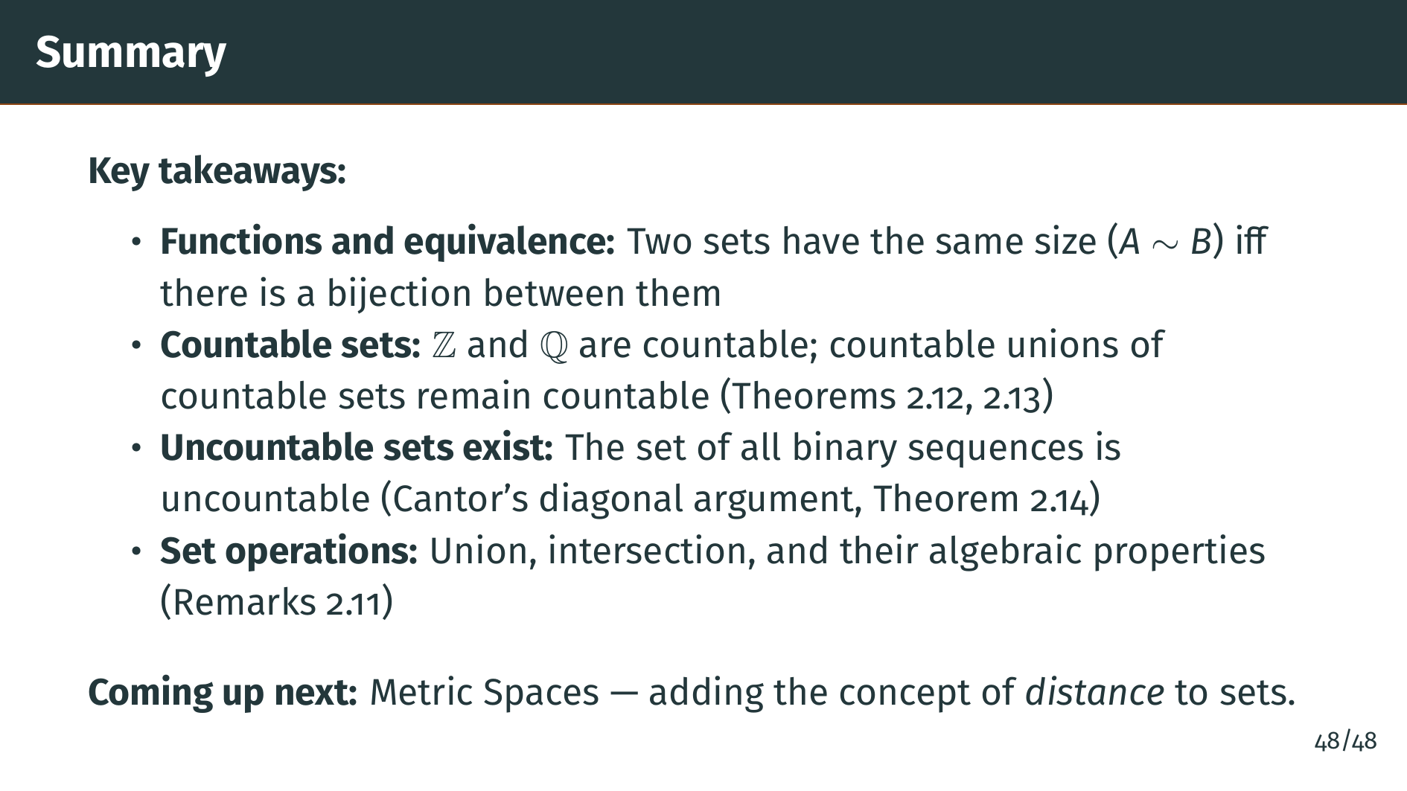
Notes:
We also established the basic algebraic properties of unions and intersections, which will be used constantly throughout the rest of the book. In the next section, we introduce metric spaces, where we add the concept of distance. This will allow us to talk about neighborhoods, limits, and open and closed sets, which are the core of topology. Thank you for watching, and see you in the next episode.

