Slide 1
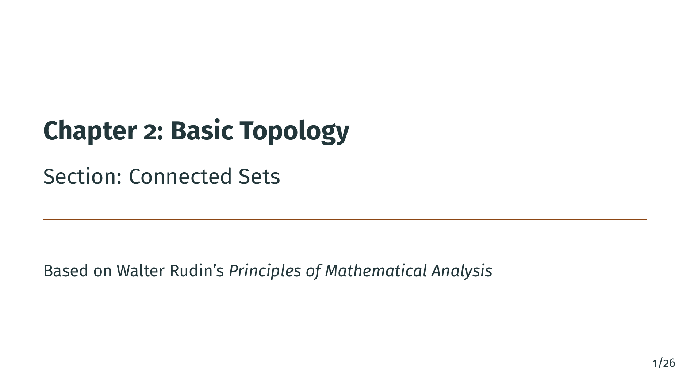
Notes:
Welcome back to Chapter 2 of Principles of Mathematical Analysis. This is the final section of the topology chapter, and it introduces one last structural property that a set in a metric space can have: connectedness. Intuitively, a connected set is a set that cannot be broken into two pieces that stand apart from each other. We will make this precise using the notion of separated sets, and then we will see that the connected subsets of the real line have a remarkably simple description: they are exactly the intervals, in a broad sense of the word. Let us begin.

Slide 2
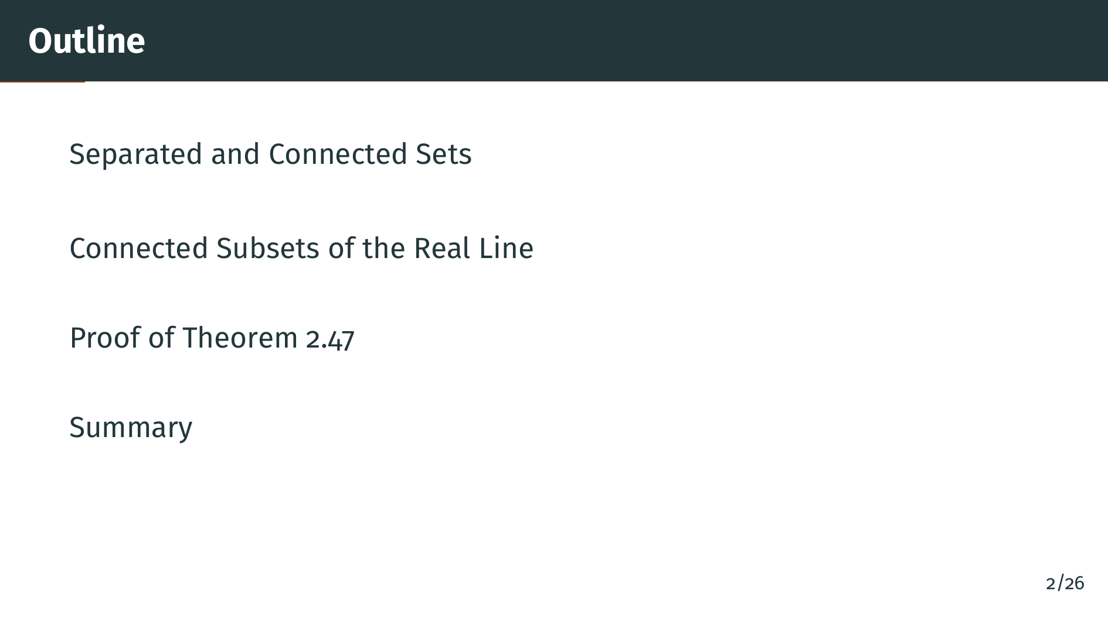
Notes:
Here is the plan. We first define what it means for two sets to be separated, and then what it means for a set to be connected. After a short remark that clarifies the difference between disjoint and separated, we state the main theorem of the section: a subset of the real line is connected if and only if it satisfies a simple order condition. We then work through the proof in both directions, and we close with a summary of what we have learned.

Slide 3
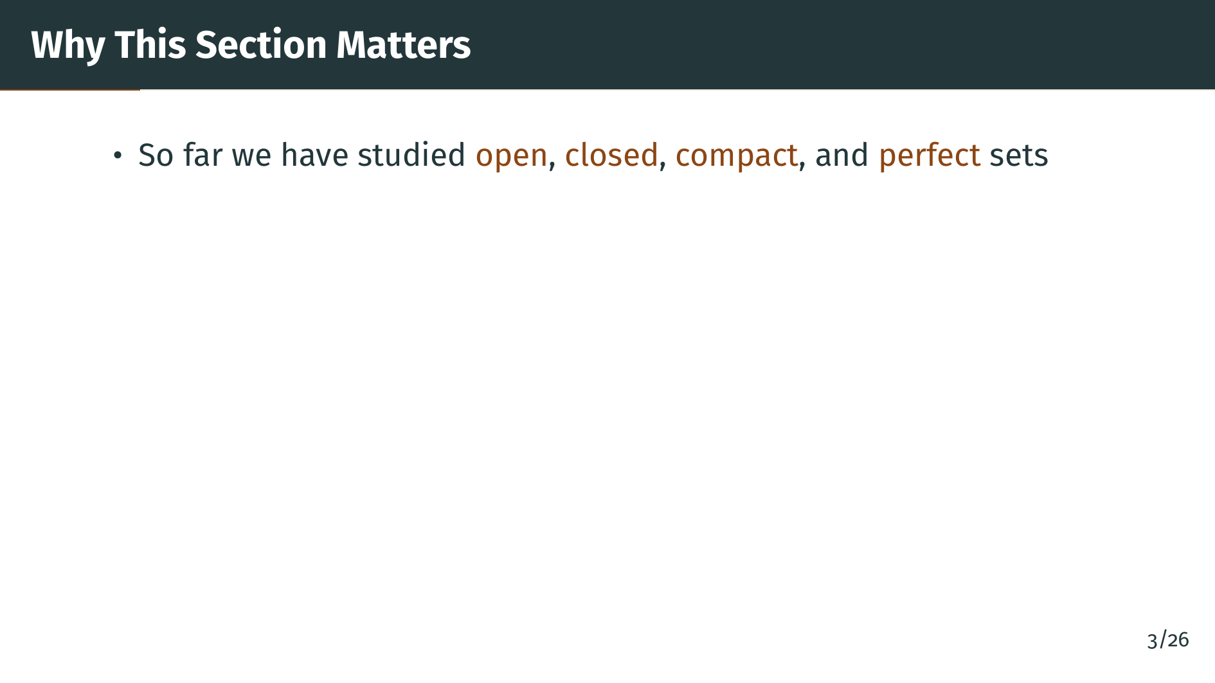
Notes:
So far in Chapter 2 we have built up a toolkit of topological properties. We studied open sets and closed sets, which capture what it means for a set to have no boundary missing or no boundary extra. We studied compact sets, which combine closedness with a finiteness-like property. And in the previous section we studied perfect sets, which have no isolated points.

Slide 4
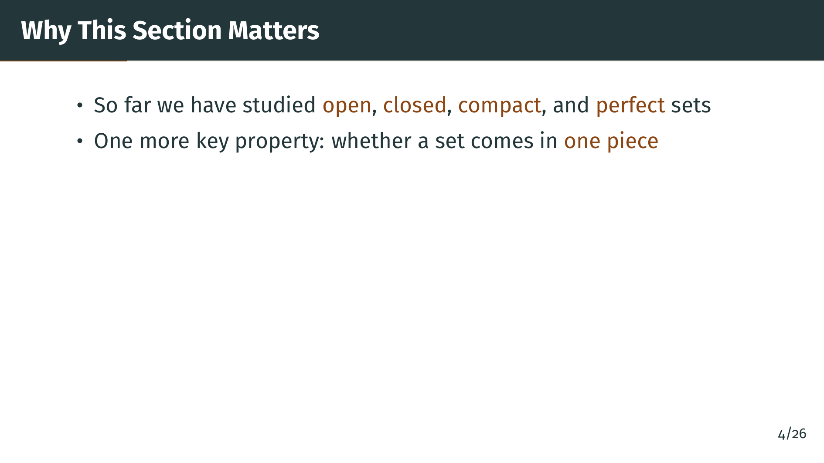
Notes:
There is one more qualitative property that is fundamental in analysis and topology: whether a set comes in one piece or whether it can be split into pieces that have nothing to do with each other. A set like the interval from 0 to 1 feels like one piece, while a set like the interval from 0 to 1 together with the interval from 2 to 3 clearly comes in two pieces.

Slide 5
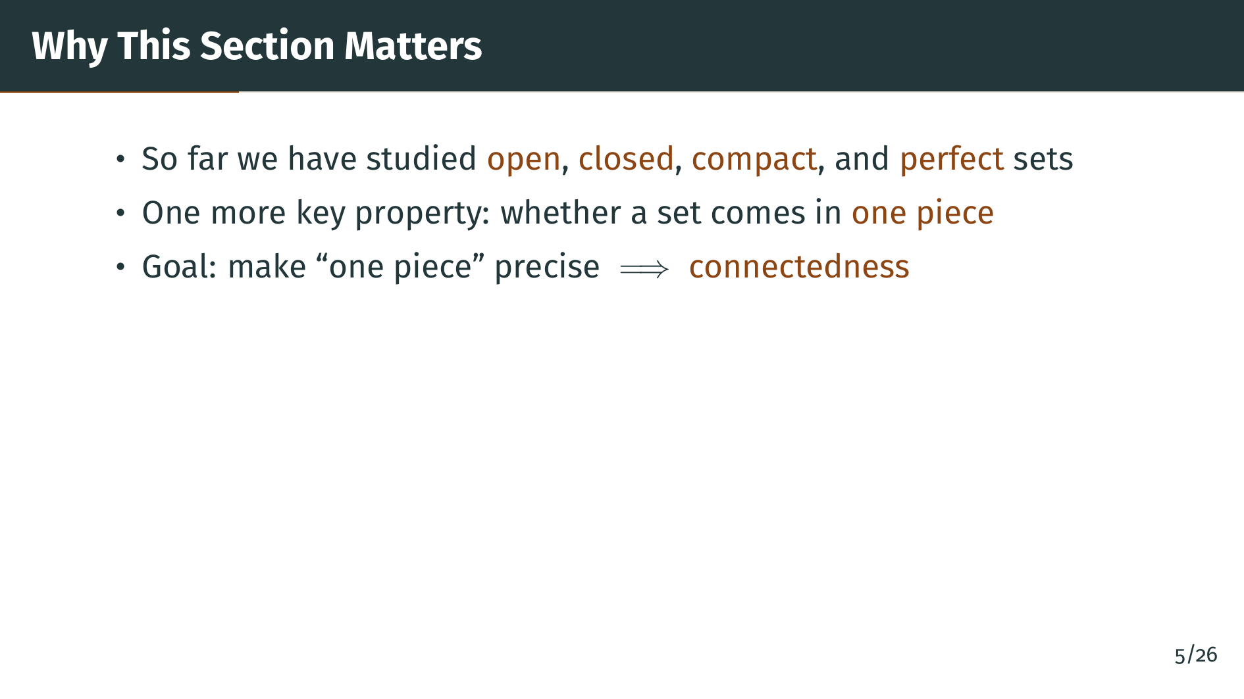
Notes:
Our goal in this section is to turn this intuitive idea of being in one piece into a rigorous mathematical definition. The resulting concept is called connectedness. It will turn out to be the property that ties together many later results, for example the intermediate value theorem for continuous functions. Let us see the formal definition.

Slide 6


Slide 7
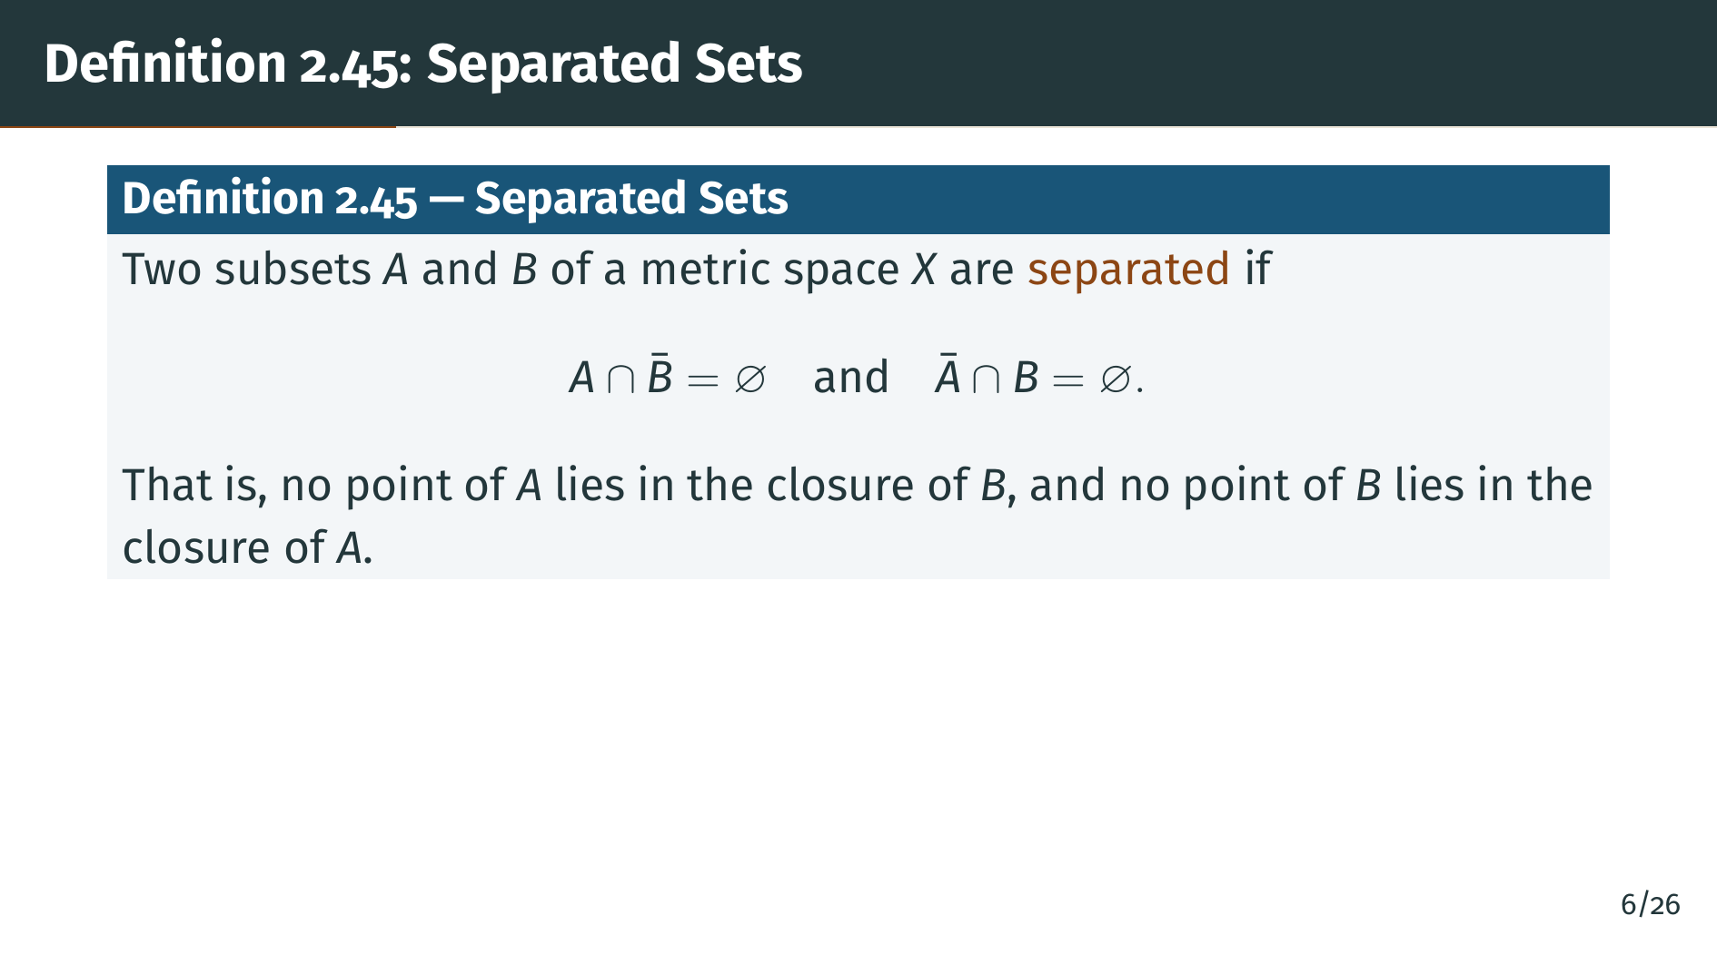
Notes:
The intuition behind separated sets is this: two sets are separated when they sit genuinely apart from each other, with no approach even in the limit sense. It is not enough for them to share no elements. They must also not be able to reach each other through limit points. Formally, as the slide shows, we ask for two conditions: "A" does not meet the closure of "B", and "B" does not meet the closure of "A". Recall that the closure of a set is the set together with all of its limit points. So separation is strictly stronger than disjointness: two disjoint sets can still touch through closures, but separated sets cannot. A concrete picture is coming up shortly.

Slide 8
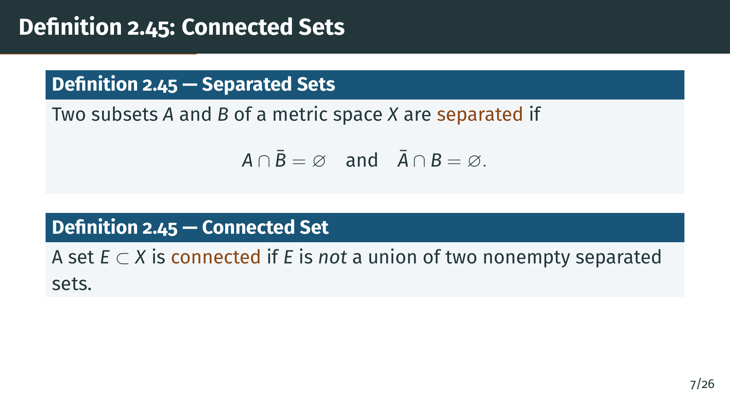
Notes:
Now we can define connectedness. Notice that the definition is negative: a set "E" is connected precisely when it cannot be split into two nonempty separated pieces. This style of definition, where the positive property is the absence of a certain decomposition, is common and powerful. It tells us exactly how to argue. To show "E" is connected, we typically assume for contradiction that such a decomposition existed, and derive an impossibility. To show "E" is not connected, we exhibit a concrete decomposition into two nonempty separated pieces. Both patterns will appear in the proof later in this section.

Slide 9
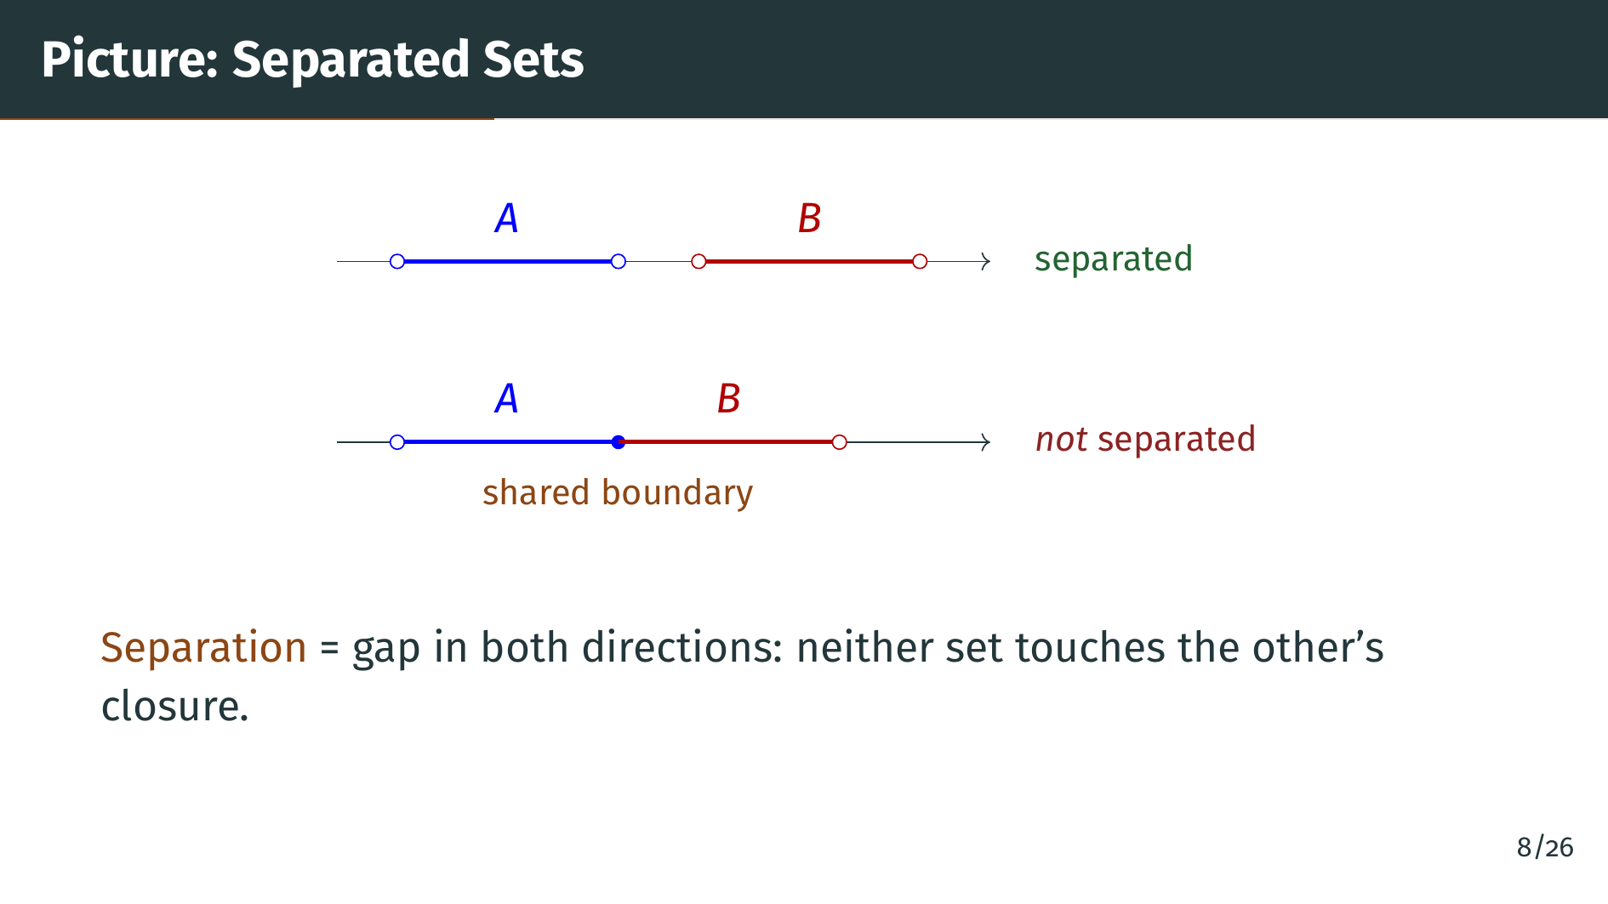
Notes:
This picture shows two scenarios on the real line. In the top row we see two blue and red intervals separated by a visible gap. Neither set contains a limit point of the other, so they are separated in the sense of the definition. In the bottom row, the right endpoint of the blue interval and the left endpoint of the red interval coincide at a single shared boundary point. The blue set contains this boundary point, and it is also a limit point of the red set, so the closure of the red set meets the blue set. These two sets are disjoint but not separated. Separation requires not just disjointness, but also that no limit-point contact exists between the two sets.

Slide 10
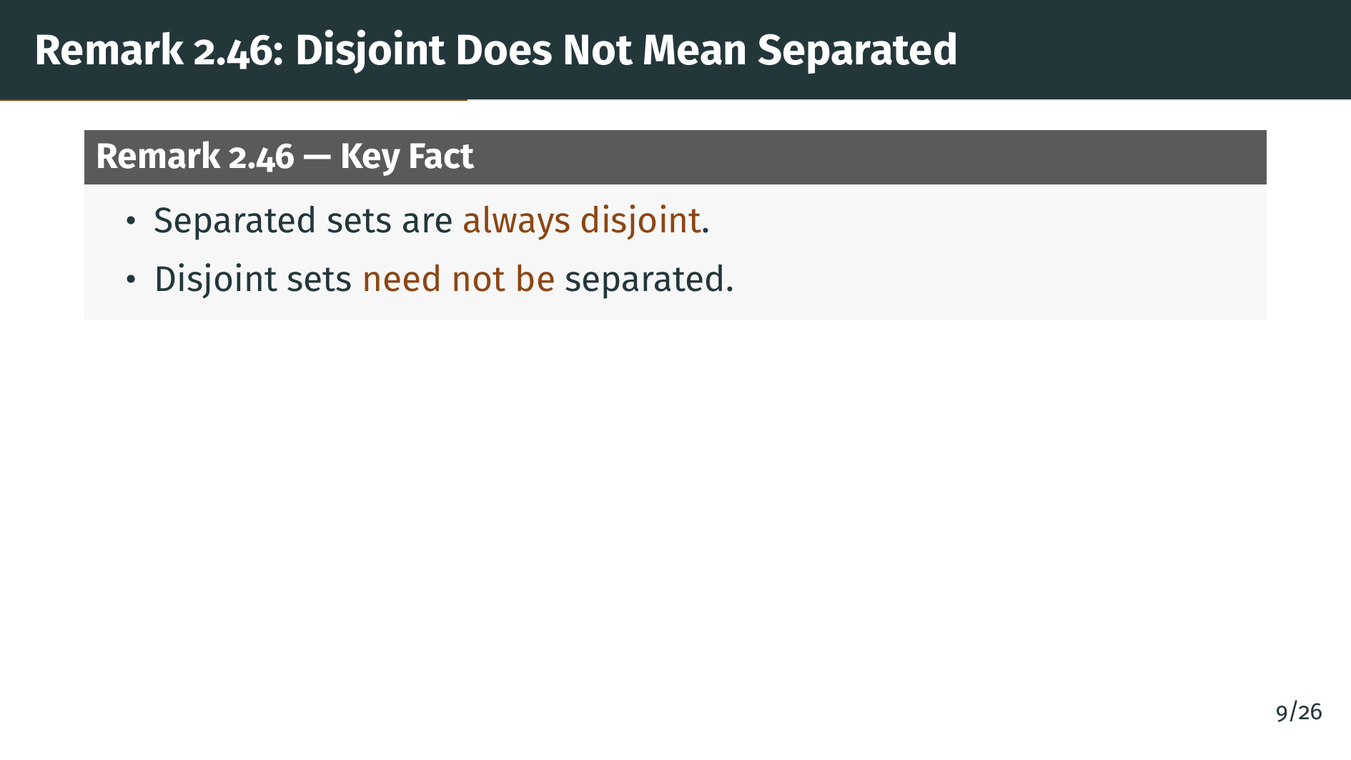
Notes:
The remark clarifies the relationship between the two notions of disjointness and separation. If two sets are separated, then the closure of each one is disjoint from the other, so in particular the sets themselves are disjoint. That direction is easy. The converse, however, fails. Two sets can be disjoint without being separated, and the next two slides give concrete examples of this distinction on the real line.

Slide 11
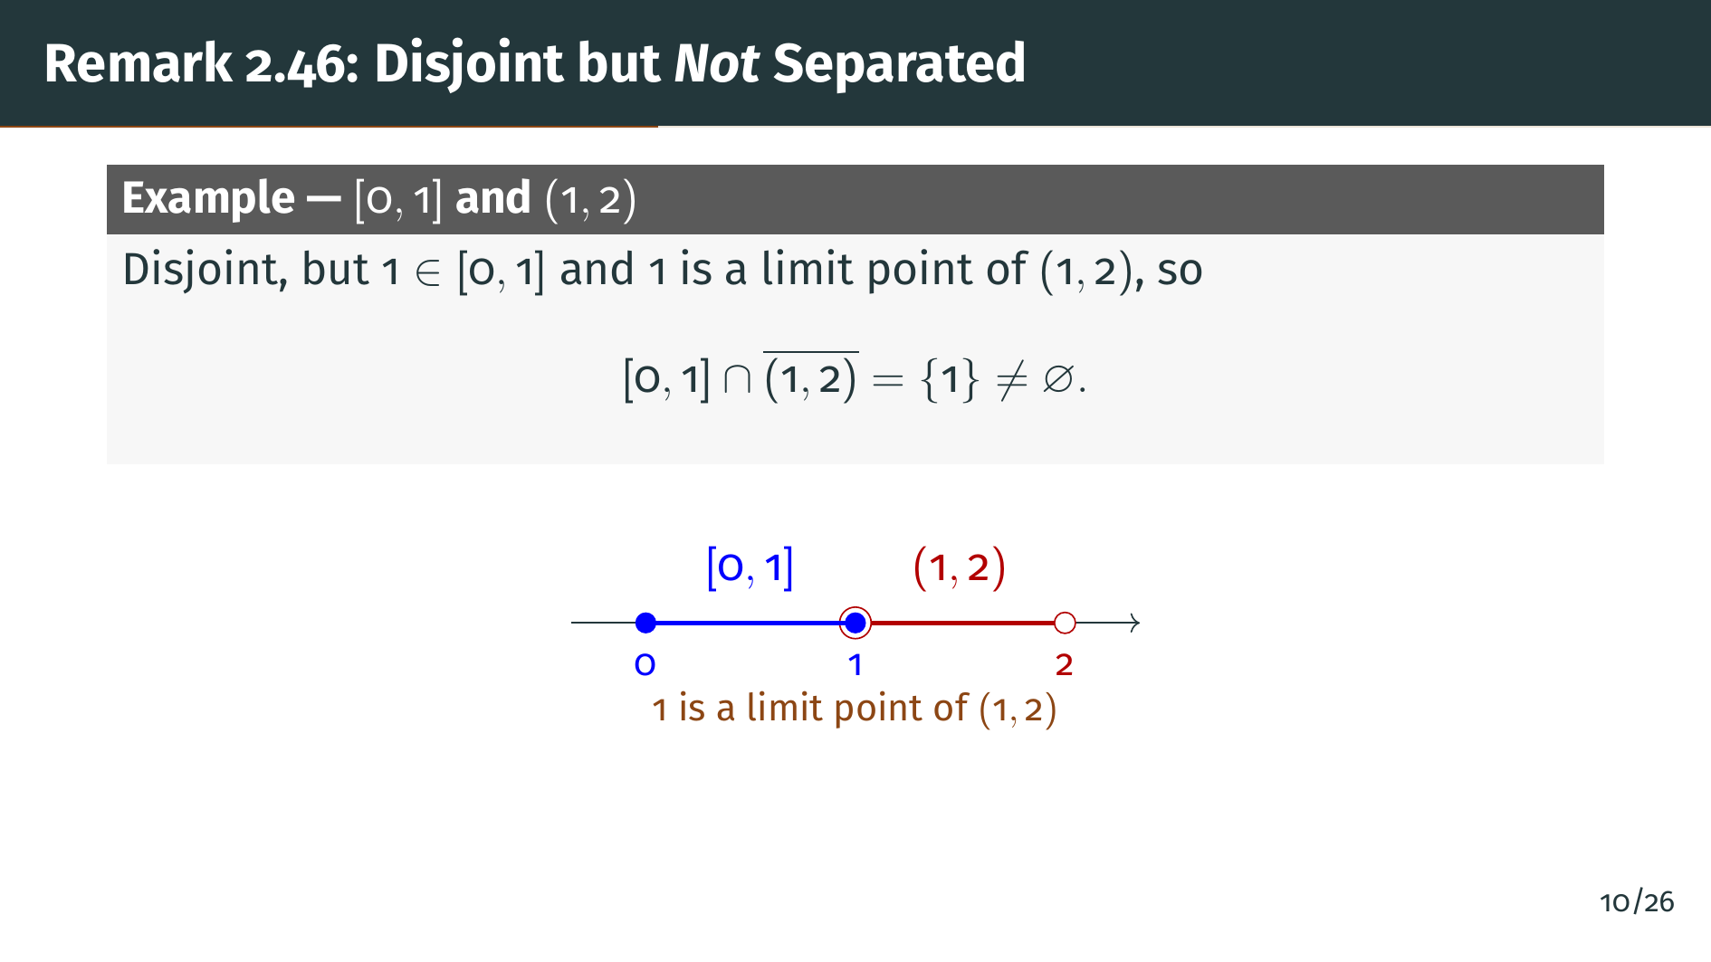
Notes:
Consider the closed interval from 0 to 1 and the open segment from 1 to 2. These two sets are disjoint: they share no element, because the segment from 1 to 2 does not contain the endpoint 1. But the number 1 belongs to the first set, and 1 is a limit point of the segment from 1 to 2, since every neighborhood of 1 meets the segment. So 1 lies in the closure of the segment, which means the first set meets the closure of the second. These sets are therefore disjoint but not separated.

Slide 12
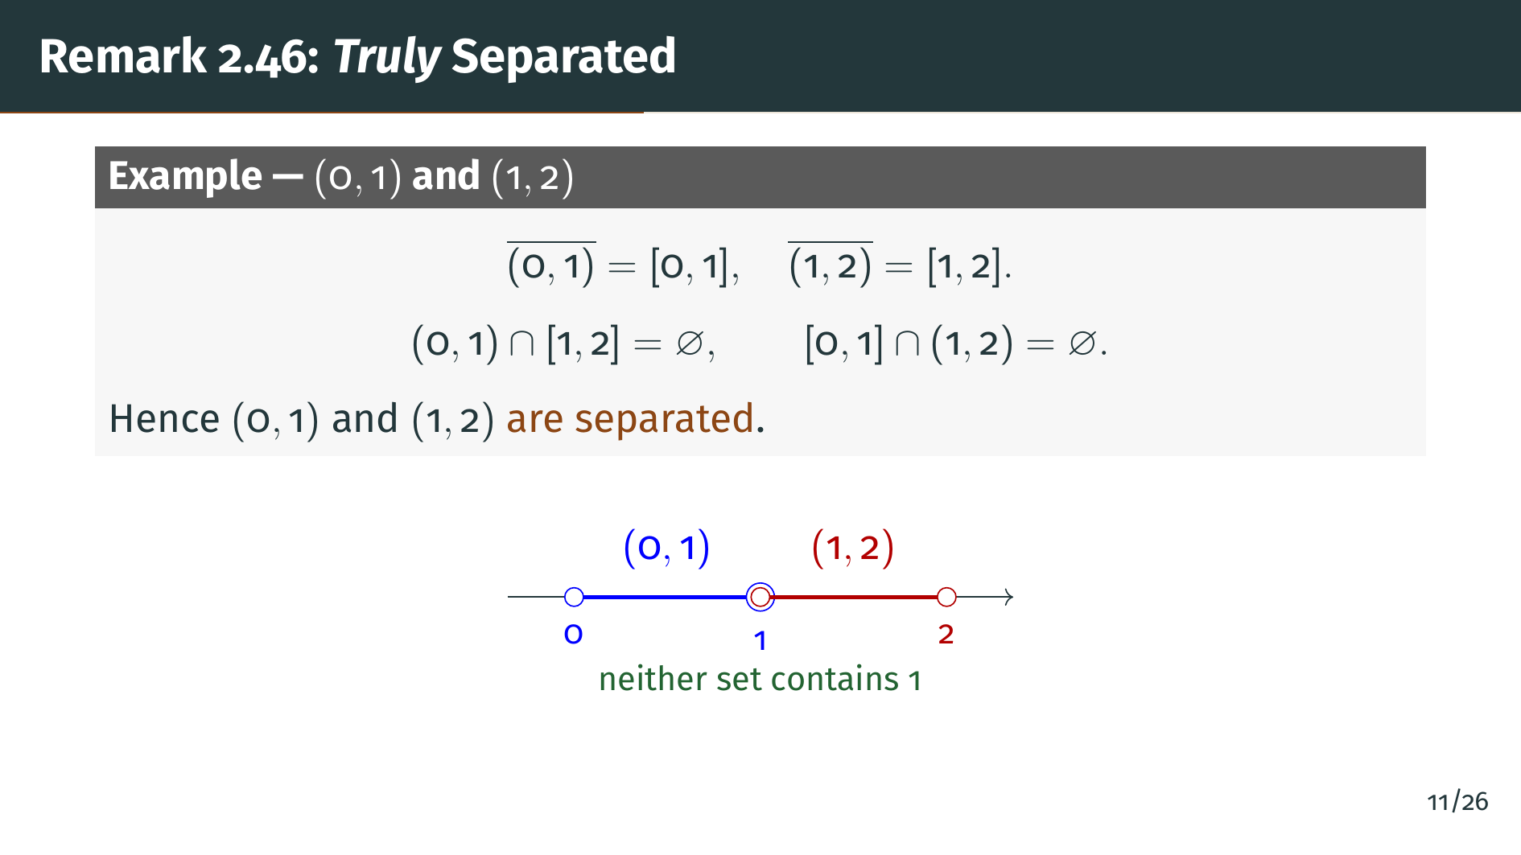
Notes:
Now replace the closed left interval with the open segment from 0 to 1. The two open segments from 0 to 1 and from 1 to 2 are still disjoint, but now neither one contains the point 1. The closure of the first segment is the closed interval from 0 to 1, and the closure of the second segment is the closed interval from 1 to 2. When we check the two required intersections, both turn out to be empty. So these two segments really are separated. The pivotal difference is whether the common boundary point 1 belongs to one of the sets.

Slide 13


Slide 14
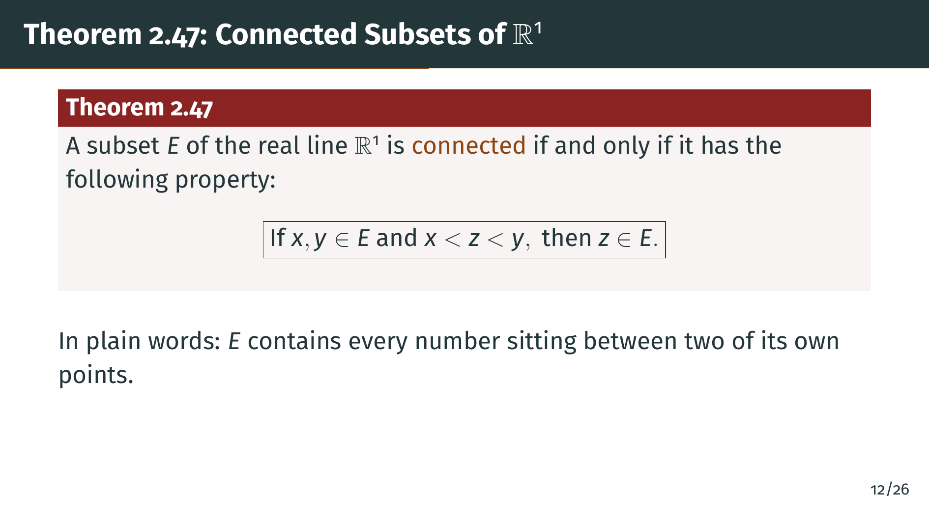
Notes:
This is the main theorem of the section. It completely characterizes connectedness for subsets of the real line. The statement is a biconditional: "E" is connected if and only if "E" has the property that, whenever it contains two points "x" and "y", it also contains every real number sitting strictly between them. Geometrically, this says that "E" has no holes: it cannot skip over any point that lies between two of its existing points. Sets with this property are exactly the intervals in a very broad sense, including open, closed, half-open, and unbounded intervals.

Slide 15
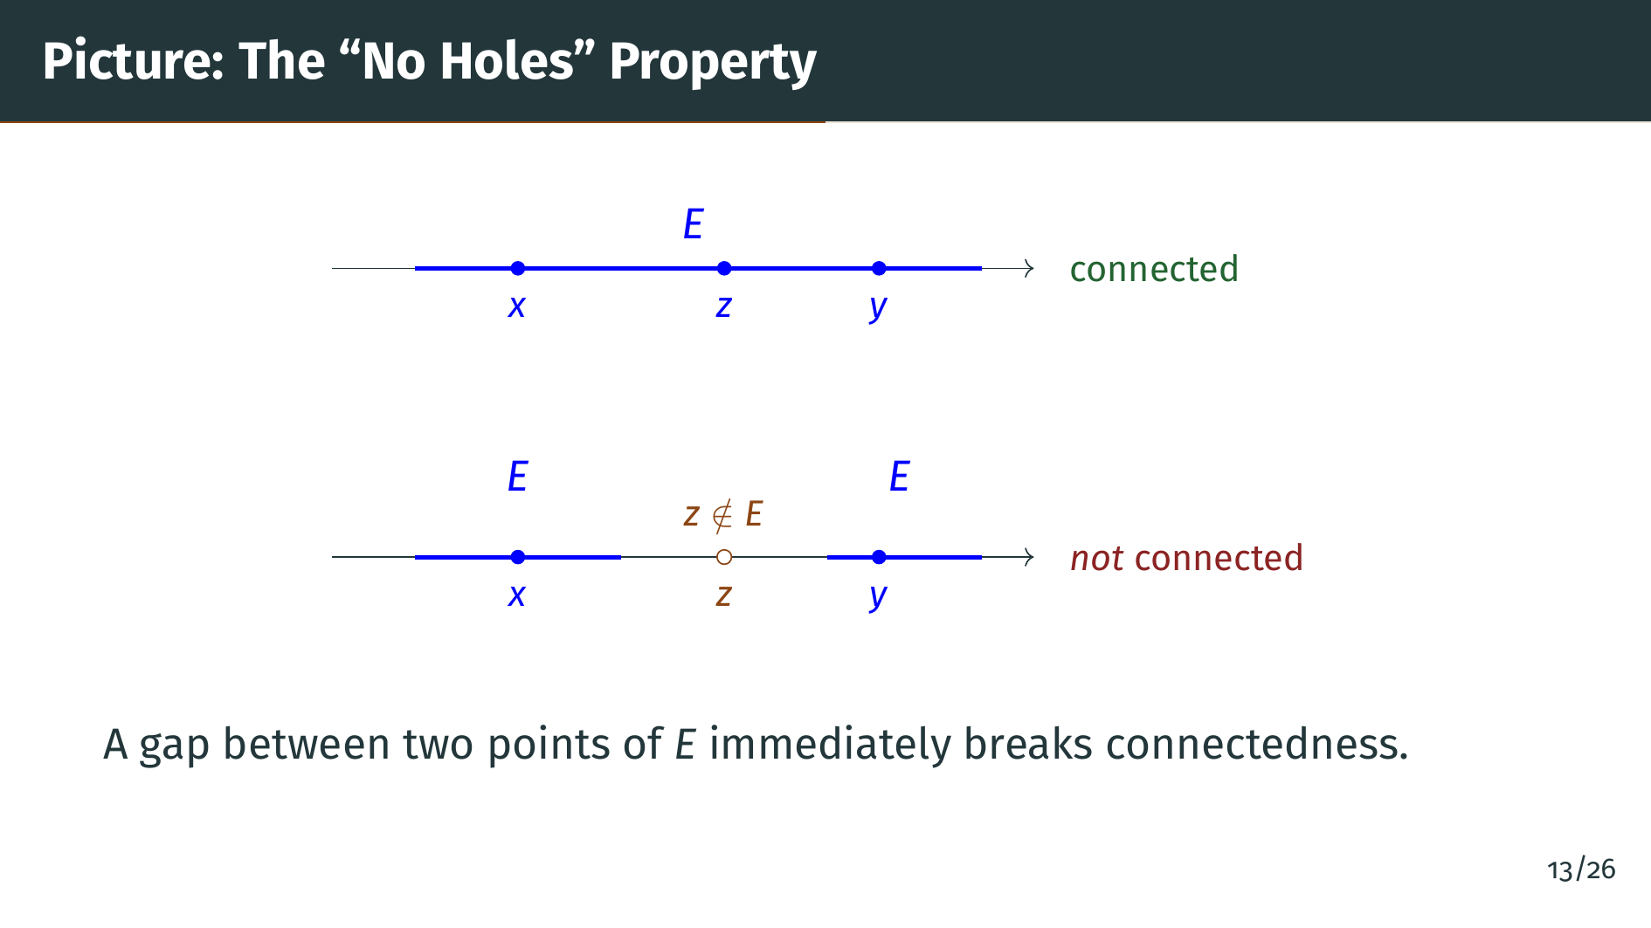
Notes:
This picture shows both scenarios. On the top, the blue set "E" is one solid interval, and any three points "x", "z", "y" with "z" between "x" and "y" all lie in "E". On the bottom, the blue set "E" consists of two disjoint pieces with a gap in the middle. The points "x" and "y" belong to "E", but the point "z", marked in orange, sits in the gap and is not in "E". Any such missed point between two points of "E" is enough to break connectedness, and the theorem says this is the only way connectedness can fail on the real line.

Slide 16
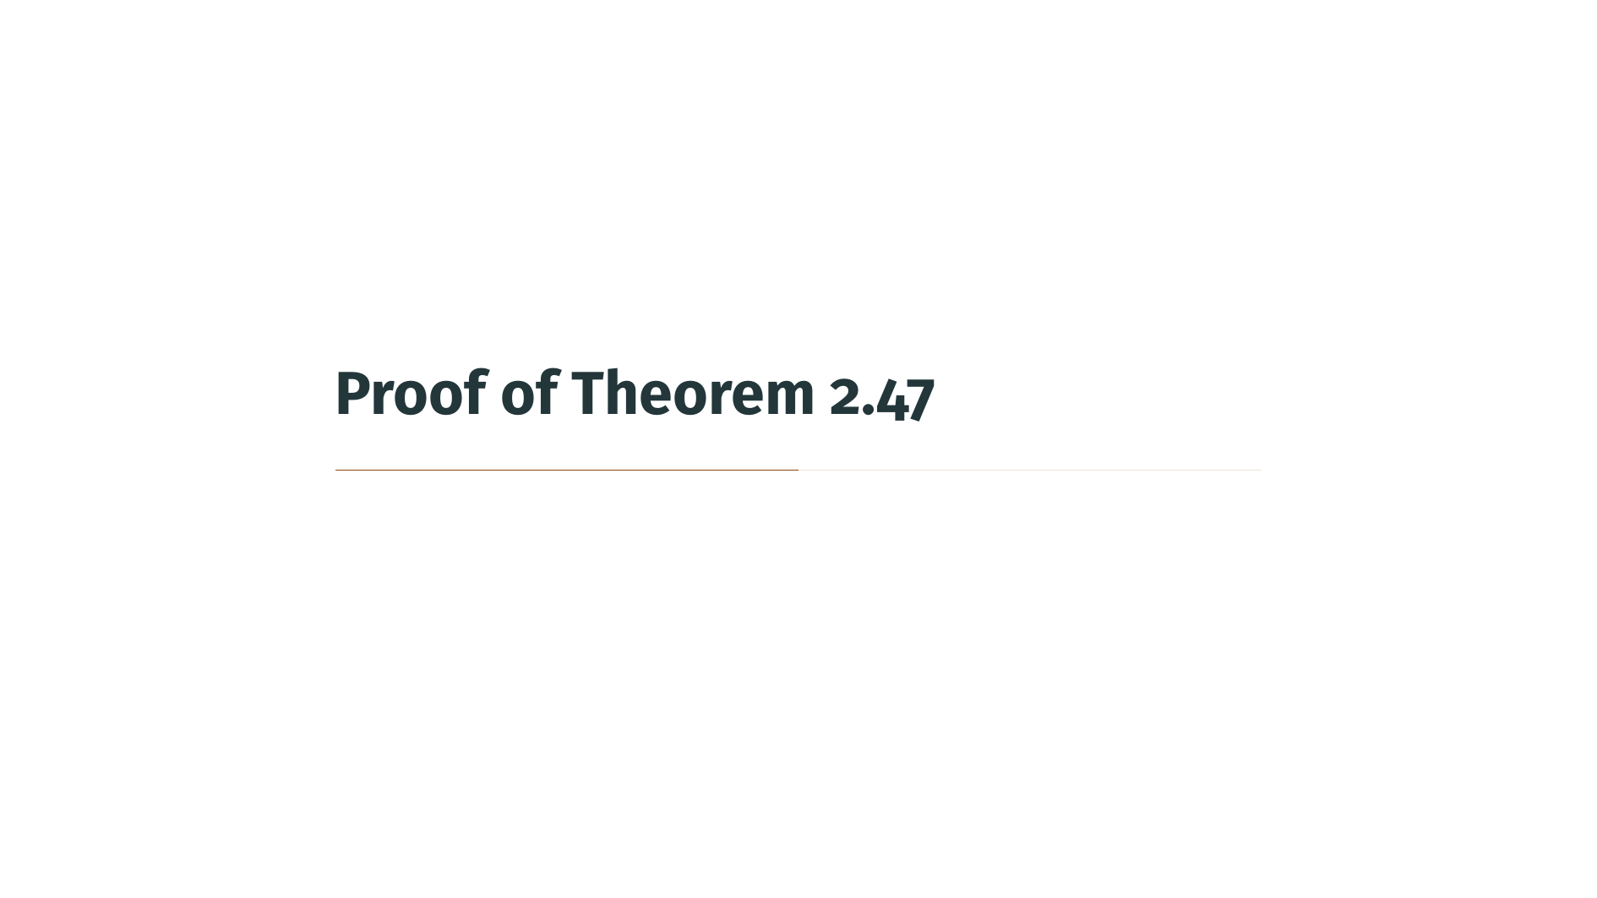

Slide 17
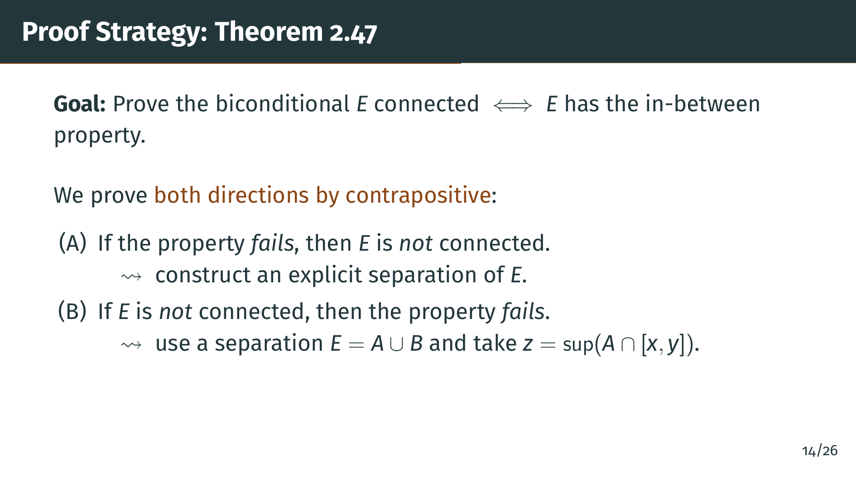
Notes:
Before we dive into the details, here is the high-level plan. We want to prove a biconditional, so there are two directions. We prove each by contrapositive, which will feel more natural than trying to argue directly. In part "A", we assume the in-between property fails, meaning we can find two points of "E" and a missing point between them, and we use that missing point to explicitly split "E" into two separated pieces. In part "B", we assume "E" is not connected, so there is already a separation, and we use the supremum trick along with Theorem 2.28 to locate a missing point between two points of "E".

Slide 18
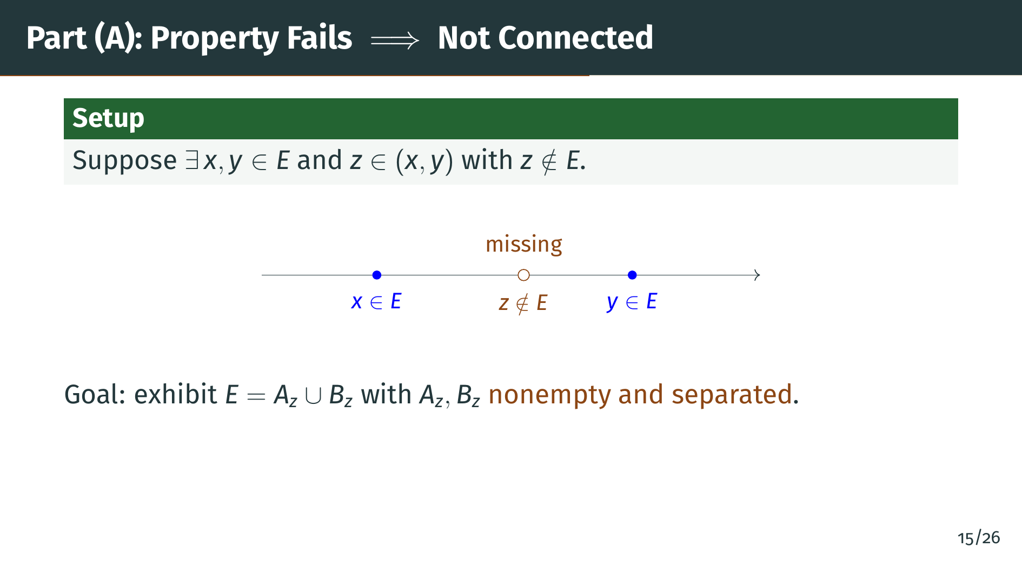
Notes:
We start part "A" by assuming the in-between property fails. That means we can pick two points "x" and "y" in "E", with "x" less than "y", and a point "z" strictly between them that does not belong to "E". The picture shows "x" and "y" as solid blue dots in "E", while "z" in the middle is shown as an empty orange circle to mark that it is missing. Our goal is to use this single missing point to split "E" into two nonempty pieces that are separated, thereby showing that "E" is not connected.

Slide 19
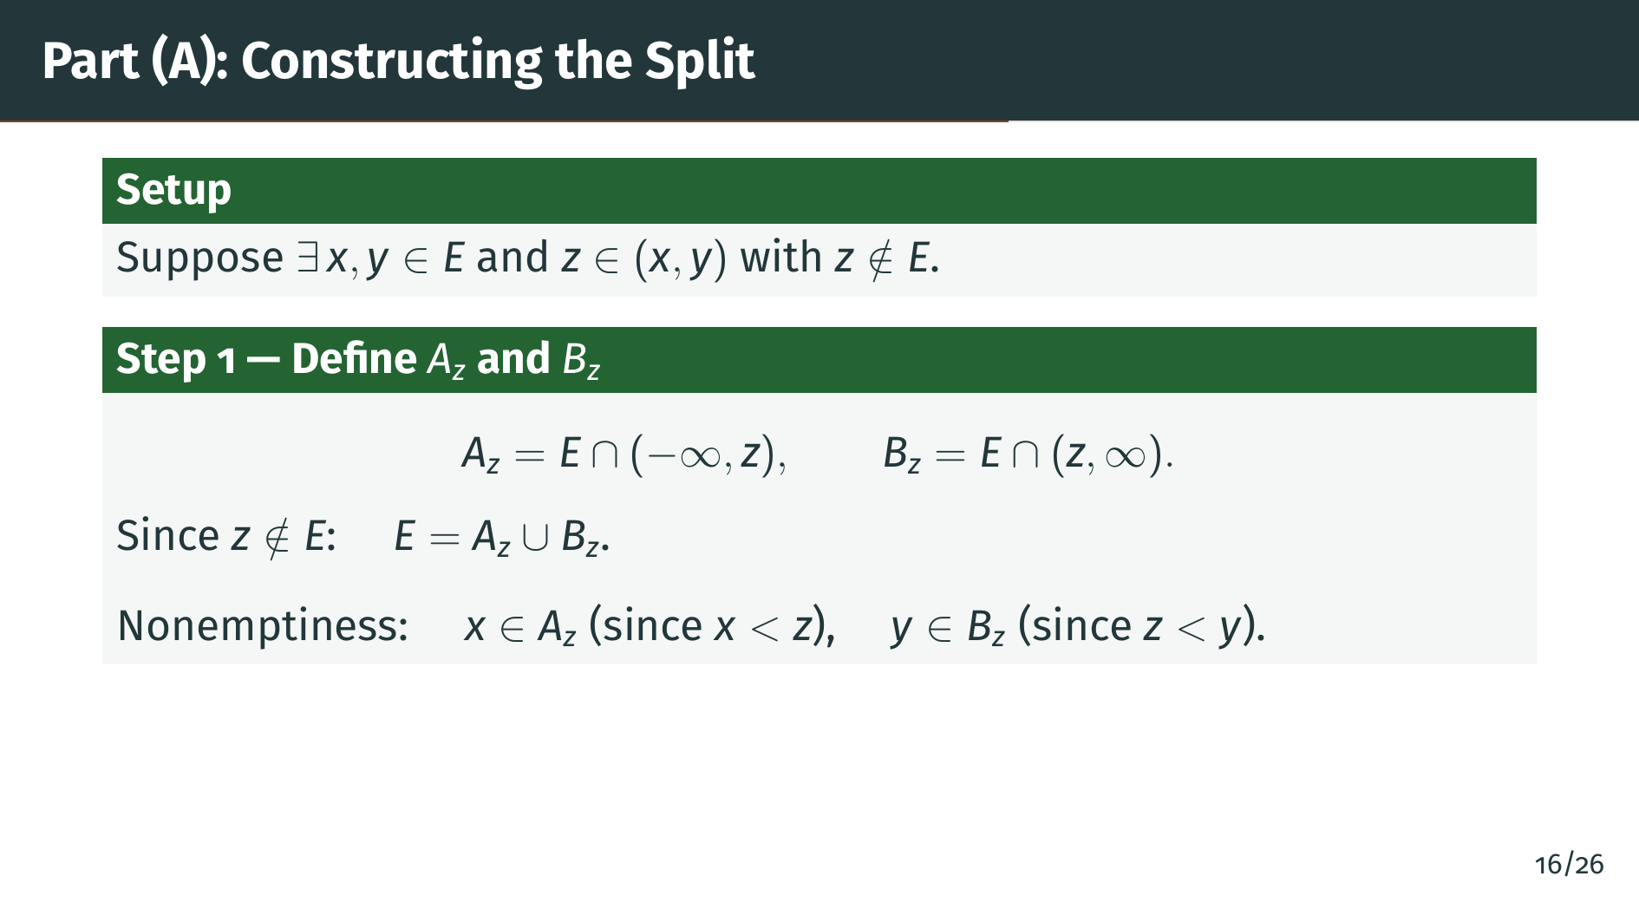
Notes:
We split "E" by cutting at the missing point "z". Define "A" sub "z" to be the part of "E" lying strictly to the left of "z", and "B" sub "z" to be the part lying strictly to the right of "z". Because "z" itself is not in "E", every element of "E" is either strictly less than "z" or strictly greater than "z", so the union of "A" sub "z" and "B" sub "z" is all of "E". Both pieces are nonempty: "x" lies in "A" sub "z" because "x" is less than "z", and "y" lies in "B" sub "z" because "z" is less than "y". Next we check separation.

Slide 20
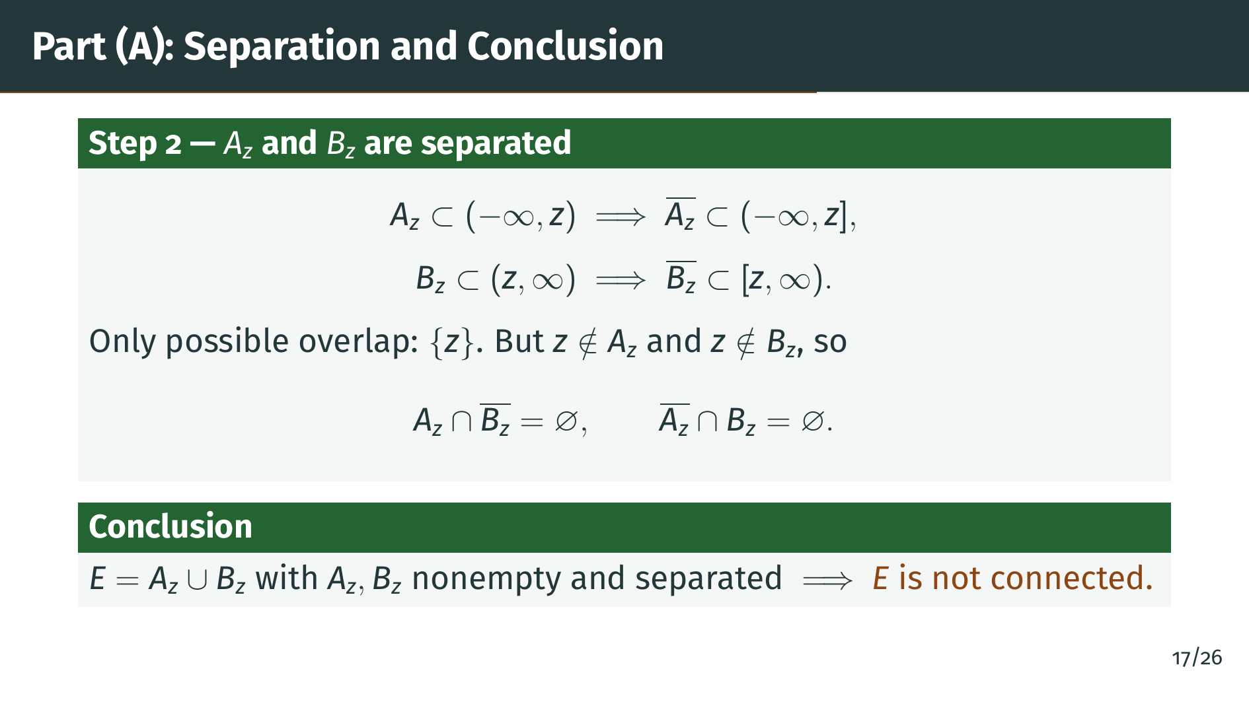
Notes:
Now for the separation check. The set "A" sub "z" lives inside the half-line to the left of "z", so its closure stays inside the half-line to the left of "z" together with "z" itself. Similarly the closure of "B" sub "z" lives in the half-line from "z" to the right. The only possible overlap between these two closed half-lines is at "z". But "z" is not in "A" sub "z" and not in "B" sub "z", so both intersections in the definition of separation are empty. We have split "E" into two nonempty separated sets, so "E" is not connected. Part "A" is done.

Slide 21
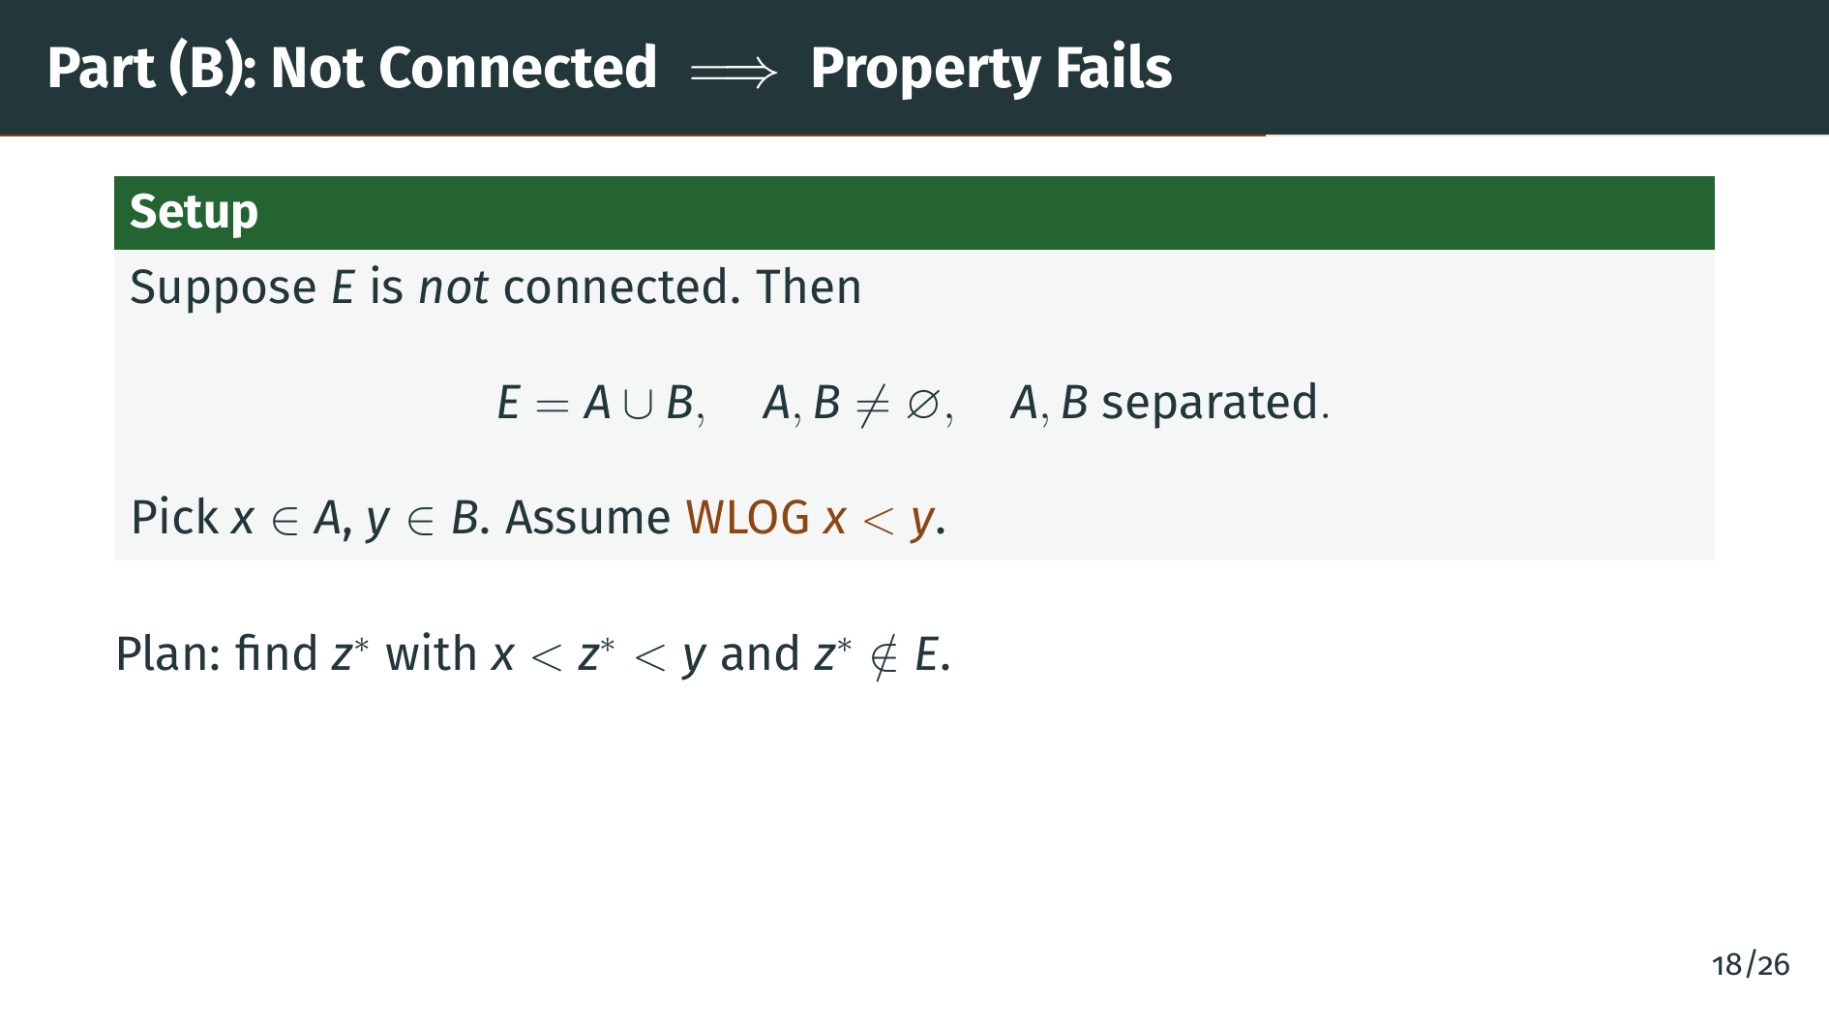
Notes:
Now we turn to part "B". Assume "E" is not connected. By definition, we can write "E" as the union of two nonempty separated sets, call them "A" and "B". Pick any element "x" of "A" and any element "y" of "B". Since they come from disjoint sets we have "x" not equal to "y", so without loss of generality we can assume "x" is less than "y". If instead "y" were less than "x", we could simply swap the names "A" and "B" and repeat. Our goal is to find some point strictly between "x" and "y" that does not belong to "E".

Slide 22
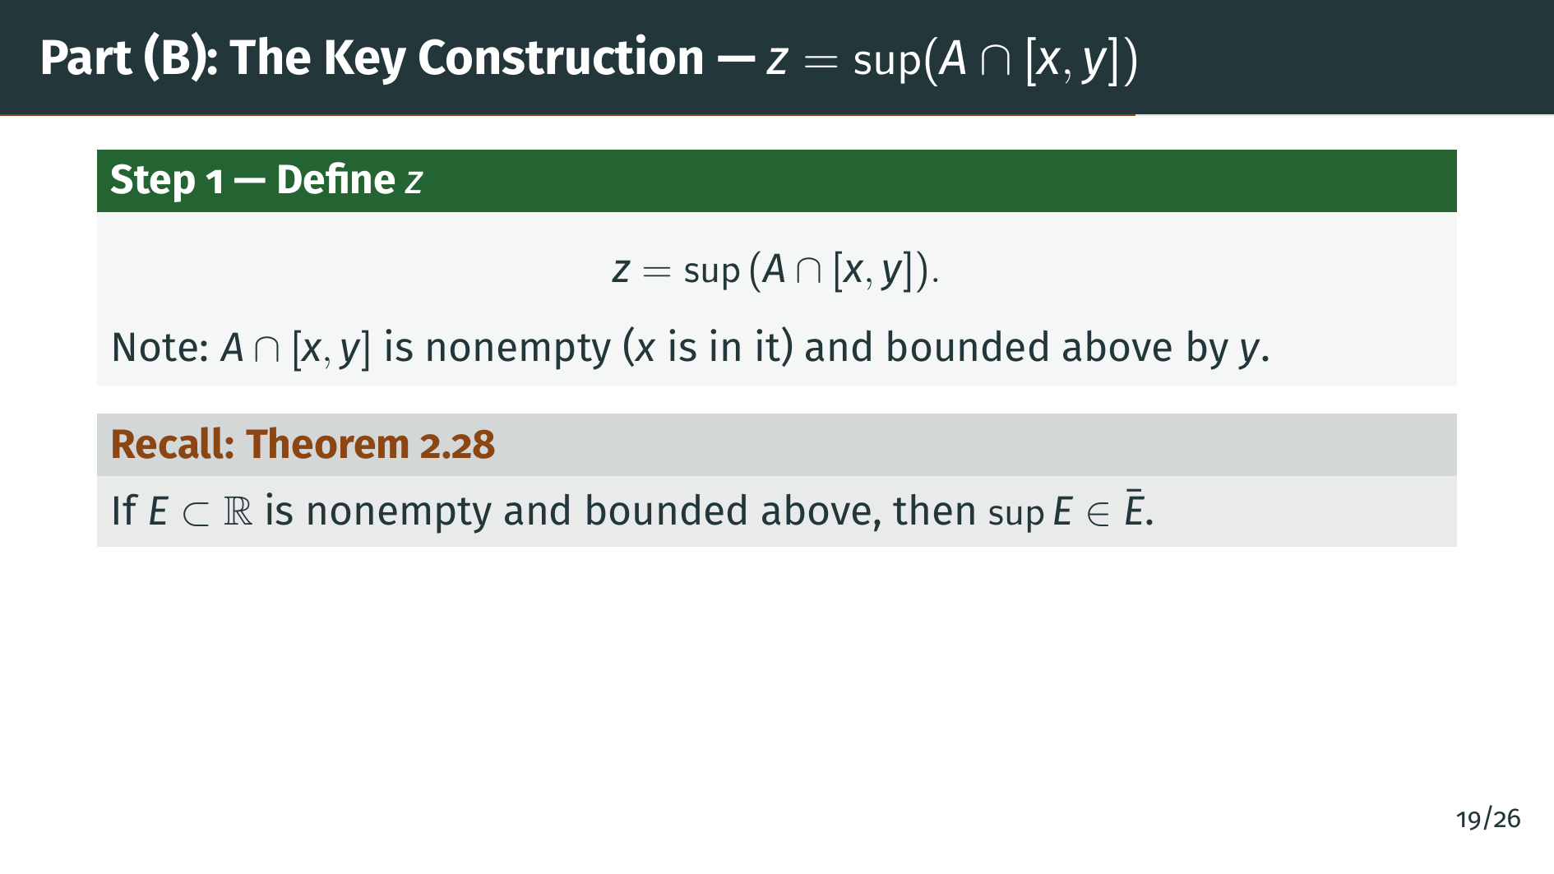
Notes:
Here is the key construction of part "B". The motivating idea: we want to find a point sitting right at the boundary between "A" and "B". A natural candidate is the rightmost point of "A" that still lies inside the interval from "x" to "y". Formally, we take "z" to be the supremum of "A" intersected with the closed interval from "x" to "y". This supremum is well-defined because the intersection is nonempty, since it contains "x", and it is bounded above by "y". To analyze where this supremum sits, we invoke Theorem 2.28, shown on the slide: for any nonempty bounded-above subset of the reals, the supremum always lies in the closure of the set. This gives us the leverage we need to trap "z" in a very specific spot. On the next slide we pin down exactly where "z" is.

Slide 23
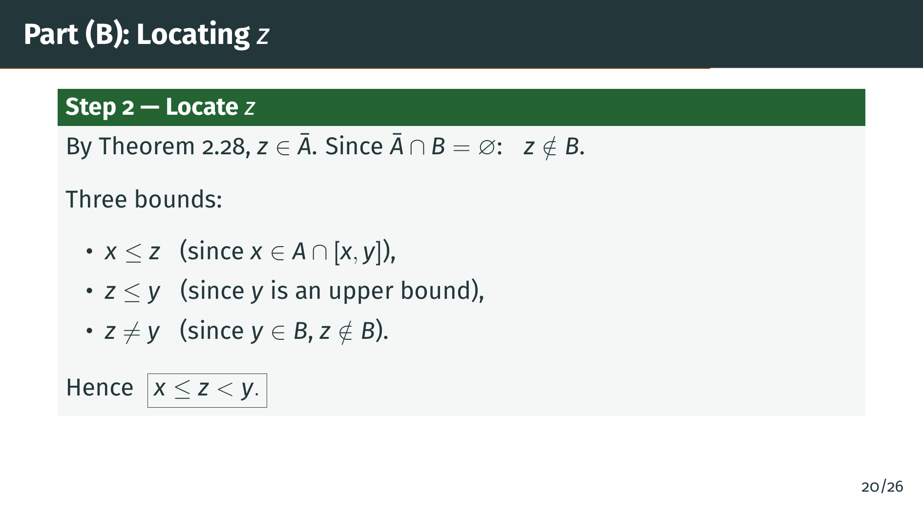
Notes:
Now we apply Theorem 2.28. Since "z" is the supremum of a nonempty set that is bounded above, "z" lies in the closure of "A". Because "A" and "B" are separated, the closure of "A" is disjoint from "B", so "z" is not in "B". That already rules out one location for "z". To pin it down further, we collect three bounds shown on the slide. First, "x" is less than or equal to "z", because "x" itself belongs to the set whose supremum we took. Second, "z" is less than or equal to "y", because "y" is an upper bound of that set, and the supremum is the least upper bound. Third, "z" is not equal to "y", because "y" lies in "B" while "z" does not. Combining these, "z" sits in the half-open interval from "x" up to, but not including, "y". Next we split into two cases depending on whether "z" belongs to "A".

Slide 24
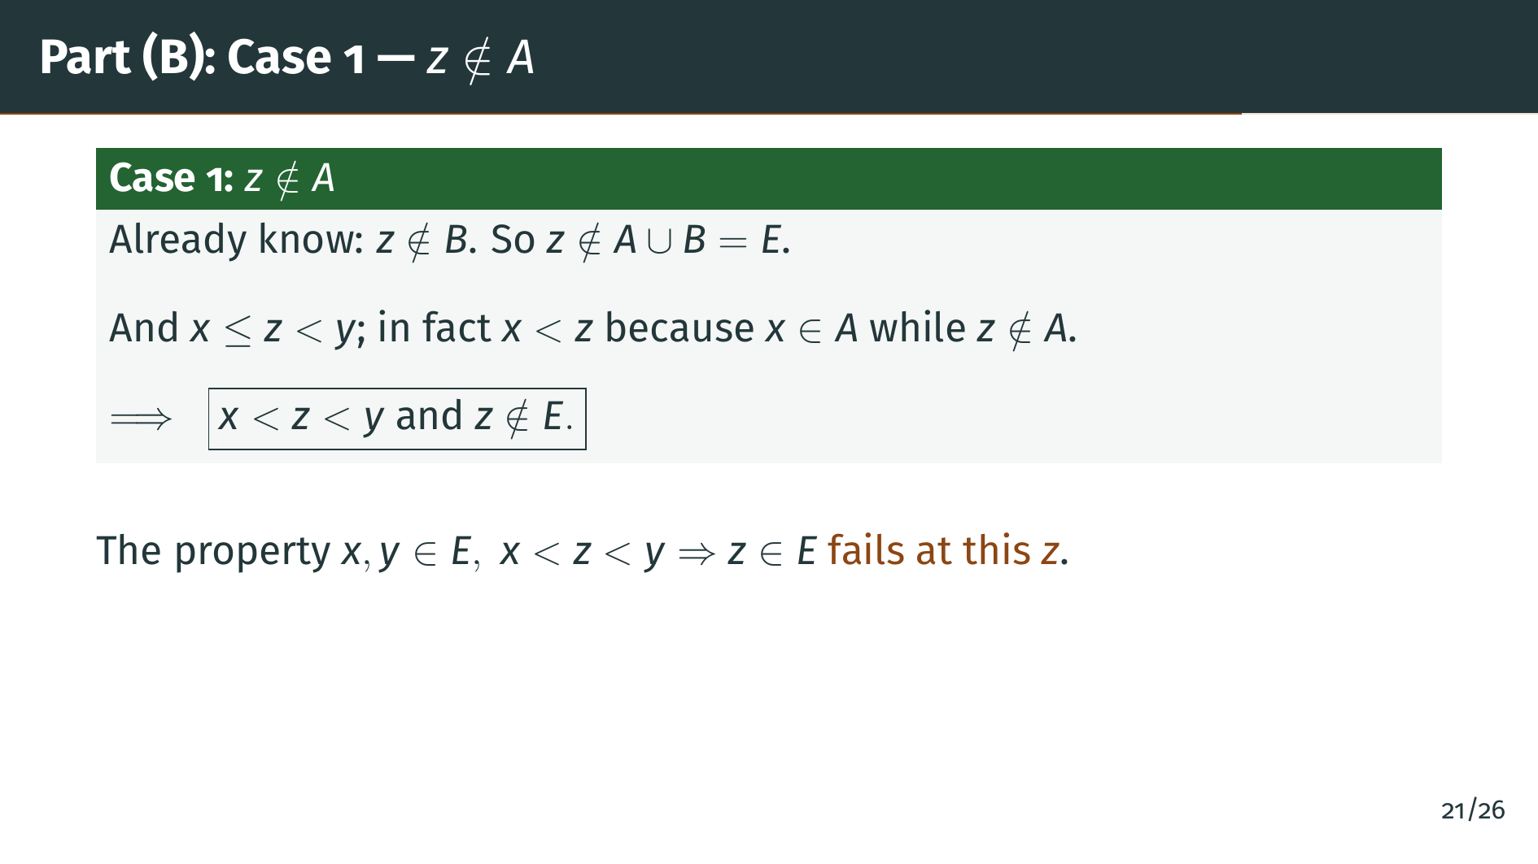
Notes:
Case 1 is the easy case: suppose "z" is not in "A". We already showed "z" is not in "B". So "z" is not in the union of "A" and "B", which is all of "E". Also, "x" is in "A" but "z" is not in "A", so "x" and "z" are different, which together with the earlier bound "x" less than or equal to "z" forces "x" strictly less than "z". Combining with "z" less than "y", we have found a point strictly between "x" and "y" that is not in "E". The in-between property fails at this "z". Case 1 is done.

Slide 25
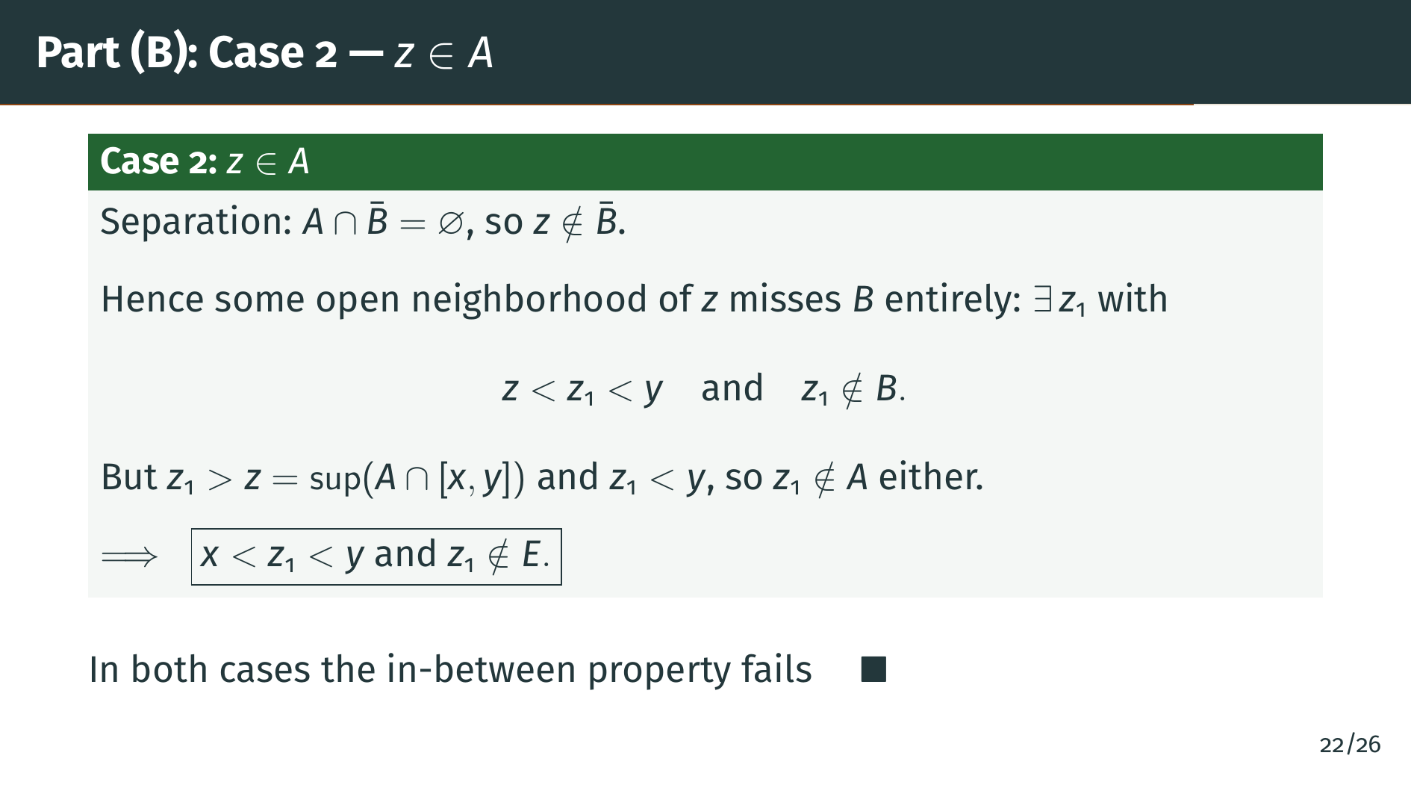
Notes:
Case 2 is the harder case: suppose "z" does belong to "A". Since "A" and "B" are separated, "A" does not meet the closure of "B", so "z" is not in the closure of "B". That means we can find a little room to the right of "z" that contains no points of "B". Recall from Step 2 that "z" is strictly less than "y", so there is genuine room between "z" and "y", and we can pick a point "z" sub 1 inside that room, with "z" less than "z" sub 1 less than "y", and "z" sub 1 not in "B". On the other hand, "z" sub 1 is strictly greater than the supremum of "A" intersected with the interval from "x" to "y", so "z" sub 1 cannot lie in that intersection either, meaning "z" sub 1 is not in "A". So "z" sub 1 is not in "E", and it sits strictly between "x" and "y". The in-between property fails at "z" sub 1. Both cases are complete, so the proof is finished.

Slide 26


Slide 27
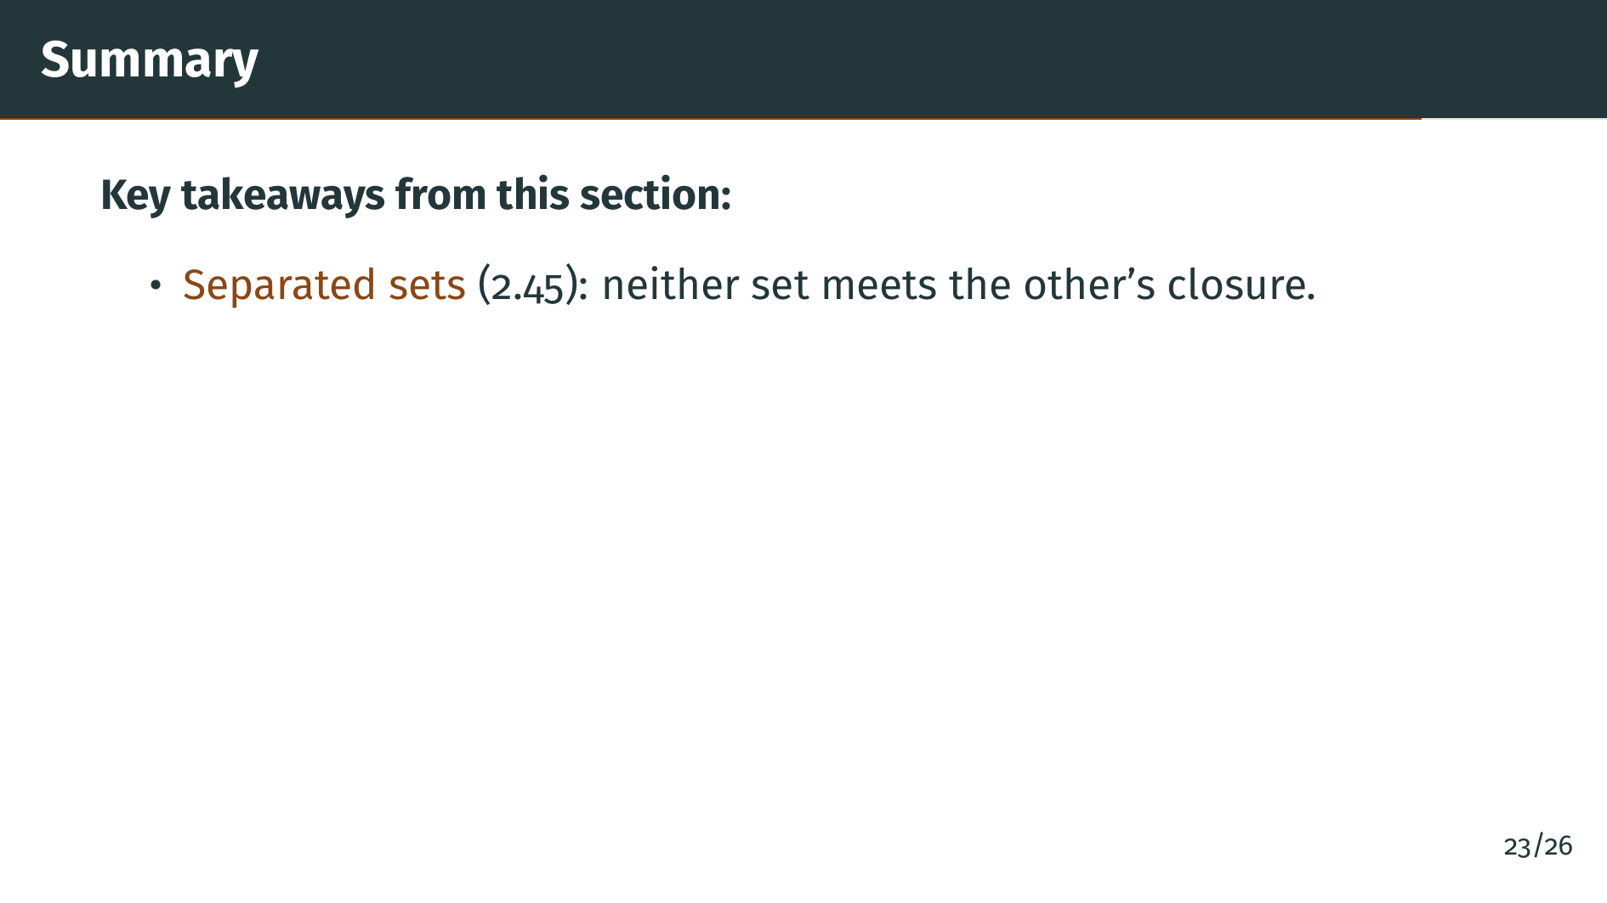
Notes:
Let us review what we have learned. We began with the notion of separated sets. Two sets are called separated when neither one contains a point of the other's closure. This is strictly stronger than saying the sets are disjoint.

Slide 28
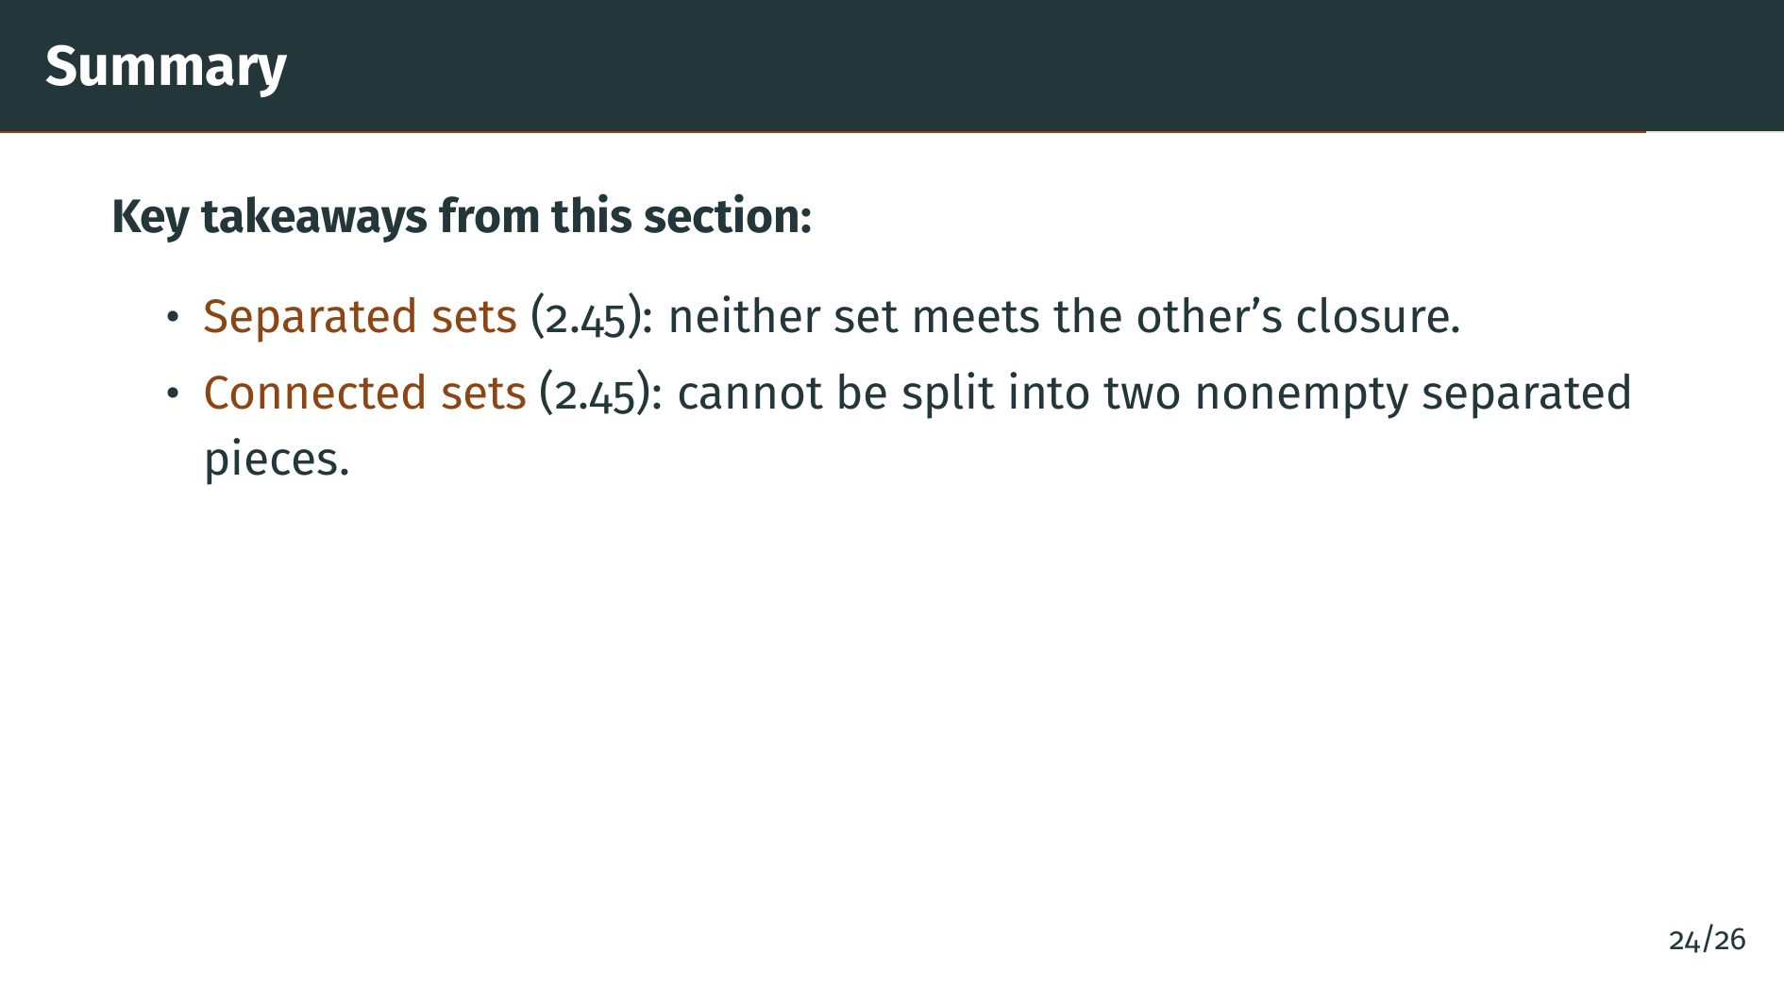
Notes:
Using separation, we defined connectedness. A set is connected when it cannot be written as the union of two nonempty separated pieces. It is a negative definition: a set is connected precisely when no such splitting exists.

Slide 29
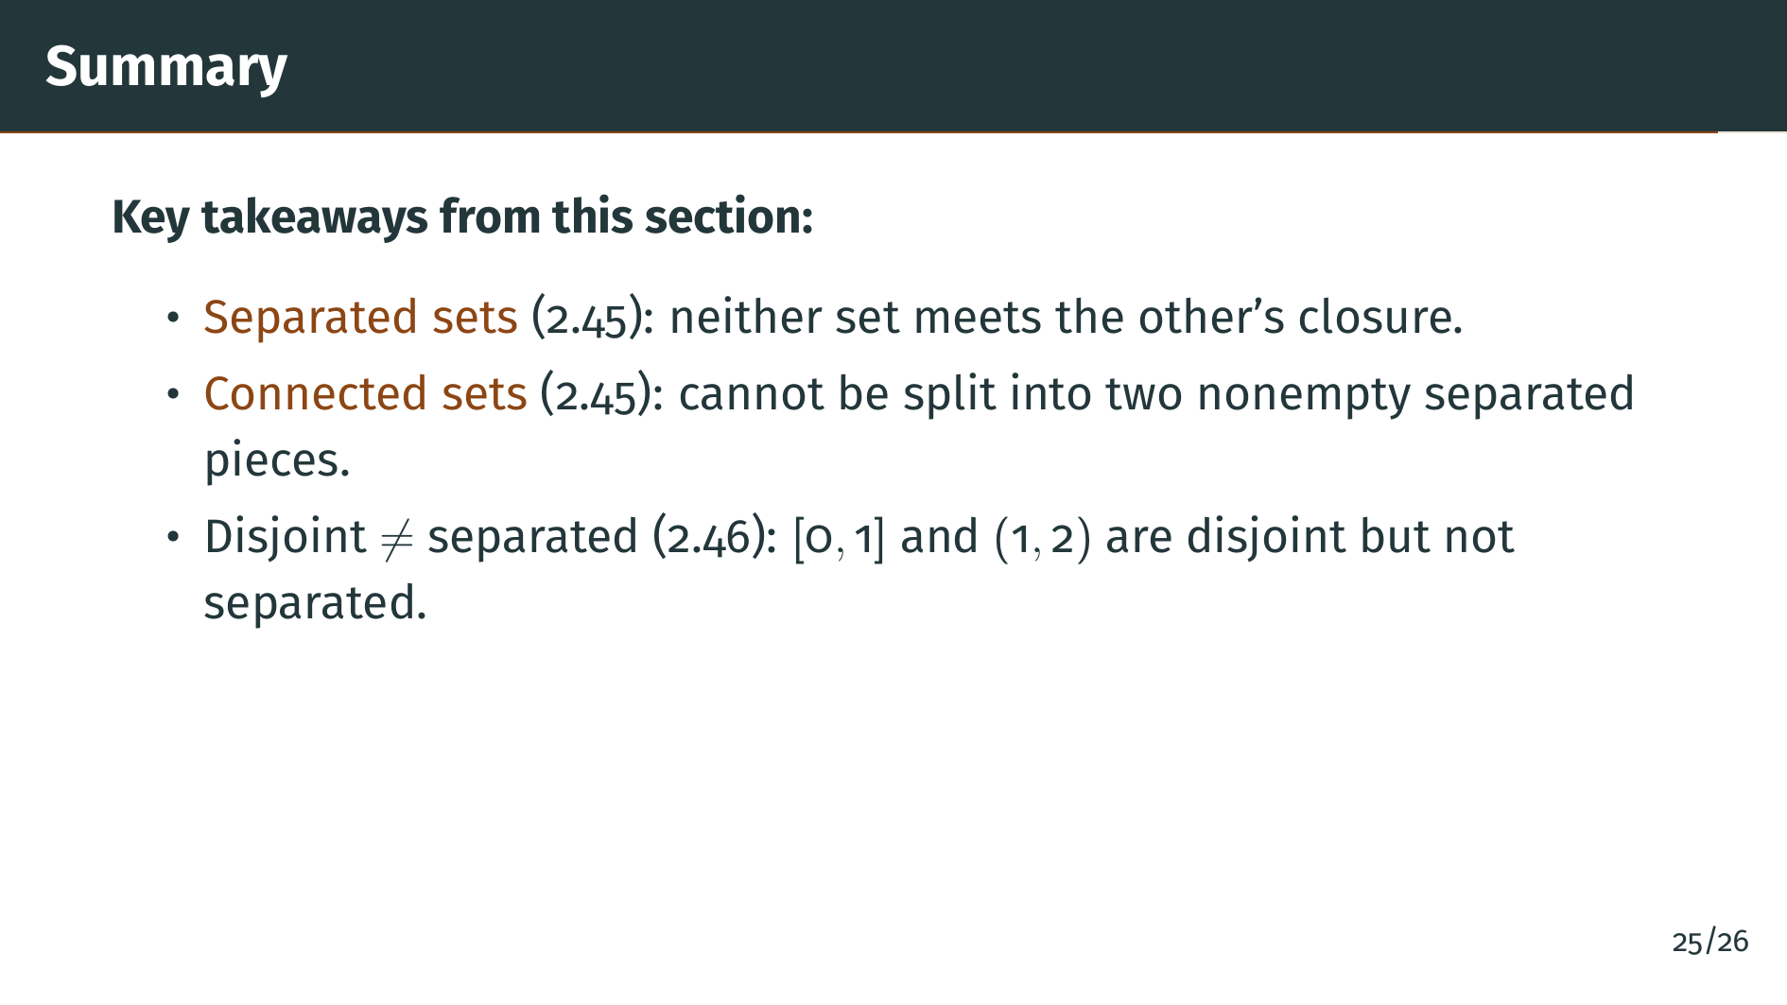
Notes:
Remark 2.46 clarified that disjointness alone is not enough for separation. The closed interval from 0 to 1 and the open segment from 1 to 2 are disjoint, but 1 is a limit point of the segment, so they are not separated. Two open segments sharing only a boundary value are truly separated.

Slide 30
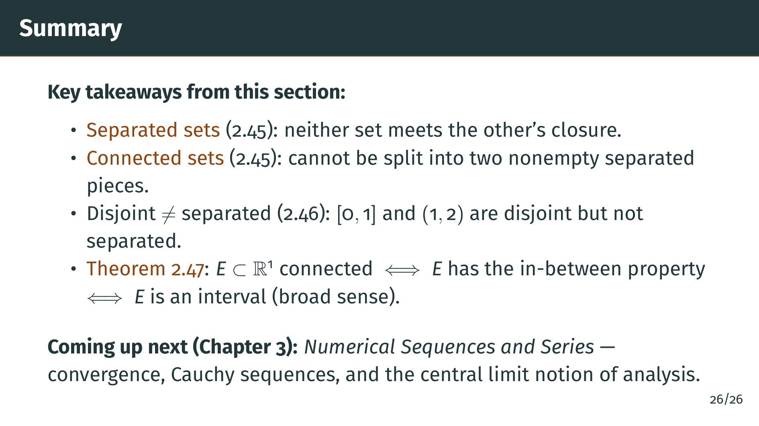
Notes:
The main theorem, Theorem 2.47, completely characterized connected subsets of the real line. They are exactly the sets with the in-between property, which means they are intervals in the broad sense: open, closed, half-open, or unbounded. This wraps up Chapter 2 on basic topology. In Chapter 3 we turn to numerical sequences and series, where the limit processes that drive analysis really begin. See you there.

