Slide 1
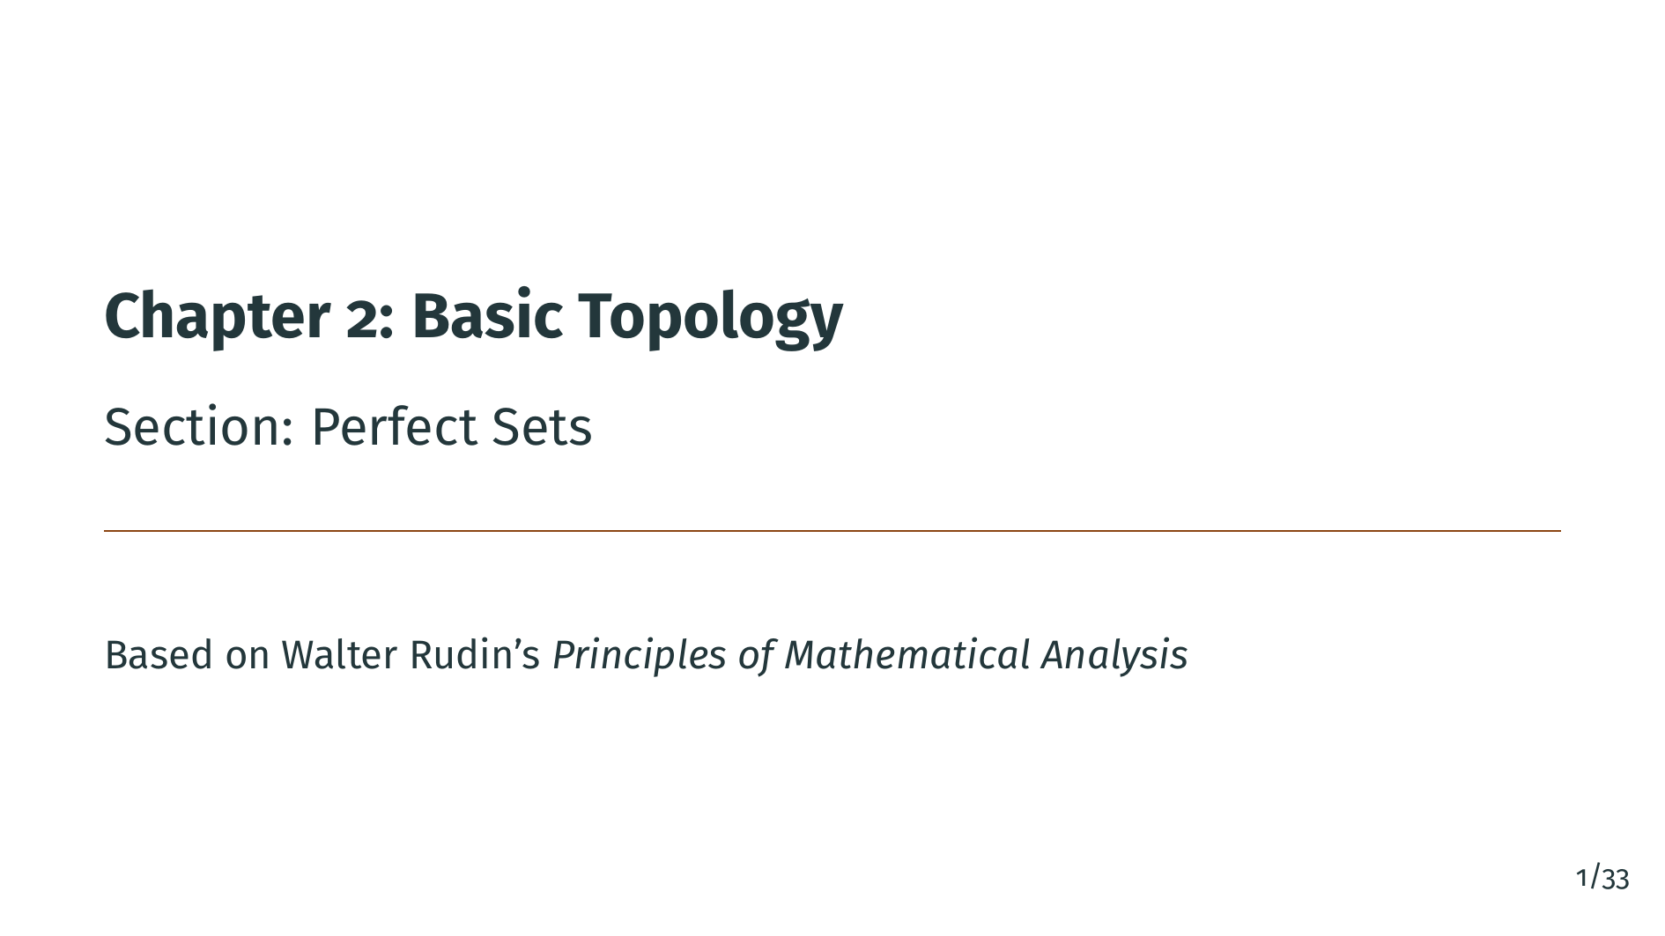
Notes:
Welcome back to Chapter 2 of Principles of Mathematical Analysis. In this section we study perfect sets. A perfect set is a closed set in which every point is a limit point, so there are no isolated points. These look like small, rigid objects, but we will see that they are always very large in a specific sense: every nonempty perfect set in Euclidean space is uncountable. As a striking application we will build the Cantor set, a perfect subset of the unit interval that contains no segment at all, yet is still uncountable. It is one of the most famous examples in analysis and in topology.

Slide 2
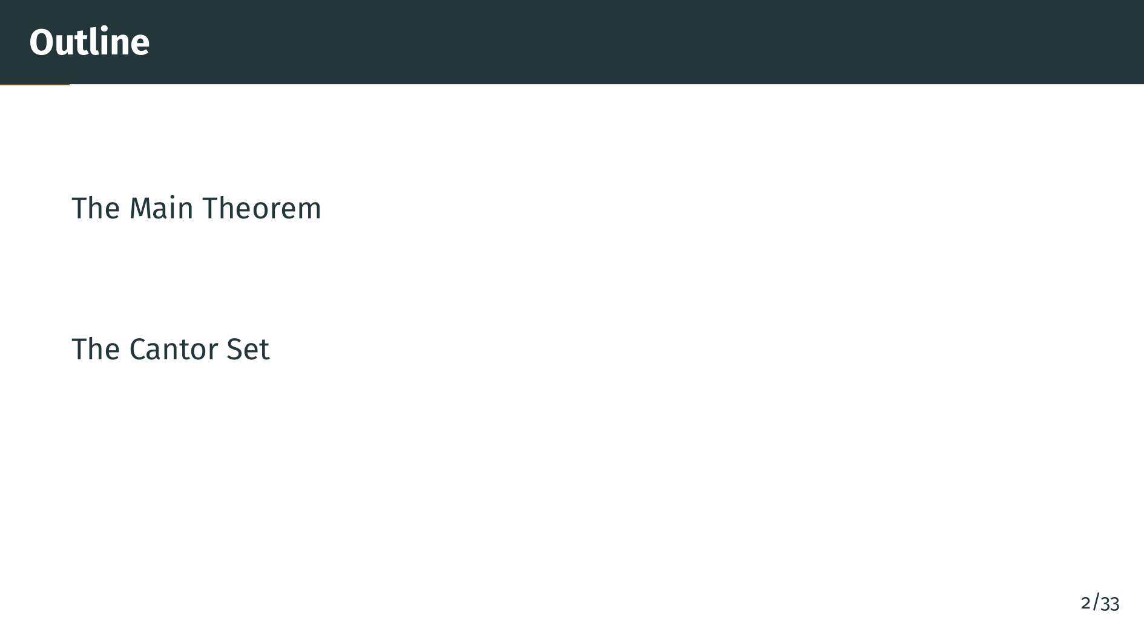
Notes:
Here is the plan. We start with a short motivation for why perfect sets deserve a dedicated section. Then we state and prove Theorem 2.43, which says that every nonempty perfect set in "R" to the "k" is uncountable. As an immediate corollary we get that every closed interval with more than one point, and therefore the entire real line, is uncountable. The second half of the section is devoted to the Cantor set: its construction, its properties, and why it is perfect even though it contains no segment at all.

Slide 3
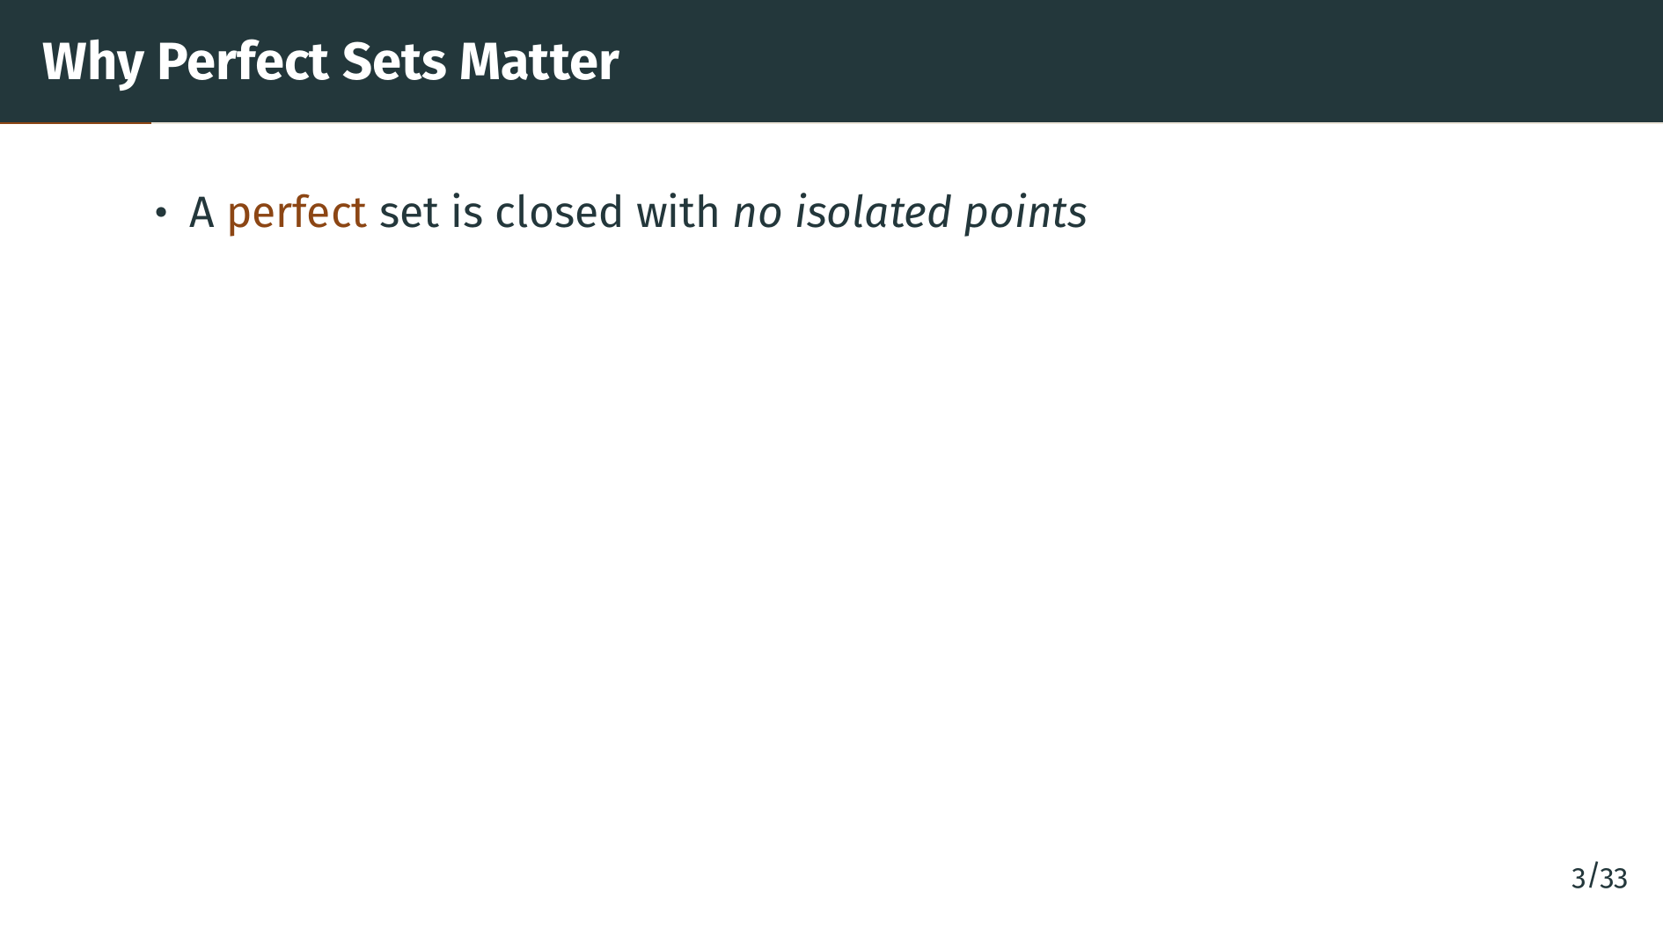
Notes:
Recall from Definition 2.18 that a set is perfect if it is closed and every point of the set is also a limit point. In plain terms, every point has other points of the set arbitrarily close by. There are no lonely points floating off on their own. This definition sounds mild, but it is the only hypothesis we need to conclude something very strong.

Slide 4
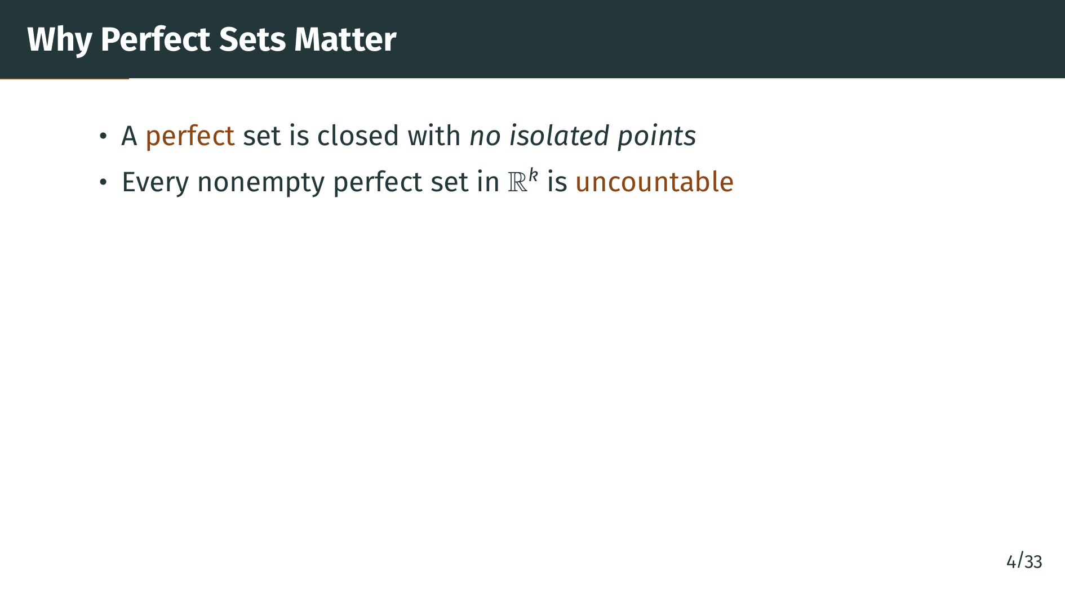
Notes:
The main result of this section is that every nonempty perfect subset of Euclidean space is uncountable. So once a closed set packs itself together densely enough that every point has neighbors, it must already contain continuum many points. This is a beautiful bridge between the topological property of no isolated points and the set theoretic property of uncountability.

Slide 5
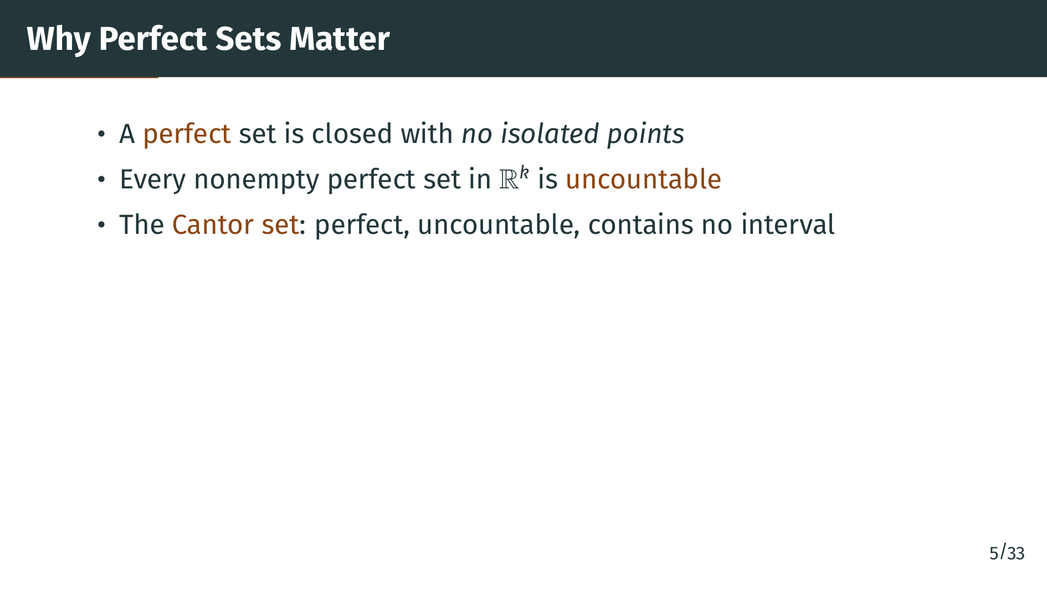
Notes:
Then we turn to the headline example: the Cantor set. It lives inside the unit interval, it contains no segment whatsoever, and yet it is perfect. By our theorem it must therefore be uncountable. The Cantor set is the prototype for many pathological examples later in the book, and in measure theory it gives an uncountable set of measure zero. Let us now make everything precise.

Slide 6
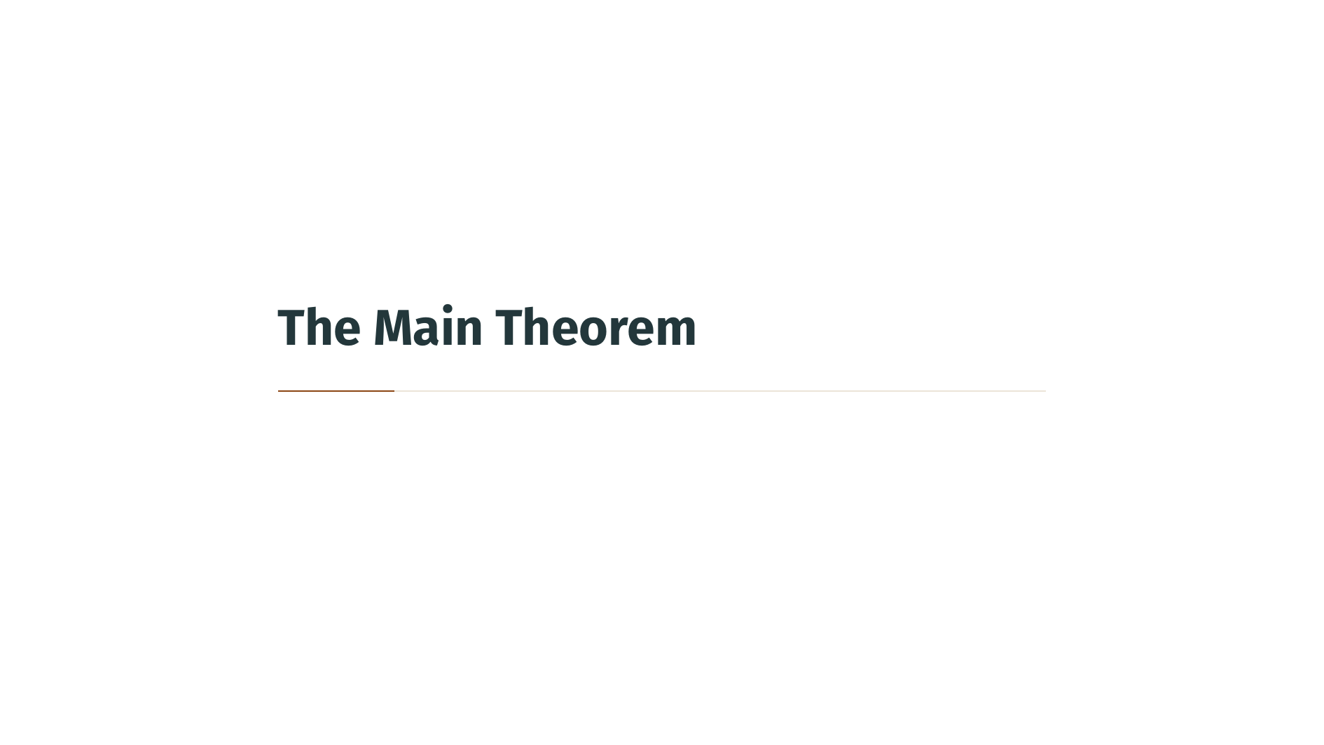

Slide 7
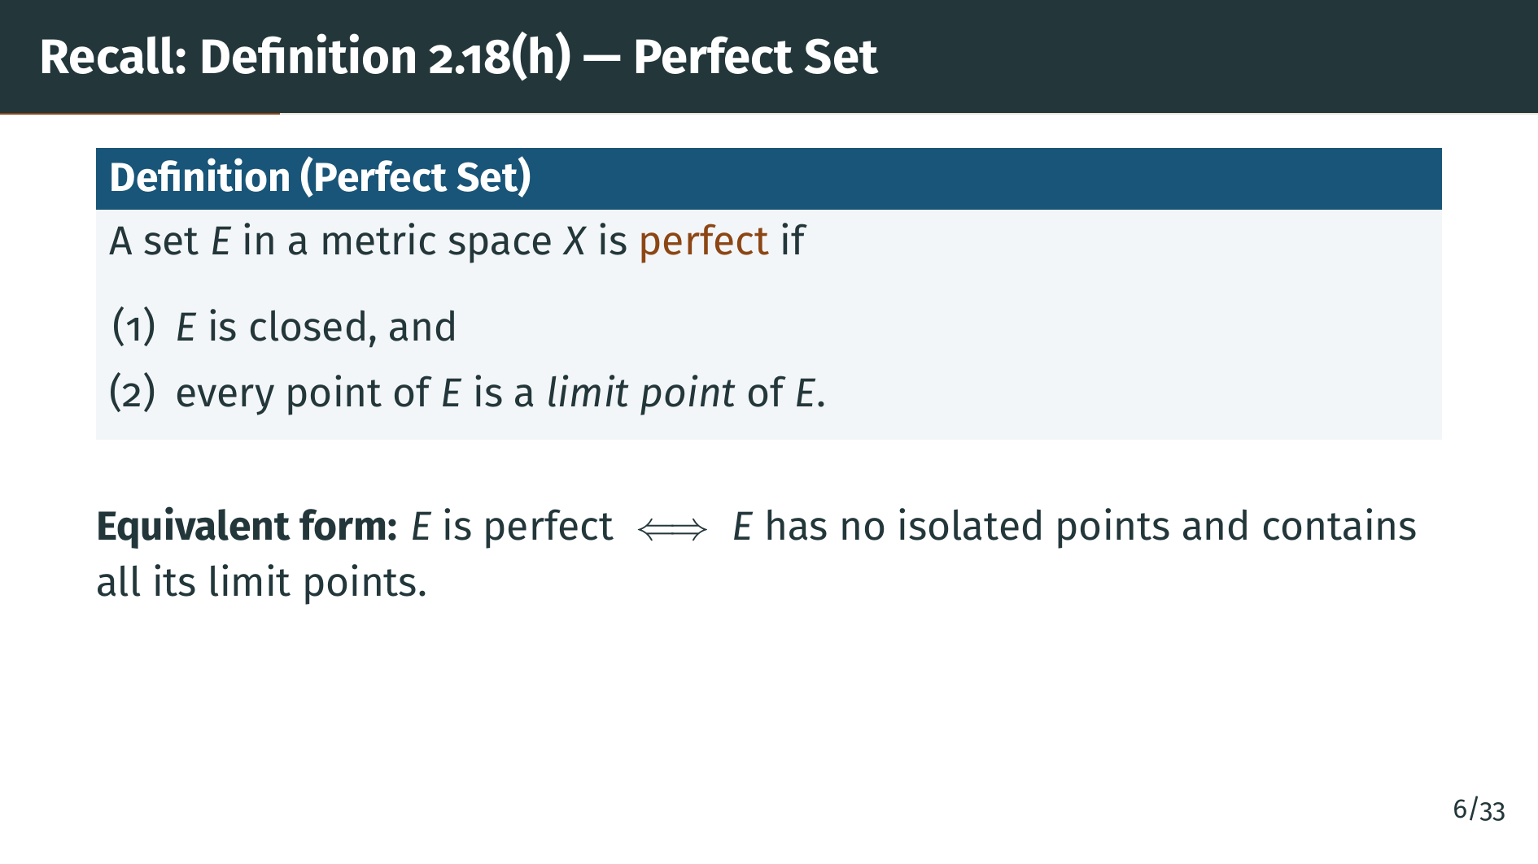
Notes:
Before we prove anything, let us remind ourselves what a perfect set is. The slide lists the two conditions. First, "E" must be closed, meaning it contains all of its limit points. Second, every point of "E" must be a limit point of "E", meaning every neighborhood of any point of "E" contains other points of "E". Combining the two, "E" has no isolated points and contains all its limit points. The two famous examples to keep in mind are any closed interval with positive length, and all of "R" to the "k". In the exercises we will see more exotic examples.

Slide 8
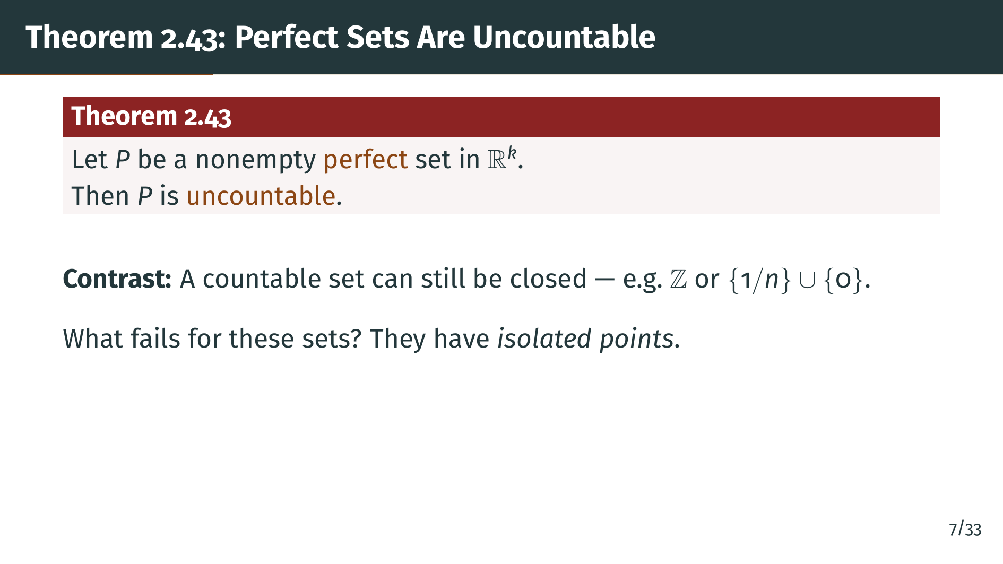
Notes:
Here is the theorem. Take any nonempty perfect set "P" sitting inside "R" to the "k". The conclusion is that "P" is uncountable, meaning its cardinality is at least that of the real line. Notice how little we are assuming about "P". We do not require it to be bounded, we do not require it to contain any segment, and we do not require it to be convex or nicely shaped. The only input is that it is closed with no isolated points. Compare this with the integers, which are closed but entirely made of isolated points, or with the set of zero together with 1 over "n", which has a limit point at zero but is still countable. Perfection is exactly the condition that rules out such countable closed sets.

Slide 9
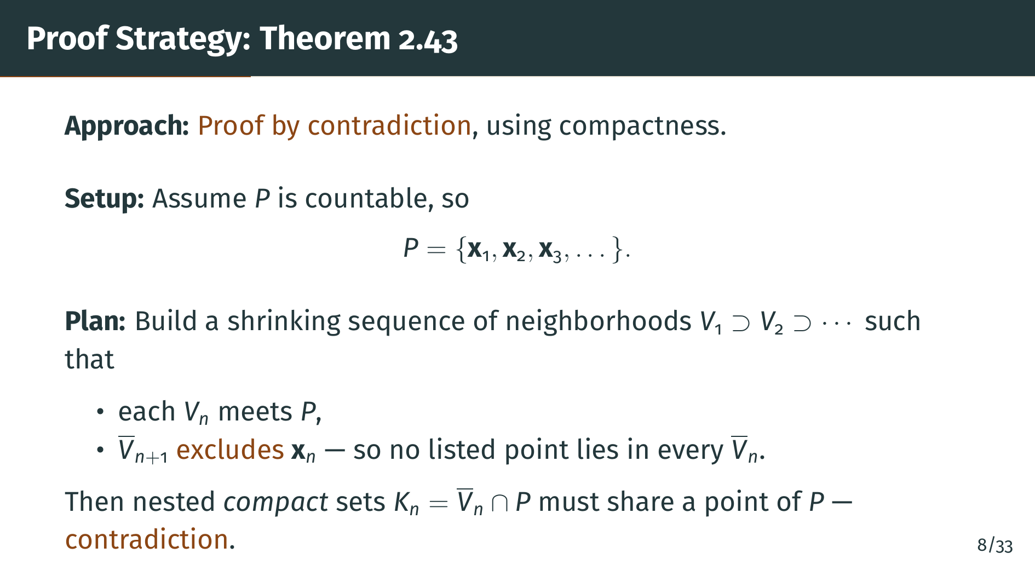
Notes:
The proof is a contradiction argument with a compactness twist. We suppose for contradiction that "P" is countable, so we can list all its points as "x" sub 1, "x" sub 2, "x" sub 3, and so on. The idea is to construct an infinite sequence of open balls, each with its closure sitting strictly inside the previous ball, and to do this so that two features hold. First, each ball meets "P", so the closures intersected with "P" are all nonempty compact sets. Second, by the time we reach the "n" plus first ball, we have excluded the "n"-th listed point of "P" from its closure, so no listed point survives in all of the nested compact sets. The corollary to Theorem 2.36 says nested nonempty compact sets have nonempty intersection. That intersection lies in "P", so it must contain some listed point; but we just kicked every listed point out. That is our contradiction. Let us work through each piece.

Slide 10
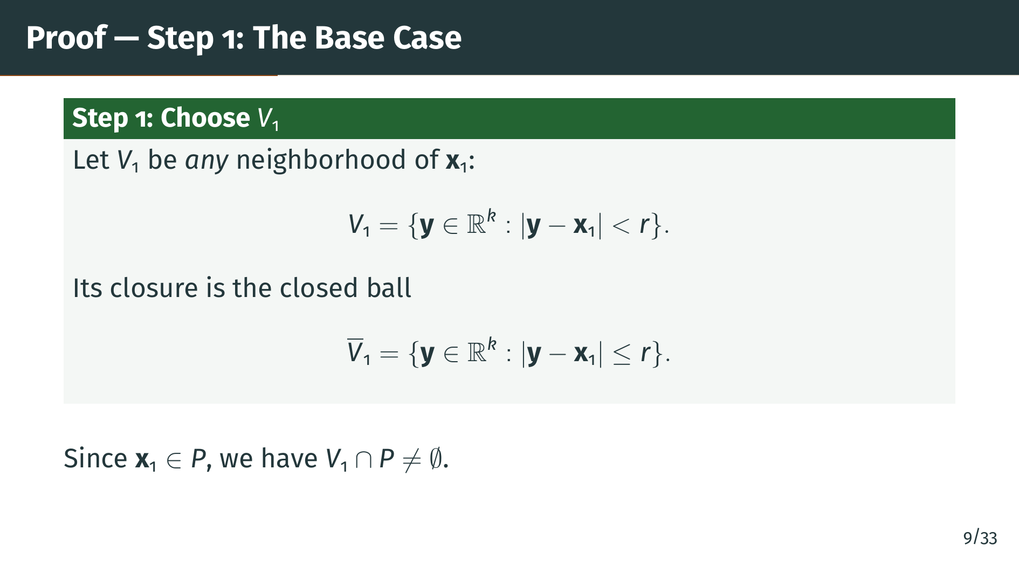
Notes:
We start by choosing any open ball around the first listed point "x" sub 1, and we call that ball "V" sub 1. The radius can be anything positive, it does not matter for the construction. The closure of "V" sub 1 is the corresponding closed ball with the boundary attached, shown on the slide. The key observation is that "x" sub 1 itself belongs to "P", so the open ball "V" sub 1 meets "P". This is the induction hypothesis we will propagate.

Slide 11
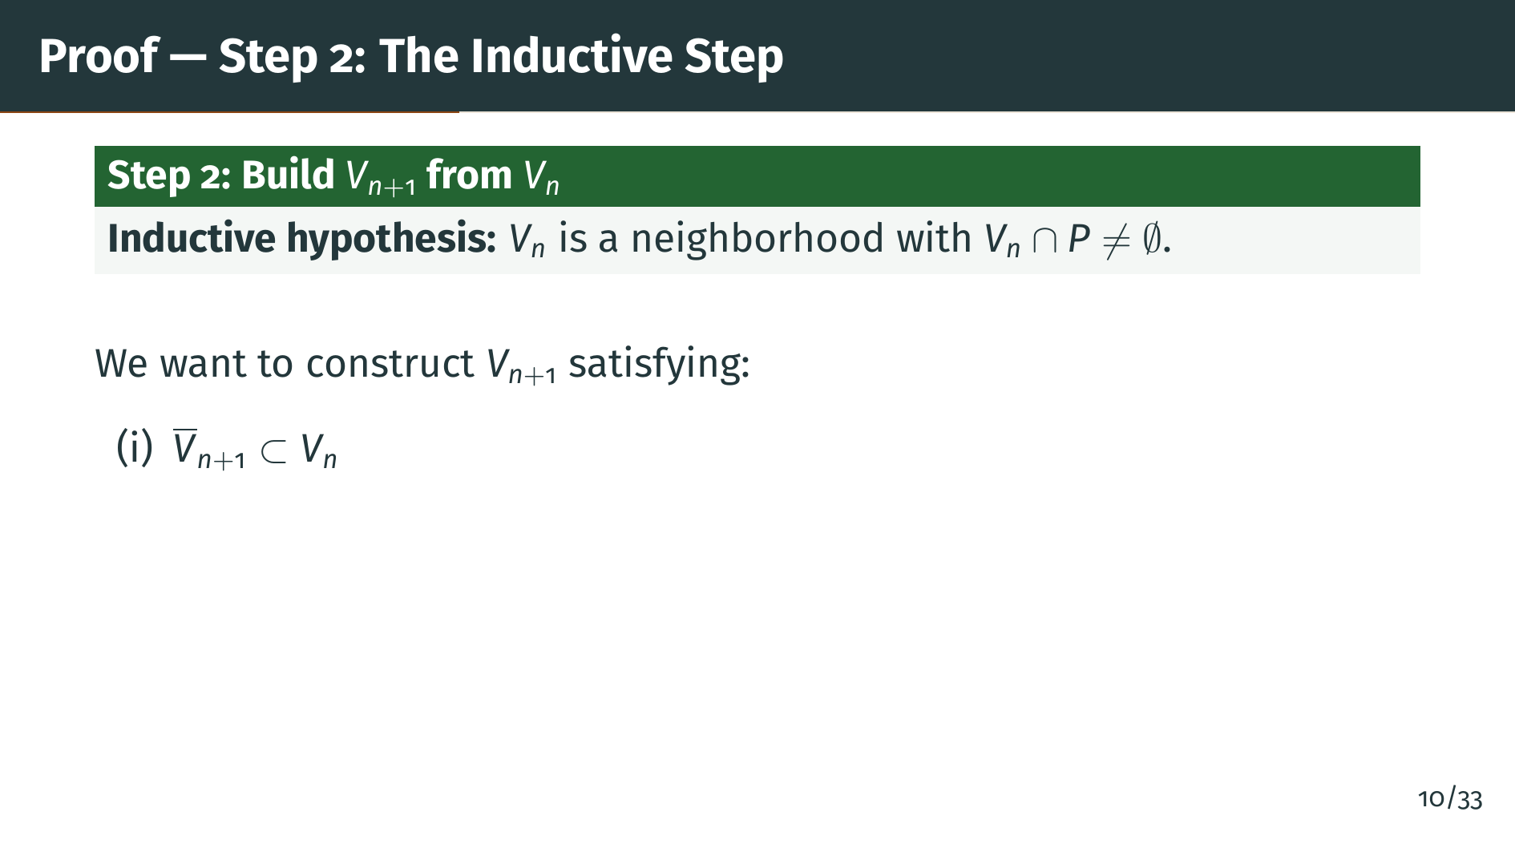
Notes:
Now for the inductive step. Suppose we have already constructed "V" sub "n" and it meets "P". Our goal is to choose a smaller neighborhood "V" sub "n" plus 1 with three properties. The first property is that the closure of "V" sub "n" plus 1 sits strictly inside "V" sub "n". This makes the sequence of closures a genuinely nested decreasing sequence, which is what we need for the compactness argument at the end.

Slide 12
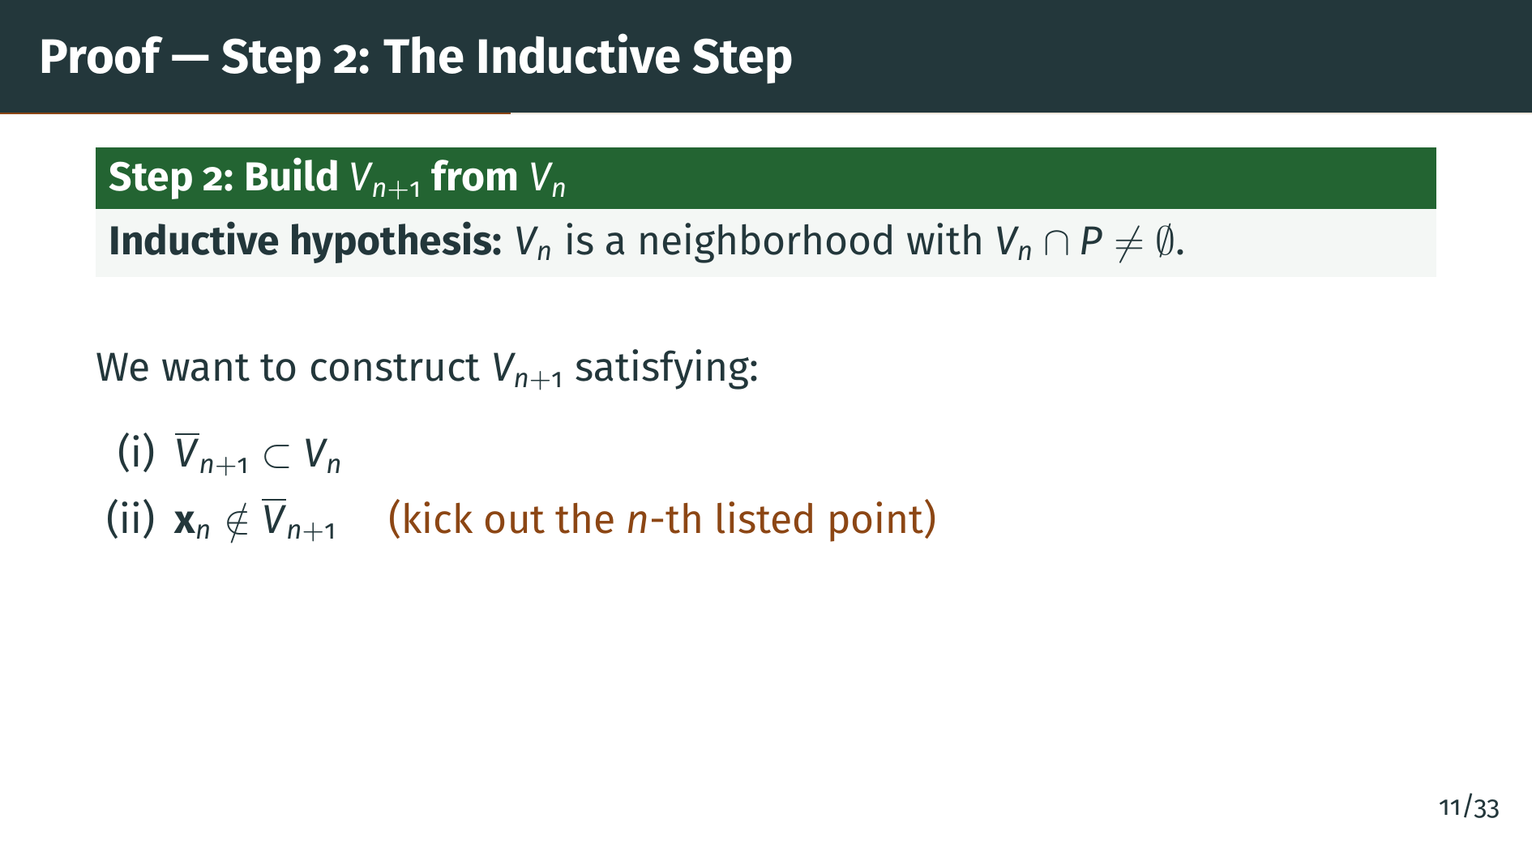
Notes:
The second property is the clever part. We insist that "x" sub "n", the "n"-th listed point of "P", is not in the closure of "V" sub "n" plus 1. In other words, we kick the "n"-th point of "P" out of our closed ball. Over the course of the induction, we will have kicked out every listed point of "P", so nothing in our countable listing can survive in every closure.

Slide 13
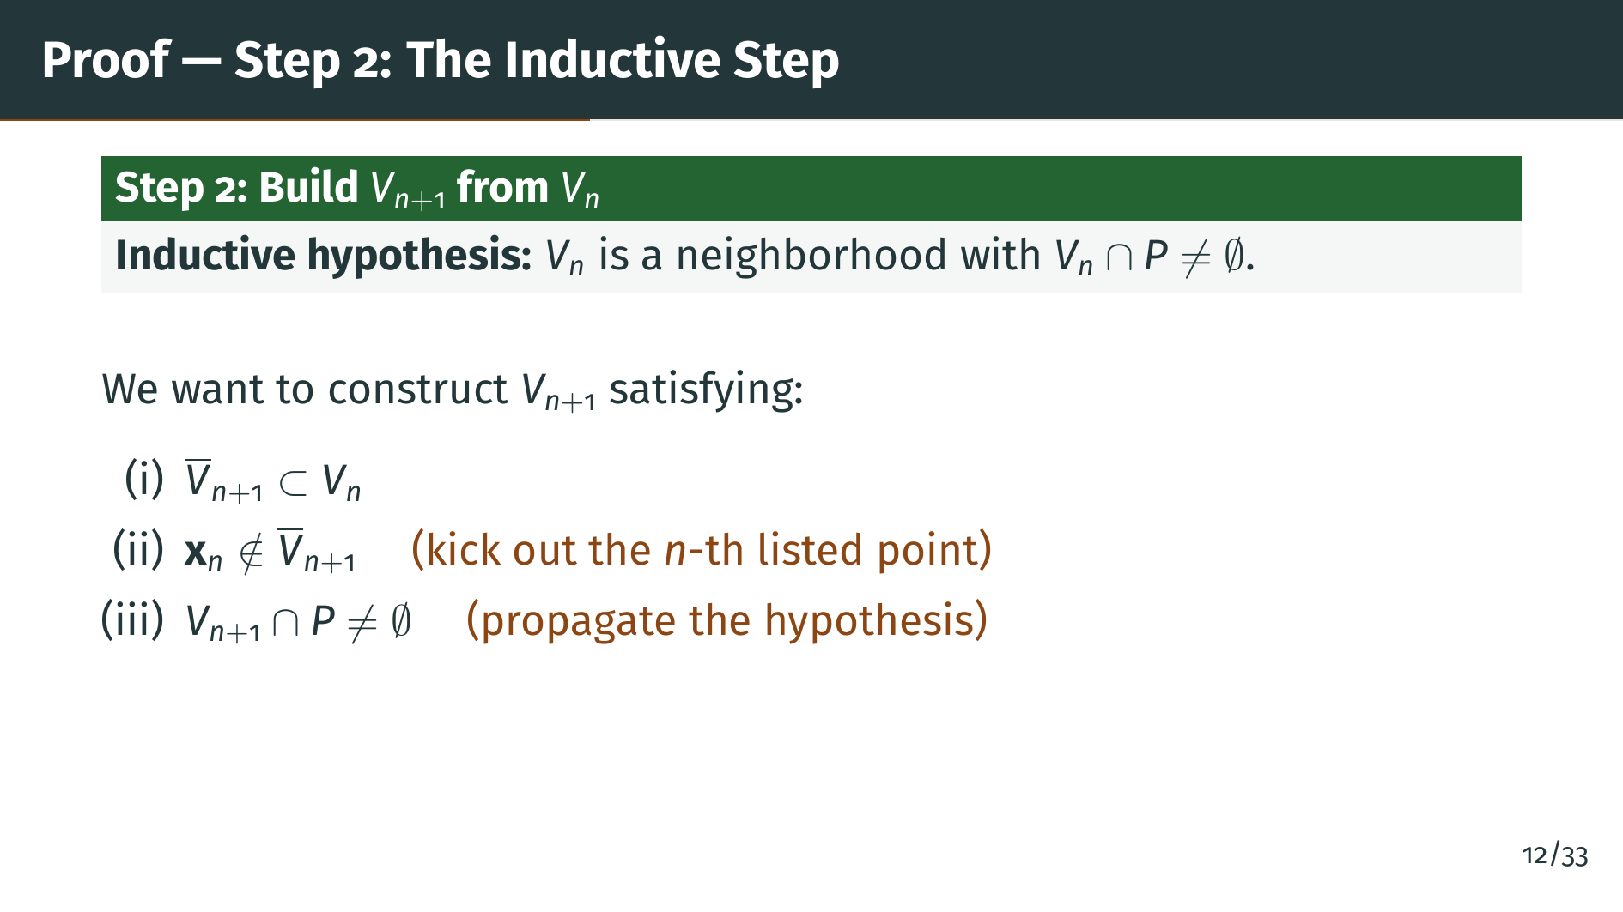
Notes:
The third property is what we need to run the induction again: the new neighborhood must also meet "P". Without this we could not continue the construction past step "n" plus 1. Now, can we really always achieve all three simultaneously? That is where perfection of "P" enters the argument.

Slide 14
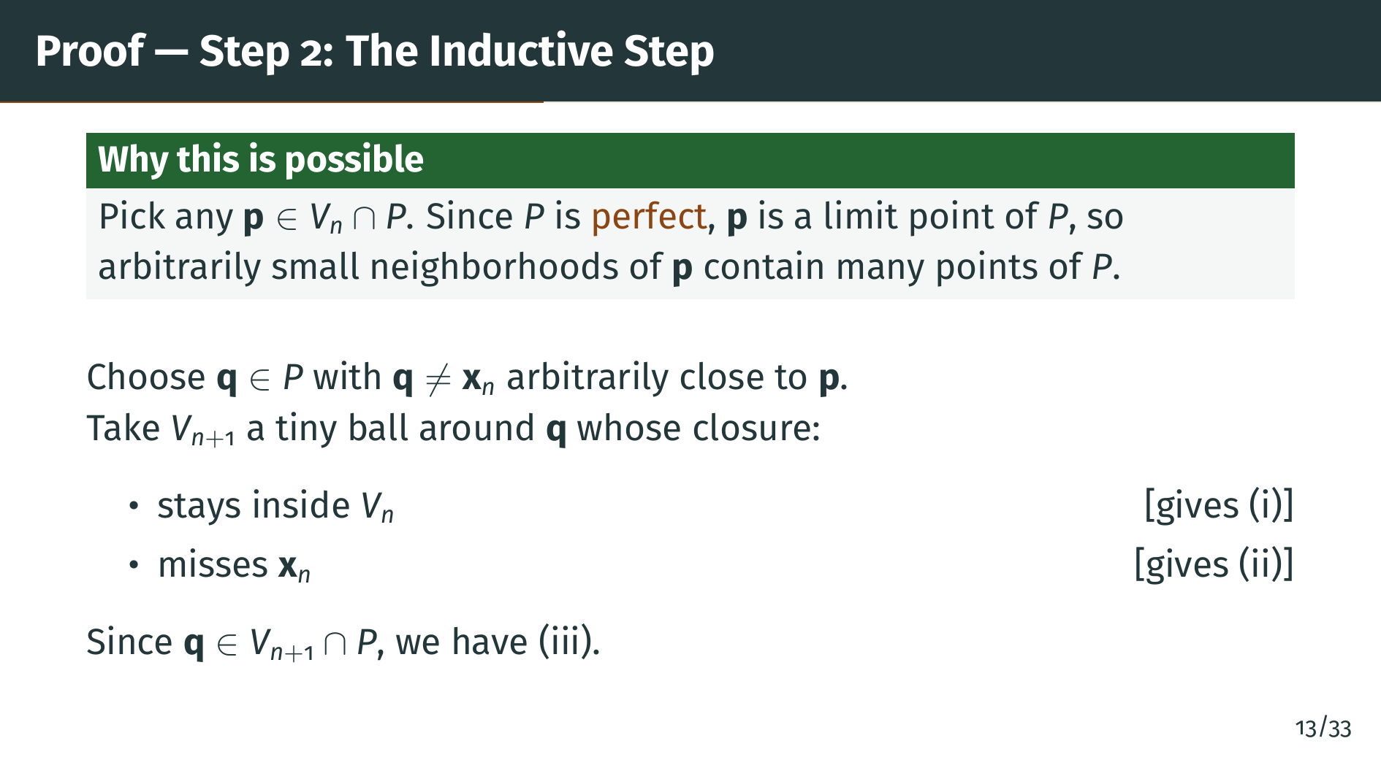
Notes:
Here is the construction, powered by perfection. Take any point "p" of "P" inside "V" sub "n", which exists by the inductive hypothesis. Since "P" is perfect, "p" is a limit point of "P", so every neighborhood of "p" contains infinitely many points of "P" by Theorem 2.20. Pick a point "q" of "P" near "p" but different from "x" sub "n". Then take a small open ball around "q" whose closure stays inside "V" sub "n" and does not touch "x" sub "n". Call that ball "V" sub "n" plus 1. The first two conditions are built in by the choice of radius, and the third condition holds because "q" itself is in "V" sub "n" plus 1 and in "P". The induction proceeds.

Slide 15
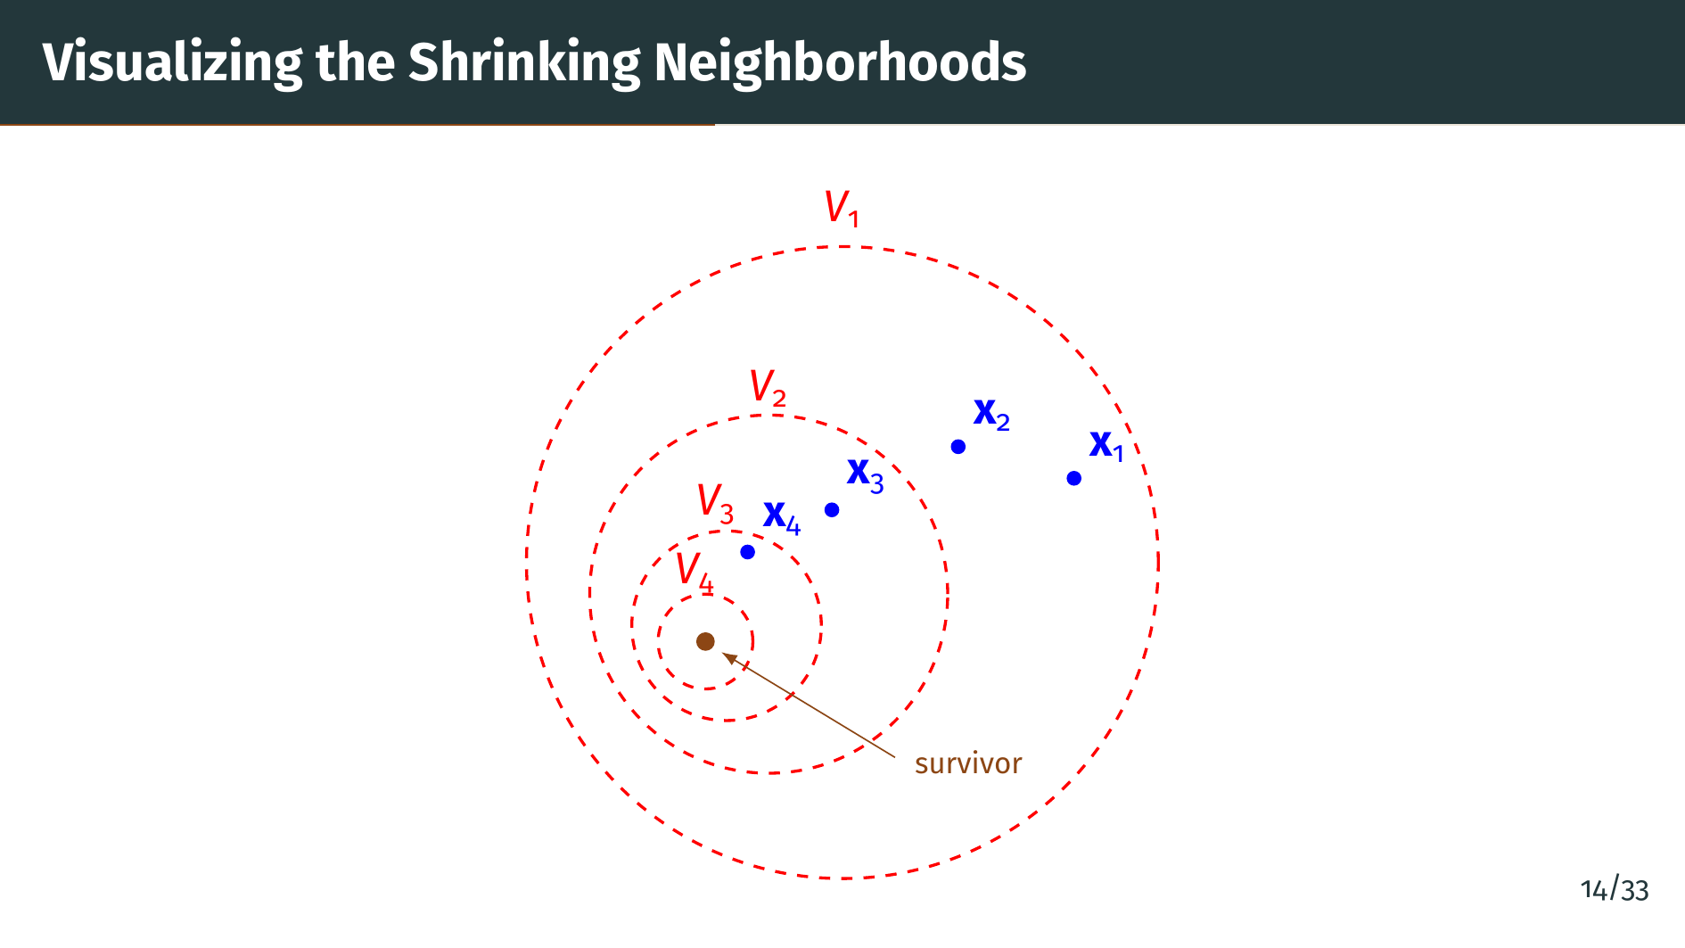
Notes:
This picture shows the idea behind the construction. The four red dashed circles are successive open balls "V" sub 1, "V" sub 2, "V" sub 3, "V" sub 4, each with its closure strictly inside the previous one. The blue dots are the listed points of "P", namely "x" sub 1, "x" sub 2, "x" sub 3, "x" sub 4. Notice that "x" sub 1 sits inside "V" sub 1 but is kicked out once we pass to "V" sub 2. At each successive step we steer the next ball so that its closure excludes the next listed point. So after a few steps, none of "x" sub 1, "x" sub 2, "x" sub 3, or "x" sub 4 remain in the inner balls. The orange dot in the center represents the target of the nesting, a point that should survive all intersections. Compactness will tell us that such a surviving point actually exists.

Slide 16
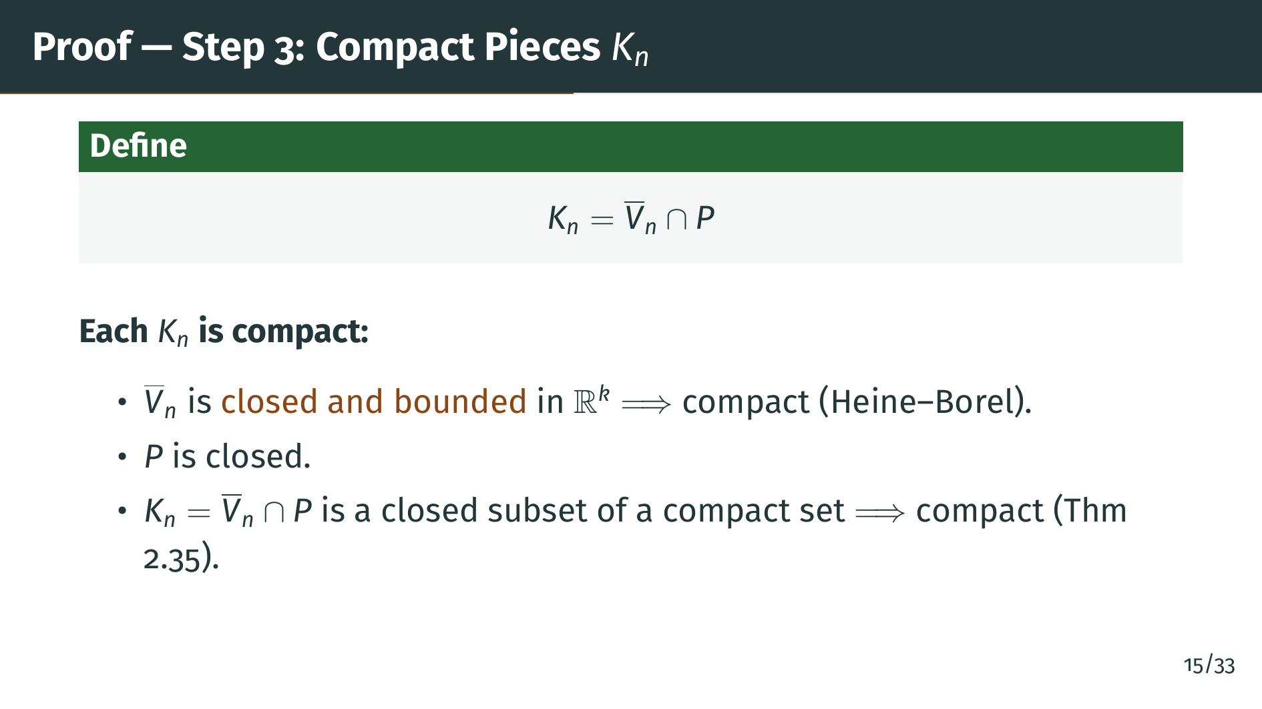
Notes:
Now we switch from open neighborhoods to compact building blocks. Define "K" sub "n" to be the closure of "V" sub "n" intersected with "P". Each "K" sub "n" is compact, for two reasons on the slide. First, the closure of "V" sub "n" is a closed ball, hence closed and bounded in Euclidean space, which makes it compact by the Heine-Borel theorem. Second, "P" is closed by perfection, so the intersection of a closed set and a compact set is a closed subset of a compact set, which is again compact by Theorem 2.35. So each "K" sub "n" is a compact subset of "P".

Slide 17
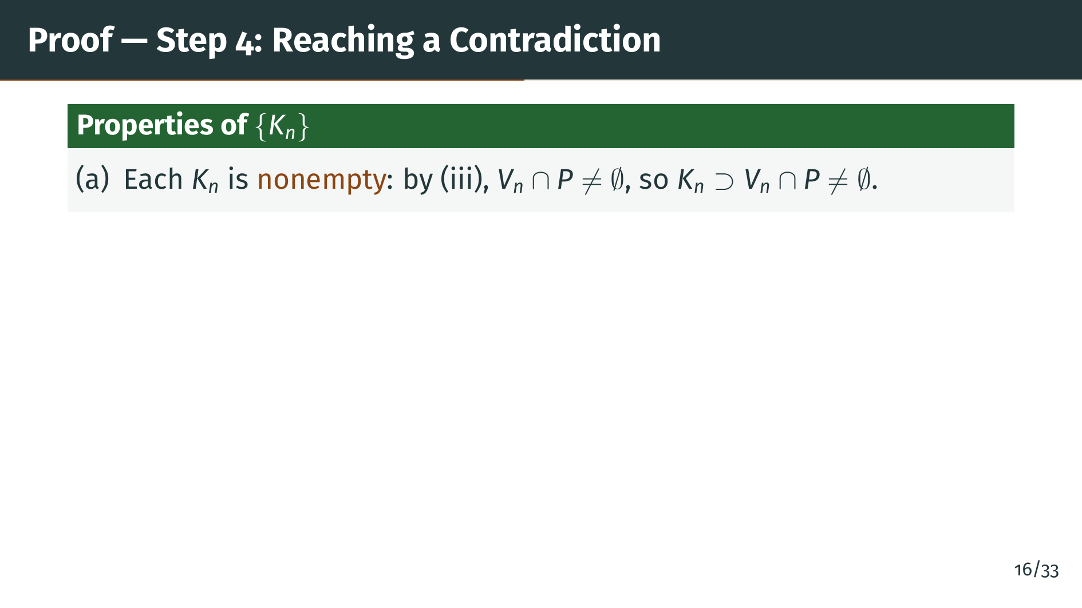
Notes:
We will show that the compact sets "K" sub "n" satisfy the hypotheses of the corollary to Theorem 2.36, but their intersection is nevertheless empty. That corollary says nested nonempty compact sets cannot have empty intersection, so we will have a contradiction. First, each "K" sub "n" is nonempty. This is because "V" sub "n" meets "P" by the third condition of our construction, and "K" sub "n" is even larger than "V" sub "n" intersected with "P", since it uses the closure. So "K" sub "n" is nonempty.

Slide 18
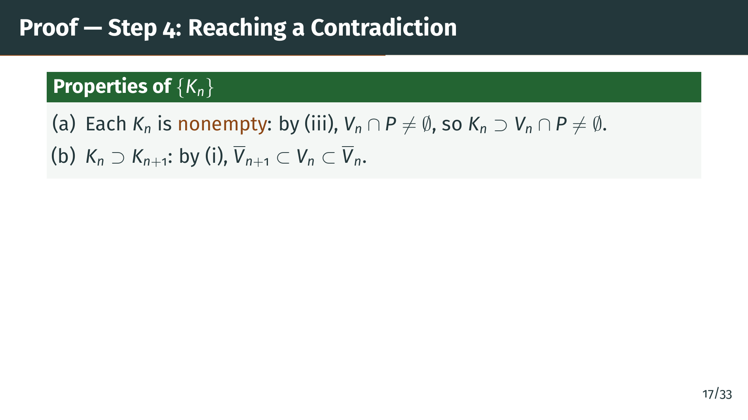
Notes:
Second, the sets are nested. By the first condition of our construction, the closure of "V" sub "n" plus 1 lies in "V" sub "n", hence in the closure of "V" sub "n". So intersecting with "P" gives "K" sub "n" plus 1 as a subset of "K" sub "n". The sequence "K" sub 1, "K" sub 2, "K" sub 3, and so on, is a decreasing chain of nonempty compact sets.

Slide 19
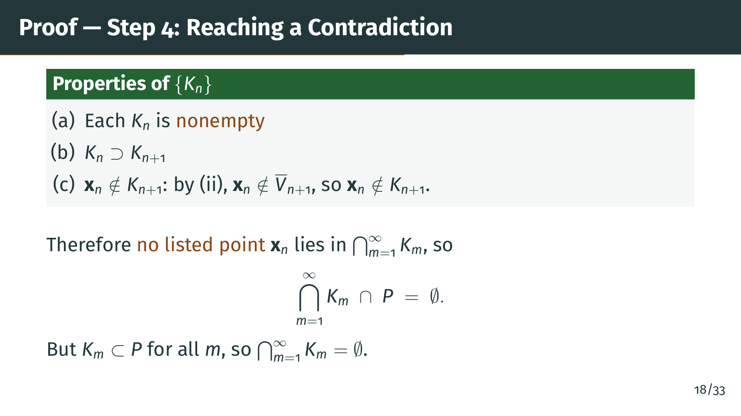
Notes:
Third, and this is the key observation, for each "n" the point "x" sub "n" is not in "K" sub "n" plus 1. This is exactly the second condition of our construction, phrased in terms of "K". So "x" sub "n" is missing from "K" sub "n" plus 1 and therefore, by nesting, from every "K" sub "m" with "m" bigger than "n". So "x" sub "n" is not in the total intersection. Since every point of "P" appears somewhere in our list, no point of "P" is in the intersection. But the "K" sub "m" are all subsets of "P", so their intersection is a subset of "P" that contains no point of "P". In other words, the intersection is empty.

Slide 20
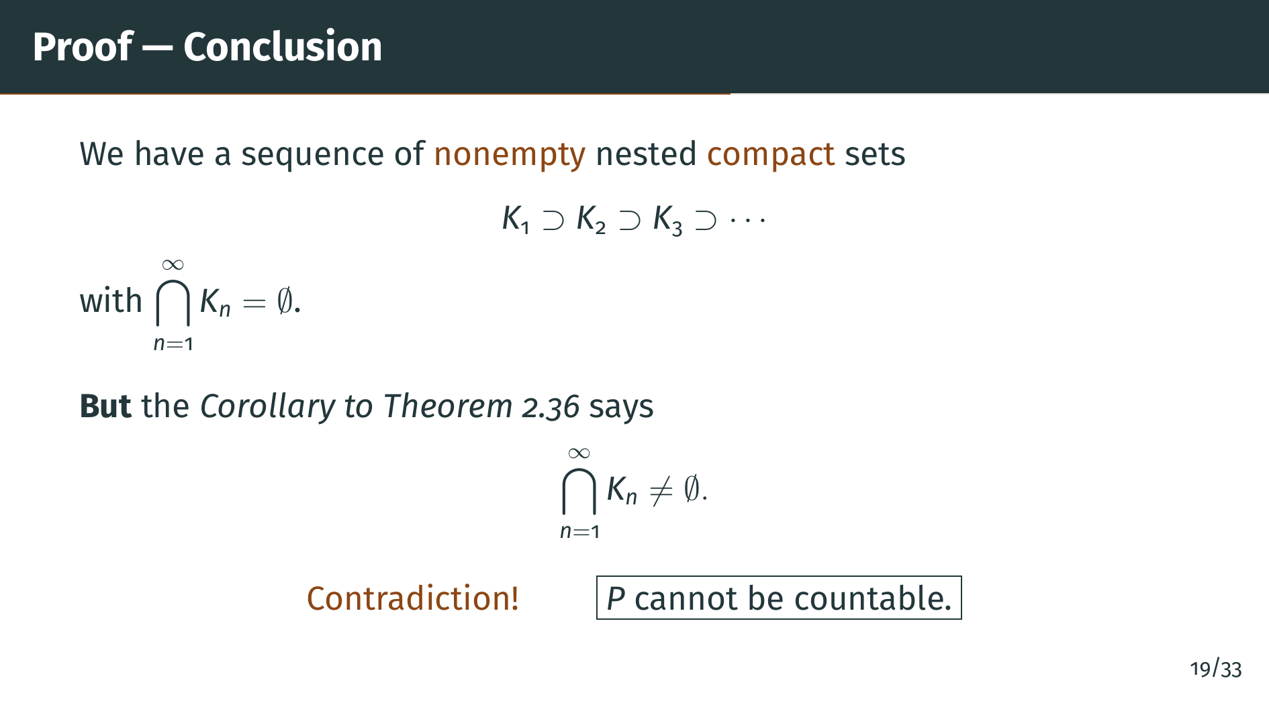
Notes:
We have reached a contradiction. The corollary to Theorem 2.36 stated that a nested decreasing sequence of nonempty compact sets has nonempty intersection. Our "K" sub "n" are nonempty, nested, and compact, so their intersection should be nonempty. But we just showed it is empty. The only way to avoid this contradiction is to reject the assumption that "P" is countable. Therefore every nonempty perfect set in "R" to the "k" is uncountable. The theorem is proved.

Slide 21
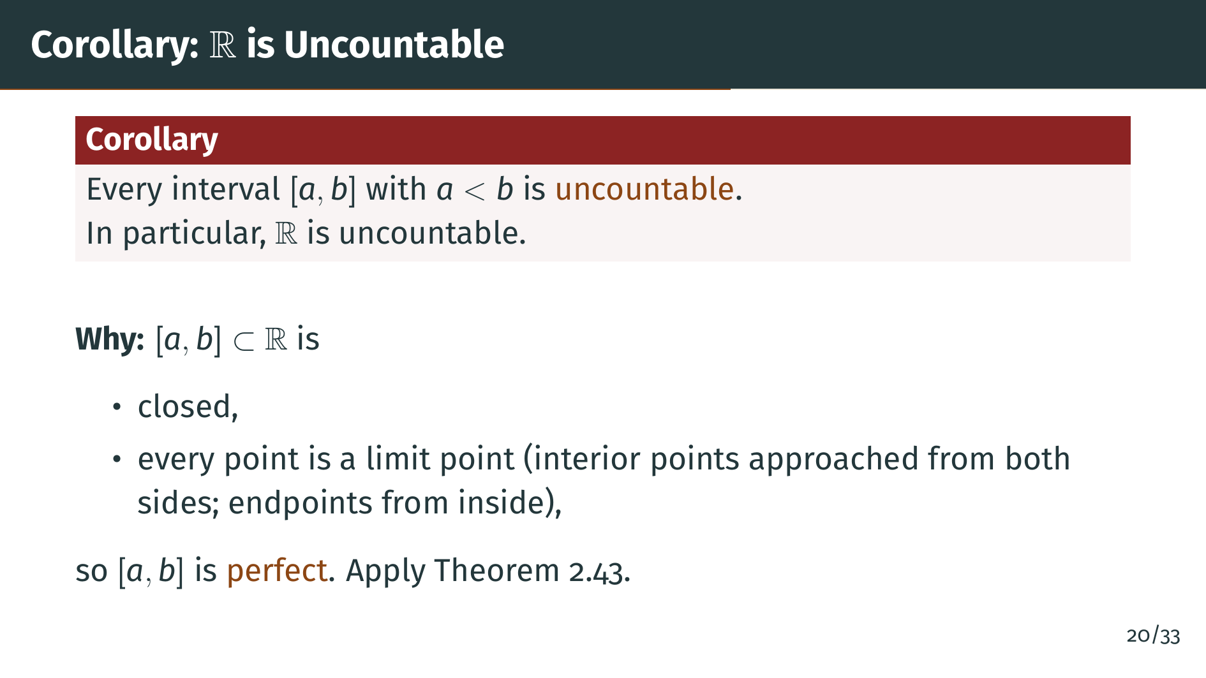
Notes:
As an immediate consequence we get a classical result: every closed interval with distinct endpoints is uncountable, and therefore the real line itself is uncountable. The reason is that such an interval is perfect. It is closed, and every one of its points is a limit point. An interior point has other points of the interval on both sides approaching it, while each endpoint has points of the interval approaching it from inside. Since there are no isolated points, Theorem 2.43 applies and tells us the interval is uncountable. This gives a second proof of the uncountability of the real numbers, using topology rather than a diagonal argument.

Slide 22


Slide 23
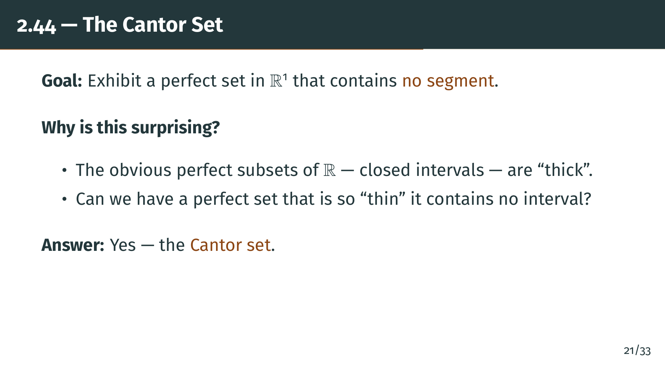
Notes:
To round out the section, Rudin constructs the most famous example of a perfect set, the Cantor set. The surprise is this: the obvious perfect subsets of the real line, like a closed interval, are what we might call thick, because they contain open intervals. Is there a perfect set so thin that it contains no interval at all? The answer is yes, and the Cantor construction will build one. Once we have it, our main theorem automatically tells us it is uncountable, giving a strange little set that is as small as possible in one sense and as big as possible in another.

Slide 24
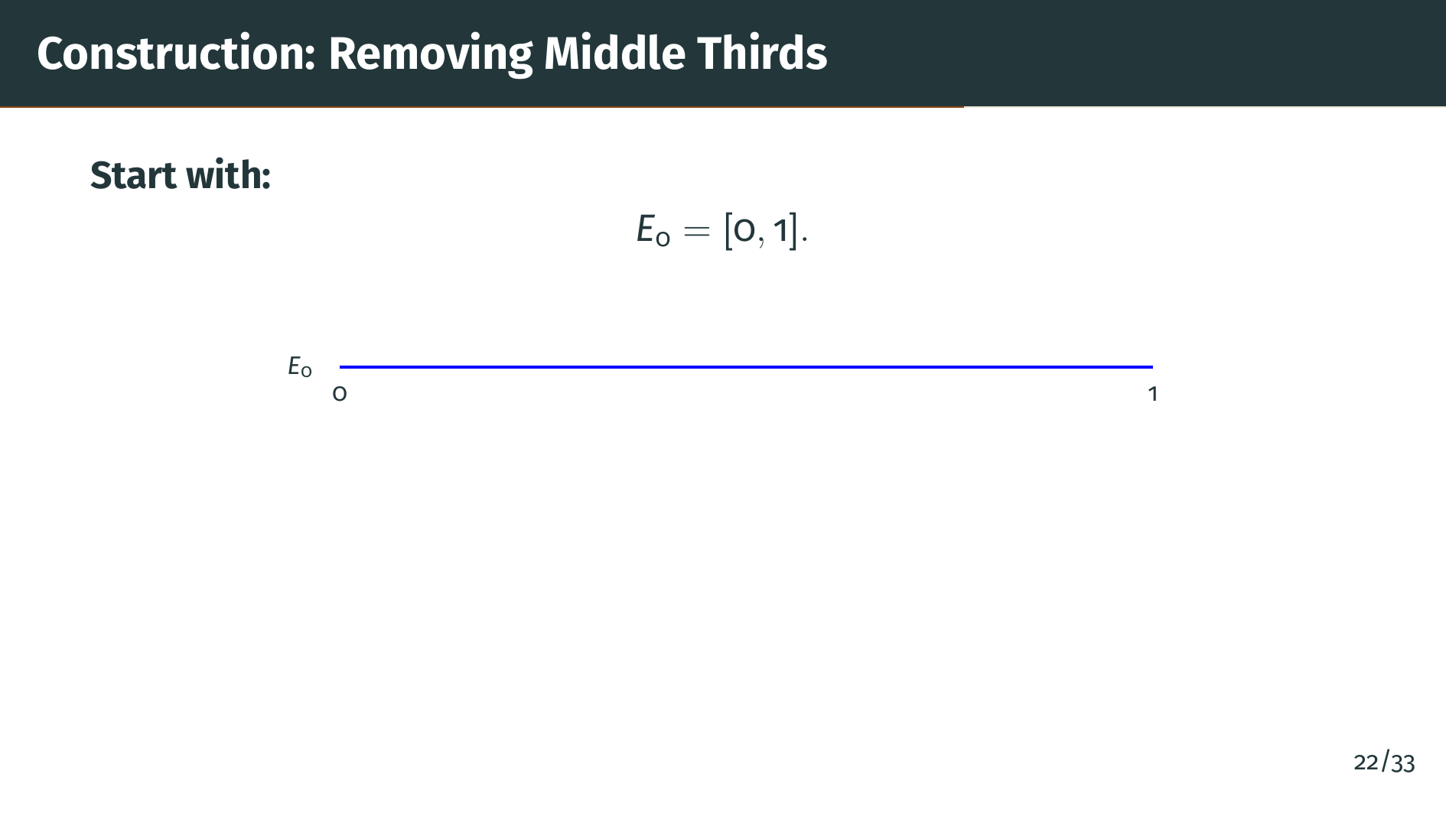
Notes:
The construction proceeds in stages. Stage zero is easy: "E" sub zero is just the closed unit interval from 0 to 1, shown as the blue bar on the slide. At each subsequent stage we will delete the open middle third of every interval present, leaving a shorter, more fragmented set. Let us watch the first few stages.

Slide 25
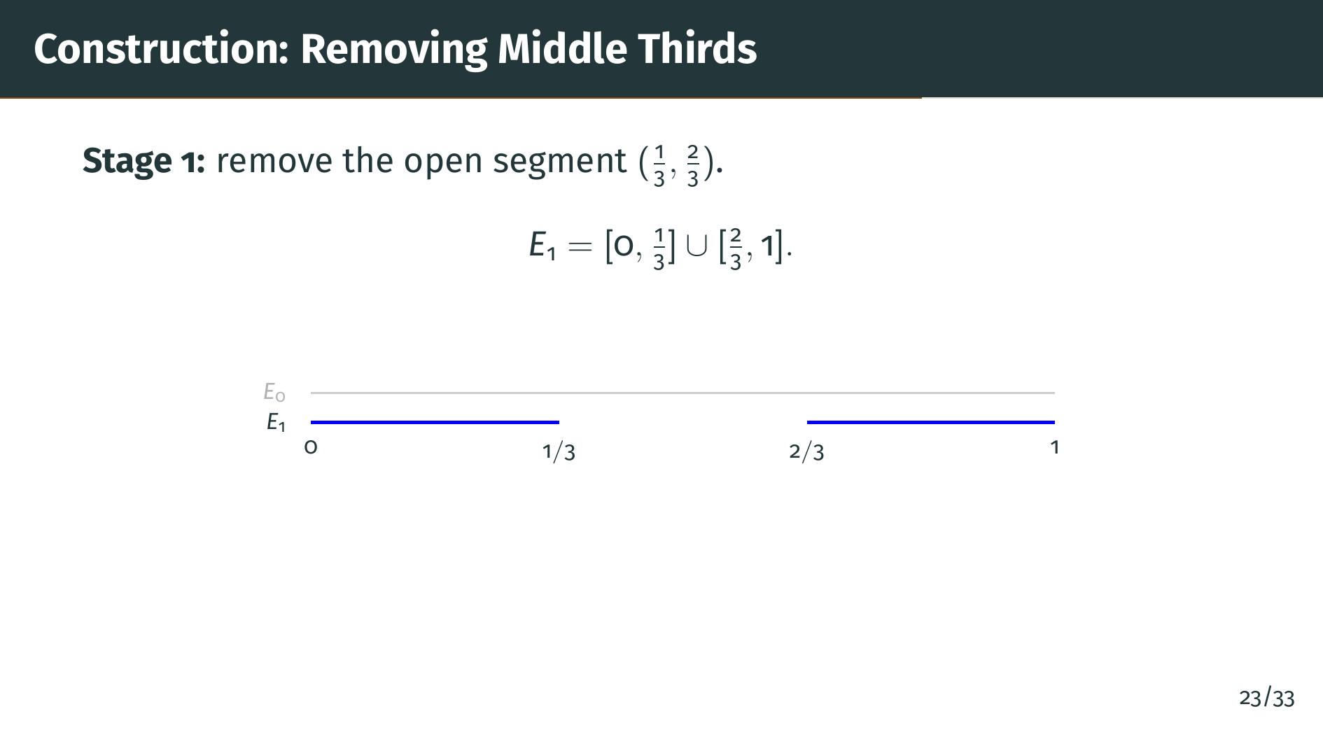
Notes:
At stage 1 we remove the open middle third of the unit interval, that is, the open segment from 1 over 3 to 2 over 3. What remains is "E" sub 1, the union of two closed intervals, the left third and the right third. On the picture, the grey bar above is "E" sub zero for reference, and the blue pieces below are "E" sub 1.

Slide 26
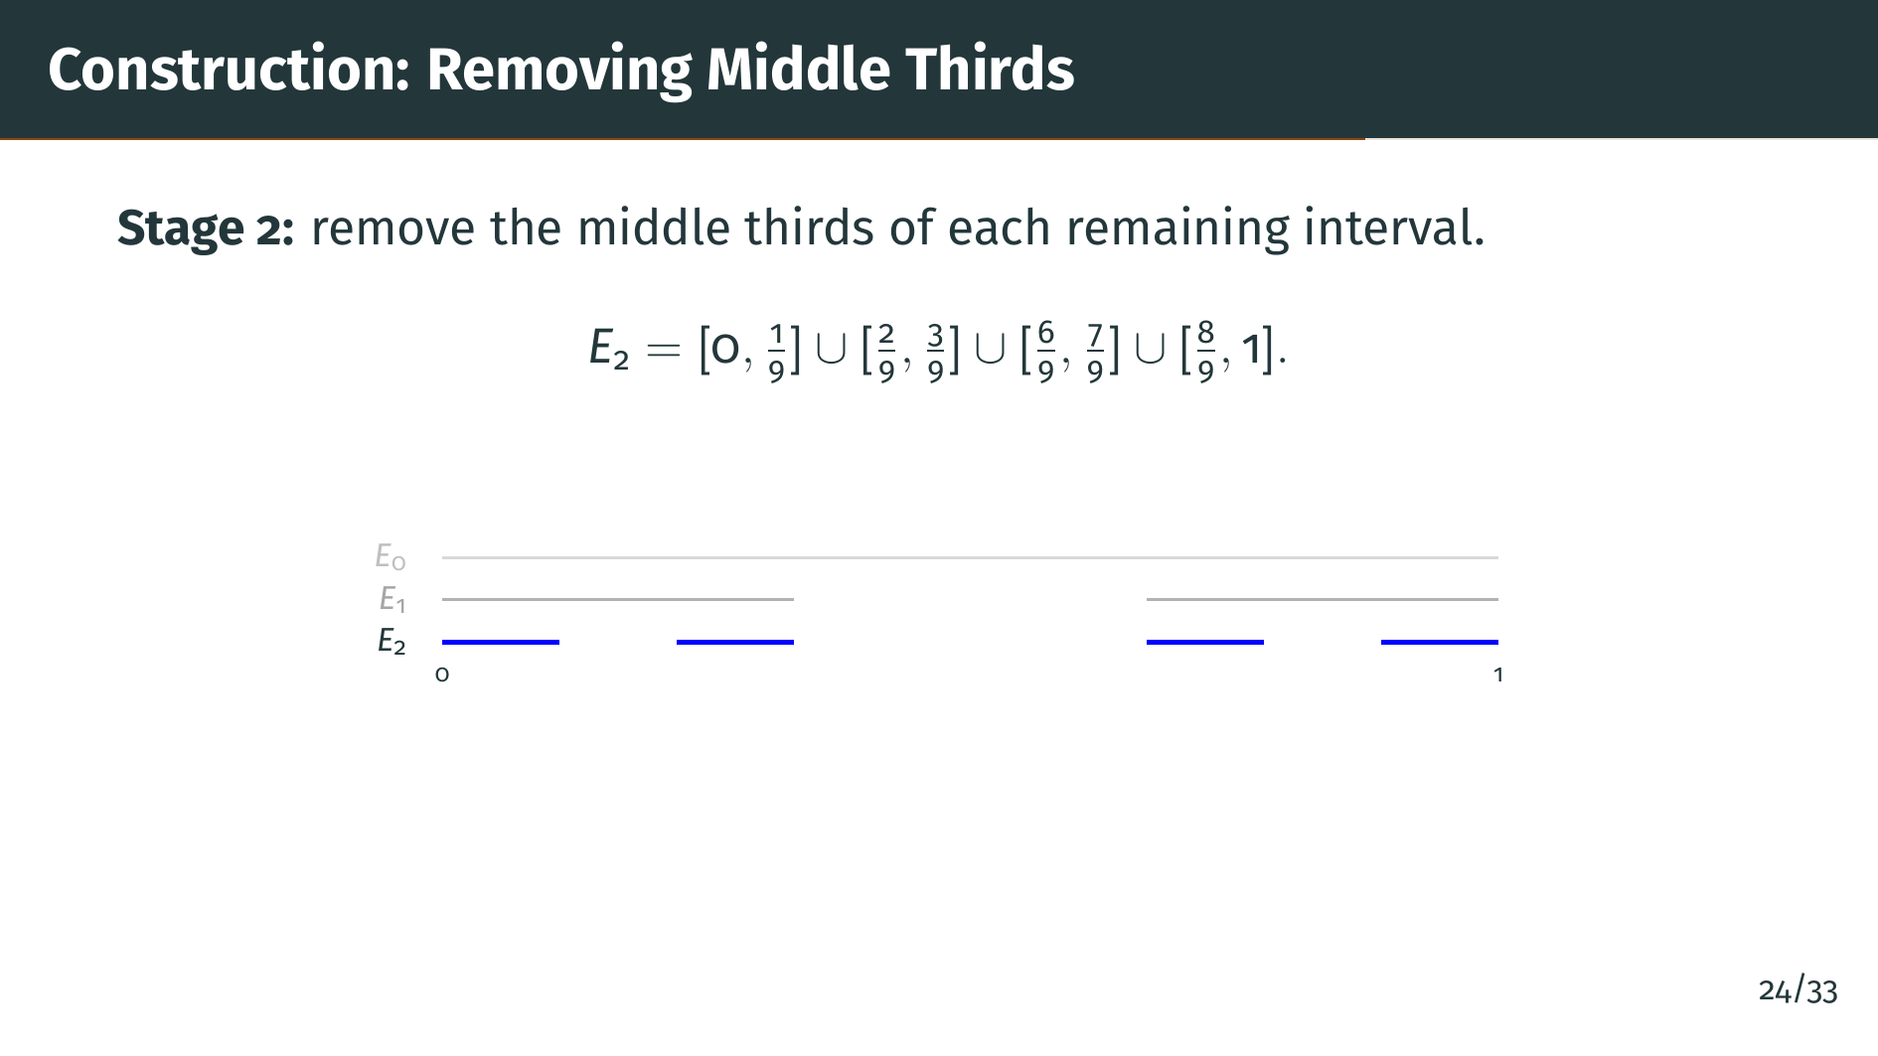
Notes:
At stage 2 we repeat the trick inside each remaining interval of "E" sub 1. Each of the two surviving intervals has its middle third removed, leaving two pieces. That gives 4 intervals total in "E" sub 2, each of length 1 over 9. The slide lists the explicit endpoints, and the picture shows the three levels stacked: "E" sub zero at the top, "E" sub 1 in the middle, and "E" sub 2 in blue at the bottom.

Slide 27
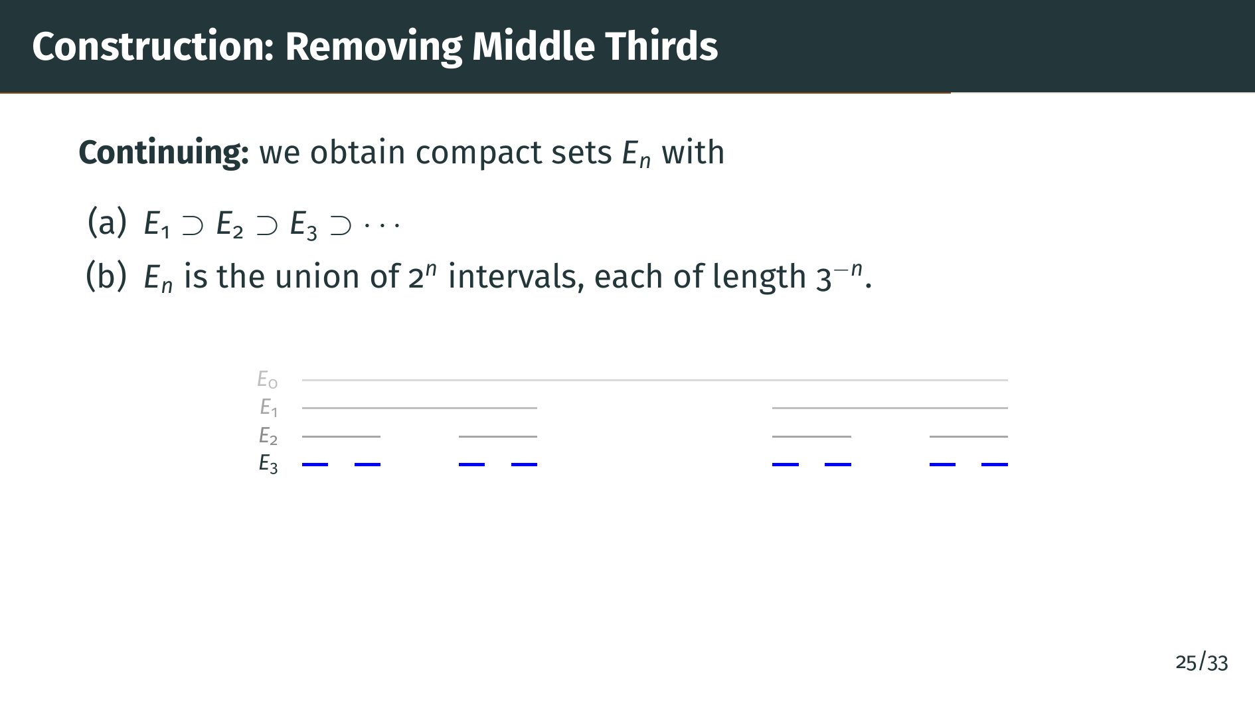
Notes:
Continuing this process forever, we get an infinite decreasing sequence of compact sets "E" sub "n". Two properties are worth recording. Property "a": the sets are nested. Property "b": at stage "n" we have 2 to the "n" disjoint closed intervals, each of length 1 over 3 to the "n". The picture shows the first four stages stacked; notice how quickly the set shatters into many tiny pieces, even though the total length is shrinking geometrically to zero.

Slide 28
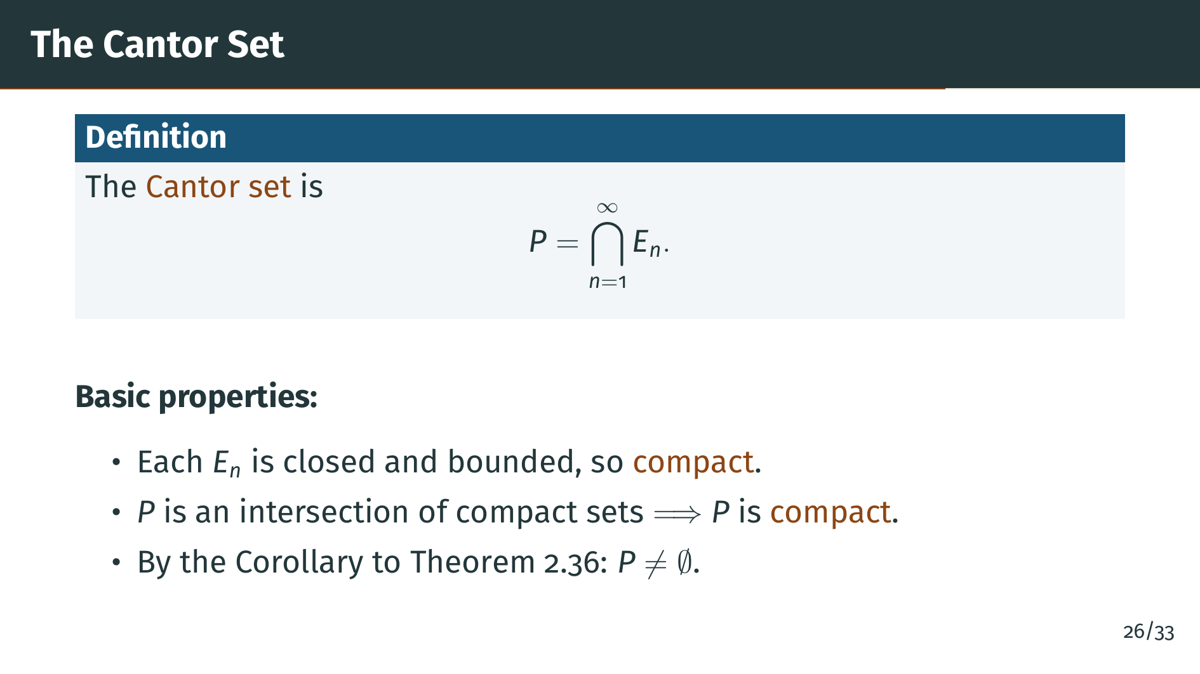
Notes:
The Cantor set "P" is the intersection of all the stages "E" sub "n" as "n" ranges over the positive integers. In other words, "P" is the set of points that are never removed, no matter how many middle thirds we delete. Since each "E" sub "n" is a finite union of closed intervals, it is closed and bounded, hence compact. An intersection of compact sets is compact, so "P" is compact. Moreover, the "E" sub "n" form a nested decreasing sequence of nonempty compact sets, so by the corollary to Theorem 2.36 their intersection "P" is nonempty. The endpoints of the intervals at every stage, such as 0 and 1, clearly lie in "P", so we even have concrete members.

Slide 29
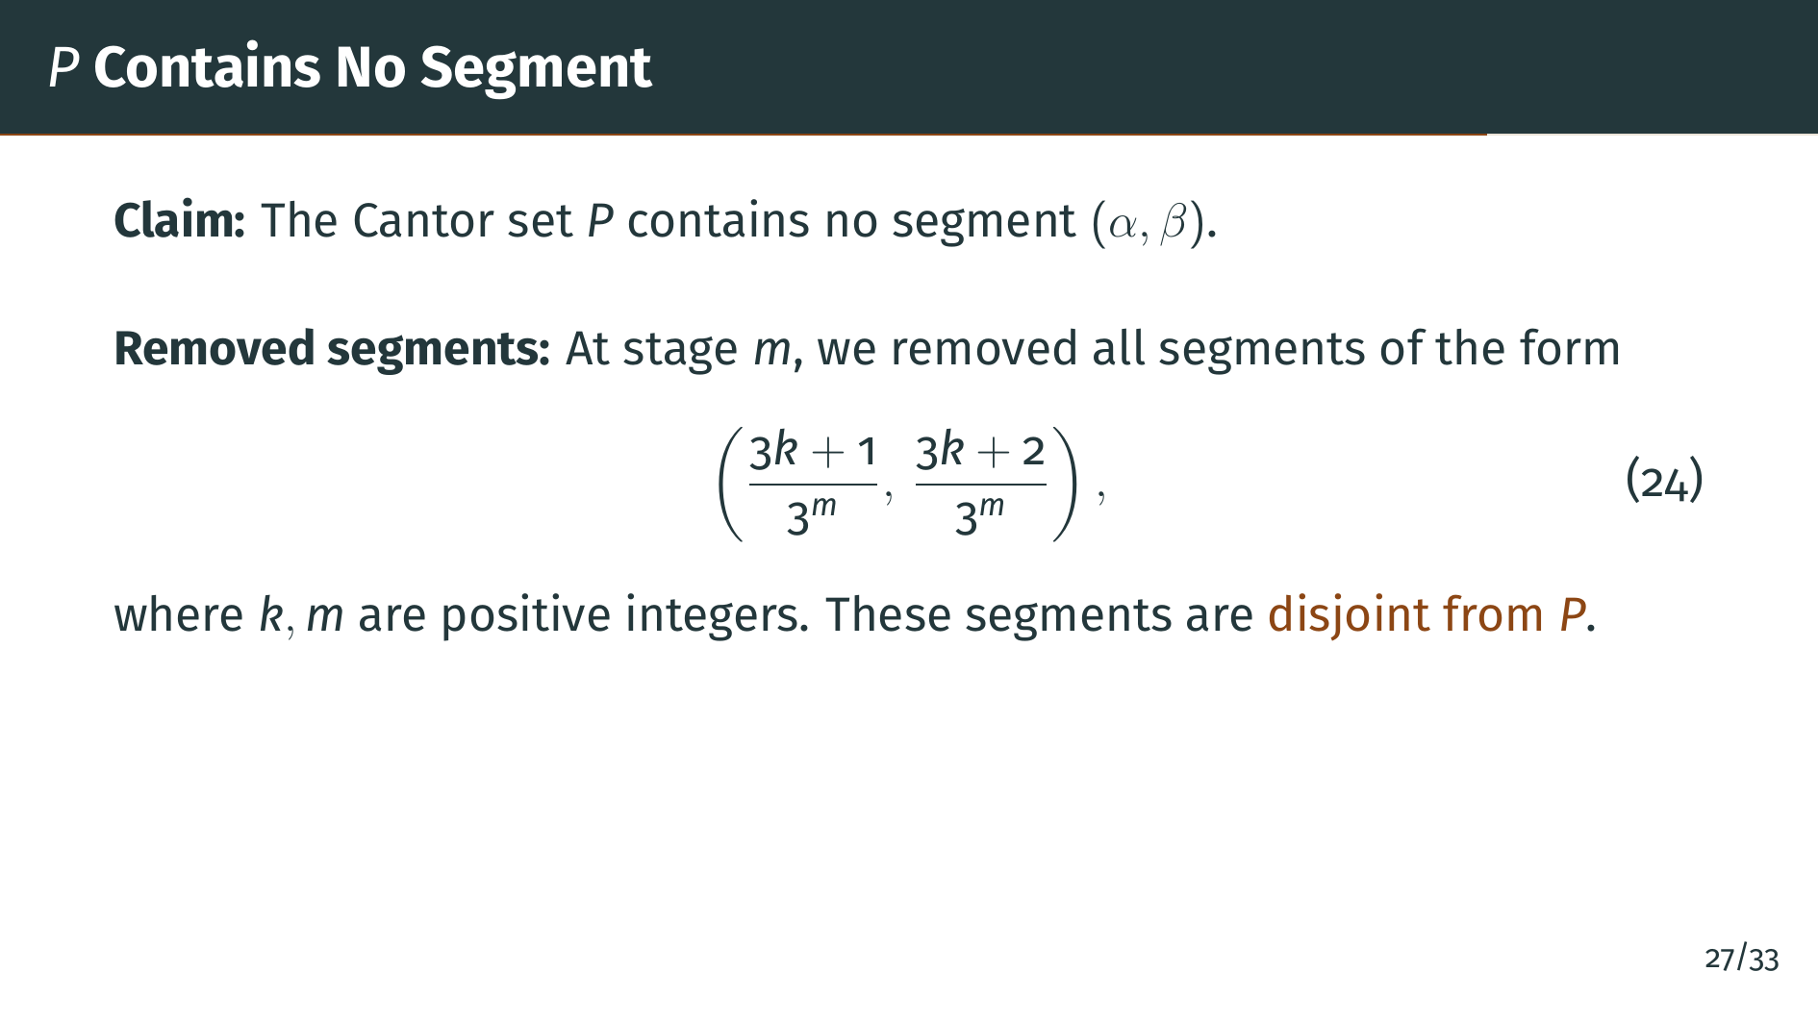
Notes:
The Cantor set has a striking smallness property: it contains no open interval at all. The key observation is that the segments we remove at stage "m" have a very specific arithmetic form, shown on the slide as equation 24. They are the middle-third gaps, and there is one for each value of "k" and "m" with "k" running over appropriate integers. Every such segment was deleted in the construction, so none of them meets "P".

Slide 30
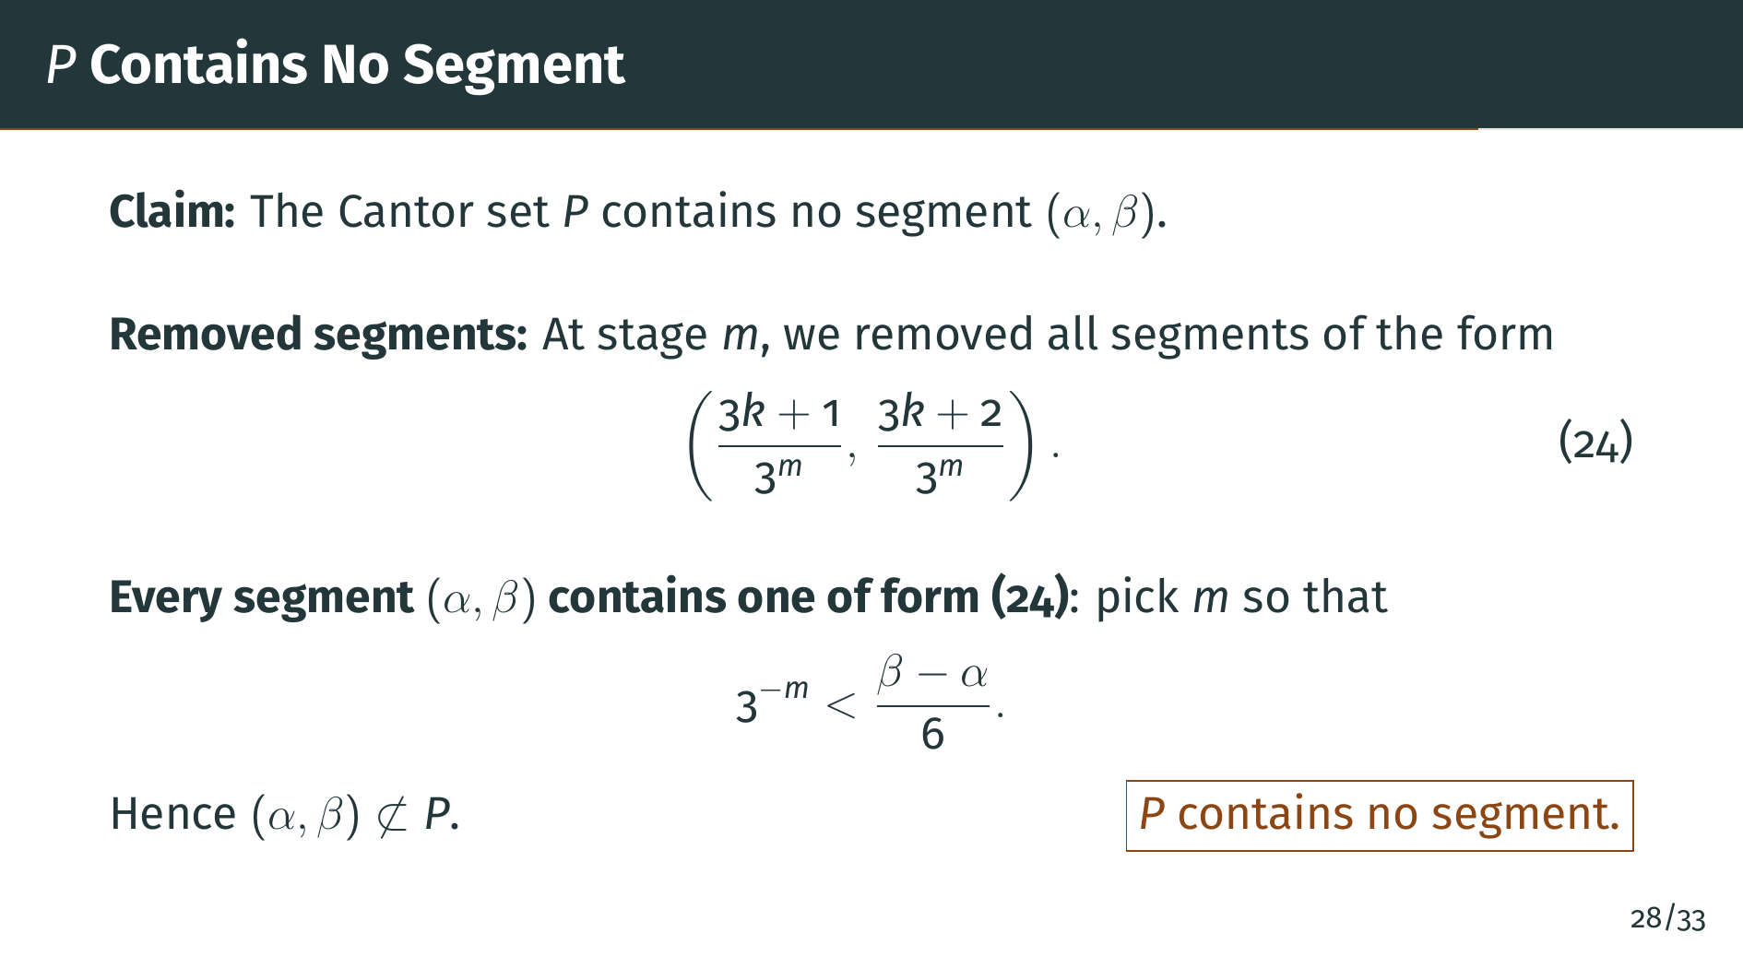
Notes:
Now take any open segment with endpoints alpha and beta, no matter how short, and choose "m" so large that 1 over 3 to the "m" is smaller than one sixth of the length of that segment. At stage "m" the grid spacing is small enough that some removed middle-third interval, shown on the slide as equation 24, fits entirely inside alpha beta. Since that removed interval is disjoint from "P", our segment alpha beta cannot be a subset of "P" either. So the Cantor set contains no open interval at all. Topologically it is extremely thin.

Slide 31
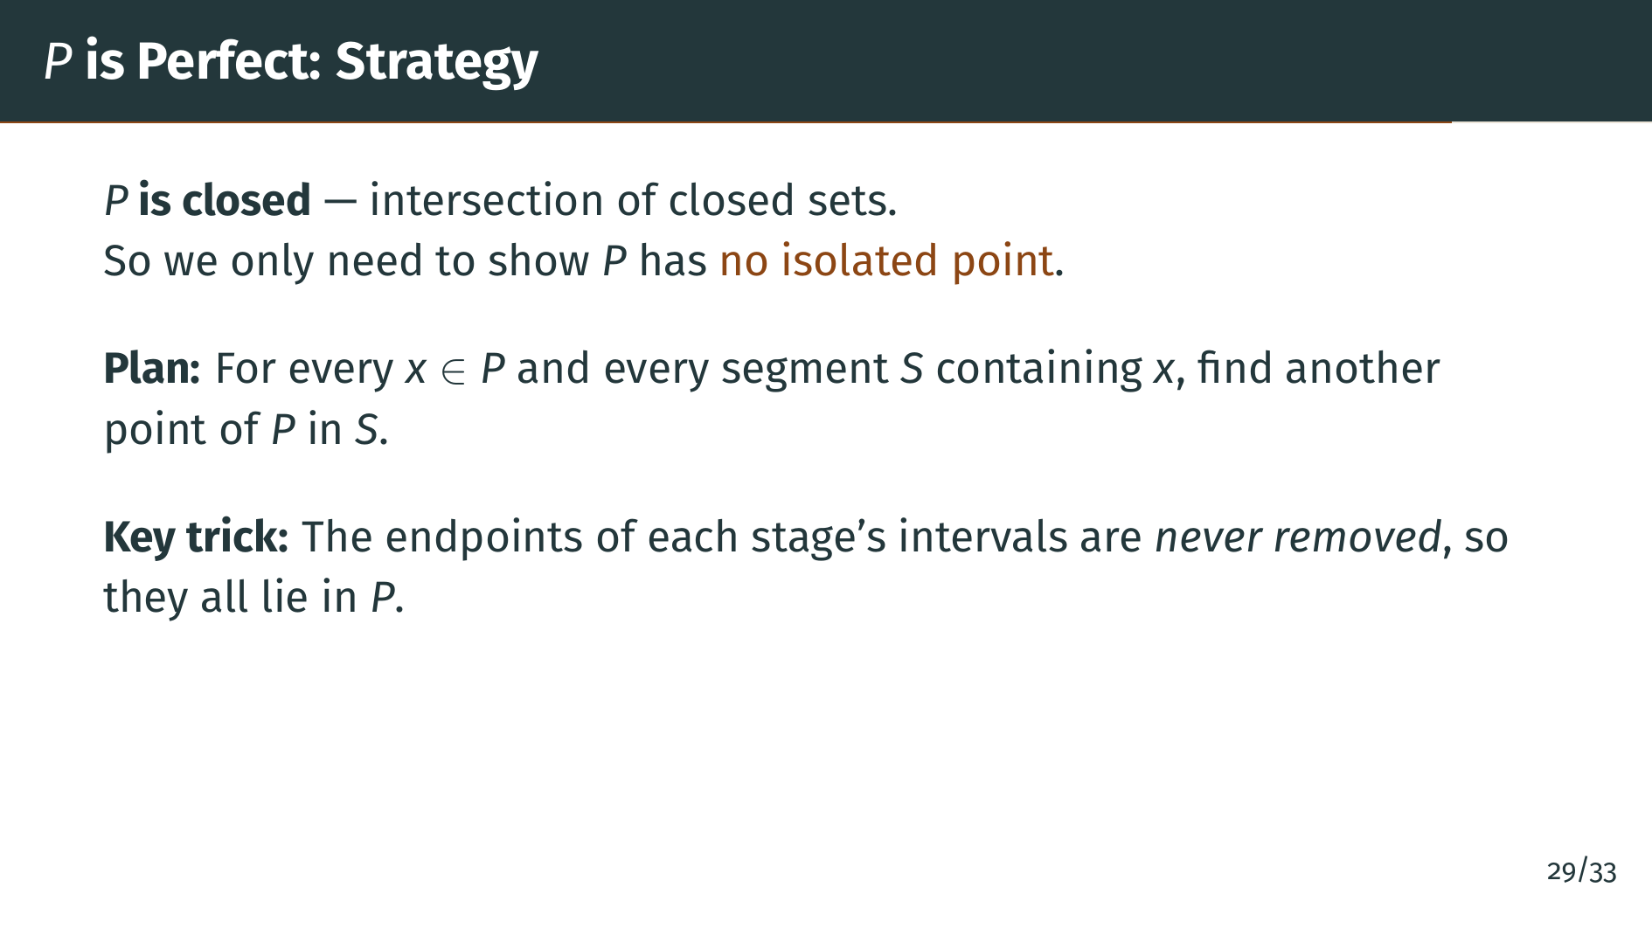
Notes:
To show that "P" is perfect, we first note that "P" is closed, since it is an intersection of closed sets. So perfection comes down to showing that no point of "P" is isolated. Concretely, we must show that given any point "x" of "P" and any open segment "S" containing "x", there is another point of "P" in "S" different from "x". The secret is this: the endpoints of the intervals at each stage of the construction are never removed, because we only remove open middle thirds, and endpoints stay. So endpoints are a rich supply of points already guaranteed to be in "P". We will use a very close endpoint as our witness.

Slide 32
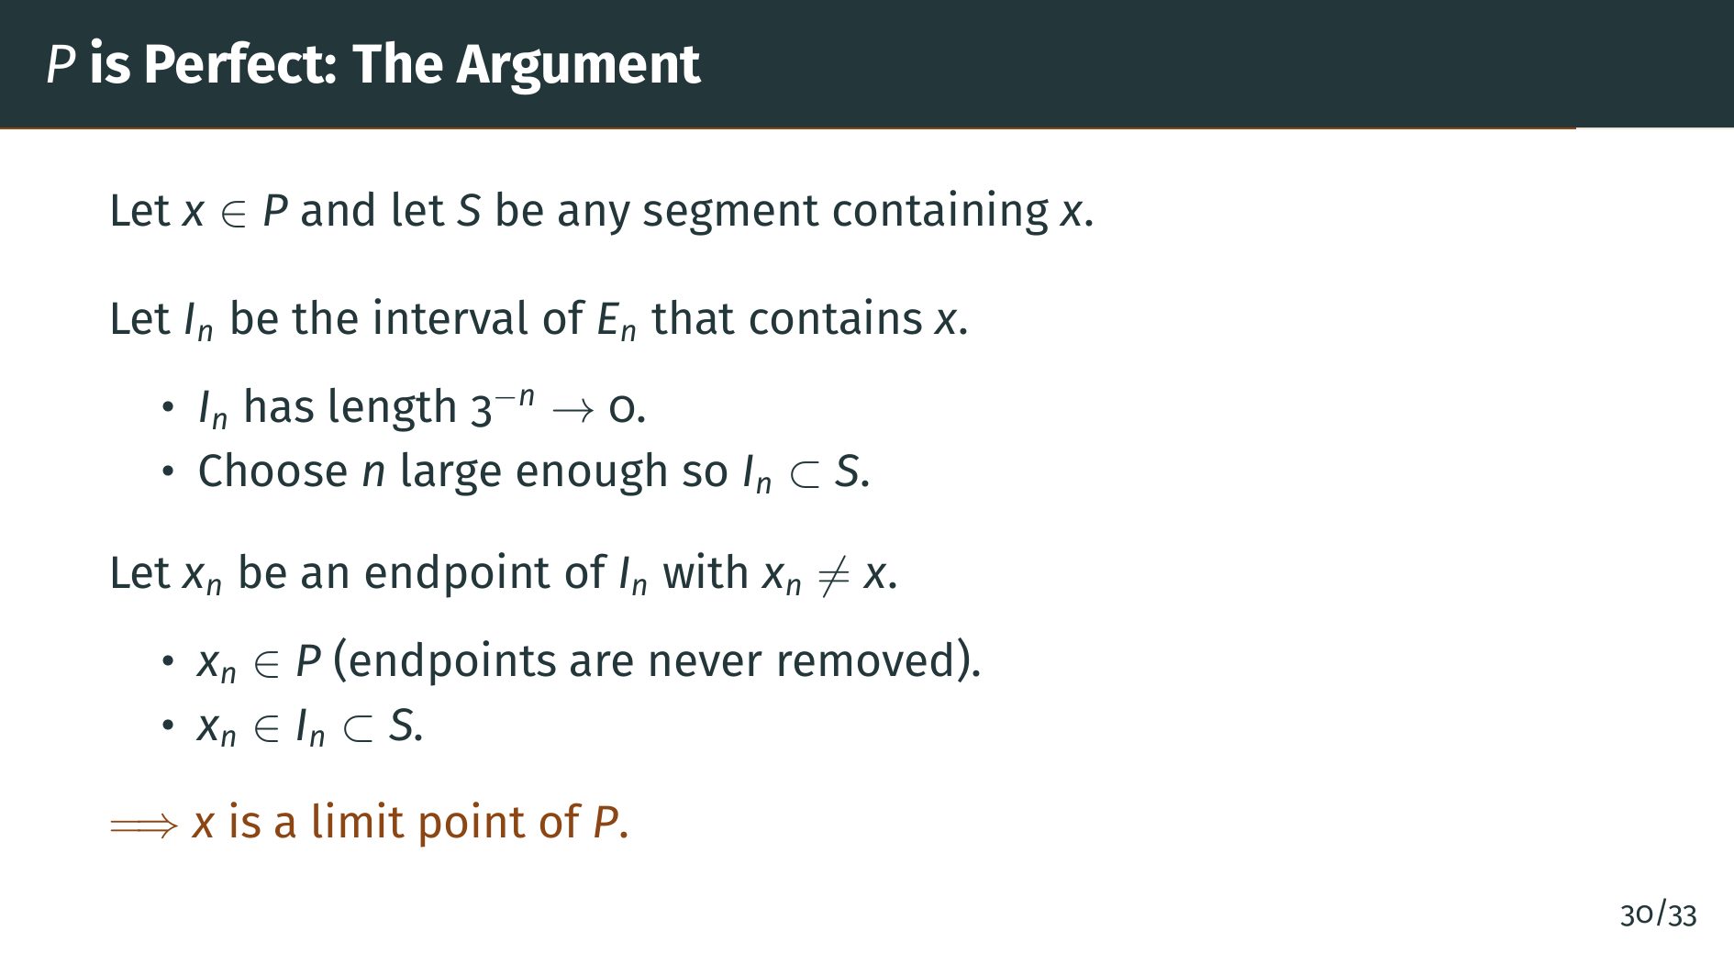
Notes:
Fix "x" in "P" and any segment "S" around "x". For each stage "n", let "I" sub "n" be the one interval of "E" sub "n" that contains "x"; at every stage there is exactly one such interval, because "x" lies in "P" and therefore in "E" sub "n". The length of "I" sub "n" is 1 over 3 to the "n", which goes to zero, so for "n" large enough "I" sub "n" sits entirely inside "S". Now pick any endpoint of "I" sub "n" other than "x", and call it "x" sub "n". That endpoint is in "P" because endpoints of the construction are never removed, and it is in "I" sub "n", hence in "S". So we have found a point of "P" different from "x" inside every segment around "x". Therefore "x" is a limit point of "P". Since "x" was arbitrary, "P" has no isolated points, and "P" is perfect.

Slide 33
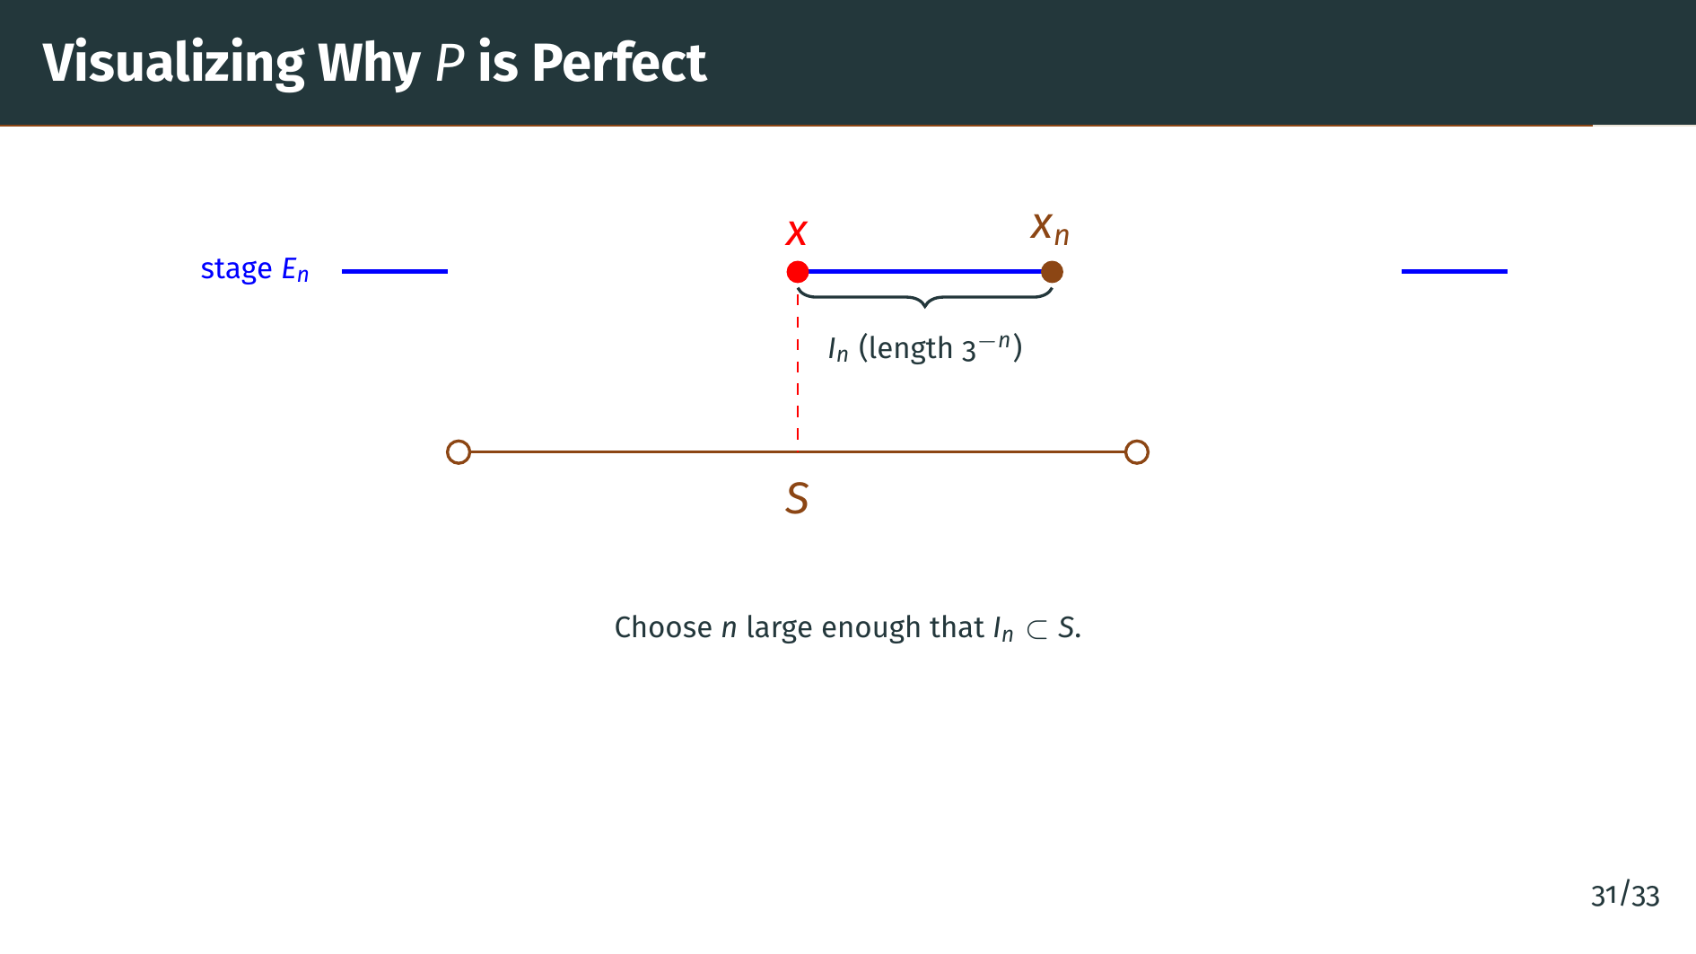
Notes:
Here is a schematic picture of the argument. The three blue bars at the top represent a few surviving intervals of "E" sub "n" near our point. Because "x" lies in "P", it sits inside exactly one of these intervals at every stage; that interval is labeled "I" sub "n" and is the middle blue bar, marked with a brace below for emphasis. Its length is 1 over 3 to the "n", which we can make as small as we like by taking "n" large. Below the blue intervals, the orange line with hollow endpoints is our given open segment "S", drawn centered on "x" for clarity; the dashed red line drops from "x" to the center of "S" to highlight that alignment. Once "n" is large enough, the short interval "I" sub "n" fits entirely inside "S". The red dot marks "x" at the left end of "I" sub "n", and the orange dot marks the other endpoint, which we call "x" sub "n". Because "x" sub "n" is a construction endpoint, it is never removed, so it lies in "P"; and since "I" sub "n" is inside "S", it also lies in "S". So inside any segment around "x" we can always find another point of "P", which is exactly what it means for "x" to be a limit point.

Slide 34
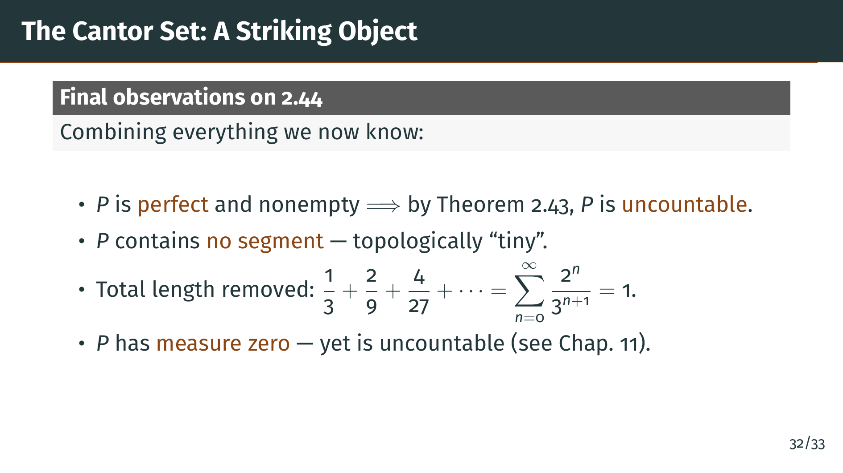
Notes:
Let us take stock. The Cantor set "P" is perfect and nonempty, so by our main theorem it is uncountable, so it has as many points as the real line. On the other hand, "P" contains no open segment, so it is topologically extremely thin. We can even compute the total length removed during the construction: at stage 1 we remove one piece of length 1 third, at stage 2 we remove two pieces each of length 1 ninth, and so on. The total is a geometric series that sums to 1, so nothing is left in the sense of length. In Chapter 11 we will see that this means the Cantor set has Lebesgue measure zero. So "P" is an uncountable set of measure zero, simultaneously as big as the reals and as small as a single point from the measure-theoretic perspective. This is one of the reasons the Cantor set is so important.

Slide 35
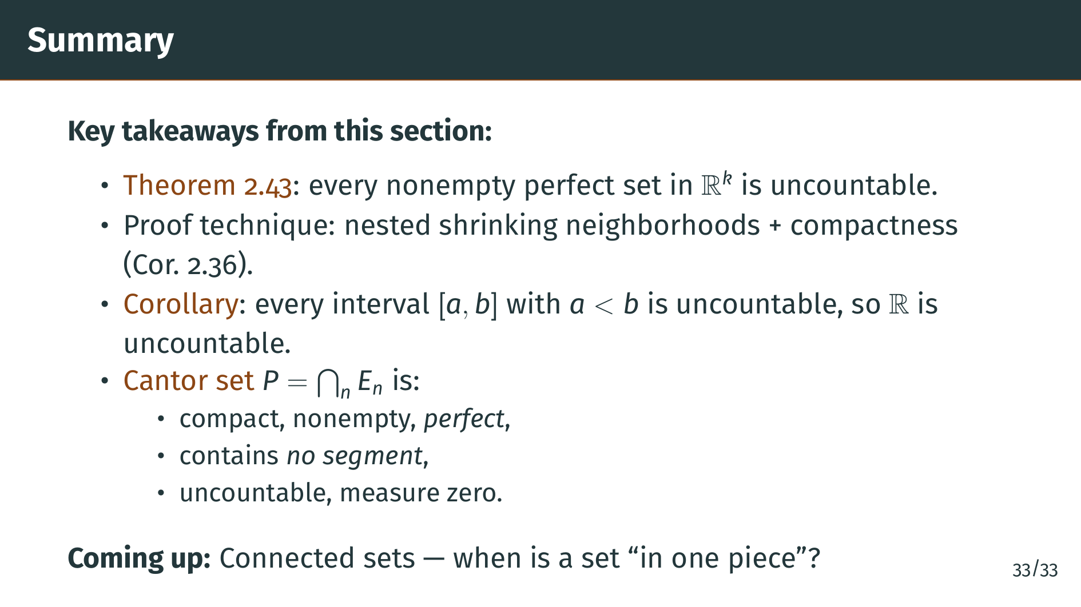
Notes:
To summarize, the main theorem of this section is that every nonempty perfect subset of Euclidean space is uncountable. The proof used a clever construction of nested shrinking neighborhoods, each one designed to kick out one listed point, together with the compactness corollary of Theorem 2.36. A direct corollary is that every nondegenerate closed interval and therefore the whole real line are uncountable. We then built the Cantor set by repeatedly removing middle thirds from the unit interval. The resulting set is compact, nonempty, contains no segment, yet is perfect and therefore uncountable. It also has Lebesgue measure zero, as we will see in Chapter 11. In the next section we turn to connectedness, the precise notion of a set being in one piece. See you there.

