Slide 1
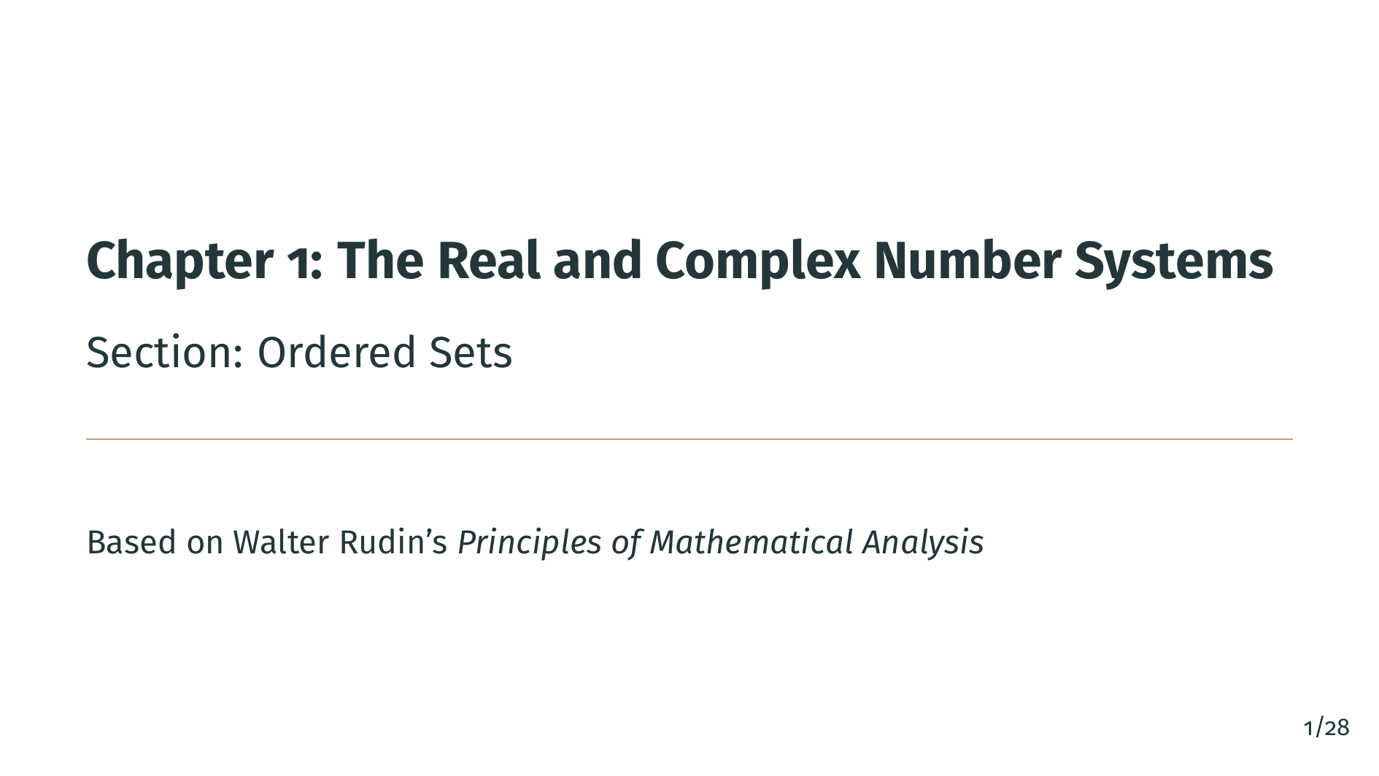
Notes:
Welcome back to the Principles of Mathematical Analysis video series. This is Chapter 1, Section 2: Ordered Sets. In the previous section, we saw that the rational numbers have gaps, and that the set of rationals "p" with "p" squared less than 2 has no least upper bound in the rationals. In this section, we will make these ideas precise by defining what it means for a set to be ordered, and what it means for a set to have the least-upper-bound property. Let's begin.

Slide 2
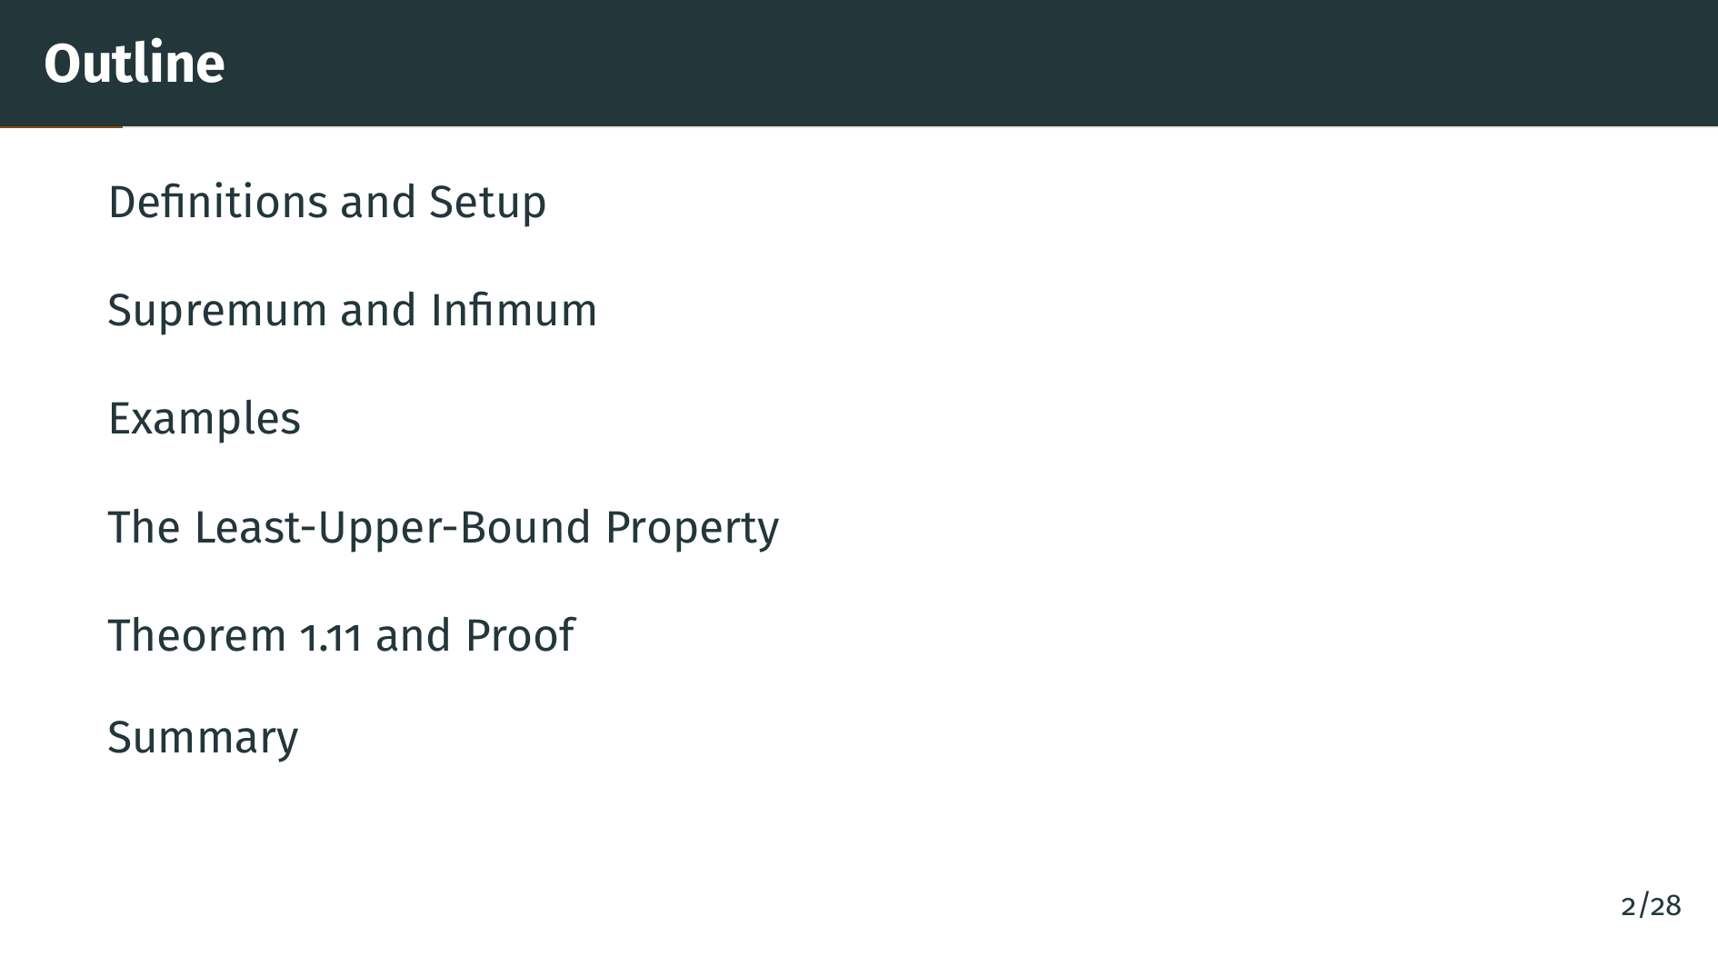
Notes:
Here is our plan for this section. We will start with the basic definitions of order and ordered sets. Then we will define upper bounds, lower bounds, and the supremum and infimum. After exploring some key examples, we will introduce the least-upper-bound property and prove an important theorem connecting least upper bounds and greatest lower bounds.

Slide 3
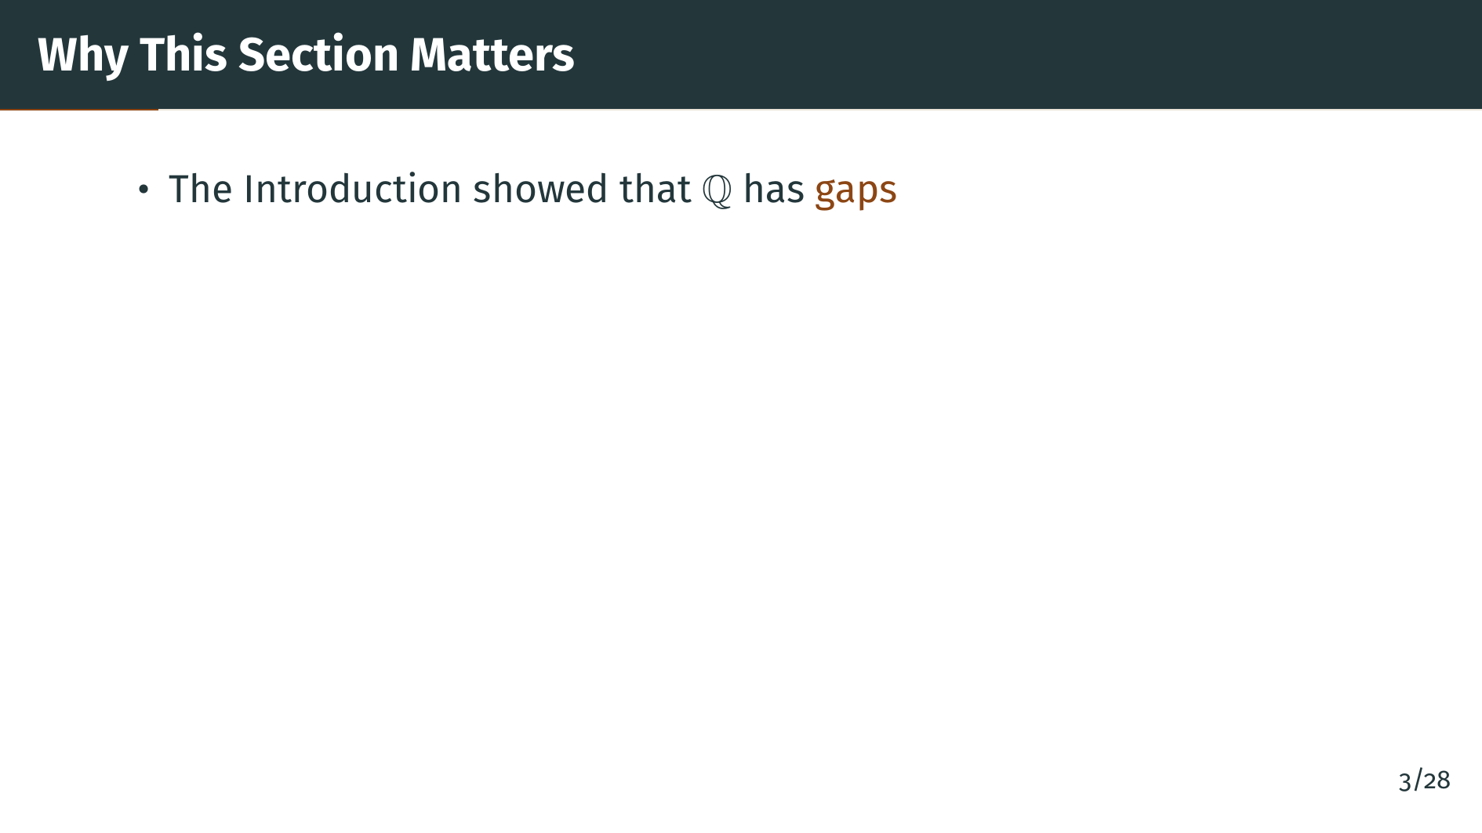
Notes:
In the previous section, we showed that there is no rational number whose square is 2. This revealed a fundamental gap in the rational number system. Now we need the language to describe this gap precisely.

Slide 4
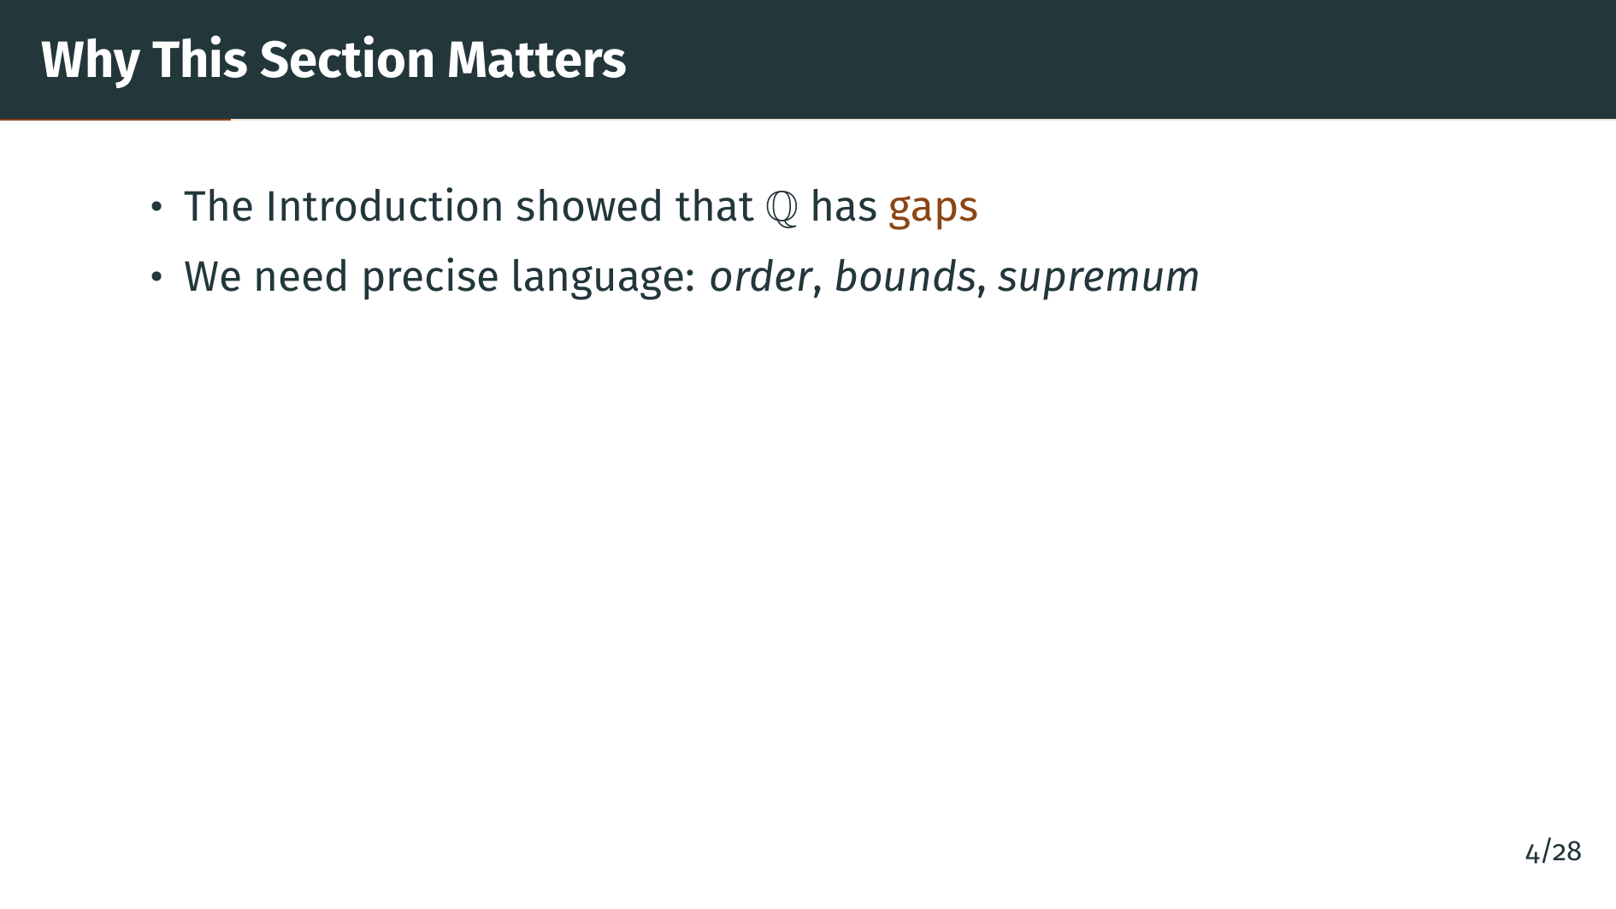
Notes:
To describe these gaps, we need to formalize the notions of order, upper and lower bounds, and the supremum. These are the core concepts of this section.

Slide 5
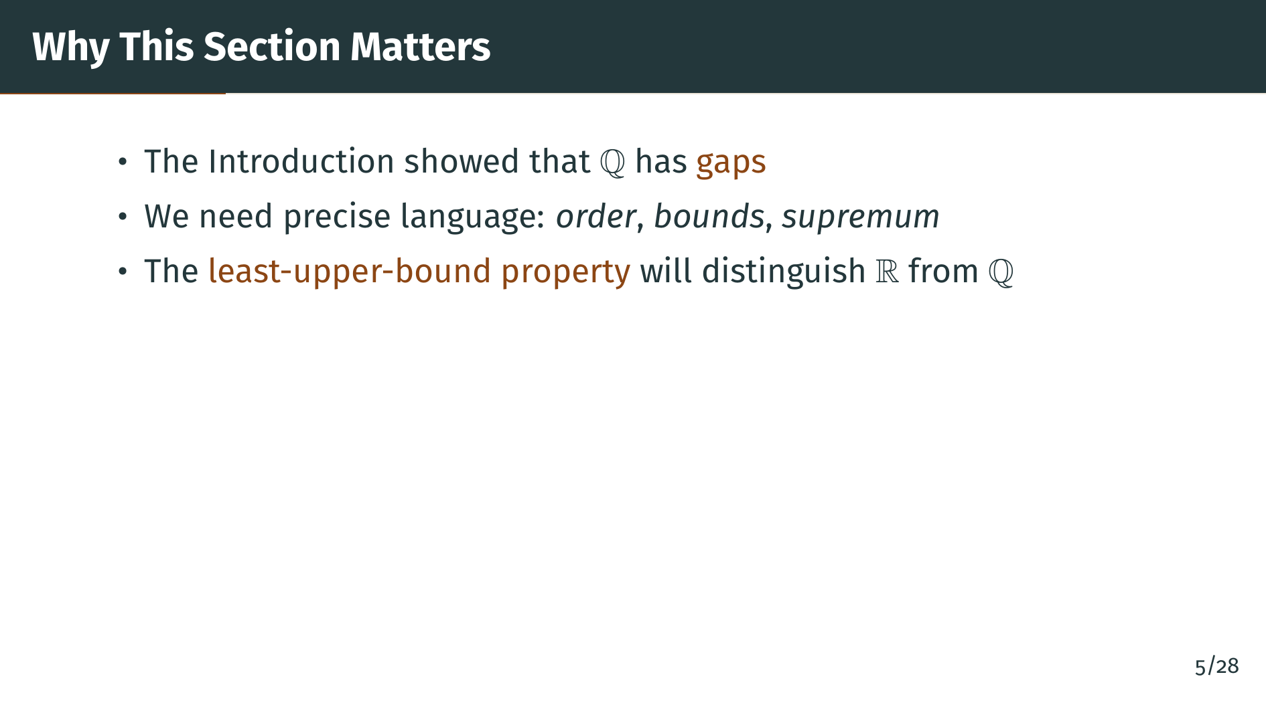
Notes:
The key idea in this section is the least-upper-bound property. This is the property that the real numbers have but the rationals do not. It will be the foundation for everything that follows in this book. Let's start with the basic definitions.

Slide 6
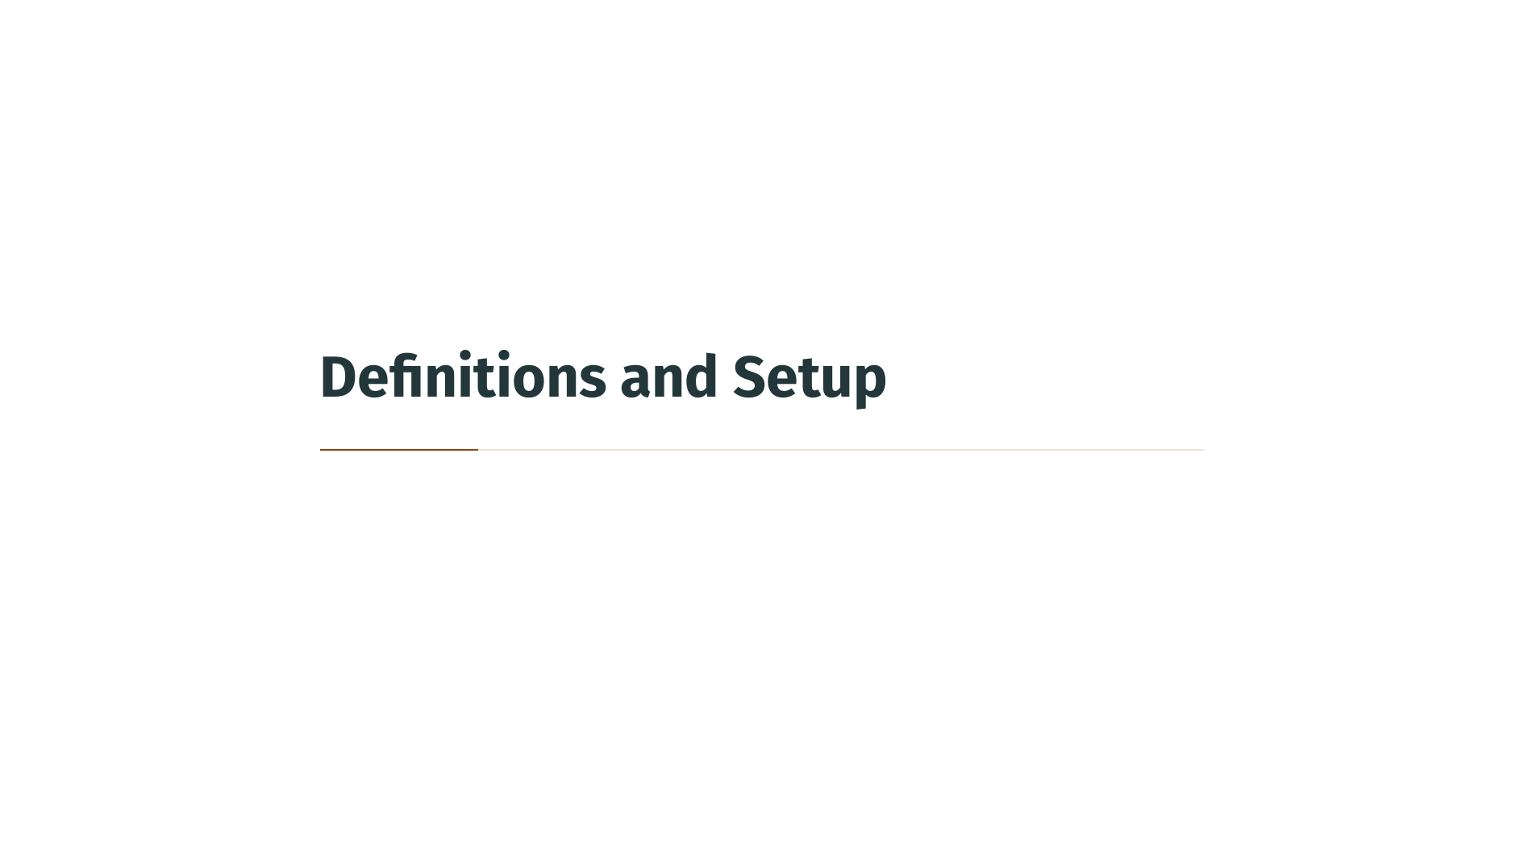

Slide 7
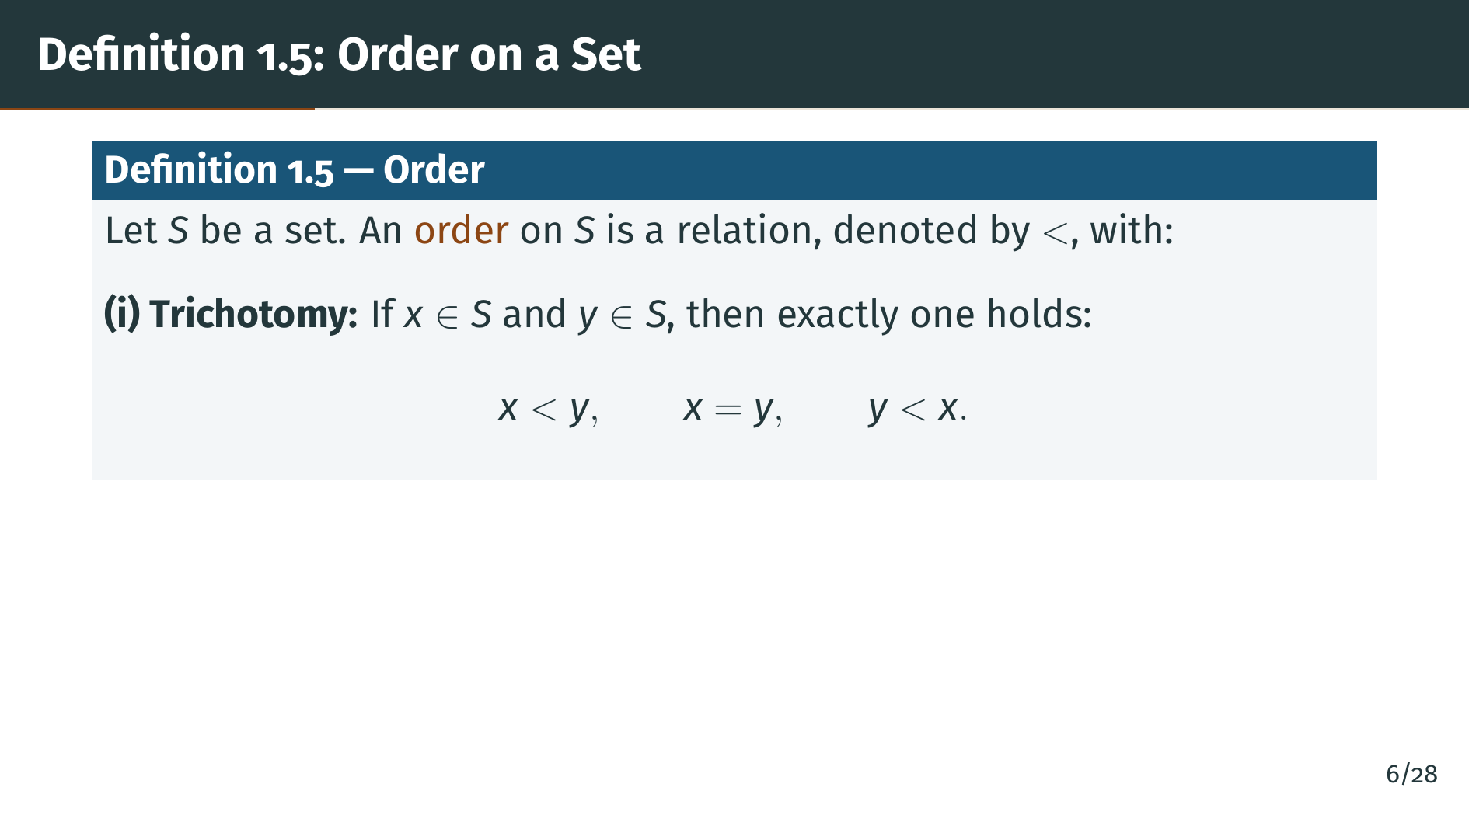
Notes:
Let's define what an order is. An order on a set "S" is a relation, written with the less-than symbol, satisfying two properties. The first property is called trichotomy: for any two elements "x" and "y" in "S", exactly one of the three statements "x" less than "y", "x" equals "y", or "y" less than "x" is true. There is no ambiguity --- one and only one of these holds.

Slide 8
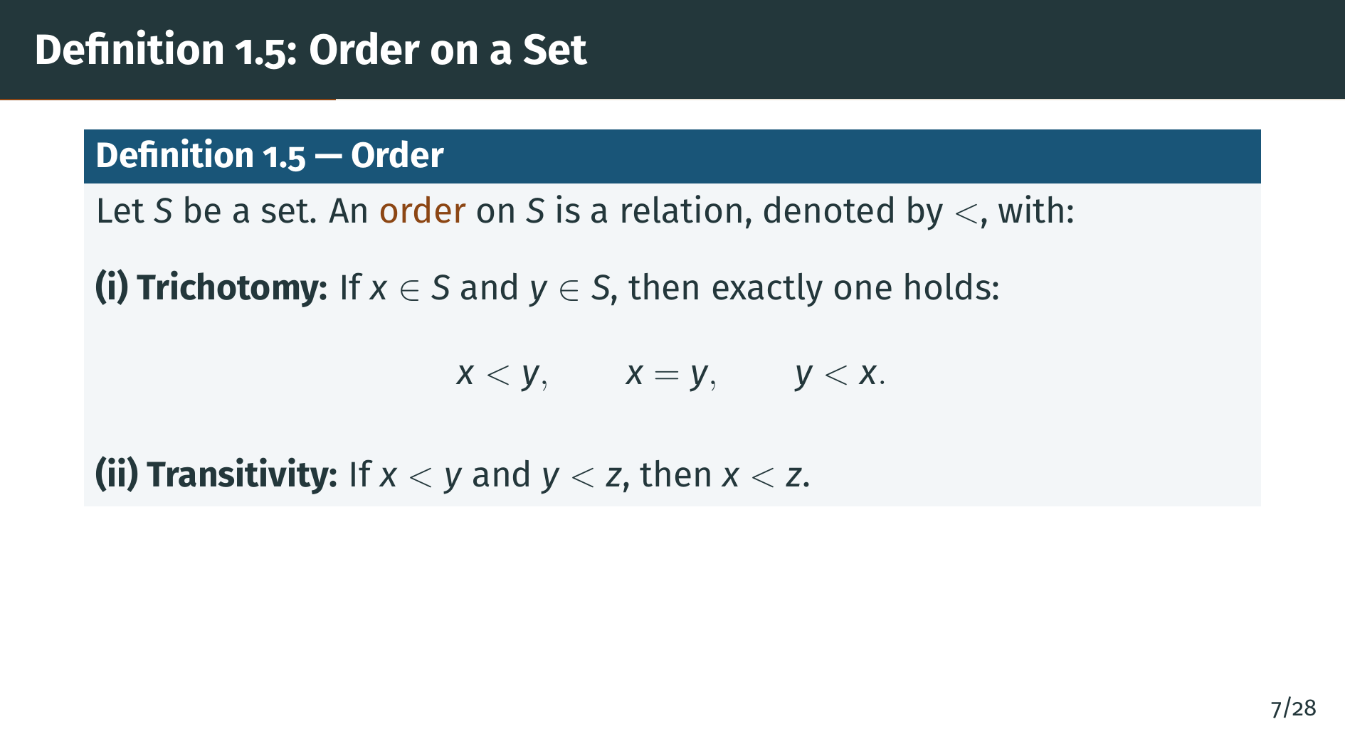
Notes:
The second property is transitivity. If "x" is less than "y" and "y" is less than "z", then "x" is less than "z". This is the familiar chaining property that lets us build up a consistent ordering of elements. Together, trichotomy and transitivity are all we need for an order.

Slide 9
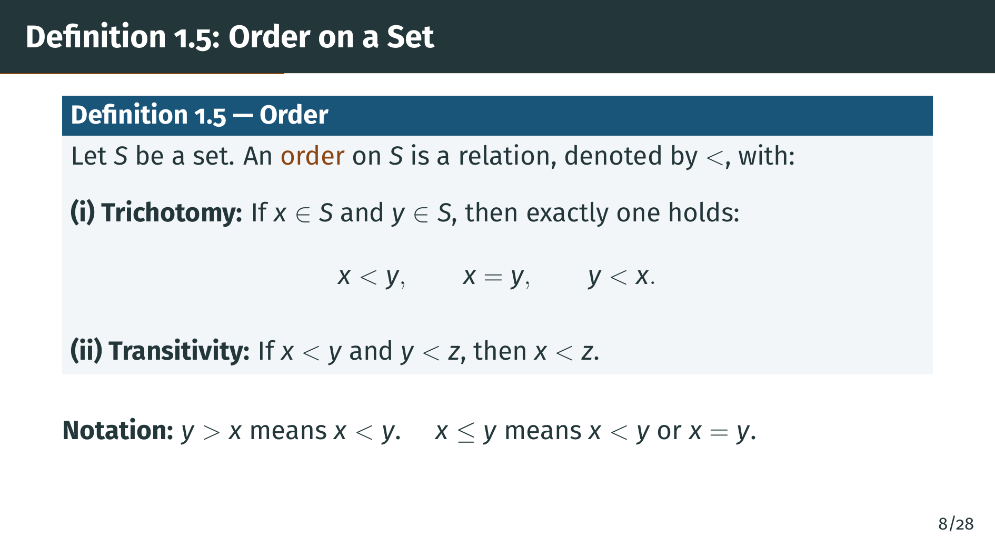
Notes:
A few words about notation. We write "y" greater than "x" as a synonym for "x" less than "y". And "x" less than or equal to "y" means that either "x" is strictly less than "y", or "x" equals "y". In other words, "x" less than or equal to "y" is the negation of "x" greater than "y". Now let's define ordered sets.

Slide 10
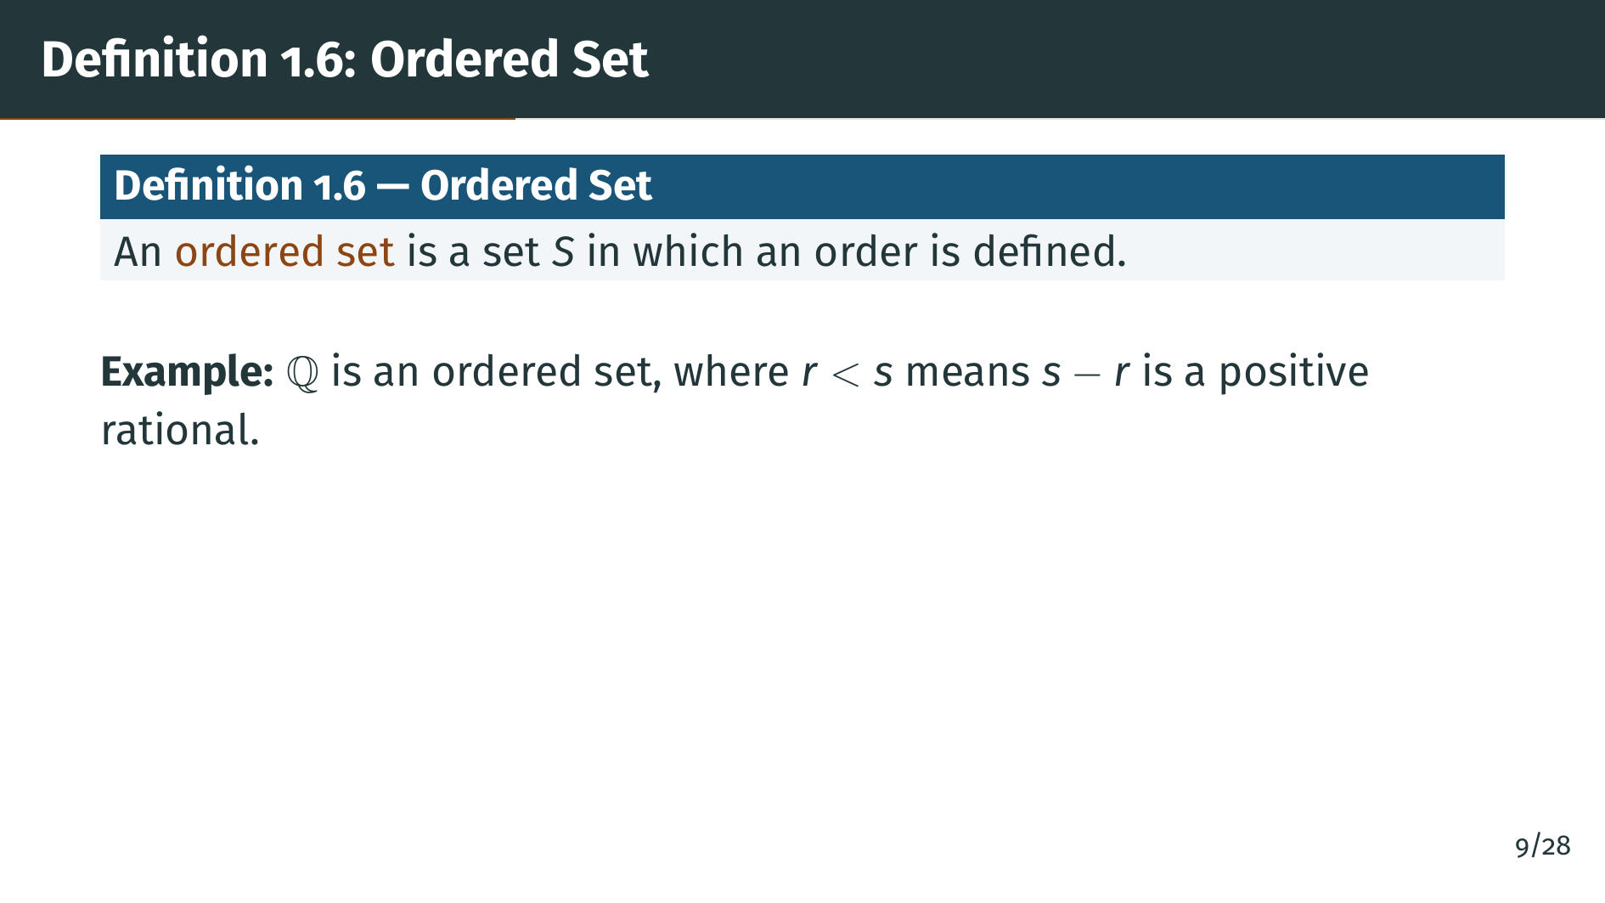
Notes:
An ordered set is simply a set equipped with an order relation satisfying the two properties we just defined. The most familiar example is the rational numbers, where "r" is less than "s" means that "s" minus "r" is a positive rational number. You can verify that this relation satisfies both trichotomy and transitivity. Now that we have ordered sets, let's talk about bounds.

Slide 11
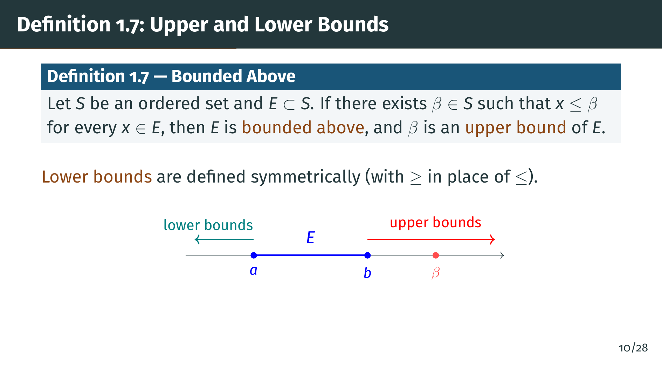
Notes:
Here is the definition of an upper bound. Suppose "S" is an ordered set and "E" is a subset of "S". If there is some element "beta" in "S" such that "x" is less than or equal to "beta" for every "x" in "E", we say that "E" is bounded above, and we call "beta" an upper bound of "E". As the diagram shows, upper bounds are elements that sit to the right of the entire set "E". Lower bounds are defined symmetrically --- they sit to the left of "E". Notice that the bound "beta" does not need to be in "E" itself; it just needs to be in "S".

Slide 12
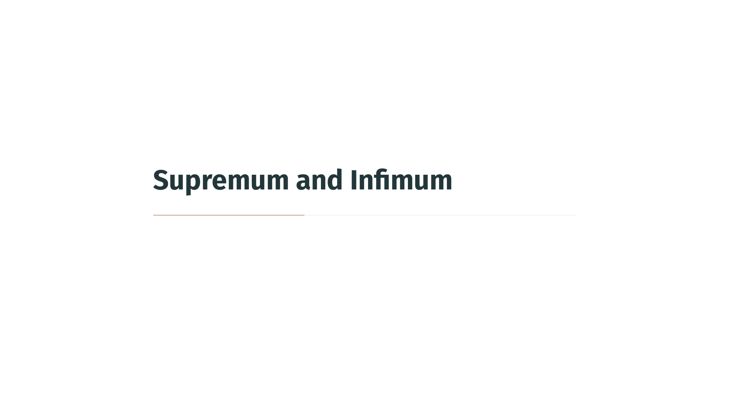

Slide 13
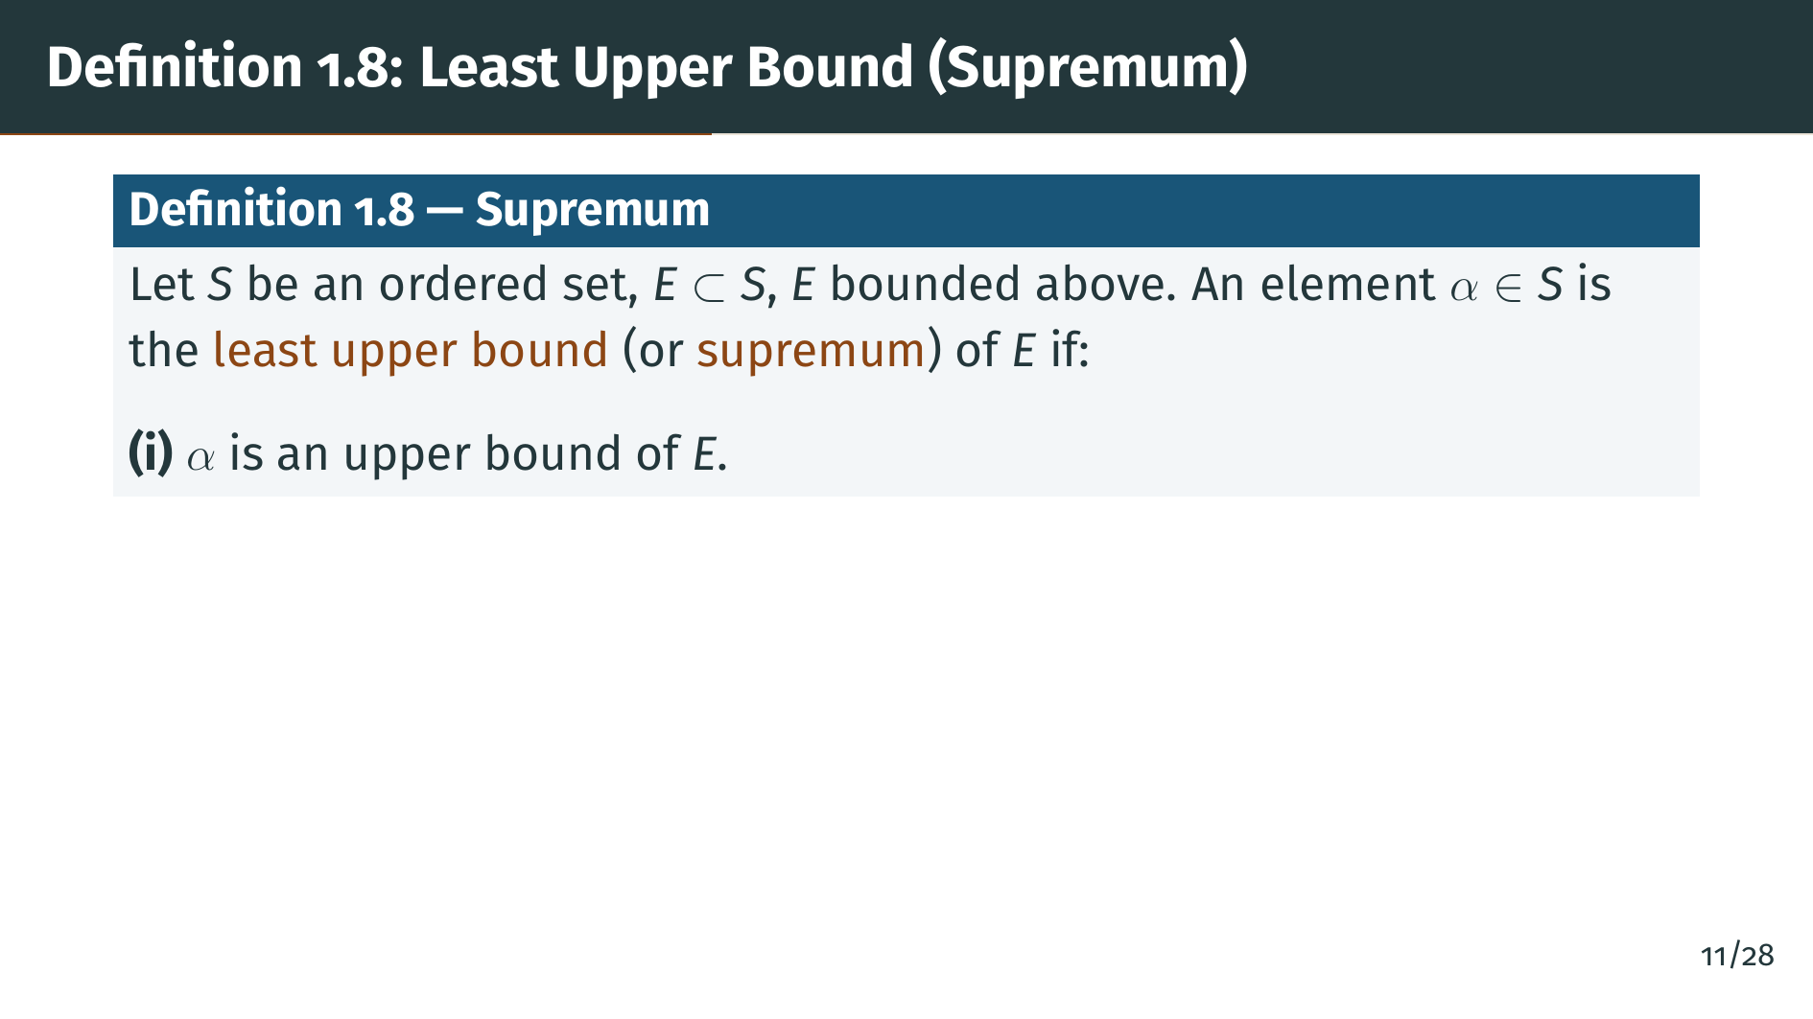
Notes:
Now we come to one of the most important definitions in this section: the supremum. Suppose "E" is a subset of an ordered set "S" and "E" is bounded above. The supremum of "E" is an element "alpha" in "S" satisfying two conditions. The first condition is that "alpha" must itself be an upper bound of "E". But being an upper bound is not enough --- many elements could be upper bounds. The key is the second condition, which we will see on the next slide.

Slide 14
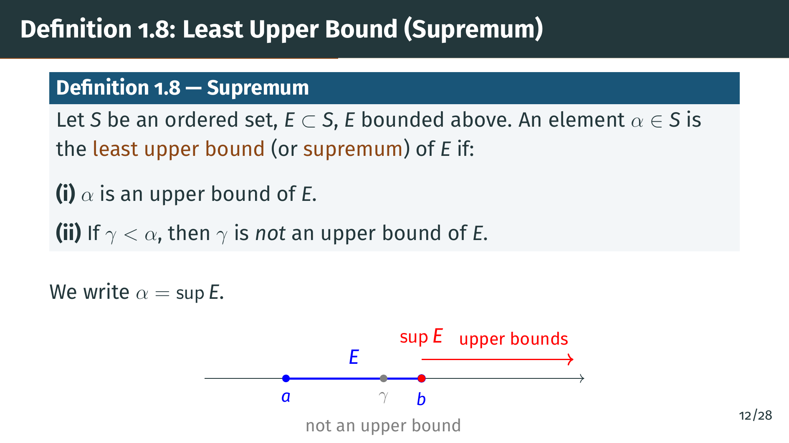
Notes:
The second condition says that no element strictly smaller than "alpha" is an upper bound of "E". In other words, "alpha" is the smallest of all upper bounds. That's why we call it the least upper bound. We write "alpha" equals sup "E". Looking at the diagram, the supremum sits right at the boundary between "E" and the upper bounds. Any "gamma" to the left of it fails to be an upper bound because some element of "E" exceeds it. Notice from condition two that there is at most one supremum, since if two elements both satisfied these conditions, neither could be strictly less than the other.

Slide 15
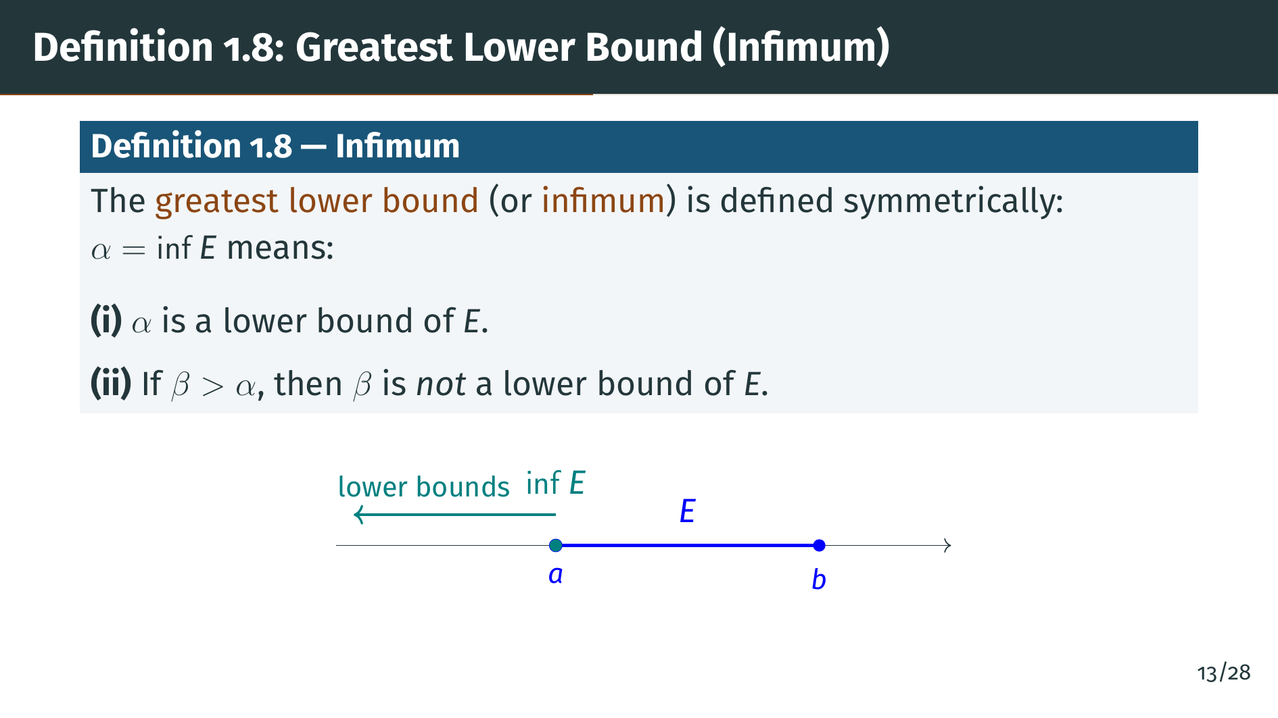
Notes:
The greatest lower bound, or infimum, is defined in the same manner but in the other direction. "Alpha" equals inf "E" means that "alpha" is a lower bound of "E", and no "beta" strictly greater than "alpha" is a lower bound of "E". So the infimum is the largest of all lower bounds. In the diagram, you can see the infimum sitting at the left boundary of "E", with all lower bounds to its left. Now let's look at some examples to build intuition.

Slide 16
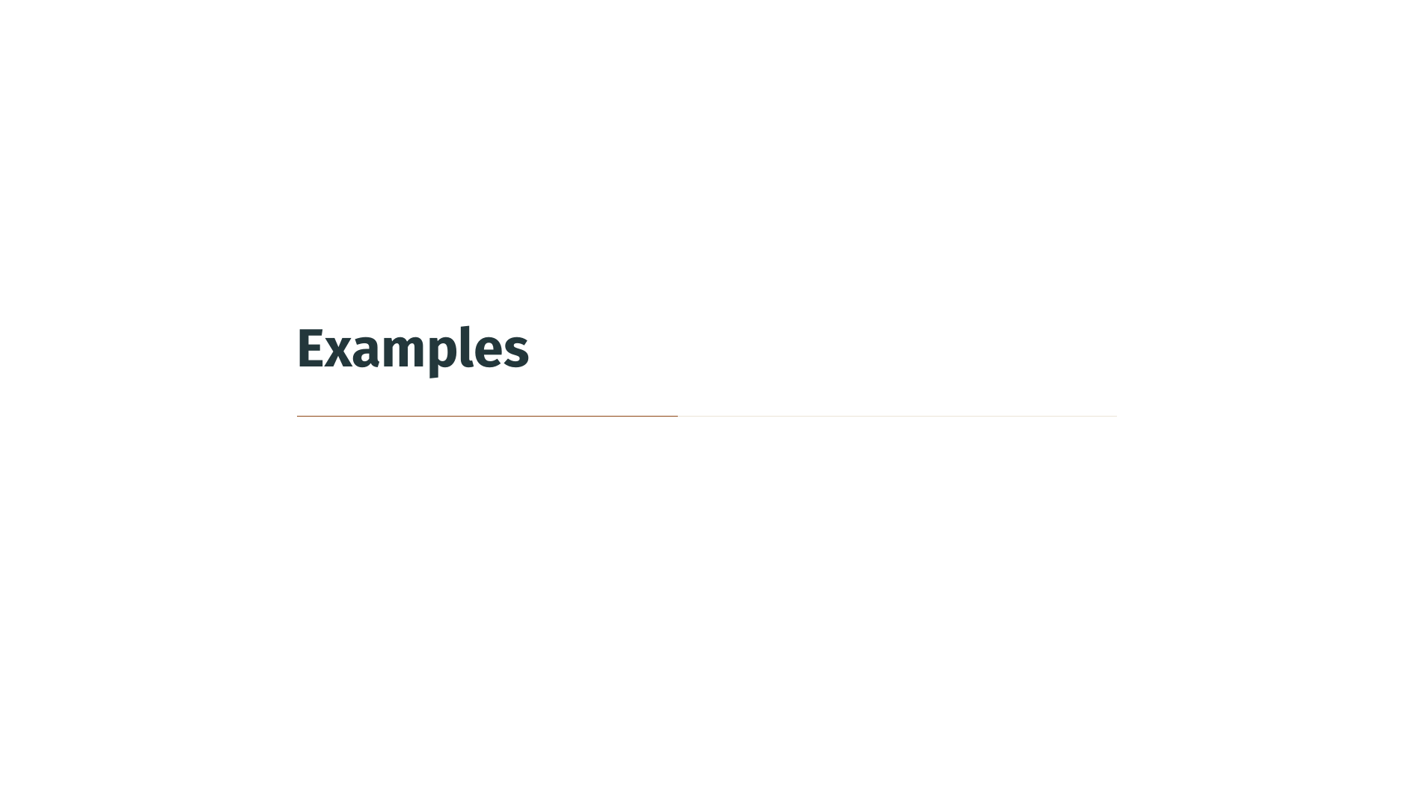

Slide 17
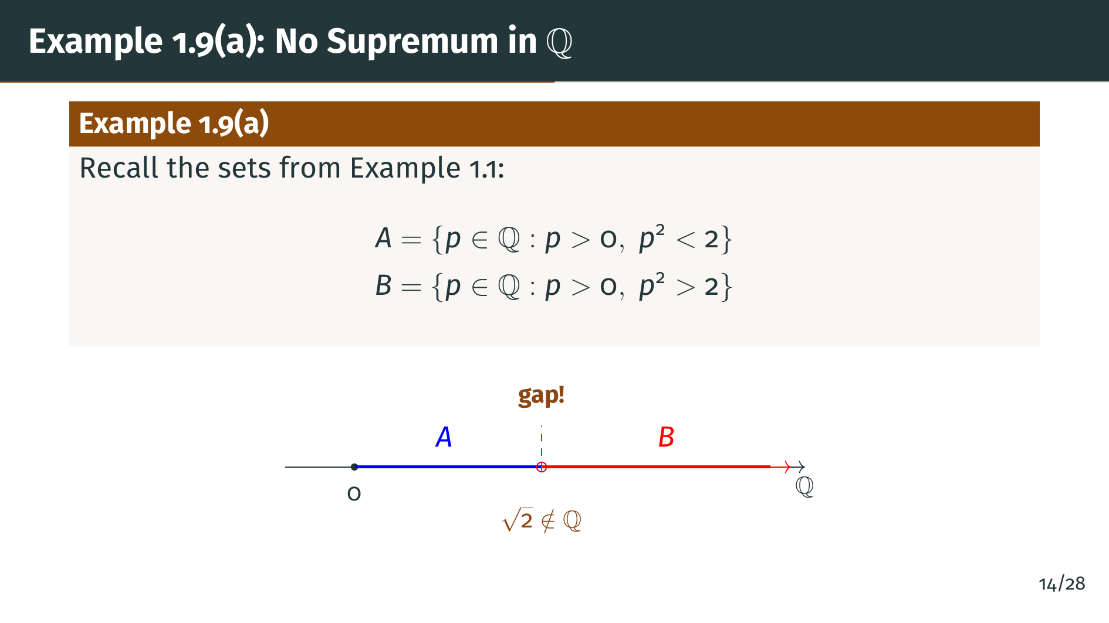
Notes:
Let's revisit the sets from Example 1.1. The set "A" consists of all positive rationals whose square is less than 2, and "B" consists of all positive rationals whose square is greater than 2. On the number line, "A" lies to the left of the square root of 2, and "B" lies to the right. But the square root of 2 is not rational, so there is a gap between "A" and "B". No rational number sits at the boundary.

Slide 18
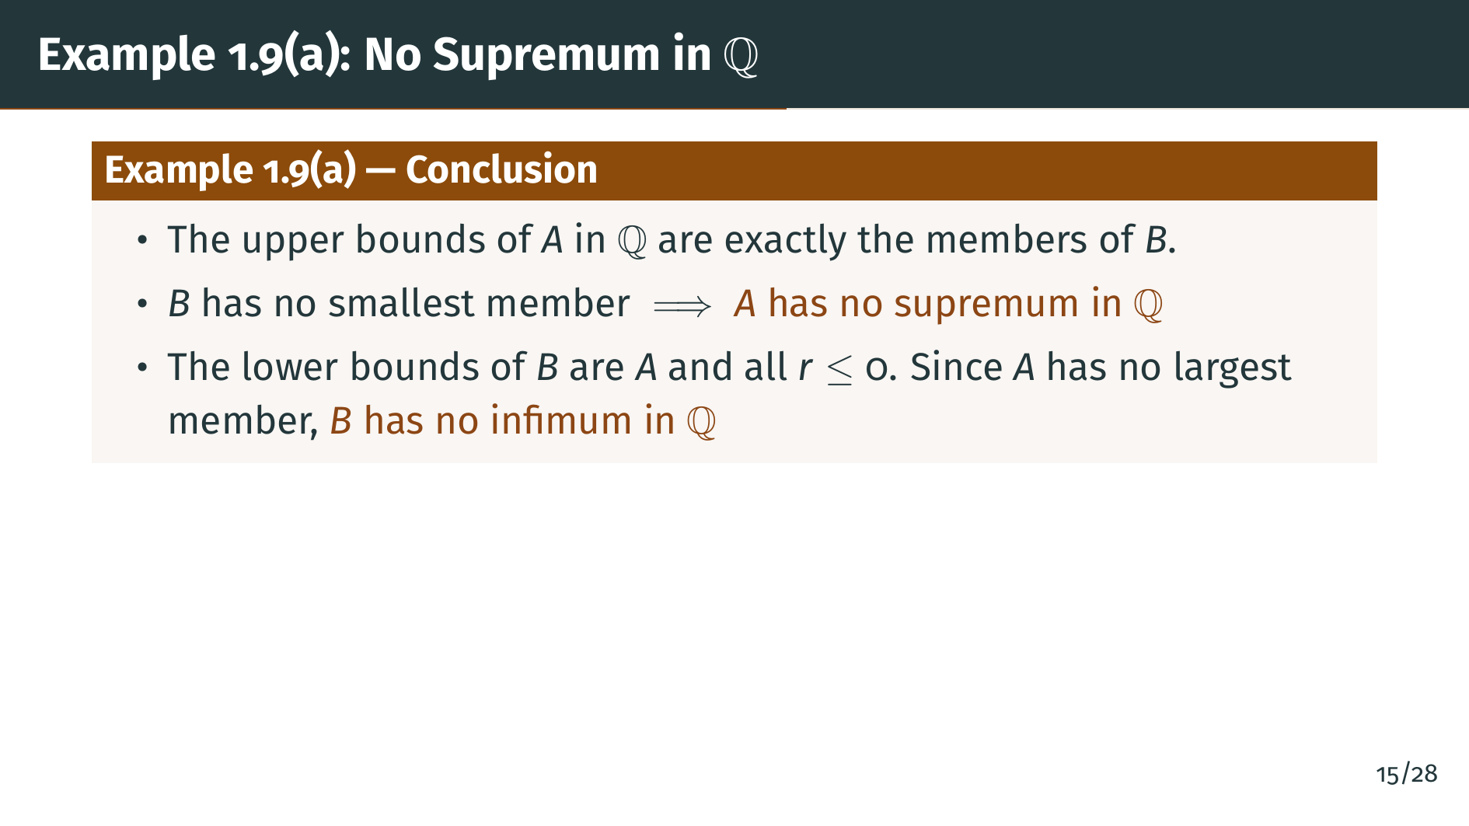
Notes:
The upper bounds of "A" within the rationals are exactly the members of "B". Why? Any rational upper bound of "A" must satisfy "p" squared greater than or equal to 2, but since no rational has "p" squared equal to 2, it must satisfy "p" squared greater than 2, placing it in "B". Now, "B" has no smallest member, as we proved in the introduction. That means there is no least upper bound for "A" within the rationals. "A" has no supremum in "Q". Similarly, the lower bounds of "B" consist of all members of "A" together with all non-positive rationals. Since "A" has no largest member, "B" has no greatest lower bound in Q either. This is the fundamental gap that motivates everything that follows.

Slide 19
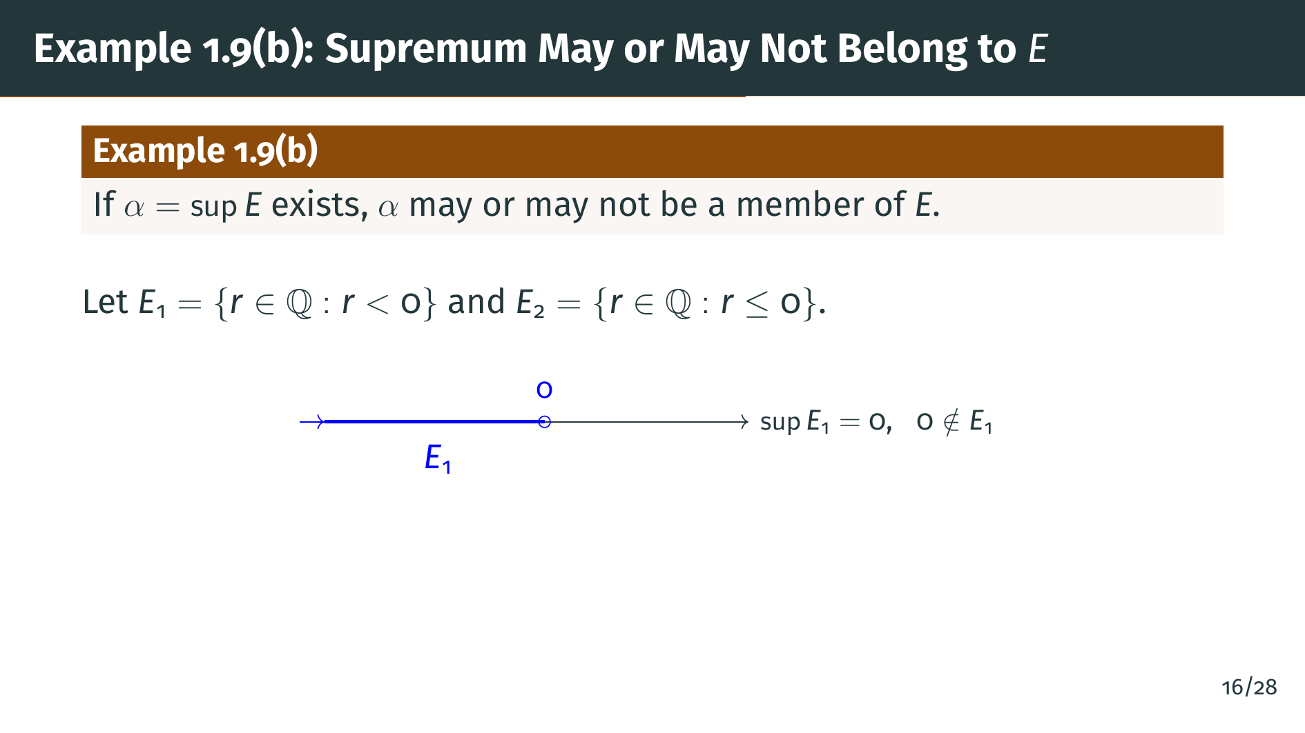
Notes:
An important point: the supremum of a set may or may not actually belong to that set. Consider "E" sub 1, the set of all rationals strictly less than 0. The supremum is 0, but 0 is not in "E" sub 1, because we required strict inequality.

Slide 20
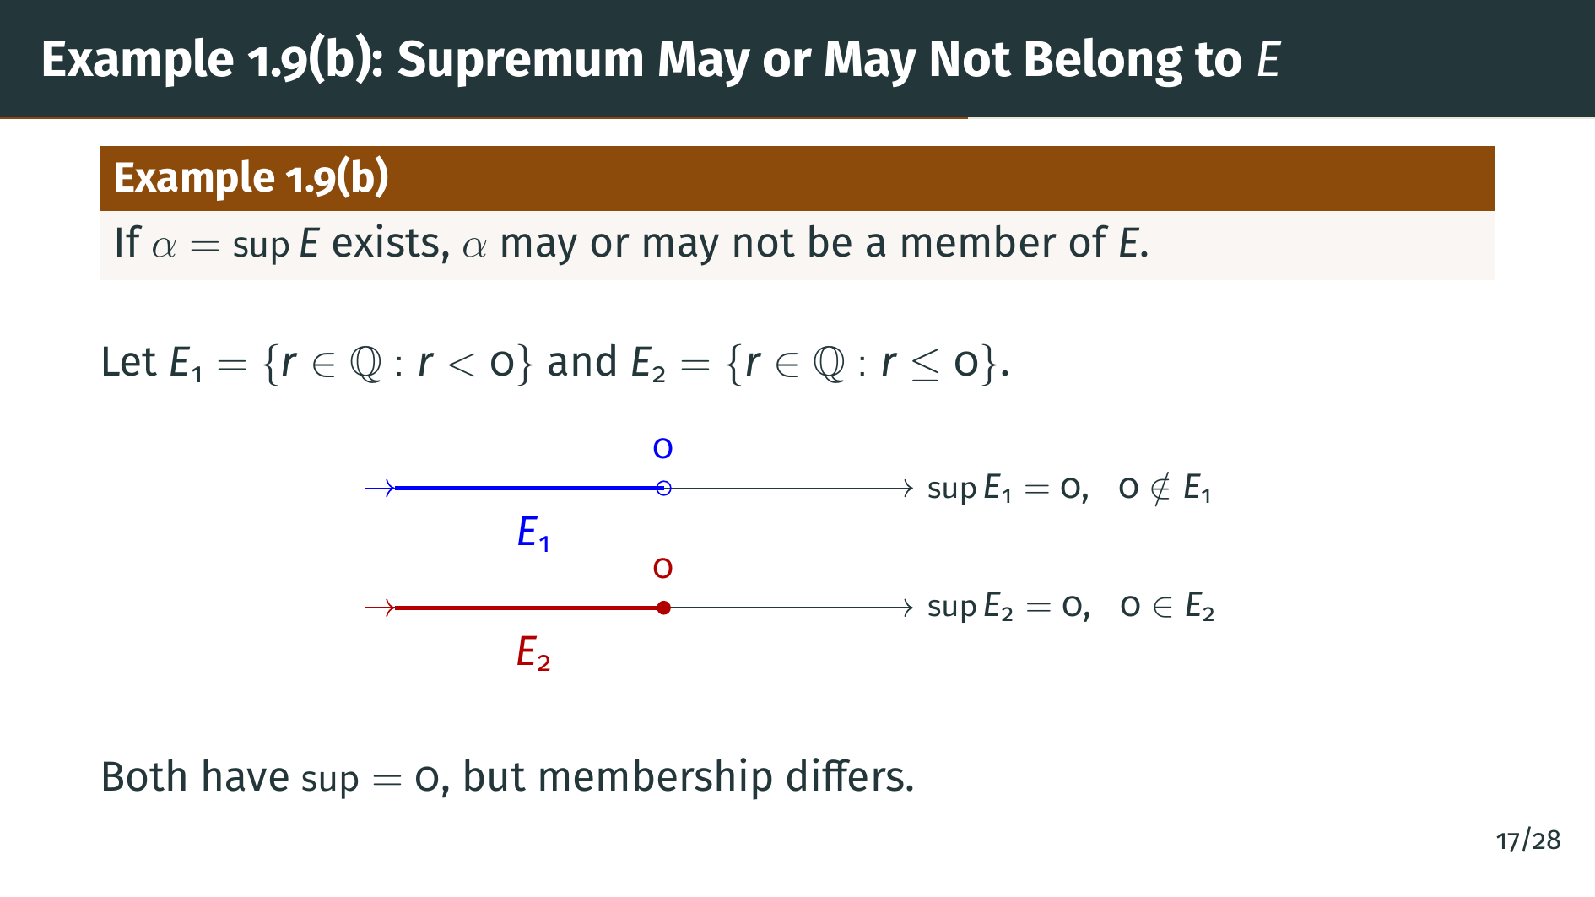
Notes:
Now consider "E" sub 2, the set of all rationals less than or equal to zero. The supremum is again 0, but this time 0 belongs to "E" sub 2. The open circle on the "E" sub 1 diagram shows that 0 is excluded, while the filled circle for "E" sub 2 shows inclusion. Both sets have the same supremum, but membership differs. This is an important subtlety: the supremum need not be an element of the set.

Slide 21
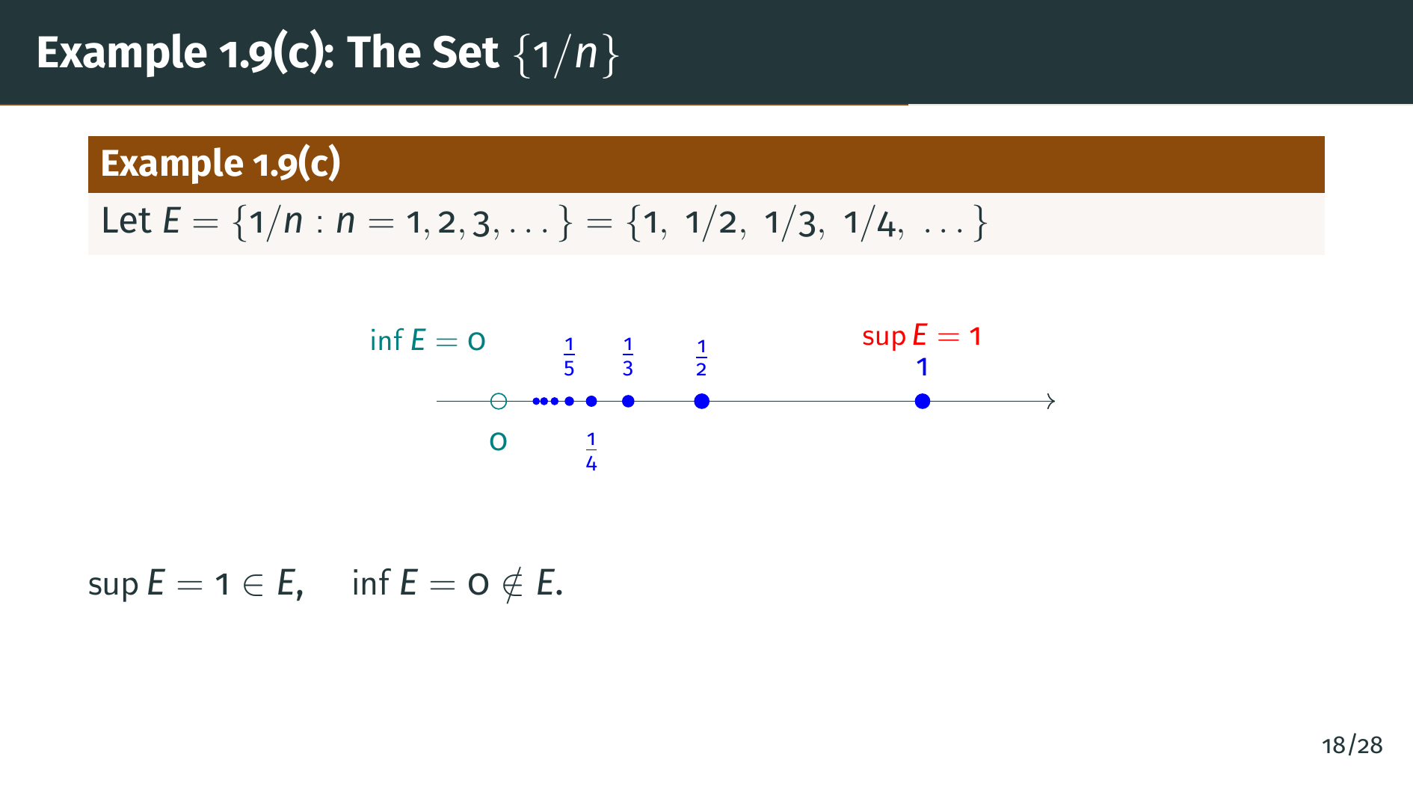
Notes:
Here is another instructive example. Let "E" be the set of all numbers 1 over "n", where "n" ranges over the positive integers. So "E" is the set containing 1, one half, one third, one fourth, and so on. The supremum is 1, which is a member of "E" since 1 equals 1 over 1. The infimum is 0, which is not a member of "E" because there is no positive integer "n" with 1 over "n" equal to 0. The elements of "E" get closer and closer to 0, accumulating near it, but never reaching it. This example again illustrates that the supremum can belong to the set while the infimum does not, or vice versa.

Slide 22
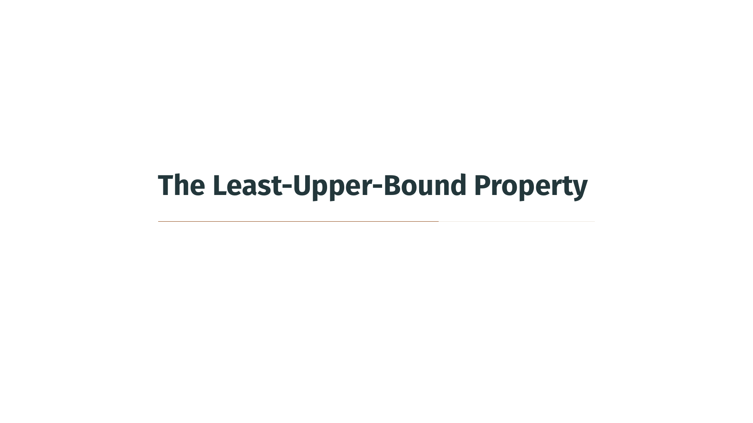

Slide 23
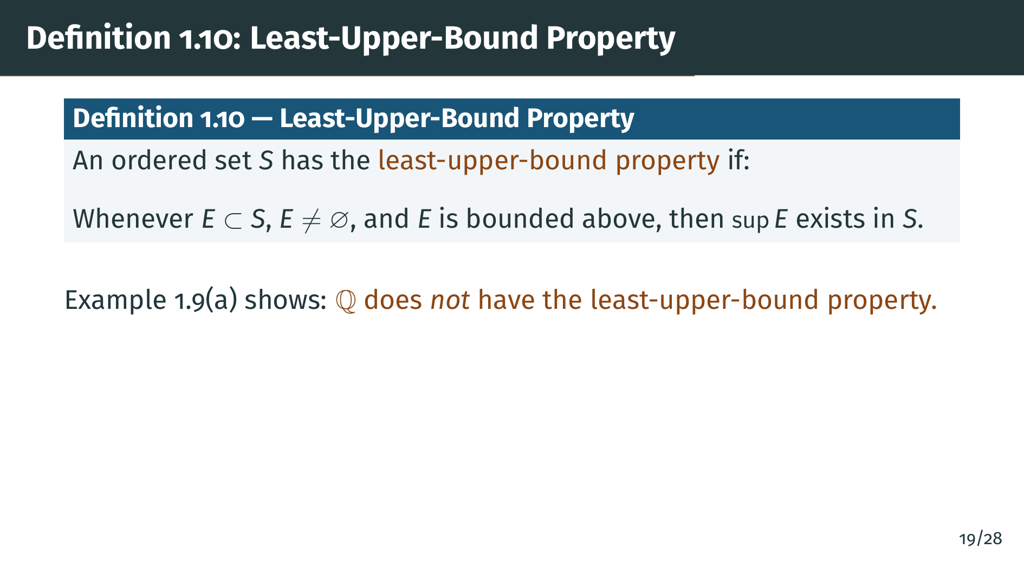
Notes:
This is one of the most important definitions in the book. An ordered set "S" has the least-upper-bound property if every nonempty subset of "S" that is bounded above has a supremum that exists within "S". We already saw in Example 1.9 part "a" that the rationals do not have this property, because the set "A" of rationals with "p" squared less than 2 is bounded above but has no supremum in "Q". In the next section, we will see that the real numbers are constructed precisely to have this property. But first, let's see an important consequence: the least-upper-bound property implies the greatest-lower-bound property.

Slide 24
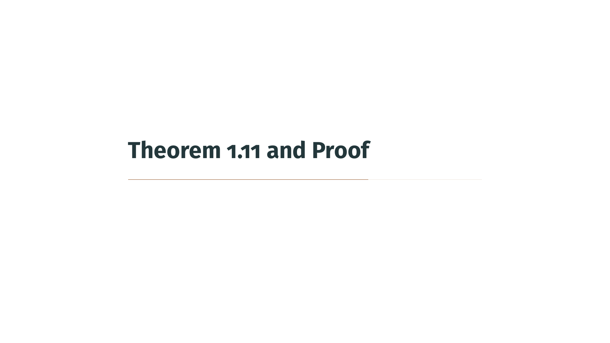

Slide 25
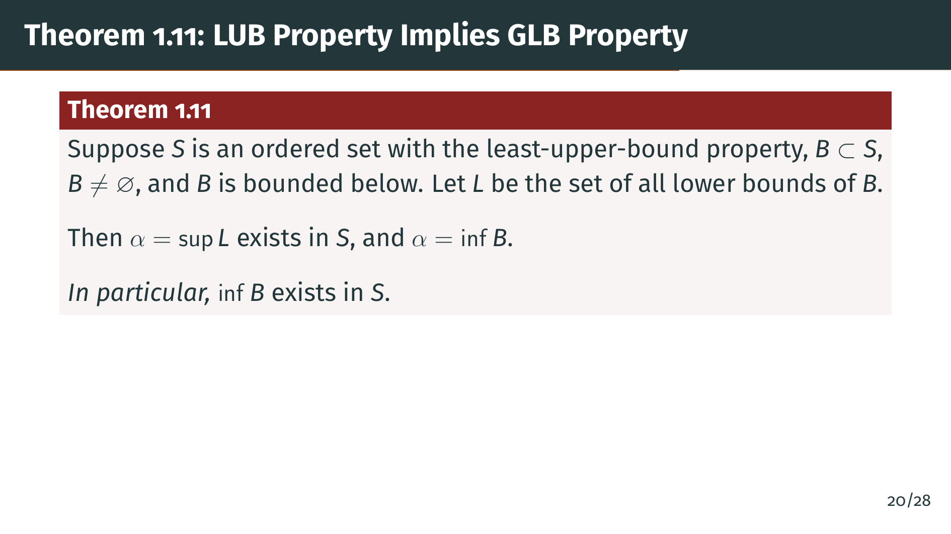
Notes:
Here is Theorem 1.11, which establishes a beautiful connection. If an ordered set "S" has the least-upper-bound property, then it also has the greatest-lower-bound property. More precisely, if "B" is a nonempty subset of "S" that is bounded below, and "L" is the set of all lower bounds of "B", then the supremum of "L" exists and equals the infimum of "B". This means we get greatest lower bounds for free once we have least upper bounds. Let's see why.

Slide 26
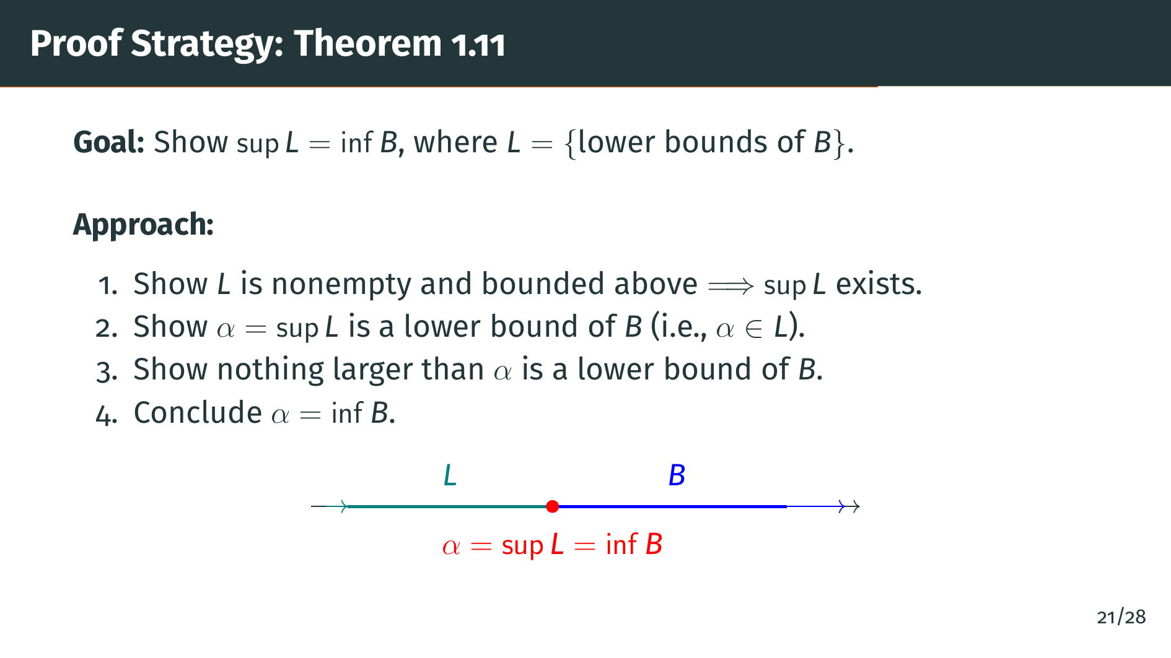
Notes:
Before we dive into the formal proof, let's understand the strategy. We have the set "B", which is bounded below, and "L", the set of all lower bounds of "B". The picture shows "L" to the left and "B" to the right, with "alpha" at the boundary. Our plan is: first, use the least-upper-bound property to show that sup "L" exists. Then show that this supremum is actually a lower bound of "B", meaning it belongs to "L". Finally, show that nothing bigger than "alpha" is a lower bound of "B". That will make "alpha" the greatest lower bound, the infimum of "B".

Slide 27
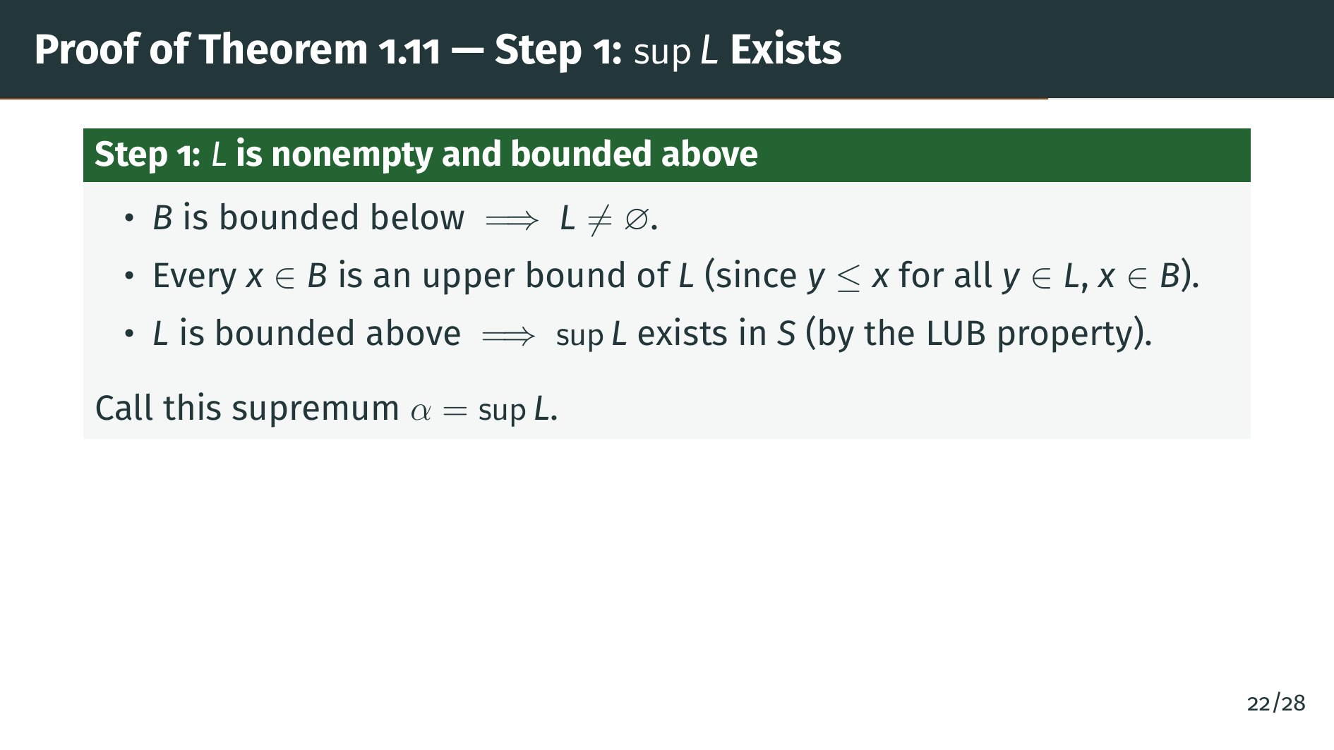
Notes:
Let's begin. Since "B" is bounded below, there exists at least one lower bound, so "L" is not empty. Now, every element "x" of "B" is an upper bound for "L". Why? Because "L" consists of all lower bounds of "B", meaning every element of "L" is less than or equal to every element of "B". So every element of "B" bounds "L" from above. Since "L" is nonempty and bounded above, and "S" has the least-upper-bound property, sup "L" must exist in "S". Call it "alpha".

Slide 28
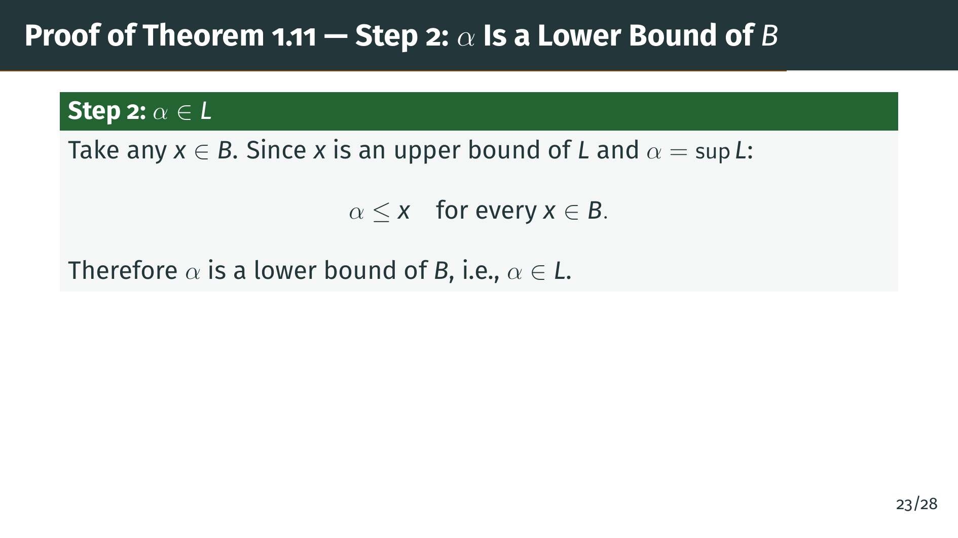
Notes:
Now we show that "alpha" is actually a lower bound of "B". Take any element "x" in "B". We just showed that "x" is an upper bound of "L". Since "alpha" is the least upper bound of "L", "alpha" must be less than or equal to "x". But "x" was arbitrary in "B". So "alpha" is less than or equal to every element of "B", which means "alpha" is a lower bound of "B". In other words, "alpha" belongs to "L". Now we just need to show that nothing larger than "alpha" is also a lower bound of "B".

Slide 29
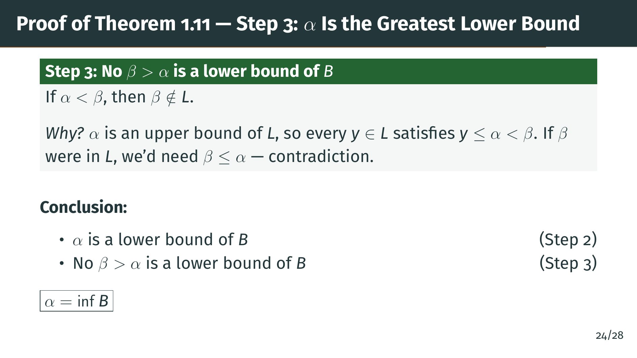
Notes:
Finally, suppose "beta" is strictly greater than "alpha". Since "alpha" is the supremum of "L", every element of "L" is at most "alpha". So if "beta" were in "L", we would need "beta" less than or equal to "alpha", which contradicts "beta" being strictly greater. Therefore "beta" is not in "L", meaning "beta" is not a lower bound of "B". Putting it all together: "alpha" is a lower bound of "B" from Step 2, and no element greater than "alpha" is a lower bound of "B" from Step 3. By definition, this means "alpha" equals the infimum of "B". The proof is complete. This elegant argument shows that the least-upper-bound property automatically gives us the greatest-lower-bound property as well.

Slide 30
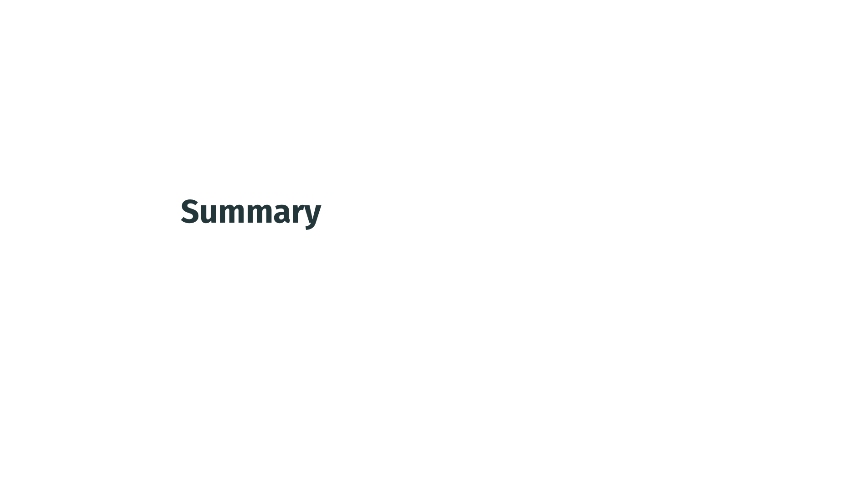

Slide 31
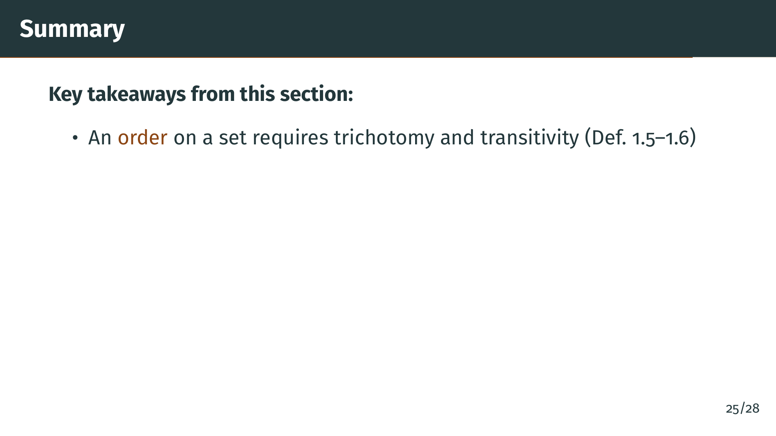
Notes:
Let's review what we covered. First, we defined what an order is: a relation satisfying trichotomy, meaning every pair of elements is comparable in exactly one way, and transitivity, meaning the relation chains consistently.

Slide 32
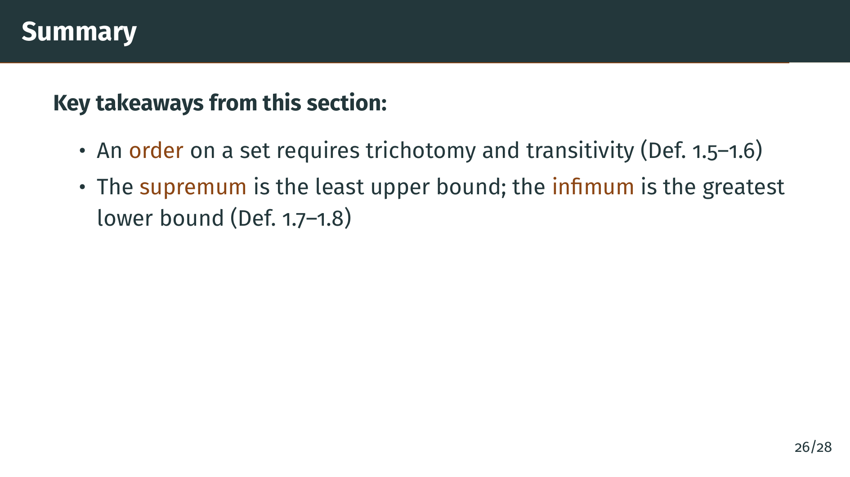
Notes:
Second, we defined upper and lower bounds, and introduced the supremum and infimum as the tightest possible bounds. The supremum may or may not belong to the set.

Slide 33
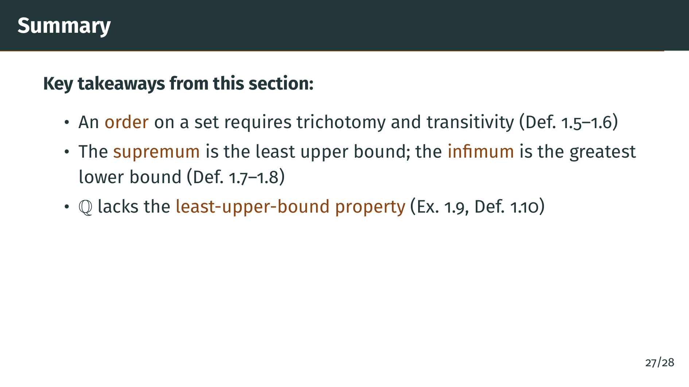
Notes:
Third, we saw concretely that the rationals do not have the least-upper-bound property. The set of rationals whose square is less than 2 is bounded above but has no supremum in the rationals.

Slide 34
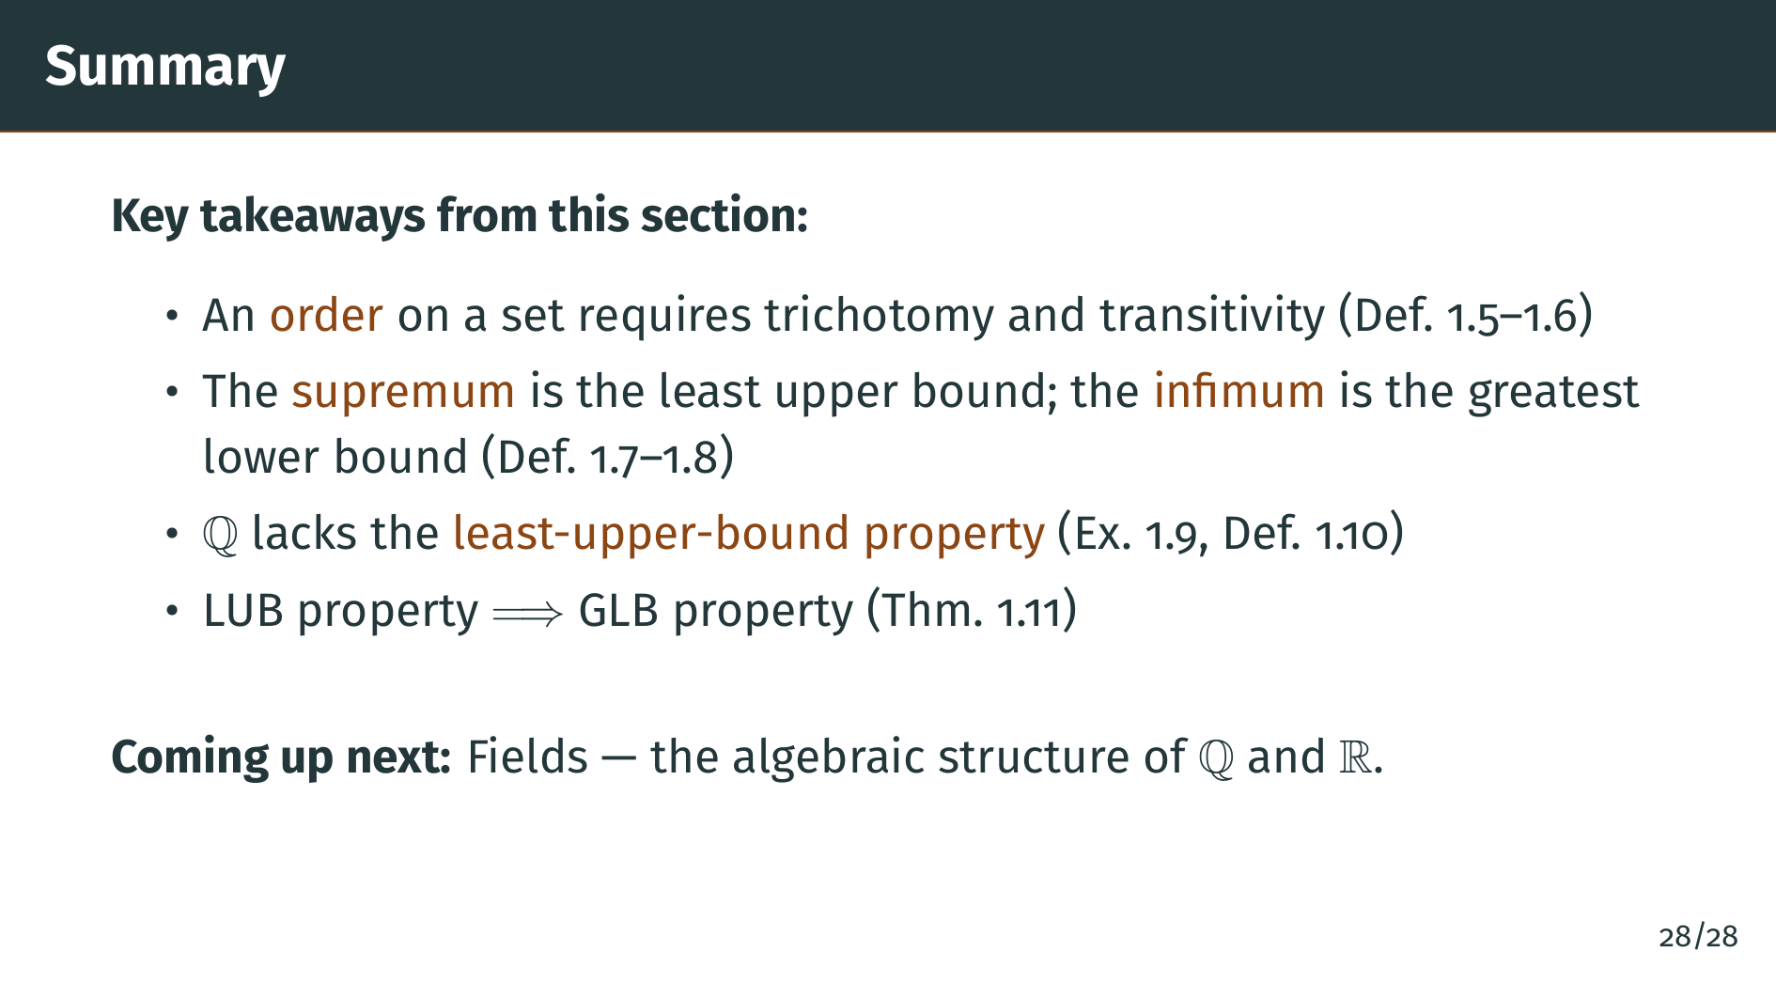
Notes:
And finally, Theorem 1.11 showed that the least-upper-bound property automatically implies the greatest-lower-bound property. So once we construct the real numbers with the least-upper-bound property, we get infima for free as well. In the next section, we will study fields, which capture the algebraic structure --- addition and multiplication --- of the rational and real numbers. See you there.

