Slide 1
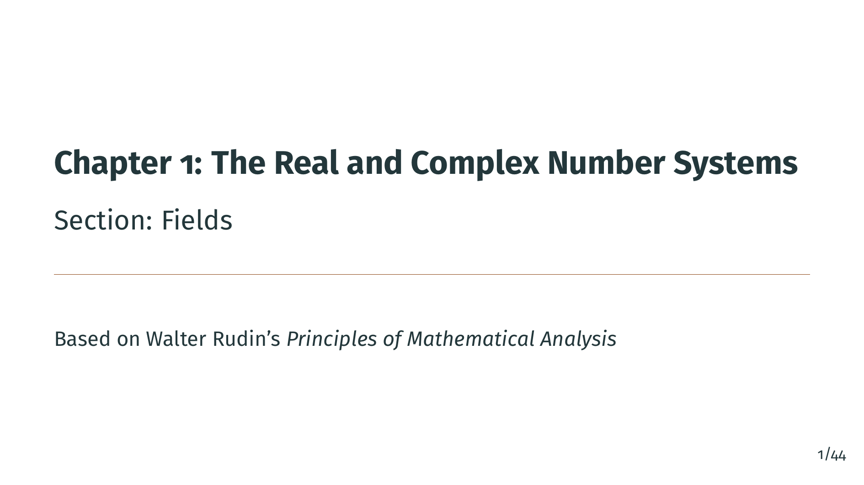
Notes:
Welcome to Chapter 1, Section 3: Fields. In this section, we introduce the algebraic structure known as a field. Fields give us the precise rules for addition and multiplication that underlie the real numbers, the rationals, and the complex numbers. We will also define ordered fields, which combine algebraic and order structure. Let's get started.

Slide 2
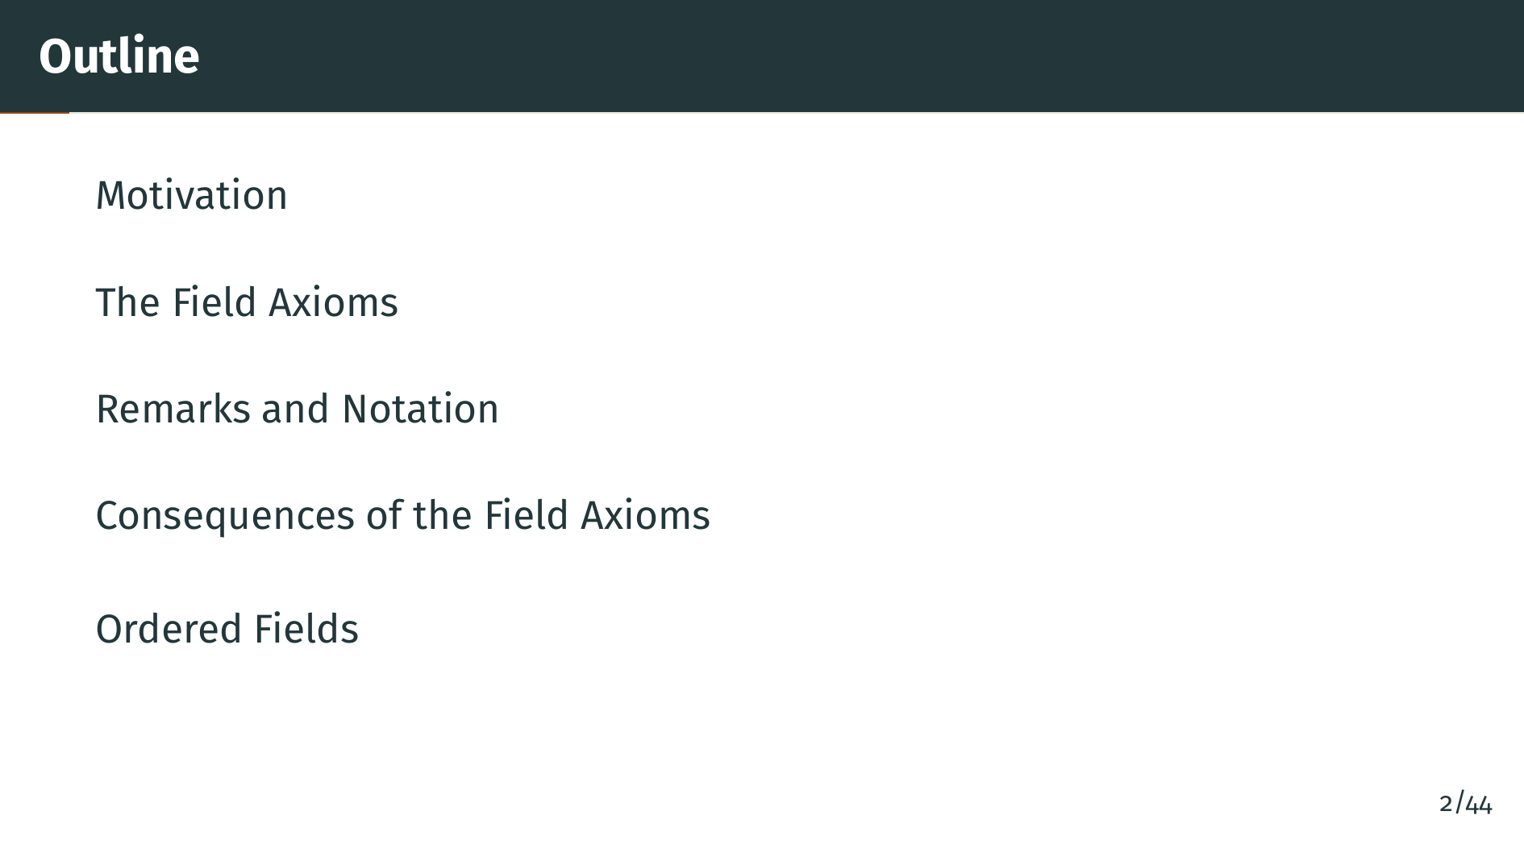
Notes:
Here is our roadmap for this section. We will begin with the definition of a field and its axioms, then explore the immediate consequences of those axioms. After that, we will introduce ordered fields and prove the basic properties of inequalities. Let's dive in.

Slide 3


Slide 4
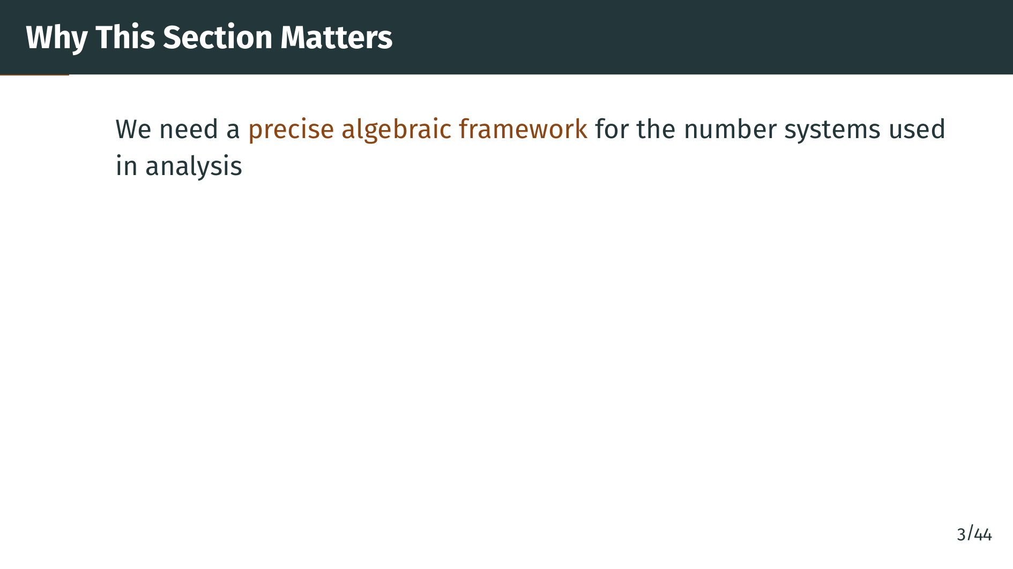
Notes:
Before we can do analysis, we need to know exactly what operations are available and what rules they follow. The concept of a field gives us this precise algebraic framework. It captures the essential properties of addition and multiplication.

Slide 5
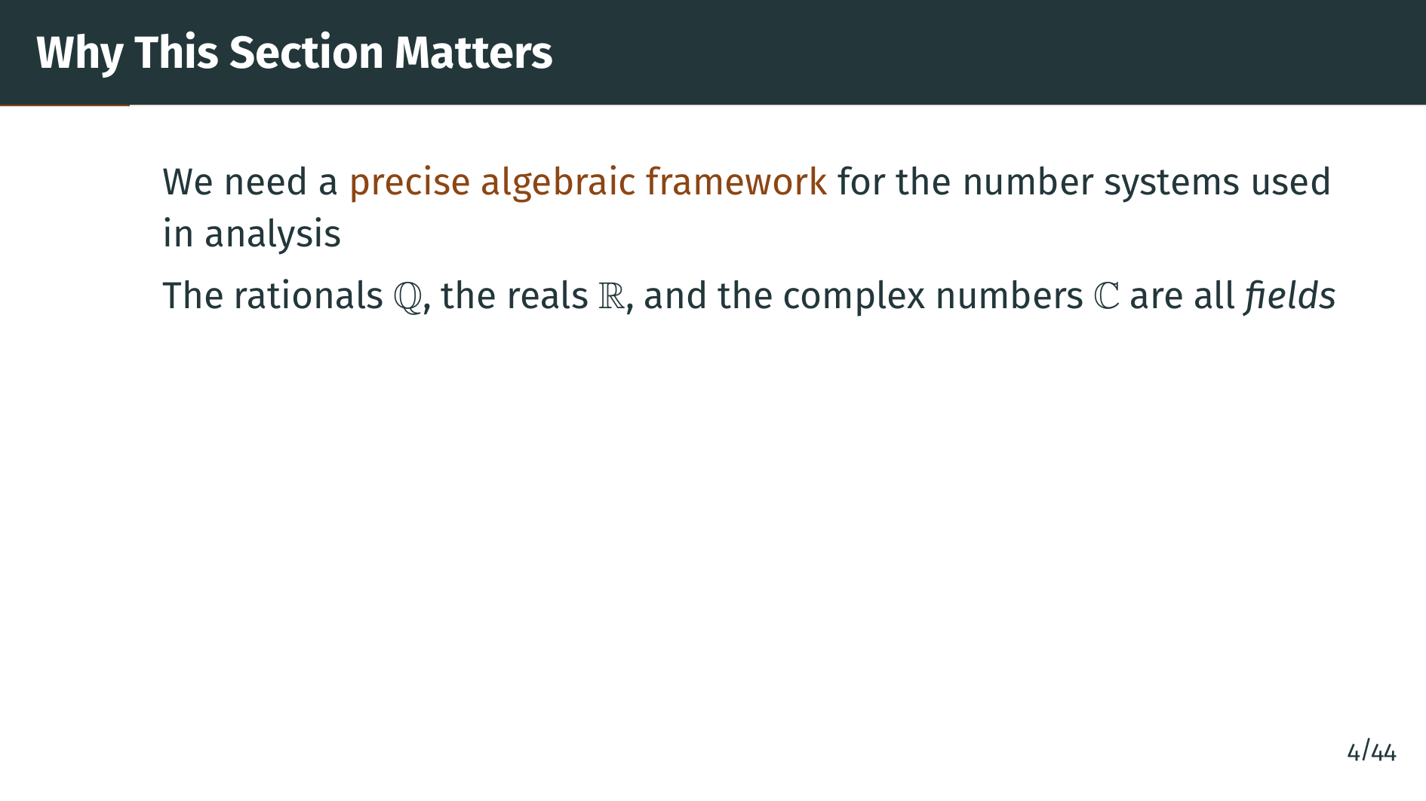
Notes:
The rationals, the reals, and the complex numbers all share the same basic algebraic structure. By proving results at the level of fields, we prove them once and for all, rather than repeating the work for each number system separately.

Slide 6
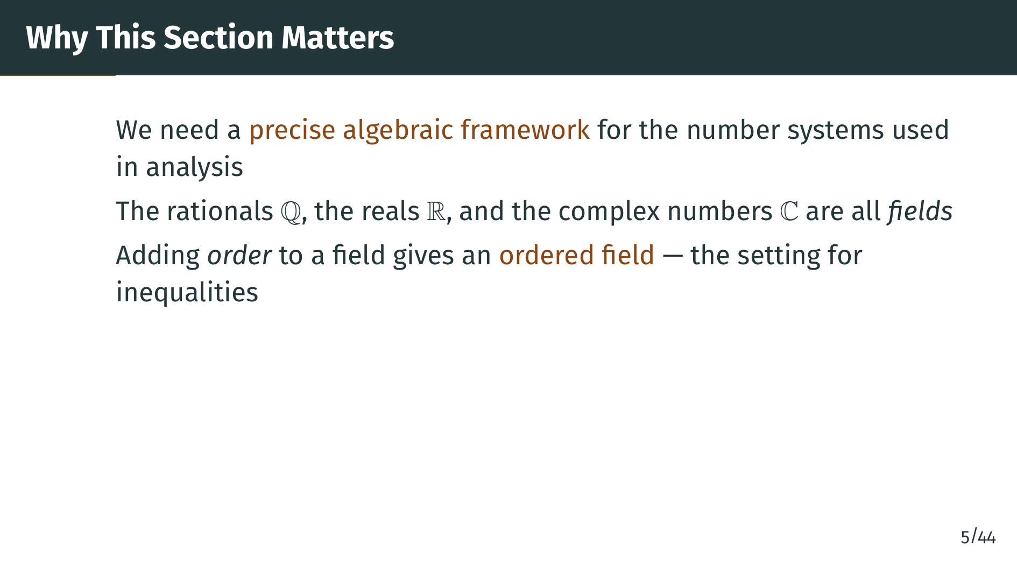
Notes:
Finally, we will combine the algebraic structure of a field with the order structure from the previous section to get an ordered field. Ordered fields are where inequalities live, and they provide the natural setting for the real number system. Let's begin with the definition of a field.

Slide 7


Slide 8
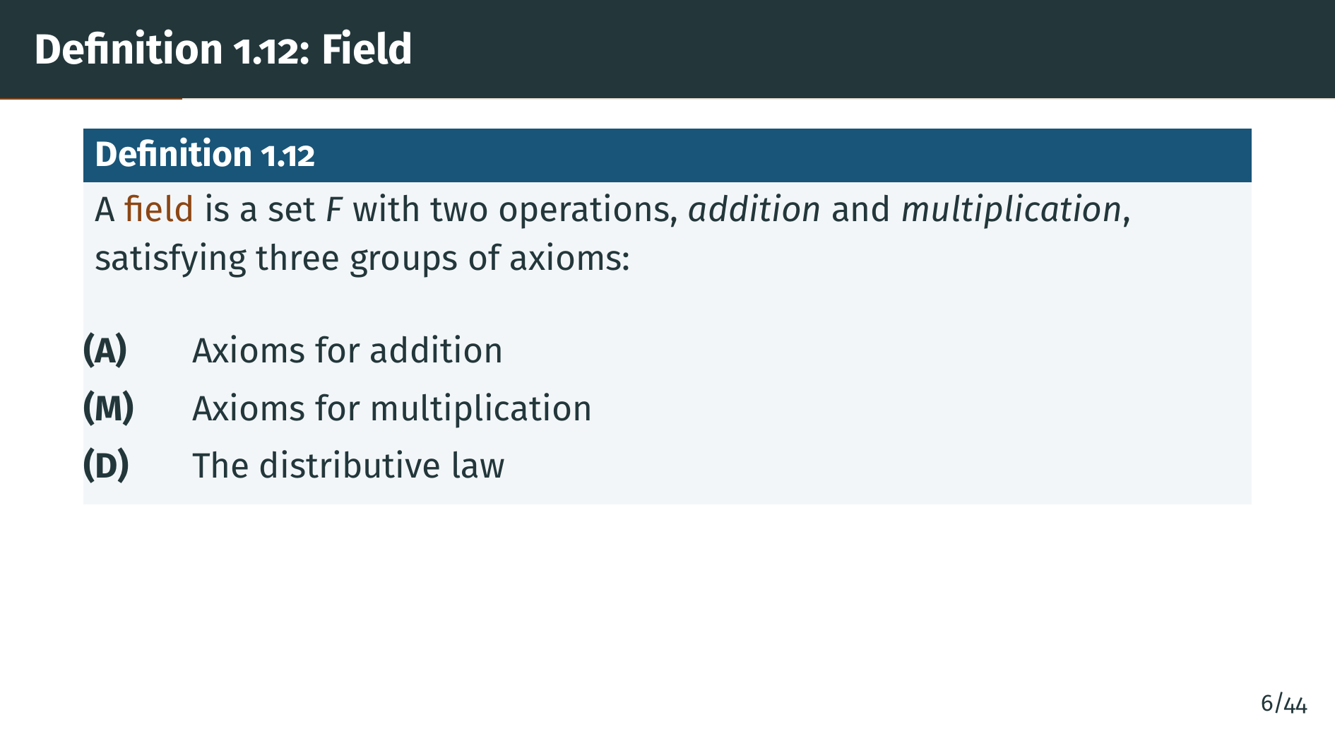
Notes:
A field is a set equipped with two operations, addition and multiplication, that satisfy a specific list of axioms. These axioms are organized into three groups: the addition axioms, the multiplication axioms, and the distributive law that links the two operations together. Let's look at each group in turn.

Slide 9
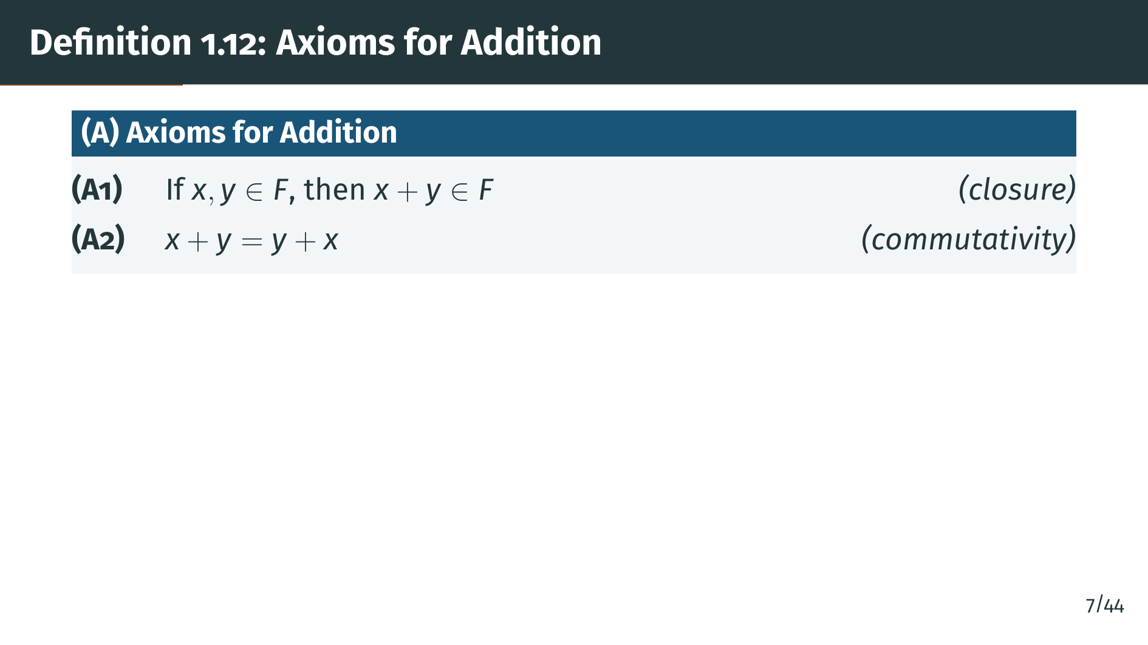
Notes:
The first two addition axioms are closure and commutativity. Closure says that adding two elements of the field always gives another element of the field. Commutativity says the order of addition does not matter. These are familiar properties from ordinary arithmetic. Next come the structural axioms.

Slide 10
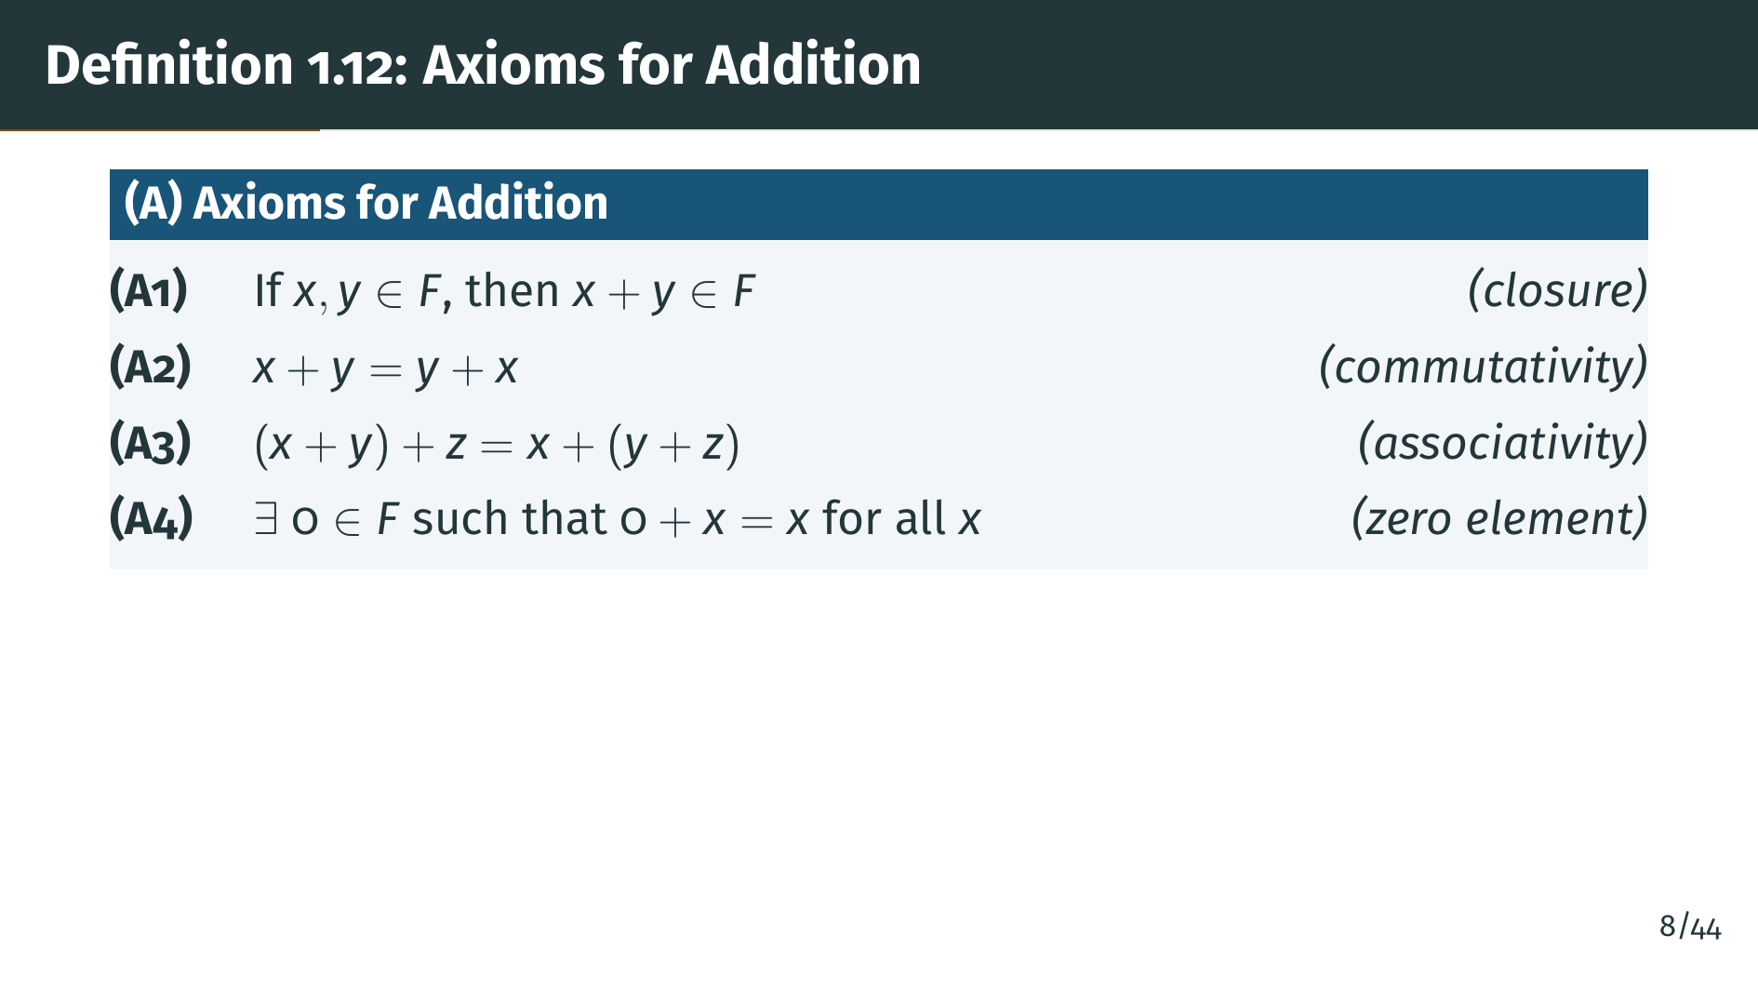
Notes:
Associativity tells us that grouping does not matter when adding three elements. Axiom A4 guarantees the existence of an additive identity, the element zero, which leaves every element unchanged when added to it. One more axiom completes the picture for addition.

Slide 11
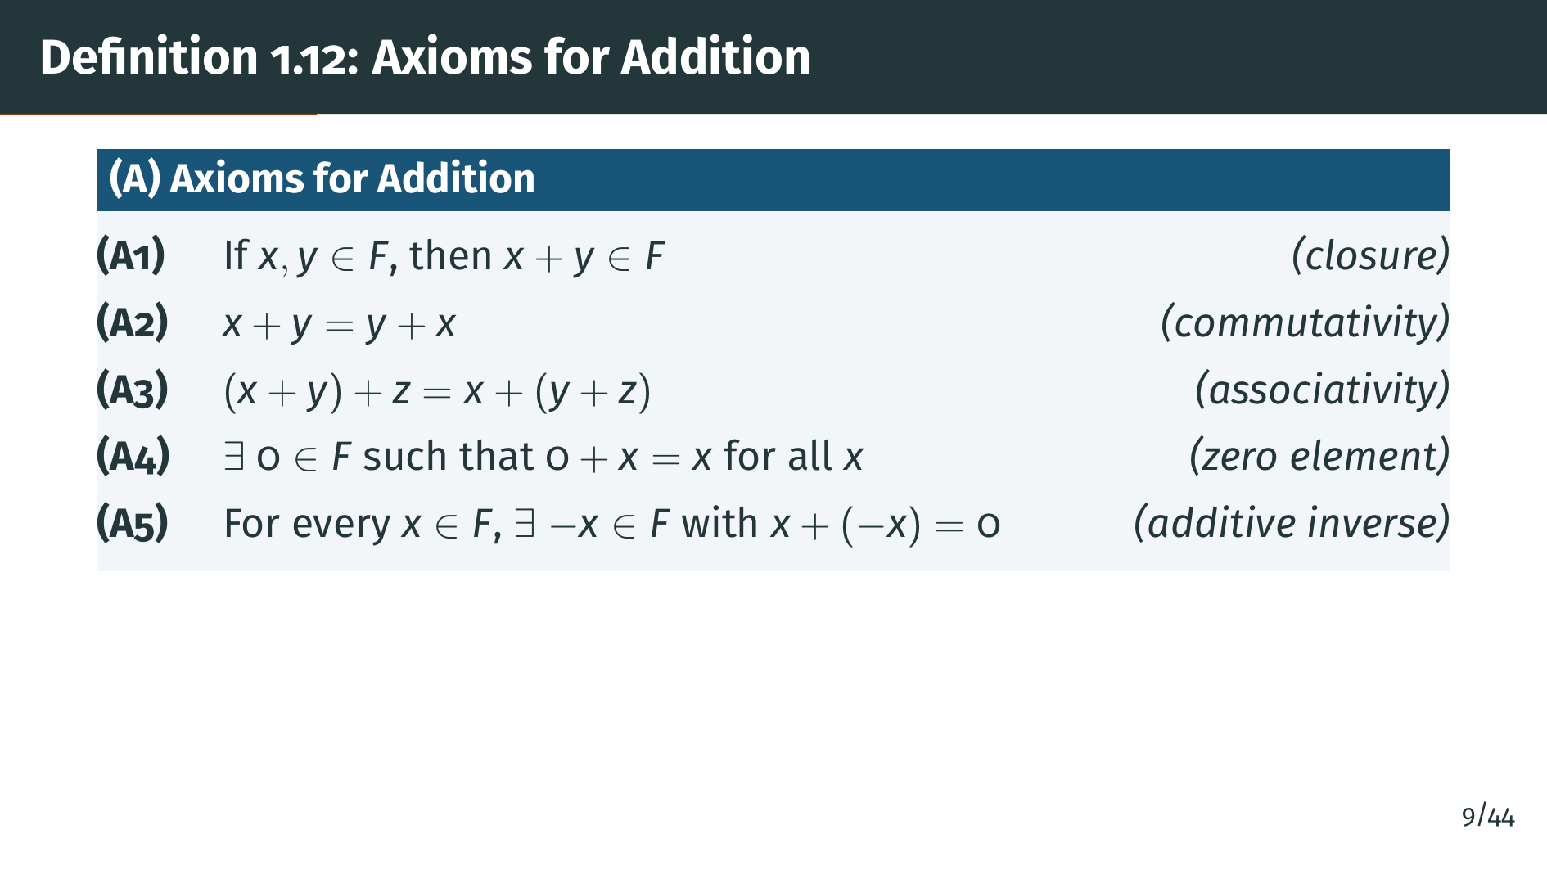
Notes:
The final addition axiom guarantees that every element has an additive inverse, denoted negative "x", whose sum with "x" is zero. Together, these five axioms say that the set "F" under addition forms what algebraists call an abelian group. Now let's see the multiplication axioms.

Slide 12
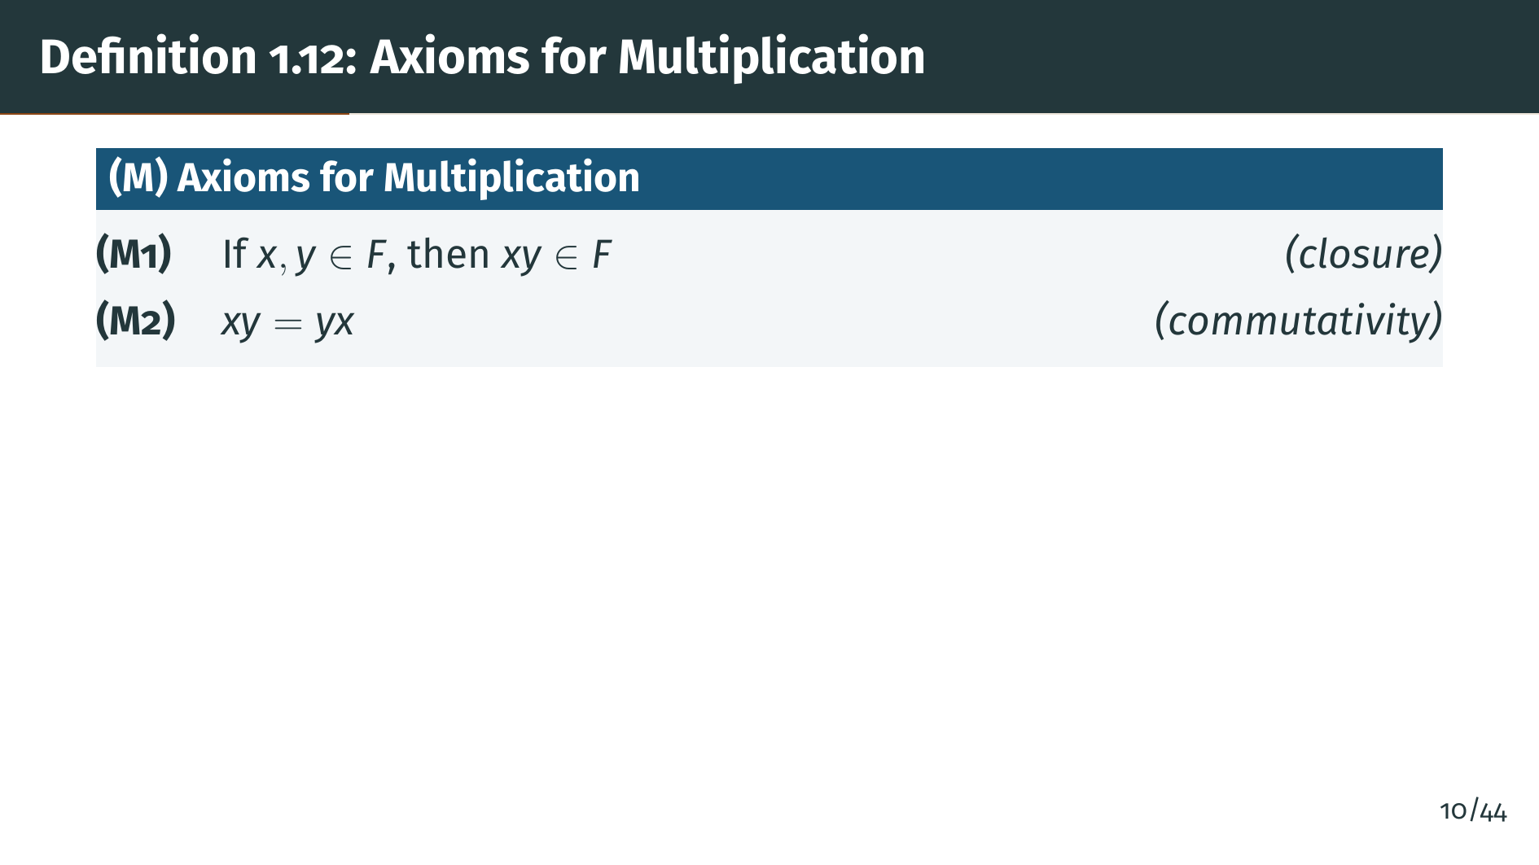
Notes:
The multiplication axioms mirror the addition axioms almost exactly. M1 says the product of two field elements is again in the field, and M2 says multiplication is commutative. So far, the pattern is the same as for addition. Let's see the remaining three.

Slide 13
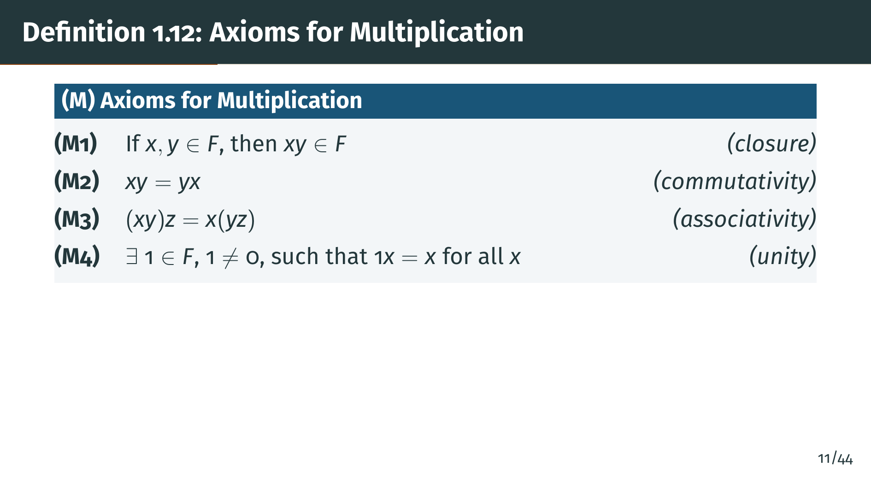
Notes:
M3 gives associativity of multiplication. M4 guarantees a multiplicative identity, the element 1, which must be different from 0. This requirement that 1 is not equal to 0 ensures the field has at least two elements. One more axiom to go.

Slide 14
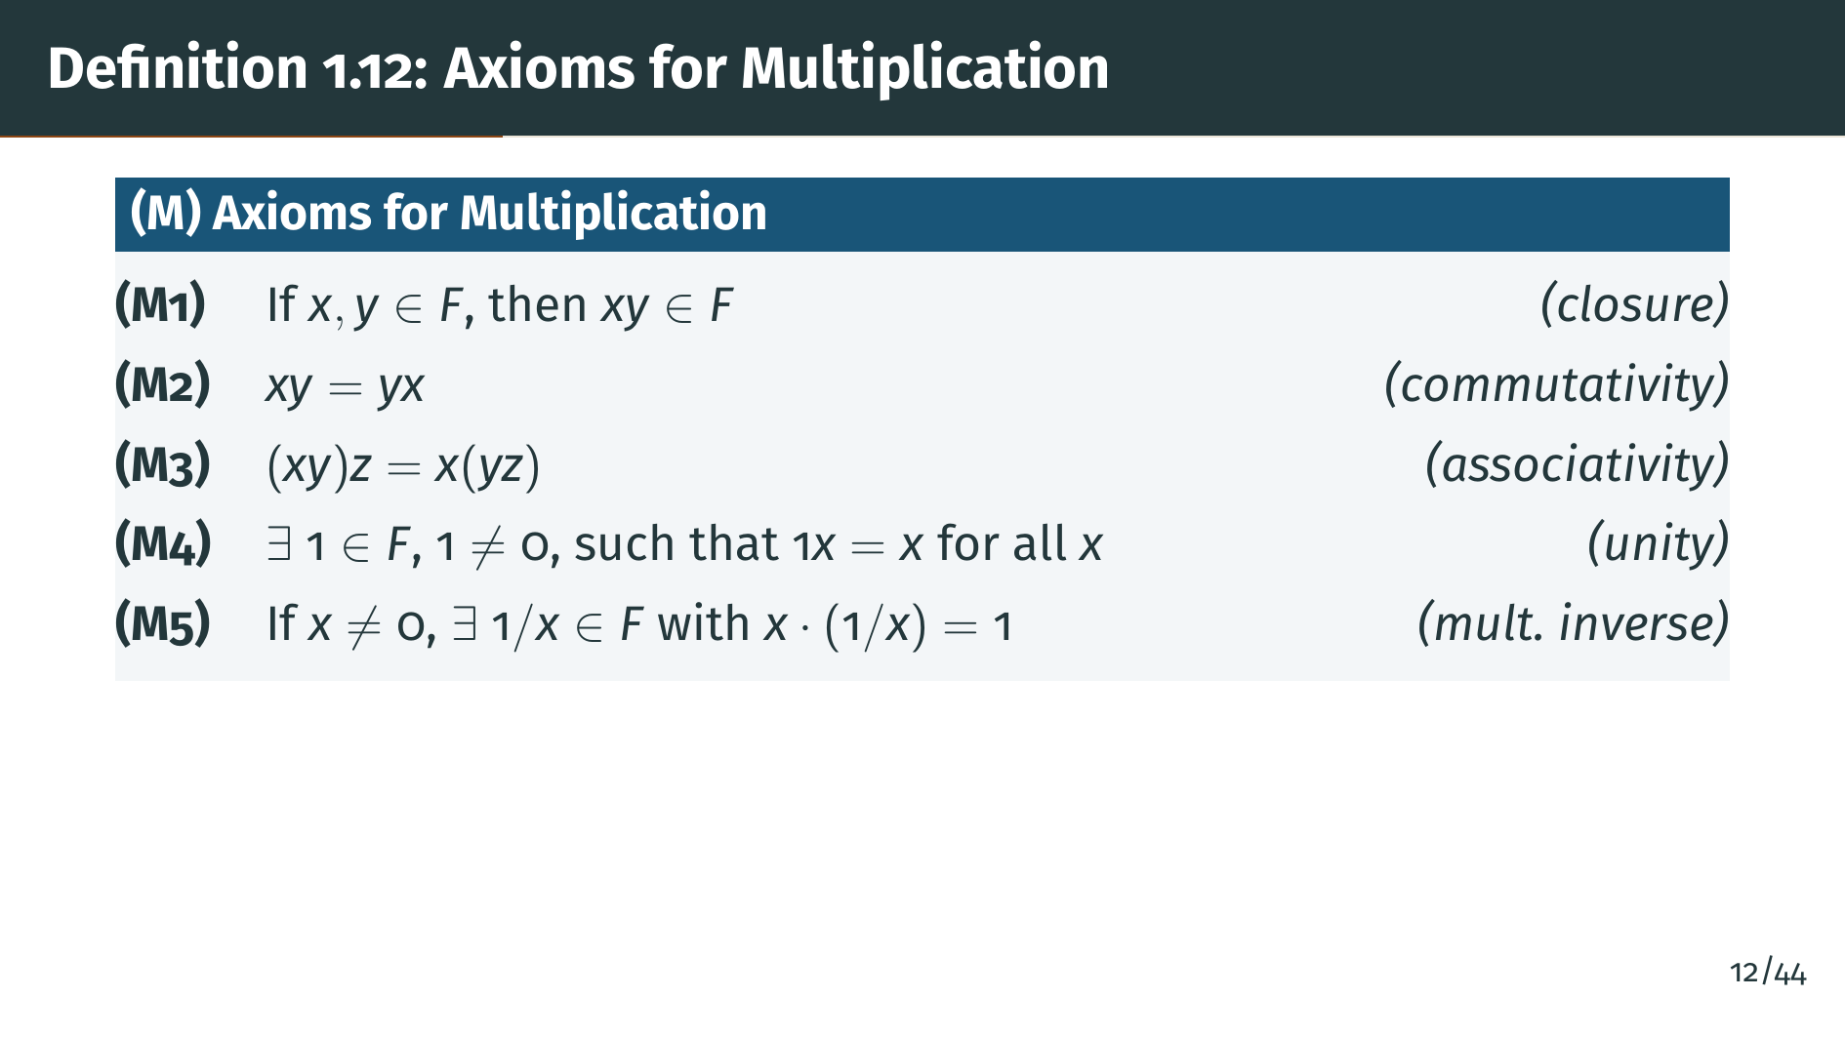
Notes:
M5 says every nonzero element has a multiplicative inverse. Notice the key difference from the addition axioms: zero does not have a multiplicative inverse. The nonzero elements of "F" under multiplication also form an abelian group. One more axiom ties addition and multiplication together.

Slide 15
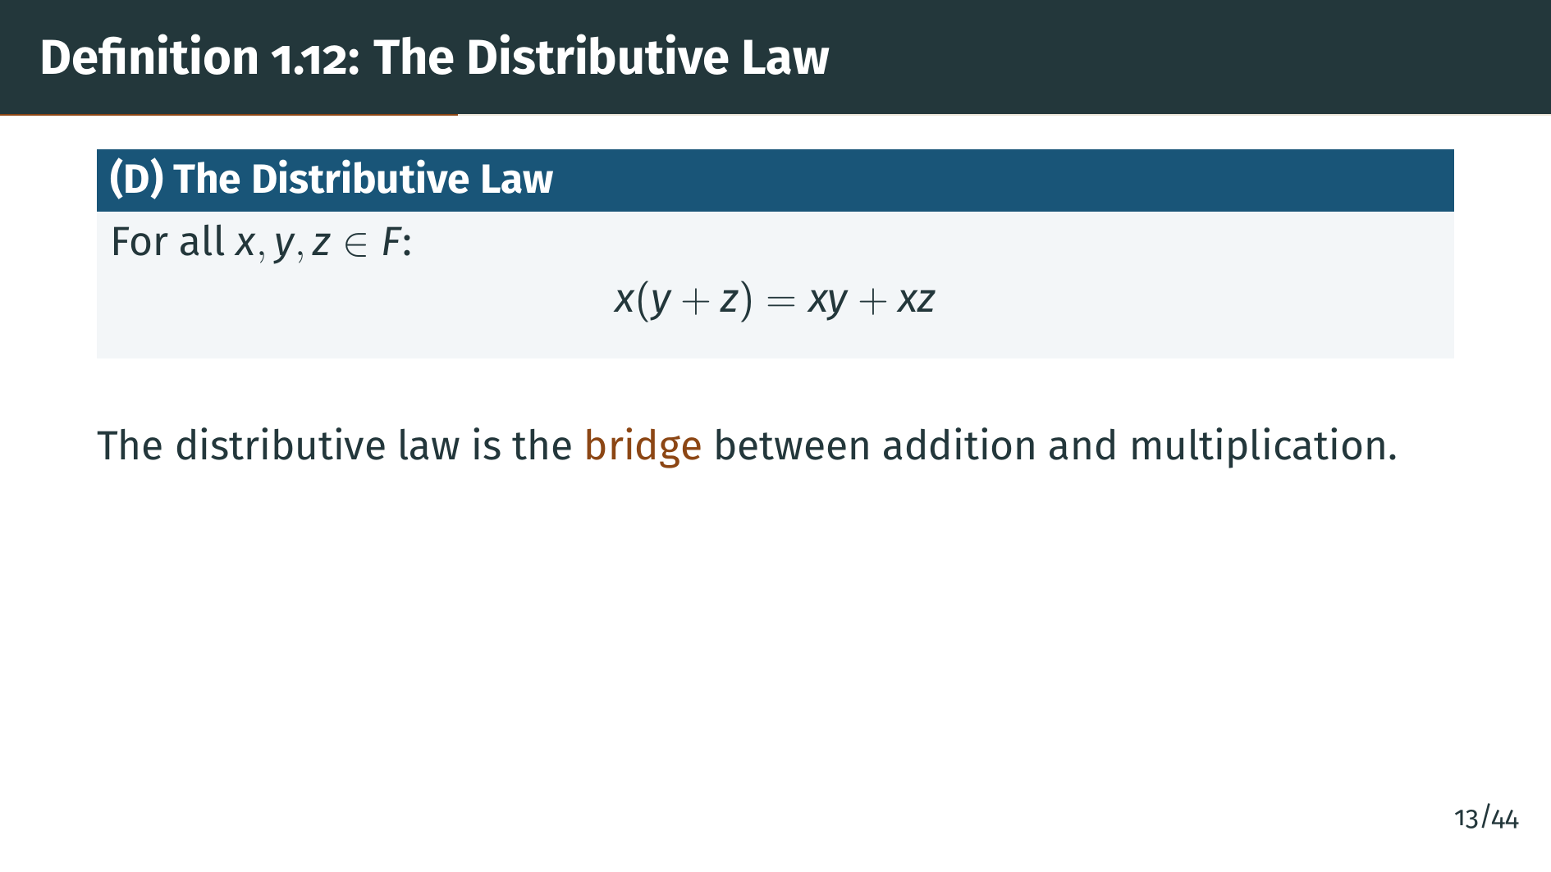
Notes:
The distributive law is the single axiom that connects the two operations. Without it, addition and multiplication would be completely independent structures. This law tells us that multiplication distributes over addition, which is the familiar rule we use when expanding expressions like a times the quantity "b" plus c.

Slide 16
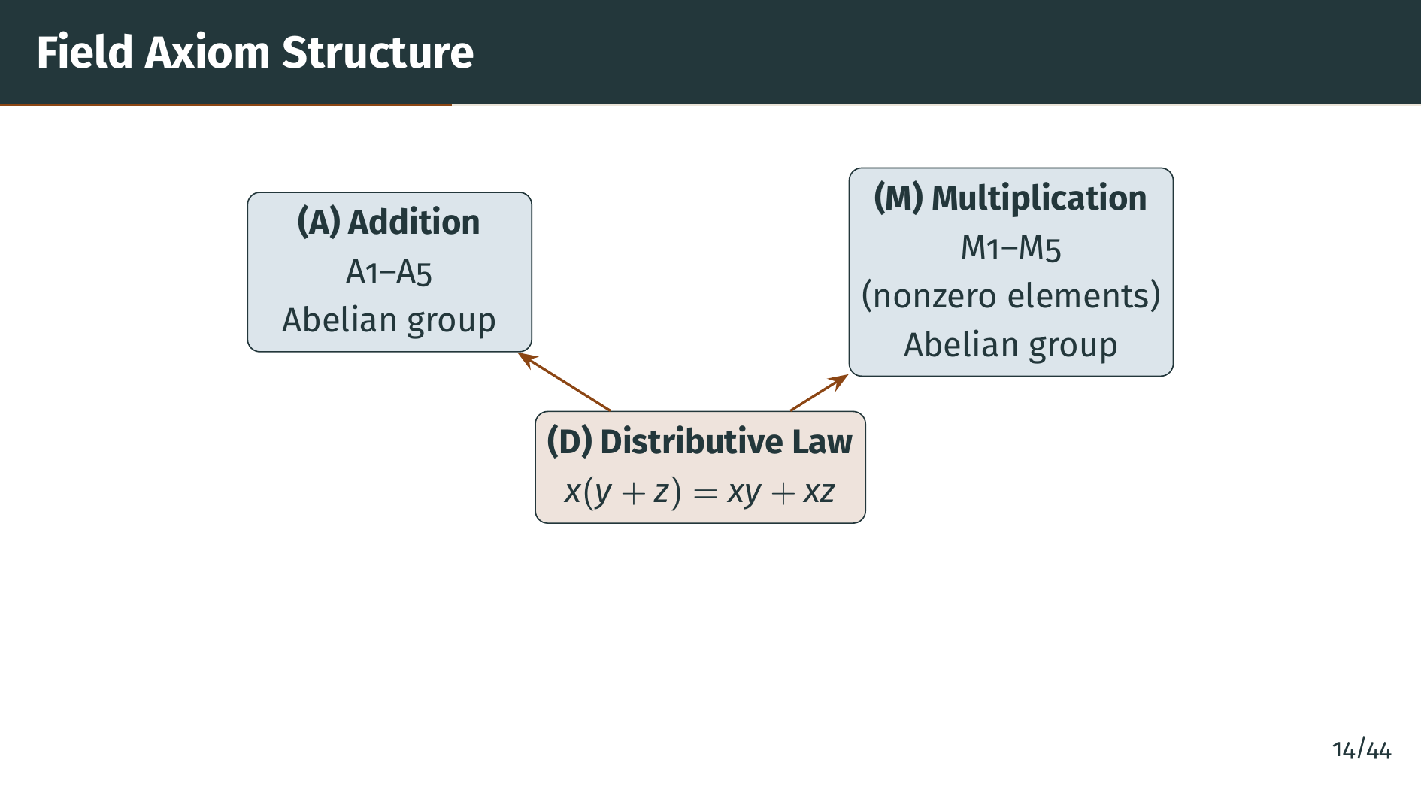
Notes:
This diagram summarizes the structure of the field axioms. On the left we have the five addition axioms, which make the set an abelian group under addition. On the right, the five multiplication axioms make the nonzero elements an abelian group under multiplication. The distributive law at the bottom is the bridge connecting the two operations into a single coherent structure. Next, let's note some useful conventions and examples.

Slide 17


Slide 18
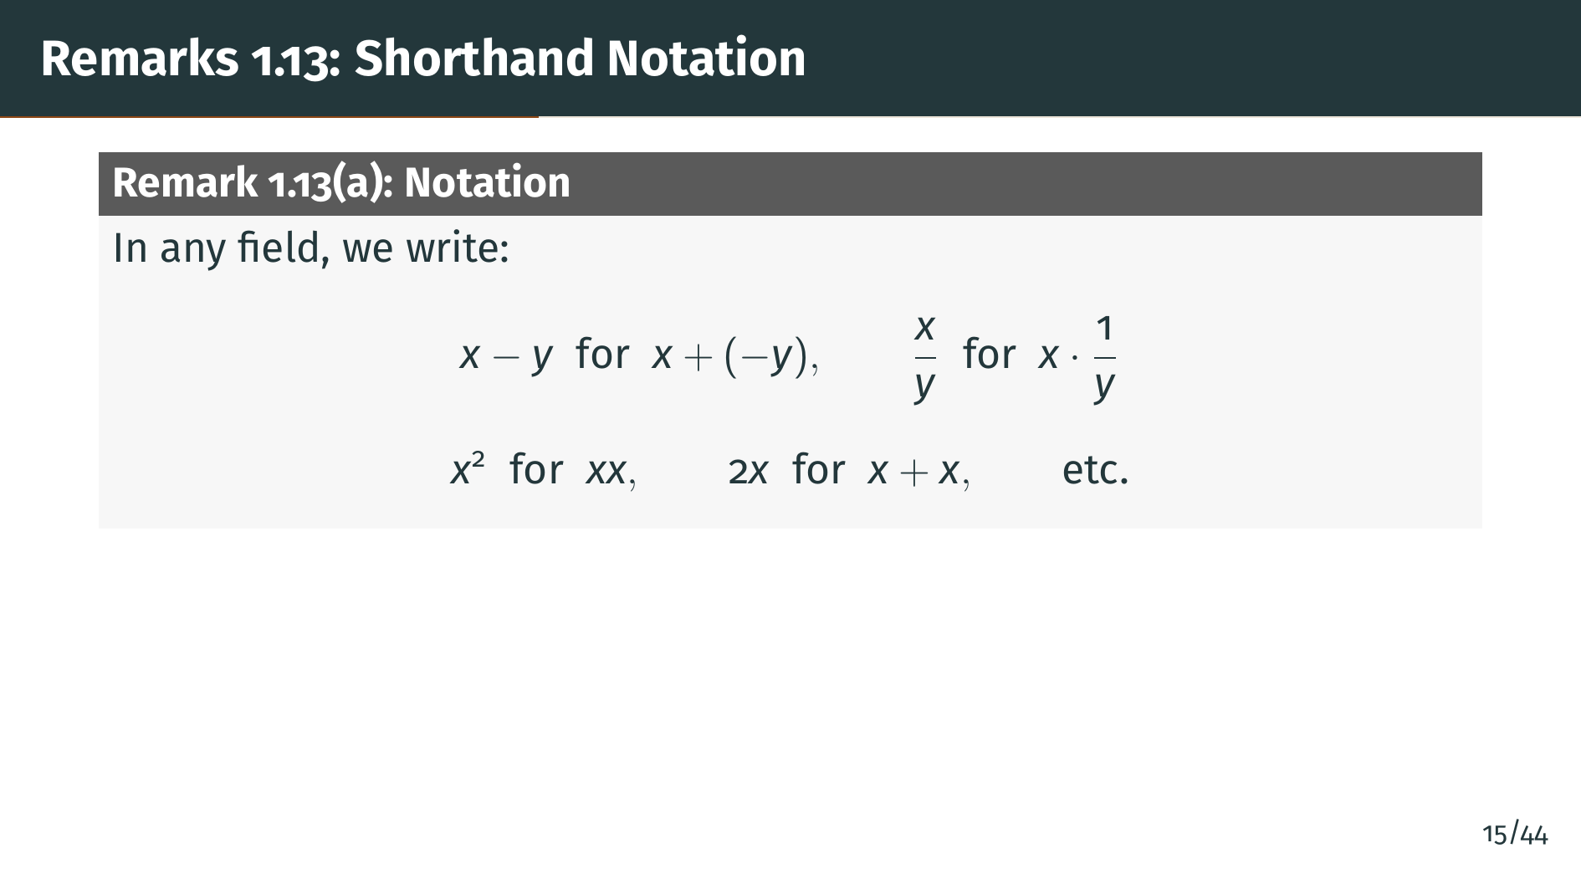
Notes:
Remark 1.13 part "a" introduces the standard shorthand notations we use in fields. Subtraction is defined as adding the additive inverse, and division is defined as multiplying by the multiplicative inverse. Similarly, "x" squared means "x" times x, and 2 "x" means "x" plus x. These are all abbreviations built from the two basic operations. With this notation in hand, let's see the most important example of a field.

Slide 19
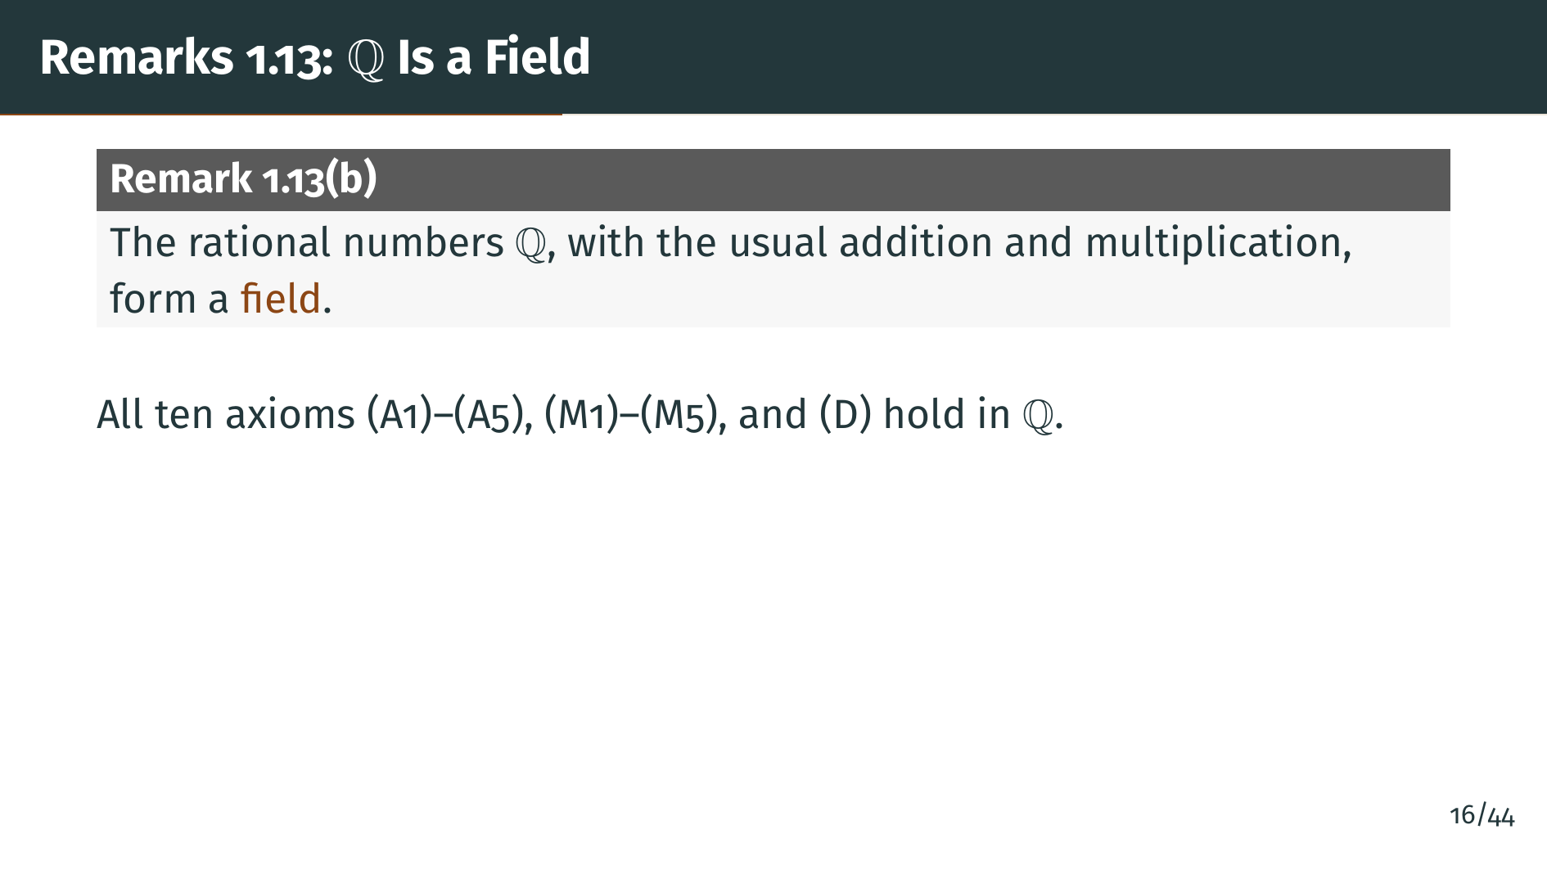
Notes:
The most familiar example of a field is the set of rational numbers "Q". All the field axioms hold for the rationals with their customary addition and multiplication. So "Q" is a field, and everything we prove about fields in general will automatically apply to the rationals.

Slide 20
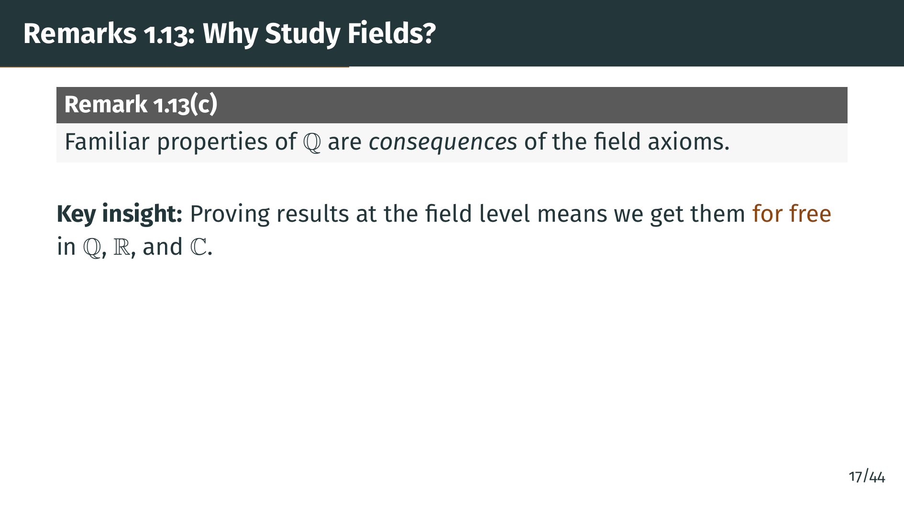
Notes:
Part "c" of Remark 1.13 explains why we bother with this abstract setup. Many familiar properties of the rationals, such as cancellation laws and sign rules, are actually consequences of the field axioms alone. Once we prove them at this level of generality, we will not need to reprove them when we construct the real numbers or the complex numbers. Let's now see what the field axioms imply.

Slide 21
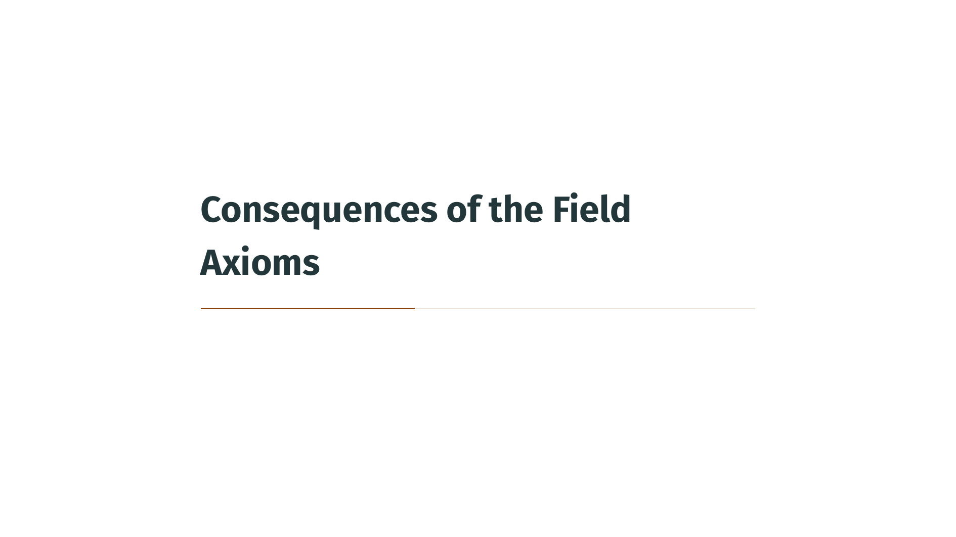

Slide 22
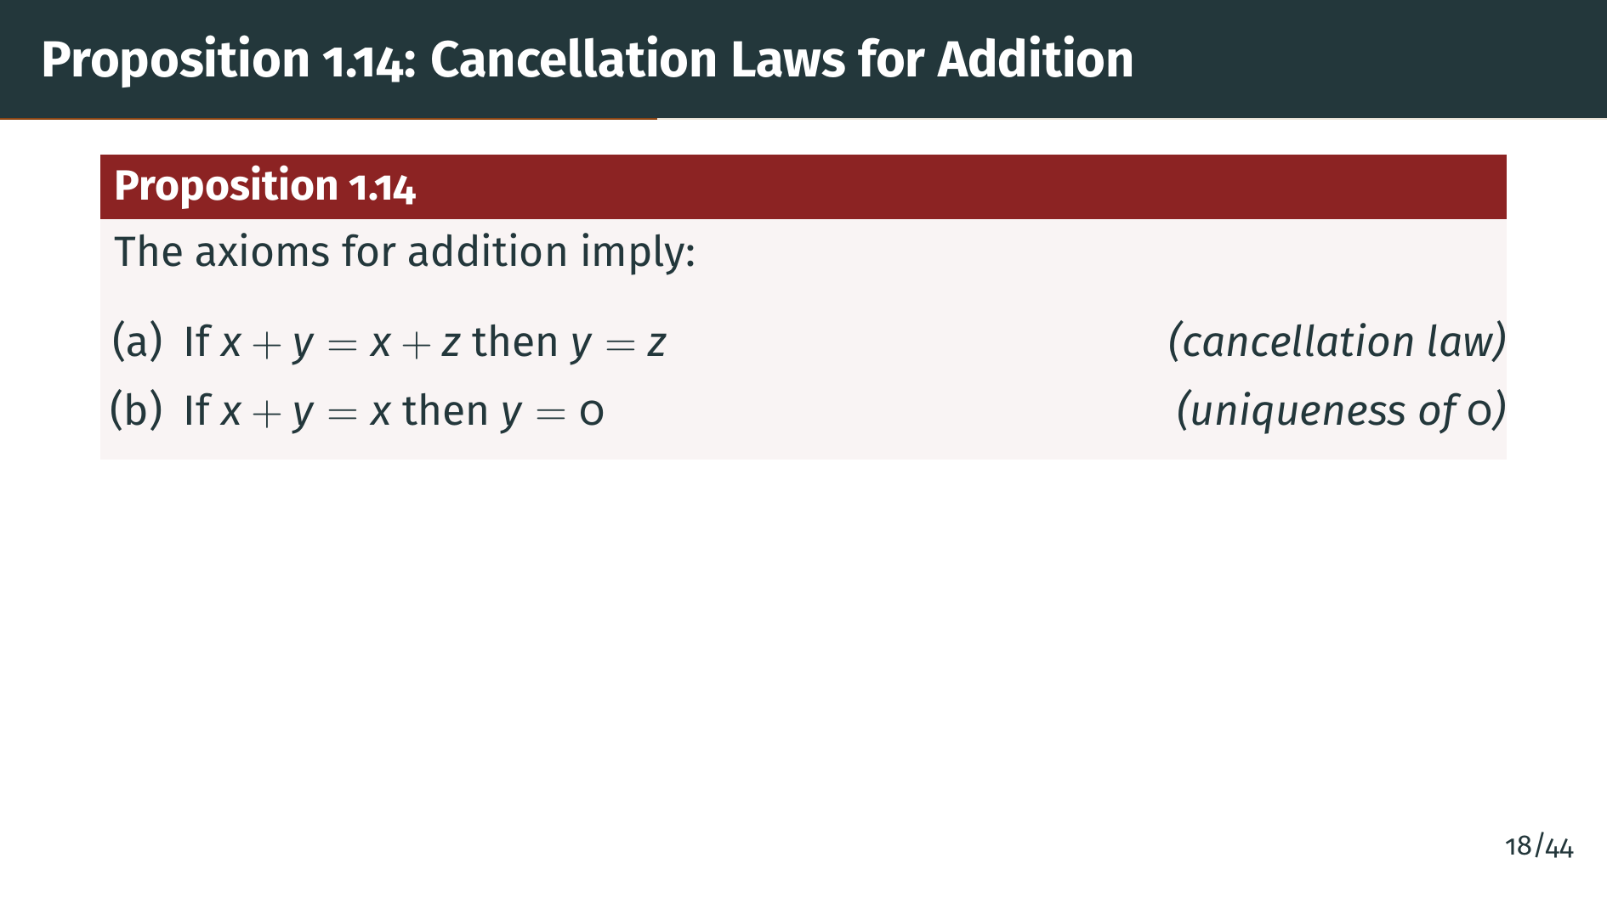
Notes:
Proposition 1.14 lists four consequences of the addition axioms. Part "a" is the cancellation law for addition: if "x" plus "y" equals "x" plus z, then "y" must equal z. Part "b" says that the additive identity zero is unique. If adding "y" to "x" gives back x, then "y" must be zero.

Slide 23
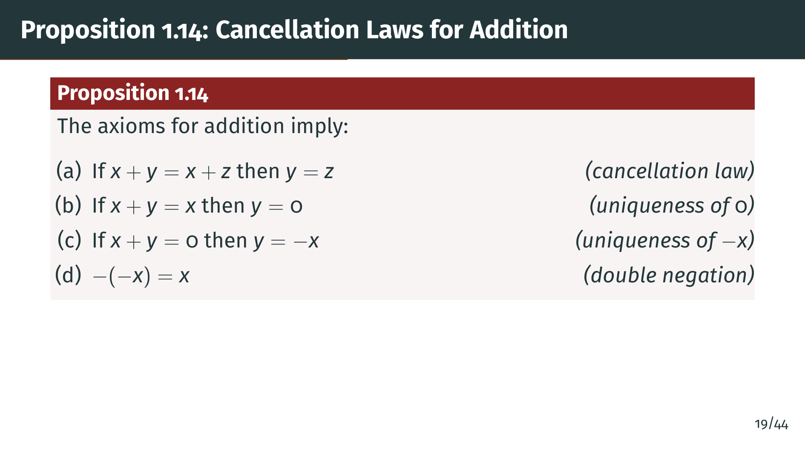
Notes:
Part "c" says the additive inverse is unique: the only element that sums with "x" to give zero is negative "x". And part "d" is the double negation law: negating "x" twice gives back "x". Let's prove these statements.

Slide 24
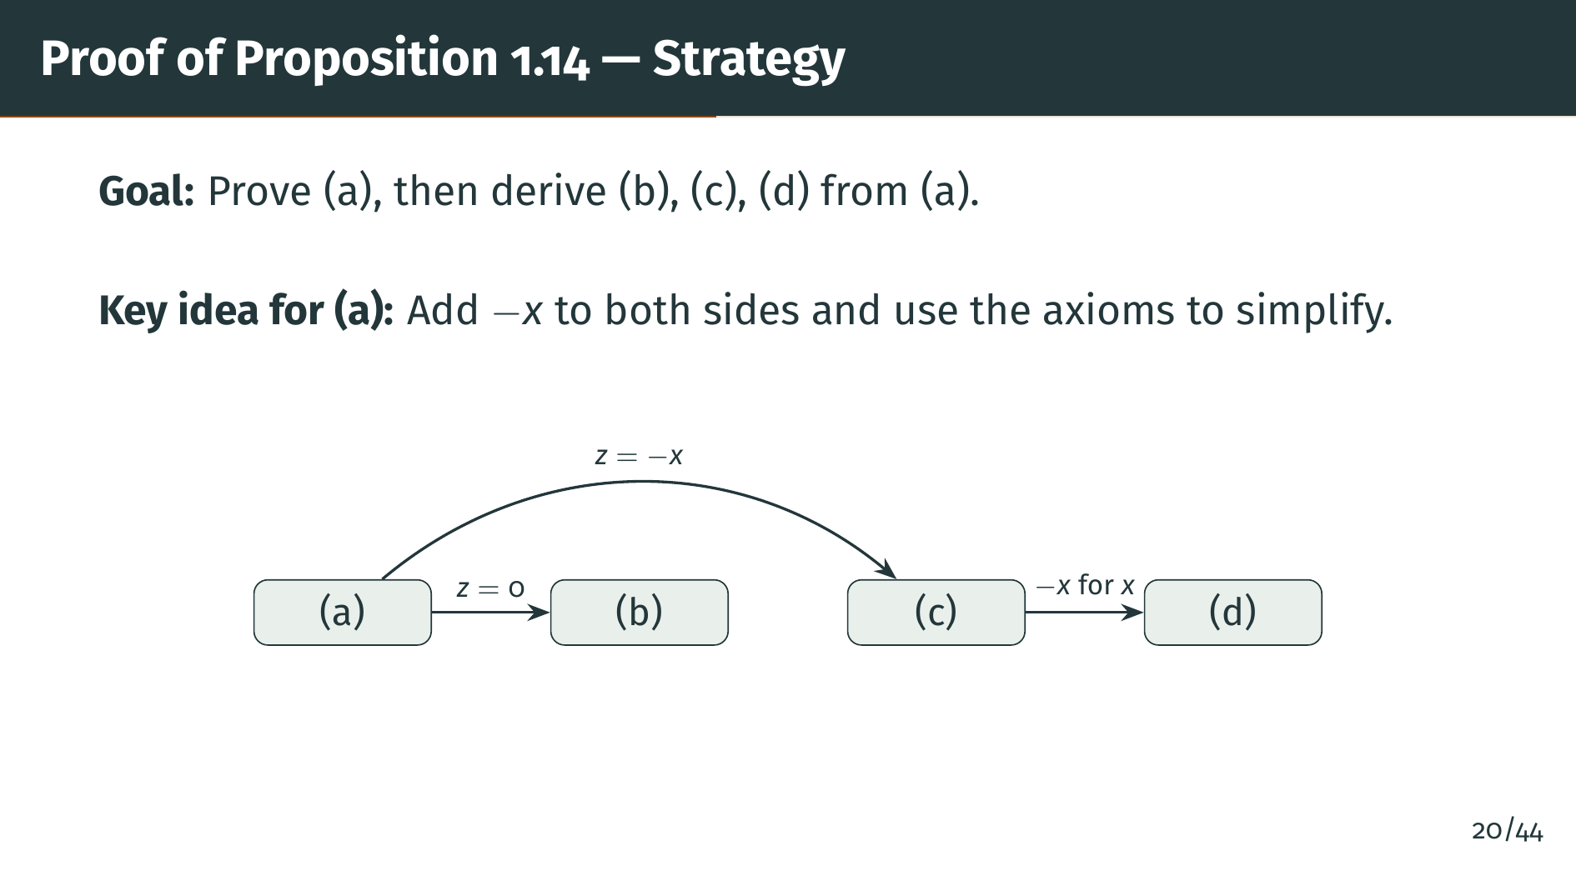
Notes:
Before we dive into the details, let's see the big picture. The core result is part "a", the cancellation law. Once we have that, parts "b", "c", and "d" follow as special cases. Part "b" comes from setting "z" equal to zero in part "a". Part "c" comes from setting "z" equal to negative "x". And part "d" follows from part "c" by replacing "x" with negative "x". So the real work is in proving part "a".

Slide 25
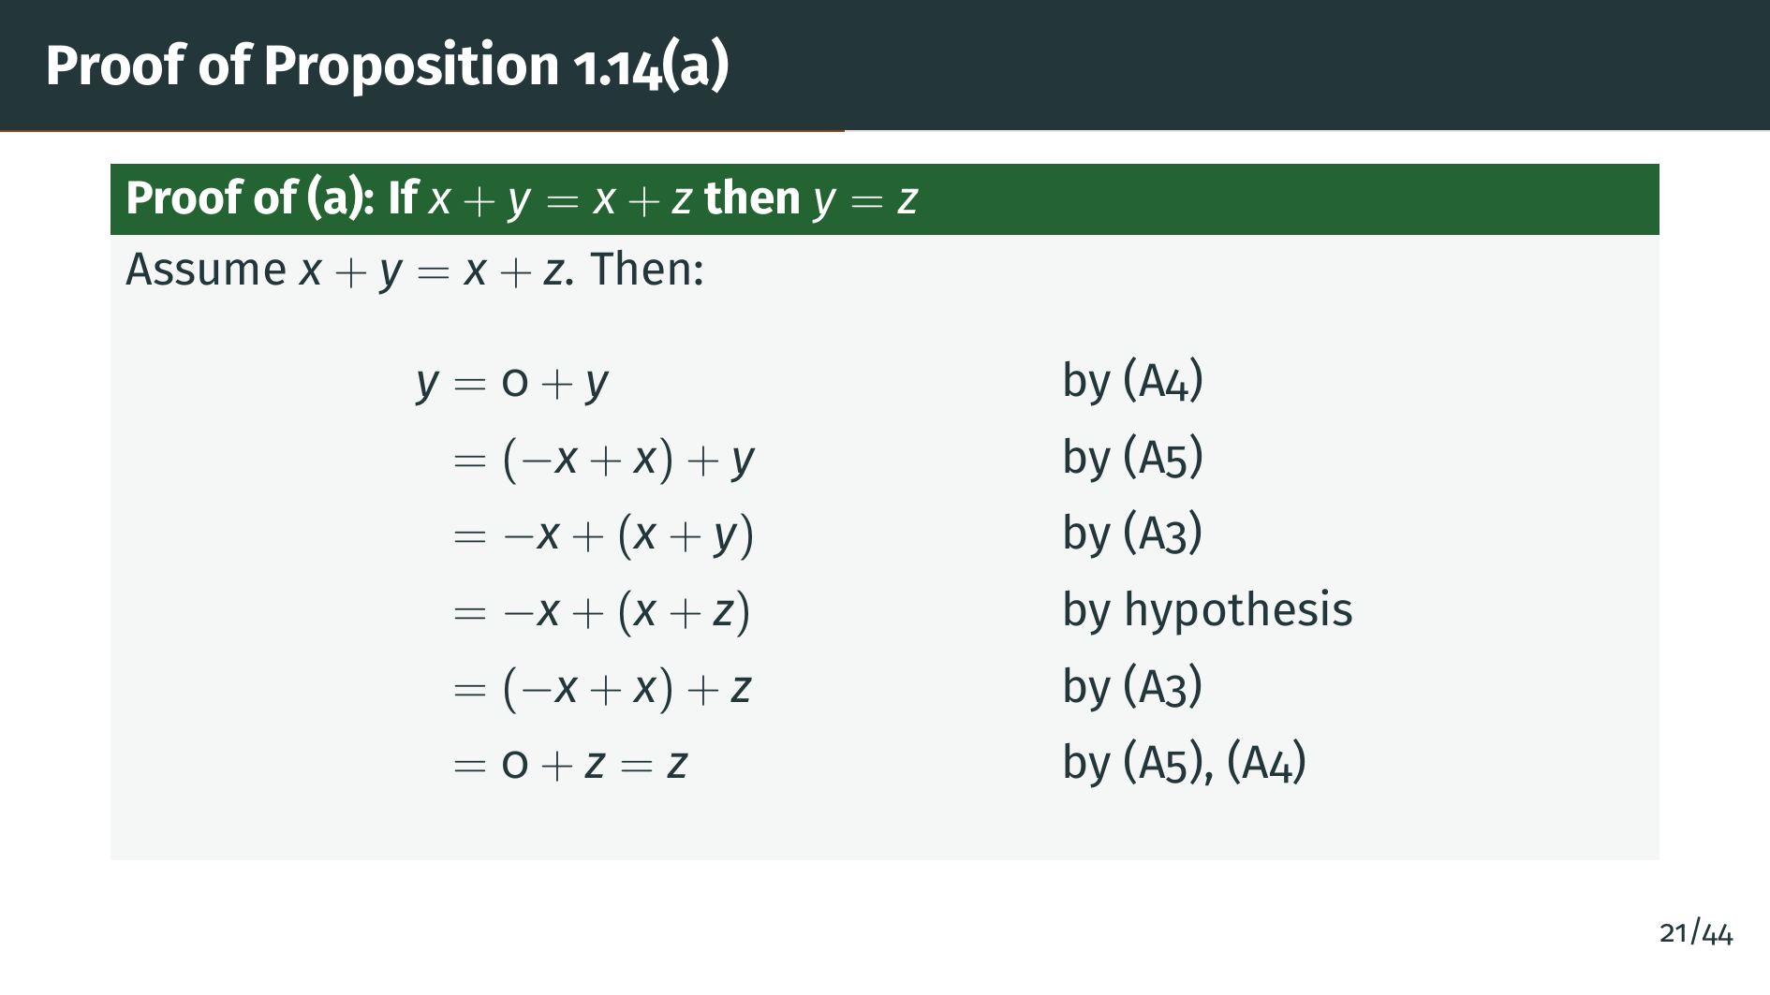
Notes:
Here is the proof of part "a". We start with "y", rewrite 0 as negative "x" plus "x" using axiom A5, then use associativity to regroup. At the crucial step, we swap "x" plus "y" for "x" plus "z" using our hypothesis. Then we regroup again and simplify using A5 and A4 to get "z". Every step uses only the addition axioms and the hypothesis.

Slide 26
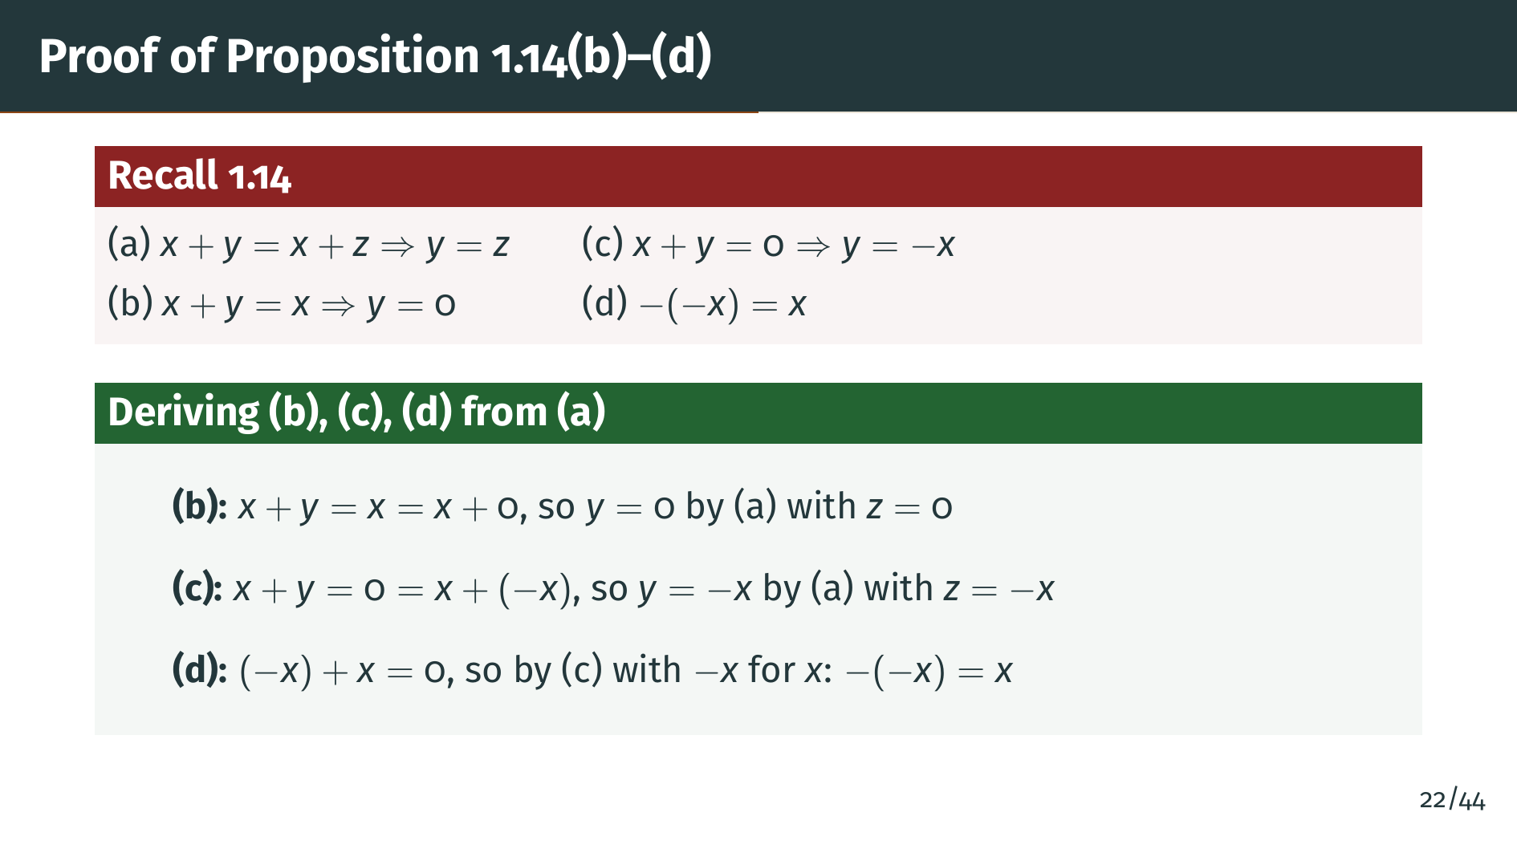
Notes:
Parts "b" through "d" all follow from the cancellation law. For part "b", the equation "x" plus "y" equals "x" is the same as "x" plus "y" equals "x" plus zero, so "y" equals zero by cancellation. For part "c", "x" plus "y" equals zero is the same as "x" plus "y" equals "x" plus negative "x", so "y" equals negative "x". For part "d", we know negative "x" plus "x" equals zero, and by part "c" this means the element that sums with negative "x" to give zero must be "x", so the negative of negative "x" is "x".

Slide 27
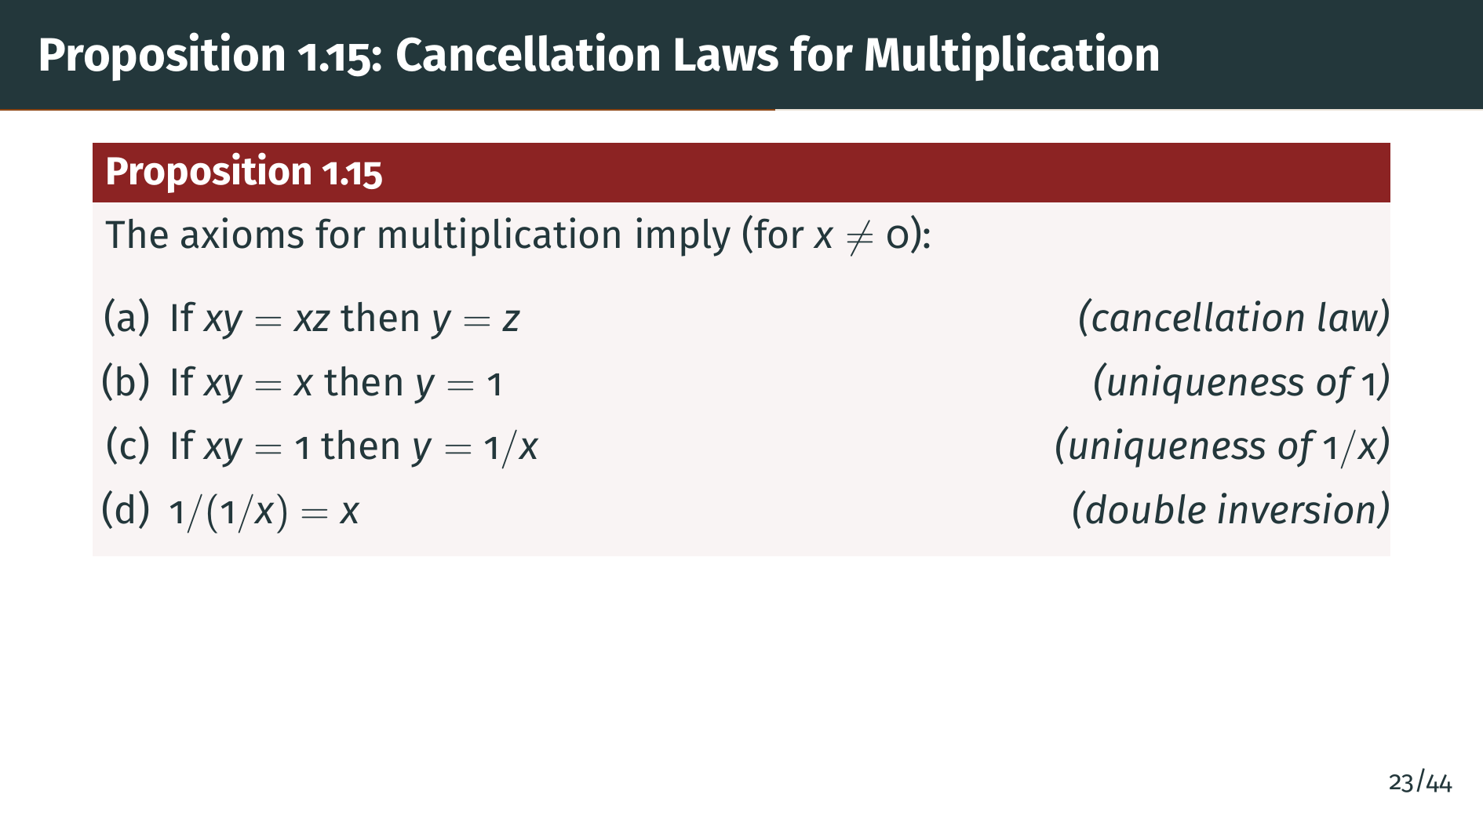
Notes:
Proposition 1.15 states the exact same cancellation laws, but for multiplication instead of addition. The requirement that "x" is nonzero is essential, since zero does not have a multiplicative inverse. The proof follows the same pattern as the proof of Proposition 1.14: prove part "a" by multiplying both sides by 1 over x, then derive the rest as special cases. Rudin omits the proof because it is so similar. Let's see the analogy more clearly on the next slide.

Slide 28
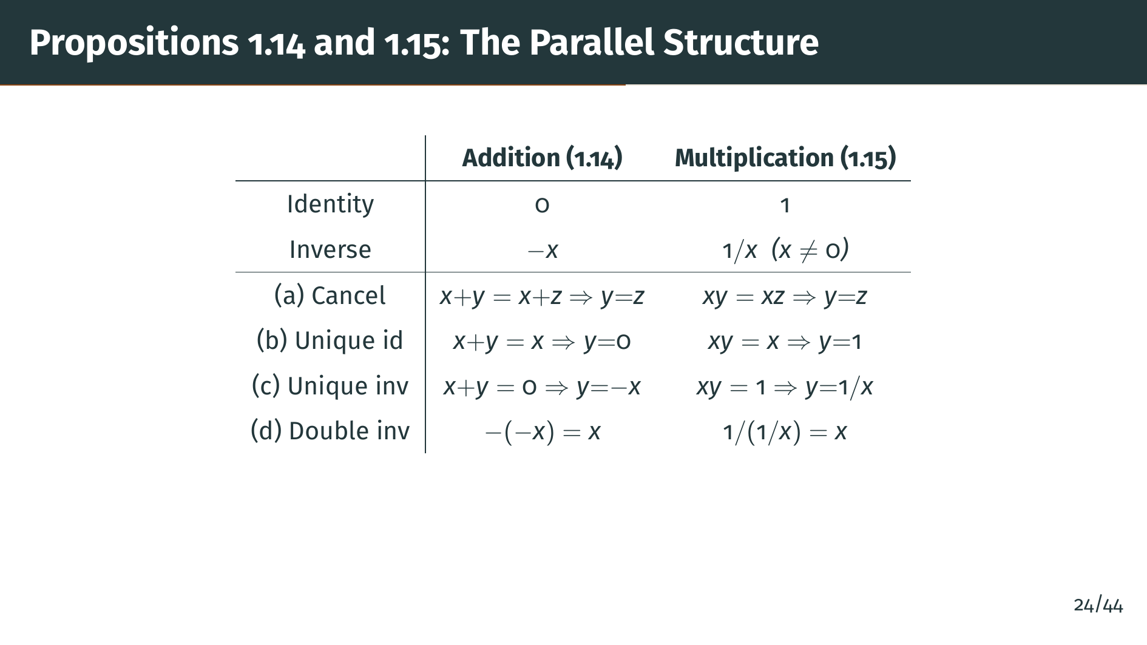
Notes:
This table makes the parallel between Propositions 1.14 and 1.15 explicit. Every statement about addition has an exact counterpart for multiplication. You just replace plus with times, zero with one, and negative "x" with 1 over x. The only difference is that the multiplication versions require "x" to be nonzero, since zero has no multiplicative inverse. This symmetry is not a coincidence: both addition and multiplication give abelian groups, so they satisfy the same abstract cancellation laws. Now let's see what happens when we use both operations together.

Slide 29
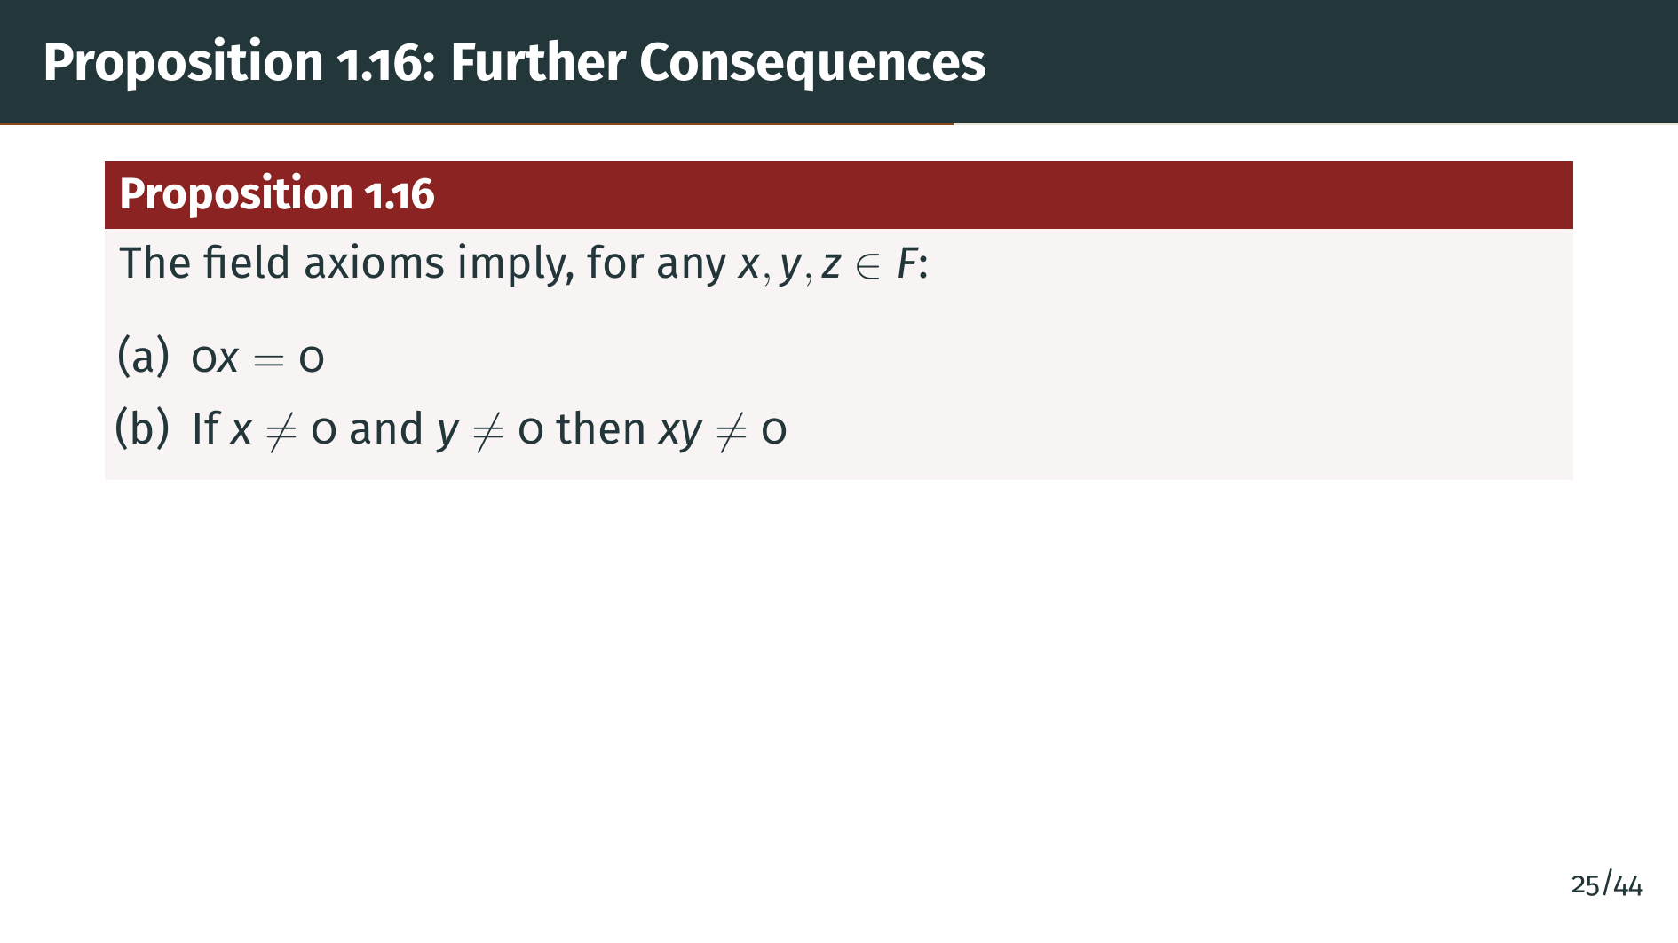
Notes:
Proposition 1.16 gives four more consequences of the full field axioms. Part "a" says that zero times anything is zero. This seems obvious, but it actually requires proof because the axioms only tell us about the additive role of zero, not about what happens when we multiply by it. Part "b" says a product of nonzero elements is nonzero. This is sometimes called the absence of zero divisors. Two more consequences are coming next.

Slide 30
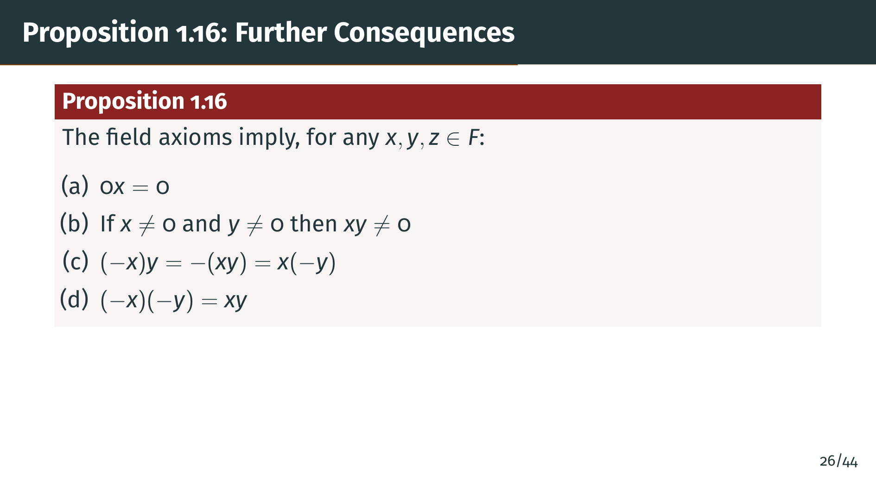
Notes:
Part "c" is the sign rule for products: negative "x" times "y" equals the negative of "x" times y, and the same holds if we negate "y" instead. Part "d" says that negating both factors leaves the product unchanged. Let's prove each of these.

Slide 31
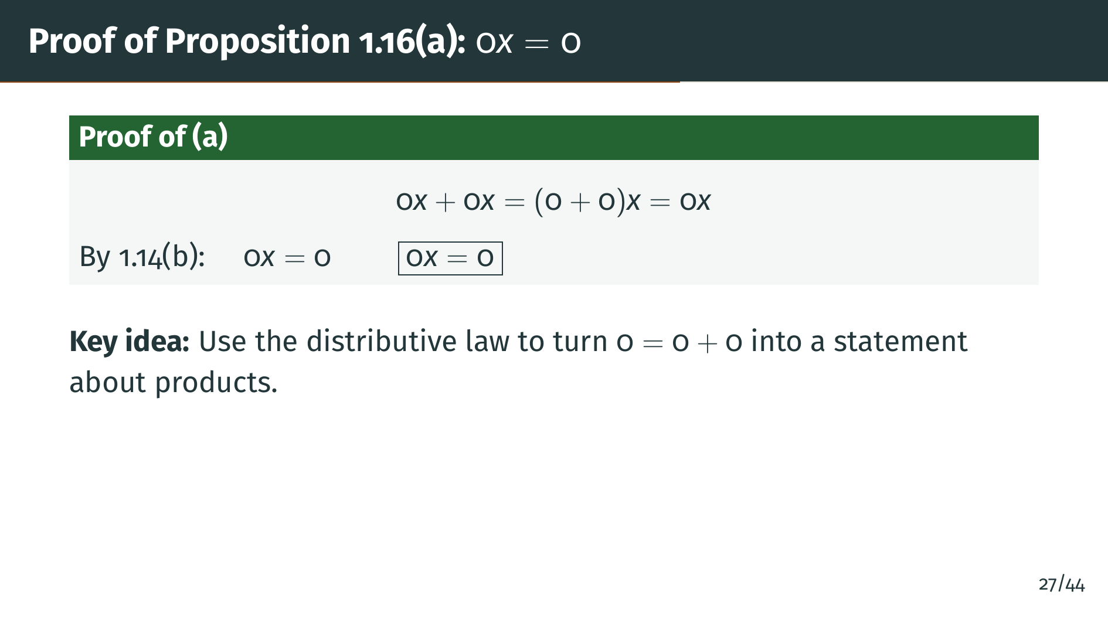
Notes:
The proof of part "a" is elegant and short. We use the fact that zero plus zero equals zero, which is just axiom A4. Multiplying both sides by "x" and applying the distributive law gives 0 "x" plus 0 "x" equals 0 "x". Now recall Proposition 1.14 part "b", which says that if "x" plus "y" equals "x", then "y" must be zero. Here, 0 "x" plays the role of both "x" and "y", so 0 "x" must be zero. This is the first time we have used the distributive law, and it is the bridge that lets us connect the additive property of zero with multiplication.

Slide 32
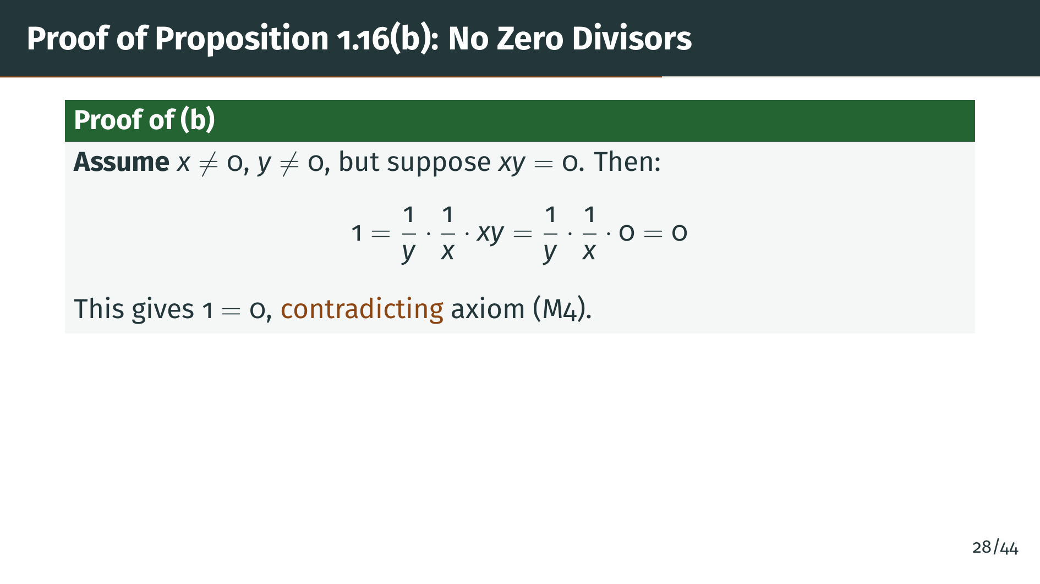
Notes:
For part "b", we use proof by contradiction. Suppose "x" and "y" are both nonzero but their product is zero. Since "x" and "y" are nonzero, their multiplicative inverses exist. Multiplying both sides of "x" "y" equals zero by 1 over "y" times 1 over "x", the left side simplifies to 1, while the right side is zero by part "a". So we get 1 equals 0, which contradicts axiom M4. Therefore the product "x" "y" cannot be zero.

Slide 33
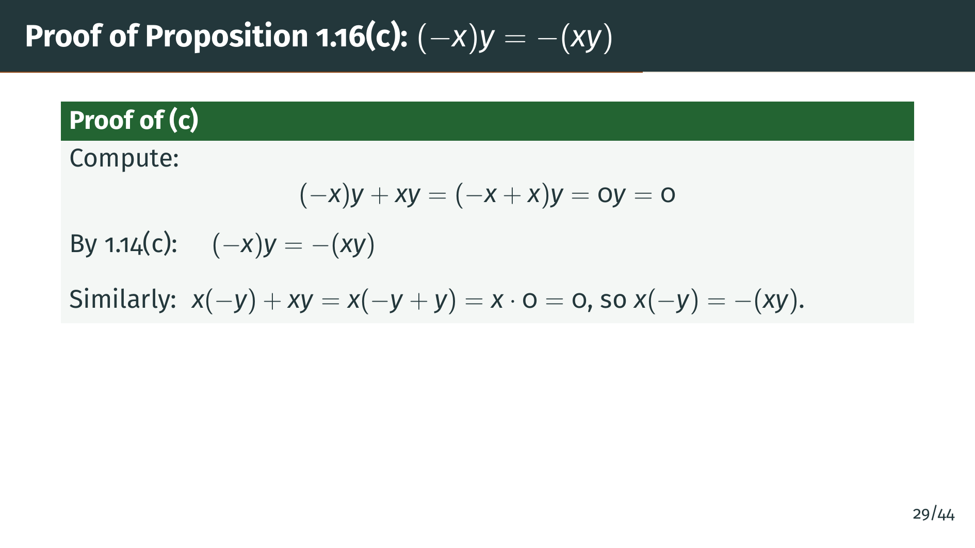
Notes:
To prove that negative "x" times "y" equals negative of "x" "y", we show that their sum with "x" "y" is zero. By the distributive law, negative "x" times "y" plus "x" times "y" equals the quantity negative "x" plus "x" times "y", which is zero times "y", which is zero by part "a". Now recall Proposition 1.14 part "c", which says that if "x" plus "y" equals zero, then "y" is the additive inverse of "x". Applying that here, negative "x" times "y" must be the additive inverse of "x" "y". The second equality follows by the same argument with "y" negated instead.

Slide 34
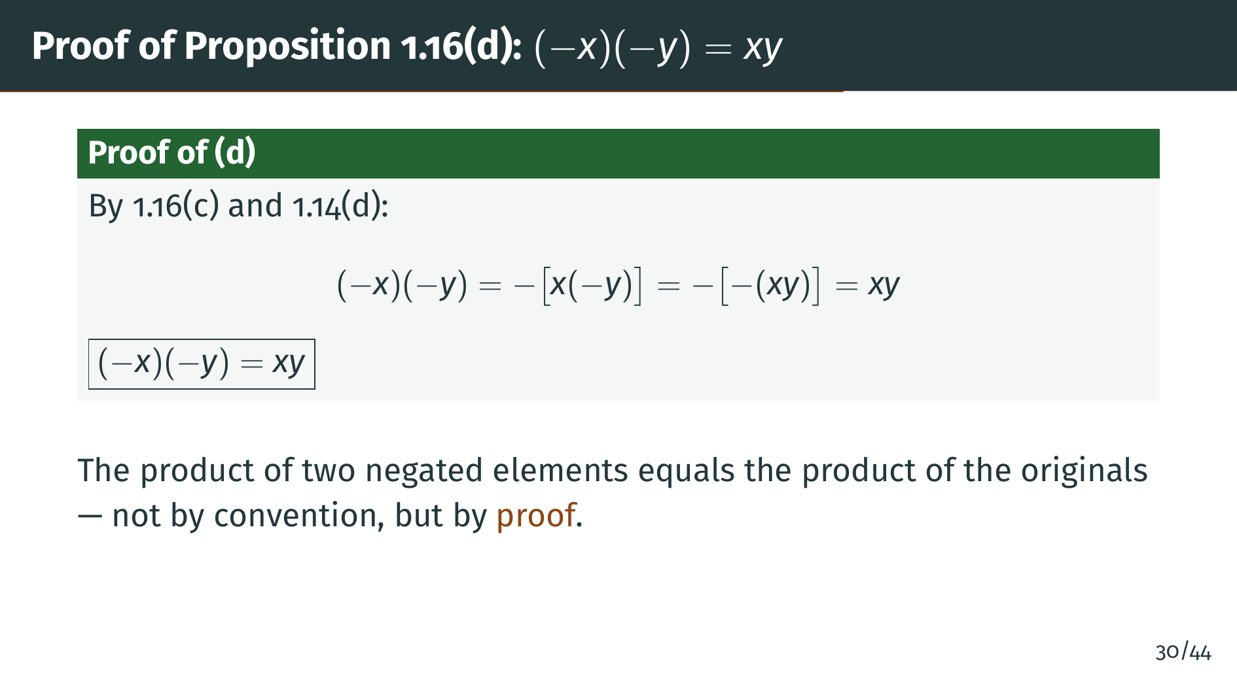
Notes:
Part "d" follows from two applications of what we have already proved. Recall that part "c" tells us that negating one factor is the same as negating the whole product. By part "c", negative "x" times negative "y" equals the negative of "x" times negative "y". Applying part "c" again, "x" times negative "y" is the negative of "x" "y". So we have the negative of the negative of "x" "y". And recall Proposition 1.14 part "d", the double negation law, which says the negative of the negative of "x" "y" is just "x" "y". Notice that this result holds in any field, not just ordered fields. We have not used any notion of positivity here, only the algebraic axioms. The familiar sign rule from arithmetic is a purely algebraic consequence. Now let's add order structure to our fields.

Slide 35


Slide 36
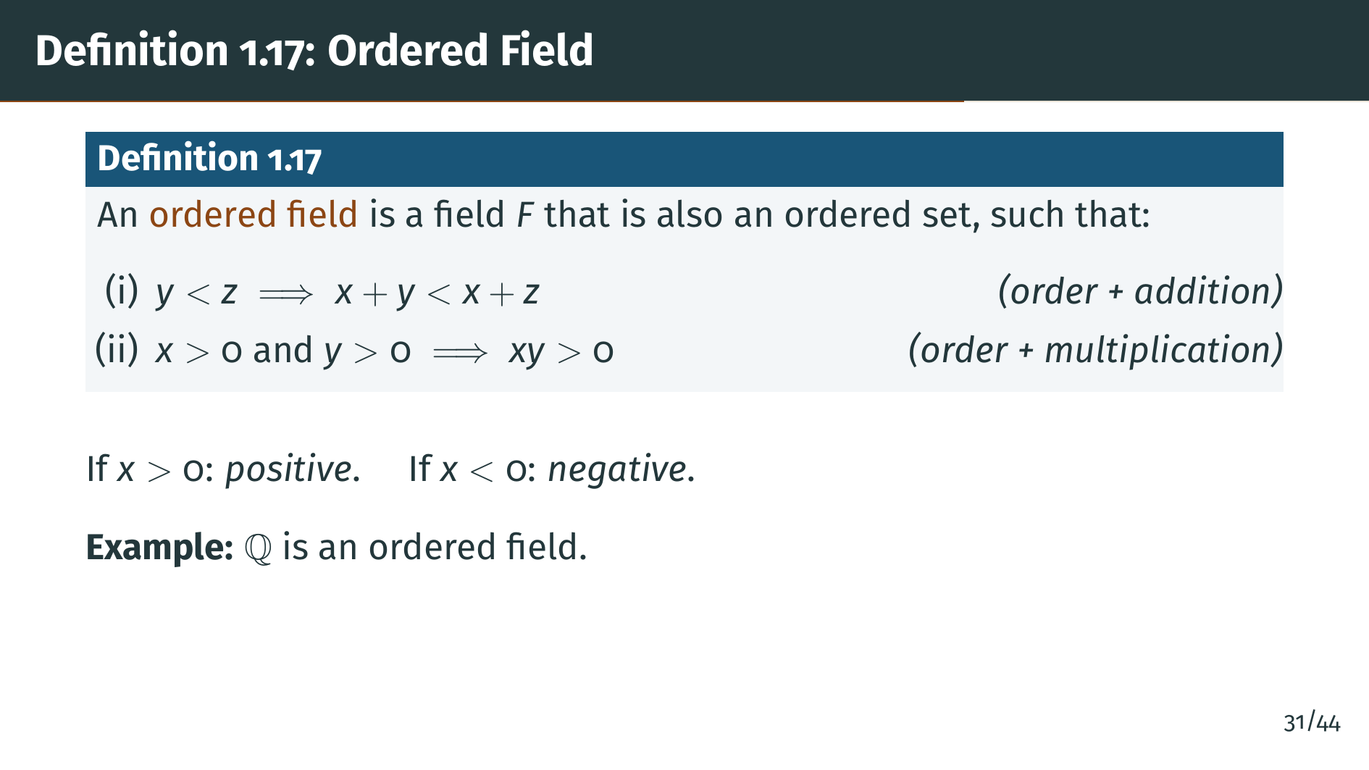
Notes:
An ordered field combines the algebraic structure of a field with the order structure from the previous section. Two compatibility conditions are required. First, adding the same element to both sides of an inequality preserves the inequality. Second, the product of two positive elements is positive. Elements greater than zero are called positive, and elements less than zero are called negative. The rationals "Q" are the primary example of an ordered field we have seen so far.

Slide 37
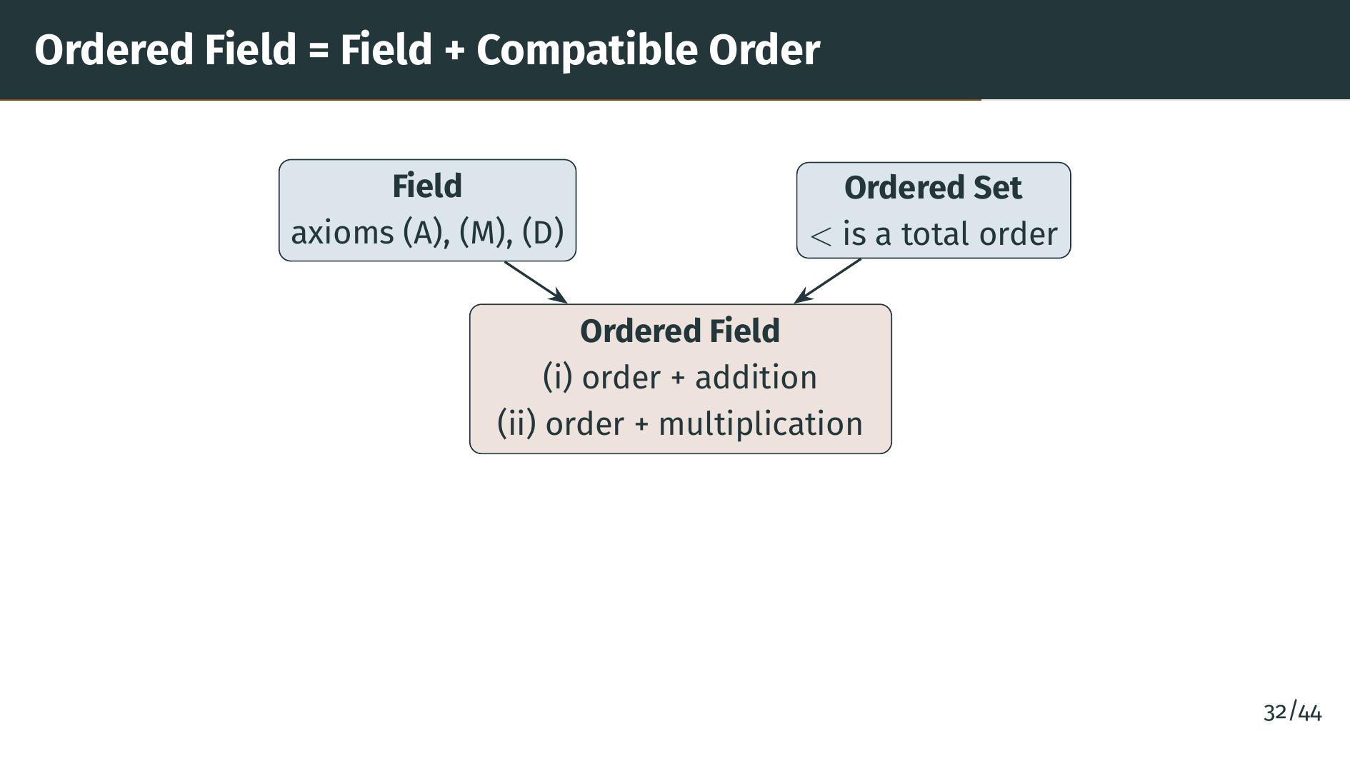
Notes:
This diagram shows how the concept of an ordered field brings together two structures we have already defined: a field and an ordered set. The two compatibility conditions, shown in the box at the bottom, ensure that the algebraic operations respect the ordering. This combined structure is what allows us to work with both equations and inequalities in a consistent way. Let's see what these compatibility conditions look like. Let's see what properties follow.

Slide 38
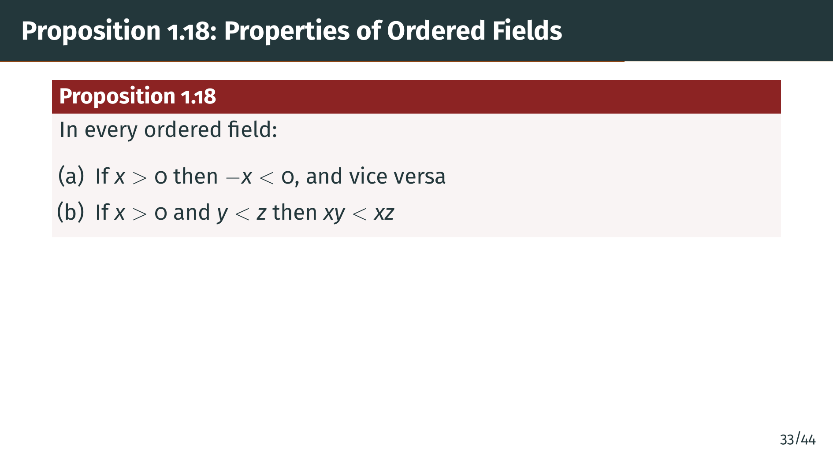
Notes:
Proposition 1.18 lists the fundamental properties of ordered fields. Part "a" says that positive and negative are linked through negation: the negative of a positive number is negative, and vice versa. Part "b" says that multiplying an inequality by a positive number preserves the direction of the inequality. But what happens when we multiply by a negative number?

Slide 39
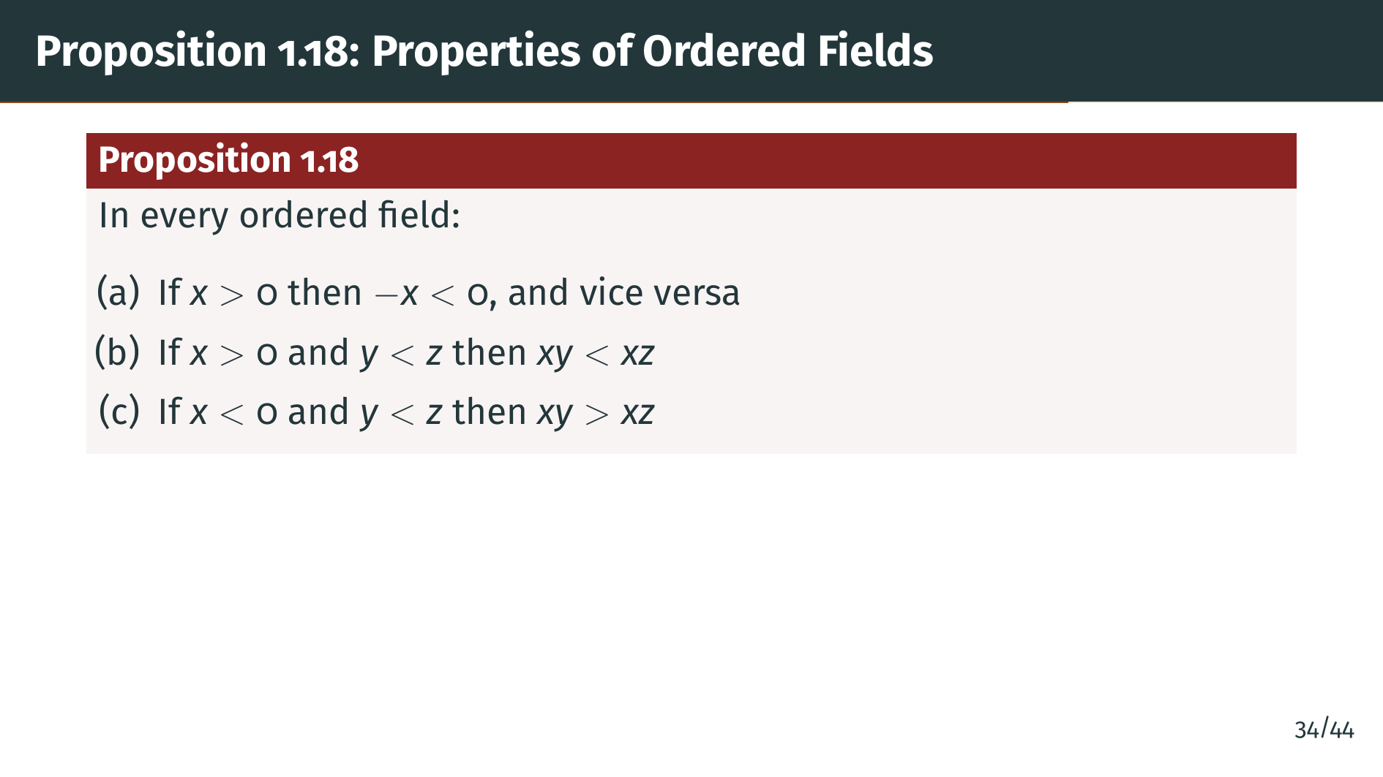
Notes:
Part "c" is the complementary rule: multiplying by a negative number reverses the inequality. This is the familiar rule that multiplying both sides of an inequality by a negative flips the direction. Two more properties round out the picture.

Slide 40
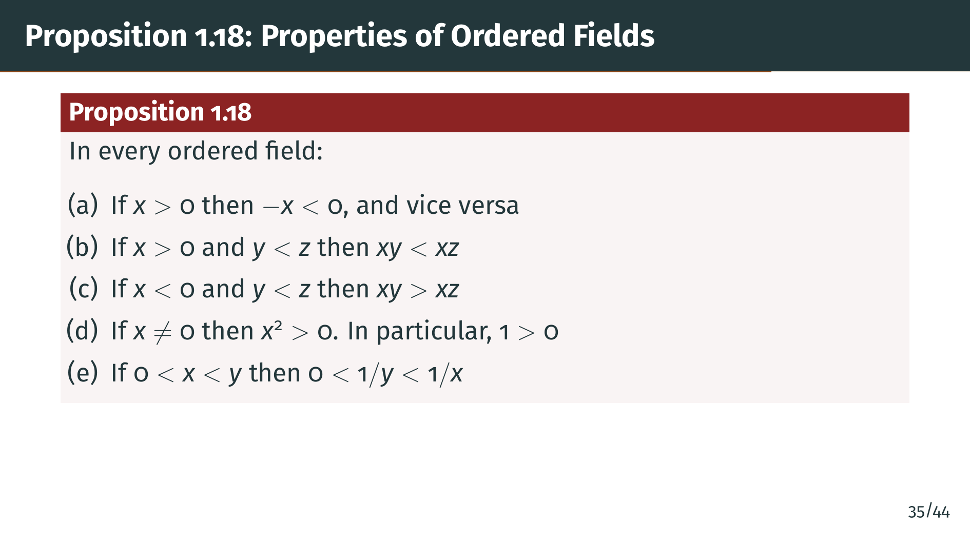
Notes:
Part "d" tells us that every nonzero square is positive, and since 1 equals 1 squared, we get that 1 is positive. Part "e" says that taking reciprocals of positive numbers reverses their order. These are all rules you have used many times, and now we will prove them rigorously from the axioms.

Slide 41
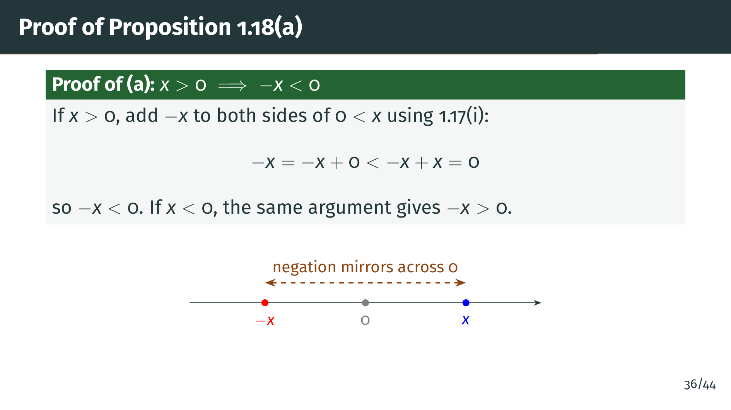
Notes:
To prove part "a", suppose "x" is positive, meaning 0 is less than "x". By Definition 1.17 part i, we can add negative "x" to both sides of the inequality 0 less than "x". On the left, negative "x" plus 0 equals negative "x". On the right, negative "x" plus "x" equals 0. So we get negative "x" is less than 0, which means negative "x" is negative. The converse direction, that if "x" is negative then negative "x" is positive, works the same way: start from "x" less than 0 and add negative "x" to both sides. Let's continue with part "b".

Slide 42
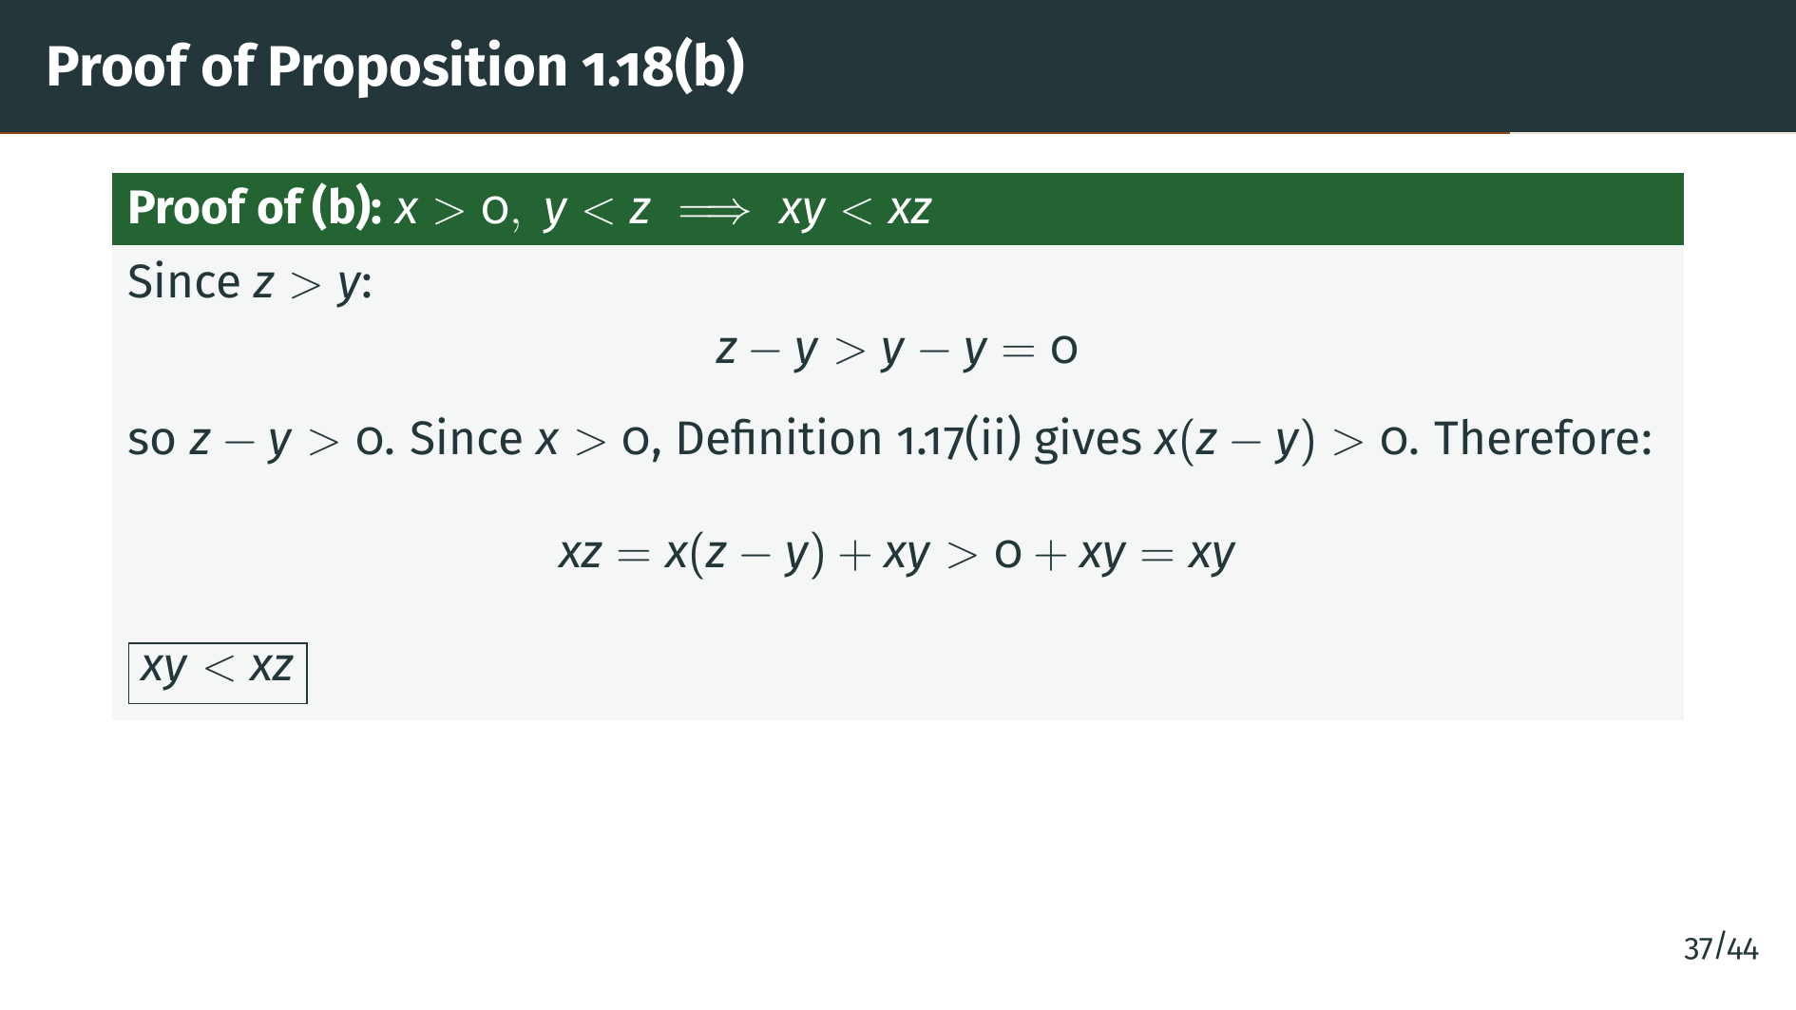
Notes:
For part "b", we need to show that multiplying a strict inequality by a positive number preserves the direction. Since "z" is greater than "y", "z" minus "y" is positive. Multiplying two positive numbers, "x" and "z" minus "y", gives a positive product. So "x" times "z" minus "y" is positive, which means "x" "z" is greater than "x" "y". This is exactly the rule we wanted. Next, let's handle the case of multiplying by a negative.

Slide 43
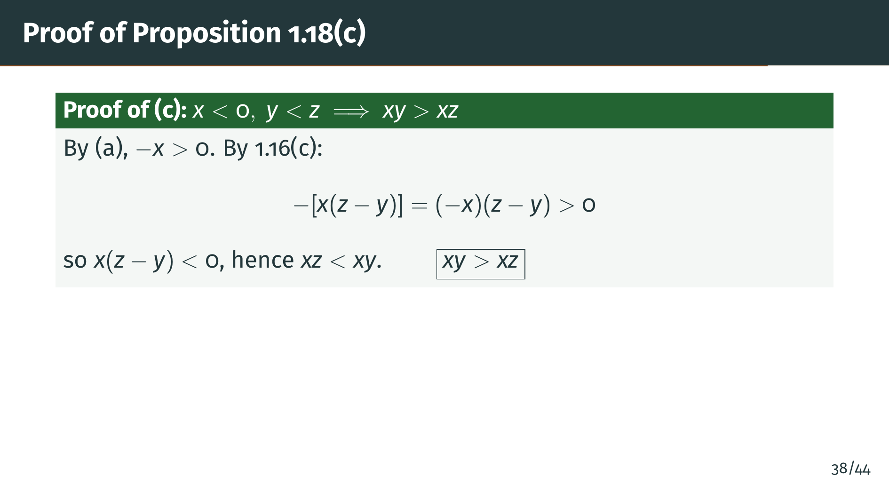
Notes:
Part "c" handles the case where we multiply by a negative number. Since "x" is negative, negative "x" is positive by part "a". Since "y" is less than "z", "z" minus "y" is positive. So the product of negative "x" and "z" minus "y" is positive by the ordered field axiom. Using the sign rule from Proposition 1.16 part "c", this means the negative of "x" times "z" minus "y" is positive, so "x" times "z" minus "y" is negative, meaning "x" "z" is less than "x" "y". The inequality is reversed. Now let's prove the result about squares.

Slide 44
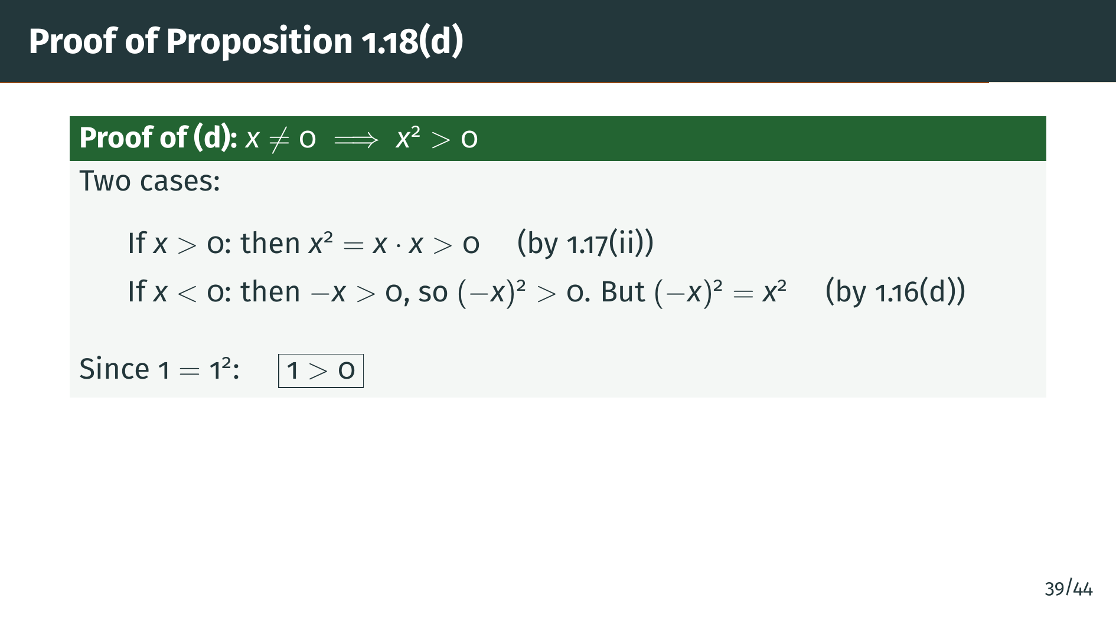
Notes:
Part "d" has two cases. If "x" is positive, then "x" times "x" is the product of two positive numbers, which is positive by Definition 1.17 part ii, the axiom that says the product of two positive elements is positive. If "x" is negative, then negative "x" is positive, so negative "x" squared is positive. But recall Proposition 1.16 part "d", which says that negative "x" times negative "y" equals "x" "y". Setting "y" equal to "x", we get negative "x" squared equals "x" squared. Either way, "x" squared is positive. Since 1 equals 1 squared, we conclude that 1 is positive. This is a remarkable fact: the positivity of 1 is not an axiom, but a consequence of the other axioms. One more property to go: reciprocals.

Slide 45
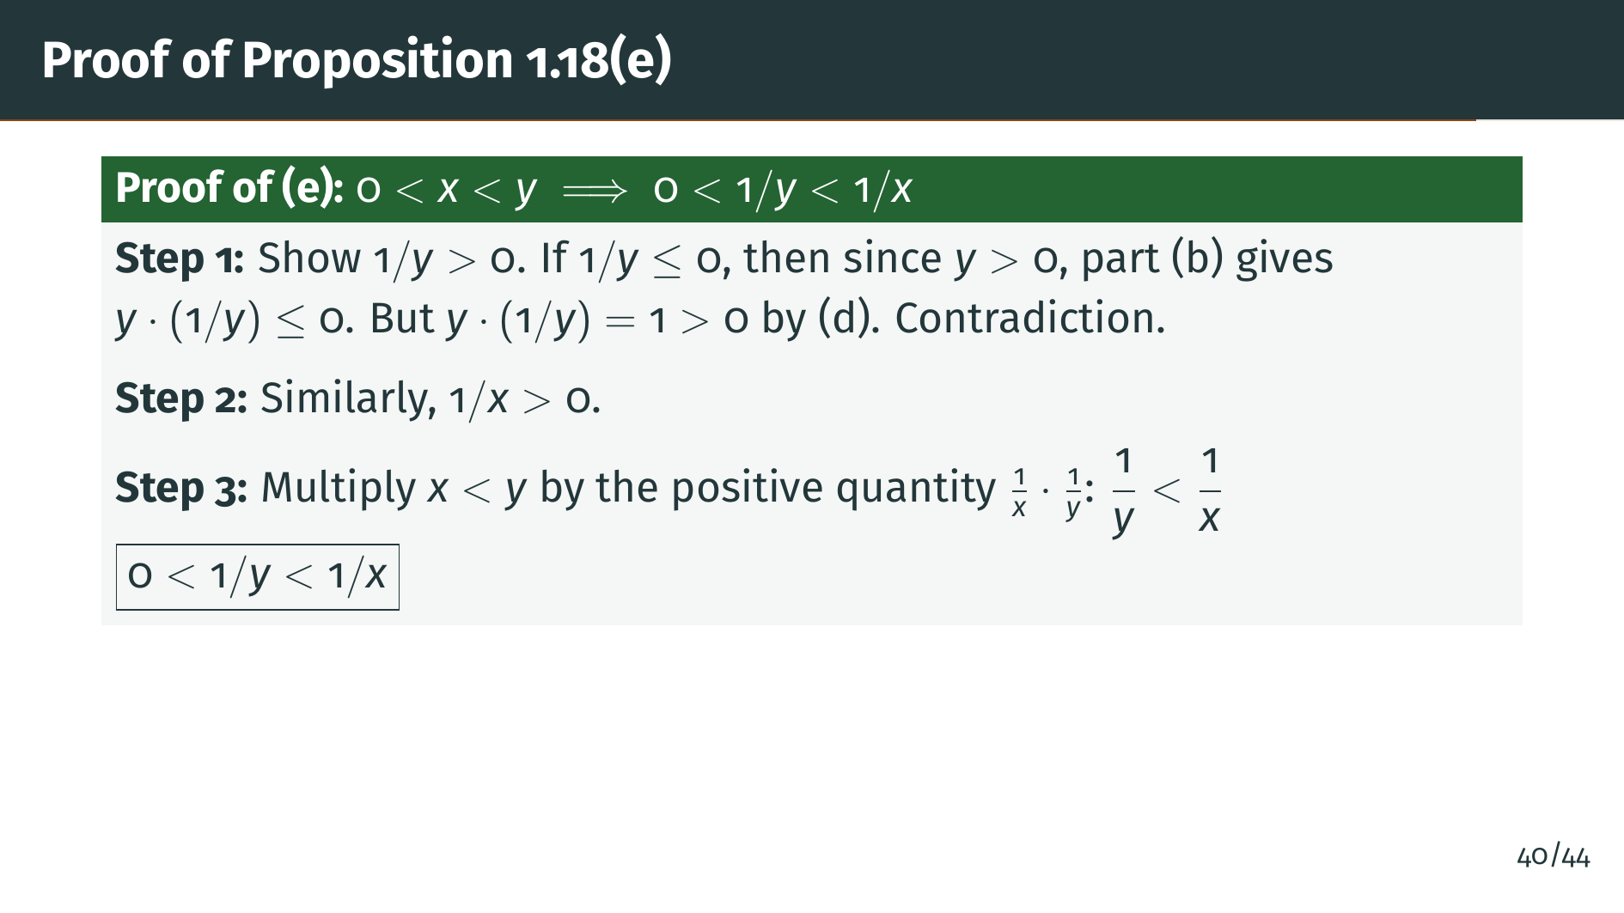
Notes:
For part "e", we first show that 1 over "y" is positive. If 1 over "y" were zero or negative, then since "y" is positive, their product "y" times 1 over "y" would be at most zero by parts "b" and "a". But "y" times 1 over "y" equals 1, which is positive by part "d". That is a contradiction, so 1 over "y" must be positive. The same argument shows 1 over "x" is positive. Now, multiplying both sides of "x" less than "y" by the positive number 1 over "x" times 1 over "y" preserves the inequality and gives us 1 over "y" is less than 1 over "x". Taking reciprocals of positive numbers reverses the order.

Slide 46
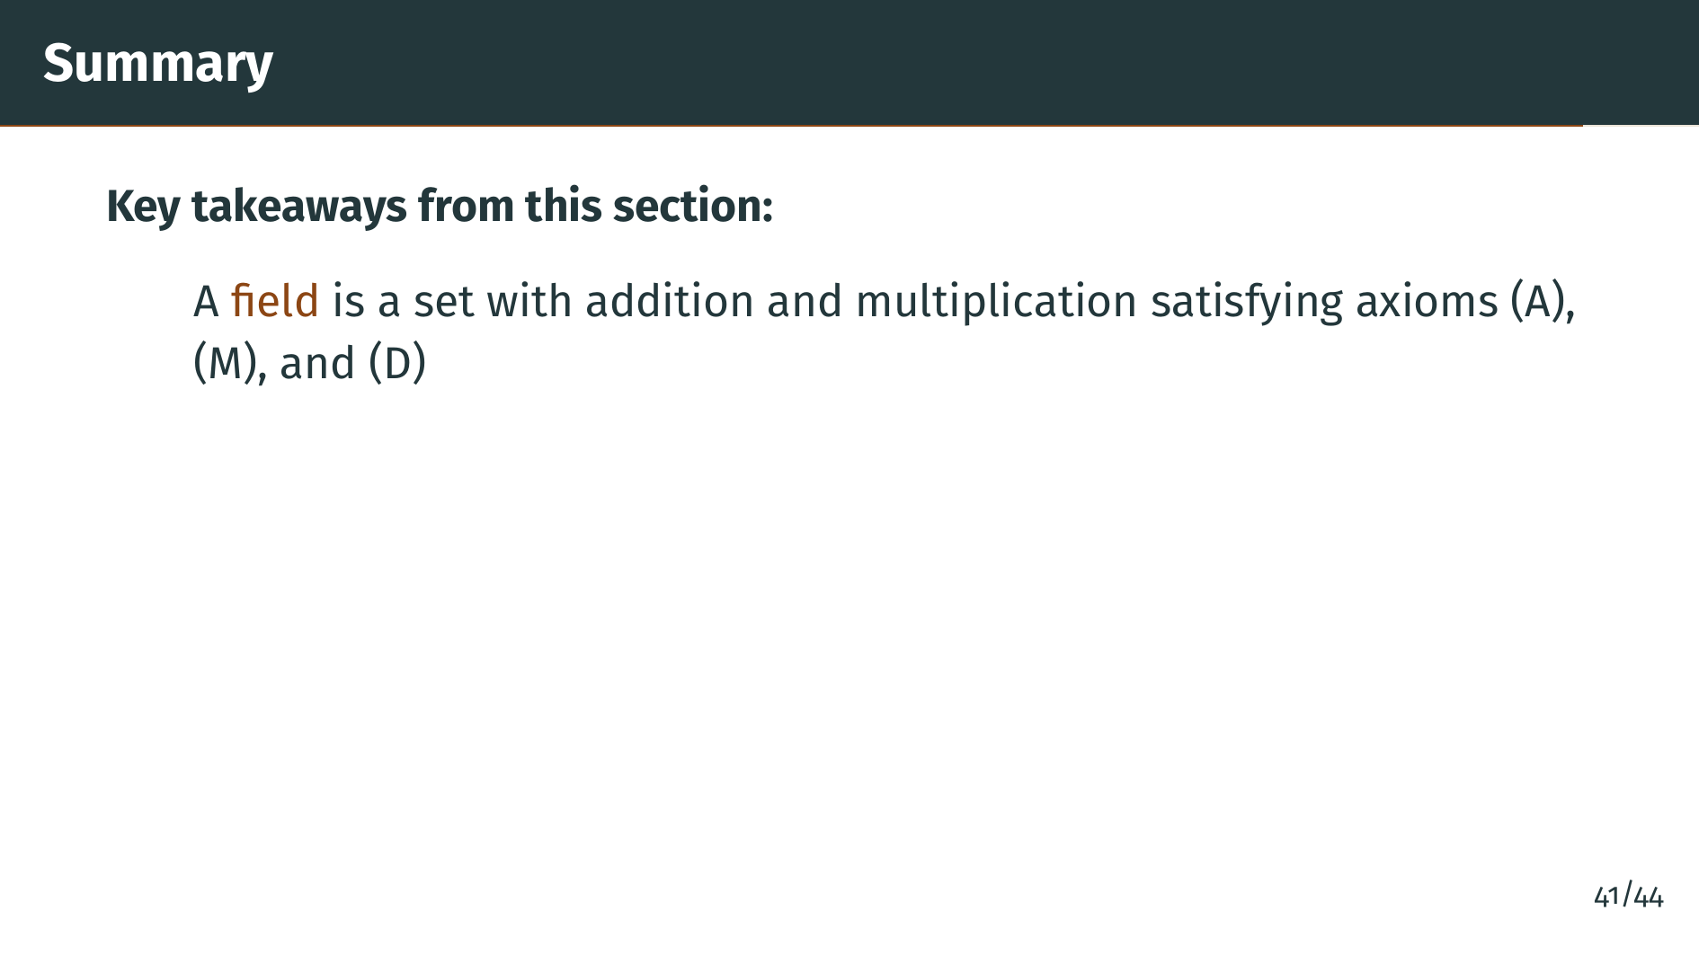
Notes:
Let's review what we covered. A field is a set equipped with addition and multiplication that satisfy ten axioms plus the distributive law. The addition axioms and multiplication axioms each give the structure of an abelian group, and the distributive law connects them.

Slide 47
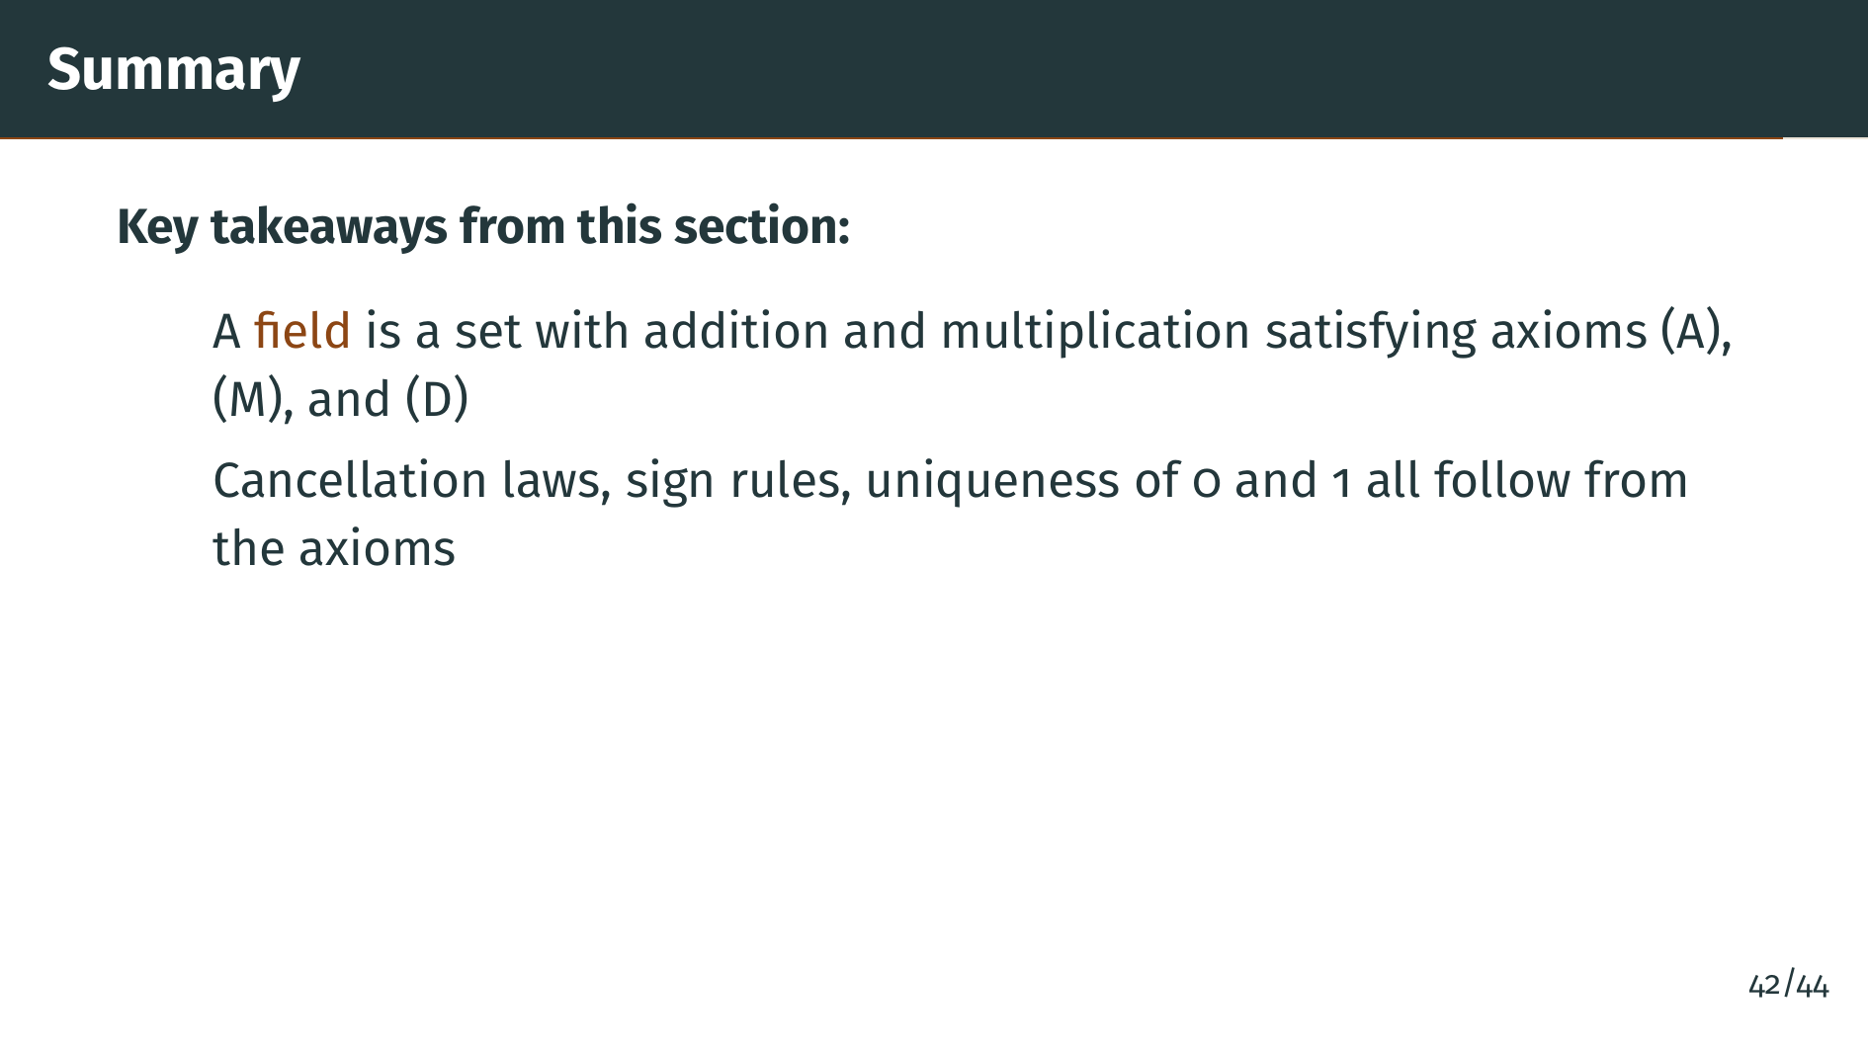
Notes:
We proved that familiar algebraic properties, such as cancellation laws, the uniqueness of zero and one, and sign rules like negative times negative equals positive, are all consequences of the field axioms. We do not need to re-prove them for each specific field.

Slide 48
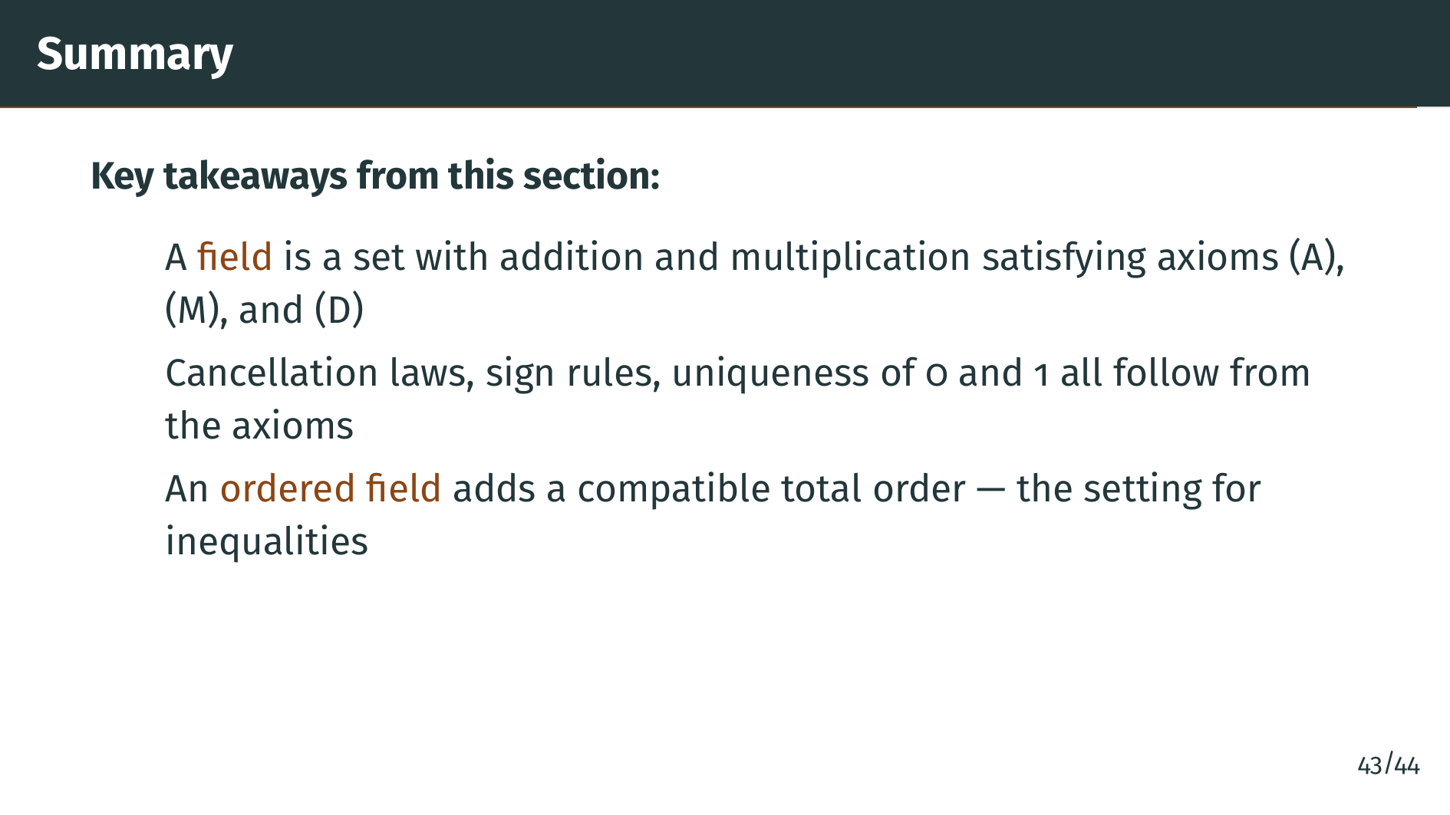
Notes:
An ordered field combines the field structure with a total order that is compatible with both addition and multiplication. This is the natural setting for working with inequalities.

Slide 49
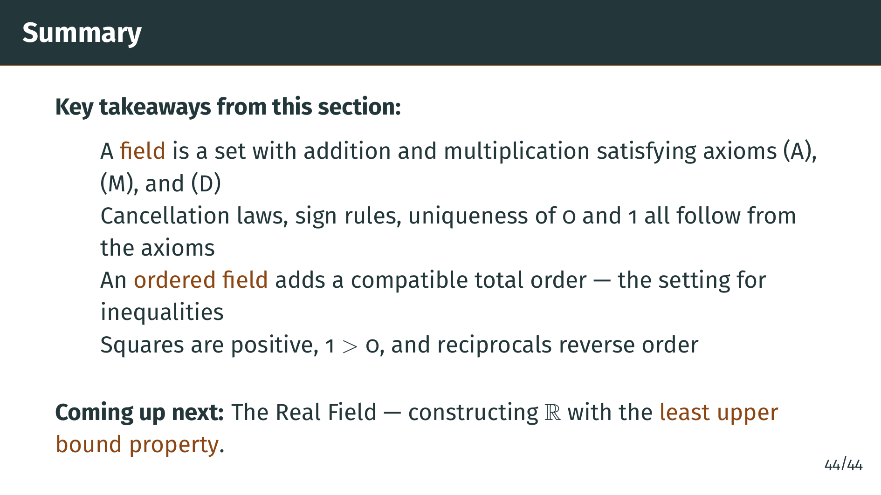
Notes:
In every ordered field, nonzero squares are positive, 1 is positive, multiplying by a negative reverses inequalities, and taking reciprocals of positive numbers reverses their order. In the next section, we will construct the real numbers as an ordered field with one crucial extra property: the least upper bound property. This is the property that fills the gaps in the rationals that we identified in the introduction. See you there.

