Slide 1
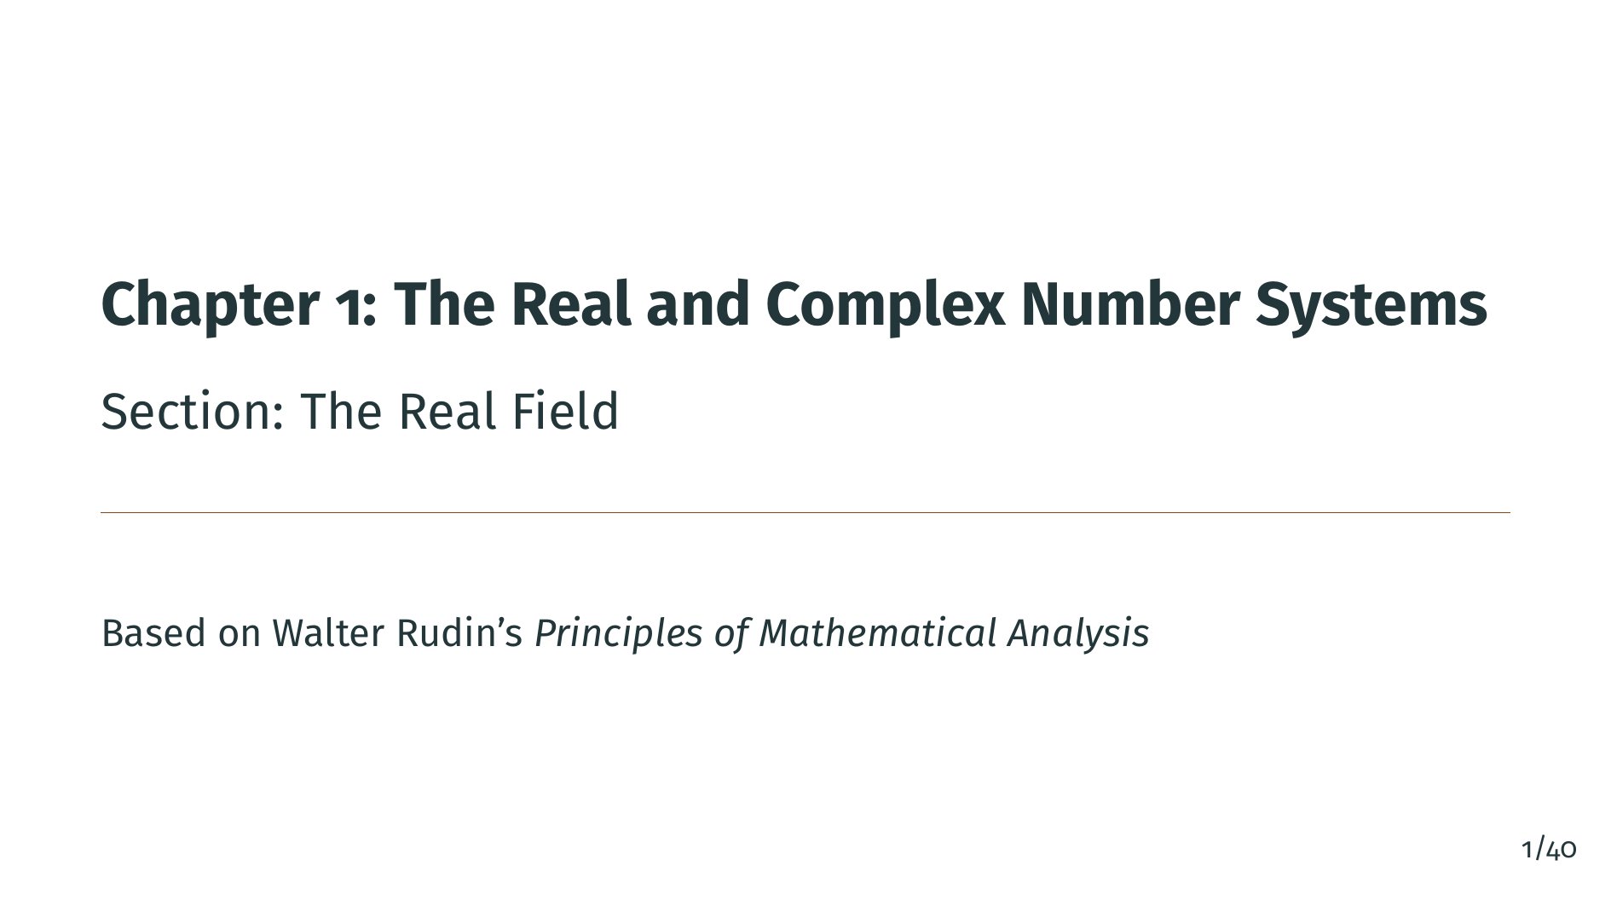
Notes:
Welcome to Chapter 1, Section 4: The Real Field. In this section, we finally arrive at the central object of study in analysis: the real numbers. We will state the existence theorem for the reals, explore the archimedean property, prove that the rationals are dense in the reals, and establish the existence of nth roots. Let's get started.

Slide 2
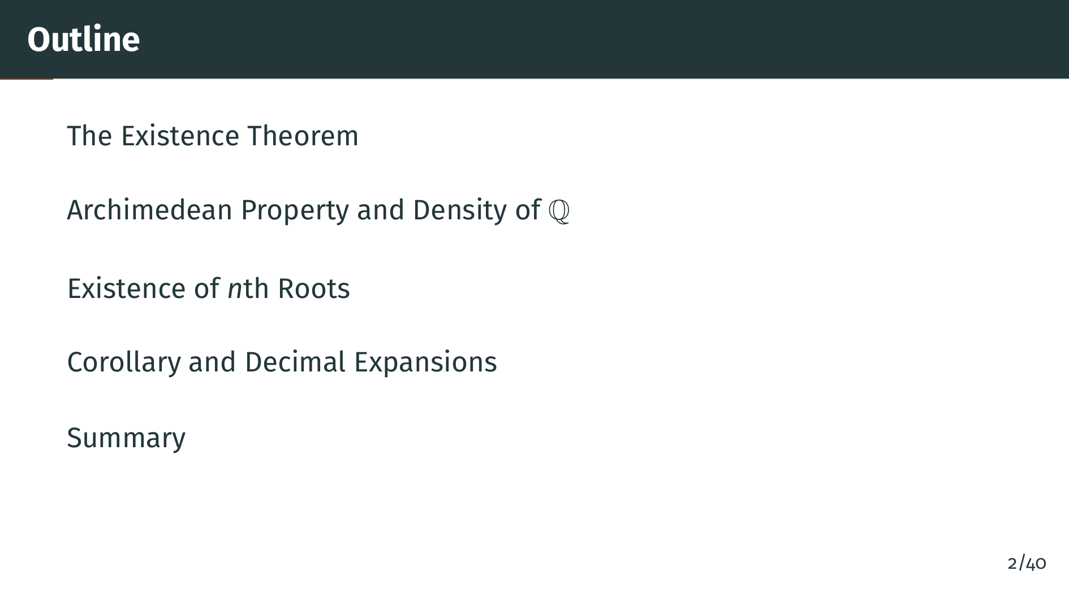
Notes:
Here is our outline for this section. We begin with the existence theorem for the real field, then explore two key consequences: the archimedean property and the density of the rationals. After that, we prove the existence of nth roots, which resolves the gap we identified in the introduction. We finish with a brief look at decimal expansions.

Slide 3
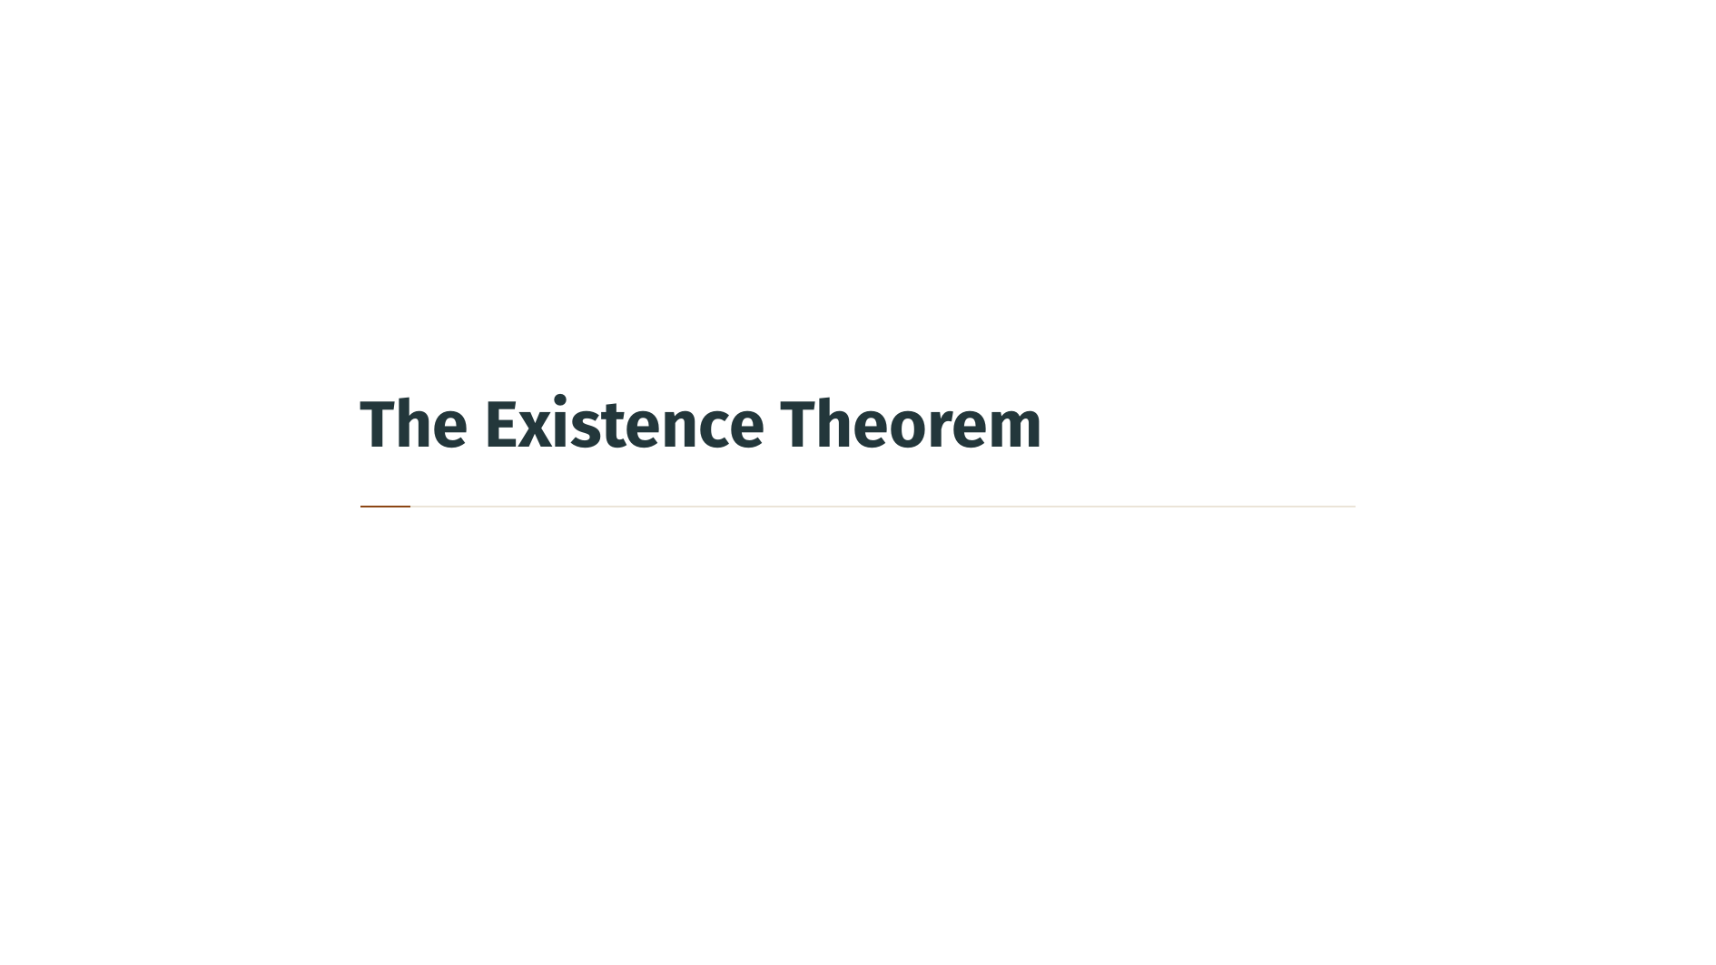

Slide 4
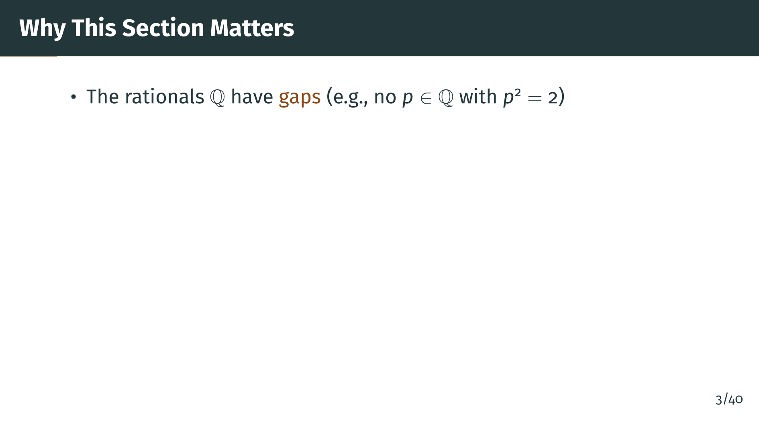
Notes:
Let's recall the key problem from the introduction. We showed that there is no rational number whose square equals 2. This means the rationals have gaps, and those gaps make the rationals unsuitable as a foundation for analysis. So what do we need instead?

Slide 5
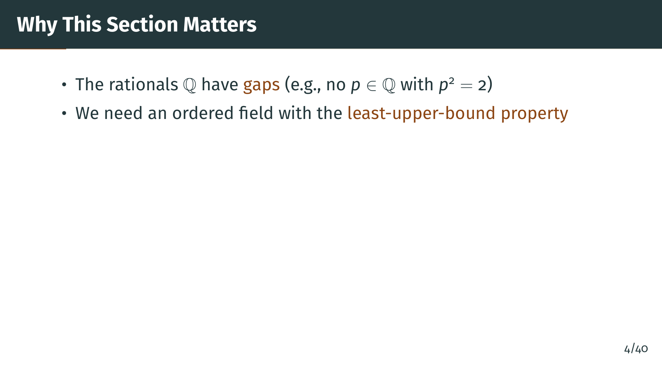
Notes:
To do analysis properly, we need an ordered field that has no such gaps. The precise way to express this is through the least-upper-bound property: every nonempty set that is bounded above must have a supremum. Let's see what this section will cover.

Slide 6
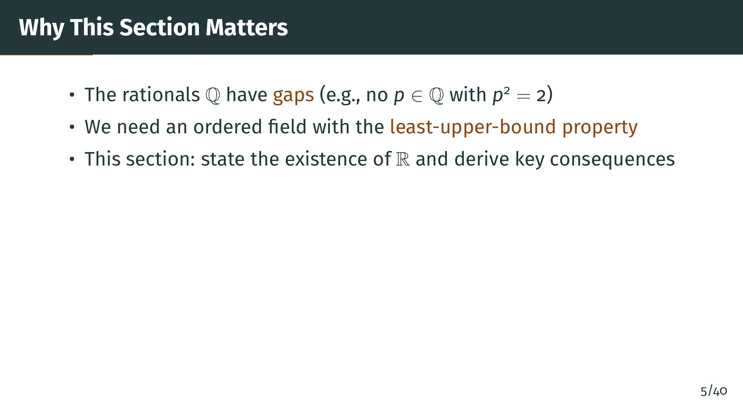
Notes:
In this section, we state the existence of such a field, which we call the real numbers, and then derive several important consequences: the archimedean property, the density of the rationals, and the existence of nth roots. Let's begin with the existence theorem itself.

Slide 7
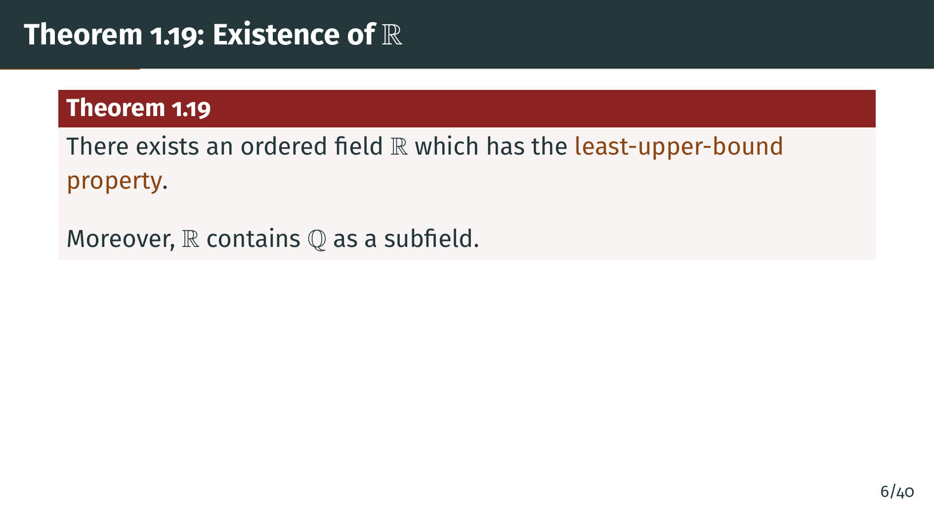
Notes:
Here is the central existence theorem. There exists an ordered field "R" that has the least-upper-bound property. Moreover, "R" contains the rationals "Q" as a subfield. This means "Q" sits inside "R", and the addition and multiplication operations in "R", when restricted to rational numbers, agree with the usual rational arithmetic. Let's also note what happens with the ordering.

Slide 8
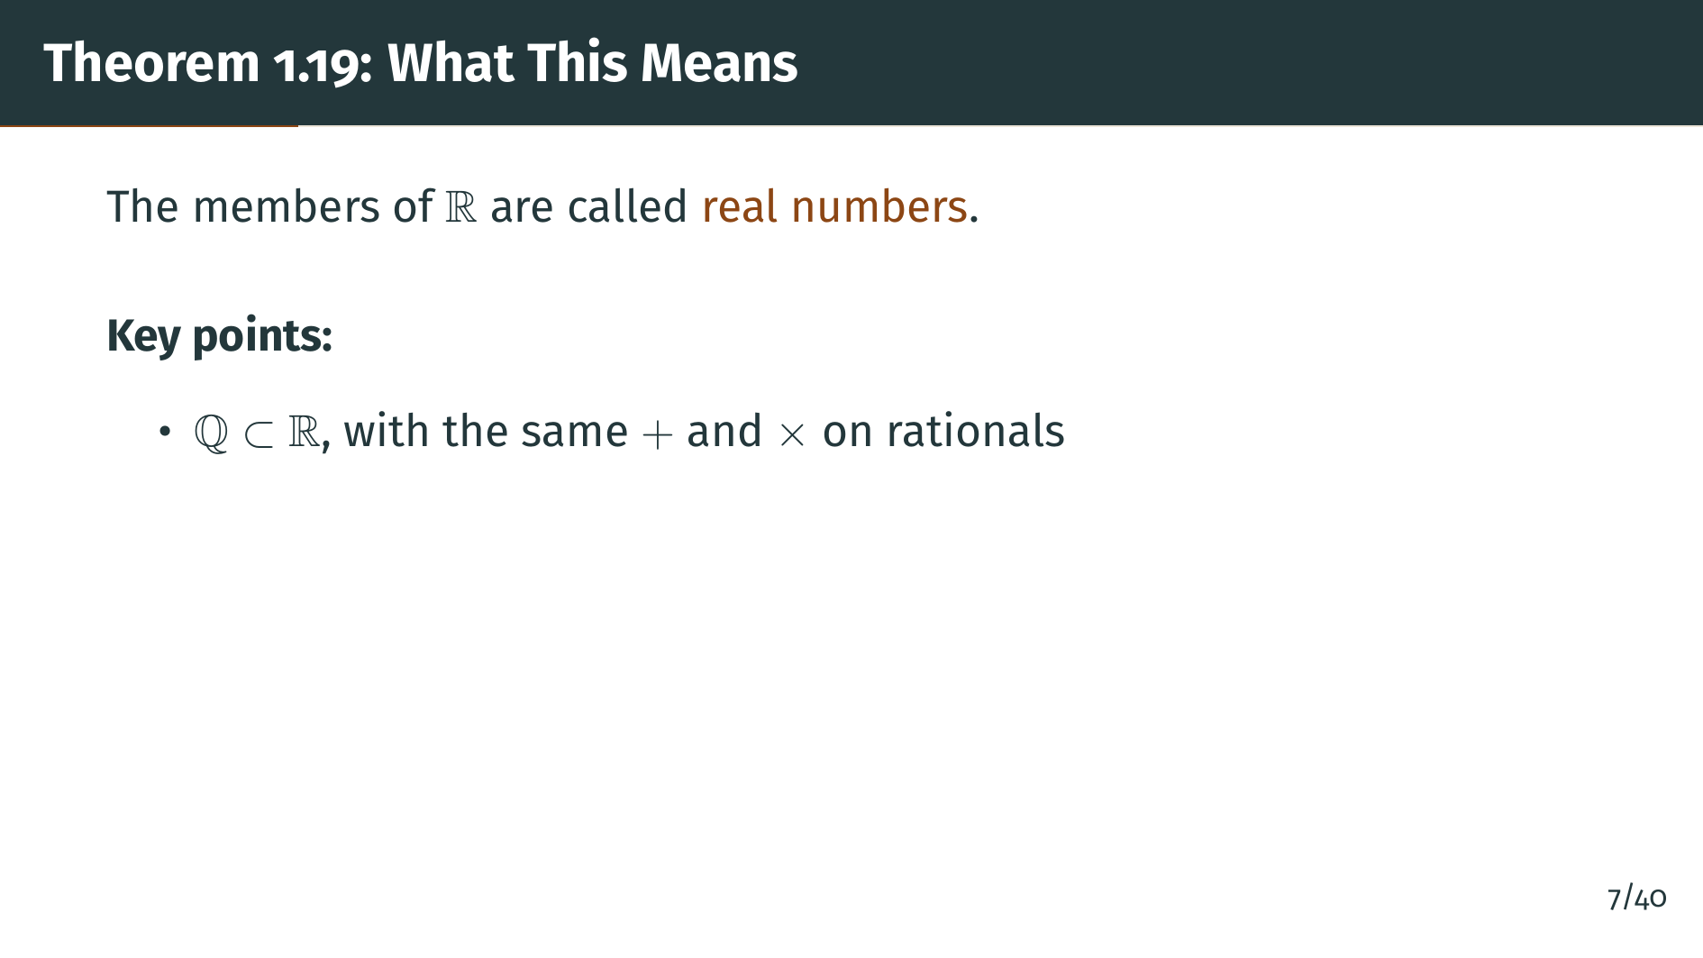
Notes:
The elements of "R" are called real numbers. The statement that "Q" is a subfield of "R" means, first, that "Q" is a subset of "R", and that the operations of addition and multiplication in "R" coincide with the usual ones when applied to rationals.

Slide 9
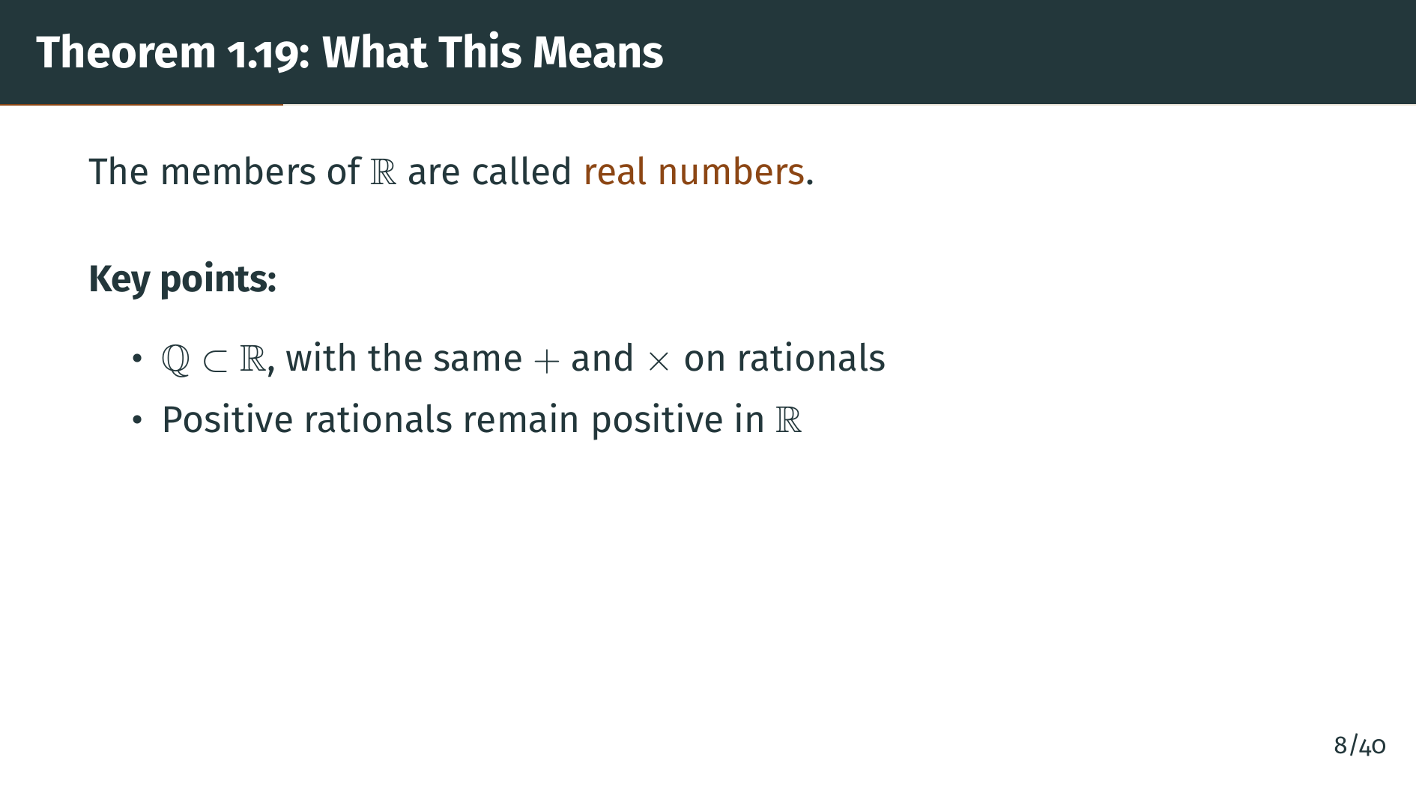
Notes:
Second, the positive rationals remain positive elements of "R". This is important because it ensures that the ordering on "Q" inherited from "R" agrees with the usual ordering of the rationals. In other words, "R" doesn't just contain "Q" algebraically; it respects the order structure of "Q" as well.

Slide 10
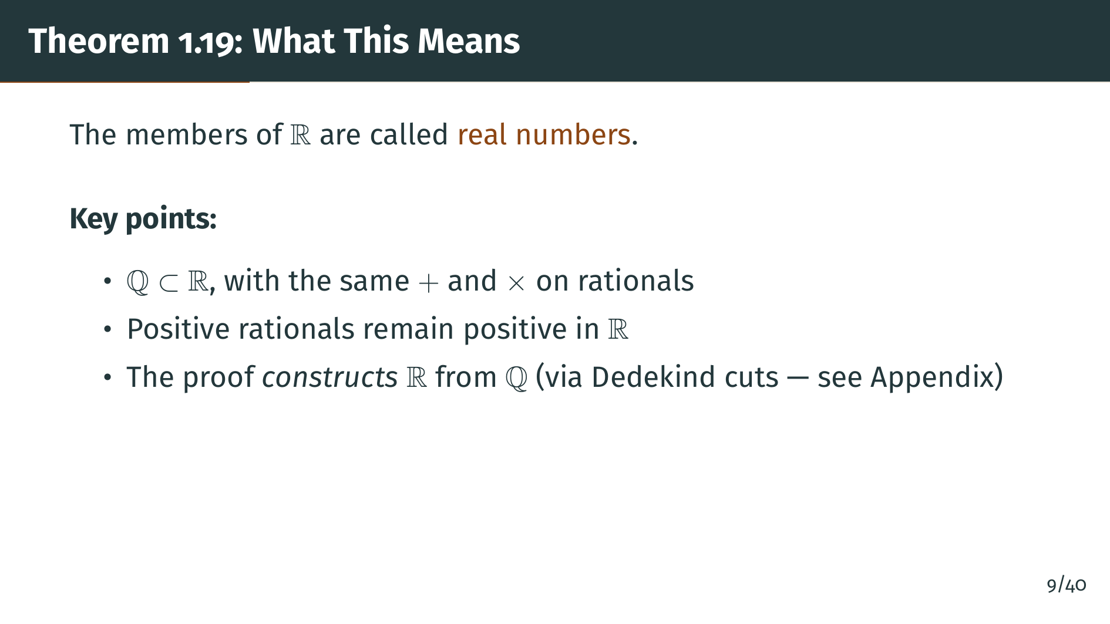
Notes:
Third, the proof of this theorem is quite long and is given in the Appendix to Chapter 1, where "R" is explicitly constructed from "Q" using Dedekind cuts. We will not go through that construction here, but instead focus on the powerful consequences of the least-upper-bound property. Let's first visualize what "R" looks like compared to "Q".

Slide 11
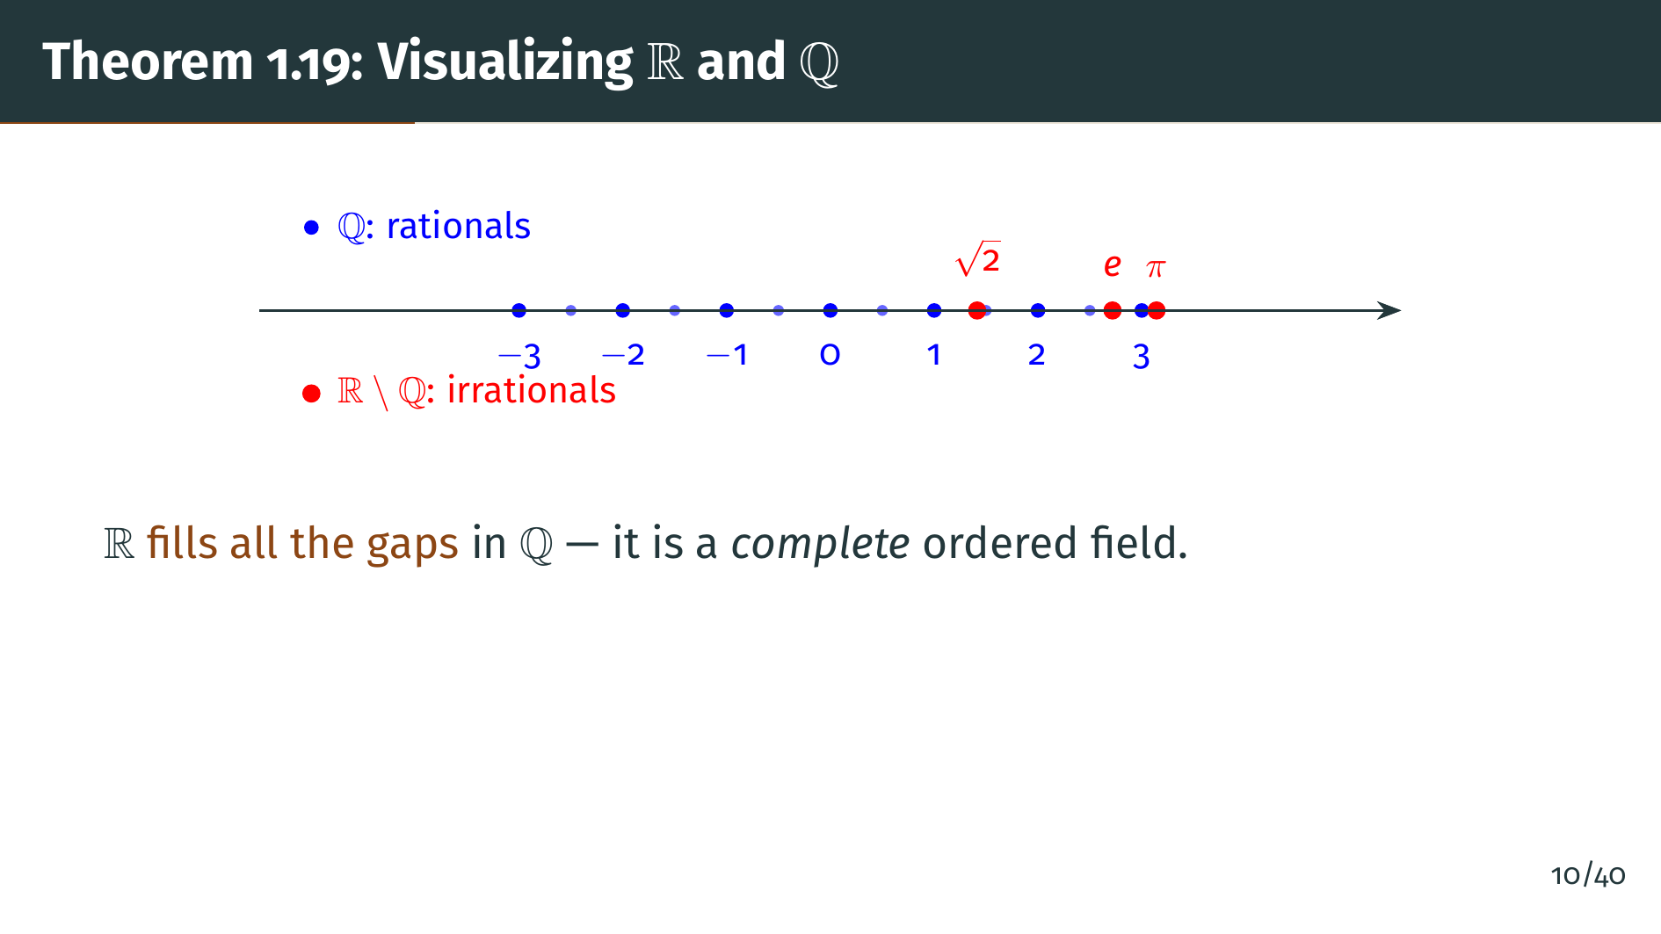
Notes:
This diagram shows the real number line. The blue dots represent rational numbers, which are scattered densely along the line but still leave gaps. The red dots represent irrationals like the square root of 2, "e", and pi, which fill those gaps. The real numbers form a complete number line with no gaps at all. This is precisely what the least-upper-bound property guarantees. Now let's see what powerful consequences follow from this completeness.

Slide 12


Slide 13
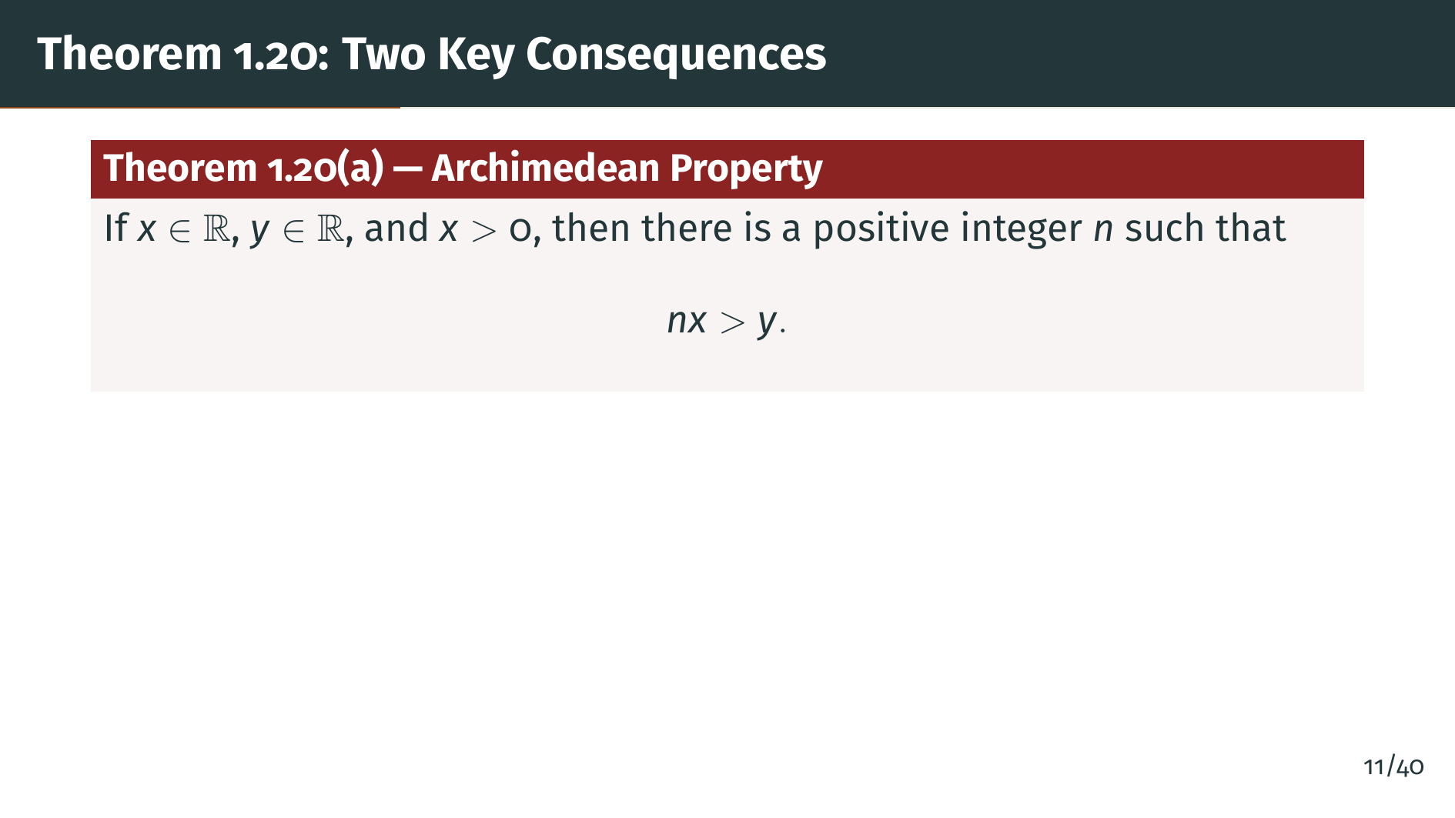
Notes:
Our first major consequence of the least-upper-bound property is the archimedean property. It says: given any two positive real numbers "x" and "y", no matter how small "x" is and how large "y" is, if you add "x" to itself enough times, you will eventually exceed "y". In other words, there are no infinitely large or infinitely small real numbers.

Slide 14
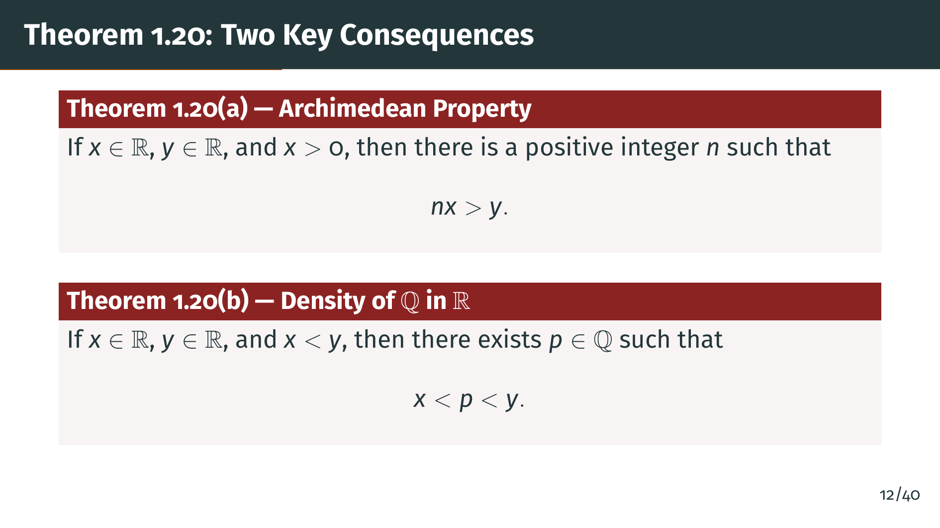
Notes:
The second consequence is the density of the rationals in the reals. Between any two distinct real numbers, no matter how close together, there is always a rational number. This means the rationals are, in a sense, spread everywhere throughout the real line. Let's look at a diagram to build some intuition.

Slide 15
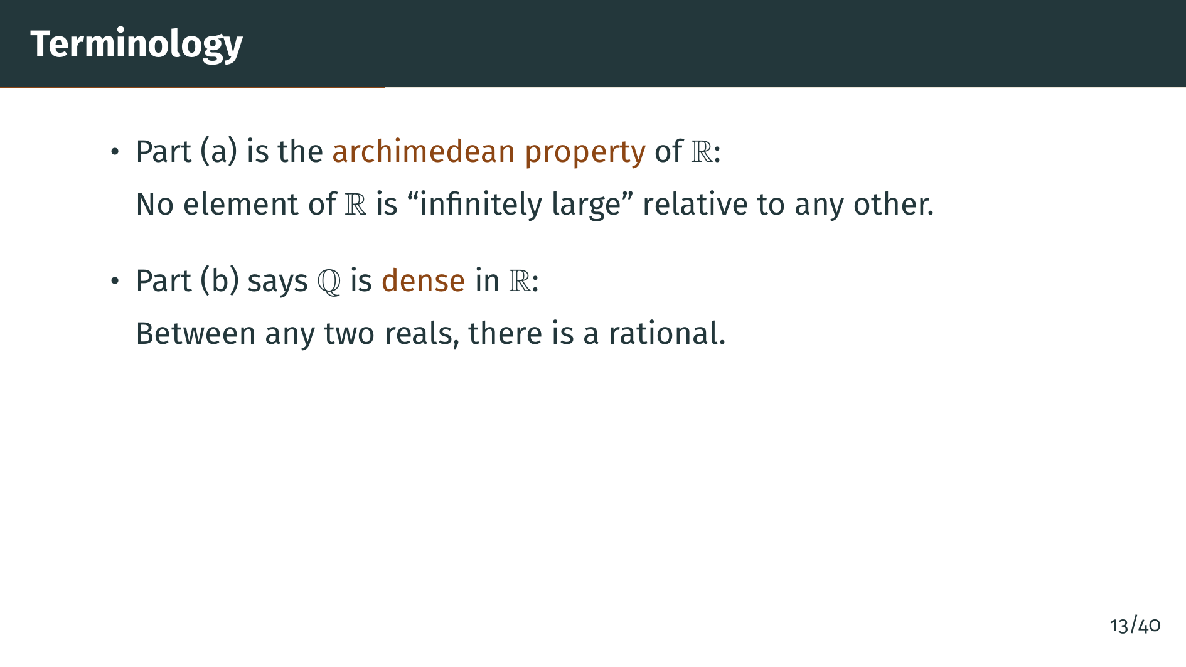
Notes:
Let's clarify the terminology. The archimedean property means there are no infinitely large elements: you can always reach any real number by adding up enough copies of any positive real number. The density of "Q" in "R" means that no matter how close two real numbers are, you can always squeeze a rational number between them. Let's see visual illustrations of both properties, starting with the archimedean property.

Slide 16
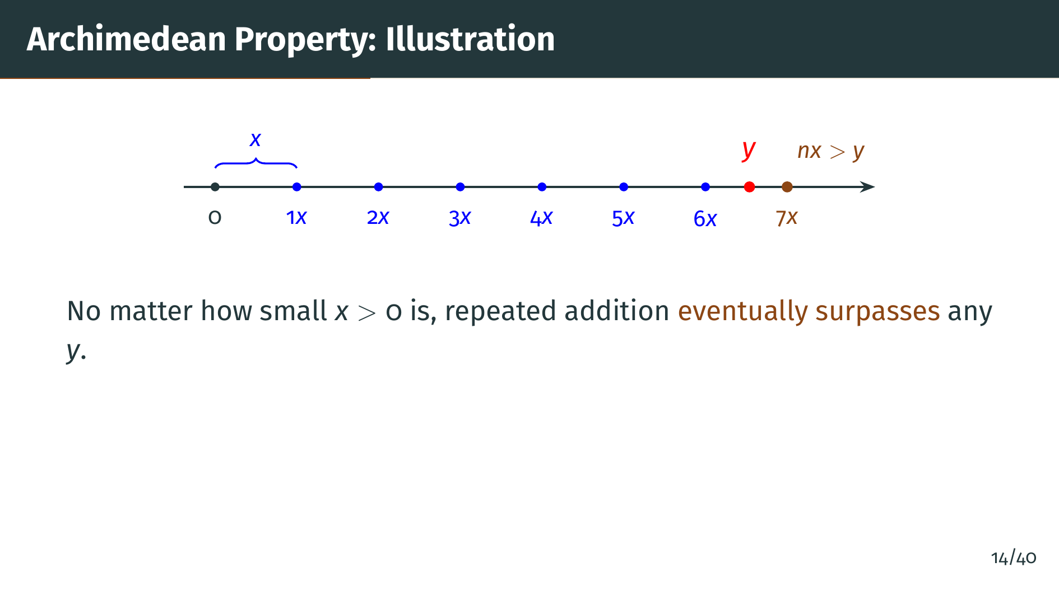
Notes:
This diagram illustrates the archimedean property. We start with a small positive number "x", shown by the blue bracket, and keep adding copies of "x": one "x", two "x", three "x", and so on. No matter how large "y" is, we will eventually surpass it. There is no positive real number so small that its multiples stay bounded. Now let's visualize the other key consequence: the density of the rationals.

Slide 17
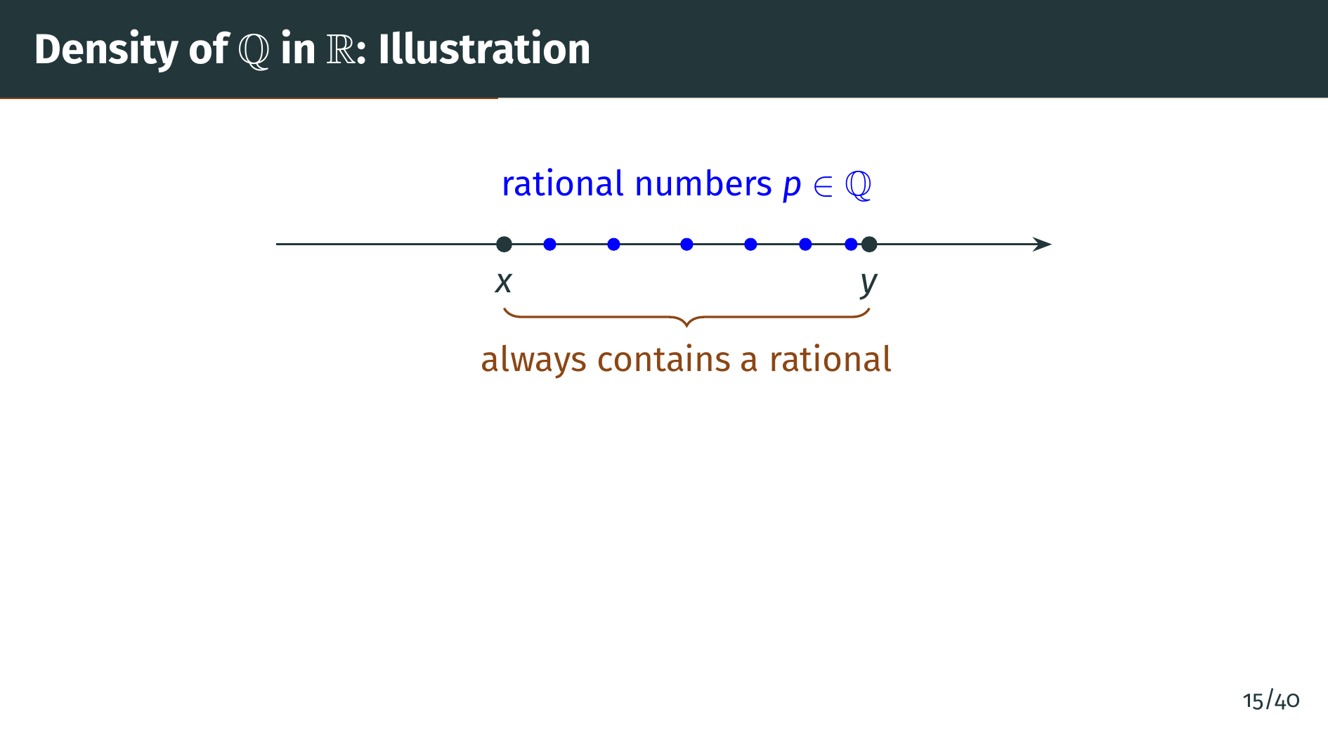
Notes:
Here we see the real number line with two arbitrary points "x" and "y". The orange bracket shows the interval between them. No matter how close "x" and "y" are to each other, there are always rational numbers between them, shown as the blue dots. In fact, there are infinitely many rationals between any two reals. This is a remarkable property. Now let's prove both parts of Theorem 1.20.

Slide 18
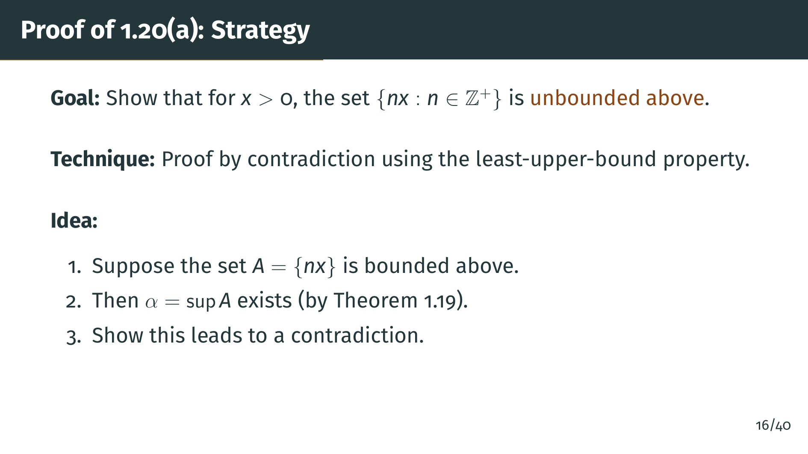
Notes:
Let's prove the archimedean property. Our strategy is proof by contradiction. We consider the set "A" of all positive integer multiples of "x", and assume for contradiction that this set is bounded above. Since "R" has the least-upper-bound property, "A" would then have a supremum. We will show this supremum cannot actually be an upper bound, giving us our contradiction.

Slide 19
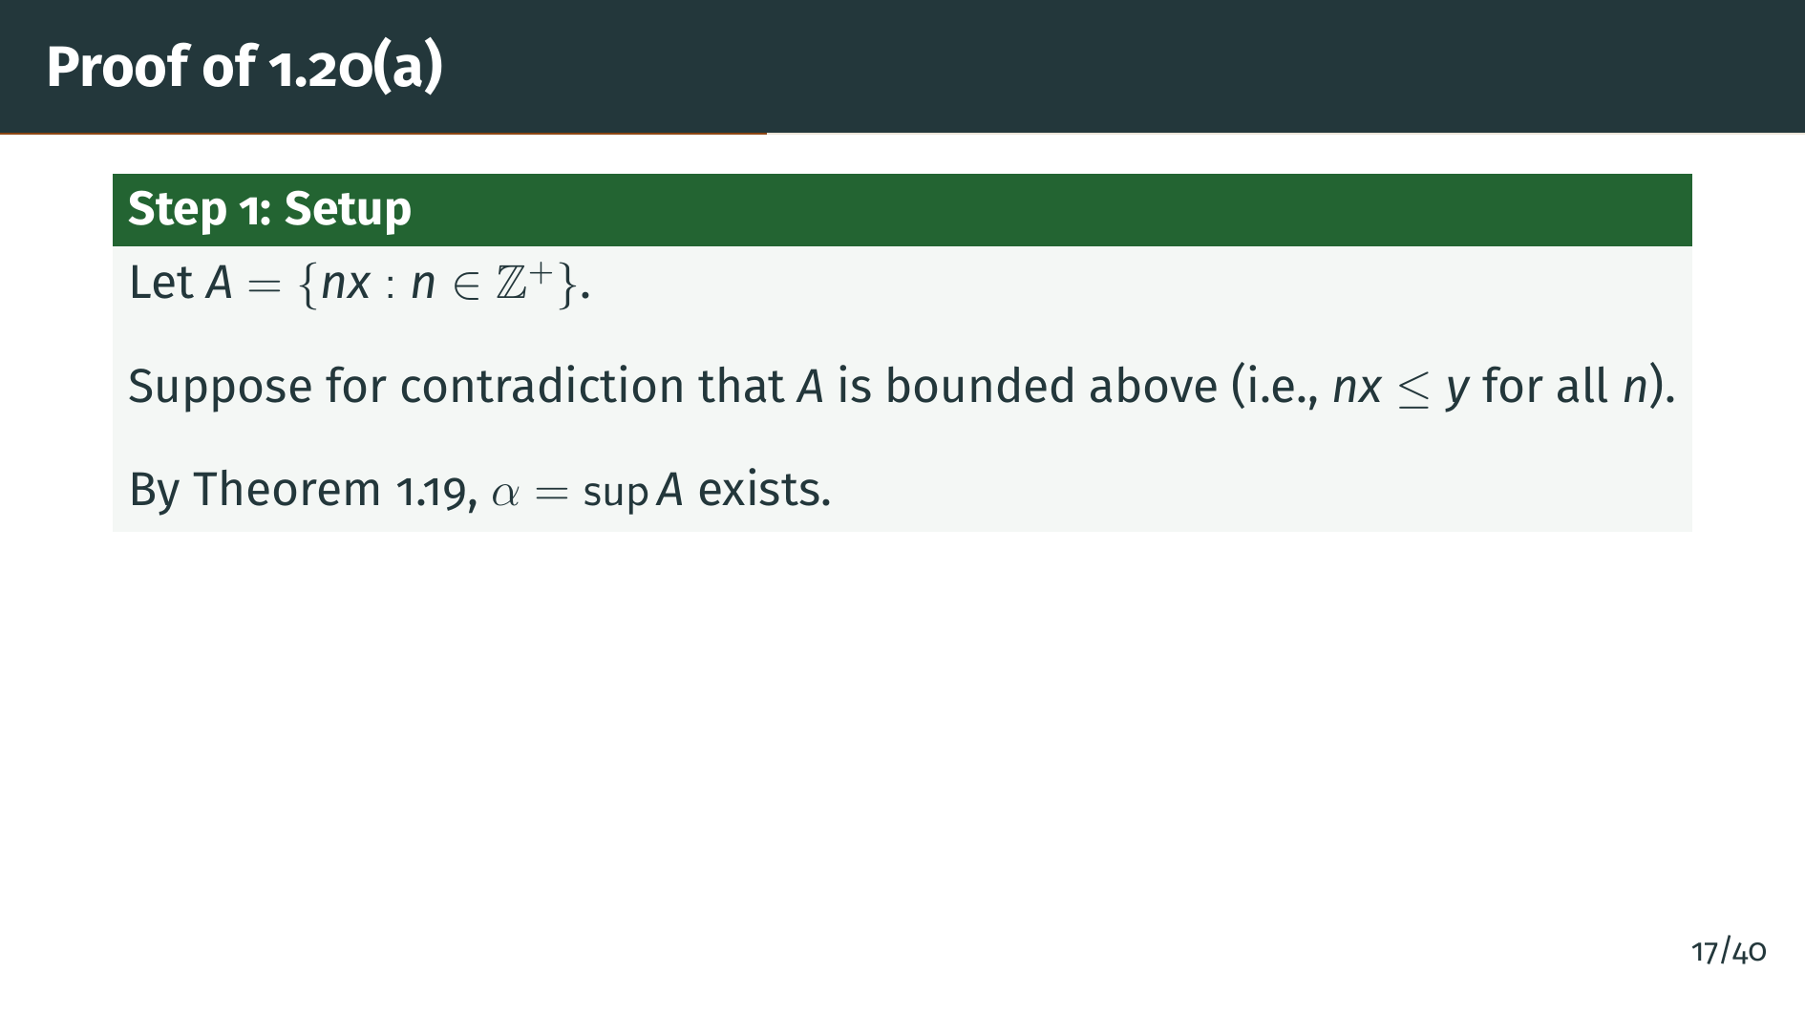
Notes:
Let "A" be the set of all positive integer multiples of "x". If the archimedean property fails, then "y" is an upper bound of "A". Since "A" is nonempty and bounded above, the least-upper-bound property gives us alpha equals the supremum of "A".

Slide 20
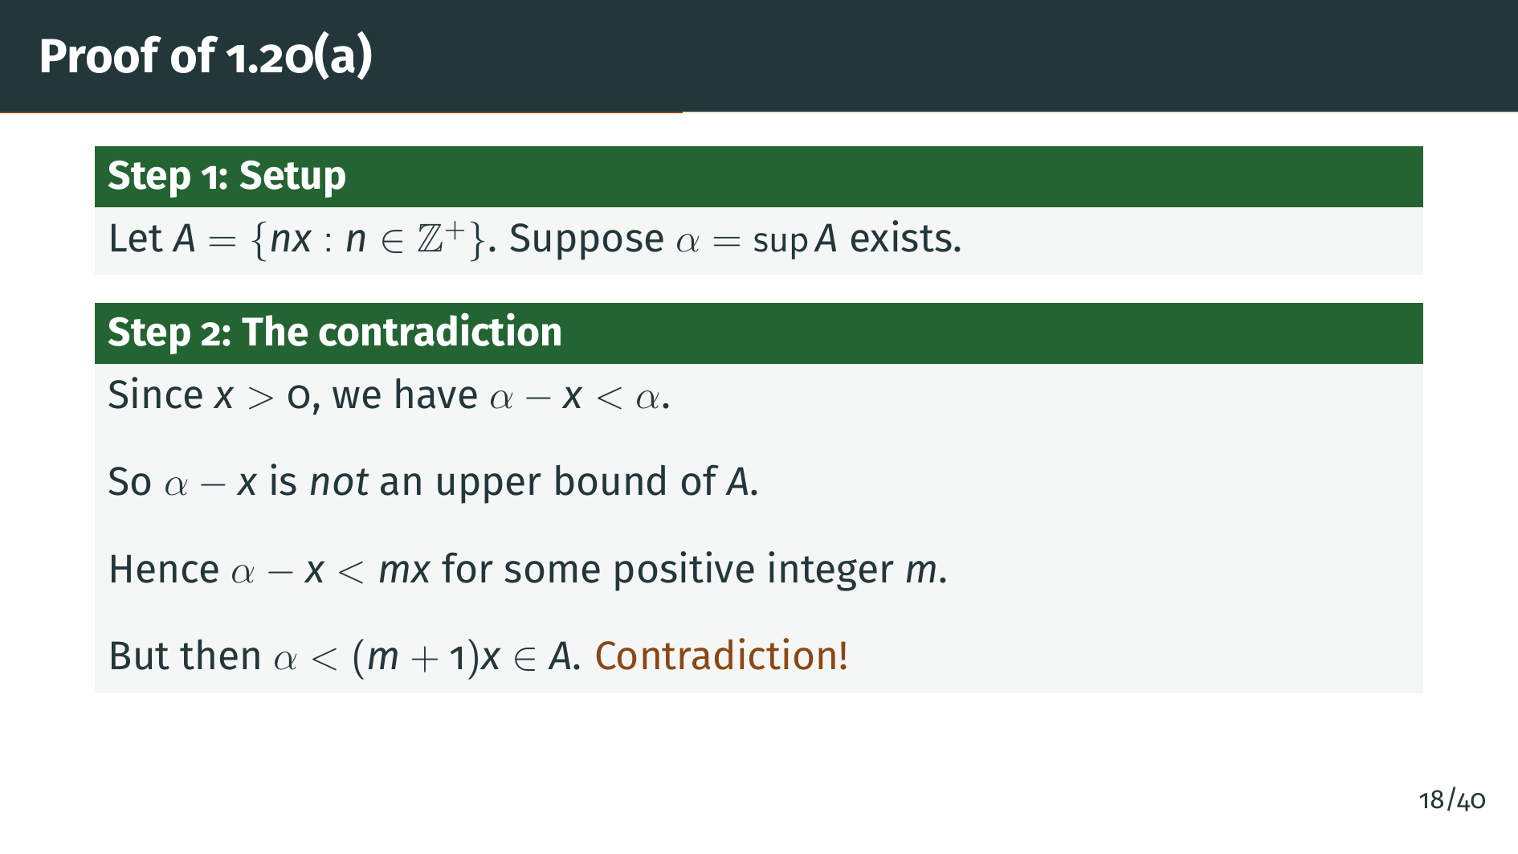
Notes:
Here is the key step. Since "x" is positive, alpha minus "x" is strictly less than alpha. Since alpha is the least upper bound, alpha minus "x" cannot be an upper bound of "A". Therefore, there exists some positive integer "m" such that "m" times "x" exceeds alpha minus "x". But then "m" plus 1 times "x" exceeds alpha. Since "m" plus 1 times "x" is an element of "A", we have found an element of "A" that exceeds alpha. This contradicts alpha being an upper bound of "A". The archimedean property is proved. Now let's use it to prove the density of the rationals.

Slide 21
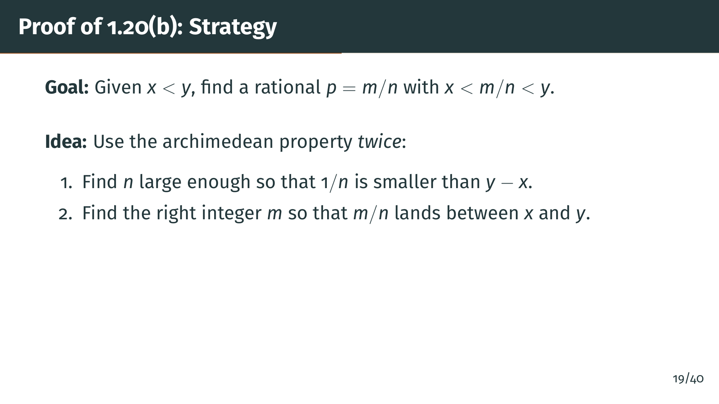
Notes:
Now let's prove part "b", the density of the rationals. We need to find a rational number "m" over "n" between "x" and "y". The strategy uses the archimedean property twice. First, we use it to find an integer "n" large enough that 1 over "n" is smaller than the gap "y" minus "x". Then we use it again to find the right numerator "m". Let's see the details.

Slide 22
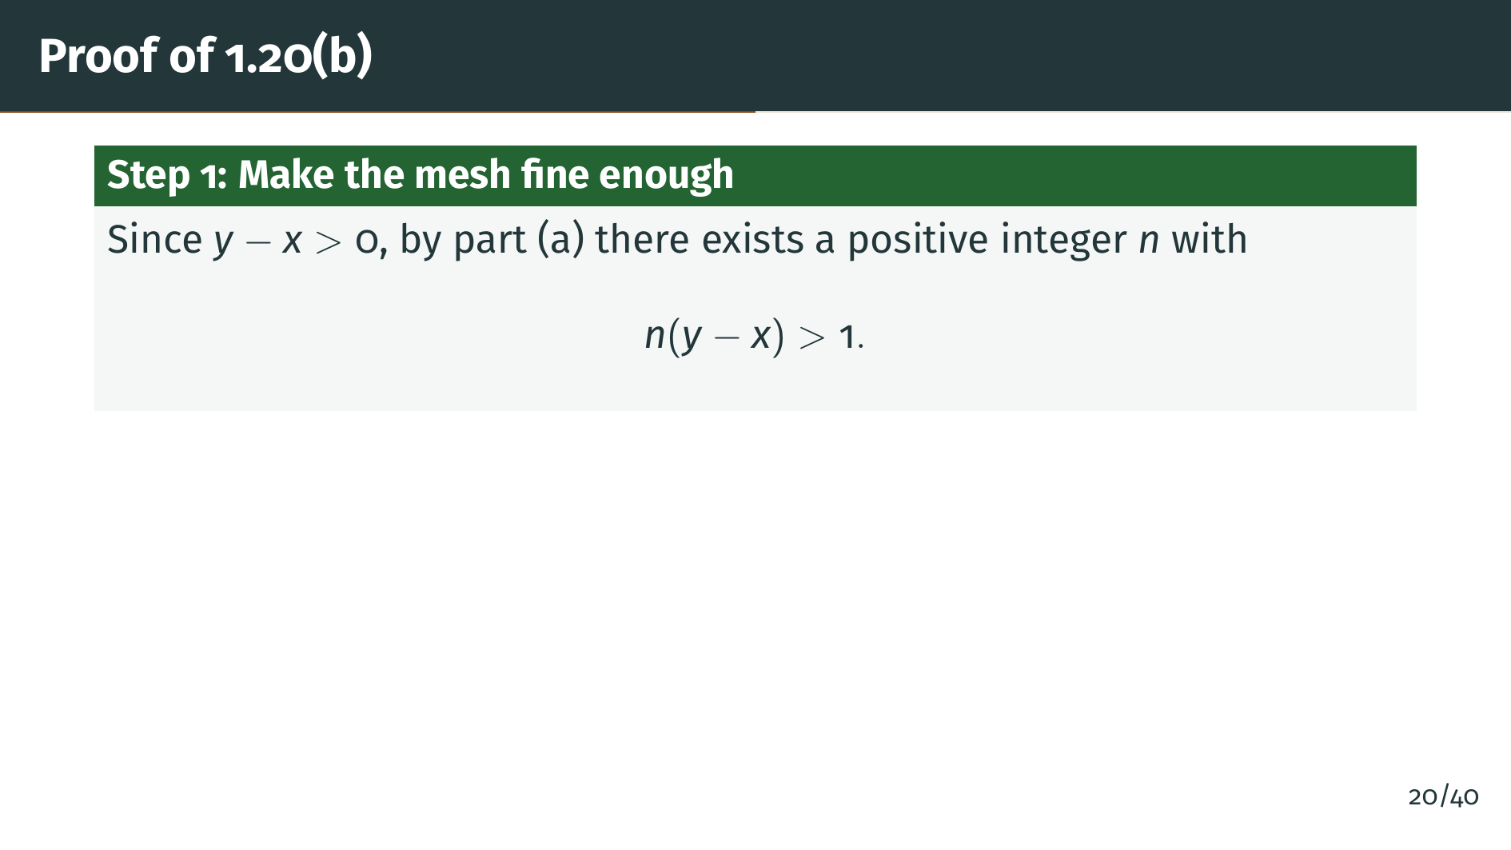
Notes:
Since "y" minus "x" is positive, we apply the archimedean property with "x" replaced by "y" minus "x" and "y" replaced by 1. This gives us a positive integer "n" such that "n" times the quantity "y" minus "x" exceeds 1. Equivalently, the spacing 1 over "n" is smaller than "y" minus "x". This ensures our rational grid is fine enough to land a point inside the interval.

Slide 23
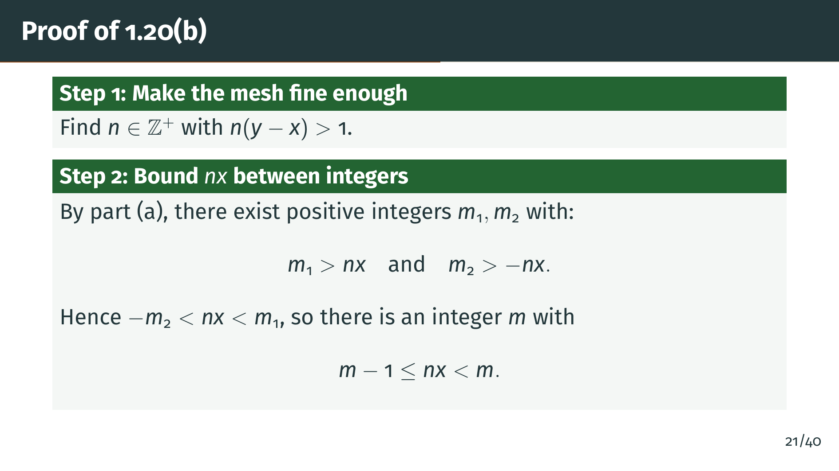
Notes:
Next, we apply the archimedean property again to find positive integers "m" 1 and "m" 2 such that "m" 1 exceeds "n" times "x" and "m" 2 exceeds negative "n" times "x". This means "n" times "x" is trapped between negative "m" 2 and "m" 1, so there must be an integer "m" that is the smallest integer exceeding "n" times "x". In other words, "m" minus 1 is at most "n" times "x", and "n" times "x" is strictly less than "m".

Slide 24
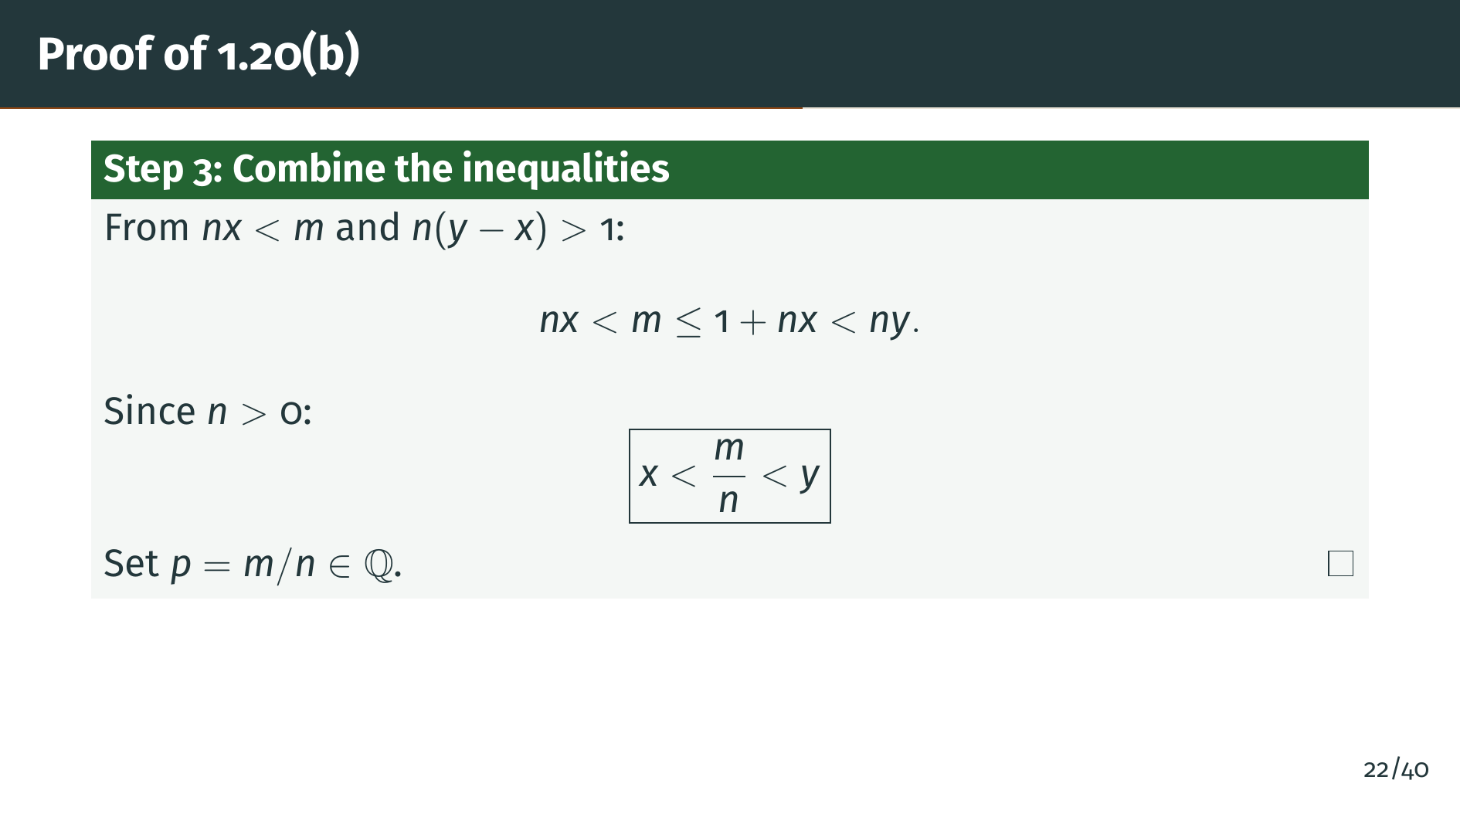
Notes:
Now we combine everything. We know "n" times "x" is less than "m", and "m" is at most 1 plus "n" times "x". But 1 plus "n" times "x" is less than "n" times "y", since "n" times the quantity "y" minus "x" exceeds 1. Dividing through by the positive integer "n", we get "x" is less than "m" over "n", which is less than "y". So "p" equals "m" over "n" is the rational number we were looking for. The density of "Q" in "R" is proved. Let's see a visual summary of this proof idea.

Slide 25
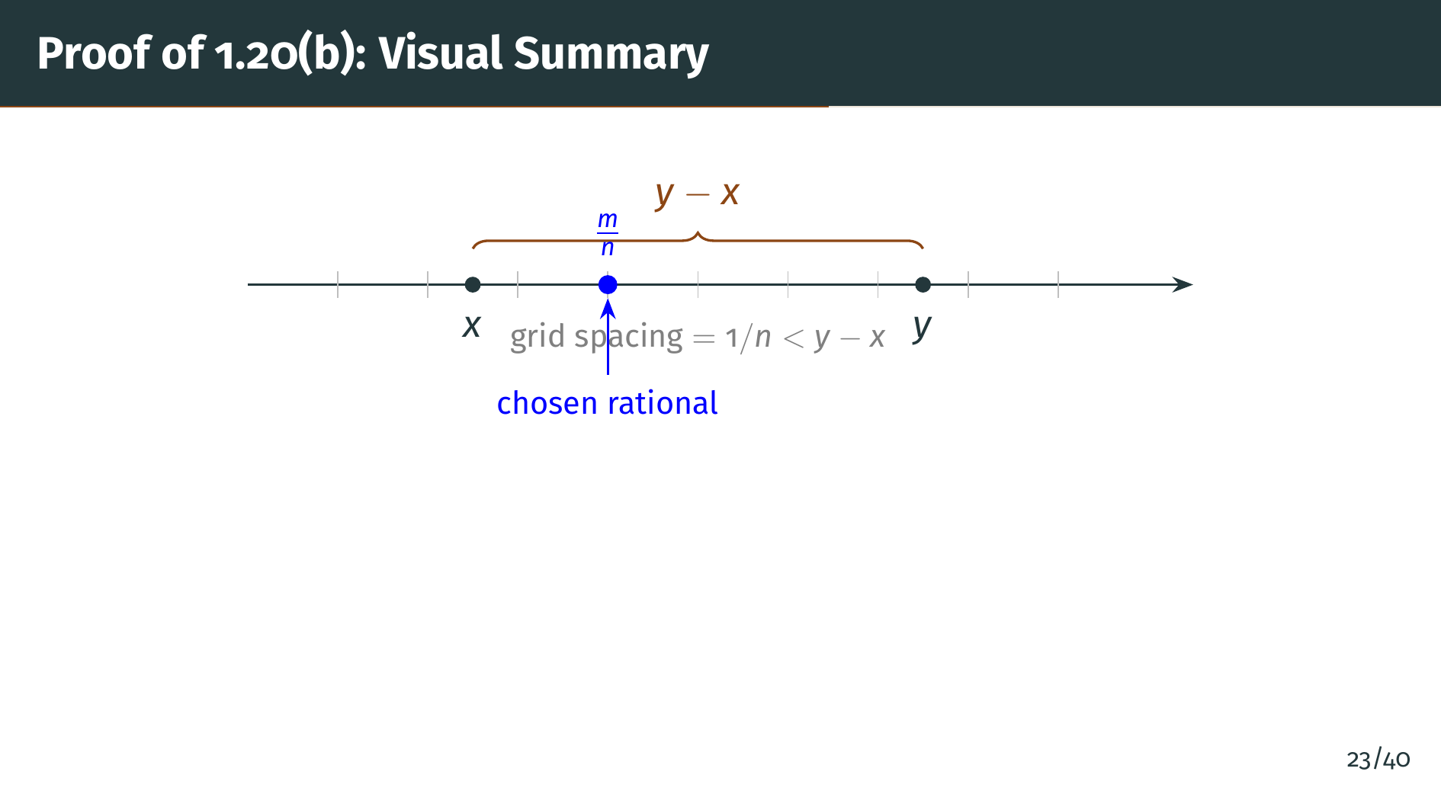
Notes:
This diagram summarizes the proof idea. The key insight is to choose a denominator "n" large enough that the grid spacing 1 over "n" is smaller than the gap "y" minus "x". Once the grid is that fine, at least one grid point "m" over "n" must fall inside the interval from "x" to "y". It's a beautifully simple argument once you have the archimedean property. Next, we turn to another important consequence of the least-upper-bound property: the existence of nth roots.

Slide 26


Slide 27
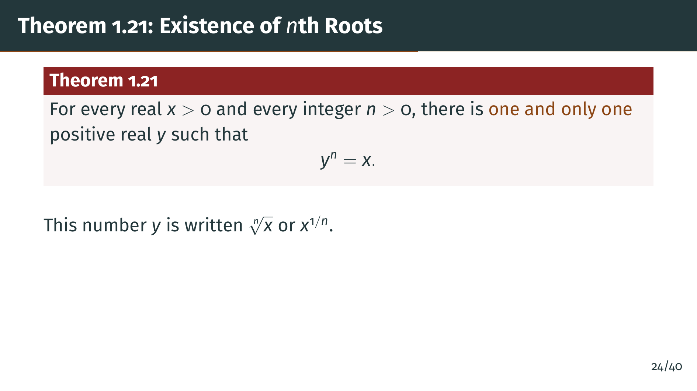
Notes:
Now we come to a beautiful application of the least-upper-bound property. Theorem 1.21 says that every positive real number has a unique positive nth root. This directly resolves the problem from the introduction: while the square root of 2 does not exist in the rationals, it does exist in the reals. The proof will show exactly how the least-upper-bound property fills the gap.

Slide 28
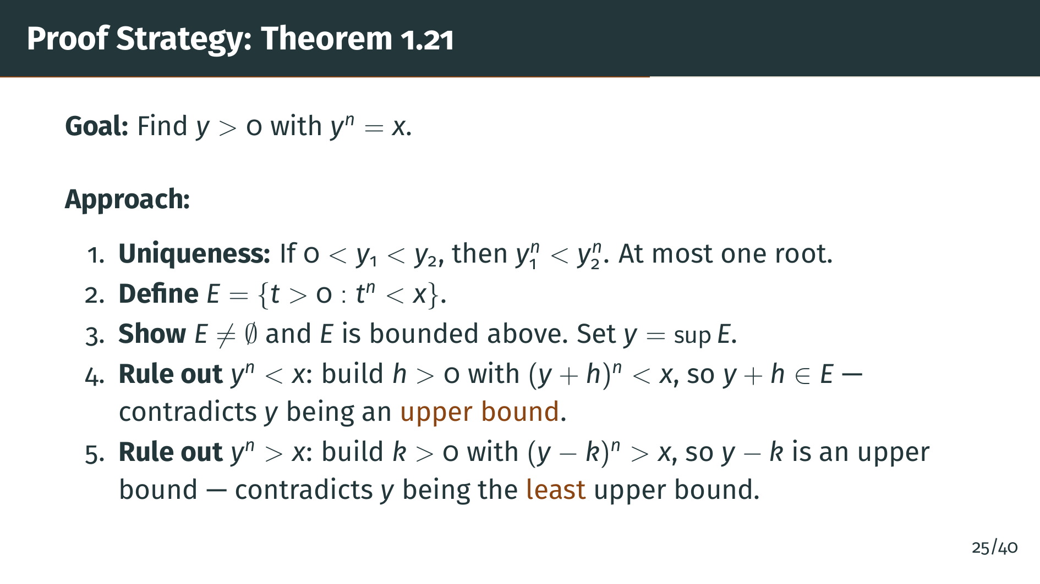
Notes:
Here is the proof strategy. Uniqueness is immediate: the function "t" to the "n" is strictly increasing on positive reals. For existence, we define "E" to be the set of all positive reals "t" whose nth power is less than "x". We take "y" to be the supremum of "E", which exists by the least-upper-bound property. Then we prove "y" to the "n" equals "x" by ruling out both alternatives. If "y" to the "n" were less than "x", we would construct a small positive number "h" so that "y" plus "h" is still in "E", contradicting the fact that "y" is an upper bound of "E". If "y" to the "n" were greater than "x", we would construct a small positive "k" so that "y" minus "k" is already an upper bound of "E", contradicting the fact that "y" is the least upper bound.

Slide 29
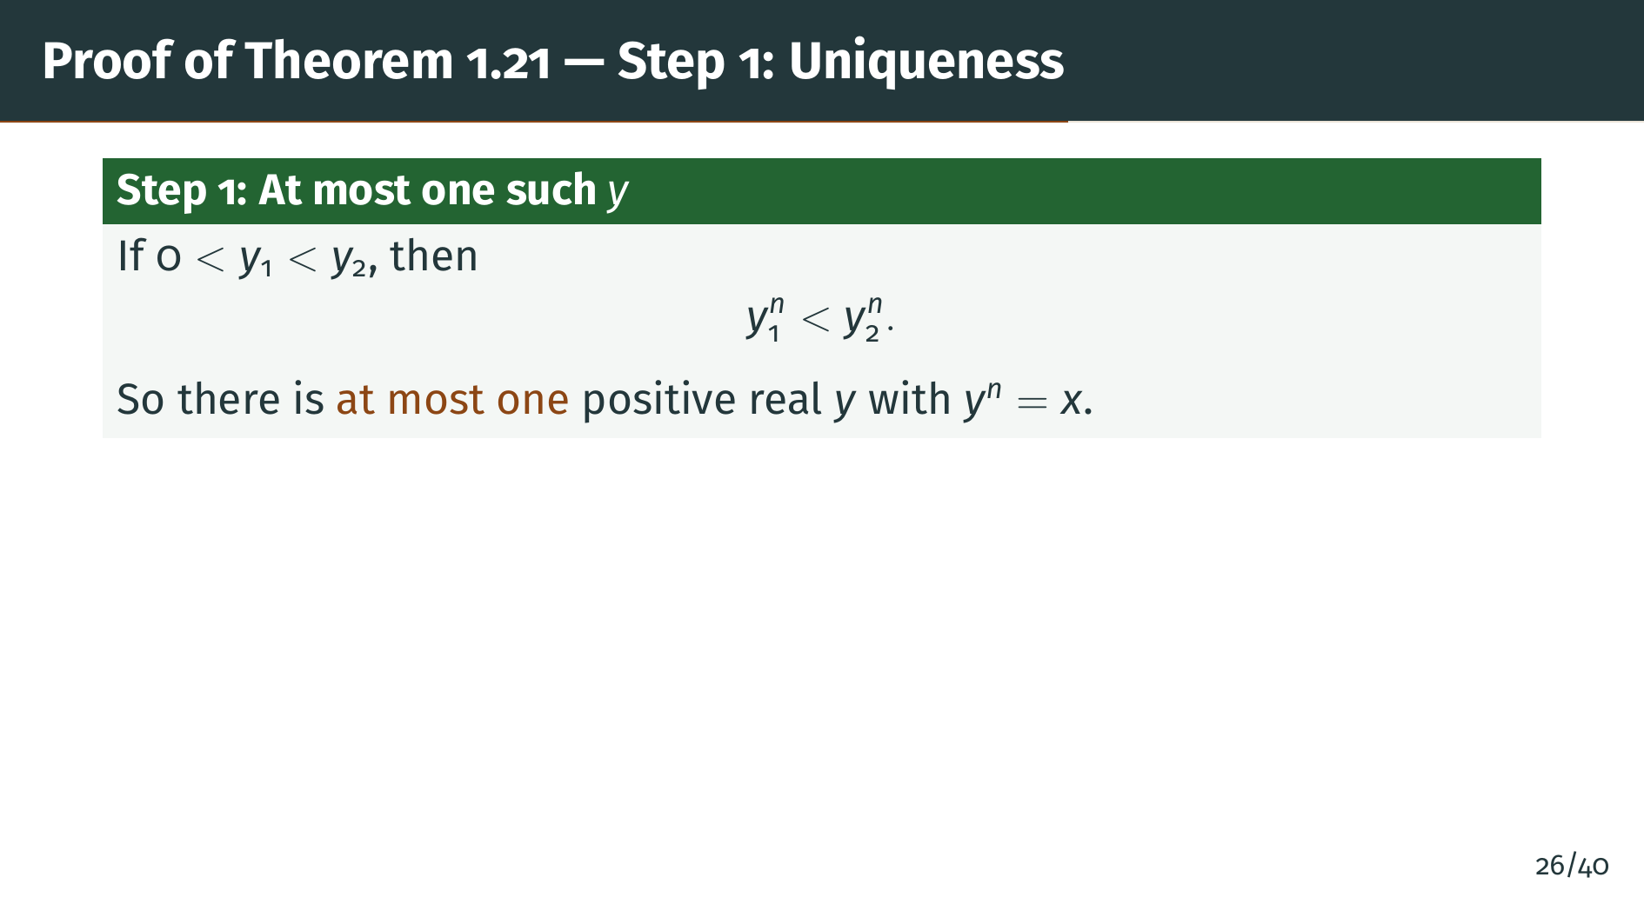
Notes:
The uniqueness part is straightforward. If "y" 1 is less than "y" 2, and both are positive, then "y" 1 to the "n" is strictly less than "y" 2 to the "n". This follows because multiplication by a positive number preserves inequalities. Therefore, the equation "y" to the "n" equals "x" can have at most one positive solution. Now we need to show that at least one such "y" exists.

Slide 30
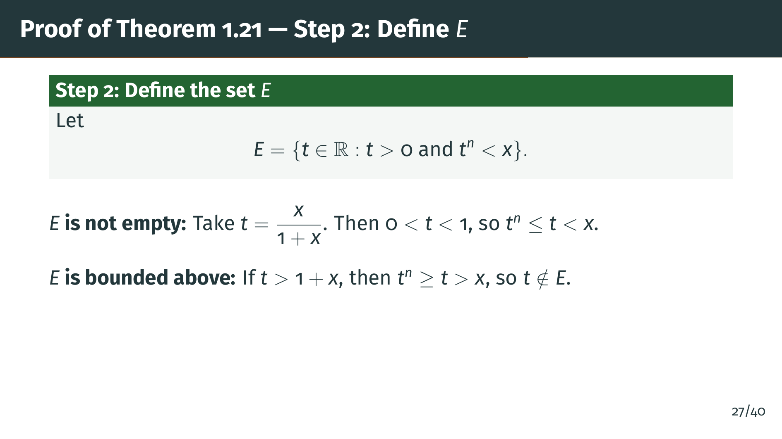
Notes:
We define "E" to be the set of all positive reals "t" whose nth power is less than "x". We need to check "E" is nonempty and bounded above. For nonempty: take "t" equals "x" over 1 plus "x". This number lies strictly between 0 and 1, and raising a number in that range to a positive power only makes it smaller, so "t" to the "n" is at most "t", which is less than "x". So "t" belongs to "E". For bounded above: if "t" exceeds 1 plus "x", then since "t" is greater than 1, "t" to the "n" is at least "t", which exceeds "x". So 1 plus "x" is an upper bound of "E".

Slide 31
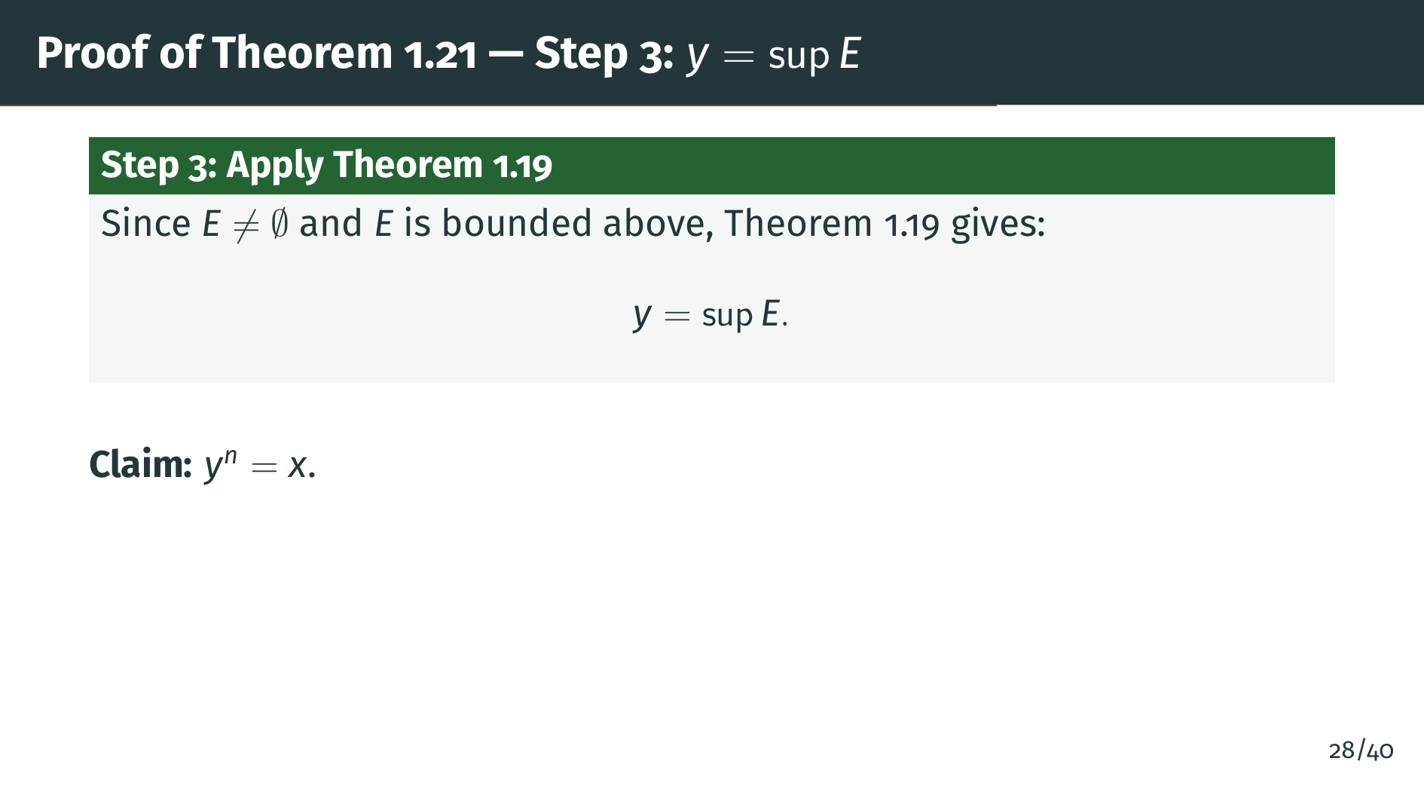
Notes:
By the least-upper-bound property, the supremum "y" of "E" exists. Our claim is that "y" to the "n" equals "x". As outlined in the strategy, we will establish this by ruling out the two alternatives: "y" to the "n" less than "x", and "y" to the "n" greater than "x". Before handling them, we pause to record the key algebraic inequality that both cases will need.

Slide 32
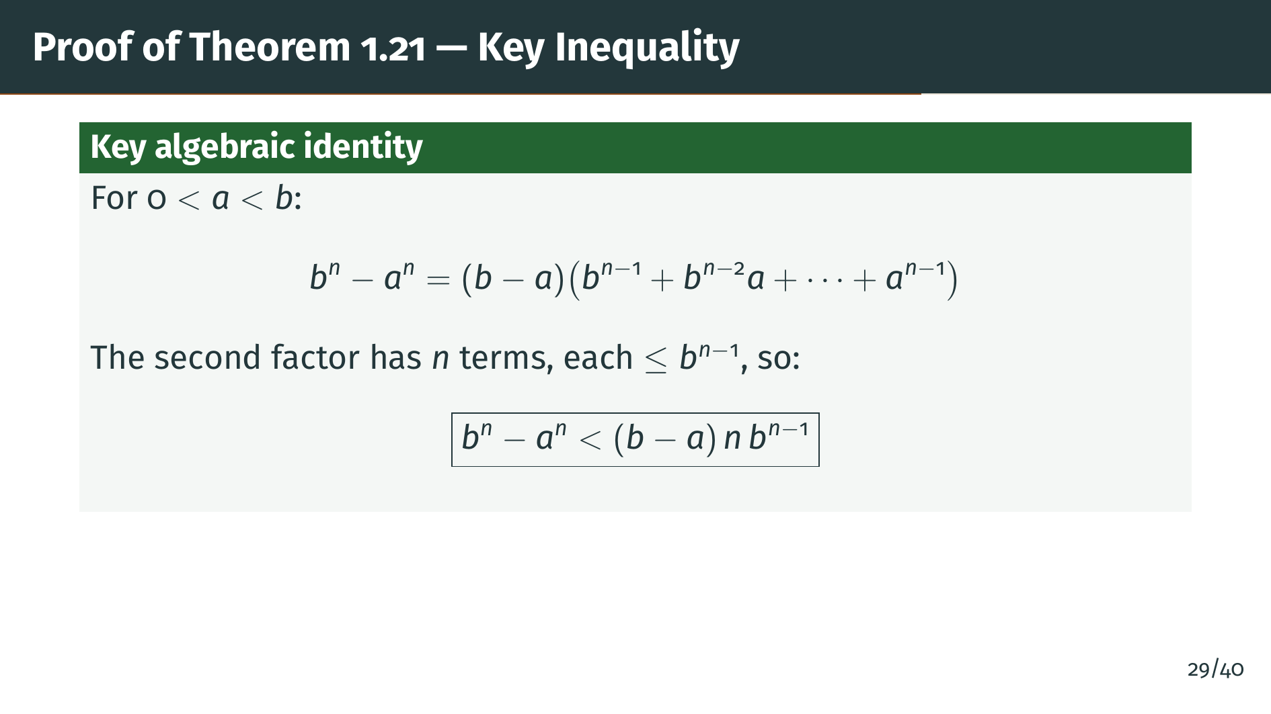
Notes:
Before we handle the two cases, we need a key algebraic inequality. The factorization of "b" to the "n" minus "a" to the "n" gives us "b" minus "a" times a sum of "n" terms. When "a" is less than "b", each term in that sum is at most "b" to the "n" minus 1. So the entire sum is at most "n" times "b" to the "n" minus 1. This gives us the boxed upper bound, which we will use in both cases of the proof.

Slide 33
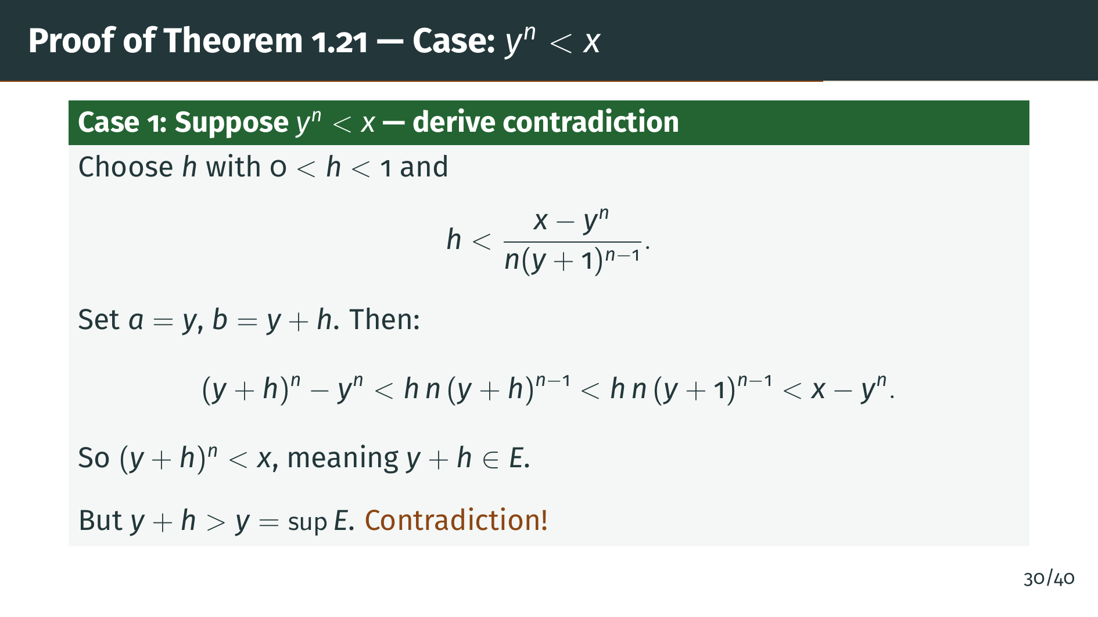
Notes:
Assume "y" to the "n" is less than "x". We choose a small positive "h", less than 1, and small enough that "h" times "n" times the quantity "y" plus 1 to the "n" minus 1 is less than "x" minus "y" to the "n". Applying our key inequality, the chain of inequalities on the slide shows that "y" plus "h" to the "n" is still less than "x". So "y" plus "h" belongs to "E", but "y" plus "h" exceeds "y". This contradicts "y" being an upper bound of "E". Now let's handle the other case.

Slide 34
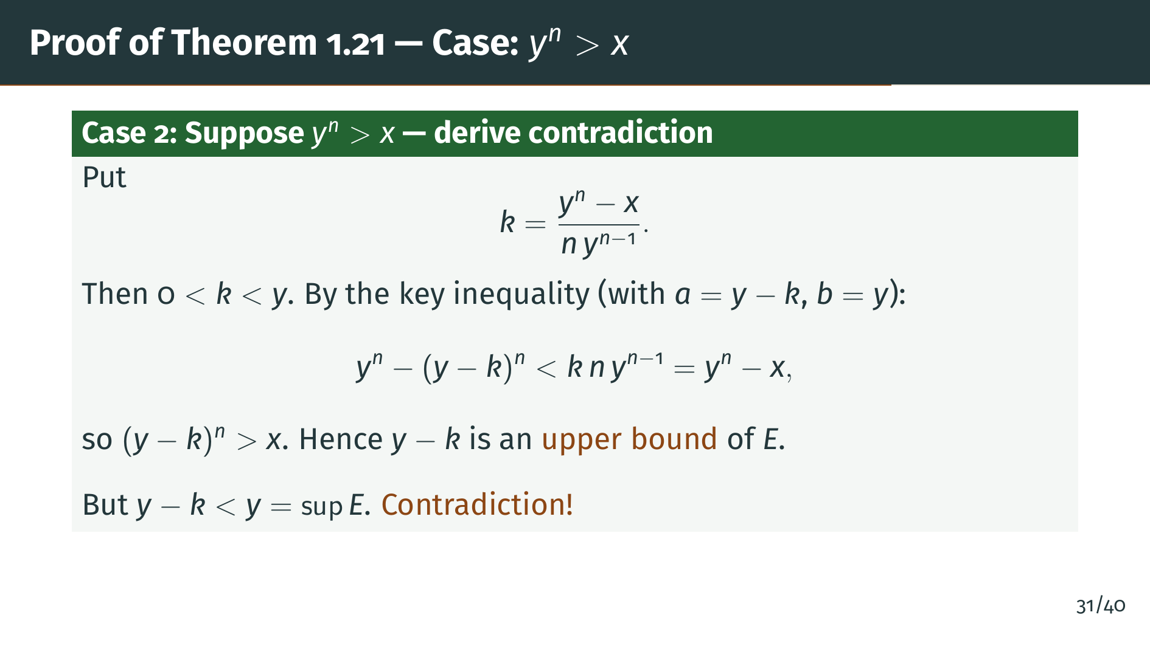
Notes:
Now assume "y" to the "n" is greater than "x". We define "k" as shown, which is positive and less than "y". Applying the key inequality with "a" equal to "y" minus "k" and "b" equal to "y", we find that "y" to the "n" minus the quantity "y" minus "k" to the "n" is strictly less than "y" to the "n" minus "x". So "y" minus "k" to the "n" is greater than "x", which means "y" minus "k" is an upper bound of "E". But "y" minus "k" is strictly less than "y", contradicting that "y" is the least upper bound. Both cases lead to contradictions, so "y" to the "n" must equal "x". The proof is complete.

Slide 35
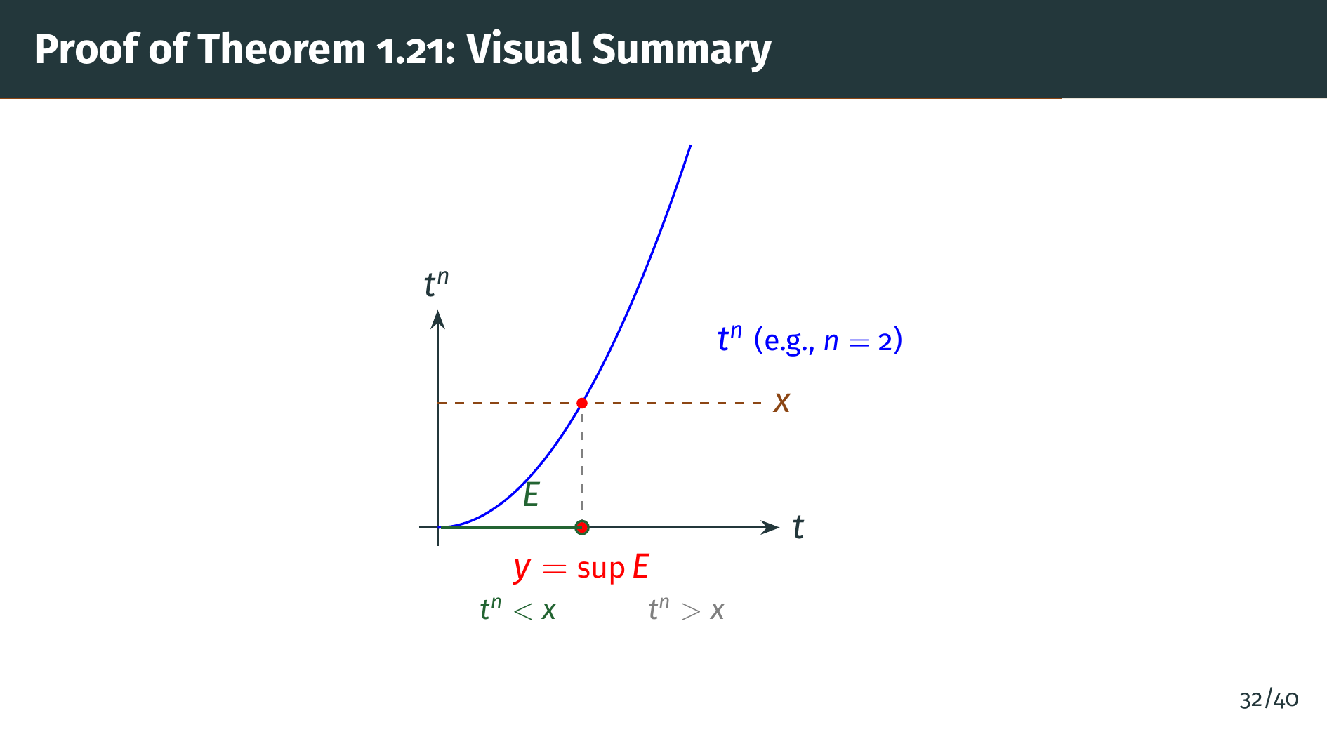
Notes:
This diagram shows the function "t" to the "n" as the blue curve. The horizontal dashed line is at height "x". The set "E", shown in green, consists of all positive "t" where the curve lies below "x". The supremum "y" is where the curve meets the line. If "y" to the "n" were less than "x", we could move right and stay in "E". If "y" to the "n" were greater than "x", we could find a smaller upper bound by moving left. So "y" to the "n" must equal "x" exactly. Now let's look at a nice corollary of this result.

Slide 36
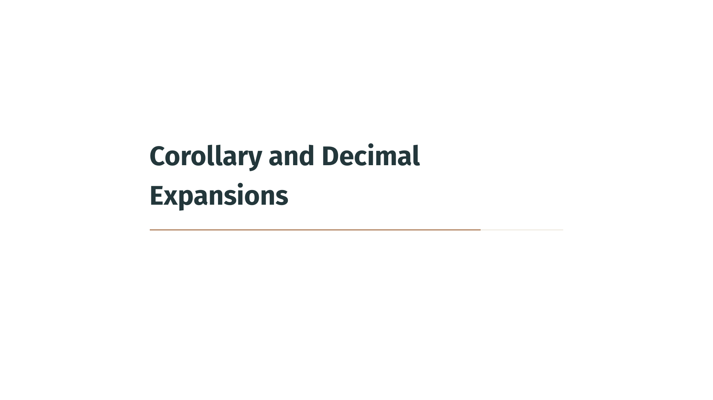

Slide 37
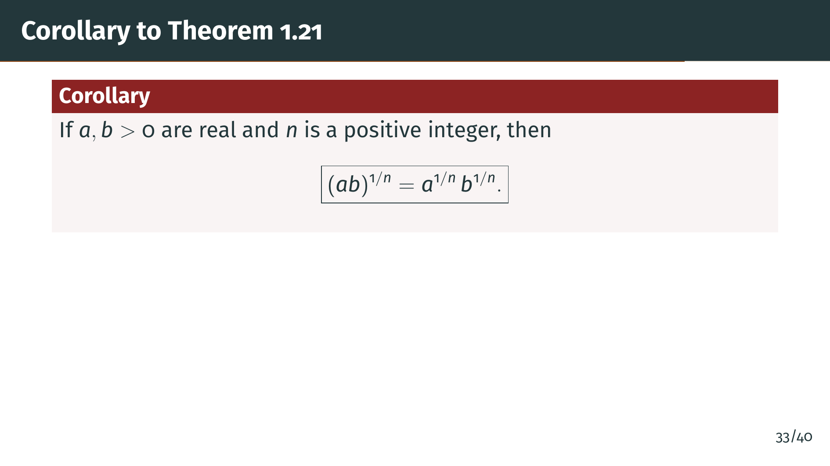
Notes:
A nice consequence of the uniqueness part of Theorem 1.21 is this corollary about nth roots of products. The nth root of a product equals the product of the nth roots. This is a familiar rule, but it requires the existence and uniqueness of nth roots to make rigorous. Let's see the short proof.

Slide 38
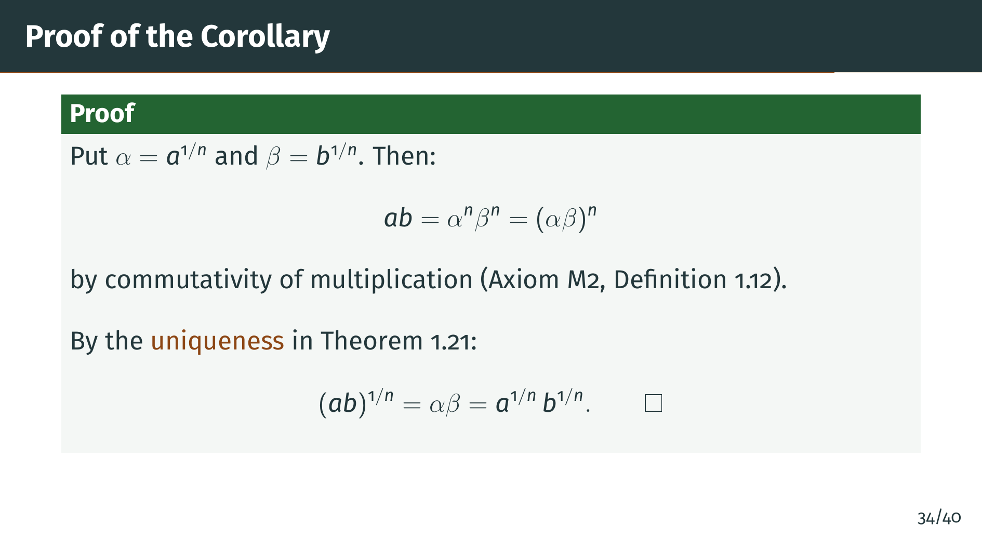
Notes:
The proof is elegant and short. Let alpha be the nth root of "a" and beta be the nth root of "b". Then "a" times "b" equals alpha to the "n" times beta to the "n", which equals alpha beta to the "n", by commutativity of multiplication. Now, alpha beta is a positive real number whose nth power equals "a" "b". By the uniqueness assertion of Theorem 1.21, it must be the nth root of "a" "b". That completes the proof. We finish the section with a brief look at decimal expansions.

Slide 39
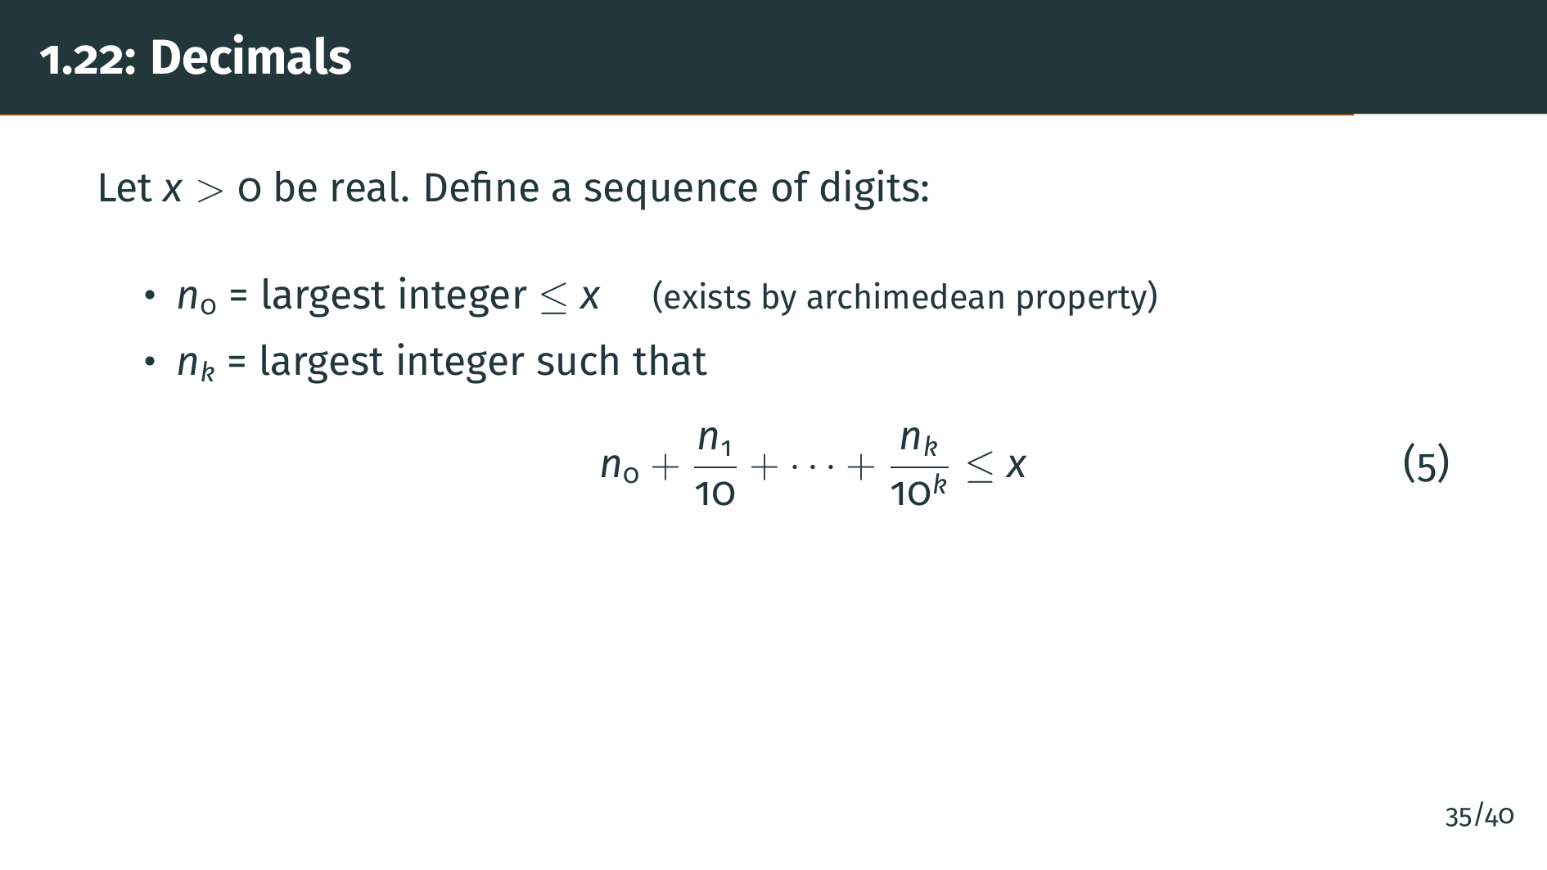
Notes:
We conclude this section with a brief discussion of decimal expansions. Given a positive real number "x", we can construct its decimal expansion as follows. First, let "n" 0 be the largest integer that does not exceed "x". This exists by the archimedean property. Then, having chosen the digits "n" 0 through "n" "k" minus 1, let "n" "k" be the largest integer such that the partial decimal sum does not exceed "x".

Slide 40
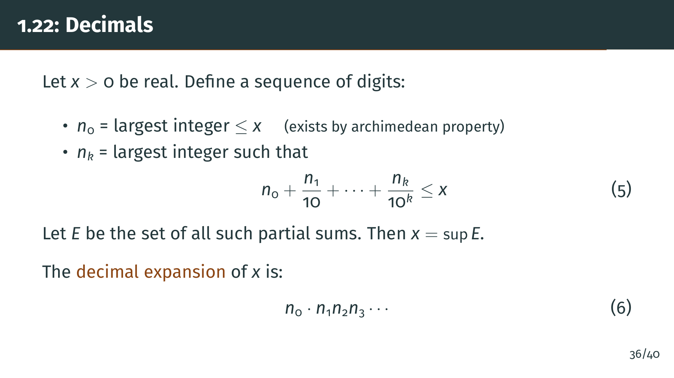
Notes:
The set "E" of all these partial decimal sums is bounded above by "x" itself. The crucial fact is that "x" equals the supremum of "E". This connects the decimal representation to the least-upper-bound property. Conversely, any infinite decimal defines a bounded set of partial sums, whose supremum is the real number it represents. Since we will not use decimals in the rest of the book, we do not pursue this further. Let's wrap up with a summary of the key results from this section.

Slide 41


Slide 42
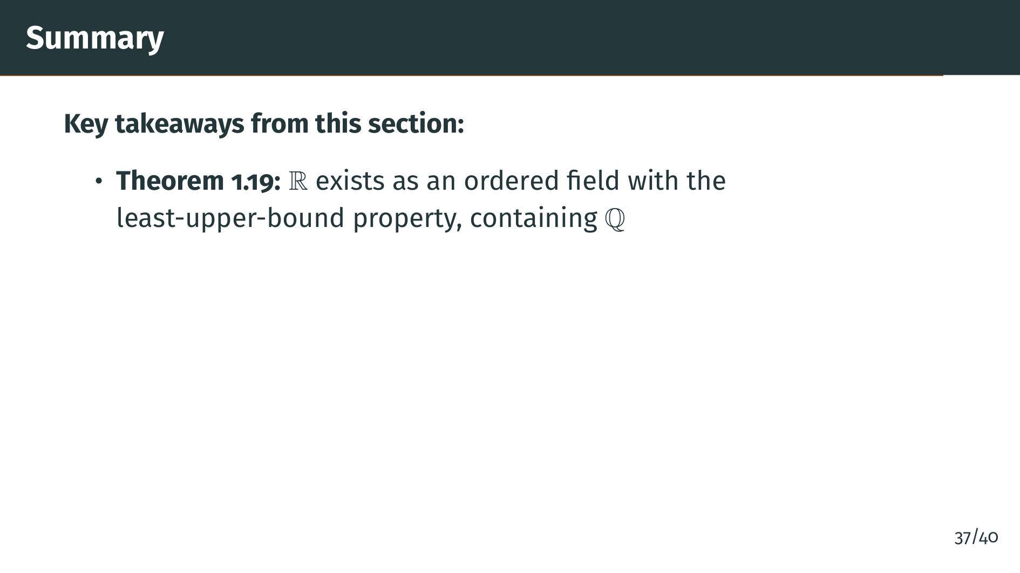
Notes:
Let's summarize what we covered in this section. The foundational result is Theorem 1.19: the real numbers exist as an ordered field with the least-upper-bound property, and they contain the rationals as a subfield. Everything else in this section flows from this single powerful property.

Slide 43
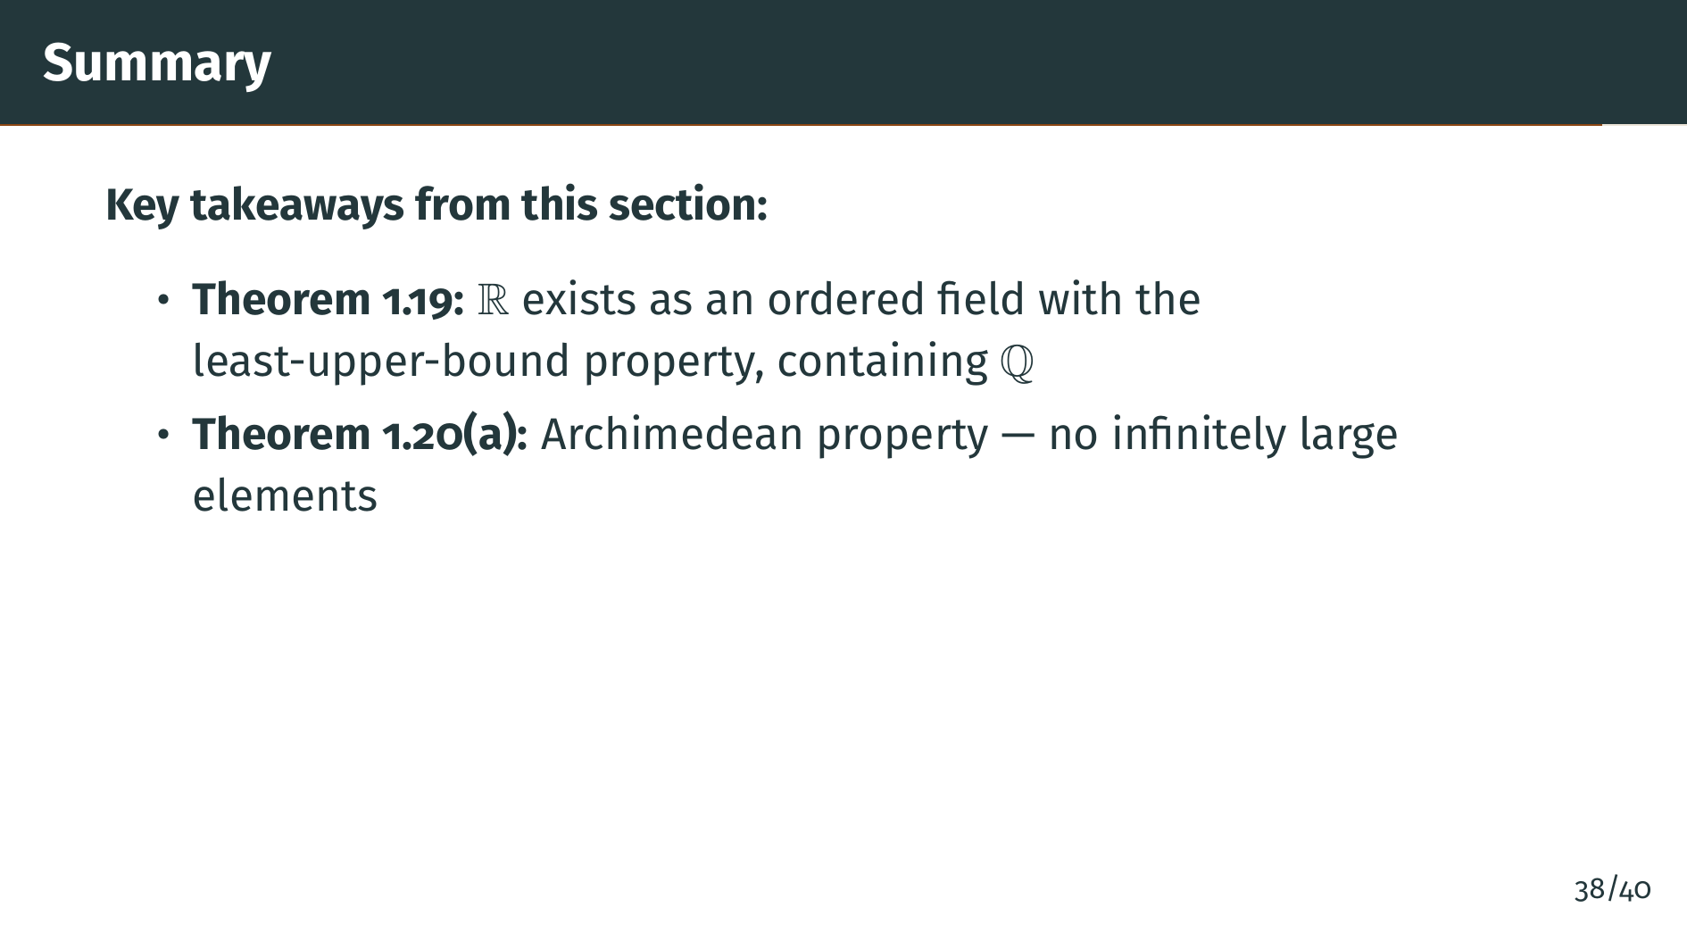
Notes:
The archimedean property, Theorem 1.20 part a, tells us that the reals have no infinitely large or infinitely small elements relative to one another. You can always exceed any real number by adding up enough copies of any positive real number, no matter how small.

Slide 44
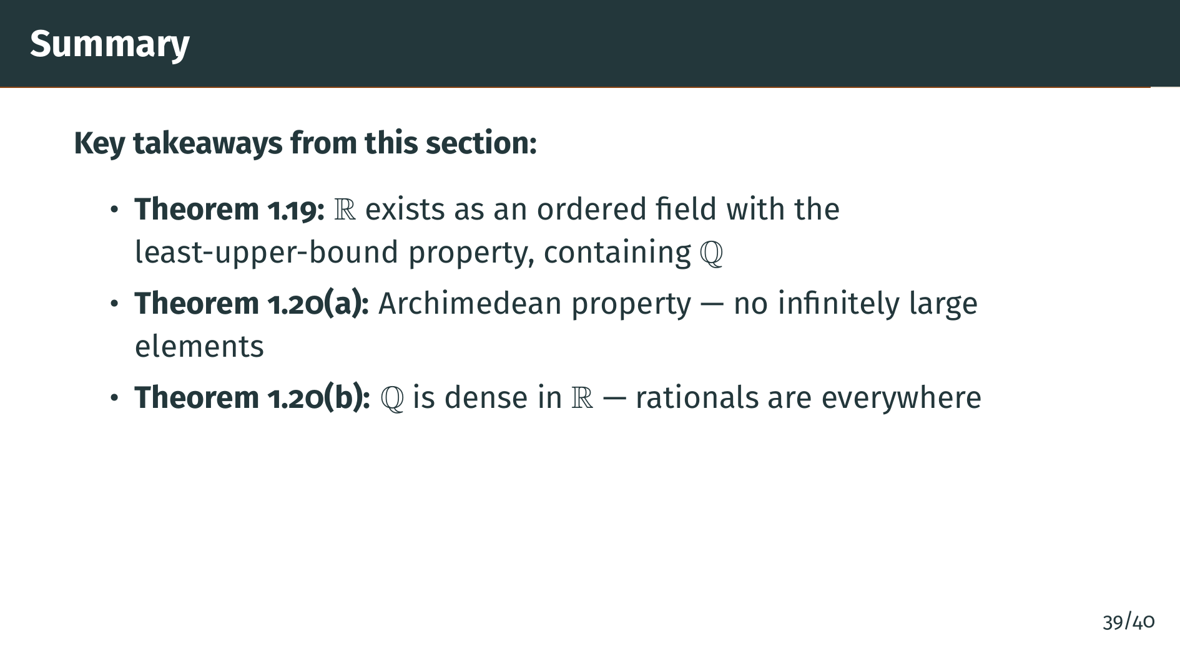
Notes:
Part "b" of Theorem 1.20 shows that the rationals are dense in the reals: between any two real numbers, no matter how close together, you can always find a rational number sitting between them. We proved this using the archimedean property to make the rational grid fine enough to land a point inside any interval.

Slide 45
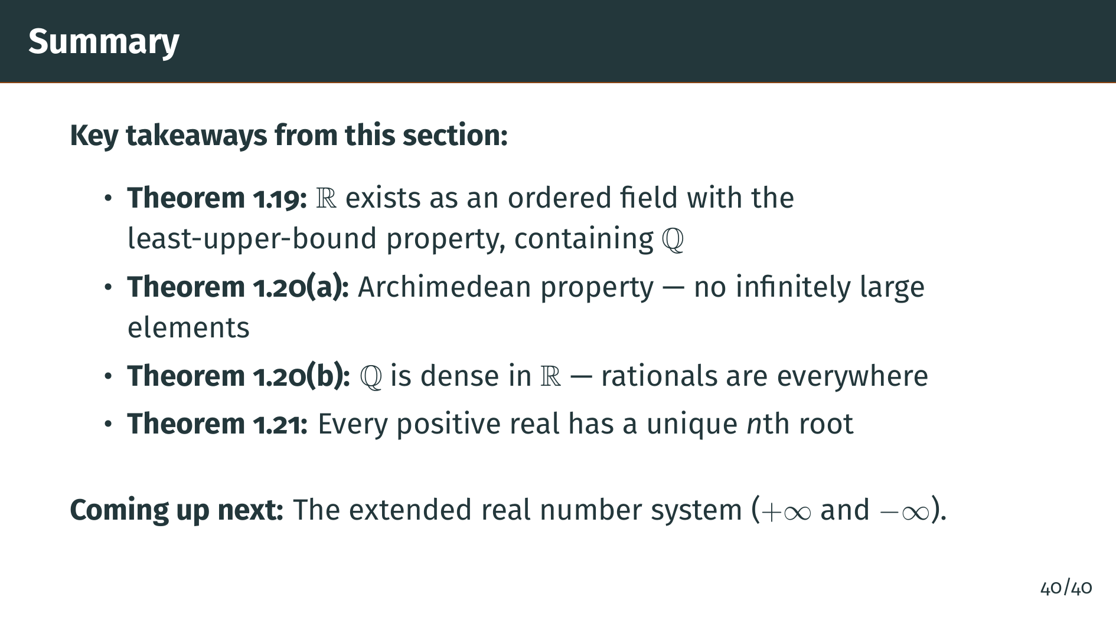
Notes:
Finally, Theorem 1.21 establishes that every positive real number has a unique nth root. This resolves the problem of the square root of 2 that motivated the entire chapter. All three results flow from the single powerful assumption that "R" has the least-upper-bound property. In the next section, we will extend the real number system by adding positive infinity and negative infinity, creating the extended real number system.

