Slide 1
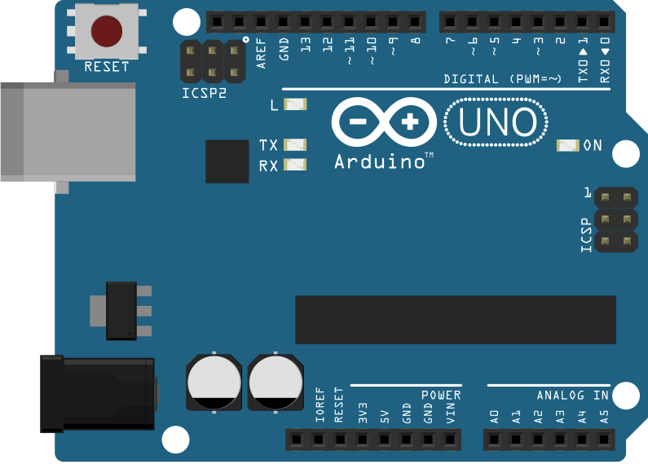
Robot_Hand Project
Wiring Diagram and Code
Author: Peter Chan
Date: 12 Sept 2017

Slide 2
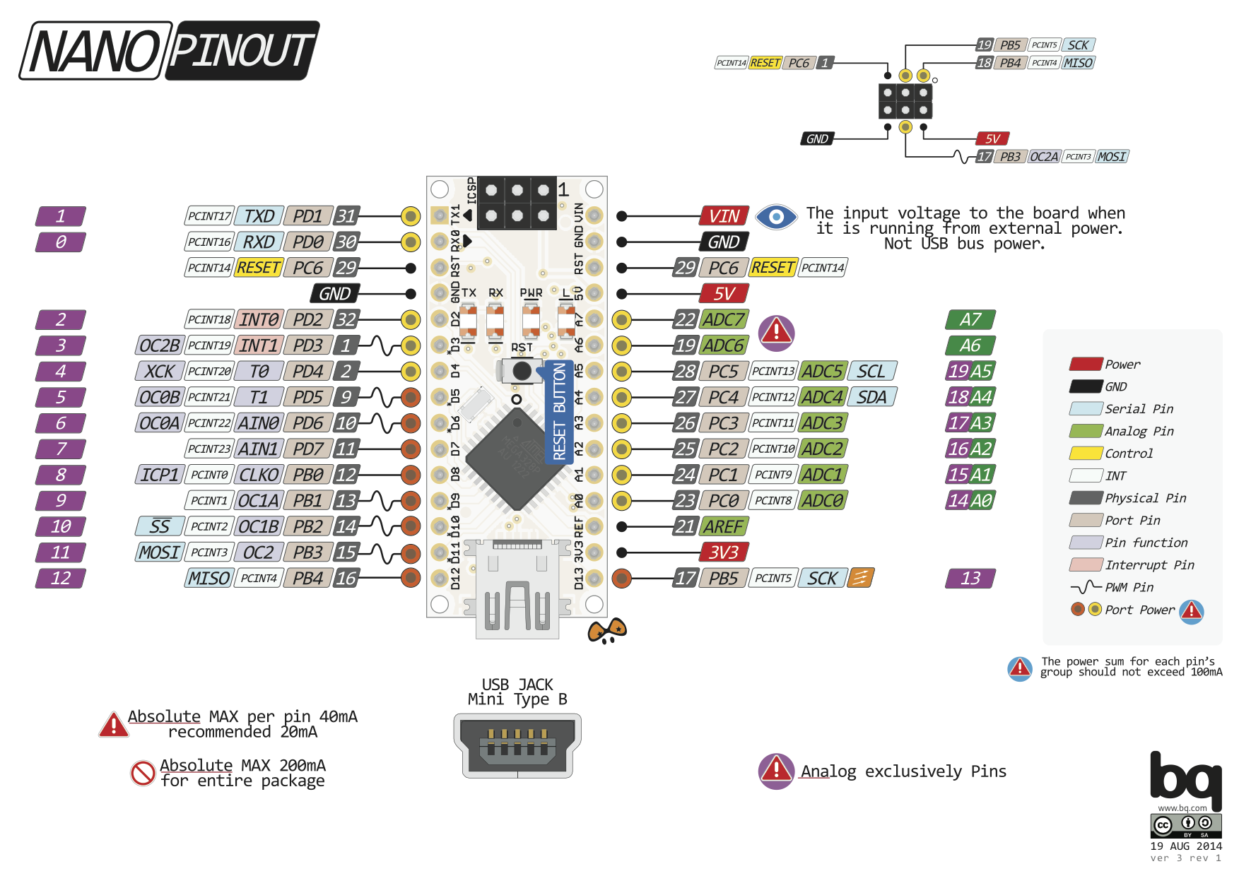
Arduino Nano board pinout

Slide 3

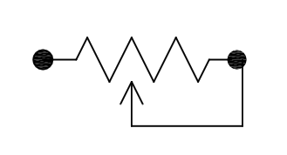
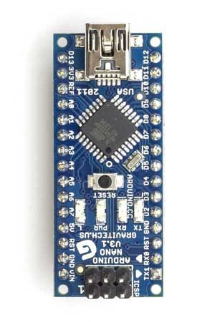

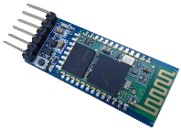

Project Robot_Hand - transmitter
1KΩ
Flex Sensor 1
(potentiometer)
Flex Sensor 2
(potentiometer)
Flex Sensor 3
(potentiometer)
Flex Sensor 4
(potentiometer)
Flex Sensor 5
(potentiometer)
2KΩ
Demo
Switch
10kΩ
10kΩ
10kΩ
10kΩ
10kΩ
RXD
VCC
HC-05 module
(Master)
Power Switch
EN: No Connection
VCC: 5V
GND: 0V
TXD: D10
RXD D11 (3.3V)
STATE: No Connection
3.7V x 2 18650 Battery

Slide 4
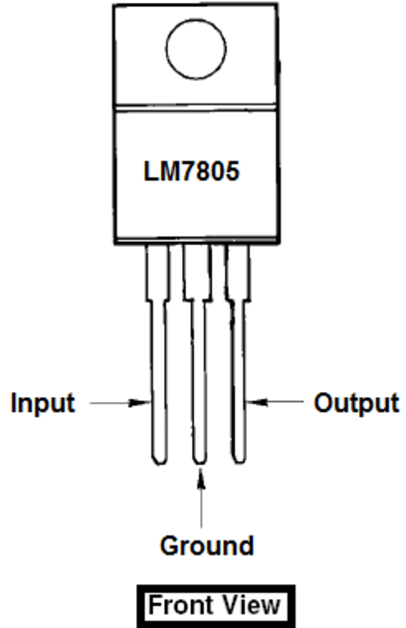
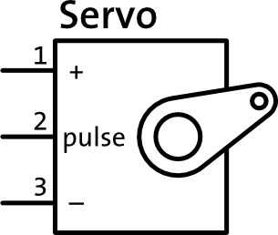
Project Robot_Hand - receiver
1KΩ
7.2V
5V
7.2V
5V
2KΩ
Test
Switch
RXD
VCC
3.7V x 2 18650 Battery
HC-05 module
(Master)
Power Switch
EN: No Connection
VCC: 5V
GND: 0V
TXD: D10
RXD D11 (3.3V)
STATE: No Connection
Power
Switch
3.7V x 2 18650 Battery

Slide 5

Contact: Peter W. Chan
Email: peter_w_chan@outlook.com

Slide 6
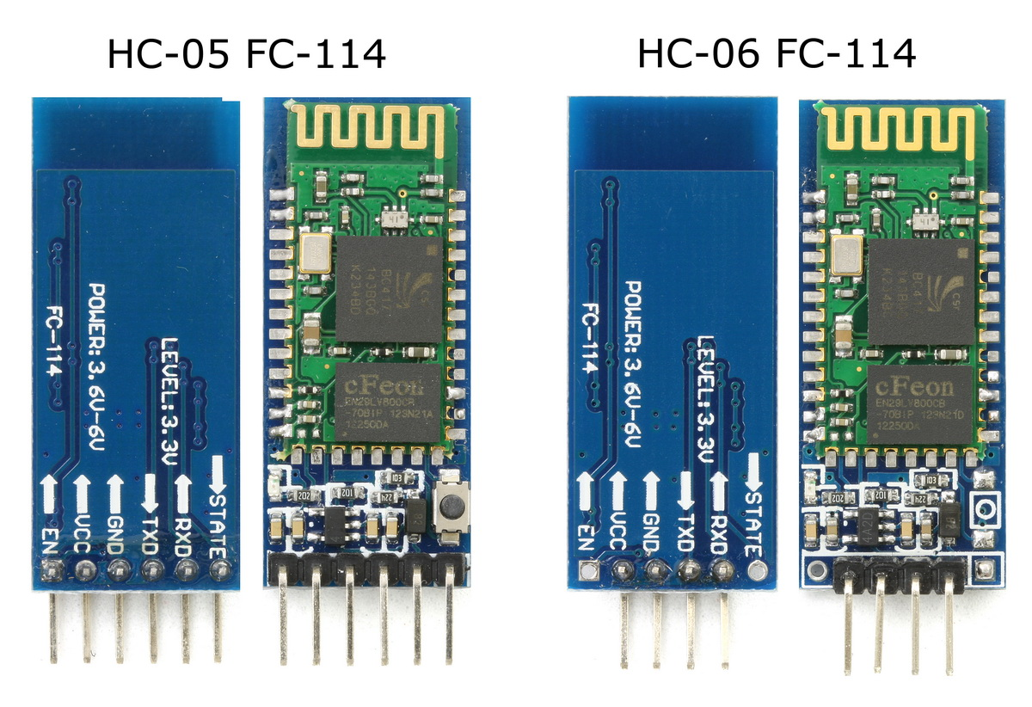
HC-05 and HC-06 Bluetooth transceiver and receiver
Bluetooth is a wireless technology standard for exchanging data over short distances (using short-wavelength UHF radio waves in the ISM band from 2.4 to 2.485 GHz) from fixed and mobile devices, and building personal area networks (PANs). Range is approximately 10 Meters (30 feet).
HC-05 is a more capable module that can be set to be either Master or Slave for Bluetooth communication. Transmission distance is 20m~30m in free space
HC-06 is a Slave only device for Bluetooth communication. HC-05 or Android/iPhone/PC device are required for initiate the Bluetooth communication.
These small HC-05/HC-06 modules run on 3.3V power with 3.3V signal levels.
The module has two modes of operation, Command Mode where we can send AT commands to it and Data Mode where it transmits and receives data to another Bluetooth module.
Further Information:
https://arduino-info.wikispaces.com/BlueTooth-HC05-HC06-Modules-How-To
http://www.instructables.com/id/How-to-Configure-HC-05-Bluetooth-Module-As-Master-/

Slide 7
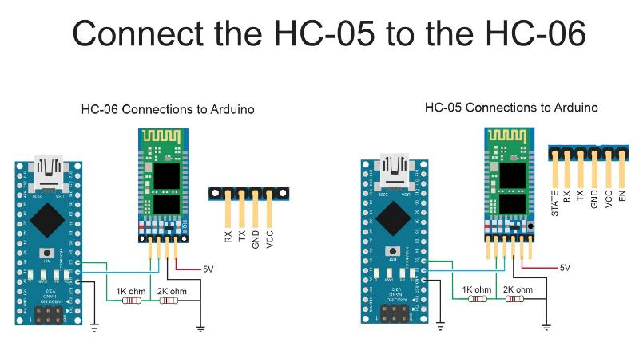
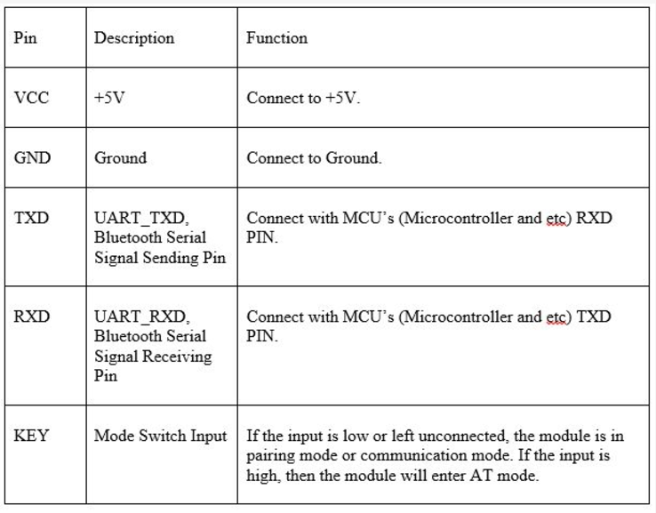
HC-05 / HC-06 Bluetooth and Arduino
Since HC-05/HC-06 RX pin accept 3.3 volts only, you need to have a voltage divider (e.g. 1kΩ and 2kΩ resistor in series) to spit Arduino output pin’s voltage from 5 volts into 1.67 volts and 3.33 volts for RX pin.
Note: TX pin could stay as 3.3 volts as Arduino could recognise a HIGH from 3 volts to 5 volts.
HC-06 default settings: Slave only | Baud Rate: 9600,n,8,1 | Pin Code: 1234
HC-05 default settings: Slave (Master/Slave) | Baud Rate: 38400,n,8,1 | Pin Code: 1234 | Connection mode: Bluetooth device specified
HC-05/HC-06 LED light status:
Wait for Bluetooth connection: Blinking continuously every 1 second
Enter AT command mode: Blinking continuously every 2-3 seconds
Bluetooth communication established: Flashing every few seconds interval

Slide 8
HC-05 module setup for BT communication
Steps to enter AT command mode for HC-05 Bluetooth module:
Connect the HC-05 module as following:
Vcc (HC-05) ⇨ 5V (Arduino)
Gnd (HC-05) ⇨ GND (Arduino)
TXD (HC-05) ⇨ D10 (Arduino pin 10)
RXD (HC-05) ⇨ D11 (Arduino pin 11)
KEY (HC-05) ⇨ D9 (Arduino pin 9)
Note: Avoid Tx1 and Rx0 pin at Arduino so that serial communication between PC and Arduino will not be affected.
Before connecting the Arduino board to the USB cable, REMOVE THE VCC WIRE FROM THE HC-05. Only after you have removed the VCC wire, connect the USB to the Arduino board.
Download the sample source code (file name: AT mode) and upload it into your Arduino board.
After the uploading process is complete, press the button in HC-05 module before reconnecting the VCC wire back to your HC-05 module
LED on the HC-05 Bluetooth module should blink for every 2 seconds interval. This indicates that the Bluetooth module has entered AT mode.
Open the Serial Monitor and ensure you have change "No Line Ending" to "Both NL & CR" and fix the baud rate at 9600 at the bottom right hand corner of the window. For about 1 second, a sentence saying "Enter AT commands:" will pop up.
To see whether everything is okay or not, enter "AT" and send. An "OK" will pop up on the Serial Monitor and this implies that no problems occur.
Note: KEY (HC-05) pin could be left open or ground for normal BT communication (i.e. Data Mode). Use “SoftwareSerial” built-in Arduino library to configure the HC-05/HC-06 Bluetooth module
https://www.arduino.cc/en/Reference/SoftwareSerial

Slide 9
Configure HC-05 using module AT commands
Slave Configuration:
The required AT commands to set the configuration
AT+RMAAD (To clear any paired devices)
AT+ROLE=0 (To set it as slave)
AT+ADDR (To get the address of this HC-05, remember to jot the address down as it will be used during master configuration)
AT+UART=38400,0,0 (To fix the baud rate at 38400)
If the commands entered are replied with "OK" then it indicates that the settings mentioned have been customized.
You may also try out other AT commands such as how to change the name, the password, and so on.
Note that the password for both master and slave must be the same otherwise pairing will not be done.
Master Configuration:
The required AT commands to set the configuration:
AT+RMAAD (To clear any paired devices)
AT+ROLE=1 (To set it as master)
AT+CMODE=0 (To connect the module to the specified Bluetooth address and this Bluetooth address can be specified by the binding command)
AT+BIND=xxxx,xx,xxxxxx (Now, type AT+BIND=98d3,34,906554 obviously with your respective address to the slave. Note the commas instead of colons given by the slave module.
AT+UART=38400,0,0 (To fix the baud rate at 38400)
If the commands entered are replied with "OK" then it indicates that the settings mentioned have been customized.
You may also try out other AT commands such as how to change the name, the password, and so on.
Note that the password for both master and slave must be the same otherwise pairing will not be done.

