Slide 1
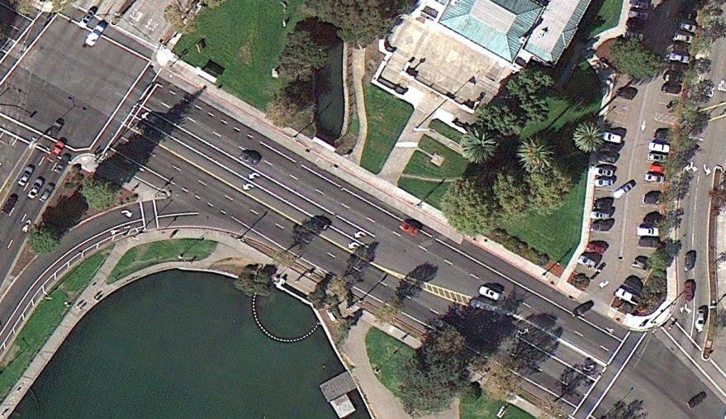
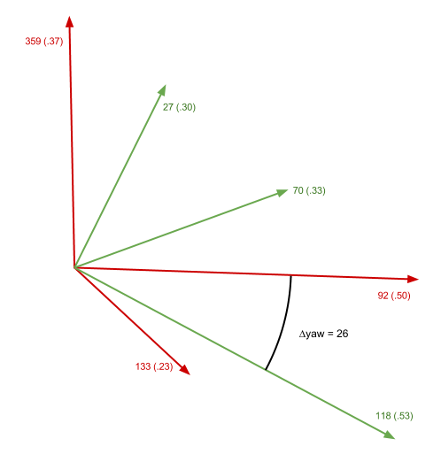
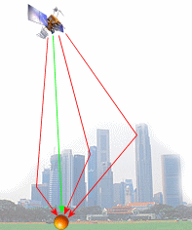
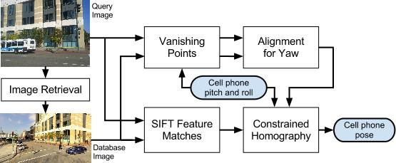
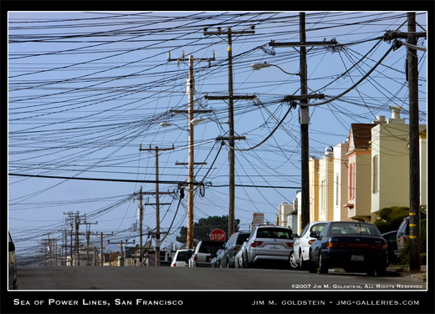

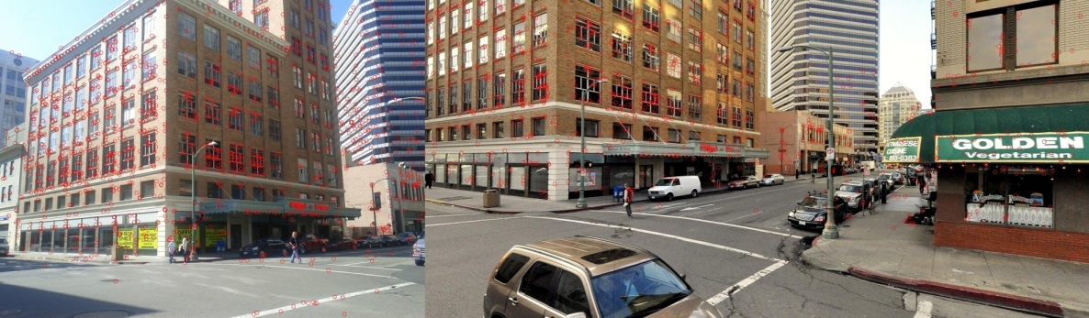
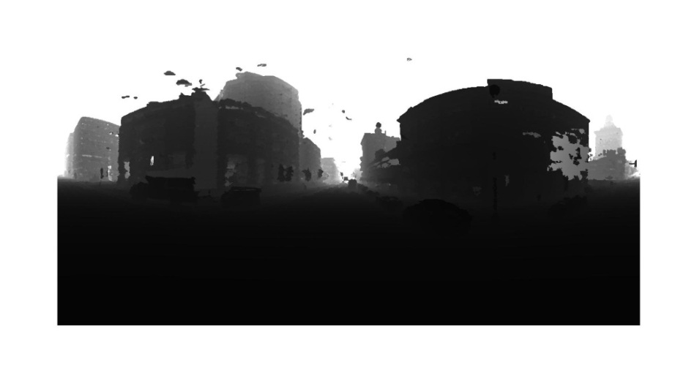
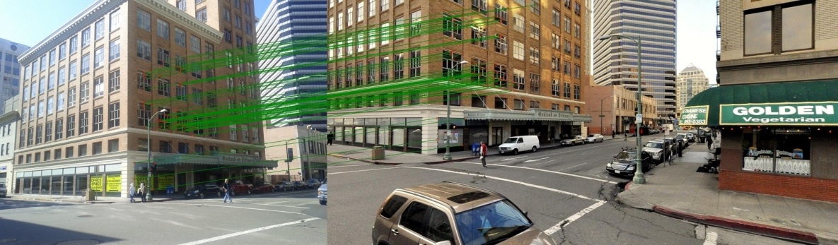
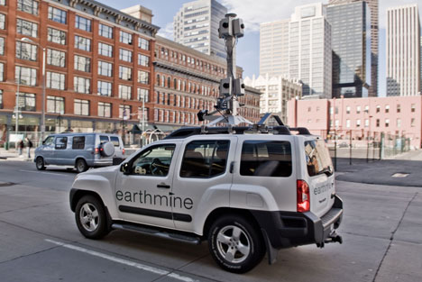

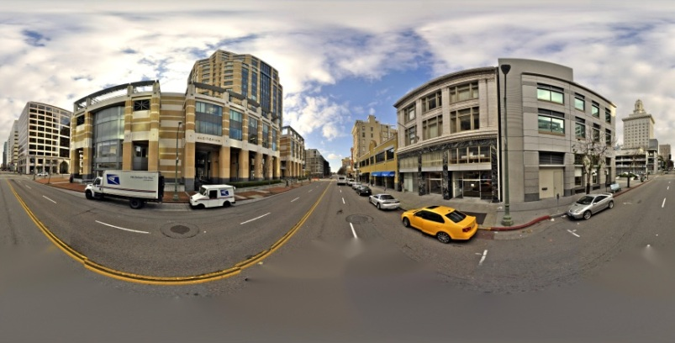
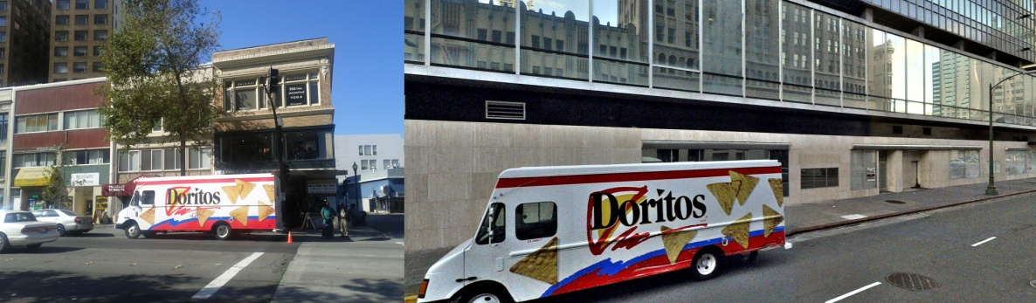
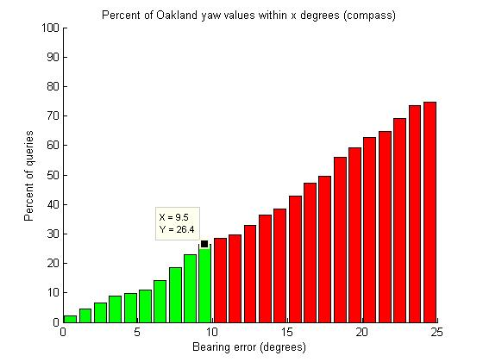
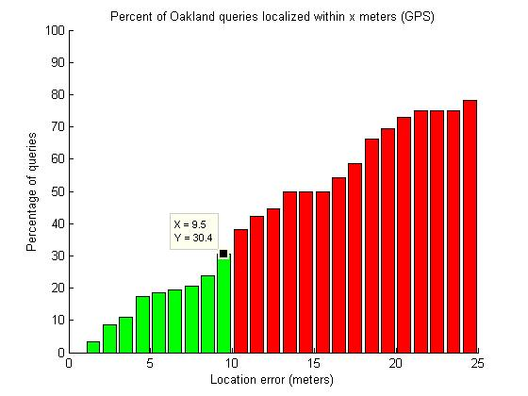
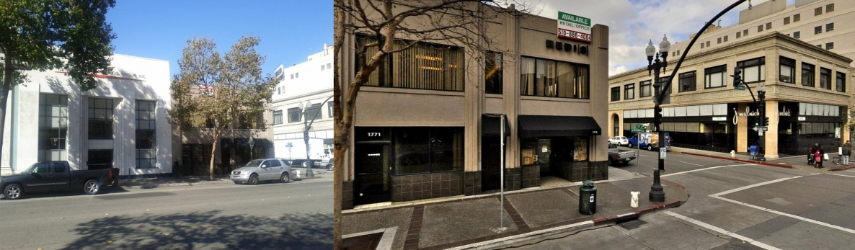
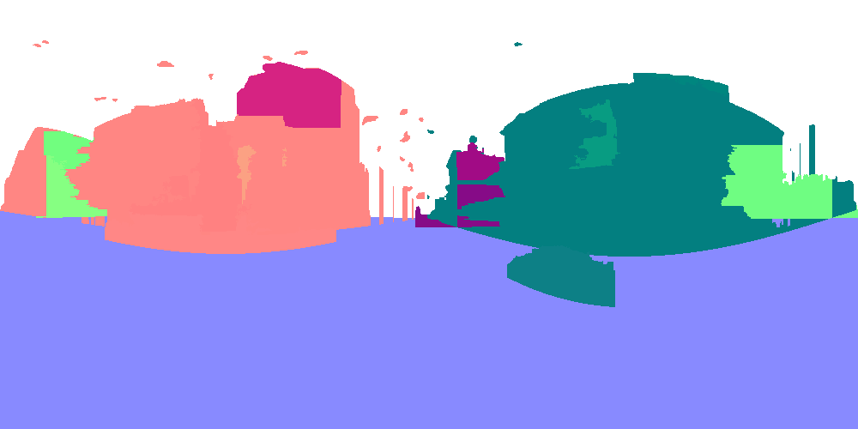
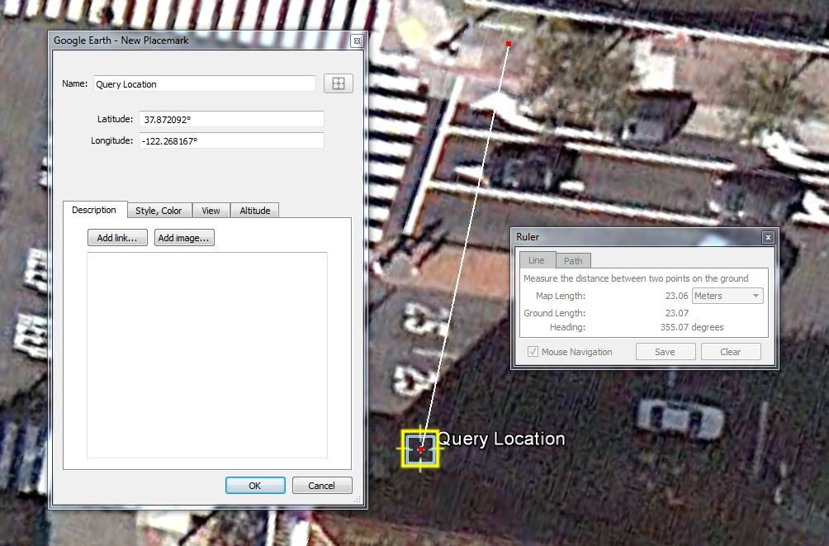
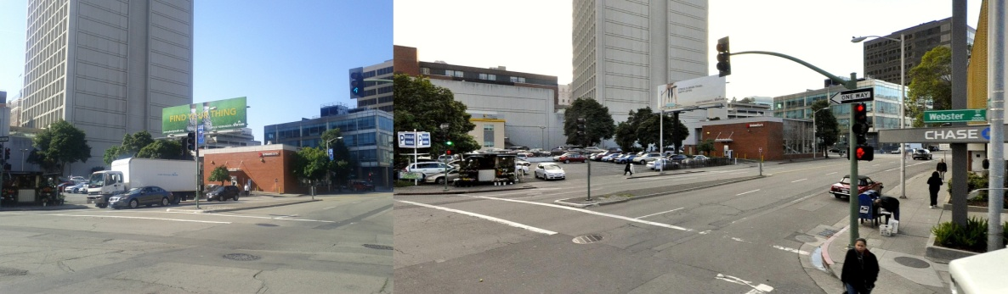

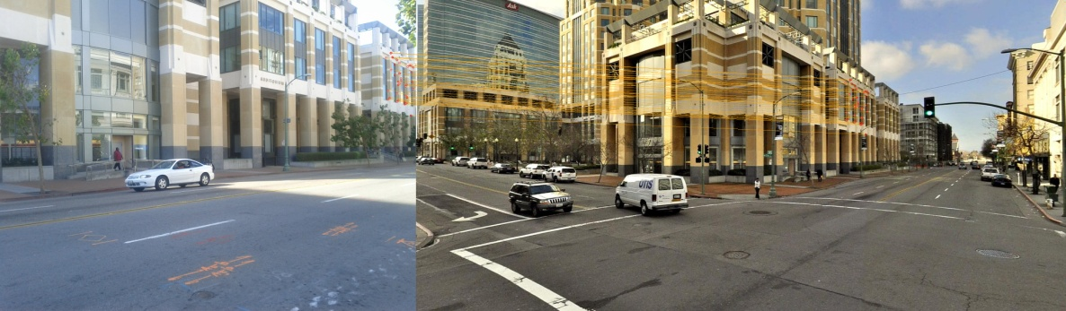
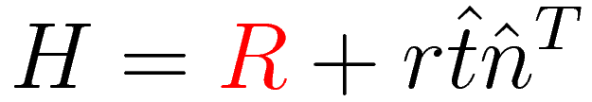
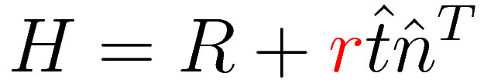
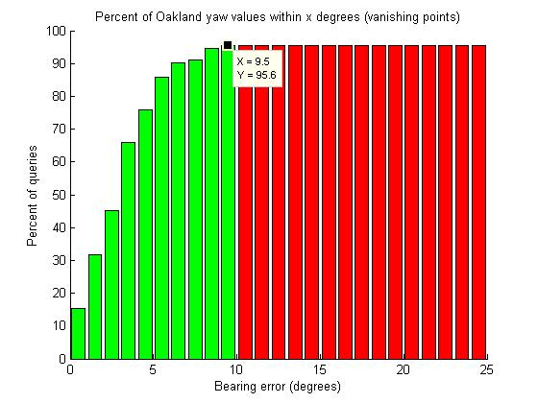
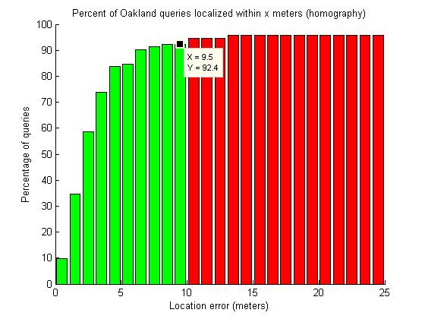
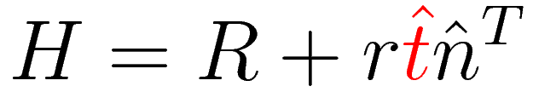
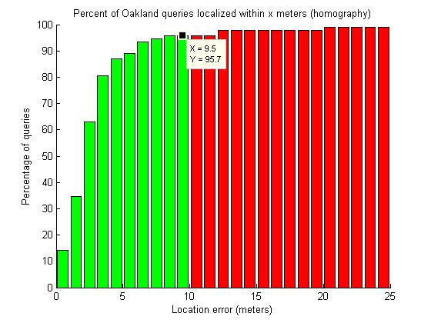
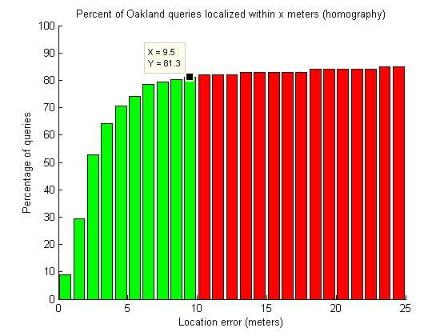


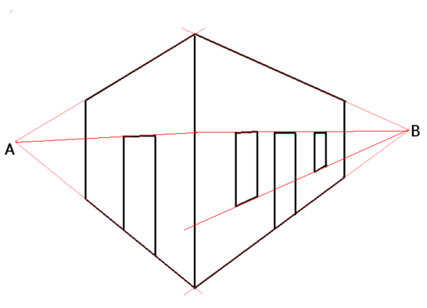
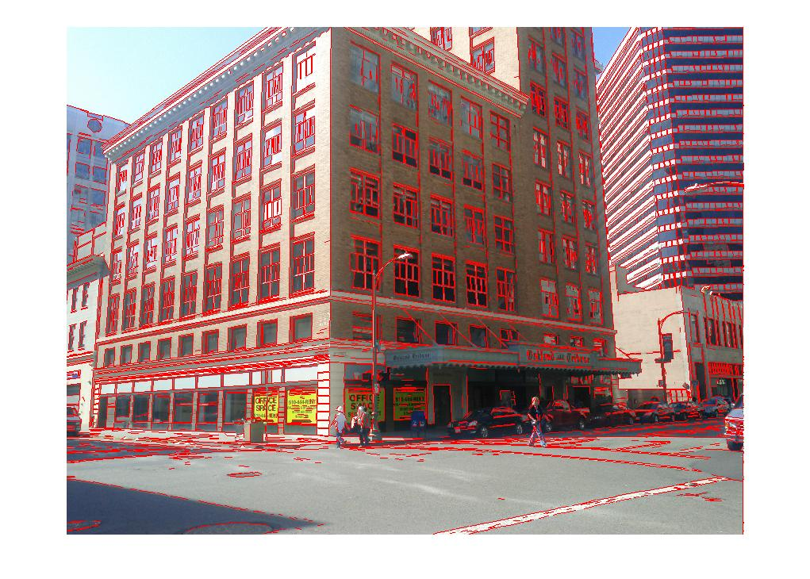
1. Pose Estimation Overview
Goal: Recover the pose of a cell phone:
Image retrieval from a database using an image produced by the cell phone [Zhang et. al. ’11].
Using the matching images, cell phone sensors, and urban scene assumptions to estimate pose (focus of paper and poster).
Motivations:
Provide feedback to the user about his position over time.
Transfer metadata from the database to query image(tag transfer).
Geo-tagging of urban images, improving upon GPS and compass.
Single View Pose Estimation of Mobile Devices in Urban Environments
7. Alignment for Yaw
Assume all building faces are upright, → Altitude does not factor into plane normals → There is only the yaw direction of plane normals to be determined (one parameter).
Compass error on the phone → the direction of plane normals detected in cell phone and database imagery will be offset.
Align vanishing points in the query image with those in the database image.
Alignment gives phone yaw.
Alignment choice:
Assume compass yaw error Δyaw < 50°.
Optimizes for strongest alignment of vanishing pts.
From the alignment, extract a set of normal vectors.
Plane normal set to be perpendicular to both gravity and vanishing pt.
Sample vanishing points on the horizontal plane.
Length represents weight of VP.
Direction represents yaw bearing of VP.
Red represents the VPs from query image.
Green represents the VPs from db image.
Blue arrows link the aligned vanishing points.
Compass error Δyaw is the alignment chosen.
Aaron Hallquist & Avideh Zakhor, EECS, UC Berkeley
System Layout
2. System Process (see center section for layout )
Estimate pitch and roll by determining the direction of gravity with the cell phone accelerometer.
Estimate yaw for the phone and planes describing urban building faces with vanishing points.
Solve for a reduced parameter homography matrix using an urban assumption that the scene is planar.
8. Constrained Homography
Cell phone sensors, urban scene assumptions, and vanishing points have reduced the number of free parameters to 4, highlighted below in red.
3. Cell Phone Sensors
GPS – latitude and longitude
Multipath from buildings → error
Accelerometer – pitch and roll
Requires steady phone
Compass – yaw
Magnetic interference from trains and power lines → error
Δyaw = 26°
Solve for the homography using SIFT feature matches between images and the robust estimation algorithm RANSAC.
Total of 3 constraints in the error metric constrained homography:
(2) reprojection error of SIFT feature matches.
(1) feature depth error relative to 3D database.
Experimental Results
Below are cumulative plots of location error for Oakland with dataset properties to the right.
Top plots show compass (left) and GPS (right)
Bottom plots show vanishing point (left) and constrained homography estimation (right).
Observation: 3 to 4 times as many queries can be localized within 10 meters or 10 degrees using our system rather than cell phone sensors.
Dataset properties
4. 3D Image Database
Geo-tagged image panoramas
Image view, depth and plane maps
Position and orientation is known
Dataset | Berkeley | Oakland
Database area | ~1 km² | ~4 km²
Db image size | 2048x1371 | 2500x1200
Database size | ~12000 images | ~29000 images
Plane fitting | no | yes
Query image size | 2592x1952 | 2560x1920
Query size | 91 images | 112 images
Correct retrievals | 83 images | 102 images
Useful retrievals | 73 images | 92 images
9. Common Problem Cases
Incorrect image retrieval
Lack of a dominant plane
Alignment of incorrect planes giving erroneous yaw estimate
Highly different orientation between matching images
Repeated features resulting from regular patterns in the scene
Different lighting or occlusion
Manual Ground Truth
Manual ground truth used to find error
Using Google Earth, manually record a “ground truth” position and orientation for each query image in the set.
Yaw, Latitude, and Longitude
Error up to 5 meters or 5 degrees.
Berkeley Performance
Less accurate 3D database and image retrieval.
Compass and GPS perform better with shorter buildings and fewer power lines.
Yaw Performance:
Compass reading within 10° → 35%
VP alignment within 10° → 90%
Location Error:
GPS location within 10m → 66%
Pose estimation within 10m → 82%
Left: Earthmine vehicle generating image panoramas.
Middle: Six rectilinear scenes from each panorama.
Right: An example set of image panoramas, with the scene (middle), its depth map (top), and its plane map (bottom).
Percent of queries within X degrees: Compass
Percent of queries within X meters: GPS
5. Pose Estimation Parameters
Homography mappings are an application of planar scene assumptions to epipolar geometry.
In parameter equations throughout the poster, red marks unknown and blue marks known parameters.
8 from homography + scale = 9 unknown parameters
(3) Relative orientation R (yaw, pitch, and roll)
(1) Ratio of translation distance to plane distance r = |t|/d
(2) Direction of translation
(2) Direction of plane normal
(1) Distance to plane d (scale)
10. System Dependencies
The plots below show the effects of some system issues above.
Both show a cumulative plot of location error for Oakland.
On the left is performance when ground truth yaw is used in place of the result from VP alignment.
On the right are the results when query images with incorrect retrievals (see top image on right) are included in performance.
Percentage of queries
Percentage of queries
Orientation error (degrees)
Location error (meters)
Percent of queries within X degrees: Proposed
Percent of queries within X meters: Proposed
Above: Various examples of failure cases, with query on left.
Percent of queries within X meters
6. Vanishing Points
Find yaw and planes with the vanishing lines.
Detect vanishing points in the cell phone and database images to estimate plane normals for the both scenes’ building faces.
(system details continue on top right)
Percentage of queries
Percentage of queries
Percentage of queries
Percentage of queries
Orientation error (degrees)
Location error (meters)
Location error (meters)
Location error (meters)
Replacing yaw from VP alignment with ground truth Including incorrect retrievals in pose recovery

