Slide 1
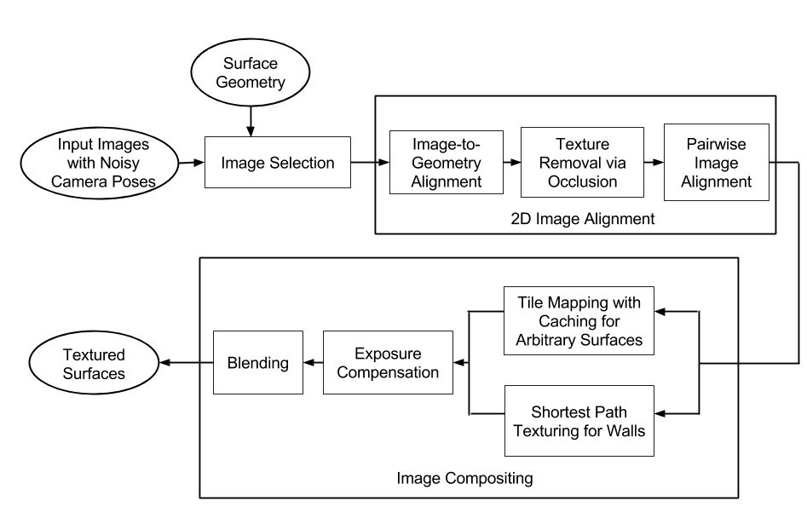
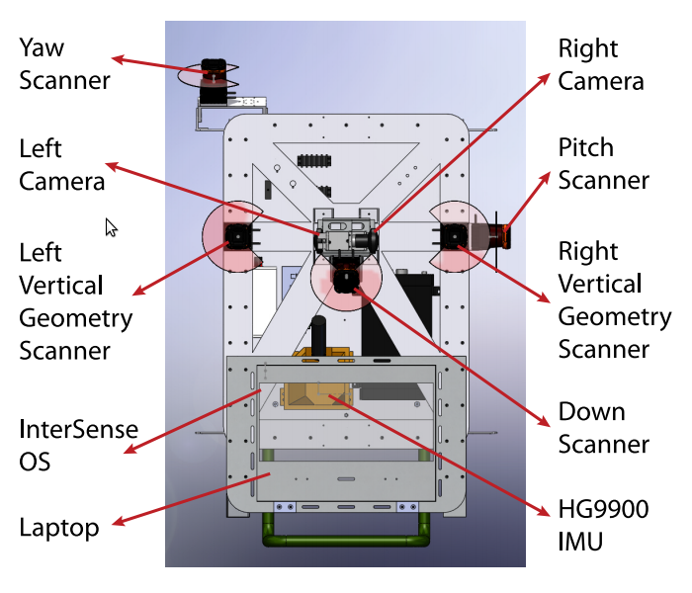
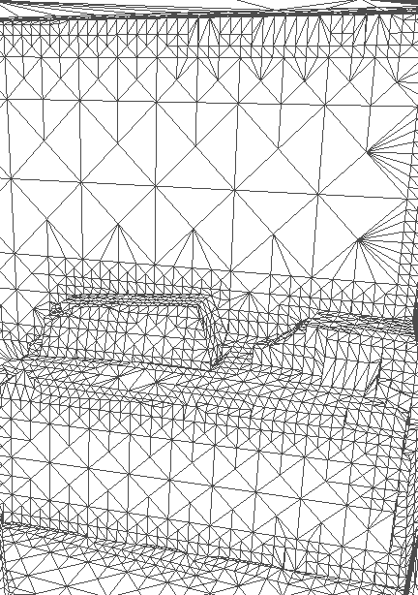
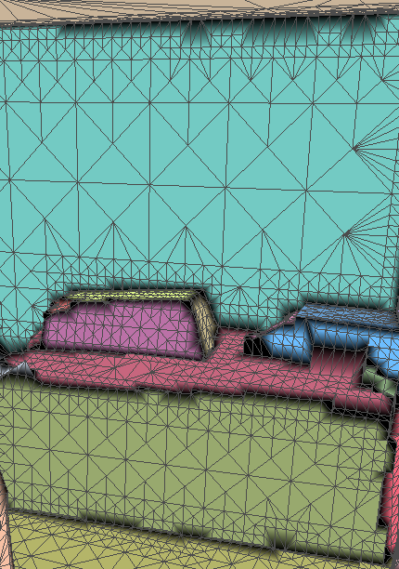
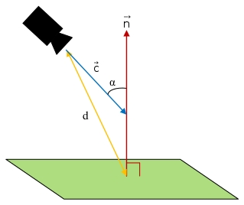
Texture Mapping Overview
Texture Mapping 3D Models of Indoor Environment with Noisy Camera Poses
Image Alignment
Goal:
Given approximate surface geometry and images with noisy camera poses, produce a realistic textured 3d model
Motivation:
Provide accurate 3d visualizations of interior spaces for applications such as remodeling or virtual walkthrough generation.
Linear Geometry Alignment
Peter Cheng, Michael Anderson, Stewart He, Avideh Zakhor
Video and Image Processing Lab - UC Berkeley
System Process
(See center panel)
System Layout
Acquire (noisy) geometry and image data from a variety of sensors mounted upon an ambulatory backpack platform.
Partition geometry into spatially consistent regions, and acquire a set of candidate images for each region
Refine camera poses by detecting linear matches between images and geometry, as well as pairwise feature matches in images alone.
Composite images onto each region using either a tile-based or a shortest-path method, followed by exposure compensation and blending
Occlusion Removal
Data Acquisition System
Pairwise Feature Matching
CAD diagram of backpack system is shown to the right
IMUs and laser scanners are used to localize backpack and generate point cloud of surrounding environment, though results are noisy [Liu et. al. 2010]
Side-facing fisheye cameras provide source imagery for texturing
Least Squares Solution
Geometry Partitioning
Image Composition
Models can be textured faster by splitting environment geometry into regions for independent processing
Triangular mesh is generated from point cloud. [Sanchez 2012, Turner 2012, Turner 2013]
Triangles are merged with coplanar neighbors, and then clustered spatially by relative orientation.
Results
Cached Tiles
Image Selection
For each geometrical region, obtain a set of images with good viewing poses
We desire a set of images that together cover the entire region, and provide high resolution imagery for the region
Split each region into rectangular tiles, and for each tile, find an image such that
Shortest Path
Exposure Compensation and Blending

