Slide 1

ch1_practice
student

Slide 2

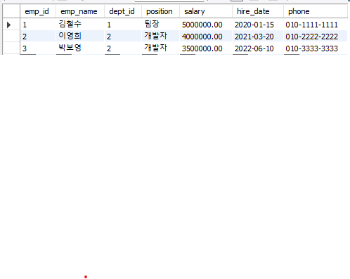
ch2_design
department
employee

Slide 3
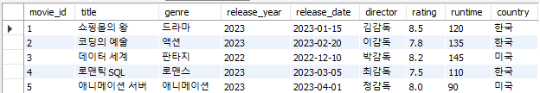
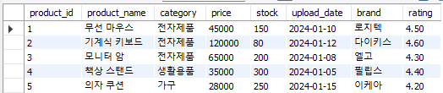
ch3_practice
movie
product

Slide 4
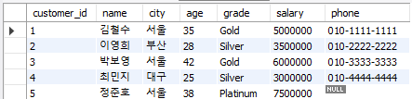
ch4_filtering
customer

Slide 5



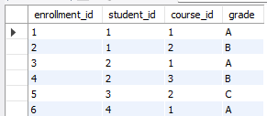
ch5_join
professor
course
student
enrollment

Slide 6
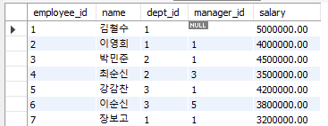


ch6_join
employees
departments
salary_grades

Slide 7
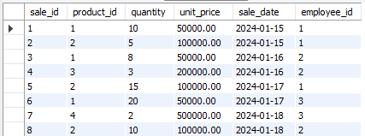

ch7_aggr
sales
products

Slide 8
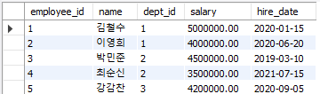


ch8_subq
employees
departments
orders
customers

Slide 9
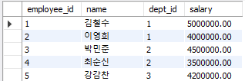

ch9_dml
employees
accounts

Slide 10
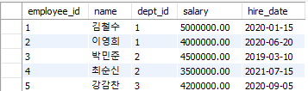

ch10_view
employees
departments
employees_archive

Slide 11
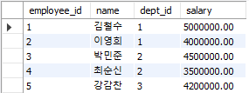
ch11_control
employees
temp_table

Slide 12



ch12_trigger
employees
employee_archive
salary_history
products
salary_history_archive
salary_change_percent
audit_log

Slide 13





ch13_normal
customers
products
categories
orders
order_details

