Slide 1
TMEM106B neuron alignment
All-well longitudinal pilot and single-neuron candidate examples
260213 Feb recopy dataset | Days 8, 12, 16
Key takeaway: the pipeline now scales from one pilot pair to all 192 wells and shows stronger punctate-to-diffuse mCherry redistribution in PLD3+TMEM106B+mCherry wells.
Prepared for PI meeting
+
1

Slide 2
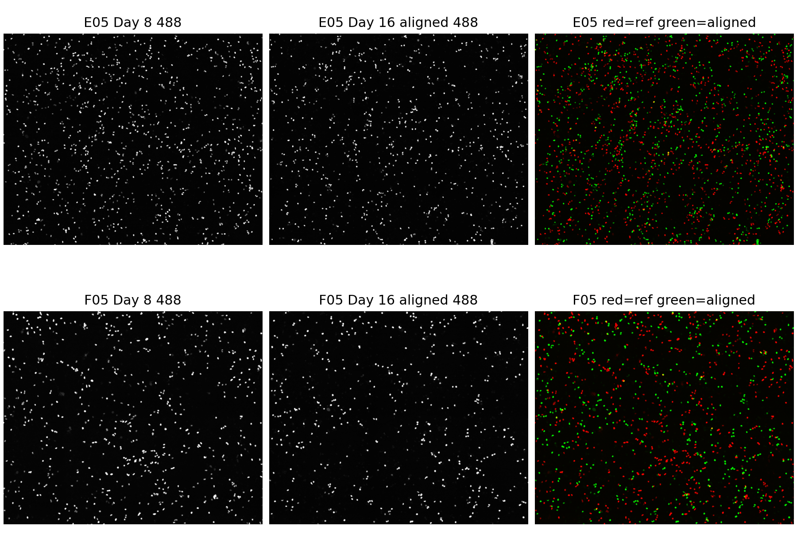
From raw ND2 to trajectories
Register on 488, measure mCherry as phenotype.
Raw fluorescence ND2 files are loaded read-only.
488 channel estimates X/Y drift, avoiding bias from mCherry redistribution.
Same transform is applied to 561/mCherry, then puncta/diffuse signal is quantified.
Outputs are CSV/QC figures now; OME-Zarr stores support scalable image review.
Example registration QC: before/after 488-channel alignment
+
2
TMEM106B neuron alignment

Slide 3
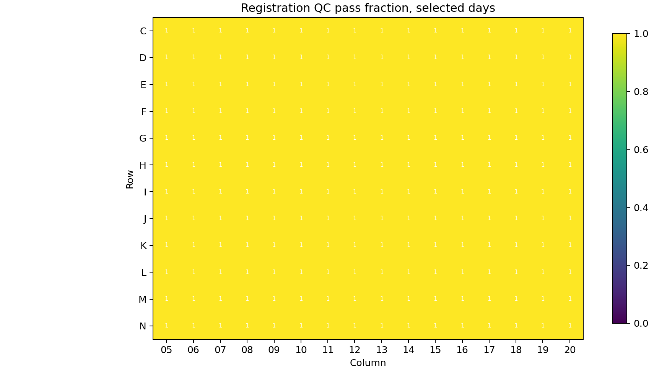
Scale-up: all wells, not just E05/F05
The E05/F05 pair was only the first pilot.
192/192
576
wells processed
ND2 files read
576/576
96
registration QC pass
mCherry-valid wells measured
Rows C/D/G/H/K/L are included for registration QC, but excluded from mCherry puncta/diffuse interpretation.
+
3
TMEM106B neuron alignment

Slide 4
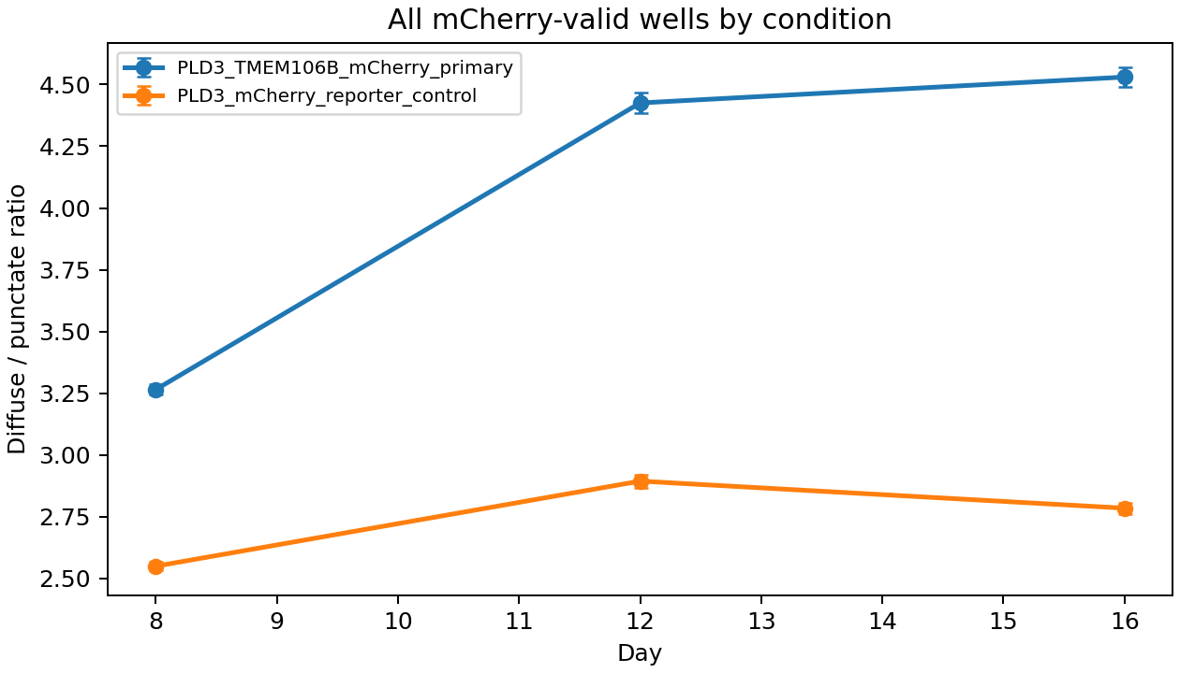
mCherry signal shifts more in TMEM106B wells
Screening metric: diffuse / punctate mCherry ratio.
Primary wells: 3.26 -> 4.53 from Day 8 to Day 16.
Reporter controls: 2.55 -> 2.78 over the same window.
Interpret as punctate-to-diffuse reporter redistribution, not rupture proof.
+
4
TMEM106B neuron alignment

Slide 5
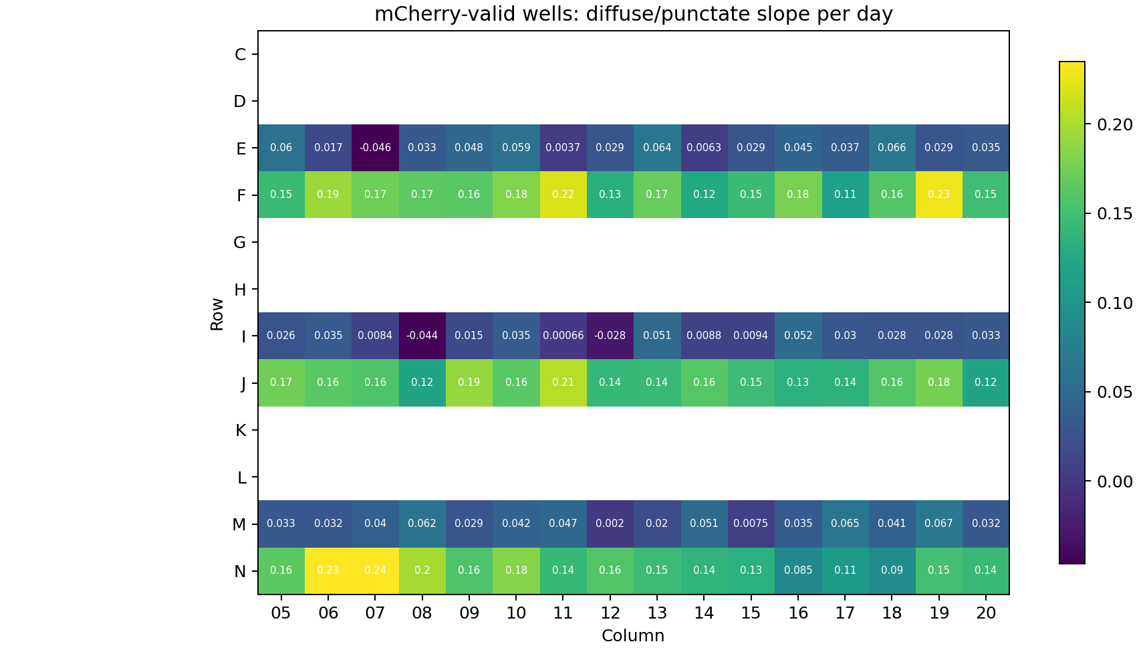
Plate-level heterogeneity
All mCherry-valid rows are visible in one heatmap.
This view helps choose wells/timepoints for manual ROI review, segmentation validation, and follow-up assays.
+
5
TMEM106B neuron alignment

Slide 6
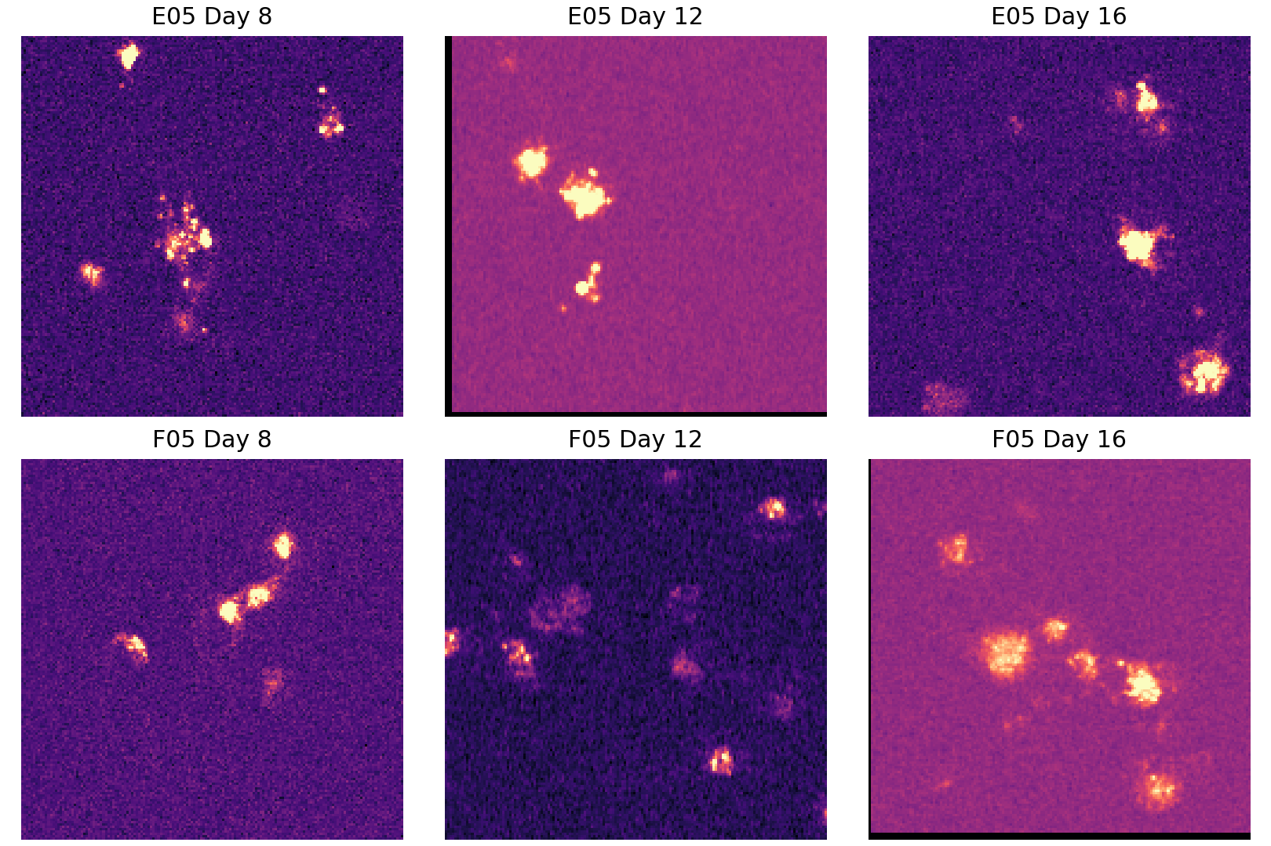
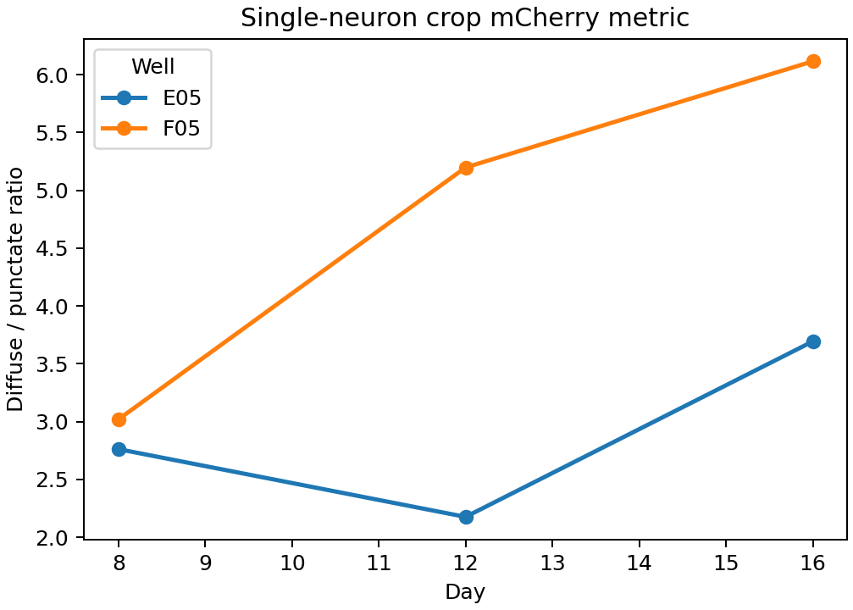
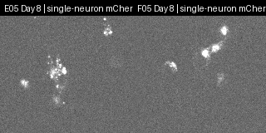
Single-neuron candidate examples
Local ROI crops make the alignment concept visible.
Automatic 488-positive local ROI selection across Days 8/12/16.
Crop-level local registration is applied before mCherry quantification.
Manual same-neuron identity review is still required.
Embedded GIF: E05 vs F05 local ROI mCherry
+
6
TMEM106B neuron alignment

Slide 7
Why OME-Zarr next
Metrics are compact; images need a scalable store.
The all-well run writes compact QC/measurement CSVs rather than duplicating hundreds of image stacks.
OME-Zarr supports chunked, lazy image access for napari and web viewers.
Registered single-neuron ROI stacks were exported as proof-of-format.
Next: plate-level OME-Zarr layout for selected registered wells/days/channels.
Verified OME-Zarr example
Shape: 3 timepoints x 3 channels x 160 x 160 px
Chunks: 1 x 1 x 160 x 160
Location: single_neuron_examples/ome_zarr/
+
7
TMEM106B neuron alignment

Slide 8
What is needed before a manuscript claim
This is a strong screening workflow, not final rupture proof.
Manual ROI review and segmentation/tracking validation for same-neuron claims.
Extend from Days 8/12/16 to all available days: 8, 12, 16, 20, 25, 29, 32, 36, 39.
Orthogonal rupture markers: Galectin-3/8, LAMP1/2 morphology, LysoTracker loss, p62/LC3, LLOMe positive control.
Export selected registered wells to OME-Zarr for scalable review.
Then test condition x time with well/site/neuron-level replicates.
Bottom line
The pipeline now turns longitudinal microscopy into all-well quantitative trajectories that can prioritize TMEM106B conditions for deeper lysosome validation.
Thank you
+
8
TMEM106B neuron alignment

