Slide 1
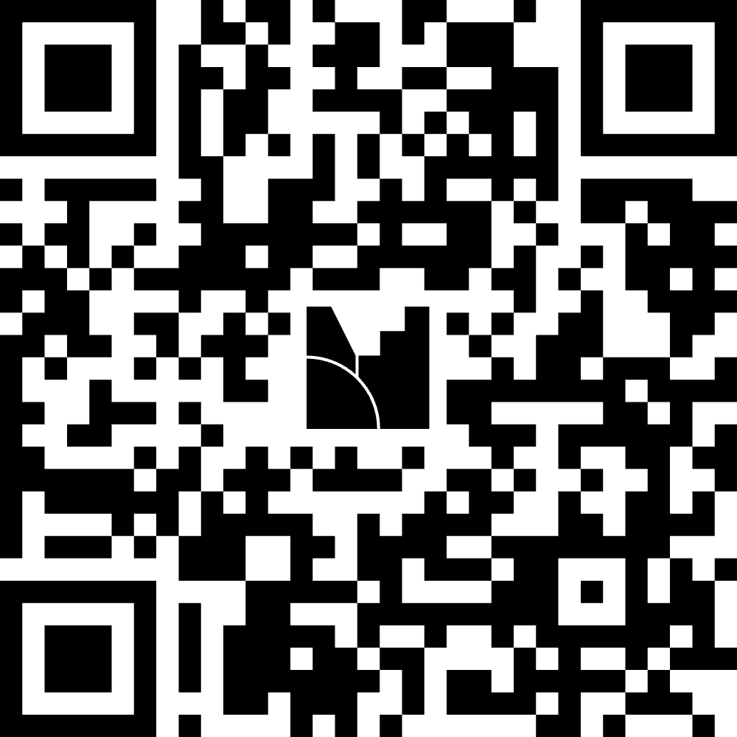
Code & Follow Along
https://tinyurl.com/ICRA26-KT3
Questions (Mentimeter)

