Slide 1
Chapter 2:
Overview of C
Problem Solving & Program Design in C
Seventh Edition
By Jeri R. Hanly &
Elliot B. Koffman

Slide 2
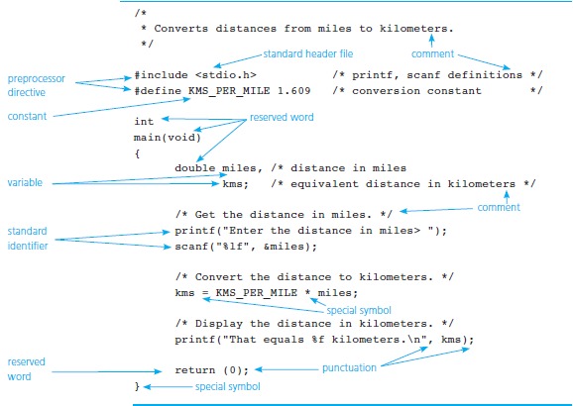
Figure 2.1 C Language Elements in
Miles-to-Kilometers Conversion Program
1-<number>

Slide 3
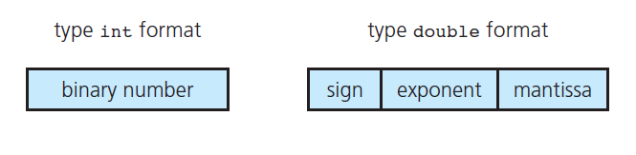
Figure 2.2 Internal Format of Type int and Type double
1-<number>

Slide 4
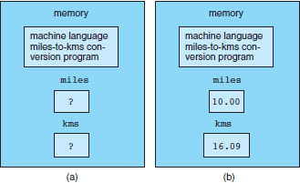
Figure 2.3 Memory(a) Before and (b) After Execution of a Program
1-<number>

Slide 5
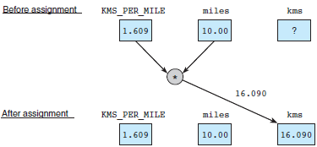
Figure 2.4
Effect of kms = KMS_PER_MILE * miles;
1-<number>

Slide 6
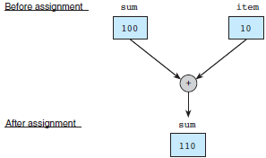
Figure 2.5 Effect of sum = sum + item;
1-<number>

Slide 7

Figure 2.6 Effect of scanf("%lf", &miles);
1-<number>

Slide 8
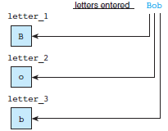
Figure 2.7 Scanning Data Line Bob
1-<number>

Slide 9
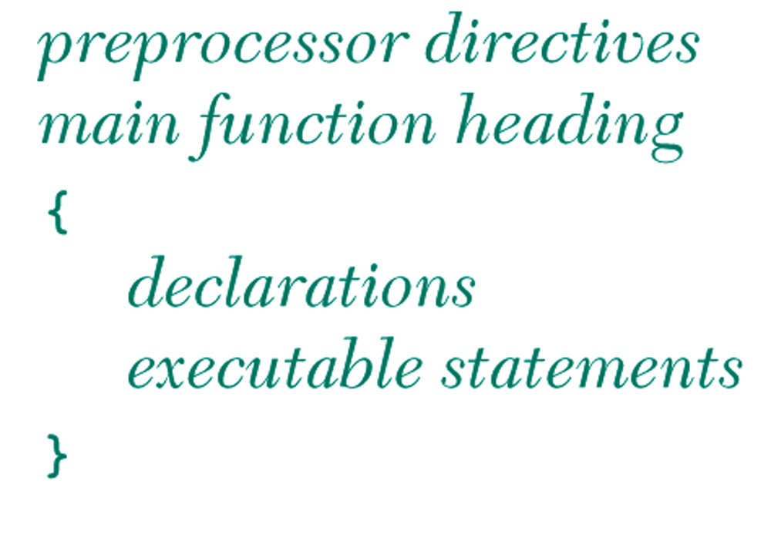
Figure 2.8 General Form of a C Program
1-<number>

Slide 10
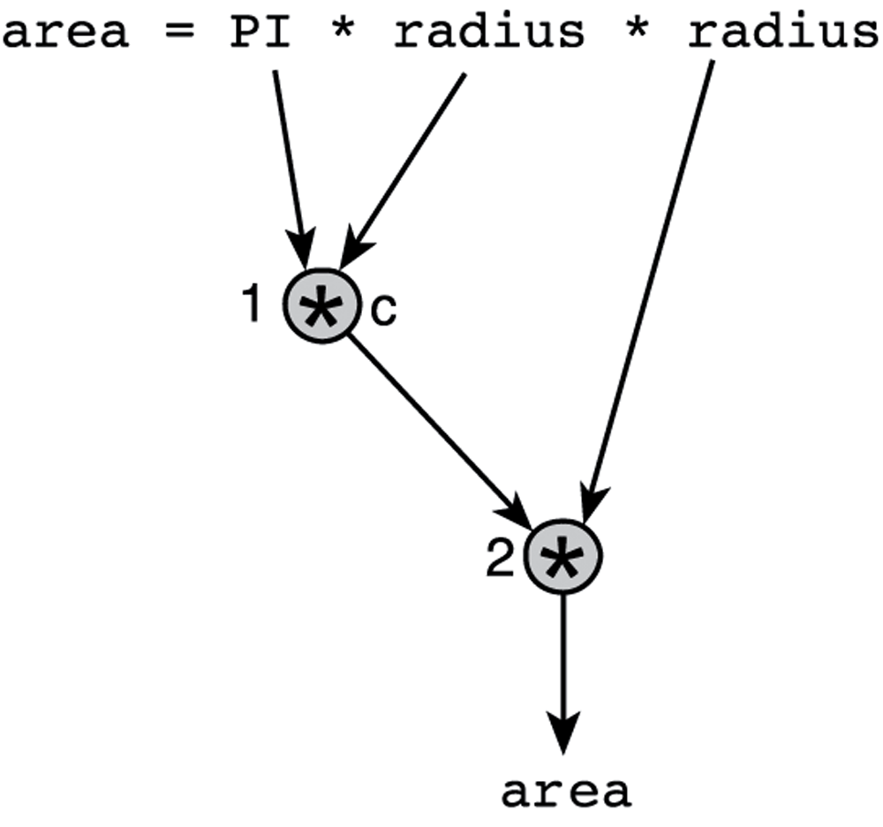
Figure 2.9 Evaluation Tree for area = PI * radius * radius;
1-<number>

Slide 11
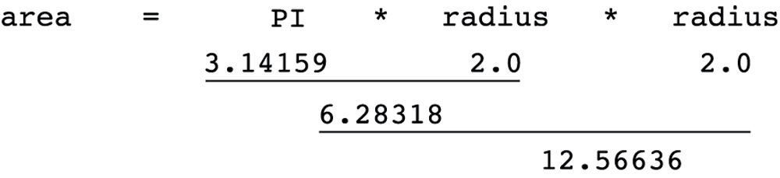
Figure 2.10 Step-by-Step Expression Evaluation
1-<number>

Slide 12
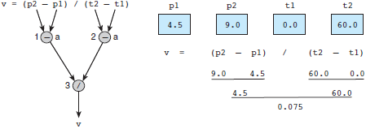
Figure 2.11 Evaluation Tree and Evaluation for v = (p2 - p1) / (t2 - t1);
1-<number>

Slide 13
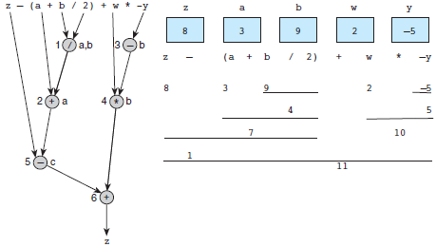
Figure 2.12 Evaluation Tree and Evaluation for z - (a + b / 2) + w * -y
1-<number>

Slide 14
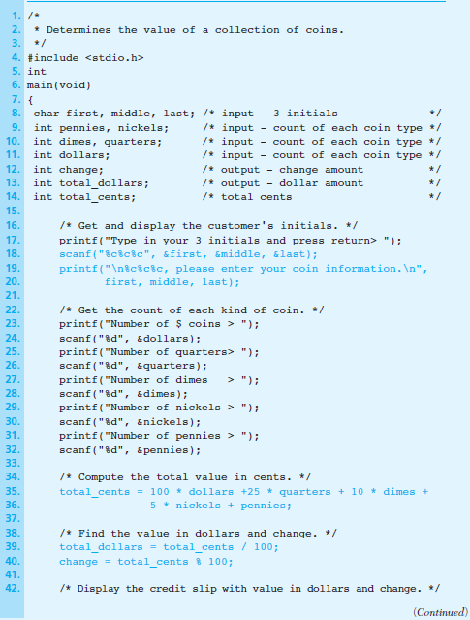
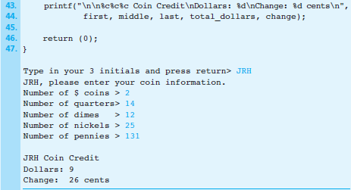
Figure 2.13 Supermarket Coin Value Program
1-<number>

Slide 15
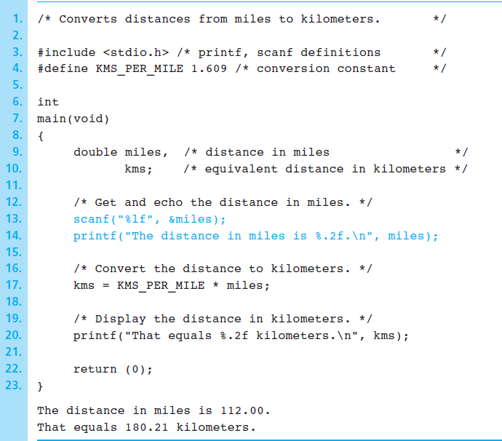
Figure 2.14 Batch Version of Miles-to-Kilometers Conversion Program
1-<number>

Slide 16
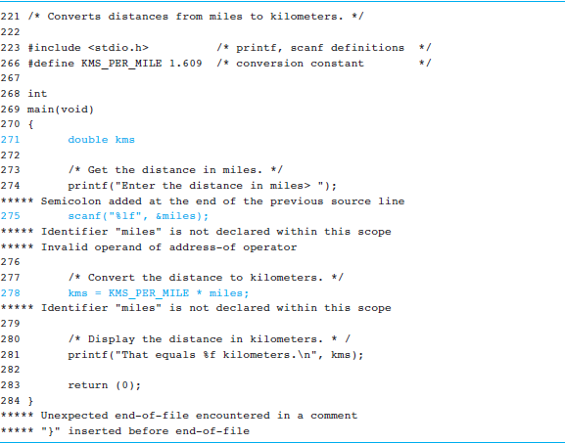
Figure 2.15 Compiler Listing of a Program with Syntax Errors
1-<number>

Slide 17
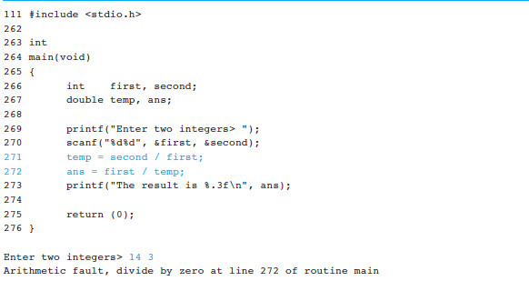
Figure 2.16 A Program with a Run-Time Error
1-<number>

Slide 18
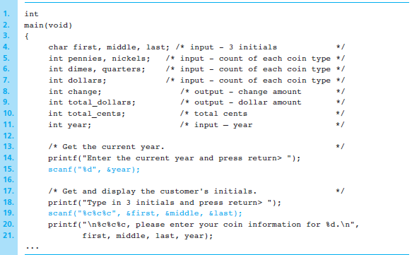
Figure 2.17 Revised Start of main Function for Supermarket Coin Value Program
1-<number>

Slide 19
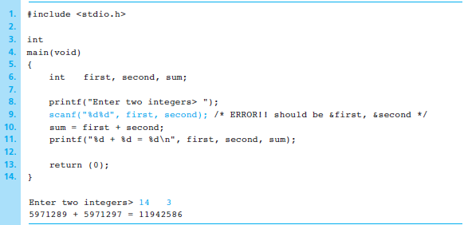
Figure 2.18 A Program That Produces Incorrect Results Due to & Omission
1-<number>

