Slide 1
Chapter 4:
Selection Structures: if and switch Statements
Problem Solving & Program Design in C
Seventh Edition
By Jeri R. Hanly &
Elliot B. Koffman

Slide 2
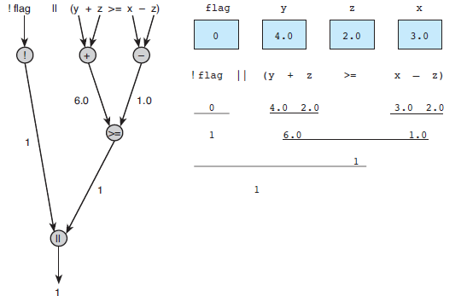
Figure 4.1 Evaluation Tree and Step-by-Step Evaluation for !flag || (y + z >= x - z)
1-<number>

Slide 3
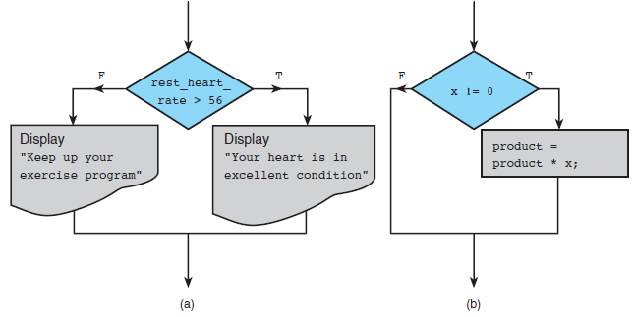
Figure 4.4 Flowcharts of if Statements with
(a) Two Alternatives and (b) One Alternative
1-<number>

Slide 4
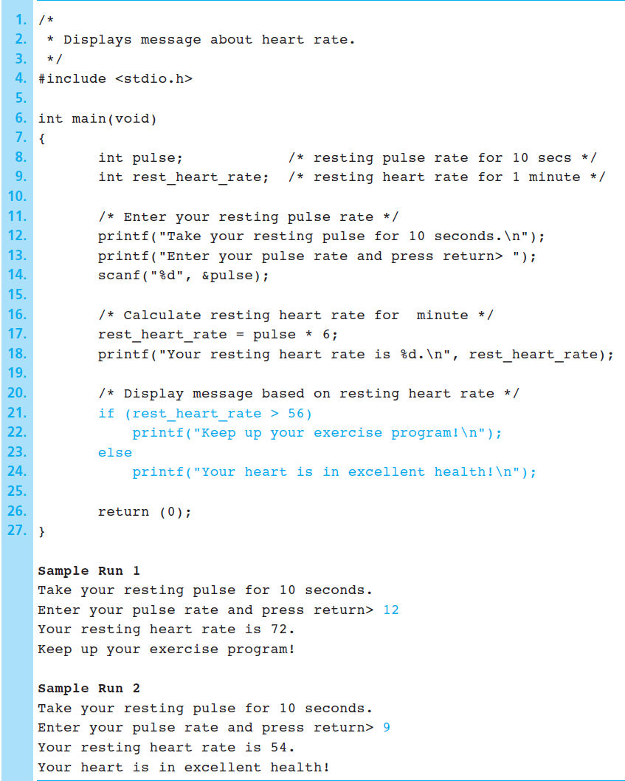
Figure 4.5 Program Using an if statement for selection
1-<number>

Slide 5
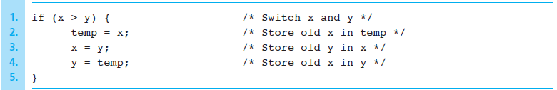
Figure 4.6 if Statement to Order x and y
1-<number>

Slide 6
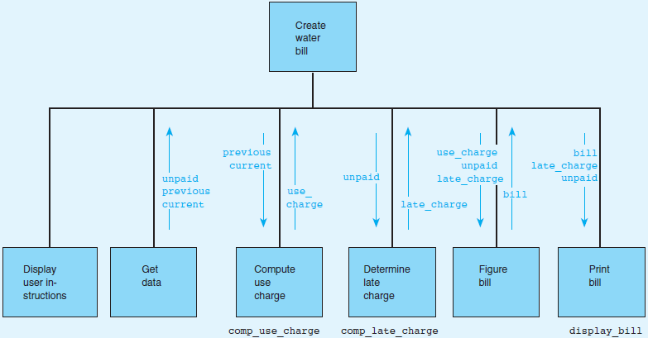
Figure 4.7 Structure Chart for Water Bill Problem
1-<number>

Slide 7
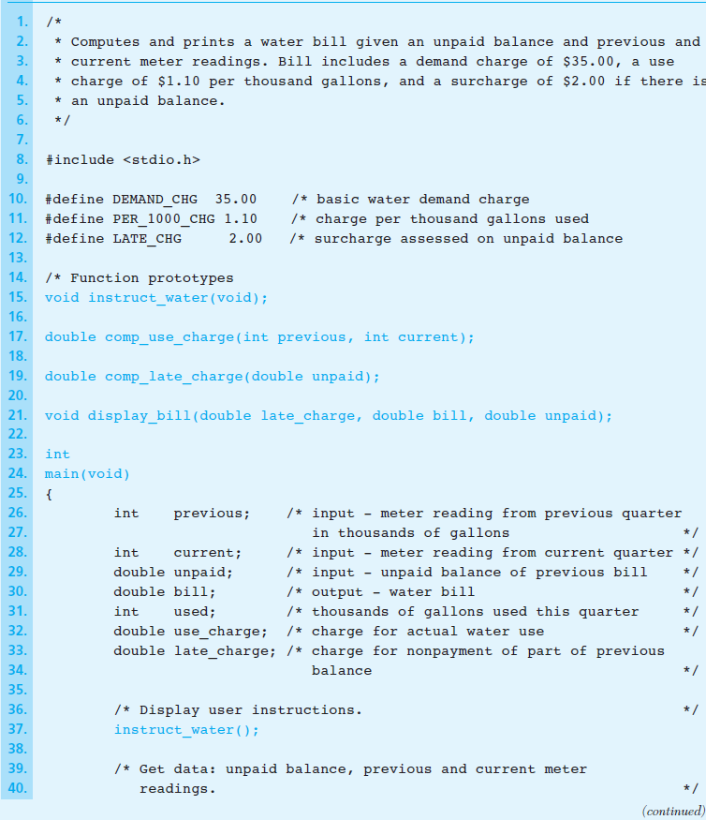
Figure 4.8 Program for Water Bill Problem
1-<number>

Slide 8
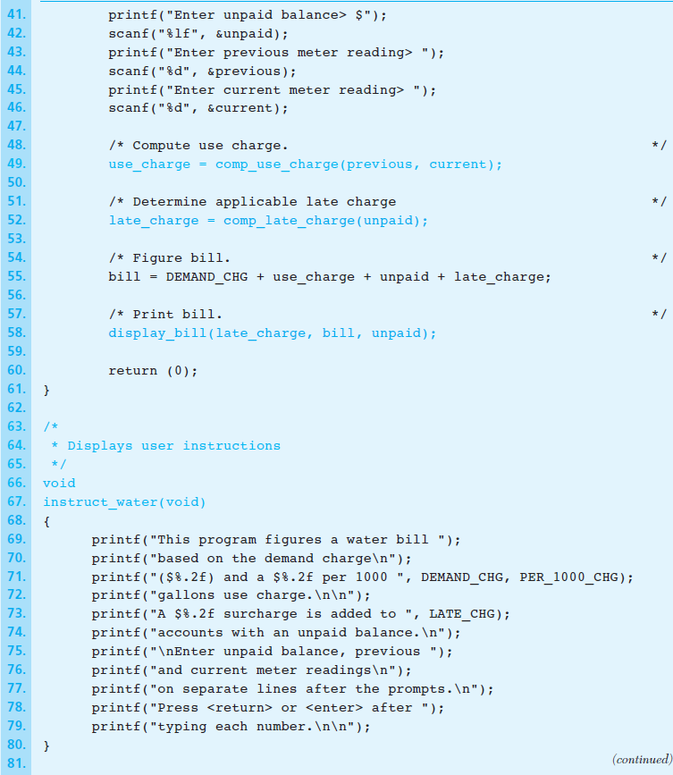
Figure 4.8 Program for Water Bill Problem (cont’d)
1-<number>

Slide 9
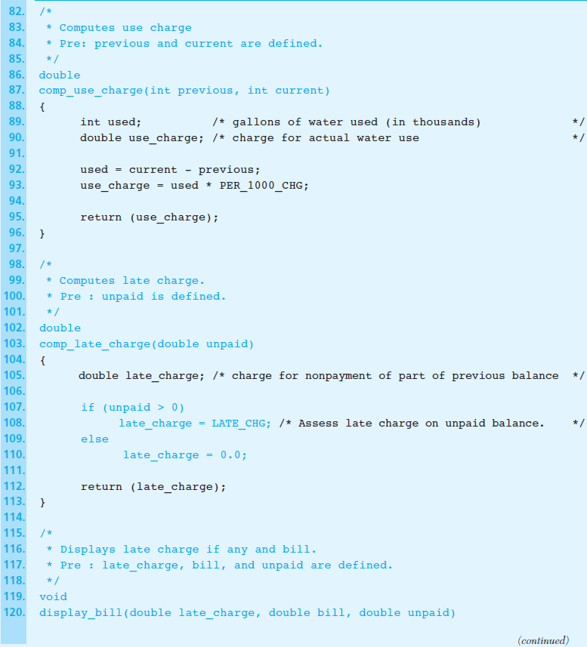
Figure 4.8 Program for Water Bill Problem (cont’d)
1-<number>

Slide 10
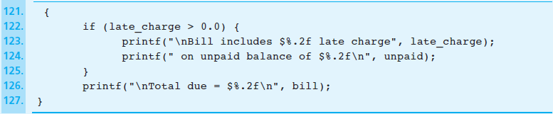
Figure 4.8 Program for Water Bill Problem (cont’d)
1-<number>

Slide 11
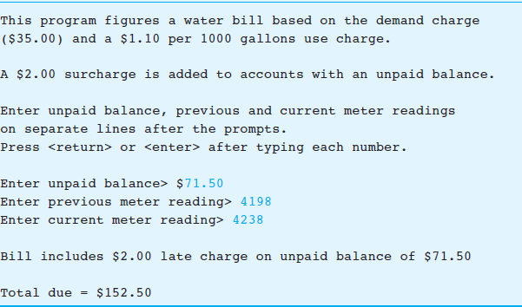
Figure 4.9 Sample Run of Water Bill Program
1-<number>

Slide 12
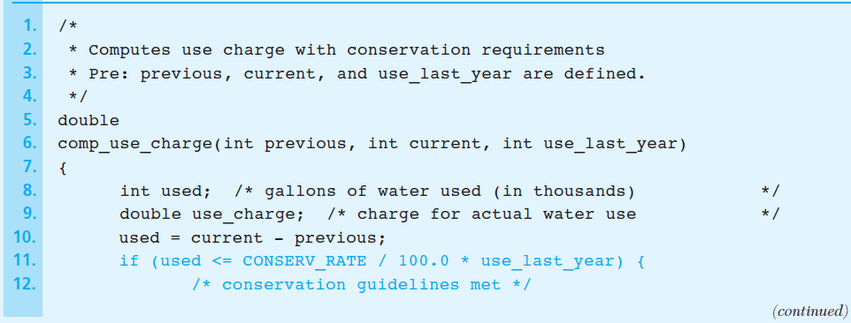
Figure 4.10 Function comp_use_charge Revised
1-<number>

Slide 13
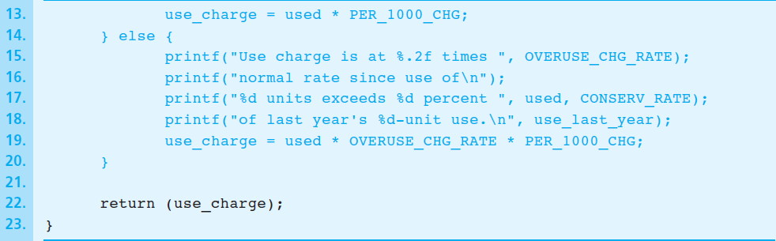
Figure 4.10 Function comp_use_charge Revised (cont’d)
1-<number>

Slide 14
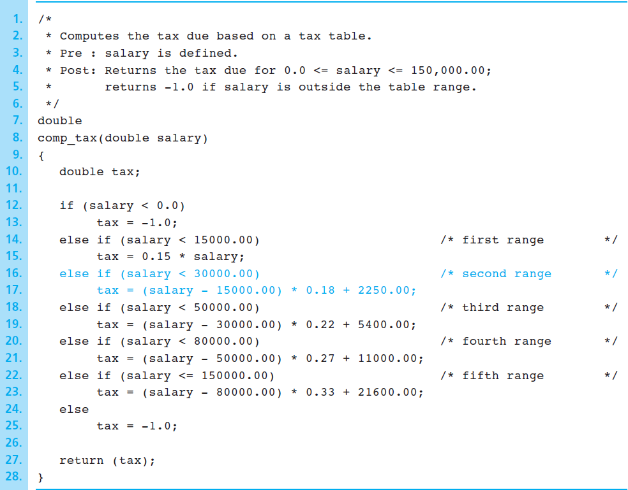
Figure 4.11 Function comp_tax
1-<number>

Slide 15
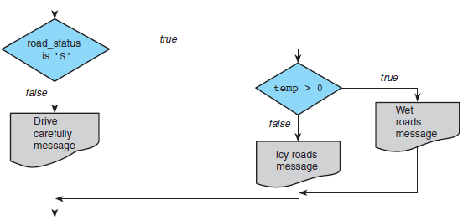
Figure 4.12 Flowchart of Road Sign Decision Process
1-<number>

Slide 16
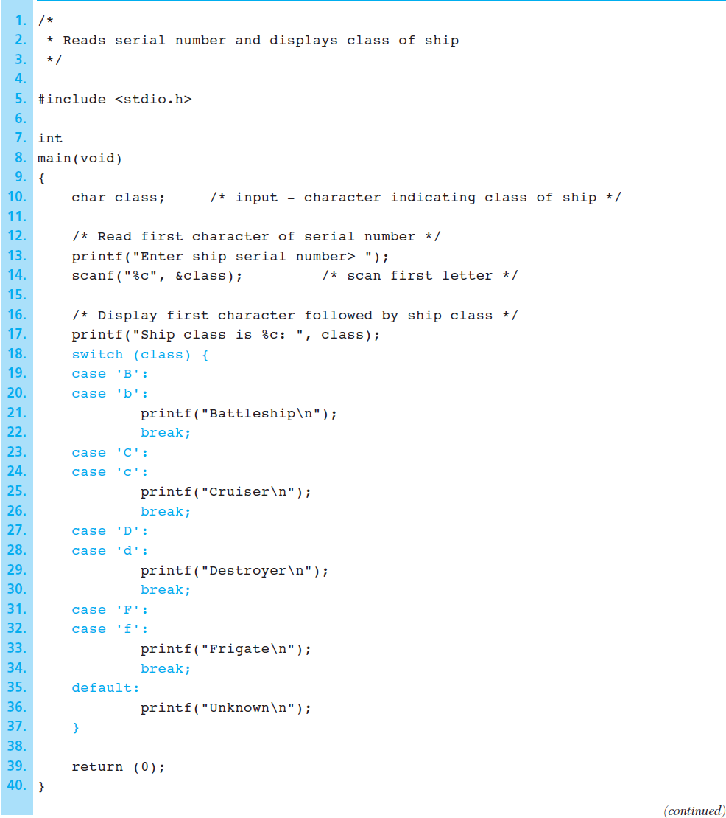
Figure 4.13 Program Using a switch Statement for Selection
1-<number>

Slide 17
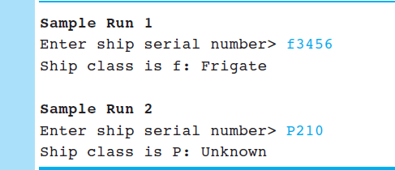
Figure 4.13 Program Using a switch Statement for Selection (cont’d)
1-<number>

