Slide 1
Chapter 5:
Repetition and Loop Statements
Problem Solving & Program Design in C
Seventh Edition
By Jeri R. Hanly &
Elliot B. Koffman

Slide 2
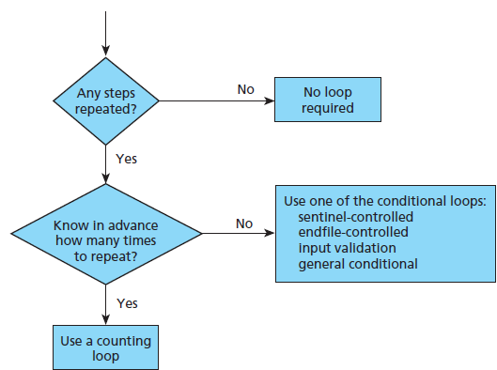
Figure 5.1 Flow Diagram of Loop Choice Process
1-<number>

Slide 3
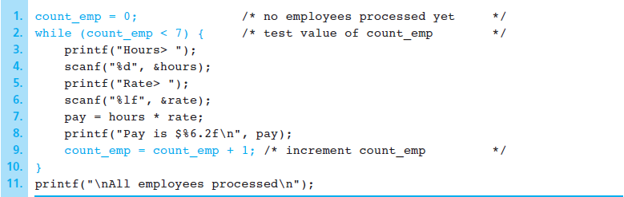
Figure 5.2 Program Fragment with a Loop
1-<number>

Slide 4
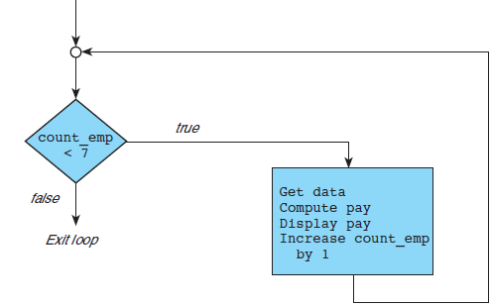
Figure 5.3 Flowchart for a while Loop
1-<number>

Slide 5
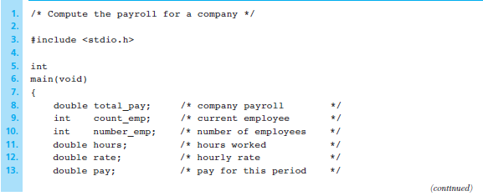
Figure 5.4 Program to Compute Company Payroll
1-<number>

Slide 6
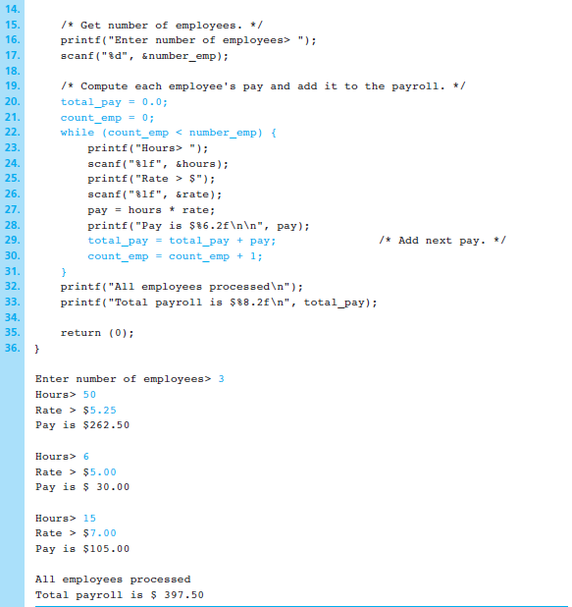
Figure 5.4
Program to Compute Company Payroll
(cont’d)
1-<number>

Slide 7
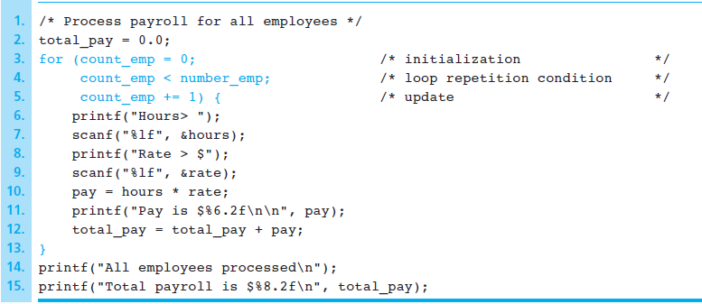
Figure 5.5 Using a for Statement in a Counting Loop
1-<number>

Slide 8
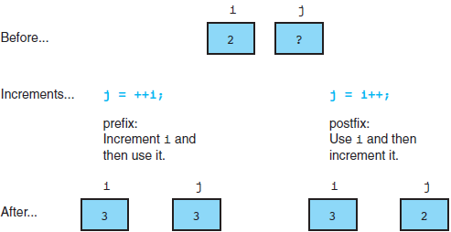
Figure 5.6 Comparison of Prefix and Postfix Increments
1-<number>

Slide 9
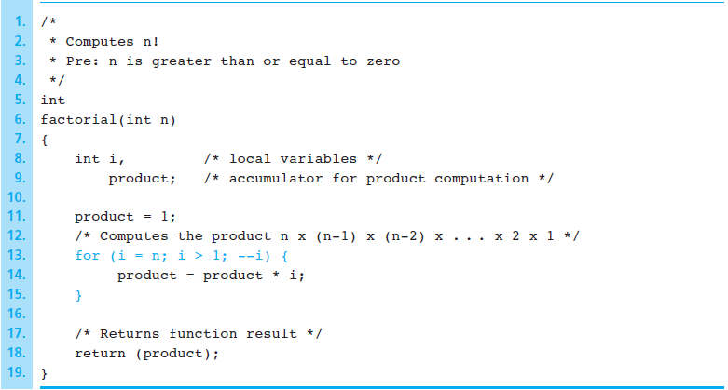
Figure 5.7 Function to Compute Factorial
1-<number>

Slide 10
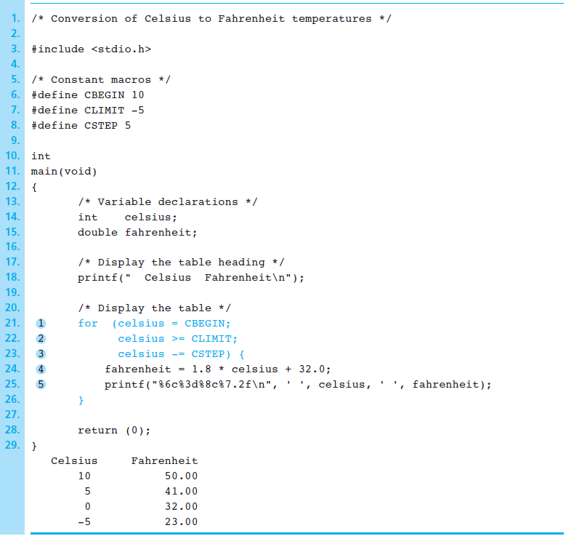
Figure 5.8 Displaying a Celsius-to-Fahrenheit Conversion Table
1-<number>

Slide 11
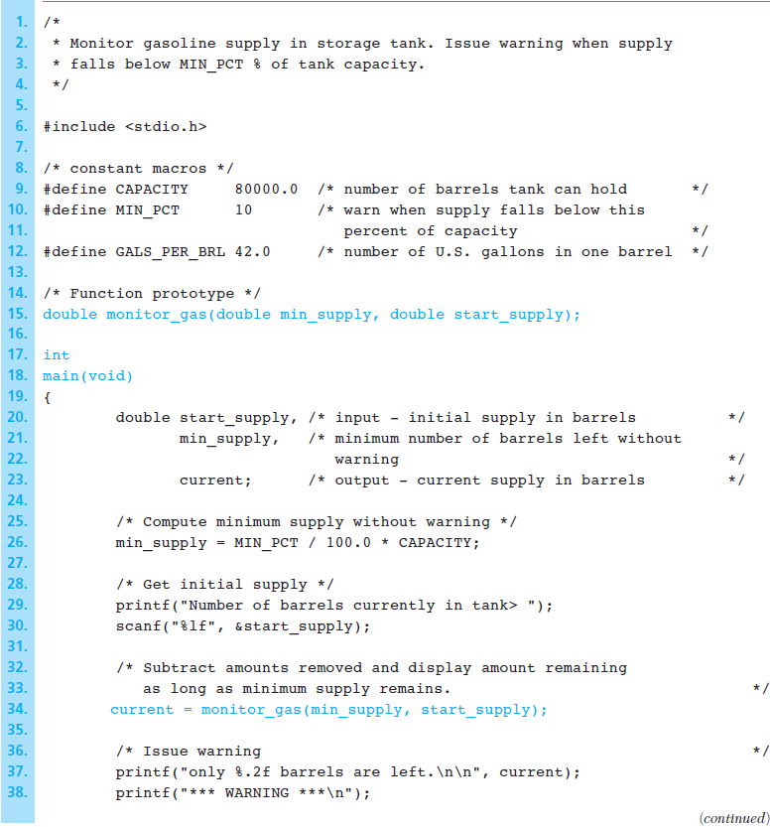
Figure 5.9 Program to Monitor Gasoline Storage Tank
1-<number>

Slide 12
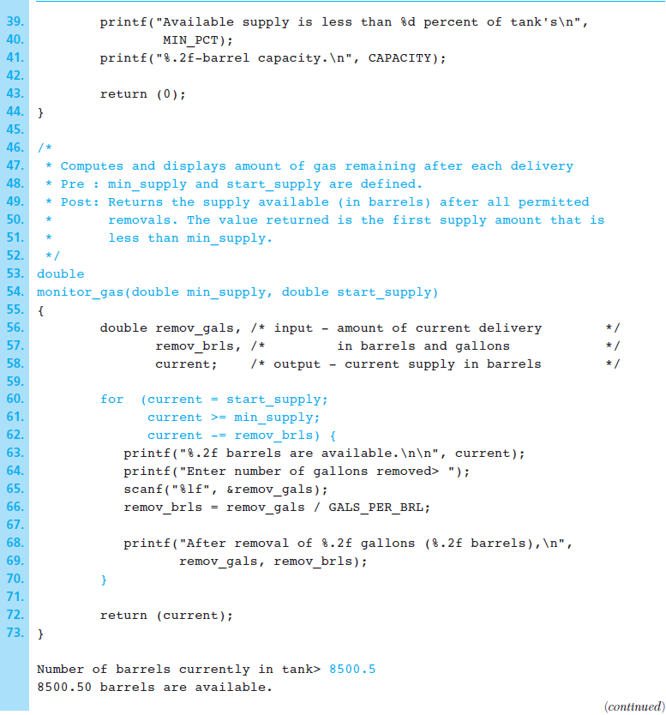
Figure 5.9 Program to Monitor Gasoline Storage Tank (cont’d)
1-<number>

Slide 13
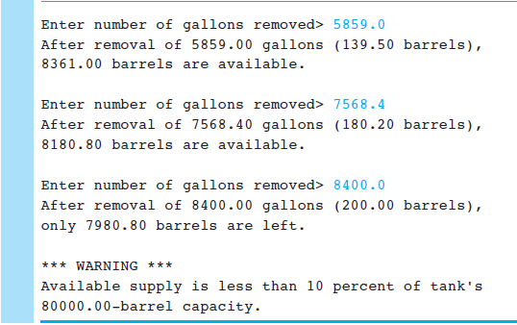
Figure 5.9 Program to Monitor Gasoline Storage Tank (cont’d)
1-<number>

Slide 14
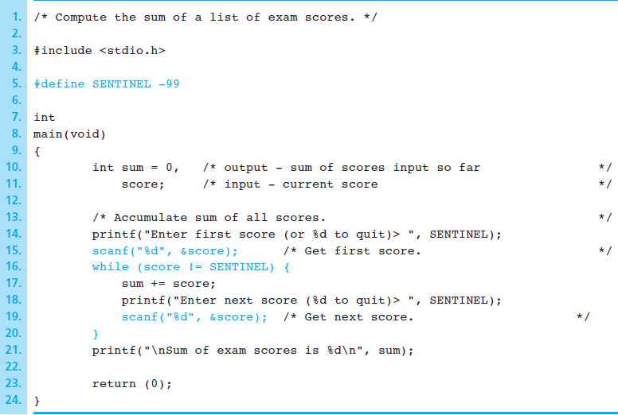
Figure 5.10 Sentinel-Controlled while Loop
1-<number>

Slide 15
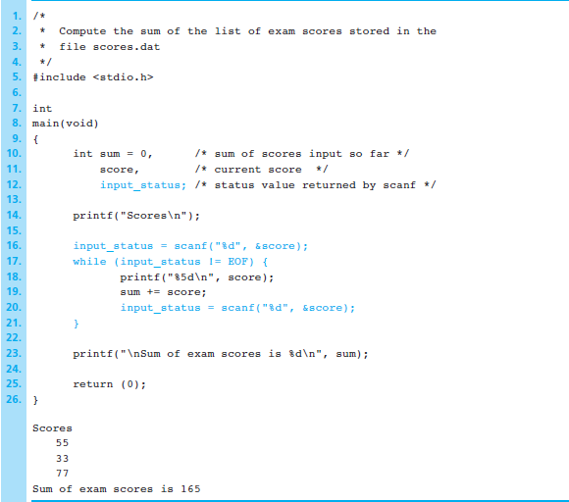
Figure 5.11 Batch Version of Sum of Exam Scores Program
1-<number>

Slide 16
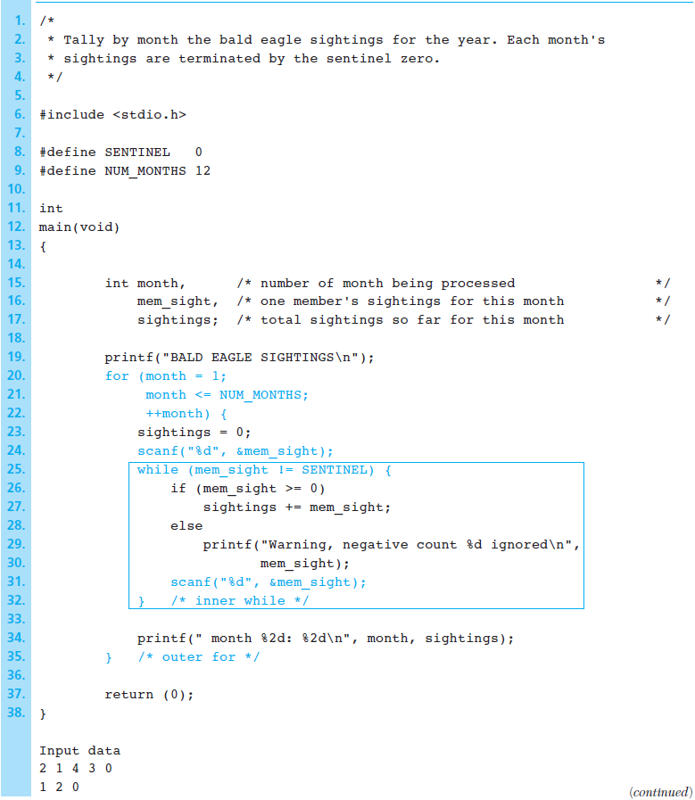
Figure 5.12 Program to Process Bald Eagle Sightings for a Year
1-<number>

Slide 17
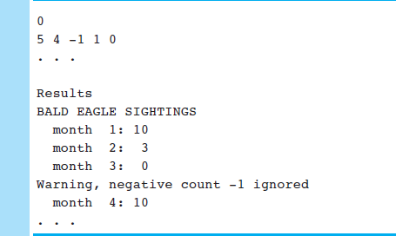
Figure 5.12 Program to Process Bald Eagle Sightings for a Year (cont’d)
1-<number>

Slide 18
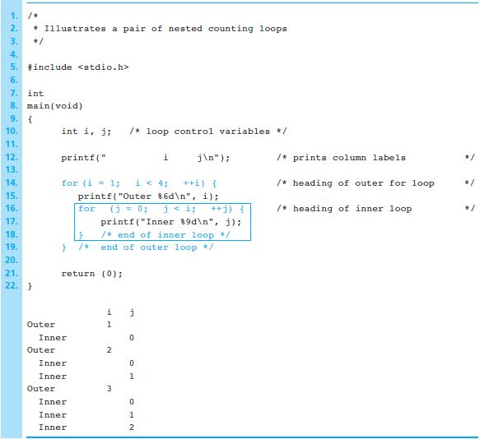
Figure 5.13 Nested Counting Loop Program
1-<number>

Slide 19
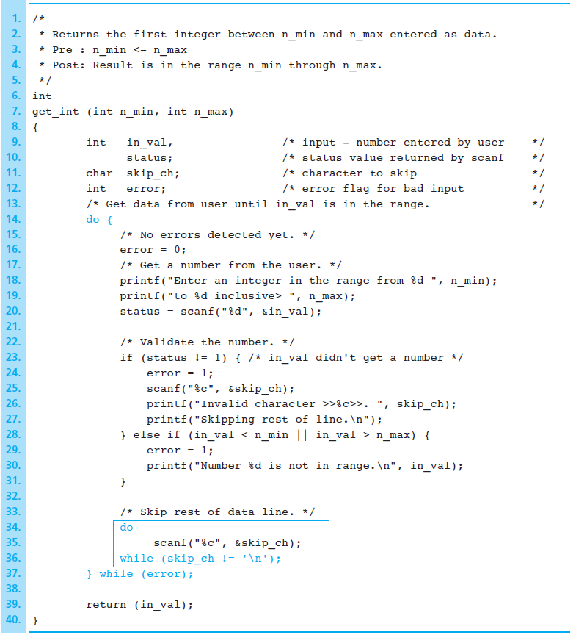
Figure 5.14 Validating Input Using do-while Statement
1-<number>

Slide 20
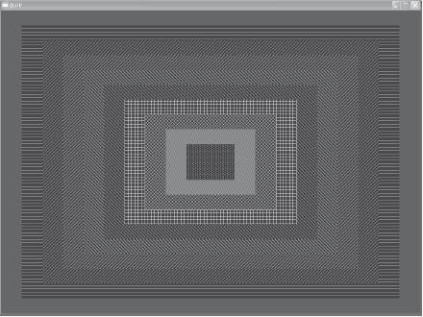
Figure 5.21 Nested Rectangles for a Quilt Pattern
1-<number>

Slide 21
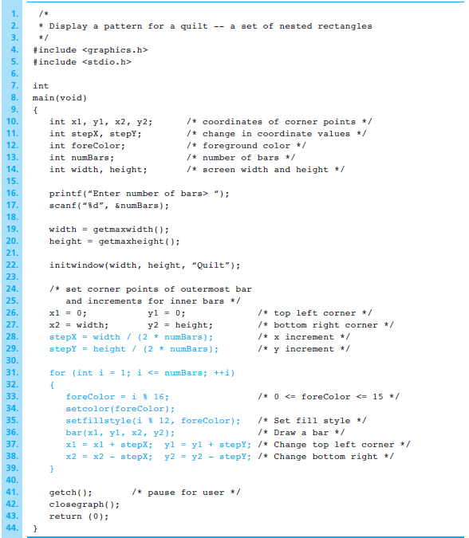
Figure 5.22
Program to draw a quilt
1-<number>

Slide 22
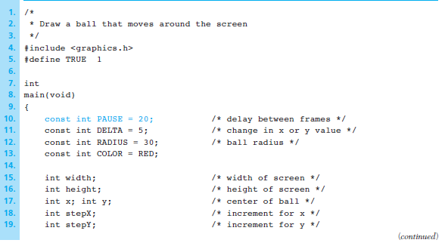
Figure 5.23 Program to draw a moving ball
1-<number>

Slide 23
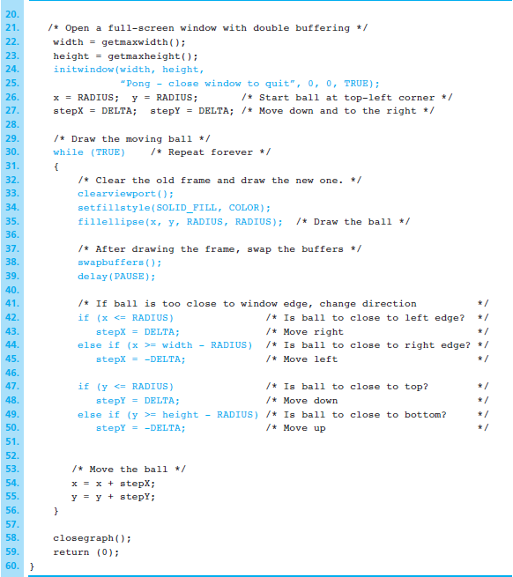
Figure 5.23
Program to draw a moving ball
(cont’d)
1-<number>

Slide 24
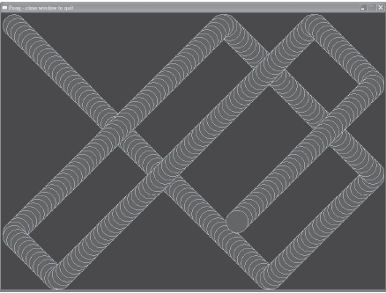
Figure 5.24 Trace of the moving ball
1-<number>

