Slide 1
Chapter 9:
Recursion
Problem Solving & Program Design in C
Seventh Edition
By Jeri R. Hanly &
Elliot B. Koffman

Slide 2
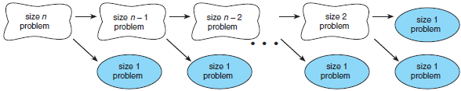
Figure 9.1 Splitting a Problem into Smaller Problems
1-<number>

Slide 3
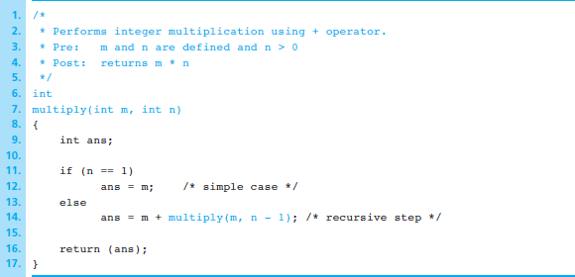
Figure 9.2 Recursive Function multiply
1-<number>

Slide 4
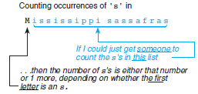
Figure 9.3 Thought Process of Recursive Algorithm Developer
1-<number>

Slide 5
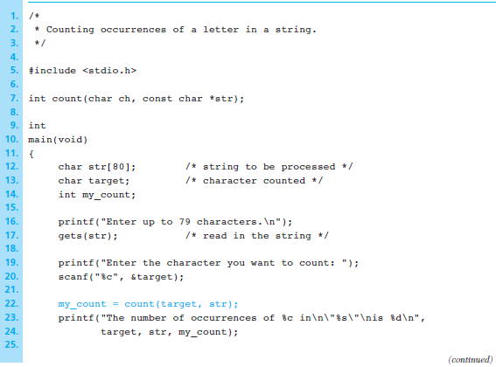
Figure 9.4 Counting Occurrences of a Character in a String
1-<number>

Slide 6
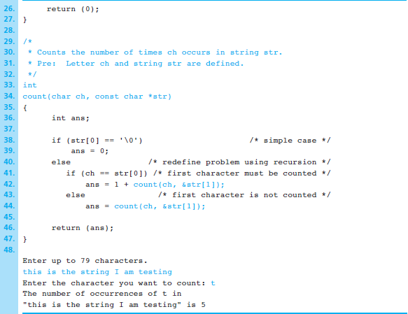
Figure 9.4 Counting Occurrences of a Character in a String (cont’d)
1-<number>

Slide 7
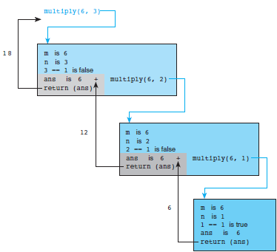
Figure 9.5 Trace of Function multiply
1-<number>

Slide 8
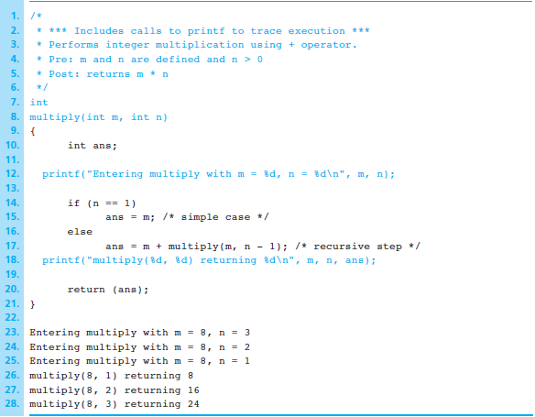
Figure 9.9 Recursive Function multiply with Print Statements to Create Trace and Output from multiply(8, 3)
1-<number>

Slide 9
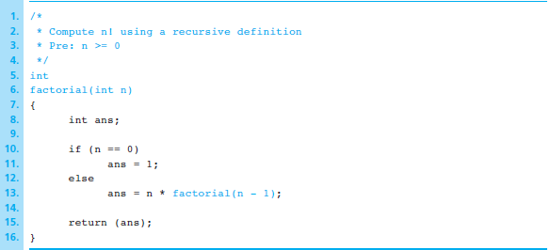
Figure 9.10 Recursive factorial Function
1-<number>

Slide 10
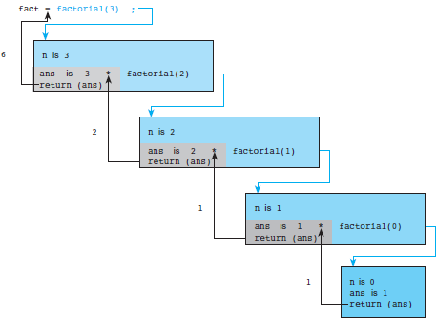
Figure 9.11 Trace of fact = factorial(3);
1-<number>

Slide 11
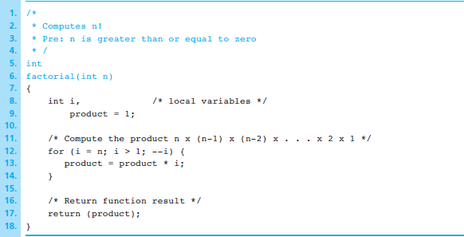
Figure 9.12 Iterative Function factorial
1-<number>

Slide 12
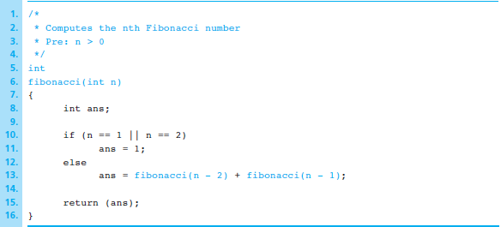
Figure 9.13 Recursive Function fibonacci
1-<number>

Slide 13
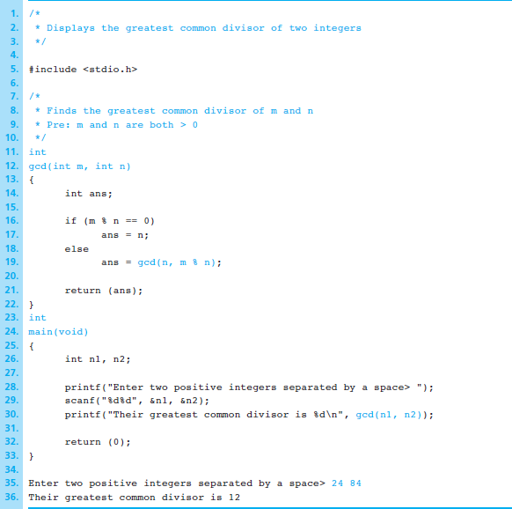
Figure 9.14 Program Using Recursive Function gcd
1-<number>

Slide 14
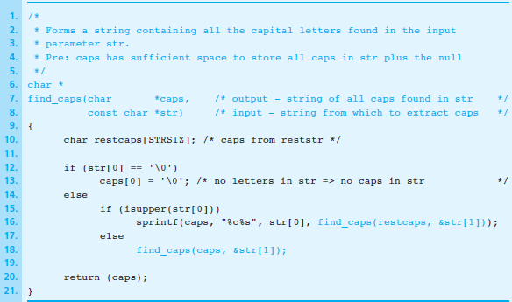
Figure 9.15 Recursive Function to Extract Capital Letters from a String
1-<number>

Slide 15
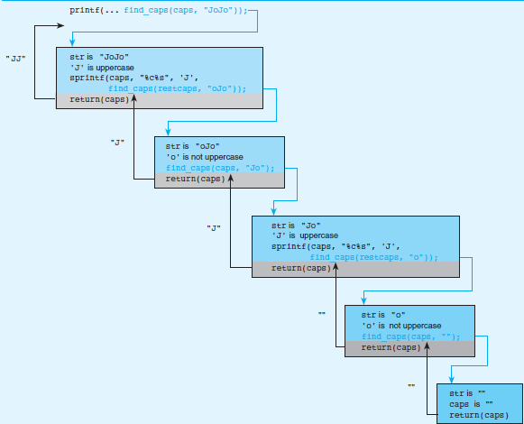
Figure 9.16 Trace of Call to Recursive Function find_caps
1-<number>

Slide 16
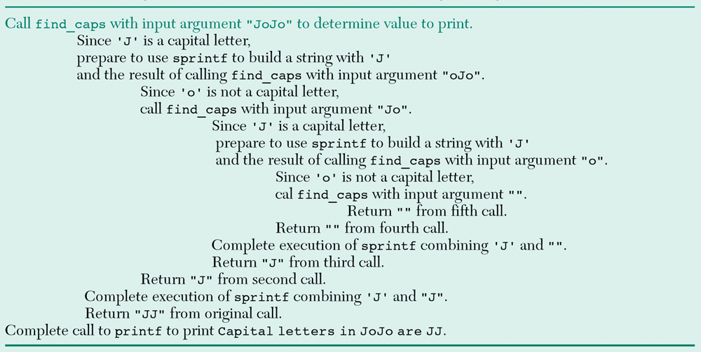
Figure 9.17 Sequence of Events for Trace of Call to find_caps from printf Statements
1-<number>

Slide 17
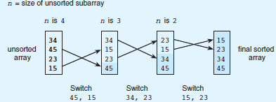
Figure 9.18 Trace of Selection Sort
1-<number>

Slide 18
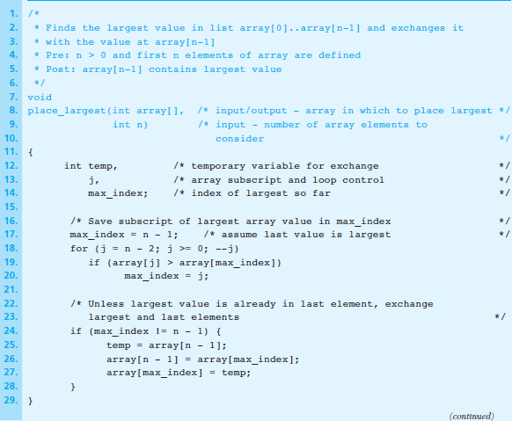
Figure 9.19 Recursive Selection Sort
1-<number>

Slide 19
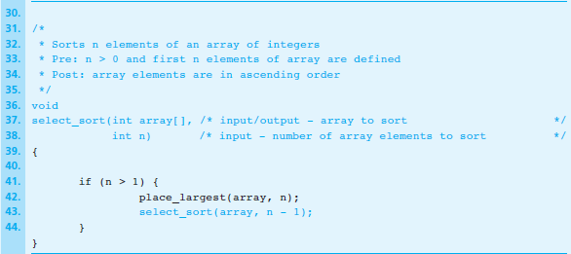
Figure 9.19 Recursive Selection Sort (cont’d)
1-<number>

Slide 20
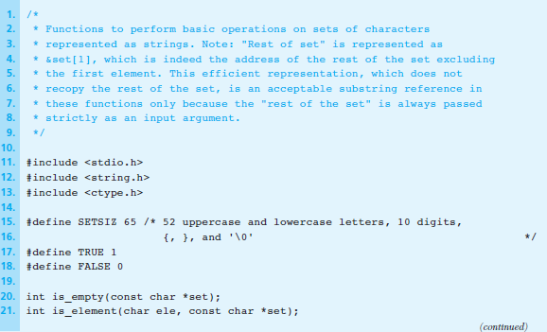
Figure 9.20 Recursive Set Operations on Sets Represented as Character Strings
1-<number>

Slide 21
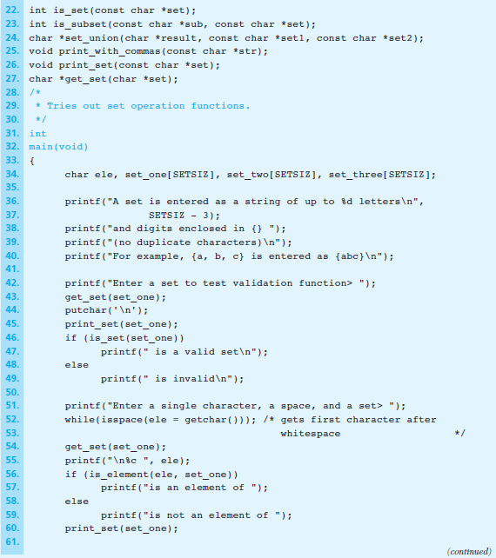
Figure 9.20 Recursive
Set Operations on Sets Represented as Character Strings (cont’d)
1-<number>

Slide 22
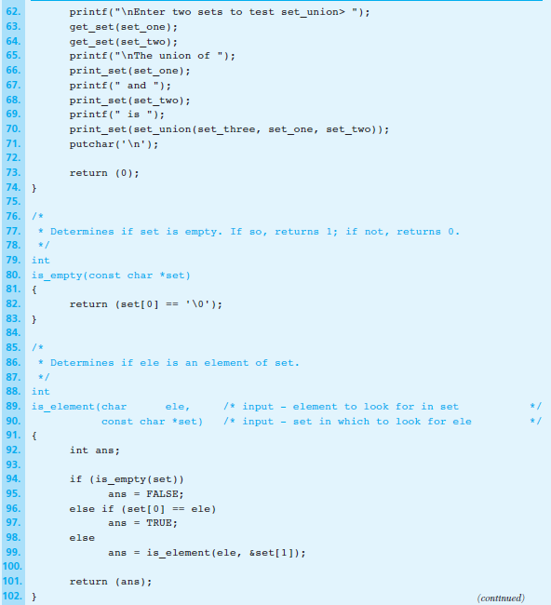
Figure 9.20 Recursive
Set Operations on Sets Represented as Character Strings (cont’d)
1-<number>

Slide 23
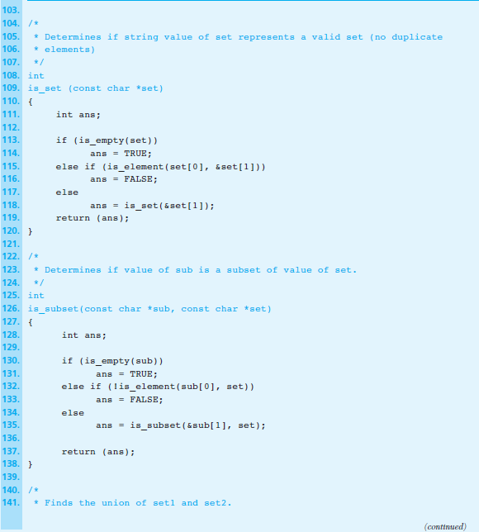
Figure 9.20 Recursive
Set Operations on Sets Represented as Character Strings (cont’d)
1-<number>

Slide 24
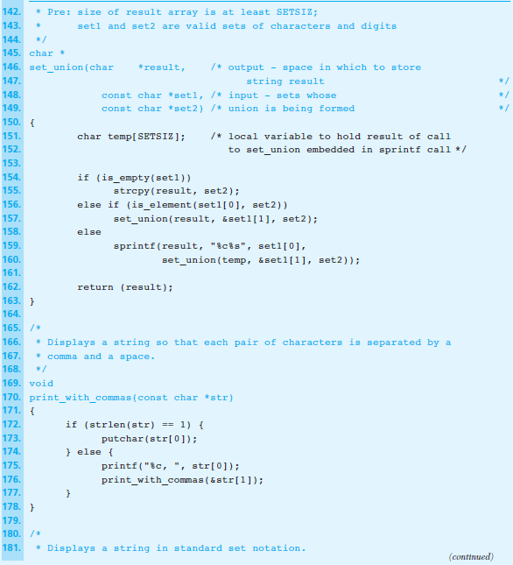
Figure 9.20 Recursive
Set Operations on Sets Represented as Character Strings (cont’d)
1-<number>

Slide 25
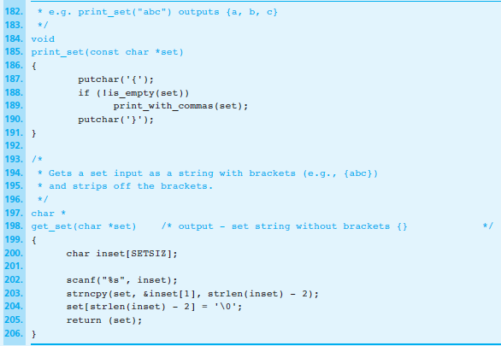
Figure 9.20 Recursive Set Operations on Sets Represented as Character Strings (cont’d)
1-<number>

Slide 26
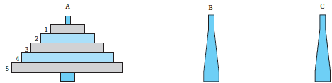
Figure 9.21 Towers of Hanoi
1-<number>

Slide 27
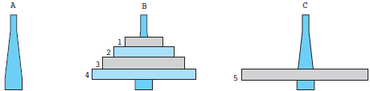
Figure 9.22 Towers of Hanoi After Steps 1 and 2
1-<number>

Slide 28
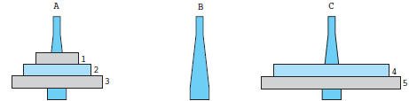
Figure 9.23 Towers of Hanoi After Steps 1, 2, 3.1, and 3.2
1-<number>

Slide 29
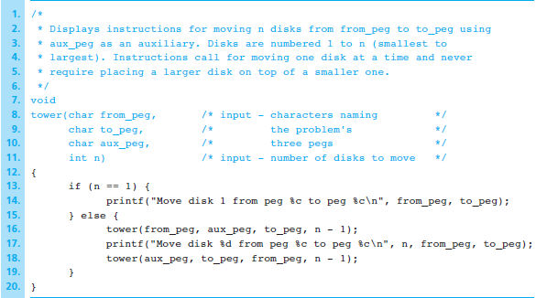
Figure 9.24 Recursive Function tower
1-<number>

Slide 30
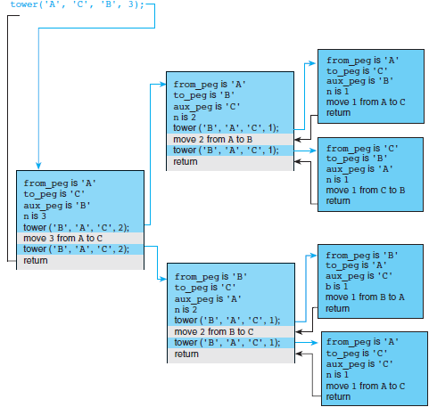
Figure 9.25 Trace of tower ('A', 'C', 'B', 3);
1-<number>

