Slide 1
Chapter 0: Computer Science as a Career Path
Problem Solving & Program Design in C
Seventh Edition
By Jeri R. Hanly &
Elliot B. Koffman

Slide 2
Questions to ask yourself:
Why would I choose this field?
Will I be good at it?
Will I enjoy my work?
Will there be jobs for me when I finish my education?

Slide 3
Reasons to major in computer science
Your generation has grown up with computers. You embrace new technology and expect it to do fantastic things.
Previous generations are not as comfortable with technology and turn to the youngest employees to take over technology issues and to make choices that will have important consequences.

Slide 4
Reasons to major in computer science
The computer industry is one of the fastest growing segments of our economy and promises to continue to see growth well into the future.
All businesses must continue to hire technology-savvy professionals in order to be competitive.

Slide 5
Reasons to major in computer science
A person who is part of the computer industry can choose from a wide variety of fields where many interesting and challenging problems will need to be solved.

Slide 6
Interesting and Challenging problems
Business and communications examples:
developing electronic balloting for state and national elections;
using signals from wireless devices to update vehicle and pedestrian travel times in order to make the best decisions for traffic signals or to manage construction zones;
using a supercomputer-powered “virtual earthquake” to study benefits of an early warning system using 3D models of actual geographic locations and damage scenarios;

Slide 7
Interesting and Challenging problems
Medical field examples:
understanding how the human brain works by modeling brain activation patterns with emphasis on helping people impacted by autism or disorders like paranoid schizophrenia;
customizing a wide array of helpful devices for the physically impaired from programmable robotic prostheses to digital “sight”;
gathering information from implanted pacemakers in order to make timely decisions in times of crisis;
developing a computer system capable of recognizing human emotional states by analyzing a human’s face in real-time;
developing human-computer interfaces that allow a computer to be operated solely by human gestures in order to manipulate virtual objects.

Slide 8
Interesting and Challenging problems
Security and law enforcement examples:
The US government is performing observational studies on normal behavior in online worlds in hopes of developing techniques for uncovering online activities of terrorist groups.
Advancements in voice biometrics technology allow speech to be analyzed by computer software to determine identity, truthfulness, and emotional states.
Electronic protection against malicious software is of great concern to national economies and security interests.

Slide 9
Another Reason to major in computer science
To make a positive impact by working to solve pressing world problems.
Examples:
human genome project,
environmental monitoring,
AIDS vaccine research,
clean fuels,
tracking weather changes by using robots in potentially dangerous areas,
using supercomputers to simulate the earth’s architecture and functions in order to predict natural disasters.

Slide 10
Traits of a computer scientist
You love the challenge of problem-solving.
You enjoy being creative and “thinking outside the box”.
You enjoy working with technology.
You are committed to being a life-long learner.
You enjoy puzzles and work tenaciously to find solutions.
You enjoy building things, both in the actual world and in a “virtual world.”
You can see how to customize a particular object to make it work in a specific environment.
You like to tackle large projects and see them to completion.
You like to build things that are useful to people and that will impact their lives in a positive way.

Slide 11
…Computer science is more about finding solutions to problems than it is about using the current computer hardware or programming language…

Slide 12
Skills required of a computer scientist
You must be a good communicator.
You must be able to explain plans and solutions to technical and non-technical people alike.
You must be able to write clearly and concisely in the technical environment.
Since most projects involve multiple people, you must be able to work well in a group.
If you plan to become a manager or run your own company, it is very important to be able to work well with many different personalities.

Slide 13
Joys of the Craft
The sheer joy of making things of your own design.
The pleasure of making things that are useful to and respected by other people.
The joy of fashioning complex puzzle-like entities into a system that works correctly.
The joy of always learning something new.
The joy of working with a very tractable medium.
Frederick P. Brooks, The Mythical Man Month – Essays on Software Engineering.

Slide 14
College goals
Most professionals have at least a four-year undergraduate degree in mathematics, computer science, or a related field.
Many have graduate degrees – Masters or PhDs, especially those involved primarily in research or education.

Slide 15
Focusing on the right degree
There are many different degrees that involve computing offered at colleges and universities.
These degrees can even be from different departments within the same institution.
Although computing degrees can share some of the same courses, they can also be quite different from each other. How to choose among them can be confusing.
Five most common fields are: computer science, computer engineering, information systems, information technology, and software engineering.

Slide 16
Computer Science
This discipline encompasses a wide range of topics from theoretical and algorithmic foundations to cutting-edge developments.
The work computer scientists are trained to do can be arranged into three categories:
Designing and implementing useful software.
Devising new ways to use computers.
Developing effective ways to solve computing problems.

Slide 17
Computer Science
A computer science degree will consist of courses that include computing theory, programming, and mathematics.
The math sequence will include calculus I and II (and in many cases calculus III) as well as discrete mathematics, linear algebra, and probability and statistics.
A computer science degree offers a comprehensive foundation that permits graduates to understand and adapt to new technologies and new ideas.
Computer science departments are often found at universities as part of the Science, Engineering, or Mathematics divisions.

Slide 18
Computer Scientists
Computer scientists take on challenging programming jobs and supervise or advise other programmers.
Computer science researchers work with scientists from other fields. Examples: using data bases to create and organize new knowledge, making robots that will be practical and intelligent aides, and using computers to help decipher the secrets of human DNA.
Their theoretical background allows them to determine the best performance possible for new technologies and their study of algorithms helps them to develop creative approaches to new (and old) problems.

Slide 19
Computer Engineering
Computer engineering encompasses the design and construction of computers and computer-based systems.
A CE degree involves the study of hardware, software, communications, and the interaction among them.
A CE degree is a customized blend of an Electrical Engineering degree with a Computer Science degree.

Slide 20
Computer Engineering
The CE curriculum will include courses on the theories, principles, and practices of traditional electrical engineering as well as mathematics through the standard calculus sequence and beyond.
This knowledge will then be applied in courses dealing with designing computers and computer-based devices.
In addition, programming courses are required so that the computer engineer can develop software for digital devices and their interfaces.

Slide 21
Computer Engineers
Computer engineers design generalized computer systems.
Computer engineers design specialized devices that have software and hardware embedded in them.
Examples of embedded systems: cell phones, digital music players, alarm systems, medical diagnostic devices, laser surgical tools, etc.
The devices a computer engineer might work with are limitless as he applies his knowledge of how to integrate hardware and software systems.

Slide 22
Information Systems
The Information Systems field focuses on integrating technology into businesses and other enterprises to manage their information in an efficient and secure manner.
Technology is viewed as an instrument for generating, processing, and distributing information.
The focus in this field is on business and organizational principles.

Slide 23
Information Systems
Most Information Systems (IS) programs are located in the business school of a university or college.
Information Systems degrees combine business and computing coursework and the math that is required has a business application focus.
These degrees may be found under such programs as Computer Information Systems (CIS) or Management Information Systems (MIS).
Degree program names are not always consistent, but they all have their focus on business principles and applications of technology with less emphasis on the theory of computer science or the digital design of computer engineering.

Slide 24
Information Systems Specialists
Information Systems specialists must understand both technical and organizational factors.
They must be able to help an organization determine how to use information and technology to provide a competitive edge.
These professionals serve as a bridge between the technical community and the management community within an organization.
They are called upon to determine the best way to use technology, organize information, and communicate effectively.

Slide 25
Information Technology
Information Technology (IT) has its emphasis on working with the technology itself. Less emphasis is placed on the information handled, on theory, or on how to design hardware or software.
IT professionals work with computer systems to ensure they work properly, are secure, are upgraded and maintained, and are replaced as appropriate.
An (IT) program prepares students to support the computer technology needs of business, government, healthcare, education, and other organizations.
Most enterprises of any size must maintain whole departments of IT workers.

Slide 26
Information Technology
Degree programs in information technology are commonly found in business or information management departments, or as an alternate degree in a Computer Science department.
Courses will focus on using the proper application programs, networking, systems integration, and resource planning.
The emphasis is less on programming and more on using programs already written to the best advantage.
Required math courses focus on business applications.

Slide 27
Information Technology Specialists
IT specialists select appropriate hardware and software products for an organization and then integrate these products within the existing infrastructure.
They install and customize and maintain the software as needed.
Other responsibilities include: network administration and security, design and implementation of web pages, development of multimedia resources, oversight of email systems, and installation of communication components.
User support and training are often important responsibilities for the Information Technology professional as well.

Slide 28
Software Engineering
Software engineering is the discipline of developing and maintaining large software systems.
These systems must behave reliably and efficiently, be affordable, and satisfy all requirements defined for them.
Software engineering seeks to integrate the theory of computer science and mathematics with the practical engineering principles developed for physical objects.

Slide 29
Software Engineering
A Software Engineering degree program is closely related to the computer science degree program and they are usually offered within the same department.
A Software Engineering degree can be considered a specialized degree within the confines of the field of Computer Science.
SE students learn more about software reliability and maintenance of large systems and focus more on techniques for developing and maintaining software that is engineered to be correct from its inception.
Most programs require SE students to participate in group projects for the development of software that will be used in earnest by others. The students will assess customer needs, develop usable software, test the product thoroughly, and analyze its usefulness.

Slide 30
Software Engineers
Professionals that hold a software engineering degree expect to be involved with the creation and maintenance of large software systems that may be used by many different organizations.
Their focus will be on the design principles that make the system viable for many people and through many years.
Note: While a Software Engineering degree has a recognized description, the term “software engineer” is merely a job label in the workplace. There is no standard definition for this term when used in a job description and its meaning can vary widely among employers. An employer may think of a programmer or an IT specialist as a “software engineer.”

Slide 31
Mixed Disciplinary Majors
Bioinformatics - the use of computer science to maintain, analyze, and store biological data as well as to assist in solving biological problems
Artificial Intelligence - the implementation and study of systems that can exhibit autonomous intelligence or behaviors.
Computer Forensics - a branch of forensic science pertaining to legal evidence that may be found in computers and digital storage devices.
Cryptology (or cryptography) - the study of electronic data security and of encrypting information.
Mechatronics - the combination of mechanical engineering, electronic engineering, and software engineering in order to design advanced hybrid systems such as a Mars rover or anti-lock braking systems.

Slide 32
The demand in the US and in the world
According to the Bureau of Labor Statistics, computer software engineer and computer scientist and database administrator are some of the occupations projected to grow the fastest and to add the most new jobs over the 2006-2016 decade.
Strong employment growth combined with a limited supply of qualified workers will result in excellent employment prospects.
Those with practical experience and at least a bachelor’s degree in computer engineering or computer science should have the best opportunities.
Employers will continue to seek computer professionals with strong programming, systems analysis, interpersonal, and business skills.

Slide 33
The demand in the US and in the world
The growing need for computer professionals is increased by the looming retirement of a generation of baby boomers.
The government projects that the computer science/IT workforce will grow nearly 25 percent, more than twice as fast as the overall workforce, between 2006 and 2016.
The number of graduates from the computing fields will not meet the demand in the marketplace in the foreseeable future.
Projections and statistics show that there will be plenty of jobs to be offered to the qualified computer professional.
Salaries will be higher than for the average full-time worker in the United States.

Slide 34
What about jobs outsourced to other countries?
Today’s student should not be worried about any impact outsourcing computer jobs to other countries will have on their ability to find a job.
The fact is many companies have tried outsourcing entire projects and found that it does not work well.
Some of the more mundane aspects of coding can be outsourced, but the more creative work is best kept in house.
Many companies are abandoning outsourcing and doing more system development at home.

Slide 35
The demand for underrepresented groups
The demand for women and minorities to fill computer related jobs is higher than ever.
The computer related fields have traditionally seen small numbers of women and minorities in the workplace.
Colleges and universities would like to attract these groups to computer science and IS departments and often offer very nice scholarships and opportunities.
According to a recent study by the National Center for Women and Information Technology, the most successful IT teams were also the most diverse.
Studies show that diversity of thought lead to innovation and that companies should be aware of the significance of diversity.
Prospective students should not be turned away by the stereotypical view of a “computer geek” who sits in front of a computer all day, but should realize all the opportunities to be found in such a diverse and fast-growing field.

Slide 36
New careers constantly on the horizon
It is clear that there will be a healthy need for computer professionals in the career paths that are known about today.
For the student just starting to plan a career, there will surely be opportunities that have not even been imagined yet.
The possibilities are amazing and the rewards are many.

Slide 37
Why major in Computer Science?
Challenging and interesting classes.
Degrees will be highly marketable in diverse employment fields.
Opportunities to be at the forefront of innovative technology in a constantly changing world.
Opportunities to work on solving formidable world problems and to make a positive impact.
Prospects are limited only by the imagination.

Slide 38
Words from Rick Rashid, senior vice president for research at Microsoft --Communications of the ACM Volume 51, Number 7 (2008)
“For decades, the ability of U.S. companies to transform innovations into successful businesses has been the foundation for our economic growth. Technologies such as the microprocessor, the Internet, and fiber optics that were developed by scientists and engineers trained in U.S. universities laid the foundation for new industries that generated millions of high-paying jobs.
But if the number of young people in the U.S. who study computer science continues to decline, the center of gravity for innovation will shift to countries where students flock to universities to pursue degrees in the technical fields.
As head of Microsoft Research, I am acutely aware of the impact that the shortage of computer professionals can have. Although the majority of our researchers are based in the U.S. and these facilities continue to grow, we are expanding our research facilities in other parts of the world, in part because we recognize that this may be the only way we can continue to find and hire the world's top computer scientists. I also see the increasing difficulty that Microsoft has in filling positions that require a high level of training and skill in computer science and engineering.”

Slide 39
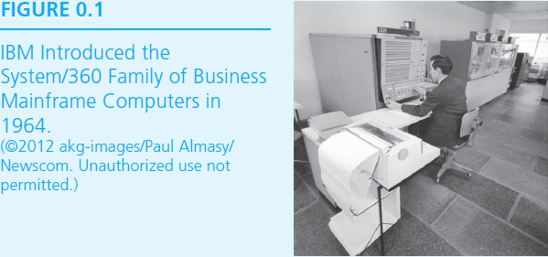

Slide 40
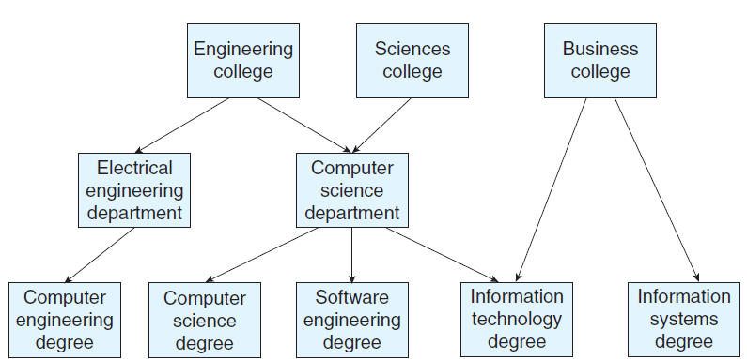
Figure 0.2 Example of relationships between computing degrees and university colleges and departments. This can vary widely from school to school.

Slide 41
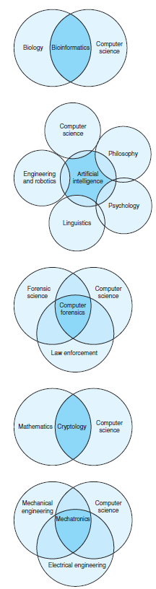
Figure 0.3
Illustrations of the overlapping fields within mixed disciplinary majors.

Slide 42
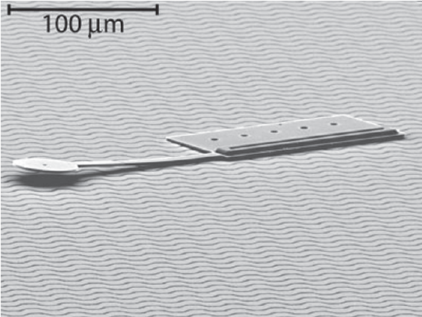
Figure 0.4 Untethered, Electrostatic, Globally-Controllable MEMS Micro-Robot. (© 2008 IEEE/Journal of Microelectromechanical Systems [2006])

