Slide 1
Chapter 3:
Top-Down Design with Functions
Problem Solving & Program Design in C
Seventh Edition
By Jeri R. Hanly &
Elliot B. Koffman

Slide 2
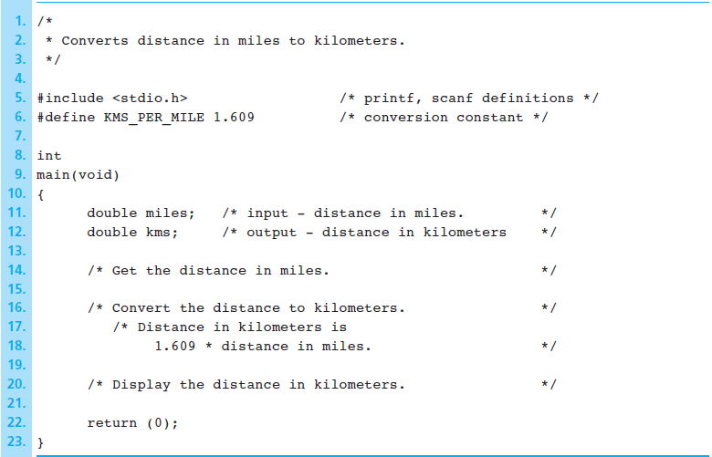
Figure 3.1 Edited Data Requirements and Algorithm for Conversion Program
1-<number>

Slide 3
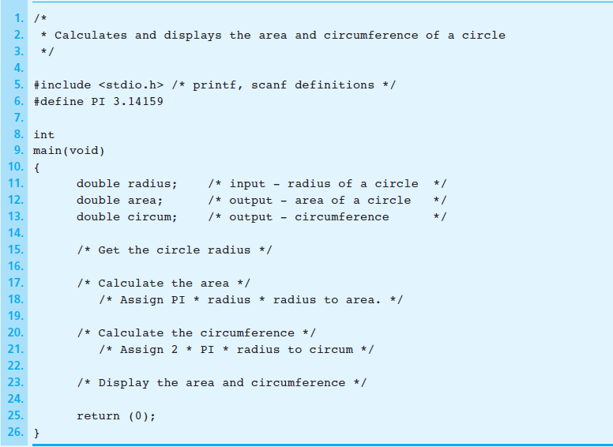
Figure 3.2 Outline of Program Circle
1-<number>

Slide 4
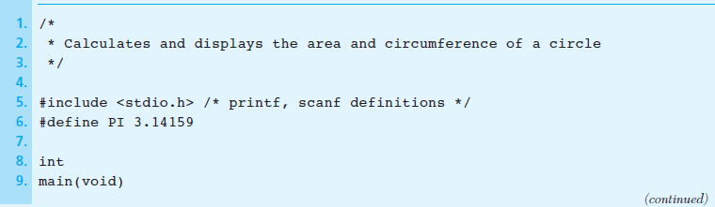
Figure 3.3 Calculating the Area and the Circumference of a Circle
1-<number>

Slide 5
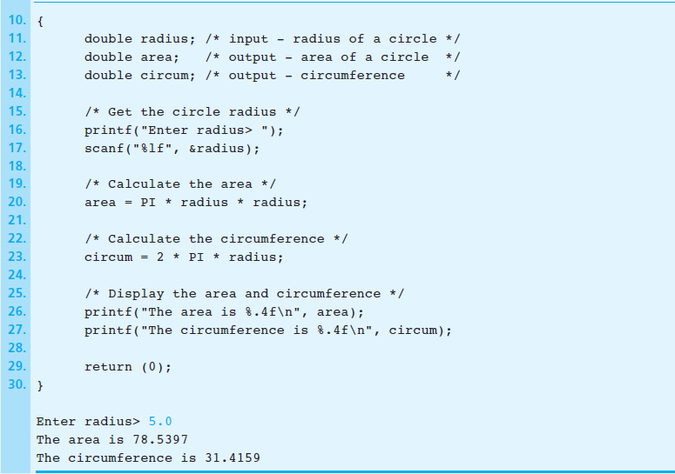
Figure 3.3 Calculating the Area and the Circumference of a Circle (cont’d)
1-<number>

Slide 6
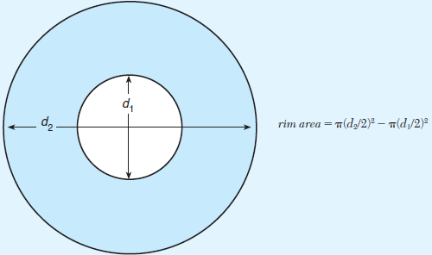
Figure 3.4 Computing the Rim Area of a Flat Washer
1-<number>

Slide 7
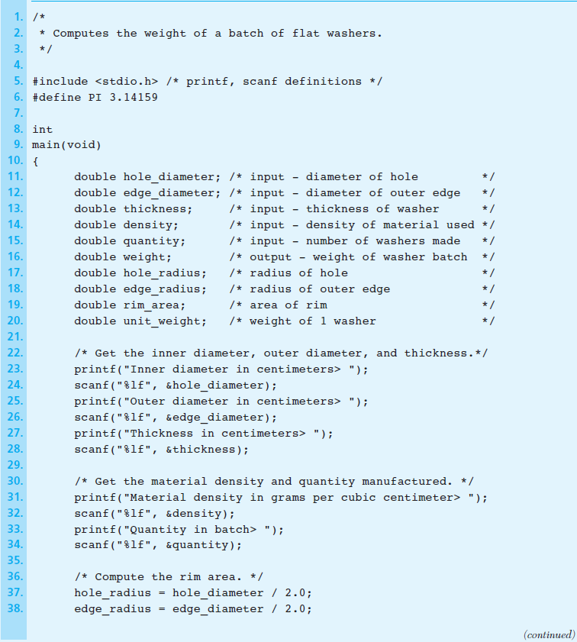
Figure 3.5
Flat Washer Program
1-<number>

Slide 8
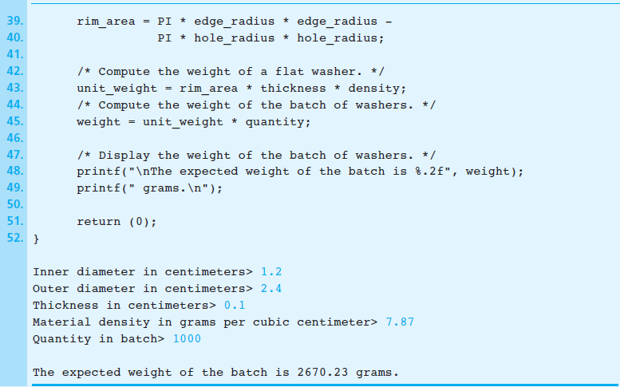
Figure 3.5 Flat Washer Program (cont’d)
1-<number>

Slide 9
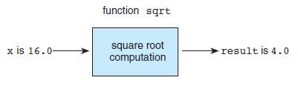
Figure 3.6 Function sqrt as a “Black Box”
1-<number>

Slide 10
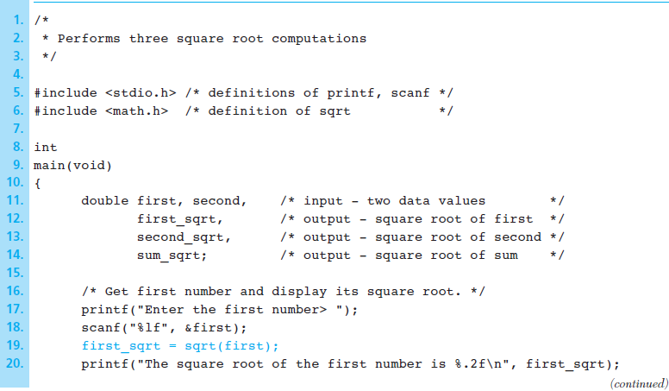
Figure 3.7 Square Root Program
1-<number>

Slide 11
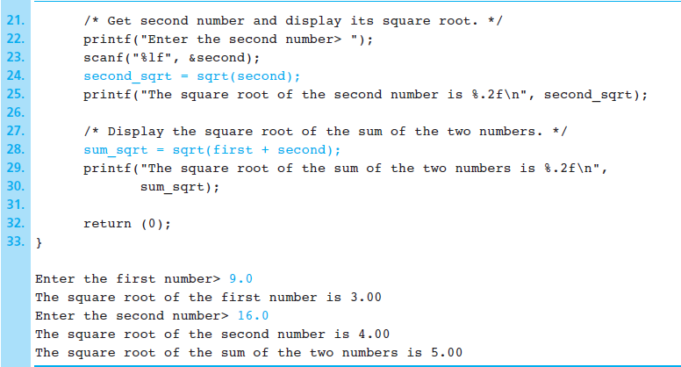
Figure 3.7 Square Root Program (cont’d)
1-<number>

Slide 12
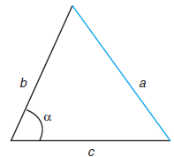
Figure 3.8 Triangle with Unknown Side a
1-<number>

Slide 13
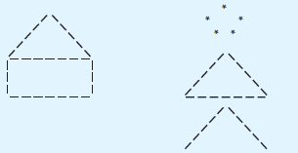
Figure 3.9 House and Stick Figure
1-<number>

Slide 14
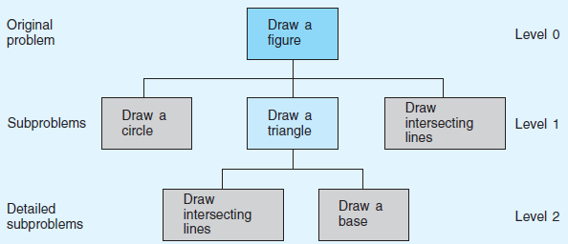
Figure 3.10 Structure Chart for Drawing a Stick Figure
1-<number>

Slide 15
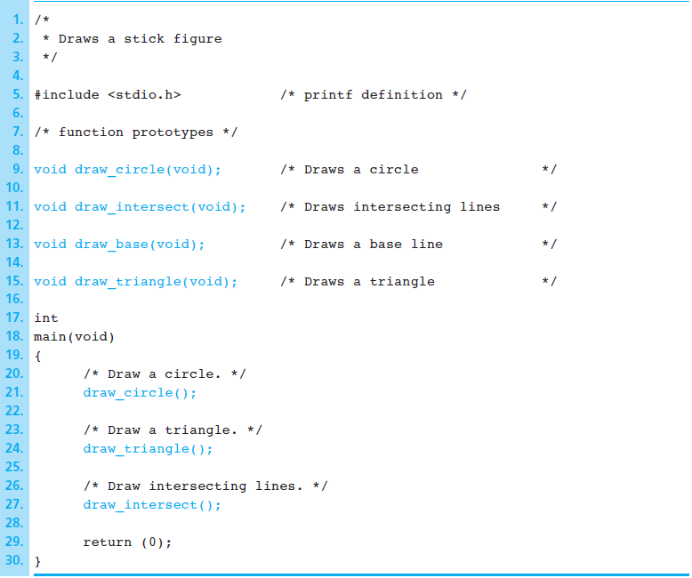
Figure 3.11 Function Prototypes and Main Function for Stick Figure
1-<number>

Slide 16
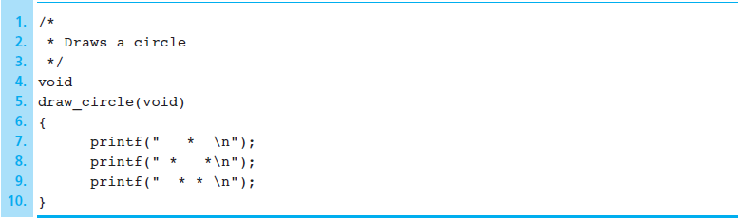
Figure 3.12 Function draw_circle
1-<number>

Slide 17
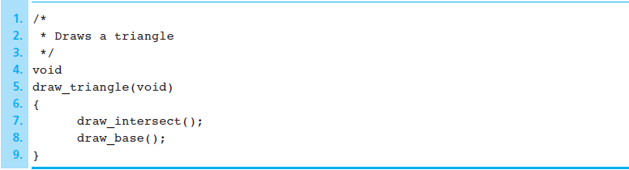
Figure 3.13 Function draw_triangle
1-<number>

Slide 18
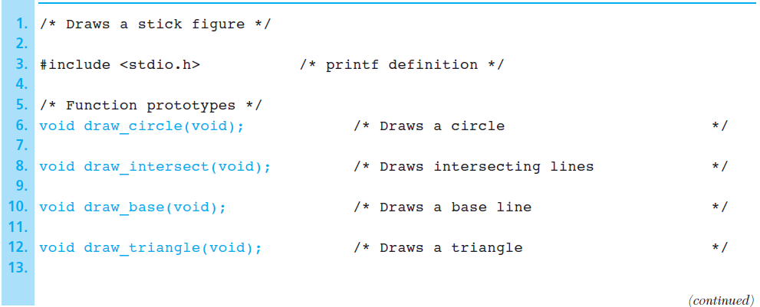
Figure 3.14 Program to Draw a Stick Figure
1-<number>

Slide 19
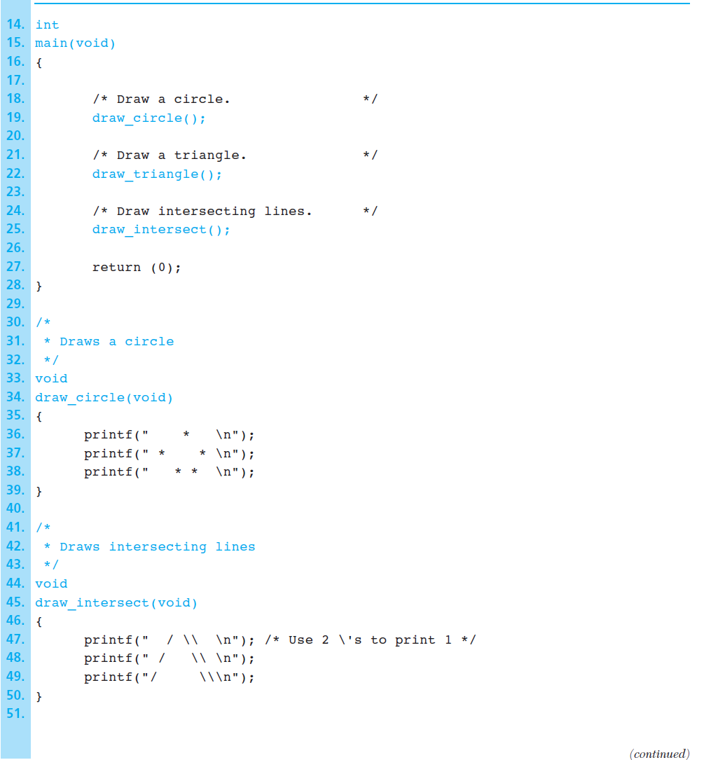
Figure 3.14 Program to Draw a Stick Figure (cont’d)
1-<number>

Slide 20
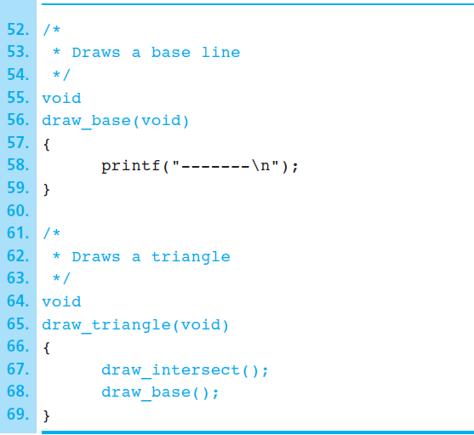
Figure 3.14 Program to Draw a Stick Figure (cont’d)
1-<number>

Slide 21
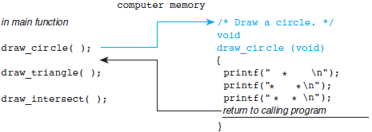
Figure 3.15 Flow of Control Between the main Function and a Function Subprogram
1-<number>

Slide 22
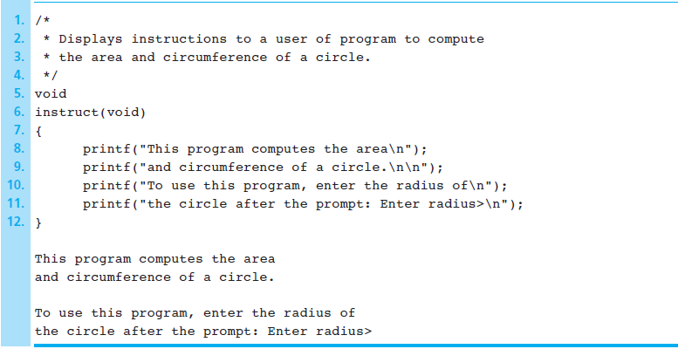
Figure 3.16 Function instruct and the Output Produced by a Call
1-<number>

Slide 23
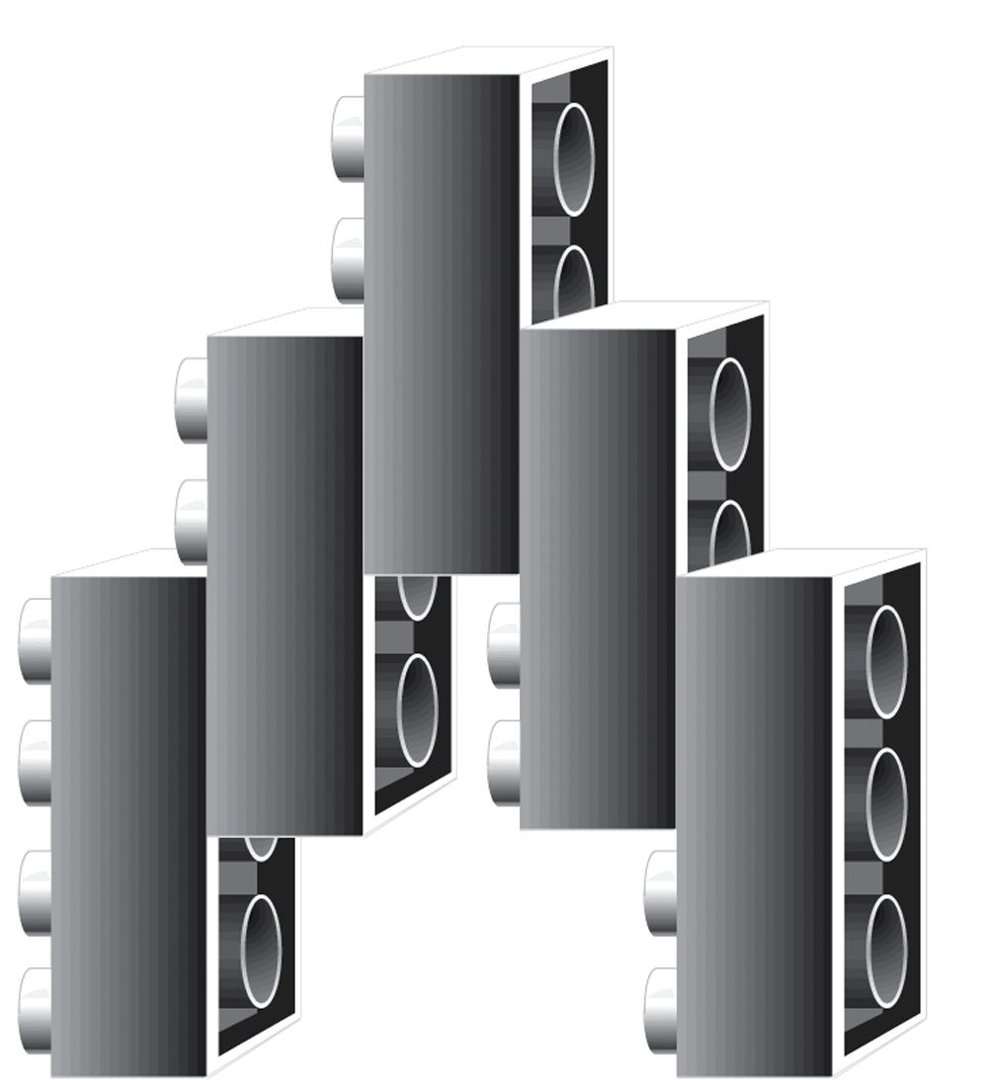
Figure 3.17 Lego® Blocks
1-<number>

Slide 24
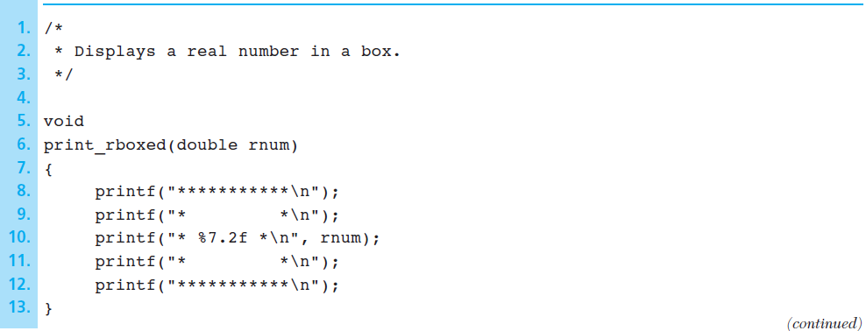
Figure 3.18 Function print_rboxed and Sample Run
1-<number>

Slide 25

Figure 3.18 Function print_rboxed and Sample Run (cont’d)
1-<number>

Slide 26
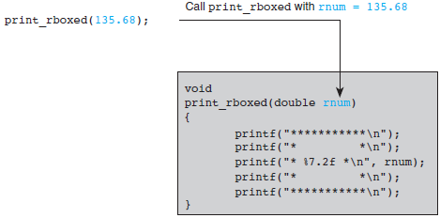
Figure 3.19 Effect of Executing print_rboxed (135.68);
1-<number>

Slide 27
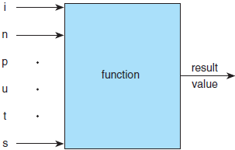
Figure 3.20 Function with Input Arguments and One Result
1-<number>

Slide 28
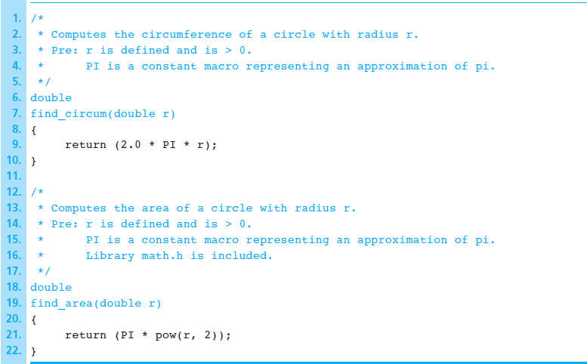
Figure 3.21 Functions find_circum and find_area
1-<number>

Slide 29
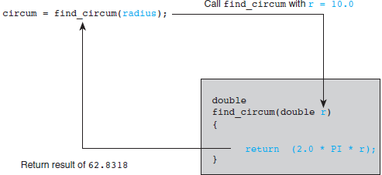
Figure 3.22 Effect of Executing circum = find_circum (radius);
1-<number>

Slide 30
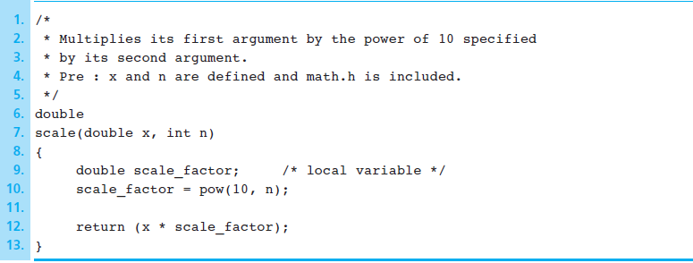
Figure 3.23 Function scale
1-<number>

Slide 31
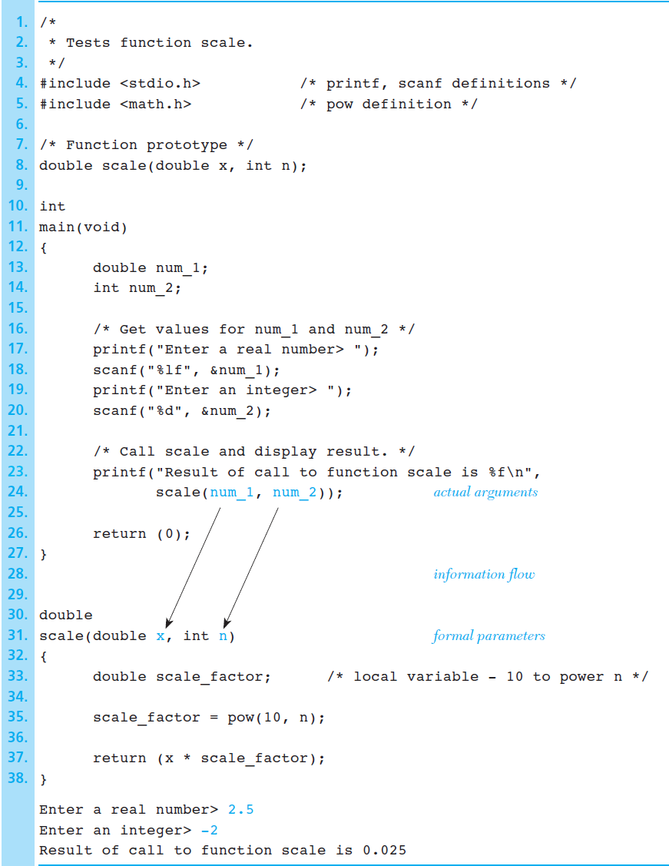
Figure 3.24 Testing Function scale
1-<number>

Slide 32
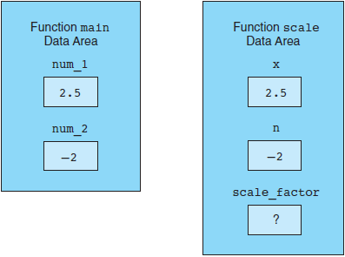
Figure 3.25 Data Areas After Call scale(num_1, num_2);
1-<number>

Slide 33
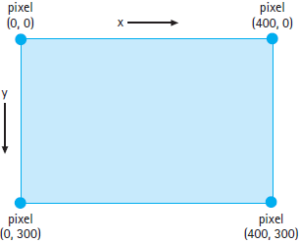
Figure 3.26 Referencing pixels in a window
1-<number>

Slide 34
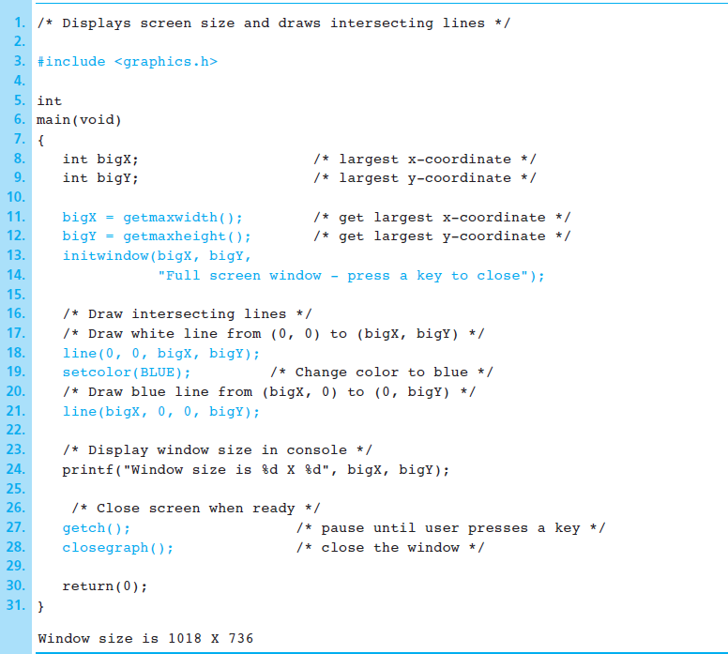
Figure 3.27
Drawing intersecting lines
1-<number>

Slide 35
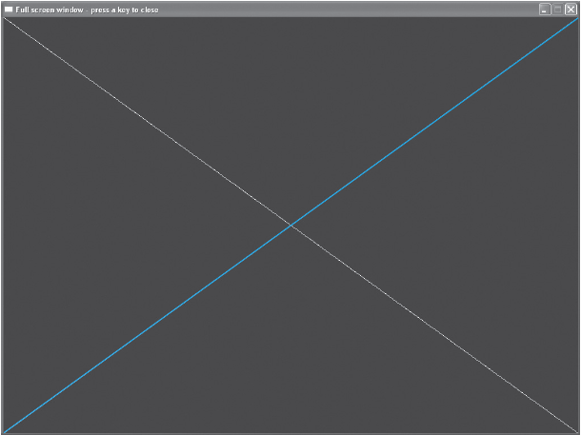
Figure 3.28
Window drawn by lines.c
1-<number>

Slide 36
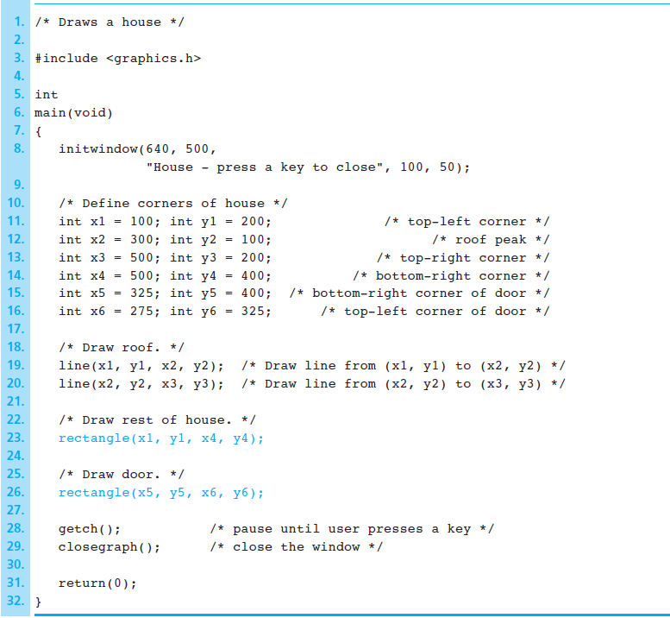
Figure 3.29
Drawing a house
1-<number>

Slide 37
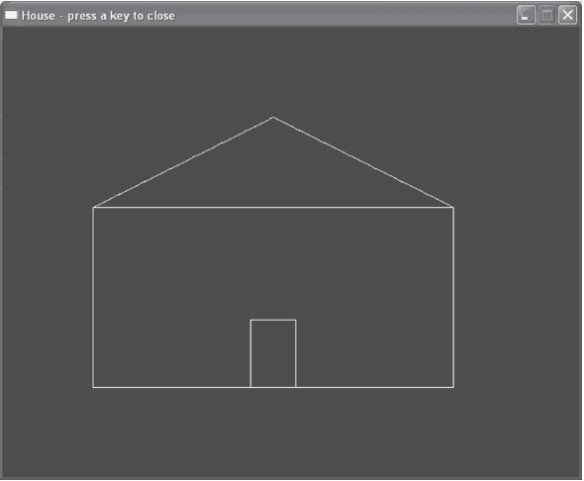
Figure 3.30
House drawn by house.c
1-<number>

Slide 38
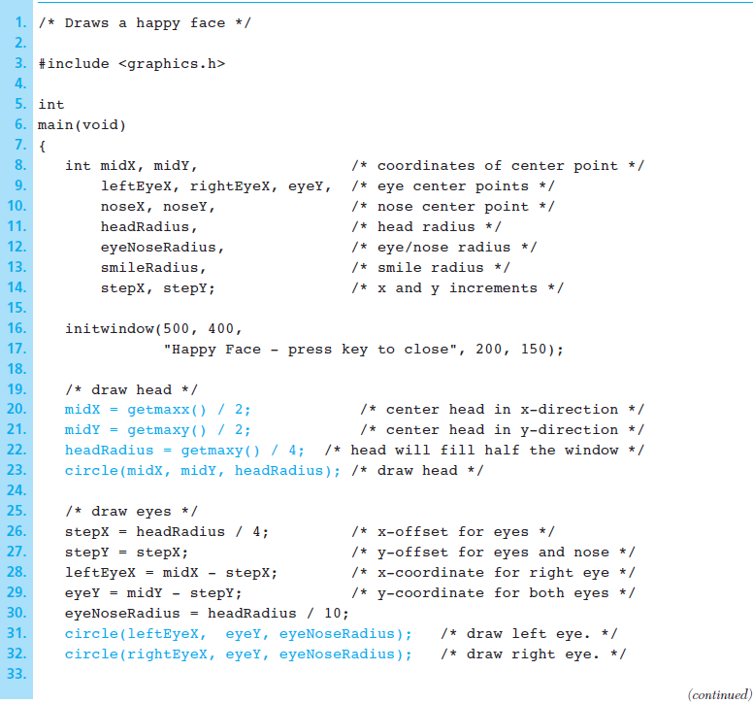
Figure 3.31
Program to draw a happy face
1-<number>

Slide 39
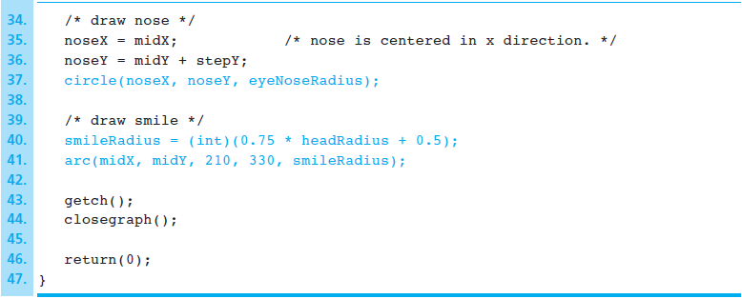
Figure 3.31 Program to draw a happy face
(cont’d)
1-<number>

Slide 40
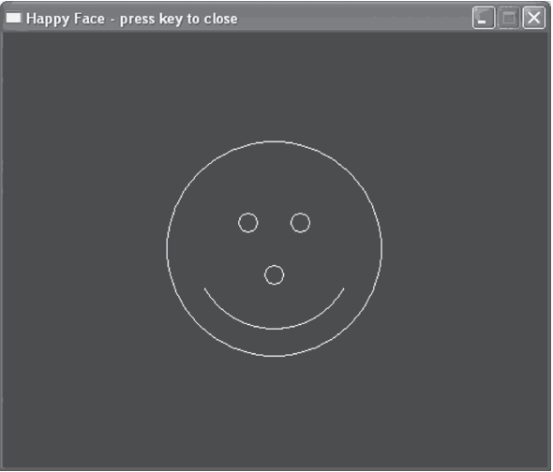
Figure 3.32
Program to draw a happy face
(cont’d)
1-<number>

Slide 41
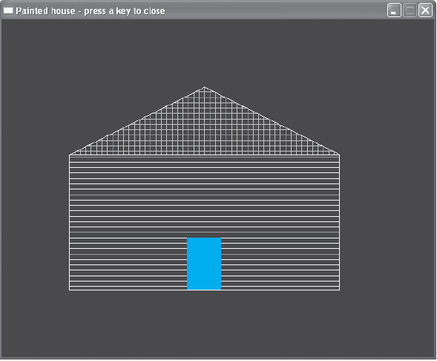
Figure 3.33
Painted house drawn by paintedHouse.c
1-<number>

Slide 42
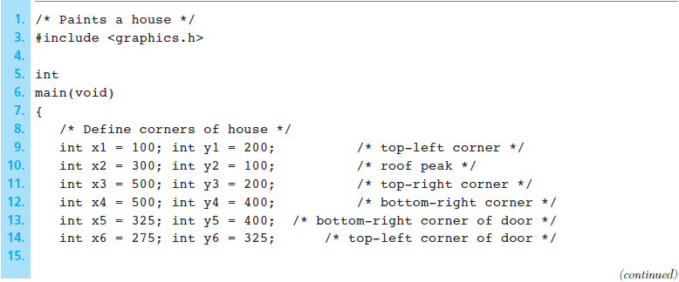
Figure 3.34 Program to paint a house
1-<number>

Slide 43
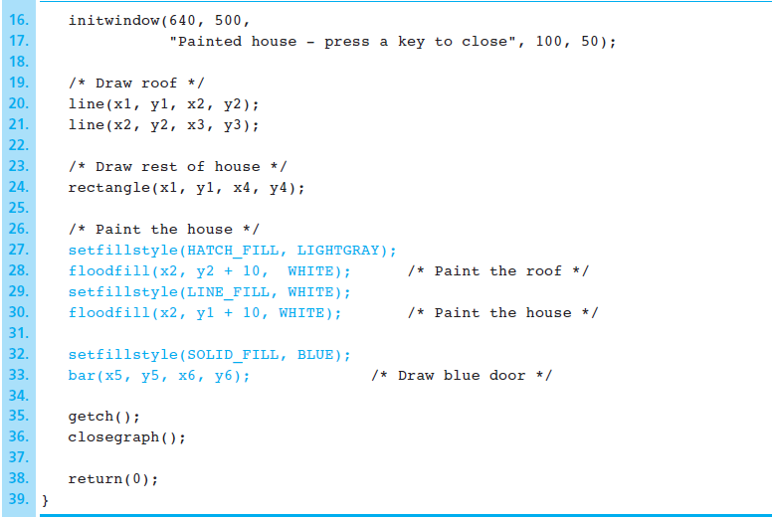
Figure 3.34 Program to paint a house (cont’d)
1-<number>

Slide 44
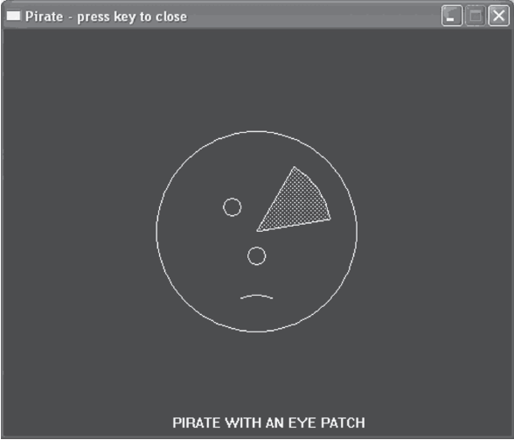
Figure 3.35
Pirate drawn by pirate.c
1-<number>

Slide 45
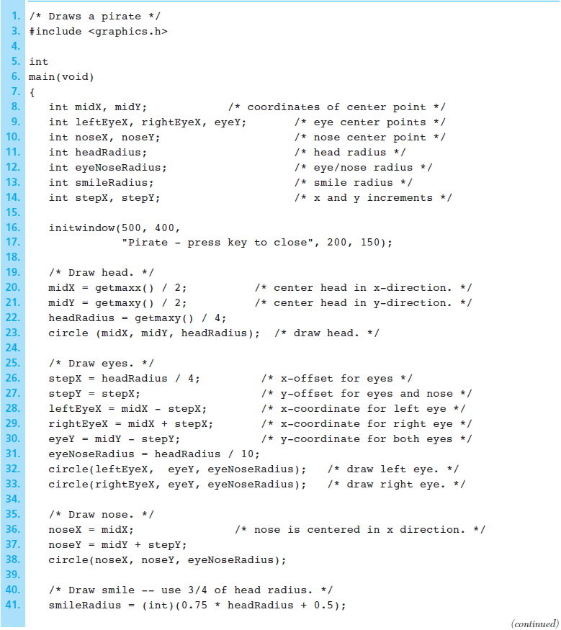
Figure 3.36
Program to draw a pirate
1-<number>

Slide 46
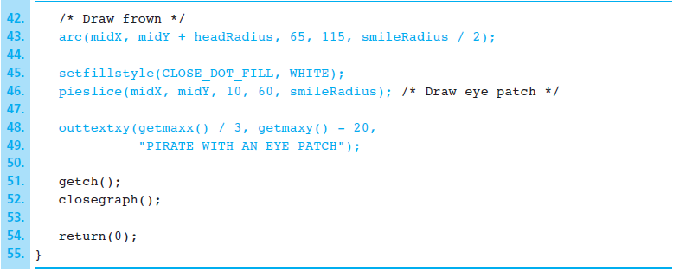
Figure 3.36 Program to draw a pirate (cont’d)
1-<number>

