Slide 1
Chapter 6:
Pointers and Modular Programming
Problem Solving & Program Design in C
Seventh Edition
By Jeri R. Hanly &
Elliot B. Koffman

Slide 2

Figure 6.1 Referencing a Variable through a Pointer
1-<number>

Slide 3
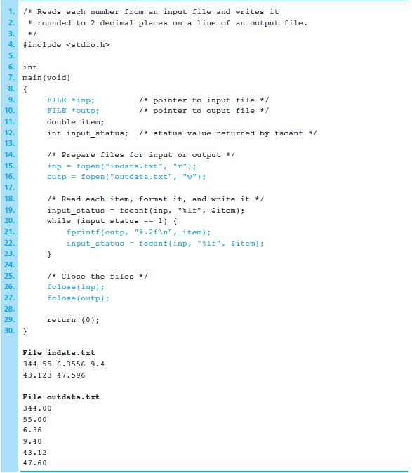
Figure 6.2
Program Using
File Pointers
1-<number>

Slide 4
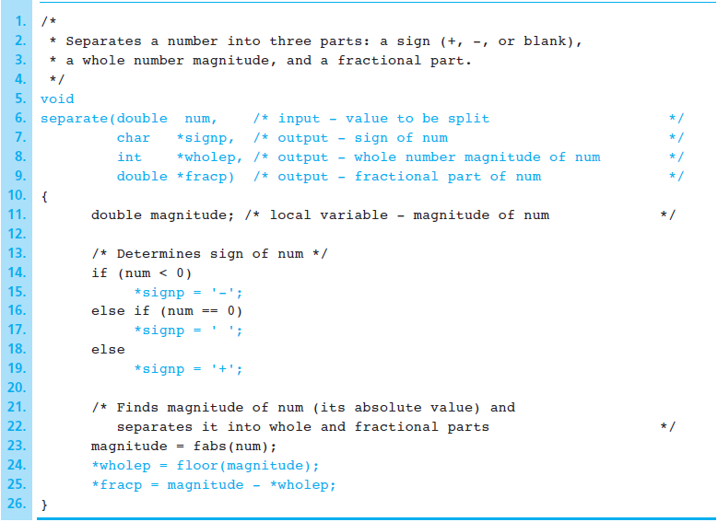
Figure 6.3 Function separate
1-<number>

Slide 5

Figure 6.4 Diagram of Function separate with Multiple Results
1-<number>

Slide 6
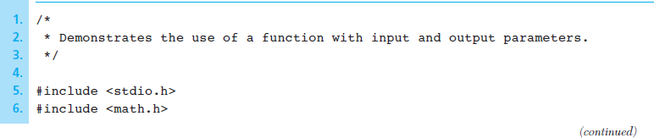
Figure 6.5 Program That Calls a Function with Output Arguments
1-<number>

Slide 7
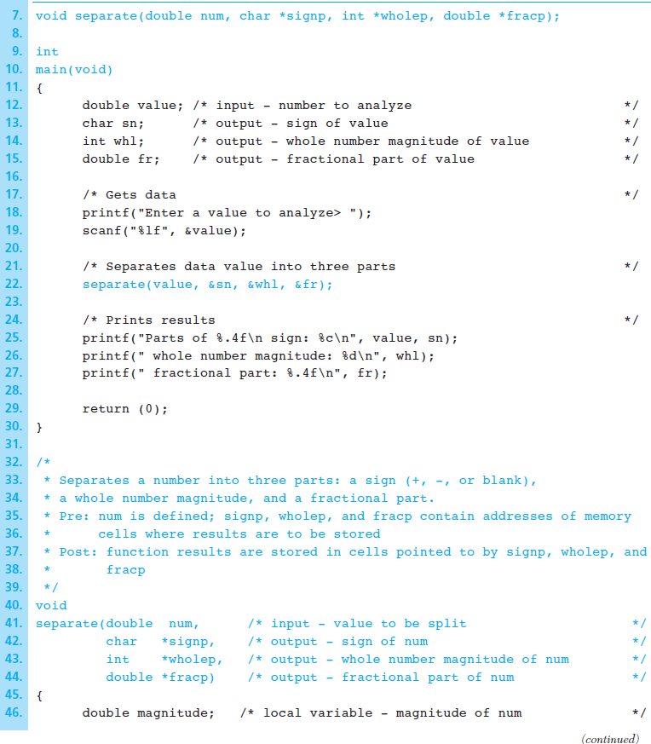
Figure 6.5 Program That Calls a Function with Output Arguments (cont’d)
1-<number>

Slide 8
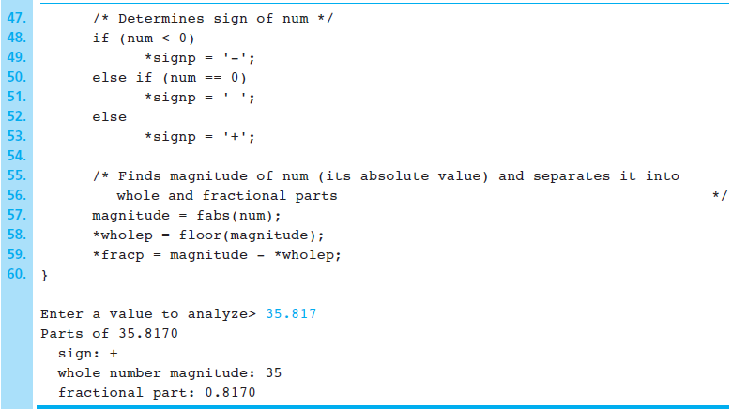
Figure 6.5 Program That Calls a Function with Output Arguments (cont’d)
1-<number>

Slide 9
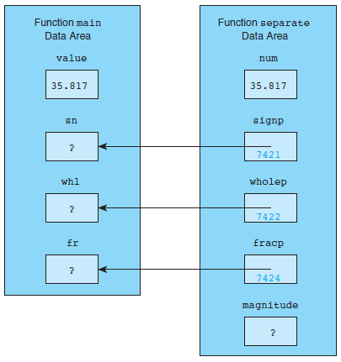
Figure 6.6 Parameter Correspondence for separate(value, &sn, &whl, &fr);
1-<number>

Slide 10
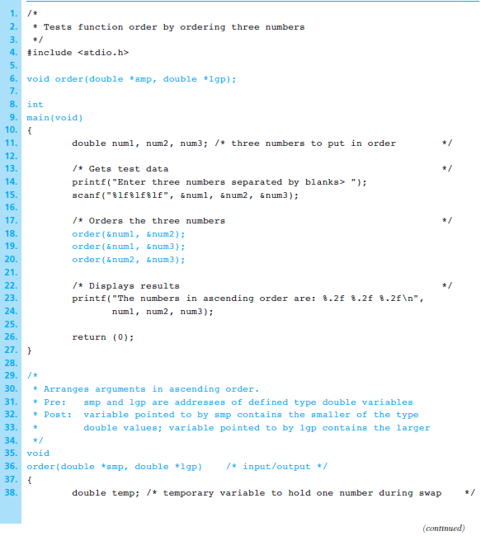
Figure 6.7
Program to
Sort Three
Numbers
1-<number>

Slide 11
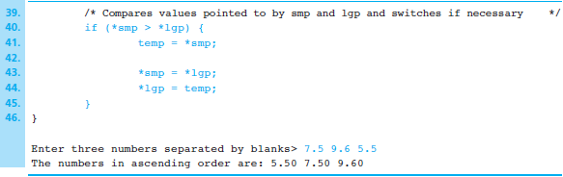
Figure 6.7 Program to Sort Three Numbers (cont’d)
1-<number>

Slide 12
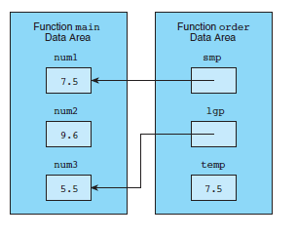
Figure 6.8 Data Areas After temp = *smp;
During call order (&num1, &num3);
1-<number>

Slide 13
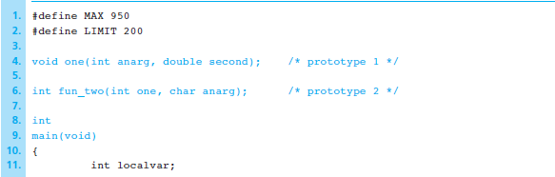
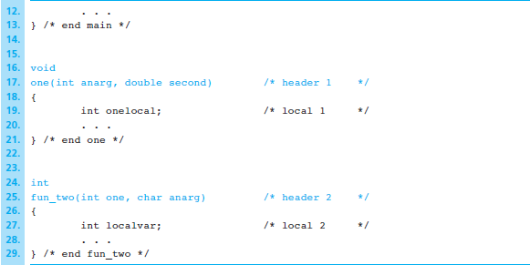
Figure 6.9 Outline of Program for Studying Scopes of Names
1-<number>

Slide 14
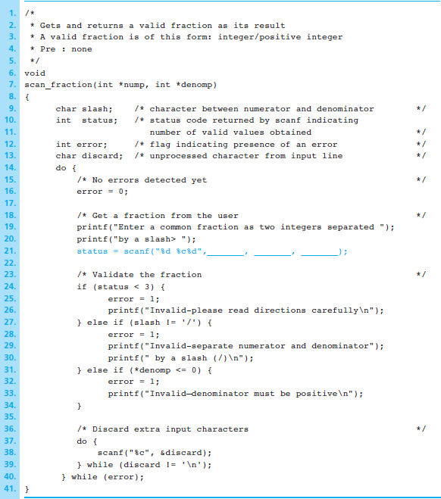
Figure 6.10
Function scan_fraction
(incomplete)
1-<number>

Slide 15
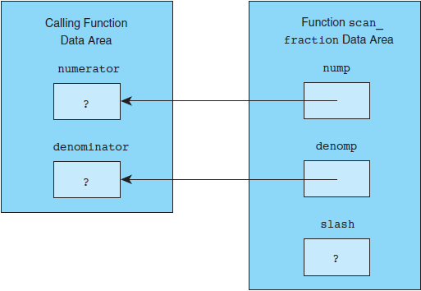
Figure 6.11 Data Areas for scan_fraction and Its Caller
1-<number>

Slide 16
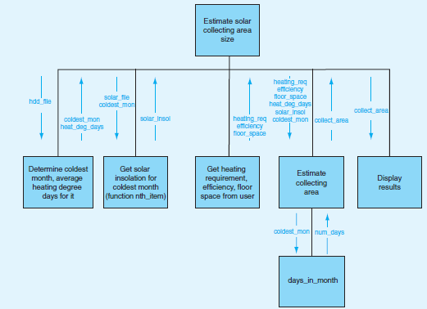
Figure 6.12 Structure Chart for Computing Solar Collecting Areas Size
1-<number>

Slide 17
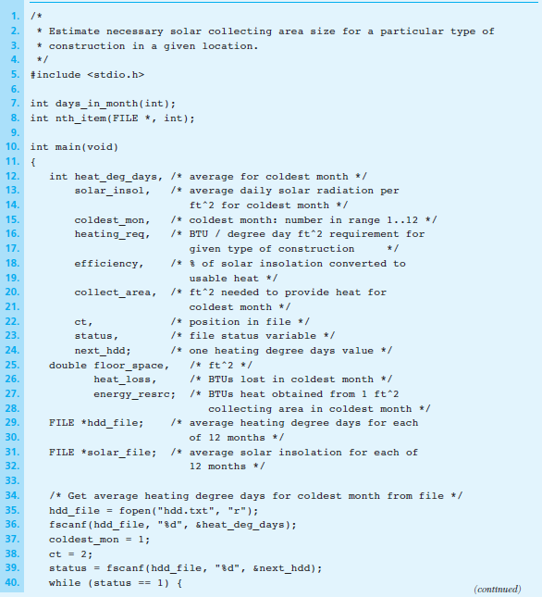
Figure 6.13 Program to Approximate Solar collecting Area Size
1-<number>

Slide 18
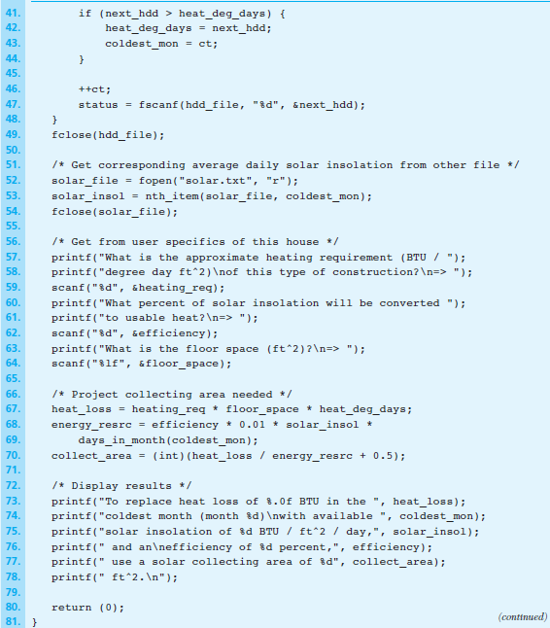
Figure 6.13 Program to Approximate Solar collecting Area Size
(cont’d)
1-<number>

Slide 19
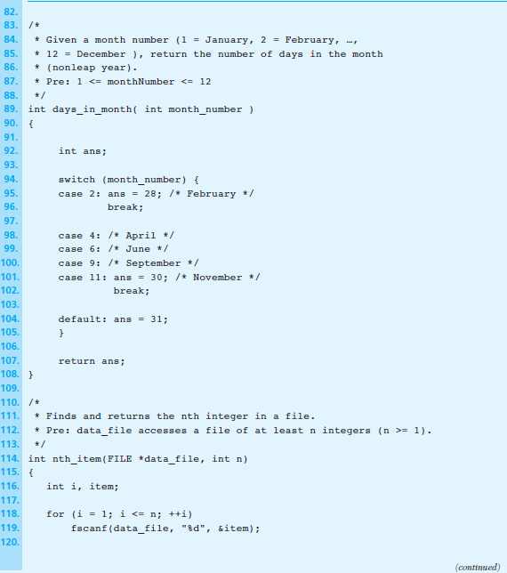
Figure 6.13 Program to Approximate Solar collecting Area Size
(cont’d)
1-<number>

Slide 20
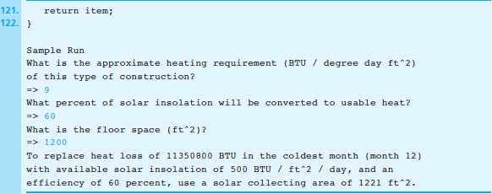
Figure 6.13 Program to Approximate Solar collecting Area Size
(cont’d)
1-<number>

Slide 21
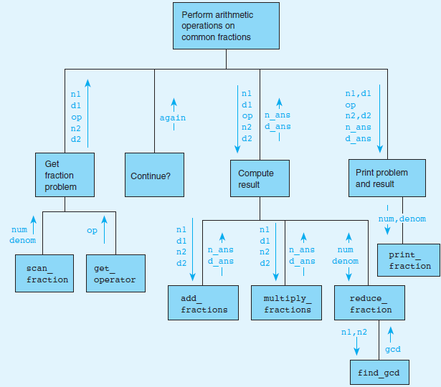
Figure 6.14 Structure Chart for Common Fraction Problem
1-<number>

Slide 22
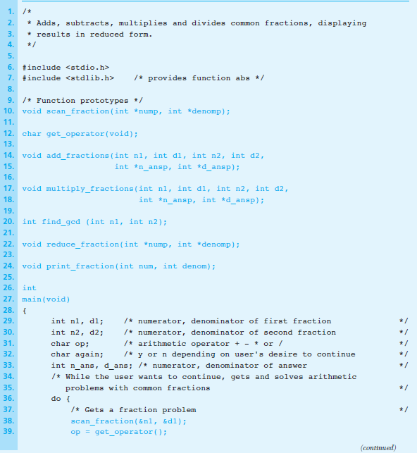
Figure 6.15 Program to Perform Arithmetic Operations on Common Fractions
1-<number>

Slide 23
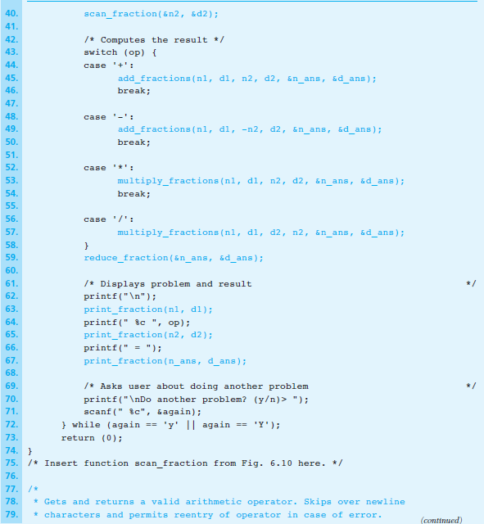
Figure 6.15 Program to Perform Arithmetic Operations on Common Fractions
(cont’d)
1-<number>

Slide 24
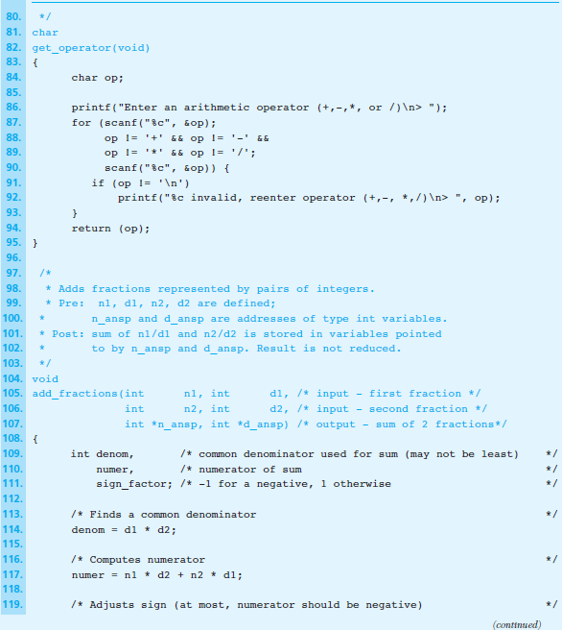
Figure 6.15 Program to Perform Arithmetic Operations on Common Fractions
(cont’d)
1-<number>

Slide 25
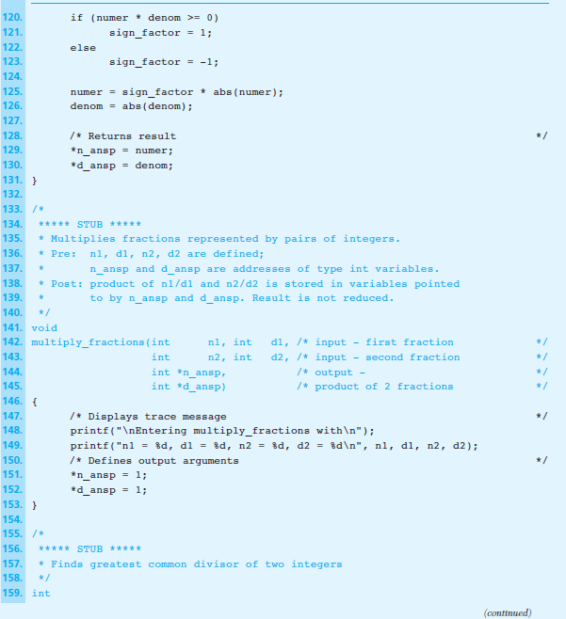
Figure 6.15 Program to Perform Arithmetic Operations on Common Fractions
(cont’d)
1-<number>

Slide 26
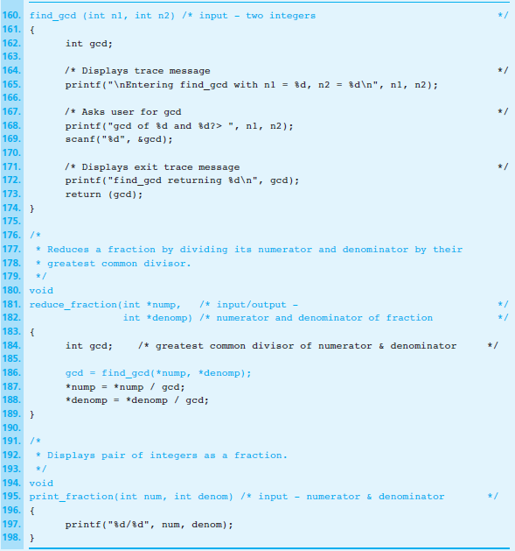
Figure 6.15 Program to Perform Arithmetic Operations on Common Fractions
(cont’d)
1-<number>

Slide 27
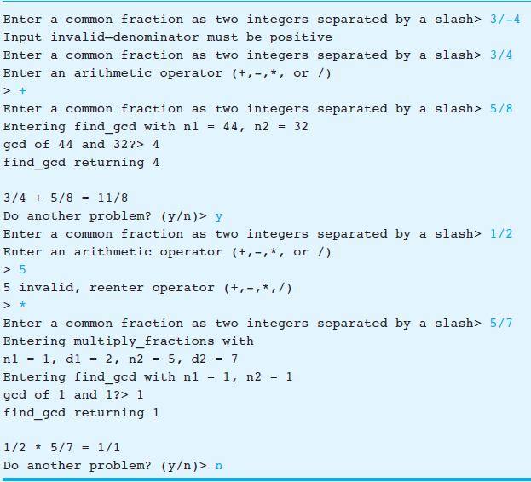
Figure 6.16
Sample Run of a Partially
Complete
Program
Containing
Stubs
1-<number>

Slide 28
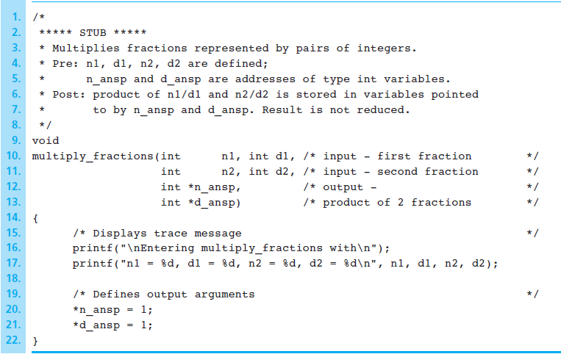
Figure 6.17 Stub for Function multiply_fractions
1-<number>

Slide 29
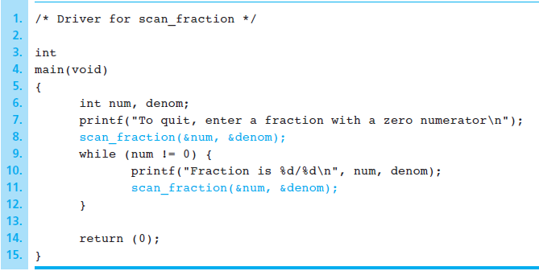
Figure 6.18 Driver for Function scan_fraction
1-<number>

