Slide 1
Chapter 7:
Arrays
Problem Solving & Program Design in C
Seventh Edition
By Jeri R. Hanly &
Elliot B. Koffman

Slide 2

Figure 7.1 The Eight Elements of Array x
1-<number>

Slide 3
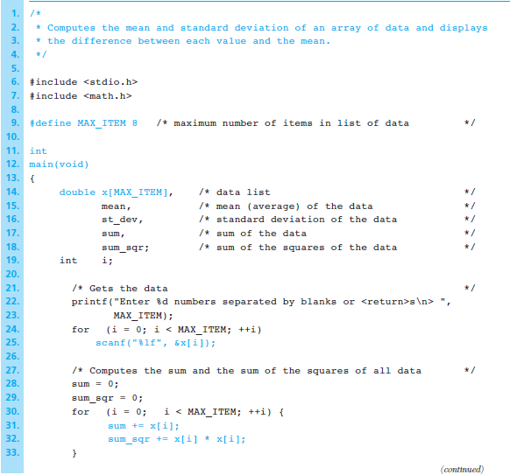
Figure 7.2
Program to Print a Table of Differences
1-<number>

Slide 4
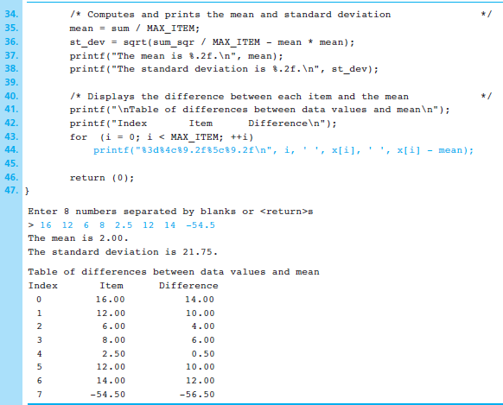
Figure 7.2
Program to Print a Table of Differences (cont’d)
1-<number>

Slide 5
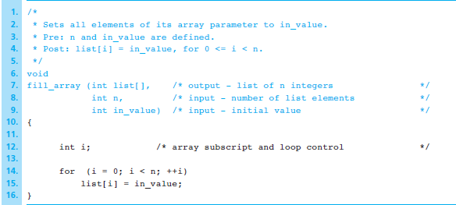
Figure 7.4 Function fill_array
1-<number>

Slide 6
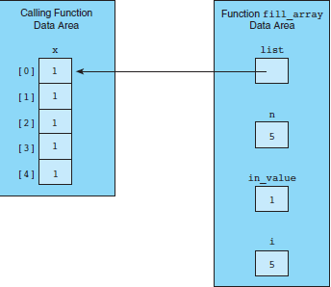
Figure 7.5 Data Areas Before Return from fill_array (x, 5, 1);
1-<number>

Slide 7
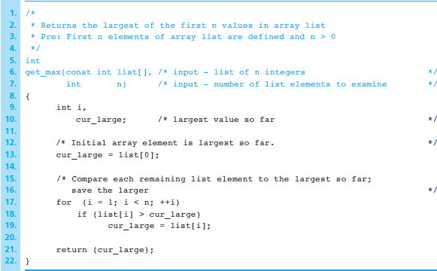
Figure 7.6 Function to Find the Largest Element in an Array
1-<number>

Slide 8

Figure 7.7 Diagram of a Function That Computes an Array Result
1-<number>

Slide 9
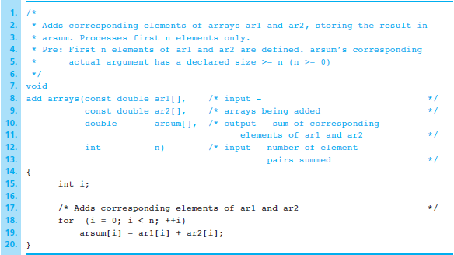
Figure 7.8 Function to Add Two Arrays
1-<number>

Slide 10
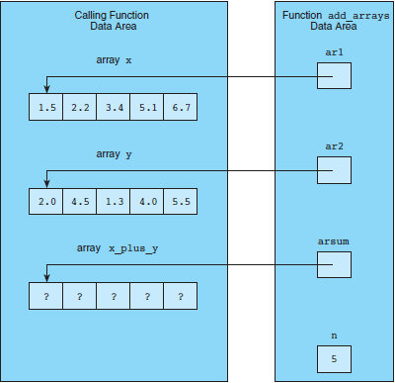
Figure 7.9 Function Data Areas for add_arrays (x, y, x_plus_y, 5);
1-<number>

Slide 11

Figure 7.10 Diagram of Function fill_to_sentinel
1-<number>

Slide 12
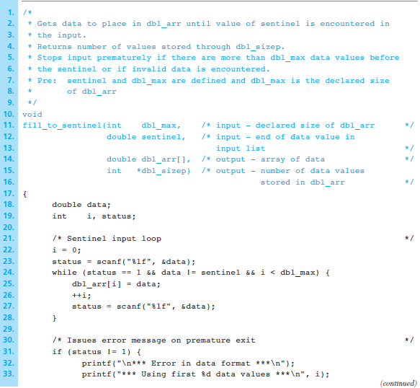
Figure 7.11
Function Using a Sentinel-Controlled
Loop to Store Input
Data in an Array
1-<number>

Slide 13
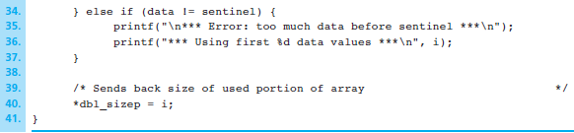
Figure 7.11 Function Using a Sentinel-Controlled
Loop to Store Input Data in an Array (cont’d)
1-<number>

Slide 14
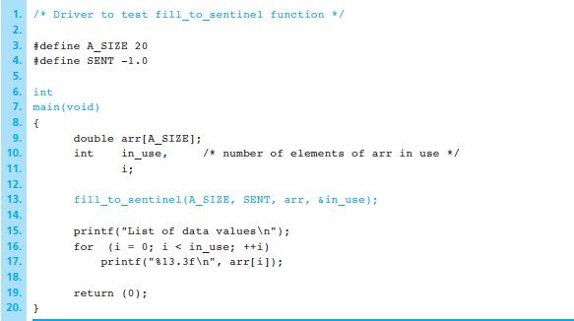
Figure 7.12 Driver for Testing fill_to_sentinel
1-<number>

Slide 15
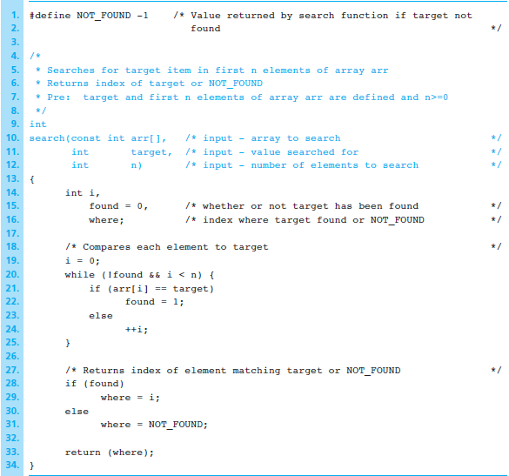
Figure 7.14 Function That Searches for a Target Value in an Array
1-<number>

Slide 16
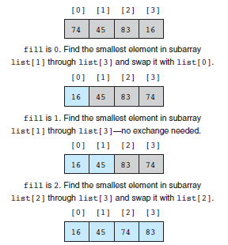
Figure 7.15
Trace of
Selection Sort
1-<number>

Slide 17
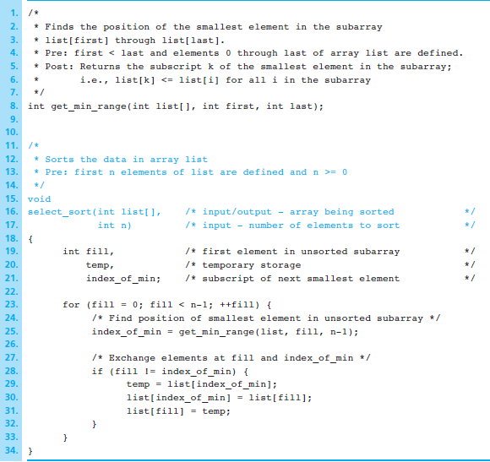
Figure 7.16
Function select_sort
1-<number>

Slide 18
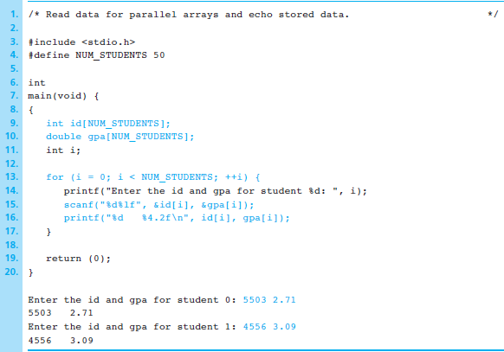
Figure 7.17 Student Data in Parallel Arrays
1-<number>

Slide 19
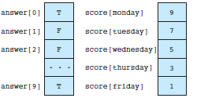
Figure 7.19 Array answer and score
1-<number>

Slide 20

Figure 7.20 A Tic-tac-toe Board Stored as Array tictac
1-<number>

Slide 21
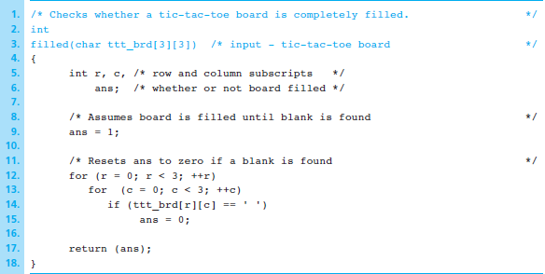
Figure 7.21 Function to Check Whether Tic-tac-toe Board Is Filled
1-<number>

Slide 22
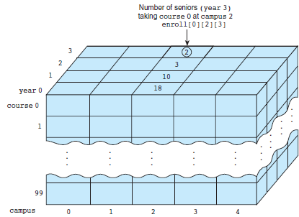
Figure 7.22 Three-Dimensional Array enroll
1-<number>

Slide 23
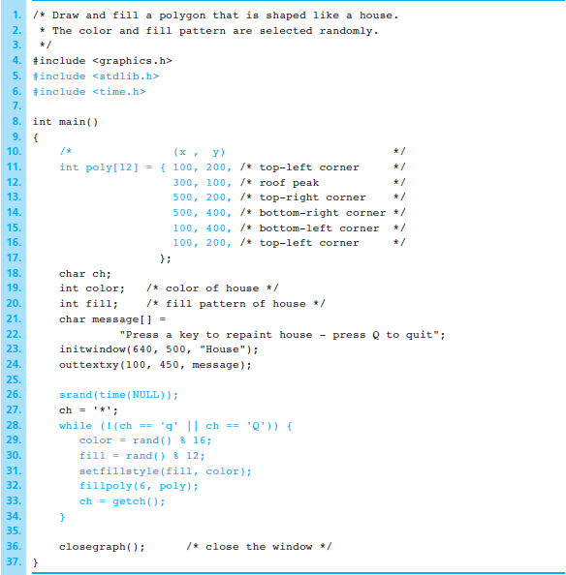
Figure 7.27
Drawing and filling a polygon
1-<number>

Slide 24
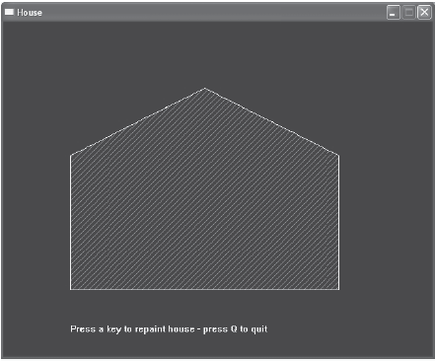
Figure 7.28 A Painted House
1-<number>

Slide 25
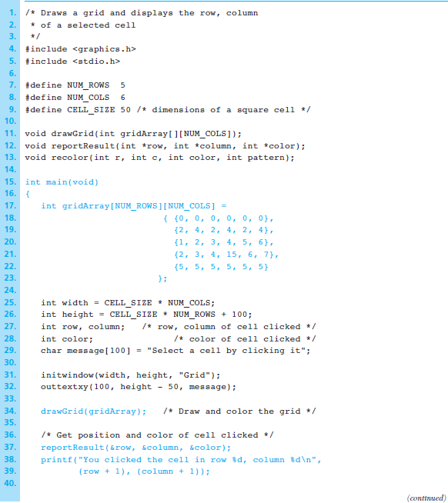
Figure 7.29
Program to
Draw a Two-
Dimensional
Grid
1-<number>

Slide 26
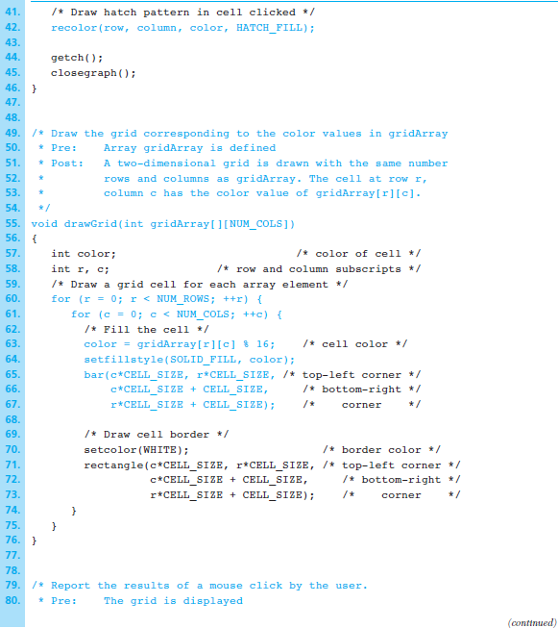
Figure 7.29
Program to
Draw a Two-
Dimensional
Grid (cont’d)
1-<number>

Slide 27
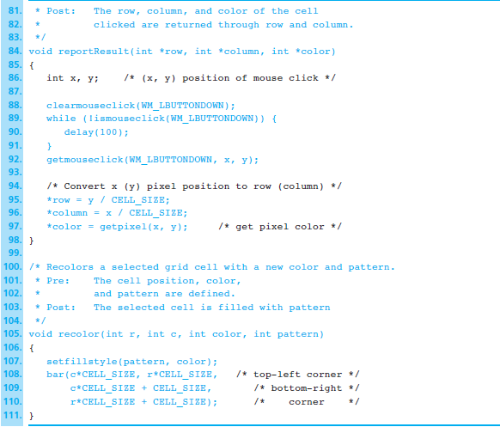
Figure 7.29
Program to
Draw a Two-
Dimensional
Grid (cont’d)
1-<number>

Slide 28
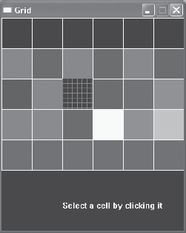
Figure 7.30 Two-Dimensional Grid
1-<number>

